Slide 1
IBM FlashSystem
Keynote
Neil McGovern
IBM FlashSystem Sales Leader

Slide 2
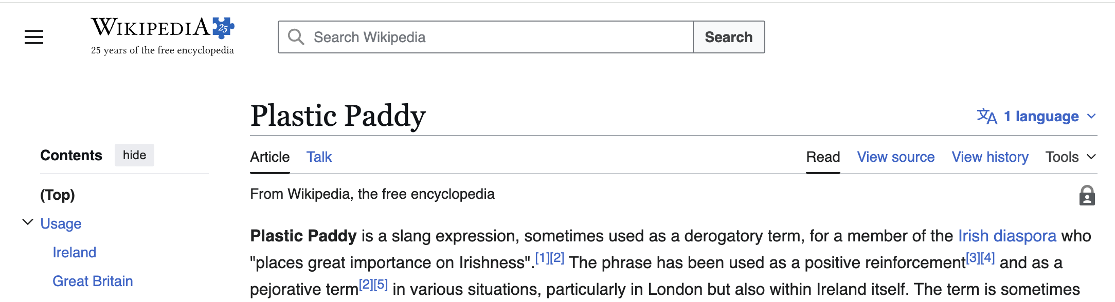
I’m a Plastic Paddy
Brought up outside Ireland – but super-proud to be Irish

Slide 3
What makes me so proud to be Irish?

Slide 4
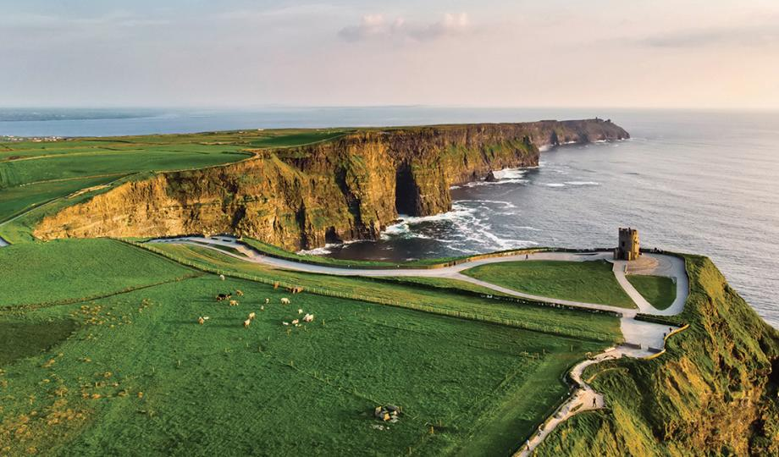
Is it the Beautiful Irish scenery?

Slide 5

Irish Arts, Culture & Music?

Slide 6

The taste of a pint of Guinness?

Slide 7

Or a nip of Jameson’s Whiskey?

Slide 8
I am most proud of…

Slide 9
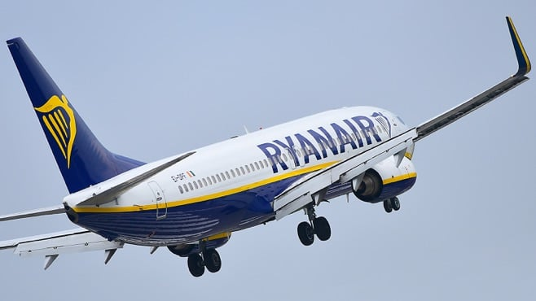
Ryanair
Ryanair!

Slide 10

Ryanair
The largest airline in Europe, based on annual passengers, fleet size, and number of flights.
€13.44 billion revenue
208 million passengers
Fleet of 648 aircraft
Servicing 220 destinations
3,800 flights a day
Seats from €1

Slide 11
Why am I so proud of Ryanair?

Slide 12
Everyone’s happy

Slide 13
Super Efficient

Slide 14
And the Landings!

Slide 15
I fly a lot

Slide 16
I fly a lot in:
IBM Business Class

Slide 17

IBM Business Class - Seat 39A
IBM Business Class
Get Seat map

Slide 18
Wouldn’t I prefer real business class?

Slide 19
Wouldn’t I prefer real business class?
“Planes don’t fly backwards into Mountains”

Slide 20
IBM Business Class - Seat 39A
IBM Business Class
Get Seat map
Statistically, the safest seat on the plane

Slide 21
And you get to talk to people…
In economy..
People talk

Slide 22
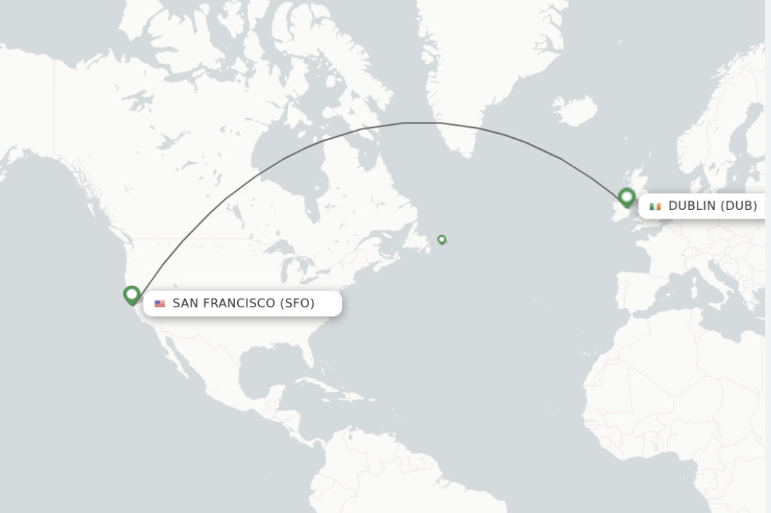

Recently, on a flight from..
Dublin to San Francisco

Slide 23
I met a fellow traveller

Slide 24
I met a fellow traveller
He was in seat 39B
Let’s call him Paddy

Slide 25
He’s Irish

Slide 26
I knew he was Irish when he ordered the:

Slide 27
I knew he was Irish when he ordered the:
“Holy Trinity”

Slide 28
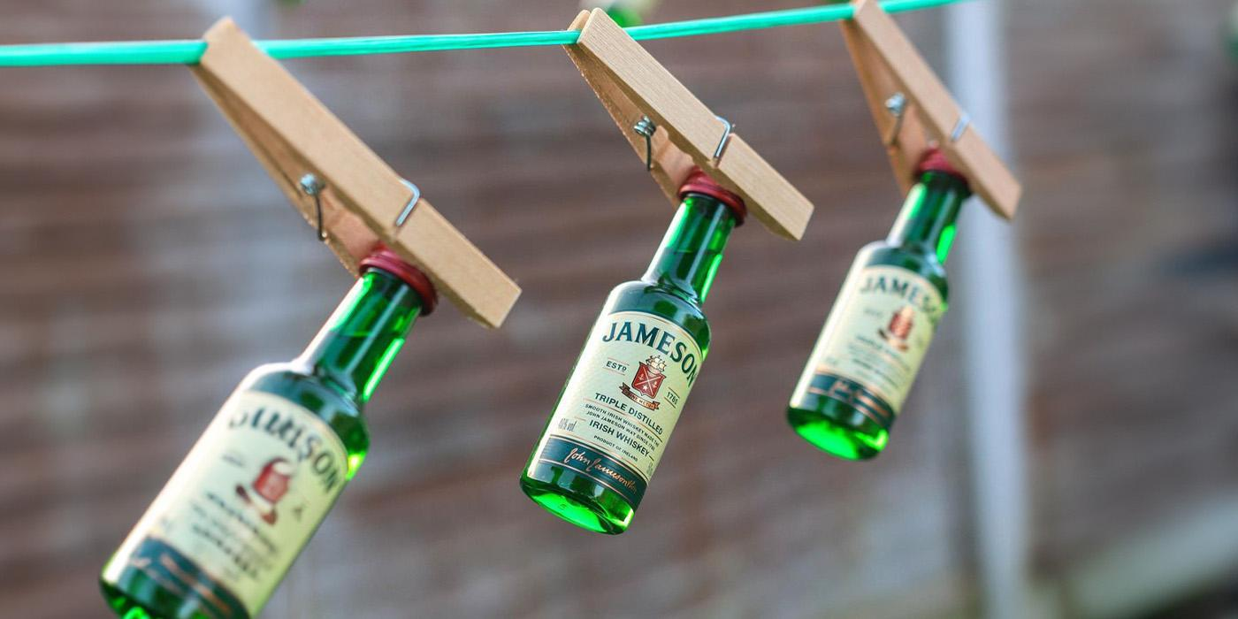

Slide 29
I knew he was Irish…
…when I heard is accent!

Slide 30
I ordered the same…

Slide 31
So, we got talking…

Slide 32
“What do you do?” I asked

Slide 33
“I’m a product Manager, we make aeroplane interiors”
“What do you do?” I asked

Slide 34
“I work with lots of product managers, I really respect their work…”

Slide 35
“Thank you. What do you do?”

Slide 36
“I sell Storage”

Slide 37
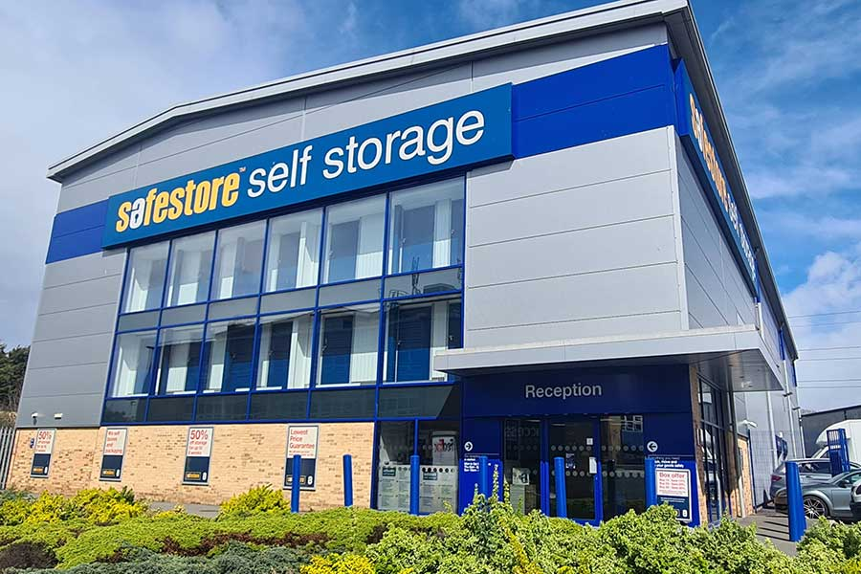
“Not Self-Storage”

Slide 38
“IT, Storage Infrastructure”

Slide 39
“Sales?
I have a new-found respect for salespeople”

Slide 40
“Sales?
I have a new-found respect for salespeople”
Really?

Slide 41
“Tell me more…”

Slide 42
“Yes, recently, we launched a revolutionary new product – a new type of aircraft seat”

Slide 43
“A seat?”

Slide 44
“A seat?”
“Yes!
Ultra Comfortable
Incredibly Light
Super Thin
Mega-High Safety Score
Totally-Robust
Maintenance Free
and Easy to Clean
it’s Revolutionary”

Slide 45
“Sounds like it would sell itself!”

Slide 46
“Sounds like it would sell itself!”
“That is what we thought…
but it was the opposite..”

Slide 47
“Previous seats were just commodity products, we & the other 4 or 5 seat manufacturers received an RFP from the airline”

Slide 48
“We completed the RFP specification sheets and produced a price quote”

Slide 49
“The cheapest price, which hit the minimum criteria, won the contract”

Slide 50
“In an RFP, written for a commodity product, no-one really cares about revolutionary features”

Slide 51
“Our main contacts in Aircraft Interiors loved the new features…
they just didn’t know how to represent them outside of the RFP process”

Slide 52
“So, you needed a salesperson?”

Slide 53
“So, you needed a salesperson?”
“Yes, we needed someone who could find the people Who Cared about the client value our unique features could deliver..”

Slide 54
“…And explain the real, tangible benefits to a client, in a language they would understand”

Slide 55
“Did it work?”

Slide 56
“Did it work?”
“Oh yes!..
Big Time!
We hired a professional salesperson & she got immediate results”

Slide 57
“Tell me more”

Slide 58
“Tell me more”
“Through our existing Aircraft Interiors contacts, She was able to find other contacts in the organisation Who Care about the business outcome”

Slide 59
“She went to the Safety Compliance team and explained that the seats complied with the next generation of safety standards – meaning no upgrade would be required for at least 15 years”

Slide 60
“And she showed the Safety Compliance team they could print the safety card right on the back of the seat, removing hard copies & saving 250M compliance checks a year”

Slide 61
“After that she went to the Flight Economics team – and showed that seats, with 30% less weight will save 1% of fuel”

Slide 62
“She went to the Cargo Operations team and demonstrated that lighter seats means 500KG more cargo capacity per flight”

Slide 63
“She spoke to Aircraft Servicing – the cleaning crew – and showed them the seat was easier to clean & took 3 seconds less to clean – 10 minutes quicker turn around per plane - 100 hrs per day”

Slide 64
“She went to the Engineering Team, proving the seats, with no moving parts, were far more robust & did not need spare parts – the airline could save €4M a year in lost revenue due to broken seats ”

Slide 65
“Finally, she went to the Chief Revenue Officer, she showed him that because our seats are 3cm thinner, over 30 rows, that’s enough room to add a whole ADDITIONAL ROW OF SEATS!”

Slide 66
“a whole extra row of seats adds 3% to the aircraft’s capacity – 3% extra potential income.
On an airline fleet level – that’s the equivalent of adding 18 Boeing 737s at a cost of €120M each”

Slide 67
“Our seats were now €2BN cost saving seats!
We had the whole airline supporting the purchase”

Slide 68
“WOW…
But weren't your original contacts annoyed your salesperson approached other contacts?”

Slide 69
“WOW…
But weren't your original contacts annoyed your salesperson approached other contacts?”
“Are you kidding?
They became Heroes for introducing the value - they won an innovation award!”

Slide 70
“The Director of Procurement told us it was the easiest sign off in history”

Slide 71
Let’s get back to IBM FlashSystem

Slide 72
You may have heard some great things about the Future of IBM FlashSystem

Slide 73
You may have heard some Revolutionary things…

Slide 74
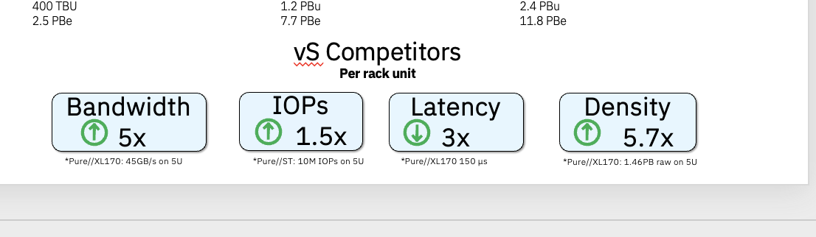
You may have heard about…
The next Generation of FlashCore Module 5 on IBM FlashSystem
5x More Bandwidth vs Competition
1.5 More IOPs vs Competition
3x Less Latency vs Competition
5.7x More Density vs Competition
Greater Data Reduction
Reducing storage operations cost by as much as 57%
Up to 68% Performance Improvement
Up to 40% Greater Efficiency & capacity

Slide 75
You may have heard about…
Supercharged resiliency
Better, faster threat detection
Our new Exfiltration, Wiperware and sneaky ransomware detection
Alerts better integrated free into in Storage Insights Foundation
Automatic protection - with SafeGuarded Copy triggers
Advancements in application aware scanning with IBM Sentinel

Slide 76
You may have heard about…
FlashSystem grid
Instant data mobility
Non-disruptive migrations
Reducing maintenance windows to Zero
Optimising Performance for all arrays
Optimising Capacity across the grid
Reducing physical arrays by 47%

Slide 77
You may have heard about…
FlashSystem.ai
Deploying supervised “human in the loop” AI to save mundane & routine storage admin tasks
Reducing the risk of human error
Amplifying Human Skill
Automatically Identifying issues & optimisation potential

Slide 78
As you digest all this…

Slide 79
Here’s my challenge to
You

Slide 80
As you reflect on these functions…

Slide 81
Don’t just say “That’s Cool” like Paddy’s first contacts

Slide 82
Think!

Slide 83
Think, how will you introduce IBM FlashSystem’s Client Value into your organisation?

Slide 84
Think, who in the CISO’s office needs to hear that:
“IBM FlashSystem’s unique Resiliency Solution: Protection, Detection & Recovery will prevent your organisation suffering the impacts of a catastrophic attack”

Slide 85
Think, which of your Line of Business leaders need to hear that:
“IBM FlashSystem will deliver real business Recovery in hours, not days, weeks or months…
How much is a day worth to their business?”

Slide 86
Think, how do we help you tell Application Owners that:
“FlashSystem.ai & FlashSystem grid will constantly optimise their application performance – letting them do more & manage peak & seasonal demand”

Slide 87
Think, how do we help you tell Finance & Procurement:
“IBM FlashSystem grid will change they way they buy IT forever, taking the guesswork out, only buying what they need today…”

Slide 88
Think, when do we talk to the ESG team:
“FlashSystem consumes 24% less watts per TB and takes up 67% less space”

Slide 89
Think, how do we help you explain to Compliance & Legal that:
“FlashSystem can help your organisation comply with NIST2 & DORA right Out-of-the-Box”

Slide 90
Think, how do we help you explain to Operations that:
“FlashSystem grid will remove the need for storage maintenance windows...
Forever”

Slide 91
Think, how can we help you explain to the CIO that:
“FlashSystem.ai could save 90% of storage admin time
&
remove human error, the #1 cause of system outages”

Slide 92
Think, how can we help you explain to the head of transformation that:
“FlashSystem.ai will alleviate your skills gap and free up human capacity, allowing your skilled people to work on the truly transformational & revenue generating projects”

Slide 93
Think about how we can bring this story to the people Who Care in your organisation…

Slide 94
…so, we can explain the Unique Business Value to those contacts & functions…

Slide 95
…so, we will help make
You

Slide 96
a Hero

Slide 97
And, what happened to Paddy’s seats?

Slide 98
His salesperson closed their first massive deal

Slide 99
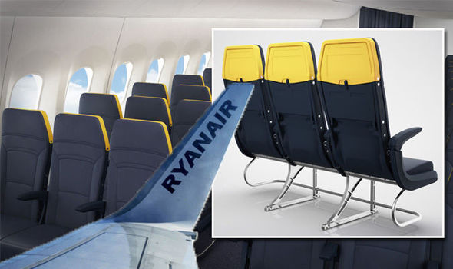
With Ryanair!

Slide 100
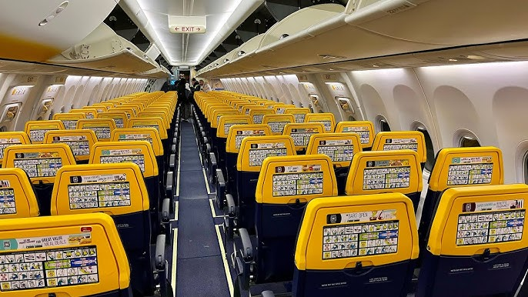
Think of Paddy next time you fly Ryanair!

Slide 101

Thank You!
Neil McGovern
neil_mcgovern@uk.ibm.com
IBM FlashSystem Sales Leader

