Slide 1
Resource Groups in Power11
COMMON EU 2026
Bartlomiej Grabowski – Principal System Specialist
Lyon , June 2026

Slide 2
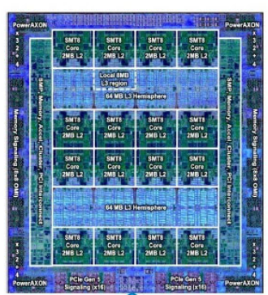
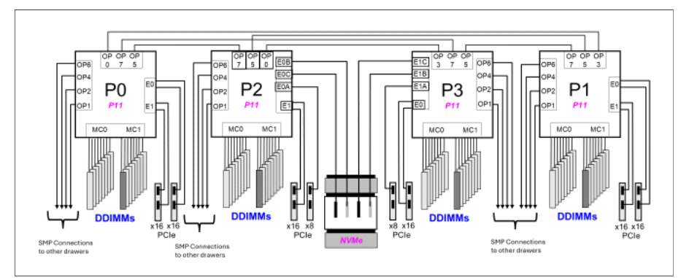
Power Systems SMP and NUMA
Symmetric multiprocessing (SMP) architecture allows a system to scale beyond one processor
Each processor is connected to the same bus (also known as crossbar switch) to access the main memory. But this computation scaling is not infinite due to the fact that each processor needs to share the same memory bus, so access to the main memory is serialized

Slide 3
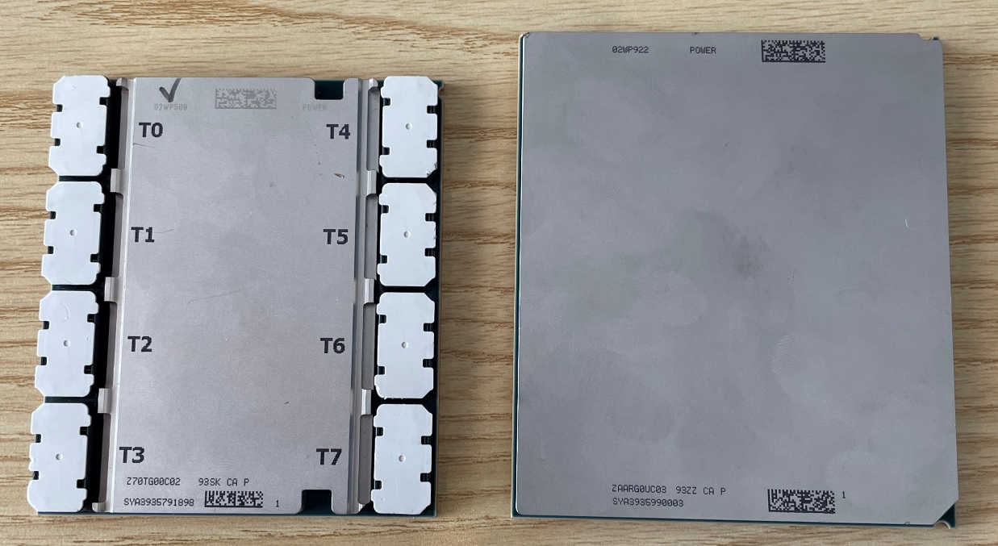
Power Systems SMP and NUMA
The Non-Uniform Memory Access (NUMA) architecture is a way to partially solve the SMP scalability issue by reducing pressure on the memory bus.
NUMA nodes are connected using special “interlink bus” to provide processor data coherency across the entire system

Slide 4
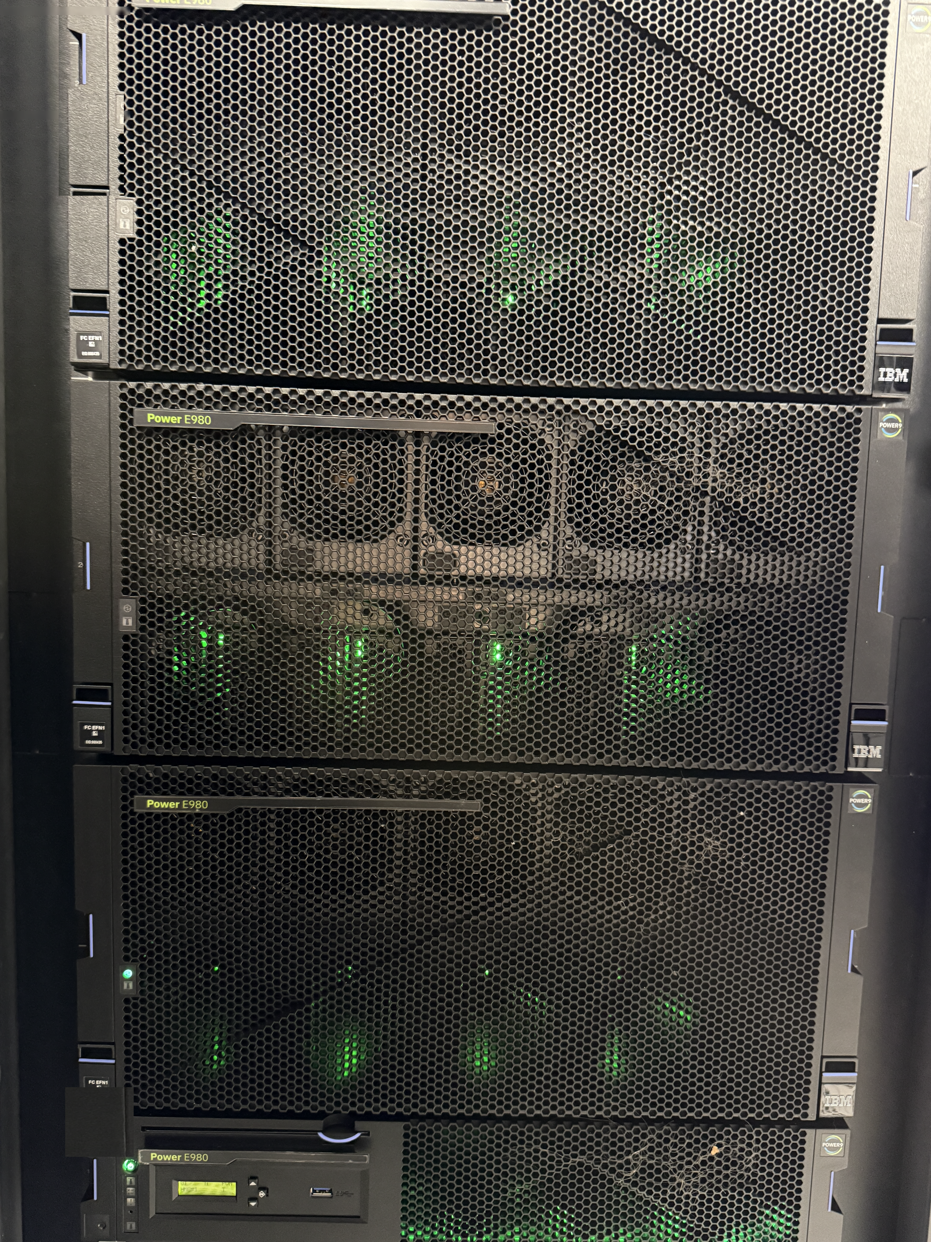
Power Systems SMP and NUMA
LPAR1
CPU
CPU
DIMM
DIMM
DIMM
DIMM
DIMM
DIMM
DIMM
DIMM
CPU
CPU
DIMM
DIMM
DIMM
DIMM
DIMM
DIMM
DIMM
DIMM
CPU
CPU
DIMM
DIMM
DIMM
DIMM
DIMM
DIMM
DIMM
DIMM

Slide 5
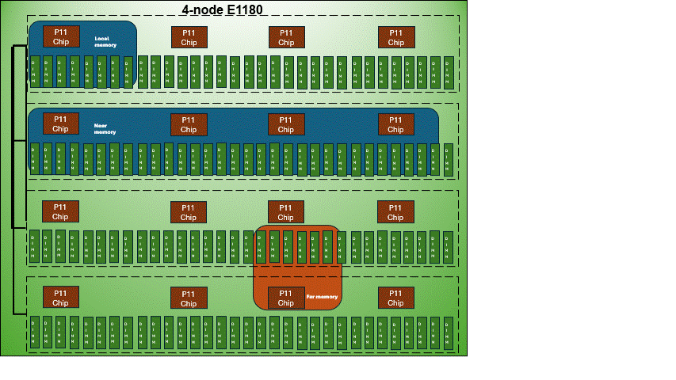
Power Systems SMP and NUMA
Each processor can have access to the entire memory of a system; but access to this memory is not uniform
Access to memory located in the same node (local memory) is direct with a very low latency
Access to memory located in another node is achieved through the interlink bus with a higher latency

Slide 6
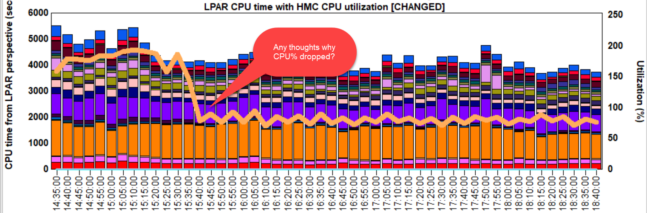
Performance impact

Slide 7
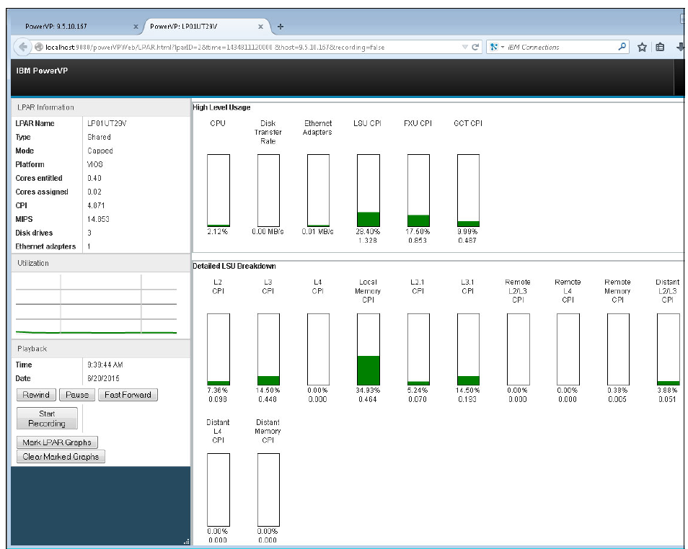
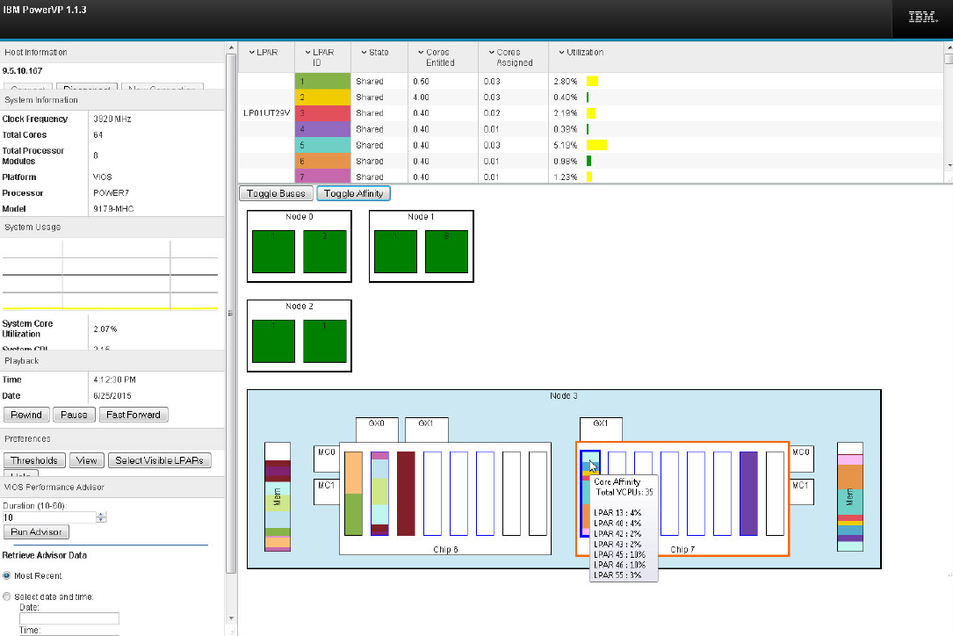
PowerVP tool
With POWER7 IBM introduced PowerVP, a JAVA based program to visualize a performance view in PowerVM environment. It gathered resource utilization how a workload use specific physical resources on an IBM Power System.
The tool desired to understand cache and memory affinity.
The product withdrawn with POWER8.

Slide 8
How to achieve the best affinity?
The resources are assigned by the PowerHypervisor (Phyp) during IPL of the LPAR.
The best practice is to activate the LPARs with the highest number of CPUs and MEM as the first partitions. The Phyp allocates „the closest” resources with the best affinity.
The affinity is lost due to number of DLPAR operations.
Allways plan the LPAR sizing (Min,Max values) wisely. Each partition on the system has its own hardware page table that contributes to hypervisor memory usage. The HPT is used by the operating system to translate from effective addresses to physical real addresses in the hardware. The maximum values define how much resources willl be consumed/reserved for the PHyp
The amount of memory for the HPT is based on the maximum memory size of the partition and the HPT ratio. The default HPT ratio is either 1/64th of the maximum (for IBM i partitions) or 1/128th (for AIX, VIOS and Linux partitions) of the maximum memory size of the partition.
As an example, for an AIX partition with a maximum memory size of 256GB, the HPT would be 2GB.

Slide 9
Dynamic Platform Optimized (DPO)
Since POWER7 IBM introduces Dynamic Platform Optimizer
DPO a tool to improve resource distribution and afiinity for running LPARs.
Commands such lsmemopt and optmem executed from the HMC list, start/stop reallocate resource to achieve high affinity on the active LPAR.
  currscore queries the current affinity scores.
  calcscore queries the current and potential affinity scores.

Slide 10
Resource Groups overview
Improves performance by optimizing workload and resource affinity.
Available for all Power11 models, however it make the most sense on the scale-up machines due to NUMA architecture.
Improves performance up to 25%, enabling shared processor performance nearly equivalent to dedicated processors.
Improves security - provides isolation between different workloads, particularly in a multi tenant environment.
Shared Processor Pools & Resource Groups can be used in conjunction with each other to optimize application TCO and performance simultaneously.
Provides isolation for cores assigned to a resource group.
A resource group can contain both dedicated

Slide 11
Resource Groups scenario
This about following scenario
  2 chips in a server, each chip has 6 cores.
  RG1 with 4 cores and a priority of 200
  RG2 with 4 cores and a priority of 100s
  The default RG would therefore also have 4 cores and its priority defaults to 128

Slide 12
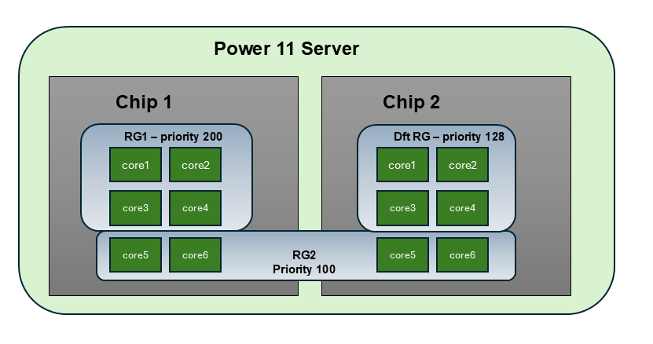
Resource Groups scenario

Slide 13
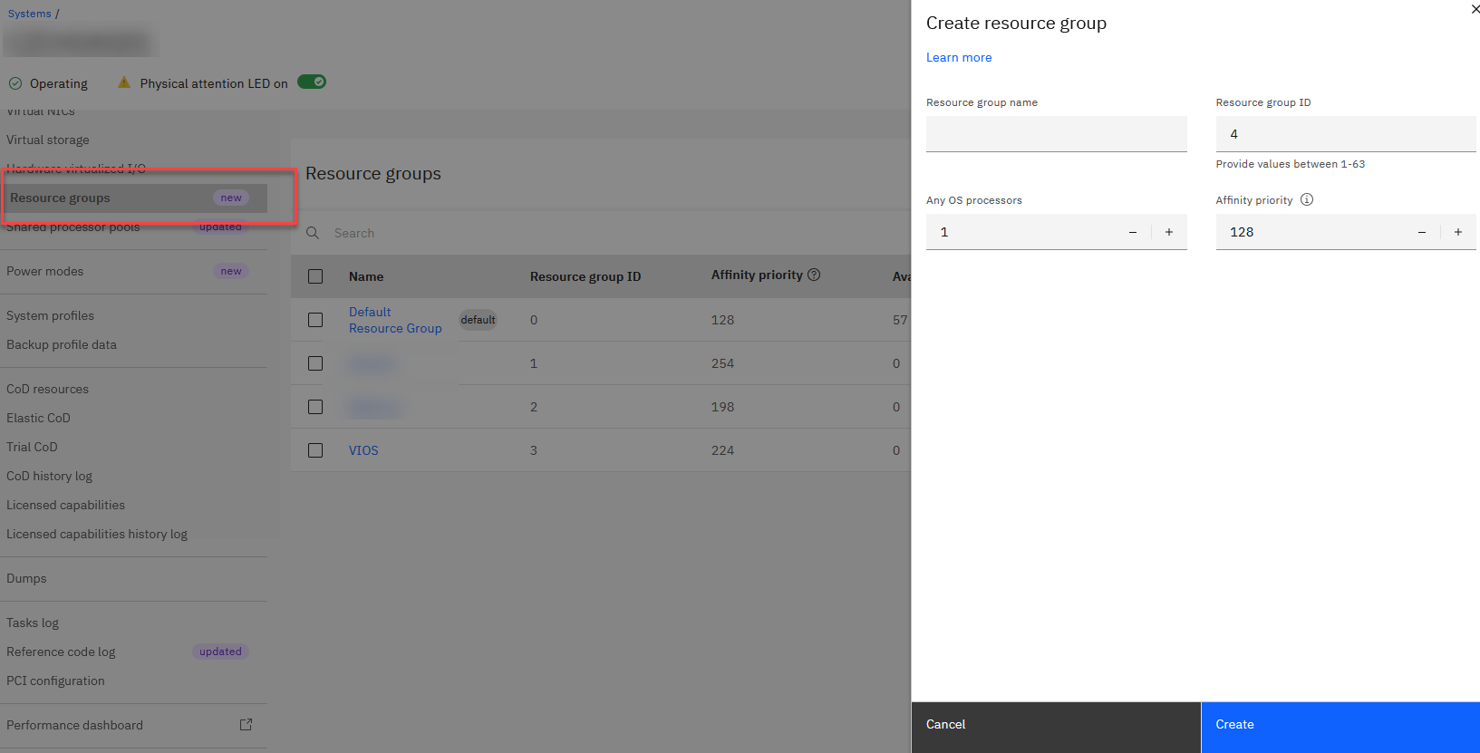
Resource Groups creation

Slide 14
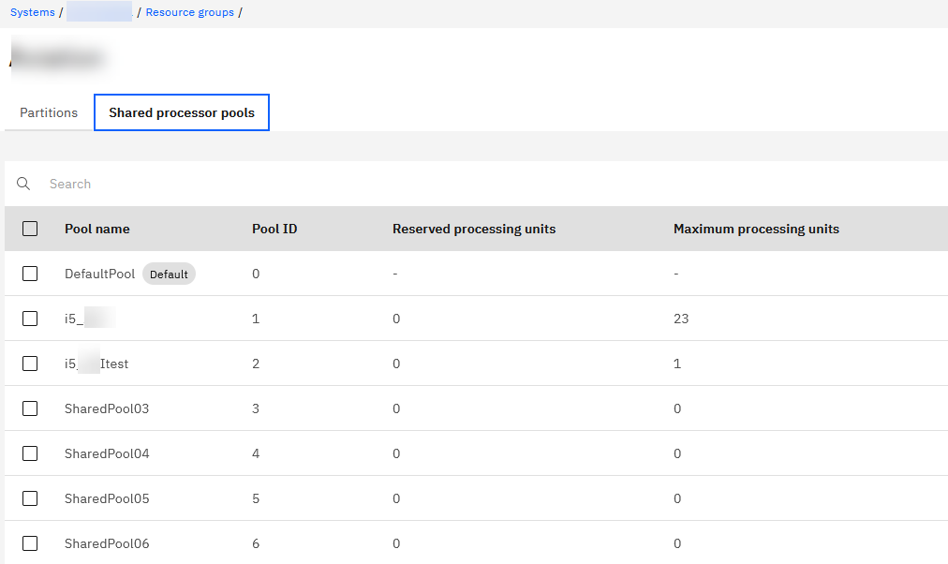
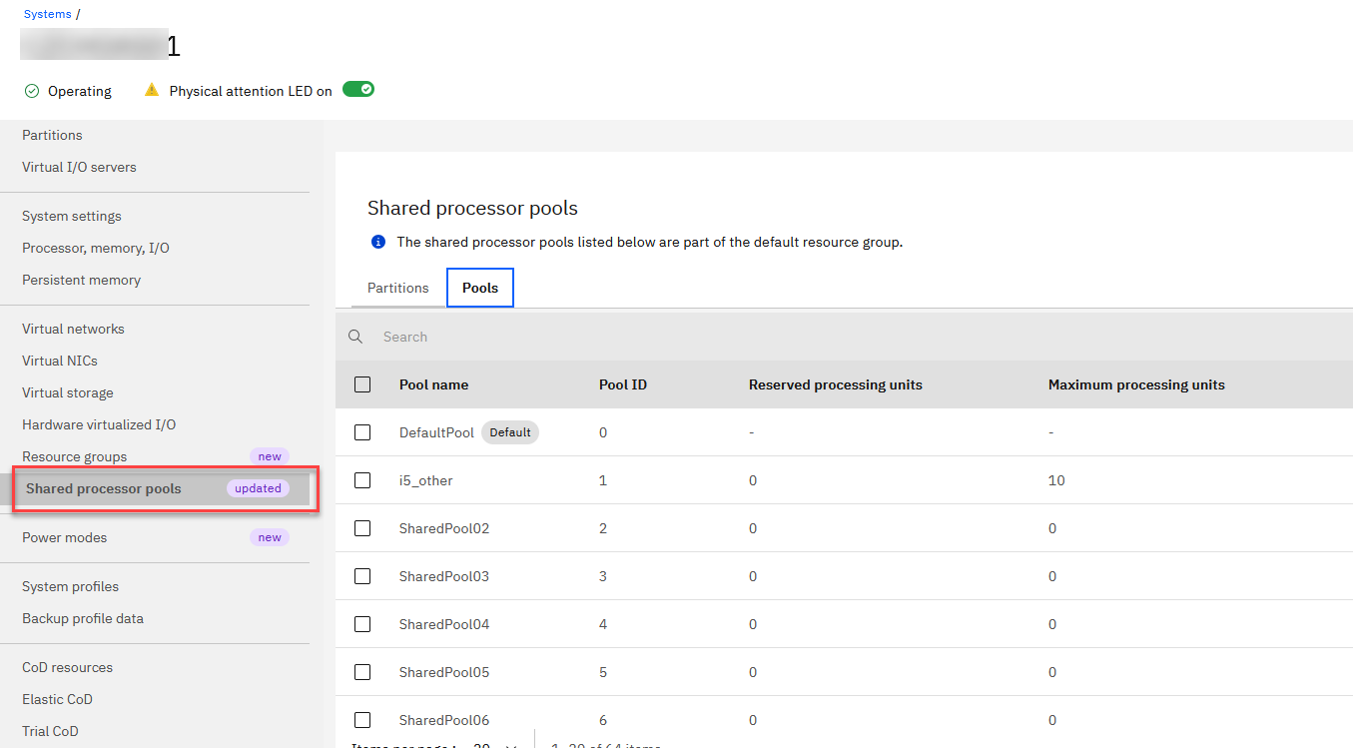
Share processor pools in Resource Groups
Shared Processor pools within RG are visible in Resource groups menu, not in SPP menu

Slide 15
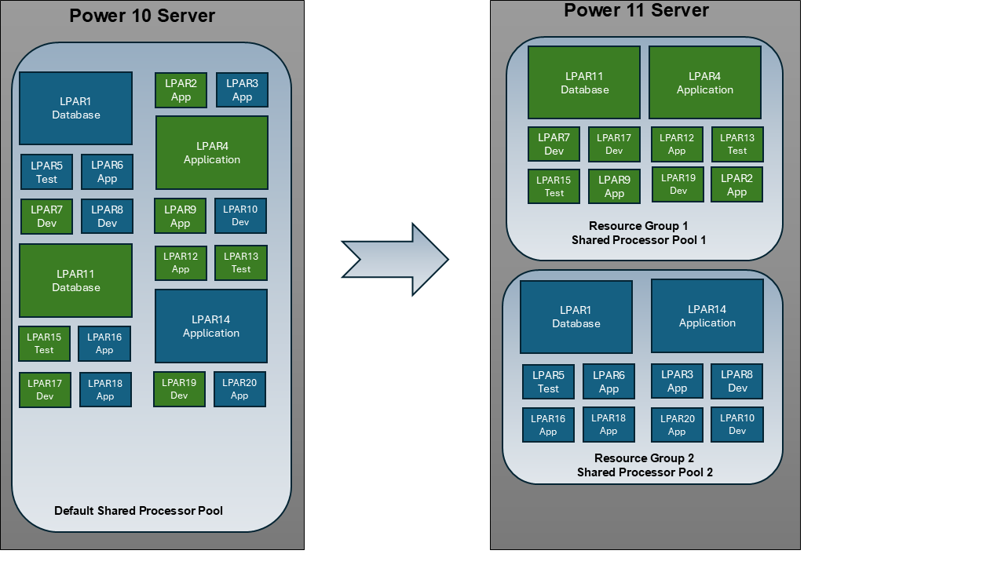
Resource Groups use cases
Consolidate across multiple lines of business - resource allocation becomes significantly more efficient, enabling better workload isolation and improved performance across the system

Slide 16
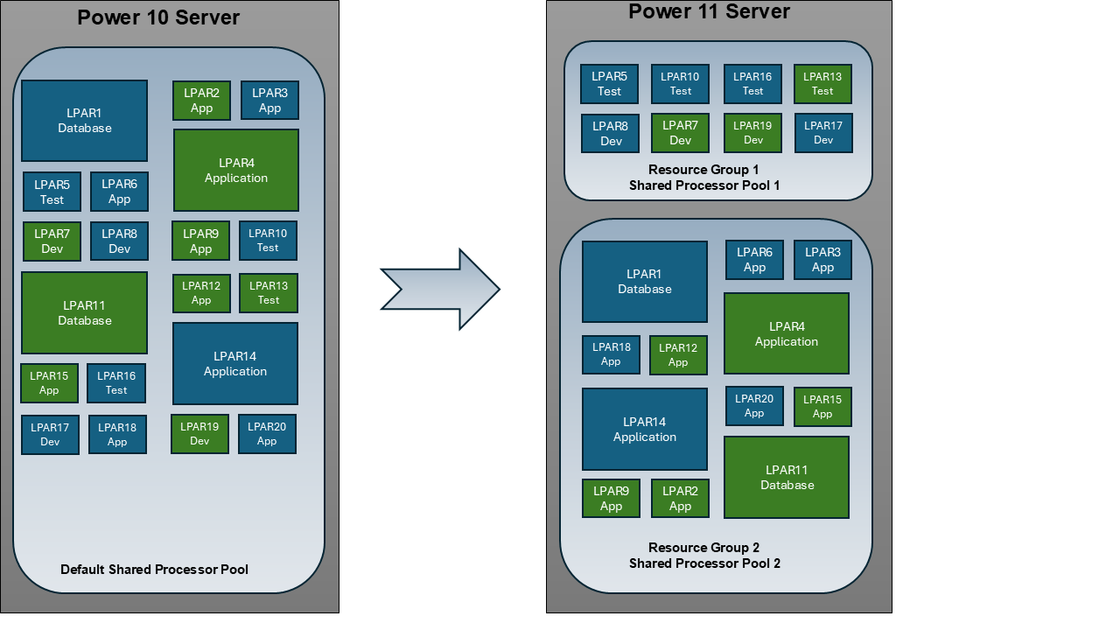
Resource Groups use cases
Isolation of production workloads from test/dev workload - limit their access to shared system resources and isolating them from production workloads.

Slide 17
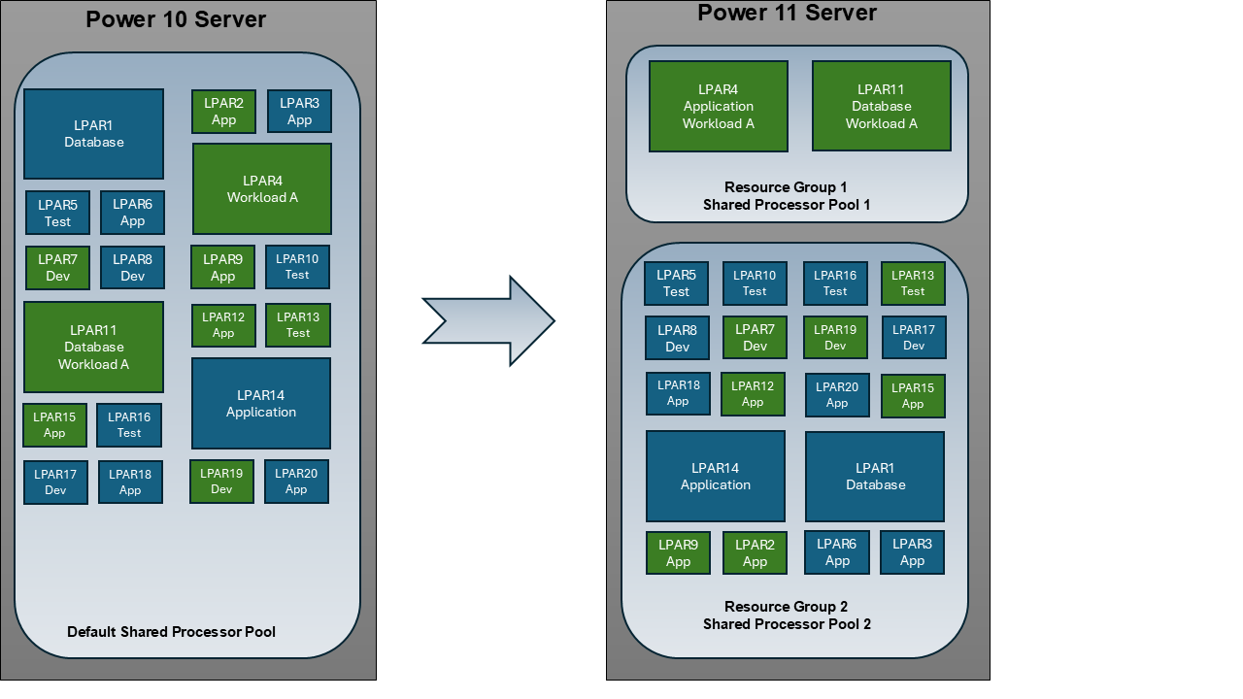
Resource Groups use cases
Improve application performance by grouping workload tiers into resource groups - improvess affinity between the database and application server.

Slide 18
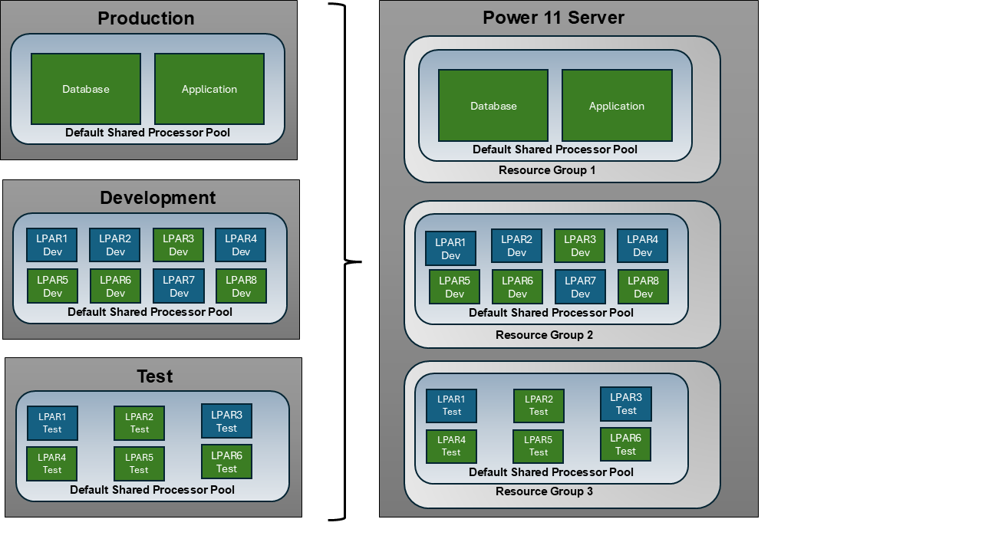
Resource Groups use cases
System-level isolation in multi-server consolidation scenarios - consolidate multiple smaller servers into a single, more powerful Power11 system while logically separating workloads into distinct groups.

Slide 19
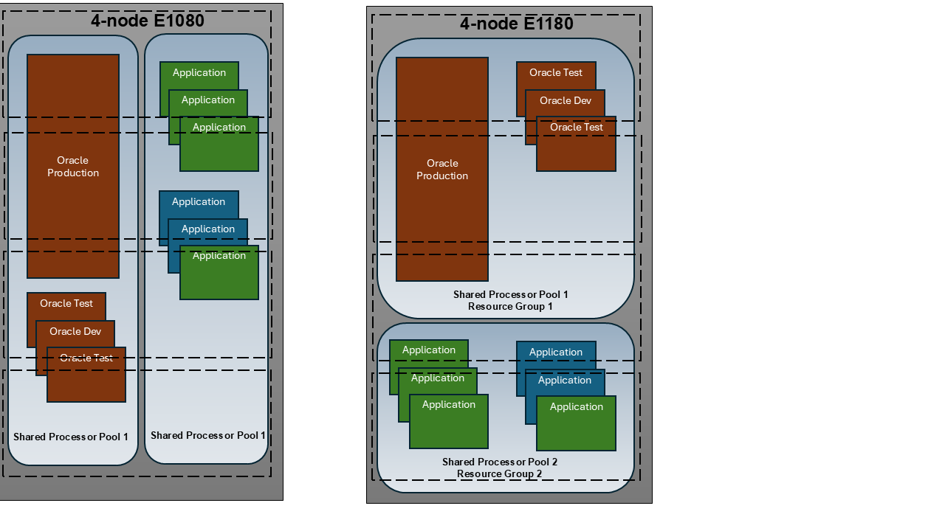
Resource Groups use cases
Improved performance by mapping Shared Processor Pools into Resource Groups allows for precise control over resource allocation and workload isolation, ensuring efficient utilization of compute capacity while maintaining performance consistency across diverse workloads

Slide 20
Resource Groups properties
RG can contain dedicated processor partitions and/or shared processor partitions.
Priorities - higher priority resource group the higher the priority that the cores would be optimally allocated.
The default resource group will contain resources not assigned to user defined groups.
Powered off partitions can be moved from one resource group to another.
The cores assigned to each resource group can be modified dynamically.
Each resource group will have its own set of shared processor pools.
Utilization metrics on the management console will be available for resource groups, shared processor pools and the system.
DPO can be run at either a system wide or resource group scope.
When using LPM the resource group on the target system can be selected.
Resource group configuration will specify the number of general-purpose cores (AIX/IBMi/Linux/VIOS) and IFL cores (Linux/VIOS).
Resource Groups and PEP 2.0 are fully compatible.

Slide 21
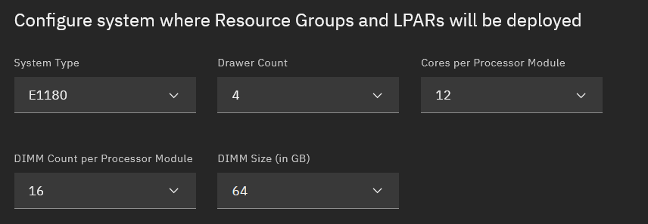

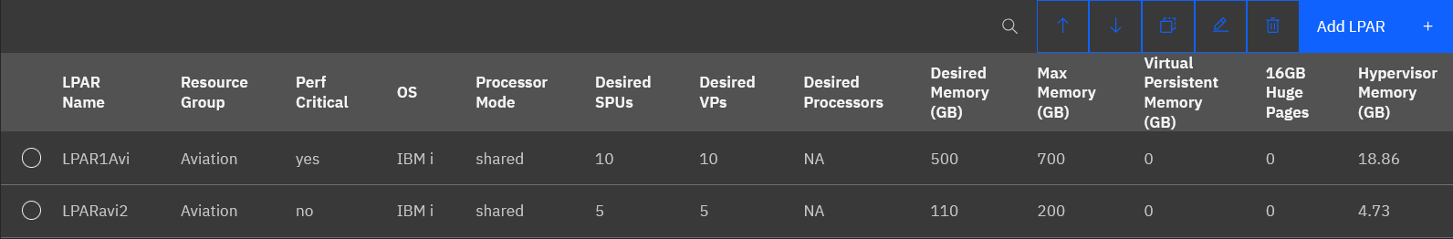
Resource Groups Advisor
It is a web-based tool, hosted in the IBM cloud.
It helps model and validate configurations to ensure efficient resource allocation and system performance.
https://www.ibm.com/it-infrastructure/resources/resource-groups-advisor

Slide 22
Resource Groups performance statistics
Currently RG statistics are not collected by IBM i Collection Services
IBM i 7.5 (TR8) and IBM i 7.6 (TR2) will provide initail information
GA in 4Q2026, the IBM i Collection Services files QAPMSYSPRC, QAPMLPARH, and QAPMCONF, and possibly QAPMSYSTEM will include Resource Group ID information when running a system that supports Resource Groups and has the prerequisite firmware and IBM i updates applied
In HMC performance collection was recognized a bug, it will be addressed in a future HMC release 3Q26.

Slide 23
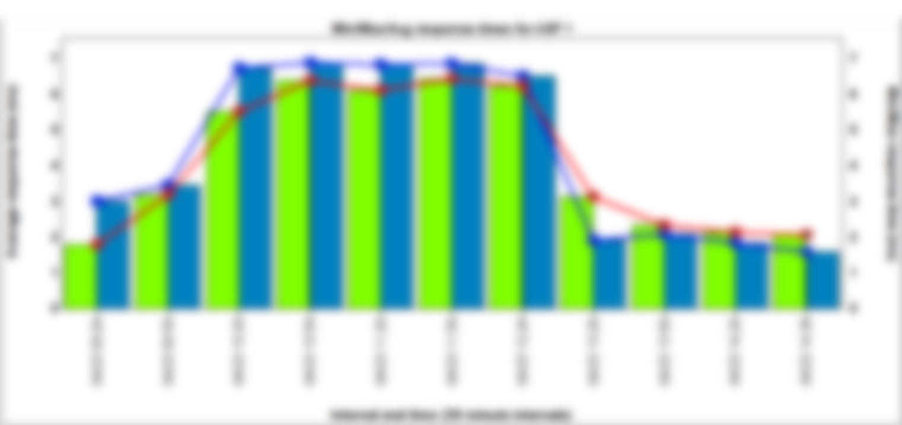
Resource Groups
Cliffhanger

Slide 24
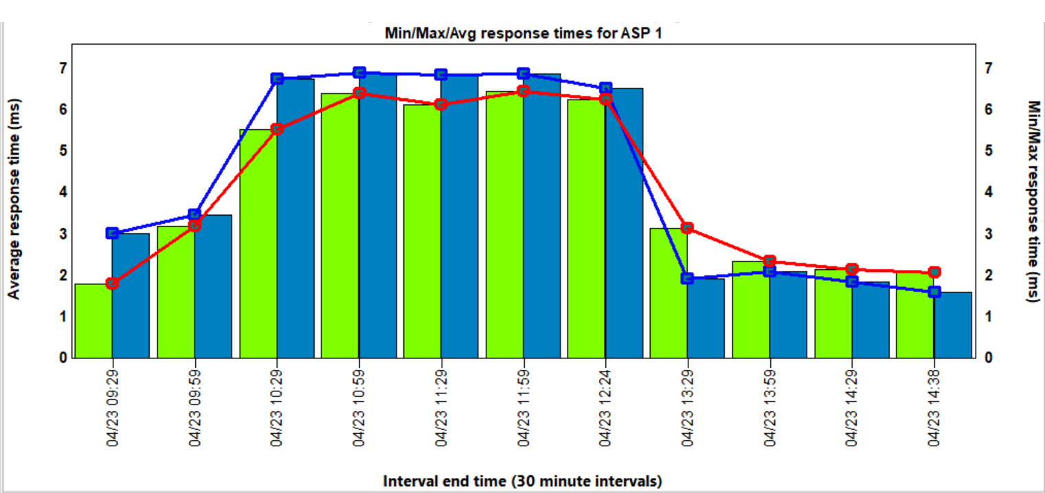
Resource Groups issue

Slide 25
Resource Groups issue
IBM support confirmed I/O Performance Degradation
Significant degradation of I/O performance for shared processor partitions within the impacted resource groups.
Performance issues persist until corrective action is taken.
The issue is isolated to shared processor partitions in the default and user defined resource group and does not affect dedicated processor partitions.
The issue occurs during dynamic processor reassignment between Resource Groups
The defect is triggered by a timing issue as processors are dynamically reassigned while shared processors are actively running.

Slide 26
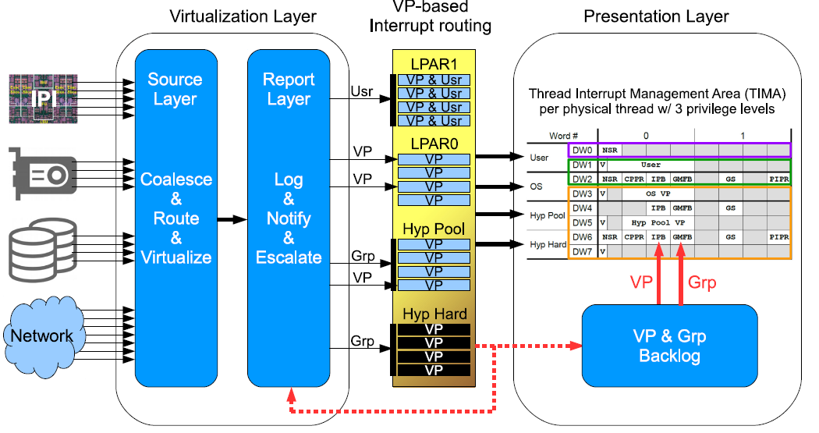
Resource Groups and XIVE
The root cause is related to eXternal Interrupt Virtualisation Engine (XIVE)
If someone is interested, it is IBM patented technology https://research.ibm.com/publications/xive-external-interrupt-virtualization-for-the-cloud-infrastructure
Issue documented here - https://www.ibm.com/support/pages/node/7274074

