Slide 1
IBM FlashSystem
Imagining the Future of Storage
Neil McGovern
IBM FlashSystem Sales Leader

Slide 2
Dave is an IT infrastructure manager at a large company…

Slide 3
The last time I met him, he said…

Slide 4
“They hate me at work”

Slide 5
“They hate me at work”
“What do you mean they hate you? Everyone loves you.”

Slide 6
“They don’t hate me personally…

Slide 7
“They don’t hate me personally…
They hate us…

Slide 8
“They don’t hate me personally…
They hate us…
...My department, the IT department

Slide 9
“They don’t hate me personally…
They hate us…
...My department, the IT department
“Why would they hate your department”

Slide 10
“we are always saying
NO
”

Slide 11
“we are always saying
NO
”
“What?”

Slide 12
“Yep, they want us to engage on strategic AI projects…

Slide 13
“Yep, they want us to engage on strategic AI projects…
I have to say
NO
”

Slide 14
“users want us to help & support all their self created AI tools…

Slide 15
“users want us to help & support all their self created AI tools…
I have to say
NO
”

Slide 16
“They want us to lower costs…

Slide 17
“They want us to lower costs…
I have to say
NO
”

Slide 18
“The answer is always…
NO
”

Slide 19
“The answer is always…
NO
”
“Why?”

Slide 20
“I am battling to keep the lights on…

Slide 21
I’ve got multiple arrays, from multiple vendors, with multiple management consoles…

Slide 22
I’ve got narrow maintenance windows, and have scarce skilled staff, manually holding it all together…

Slide 23
I’ve got workloads on arrays at capacity & we are doing manual deletes…

Slide 24
I’ve got some workloads on old arrays with excess capacity, taking up space, burning electricity & pumping out heat…

Slide 25
I’ve got workloads with increasing performance demands… and storage that can’t keep up…

Slide 26
I’ve got orphaned workloads stuck on old arrays costing me a fortune in maintenance charges…

Slide 27
I have to say
NO

Slide 28
I have to say
NO
because we are drowning…

Slide 29
I have to say
NO
because we are drowning…
…That’s why they hate me!”

Slide 30
How can we help Dave?

Slide 31
To help,
We need to understand…

Slide 32
To help,
We need to understand…
“How did we get here?”

Slide 33
What causes this sprawl, wastage & management nightmare?

Slide 34
There’s a single root cause…

Slide 35
We all hate migrations…

Slide 36
We all hate migrations…
Migration Actions
Agree maintenance window with all application owners
Schedule skilled resource to be available (overnight, weekend)
Bring down applications
Stop connections
Stop DR replications
Move data
Remap network connections
Set up new configurations
Establish new DR replications
Reconfigure snapshot policies
Test & Validate storage
Inform Application owners
Application owner Validation tests
Migrations are painful, work intensive, risky & slow and requires huge amounts of co-ordination…
We avoid moving data at all costs…
High Risk – Human Error

Slide 37
So, when we buy storage…

Slide 38
We buy storage to minimize migrations

Slide 39
We buy storage to “leave alone” for 5 years

Slide 40

When we add a workload

Slide 41
The workload needs storage
?

Slide 42
We calculate what we need to migrate on day 1

Slide 43
And our stable capacity over 5 years

Slide 44
We estimate what we need for growth

Slide 45
Add a contingency for performance

Slide 46
Add a bit more contingency – just in case

Slide 47
Then we add a storage array with the estimated terminal capacity
Massive amounts of capacity

Slide 48
Perhaps, the capacity will get used…

Slide 49
Most of our capacity does not get used…

Slide 50
Average Capacity usage over all FlashSystems worldwide…
43

Slide 51
Average Capacity usage over all FlashSystems worldwide…
43
42%

Slide 52
What a waste!

Slide 53
Servers
And every other workload is just the same, multiple arrays, each serving a single workload, over sized for contingency
Storage

Slide 54
Servers
And growing!
lots of different arrays, all different ages, performance, rates of growth & management systems
Soon, lots of different arrays, all different ages, performance, rates of capacity & management systems
Storage

Slide 55
And growing!
Servers
Soon, lots of different arrays, all different ages, performance, rates of capacity & management systems
Storage
Notes:
Its not simple, in reality, there are Multiple storage arrays each serving individual servers, workloads or applications, each with different application owners, performance requirements & growth rates – That’s complex

Slide 57
All that Complexity

Slide 58
All that Complexity
All that wasted capacity

Slide 59
All that Complexity
All that wasted capacity
All that infrastructure, requiring Management, taking up Space, burning Electricity and kicking out Heat…

Slide 60
All because we want to avoid migration…

Slide 61
It’s a similar story with Performance

Slide 62
We estimate our performance needs over 5 years

Slide 63
The reality is always a surprise!
Especially with modern workloads, there is often a gap...
But we are chained into a 5-year model
Performance Gap

Slide 64
Gap to the Market
And all the time the performance available in the market grows

Slide 65
The combined impact

Slide 66
NO
Time for Strategic Projects

Slide 67
NO
Capacity for new workloads without buying new

Slide 68
NO
Performance improvement

Slide 69
NO
Time for User Support

Slide 70
NO
Time for Resilinecy

Slide 71
NO
Time for Regulation Compliance

Slide 72
NO
Opportunity to Reduce overall Capital Expenditure

Slide 73
NO
Opportunity to Reduce Operational Costs

Slide 74
It could be Different for Dave

Slide 75
Servers
Just imagine taking existing arrays
Soon, lots of different arrays, all different ages, performance, rates of capacity & management systems
Storage

Slide 76
Servers
Imagine federating those arrays into a grid…
Soon, lots of different arrays, all different ages, performance, rates of capacity & management systems
Storage

Slide 77
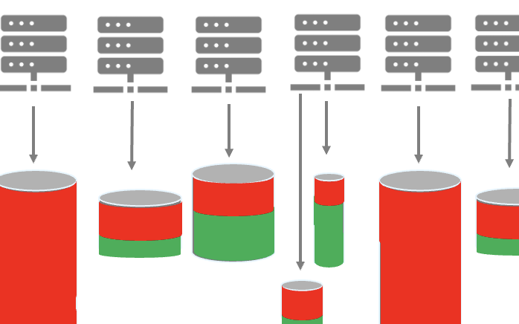
And imagine being able to manage that grid from a single pane of glass…
Servers
Soon, lots of different arrays, all different ages, performance, rates of capacity & management systems
Storage

Slide 78
Servers
Imagine being able to package
an entire workload & all its metadata, configurations & replications into one package
Soon, lots of different arrays, all different ages, performance, rates of capacity & management systems
Storage

Slide 79
Servers
Then imagine making that package mobile
Non-disruptively mobile, with zero workload or server impact
Soon, lots of different arrays, all different ages, performance, rates of capacity & management systems
Storage

Slide 80
Servers
Imagine being able to move the entire workload to any array…
Storage

Slide 81
Servers
Instantly, at the click of a mouse…
Storage

Slide 82
Servers
Non-disruptively, with no risk, with no server impact
Storage

Slide 83
Servers
Because, if we could truly mobilise data
Storage

Slide 84
Servers
We could start to optimise our storage arrays
Soon, lots of different arrays, all different ages, performance, rates of capacity & management systems
Storage

Slide 85
Servers
Reducing arrays,
Soon, lots of different arrays, all different ages, performance, rates of capacity & management systems
Storage

Slide 86
Servers
Reducing arrays, simplifying
Soon, lots of different arrays, all different ages, performance, rates of capacity & management systems

Slide 87
Servers
Reducing arrays, simplifying and saving cost
Soon, lots of different arrays, all different ages, performance, rates of capacity & management systems

Slide 88
Servers
Imagine transforming from single arrays into optimised Performance Tiers
Tier 1 Performance
Tier 2 Performance
Tier 3 Performance

Slide 89
Servers
Imagine:
Fewer arrays
Less maintenance
Less management
Less power, cooling & space
100% up time
And where disruptive maintenance becomes a thing of the past!
Tier 1 Performance
Tier 2 Performance
Tier 3 Performance

Slide 90
And importantly, the opportunity to Buy Less
But seamlessly grow if you need to…

Slide 91
Let’s look at performance

Slide 92
Performance Optimisation Example
Imagine a client with 4 applications
Application | Core Banking | Banking App | Credit check | Internal training
Information | Critical, needs to be online all the time as runs automated background banking transactions | Client access point important but not critical as clients don’t use all the time and they can call | Applies to new business only – is less important | Not important
Recovery Time Objective (RTO) | Minutes | Hours | Days | Weeks
Classification | Critical | Principal | Core | Minor

Slide 93
Let’s put them on a map

Slide 94
Application Map – System Performance
 |  |  |  |  |  |  |  | System Key
 |  |  |  |  |  |  |  | Critical
 |  |  |  |  |  |  |  | Principal
 |  |  |  |  |  |  |  | Core
 |  |  |  |  |  |  |  | Minor
The Relative System Performance
Relative System Performance
System Age: 1 Year 2 Years 3 Years 4 Years 5 Years 6 Years

Slide 95
Application Map – System Age
 |  |  |  |  |  |  |  | System Key
 |  |  |  |  |  |  |  | Critical
 |  |  |  |  |  |  |  | Principal
 |  |  |  |  |  |  |  | Core
 |  |  |  |  |  |  |  | Minor
Relative System Performance
Age of the system
System Age: 1 Year 2 Years 3 Years 4 Years 5 Years 6 Years

Slide 96
Application Map
 |  |  |  |  |  |  |  | System Key
 |  |  |  |  |  |  |  | Critical
 |  |  |  | Core Banking |  |  |  | Principal
 | Internal training |  |  |  | Banking App |  |  | Core
 |  |  |  |  |  | Credit check |  | Minor
Relative System Performance
System Age: 1 Year 2 Years 3 Years 4 Years 5 Years 6 Years

Slide 97
Application HW due for sunset
 |  |  |  |  |  |  |  | System Key
 |  |  |  |  |  |  |  | Critical
 |  |  |  | Core Banking |  |  |  | Principal
 | Internal training |  |  |  | Banking App |  |  | Core
 |  |  |  |  |  | Credit check |  | Minor
This System is 6 years old, it needs a refresh
What do we do?
Relative System Performance
System Age: 1 Year 2 Years 3 Years 4 Years 5 Years 6 Years

Slide 98
Traditional approach - Buy New Hardware
 |  |  |  |  |  |  |  | System Key
 |  |  |  |  |  |  |  | Critical
 |  |  |  | Core Banking |  |  |  | Principal
 | Internal training |  |  |  | Banking App |  |  | Core
New Array |  |  |  |  |  | Credit check |  | Minor
Relative System Performance
Buy New
System Age: 1 Year 2 Years 3 Years 4 Years 5 Years 6 Years

Slide 99
Migrate
 |  |  |  |  |  |  |  | System Key
 |  |  |  |  |  |  |  | Critical
 |  |  |  | Core Banking |  |  |  | Principal
 | Internal training |  |  |  | Banking App |  |  | Core
Credit check |  |  |  |  |  | Credit check |  | Minor
Relative System Performance
Migrate
System Age: 1 Year 2 Years 3 Years 4 Years 5 Years 6 Years

Slide 100
Sunset Hardware
 |  |  |  |  |  |  |  | System Key
 |  |  |  |  |  |  |  | Critical
 |  |  |  | Core Banking |  |  |  | Principal
 | Internal training |  |  |  | Banking App |  |  | Core
Credit check |  |  |  |  |  | Credit check |  | Minor
Relative System Performance
Sunset old
System Age: 1 Year 2 Years 3 Years 4 Years 5 Years 6 Years

Slide 101
Results. Sub optimal investment
 |  |  |  |  |  |  |  | System Key
 |  |  |  |  |  |  |  | Critical
 |  |  |  | Core Banking |  |  |  | Principal
 | Internal training |  |  |  | Banking App |  |  | Core
Credit check |  |  |  |  |  |  |  | Minor
Investment does not improve any other system!
Relative System Performance
System Age: 1 Year 2 Years 3 Years 4 Years 5 Years 6 Years

Slide 102
Sub Optimal Investment
This System deployed 4 years ago, already suffering for degrading performance & way behind current available technology & performance and lacks modern resiliency
 |  |  |  |  |  |  |  | System Key
 |  |  |  |  |  |  |  | Critical
 |  |  |  | Core Banking |  |  |  | Principal
 | Internal training |  |  |  | Banking App |  |  | Core
Credit check |  |  |  |  |  |  |  | Minor
Investment does not improve any other system!
Relative System Performance
System Age: 1 Year 2 Years 3 Years 4 Years 5 Years 6 Years

Slide 103
Just imagine your workloads were truly mobile…

Slide 104
Imagine you could cascade them to optimise performance…

Slide 105
Introducing IBM FlashSystem
IBM FlashSystem |  |  |  |  |  |  |  | System Key
 |  |  |  |  |  |  |  | Critical
 |  |  |  | Core Banking |  |  |  | Principal
 | Internal training |  |  |  | Banking App |  |  | Core
 |  |  |  |  |  | Credit check |  | Minor
Alternative is to add IBM FlashSystem
Relative System Performance
System Age: 1 Year 2 Years 3 Years 4 Years 5 Years 6 Years

Slide 106
Virtualisation & FlashSystem Grid
Virtualise 3rd party arrays & View everything from a single pane of glass
Virtualise all Systems under IBM FlashSystem Grid
IBM FlashSystem |  |  |  |  |  |  |  | System Key
 |  |  |  |  |  |  |  | Critical
 |  |  |  | Core Banking |  |  |  | Principal
 | Internal training |  |  |  | Banking App |  |  | Core
 |  |  |  |  |  | Credit check |  | Minor
Relative System Performance
System Age: 1 Year 2 Years 3 Years 4 Years 5 Years 6 Years

Slide 107
Non disruptive migration for Resiliency
Migrate most important Core Banking to IBM FlashSystem to get Safe Guarded Copy and Ransomware Threat Detection
Now
IBM FlashSystem |  |  |  |  |  |  |  | System Key
 |  |  |  |  |  |  |  | Critical
 |  |  |  | Core Banking |  |  |  | Principal
 | Internal training |  |  |  | Banking App |  |  | Core
 |  |  |  |  |  | Credit check |  | Minor
Relative System Performance
System Age: 1 Year 2 Years 3 Years 4 Years 5 Years 6 Years

Slide 108
Non disruptive migration for Resiliency
Core Banking |  |  |  |  |  |  |  | System Key
 |  |  |  |  |  |  |  | Critical
 |  |  |  |  |  |  |  | Principal
 | Internal training |  |  |  | Banking App |  |  | Core
 |  |  |  |  |  | Credit check |  | Minor
You now have Free capacity
Relative System Performance
System Age: 1 Year 2 Years 3 Years 4 Years 5 Years 6 Years

Slide 109
Year 1 Cascade
Core Banking |  |  |  |  |  |  |  | System Key
 |  |  |  |  |  |  |  | Critical
 |  |  |  |  |  |  |  | Principal
 | Internal training |  |  |  | Banking App |  |  | Core
 |  |  |  |  |  | Credit check |  | Minor
Migrate Banking App to free capacity
Relative System Performance
System Age: 1 Year 2 Years 3 Years 4 Years 5 Years 6 Years

Slide 110
Year 1 Cascade
Core Banking |  |  |  |  |  |  |  | System Key
 |  |  |  |  |  |  |  | Critical
 |  |  |  | Banking App |  |  |  | Principal
 | Internal training |  |  |  |  |  |  | Core
 |  |  |  |  |  | Credit check |  | Minor
Free capacity
Relative System Performance
System Age: 1 Year 2 Years 3 Years 4 Years 5 Years 6 Years

Slide 111
Year 1 Cascade
Core Banking |  |  |  |  |  |  |  | System Key
 |  |  |  |  |  |  |  | Critical
 |  |  |  | Banking App |  |  |  | Principal
 | Internal training |  |  |  |  |  |  | Core
 |  |  |  |  |  | Credit check |  | Minor
Migrate Internal Training to freed space
Relative System Performance
System Age: 1 Year 2 Years 3 Years 4 Years 5 Years 6 Years

Slide 112
Year 1 Cascade
Core Banking |  |  |  |  |  |  |  | System Key
 |  |  |  |  |  |  |  | Critical
 |  |  |  | Banking App |  |  |  | Principal
 |  |  |  |  | Internal training |  |  | Core
 |  |  |  |  |  | Credit check |  | Minor
Free capacity
Relative System Performance
System Age: 1 Year 2 Years 3 Years 4 Years 5 Years 6 Years

Slide 113
Year 1 Cascade
Core Banking |  |  |  |  |  |  |  | System Key
 |  |  |  |  |  |  |  | Critical
 |  |  |  | Banking App |  |  |  | Principal
 |  |  |  |  | Internal training |  |  | Core
 |  |  |  |  |  | Credit check |  | Minor
Migrate Credit check to free space
Relative System Performance
System Age: 1 Year 2 Years 3 Years 4 Years 5 Years 6 Years

Slide 114
Year 1 Cascade
Core Banking |  |  |  |  |  |  |  | System Key
 |  |  |  |  |  |  |  | Critical
 |  |  |  | Banking App |  |  |  | Principal
 | Credit Check |  |  |  | Internal training |  |  | Core
 |  |  |  |  |  |  |  | Minor
Sunset old system
Relative System Performance
System Age: 1 Year 2 Years 3 Years 4 Years 5 Years 6 Years

Slide 115
Imagine what happens in Year 2

Slide 116
Year 2 Cascade
Technology Advances – higher performance systems available so relative performance of all systems moves down
 |  |  |  |  |  |  |  | System Key
 | Core Banking |  |  |  |  |  |  | Critical
 |  |  |  |  |  |  |  | Principal
 |  |  |  |  | Banking App |  |  | Core
 |  | Credit Check |  |  |  | Internal training |  | Minor
Relative System Performance
System Age: 1 Year 2 Years 3 Years 4 Years 5 Years 6 Years

Slide 117
Year 2 Cascade
 |  |  |  |  |  |  |  | System Key
 | Core Banking |  |  |  |  |  |  | Critical
 |  |  |  |  |  |  |  | Principal
 |  |  |  |  | Banking App |  |  | Core
 |  | Credit Check |  |  |  | Internal training |  | Minor
All systems are a year older
Relative System Performance
System Age: 1 Year 2 Years 3 Years 4 Years 5 Years 6 Years

Slide 118
Year 2 Cascade
 |  |  |  |  |  |  |  | System Key
 | Core Banking |  |  |  |  |  |  | Critical
 |  |  |  |  |  |  |  | Principal
 |  |  |  |  | Banking App |  |  | Core
 |  | Credit Check |  |  |  | Internal training |  | Minor
Relative System Performance
This System is 6 years old, and needs a refresh,
System Age: 1 Year 2 Years 3 Years 4 Years 5 Years 6 Years

Slide 119
Year 2 Cascade
Let’s add new IBM FlashSystem
IBM FlashSystem |  |  |  |  |  |  |  | System Key
 | Core Banking |  |  |  |  |  |  | Critical
 |  |  |  |  |  |  |  | Principal
 |  |  |  |  | Banking App |  |  | Core
 |  | Credit Check |  |  |  | Internal training |  | Minor
Relative System Performance
System Age: 1 Year 2 Years 3 Years 4 Years 5 Years 6 Years

Slide 120
Year 2 Cascade
IBM FlashSystem |  |  |  |  |  |  |  | System Key
 | Core Banking |  |  |  |  |  |  | Critical
 |  |  |  |  |  |  |  | Principal
 |  |  |  |  | Banking App |  |  | Core
 |  | Credit Check |  |  |  | Internal training |  | Minor
Move Core banking to new System
Relative System Performance
System Age: 1 Year 2 Years 3 Years 4 Years 5 Years 6 Years

Slide 121
Year 2 Cascade
Core Banking |  |  |  |  |  |  |  | System Key
 |  |  |  |  |  |  |  | Critical
 |  |  |  |  |  |  |  | Principal
 |  |  |  |  | Banking App |  |  | Core
 |  | Credit Check |  |  |  | Internal training |  | Minor
Free Capacity
Relative System Performance
System Age: 1 Year 2 Years 3 Years 4 Years 5 Years 6 Years

Slide 122
Year 2 Cascade
Core Banking |  |  |  |  |  |  |  | System Key
 |  |  |  |  |  |  |  | Critical
 |  |  |  |  |  |  |  | Principal
 |  |  |  |  | Banking App |  |  | Core
 |  | Credit Check |  |  |  | Internal training |  | Minor
Move Banking App to free capacity
Relative System Performance
System Age: 1 Year 2 Years 3 Years 4 Years 5 Years 6 Years

Slide 123
Year 2 Cascade
Core Banking |  |  |  |  |  |  |  | System Key
 | Banking App |  |  |  |  |  |  | Critical
 |  |  |  |  |  |  |  | Principal
 |  |  |  |  |  |  |  | Core
 |  | Credit Check |  |  |  | Internal training |  | Minor
Free Capacity
Relative System Performance
System Age: 1 Year 2 Years 3 Years 4 Years 5 Years 6 Years

Slide 124
Year 2 Cascade
Core Banking |  |  |  |  |  |  |  | System Key
 | Banking App |  |  |  |  |  |  | Critical
 |  |  |  |  |  |  |  | Principal
 |  |  |  |  |  |  |  | Core
 |  | Credit Check |  |  |  | Internal training |  | Minor
Move internal Training
Relative System Performance
System Age: 1 Year 2 Years 3 Years 4 Years 5 Years 6 Years

Slide 125
Year 2 Cascade
Core Banking |  |  |  |  |  |  |  | System Key
 | Banking App |  |  |  |  |  |  | Critical
 |  |  |  |  |  |  |  | Principal
 |  |  |  |  | Internal Training |  |  | Core
 |  | Credit Check |  |  |  |  |  | Minor
Relative System Performance
Sunset old system
System Age: 1 Year 2 Years 3 Years 4 Years 5 Years 6 Years

Slide 126
Year 2 Cascade
Core Banking |  |  |  |  |  |  |  | System Key
 | Banking App |  |  |  |  |  |  | Critical
 |  |  |  |  |  |  |  | Principal
 |  |  |  |  | Internal Training |  |  | Core
 |  | Credit Check |  |  |  |  |  | Minor
Every System benefits from improved performance!
Relative System Performance
Sunset old system
System Age: 1 Year 2 Years 3 Years 4 Years 5 Years 6 Years

Slide 127
Imagine…

Slide 128
Imagine…
Non disruptive workload mobility

Slide 129
Imagine…
Non disruptive workload mobility
Highest value workloads always on the highest performance arrays

Slide 130
Imagine…
Non disruptive workload mobility
Highest value workloads always on the highest performance arrays
Every workload optimised for performance

Slide 131
And importantly, the opportunity to Buy Less
But seamlessly grow if you need to...

Slide 132
So, fantastic optimisation possibilities…

Slide 133
But who is going to do this work?…

Slide 134
Just imagine you had an AI assistant…

Slide 135
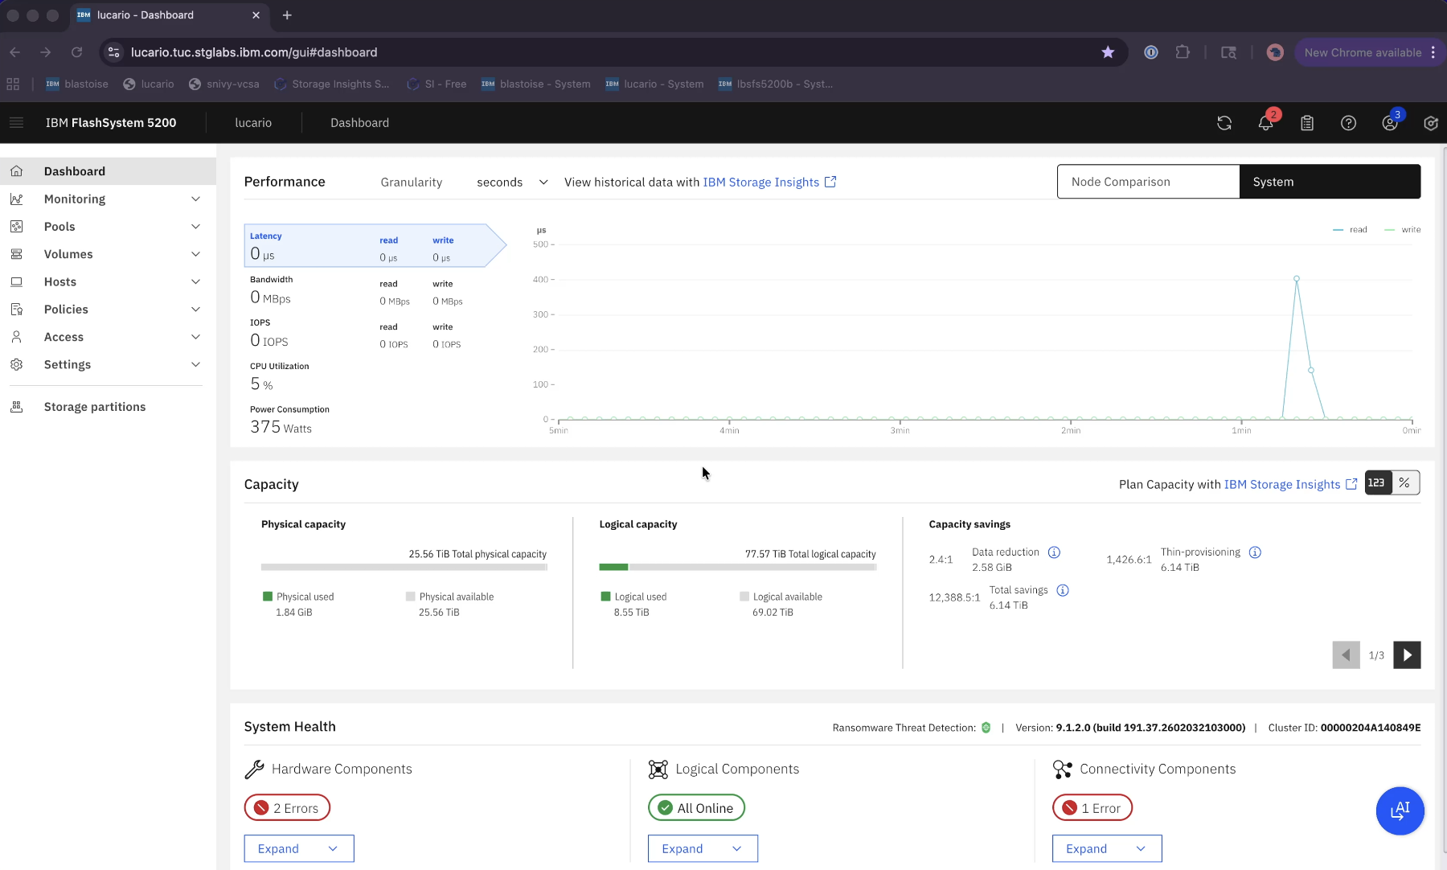
FlashSystem.ai – always ready
Click to access your FlashSystem.ai assistant

Slide 136
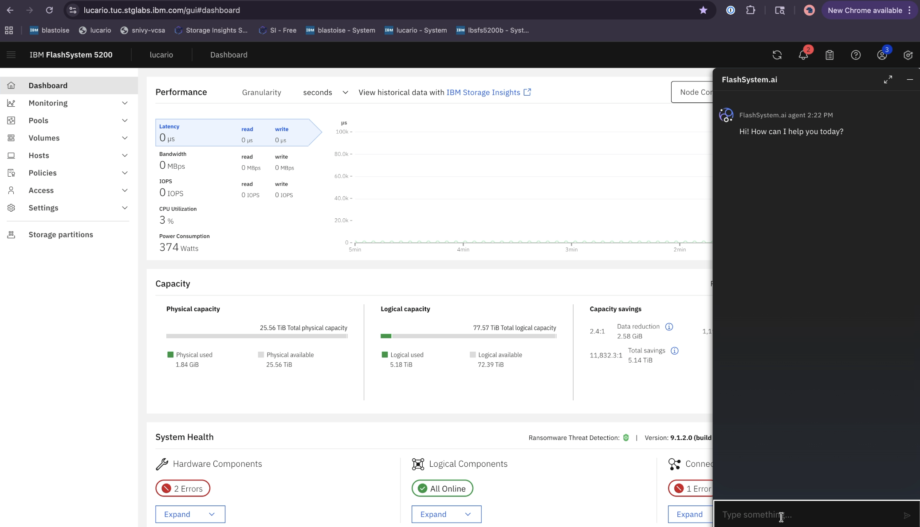
FlashSystem.ai – user prompt
Ask any question in Natural Language

Slide 137
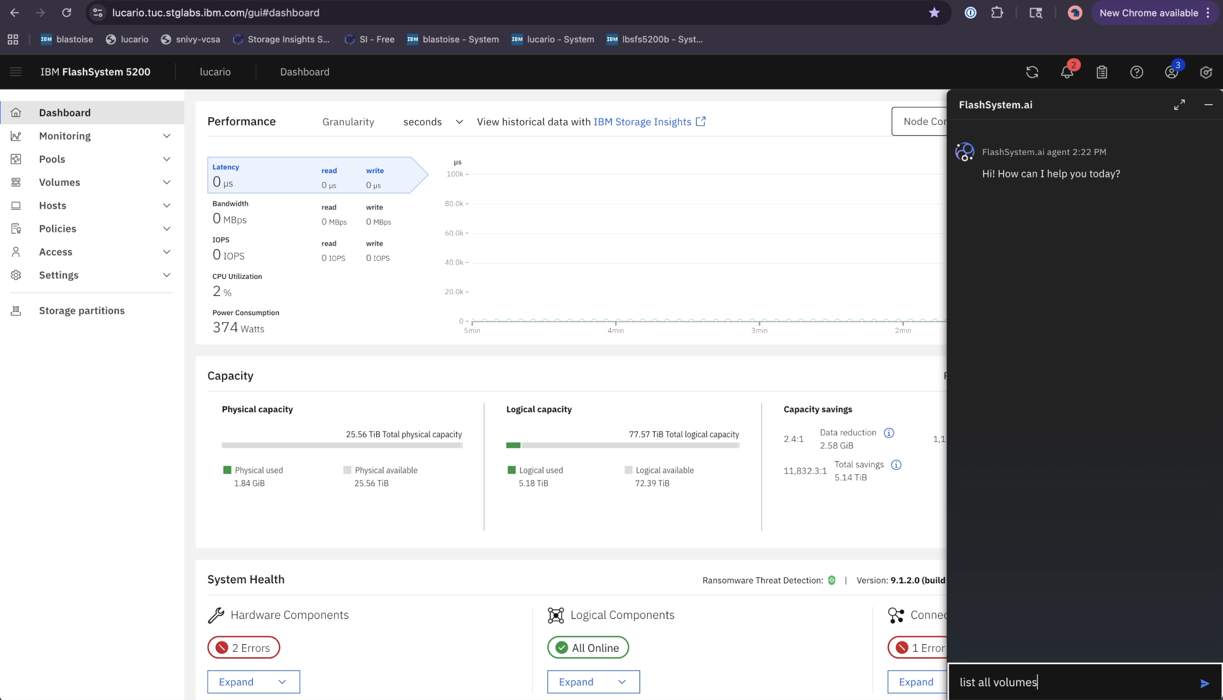
FlashSystem.ai – List Volumes
Let’s list volumes

Slide 138
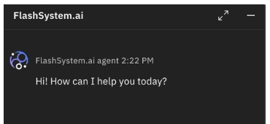
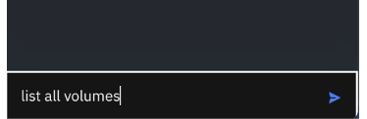
FlashSystem.ai – Volumes listed
Your wish…

Slide 139
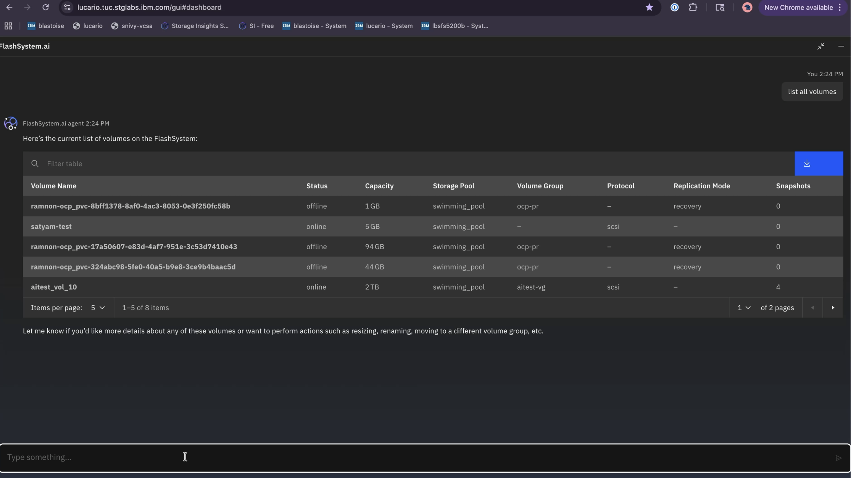
FlashSystem.ai – Volumes listed
Your wish…
…is my command

Slide 140
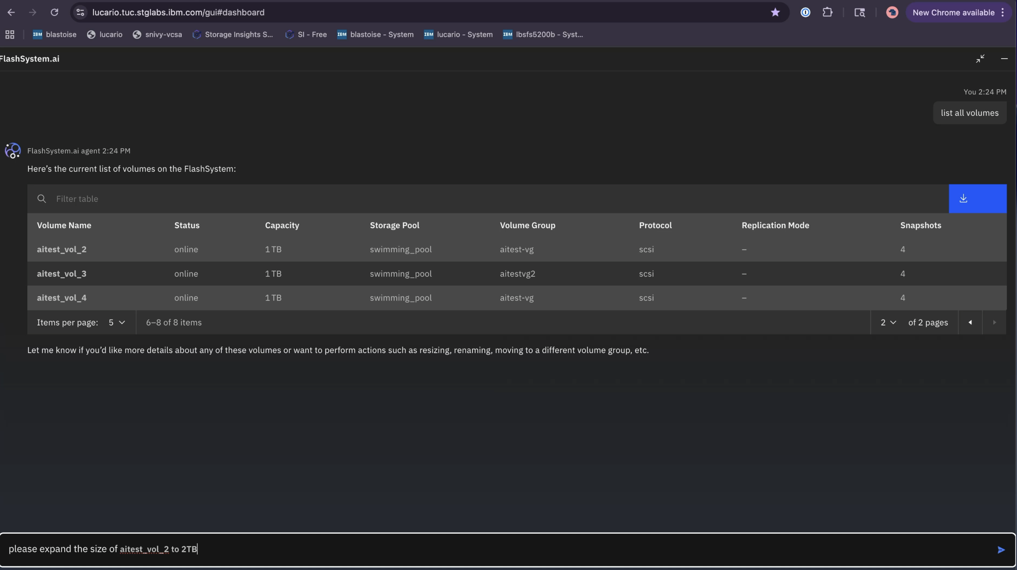
FlashSystem.ai – Expand Volumes
Request to expand volumes

Slide 141
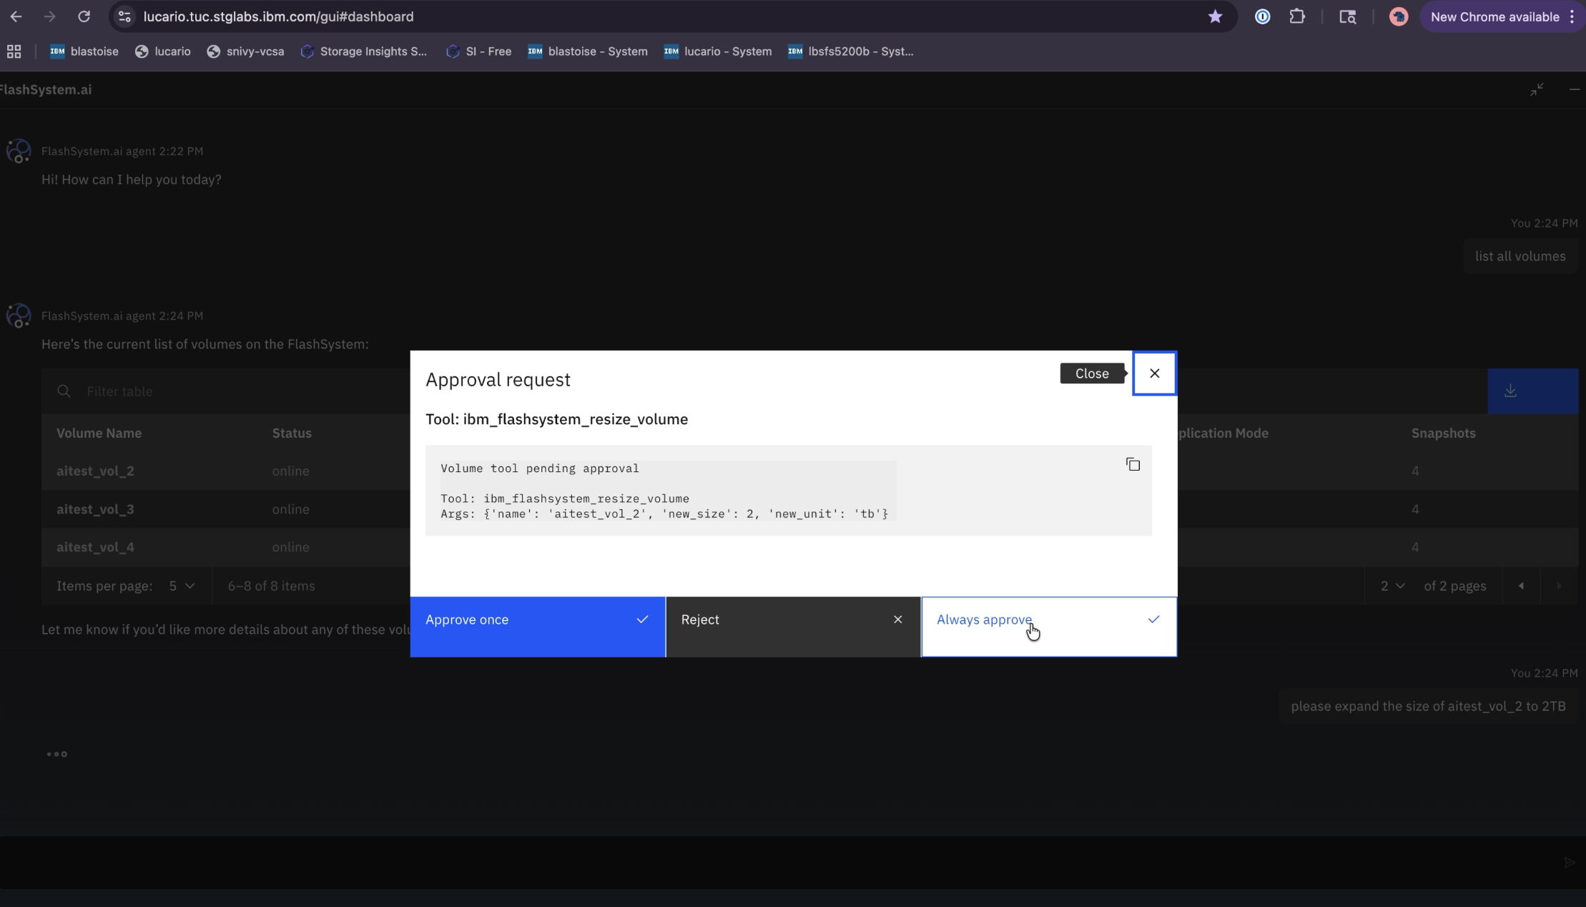
FlashSystem.ai – Human Approval
The human is always in the loop to approve actions

Slide 142
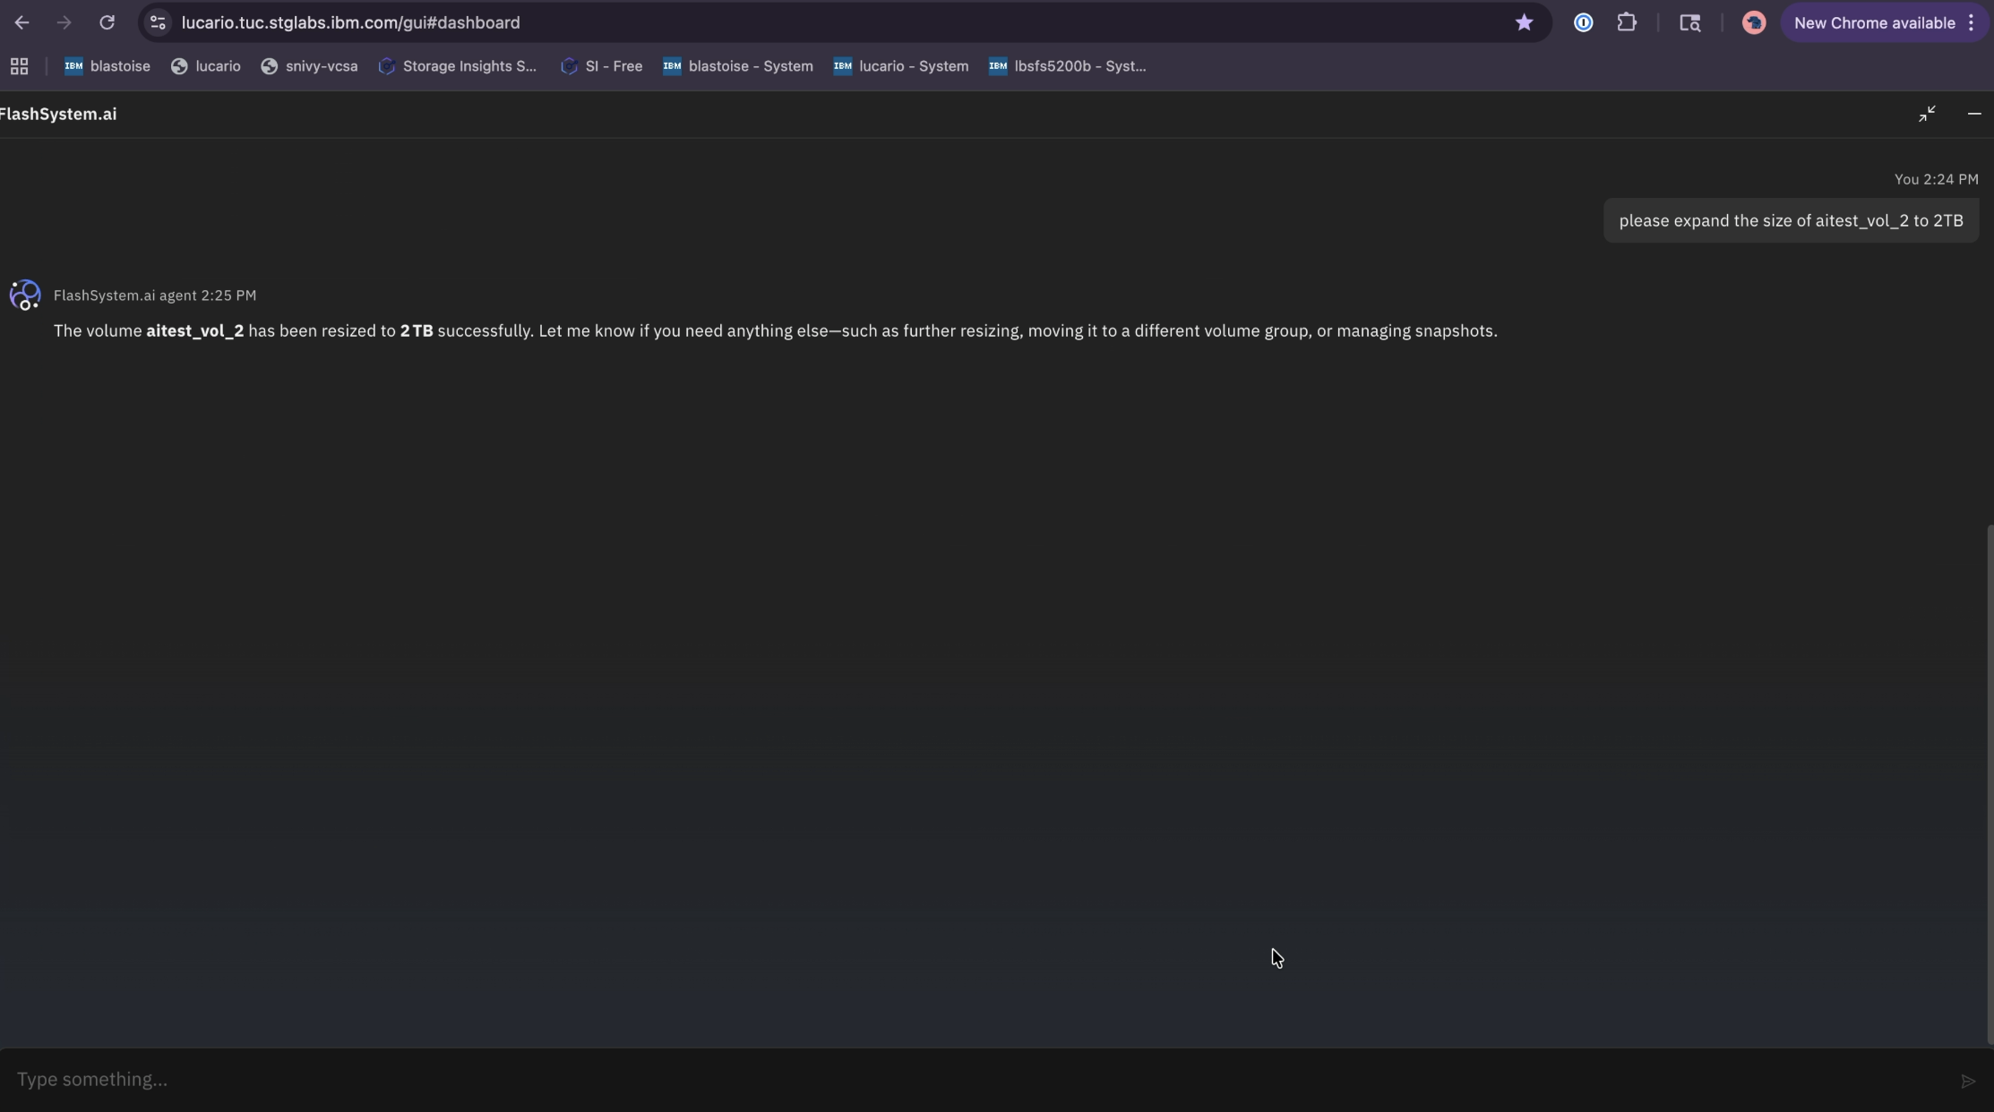
FlashSystem.ai – Task Completed
Job Done!

Slide 143
Just imagine…

Slide 144
Just imagine…
Human supervised FlashSystem.ai

Slide 145
Just imagine…
Human supervised FlashSystem.ai
Mundane, everyday actions automated

Slide 146
Just imagine…
Human supervised FlashSystem.ai
Mundane, everyday actions automated
Human Risk removed…

Slide 147
Just imagine

Slide 148
Just imagine
Your AI assistant monitoring your grid…

Slide 149
Just imagine
Your AI assistant monitoring your grid…
Reading your support tickets & recommending action

Slide 150
Just imagine
Your AI assistant monitoring your grid…
Reading your support tickets & recommending action
Recommending optimisation & asking your permission to optimise

Slide 151
The Future is here…

Slide 152
The Future is here..
FlashSystem grid for:
Single pane of glass overview & management
Non-disruptive mobility
Ultimate optimisation
FlashSystem.ai for:
Routine & Mundane task automation
Performance & Capacity optimisation suggestions
Human supervised automatic task execution

Slide 153
The Future delivers real outcomes…
FlashSystem grid:
Easier to manage systems – freeing staff
Higher performance levels – for ALL workloads
Fewer physical arrays
  Saving Capital Cost & Operational Space, Power, Staffing & cooling costs
FlashSystem.ai:
The engine of optimisation
Removing manual work – freeing staff
Removing risk of human error

Slide 154
Dave’s story will be different…

Slide 155
47%
IBM FlashSystem grid removed 47% of storage arrays

Slide 156
€€€
IBM FlashSystem grid saved €€€ in Power, Cooling & Space

Slide 157
€€€
IBM FlashSystem grid saved €€€ in maintenance costs for old Arrays

Slide 158
28%
Improved workload Performance across the grid

Slide 159
90%
Saving in manual system administration effort

Slide 160
2headcount
Two FTE administrators refocussed from mundane admin tasks to Strategic Projects

Slide 161
100%
System availability

Slide 162
Now, Dave is a

Slide 163
Now, Dave is a
YES man

Slide 164
The future of storage is
IBM FlashSystem

Slide 165

Thank You!
Neil McGovern
neil_mcgovern@uk.ibm.com
IBM FlashSystem Sales Leader

