Slide 1


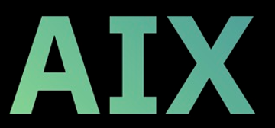

IBM AIX Live Update Workshop
Sunday June 14th, 10.00am-1.00pm
Chris Gibson
IBM Power/AIX SME
IBM Power Technical Training

Slide 2
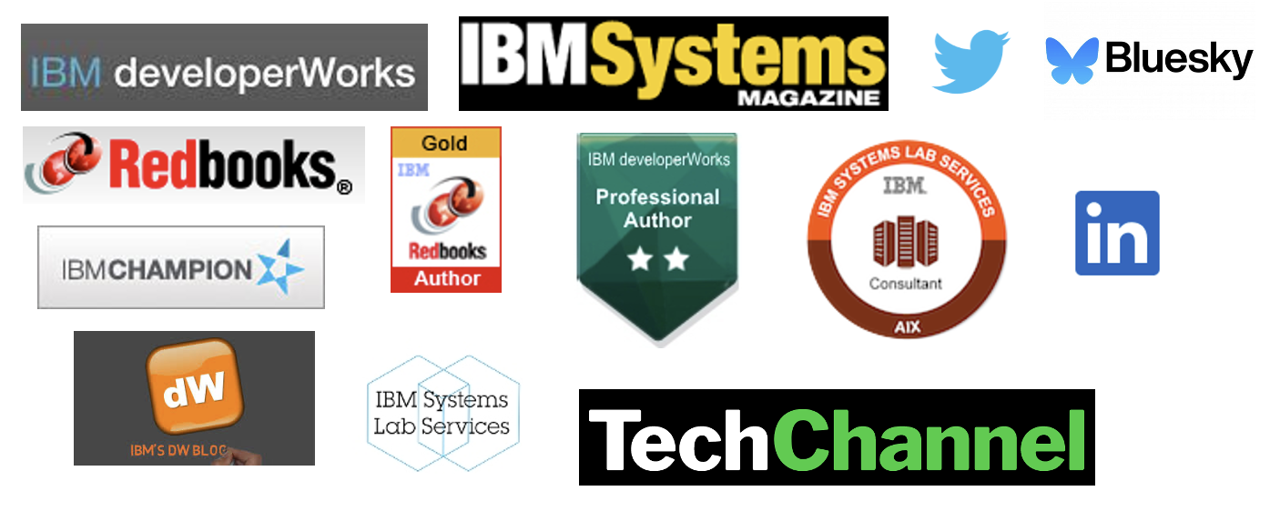
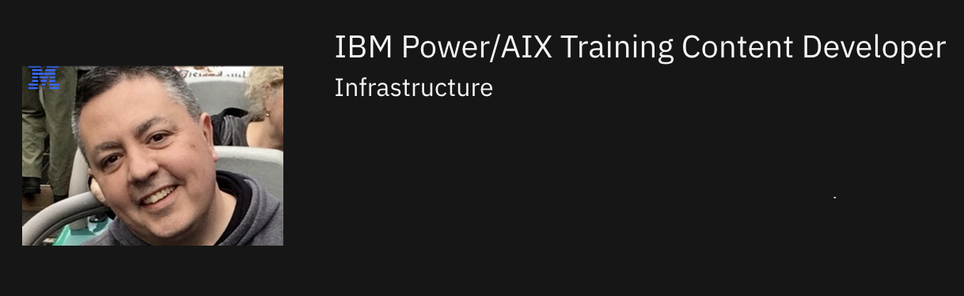
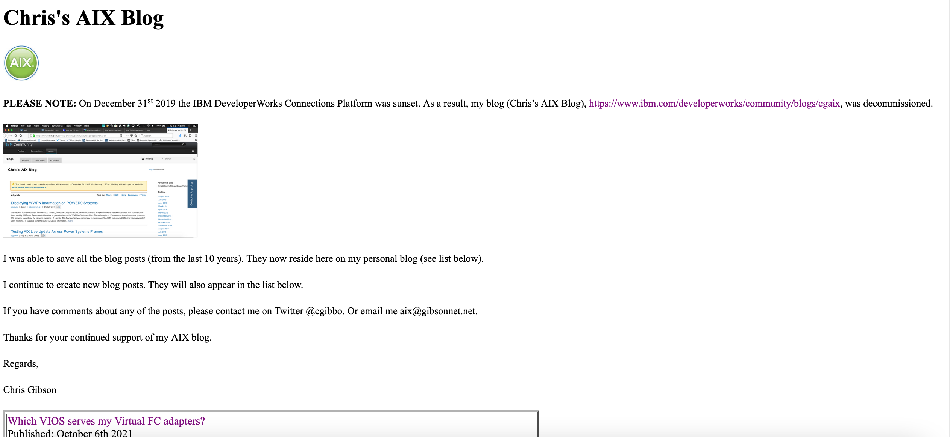
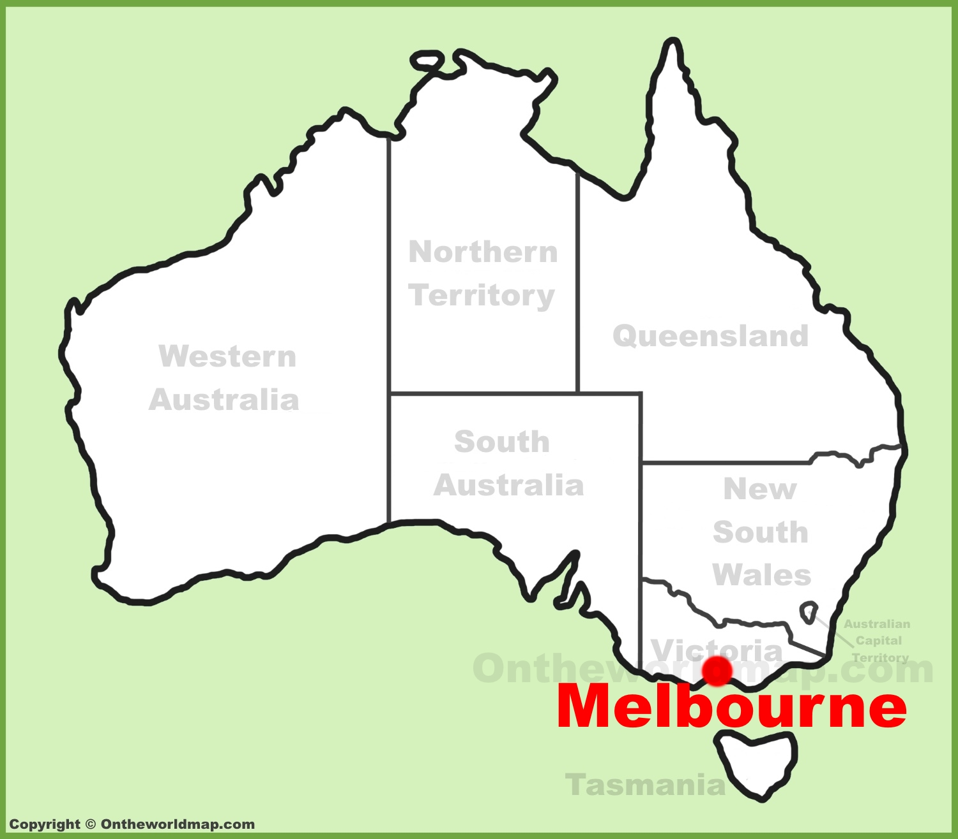
Common Europe Congress 2026

Slide 3
About this hands-on workshop:
YOU NEED A LAPTOP!
Overview
The purpose of this hands-on lab is to give students the opportunity to perform AIX Live Update operations
Objectives
Install an AIX SP without a reboot (60 minutes)
Install an AIX TL and interim fix without a reboot (60 minutes)
Perform a PowerVC-based live update operation (60 minutes)
Introduction
This workshop provides hands-on experience with AIX Live Update, including installing SPs, TLS, & ifixes without reboots. There are three sections covering HMC-managed & PowerVC-managed LPARs, where students will perform live updates using tools such as geninstall, and execute both disruptive & non-disruptive rollbacks
YOU NEED A LAPTOP!

Slide 4
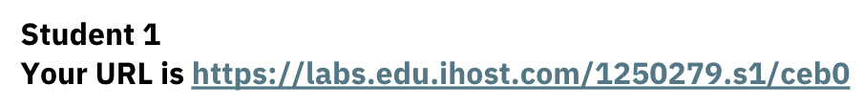
How to get started?
YOU NEED A LAPTOP! Connected to the internet.
In your web-browser open: ibm.biz/aixlu26
Open the folder for your Student number
Open the sX_course_kit.pdf
  Corresponding to your student number. Do not use someone else’s, where X is your student number
Select the lab link in this PDF to launch your Windows Jumpbox – Your URL is....
Open AIX_LU_WORKSHOP.pdf. Follow the instructions in this exercise guide
Ask questions if you need help
We will come around to each of you now and help you get started

Slide 5
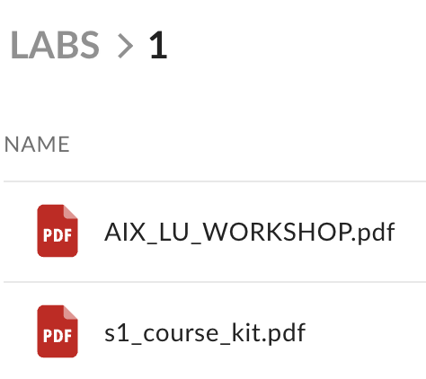
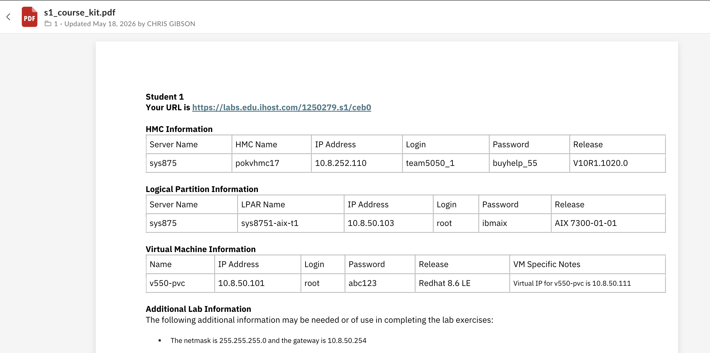

Slide 6
IBM authorized worldwide training for IBM AIX
AN34G: Mastering AIX Live Update
  Duration: 2 days
Overview:
  This course enables students to perform AIX Live Update operations on the AIX operating system.
  This includes installing interim fixes, service packs and technology levels using the AIX Live Update capability. Students in this course will learn how to implement AIX Live Update.
  Students will also be exposed to the different management types for live update and learn skills required to install AIX updates, such as technology levels, service packs and interim fixes, without requiring downtime (a reboot) for the server.
  Best practices and testing methods for live update will be discussed, providing students with the knowledge to effectively configure and manage live update in a production environment.
  Additionally, students will learn skills to troubleshoot and debug live update issues.
  More details and enrollment: https://www.ibm.com/training/course/mastering-aix-live-update-AN34G

Slide 7
How to continue your learning journey
1
Search for IBM Power training at: ibm.com/training
Or,
Explore our Learning Paths:
https://www.ibm.com/training/learning-paths-and-collections
2
AN34G: Mastering AIX Live Update :
https://www.ibm.com/training/course/mastering-aix-live-update-AN34G
3
Search for AIX training: https://www.ibm.com/training/search?query=aix

Slide 8
Notices and disclaimers
© 2026 International Business Machines Corporation.
All rights reserved.
This document is distributed “as is” without any warranty, either express or implied. In no event shall IBM be liable for any damage arising from the use of this information, including but not limited to, loss of data, business interruption, loss of profit or loss of opportunity.
Case studies and client examples are presented as illustrations of how customers or IBM has used IBM products in production or test environments and the results they may have observed. Actual performance, cost, savings or other results in other operating environments may vary.
Workshops, sessions and associated materials may have been prepared by independent session speakers, and do not necessarily reflect the views of IBM.
Not all offerings are available in every country in which IBM operates.
Any statements regarding IBM’s future direction, intent or product plans are subject to change or withdrawal without notice.
IBM, the IBM logo, and ibm.com are trademarks of International Business Machines Corporation, registered in many jurisdictions worldwide. Other product and service names might be trademarks of IBM or other companies. A current list of IBM trademarks is available on the Web at “Copyright and trademark information” at: www.ibm.com/legal/copytrade.shtml.
Certain comments made in this presentation may be characterized as forward looking under the Private Securities Litigation Reform Act of 1995.
Forward-looking statements are based on the company’s current assumptions regarding future business and financial performance. Those statements by their nature address matters that are uncertain to different degrees and involve a number of factors that could cause actual results to differ materially. Additional information concerning these factors is contained in the Company’s filings with the SEC.
Copies are available from the SEC, from the IBM website, or from IBM Investor Relations.
Any forward-looking statement made during this presentation speaks only as of the date on which it is made. The company assumes no obligation to update or revise any forward-looking statements except as required by law; these charts
and the associated remarks and comments are integrally related and are intended to be presented and understood together.

