Slide 1
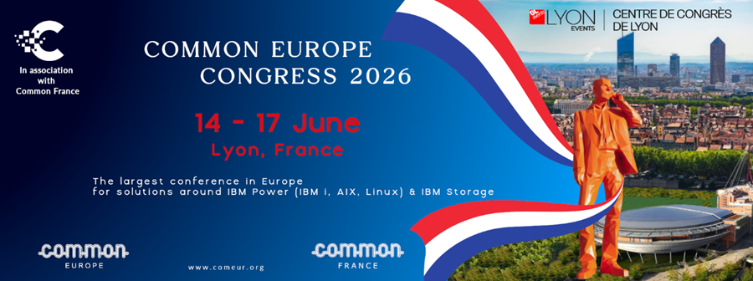
Welcome to Lyon, France
and the 2026 Common Europe Congress
Bienvenue à Lyon, en France,
et au Congrès de Common Europe 2026

Slide 2
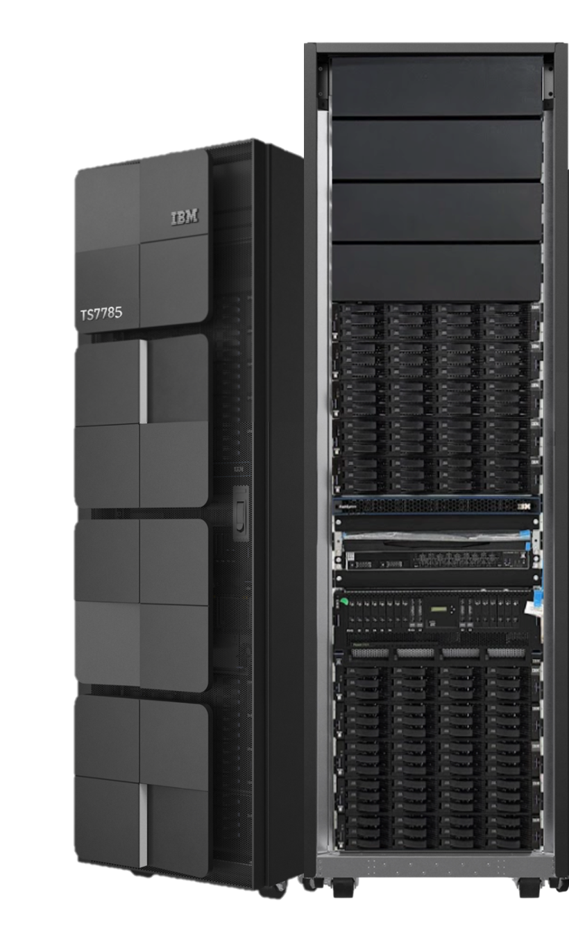
IBM Storage TS7785
Virtual Tape Library for
IBMi & Distributed Systems
Shreya Nair
TS7785 Product Manager
shreyanair@ibm.com
Joe Hayward
Program Director, TS7700 Development
jhayward@us.ibm.com
Notes:
Welcome to the TS seventy-seven Eighty-five Distributed systems Virtual Tape library for distributed systems introduction.
TS seventy-seven Eighty-five is part of the IBM virtual tape family but is specifically designed as the next generation for distributed and IBMi.
While TS seventy-Seven Eighty-five’s pedigree is from TS seventy-Seven Eighty mainframe VTS, the TS seventy-Seven Eighty-five does not attach, nor does it utilize the same operational commands that are tightly integrated between TS seventy-Seven Eighty and IBMz systems.
In this session you will get a deeper look at the design, performance and operational features of the TS seventy-Seven Eighty-five.
By the end of the session you will have a solid understanding of of the features and capabilities of TS seventy-Seven Eighty-five and be able to describe the features during sales engagements.

Slide 3

167 ZB
data created, consumed
and captured in 2025
6.4ZB
Archive Data
>12ZB
of organizations backup data
IDC Global datasphere 2024-2028
ESG Research Report: The Transformational Rise of Active Archives
IBM internal archive data report
Notes:
The data verse is exploding, with an estimated 167 zettabytes of data being created, consumed and stored in 2023.
It is estimated that as much as 6.4 zettabytes of information sits on archive mediums.
All of this data creation requires substantial back-ups and archives supporting a cyber resilient strategy.
This further expands the demand for efficient data protection to an estimated 12 zettabytes or more.
As these storage requirements expand greater performance is required of secondary and purpose-built appliances

Slide 4
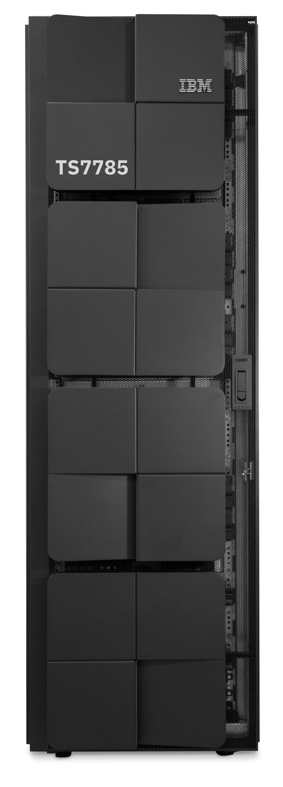
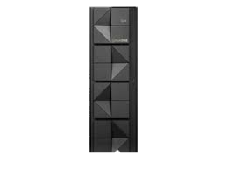
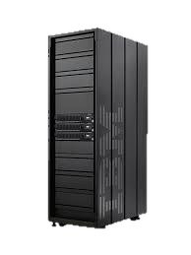
TS7700 – From IBM Z to Open Systems
TS7700: Commands 81% of the Mainframe VTS market
Driven by expertise in GRID technology and virtualization experience
Introduced the first mainframe VTS solution (B16) in 1997
TS7700 has exclusively supported 3490 emulation over FICON
TS7700 has always been based on Power / AIX
IBM i customers are asking for alternative VTL solutions
zLinux / LinuxONE workloads are growing
These clients want the benefits of the TS7700 architecture
Expanding to Distributed Systems – TS7785
A high performance, high availability Purpose-Built Backup appliance
Delivering LTO emulation in the new TS7785
Running on RedHat Ent Linux on Power platform
Up to 61PB of uncompressed usable storage*
LinuxOne
FC
FC
Distributed Systems
X86_64 RHEL
IBM I
TS7785
* When connected to IBM Deep Archive
IBM CONFIDENTIAL
Notes:
IBM TS seventy-seven hundred has dominated the mainframe Virtual Tape Systems market since two thousand eight.
Commanding over 80% of the market revenue year-over-year.
TS seventy-seven hundred is not just about attaching to mainframe with FICON.
AS the VTS architecture has matured it has innovated many of the features that mainframe users rely on to seamlessly operate their environment.
Many of these features and capabilities are desired and unmet in the distributed systems which includes IBMi.
TS seventy-seven eighty-five is delivered to provide the capability and features of TS seventy-seven hundred to distributed systems while supporting a seamless integration point with distributed connectivity and operations.
This includes LTO and IBM drive and library emulation, IBM Red Hat Linux and an IBM Power server.
The design of TS seventy-seven eighty-five is built supporting hybrid-cloud archiving using IBM Deep Archive on Diamondback.
The TS seventy-seven eighty-five’s base design is future ready for multi-tenancy, expandability and ease of use.

Slide 5
Introducing IBM TS7785 Virtual Tape for IBM i & Distributed Systems
IBMi & Distributed Systems*
“All data, available, all the time”
High Performance: up to 4GbpS per system
  LTO Emulation
  8 x32GB FC channels
Up to 11.77PB** compressed capacity
  1.57PB raw capacity per system
In-line compression and Encryption
Geo dispersed replication
Policy managed hierarchical storage
* Initial offering for IBMi BRMS, LinuxOne/RHEL with IBM Storage Protect LAN Free
** 7.5:1 average compression ratio
Notes:
TS seventy-seven-eighty-five is specifically designed for the Distributed ecosystem.
The first release is verified with IBMi and IBM Storage Protect LAN-Free, this is only a testing limitation that will expand ass testing continues.
Fully integrated IBM Tape emulation.
Bringing multi-system grid awareness from the Mainframe VTS to provide all data, available, all the time.
And TS seventy-seven-eighty-five does not skimp on performance, supporting up to 4 GigaBytes per second of bandwidth,
And an industry average 11.7 PetaBytes of compressed capacity per system.
Cyber resiliency is no accident for TS seventy-seven-hundred. With encryption of data-at-rest, in-flight over ethernet.
Using high performance zStandard inline compression and encryption ensures no restore penalty.
And the TS seventy-seven-eighty-five carries the geo dispersed data availability and security from the mainframe environment.
The TS seventy-seven-eighty-five is a primary contributor to secure data storage and business continuance.

Slide 6
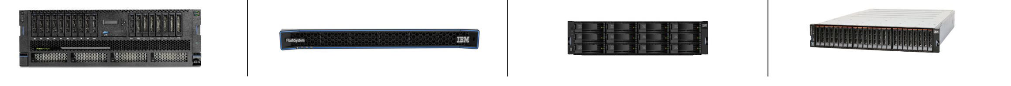
Leveraging IBM Technology – Under the Covers
TS7785 Virtualization Engine
Controller – Disk Cache Storage
Large Capacity HDD
High IOPS Enabled SSD Capacity
[FUTURE]
Power System with IBM Power9+
  Two 11 core 64-bit engines
256Gb Memory
NVMe Drives: (4) Enterprise 6.4 TB SSD PCIe4 NVMe U.2
  4 Million Logical Volumes included
RHEL
  Linux Power 9 based TSSC
  Reliable, robust, tools suites and support
Based on the new FS5300
Full AES256 Encryption
  Local Key Management supported (external in the future)
  GKLM KMIP with TLS 1.3 support
  Encryption must be enabled at time of purchase
20 TB HDD Drives
12 x 20 TB per 2U of rack space
157 TB usable capacity per drawer
1.57 PB usable capacity base frame
Distributed RAID6
15 TB SSD Drives
24 x 15 per 2U of rack space
260 TB usable capacity per drawer
2.6 PB usable capacity base frame
Distributed RAID6
Notes:
NVMe houses the OS, DB2 (contains meta data), Propriety microcode, Logs, first time data capture.
We rely on the flash systems 5300 for disk cache storage. which is where the customer data lives
We support 256 encryption and you can manage your encryption keys either locally or through an external key manager so it gives you flexibility based on your security architecture and compliance requirements
We support GKLM through the industry standard KMIP interface with TLS 1.3 used to secure key exchanges when using distributed GKLM.
and it must be enabled at the time of purchase.
HDDs, SDDs in the future, much denser drawer, so ideal for performance and lowering rack footprint.
Grow as you go model, 20TB to 100TB.
Client supplied rack, customer rack will be available post GA

Slide 7
VTL Design
  IBM Tape Emulation
    TS4500
    IBM LTO-5
  Up to 512 virtual tape drives per system
  2- System grid configuration*
  All-active system grid
  Automated Fail-over/Fail-back and restore
    Job intervention is ISV dependent
  Single VTL image across the grid
    Up to 4 distinct VTLs*
  32Gb Fibre Channel host connectivity
  Policy managed data tiering to IBM Deep Archive
  RESTful API for all queries and updates
  Modern graphical interface (GUI)
  Simplified grid joins
* Underlying design supports up to 8-way grid and greater than 4 distinct VTL images, available post GA.
IBM CONFIDENTIAL
Notes:
Digging deeper into the system specifications, TS7785 is designed to deliver enterprise virtual tape capabilities tailored for distributed environments. It provides full IBM tape emulation, supporting TS4500 libraries and LTO5 media definitions, with each volume defined at 500GB and scaling up to 4 million volumes across the system. From a capacity standpoint, this translates to an exabyte-scale platform, with a grid delivering massive usable capacity, while each system supports up to 512 virtual tape drives. At general availability, the system supports a 2-node GRID, with a design that scales to 8 systems, and importantly, every system operates as an equal, active participant—there are no primary or secondary roles.”
“Operationally, this is where TS7785 differentiates itself. Failover is fully automated, and once systems return, failback and data synchronization happen automatically without intervention, ensuring continuous availability. The system presents a single unified VTL image across the GRID, while still allowing up to four distinct VTL instances for isolation.
Host connectivity is via 32 Gigabyte fibre Channel with plans for future iSCSI support.
Automated policy management seamlessly tiers primary or secondary copies to IBM Deep Archive via Ethernet.
All system inquiries and updates are accessible via the RESTful API, for ease of integration
The gui has been modernized with the most recent interfaces providing a seamless view for existing Flash Systems customers.

Slide 8
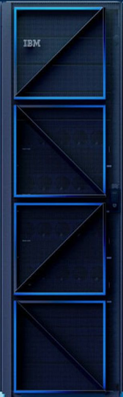

Beyond Replication – The Grid, a unified data layer
All systems are equal players
Each system’s drives within an entire grid always have access to all volumes
  System tape drives are only accessible when direct attached to the system.
  No grid span of tape drive access
Volume data is accessible from any system’s devices independent of where copies exist
Host views each emulated VTL instance within the solution as one composite library spanning the entire grid
Fully Automated system failover
  No user intervention required for the VTLs
  Job intervention is ISV dependent
Post outage
All updates are automatically reconciled on recovery
Failback can occur immediately
A
B
A
B
LAN/WAN
IBMi
IBMi
TS7785 A
TS7785 GRID
TS7785 B
Notes:
8
8
Now let’s talk about GRID technology. When you take two or more TS7700-family systems and interconnect them over IP, you form what we call a GRID. These systems can be located in the same data center or spread across cities, countries, or even continents. The GRID is what enables true business continuance, which really comes down to two things: high availability and disaster recoverability. High availability means that if something breaks, production environment keeps running without interruption, while disaster recovery means that even if an entire site is lost, operations can continue from another site. The way GRID achieves this is by removing the concept of primary and secondary systems—every cluster is an equal, active participant. Any system can access any volume, regardless of where the data physically resides, and if a local copy isn’t available, the system automatically finds a valid copy elsewhere without user intervention. After an outage, updates are reconciled automatically and failback happens seamlessly.”
“From a policy and data management perspective, TS7785 uses volume pools to control how data behaves across the GRID. You can think of volume pools as ranges of tapes assigned for different purposes—daily, monthly, or long-term retention—and each pool can have its own policies for replication and protection. For example, one pool might replicate to the cloud, another might replicate across multiple sites, and different pools can even use different replication approaches. This is all managed at the volume level and replication is volume-granular, which is key—TS7785 tracks every volume individually, where it is valid, and whether it is complete. Before any volume is updated, all systems are informed, so there’s no ambiguity about which copy is current. A volume is either fully valid or it isn’t—there’s no guesswork. The system also maintains full audit visibility so administrators always know the protection status of their data, ensuring consistency, transparency, and confidence across the environment
Regarding Fully automated system failover, this is addressing the TS seventy-seven-eighty-five grid systems not Host Job abends which are outside the scope of the system.
Only drives on a system attached to a host are accessible. If the host is attached to multiple systems it will have access to multiple drive sets, but can only access the drive sets of the systems online. If one system goes down those drives are no longer available, then the system will automatically failover operations for access to data. But the drives of the down system are not available. ISV jobs will abend to any system that goes offline during a job, fail-over of the ISV job is dependent on the ISV and the architecture of connectivity to the VTL systems in the grid.

Slide 9
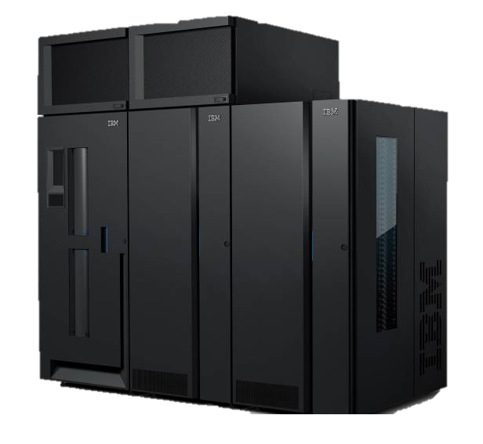
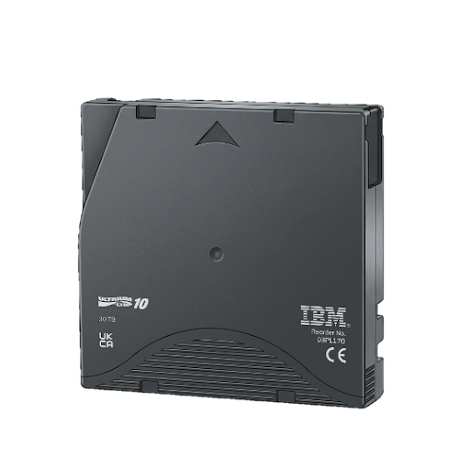
TS7785 Grid: A Unified VTL Instance
  Single VTL Instance
  Each host sees a single composite library image
    A host has a library controller for each directly attached system
    All library SMCs are for the same vlibrary instance.
    Greater than 1 VTL instance does create library SMC groups
  Each System has unique vdrives in the vlibrary
    A host can only configure the vdrives of each directly attached system
    Up to 512 total vdrives can be configured per system, across all VTL instances.
  vVols can be accessed across both systems by any host
  Each drive within each system can access data across all systems.
  All systems can be configured to have access to cloud archive data on IBM Deep Archive
GRID A
System - 1
System - 2
Virtual Tape Library Instance 1
vI/O
vI/O
vMedia Vols
Drive 1
Drive 2
Drive 3
DriveN
Drive 1
Drive 2
Drive 3
DriveN
vDrives
vDrives
Replication
Shelf-less cloud archive
Notes:
What this slide shows is one of the key architectural shifts we’re bringing from the mainframe world into distributed systems—the concept of a single, unified virtual tape library across the GRID. From the host’s perspective, there is one composite VTL image, even though it spans multiple systems. All virtual volumes, or vVols, are accessible across every system in the GRID regardless of where the data physically resides, which is what enables ‘all data available all the time.’ At the same time, drives are localized—each system has its own set of vDrives, and those drives are only accessible from that system. In the image you can see that each system has vDrives 1 thru N with N being a maximum of 512 drives for the entire system across all VTL images.
While each system has vDrives 1 thru N the drives are exclusive to the System and Virtual image, System 1 cannot access System 2 vDrives and vice-versa. This maintains performance and locality while still allowing full data access across the GRID. You can scale up to 512 drives per system, and all systems can also access cloud archive data through IBM Deep Archive, effectively extending storage into a shared, scalable archive layer. The key takeaway is that this design gives you the simplicity of one logical library with the performance and scalability of a distributed system.
Note:
Only drives on a system attached to a host are accessible, if the host is attached to multiple systems it will have access to multiple drive sets, but can only access the drive sets of the systems on line, if one system goes down those drives are no longer available. The system will automatically failover operations for access to data, but the drives of the down system are not available. ISV jobs will abend to any system that goes offline during a job, fail-over of the ISV job is dependent on the ISV and the architecture of connectivity to the VTL systems in the grid.

Slide 10
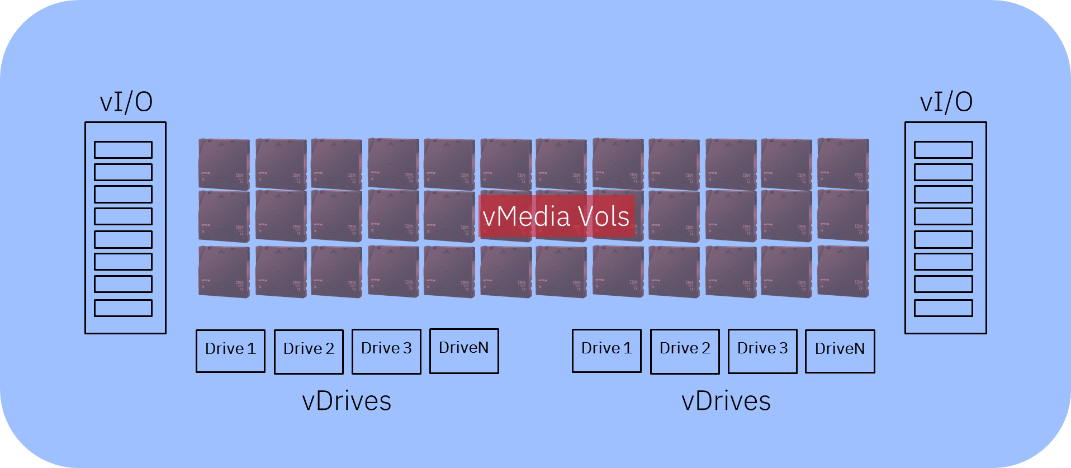
TS7785 Grid: Multiple Unified VTL Instances
GRID A
  All connected hosts can see all Virtual Tape Library(VTL) instances*
  Up to 4 VTL instances* can be configured in the systems
  Each VTL is unique and distinct in all operations
System - 1
System - 2
VTL-1
  Each connected host sees all VTL instance composite library images
    A host has a library controller for each directly attached system and VTL instance
    Each vlibrary instance has unique SMCs at the host.
  Each System has unique vdrives in each unique vlibrary
    A host can only configure the vdrives of each directly attached system for each vlibrary
  vVols can be accessed across both systems by any host configured to the unique vlibrary
  Each vdrive within each unique vlibrary and system can access data across all systems.
  All systems and unique VTL instances can be configured to have access to cloud storage tier data on IBM Deep Archive
VTL-2
VTL-N+3
Replication
* Underlying design supports up to 8-way grid, greater than 4 distinct VTL images, and multi-tenancy VTL isolation, available post GA.
Shelf-less cloud archive
IBM CONFIDENTIAL
Notes:
Building on that unified model, TS7785 also supports multiple VTL instances within the same GRID, which provides both scale and isolation, at first release we support 4 virtual library instance, moving up to 64+ in the future. In the initial release, you can configure up to four distinct VTL instances, and each one operates as its own independent virtual library, with its own vdrives and vvolumes. From the host perspective, each VTL appears as a separate library, and hosts can be mapped to specific VTL instances and subsets of drives. A host attached to System 1 will have 3 Unique library control protocols (SMCs) and have Tape Drive Device protocols for the number of drives configure to all VTL images.
For instance, is each of the 3 VTLs in System-1 has 3 tape drives the host will see 9 distinct drive devices.
Importantly, drives and volumes are not shared across VTL instances, ensuring clear separation for different workloads, while still running on the same physical infrastructure. At the same time, all systems in the GRID and all VTL instances can still leverage shared cloud archive storage through policy-based tiering. So what you get is a flexible architecture that combines a unified data layer with logical isolation, allowing you to scale across systems while maintaining predictable behavior and workload separation.

Slide 11
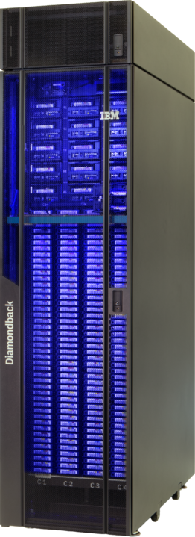

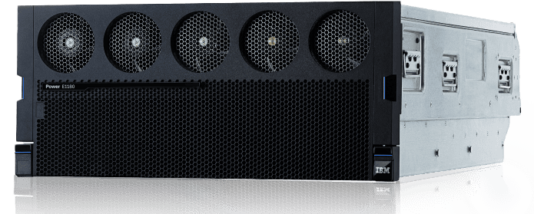
Automated Fail-over – TS7785 GRID at Work
All hosts are connected to all systems
Each host sees 2 Library connections to the same vlibrary
  SystemA/vlib1/vdrives<a,b,c…>,vVol<i,ii,ii…>
  SystemB/vlib1/vdrives<1,2,3…>,vVol<i,ii,ii…>
Outage at SystemB
  No failover required all data available via systemA
  vVols access through systemA vdrives
Online of SystemB
  No fail-back required
  Automatic new dataset synchronization
TS7785 SystemA
RHEL Host(s)
X
IBMi Host(s)
TS7785 SystemB
Notes:
What this slide is illustrating is how failover works in a TS7785 GRID environment, and the key point here is that we don’t rely on traditional failover processes.
In this example, all hosts are connected to both systems and see two library connections to the same virtual tape library.
Each host has access to all the virtual volumes, which is what we see here as vvols but the drives are still local to each system.
So a host can use drives from System A or System B depending on where it is connected, while still seeing a single, consistent data set across the environment.”
“Now, if an outage occurs on System B, any jobs running through that system may stop at the application level, but the storage layer itself does not require failover.
All the data is already accessible through System A, and workloads can continue without interruption there. When System B comes back online, there’s no need for manual failback or reconfiguration—the GRID automatically begins synchronizing data again in the background, without data loss or user intervention.
The key takeaway is that TS7785 removes failover as a complex operational event and replaces it with continuous data availability and automatic system recovery.
IF an outage happens at Sytem B, ISV jobs operating through system B will abend, but no fail-over of systems operations are required.
All SystemB abend jobs can be reinitiated on SystemA and the ISV jobs on SystemA continue to run during SystemB outage.
When SystemB is restored and brought to an online state in the grid, no intentional action is required to synch the system.
The grid will begin seamlessly, loss-lessly and automatically restoring the synchronization of data in the grid to SystemB.

Slide 12

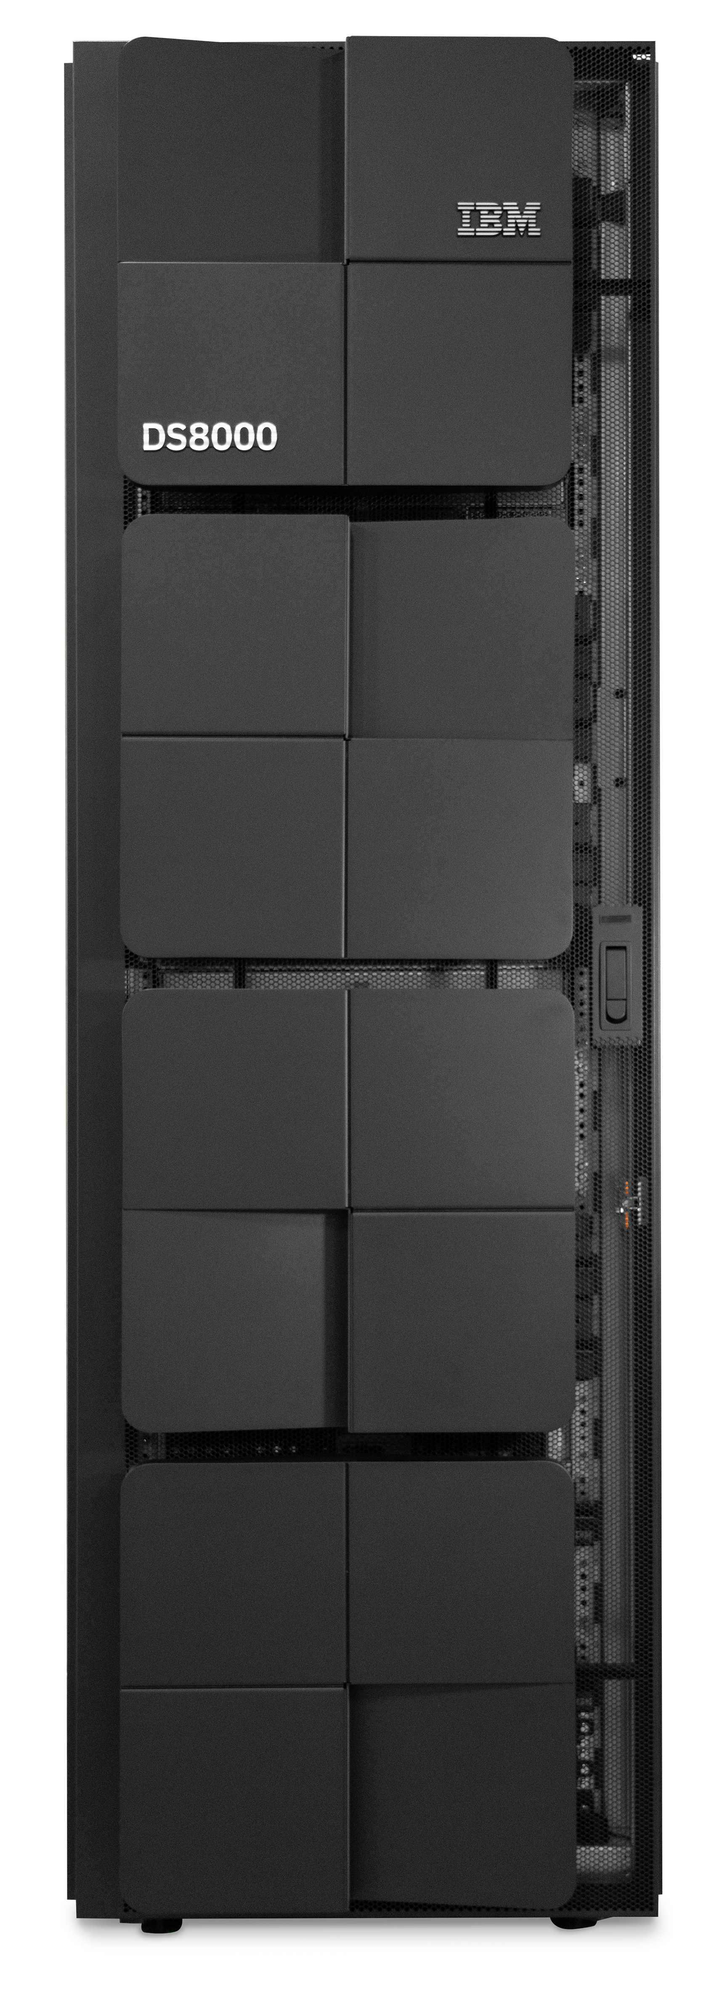
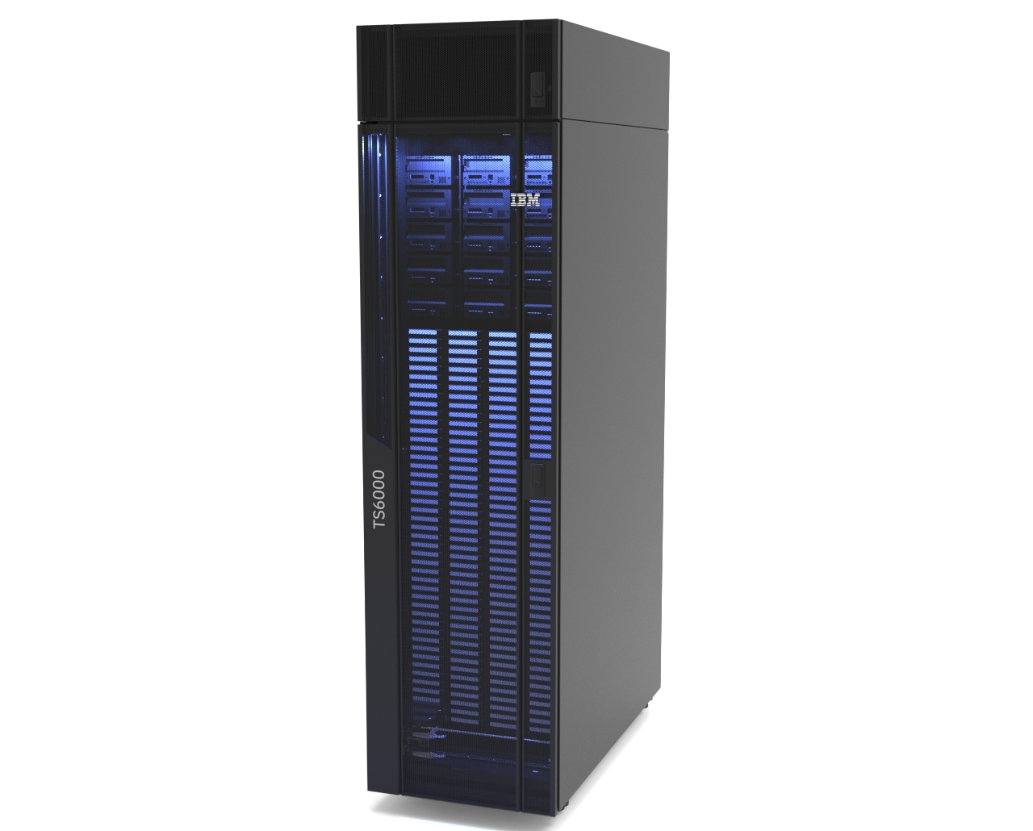
Use Case – IBMi BRMS
IBMi
IBMi
IBMi can use the TS7785
  Support for FC
  LTO emulation with 512 available drives per system
  TS4500 emulation with multiple library instances
  Feature Support
  Grid support, including access to any system by any IBMi server Automatic replication
  Tiering to physical tape via IBM Storage Deep Archive
  Tiering to S3-enabled object stores
Backup Clients
Backup Clients
iSCSI (VTL)
FC (VTL)
iSCSI (VTL)
FC (VTL)
VTL iSCSI
(Future)
VTL iSCSI
(Future)
VTL FC
VTL FC
TS7785
TS7785
GRID
V2
TS7785 A
TS7785 B
V1
V3
S3 Cloud
IBM Storage
Deep Archive
Notes:
TS7785 was really built with IBM i in mind, and that’s important because IBM i environments work a bit differently than typical distributed systems. Most customers run workloads in LPARs, which are essentially isolated environments carved out of the same Power system. Each LPAR acts like its own system, so customers expect that same level of isolation when it comes to storage and tape—each one should only see and use the devices assigned to it. TS7785 fits naturally into that model by using standard Fibre Channel zoning and NPIV, so each LPAR gets its own virtual Fibre Channel ports mapped to specific tape devices. This prevents LPARs from interfering with each other or competing for the same devices.
“From there, TS7785 behaves exactly how IBM i customers expect, just with more capability behind the scenes. It supports full LTO and TS4500 library emulation, so existing workflows don’t change, but you can scale up to hundreds of drives and multiple libraries. At the same time, you get GRID capabilities, so any IBM i system can access any volume of data from any TS7785 node, regardless of where the data lives. And because it integrates with Deep Archive and S3 storage, you can easily tier data for long-term retention. So the big takeaway here is that TS7785 doesn’t force customers to rethink how they operate—it just makes their existing IBM i environments more scalable, more resilient, and more flexible.

Slide 13

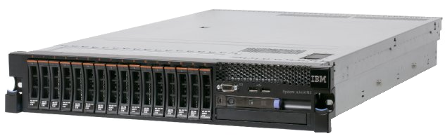

Use Case – for SAN Based Storage Protect
IP
DB2
zLinux Clients
IP
Leverage Storage Protect IP/LAN-Free VTL Tape Support
Storage Protect IP/LAN-Free VTL Tape Support
  SP “Storage Agent” incremental forever” direct FC tape path
  Distributed systems VTL support of SAN based workloads
  Non-FC clients can still benefit through Storage Protect Server
  Client to Server via LAN still supported for non-FC clients
  Synthetic Full To Tape (Retention Set)
  SP Server can put a rehydrated PIT backup from the client incremental forever VTL tape content and create a full independent copy on VTL (one copy of each file per client)
  Keep Retention Sets 1 month, 1 year or 7 years based on policy
IP Client
FC (Scale)
FC (VTL)
IP
Storage Protect Server
Storage Agent
FC (Scale)
FC (VTL)
IP
FC(VTL)
FC (VTL)
SAN (FC)
SAN (FC)
Synthetic Full
GRID
TS7785 A
TS7785 B
IBM Storage
Deep Archive
Notes:
This slide really focuses on the Fibre Channel use case for distributed systems, which is one of the core design points for TS7785. In the first release, we support IBM Storage Protect—what many customers still know as TSM—and this was actually one of the primary drivers behind building TS7785 in the first place. Most modern backup solutions rely heavily on IP, where all the backup data flows through a central server over the network. What we’re enabling here is a LANfree model, where the Storage Protect server still manages the backup process, but the actual data movement happens directly from the storage agent on the client to TS7785 over Fibre Channel. That means IP is only used for control traffic between the client and the server, while the heavy data transfer runs over the SAN, improving performance and reducing network load.”
“The same model applies to restores, where data flows directly back over Fibre Channel, giving you consistent performance in both directions. And importantly, this doesn’t exclude nonFibre Channel clients—those can still send data over IP, and the Storage Protect server will handle writing that data to TS7785. So you can have both FC and IP backups coexisting in the same environment.
Supports synthetic full backups, or retention sets, which are critical for incremental‑forever backup environments.
A retention set periodically consolidates all the data needed for a point‑in‑time restore into an independent set of tapes, eliminating dependencies on long chains of incrementals.
These retention sets can be retained for years and tiered automatically to IBM Storage Deep Archive, while clients continue sending simple daily incrementals.
The key point is that long‑term retention and compliance are handled automatically by the infrastructure, not by the clients.

Slide 14
Cloud Storage Tier
Cloud Storage Tier - off load to public or private cloud
Policy migration or copy to cloud tier
All systems have access to the copy in the cloud
Supports IBM Storage Deep Archive and S3 cloud
Up to 256 cloud storage targets
Shared grid network and dedicated network options
Secure TLS1.3 cloud connectivity
Up to 100PB of uncompressed TS7785 data
    Compression dependent on data, 2.5:1 industry average.
        Up to 250PB compressed
Cloud Tier
V1
V2
V3
IP
Private / Public Clouds
IBM Storage Deep Archive
Notes:
What this slide highlights is how TS7785 extends data protection beyond the primary system into a true hybrid cloud model. One of the key capabilities here is the ability to tier data to an airgapped cloud environment, either as a secondary copy or even as a primary archive. At initial release, the validated target is IBM Storage Deep Archive, but the architecture is designed to support multiple S3-enabled cloud endpoints—up to 256 targets—with all communication happening over standard Ethernet. These targets don’t need to sit within the customer’s network either. As long as there’s a secure IP path—whether that’s LAN, WAN, or even over the internet—data can be moved to geographically dispersed locations.”
“What makes this powerful from a security and resiliency perspective is the separation between primary and archive storage. By tiering data out to Deep Archive, you’re effectively creating a multi-step air gap, with tape-based storage underneath adding an additional layer of protection that’s much harder to compromise. All of this is policy-driven, so administrators can define exactly how data is copied, moved, and retained without managing it manually. That means you’re not only improving security and compliance, but also preventing primary systems from running out of space during critical operations, allowing teams to stay focused on performance while the system handles protection and lifecycle management in the background

Slide 15
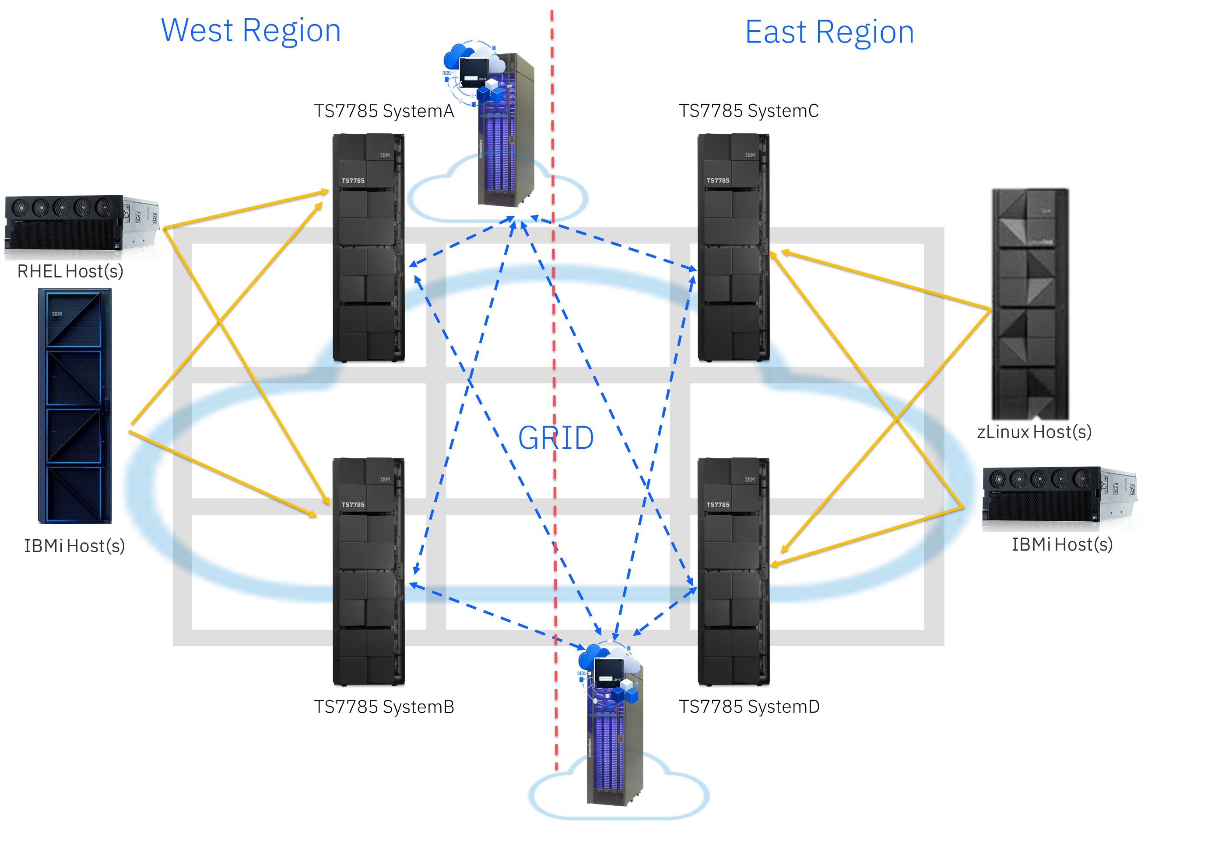
TS7785 Storage Deep Archive: Regional Enabled Grid
Each region has a Storage Deep Archive pod
Grid replicates objects between regions
Grid puts a copy into up to four cloud pools (multiplexing)
Deep Archive will optionally multiplex across multiple tapes within each Deep Archive
Deep Archive will optionally multiplex across multiple Deep Archive pods in the same region
Any system can fetch any copy from any Deep Archive
Multiple grids can share the same Deep Archive pods
Deep Archive Pods can be shared by non-TS7785 workloads too
Notes:
What this slide is really showing is how TS7785 extends GRID beyond just systems into a regional, cloud enabled architecture. As the GRID scales—starting with two systems and growing up to eight—you can distribute those systems across regions, with each region having its own IBM Storage Deep Archive. The GRID then handles replicating data between those regions while also placing copies into multiple cloud pools—up to four—so you’re not relying on a single location for protection. What’s powerful here is that this entire process is automated. TS7785 manages how data is copied, replicated, and distributed without requiring manual intervention, which simplifies operations while significantly improving resiliency.”
“The integration with IBM Storage Deep Archive is what really enables this at scale. Deep Archive provides a tape-based backend exposed through an S3 interface, so from TS7785’s perspective, it behaves like a cloud target, but with the cost and durability benefits of physical tape. Because everything is S3-based, multiple systems, grids, and even different platforms can share the same archive layer. Any system can read or write to it, and if one cluster goes down, another can continue pushing data without disruption. This approach gives customers a highly scalable, secure, and cost-efficient way to manage long-term retention, while also enabling a true air-gapped, hybrid cloud strategy for data protection.
This enables the consolidation of archive data on the most secure and lowest cost hybrid cloud for data at scale, all while optimizing storage capacity and lower storage costs.

Slide 16
Grid Awareness – Data Availability in the Cloud
Awareness of content in the cloud is synchronized with all peers
  All system (existing and future) in the same grid have immediate access to the cloud volume
Exclusive of Grid Replication
  Whether grid replicated or not, a system can get access to the data in the cloud if it has connectivity to the cloud pool where the data is stored
  Optionally, rely on cloud redundancy instead of grid replication for less critical workloads
System Joins
  Once a system joins the grid, it automatically has access to all content in the cloud
A
B
A
B
Grid Network
A
B
Object Store
Notes:
“GRID awareness means every system understands the state of every volume, no matter where the data lives.
Replication runs in both directions without freezing workloads, and hosts can connect to multiple systems to distribute load while the GRID continues operating in the background.
This same awareness extends to cloud and object storage — once any cluster places data in the cloud, all clusters can immediately see and access it.
Data doesn’t need to be recopied or manually re‑registered, which is critical for meeting recovery objectives, even if transfer times vary by environment.
Metadata is only updated when a complete copy is received, so the GRID always knows whether a volume is fully valid or not.
There’s no ambiguity: if the catalog says the data is valid, it’s complete — making recovery predictable and operationally simple.
When a new cluster joins the GRID, it automatically gains access to all existing cloud‑resident content, enabling seamless expansion without changing how recovery works.”

Slide 17
On-premise Cloud: IBM Deep Archive on Diamondback
Up to 13.2 TB/hour
Up to 61* PiB native capacity
Billions of objects
<20 watts/PB
High Availability
Feature Availability
  Automated Multi-copy
  Multi-pod Replication
  Multi-pod capacity expansion
Use cases
  Primary copy archive
  Air gap
  Second/Third copy
  Regulatory compliance
Maximum total capacity | 61PiB
Maximum object Size | 5TiB
Maximum Locally managed S3 accounts | 100
Maximum S3 buckets | 2250
Maximum objects per bucket | 1,000,000
Maximum supported objects | 2.25 Billion**
Minimum recommended average object size | 100MiB
Notes:
What this slide is really showing is the role of IBM Storage Deep Archive in extending TS7785 into a true onpremises cloud model for long-term retention. Deep Archive, built on the Diamondback platform, delivers massive scale—up to around 61 petabytes of native capacity—in a very small footprint. It’s essentially hands-off from an operations standpoint, similar to a managed cloud archive service, but with the key advantage that customers retain full control over their data. It also delivers strong performance, supporting ingest rates up to 13.2 TB per hour, while maintaining extremely low energy consumption—under 20 watts per petabyte—which is a significant efficiency advantage.”
“From a cost and scalability perspective, this is as much a financial decision as it is a technical one. Deep Archive can deliver up to 83% cost savings compared to typical managed cloud archive offerings, making it an attractive option for large-scale retention. It supports multiple configurations, starting with an entry model for infrequently accessed ‘glacial’ storage, and scaling up to higher-performance configurations for faster ingest and retrieval when needed. Customers aren’t locked into a single option—they can start small and scale over time as requirements evolve. Overall, Deep Archive gives TS7785 a highly scalable, secure, and cost-effective foundation for hybrid cloud archiving, while keeping operations simple and predictable.
Use cases are very similar with some variation for the performance of the Standard Configuration.
The Entry Configuration is positioned as a glacial storage for data that is infrequently accessed.
The Standard Configuration’s higher data rate can provide faster ingest to meet SLAs as well as faster retrieval of data that the Entry Configuration cannot offer.
Clients are not bound to the Entry Configuration. Clients can begin the S-3 journey with the Entry Configuration and field upgrade to the Standard Configuration when available or as required.

Slide 18
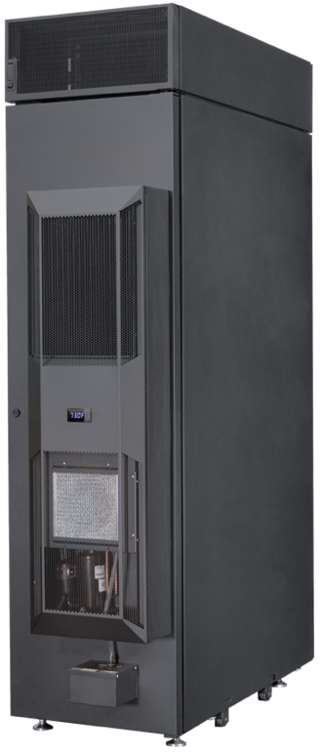
Why IBM Diamondback
Single Frame design – No expansion frames
Up to 14 LTO Tape drives
  LTO9 or LTO-10
  Future field install of mixed drive generations and interfaces
Up to 1548 Tape cartridges
  LTO9 - 27.8 PB uncompressed capacity*
  LTO-10 – 46.4 PB uncompressed capacity*
  LTO-10 40TB – 61.9 PB uncompressed capacity*
1 cartridge service magazine with 10 I/O slots
Single robot, high availability grippers
Pre-loaded media option
Simple-service design
Available for AHRAE A3/A4 operations
IBM Diamondback (front view)
IBM Climate-Controlled Diamondback (rear view)
*Actual capacity will vary depending on swap availability and number of operational cartridges
Notes:
What this slide highlights is why IBM Diamondback is such a strong foundation for Deep Archive. Unlike traditional tape libraries, Diamondback is built as a single-frame system with no expansion frames, which makes it much simpler to deploy and manage. Within that frame, you can scale pretty significantly—supporting up to 14 LTO tape drives and over 1,500 cartridges, which translates to tens of petabytes of capacity. It’s designed for efficiency and high availability, using a single robotic system with redundant grippers and a simple service model that reduces both complexity and operating costs. You can even have the system delivered pre-loaded with media, fully configured and ready to go, which speeds up deployment.”
“From a security and flexibility standpoint, Diamondback also brings some important advantages.
Diamondback support Quantum-safe encryption with GKLM library managed Encryption.
And flexible distributed systems attachment including AIX, Linux, MS Windows.
The end result is a highly scalable, secure, and easy-to-manage archive platform that complements TS7785 for long-term data protection.

Slide 19
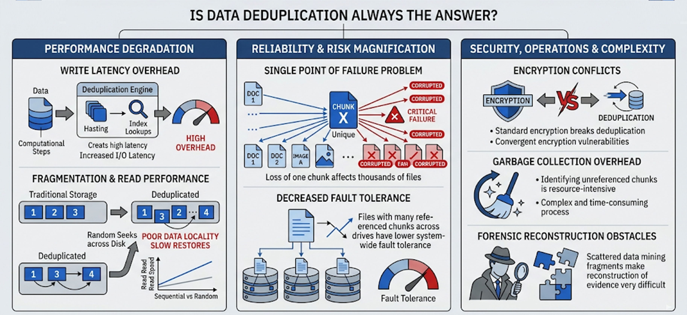
Data Reduction: Compression vs Deduplication
*Based on technical reports on performance, data integrity, and security.
Notes:
“On this slide, we’re highlighting a key design decision in TS7785 around data reduction.
TS7785 uses compression for data reduction, which reduces capacity footprint while maintaining consistent read and restore performance.
With deduplication, data fragmentation, metadata lookups, and pointer-based reconstruction can introduce latency and unpredictability, especially during restores.
Increased Complexity - Deduplication creates complex "reparse points" (pointers) instead of storing files directly.
Instead of breaking data into fragments, our approach keeps data intact and sequential, avoiding the overhead and complexity that can come with deduplication.
By using compression, we preserve data integrity and predictable performance, ensuring that backup and recovery operations behave consistently as the system scales.
The result is a simpler, more reliable model—where performance during recovery is stable, and operations remain efficient without added complexity
Resource Requirements - Proper functioning often requires significant dedicated ram.

Slide 20
TS7785: Initial Specifications
Item | R1.0 | Future
Grid | 2-way | 8-way
Devices | 512 per system | 1024+ per system
Media | LTO5 (500GB) | 2TB+
VTL Instances | 4 x TS4500 (grid-scope) | 64+ (grid-scope)
Compression | ZSTD | Deduplication FCMs
Tape Attach | Via Storage Deep Archive | -
Capacity | 1.57PB (NLSAS Single Frame) | Multi-Frame, FCMs
Tenants | 1 | 64+
Volumes | 4 million | -
Connectivity | 8x32Gb (LW & SW) | 10/25Gb iSCSI
Management | REST + Simple GUI | Advanced GUI
Block Size | 256KiB | -
Qualification | Storage Protect, IBM i BRMS | Many
IBM CONFIDENTIAL
Notes:
what customers get in the initial release and where the platform is headed.
At launch, TS7785 supports a two‑cluster GRID, with a roadmap to expand to larger GRID sizes in future releases.
Each cluster supports up to 512 emulated devices, independent of how many virtual tape libraries are defined.
The initial media type is LTO‑5, with a 500‑gigabyte cartridge size.
Customers can factor in their compression ratios to understand the effective tape size.
The system supports up to four virtual tape library instances in the first release, with plans to significantly expand that number over time.
Physical tape offload is handled exclusively through IBM Storage Deep Archive using S3, with 1.57 petabytes of usable capacity in a single‑frame configuration at launch.
The initial release supports a single tenant, up to four million volumes, and Fibre Channel connectivity with up to eight 32‑gig ports.
Management is provided through a brand‑new GUI and a comprehensive RESTful API. The GUI in the first release focuses on core setup — creating libraries, configuring drives, defining basic policies — while more advanced features will be added over time. With a clear and deliberate roadmap to expand scale, flexibility, and functionality over time.”

Slide 21


The Future of VTL
TS7xxx Grid – Unified Data Protection Platform
TS7785
A
B
C
D
  Expanded ISV support
  Up to 8 systems in a grid
  iSCSI Connectivity
  All-flash storage
  Expanded system capacity
  Cloud Export
  Cloud Version Retention
  Logical WORM with Retention
  Additional Cloud Targets
  Multi-tenancy
E
F
G
H
A
B
C
D
TS7785
TS7785
A
B
C
D
E
F
G
H
TS7xxx A
E
F
G
H
TS7xxx H
TS7xxx B
IBMi
A
B
C
D
TS7785
zHost
TS7785
A
B
C
D
E
F
G
H
ISVx
E
F
G
H
TS7xxx G
Commvault
TS7xxx C
A
B
C
D
TS7785
TS7785
A
B
C
D
E
F
G
H
E
F
G
H
TS7785 F
TS7785
A
B
C
D
TS77780 D
Forward looking statements are intentions and not a commitment by IBM. Future features are subject to change at any time without notice
A
B
C
D
E
F
G
H
E
F
G
H
IBM Deep Archive
TS7785 E
Notes:
At its core, TS7785 acts as a virtual tape orchestrator, using the GRID as a unified control plane.
It supports multiple active clusters, automatic replication, and intelligent integration with physical tape through S3, while encrypting data at rest and in flight using AES‑256.
In terms of what the future looks like we will have increased ISV support, more systems in the grid and a strong focus on cloud integration, including:
Cloud export, Version retention And LWORM capabilities for security and compliance.
One of the most important future use cases shown here is multi‑tenancy. While it’s not enabled in the first release, it’s built into the DNA of the platform.
Multi‑tenancy takes the multi‑library concept to the next level, allowing a super‑administrator to define tenants while tenants interact only through the GUI and RESTful APIs — never with the physical hardware.
Each tenant can have their own libraries, media, endpoints, and policies, and when they log in, they only see their own environment as if they own the system exclusively.
Other tenants are completely invisible, providing true isolation with no conflicts.
This model is especially attractive for service providers and large enterprises that need strong separation between customers or business units.
The key takeaway is that TS7785 is designed as a scalable, flexible orchestration platform — starting with GRID‑based virtual tape today and evolving cleanly into multi‑tenant, cloud‑integrated architectures over time.

