Slide 1

Are you ready to recover quickly from a cyber attack?
David Spurway
IBM Power AI and Security Principal EMEA, IBM Technology
david.spurway@uk.ibm.com
LinkedIn: @David Spurway

Slide 2
Agenda
Are my children the problem?!
Latest reports show increase in active ransomware groups and exploitation of public-facing applications
Traditional resiliency solutions will not protect you from cyber attack
One size does not fit all. This is a journey.
What level of validation do you need?
Free workshop with IBM Technology Expert Labs to plan and implement the right solution to fit your needs

Slide 3
Robert and Alex were at Myton School when it was hit by a cyber attack
The cyber attack on Myton School occurred on Tuesday, 13 September 2022.
The operational disruptions from the network shutdown—including the cashless catering blackout—persisted throughout September and October, with the threat group BianLian eventually leaking the school's name on the dark web later that autumn on 25 November 2022.
The attack completely wiped out the school’s internal servers, prompting an extensive community recovery effort to rebuild lost teaching resources, staff background files, and lesson plans from scratch.
The backups were also taken out in the attack.

Slide 4
Kat was one of the many students impacted by the Canvas outage
In May 2026, the University of Birmingham was caught up in a global cybersecurity incident affecting Canvas, its Virtual Learning Environment (VLE) used by students to access course materials and submit assignments.
ShinyHunters claimed responsibility for the breach.
Instructure, the vendor that operates the Canvas platform worldwide, eventually paid a ransom to the cybercriminals to ensure the deletion of the stolen student data.
ShinyHunters primarily focuses on data exfiltration and extortion.
Modern highly sophisticated methods
Public Defacement and Extortion
AI-Powered Vishing
SaaS & Supply Chain Exploitation
Notes:
Because the outage hit during a critical end-of-year assessment window, the university implemented Deadline Extensions and sent out Security Advisories. Students were warned to be highly vigilant against phishing attempts, as hackers could weaponise the stolen emails and names.
Notable recent targets include:
The Education Sector Campaign (April–June 2026)
The European Commission (March 2026)
Google (via a Salesforce integration leak), luxury brands under LVMH (Moët Hennessy Louis Vuitton) and Gucci
SaaS & Supply Chain Exploitation: They target cloud-hosted Software-as-a-Service (SaaS) systems and third-party vendors. By compromising just one trusted integration company, they can steal pre-authorized OAuth tokens to bypass Multi-Factor Authentication (MFA) and access hundreds of downstream organizations.
AI-Powered Vishing: They utilize advanced voice phishing ("vishing"), often using generative AI to clone the voices of corporate IT helpdesks. They trick employees into surrendering internal single sign-on (SSO) login credentials.
Public Defacement and Extortion: They often broadcast their attacks publicly by defacing victim websites or login portals with ransom notes rather than negotiating quietly, directly pressuring the targets.

Slide 5
Are my children the problem?
Alex also worked at Marks and Spencer before starting her apprenticeship.
The Marks and Spencer (M&S) Incident (April 2025) severely disrupted M&S's supply chain and wiped out its online trading and click-and-collect services for roughly six weeks. It ultimately cost M&S £131 million in recovery expenses and dragged down its annual profits.
The Jaguar Land Rover (JLR) Incident (September 2025) forced the carmaker to shut down its IT systems and halt global manufacturing for weeks.
The Impact: This hack became the most economically damaging cyber event in UK history. It cost the wider UK economy an estimated £1.9 billion, pushed JLR into a £485 million quarterly loss, and forced 30,000 employees to reset their passwords in person to regain access to systems.

Slide 6
X-Force
Threat Intelligence
Index 2026
Read the report
https://www.ibm.com/think/premium/threat-intelligence-report-highlights

Slide 7
X-Force Threat Intelligence Index 2026
Report highlights
44%
increase in the exploitation of public-facing applications
56%
of disclosed vulnerabilities did not require authentication to successfully exploit
49%
increase in active ransomware groups
Notes:
44% increase in the exploitation of public-facing applications
X-Force observed a rise in the exploitation of public-facing applications as an initial access vector in 2025 due to an increase in supply-chain attacks targeting development ecosystems and trusted infrastructure.
56% of disclosed vulnerabilities did not require authentication to successfully exploit
The number of vulnerabilities tracked by X-Force approached 40,000 in 2025 and over half didn’t require authentication for an attacker to successfully exploit. This finding may reflect gaps in secure-by-design implementation as attackers are finding success without using credentials, MFA bypass or even end user interaction.
>300K ChatGPT credentials observed for sale on the dark web
In 2025, infostealer malware enabled the exposure of over 300,000 ChatGPT credentials, demonstrating that AI platforms have reached the same credential risk as other core enterprise SaaS solutions. While none of the credentials posted were still valid, the credentials consistently corresponded to infostealer infections and leaked credentials collections observed in 2024 and earlier.
~4x increase in the number of major supply chain or third party breaches over 5 years
Adversaries increasingly exploited developer trust and identity integrations to steal credentials, pivot into cloud environments and maintain persistence across interconnected systems. Sprawling third‑party dependencies create hard‑to‑secure attack surfaces—where one weak link can expose many targets. Once largely confined to nation‑state actors, these supply chain attack techniques are now being adopted by financially motivated and other criminal threat groups, reflecting a clear trickle‑down of advanced tactics.
49% increase in active ransomware groups compared to 2024
Fragmentation continues in the space, with 109 different ransomware extortion groups identified by X-Force in 2025. Up from 73 groups in 2024, this fragmentation reflects a lower barrier to entry: threat actors frequently reuse leaked tooling, follow established playbooks or shift between group identities, enabling many small operators to conduct opportunistic, low-volume attacks.
Manufacturing was the top-targeted industry for the fifth year in a row
The sector accounted for 27.7% of incidents, up only slightly from 26% last year. This figure is only a few tenths of a percent higher than the finance and insurance sectors, which accounted for 27% in 2025 and 23% in 2024.
29% of attacks targeted North America
The region accounted for nearly one third of total cases. Up from 24% in 2024, North America became the most attacked region for the first time in 6 years. Conversely, Asia Pacific saw a decrease from 34% to 27%.

Slide 8
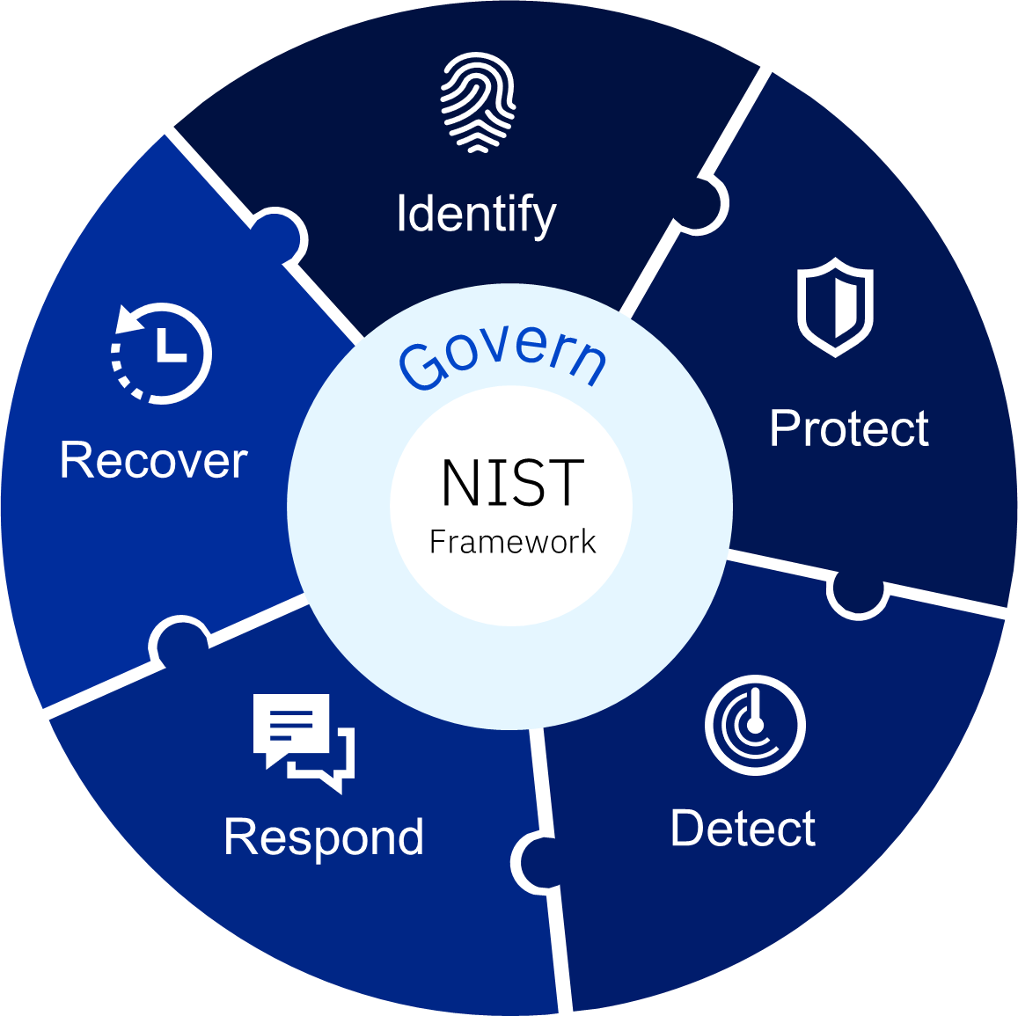
Cyber Crime is creating critical events industry-wide
59%
Organisations were hit by ransomware in the last year*
94%
Victims said the attackers targeted their backups*
50%
Attacks resulted in data encryption***
78%
Organisations took more than 100 days to recover**
49%
Pay ransom to get data back***
$4.88M
Average cost of a breach**
Notes:
* Source: Sophos The State of Ransomware 2024
** Source: IBM Cost of a Data Breach 2024
*** Source: Sophos The State of Ransomware 2025: https://www.sophos.com/en-us/content/state-of-ransomware

Slide 9
Traditional resiliency solutions will not protect you from cyber attack
 | Traditional Approaches | What’s required for Cyber Resiliency
Data Replication | Backups or clones stored in secondary storage | Immutable, point in time copies stored in an isolated environment
Error detection | System and application outages are detected immediately | Proactive data validation on point in time copies to allow rapid response
Recovery points | Often a single recovery point that likely will be compromised in case of a cyber attack | Multiple recovery points to account for corruption from cyberattacks
Recovery Scope | Continuous availability and disaster recovery | Forensic, surgical or catastrophic recovery capabilities
Anomaly Detection | Rely on SIEM and EDR systems, which have high false positive rates | Multi-layer malware and ransomware detection technologies to spot attacks faster and more accurately
Notes:
Traditional approaches fall short
Replication: but corrupted data is also replicated instantly or can be corrupted in the future
Malware (Malicious Software)
Definition: An umbrella term for any software designed to harm, exploit, or illegally access systems or data.
Types of Malware include:
Ransomware (locks/encrypts data for ransom)
Viruses (replicate and spread)
Trojans (disguise as legitimate software)
Spyware (steals user information)
Worms (spread automatically through networks)
Adware (delivers unwanted ads)
Goal: Varies — may steal data, damage systems, spy on users, or disrupt operations.
What is Ramsomware ?
Ransomware (a subtype of malware)
Definition:
A specific type of malware that encrypts files or locks systems and demands payment (ransom) to restore access.
Key Features:
Data or systems are held hostage.
Often accompanied by a ransom note or payment instructions.
May threaten data leaks (double extortion).
Goal: Financial gain through extortion.

Slide 10
Cyber Security and Cyber Resilience
Cyber Security
Cyber Resilience
Cyber security is about prevention; it’s about trying to keep the bad actors out of your environment
Cyber resilience is about an organizations ability to continue operations and rapidly recover despite a cyber-incident
Organizations need to be both cyber secure and cyber resilient

Slide 11
Key Question:
Can we confidently restore business operations within an acceptable timeframe after a major attack?

Slide 12

IBM Power Cyber Vault

Slide 13
IBM Power Cyber Vault is not a feature code!

Slide 14
IBM Power Cyber Vault (PCV) - Solution Tiers and components
Components |  | Tier 0 Protect Volumes | Tier 1 Protect Workloads | Tier 2 Proactive validation | Tier 3 Reactive validation
1 | Source IBM Power server(s) | ✅ | ✅ | ✅ | ✅
2 | IBM Storage with required SGC capacity | ✅ | ✅ | ✅ | ✅
3 | Red Hat Ansible Automation Platform (AAP) |  | ✅ | ✅ | ✅
4 | IBM Copy Services Manager |  | ✅ | ✅ | ✅
5 | Clean room IBM Power server(s) with capacity to host validation LPARs |  |  | ✅ | ✅
6 | IBM Power and Security Compliance (PowerSC) |  |  |  | ✅
7 | IBM FCM4/5 and Storage Insights Pro | *1 |  |  | ✅
8 | IBM Zero Trust Execution for AIX (Optional) |  |  |  | ✅
*1 – Storage Insights Pro is available in Tier 0. Integration with IBM Power Cyber Vault occurs during Tier 3 deployment.
Notes:
Tiers - how far down the architecture journey you want to go
Validation Types (brought in from Tier 2) - how much do you want to validate in the clean room

Slide 15
IBM Power Cyber Vault (PCV) - Solution Tiers and components
Components |  | Tier 0 Protect Volumes | Tier 1 Protect Workloads | Tier 2 Proactive validation | Tier 3 Reactive validation
1 | Source IBM Power server(s) | ✅ | ✅ | ✅ | ✅
2 | IBM Storage with required SGC capacity | ✅ | ✅ | ✅ | ✅
3 | Red Hat Ansible Automation Platform (AAP) |  | ✅ | ✅ | ✅
4 | IBM Copy Services Manager |  | ✅ | ✅ | ✅
5 | Clean room IBM Power server(s) with capacity to host validation LPARs |  |  | ✅ | ✅
6 | IBM Power and Security Compliance (PowerSC) |  |  |  | ✅
7 | IBM FCM4/5 and Storage Insights Pro | *1 |  |  | ✅
8 | IBM Zero Trust Execution for AIX (Optional) |  |  |  | ✅
*1 – Storage Insights Pro is available in Tier 0. Integration with IBM Power Cyber Vault occurs during Tier 3 deployment.

Slide 16
One size does not fit all. This is a journey.
Type 3 (Data Content)
Type 1 + Type 2 +
Application data specific validation
Type 1 (System)
PIT Recovery (SGC)
IPL & Operating System validation
Type 2 (Data Structure)
Type 1 validation +
Application startup
System and data structure validation
Support forensic analysis and recovery
Factors that will affect capacity/resources needed:
How often do you want to validate your data?
How long can the validation take?
How many LPARS need to be validated?
How large do the LPARs need to be in the clean room to start the application/DB, and validated in an expectable timeframe?
How much of the environments will be validated?
How robust will the validation be – Type 1, Type 2, Type 3?
Capabilities
Resources and Capacity (CPU/Memory/Storage)
Notes:
Tiers - how far down the architecture journey you want to go
Validation Types (brought in from Tier 2) - how much do you want to validate in the clean room

Slide 17
IBM Power Cyber Vault: Validation Types
Type 1 – System Data Validation
Type 2 – Data Structure Validation
Type 3 – Data Content Validation
Validate that the OS images can successfully IPL from the recovery volumes.
Leverage existing automation
Ensure all volumes are included
Successful IPL
AIX Trusted execution checks on key files
PowerSC validation checks (optional)
Zero Trust Execution for AIX validation (optional)
Validate the structural integrity of critical system and database components.
Based on database and middleware components used
Customized to focus on critical data and time to validate
Database able to start, mount and open successfully
Oracle DBVerify/RMAN logical validation
Db2 inspect/Db2dart
Validate the business data for critical applications.
Application level specific validation scripts and commands, to identify potential corruption

Slide 18
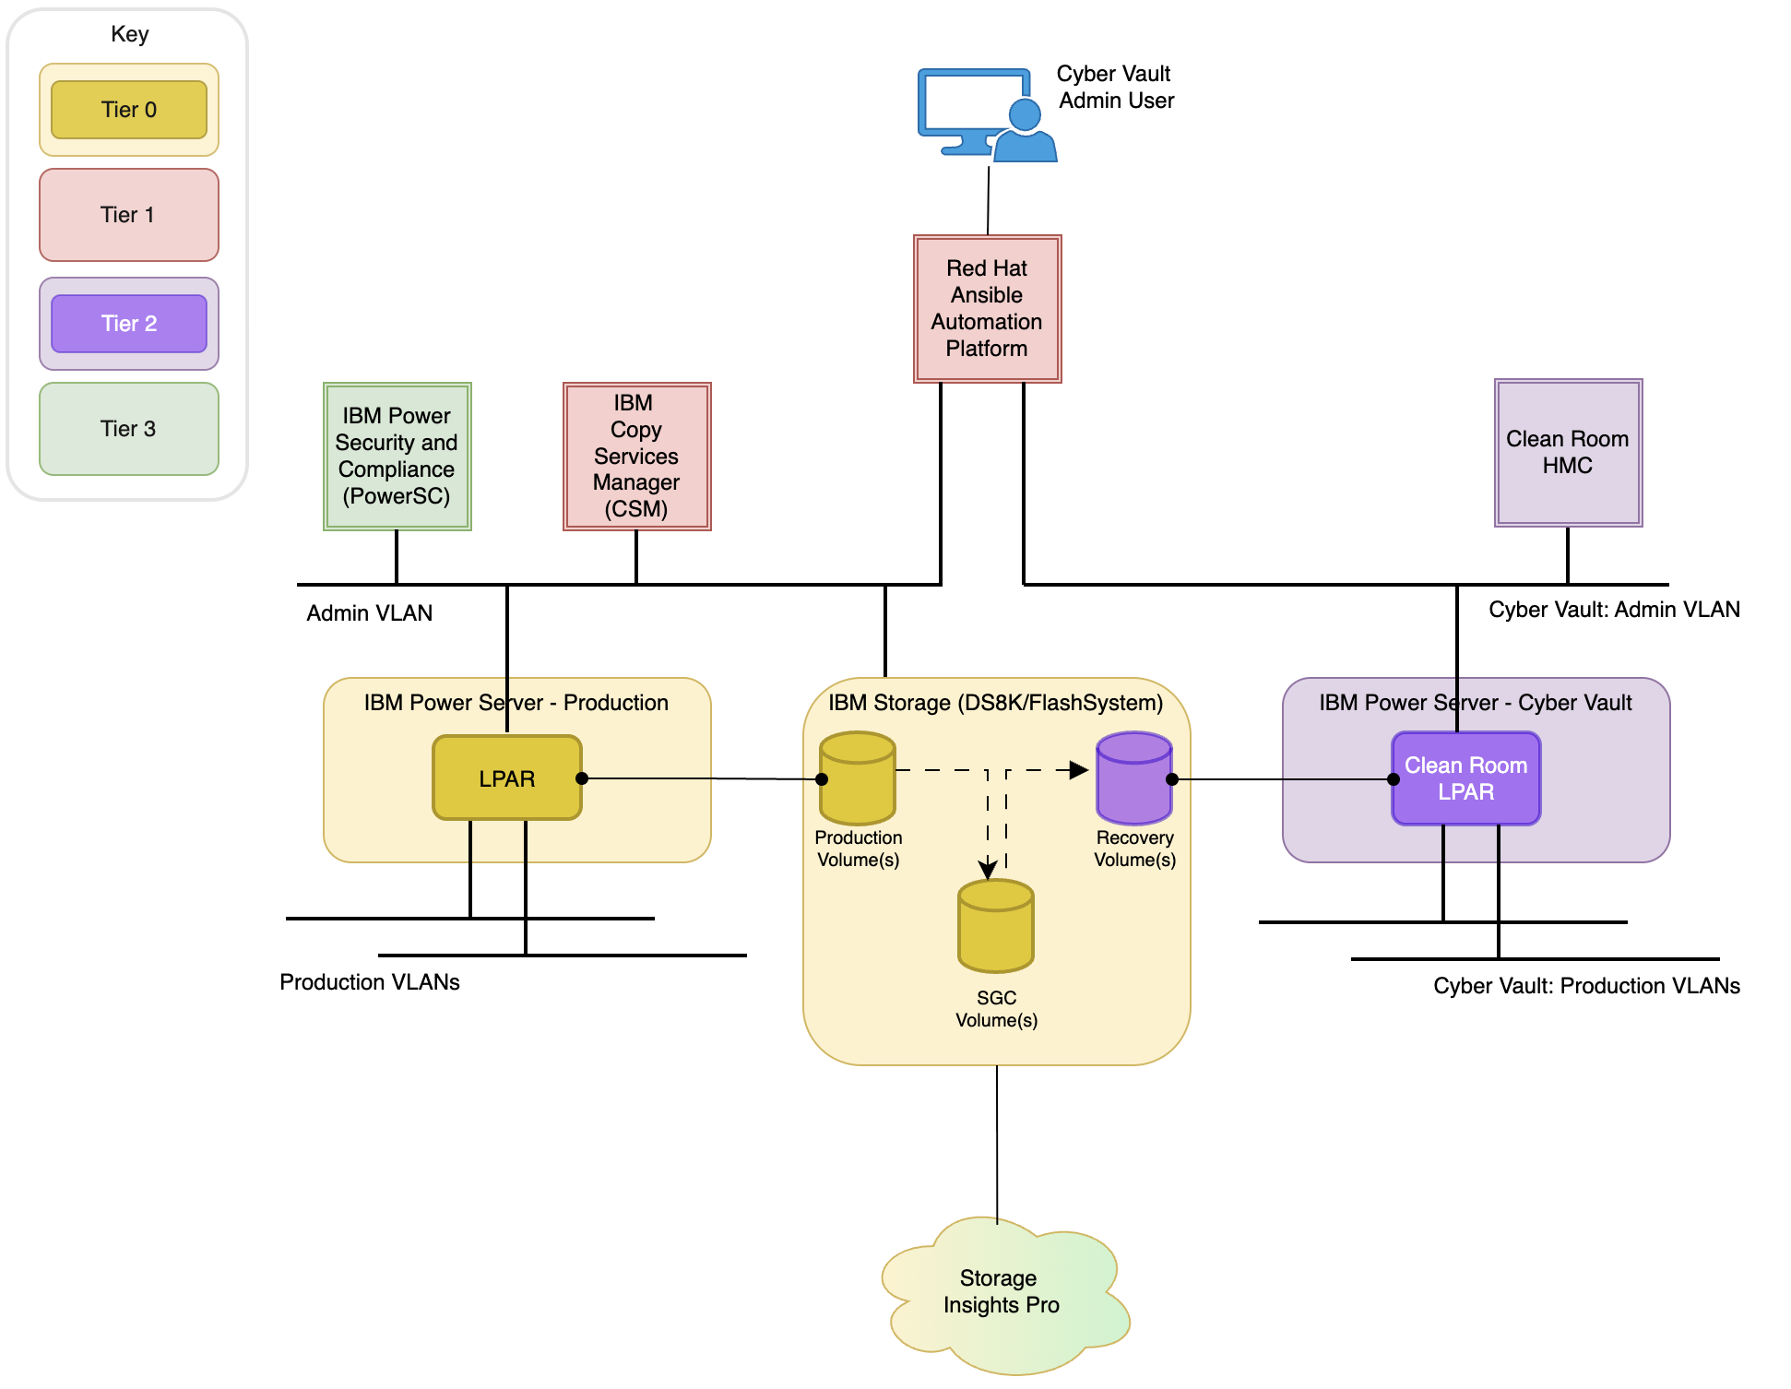
IBM Power Cyber Vault by Technology Expert Labs
Reference Architecture with Tiered Components
Storage Insights Pro is available in Tier 0. Integration with IBM Power Cyber Vault occurs during Tier 3 deployment.

Slide 19
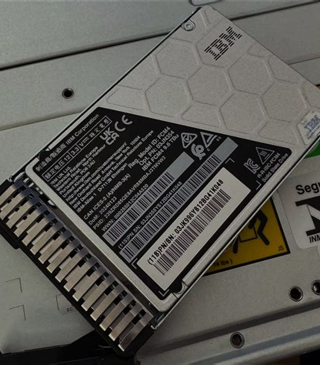
Storage: Data Protection in FCM4/5 Drives
Unique to IBM Storage hardware
Hardware solution that looks for trends across 40+ statistics using a patchable AI inference engine
Compression, entropy, read/write throughput, encryption detection, chi squared, LBA addressing sequences, etc
No impact to host performance
Workload neutral
Always running across all IO
Alerts are surfaced through Storage Insights Pro and Defender GUIs – now also integrated with PowerSC

Slide 20


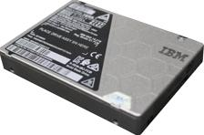



FCM4/5 - Ransomware Threat Detection
LBA Addressing and Sequencing Patterns
Statistical Analysis (Median, Distribution etc)
Encrypted payload detection
Compression Statistics
Changes in Read / Write Throughput
20

Slide 21
FCM4/5 Integration
When FCM4/5 detects threat activity, it generates a threat alert that follows this workflow:
The FCM4/5 alerts the FlashSystem or DS8000 and an alert gets forwarded to the PowerSC Server
Depending upon the PowerSC Server configuration, the PowerSC Server will processes the alert and forward it to the Cyber Vault Event-Driven Ansible (CVEDA)
Depending on the policy configuration of the Cyber Vault Response Policies, the Cyber Vault Event Driven Automation may respond to the event and begin an SGC for one or more VMs.

Slide 22





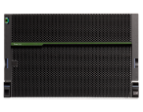

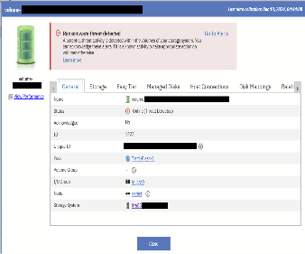
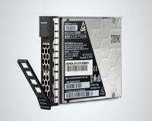
Power Cyber Vault – PowerSC Alert Correlation & Response
IBM Storage Defender
EDR Alerts
Malware Alerts
FCM4 Ransomware Alerts
IBM Storage Insights Pro
Integrates and correlates FCM4/FCM5 ransomware detection events with Power Operating Systems EDR and anti-malware events
Correlates w. OS security events across {type of event} and {time} axis, e.g.:
File integrity monitoring
Malware detection
Intrusion detection
Real-time compliance failures
PowerSC
IBM Flash System Management Console
Power Firmware w. Power VM
Sample Alert
FCM4/5 alerts export from storage controller via CSM and/or Syslog

Slide 23
IBM Zero Trust Execution for AIX (ZTEA) Integration
When ZTEA detects threat activity, it generates a security alert that follows this workflow:
On the endpoint AIX host, ZTEA generates a REST API call to the PowerSC Server that details the event
Depending upon on the PowerSC Server configuration, the event may be forwarded to the Cyber Vault Event Driven Automation.
Depending on the policy configuration of the Cyber Vault Response Policies, the Cyber Vault Event Driven Automation may respond to the event and begin an SGC for one or more VMs.

Slide 24
PowerSC Trigger Use Cases
# | Product | Name | Action | Comments
1 | ZTEA | Malware Execution Detected | Invoke full workflow | In real time, ZTEA detects Malware execution on production LPAR. CategoryID=CUSTOM_ZTEA_79_G
2 |  | Executable Deletion Detected | Invoke full workflow | In real time, ZTEA detects files immediately deleted after execution files on production LPAR. CategoryID=CUSTOM_ZTEA_DEL.
4 |  | Unknown Executable Detected | Invoke full workflow | In real time, ZTEA detects an unknown executable on a production LPAR. CategoryID=CUSTOM_ZTEA_CR_U_G
5 |  | TSD Compromise Detected | Invoke full workflow | In real time, ZTEA detects that an executable has been found in the AIX Trusted Execution database (TSD). CategoryID=CUSTOM_ZTEA_TSD_1. NOTE: this check also be done as a type 1 validation
6 | PowerSC native | Compliance Violation | Invoke full workflow | PowerSC detects policy violation on production LPAR. CategoryID=COMPLIANCE_RULE_FAILURE
7 |  | Brute Force Attack Detected | Invoke full workflow | Multiple bad password attempt over a specified time duration. CategoryID=CORRELATION_PASS_FAILURE
8 |  | PowerSC Agent Connection Loss Detected | Invoke full workflow | The PowerSC GUI Agent on a production LPAR is no longer connected. CategoryID=AGENT_DISCONNECTED
9 |  | Real Time Compliance: Content Changed | Depends on file experiencing the event | Real time detection of content change to file. CategoryID=AHAFS_MODFILE_WRITE
10 |  | Real Time Compliance: Access Changed | Depends on file experiencing the event | Real time detection of access change to file. CategoryID=AHAFS_MODFILEATTR_SETMODE
11 |  | Real Time Compliance: Directory Access Changed | Depends on directory experiencing the event | Real time detection of access change to directory. CategoryID=AHAFS_MODFILEATTR_SETMODE

Slide 25
PowerSC Trigger Use Cases
# | Product | Name | Action | Comments
9 | Trusted Execution (AIX) | TSD Verification | Type 1 validation | Verify the correctness of files registered in the AIX Trusted Execution Database. ie trustchk –n all. This is a type 1 validation check.
10 | FCM4 | All detections | Invoke full workflow | Storage Insights via FCM4 reports a malware event.
11 |  | Encryption detection | Invoke full workflow | Storage Insights via FCM4 reports an encryption event
12 | Other | Unauthorized root access | Invoke full workflow | This is an example of how other security functionality can be integrated into Cyber Vault using PowerSC's Custom Event Feature. This example provides scripting that detects unauthorized su to root. CategoryID=CUSTOM_ACCESS_ROOT_1

Slide 26
Future PowerSC Trigger Use Cases
There are many other security events reported by PowerSC that can be supported in the future:
BLOCKLIST_MATCHING_HASH
RTC_CONFIGURATION_CHANGE_REQUESTED_WARNING
IDP_WAS_SWITCHED_OFF
RTC_WAS_SWITCHED_OFF
AHAFS_MODFILEATTR_SETMODE
AHAFS_MODFILEATTR_SETOWN
IDPD_PORT_SCAN
SYSLOG_FILE_MODIFICATION_RT
PATCH_UPDATE_FAILURE_EVENT

Slide 27


IBM Power Cyber Vault -
Comprehensive Cyber Resiliency for IBM Power Systems with Expert Labs
1. Periodic scheduled copies
Protect critical workloads with application consistent immutable SGC’s
3. Reactive validation triggered by security events
2. Periodic testing of immutable copies
Reactively detect cyber events and respond with immediate protect and validate stages
Validate workloads in the cyber vault cleanroom to detect cyber incidents
IBM Power Cyber Vault
5. Automation Framework
Mark SGC’s as clean or infected for recovery planning via an incident response plane
Incident response plan
4. A list of SGC backups and their validation status

Slide 28
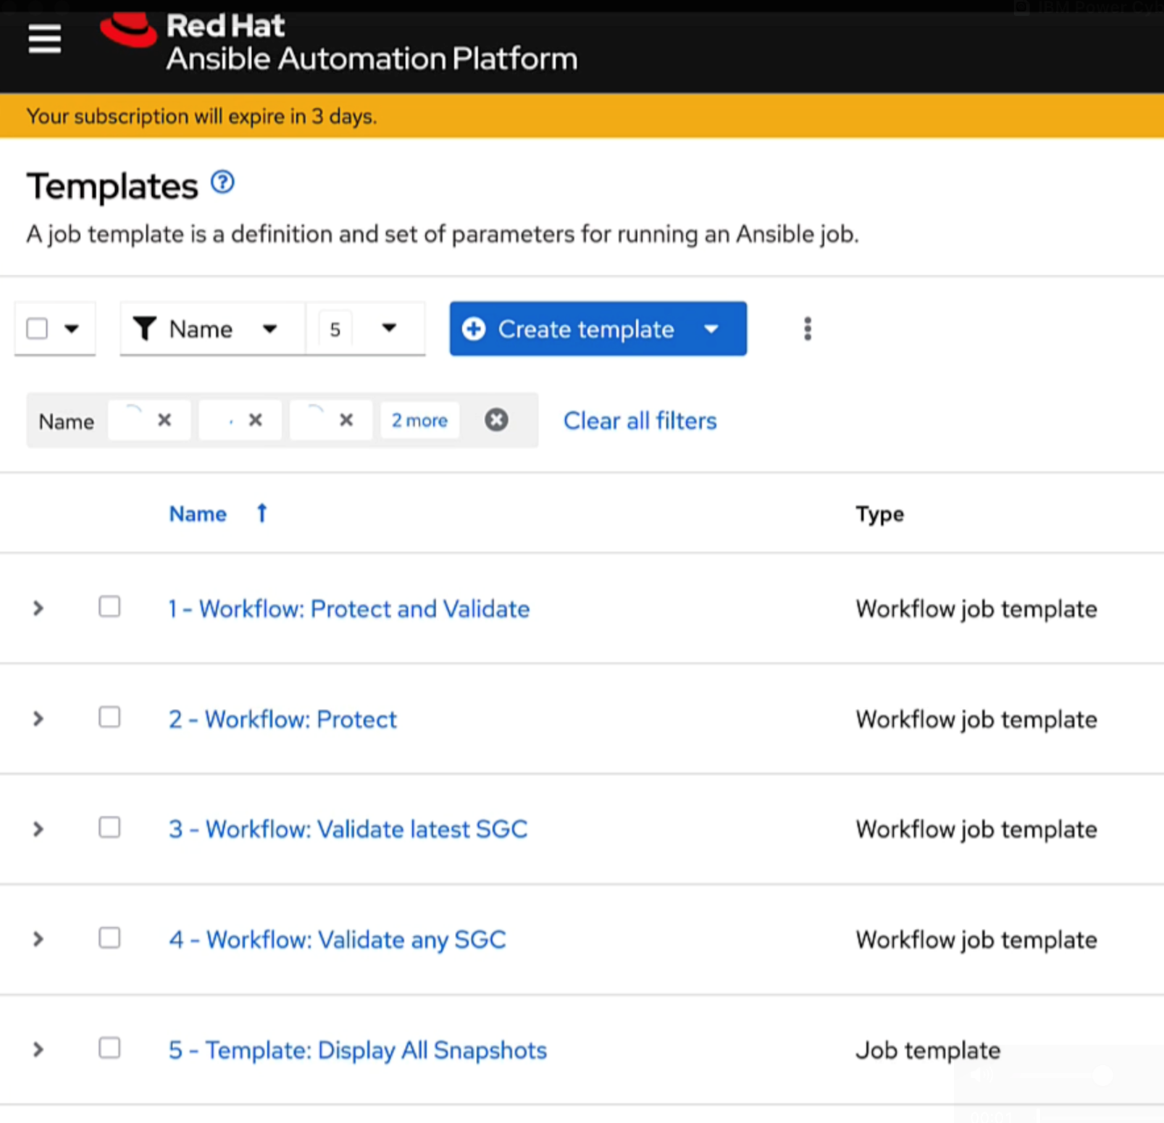
Ansible job templates
Template | Action
1 – Protect and Validate | Perform application consistent SafeGuarded Copy and validate in the IBM Power Cyber Vault clean room
2 – Protect | Perform application consistent SafeGuarded Copy
3 – Validate latest SGC | Validate the latest ’none validated’ SafeGuarded Copy in the IBM Power Cyber Vault clean room
4 – Validate any SGC | Select an existing SafeGuarded Copy and validate in the IBM Power Cyber Vault clean room
5 – Display all snapshots | List existing SafeGuarded Copies and their validation status: Validation Passed Not Validated Validation Failed

Slide 29
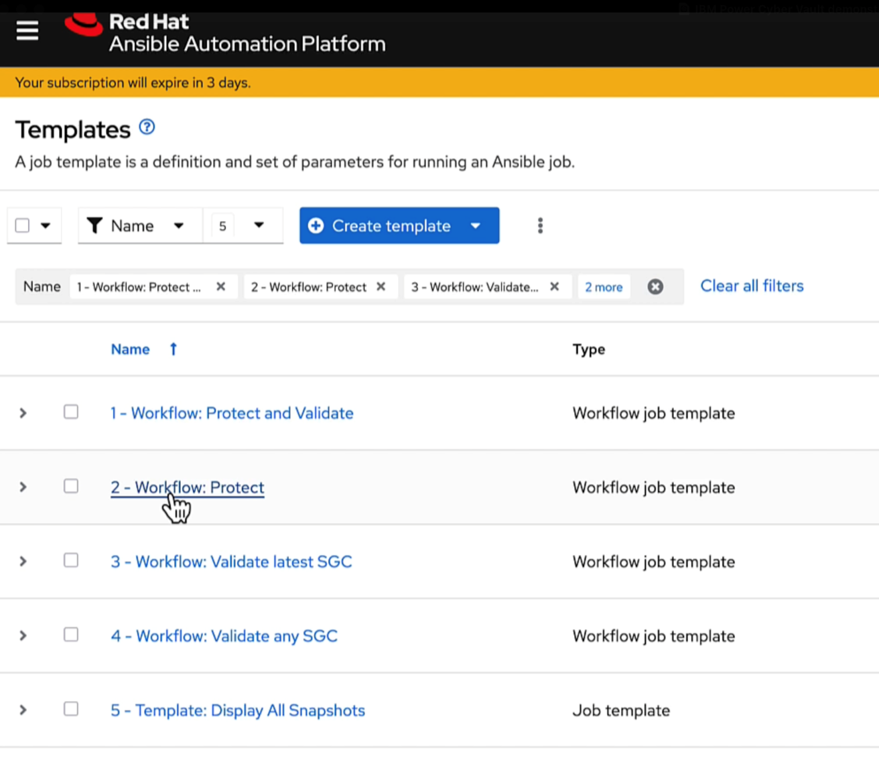
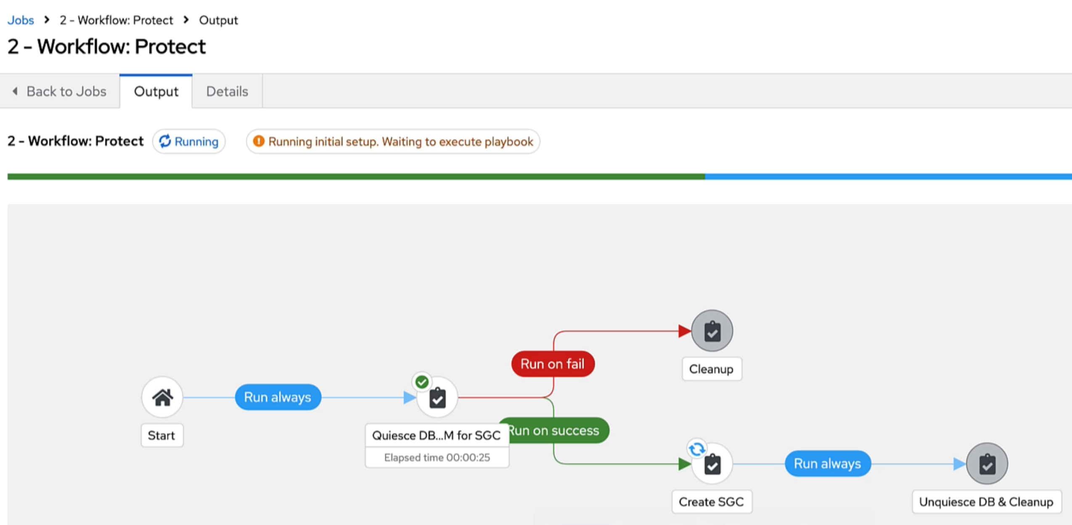
Protect
Run via Ansible scheduler at customer agreed intervals or via event triggers
(can skip application quiesce if required)

Slide 30
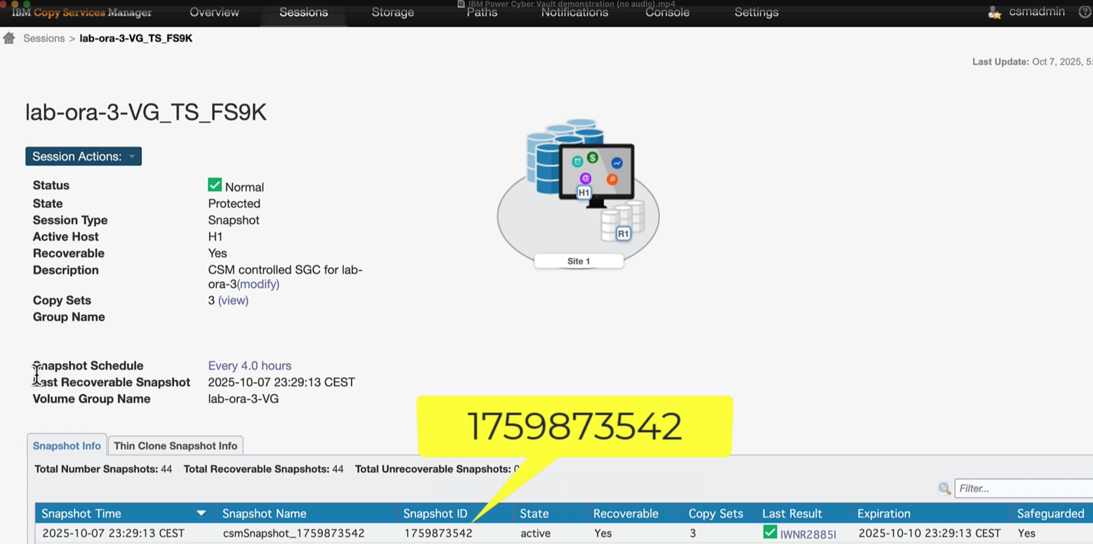
Protect
Application consistent immutable SGC taken.
The SCG is marked as “Not Validated”

Slide 31
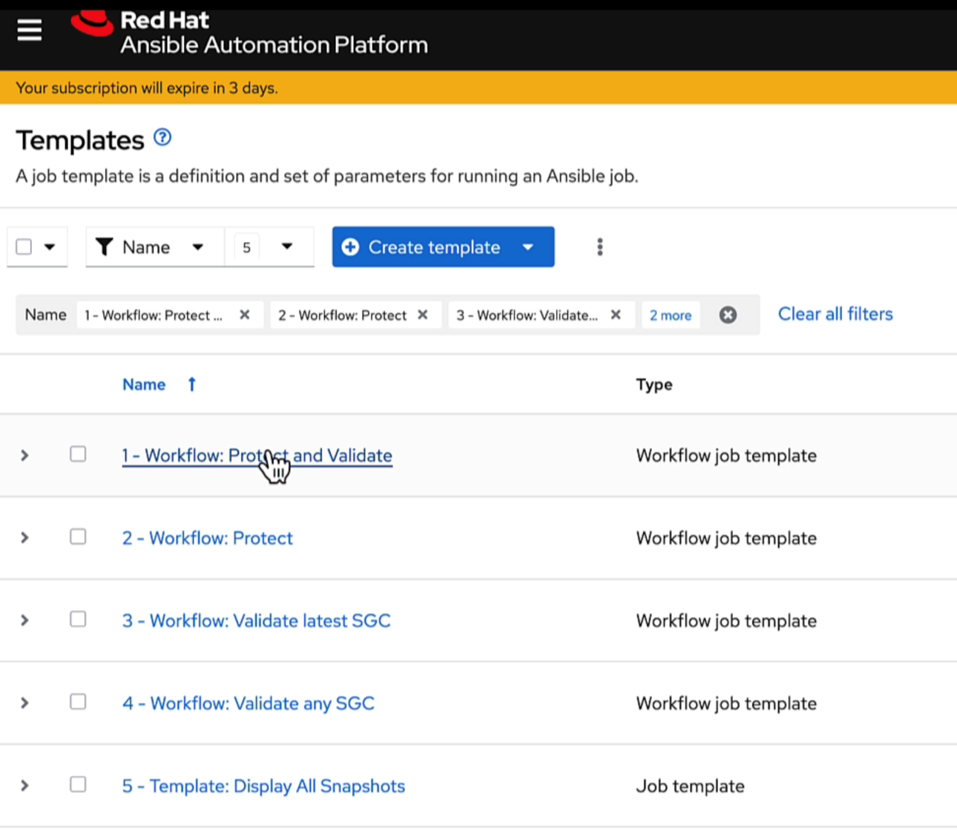
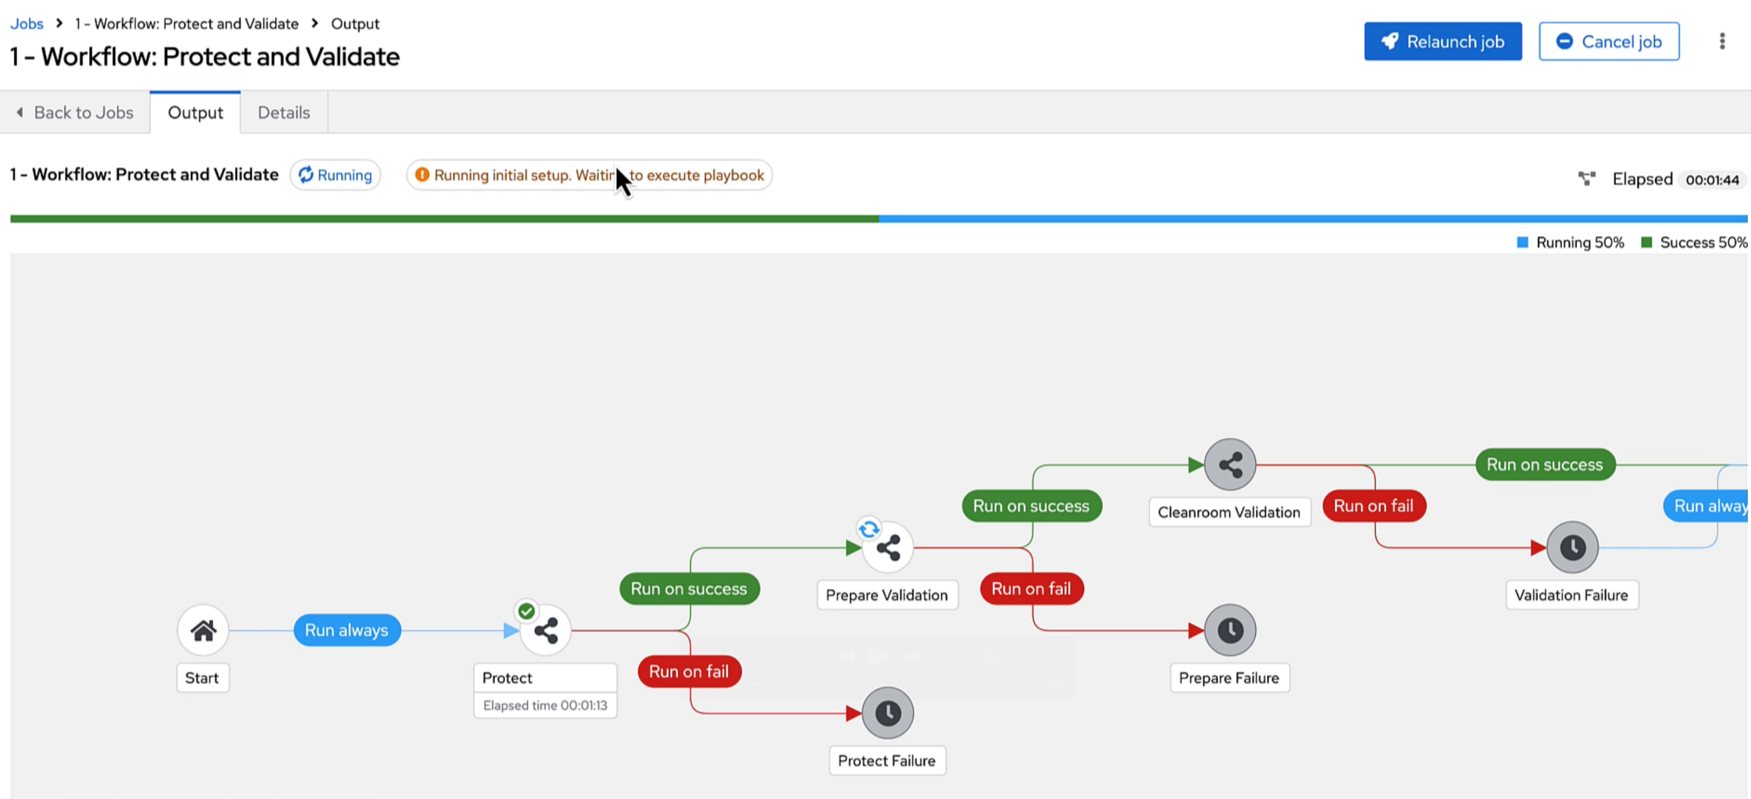
Protect and Validate
Run via Ansible scheduler at customer agreed intervals or via event triggers
(can skip application quiesce if required)

Slide 32
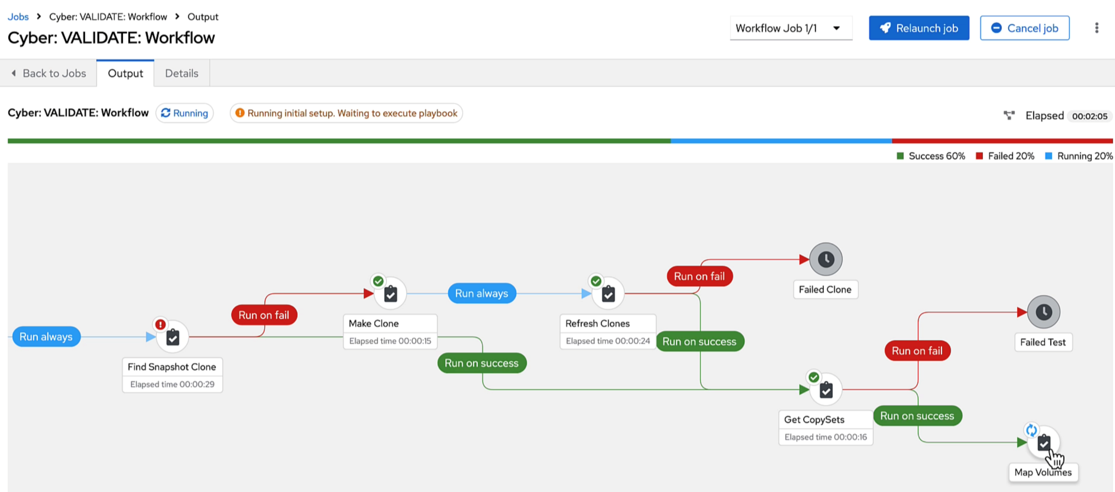
Protect and Validate
A thin clone is taken from the new SGC and mapped to the cleanroom VM

Slide 33
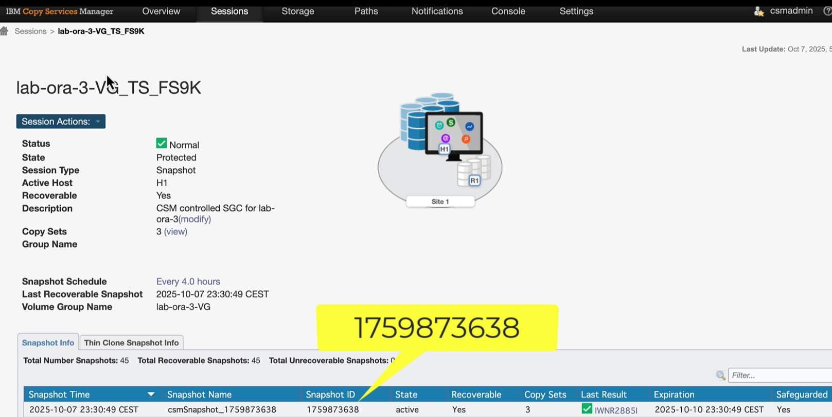
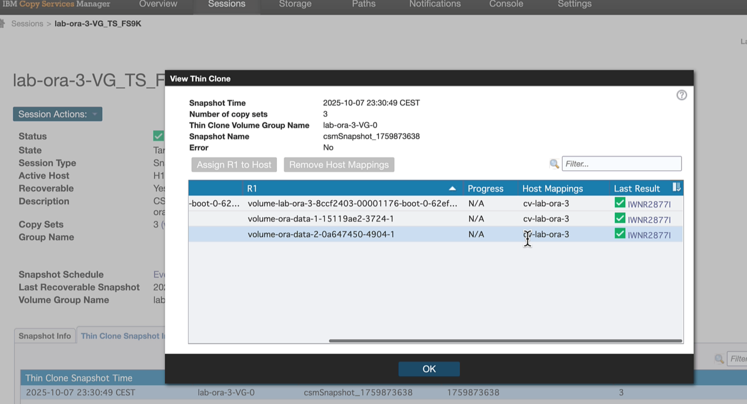
Protect and Validate
New thin cloned volumes are mapped to cleanroom VM

Slide 34
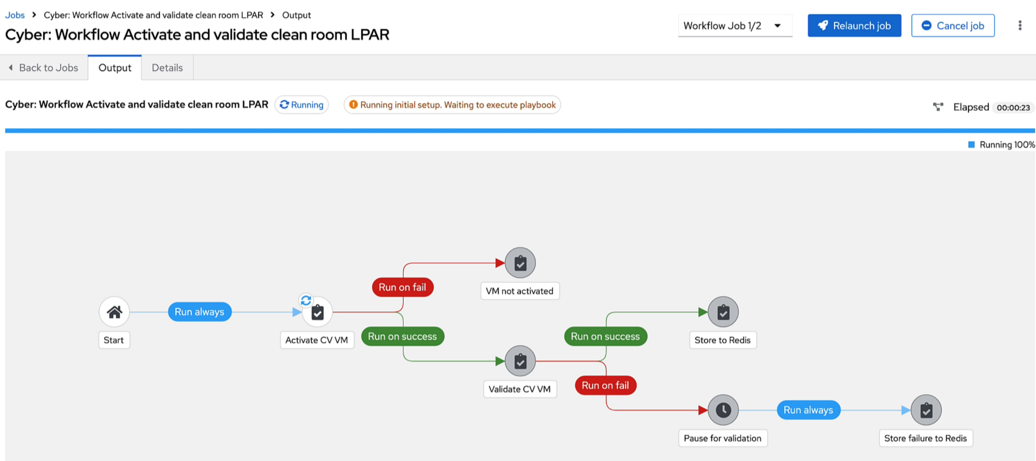
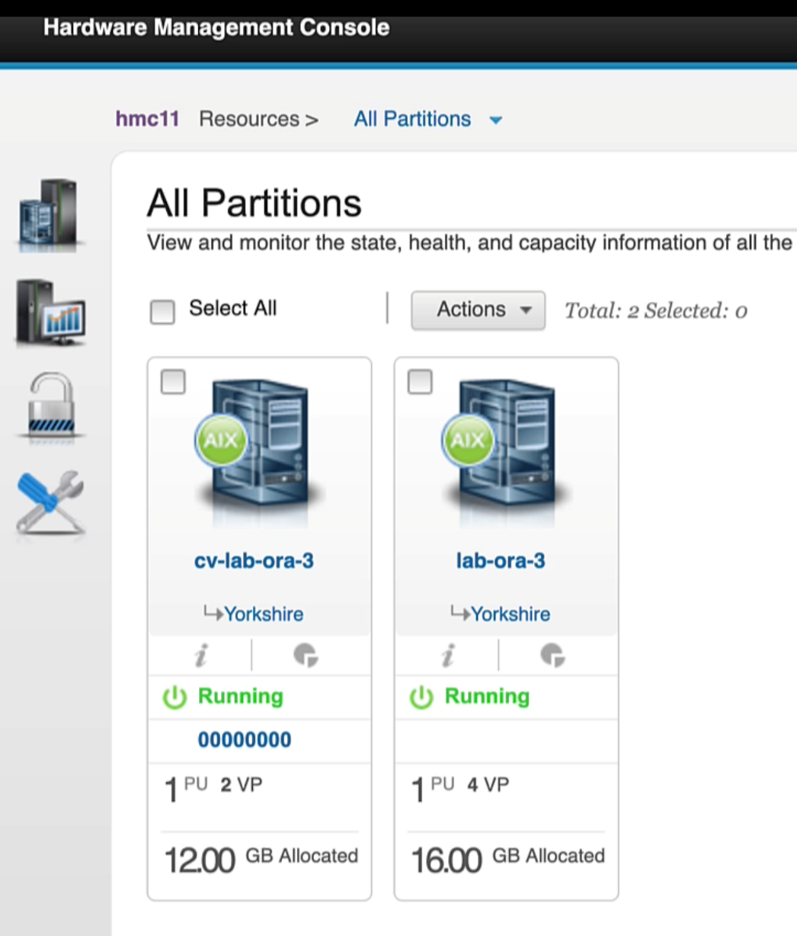
Protect and Validate
The cleanroom VM is then activated

Slide 35
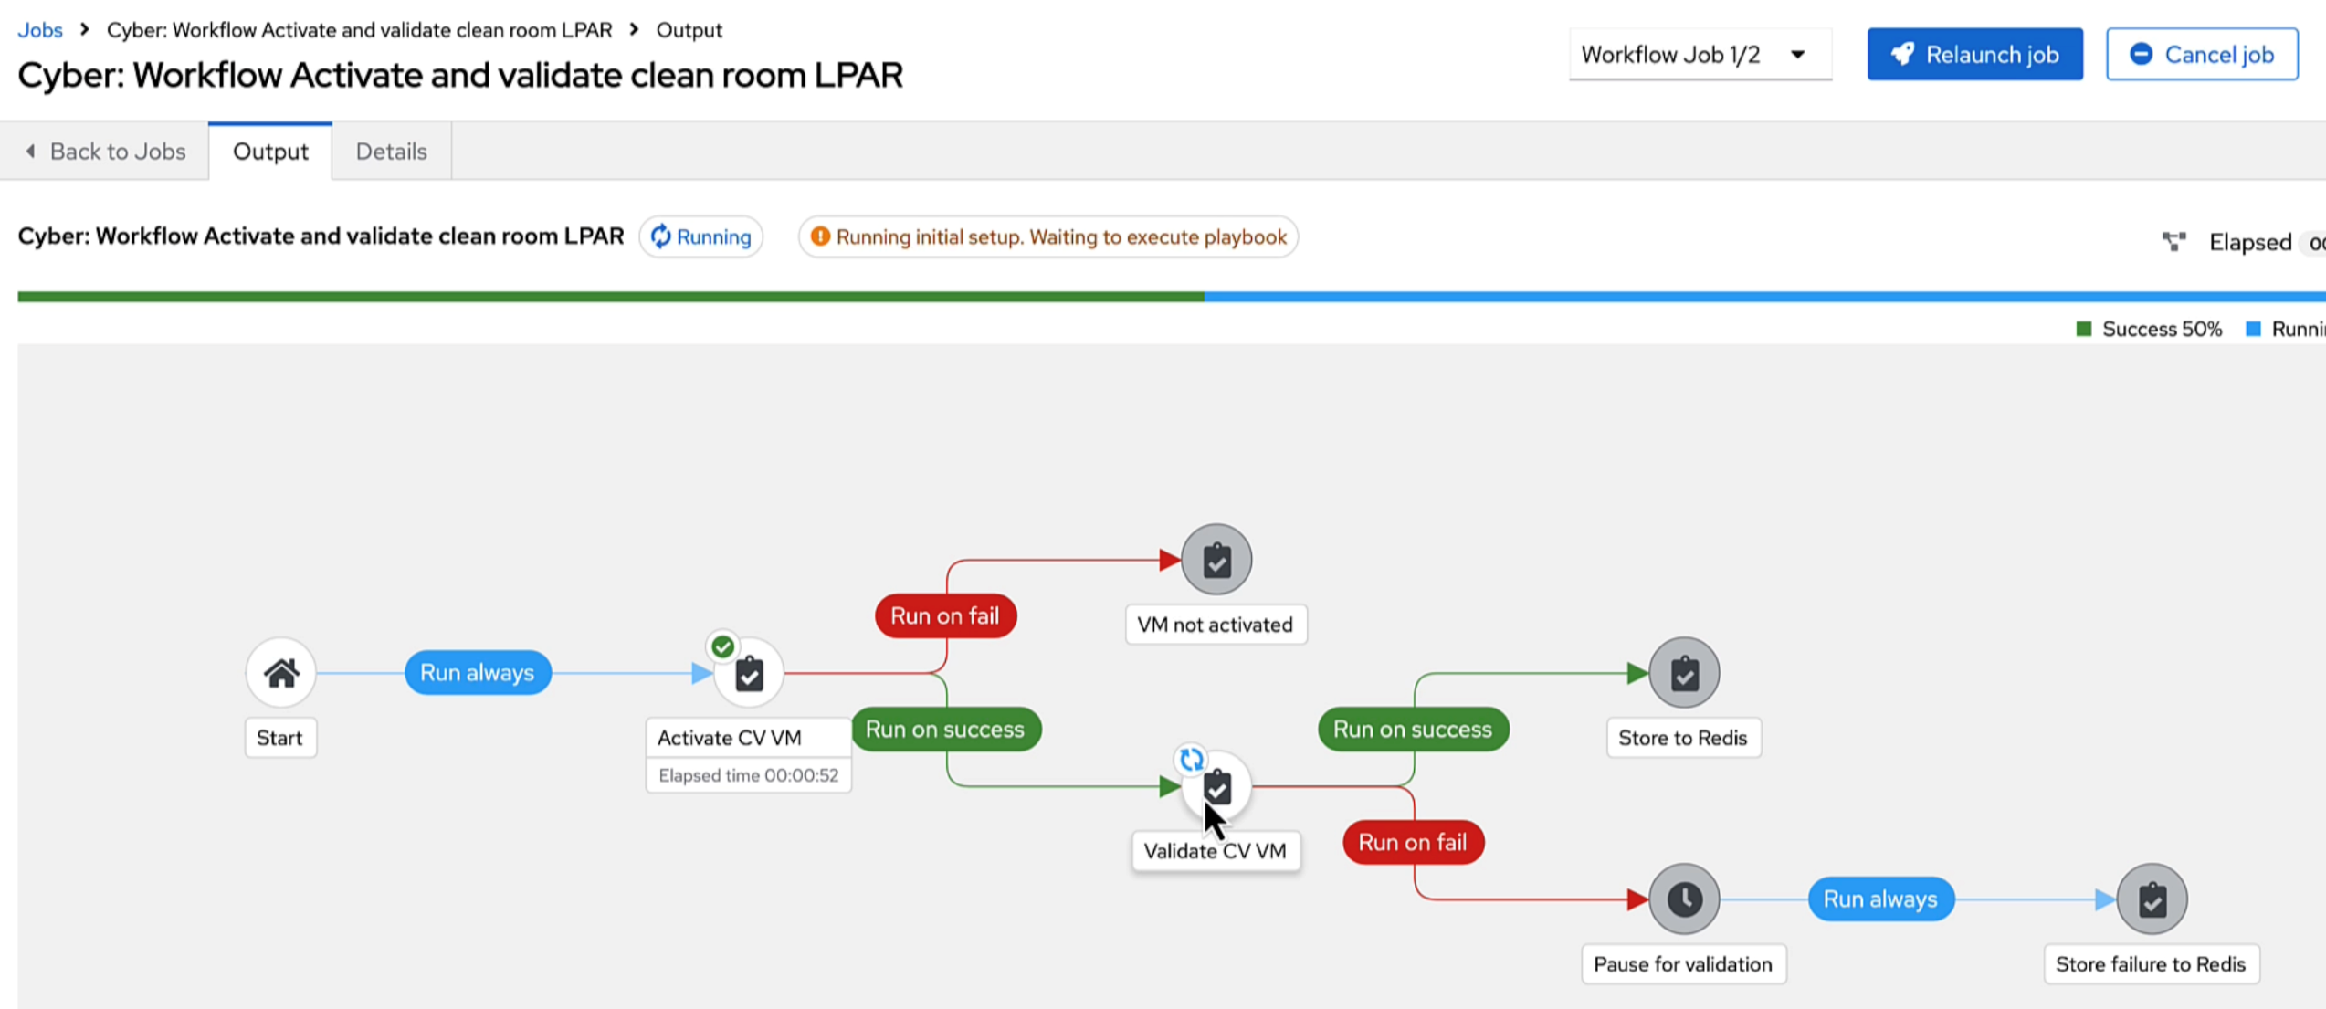
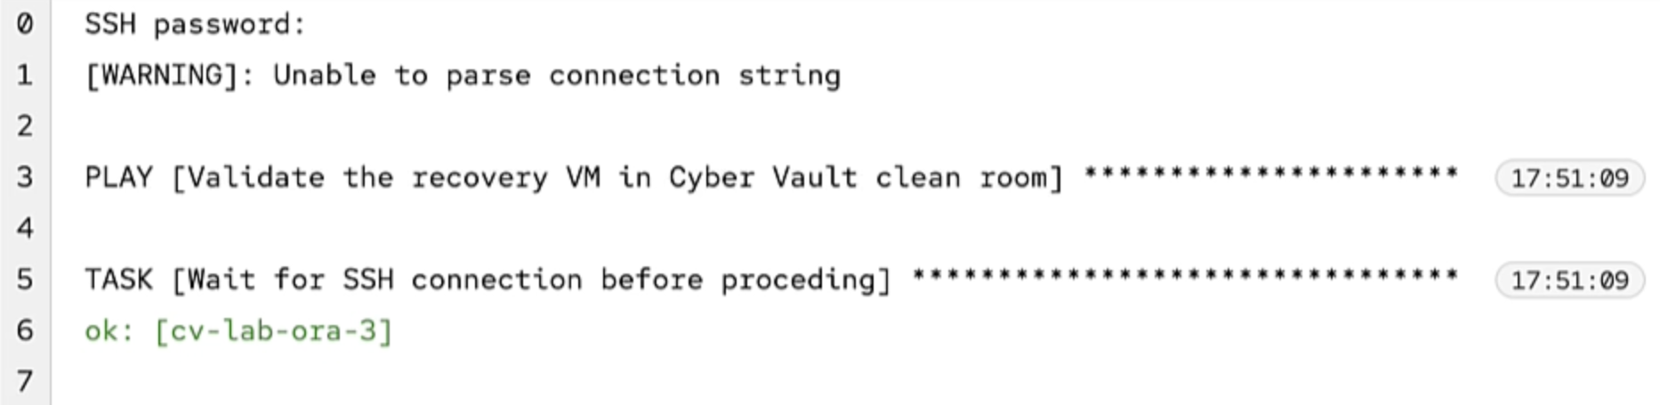
Protect and Validate
Once the cleanroom VM is activated, Ansible can connect as start validation

Slide 36
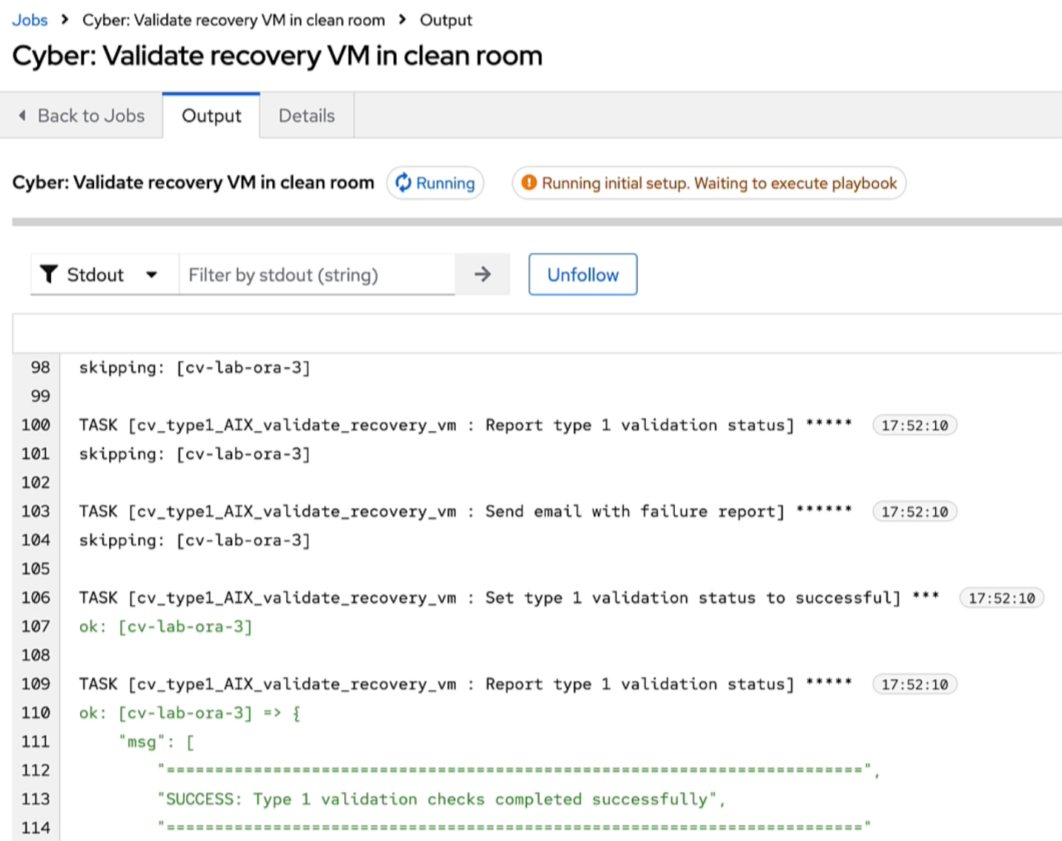
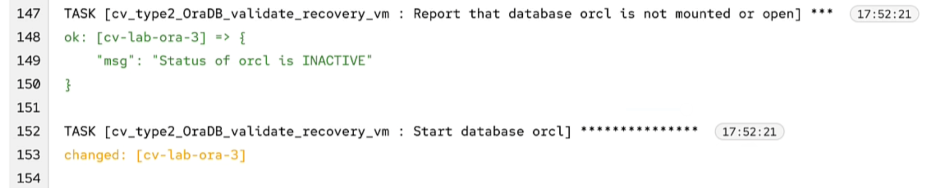
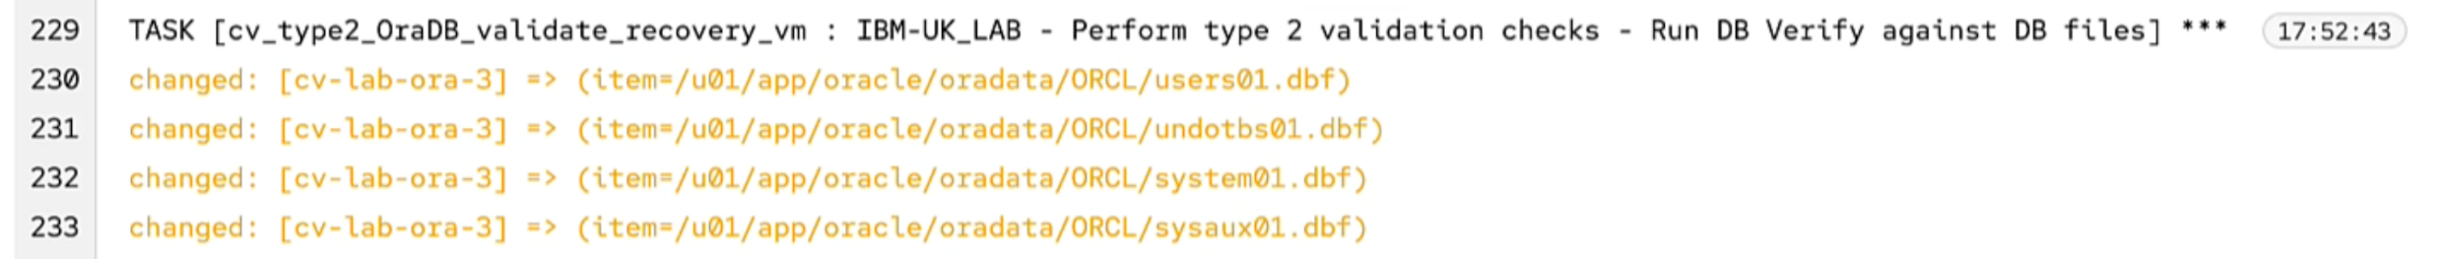
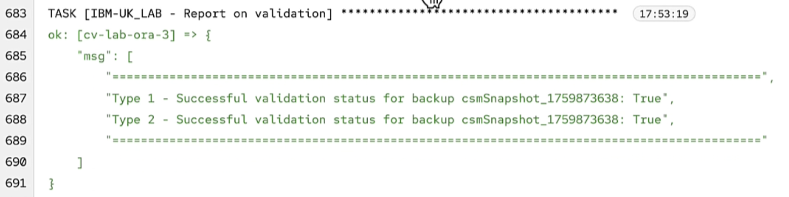
Protect and Validate
Once type 1 (IPL/OS) validation is complete, DB (type 2) validation can start.

Slide 37
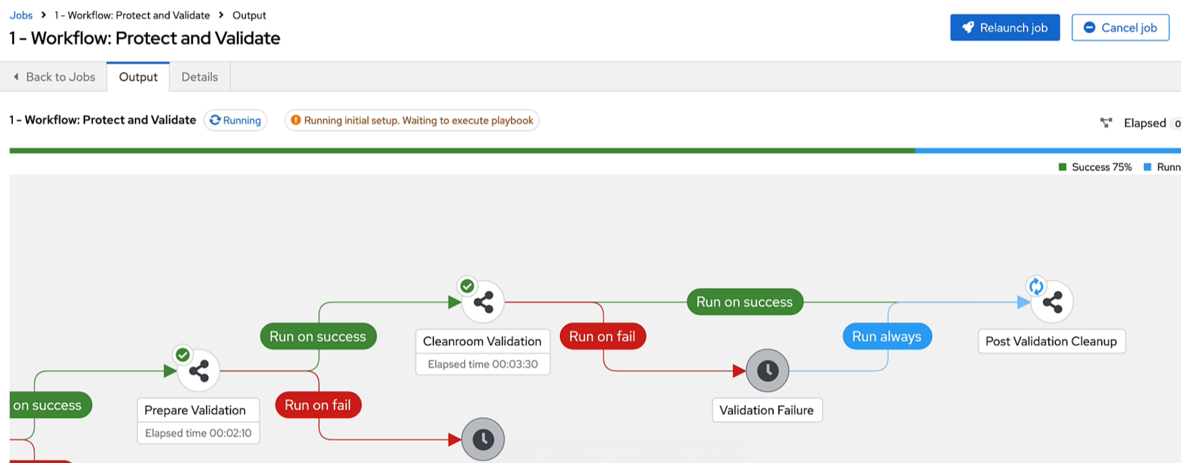
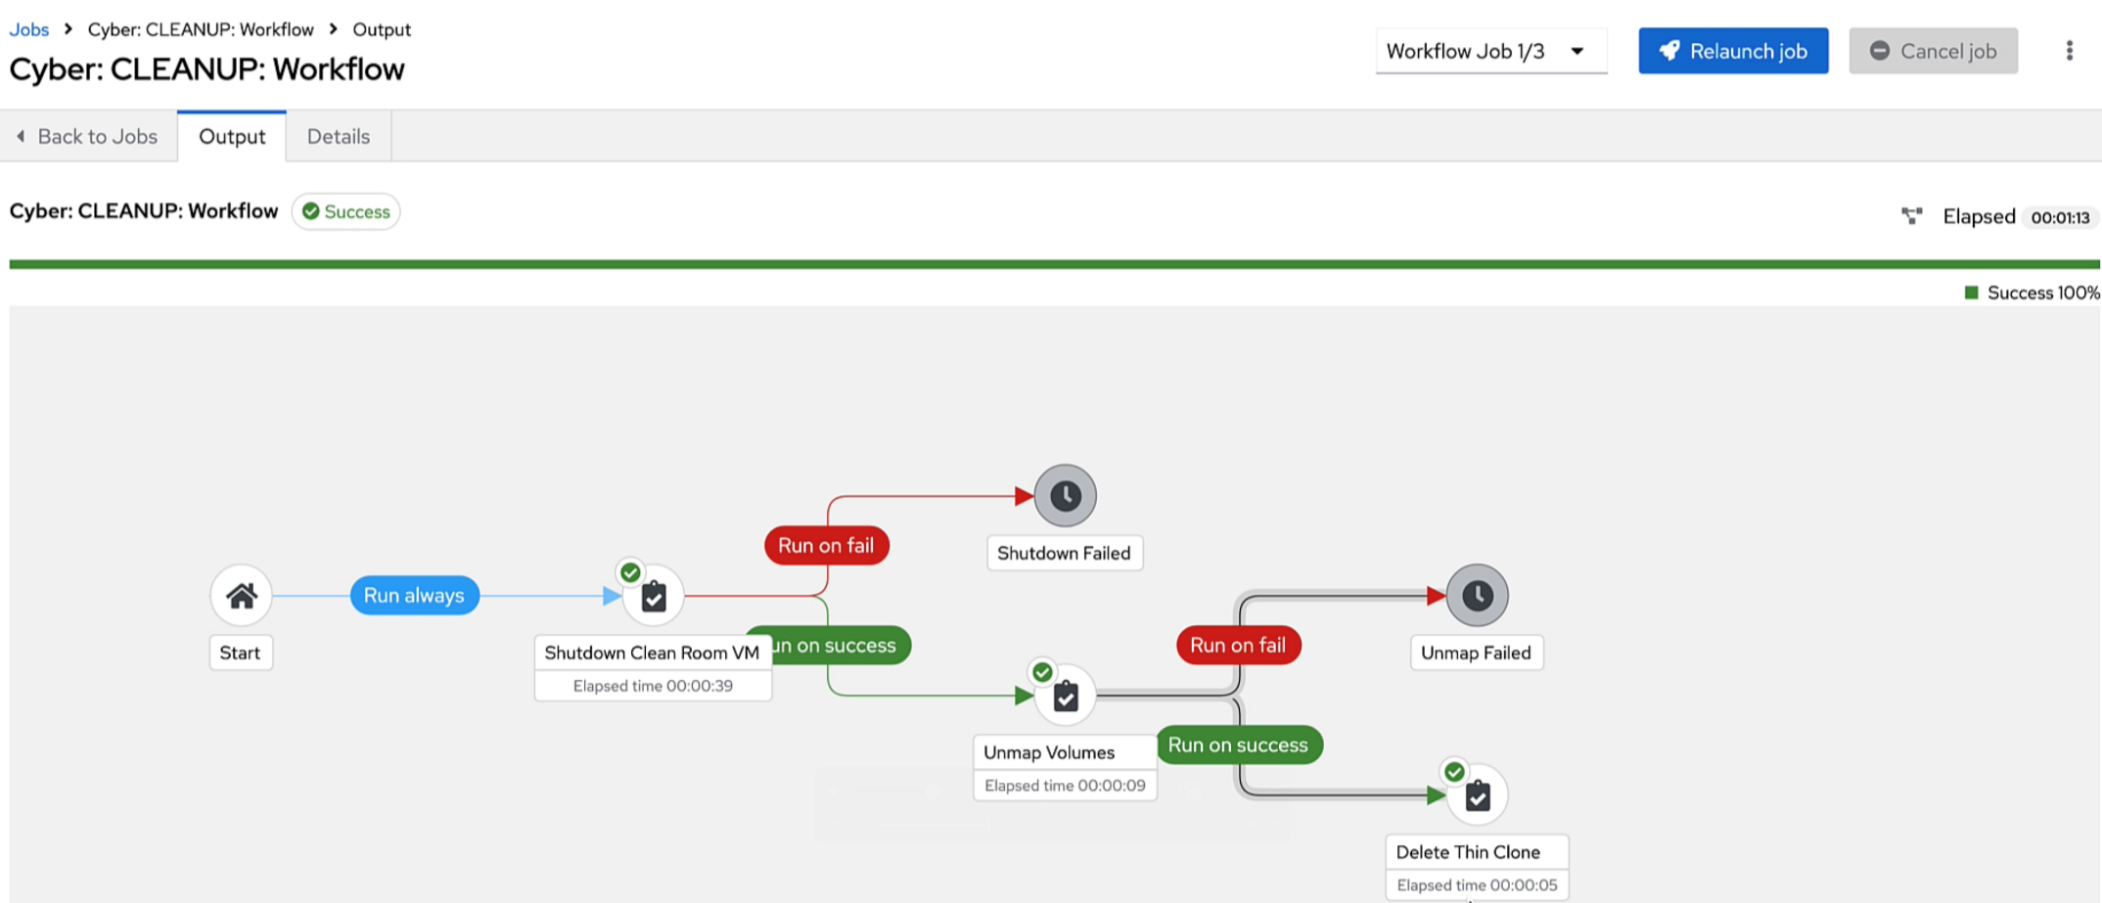
Protect and Validate
If validation was successful, the cleanroom VM is shutdown, its volumes detached and the thin clone removed.
The SCG is marked as “Validation Successful”

Slide 38
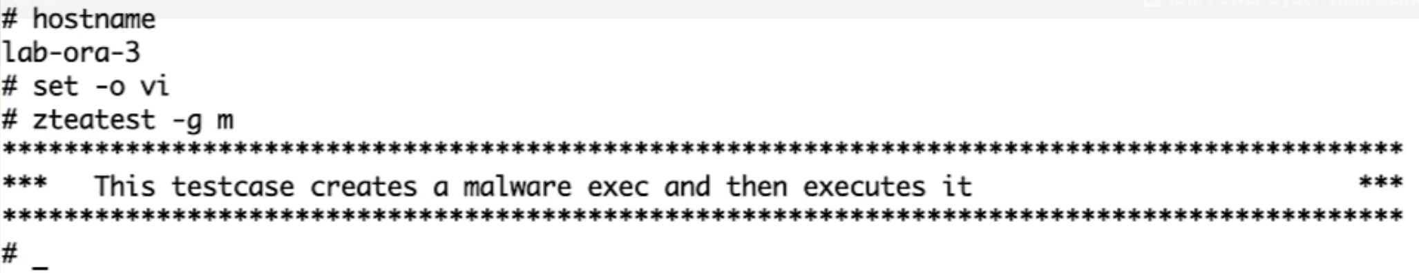
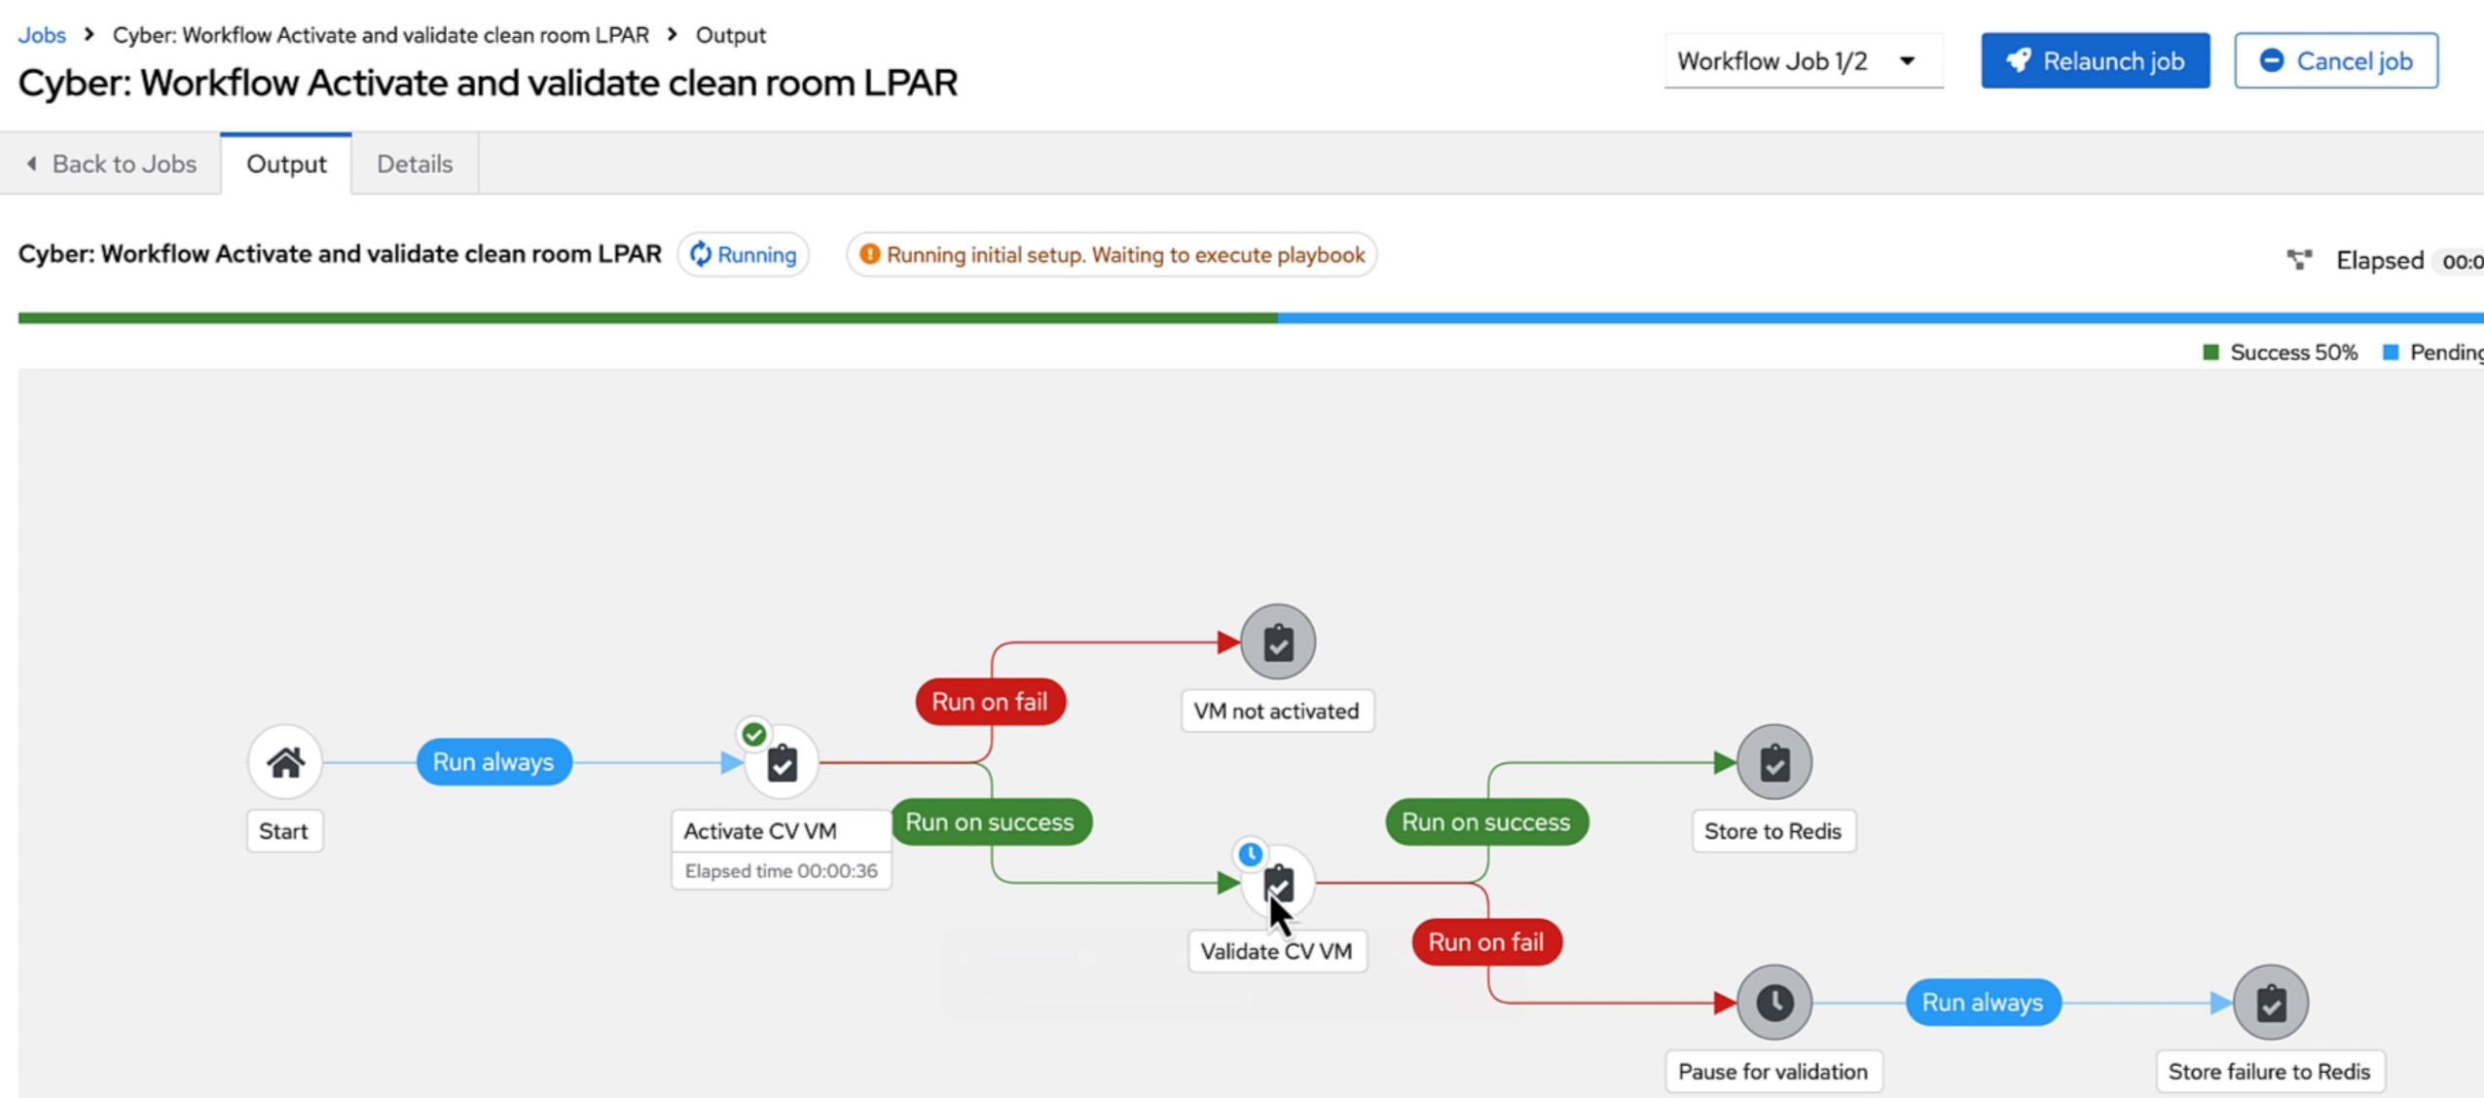
Protect and Validate – corruption detected during scheduled validation
In this scenario we have placed a malware file on our production VM and allowed the scheduled protect and validate to run as normal.

Slide 39
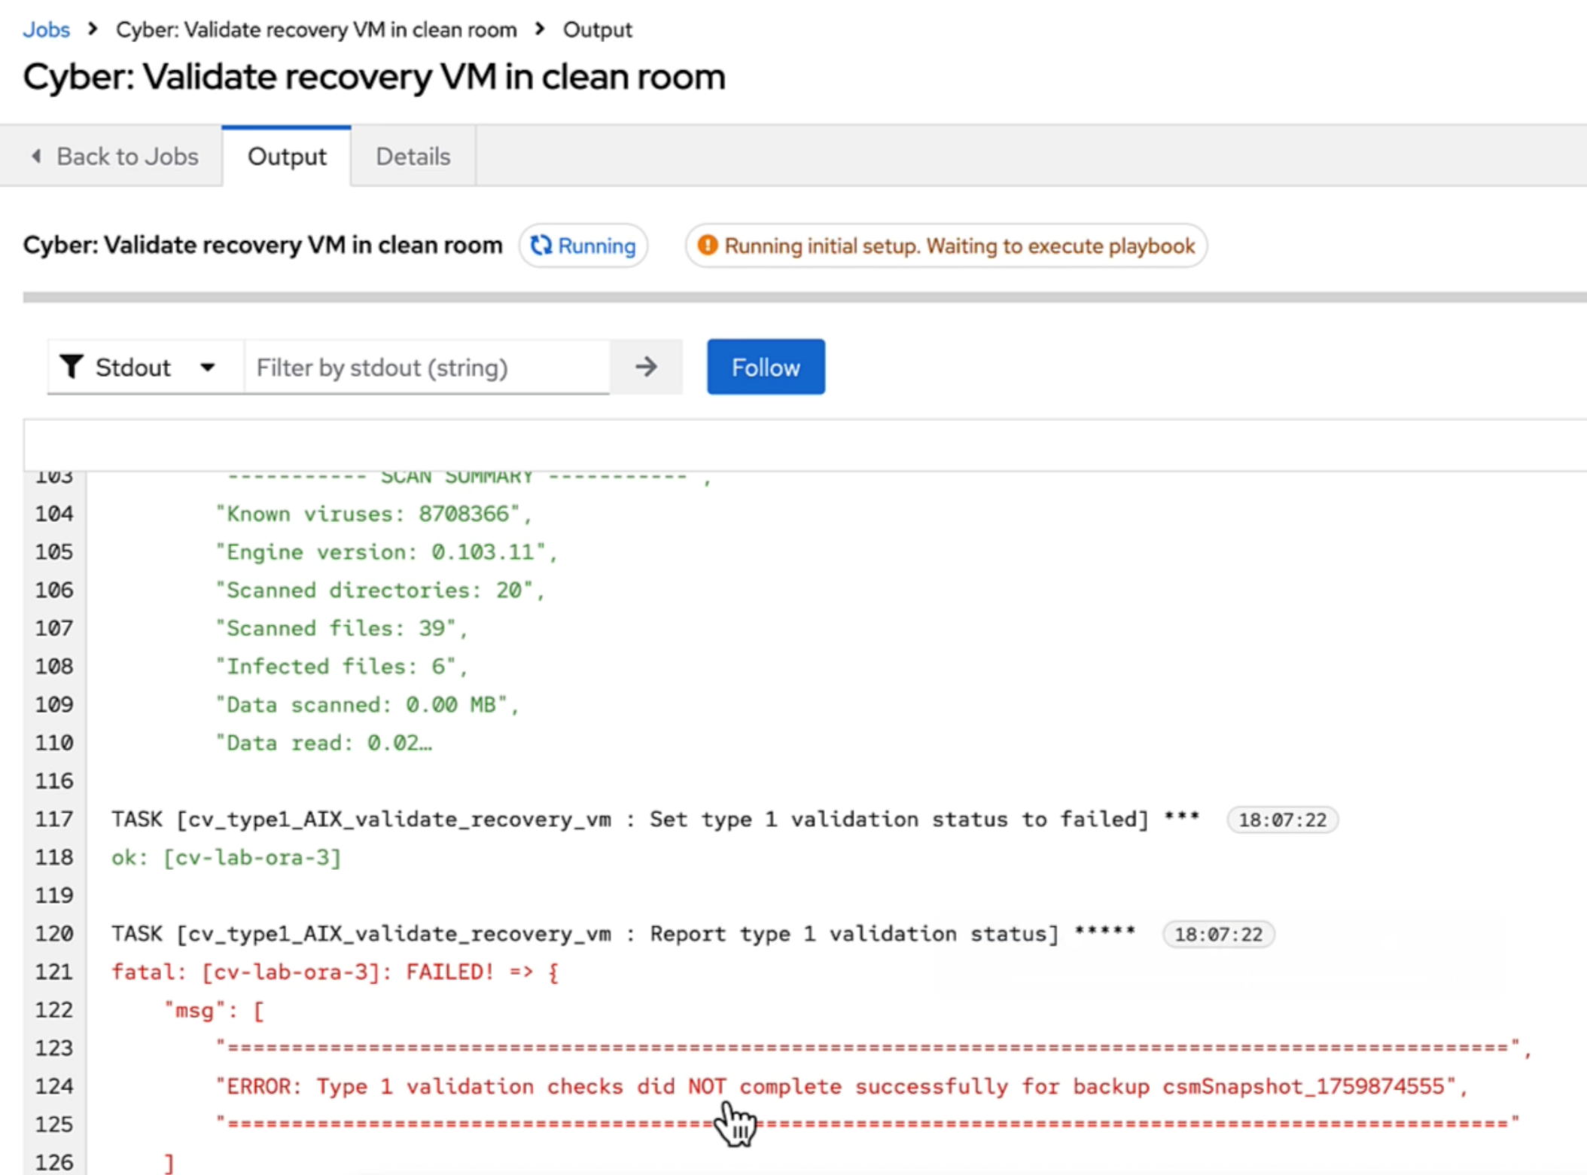
Protect and Validate – corruption detected during scheduled validation
We can see the type 1 validation checks on the cleanroom VM failed.
We mark that SGC as “Validation Failed”

Slide 40
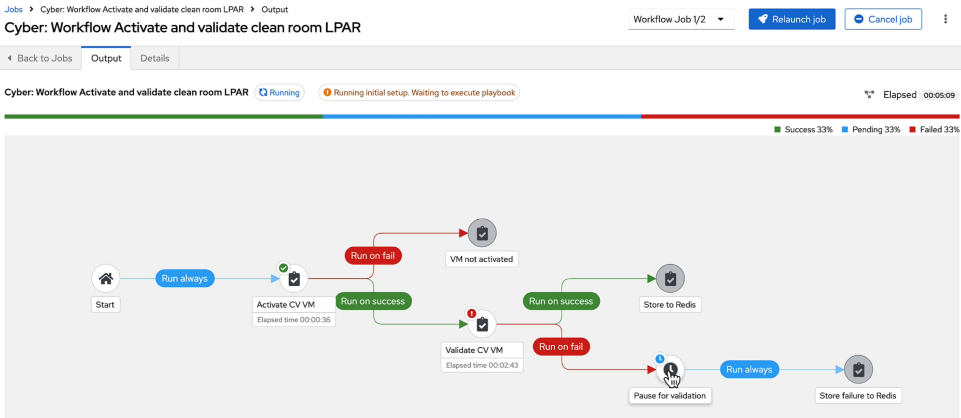
Protect and Validate – corruption detected during scheduled validation
Due to the validation failure, we do not automatically shutdown the cleanroom LPAR. It is left active for the customer to run forensic analysis to determine the reason for the failure.

Slide 41
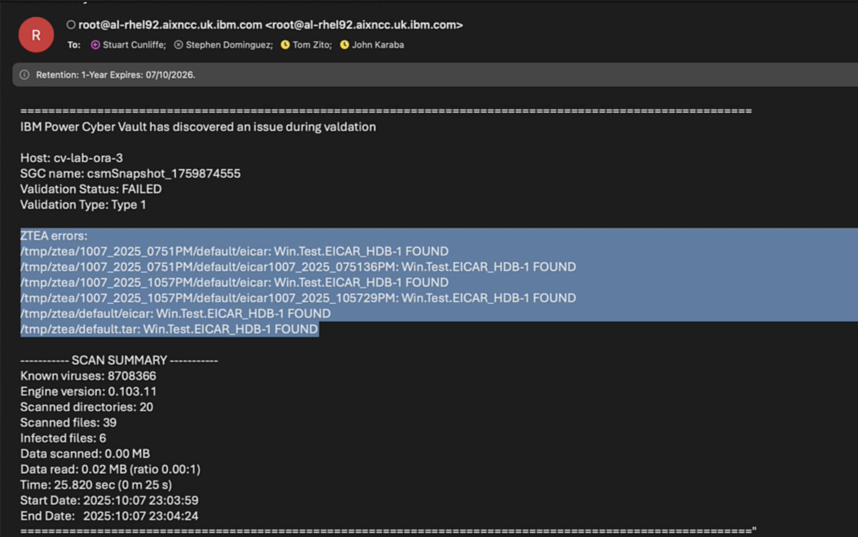
Protect and Validate – corruption detected during scheduled validation
The failure can also be reported via methods such as email.

Slide 42
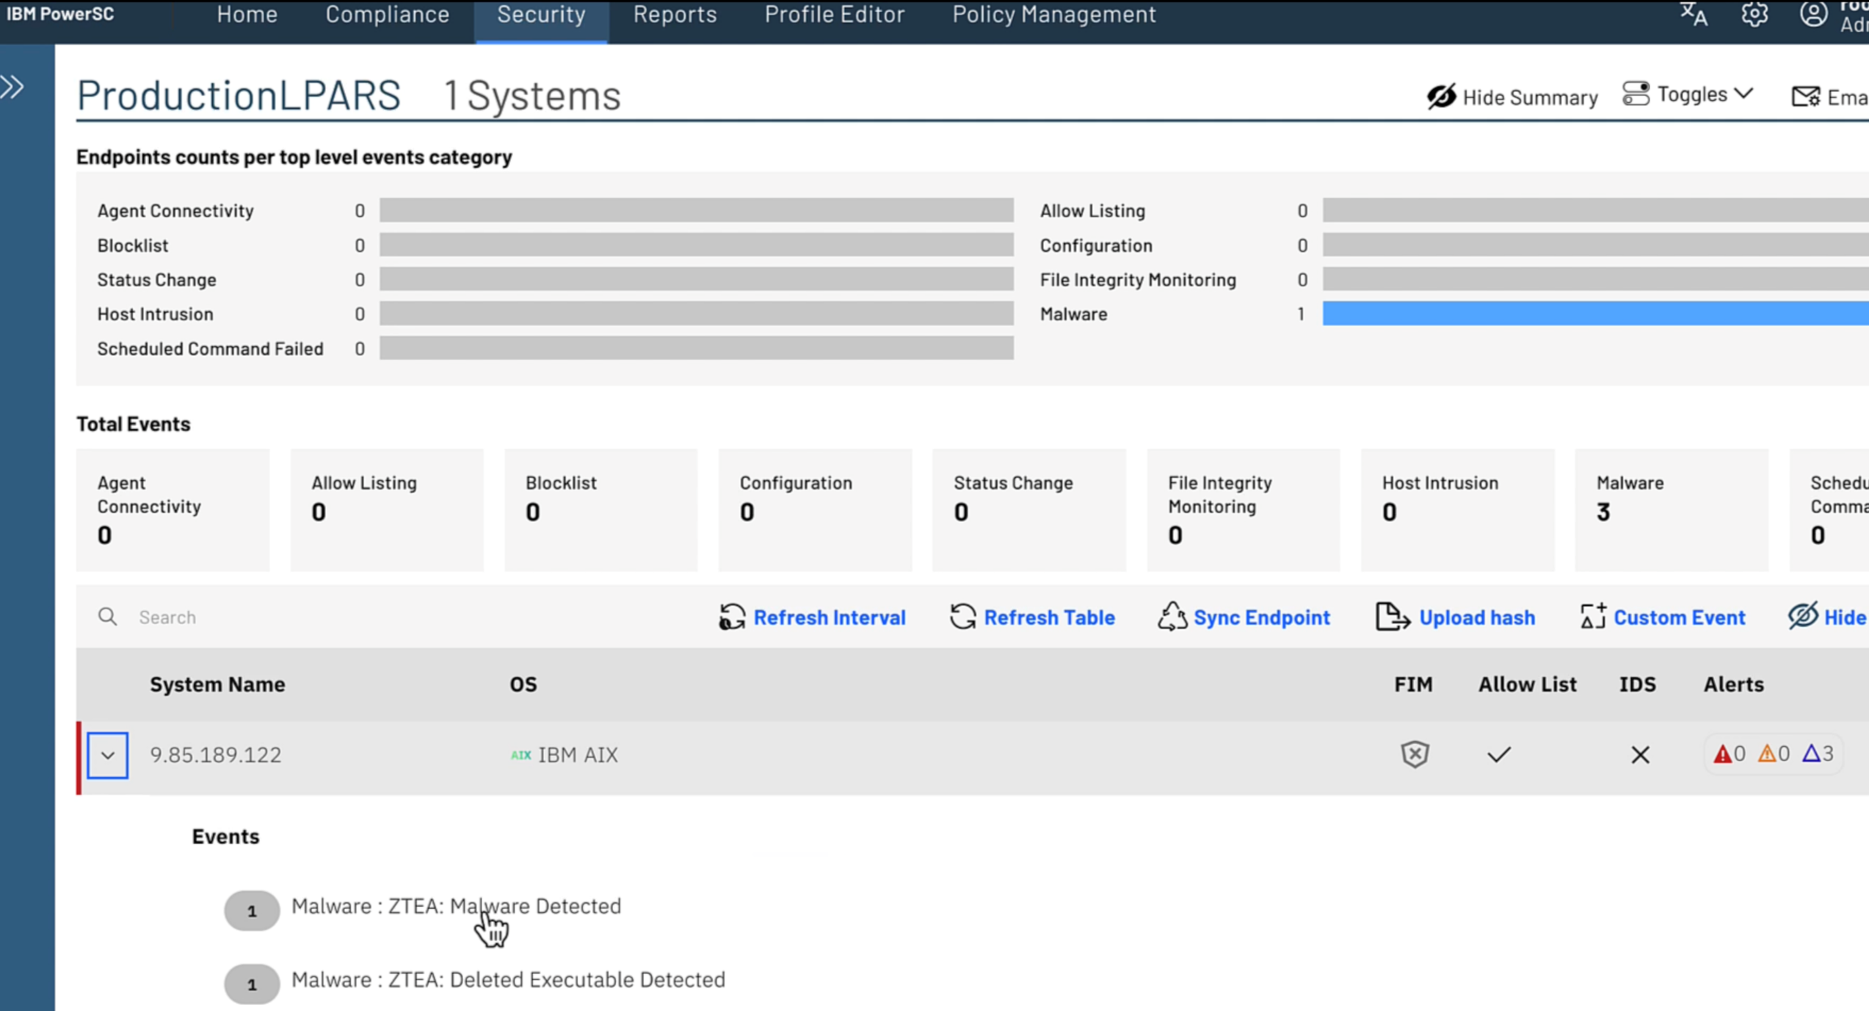
Protect and Validate – triggered via cyber event
In this scenario PowerSC had detected an event (malware file) on the production VM

Slide 43
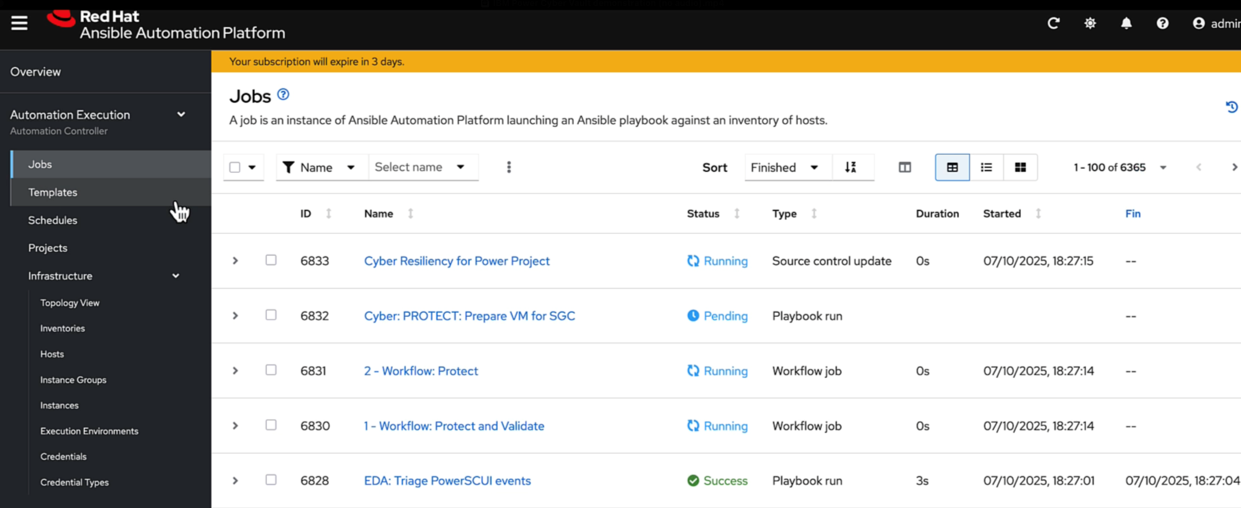
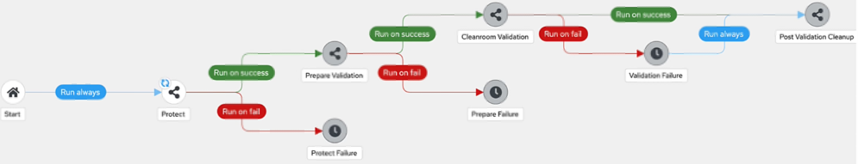
Protect and Validate – triggered via cyber event
PowerSC automatically triggers the Protect and Validate template we saw previously

Slide 44
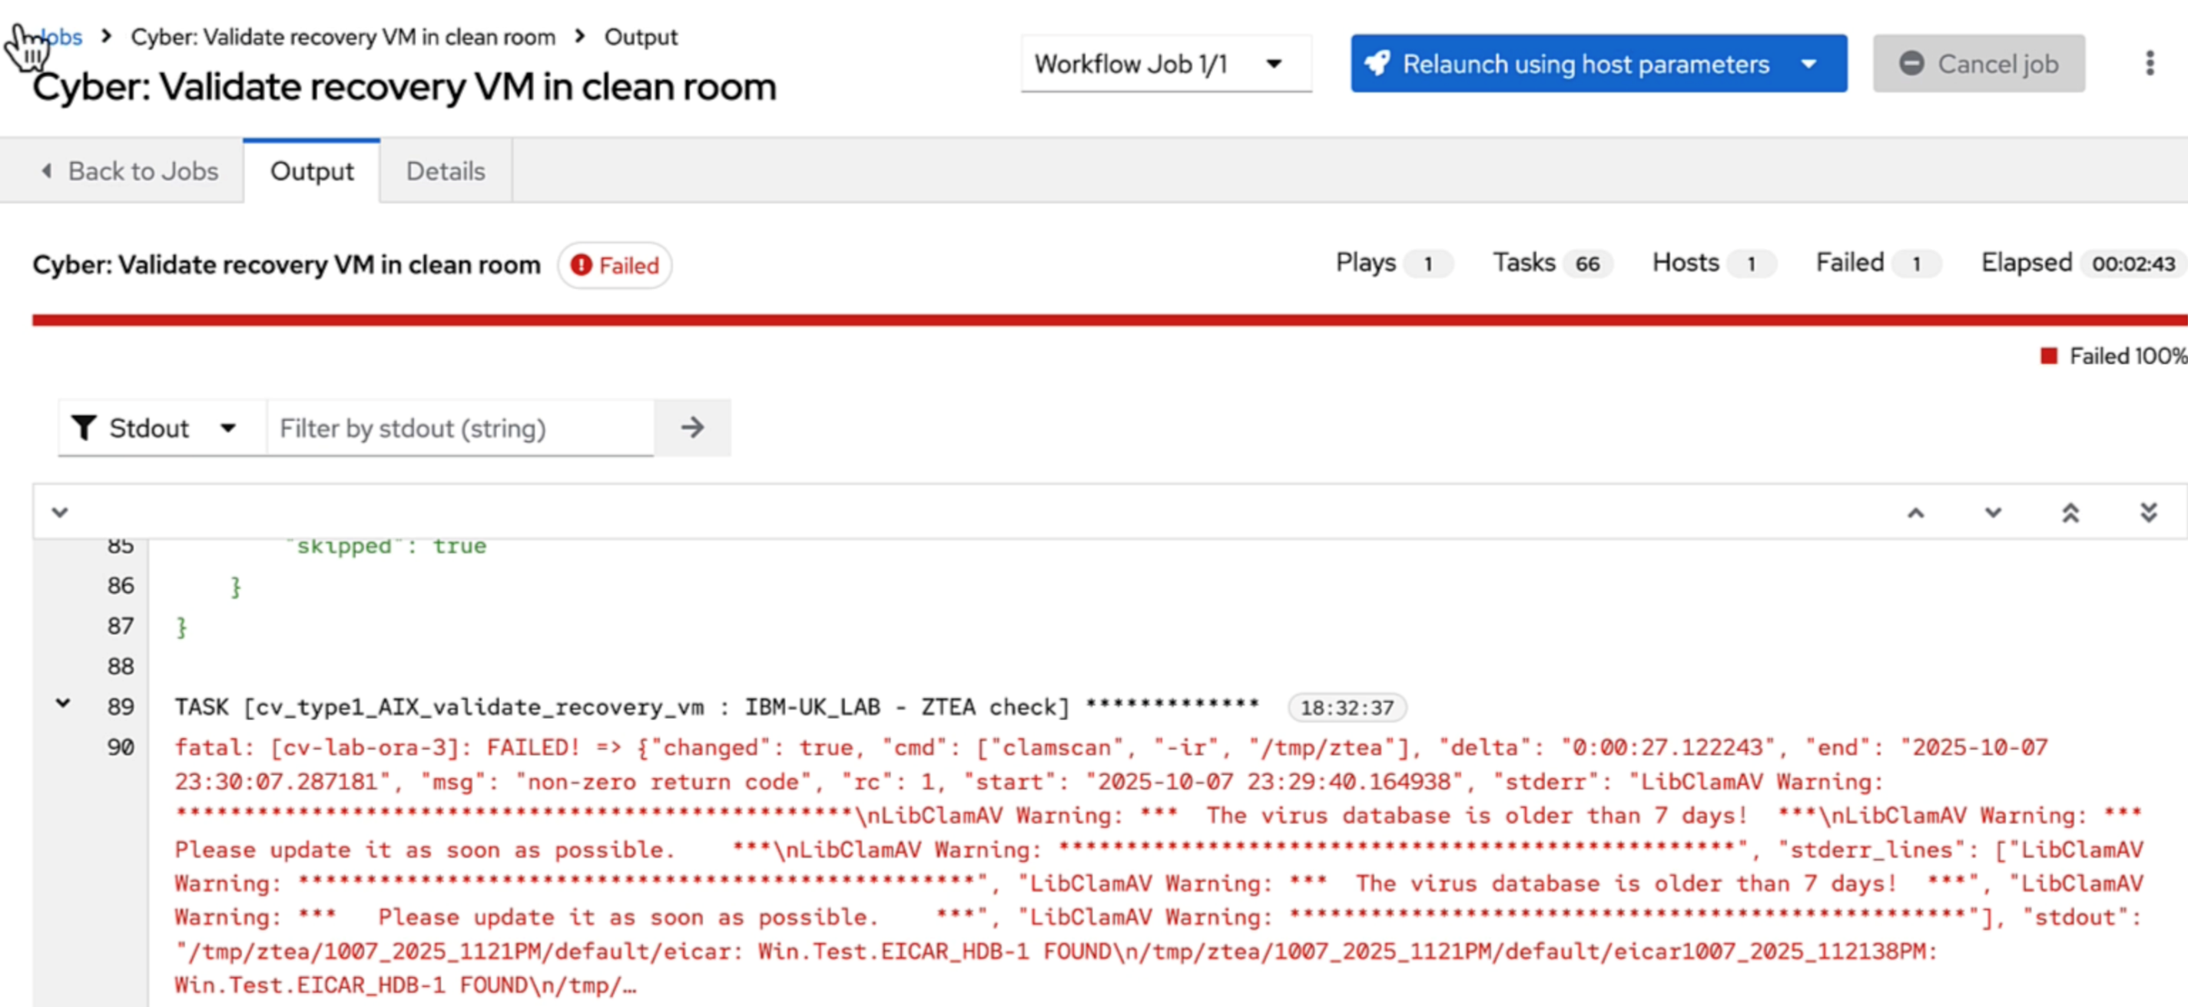
Protect and Validate – triggered via cyber event
As we’d expect due to the malware, the validation fails. As with previous failures, we do not automatically shutdown the cleanroom LPAR. It is left active for the customer to run forensic analysis to determine the reason for the failure.
We mark that SGC as “Validation Failed”

Slide 45
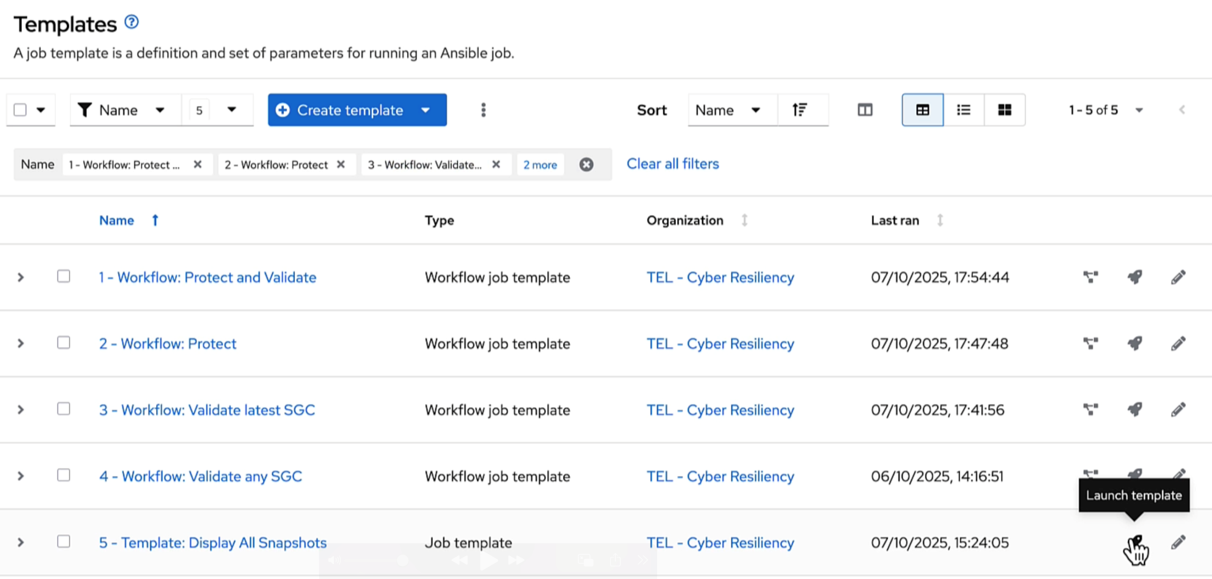
Protect and Validate – triggered via cyber event
Template 5 allows us to view the SGCs for a chosen LPAR along with the time take, retention period and their validation status.

Slide 46
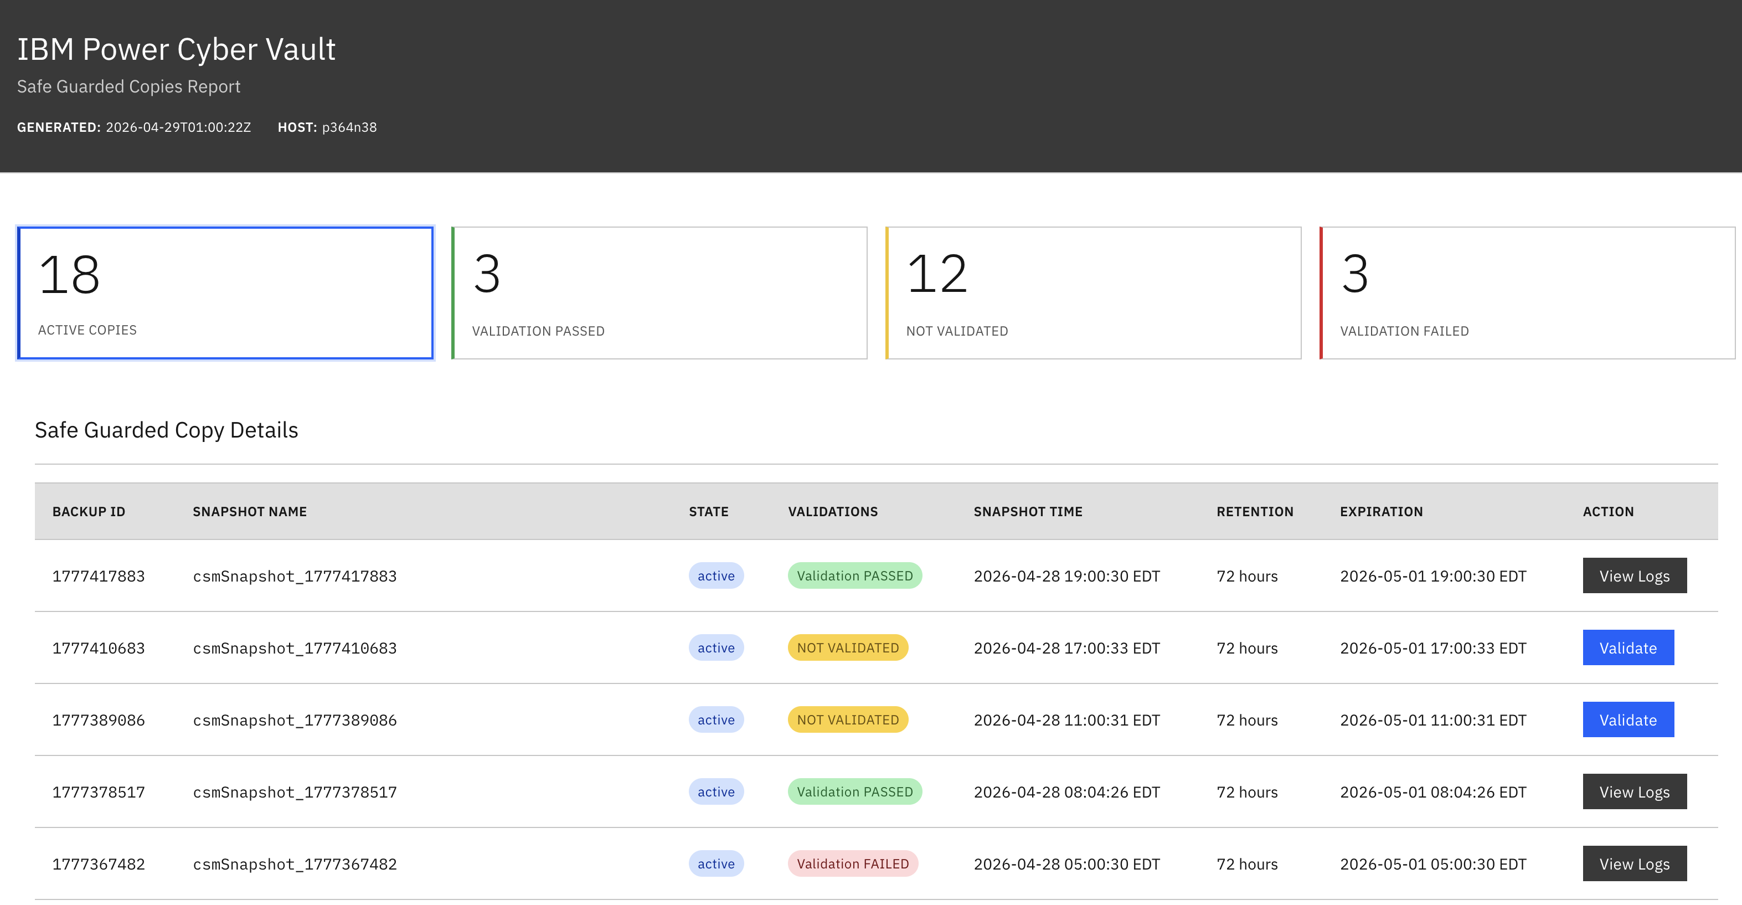
Protect and Validate – triggered via cyber event
Validation status can be “Validation Passed, Validation Failed or Not Validated”.
This allows for customers to plan their cyber recovery from given SGC’s

Slide 47
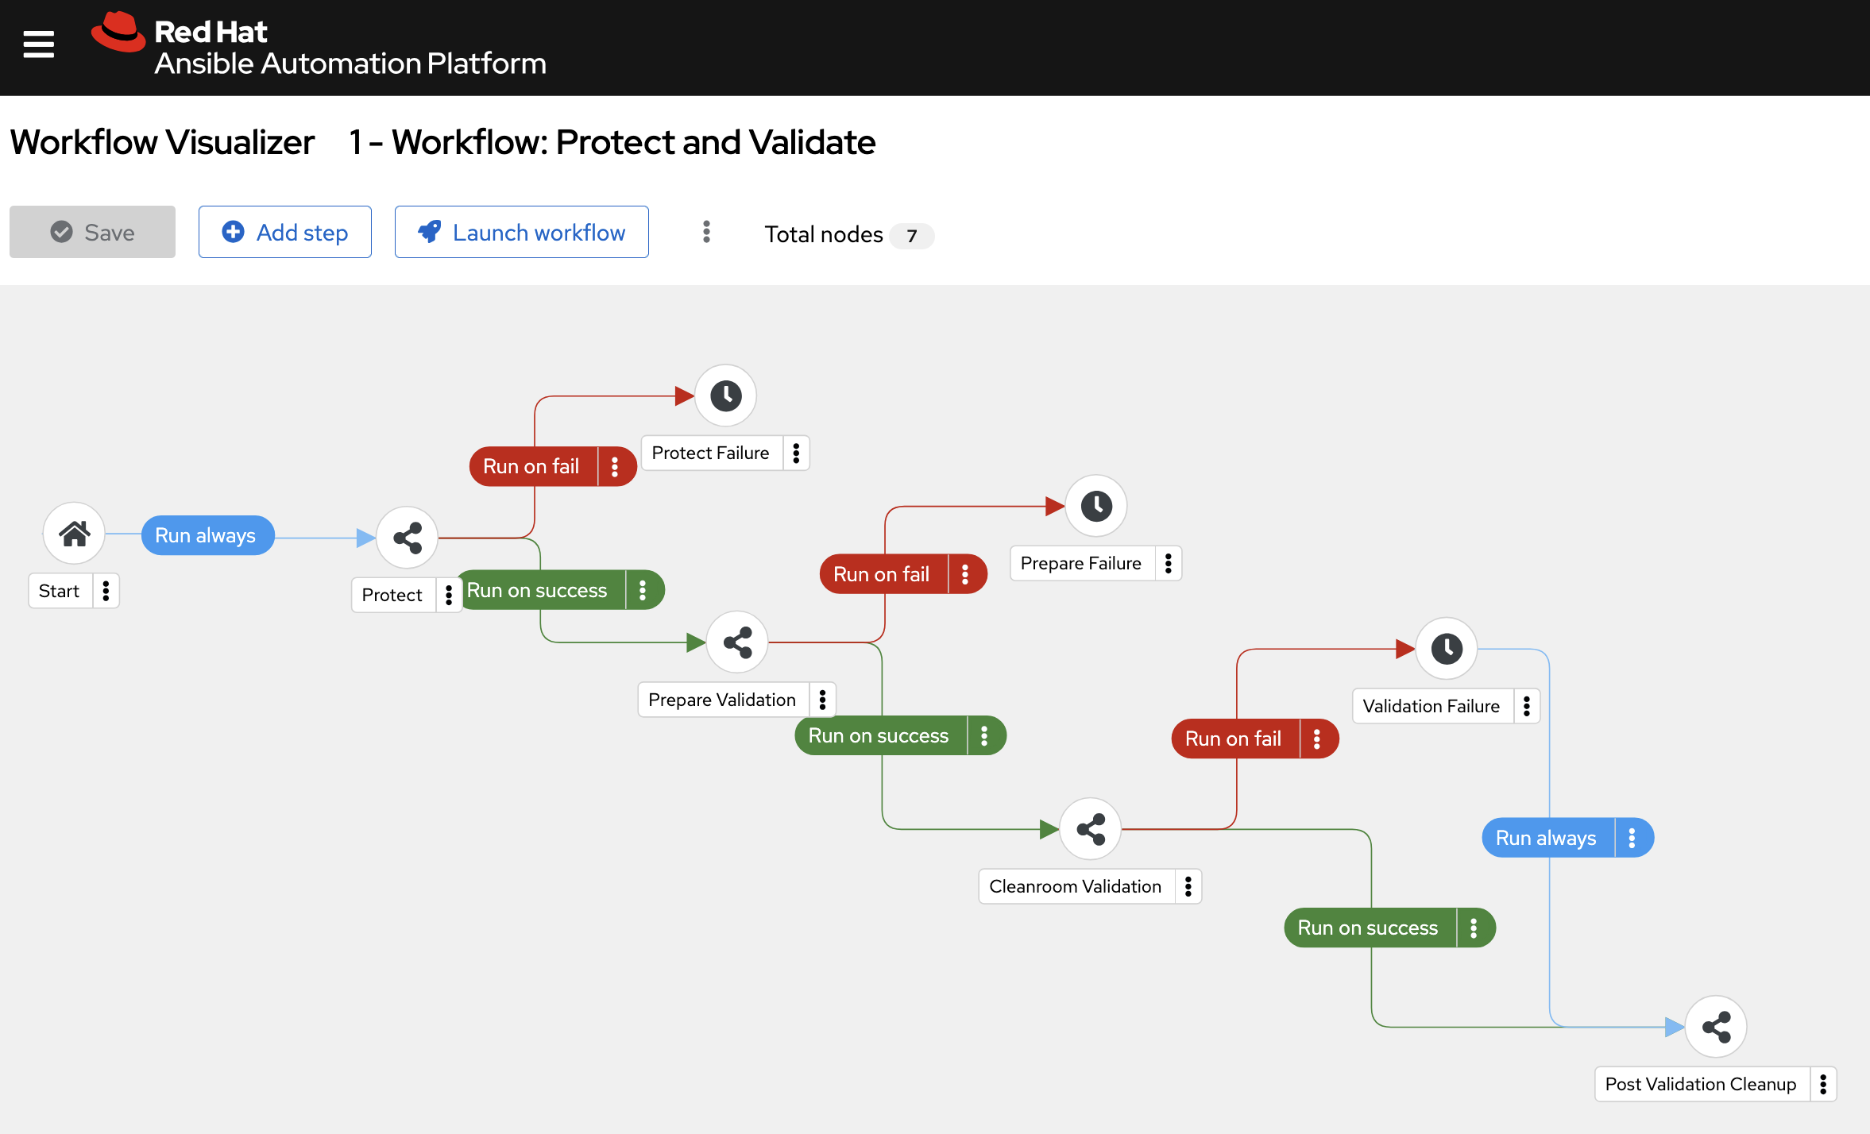
Protect and Validate Workflow

Slide 48
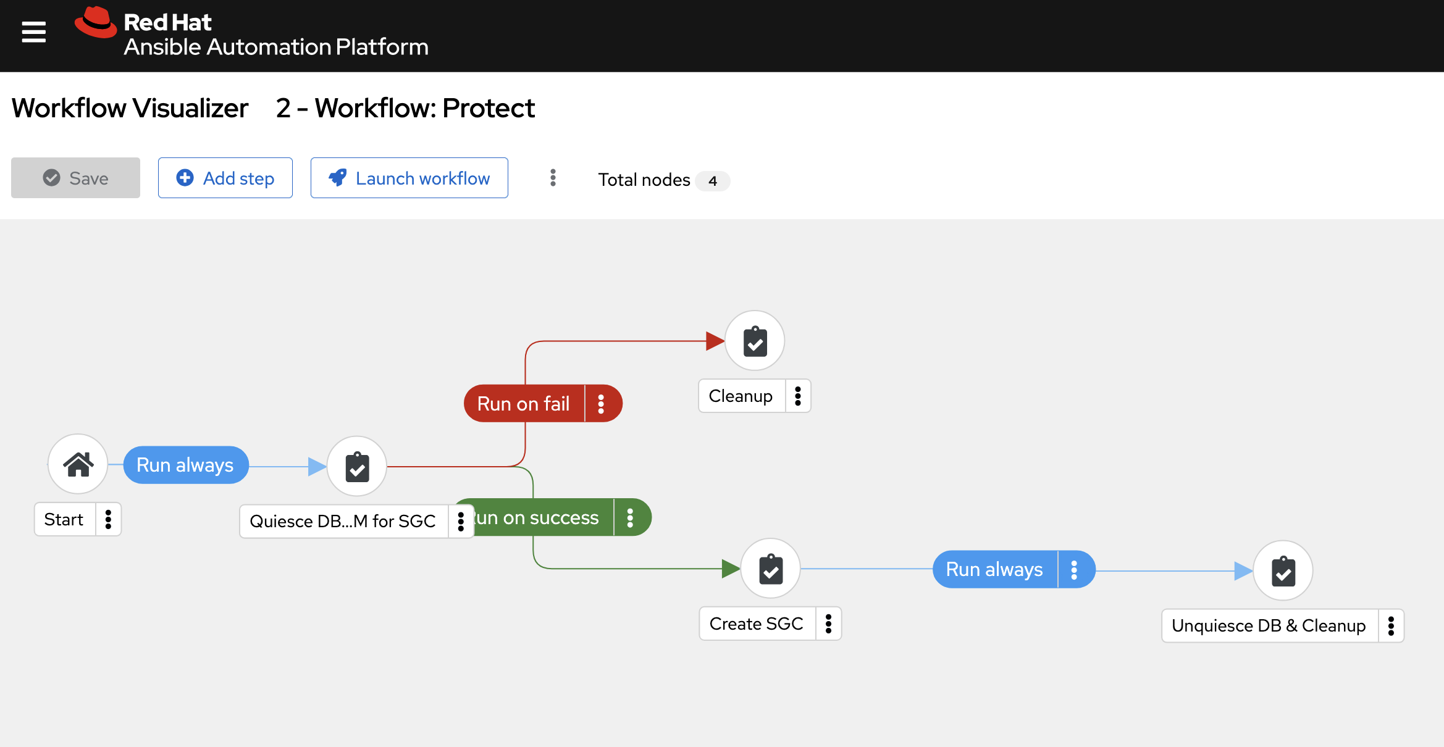
Protect and Validate Workflow

Slide 49
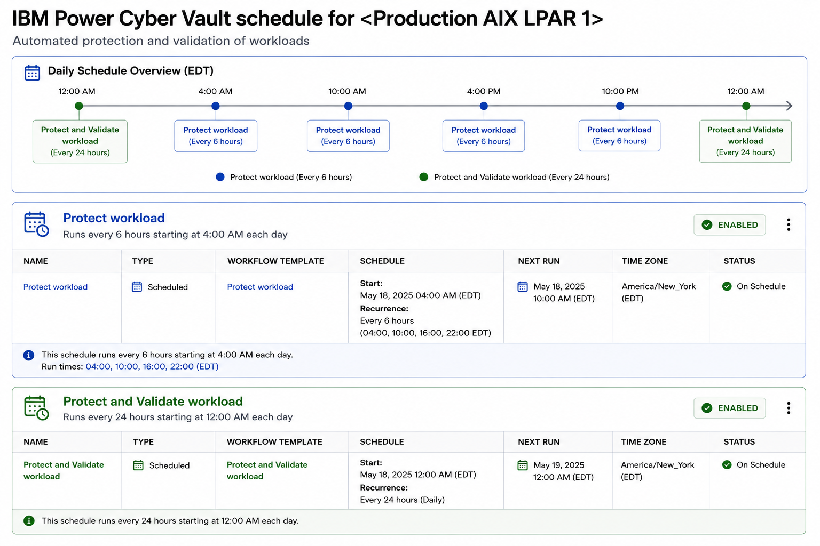
Example Protect and Validate Schedule

Slide 50
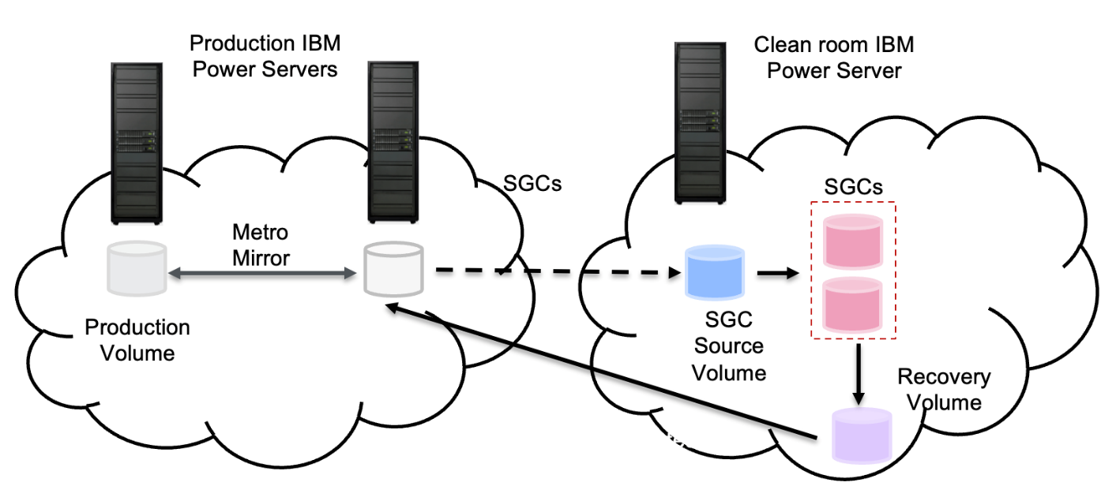
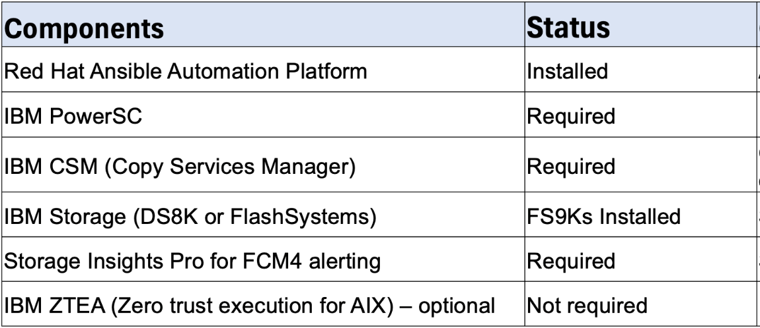
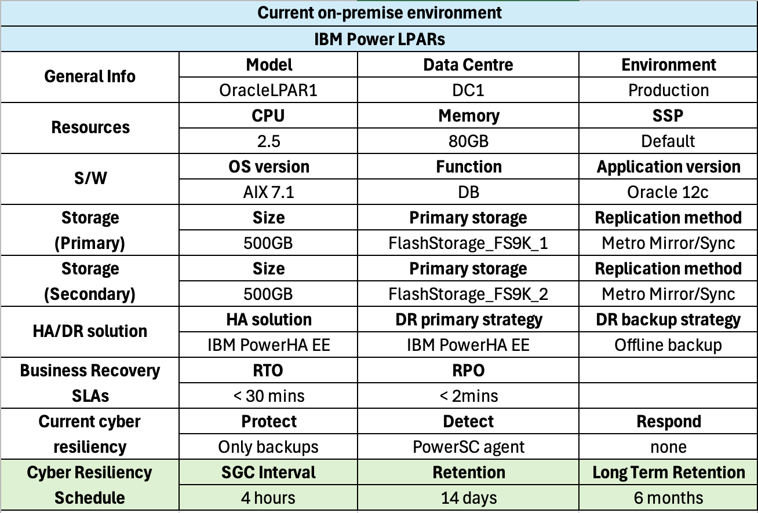
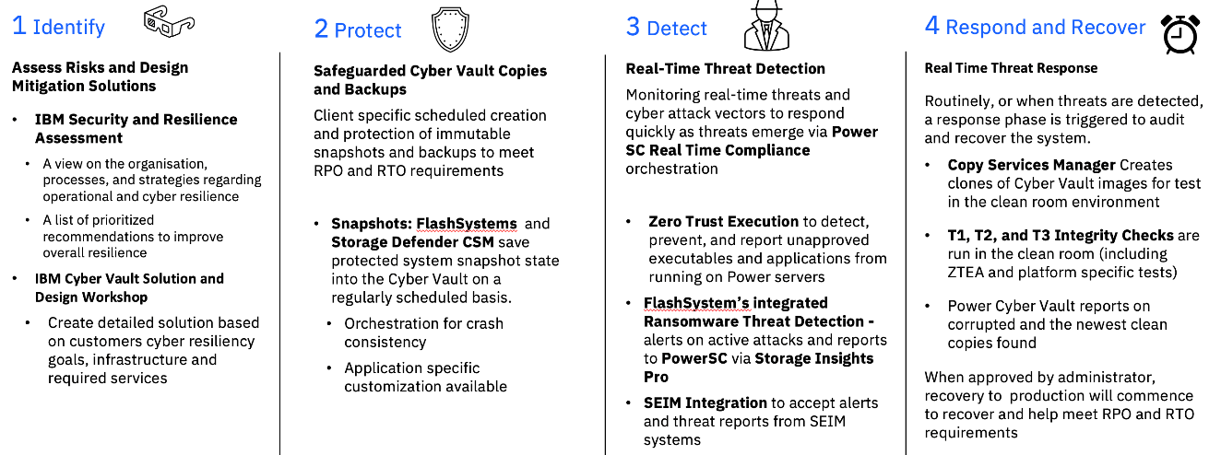
IBM Power Cyber Vault Workshop - Outputs
Final IBM Power Cyber Vault report including:
Proposed solution architecture
Pre-requisites and associated actions
High-level view of critical workloads and recovery requirements
Deployment and testing scope and schedule
50

Slide 51
Summary
Cyber Resilience is everyone’s problem!
Latest reports show increase in active ransomware groups and exploitation of public-facing applications
Traditional resiliency solutions will not protect you from cyber attack
One size does not fit all. This is a journey.
What level of validation do you need?
Free workshop with IBM Technology Expert Labs to plan and implement the right solution to fit your needs

Slide 52
Thank you!
David Spurway
IBM Power AI and Security Principal, EMEA, IBM Technology
Email: david.spurway@uk.ibm.com
LinkedIn: @David Spurway

Slide 53
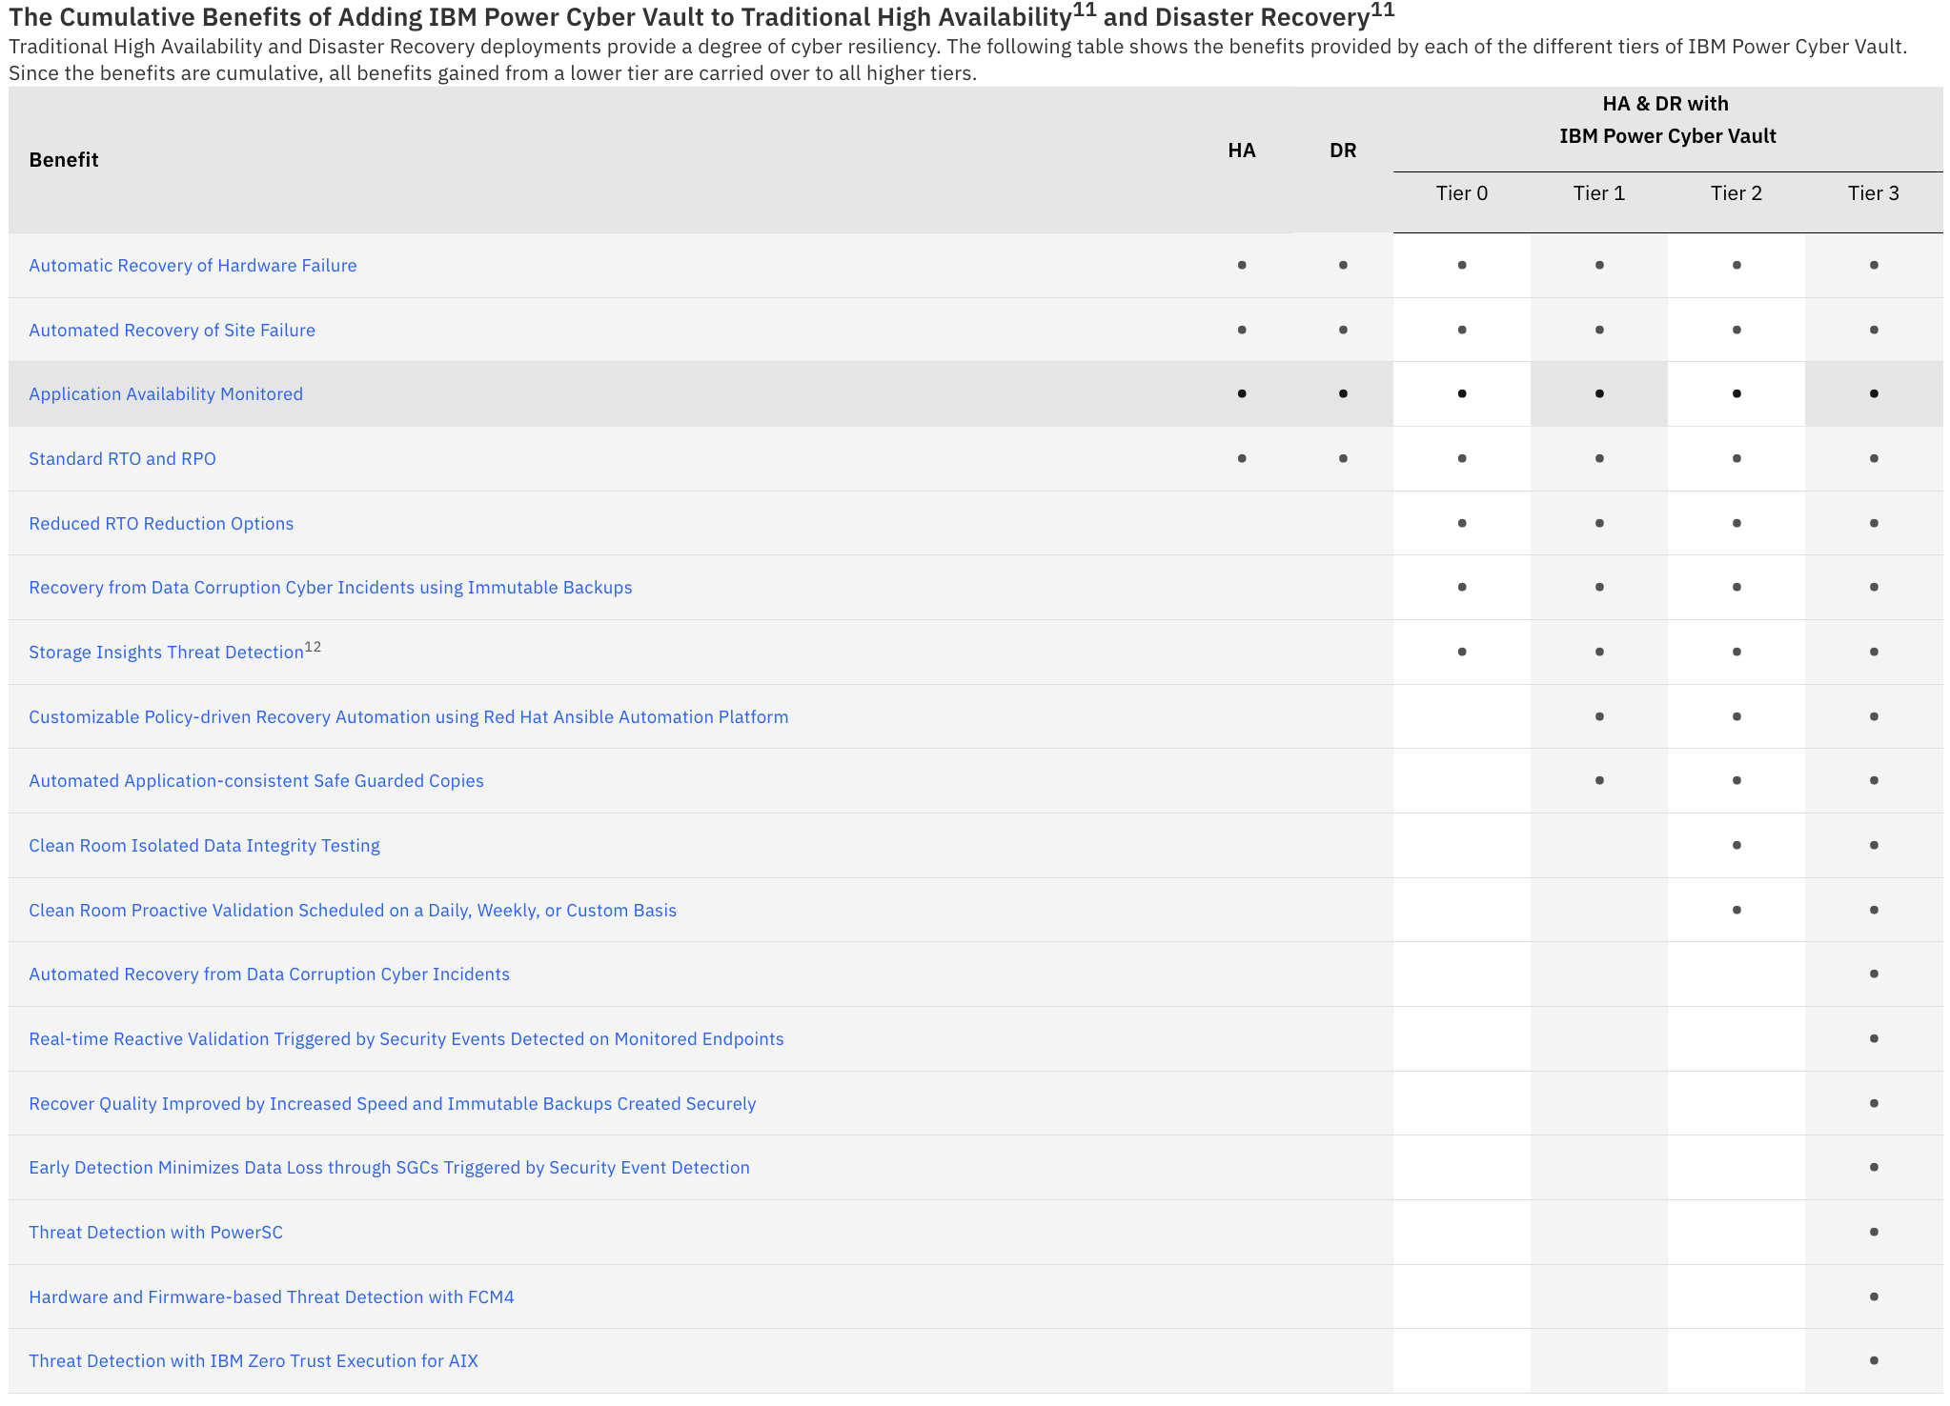

IBM Power Cyber Vault for AIX Website (http://ibm.biz/ibm_pcv)
IBM Power Cyber Vault Videos
IBM Power Cyber Vault for AIX - Frequently Asked Questions

