Slide 1


It’s How You Say It: A Guide To Effective Public Speaking

Slide 2
Developing Your Voice
‘It’s not just what you say, but how you say it…’
‘Tech skills get you on track, but communication skills get you across the finish line.’
Jessica A Mitsch

Slide 3
Developing Your Voice
AWARENESS of ourselves is essential.
Fluency impresses but INTENTION influences/convinces.

Slide 4



Communicate
Connect

Slide 5
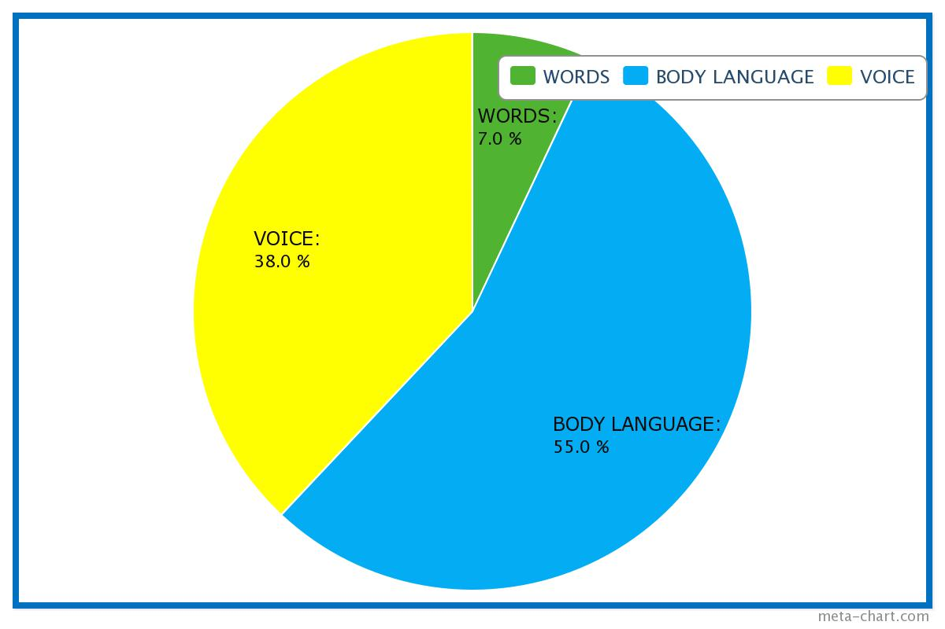
Developing Your Voice

Slide 6
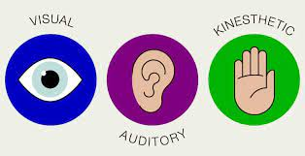

Slide 8
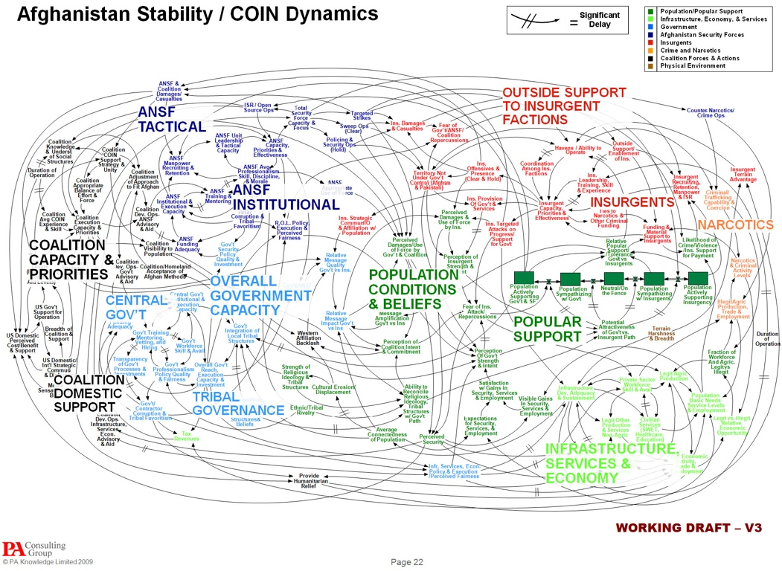
Notes:
Same point about visuals
Pentagon - chaos

Slide 9
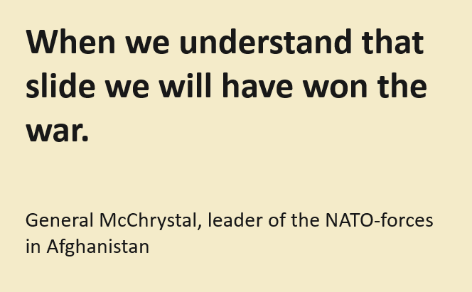

Slide 10
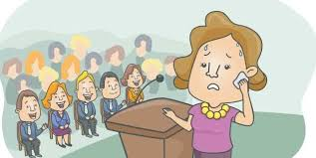
Handling Nerves

Slide 11
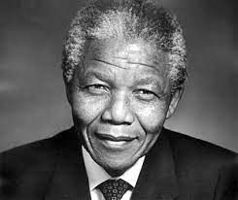



Slide 12

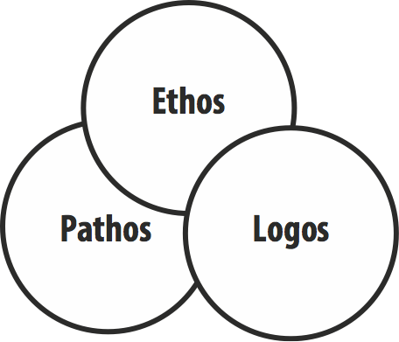
Notes:
What are they?
Ethos – establishing authority to speak on a subject – knowledge, experience etc. credibility
Logos – logical argument for your point
Pathos – the way you sway your audience emotionally.
Need ELP (need help) 3 points to be effective and memorable

Slide 13
Glossophobia
DO:
Know your content – prepare & rehearse
Visualise yourself giving the speech (see audience as an ally)
Start strong (and loud) – memorise opening
Commit to being a speaker
(Admit nervousness)

Slide 14
Glossophobia
DO:
Look after your voice – stay hydrated
(Use visual aids/crib sheets)
Use personal thoughts/experience – it helps you engage

Slide 15
Glossophobia
Don’t:
Desire to finish asap
Overlook your audience – use them
Avoid pauses
Worry about mistakes/stumbles
Self-criticise

Slide 16
Glossophobia
DO:
Warm –up – physically & vocally
Improve technique – physical and rhetorical

Slide 17
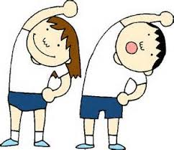
‘The body must work first: then comes the voice.’ Grotowski
Physical warm-up = relaxation + energising
Correct breathing for vocal support
Vocal warm-up

Slide 18
She sees cheese.
Truly rural.
A happy hippo hopped and hiccupped.
Twelve twins twirled twelve twigs.
A snake sneaks to seek a snack.
Six Czech cricket critics.

Slide 19

Pitch
Resonances:

Slide 20
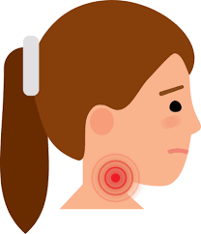
Pitch
Resonances:

Slide 21
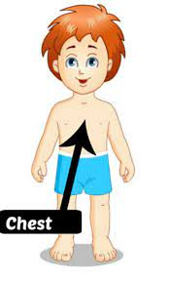
Pitch
Resonances:

Slide 22
Pitch
Resonances:
??????

Slide 23

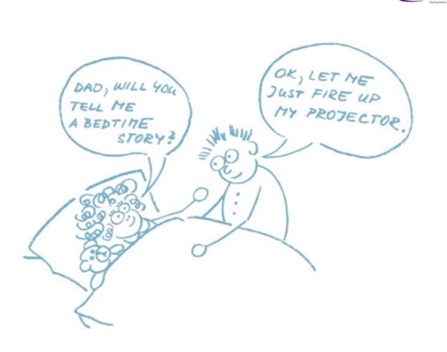
“
You can speak well if your tongue can deliver the message of your heart.” John Ford

Slide 24
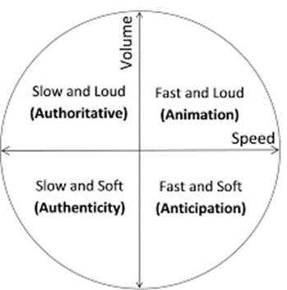
Vocal variation

Slide 25
Slow Down
Learning to slow down when speaking
Mark a paragraph / in this manner / into the shortest possible phrases. / First, / whisper it / with energetic lips, / breathing / at all the breath marks. / Then. / speak it / in the same way. / Do this / with a different paragraph / every day. / Keep your hand / on your abdomen / to make sure / it moves out / when you breathe in / and moves in / when you speak.

Slide 26
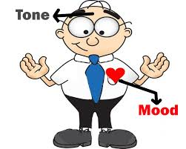
Paralinguistics
Tone – intention
Volume – projection
Speed/ Rythmn pausing

Slide 27
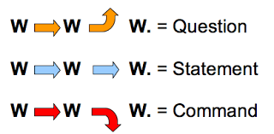
Paralinguistics
Intonation =
              Word stress
              Inflection – rise and fall pattern

Slide 28

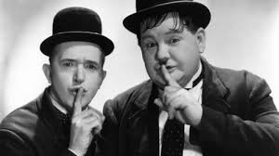
Rhetorical devices
Repetition. Repetition. Repetition
The power of silence

Slide 29
Developing Your Voice
‘It usually takes me more than three weeks to prepare a good impromptu speech.’
There are only two types of speaker in the world. 1. The nervous and 2. Liars.’
Mark Twain

Slide 30
Exercise
The most hunted person of the modern age
(This speech was delivered at Westminster Abbey on September 6 1997)
I stand before you today, the representative of a family in grief, in a country in mourning, before a world in shock.
We are all united, not only in our desire to pay our respects to Diana, but rather in our need to do so.
For such was her extraordinary appeal that the tens of millions of people taking part in this service all over the world, via television and radio, who never actually met her, feel that they, too, lost someone close to them in the early hours of Sunday morning. It is a more remarkable tribute to Diana than I can ever hope to offer her today.

Slide 31
Exercise
Hillary Clinton Speech
Women's Rights are Human Rights
Mrs. Mongella, Under Secretary Kittani, distinguished delegates and guests:
I would like to thank the Secretary General of the United Nations for inviting me to be part of the United Nations Fourth World Conference on Women. This is truly a celebration - a celebration of the contributions women make in every aspect of life: in the home, on the job, in their communities, as mothers, wives, sisters, daughters, learners, workers, citizens and leaders.

Slide 32
I am almost afraid; though I know the night
Lets no ghosts walk in the warm lamplight.
Yet ghosts there are; and they blow, they blow,
Out in the wind and the scattering snow.-
When I open the windows and go to bed,
Will the ghosts come in and stand at my head?

