Slide 1

One School. One Vision.
Creating Coherence Across Dual Language and Traditional Programs
Caroline Baker, Randall Saenz, Juli Ventura
June 5, 2026 | https://bit.ly/GlobalLeadersPD
Notes:
Caroline

Slide 2
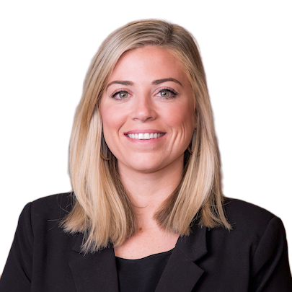
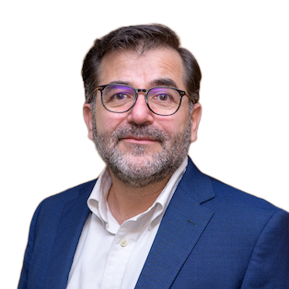

Meet the Presenters
Caroline Baker
Program Manager
Global Leaders
Participate Learning
Randall Saenz
Program Manager
Dual Language
Participate Learning
Juli Ventura
Principal
Jeffreys Grove Magnet ES
Wake County Public Schools

Slide 3
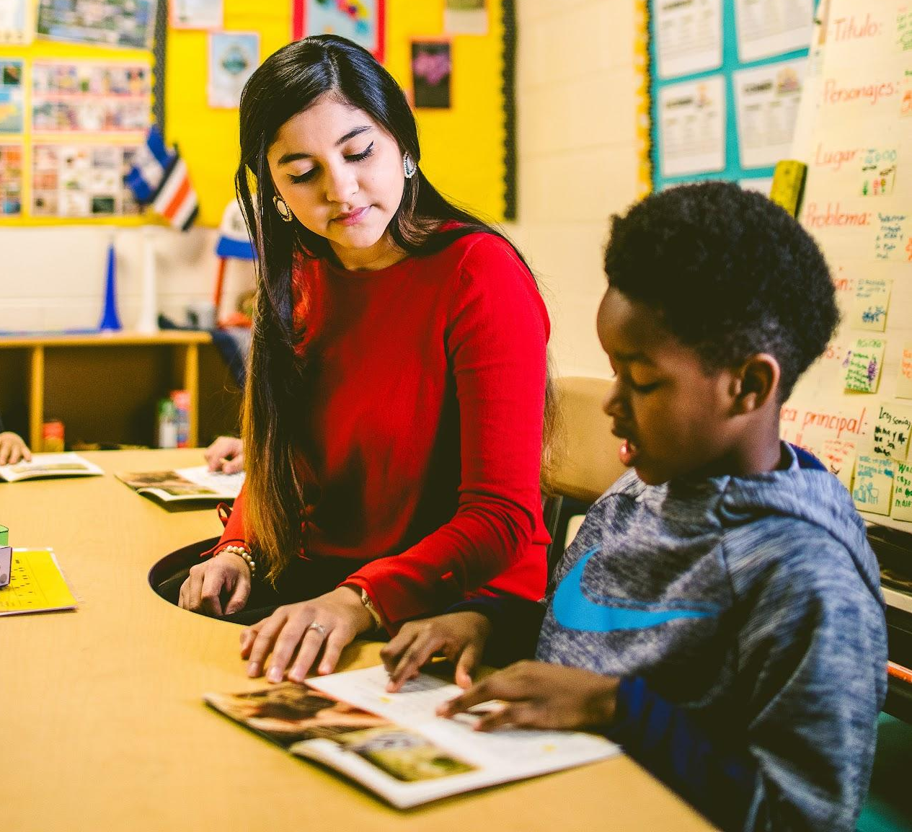
Our Mission
To create global, cultural, and language experiences that prepare students to become globally competitive for their future careers and success.

Slide 4
Opening
What is your vision for your school?
How does your DLI program fit within that vision?
What challenges are you facing in making your vision a reality?
Notes:
One minute of quiet think time. Two minutes to share

Slide 5
Common Challenges
School within a school
Limited collaboration
Global learning seen as “for DLI only”
Strong language outcomes but lacking a unified school identity

Slide 6
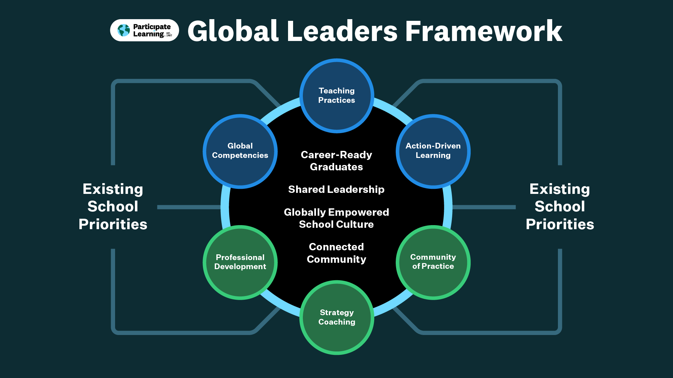

Slide 7
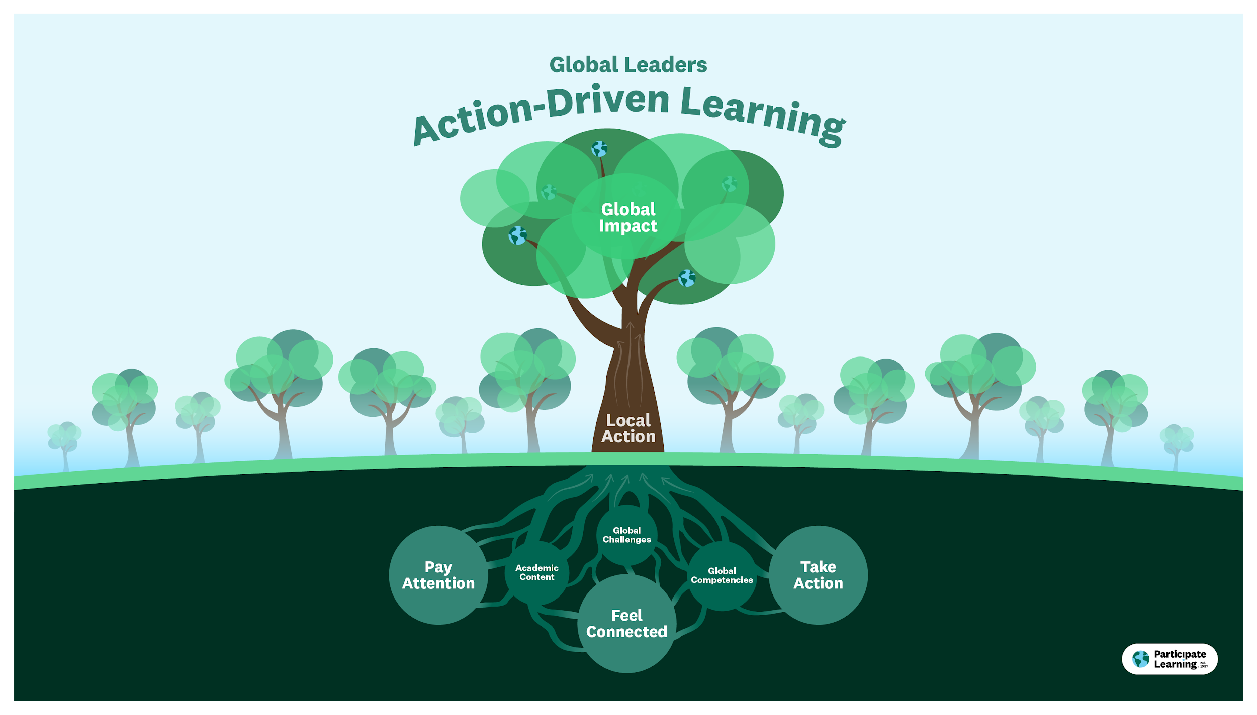
Notes:
Grounding for how we approach this work. This is our version of “when you put all the pieces together, this is what we hope happens.

Slide 8
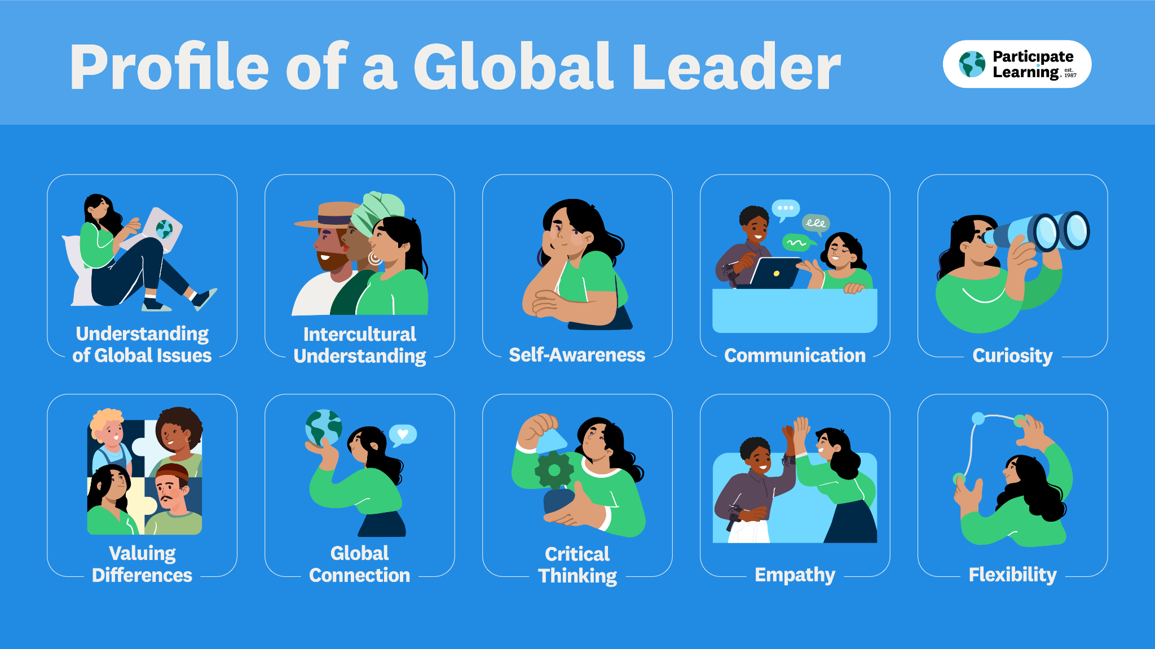
Notes:
Front and back printed handout with the blueprint

Slide 9
Bringing the Juice to You

Slide 10



Slide 11

Meet Jeffreys Grove
Spanish Language Immersion Magnet School in Wake County, North Carolina
Notes:
Tell us a bit about Jeffreys Grove - What population of students do you serve? What do you love most about your school?
1st Dual Language School in WCPSS
Half students are in dual language
Built parent support throughout course of the time there

Slide 12
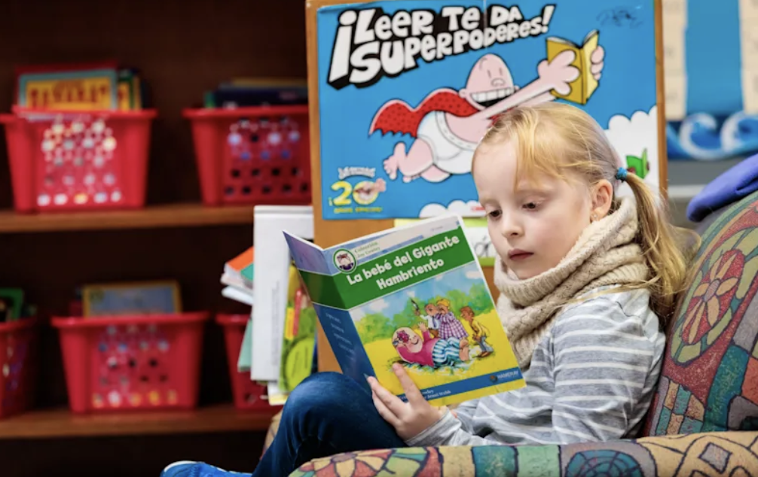
What was Jeffreys Grove like before Global Leaders?
Notes:
What did DL look like before Global Leaders?
How did DL fit in within the school’s vision before Global Leaders?
What challenges were you facing?
Parents, students, teachers
School felt like two distinct schools. Teachers had different experiences. Curriculum differences, not always following the same pacing. Data was hard to look at together because they weren’t teaching at the same time.

Slide 13

What did you hope Global Leaders would bring to your school?
Notes:
When you found out you were getting Global Leaders, what kind of concerns did you have?
What kind of hopes did you have?
How did you see that play out?
Vision: students meet full potential and will graduate with opportunities. One of the pillars is knowledge and skills, that is where global leaders comes in with the global competencies.

Slide 14
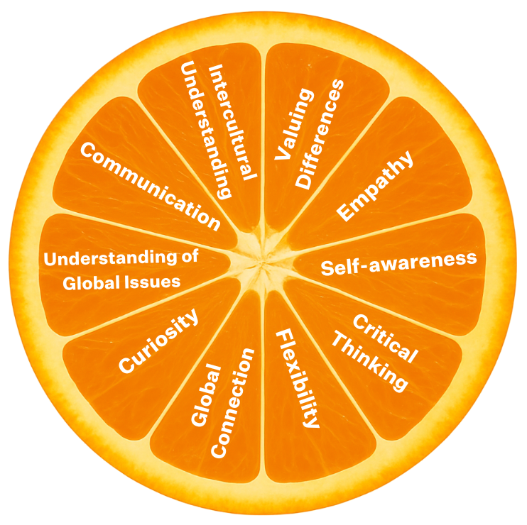
La Media Naranja:
Two halves becoming a whole
Notes:
In the past, I’ve heard you use the phrase ‘La Media Naranja,’ two halves becoming a whole, how did that idea shape your vision?
What does it actually look like when every student, not just those in Dual Language, sees themselves as a global learner?
Note: mention the global competencies and fluency beyond languages.

Slide 15
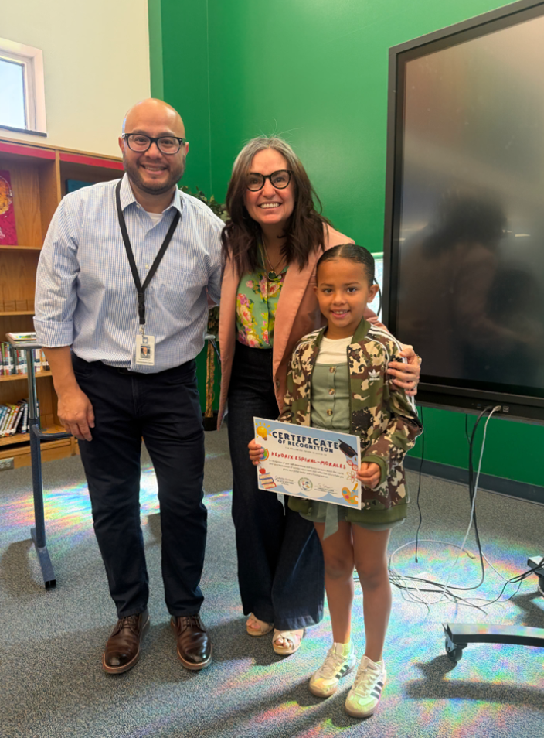
How did you make your vision a reality?
Notes:
A lot of people are probably thinking, ‘This sounds great… but how did you actually do it? What was your very first step in introducing Global Leaders across the school?
Was there any resistance at the beginning? How did you navigate that?
What resources or strategies have been most supportive for your school?

Slide 16
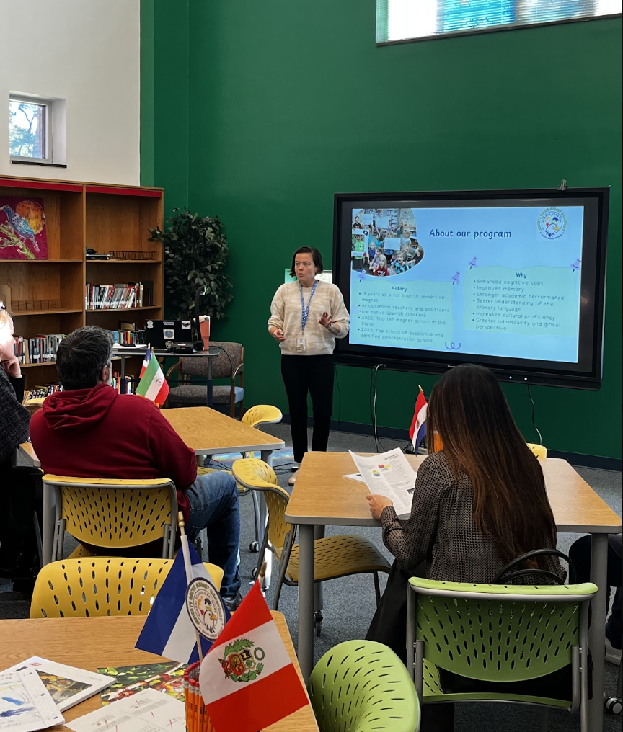
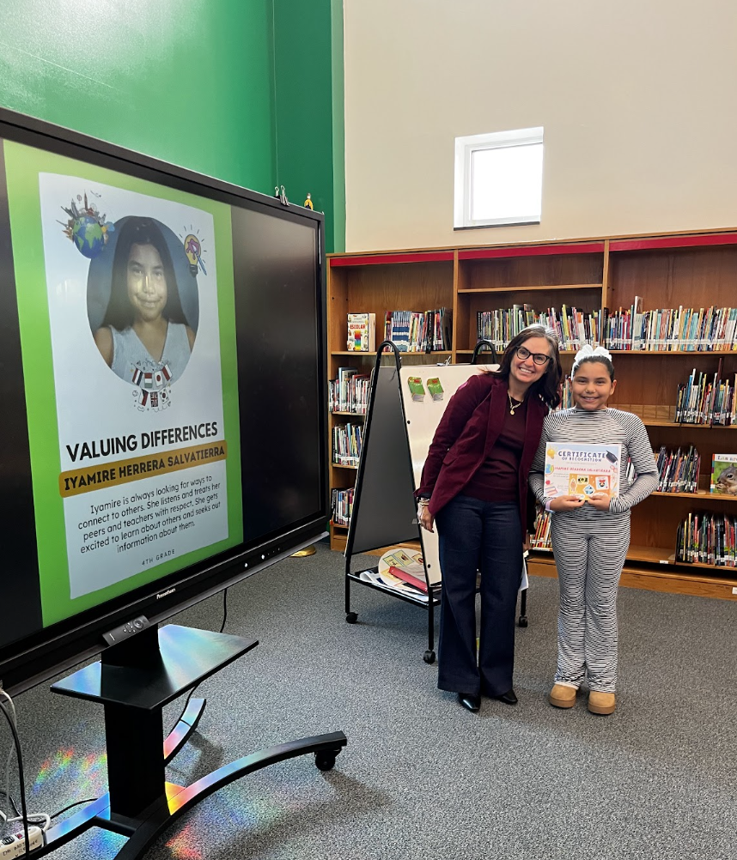
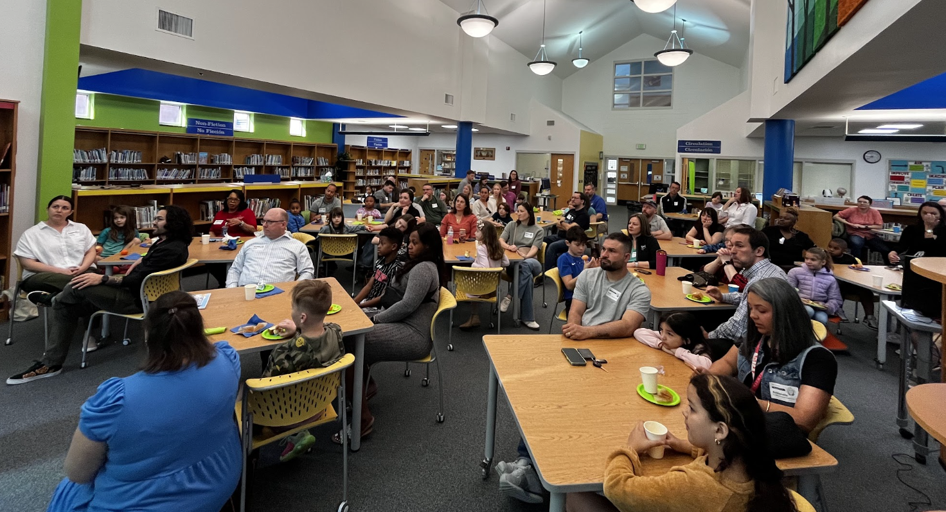
Notes:
Professional learning
Impact on students (recognition)

Slide 17
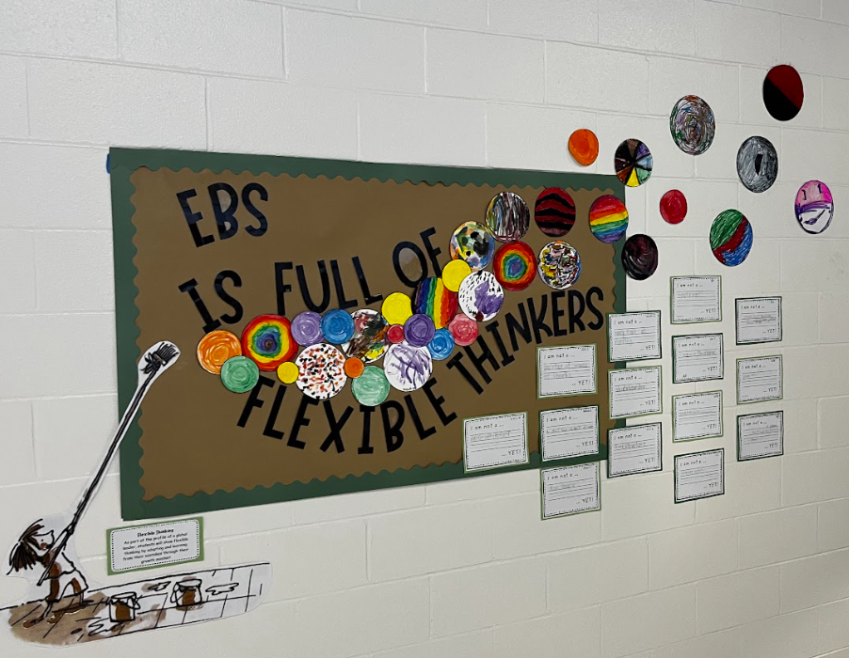
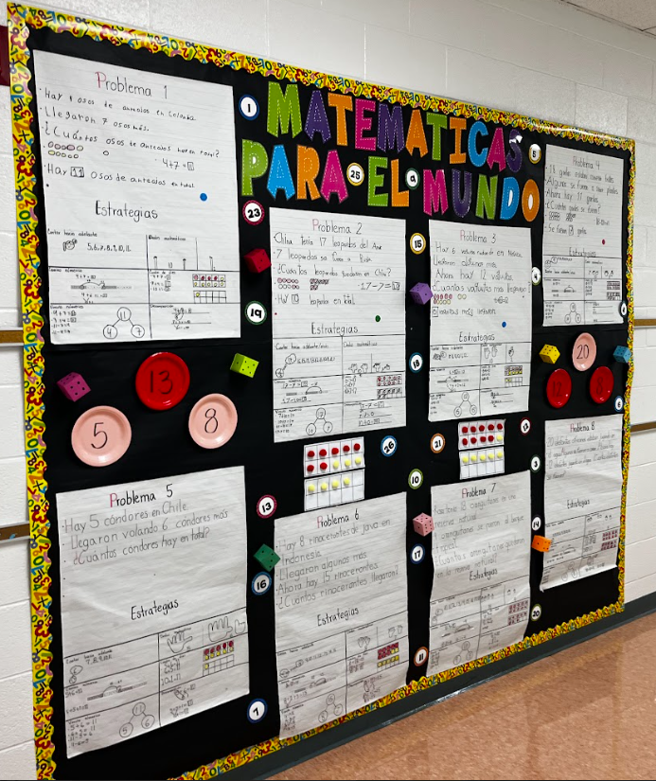
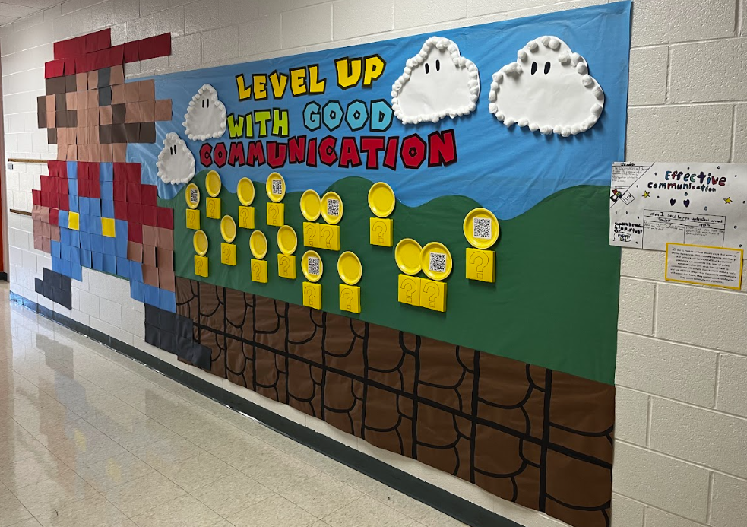
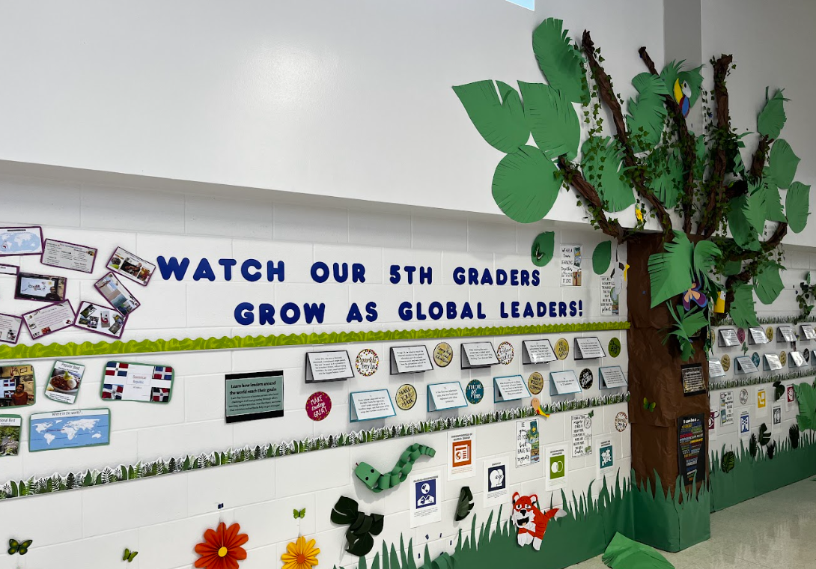
Hallway Displays

Slide 18
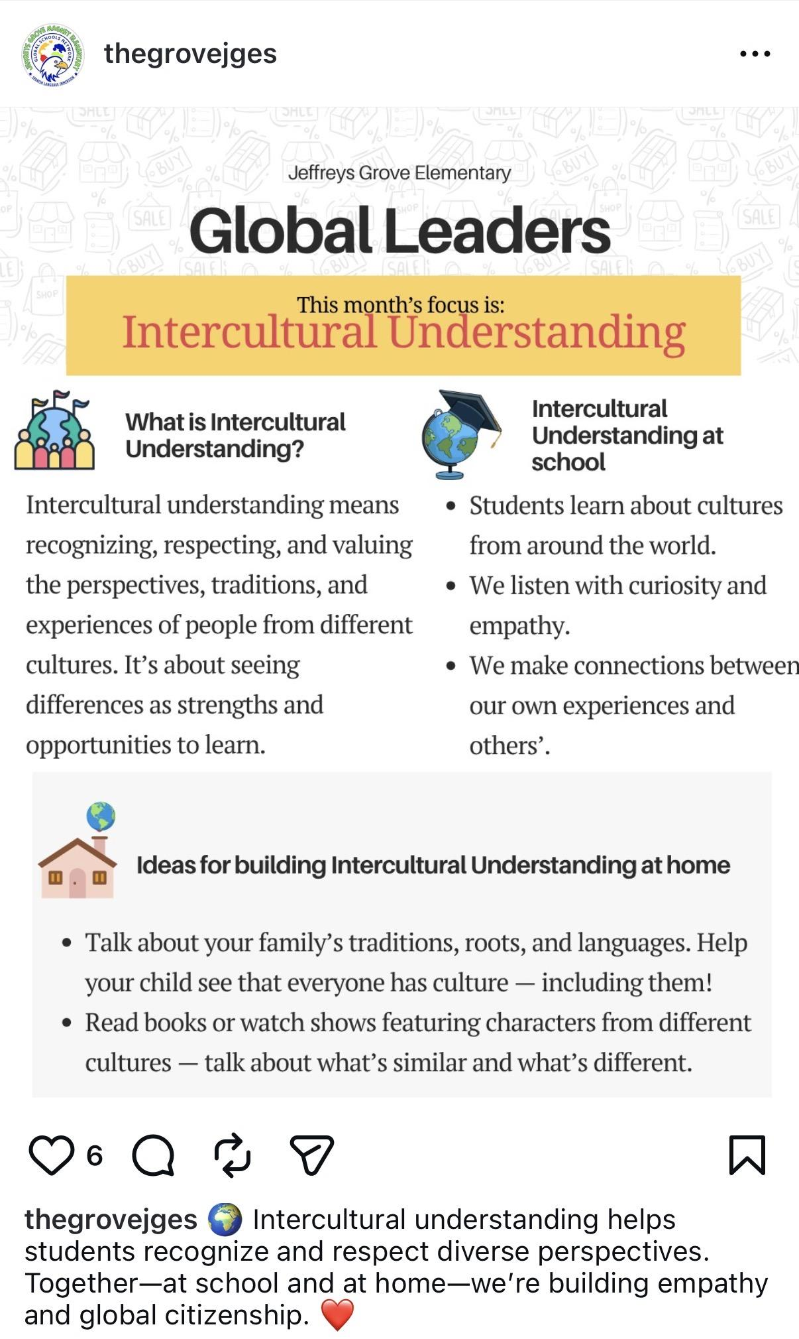
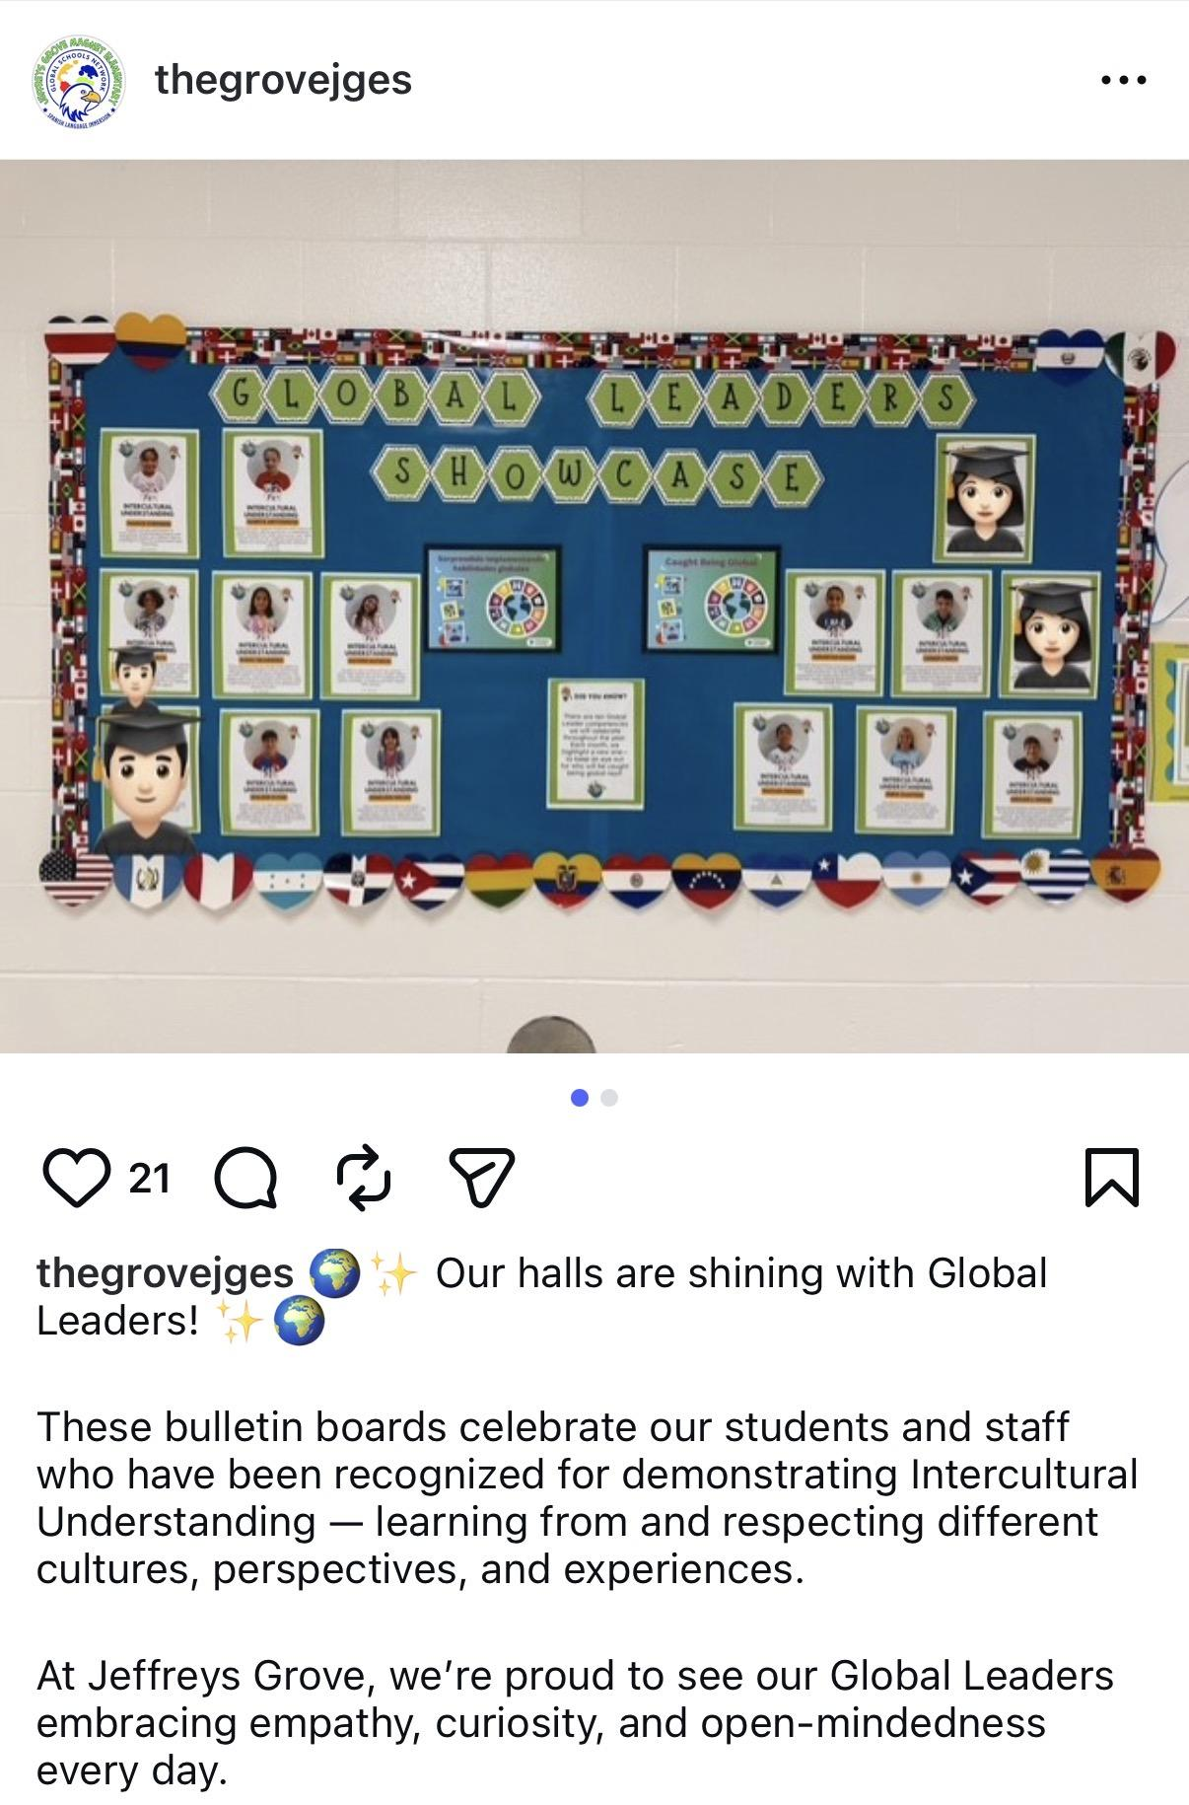
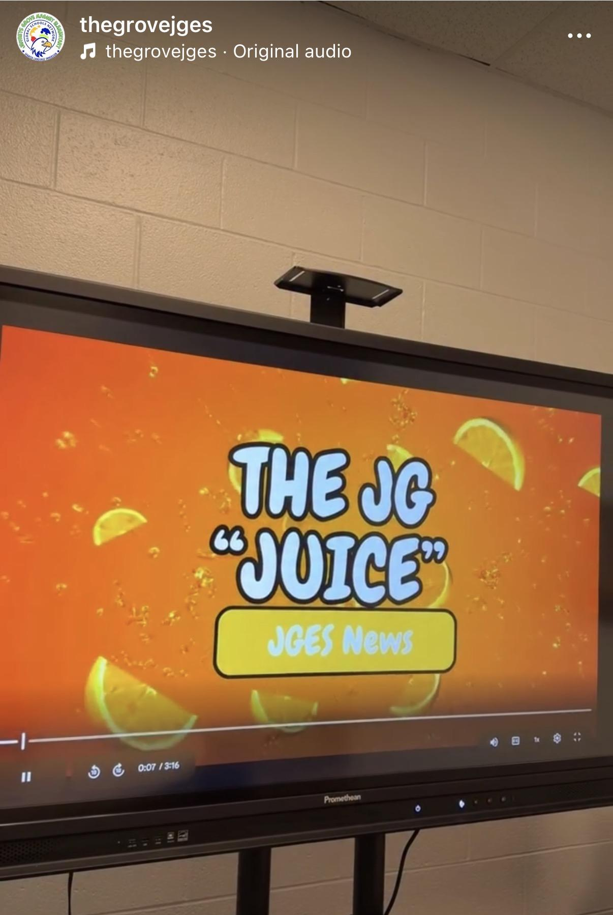
Socializing Global Efforts

Slide 19
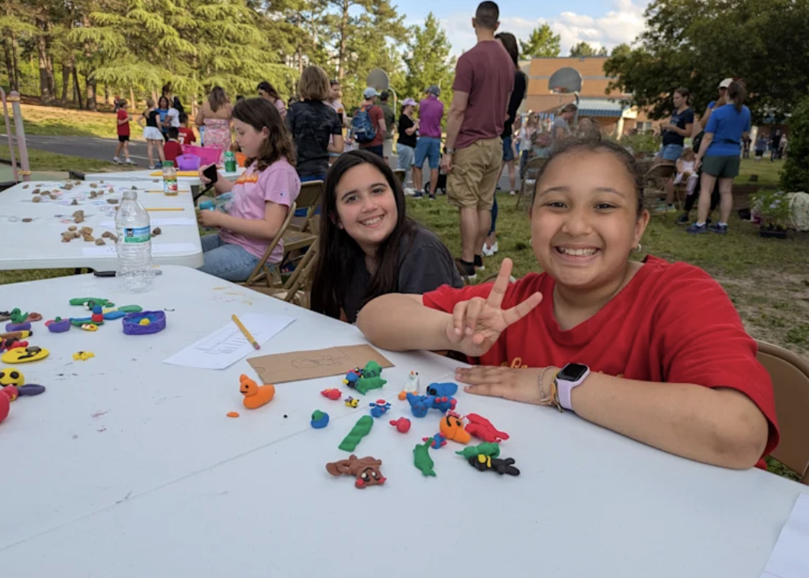
What impact have you seen so far?
Notes:
How has the implementation of Global Leaders impacted how DL and non-DL teachers collaborate?
Tell us about the impact Global leaders has had on both DL and non-DL students?
How has the implementation of Global leaders been taken by parents?
What indicators of success do you have your eye out for? What have you seen so far?

Slide 20
What is next for Jeffreys Grove?
Global
Competencies
Global Challenges
Student Action
Notes:
As we think about what's next for Jeffreys Grove, our focus is really on deepening the work we've already started.
We've spent the last few years building a shared language around the global competencies, and now we're working to make sure those competencies aren't something that only happen during a dedicated SEL block. We want them woven throughout the school day and embedded in the academic experiences students are having every day.
One way we're doing that is through our Global-SEL Committee. That team is helping us think intentionally about planning, resources, and how we support teachers in integrating competencies like empathy, critical thinking, communication, and flexibility into their instruction rather than treating them as something separate.
The next step for us is introducing the global challenges and helping teachers connect those real-world issues to the curriculum. We want students to see that what they're learning in the classroom has relevance beyond the classroom.
Ultimately, our goal is to move toward action-driven learning, where students aren't just learning about global issues, but are using their knowledge, skills, and voices to take meaningful action. We want students to see themselves as leaders now, not someday in the future.
At the end of the day, this work is about preparing students for success in school, in their future careers, and as engaged members of their communities. We want every student to leave Jeffreys Grove with the knowledge, skills, and confidence to make a positive impact in the world around them.

Slide 21
Q&A:
Taking Callers
Notes:
Section divider option

Slide 22
Lessons from Jeffreys Grove
Notes:
Section divider option

Slide 23
Strategies to take with you
Make global education the plate
Establish schoolwide ownership
Build collaborative structures
Create shared language
Integrate into the curriculum
Engage Families
Notes:
You’re in here because you’re wanting to build that one school one vision, here’s how Juli did that.

Slide 24
Tool Exploration:
Going Deeper with Global Competencies
Notes:
WHAT: A time to go deeper with global competencies and explore a specific resource that our schools are using to bring this to life with their students.
WHY:
How are global competencies = AI-future readiness?
AI is good at…
retrieving information
generating options
spotting patterns
Humans still need to…
evaluate credibility and bias
navigate cultural and global contexts
collaborate across differences
make ethical decisions with real consequences
apply knowledge to messy, real-world problems
HOW:
We will number off in a moment and give you an opportunity to explore 1 of 3 tools deeply; you will then come together as a group to share your reflections before forming new groups that will allow you to hear about the other 2 tools.

Slide 25
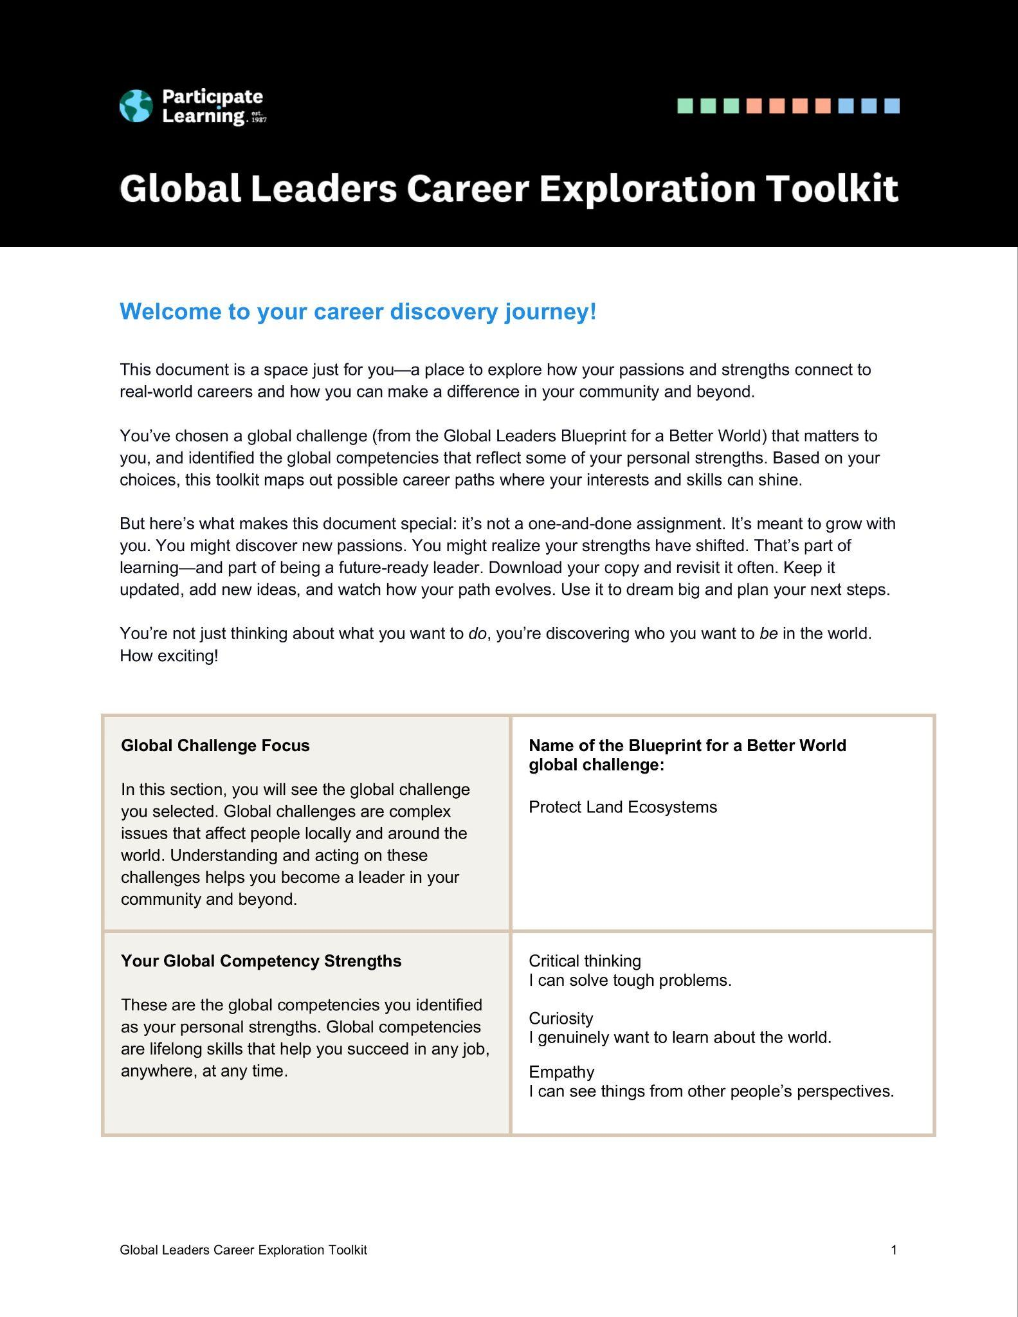
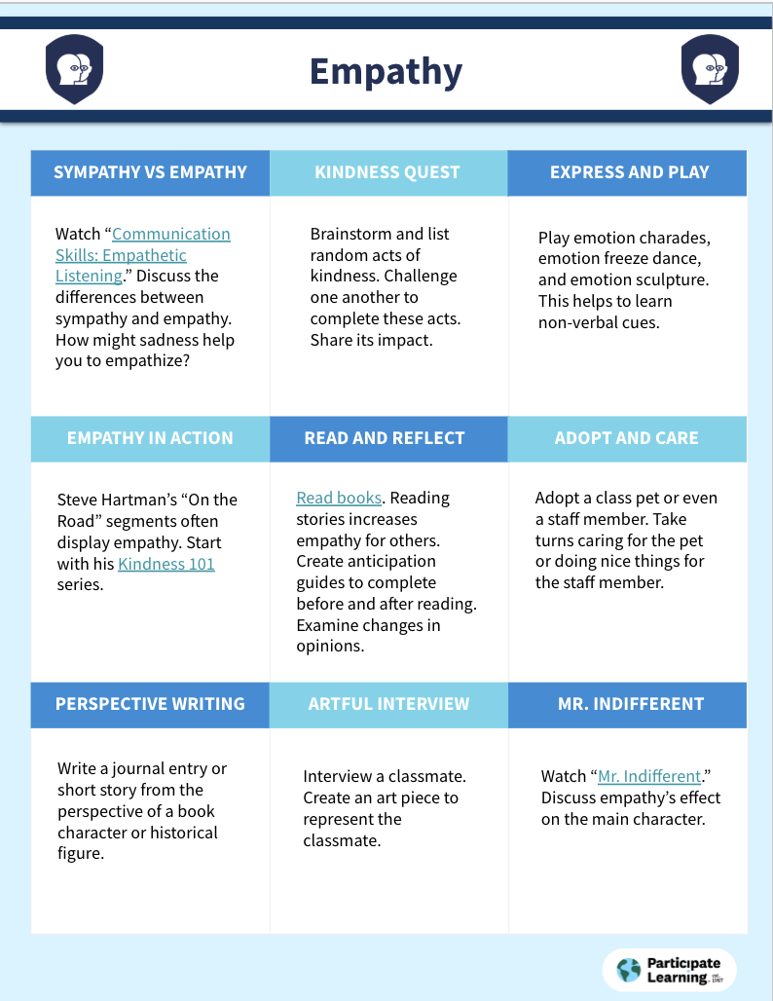
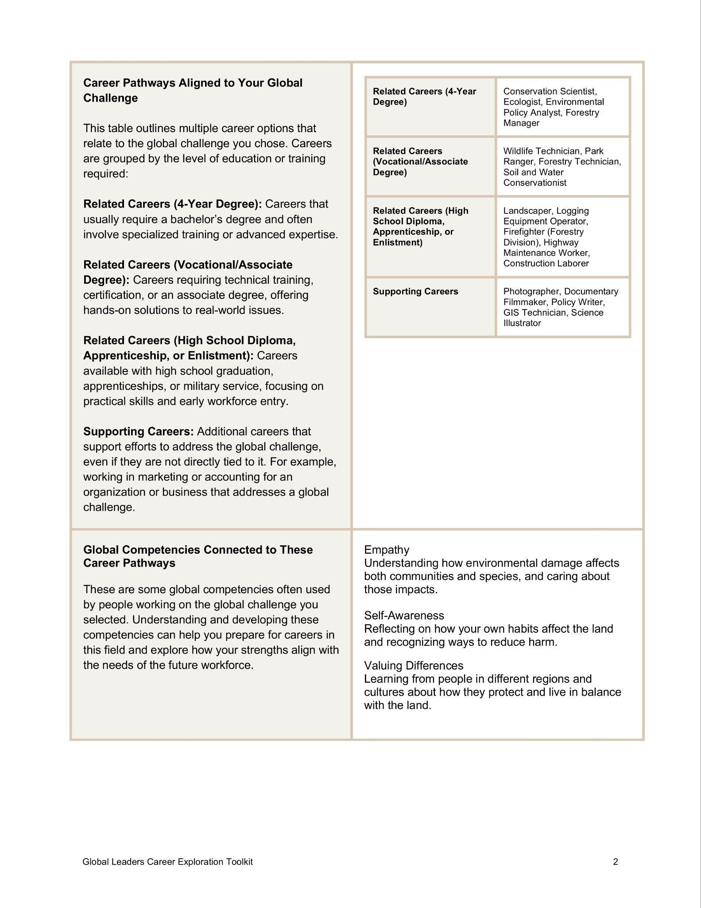
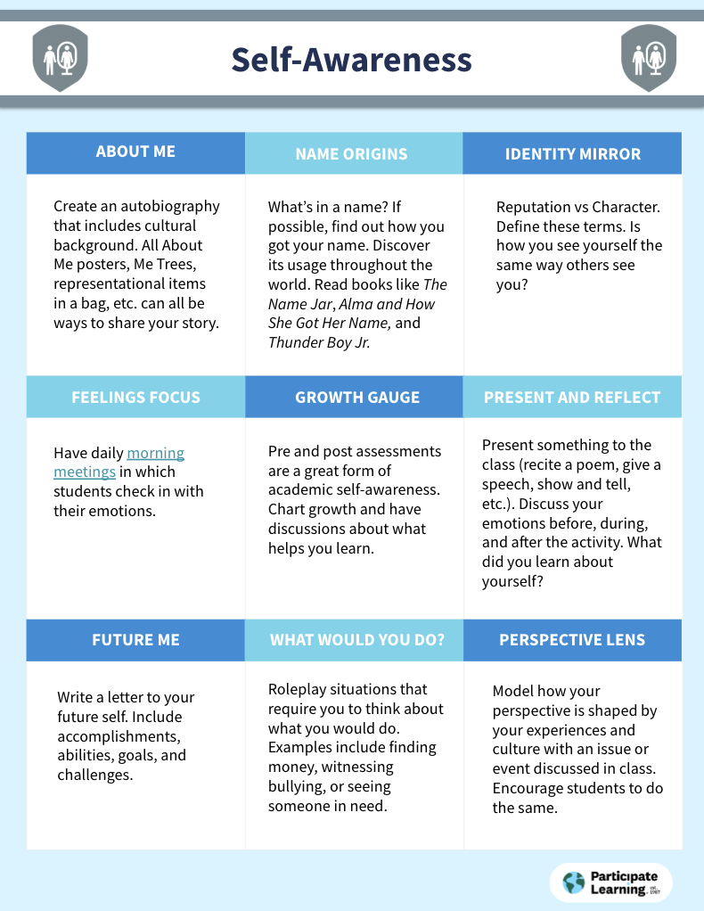
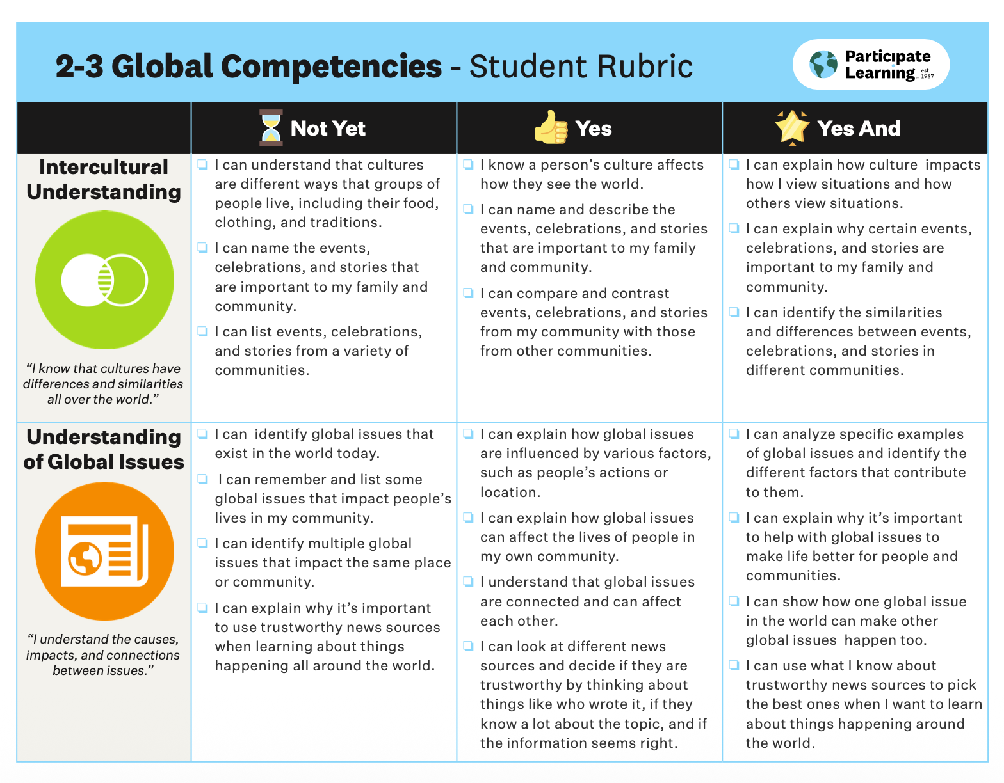
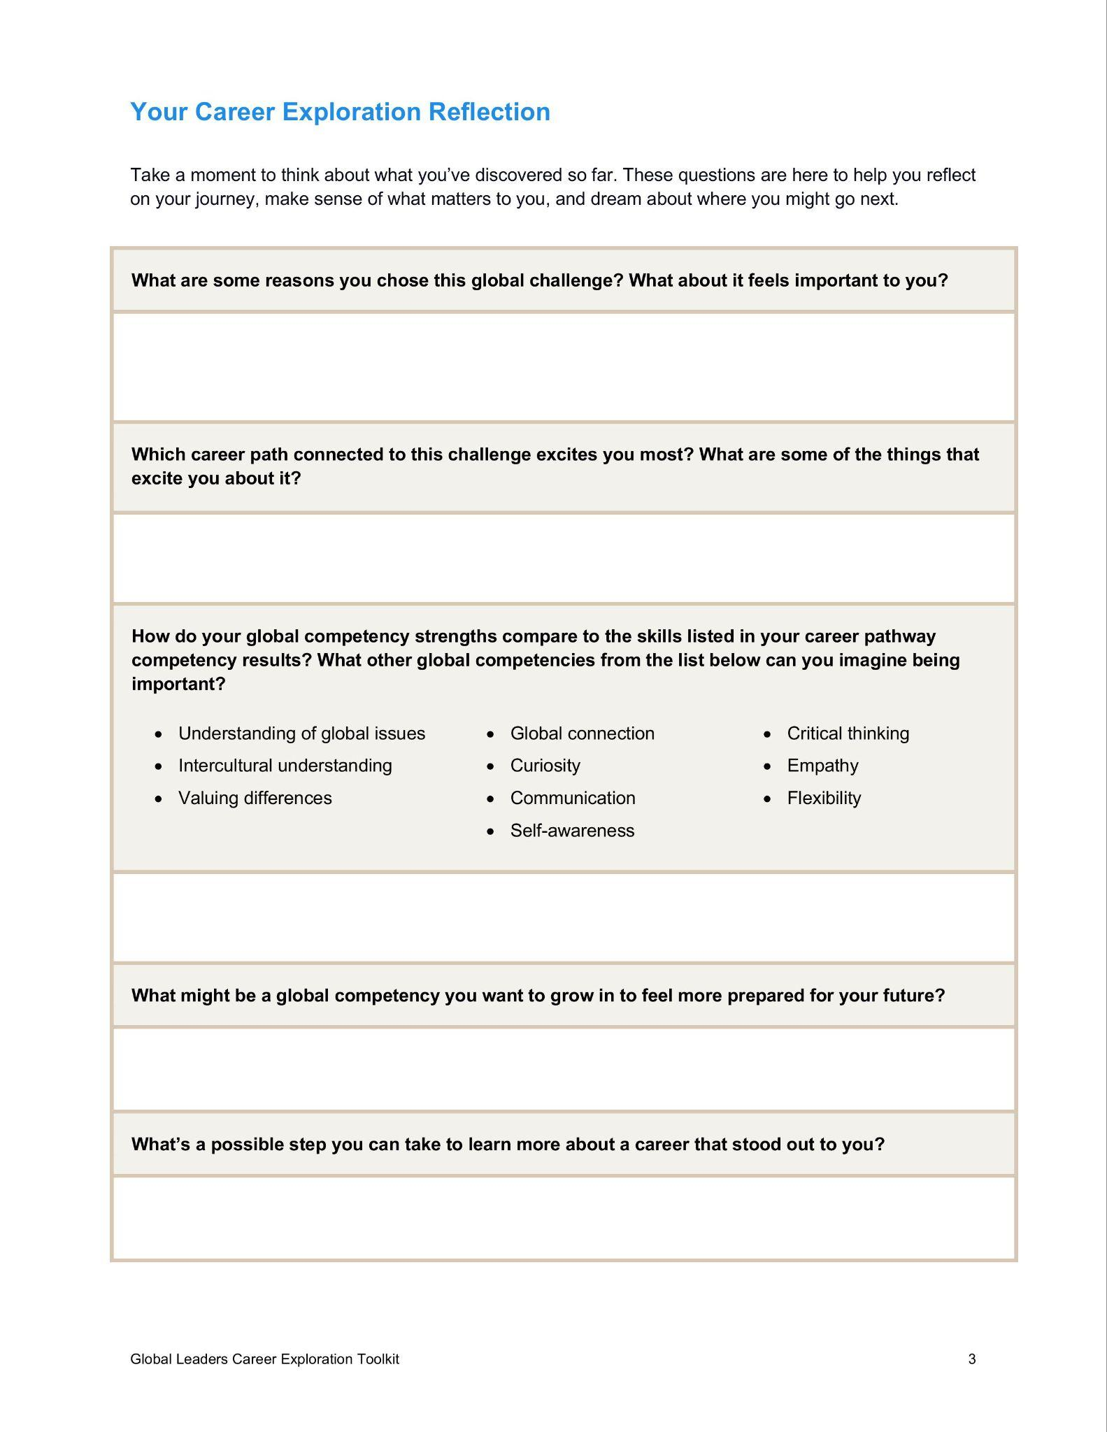
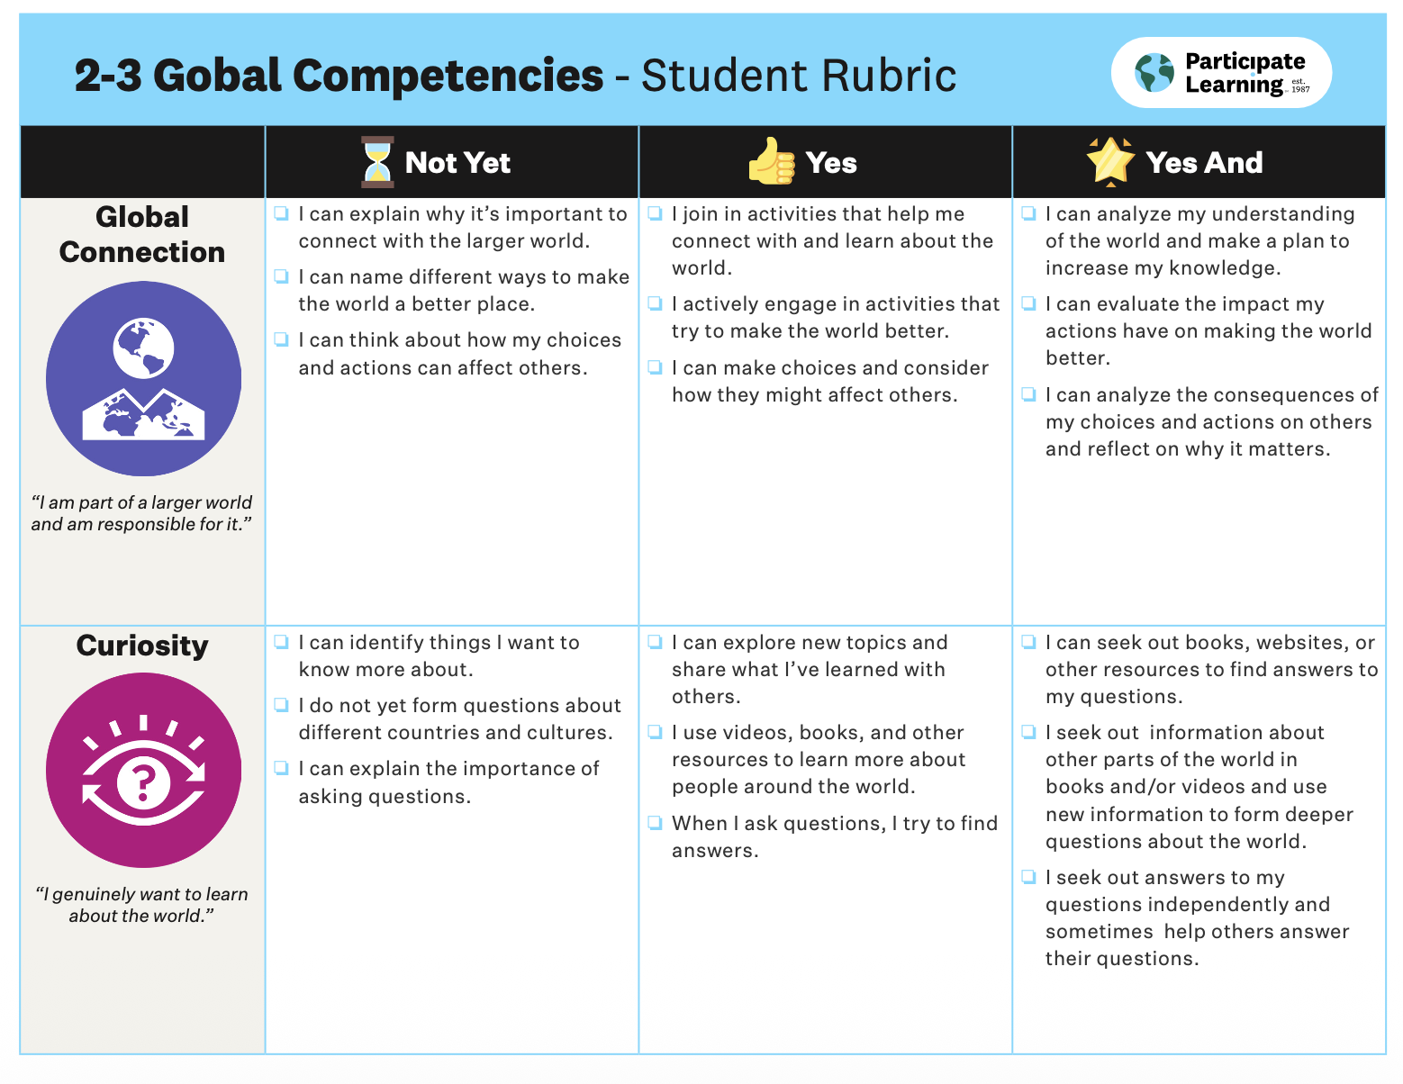
Global Competency Tools
https://bit.ly/GlobalLeadersPD
🔗 Click here
🔗 Click here
🔗 Click here
Notes:
Randall
Quick preview of each resource…
Global Competency Choice Boards
A reflection tool that helps educators—and students—identify strengths and growth areas across global competencies, building self-awareness and intentional skill development.
Global Competency Student Rubrics
Clear, student-friendly rubrics that make complex human skills visible and actionable, supporting reflection, feedback, and growth over time.
Career Exploration Tool
An interactive resource that helps students connect their interests in global challenges with their competency strengths to explore meaningful, future-ready career pathways.

Slide 26
Resource Deep Dive
Challenge
Resource
Opportunity
What challenge did you identify?
What ideas or resources might help?
What could this look like in your school?
Notes:
Chart paper

Slide 27

Reflections and Connections
Notes:
Amanda
Time to share connections and reactions:
Global Competency Self-Assessment
AI-future skill: self-awareness + metacognition
Students who can…identify their strengths, reflect on how they learn and collaborate, and recognize areas for growth…are better equipped to use AI intentionally instead of passively.
In an AI world, students won’t be asked “Do you know this?” They’ll be asked “How do you decide what to trust and how to act?”
Student Rubrics for Global Competencies
AI-future skill: self-awareness + metacognition
Rubrics…make complex skills visible, give students shared language for collaboration and impact, and help them evaluate quality, not just completion.
Heritage is modeling this by embedding competencies into daily learning—so students practice these skills constantly, not just during “special” lessons.
Career Exploration Tool (result)
AI-future skill: adaptability + purpose
AI will change how work happens—but students still need to know: what problems they care about, what strengths they bring, and how those connect to evolving careers.
This tool helps students see themselves as not competing with AI, but collaborating with it—guided by their human strengths.
Hayesville goes deep here, using portfolios to help students build a coherent story of who they are becoming in a shifting workforce.

Slide 28



Head-Heart-Hand
Head - What is one thing you will continue to think about from today?
Heart - What is one thing you are feeling right now as we close out?
Hand - What is one thing you’ll put into action in the near future?
Notes:
Protocol

Slide 29
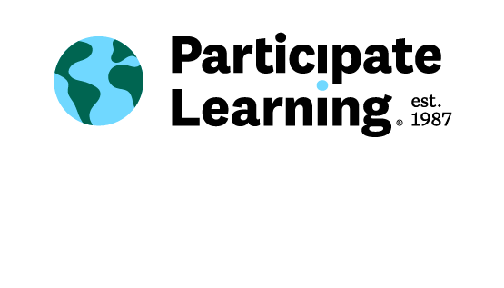
Thank you!

Slide 30

Explore how Global Leaders can support
your school:
Notes:
Caroline

