Slide 1

Numbers
That Work
A Creative's Guide to Pricing
Kellie Phelan
The Works Seattle
Craftcation 2026
Notes:
Today we're taking the emotion out of pricing and replacing it with math. Not complicated math. Just clear, grounded numbers. My goal is that you leave with a framework you can use again and again — not just a price for one product or service.
You do not need to get your pricing perfect today.
You just need to understand it. Once you know your baseline, you can stop guessing and start adjusting with confidence.

Slide 2

About Me
The Arc
Founded in May 2018 as a pop-up sharing hands-on skills
Grew into a brick-and-mortar by September 2018
Pivoted to DIY Kits and virtual events during Covid
Now: classes, events, kits, retail, Maker Bar
My Pricing Mistakes
Priced on gut feel, not math
Undercharged for labor
Guessed at overhead
Ran workshops that didn’t actually make any money
Notes:
The reason I'm qualified to teach this isn't that I got it right immediately. It's that I've made every mistake on this list — and I now run a business that works because I fixed them.

Slide 3

Why Pricing Feels Hard
"What if no one pays that?"
"I don't want to seem greedy."
"But my competitor charges less."
"I should just be grateful for the sale."
THE REFRAME
Pricing isn't about worthiness. It's about sustainability.
The most generous thing you can do is keep your doors open.
Notes:
Let's be honest — pricing brings up stuff. Fear of charging too much. Fear no one will buy. Comparing yourself to competitors. Worrying you're not 'worth it.’
I want to name something: those thoughts are normal. Every single person in this room has had at least one of them. And they are also not useful.
Pricing isn't about worthiness. It's about sustainability. If your numbers don't support the business, the business won't last. The most generous thing you can do for your customers is keep your doors open.

Slide 4
If your pricing doesn’t…
pay you fairly
cover overhead
generate profit
you don't have a business.
You have an expensive hobby.
Notes:
And there's nothing wrong with hobbies. But most of you are here because you want something sustainable. You want to pay yourself. You want to take a day off without the whole thing collapsing.
So let's build that.

Slide 5

Our Agenda
The 4 numbers every price must contain
Margin vs mark-up
Pricing products and wholesale
Pricing services: fill rate, labor, and real scenarios
Putting it together with your numbers
Common pricing mistakes
Notes:
Every section builds on the last. By the time finish today, you'll have everything you need to calculate a real price for a real thing you sell. That's the goal.

Slide 6
Part 1
The Foundations
Materials, labor, overhead, and profit

Slide 7
The 4 Numbers You Must Know
1
2
3
4
Materials
What it costs to make the thing. Raw materials, packaging, shipping to you.
Labor
Your time. Every minute spent making, prepping, selling, and shipping.
Overhead
The cost of keeping your business running, whether or not you sell.
Profit
What's left after costs. This is what funds growth, savings, and stability.
Notes:
If you know these four numbers, pricing becomes mechanical. If you don't, it is guessing. Everything we do today comes back to these four.
Brief overview (more on the following slides)
Before we go through each one: write down the product or service you're going to use today. We're going to build your real cost from scratch.
You could chose:
A product you buy and resell (most straightforward)
A product you make
A service you offer (I will focus on classes)

Slide 8
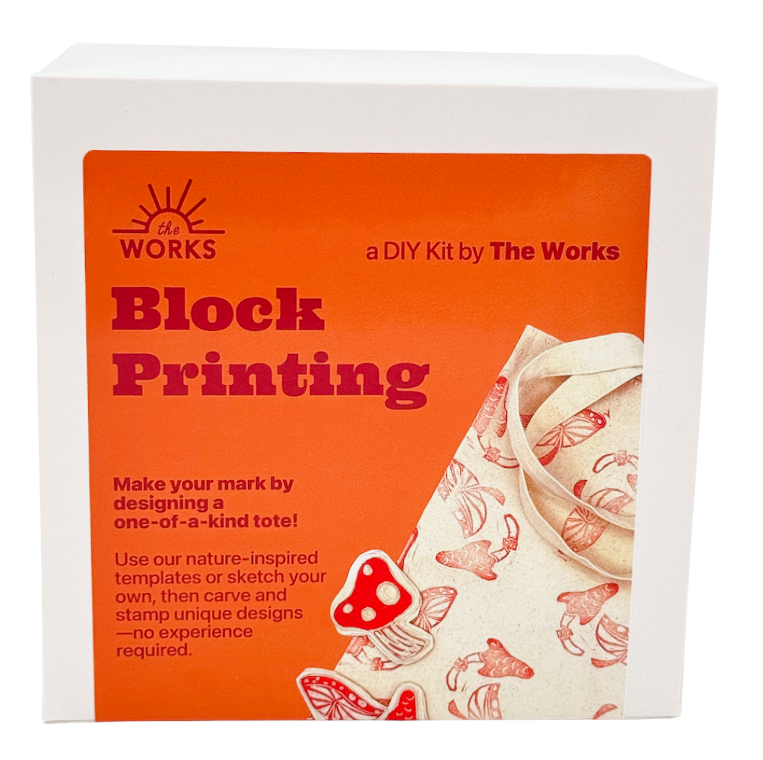
1
Materials (COGS)
Raw materials and supplies
Packaging materials
Shipping to you (inbound freight)
Tags, labels, hang cards
Anything that goes into or onto the product
PRO TIP
Get a reseller permit — you can buy materials tax-free and collect tax only when you sell.
Notes:
Not just the pretty stuff. Everything. The tape. The bags. The label. The tiny bottle of sealer you go through every two weeks.
Exercise: Write down your estimated materials cost for the product or service you chose.

Slide 9
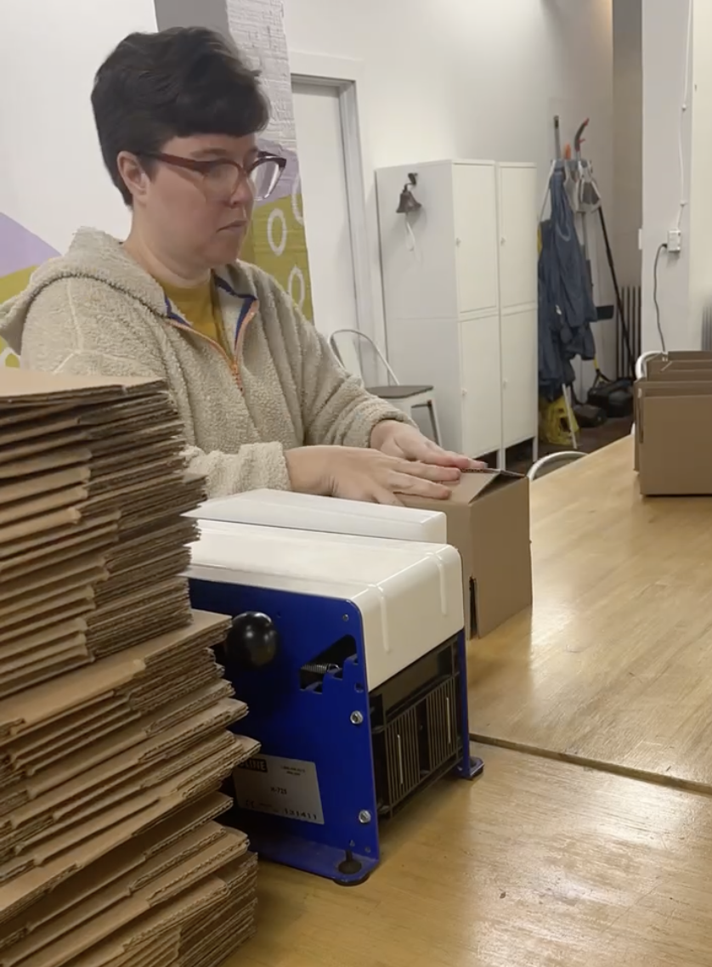
2
Labor
What are you actually paying yourself per hour?
What would you pay someone else to do it?
Count all the hours: setup, production, cleanup
Only time directly tied to making/delivering
THE FORMULA
Time × Hourly Rate = Labor Cost
Example: 3 hrs prep + teach × $30/hr = $90 labor
The test: would I do this task if I sold zero units? If yes, it’s overhead — not labor.
Notes:
This is where creatives consistently undercharge. We treat our own time as free. It is not free.
Ask yourself right now: what is my hourly rate? Not what I wish it were — what am I actually paying myself per hour based on what I charge?
For solopreneurs: if you had to hire someone to do this work, what would you pay them? That's the floor. Your rate should be at least that — and probably more, because you also bring expertise.
Now — what counts as labor? The rule is this: time that is directly in service of making or delivering the thing you sell. For a product, that's production time. For a class, that's teach time plus prep that's specific to that class. That time goes into your unit cost.
Calculate your labor cost for your product or service. Be honest with your time — include setup, production, and cleanup. But draw the line at overhead. If you're not sure which bucket something falls into, ask: would I do this task if I sold zero units this month? If yes, it's overhead.
Calculate your labor cost for your product or service.
Labor that belongs in unit cost If someone is doing work that is directly tied to preparing or delivering a specific product — receiving inventory, tagging, photographing for the website, packing an online order — that time can reasonably be allocated to that product's cost. It's the same logic as production labor: time in service of making the thing sellable.
Labor that belongs in overhead Floor staff, a manager on shift, a bookkeeper — anyone whose time isn't tied to a specific unit but keeps the store running — that's overhead. It gets covered by gross margin, not built into unit cost.

Slide 10

3
Overhead
Rent / studio space
Utilities
Insurance
Software subscriptions
Marketing
Payment processing fees
Website hosting
Packaging supplies
Professional development
Bookkeeping
Overhead is the silent profit killer.
Notes:
Overhead is the silent profit killer because it’s invisible at the point of sale — and then you’re confused at the end of the month about where the money went.
We’re not going to allocate overhead into your unit cost today — that’s a 201 topic. What we are going to do is make sure your gross margin is high enough that overhead gets covered. I’ll show you exactly how that works in a few slides.
For now: write down your total monthly or annual overhead number. If you don’t know it, that’s your homework this week.

Slide 11
Your Base Cost
Materials (COGS)
+
Labor
=
YOUR
BASE COST
This is the floor. Not the price.
Notes:
This is your base cost. Materials plus labor.
Not your overhead — that’s handled separately when we look at gross vs. net margin.

Slide 12

4
Profit (Not a Reward, a Requirement)
Profit is not what's left over — it's what you plan for
Covers overhead, taxes, savings, and business reinvestment
Without a profit target, you're pricing to break even at best
Build it in before you set your price, not after
Overhead is the silent profit killer.
Notes:
This is the one that trips people up the most. Profit feels like a bonus — something you earn if things go well. It is not. It is a line item, just like materials and labor.
Here's the framing shift: profit covers what base cost doesn't. Your overhead. Your quarterly taxes. Equipment replacement. The slow season. If you don't build it in at the front end, you will bleed it out at the back end.

Slide 13
Part 2
Understanding Margin
From cost to price: margin, markup, multipliers

Slide 14
Margin vs. Mark-up
Markup: what you add to cost to get to price
Margin: what you keep as a % of price
Same numbers — completely different picture
Markup overstates how much you’re keeping
EXAMPLE: BASE COST $40
50% markup → Price: $60 → Margin: 33%
100% markup → Price: $80 → Margin: 50%
100% markup sounds big — but it’s only 50% margin. Think in margin.
Notes:
These two terms get used interchangeably. They are not the same thing — and confusing them is one of the most common reasons creative businesses underprice.
Markup is calculated off your cost. You take your $40 base cost, add 50%, and land at $60. Feels like you're making 50% profit. You're not.
Margin is calculated off your price. At $60, your $40 cost means you're keeping $20 — which is 33% of what the customer paid you. That 33% is what has to cover overhead and generate profit.
Here's why it matters: a 50% markup sounds healthy. A 33% margin is actually pretty thin depending on your overhead. If you've been thinking in markup, you may believe you have more cushion than you do.
The math we use today is all margin. When I say aim for 50–60% gross margin, I mean 50–60 cents of every dollar you collect stays in the business after base cost. That's the number that has to be big enough to absorb overhead and leave something for you.

Slide 15
Understanding Margin
MARGIN FORMULA
(Price − Cost) ÷ Price
REMEMBER Margin is a percentage of the selling price. Markup is a percentage of the cost. They are not the same.
Notes:
Margin is the number that matters.
Again... Markup tells you what you added. Margin tells you what you kept.

Slide 16
Gross Margin
What % of your price is left after base cost
Every dollar of margin covers overhead + profit
Lower margin = less room to run your business
TARGET RANGE
2–2.5×
your base cost
50–60%
gross margin
EXAMPLE
$40 cost → $100 price → 60% gross margin
Notes:
We're going to use gross margin as our pricing tool — not markup, not a gut feeling.
Gross margin is what percent of your price is left after base cost.
If your base cost is $40 and you sell for $100, your gross margin is 60% — meaning 60 cents of every dollar is available to cover overhead and profit. The lower your margin, the less room you have to actually run your business.
The target range we'll use today: 2–2.5x your base cost, which puts you in the 50–60% gross margin range. Higher overhead load = higher end of that range. We'll dig into exactly how to set your number in the next section.

Slide 17
Part 3
Pricing Products
From cost to price: margin, markup, multipliers

Slide 18
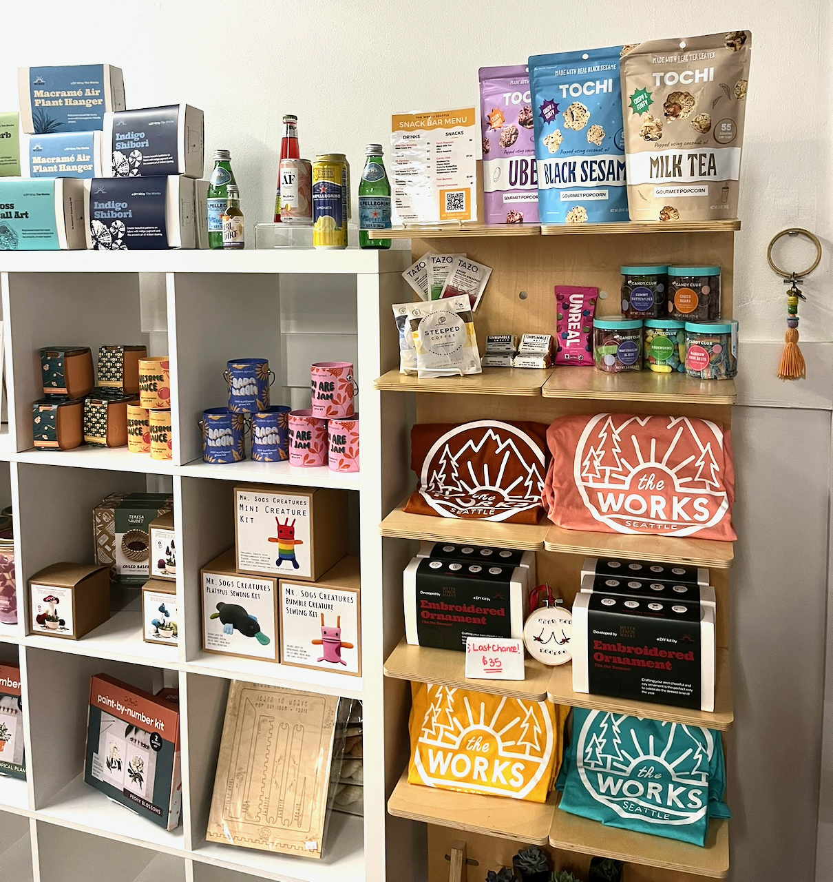
Retail Pricing Framework
THE FORMULA
Base Cost × 2 to 2.5 = Min Retail Price
2× is the floor — not the target
Low overhead? 2× may work
Retail space / high overhead? Go 2.5× or higher
EXAMPLE
Base cost $10 → $20 (at 2×) to $25 (at 2.5×)
Notes:
2x is the floor. Not the target. If your market can bear more, charge more. This multiplier protects you from pricing yourself into the ground.
The multiplier is not one-size-fits-all. Home-based, low-overhead business? 2x may be fine. Storefront, staff? You probably need 2.5x or higher. If you’re not sure where you fall, use 2.5x as your default until you know your overhead load better.

Slide 19

Example: Retail Pricing
Notes:
Calculate your minimum and target retail price right now. Then ask yourself: is that what you’re currently charging? If you’re charging less, we need to talk about that.

Slide 20

Wholesale Pricing
THE FORMULA
Retail Price × 50% = Wholesale
Your cost must be ≤ 25% of retail price
That means: retail price ≥ 4× your cost
EXAMPLE
$100 retail → $50 wholesale → $25 must be your max cost
You can't retrofit wholesale pricing onto DTC-only margins.
Notes:
If you sell wholesale — or want to — this math has to work from the start. You can't retrofit wholesale pricing onto a product that was built for direct-to-consumer margins.
Retail × 50% = Wholesale This is the industry standard. Retailers expect to buy at half of what they charge customers. That's their minimum margin. You don't get to negotiate it — it's baked into how wholesale works.
If wholesale has to cover your costs and leave you profit, your cost can't eat up the entire wholesale price. The standard is that your cost should be no more than half of what wholesale pays you — which is half of retail — so: half of half = 25% of retail.
If you want to sell wholesale, go back to your cost calculation and check: is my cost 25% or less of what I'd retail this for? If not, you need to either lower costs, raise your retail price, or decide wholesale isn't viable for this product.

Slide 21
Example: Wholesale Pricing

Slide 22
Part 4
Pricing Services
Workshops, fill rates, break-even math

Slide 23

How I Price Workshops
Start with baseline labor cost
Mark up labor 2.5x
Add materials cost per student
Mark up materials 4x
Sum marked-up labor + materials
Divide by estimated seats
Adjust for perceived value
Check margin across portfolio
Notes:
I want to share how my thinking has evolved here, because it took me a while to get this right for The Works.
When I started pricing workshops, I thought about it like this: what do people expect to pay for a class? And I charged that. I didn't start from cost. That was a mistake.

Slide 24

Fill Rate Reality
Don't plan your pricing on a full class
You need to break even at your minimum fill number
Every seat above that minimum is where your profit lives
Notes:
The question to ask yourself: what is the minimum number of people I need in the room to not lose money? Price so that you hit your floor at that number. Everything above it is real profit.
If you can't break even with a realistic minimum, your price is too low or your class is too expensive to run.

Slide 25
Example: Workshop Pricing

Slide 26
Margin by Fill Rate
At $75/student — same class, different outcomes
Minimum Fill
33%
margin
Students
5
$375 rev / $253 cost
Barely breaking even
50% Fill
54%
margin
Students
8
$600 rev / $277 cost
Healthy margin
100% Fill
72%
margin
Students
16
$1,200 rev / $341 cost
Strong profit
Notes:
Here's the point: your pricing decision and your capacity decision are not separate. If you set a price that only works at full fill, you've built a business that punishes you every time a class runs light. The goal is to find a price where minimum fill is survivable, and full fill is genuinely profitable.
Look at your own numbers. What's your minimum fill to break even at the price you're charging? Do you know that number? That's what we're solving for.

Slide 27
Part 5
Putting It Together
Portfolio thinking, gross vs. net, three levers

Slide 28
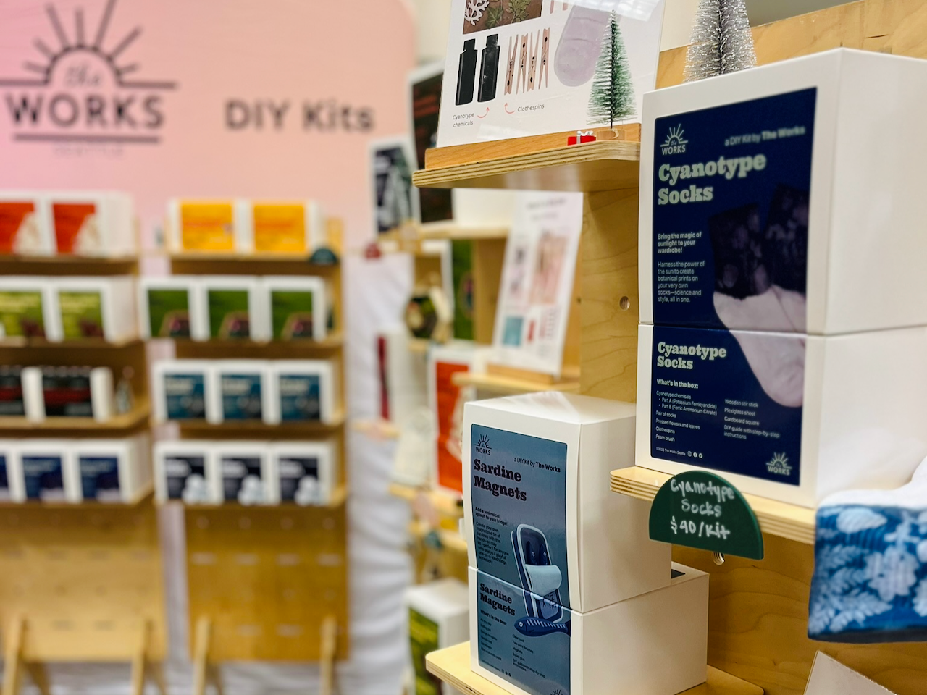
Pricing Across a Portfolio
Not every product needs to be your highest margin
Some things are loss leaders, some are your bread and butter
Your portfolio should balance
Use a pricing sheet to map all products
Know which is which. Do it on purpose.
Notes:
This is portfolio thinking. Shops don’t make the same margin on every product
The dangerous version is when you don't know which products are which. When every product is just priced by feel, you can't make strategic decisions. The math tells you what to push, what to cut, and what to raise.

Slide 29

Gross vs. Net Margin
Gross Margin
Revenue minus materials & labor
What you've been pricing for
Net Margin
Gross profit minus overhead
Rent, software, insurance, marketing
Notes:
Here’s the full picture. Gross margin is what’s left after you cover materials and labor. That’s what we’ve been pricing for. B
ut overhead — rent, software, insurance, marketing — comes out of that gross profit.
What you keep after overhead is your net margin.

Slide 30
Same Revenue, Same Revenue, Different Pricing
60% Gross Margin
$200K rev → $120K gross profit
$120K − $80K overhead = $40K net profit
20% Net Margin
30% Gross Margin
$200K rev → $60K gross profit
$60K − $80K overhead = −$20K loss
−10% Net Margin
The higher your overhead, the more gross margin you need as a buffer.
Notes:
In this example: 60% gross margin looks healthy. After $80k in overhead on $200k revenue, net margin is 20%. That’s actually solid for a small creative business — but only because the gross margin was high enough to absorb it.
Now flip it: if your gross margin was only 30% on $200k revenue, gross profit is $60k. Overhead of $80k means you’re losing $20k. Same overhead, same revenue — completely different outcome because of how you priced.
This is why gross margin has to be high enough. The higher your overhead load, the more gross margin you need as a buffer. If you want to go deeper on allocating overhead per unit, that’s a 201 topic — but now you understand why it matters.

Slide 31
The Three Levers
What if the math doesn't work?
1
2
3
Raise Price
Increase perceived value to justify higher pricing
Lower Costs
Renegotiate suppliers, simplify materials, batch production
Increase Efficiency
Reduce labor time, streamline processes, scale systems
There is no fourth lever.
Notes:
That's it. Those are the only three. There is no fourth lever.
A lot of people find themselves in the uncomfortable position of realizing they need to raise prices. That's okay. The alternative is a business that slowly bleeds out
If you're in this room and your math isn't working, I want you to sit with that today. Not panic — just let the numbers tell you the truth.

Slide 32
Common Pricing Mistakes
1
Copying competitors without knowing their costs
2
Ignoring overhead entirely
3
Forgetting to build in profit
4
Discounting too often and too deep
5
Pricing with enough margin but not enough volume to cover overhead
Notes:
On copying competitors: you have no idea what their cost structure is. They might be losing money. They might have a warehouse deal you don't have. Their pricing tells you nothing about what YOUR pricing should be.
On discounting: every dollar off your price comes directly out of margin.
And most important: Pricing with enough margin but not enough volume to cover overhead

Slide 33
Put It All Together
1
Know your base cost — always. Materials plus labor. The number.
2
Apply margin intentionally — not emotionally.
3
Build consistent structure across your product line.
4
Adjust with data. Review pricing at least twice a year.
What you measure improves. Price with intention.
Notes:
What you measure improves. If you want profit, price with intention.
Here's what I want you to do this week: go home and calculate the base cost of your top three products or services. Materials plus labor. Not all of them. Just three. Then look at what you're charging and calculate your gross margin. See what you find.
If the math is hard to face, that's information. If the math looks good, now you have confidence to price from strength instead of fear.
Either way, you'll know. And knowing is how you build something that lasts.

Slide 34
Questions?
Numbers That Work
Kellie Phelan | The Works Seattle | Craftcation 2026

