Slide 1
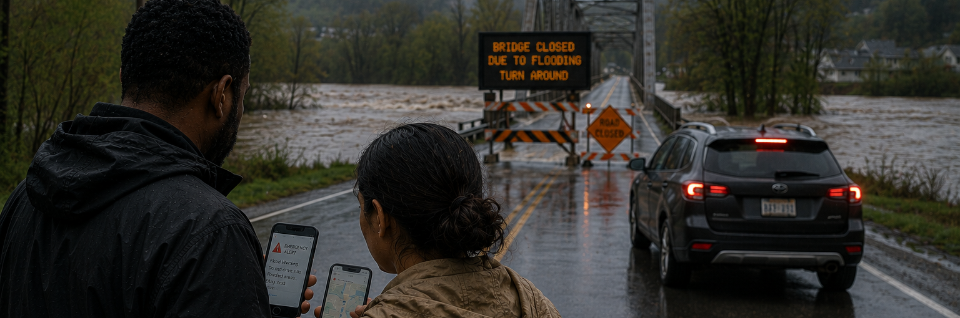

When Information is Infrastructure:
Rethinking Communications in an Era of Cascading Risk
Presented by: Shawna Bruce CD, MA DEM

Slide 2
“PREPAREDNESS is no longer a best practice. It is a public expectation.”
Notes:
““Ten years ago, preparedness was often viewed as something progressive organizations invested in.
Today, after repeated evacuations, prolonged outages, wildfire smoke events, floods, cyber incidents, and infrastructure disruptions, the public expectation has fundamentally shifted.
Preparedness is no longer viewed as optional — the public expects organizations to be ready.”

Slide 3
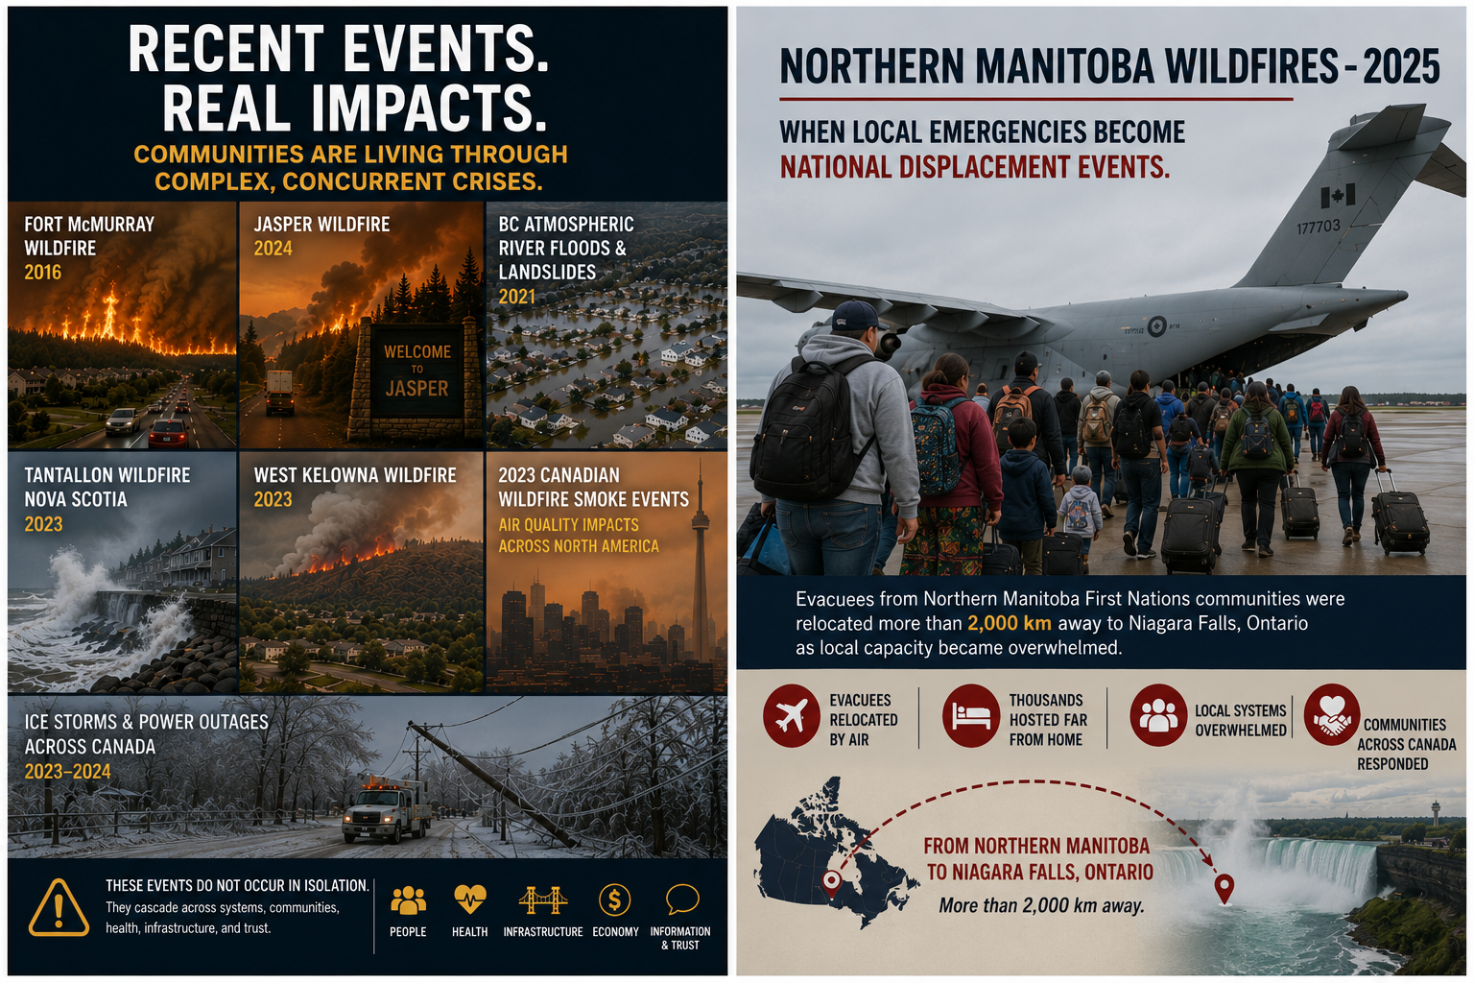
Notes:
“A wildfire quickly becomes an evacuation. An evacuation becomes a transportation challenge, a housing challenge, a misinformation challenge, and ultimately a trust challenge. These events no longer occur in isolation. This is what we mean by a polycrisis — multiple interconnected crises amplifying one another simultaneously.”

Slide 4
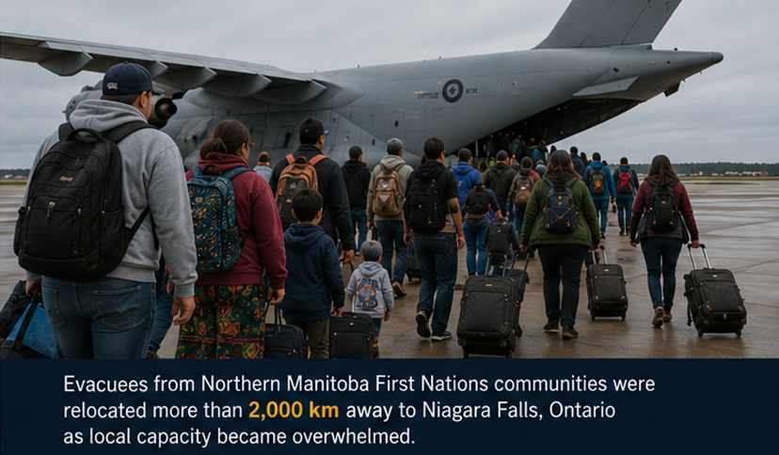
Notes:
“The Manitoba wildfires are an important example of cascading risk. A wildfire emergency in Northern Manitoba resulted in evacuees being relocated more than 2,000 kilometres away to Niagara Falls because local capacity became overwhelmed. This became more than a wildfire story. It became a housing story, a transportation story, a health services story, and a communications story.”

Slide 5
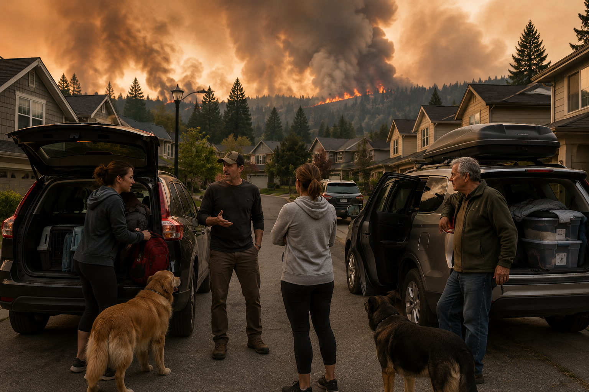
Notes:
“In a crisis, people are not thinking like emergency managers. They are thinking as parents, neighbours, caregivers, and community members trying to reduce uncertainty and make decisions quickly. Communication becomes the bridge between uncertainty and action.”

Slide 6
Communication is what enables people to make decisions that protect themselves, their families, and their communities.
Notes:
“If communication directly influences public behaviour and safety outcomes, then communications teams cannot operate at the edge of emergency management. They must be integrated into it. Communication is no longer simply supporting the response — it is part of the response itself.”

Slide 7
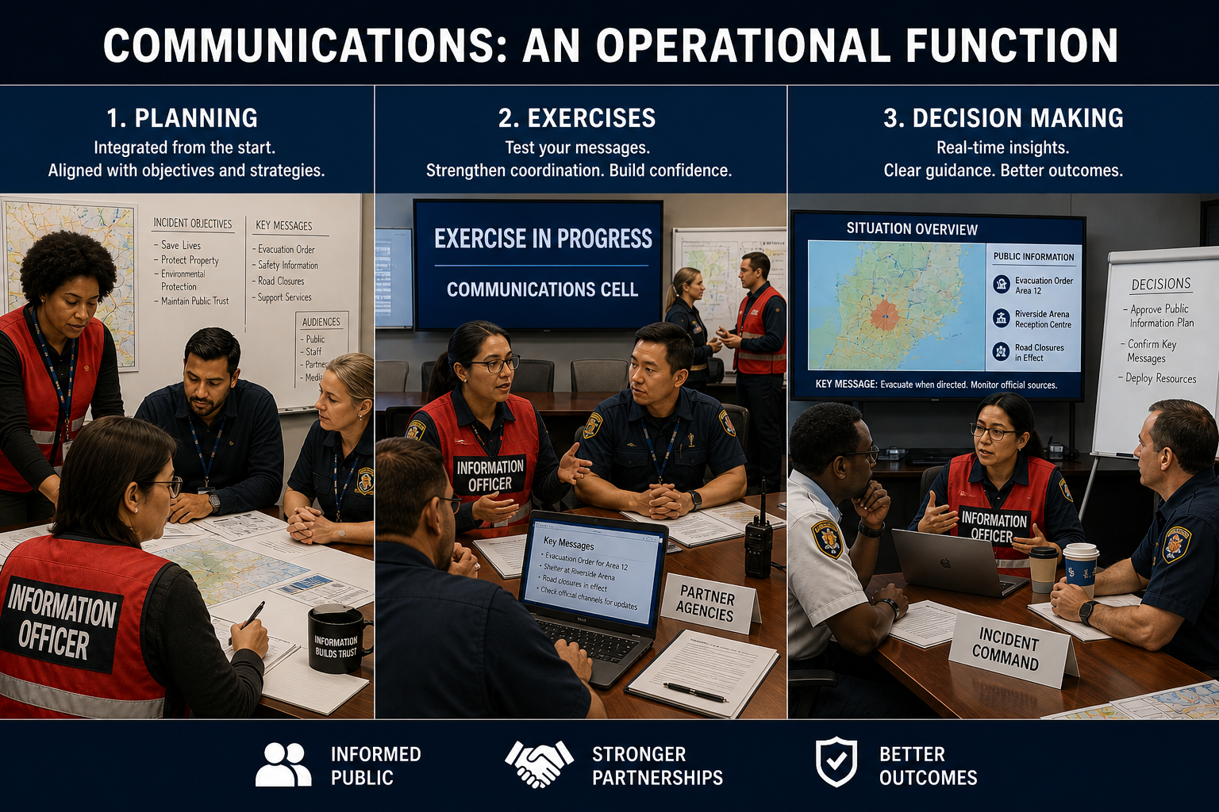
Notes:
“Communication capability must be intentionally built into emergency management systems through planning, exercises, operational coordination, and leadership structures. One important lesson is that emergency communication is a specialized operational skillset. Organizations cannot assume that every communications professional automatically has experience operating in high-pressure emergency environments.”

Slide 8
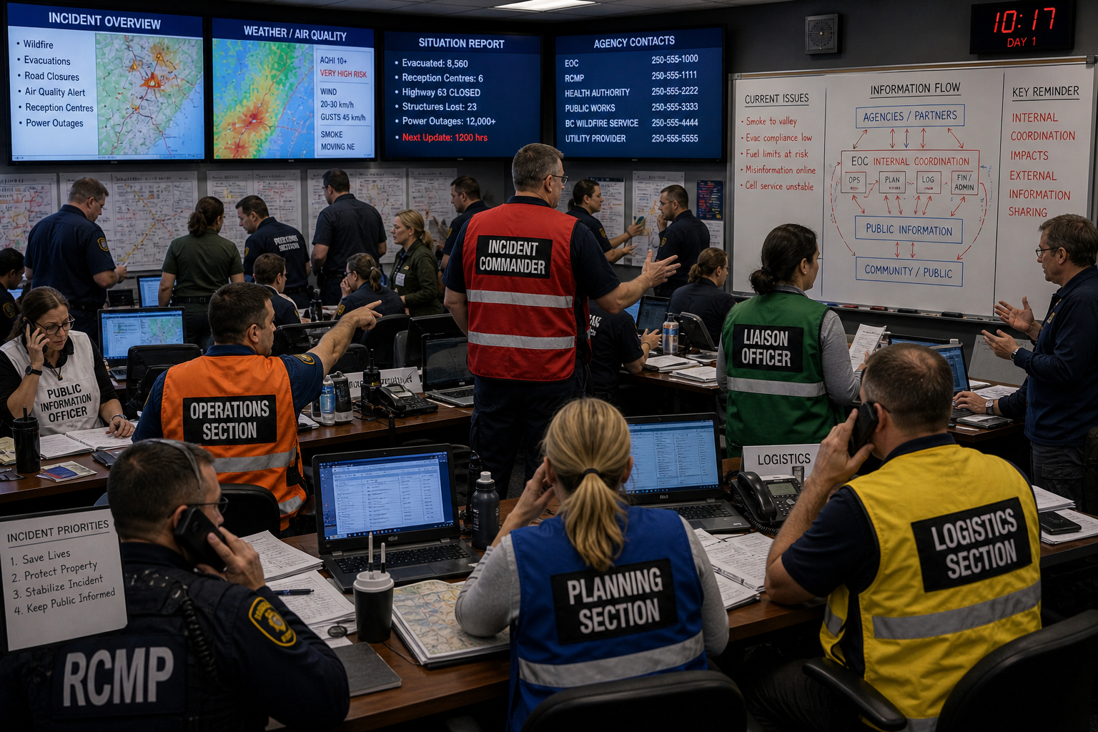
Notes:
“And once we start viewing communication as part of the operational response, we begin to see something else — the public experiences the outcome of our internal coordination, or the lack of it. When information is delayed internally, fragmented across departments, or inconsistent between agencies, that confusion does not stay inside the Emergency Coordination Centre. It moves outward very quickly. The public sees conflicting information, delayed updates, uncertainty, and gaps. And when organizations cannot provide clarity fast enough, people naturally begin turning to each other to fill those gaps — through social media, group chats, neighbours, and community networks. That’s why internal coordination now directly shapes external trust, and why trust increasingly moves through networks faster than organizations can control.”
““Many public trust failures begin as internal coordination failures. If organizations are not aligned internally, inconsistencies and information gaps quickly become visible externally.”

Slide 9
Internal information coordination shapes external trust.
Notes:
And here’s something to consider, if you’re not organized internally to share information and updates, if you don’t centralize the process – it will result in gaps, misaliagnment in your public information and it will come across as your organiszation being disorganized and chip away at the trust you’re trying to build with your audiences.

Slide 10
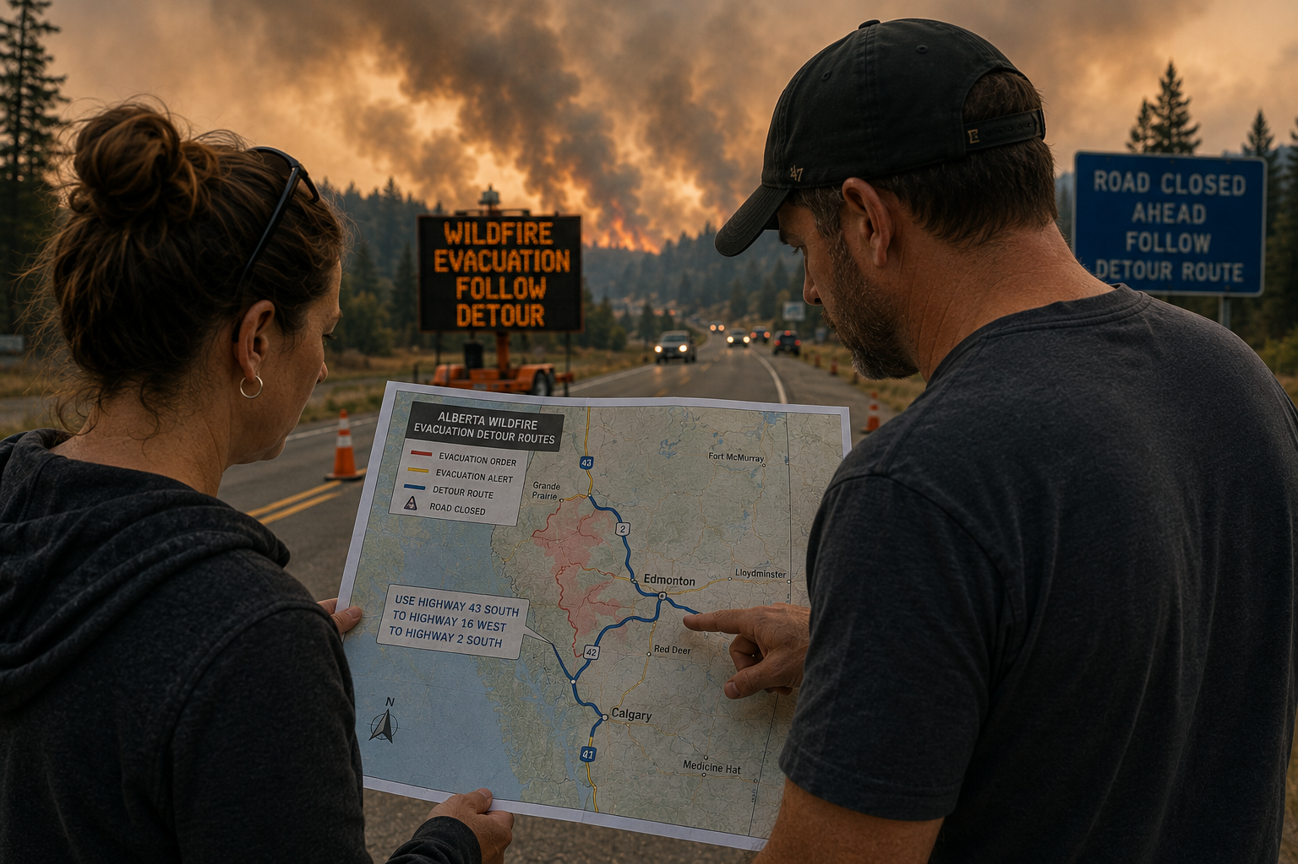
Notes:
“One of the things we are learning very quickly is that misinformation often begins with information gaps. When people are uncertain, stressed, and searching for answers, they will fill those gaps themselves — through social media, conversations with neighbours, or information that may not be verified. Misinformation is a risk multiplier – it creates confusion for your audiences, and honestly, it is time intensive and sucks up valuable resources if you’re managing misinformation throughout your emergency.
Being prepared and proactive as the credible source of truth limits the ability for misinformation to creep into your emergency narrative.

Slide 11
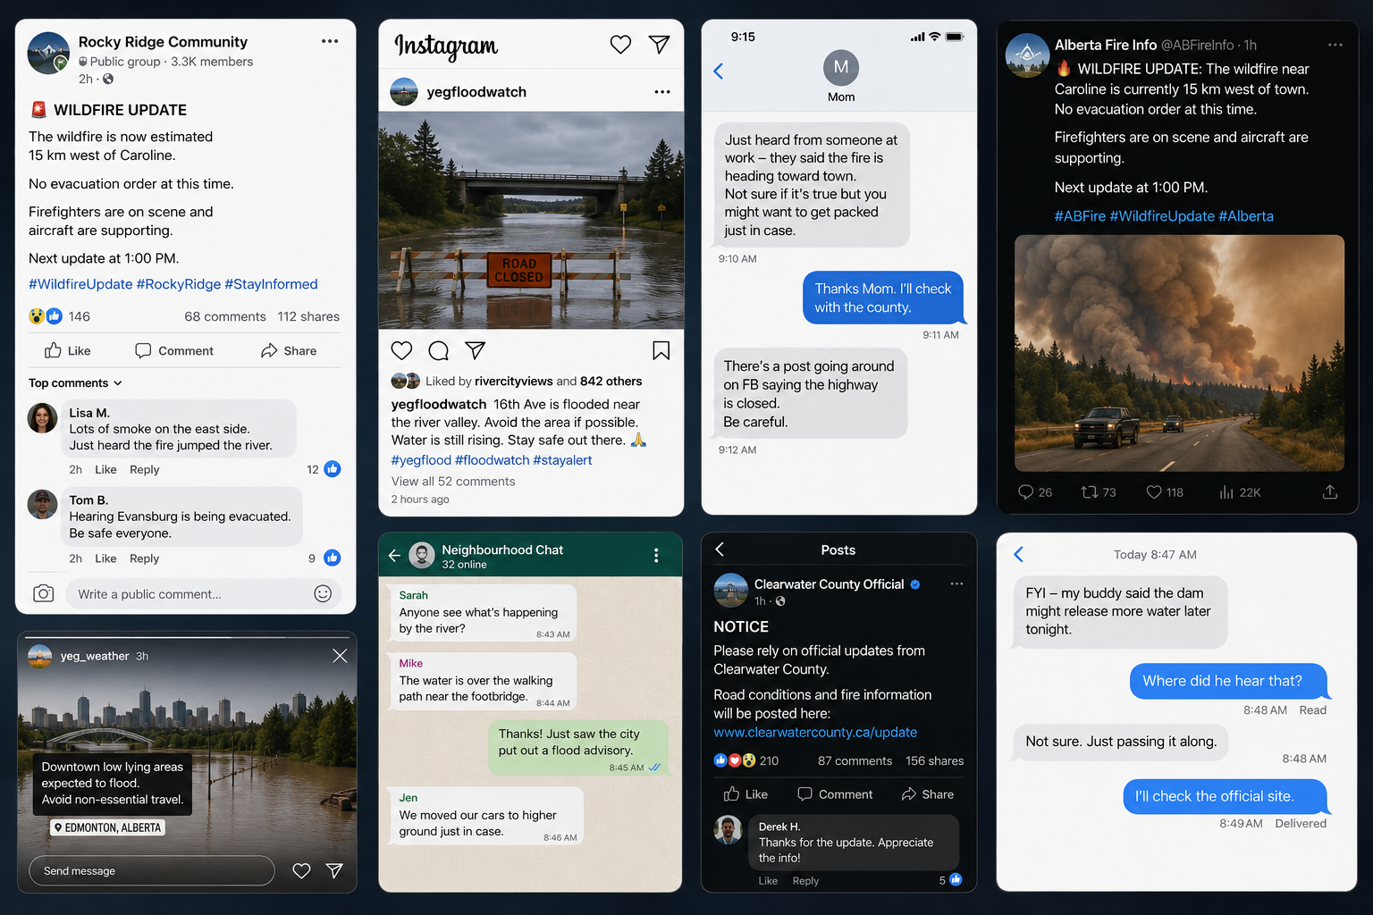
Notes:
“Increasingly, trust is not built only through official channels. Information now moves rapidly through social networks, text chains, neighbourhood groups, influencers, and community relationships.”

Slide 12
Trust moves through networks.
Notes:
And when clarity doesn’t come quickly… people begin relying on fragmented information from multiple sources.”

Slide 13
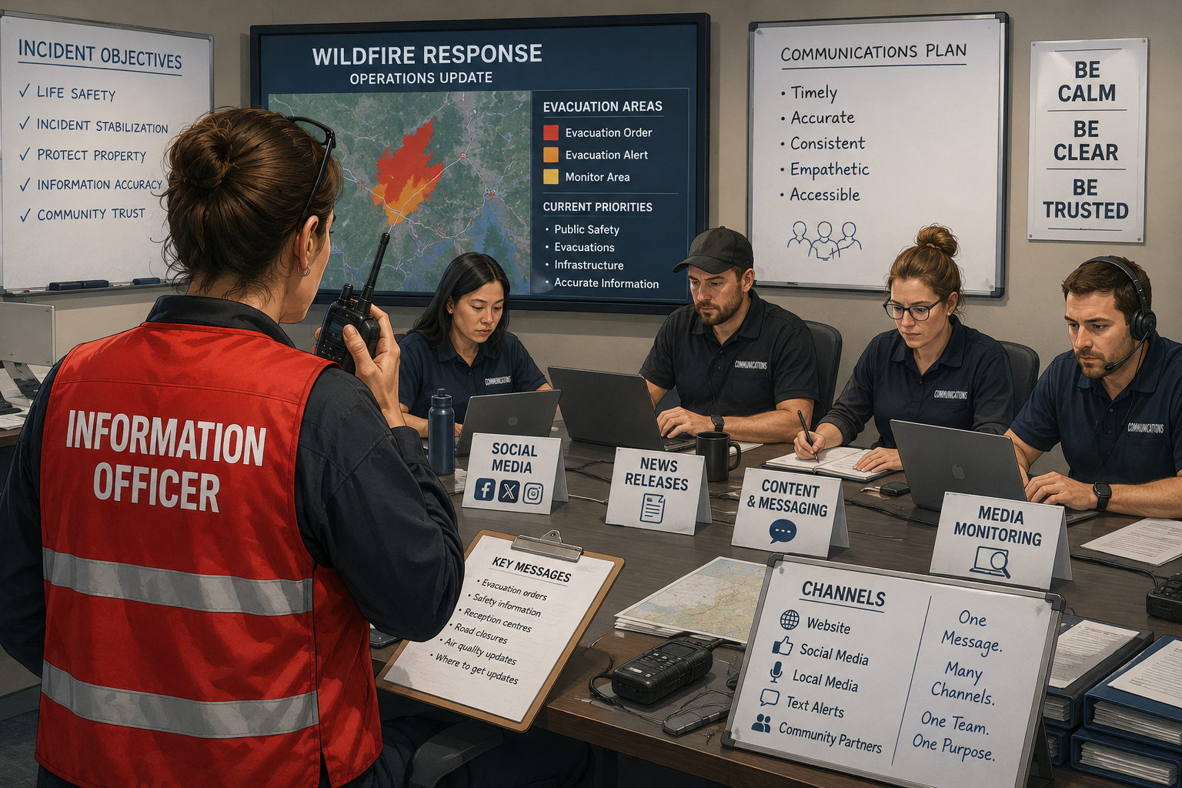
Notes:
“Organizations often focus heavily on accuracy — and accuracy matters enormously — but cadence matters too. If updates are too infrequent, people begin looked to other sources of information and not necessarily the trusted and verified ones. Last month there was a chlorine release at a municipal pool in Victoria, BC. Eight people were taken to hospital and they issued a Shelter in place for area residents. It happened right around the time kids are getting out of school, people are finishing work and daycare pickups were required. What caught my eye was that after it was issued, the alert said the next update would be within two hours. Two hours?

Slide 14
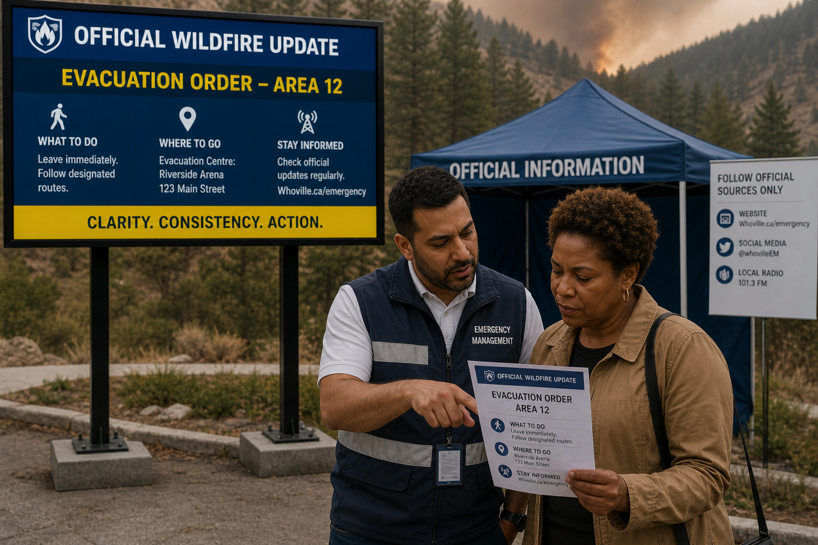
Notes:
“People trust those they know. People they’ve seen before. This is why organizations need to be building trust during the non emergency times. Let people get to know who you are and what you do. Invite people to follow official sources- show them what those are and keep feeding the beast with information.
Organizations often focus on the accuracy of information — and accuracy matters enormously — but in fast-moving events, cadence matters too.”
“Because if updates are too infrequent, people begin filling the silence themselves.” Even when you have no new information to share – provide a date and time stamped message.
There was a case in Victoria last month of a municipal pool that had a chlorine incident – they sheltered in place the neighbours around the pool and the actual alert said that the next update will be within two hours – two HOURS? This happened around the time people get out of work, schools would be dismissing children – and you’re not providing info sooner? That’s unacceptable.

Slide 15
Resilient communities depend not only on physical infrastructure, but on trusted information infrastructure.
Notes:
Communication influences whether people evacuate, whom they trust, how they interpret risk, and whether they take protective action. In an era of cascading risk and interconnected crises, communication capacity must be built, maintained, exercised, and integrated long before emergencies occur.”

Slide 16
Emergencies are now interconnected. Communication influences outcomes. Communication must be treated as operational infrastructure.
Notes:
We are operating in an environment where emergencies move quickly, overlap with one another, and create immediate pressure for information.
And the public experiences much of our response through communication.
Through the updates we provide. Through the clarity of our direction. Through whether information feels coordinated, timely, and credible.
Communication shapes how people understand risk and decide what to do next.
So perhaps the question moving forward is not whether communication supports emergency management.
It’s whether we are prepared to treat communication as part of the emergency management system itself.
Because resilient communities depend not only on physical infrastructure, but on trusted information infrastructure as well.
Thank you.”

Slide 17
Thank you.
Let’s keep the conversation going!
Email: bruceandassociatesltd@gmail.com
Connect with me on LinkedIn!

