Slide 1

Smart Insights. Safer, Stronger Communities.
www.traverseanaytics.com
arushton@traverseanalytics.com
Traverse Analytics Inc.: Overview | LinkedIn

Slide 2
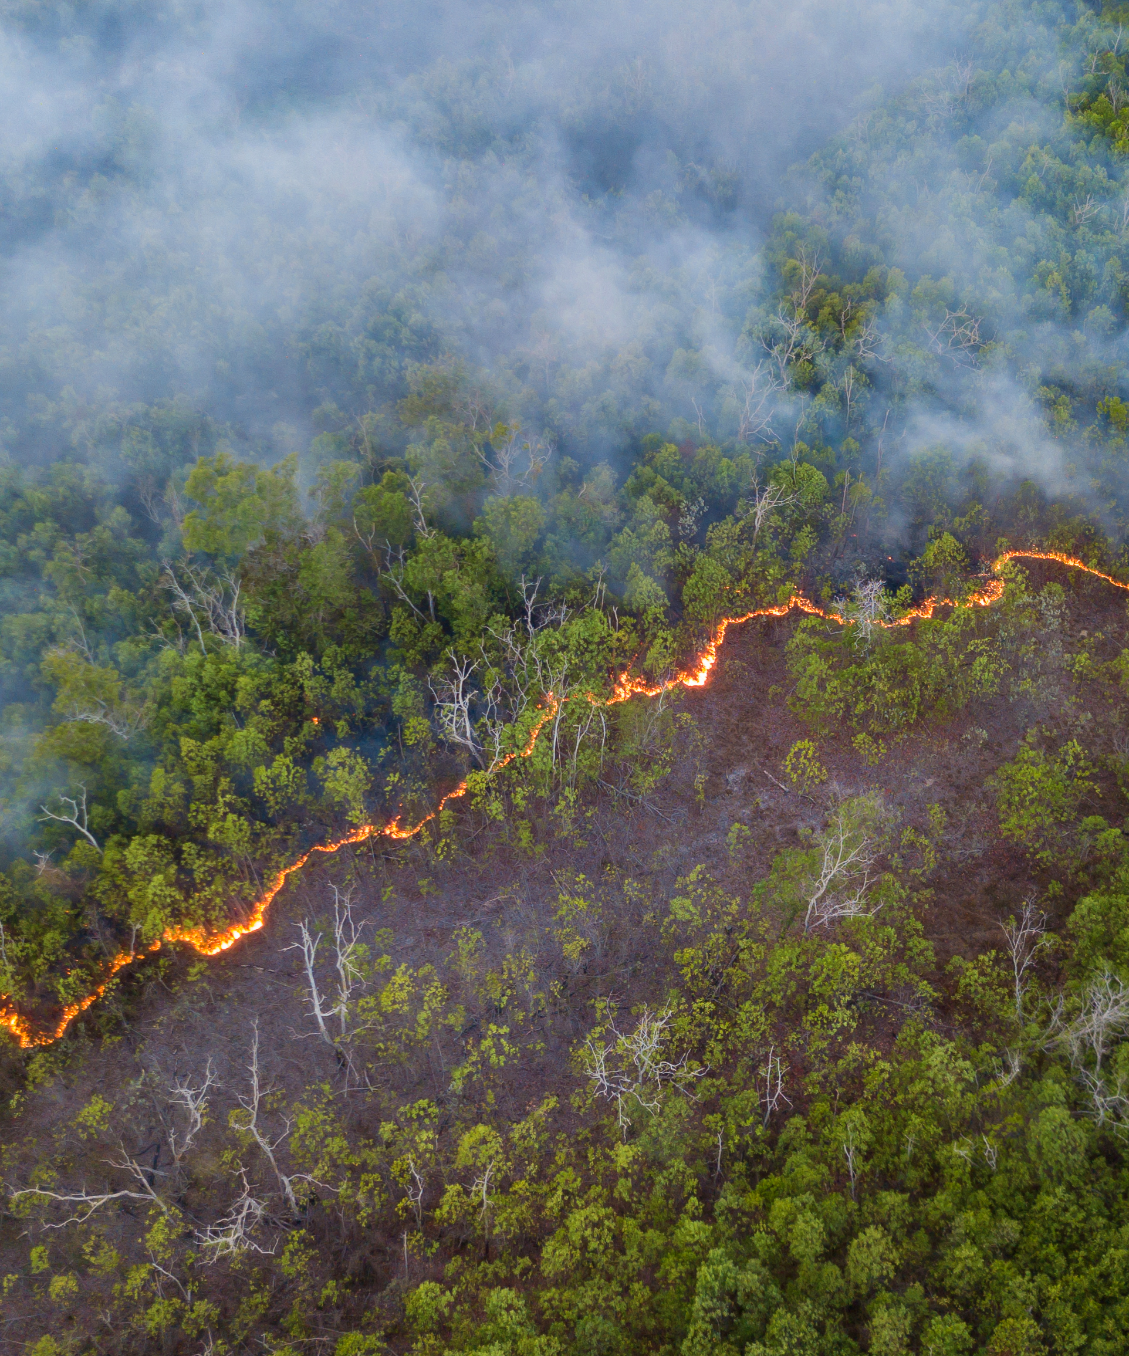

Problem: The Cost of Disasters is Far Higher than Insured Losses!
Direct global disaster losses average $180-200 billion USD annually + When cascading economic, social, and ecosystem impacts are included, the true global annual cost exceeds $2.3 trillion USD!
Why does this matter?
Increased public debt and declining household income
Growing un-insurability and retreat from risk transfer
Repetitive response and rebuild cycles without risk reduction
Result: More frequent, more costly, more compound disasters
Notes:
We no longer recover, we are constantly responding reactively

Slide 3


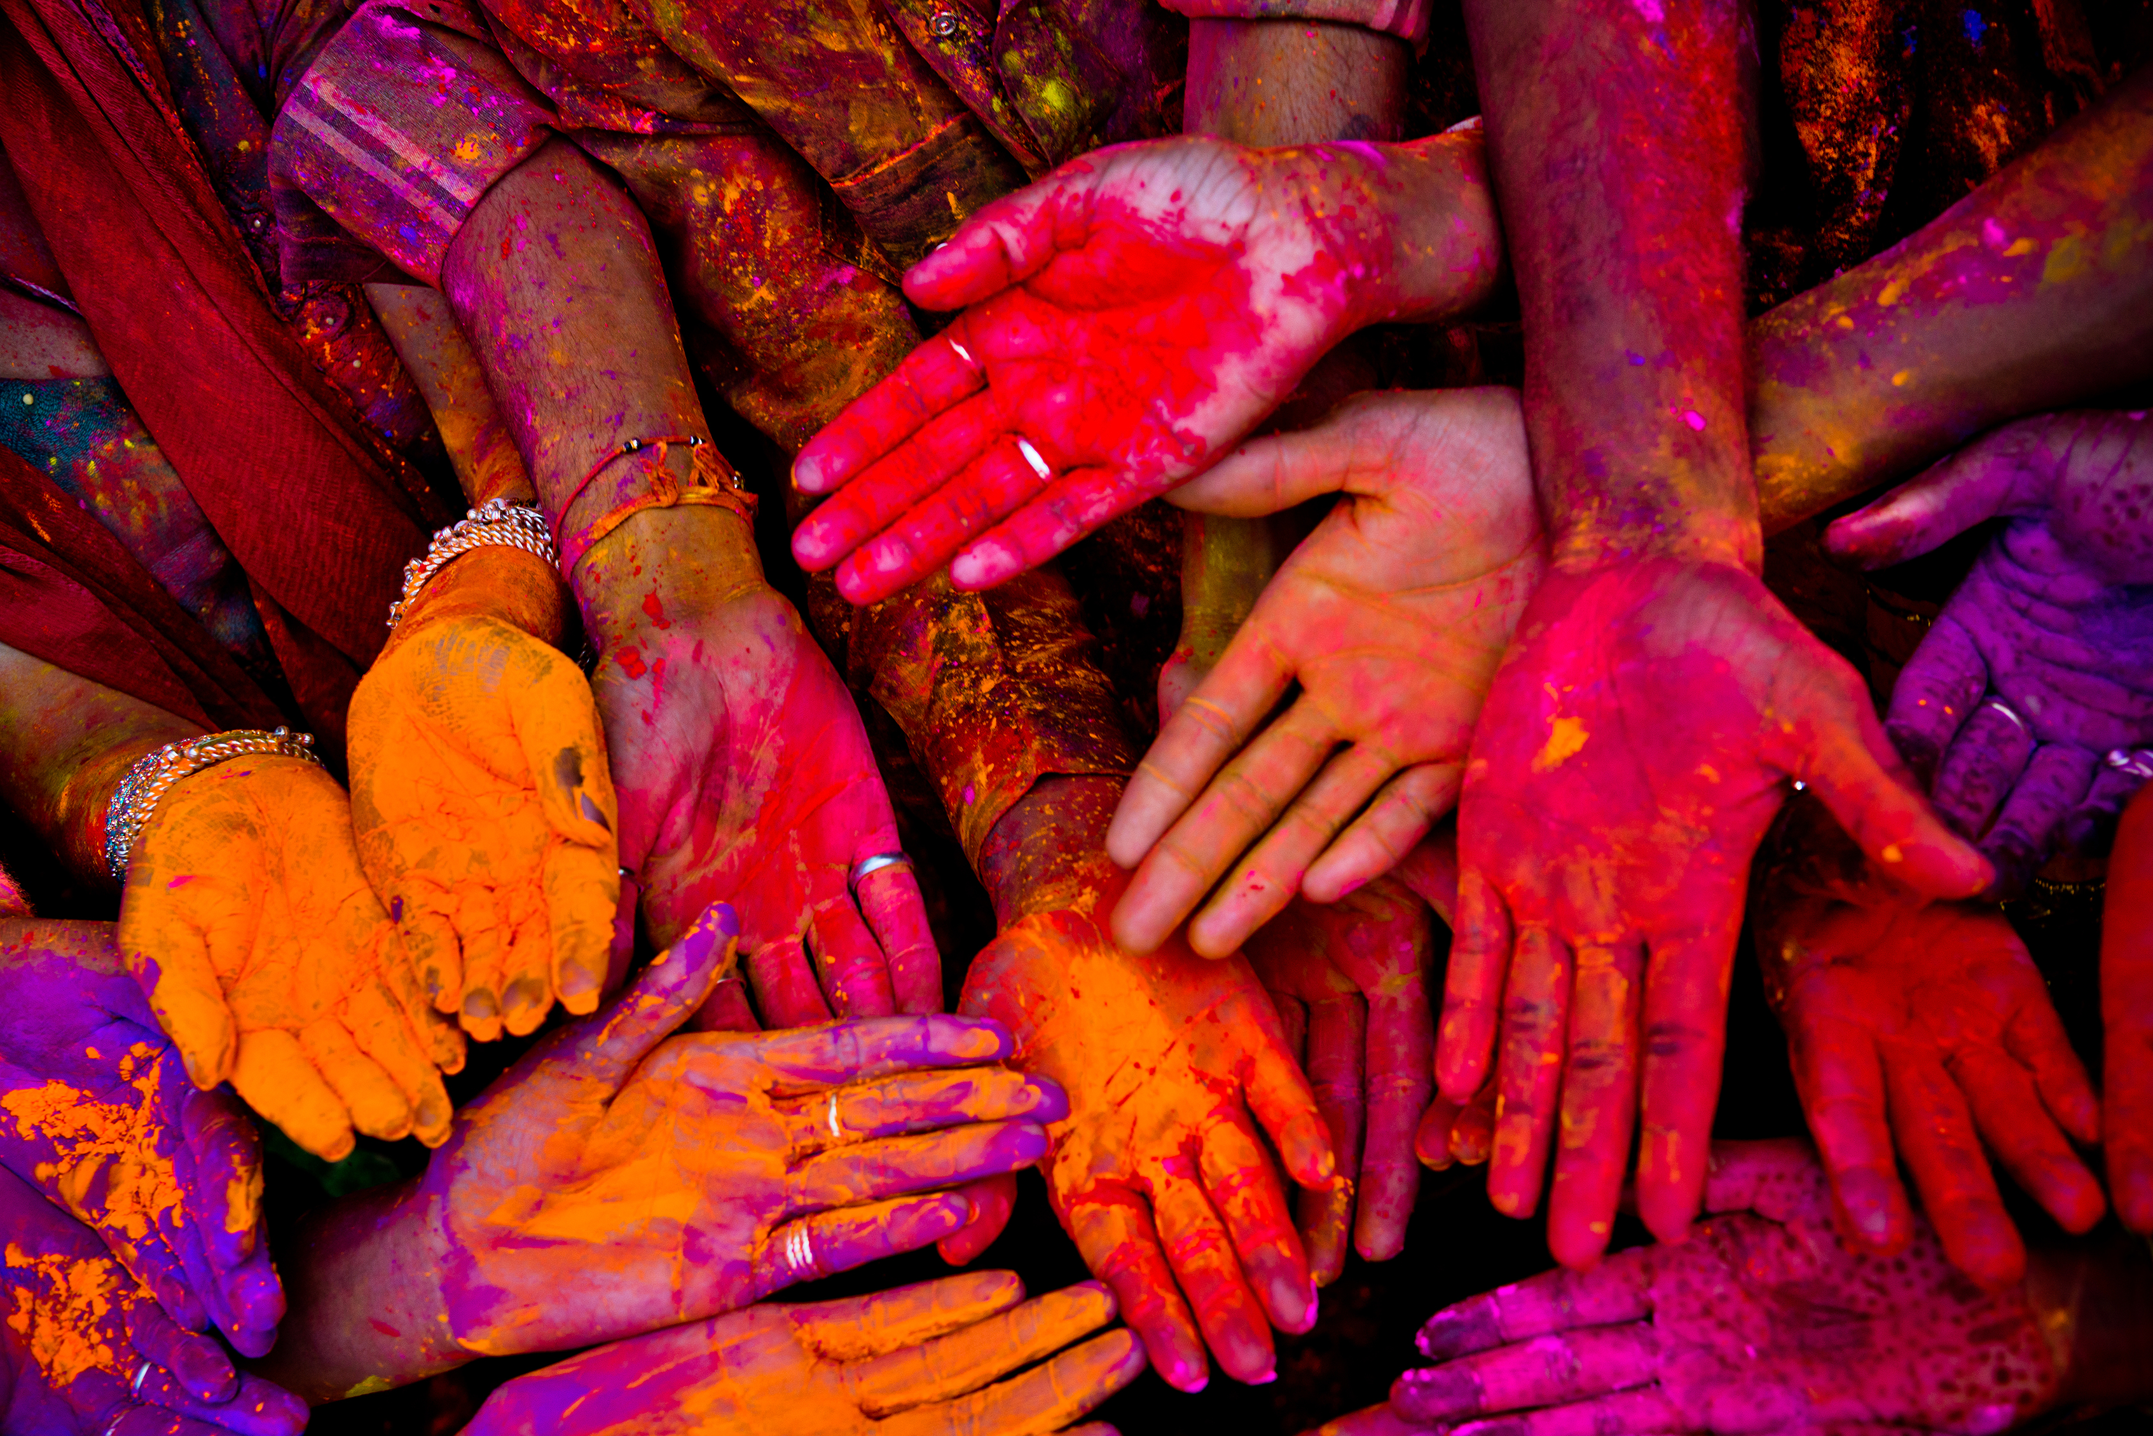
Sport Visualization
By blending sport visualization, disaster ecology, and CQ, you can enable proactive resilience measures across people, places, and systems
Disaster Ecology
Cultural Intelligence

Slide 4
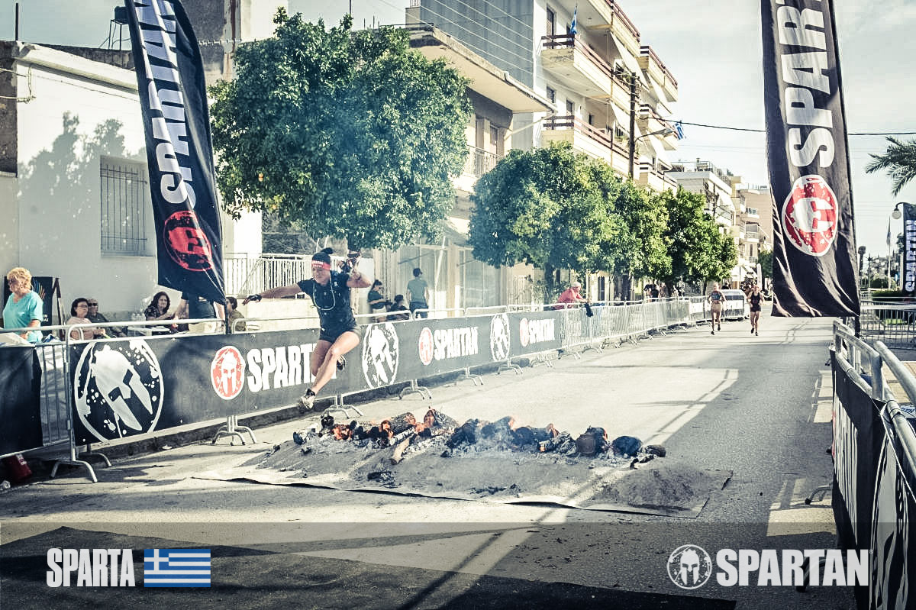
Sport Visualization
The use of mental imagery or visual representation to understand, enhance, analyze, or communicate aspects of sport performance.
Psychological / Performance Context
Analytical / Communication Context
Notes:
In simple terms, sport visualization uses images – in the mind or on the screen – to better prepare, analyze and perform in sport.

Slide 5
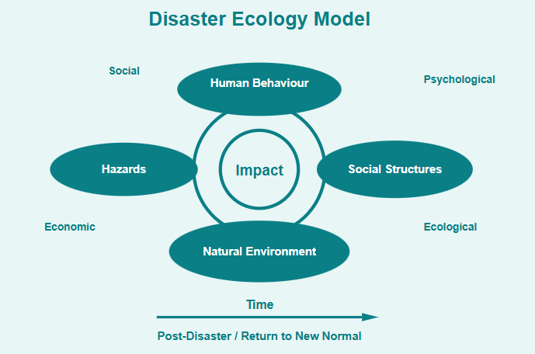
The Disaster Ecology Model
CORE IDEA: Disasters progress through predictable phases, and each phase creates different conditions, behaviour, needs and opportunities for response and recovery!
Is a framework used to explain how disasters unfold and how human systems (individuals, organizations, and communities) interact with their environment across the phases of a disaster.
Notes:
Simple terms: The Disaster Ecology model illustrates how disasters affect people and systems over time.

Slide 6

Cultural Intelligence
Cultural Intelligence (CQ) is the capability to function effectively in situations characterized by cultural diversity.
The Four Dimensions
CQ Drive (Motivation)
CQ Knowledge (Cognition)
CQ Strategy (Meta Cognition)
CQ Action (Behaviour)
Want to → Know → Think → Act appropriately across cultures.
How well someone can understand, respect, and adapt to cultural differences in real world situations
Notes:
CQ Drive (Motivation)
How interested and confident you are in working with people from different cultures.
CQ Knowledge (Cognition)
What you know about other cultures—values, norms, rules, and ways of doing things.
CQ Strategy (Metacognition)
How well you plan, notice, and adjust your thinking in cross‑cultural situations.
CQ Action (Behavior)
How well you adapt your words, tone, and actions when interacting across culture

Slide 7
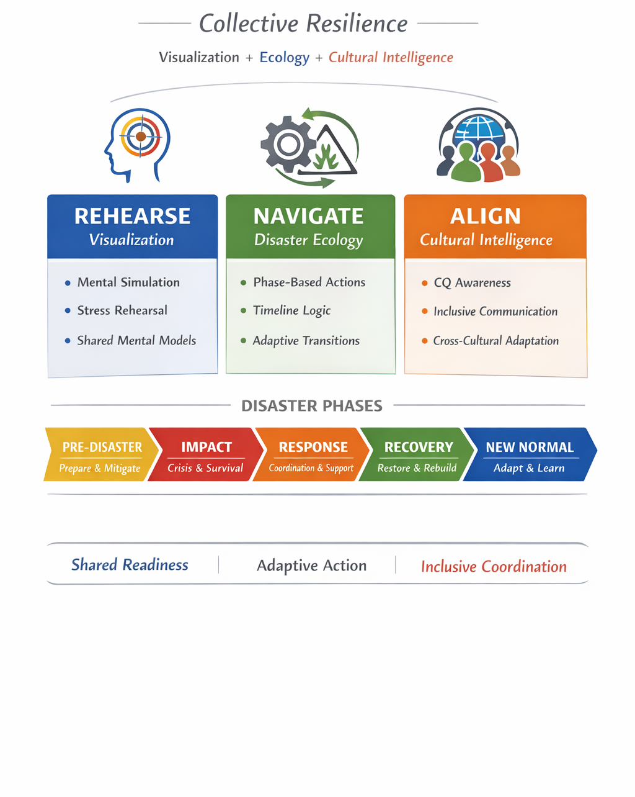
Introducing the V.E.C. Resilience Framework
How the Three Concepts Map Together
Think of them as answering three different—but complementary—questions:
A. Sport Visualization → “How do we perform under pressure?”
B. Disaster Ecology Model → “What phase are we in, and what changes now?”
C. Cultural Intelligence → “How do we coordinate effectively across difference?”
Together:
You get a framework that supports high performance (Visualization), right-time actions (Ecology phases), and right-fit coordination (CQ).
Notes:
A Collective Resilience Framework: V.E.C. Resilience
Visualization (performance rehearsal)
Ecology (disaster as a dynamic system across phases)
Cultural intelligence (adaptive, inclusive coordination)

Slide 8

Final Question for Reflection:
"What changes when we treat culture and local knowledge as critical infrastructure for resilience?"

