Slide 2
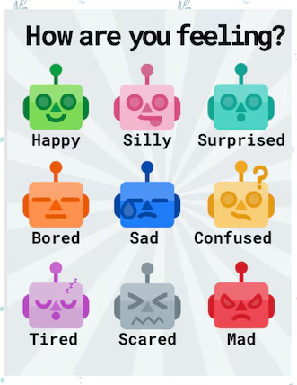
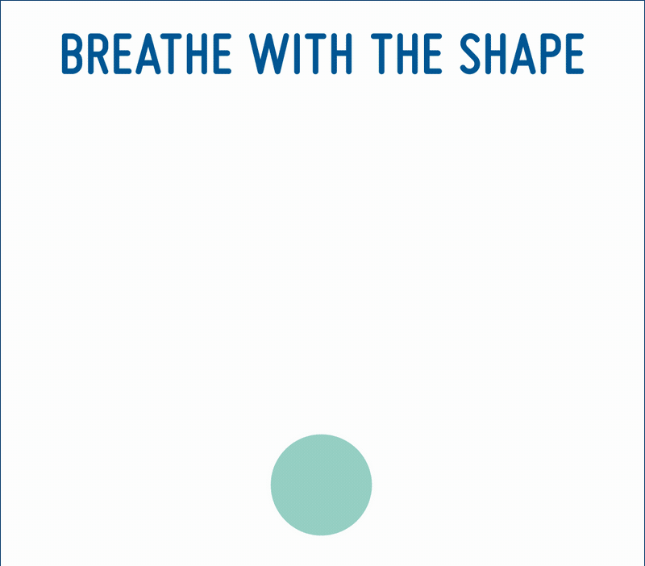

While we wait, choose which Robot mood you’re in and share in the chat. Then, get ready for the learning action!

Slide 3



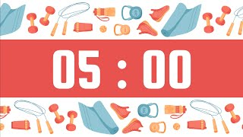


Type your answer in the chat as a waterfall
From which corner of the world are you gracing us with your presence today?
2. What is ONE thing you hope to gain from today’s session?

Slide 4



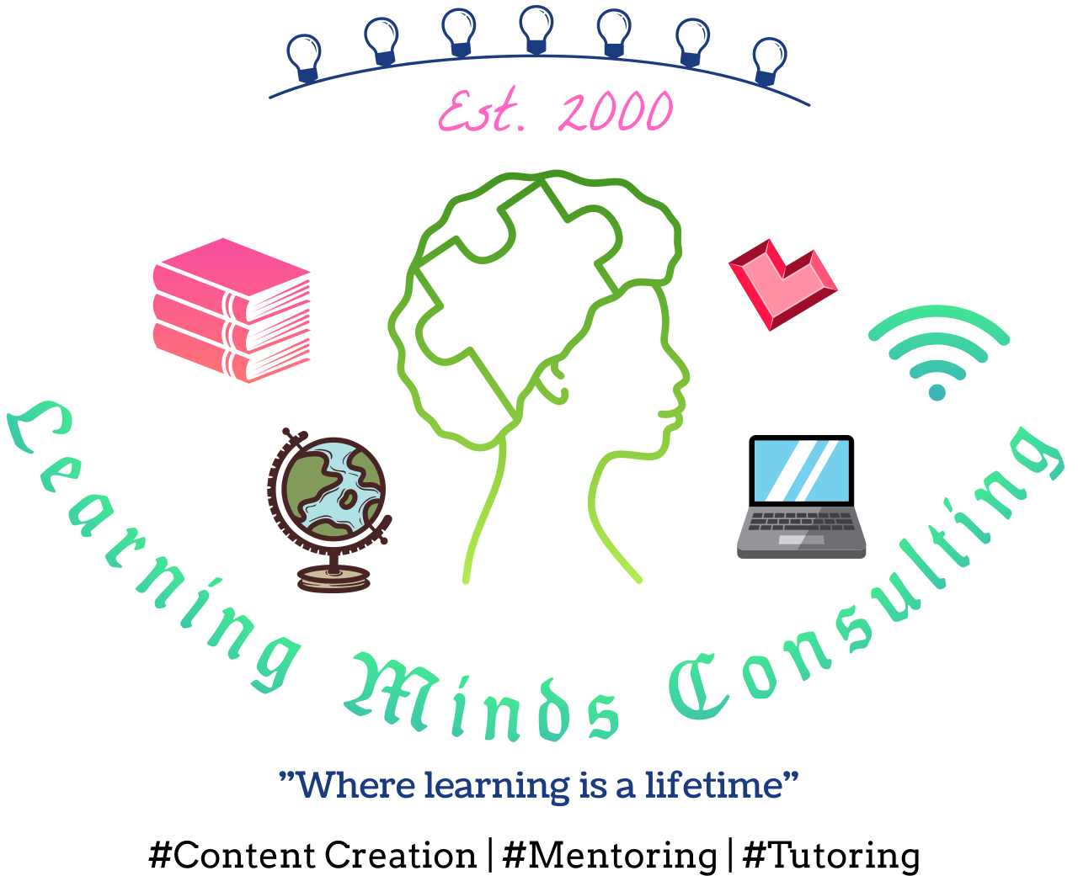
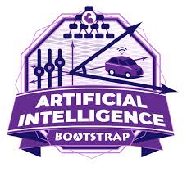

From Data
to Decisions
Bootstrap: AI & Pyret
Professional Development
@ University of New Mexico
June 22–27, 2026
Teaching AI in Data Science
Dr. Sonia Mitchell
Founder, Learning Minds Consulting
CSTA NJ CSPDWeek 2026 | August 3–6
Artificial Intelligence · Data Science · Equity

Slide 5


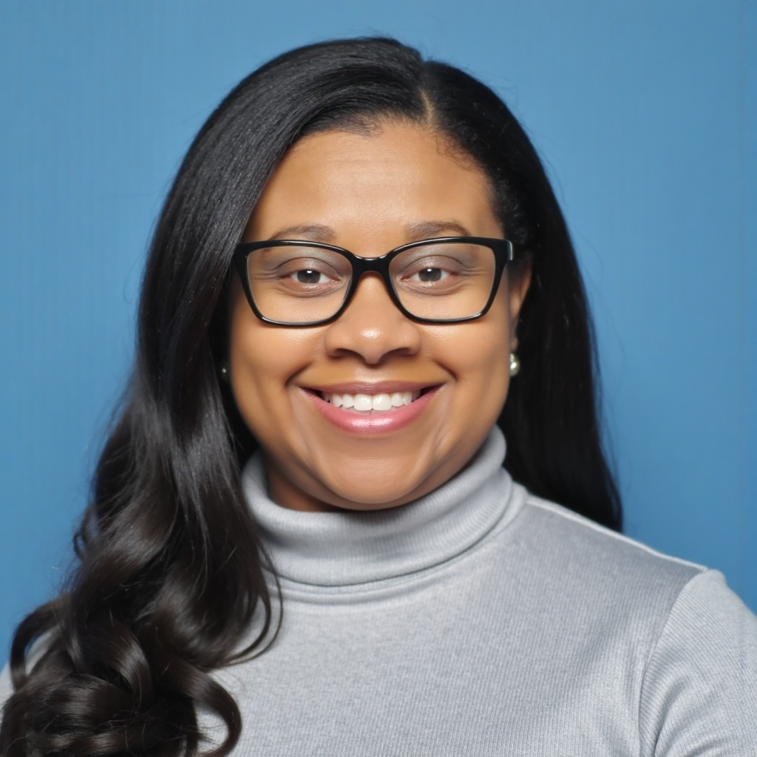
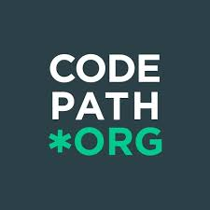

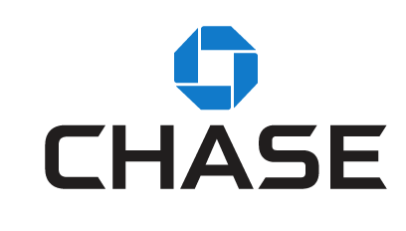
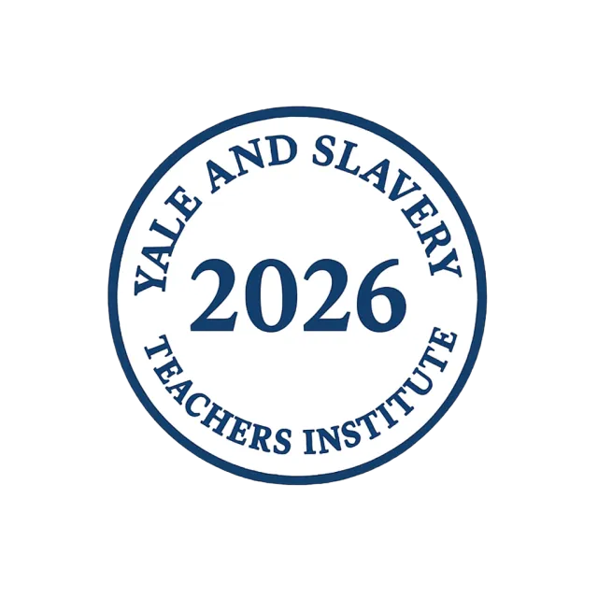




Dr. Sonia Mitchell
Founder/CEO, Learning Minds Consulting
Curriculum and Training Developer
Computer Science, Business & Entrepreneur Instructor
CT PTA Director of Technology, CSTA Standards Writer & Coach
Co-Chair, MA CSTA Pioneer Valley Representative
SCORE Certified Mentor/Workshop Presenter
STARS AI Scholar (Temple University & NC State University)
AI Institute for Societal Decision Making (AI-SDM) Carnegie Mellon University
MIT Hackathon Judge & Mentor (Global AI Hackathon), CodePath Volunteer
Former, Director of Finance & Administration, Director of Annual Giving, Chase Advisory Board Member, CBS Media Correspondent, TBN Media Journalist, Media & Web Development Consultant
25-26 Mark Cuban Foundation AI Teacher Boot Camp Graduate
2026 Selected as a participant University of New Mexico - Data Science + AI
2026 Selected as a participant Yale University Teachers Institute Cohort
Who’s your host?
Notes:
Founder, Learning Minds Consulting | SCORE Mentor & Chapter Leadership

Slide 6
Our Community Norms Agreements
Be Present
be here mentally and physically - your voice matters
Engage Fully
You get out what you put in. Participate actively
Ask & Wonder
If you’re thinking it, someone else is too - ask.
Build Community
Listen, connect, and support one another- we’re learning together
Reflect & Apply
Take time to think about how this applies to your profession and audience.
Share the Air
Make Room
for All Voices to be heard
Have fun!

Slide 7
What We'll Explore Today
60 min
1
🧠 Beyond Using AI — Understanding How It Works
The core premise of Bootstrap:AI and my UNM experience
💻 Bootstrap: AI & the Pyret Programming Language
Interactive
Session
2
Decision trees, regression, NLP, generative AI — grounded in math & statistics
📊 Authentic Datasets & Machine Learning Models
CSTA Standards
Aligned
3
Build, train, and evaluate data-driven algorithms hands-on
4
⚖️ Bias, Fairness, Privacy & Responsible AI
Structured classroom discussions rooted in real-world contexts
Bootstrap: AI
Pyret Platform
5
🎒 Your Take-Home Toolkit
Lesson ideas, sample student projects, and CSTA-aligned resources to implement immediately
CSTA NJ CSPDWeek 2026 | Dr. Sonia Mitchell

Slide 8
ESSENTIAL QUESTION
"How can students use AI
to make real-world data-driven decisions?"
🔍 Where do students already see data influencing decisions?
⚡ What tools give students real analytical power?
🌍 Whose data is represented— and whose is missing?
💬 Discuss with a partner — share out in the main room
THINK · PAIR · SHARE
Quick Breakout ROOMS
CSTA NJ CSPDWeek 2026 | Dr. Sonia Mitchell

Slide 9


Why This Matters
🚀
AI is reshaping every career field
Students need AI fluency to participate in the economy of today — not just tomorrow.
49 states — where Bootstrap is actively used over 50 countries around the globe
🧩
Students must interpret AND question data
Critical thinking about data sources, bias, and conclusions is a life skill.
30K
students — reached by Bootstrap curricula
⚖️
Equity: AI literacy for ALL learners
Access to rigorous, joyful AI learning cannot be reserved for well-resourced schools.
50%
📌
CSTA standards require it
of Bootstrap students identified as Black/Latino
AI and Data Science are now core competencies in CS PK-12 standards.
CSTA NJ CSPDWeek 2026 | Dr. Sonia Mitchell
Notes:
Bootstrap crafts FREE, research-based, integrated Computer Science and Data Science modules for Math, Science, Business and Social Studies classes grades 5-12.
By supporting non-CS teachers in delivering rigorous and engaging computing content in the classes that every student takes - regardless of gender, race, or background - Bootstrap is one of the largest providers of formal CS education to girls and underrepresented students nationwide: nearly 50% of our students are African-American or Latin(x), and nearly 45% are girls and young women. They serve teachers in 49 states and over 50 countries around the globe.
curriculum is not officially specified. The program operates through partner schools and districts nationwide rather than via uniform statewide mandates. More than 15,000 to 30,000 students participate annually, utilizing its math, science, and data science materials across grades 4 through 12.

Slide 10
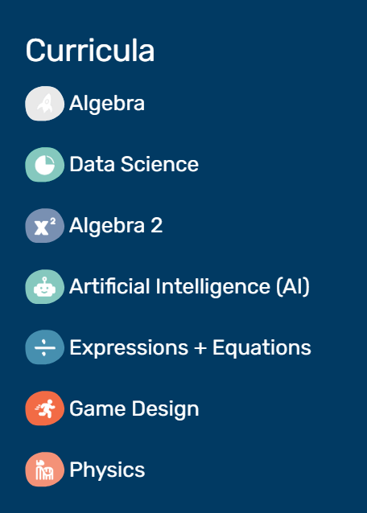
What is Bootstrap?
Bootstrap reimagines math education by integrating Computer Science, Data Science, and AI concepts into mainstream subjects.
Bootstrap Curricula
Bootstrap: Algebra
Bootstrap: Data Science
bootstrapworld.org
Gr. 7–11
Gr. 5–12
Functions, coordinates & game design in Pyret
Real datasets, statistics & CS standards
NSF-funded · Research-backed
Brown · Northeastern · UC San Diego
★ Featured
Bootstrap: Algebra 2
Bootstrap: AI
Gr. 10–12
Gr. 6–12
Quadratics + data modeling
ML concepts, bias, ethics & responsible AI
Bootstrap: Game Design
Bootstrap: Physics
Gr. 8–12
Gr. 9–12
AP CS Principles Integration
Computational modeling with AAPT
CSTA NJ CSPDWeek 2026 | Dr. Sonia Mitchell

Slide 11

Meet Pyret
Bootstrap's purpose-built programming language for data science & AI — used at UNM's Data Science + AI Professional Development Training Session, June 2026
🌳
Decision trees & classification
# Train a simple decision-tree classifier
Students build and evaluate classifiers on real data — seeing accuracy, errors, and tradeoffs firsthand
import ml as ML
import gdrive-sheets as GS
# Load real shelter data
📉
Regression & prediction
animals = load-table: name, species,
Fit linear models to scatter plots; understand slope, residuals, and what "fit" actually means
age, weight, adopted
source: animals-sheet.sheet-by-name(...)
end
Natural language processing
💬
# Split into training / test sets
Explore tokenization and word frequency — making NLP tangible without black-box libraries
training = animals.filter(lam(r):
r["id"] <= 200 end)
test = animals.filter(lam(r):
Generative AI foundations
r["id"] > 200 end)
🤖
Examine how generative models learn patterns from data — connecting to tools students already use
# Fit and evaluate
model = ML.decision-tree(training, "adopted")
model.accuracy(test)
⚖️
Math + ethics as one thread
code.pyret.org | browser-based, no install
Every model is interrogated: who does it serve, who might it harm, and what does the data miss?
CSTA NJ CSPDWeek 2026 | Dr. Sonia Mitchell

Slide 12
The Bootstrap: AI Curriculum
Students understand how AI works — not simply use it | UNM Data Science + AI Professional Development Training, June 22–27, 2026
💡 Core idea: Bootstrap:AI is built around the conviction that students should understand how AI works — not simply use AI tools. Through Pyret, mathematical reasoning, and ethical reflection, students go behind the curtain.
1
Data-Driven Algorithms
4
Generative AI — Behind the Curtain
What makes an algorithm "data-driven"? Students compare rule-based vs. learned models using Pyret and authentic datasets.
Explore how generative models learn patterns. Students critically evaluate outputs rather than accepting them at face value.
2
Decision Trees & Regression
5
Bias, Fairness & Responsible AI
Build, visualize, and evaluate classifiers. Explore linear regression to model relationships between variables.
Trace bias from data collection → model training → real-world decision. Who is harmed? Who benefits? What should we do?
3
Natural Language Processing
Tokenize text, analyze word frequency, and examine how machines "read" — connecting to generative AI students already encounter.
CSTA NJ CSPDWeek 2026 | Dr. Sonia Mitchell

Slide 13
Mini Lesson Snapshot
Driver
Navigator
Mechanic
A sample instructional flow — ready to adapt for your classroom
DO NOW
DIRECT INSTRUCTION
GUIDED PRACTICE
STUDENT TASK
EXIT REFLECTION
5 min
10 min
15 min
15 min
5 min
What patterns do you notice in this dataset?
Intro to AI + Data Patterns
Analyze a dataset using an AI-supported tool
Identify trends + share insights
Ethical pause
Display a simple table (animals, census, sports stats). Students observe for 2 minutes, then share 1 observation with a partner.
Define AI, training data, and patterns. Use Bootstrap:AI Workbook framing. Show how Pyret loads a dataset with one command.
Pairs work in Pyret: filter, sort, and scatter-plot. Teacher circulates with guiding questions from the Bootstrap:AI workbook.
Groups produce a 3-sentence data story: What did you find? What might explain it? What question does it raise?
What bias might exist in this data? How could an AI trained on it impact decisions unfairly? Sticky-note or digital exit ticket.
CSTA NJ CSPDWeek 2026 | Dr. Sonia Mitchell

Slide 14
Students Will Be Able To...
Learning outcomes drawn from Bootstrap: AI and my UNM Data Science + AI Professional Development Training experience
1
🔬 Analyze authentic datasets using AI-supported tools and Pyret
2
🌳 Build and evaluate data-driven algorithms & simple ML models
Load, filter, visualize, and interrogate real data — forming and testing hypotheses through code.
Train decision trees and regression models; evaluate accuracy, errors, and fairness tradeoffs.
3
📈 Identify patterns, trends, and anomalies through data visualization
4
🧠 Investigate decision trees, regression, and NLP in age-appropriate ways
Distinguish meaningful signal from noise using scatter plots, bar charts, and statistical reasoning.
Explore how machines classify, predict, and process language — grounded in math, not magic.
5
⚖️ Examine bias, fairness, privacy & responsible AI
6
🔗 Connect math, CS, and data science using Bootstrap's project-based framework
Trace bias from data collection through training to real-world outcome — and propose mitigations.
See how statistics, algorithms, and ethics converge — and design projects centered on community.
CSTA NJ CSPDWeek 2026 | Dr. Sonia Mitchell

Slide 15
Ethics & Responsible AI
Critical questions every data science student should learn to ask
🔍
🤔
⚖️
🌍
What bias might exist in this data?
Who collected it,
and why?
How can AI impact
decisions unfairly?
Who benefits — and
who is harmed?
💡 Takeaway for Today:
One strategy you can use tomorrow — AI-powered data analysis with students — starting with the Bootstrap: AI Workbook and Pyret.
CSTA NJ CSPDWeek 2026 | Dr. Sonia Mitchell

Slide 16
Your Take-Home Toolkit
Leave today ready to teach — resources aligned to CSTA standards, ready to implement immediately
📓
Bootstrap: AI Student Workbook
💻
Pyret Programming Environment
🐾
Sample Student Projects
Free, browser-based. Covers data-driven algorithms, decision trees, regression, NLP, and generative AI — grounded in math and ethics.
code.pyret.org — students load real datasets, build and test classifiers, plot scatter plots, and explore ML models. No install needed.
Ready-to-use Bootstrap: AI project frameworks: choose a dataset, explore patterns, build a model, evaluate fairness, present findings.
bootstrapworld.org/curricula/ai
code.pyret.org
bootstrapworld.org/materials
🗂️
Ready-to-Use Lesson Activities
📐
CSTA Standards Alignment Guide
🎓
Strategies for Integration
Practical strategies for integrating AI into existing CS and Data Science courses — modular, standalone, or sequenced.
Every activity mapped to CSTA K–12 CS Standards covering data analysis, algorithms, and societal impacts of computing.
Practical approaches for weaving Bootstrap:AI into AP CSP, data science electives, math courses, or standalone AI units.
bootstrapworld.org/materials/latest
CSTA NJ CSPDWeek 2026 | Dr. Sonia Mitchell

Slide 17
Bootstrap:AI - Contact Information
Website: BootstrapWorld.org
AI Materials: BootstrapWorld.org/materials/latest/en-us/courses/ai
  100% Open Source, Creative-Commons
Email: contact@BootstrapWorld.org
Upcoming PDs:
  Unfortunately, the public workshops for the summer are drawing to a close August 7th
  Our summer calendar is posted by March of each year (tune in March '27!)
  Looking for something sooner? Email to set up a private workshop for your school or district.

Slide 18
Let's Keep the Conversation Going!
🌐 learningmindsconsulting.setmore.com
🔗 linkedin.com/in/drsoniamitchell
📧 drmitchell.learningminds@gmail.com
📚 bootstrapworld.org/curricula/ai
"Equitable AI education isn't a privilege — it's a right.
Every student deserves to understand the tools shaping their world."
— Dr. Sonia Mitchell
CSTA NJ CSPDWeek 2026 | August 3–6
Bootstrap:AI · Pyret · Data Science for All
Notes:
https://learningmindsconsulting.setmore.com/

Slide 19

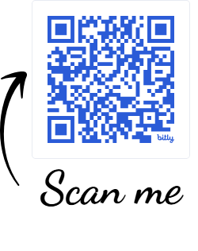

Recap of the Workshop
Chance to win free coaching session and Gift Card
Complete Feedback Survey
For Quality Assurance, please complete the Feedback Survey
Notes:
https://forms.gle/mo5Kww8ufWc1i5Bh8

Slide 20

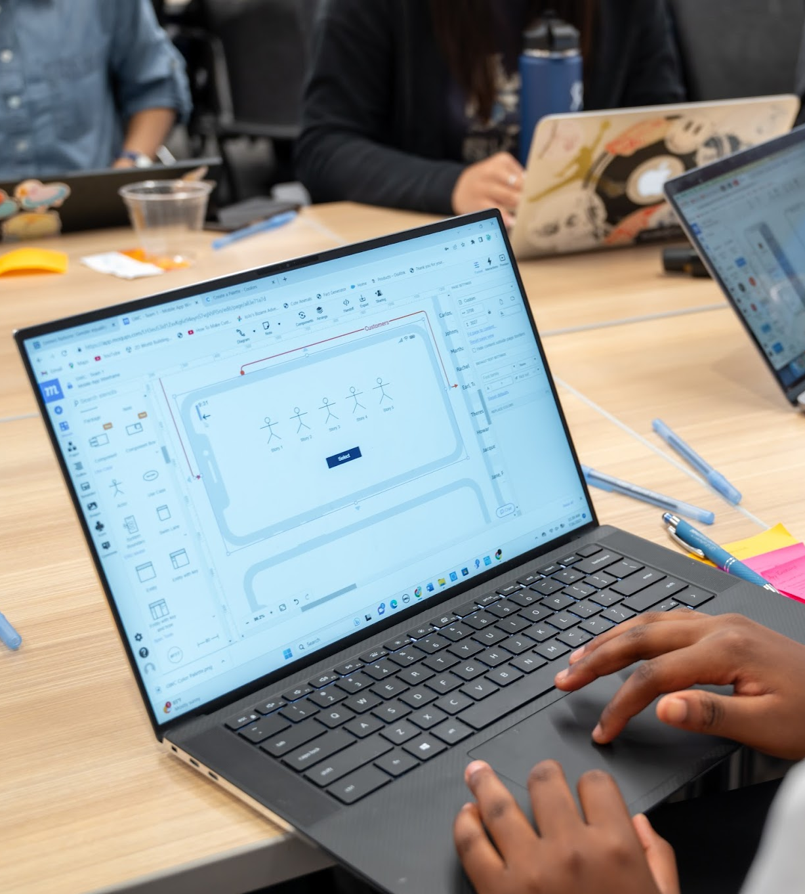





NEED TECH SUPPORT? TECH AUDIT?
WEBSITE
www.techcsblog.com
Text for Answers
424-234-1673
EMAIL
TechnologyCTpta@gmail.com

Slide 21
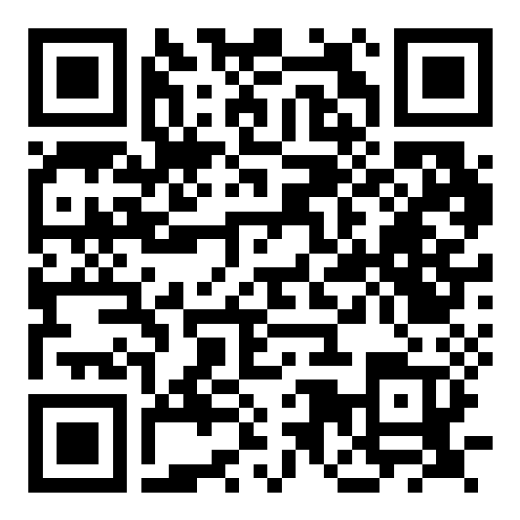



Thank You! Q&A
Let’s Stay Connected
Dr. Sonia Mitchell
Email1: TechnologyCTpta@gmail.com
Email2: drmitchell.learningminds@gmail.com
SCAN QR CODE
Find me on LinkedIn
Find me on BlueSky @cslady76.bsky.social
Digital Biz Card
Notes:
@cslady76.bsky.social
LinkedIn Group - Turning to Digital

Slide 22


Slide 23

