Slide 2
Workshop description
This Intermediate Java workshop is designed for learners who have completed the Java for Teachers course or who have basic experience with the Java programming language, including declaring variables, printing to output, writing conditional statements, and using loops.
To build on this foundation, learners will be introduced to key object-oriented programming concepts in Java:
as using objects as data types
understanding the structure of a class
writing and calling instance methods
Time permitting—basic inheritance

Slide 3



Java
classes && methods

Slide 4


Lora Santucci
Math & Computer Science teacher
Morris Hills HS
Rockaway, NJ
Goal: to create confident novice java programmers!

Slide 5

What is a class in Java?
Notes:
Source: https://www.youtube.com/watch?v=90_FL8P3JAs

Slide 6
An executing program in Java is comprised of interacting objects
Objects send messages to each other to accomplish the mission of the program:
An object is an instance of the class
An object has attributes (data) and methods (behavior)
You must first create an object before using it using the constructor
Notes:
Notes slide - teacher will discuss, students should follow/review

Slide 7
How to use class (user-defined) data types in a program
Design and implement the code that defines a class type
//more to come on this...
Create variables of that class type in a client program
Call methods, etc. on the objects to achieve your program goal!

Slide 8
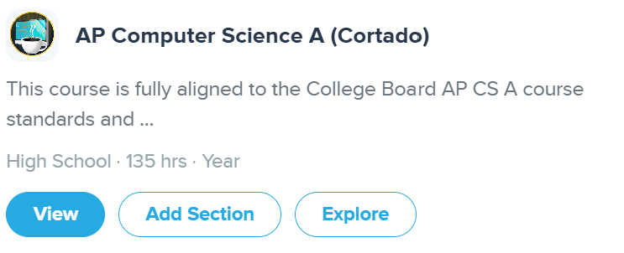
codeHS ~ Cortado
join as a student Java for Teachers: codehs.com/go/E53EC

Slide 9
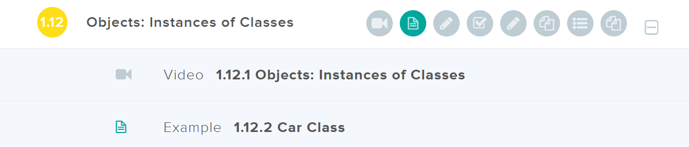
Let's look at an example ~ The Car class on CodeHS
This project includes 2 files (classes):
Car.java ~ defines the Car as a new data type
CarRunner.java ~ includes the main method

Slide 10
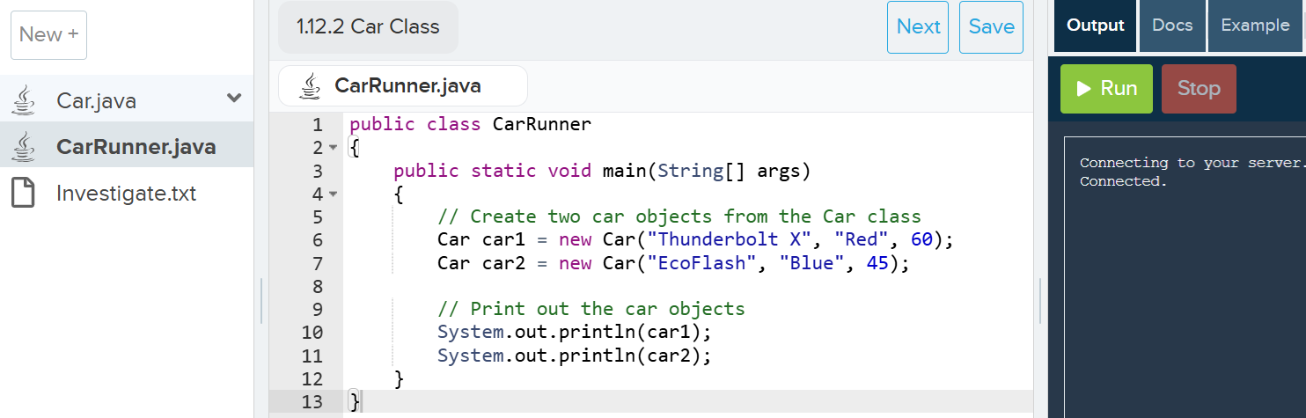
the Runner class (& main method)

Slide 11
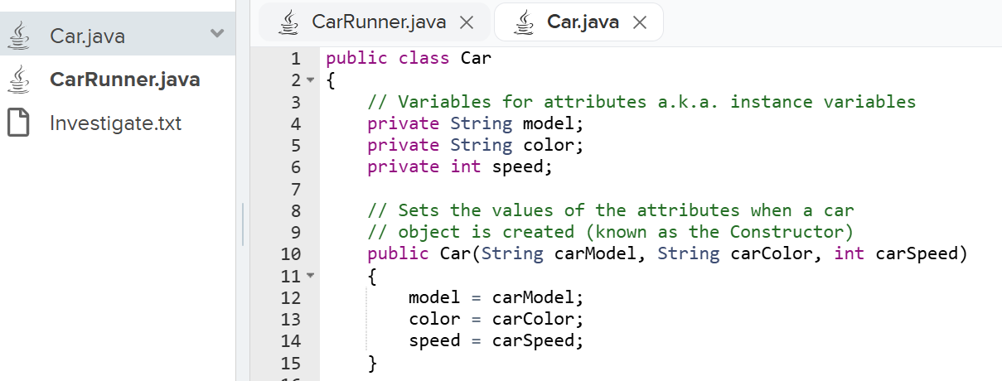
data: what makes a Car a car...

Slide 12
constructor: how to "create" a car

Slide 13
methods
are behaviors
have ONE job
interface with the program through parameters and return values

Slide 14
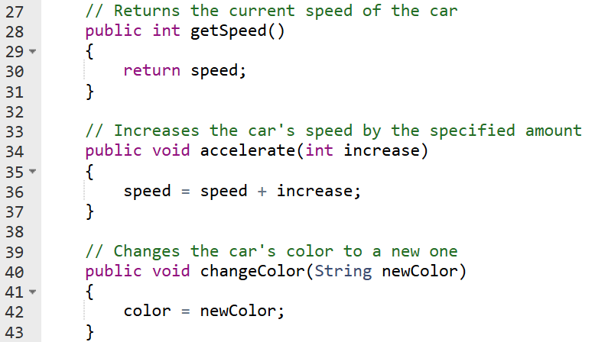
Car class instance methods

Slide 15
Car class instance methods

Slide 16
Car class instance methods

Slide 17
GUIDED CODING:
let's try writing a method together:
Writing instance methods
codehs.com/sandbox/id/methods-demo-57pDnD

Slide 18
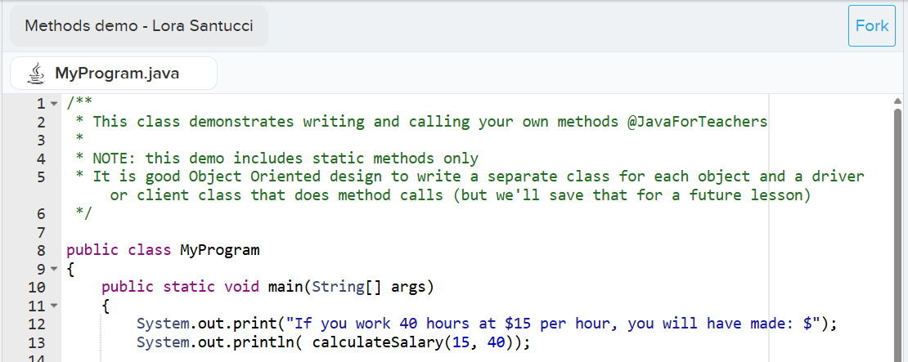

Slide 19
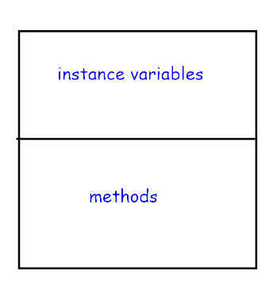
Using Object Diagrams to design a class
Notes:
Notes slide - teacher will discuss, students should follow/review

Slide 20
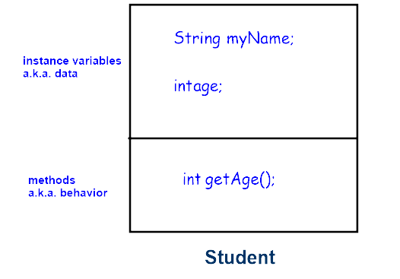
Let's say we want a Student class:
private
may return values & accept input (parameters)
Notes:
Notes slide - teacher will discuss, students should follow/review

Slide 21
Create your own object ~ actual student examples
Movie
Snowman
Refrigerator
Minecraft
Custodian
City
Superhero
Classroom
Principal
Car
Tax
Netflix
Caveman
Duck
Notes:
Each group presents their object diagram:
A student keeps track of object names on the board
They all VOTE on ONE with applause by clapping (really loudly)
Some worked really well (Car, Custodian, next slide), some didn't work so well (Tax - difficult to define, Netflix - too complex for our current needs)

Slide 22
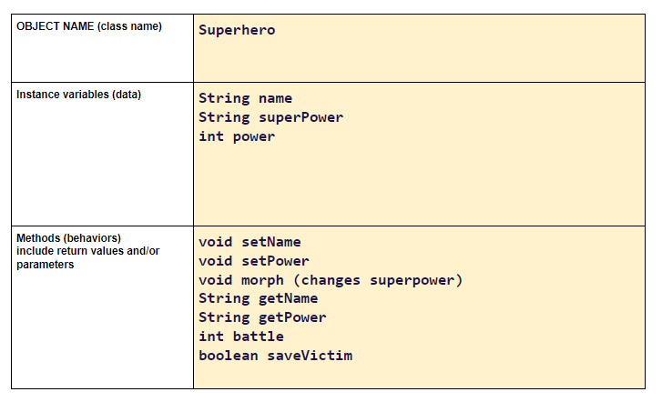

Design your own object ~ sample
Notes:
One of my favorite student samples

Slide 23
Let's design, create, and use our own class!
If you could design any object, what would YOU choose and why?
type your answer in the chat

Slide 24
Design our class with your group!
Discuss && decide:
  What will you call your class?
  What private instance variables should it have?
  What public methods should it have
Draw an object diagram:
make a copy of these slides and type on the next slide
Notes:
DIRECTIONS SLIDE: complete activity on the NEXT slide

Slide 25

CREATE YOUR OWN Object Diagram template
private data
(include types)
behaviors
(method names, etc)
Class name:
Notes:
OPTIONAL - use this slide OR the Design Your Own Object google doc (you do not need to use both): https://docs.google.com/document/d/1zcnRmTnhsMkZr9f5P8qkmsA8TQuTmtziFafZoL2oM9o/edit?usp=sharing
Choose ONE group member to be the recorder (type info in the yellow boxes)
Choose ONE group member to be the presenter (share with the class)
Choose ONE group members to be the manager- keep group on task
Choose ONE or more group member to be the timer - watch time

Slide 26
BREAK

Slide 27


Slide 28
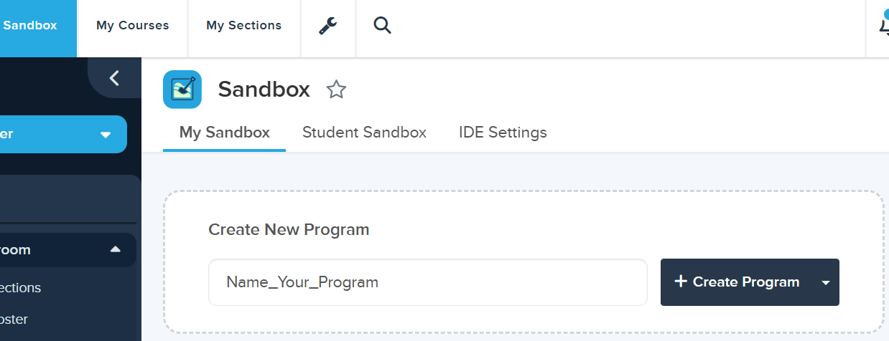
GUIDED CODING: let's implement our class

Slide 29
GUIDED CODING: Let's create a class that represents our own object
at least 2 instance variables
at least one default constructor
at at least one overloaded constructor
at least two accessor methods
at least two mutator methods
a toString() method
(CodeHS sandbox)
Notes:
Notes slide - teacher will discuss, students should follow/review

Slide 30
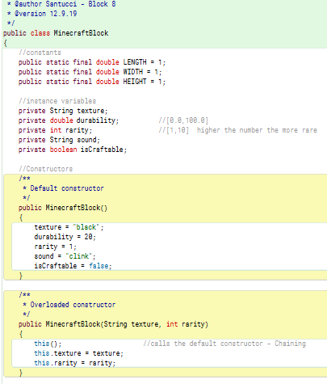
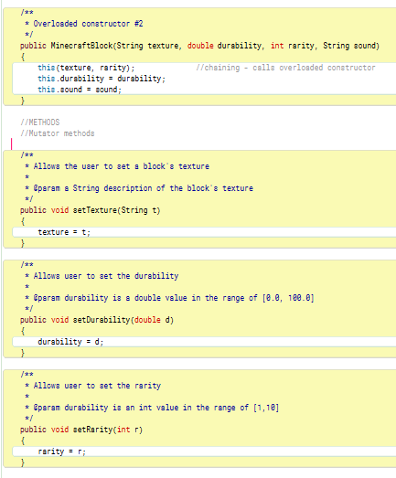

Slide 31
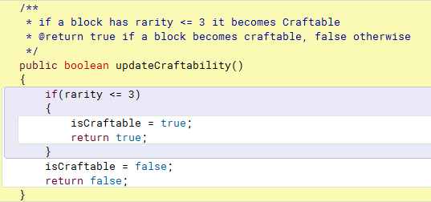
Notes:
Add some methods with a little functionality.
Can take this to the level your particular students need
Follow their lead and provide necessary guidance

Slide 32
Using a class type as a new data type!
Add a new file to your project called SampleClassRunner.java
add a main method signature
create (construct) several instances of our new class
test your objects:
call some methods using dot notation
print to output (System.out.println(...))

Slide 33
Improving the user interface
We can make our client class:
- menu driven
gives the users choices (use a Scanner & if statements)
- task controlled
asks the user if they want to continue (use a loop)

Slide 34
Extension ~ Inheritance

Slide 35
Inheritance
A hierarchy where one class INHERITS all of the data and behaviors of its PARENT class
extends
A keyword that allows the subclass to inherit all of the characteristics of the base class.
example: public class APStudent extends Student
super
A keyword that refers directly to the parent class; as opposed to this. or this() you would use super. or super()

Slide 36
Old Mac Donald
Collaborative CodeHS Activity if time

Slide 37

Notes:
Source: https://www.youtube.com/watch?v=ZqGSg4b_cZA&t=4s

