Slide 1
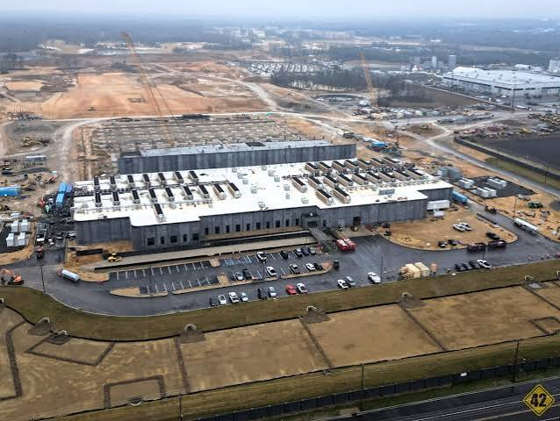
Data Centers need:
Drinking Water
Land
Electricity

Slide 2
Electricity
The average homeowner will
pay 37% more for electricity

Slide 3
Land
220 + Acres is needed for an average sized data center.

Slide 4
Drinking Water
One drop of drinking water is gone from planet earth per AI question.

Slide 5
AIR and Sound POLLUTION
Data centers pollute the air by emitting pollutants such as;
Nitrogen oxides, methane, volatile organic compounds and fine particulate matter.
Data centers may exceed 90 decibels of sound and anything more than 85 decibels is considered harmful for humans.

Slide 6
Resources;
https://www.environmentalhealthproject.org/post/the-dangers-of-data-centers
https://www.fwpcoa.org/content.aspx?page_id=5&club_id=859275&item_id=130961

Slide 7
Other interesting videos;
Building data centers secretly
https://www.youtube.com/watch?v=dWNNgltZSlA
Health issues due to sound pollution from data centers
https://www.youtube.com/watch?v=t-8TDOFqkQA

