Slide 2
Topics in Data Science
Lora Santucci ~ Morris Hills High School, Rockaway, NJ
8-12 ~ 10am
4-7 ~ 1pm

Slide 3
Topics in Data Science Workshop description:
Participants will be given a brief introduction to steps in the data science process. These include forming good statistical research questions, collecting data, cleaning data, statistics, exploratory data analysis, and interpretation of graphical data displays. Special consideration will be given to dealing with bias in data collection and presentation, and ethical use of data. This presentation will align topics with the new NJ Computer Science standards and will provide materials for use in the classroom and/or further study.

Slide 4

DISCLAIMERS:
You won't learn everything you need to know about Data Science.

Slide 5
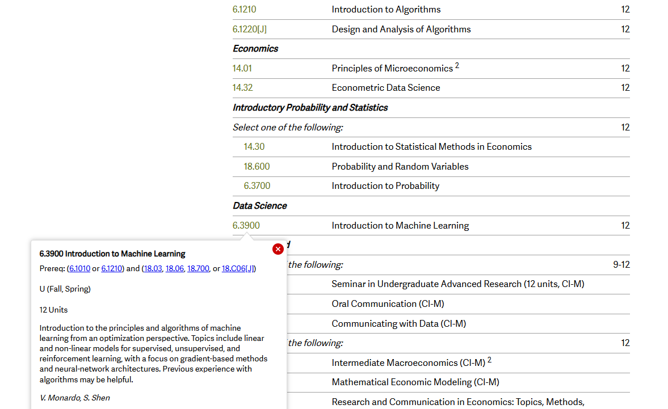


Slide 6
DISCLAIMERS:
You won't learn everything you need to know about Data Science.
What we WILL do today:
Learn about the Data Science process
See where Data Science fits in our CS curriculums & K-12 standards
Get classroom ideas that are fun (hopefully) and ready to adapt/use
Share ideas and resources!

Slide 7



Without data, all we have is an opinion
Notes:
A quote typically attributed to Edwards Deming (virally on the Internet) - but there's no evidence that he ever said or wrote this.
Edwards Deming was a statistician and businessman

Slide 8

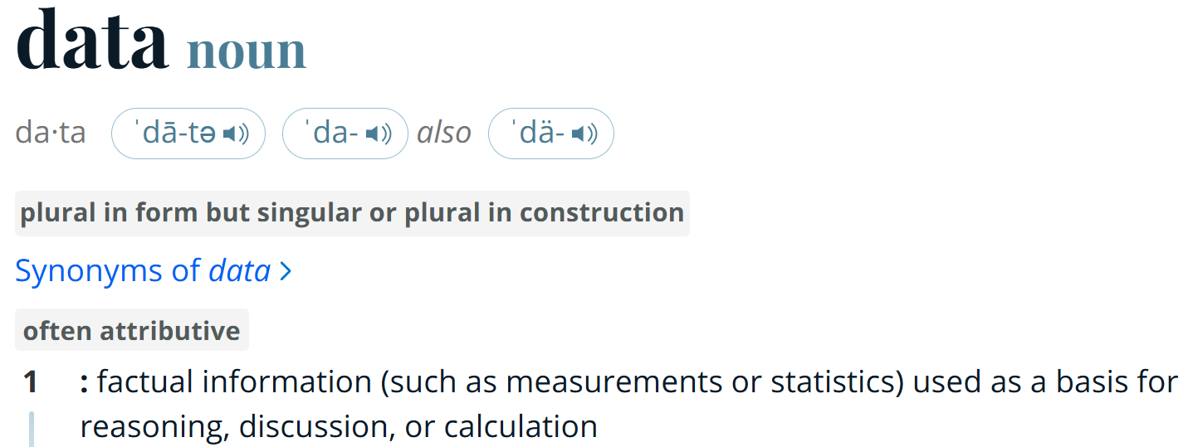
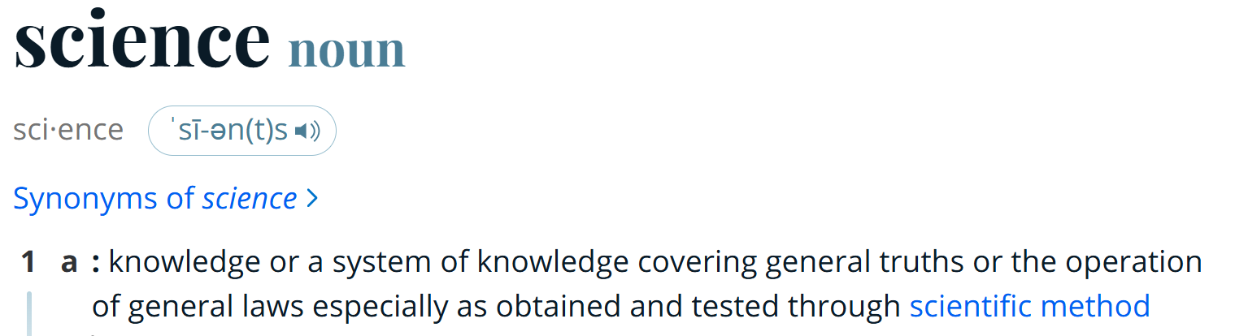
Source: merriam-webster.com/dictionary/

Slide 9
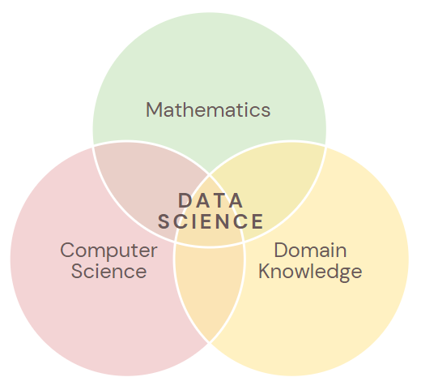

Slide 10
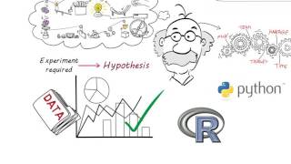
What is Data Science?
Notes:
Source: The Data Scientist - 60 Second Data Science https://www.youtube.com/watch?v=i2jwZcWicSY

Slide 11
Data Science has been around since the 1960s as a subset of Computer Science
It became popular with the advent of AI, deep learning, and machine learning in the 2000s
Data Science was first used as a job title in 2008 at Facebook and LinkedIn and the Harvard Business Review called it the "sexiest" career
The employment rate for data scientists is predicted to grow by 36% from 2021 to 2031
49% of the job ads on LinkedIn are in the IT & Tech industry
Only 33% of job ads specifically require a data science degree
Average salary in the US is as high as $212,544/year (Indeed.com)
Most in-demand coding skills for data science experts are Python, R, and SQL
Source: https://365datascience.com/career-advice/data-scientist-job-outlook/
wow!
Notes:
Source: https://365datascience.com/career-advice/data-scientist-job-outlook/
https://resources.noodle.com/articles/when-did-data-science-start/#:~:text=Data%20science%20started%20in%20the,became%20possible%20in%20the%202000s.
https://www.techtarget.com/searchenterpriseai/definition/data-scientist?Offer=abt_pubpro_AI-Insider

Slide 12
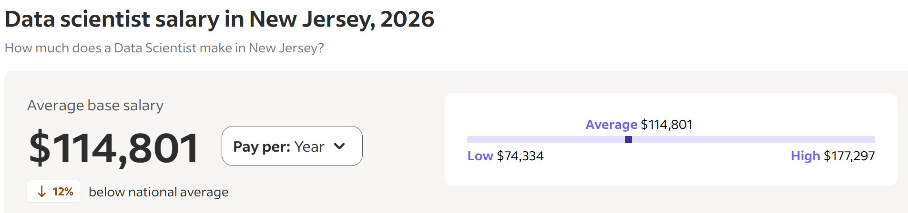
see what I did there when communicating the data?
Source: Indeed.com

Slide 13
The process of creating a system of truths out of factual information
Notes:
A quote typically attributed to Edwards Deming (virally on the Internet) - but there's no evidence that he ever said or wrote this.
Edwards Deming was a statistician and businessman

Slide 14
The Data Science Process
help_outline
Ask questions
storage
Collect & Clean data
analytics
Analyze data
insights
Communicate results
but first let's look at Data Science in the standards

Slide 15

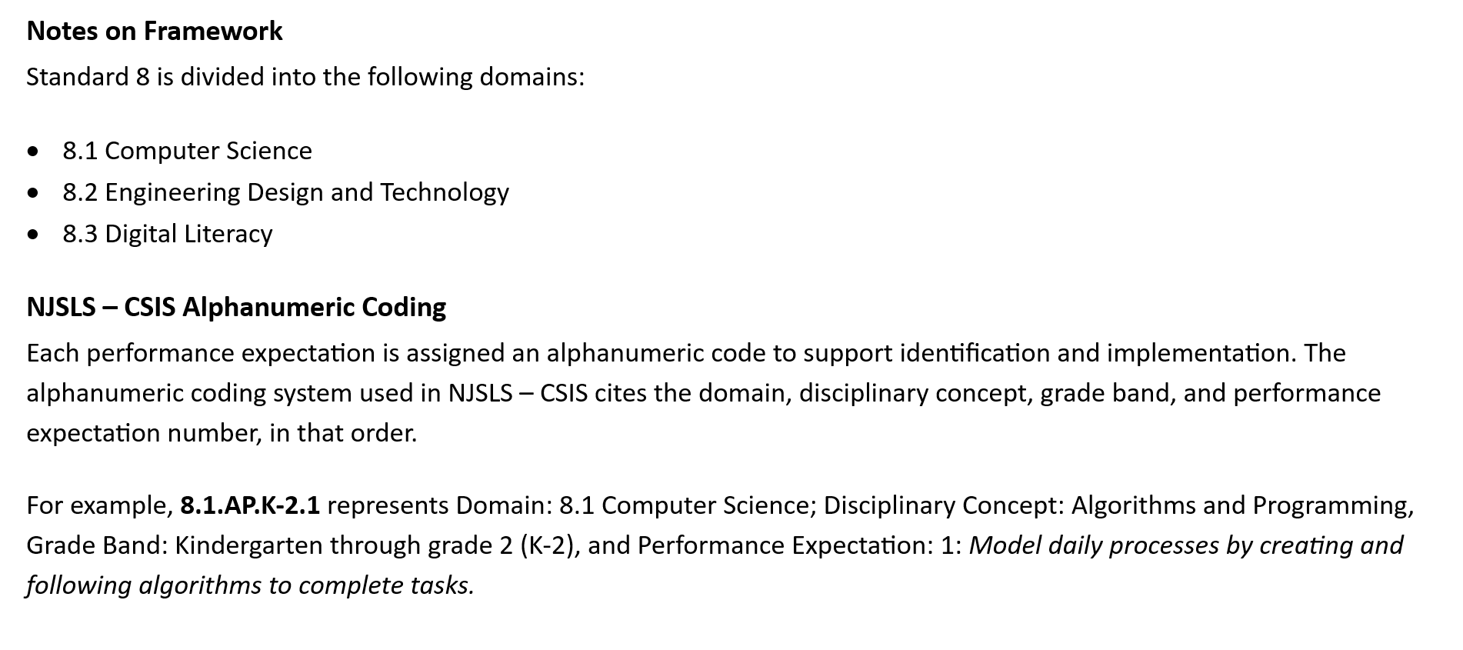
the new CS NJSLS ~ 8.1
help make useful for teachers

Slide 16
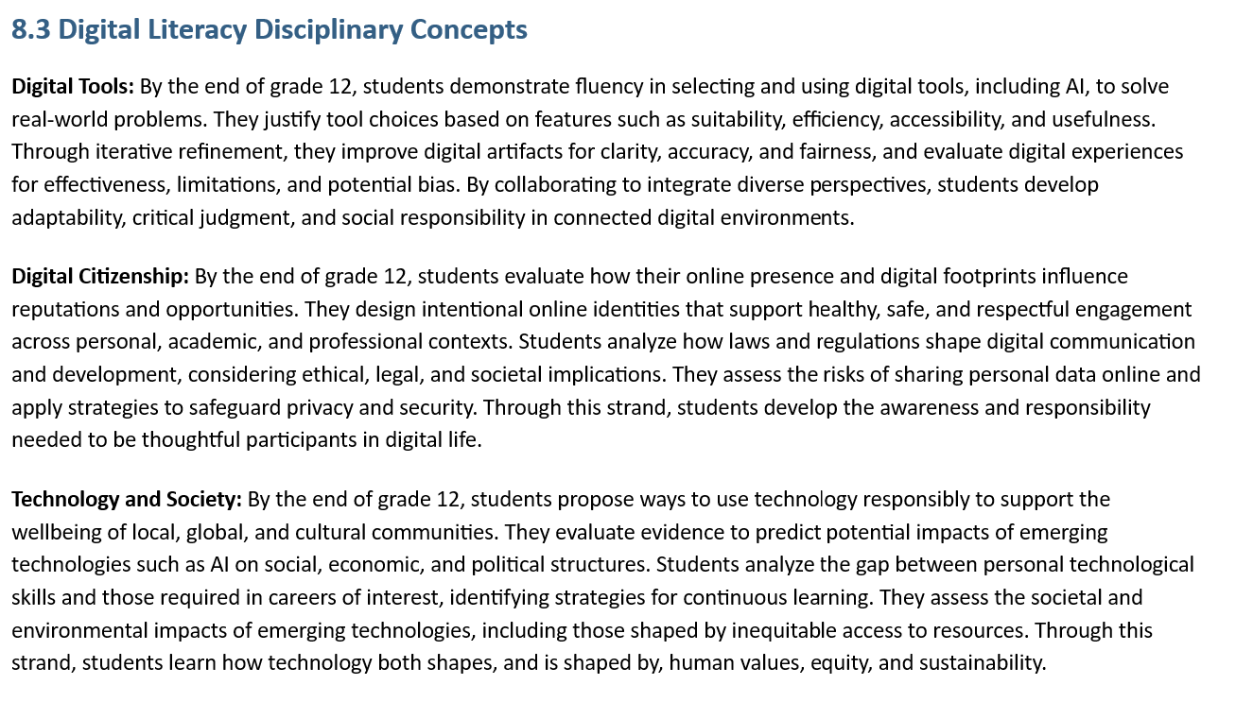
Related: NJSLS 8.3 Digital Literacy ~ refined & elevated

Slide 17
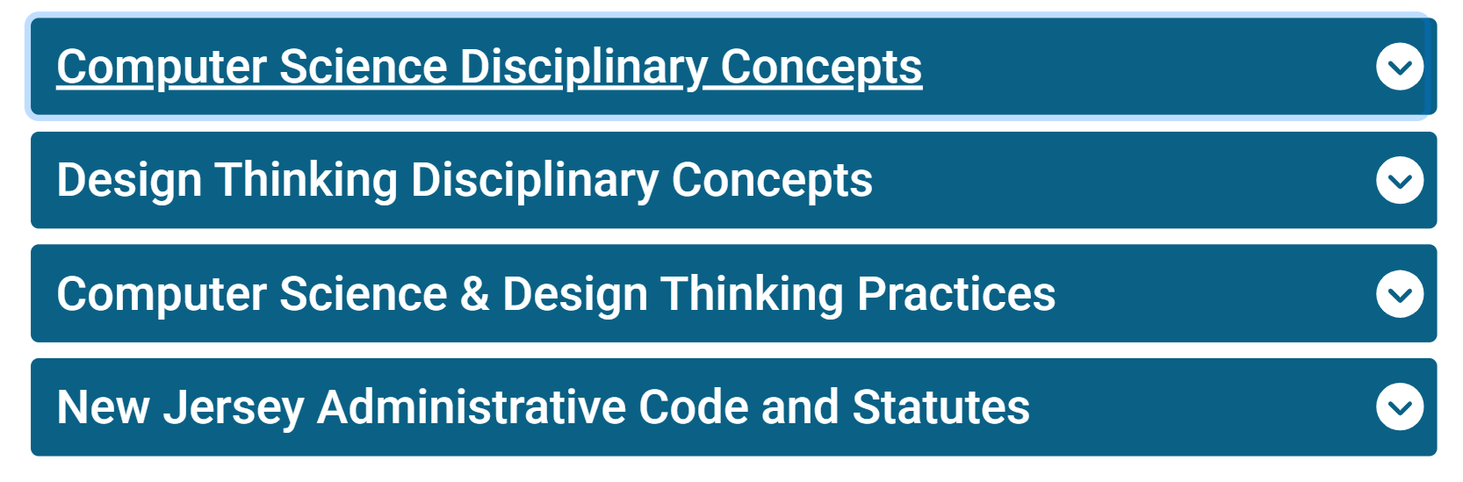
NJSLS ~ 8.1 Computer Science Disciplinary Concepts
Source: https://www.nj.gov/education/standards/compsci/

Slide 18
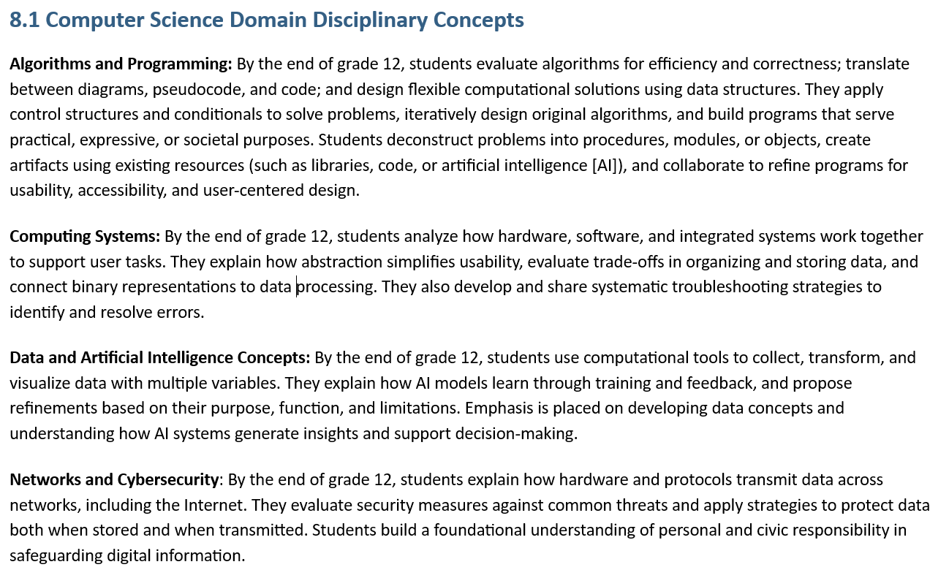
let's look more closely...

Slide 19
Data and Artificial Intelligence Concepts (DA)
By the end of grade 12, students use computational tools to collect, transform, and visualize data with multiple variables. They explain how AI models learn through training and feedback, and propose refinements based on their purpose, function, and limitations. Emphasis is placed on developing data concepts and understanding how AI systems generate insights and support decision-making.
How does the Data Science process fit in?

Slide 20
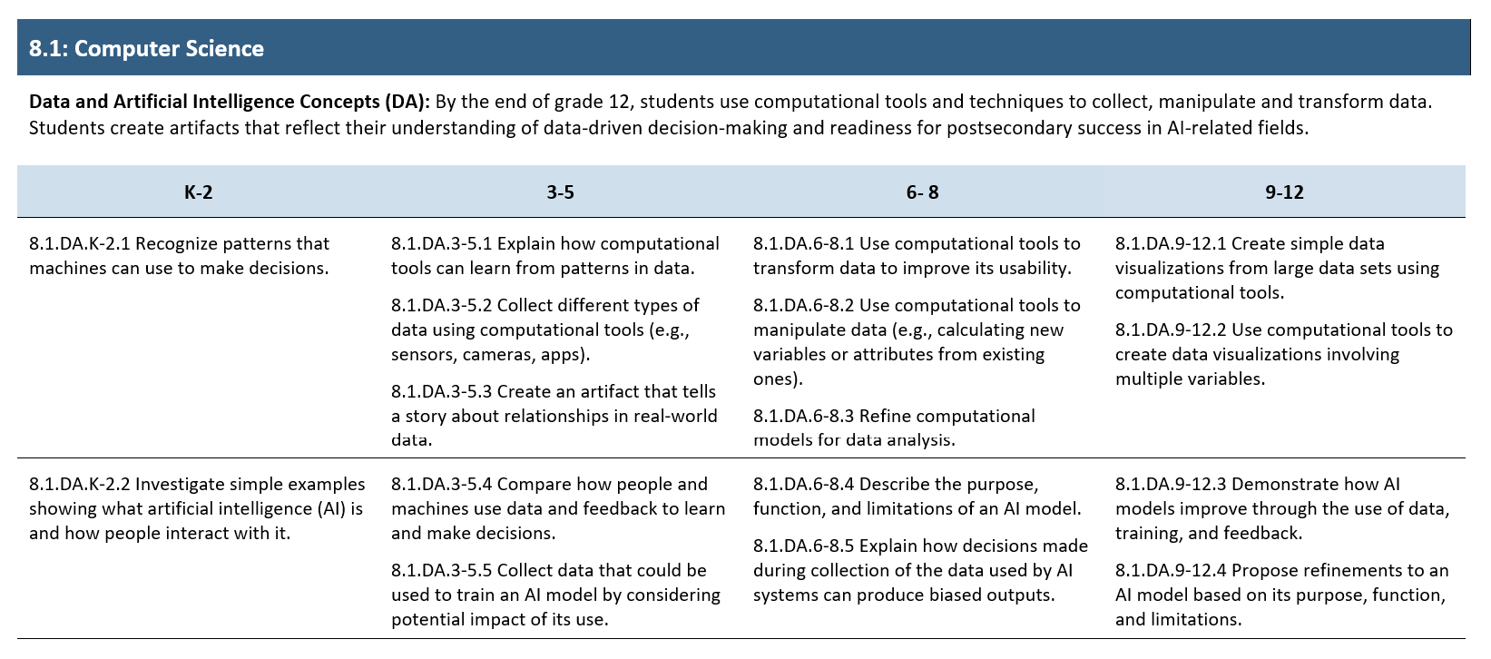
Where can we infuse Data Science concepts?

Slide 21
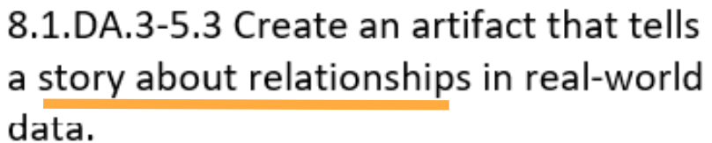

Slide 22
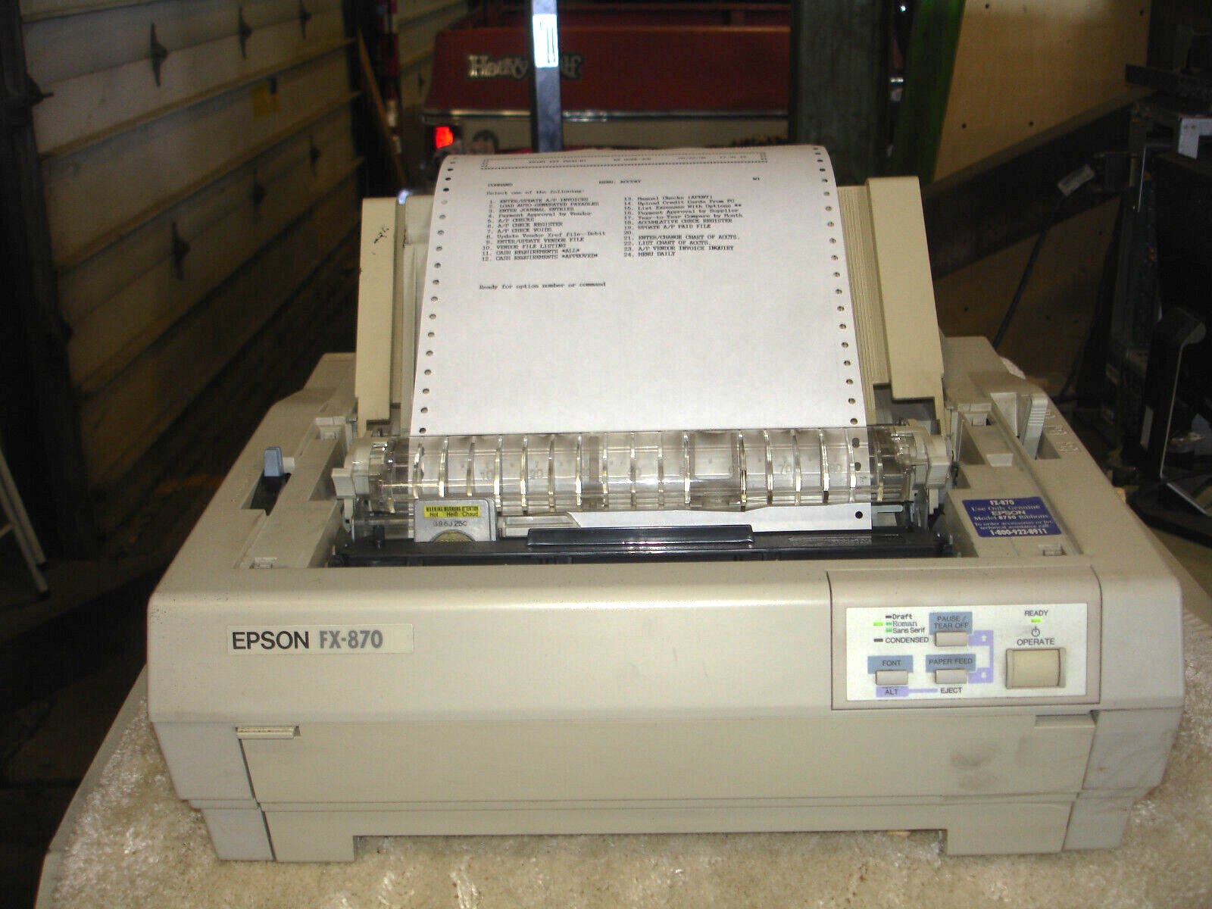
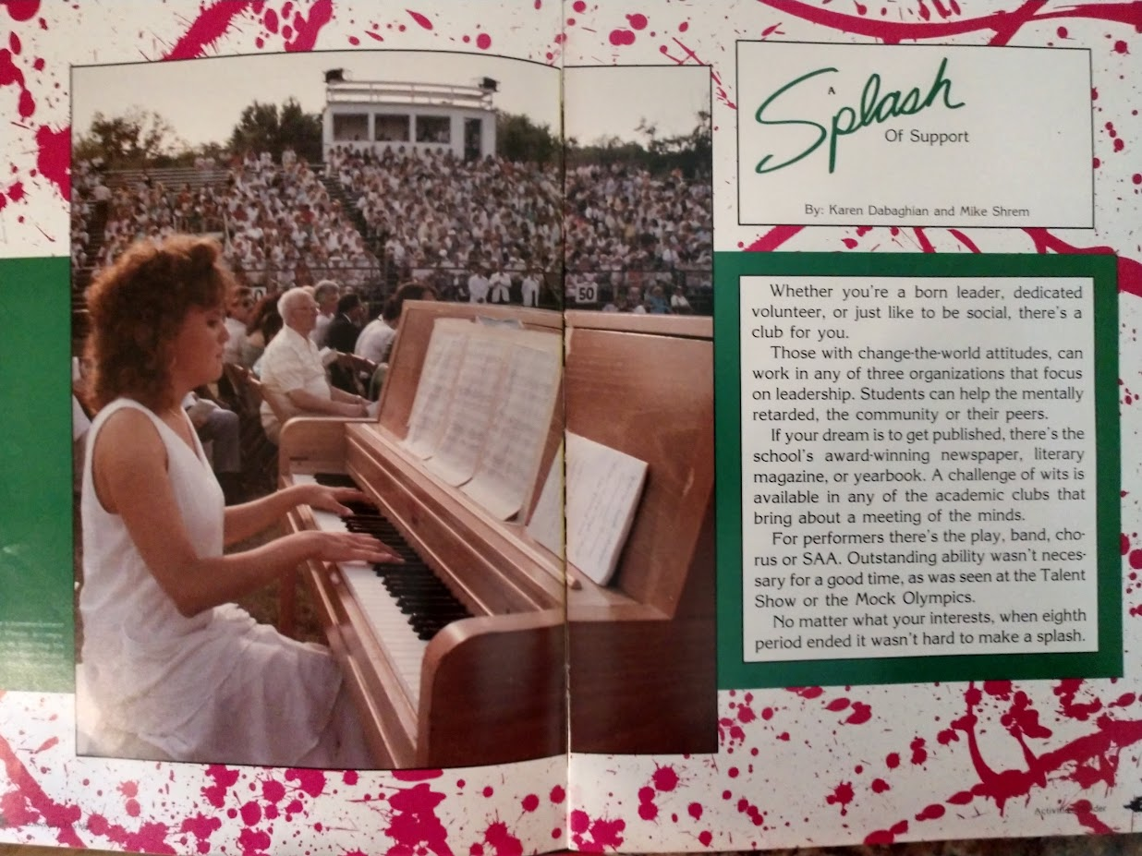

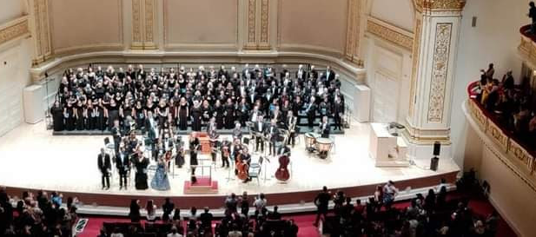
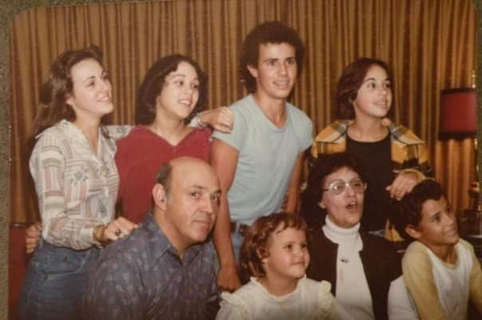
Data Scientists are storytellers!
what story does
my data
tell about me?

Slide 23

ACTIVITY: Data Scientists are storytellers!
what story does my data tell?
Notes:
ACTIVITY TEMPLATE 1: Standard 8.1.DA.3-5.3

Slide 24
The Data Science Process: Questions Activities
help_outline
Ask questions
storage
Collect & Clean data
analytics
Analyze data
insights
Communicate results
identify the problem to solve

Slide 25
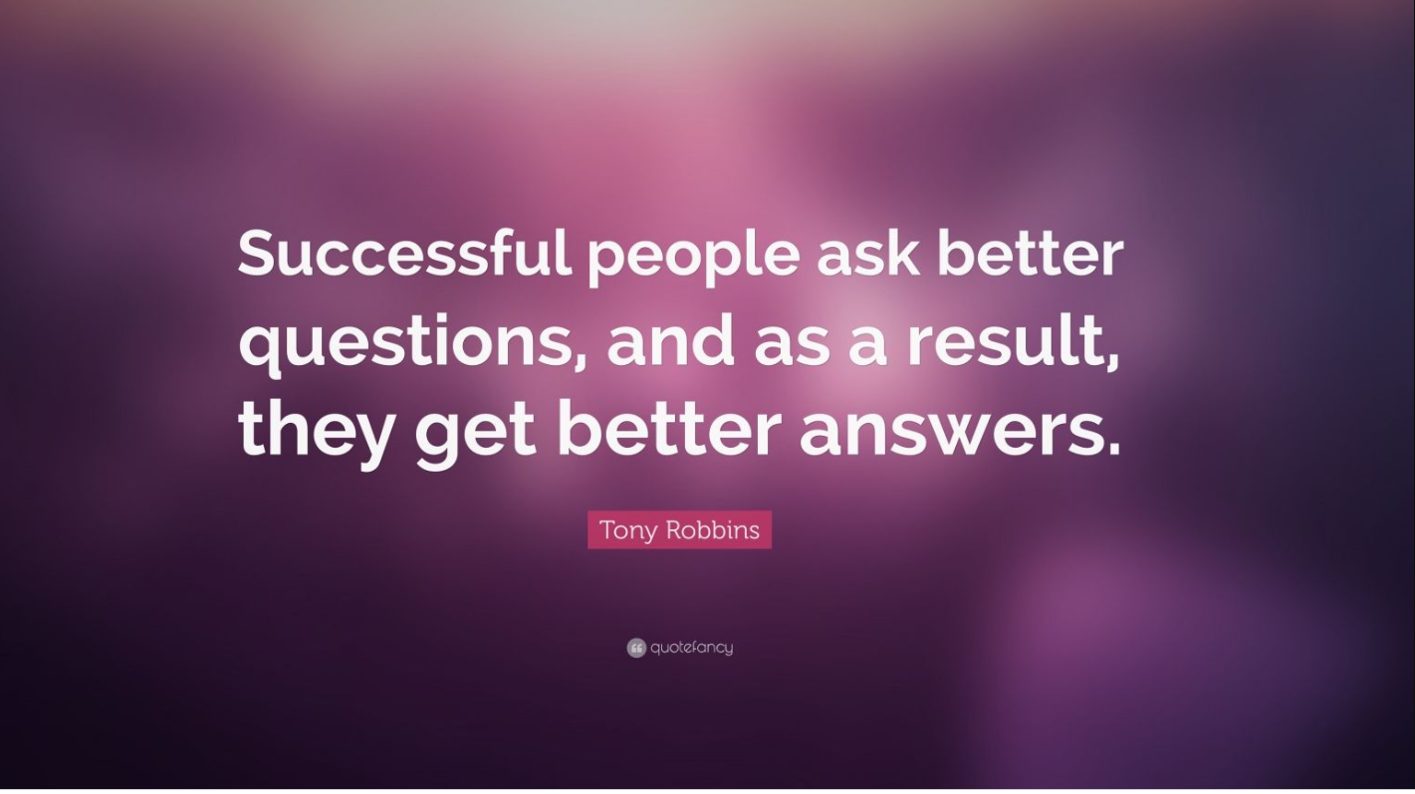
AGREE or DISAGREE

Slide 26
Statistical Questions should be investigative
"A 'good' statistical investigative question is one that allows rich exploration of the data in hand, discovery, and thinking statistically."
Source: January 2021, Journal of Statistics and Data Science Education 29(1):1-11, 29(1):1-11 researchgate.net
Notes:
POST SCENARIOS AROUND THE ROOM. STUDENTS PARTNER AND WALK AROUND TO ANSWER on their own notebooks.

Slide 27
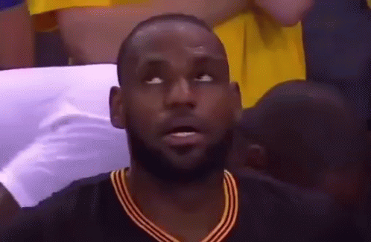
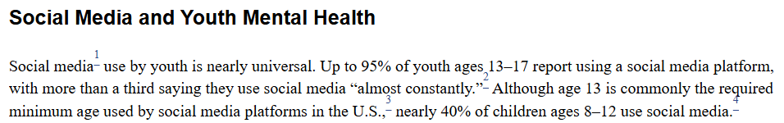
Investigative questions require a deep dive into data
Lookup questions :(
Investigative questions :)
How many students use social media?
What is the average time students spend on social media daily?
How does social media usage correlate with students' GPA? (multiple variables)
Are there specific subjects where social media usage has a more significant impact on performance?
Source: National Library of Medicine, Library of Biotechnology Information
Notes:
POST SCENARIOS AROUND THE ROOM. STUDENTS PARTNER AND WALK AROUND TO ANSWER on their own notebooks.

Slide 28

ACTIVITY: Questions Wall!
Provide datasets to each group (corgis, kaggle, etc.)
Brainstorm (individual - 2 minutes) write as MANY questions as you can, one per post-it
Refine (group - 5 minutes) discuss each question then separate into investigative vs. lookup & narrow down
Share your best questions (may analyze in future lessons)

Slide 29
The Data Science Process: Data Collection Activities
help_outline
Ask questions
storage
Collect & Clean data
analytics
Analyze data
insights
Communicate results
collection methods should avoid bias & protect privacy

Slide 30
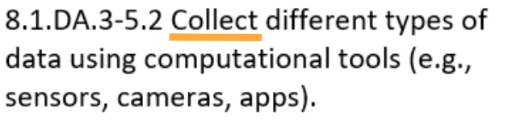

Slide 31
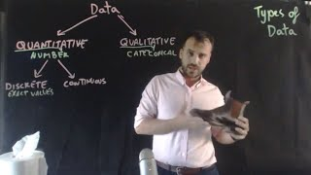
Understanding how to use different Types of Data (0:57s)

Slide 32

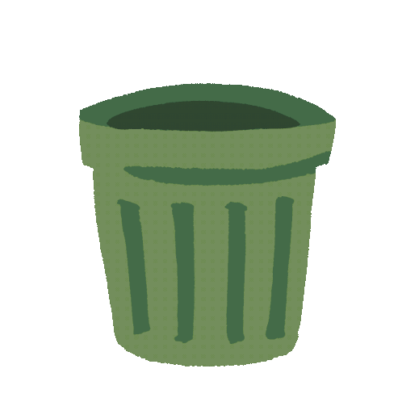
Toss away your
fears and worries!
hands on data collection & storage in google sheets
write your fears or worries on paper
always: be careful to protect student privacy when collecting data!

Slide 33
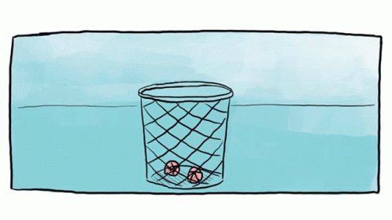
ACTIVITY: Trash Basket Challenge!
FIRST STEP: Write good statistical questions
Who can make the most baskets?
What is the average number of baskets?
Do you improve with practice?
Your ideas???
SECOND STEP: What data do we need to collect?
name (categorical)
distance in cm. (quantitative - continuous)
trial # (quantitative - ordinal)
number_baskets (quantitative - discrete)
Notes:
GIVE EVERYONE a stack of yellow post-it notes to use today!

Slide 34
ACTIVITY: The Stroop Test (what color do you see?)
Student | # seconds (matching) | # seconds (non-matching)
alternate version online iink

Slide 35
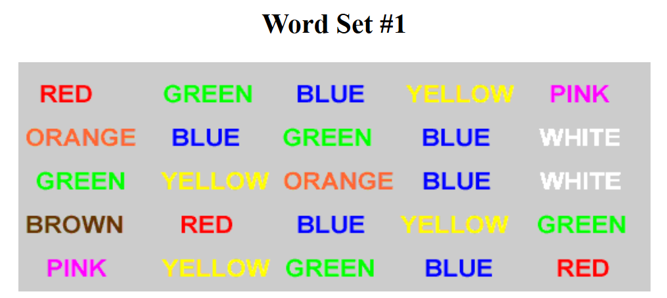
Source: faculty.washington.edu/chudler/ click image for link to online version

Slide 36
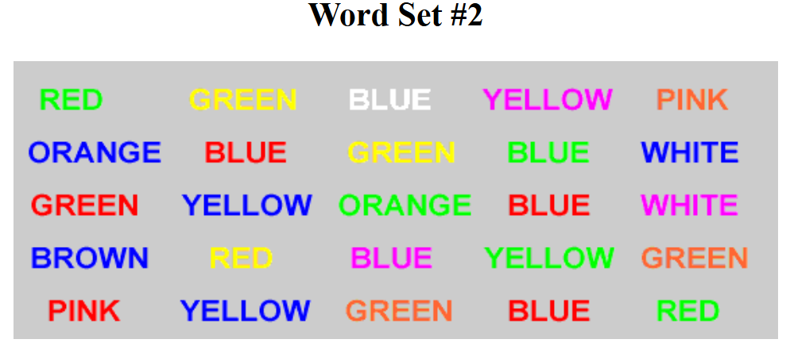

Slide 37
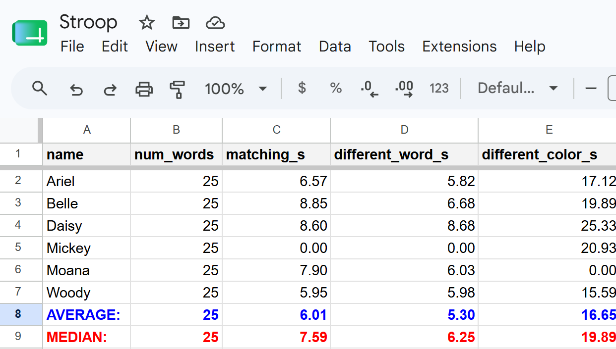
The Stroop Test ~ google sheet

Slide 38

Share: Your Data Collection ideas?

Slide 39
The Data Science Process: Data Cleaning
help_outline
Ask questions
storage
Collect & Clean data
analytics
Analyze data
insights
Communicate results
quality of data in
=
quality analysis

Slide 40


Slide 41
Cleaning Data ~ covered in a full Data Science course
Some things to consider when cleaning data:
remove duplicate data points
remove zeros
deal with missing information
format data types correctly for use
  text data that should be numerical etc.

Slide 42
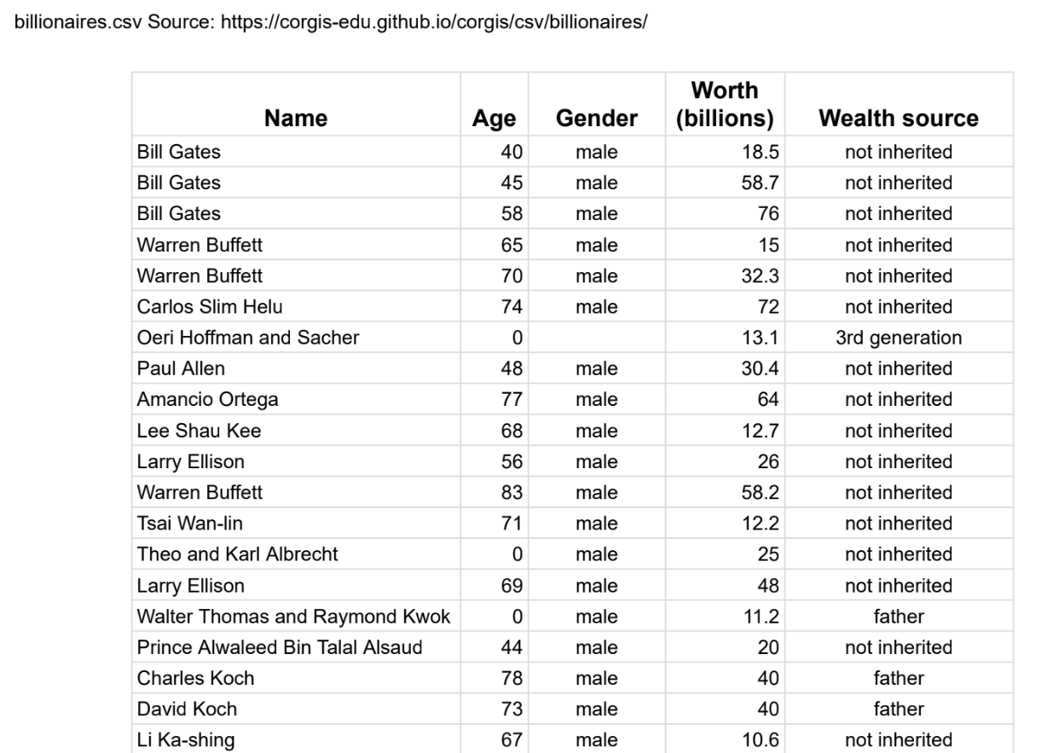
what do you notice?

Slide 43
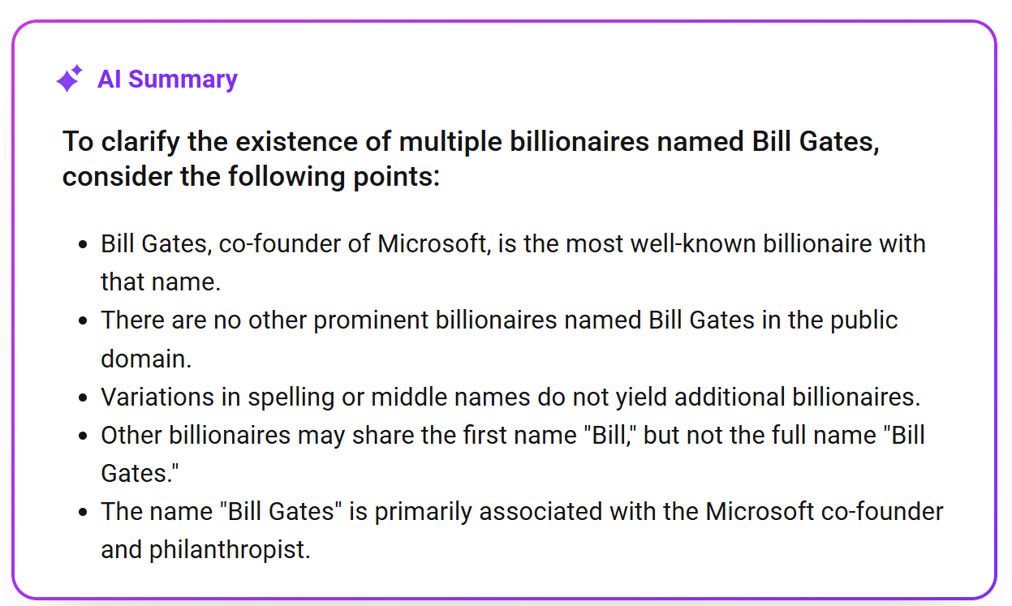

Slide 44
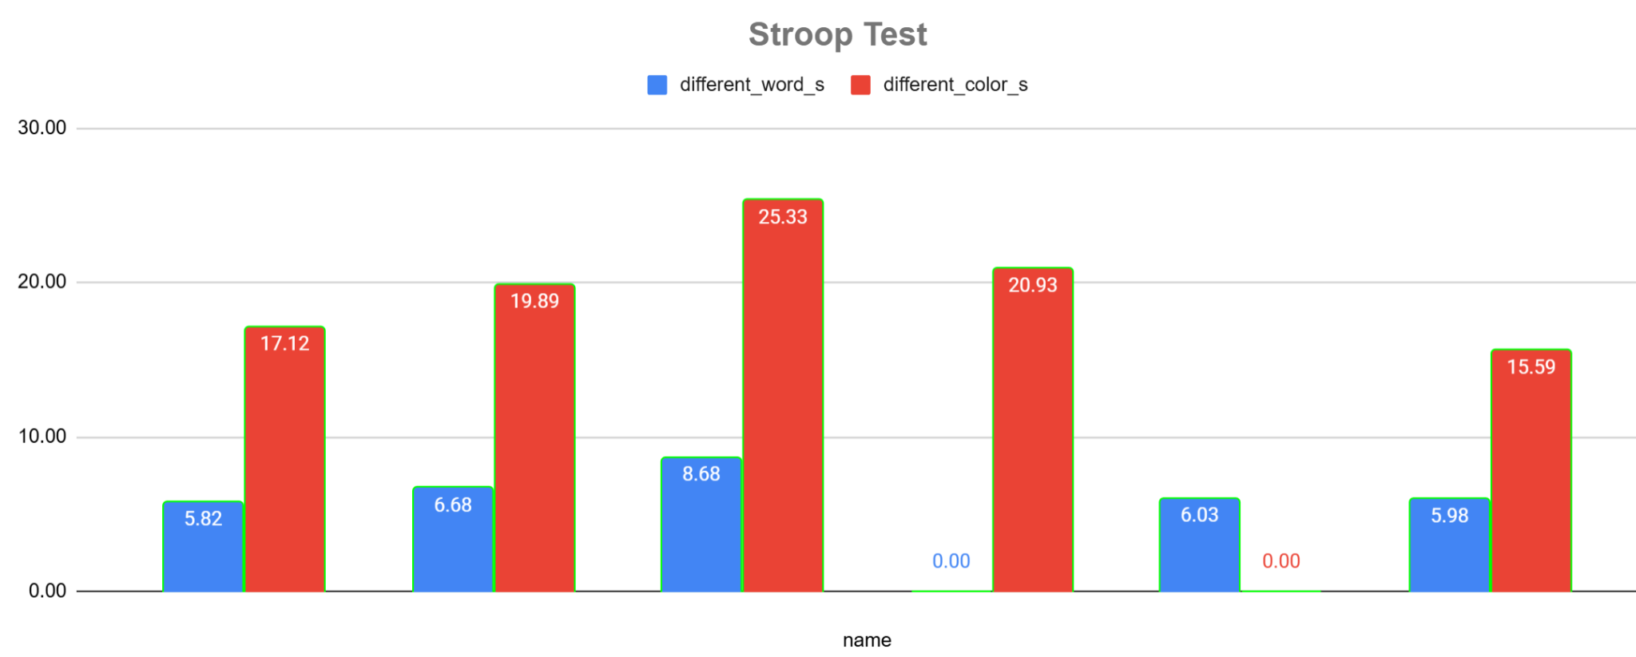
The Stroop Test ~ visualization using google sheets

Slide 45
The Stroop Test google sheet ~ what should we do?

Slide 46
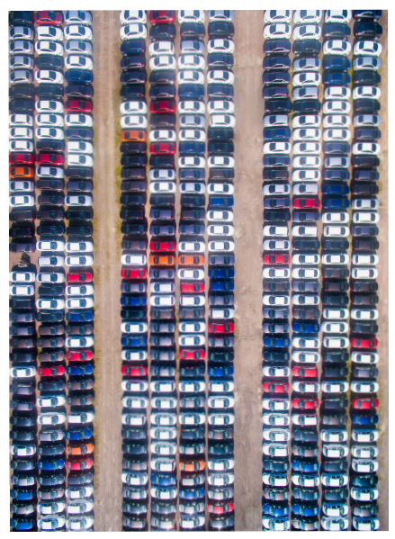
Activity: Data Organization
What is the most common car color where you live?
develop a strategy to organize this data

Slide 47
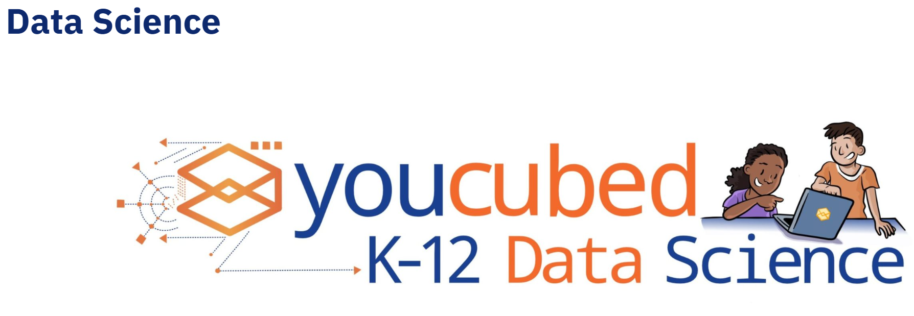
Data Organization Activity Resource

Slide 48
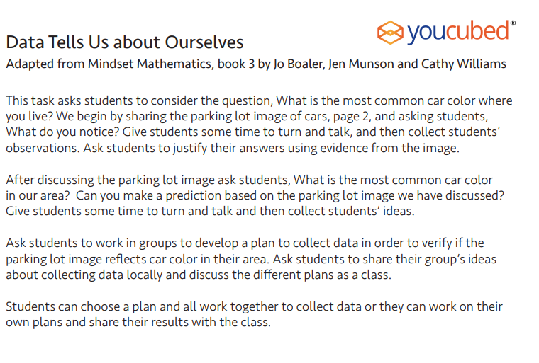

Slide 49

Many open source datasets are already "clean"
Corgis
Kaggle Open Datasets
Data.gov
Google Dataset Search
always: preview datasets you share with students!

Slide 50
The Data Science Process: Using "computational tools" to transform data
help_outline
Ask questions
storage
Collect & Clean data
analytics
Analyze data
insights
Communicate results
what you DO with the data

Slide 51
Exploratory Data Analysis ~ covered in a full course
functions
Descriptive Statistics
Average:
Mean, median, mode
Variability:
Std deviation, IQR
Range & Limits:
Min, max, percentiles
bar_chart
Visualization
Scatterplots
Line graphs
Histograms
Bar charts
Pie charts
analytics
Analysis
Regression:
Line of best fit
Correlation:
Strength of relations
And more:
Interpreting patterns

Slide 52
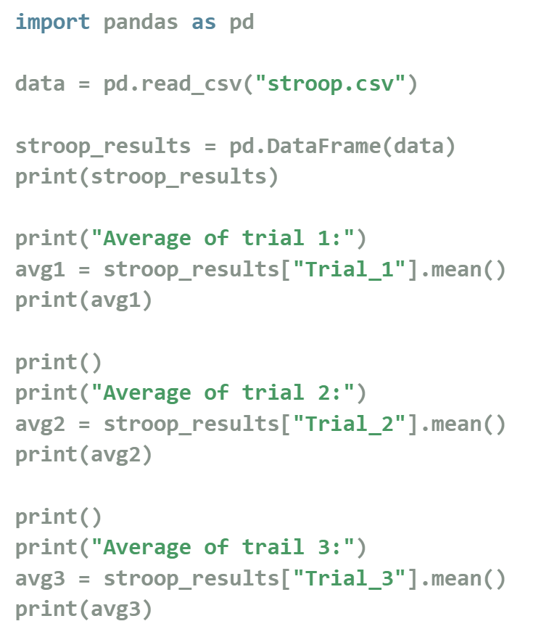

Python ~ pandas

Slide 53
Exploratory Data Analysis ~ covered in a full course
functions
Descriptive Statistics
Average:
Mean, median, mode
Variability:
Std deviation, IQR
Range & Limits:
Min, max, percentiles
bar_chart
Visualization
Scatterplots
Line graphs
Histograms
Bar charts
Pie charts
analytics
Analysis
Regression:
Line of best fit
Correlation:
Strength of relations
And more:
Interpreting patterns

Slide 54
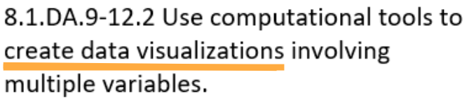

Slide 55
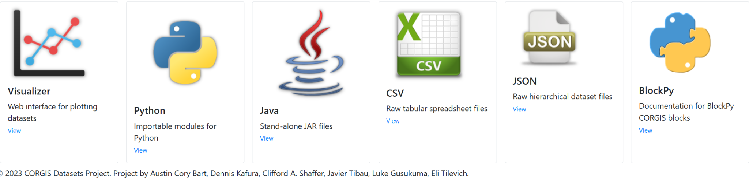
ACTIVITY: Corgis Datasets project (visualizer)

Slide 56
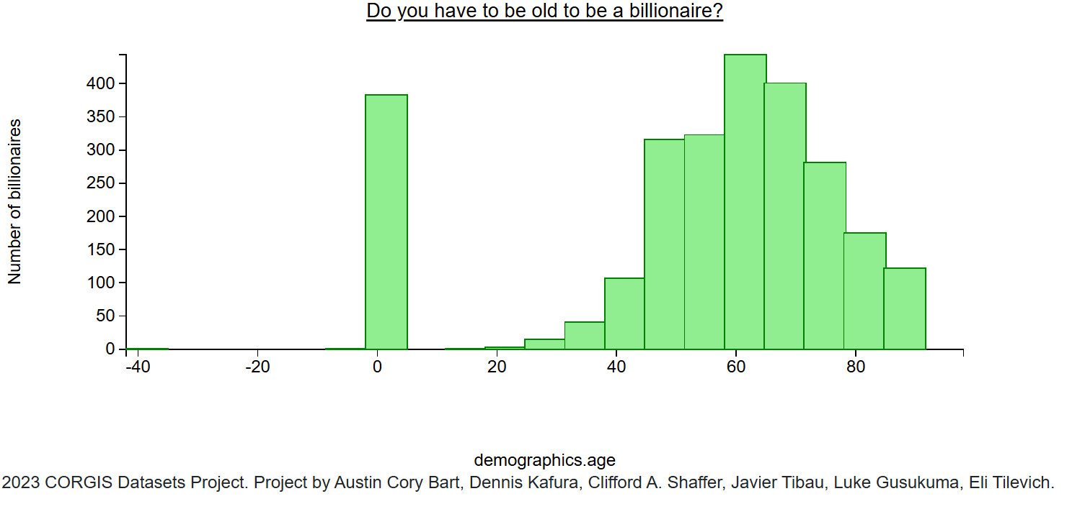

Slide 57
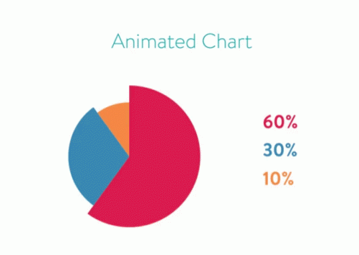
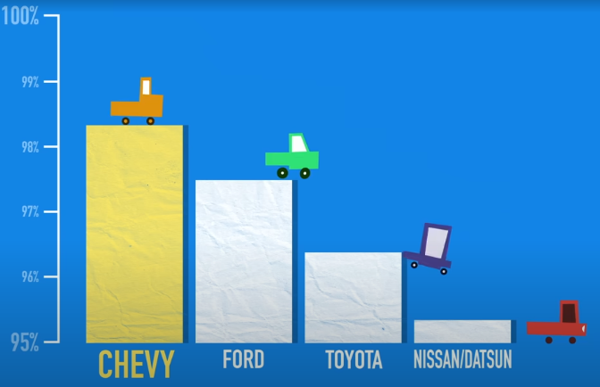
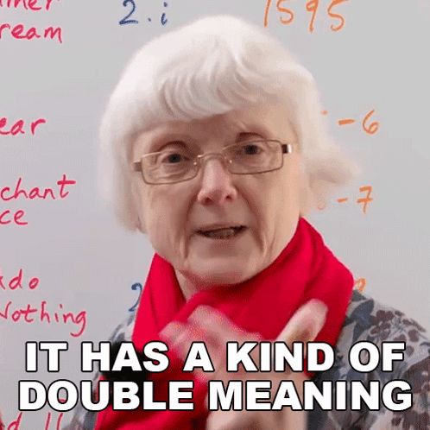
What should we teach about Graphical Data Displays?
bar_chart
How to choose an appropriate data display
report_problem
How to spot/avoid bias in data displays
pie_chart
Interpreting a data display

Slide 58
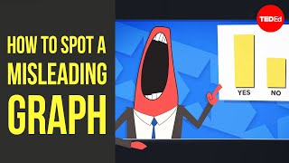
Bias in visualizations
sources not listed
truncated axes
manipulated scale
too much data
inappropriate type
intentional bias

Slide 59
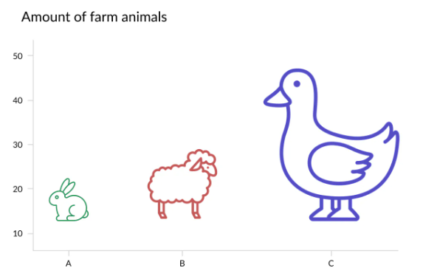

Slide 60
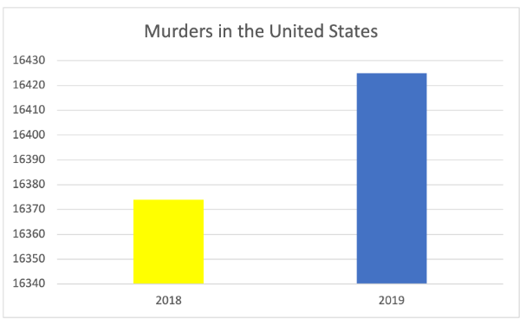

Slide 61
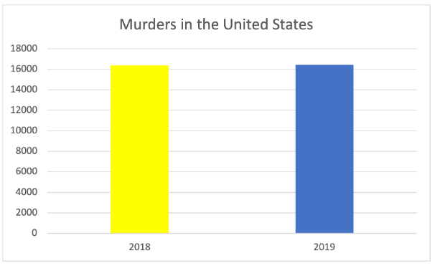
Actual graph

Slide 62
The Data Science Process: Communicate Results
help_outline
Ask questions
storage
Collect & Clean data
analytics
Analyze data
insights
Communicate results
what you DO with the data

Slide 63
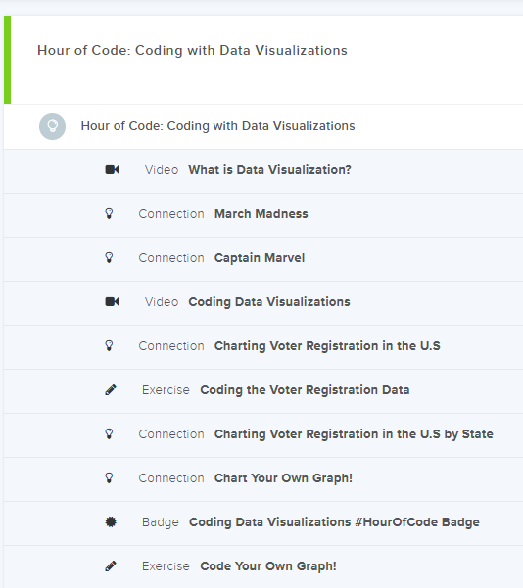
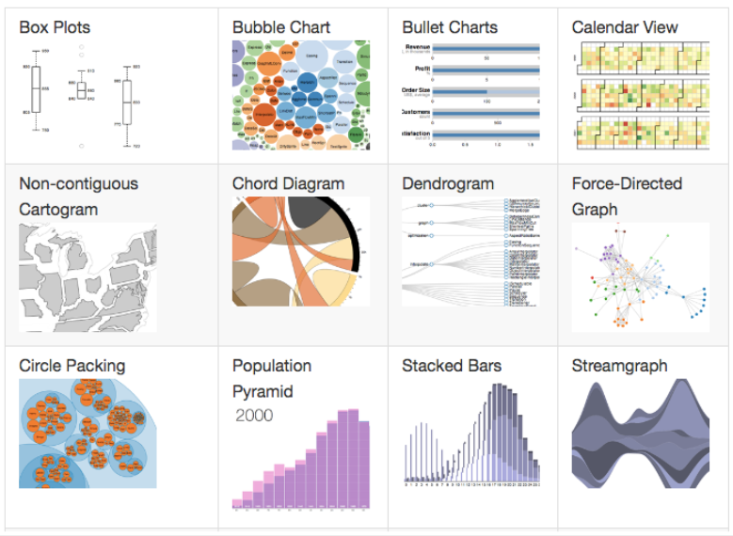
Activity: CodeHS Visuals

Slide 64
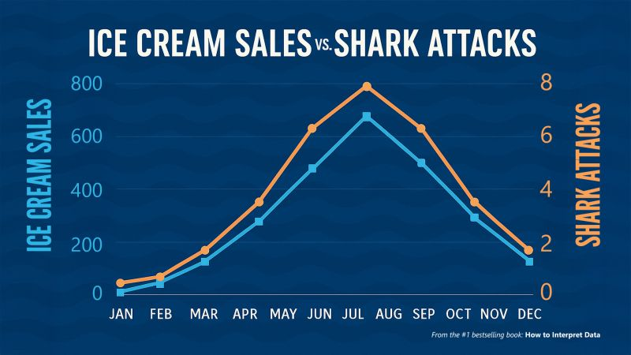
Spurious Correlations

Slide 65
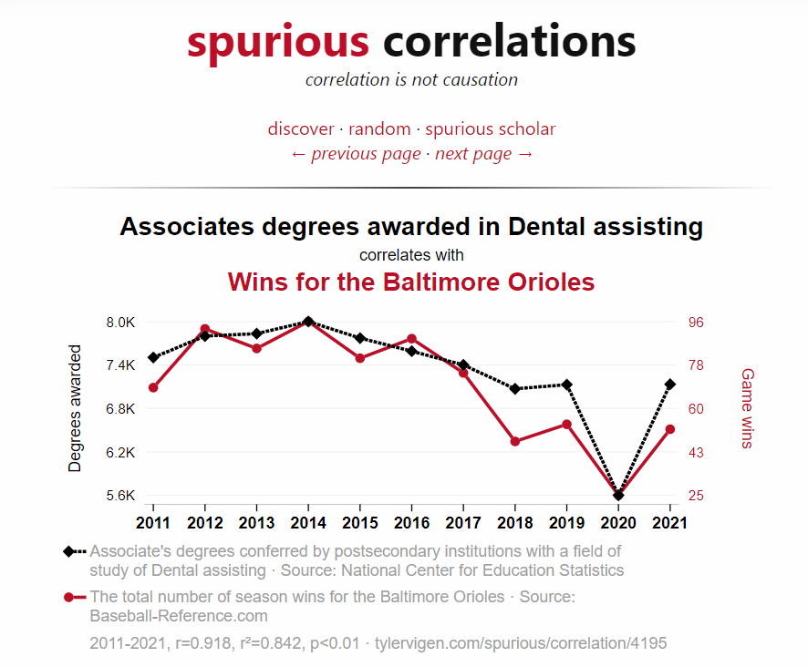
A spurious relationship is when two variables are correlated, but clearly unrelated
investigate some here
CodeHS 3.7

Slide 66
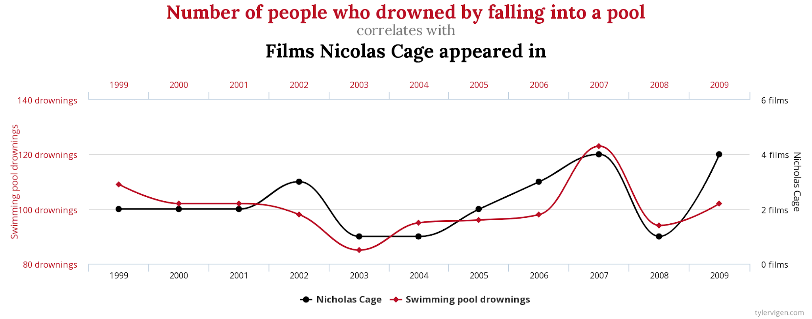
Courtesy of Tyler Vigen: https://www.tylervigen.com/spurious-correlations

Slide 67
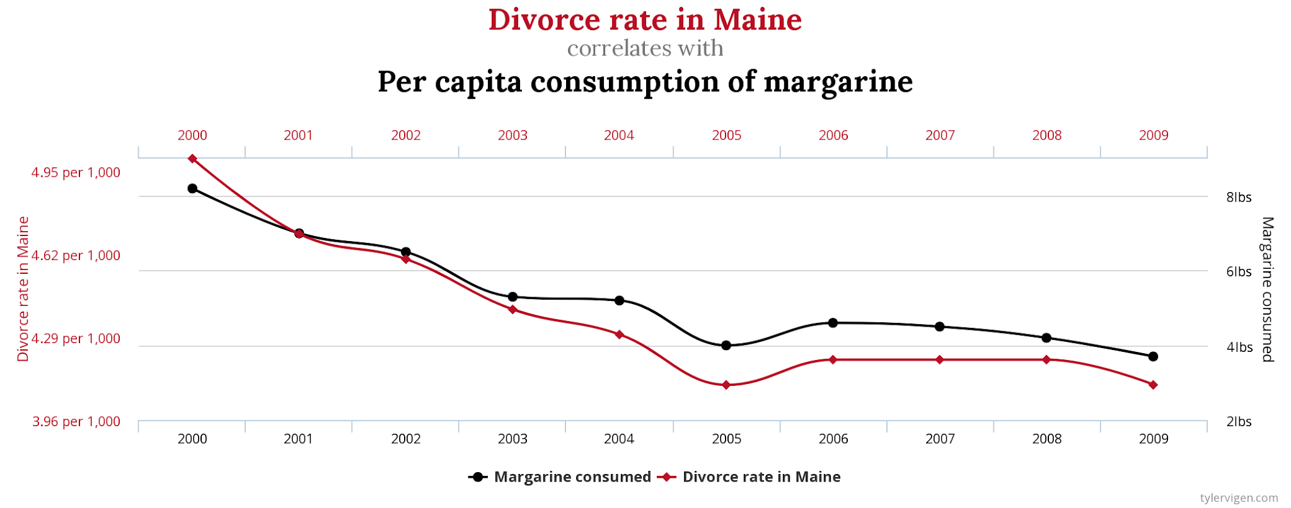
Courtesy of Tyler Vigen: https://www.tylervigen.com/spurious-correlations

Slide 68
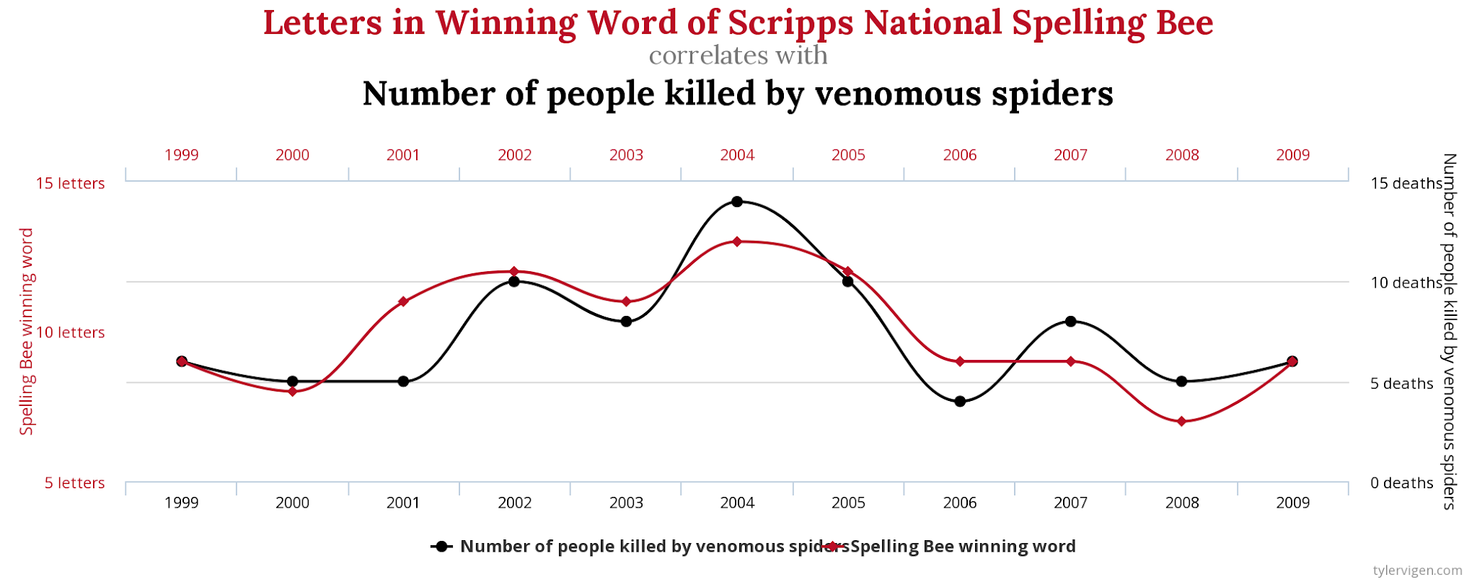
Courtesy of Tyler Vigen: https://www.tylervigen.com/spurious-correlations

Slide 69

Courtesy of Tyler Vigen: https://www.tylervigen.com/spurious-correlations

Slide 70
Correlation ≠ Causation

Slide 71
To determine causation, you must be able to:
Create an observed association (correlation)
Prove that the explanatory variable (x) occurs before the response variable (y)
Rule out other potential causes

Slide 72

Activities: Common Online Data Analysis Platform
intro activity

Slide 73

Resource: CodeHS High School Data Science courses

Slide 74

Activity:
DataTalks

Slide 75

Resource: Kaggle

Slide 76

Activity: Infographics & communicating results

Slide 77

Activity: Why Are People Left-handed data summary

Slide 78

Resource: GapMinder animated population bar graph

Slide 79

Resource: High School Data Science from youcubed

Slide 80

Resource:
Lessons

Slide 81

Resource: Digital Data Nuggets in Data Classroom

Slide 82

Data Nuggets
available
in Spanish

Slide 83

Resource: IDS ~ Introduction to Data Science (HS, CA)

Slide 84


Notes:
Source: NJ.gov

Slide 85
Resource: CSTA PK-12
new CSTA Standards
Source: csteachers.org

Slide 86
Q&A

