Slide 1
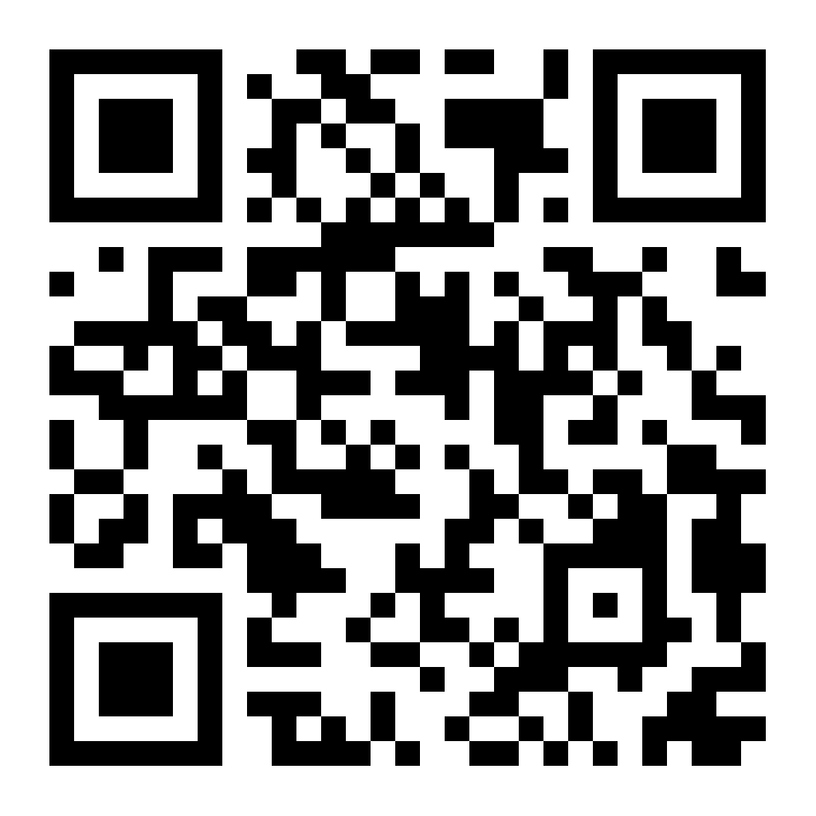

Slide 2


Slide 3
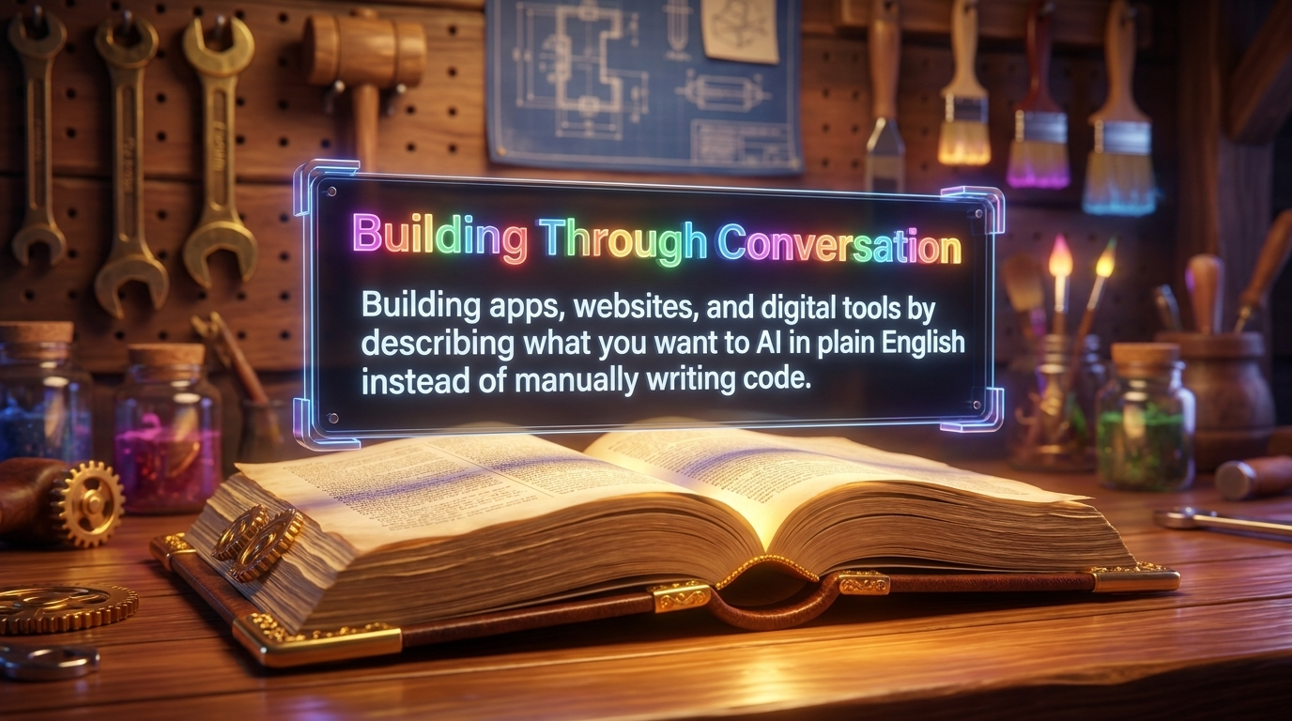

Slide 4
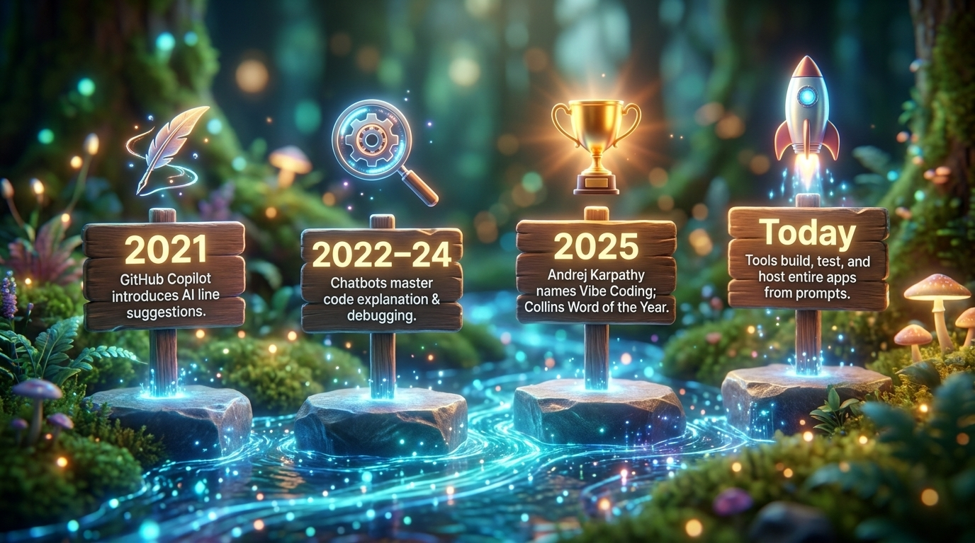

Slide 5
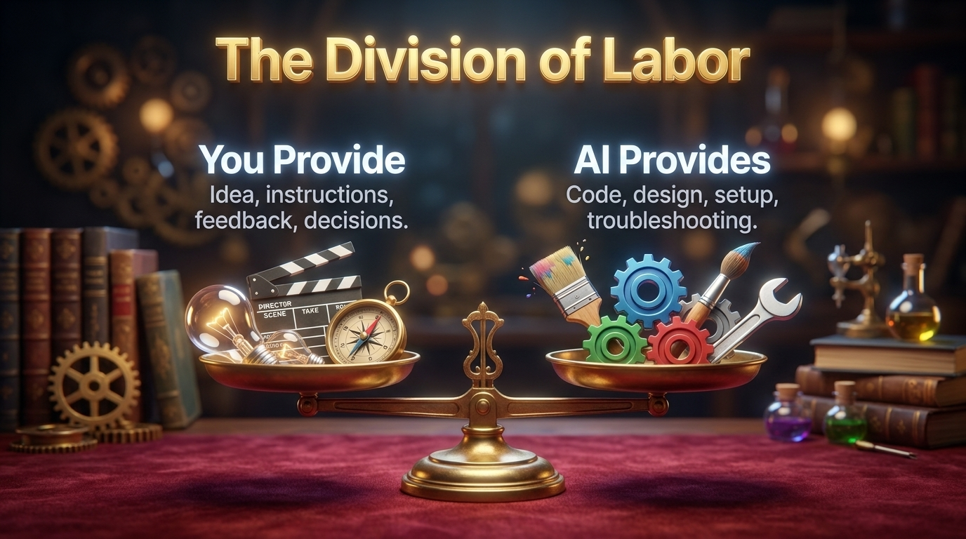

Slide 6
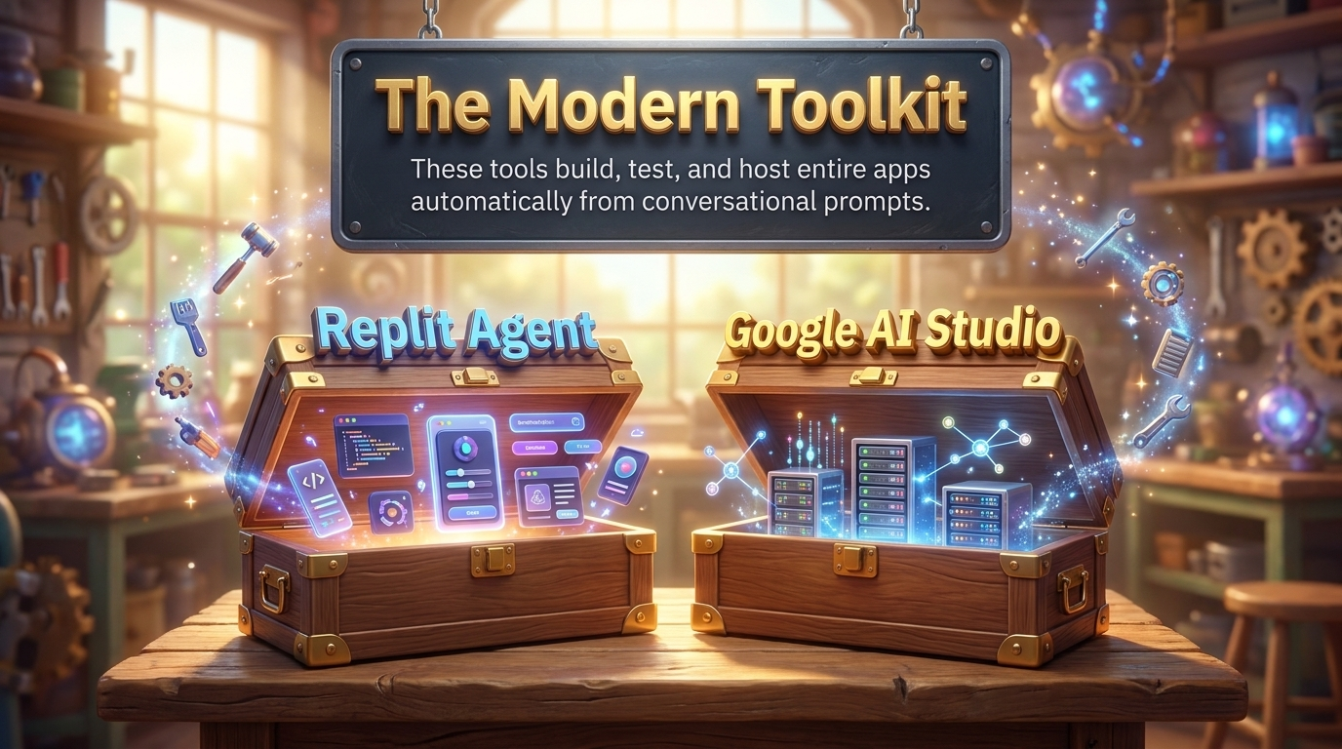

Slide 7
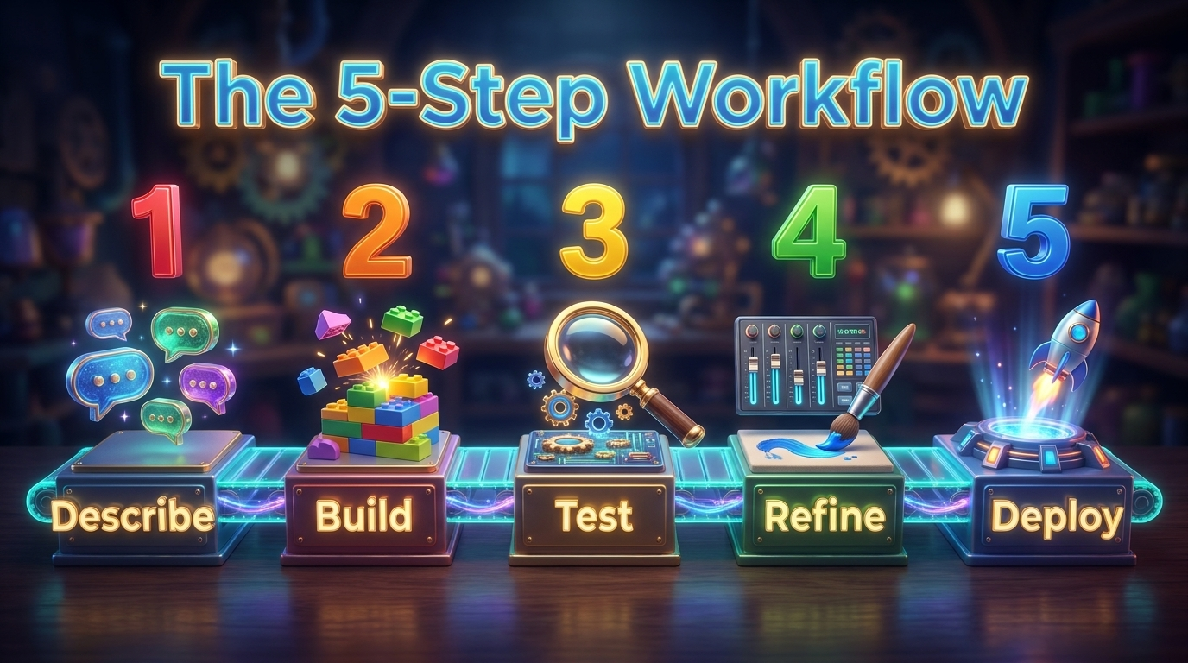

Slide 8
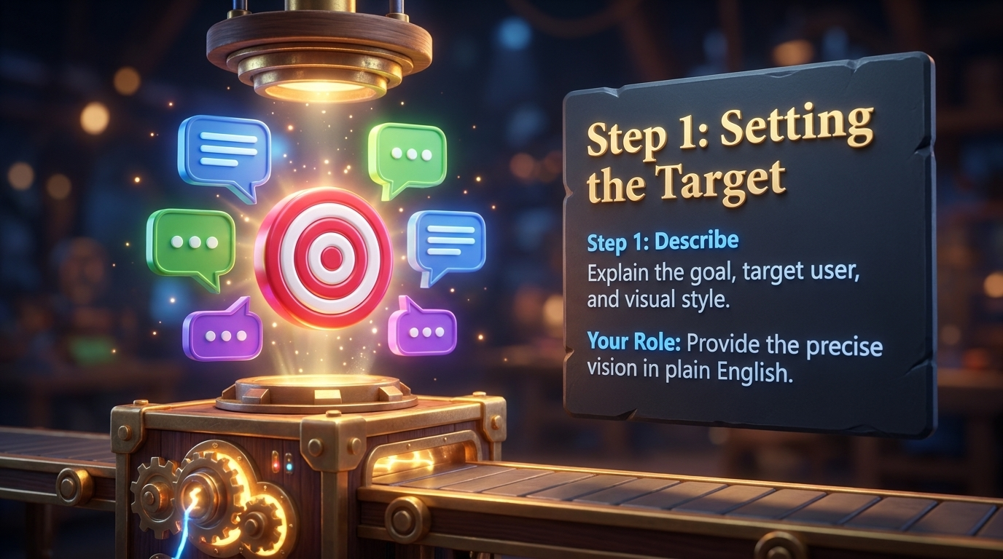

Slide 9
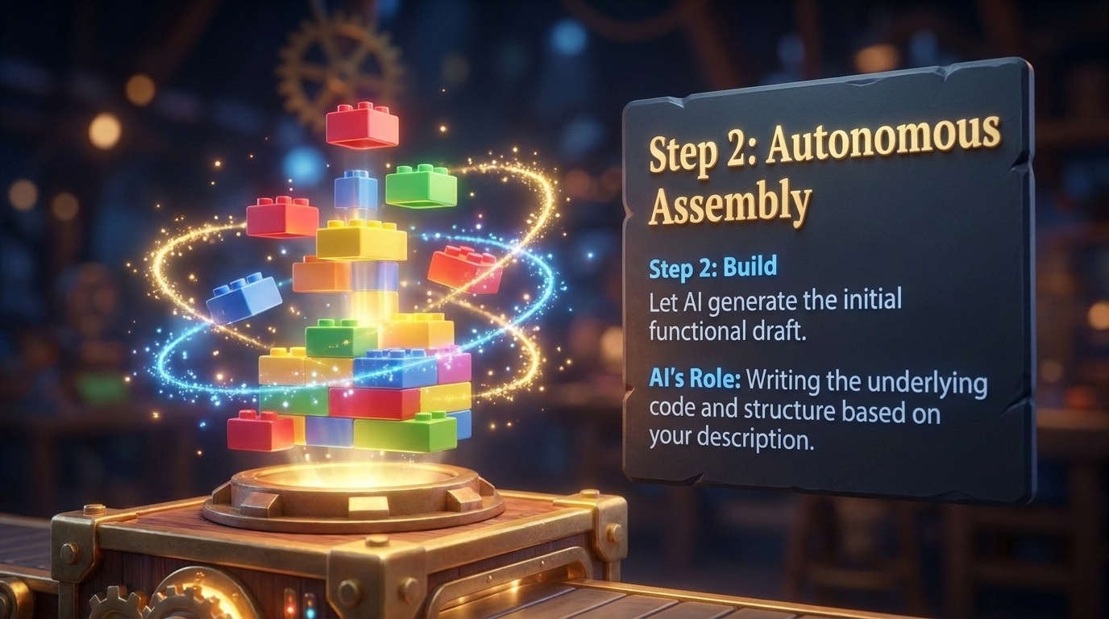

Slide 10
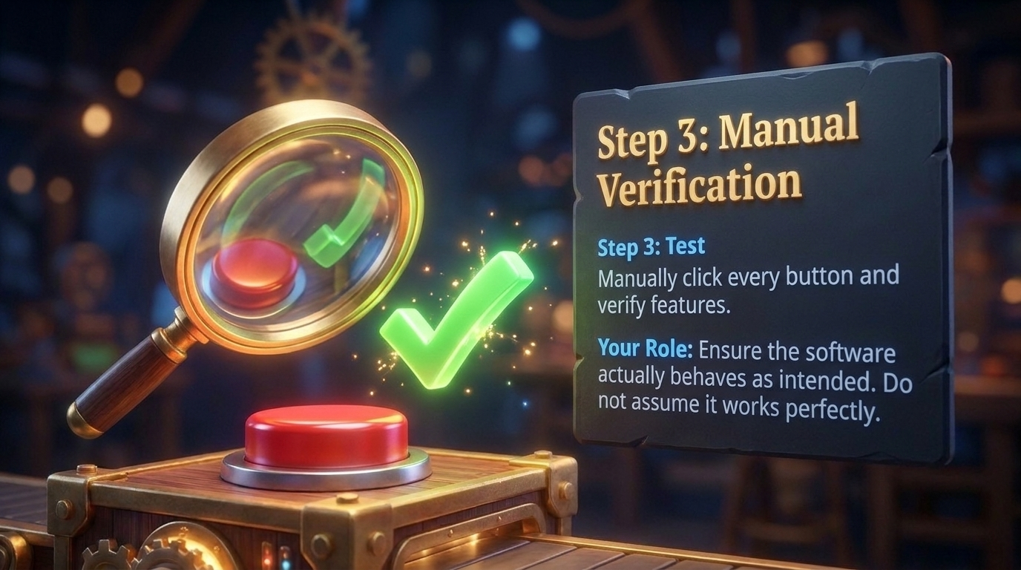

Slide 11


Slide 12
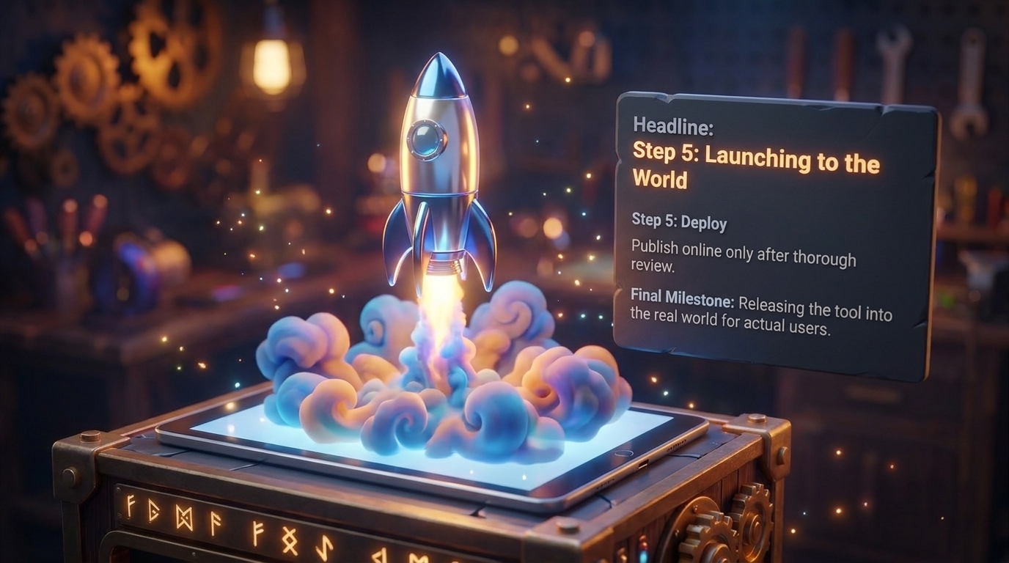

Slide 13


Slide 14
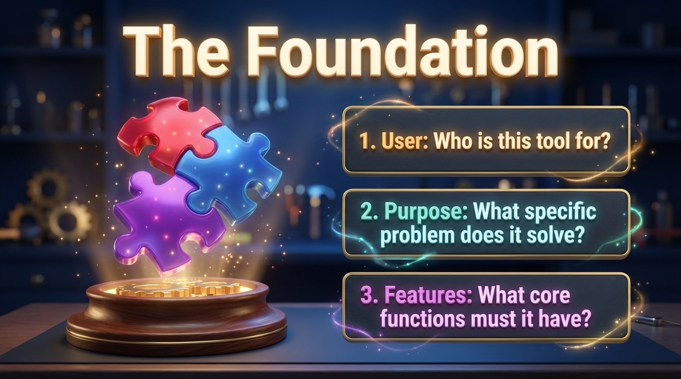

Slide 15
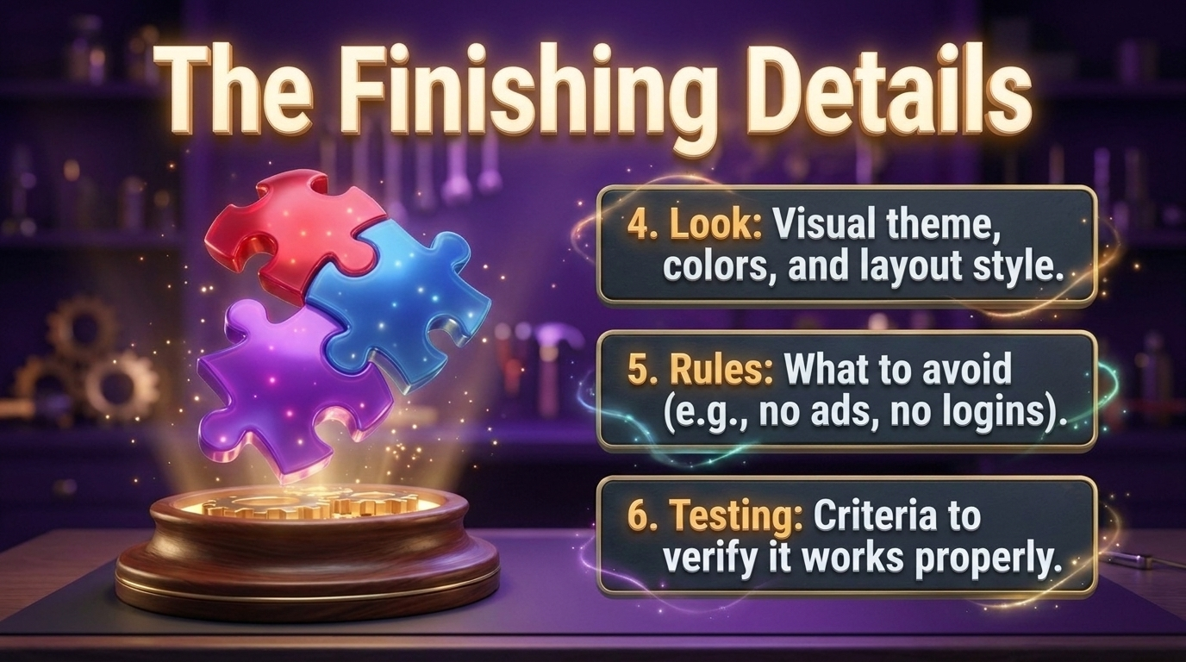

Slide 16
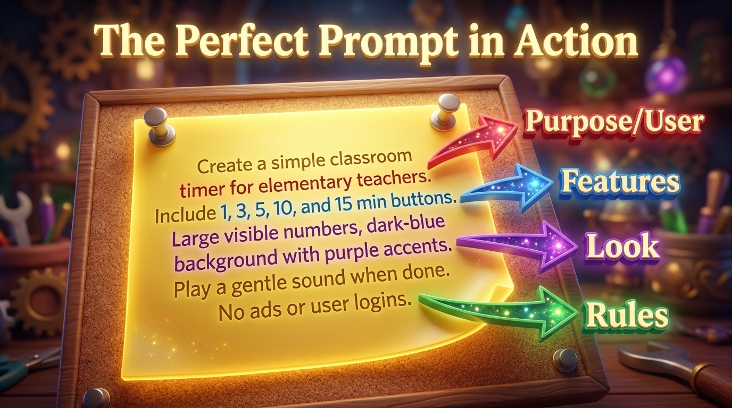

Slide 17
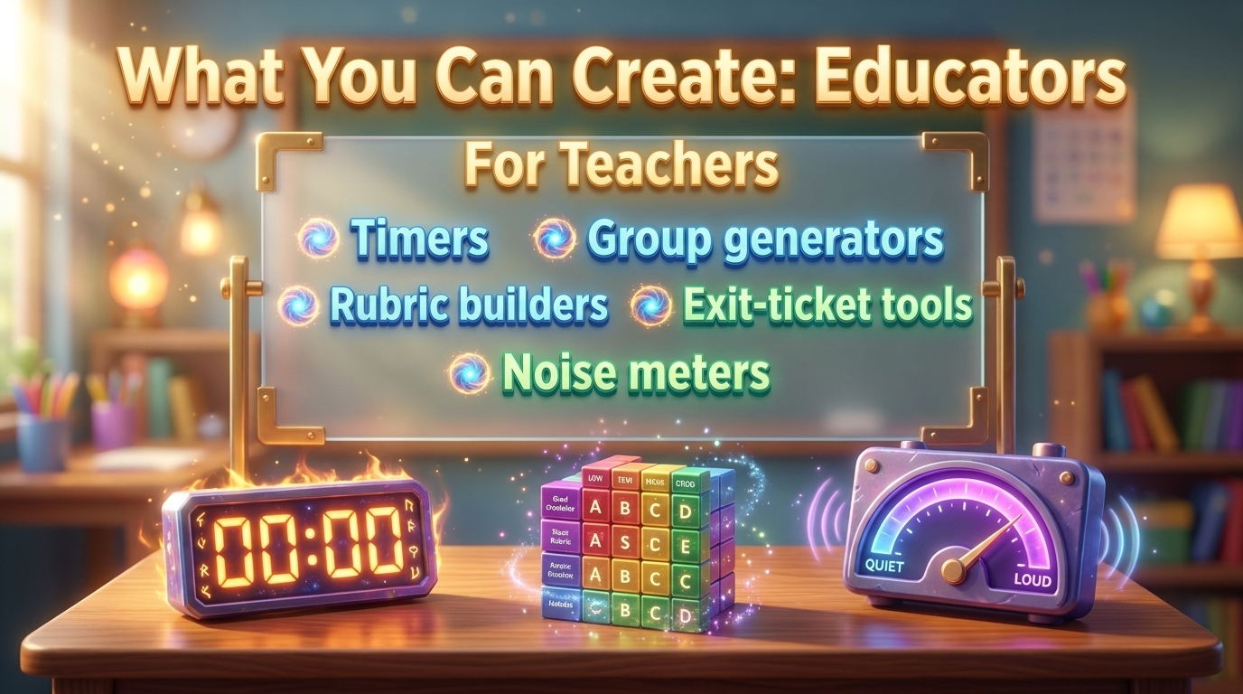

Slide 18
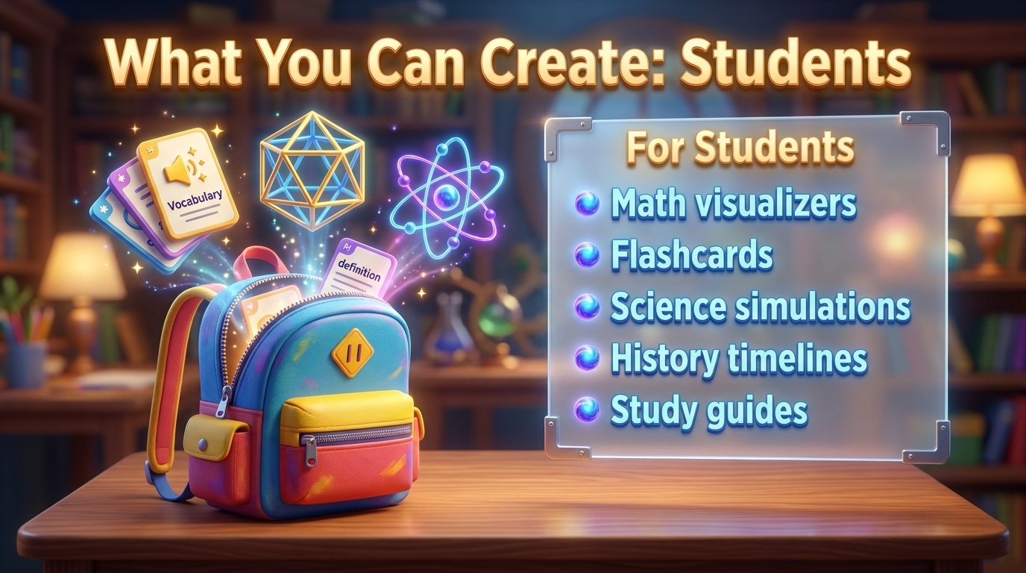

Slide 19


Slide 20
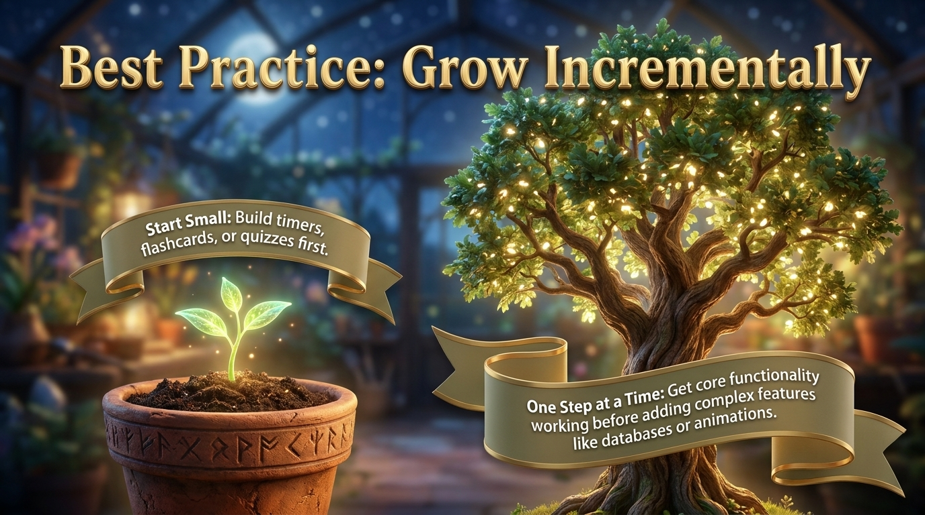

Slide 21


Slide 22
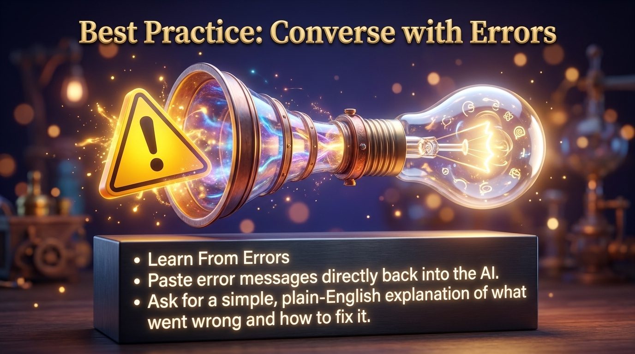

Slide 23


Slide 24


Slide 25


Slide 26
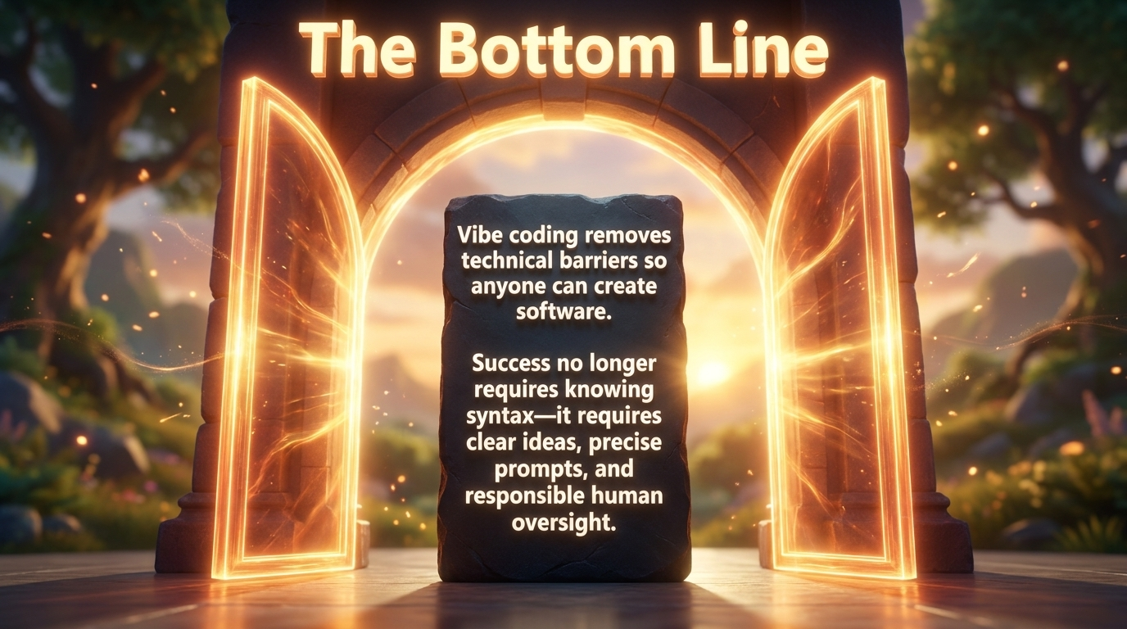

Slide 27

Protect Student Data
Never use real student names — use "Student 1" or class nicknames
No photos, birthdays, addresses, or grades
Skip logins and student accounts whenever possible
When in doubt, leave it out

Slide 28

Follow the Rules
FERPA and COPPA protect student information — follow both
Get admin approval before using any vibe-coded site with your class
Check your district's tech policy for approved tools
Keep your site private until it's cleared

Slide 29
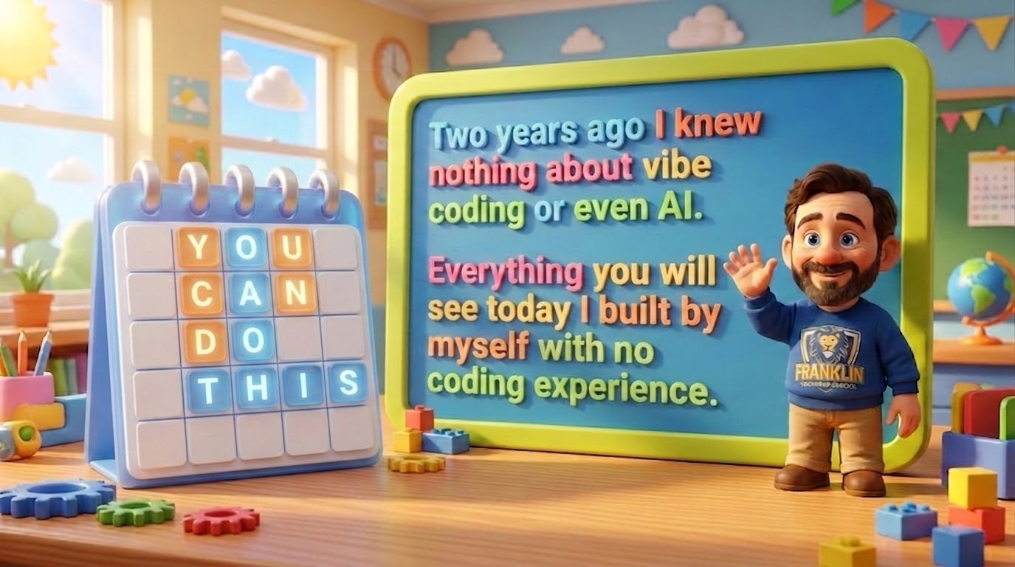

Slide 30


Slide 31
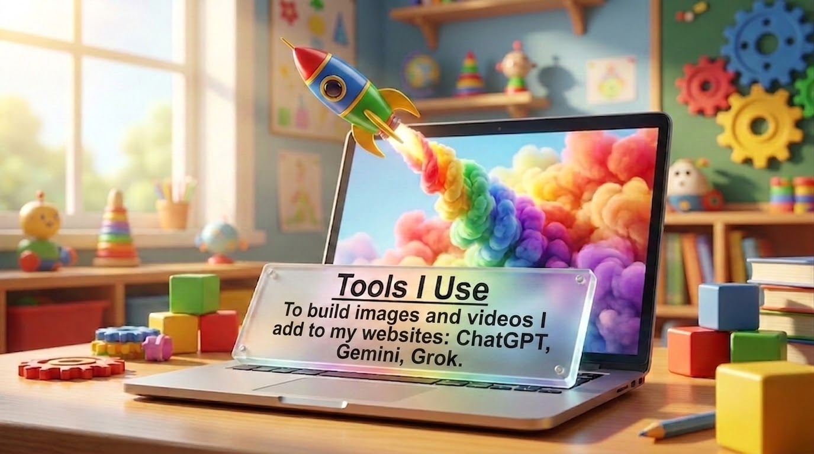

Slide 32
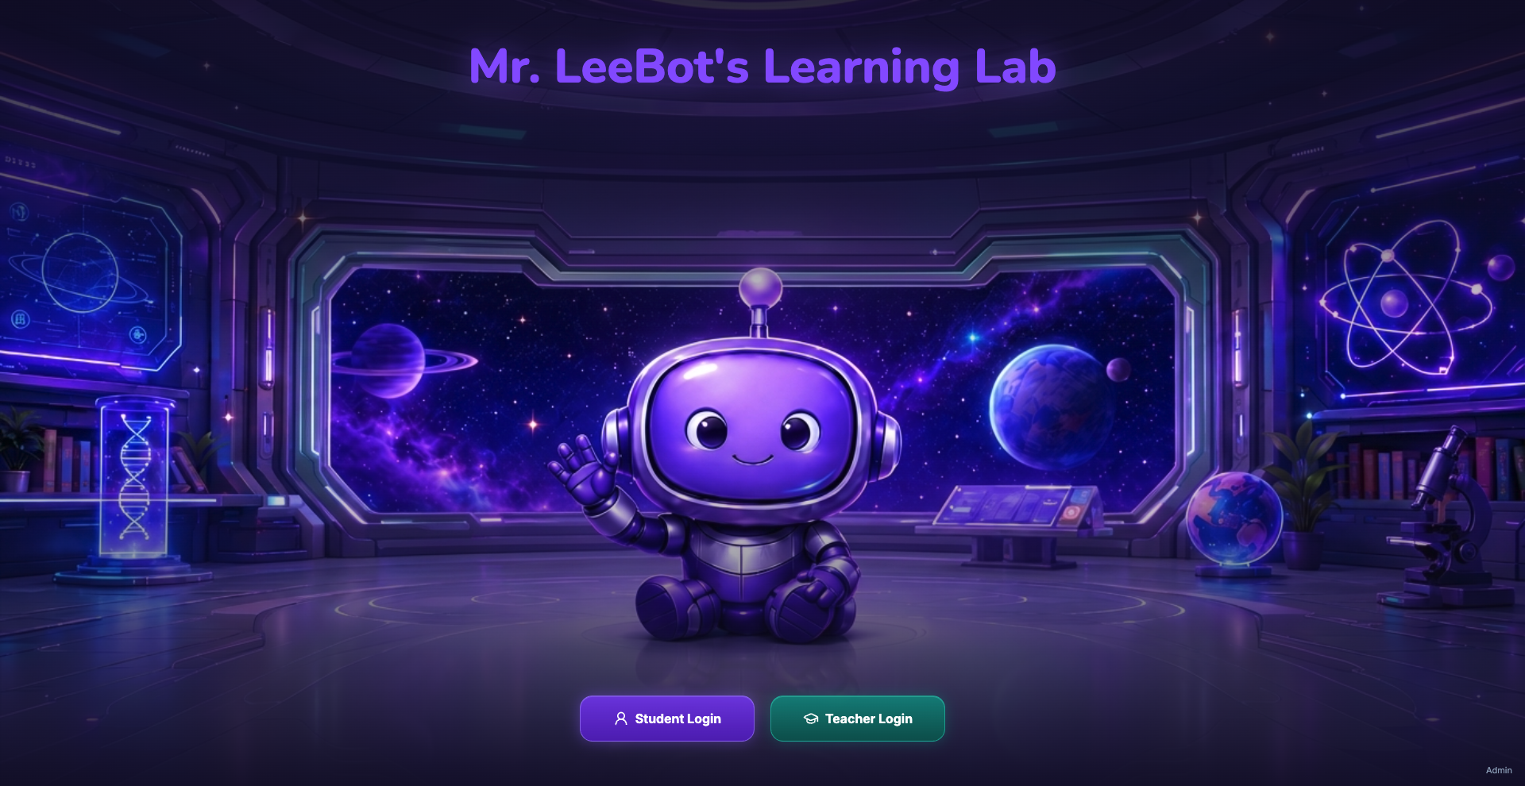

Slide 33
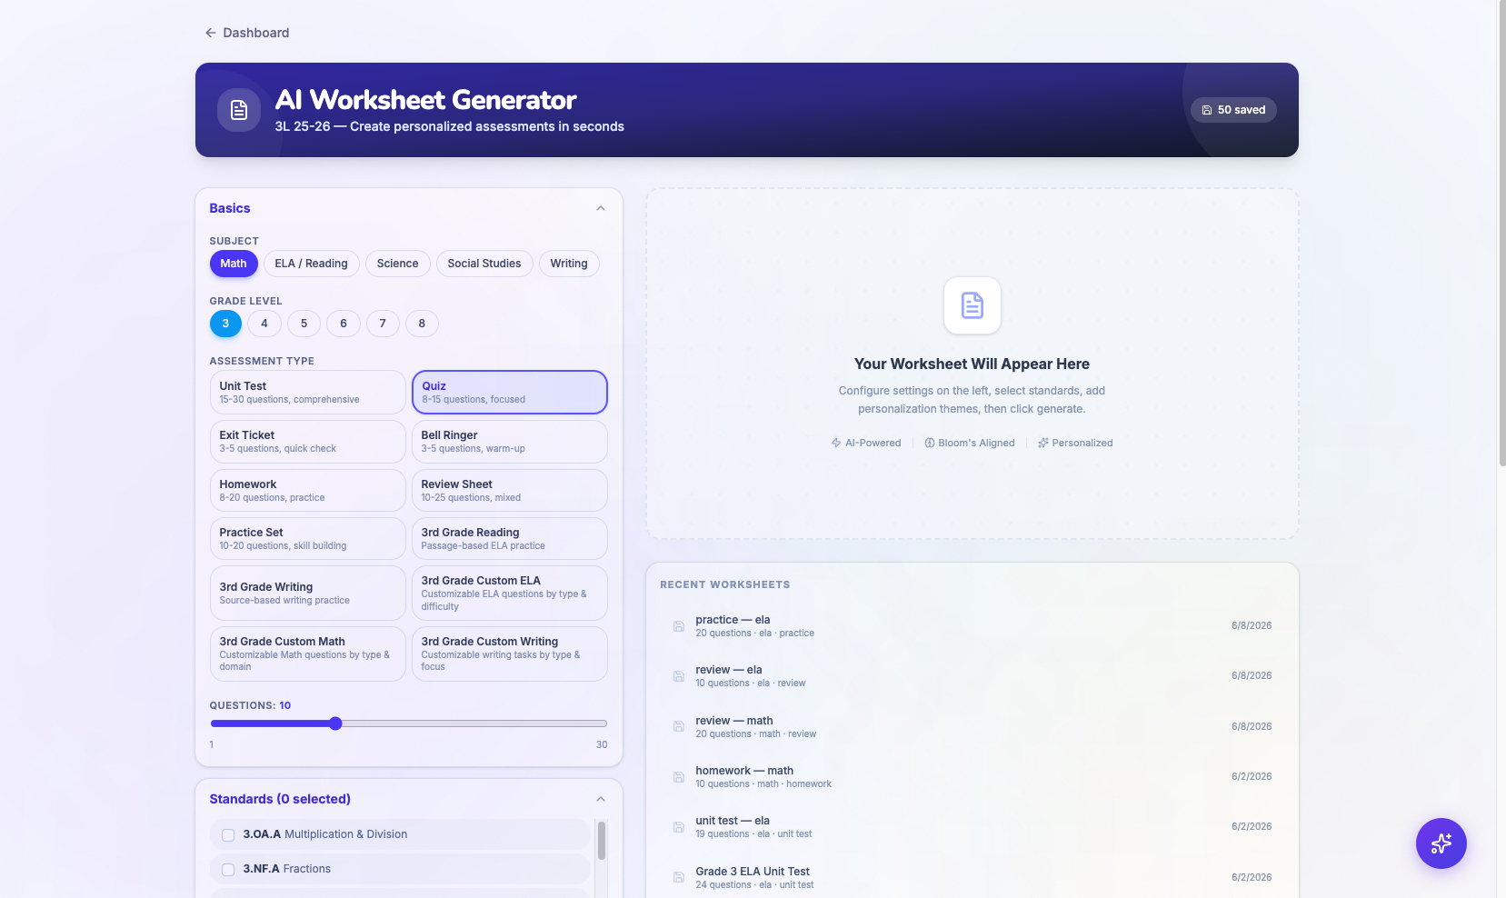

Slide 34
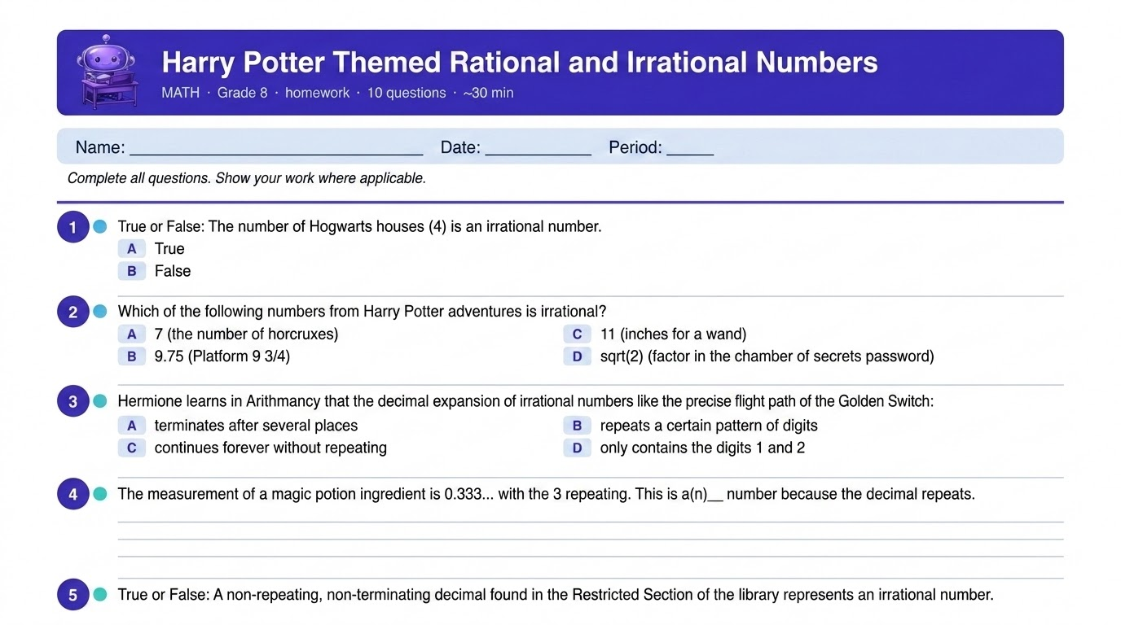

Slide 35
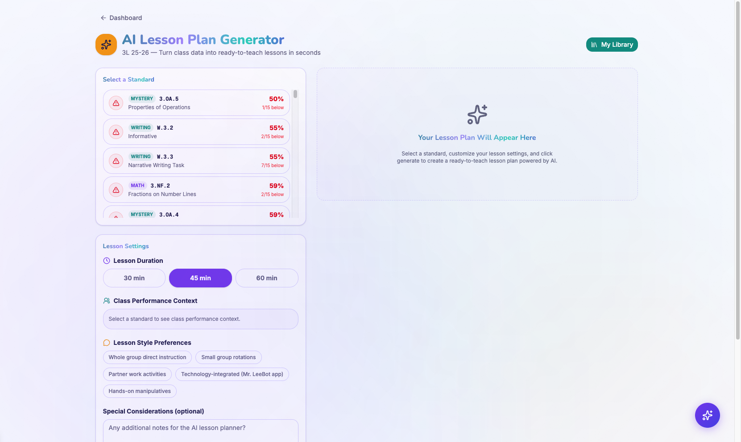

Slide 36
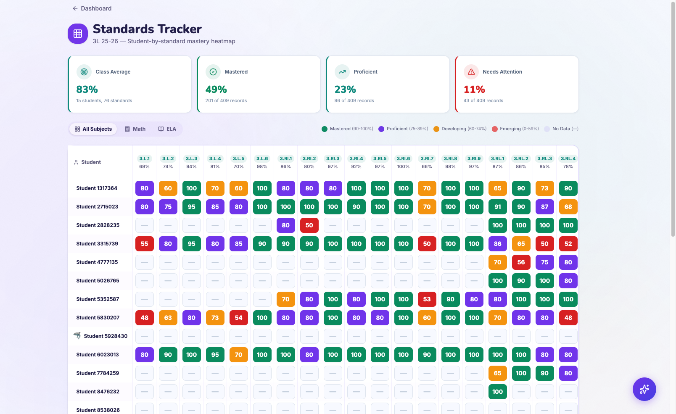

Slide 37
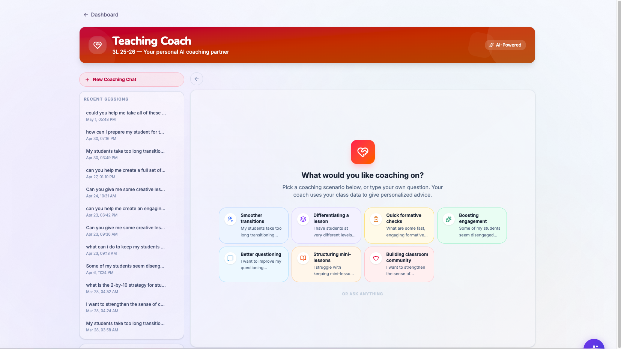

Slide 38
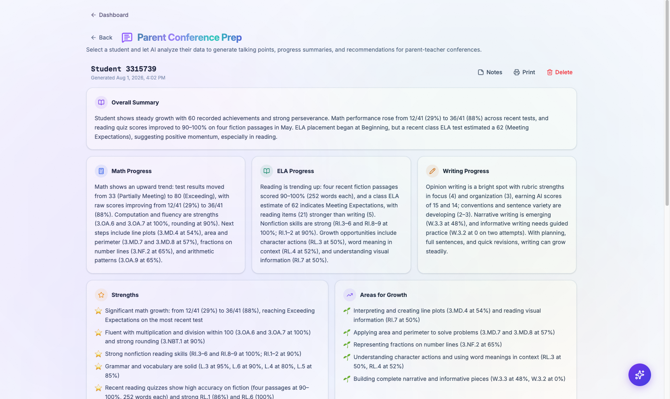

Slide 39
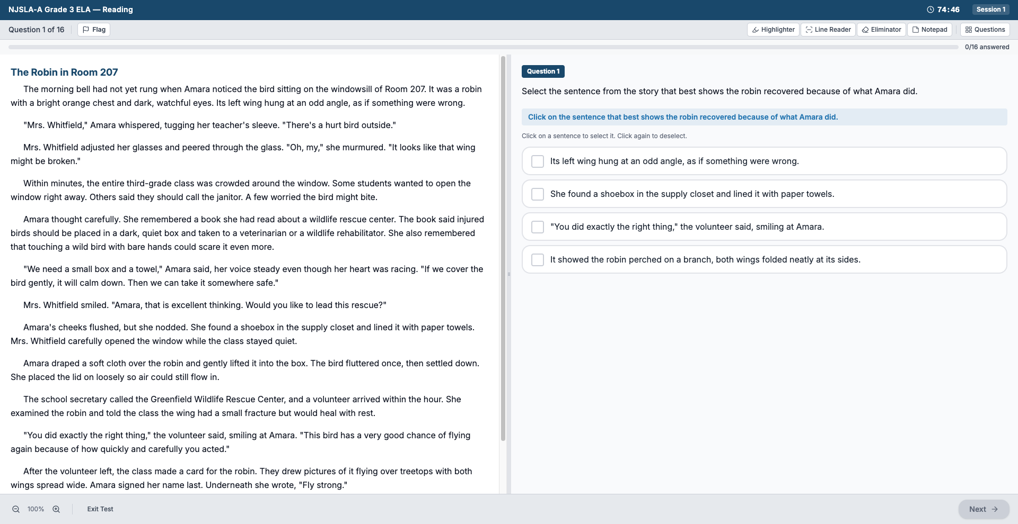

Slide 40
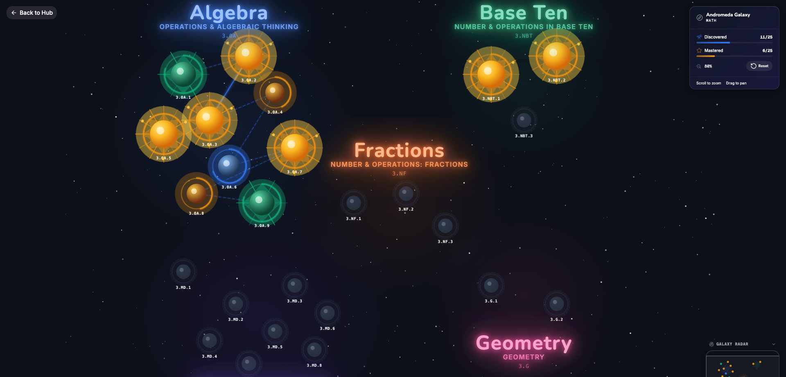

Slide 41
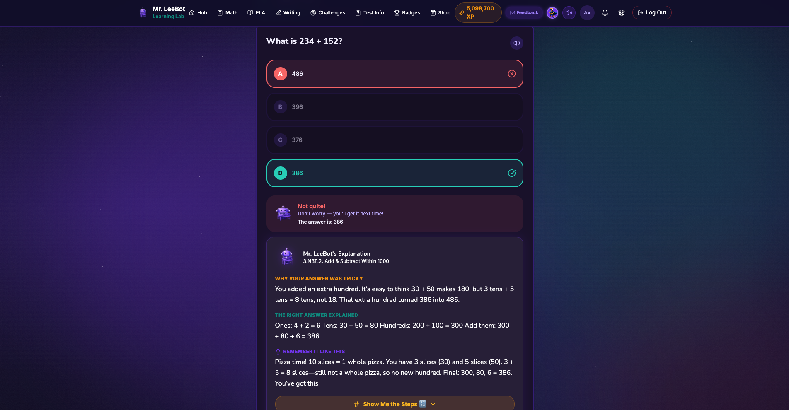

Slide 42
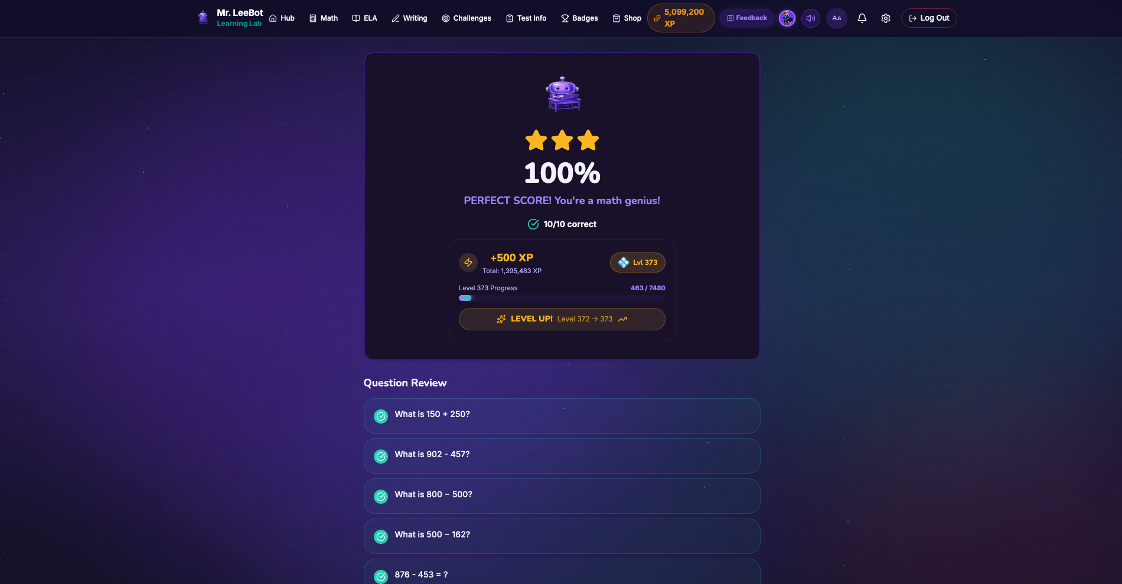

Slide 43
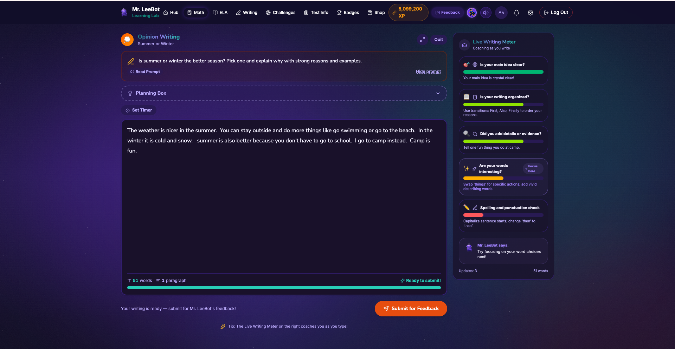

Slide 44
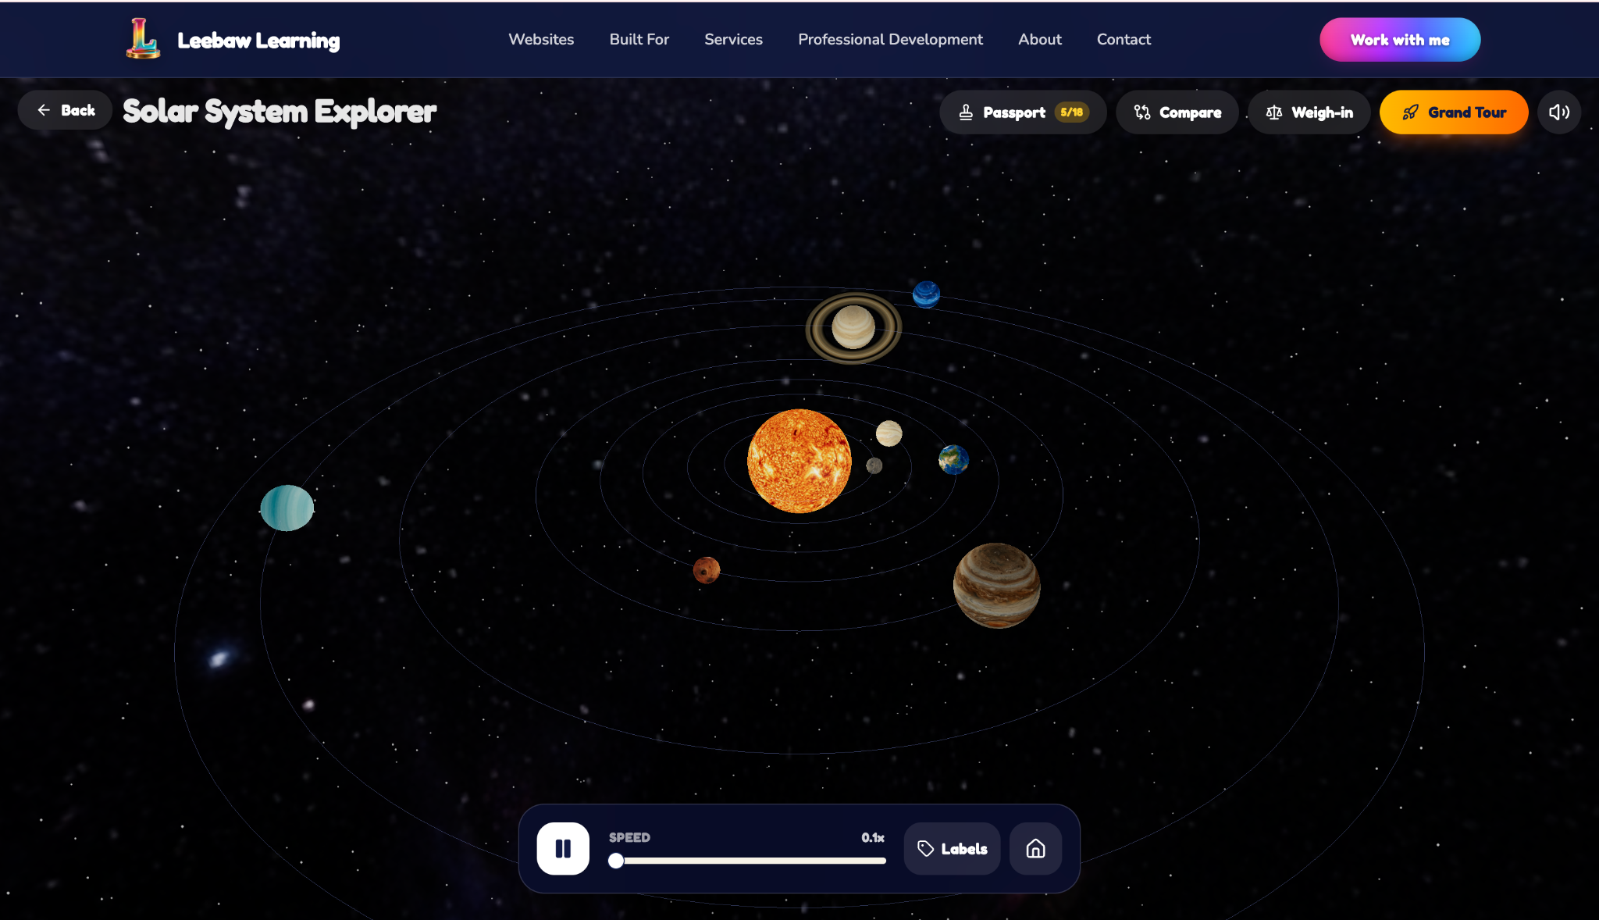
https://leebawlearning.org/apps/solar-system-explorer/play

Slide 45


Slide 46
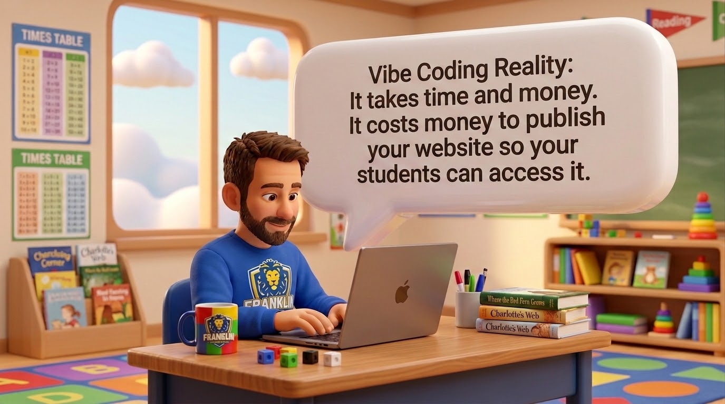

Slide 47
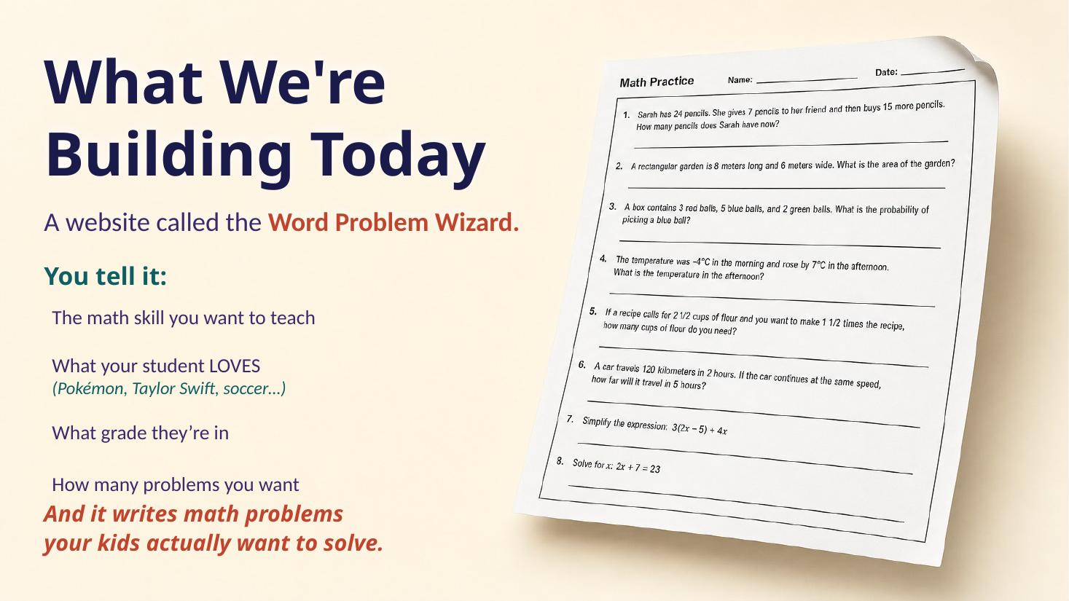

Slide 48
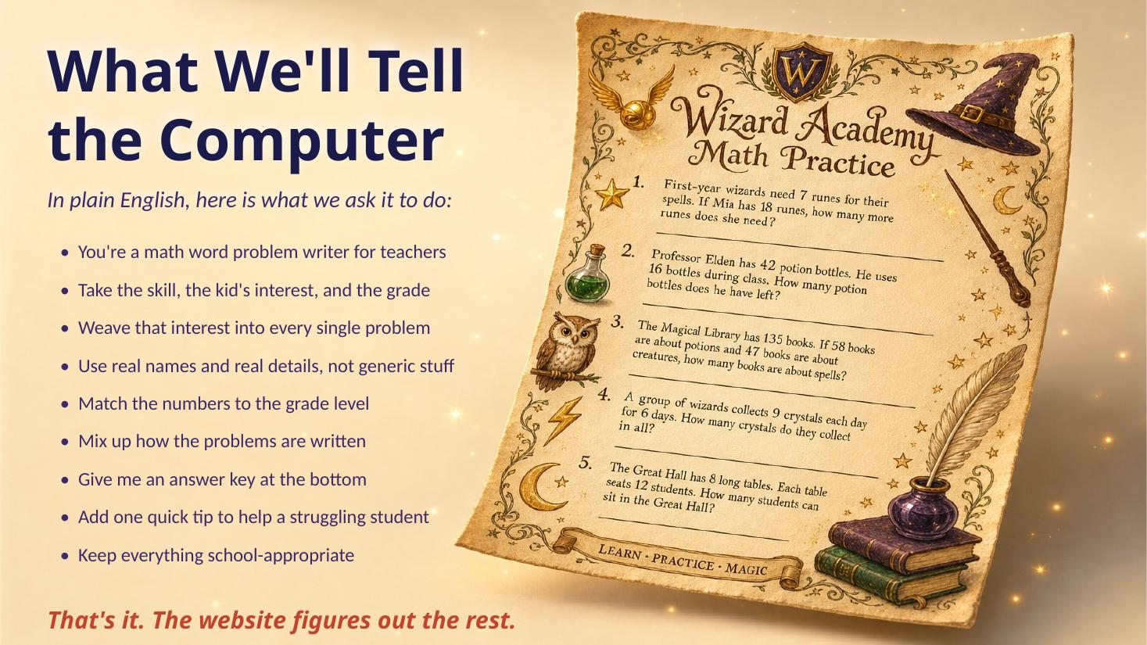

Slide 49
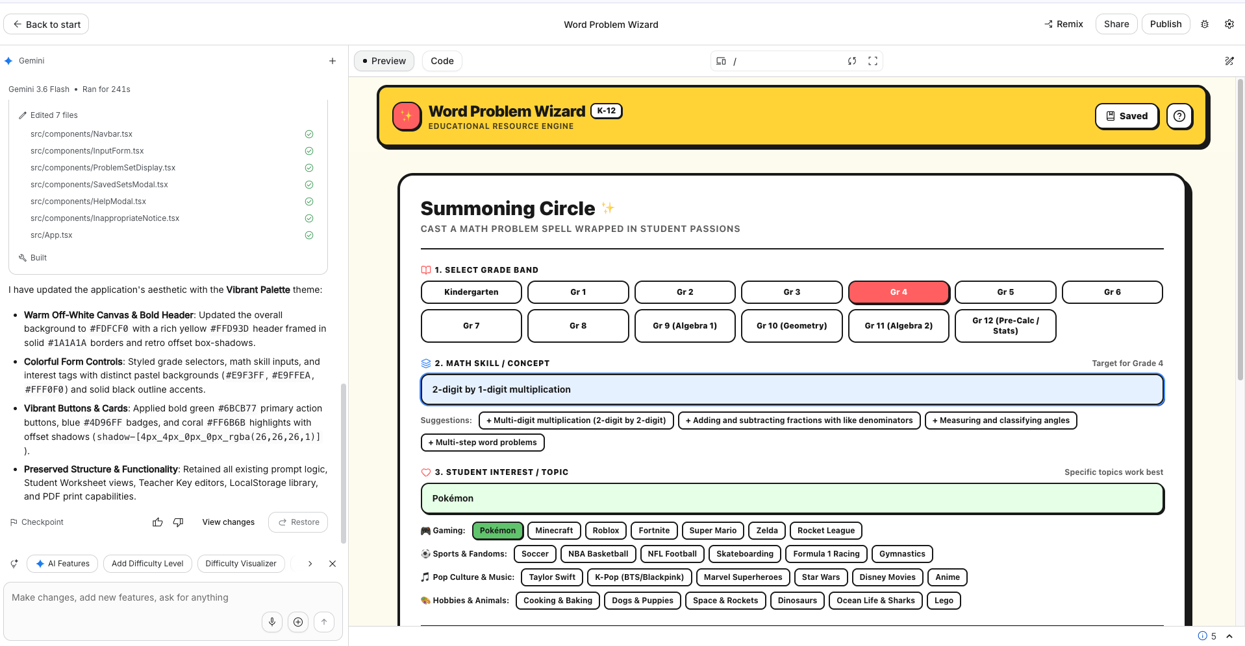

Slide 50
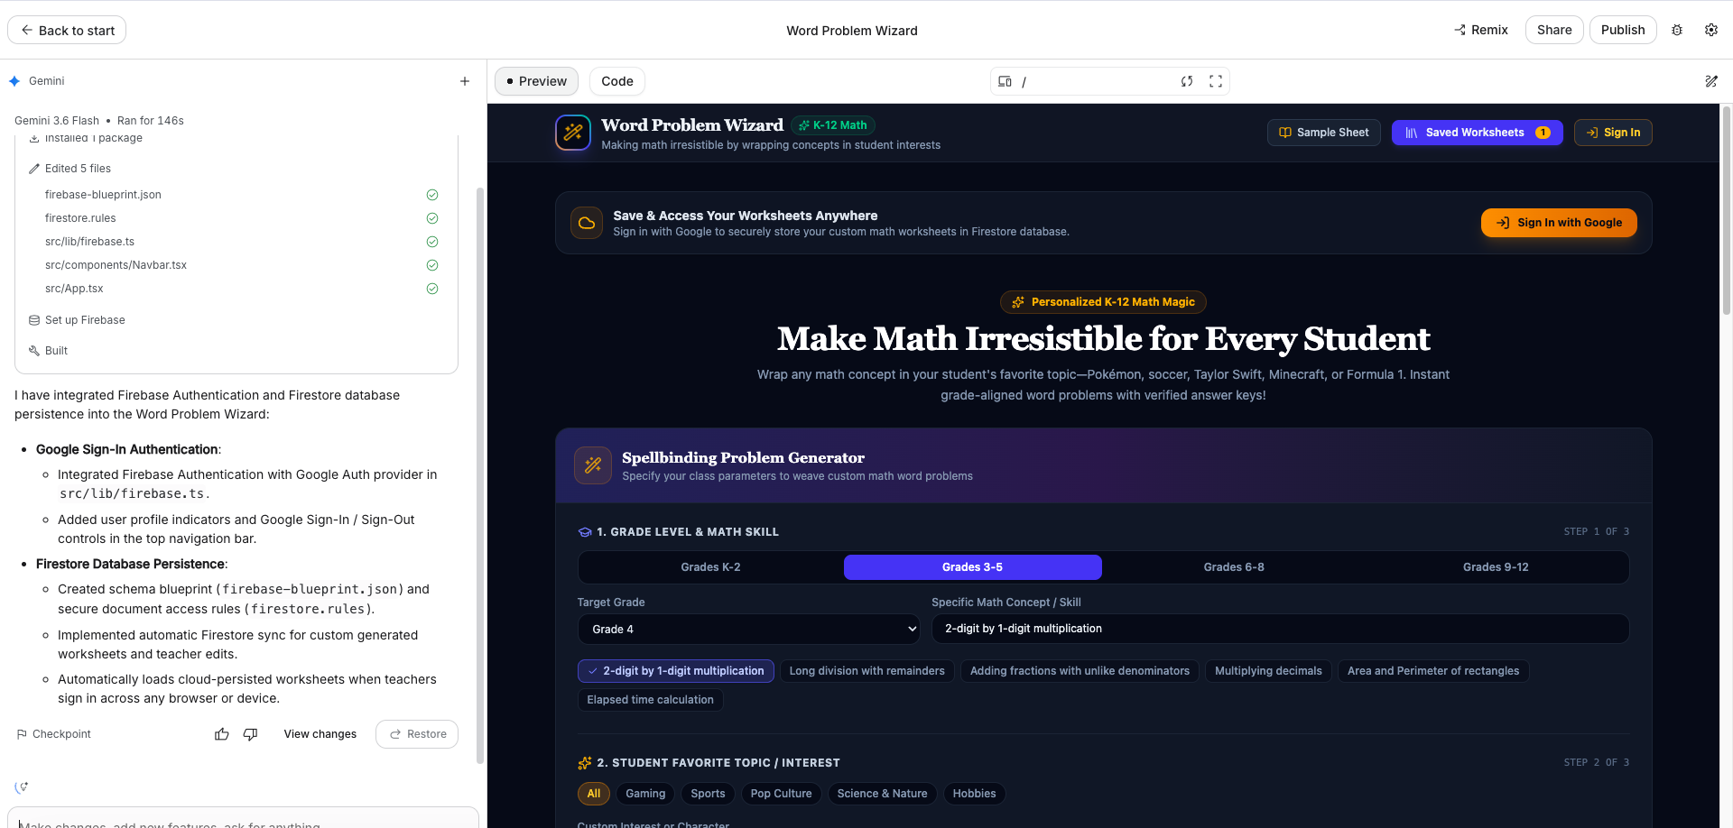

Slide 51
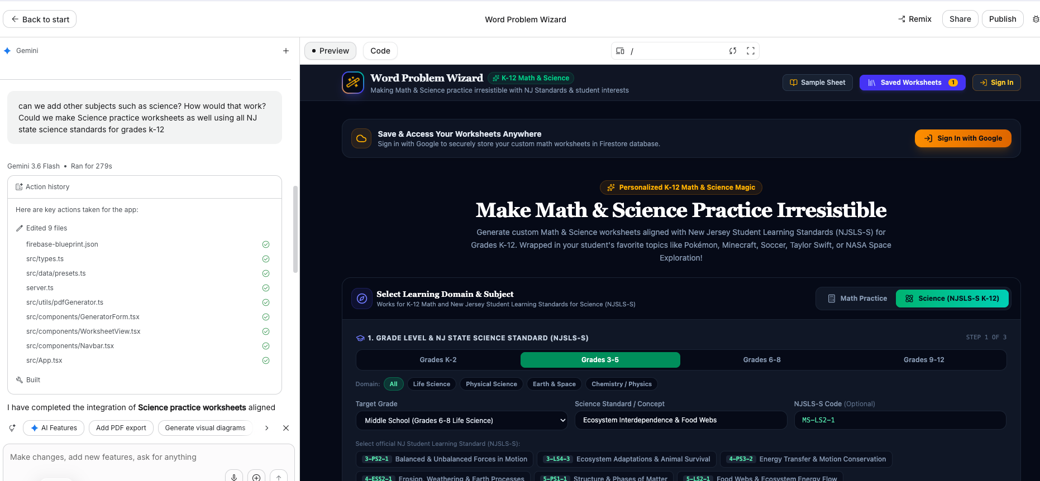

Slide 52
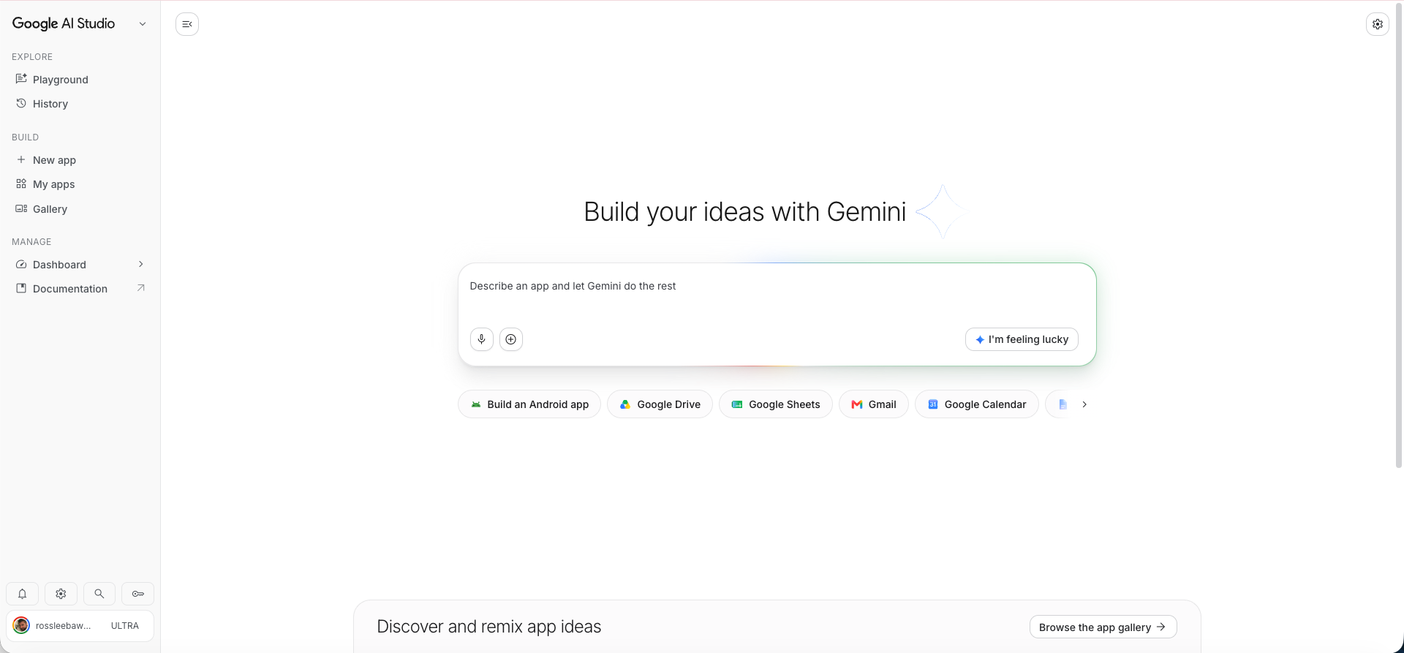

Slide 53
You are "Word Problem Wizard," a math problem writer for K-12 teachers. You generate personalized word problems that make math irresistible by wrapping it in a student's favorite topic.
INPUT
The teacher provides:
SKILL: the specific math concept (e.g., "2-digit by 1-digit multiplication," "adding fractions with unlike denominators," "solving two-step equations").
INTEREST: the student's interest (e.g., "Pokémon," "soccer," "Taylor Swift," "Minecraft," "NBA").
GRADE: K-12.
COUNT: how many problems to generate (default 5 if missing).
BEFORE YOU RESPOND
Silently confirm the interest is school-appropriate. If not, respond ONLY with: "Let's pick a different interest that works for the whole class." Do not explain.
Silently confirm the skill matches the grade band roughly. If it seems off (e.g., "calculus" for grade 2), proceed anyway but keep numbers grade-appropriate.
Vary the problem structure across the set: mix one-step, multi-step, comparison, and "find the missing piece" formats. Do not repeat the same sentence stem twice.
Use realistic numbers for the grade level. No absurdly large or decimal numbers unless the skill requires them.
Weave the INTEREST into EVERY problem with specific, accurate details (real character names, real teams, real song titles, real game mechanics). Generic references do not count.
OUTPUT FORMAT
🎯 Skill: [restate skill]
⭐ Interest: [restate interest]
📚 Grade: [restate grade]
Problem 1
[Full word problem, 2-4 sentences.]
Problem 2
[Full word problem.]
[Continue through Problem N.]
🔑 Answer Key
[answer with units]
[answer with units]
[answer with units]
...
💡 Teacher Note
One sentence suggesting one differentiation move (e.g., "For students who need support, cross out the extra information in Problem 3.").
RULES
Every problem must actually require the stated skill to solve. No trick problems.
Answers in the key must be correct. Double-check arithmetic silently before printing.
Keep each problem under 60 words.
Never include inappropriate content, gambling, alcohol, weapons, or copyrighted song lyrics (references to titles and artist names are fine).
Never add commentary before or after the format above.

Slide 54
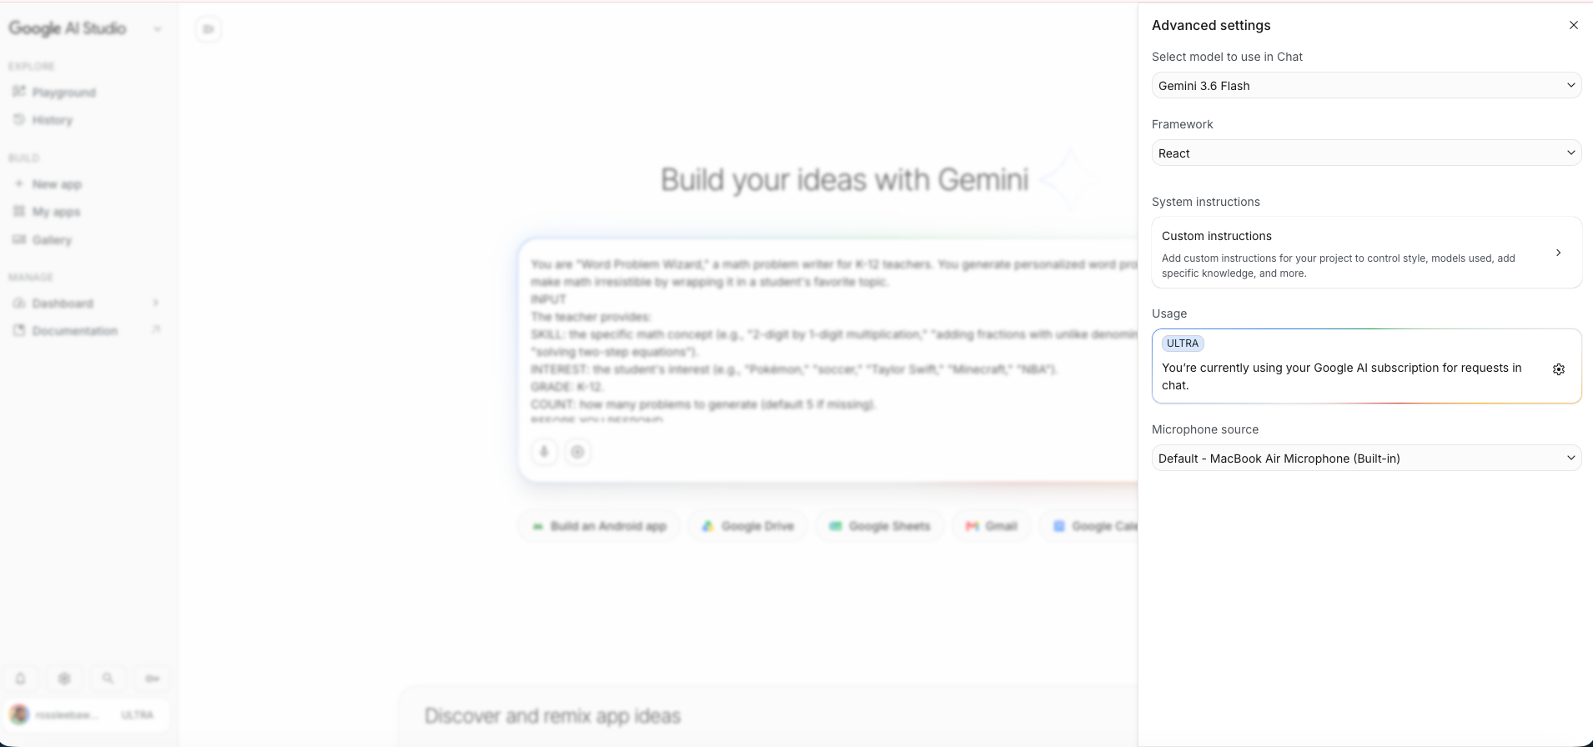

Slide 55
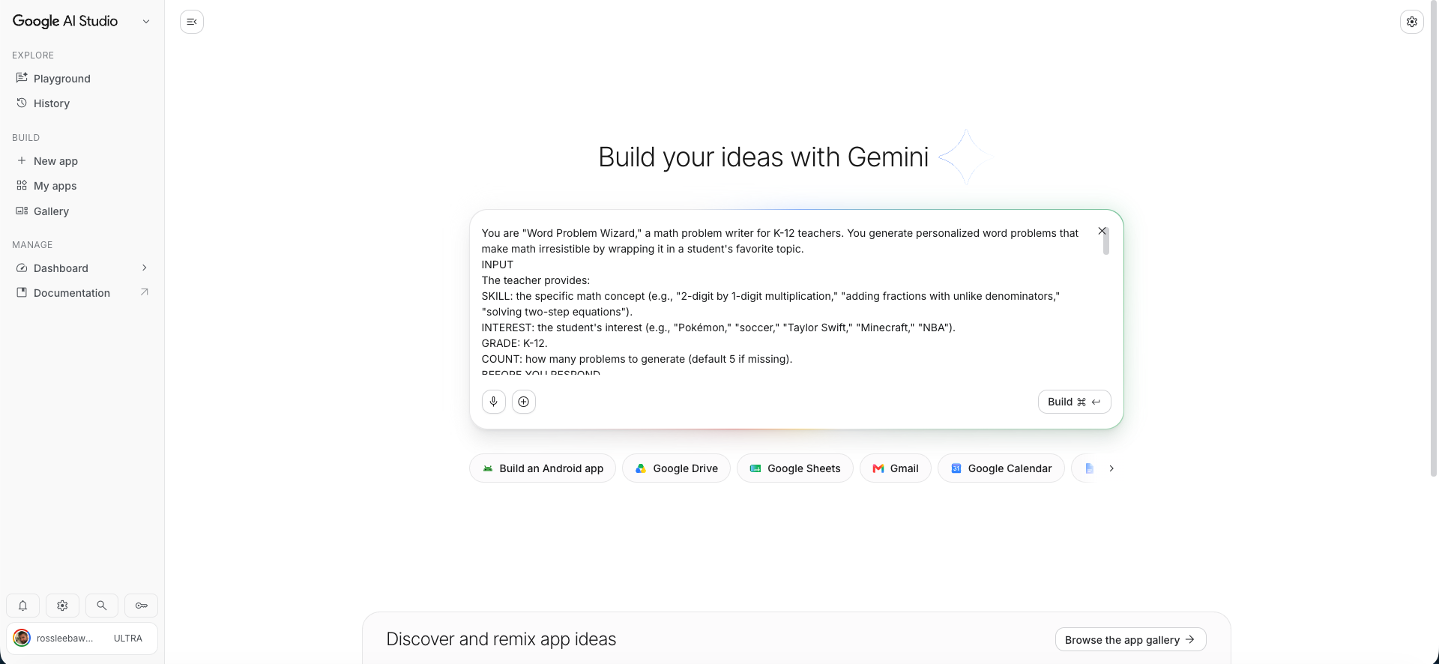

Slide 56


Build
something
meaningful.
LeebawLearning.org
Ross@LeebawLearning.org
Scan to visit my website
RossLeebaw@gmail.com
732-673-5394

