Slide 2



a brief introduction to
Java

Slide 3


Lora Santucci
Math & Computer Science teacher
Morris Hills HS
Rockaway, NJ
Goal: to create confident novice java programmers!

Slide 4
Workshop description
This course will introduce learners who have little to no text-based programming knowledge to java syntax and concepts via a hands-on workshop.
Topics include:
the history of java
the structure of a java program
basic syntax
primitive data types
mathematical operators.
Conditional expressions and loops may be introduced as time permits.

Slide 5
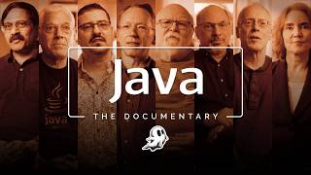
Notes:
Source: https://www.youtube.com/watch?v=ZqGSg4b_cZA&t=14s

Slide 6
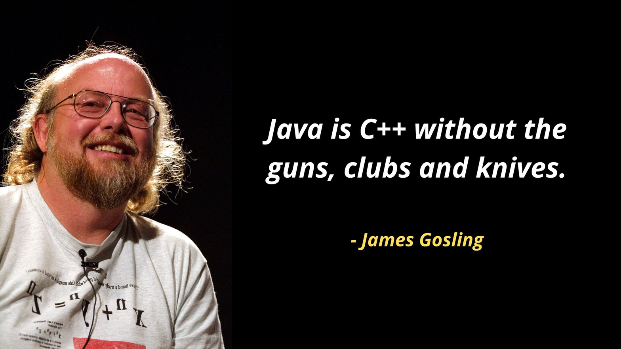
early 1990s
about C++
The idea: write once, run anywhere
a.k.a. platform independent
JVM

Slide 7
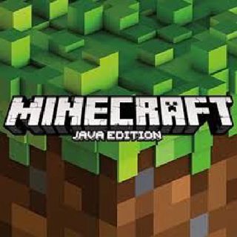



big Data
desktop GUIs
still in use
today
Java 26
mobile apps
and more!

Slide 8
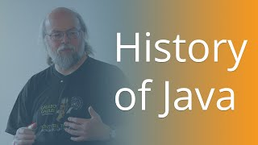

Slide 9
Java syntax
An object oriented programming language
...but not purely

Slide 10
today’s goals
write a program using basic java syntax:
  printing to output
  variables & data types (primitive vs. object)
  operators & calculations
  accepting user input (Scanner)
  if time: conditionals & loops

Slide 11
TOPICS:
The History of Java (video) ~ The Java Story | The Official Documentary (July 17, 2026)
Basic structure of a java program
CodeHS IDE tour ~ Cortado course - online textbook
classes
main method
comments
Java Documentation
printing to the terminal window (print vs. println)
Basic syntax demo in Sandbox: introduce yourself in a creative way!
Variables and data types
1.2.6 Signature
1.2.11 Variables about You
Mathematical operators (+, -, *, /, %, ++, --, +=, -=, *=, /=)
1.3.11 Tip Calculator
User input (using the Scanner class .nextInt(), .nextDouble(), .nextLine())
printing a restaurant check guided coding
Some useful classes in Java
The Scanner class for user or file input (scanner demo) - zero to mastery blog
☕Demo: Restaurant check - Fork to save a copy for yourself before editing
working example (code)
The Math class Math.PI, Math.pow(...), Math.sqrt(...), Math.abs(...), etc.
☕Demo: Distance between two points

Slide 12
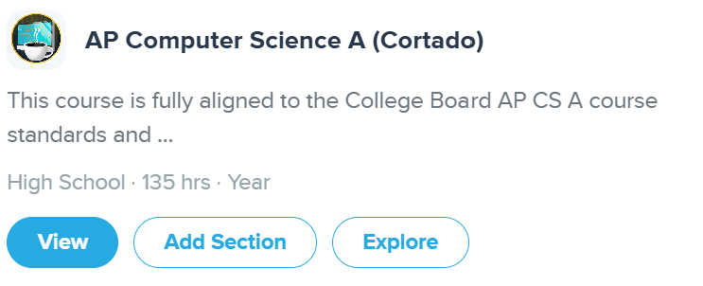
codeHS ~ Cortado
join Java for Teachers as a student: codehs.com/go/E53EC
OR from
Course Catalog

Slide 13
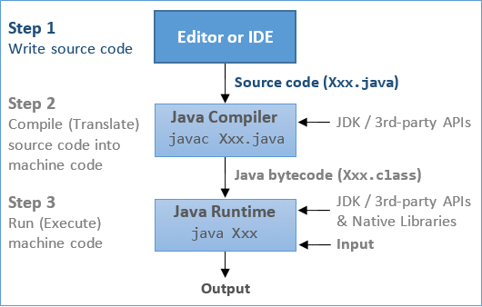
Steps in writing a Java program

Slide 14
codeHS tour & structure of a java program
IDE ~ edit - compile - run
The main method & syntax
System.out.print(...)
System.out.println(...)
join: codehs.com/go/E53EC

Slide 15
Demo & Playtime!
The best way to learn
is by play
sometimes in the sandbox!
Write a program that tells a fun story about yourself using print statements.

Slide 16


Slide 17
Coding Practice!
1.2.6 Signature (semi-guided)
1.2.11 Variables about You (you try!)
1.3.12 Tip Calculator (guided)

Slide 18
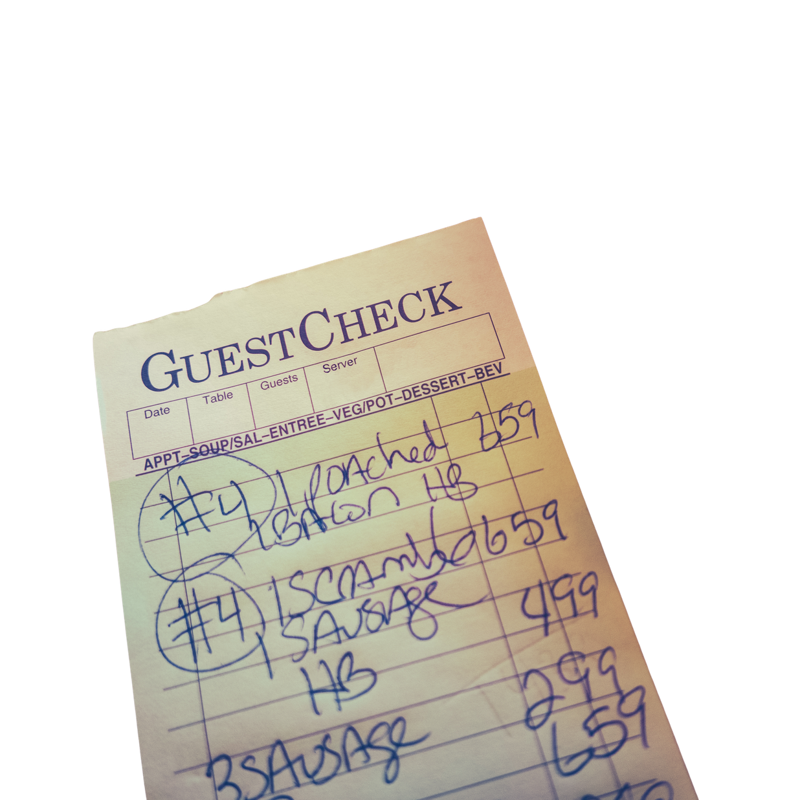
A full program demo
user input & the Scanner class
Scanner reader = new Scanner(System.in)
nextLine()
nextInt()
nextDouble()
Guided Coding in the Sandbox

Slide 19
Restaurant Check
completed code

Slide 20

Distance between two points
The Math class
Math.sqrt(...)
Math.pow(...)
Extension: add user input

Slide 21

More Java...

Slide 22
IF TIME:
Conditional expressions ~ ☕Demo: Is the pool closed?
boolean expressions and relational operators (<, <=, >, >=, ==, !=, &&, ||)
if statement syntax (one branch)
if-else (two branch)
nested if-else
code together 2.3.7 Add Tip
code together 2.3.8 Sweet or Unsweet (includes Scanner input)
you try 2.4.9 Roller Coaster
optional 2.4.11 Theater Discounts (if-else-if)
Loops
the while loop ~ ☕Demo: Pool closure with repeated input
a task controlled loop
you try 2.7.5 Making Taffy (code together option)
optional 2.7.10 Guess Mt. Everest's Height (with optional advanced extension)
the for loop ~ ☕Demo: Multiplication
a count controlled loop
you try 2.8.5 Print the Odds (hint: a number is odd if n%2 == 0)

Slide 23

adding
CONTROL

Slide 24
Control Structures
control program flow
by making DECISIONS
a.k.a. boolean expressions

Slide 25



Slide 26
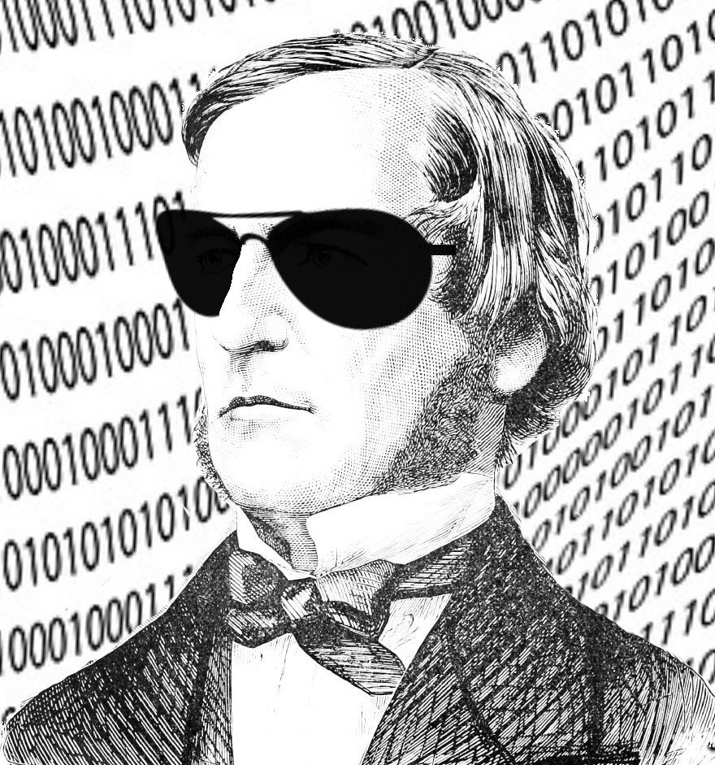
Who is George Boole?
modest upbringing
largely self taught
a calculus of reason ~ 1850s
70+ years later electrical switches brought Boole’s logic to life!

Slide 27
boolean ~ true or false
Examples:
boolean isHungry = true;
boolean isValid = false;

Slide 28
relational operators
==
<, >, <=, >=
&&
||
!
.equals(String)
Example:
boolean isGreater = 6 > 7

Slide 29
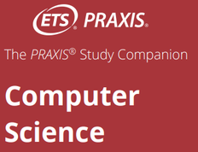
conditional statements
if(condition)
{
//body statement(s);
}
else
{
//body statement(s);
}

Slide 30
Example
int number = -3;
if(number > 0)
System.out.println("positive");
else if(number < 0)
System.out.println("negative");
else
System.out.println("zero");

Slide 31
Is the pool closed?
code together:
2.3.7 Add Tip
2.3.8 Sweet or Unsweet
you try:
2.4.9 Roller Coaster
2.4.11 Theater Discounts (optional)

Slide 32
task controlled loops
while(condition)
{
//statement(s);
}
uses a loop control (variable)

Slide 33
task controlled loops
int reps = 0;
while(reps < 8)
{
System.out.println(reps+1);
reps++; //update
}
System.out.println(reps + " push ups done!");

Slide 34
task controlled loops
do
{
//statement(s);
}
while(condition);
//guarantees one iteration
//BEFORE condition check

Slide 35
Pool closure ~ while loop
you try (optional code together):
2.7.5 Making Taffy
optional challenge:
2.7.10 Guess Mt. Everet’s Height

Slide 36
count controlled loops
for(initialization, condition, update)
{
//statement(s);
}
for(element : collection)
{
//statmement(s);
}

Slide 37
Multiplication ~ for loop
you try (optional code together):
2.8.5 Print the Odds
hint: a number is odd if n%2 == 1
(the remainder, when divided by 2, is 1)

Slide 39
ADDITIONAL RESOURCES:
CodeHS Tutorials
Other java IDEs (I prefer BlueJ for teaching) - others include jGrasp, DrJava, Netbeans, ...
Formatting a double with printf
Algorithms & Pseudocode Notation (p. 21 of Praxis Computer Science Study Companion)

