Slide 2

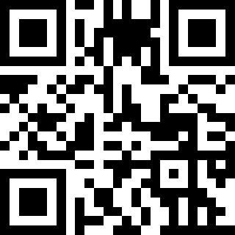
Lora Santucci
Morris Hills High School
Rockaway, NJ
https://tinyurl.com/cstanjBinary
Notes:
Find the lesson at:
https://code.org/curriculum/course2/14/Teacher

Slide 3
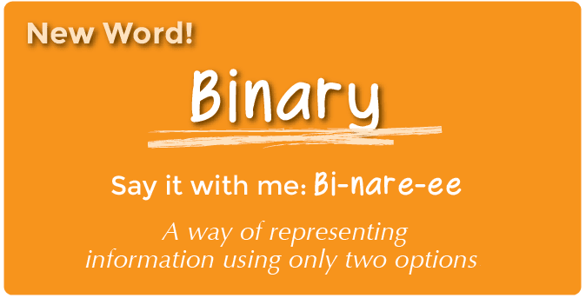

Slide 4

Video Lesson from code.org

Slide 5
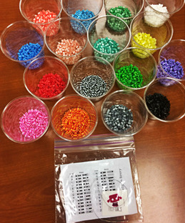
Activity Directions:
Find the first letter of your first name in the Binary Decoder Key.
Choose one color for 0 and a different color for 1.
Fill in the squares of the provided bracelet to match the pattern of the squares next to the letter that you selected. Repeat for all other letters with a separator color.
Tie ends of the bracelet around your wrist to wear it!
Share your bracelet with your classmates to see if they can figure out your code.

Slide 6
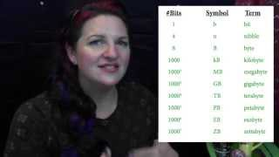
what is the OBJECTIVE? (from CS Fundamentals course 2)

Slide 7
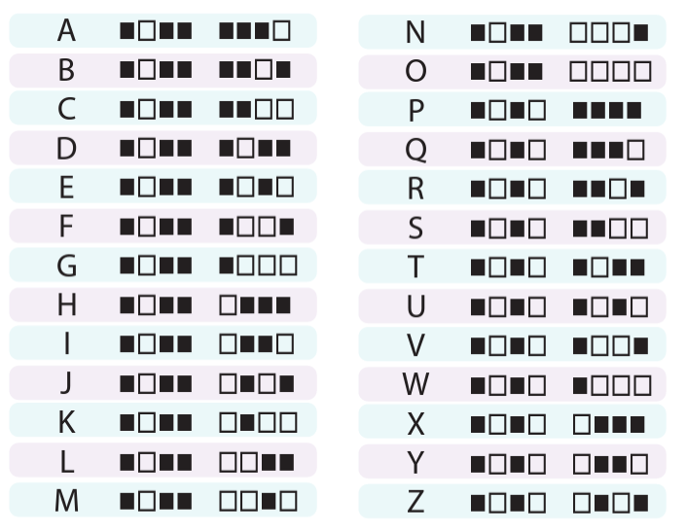
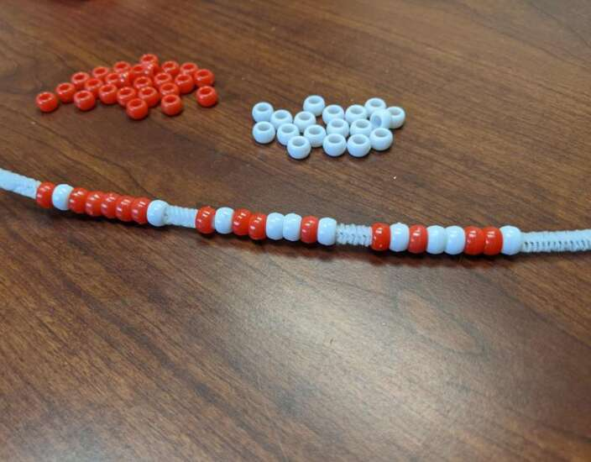
Decoding KEY
Modification:
Use an online text to Binary converter

Slide 8
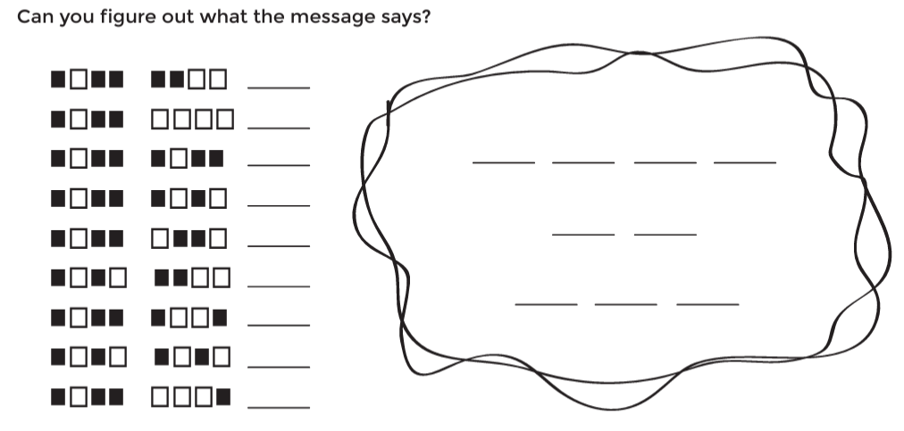
Assessment

Slide 9
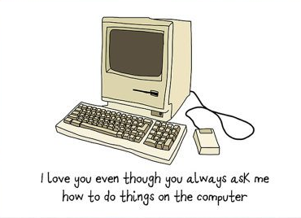
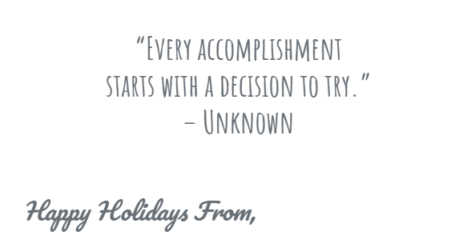
Gift Tags ~ Mother's Day Holiday/Generic

Slide 10
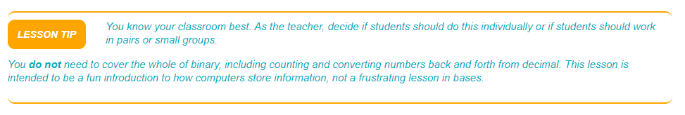
Differentiation ~ from K - 12!
At each grade level, BUILD UPON the previous level...
K-4: Introduce binary at an introductory level (ON-OFF)
5-8: Combine ideas about number systems and varied data types
9-12: Go where you can take it! Convert numbers between binary, decimal & hexadecimal, write programs to convert between bases, etc!

Slide 11
LEsson Directions ~ Off & On (adapted from code.org)
Write a short message on the board in binary and ask if anyone knows what it is or what it means.
Ask the class if they have ever seen inside a computer.
  What's in there?
  Actually show them the inside of a computer (if you have one) or pictures of the inside of a computer.
Wires carry information through the machine in the form of electricity.
  The two options that a computer uses with respect to this electrical information are "off" and "on."
    When computers represent information using only two options, it's called "Binary."
  That theme of two options doesn't stop when the information gets to its destination.
Computers also store information using binary.
  Binary isn't always off and on.
    Hard Disk Drives store information using magnetic positive and magnetic negative.
    DVDs store information as either reflective or non-reflective.
  How do you suppose we can convert the things we store in a computer into binary? Let's start with letters.
    Use the Binary Decoder Key to show how a computer might represent capital letters.
      Each spot where you have a binary option is called a "binary digit" or "bit" for short.
      Grouping of eight bits is called a byte.
      Fun fact: A grouping of four bits is called a nibble.
    Go over a few examples of converting letters into binary, then back.
    Afterward, write an encoded letter and give the class a few seconds to figure out what it is.
    When the class can figure out your encoded letters on their own, you can move on to the activity.

Slide 12
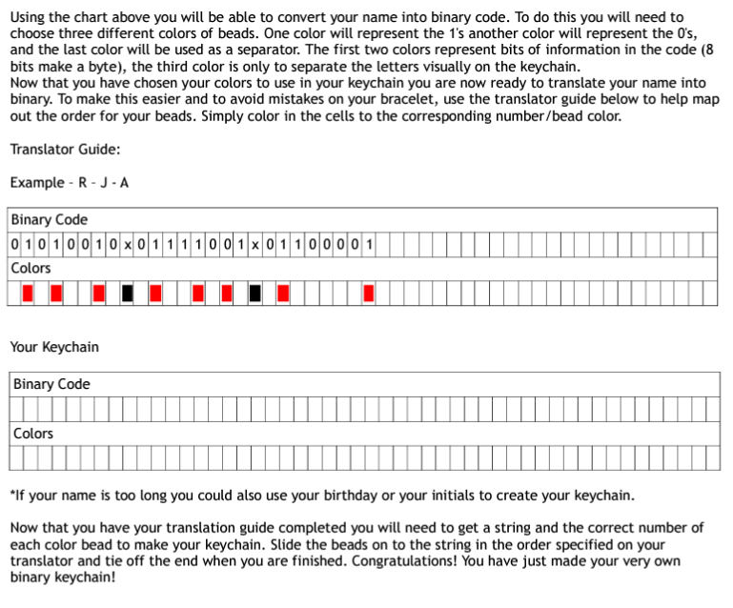
Grades 7-12
wORKSHEET
*eNRICHMENT:
hAVE sTUDENTS USE AN ascii tABLE* TO FIND LETTERS AND WRITE THEIR OWN CODE!
* ASCII, stands for American Standard Code for Information Interchange. each individual bit represents a unique character

Slide 13
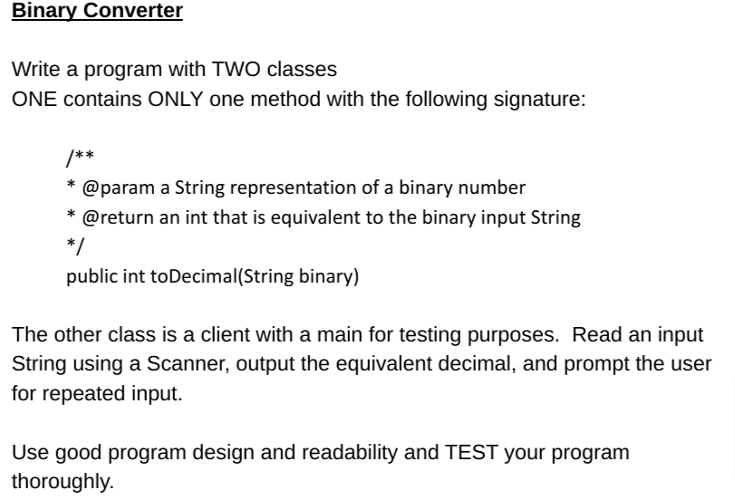
Extension for advanced programming classes

Slide 14
Extension ~ Converting between Decimal & Binary
0 1 0 0 1 0 1 1
0*2⁷ + 1*2⁶ + 0*2⁵ + 0*2⁴ + 1* 2³ + 0* 2² + 1* 2¹ + 1*2⁰
0*128 + 1*64 + 0*32 + 0*16 + 1*8 + 0*4 + 1*2 + 1*1
0 + 64 + 0 + 0 + 8 + 0 + 2 + 1
75

Slide 15
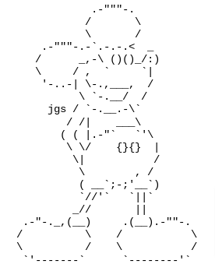
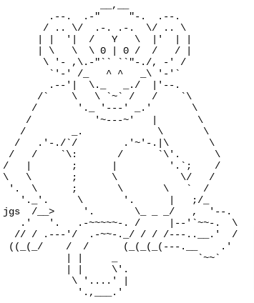
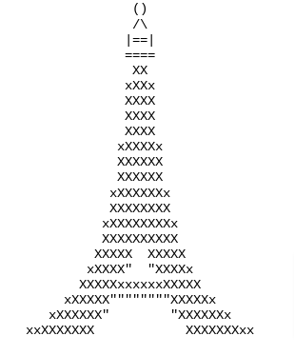

More extensions...ASCII ART!

Slide 16
NJSLS ~ Computer Science & Design Thinking
Computing Systems
People interact with a wide variety of computing devices that collect, store, analyze, and act upon information in ways that can affect human capabilities both positively and negatively. The physical components (hardware) and instructions (software) that make up a computing system communicate and process information in digital form.
Data & Analysis
Computing systems exist to process data. The amount of digital data generated in the world is rapidly expanding, so the need to process data effectively is increasingly important. Data is collected and stored so that it can be analyzed to better understand the world and make more accurate predictions.

Slide 17
References
code.org
ascii-code.com
nj.gov/education/standards/compsci/
csteachers.org/k12standards/
codebeautify.org/text-to-binary

