Slide 1

NASPO PRESENTS:
Welcome to the buying table: The Vr showdown
Let’s Start!

Slide 2
welcome!
Your school district is wanting to buy 1,000 VR headsets to power new job training programs for high school students. This will allow them to get hands-on job experience with different professions without having to build job specific labs.
Next

Slide 3

The Goal:
The goal is to buy 1,000 headsets that are:
  Durable
  Affordable
  Easy to Maintain
  Realistic
Budget: $600,000 (around $600 per unit)
Next

Slide 4
The Bids are in!
Next
VisionX Pro
SimuTech
EduVR one
NextWave

Slide 5

Evaluation
Criteria
Your evaluation criteria has to be weighted, so how do you plan to weigh the criteria? Which factors matter most for long-term success? Weigh the 5 criteria below out of 100.
Criteria:
  Cost
  Durability/Performance
  Software & Compatibility
  Ease of Use
  Support & Warranty
Next

Slide 6
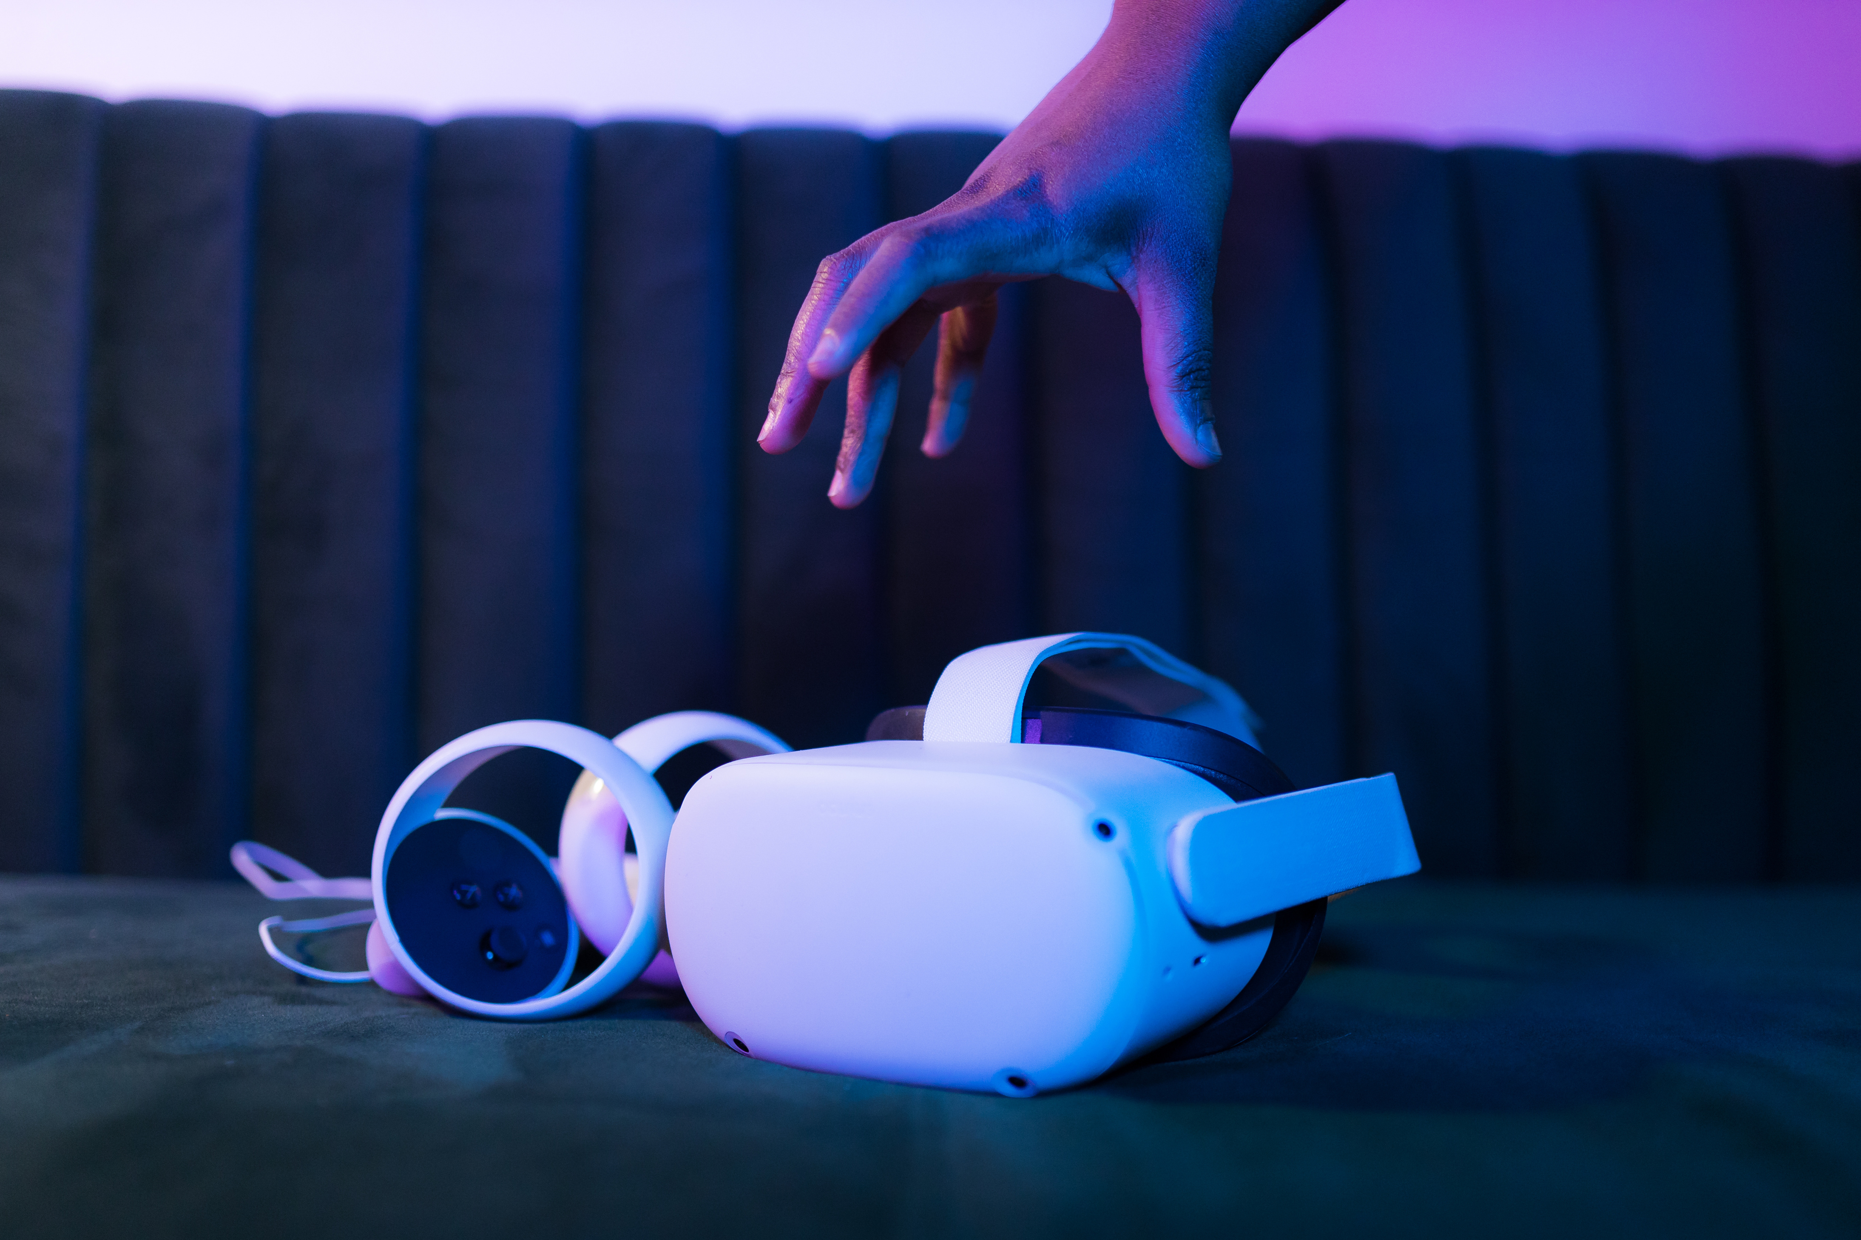
Make your choice
1
Review each bid.
2
Score them on the 5 criteria (0-100 scale)
3
Total your scores
4
Present your decision
Defend your choice. Explain how you chose to weigh your criteria and why you believe your choice is the best outcome for your school district.

Slide 7
Reflection
  What surprised you about making this decision?
  What would you ask vendors if you could?
  Would you change anything about the criteria?
  How does this show that procurement impacts people’s lives?
Next

Slide 8
NaSPO
If the public procurement profession is something you are interested in, please reach out to: talent@naspo.org
If you enjoyed the activity today, please consider submitting to the NASPO Business Challenge on the DECA website!

