Slide 1




Platform
Overview
Smarter Stores. Stronger Schools.
Summer 2026 - DECA Presentation

Slide 2

Today's Agenda
RallyOrder overview
Hardware
POS demo
HomeRoom demo
District demo
Q+A
Notes:
POS primary screen. Large buttons for easy navigation. Categories built for school stores. Focused on speed and readability to move kids through the line.

Slide 3




Thank you~!
Email us at
hello@rallyorder.com
Follow us at
RallyOrder@
rallyorder.com
RallyOrder Product Walkthrough | Confidential
Notes:
POS primary screen. Large buttons for easy navigation. Categories built for school stores. Focused on speed and readability to move kids through the line.

Slide 4




What is RallyOrder?
RallyOrder is a point-of-sale education platform built specifically for DECA SBE stores, students, advisors and districts.
Stores get a world-class POS, payments, and inventory platform.
Students get an experience built for them to run, learn and grow.
Advisors get more engaged students and a platform built for their classes.
Administrators get visibility, auditability, and peace-of-mind across all stores in their District.
RallyOrder Product Walkthrough | Confidential
Notes:
POS primary screen. Large buttons for easy navigation. Categories built for school stores. Focused on speed and readability to move kids through the line.

Slide 5
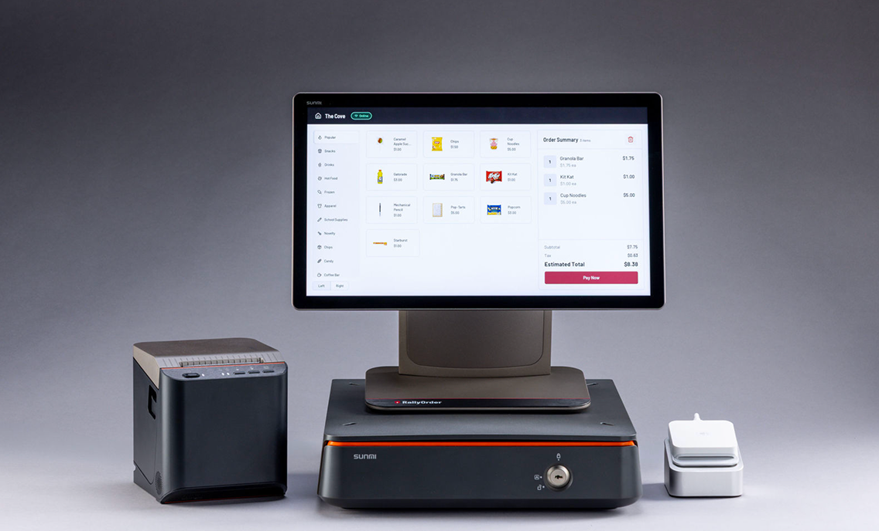
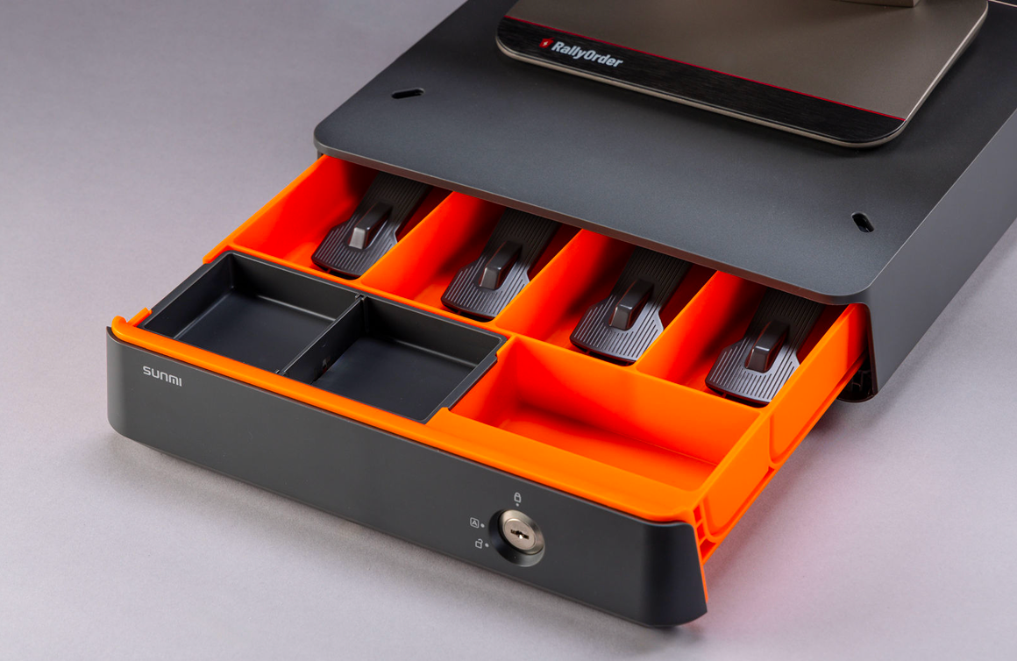
Point of Sale Hardware
POS, Card Reader, and Printer
Cashbox
RallyOrder Product Walkthrough | Confidential
Notes:
POS primary screen. Large buttons for easy navigation. Categories built for school stores. Focused on speed and readability to move kids through the line.

Slide 6
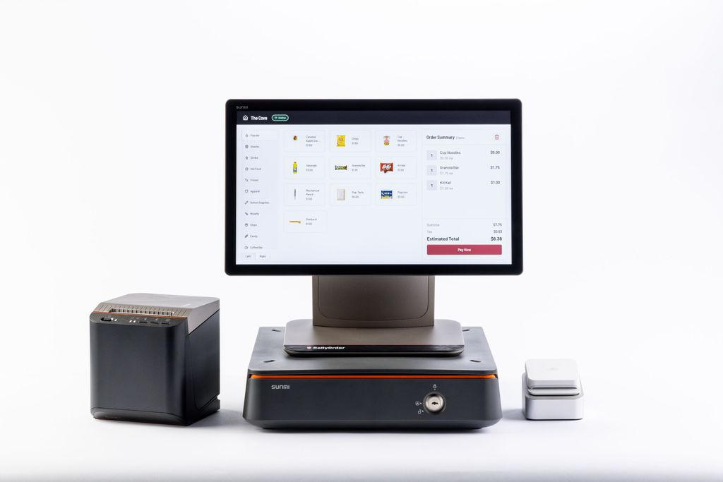
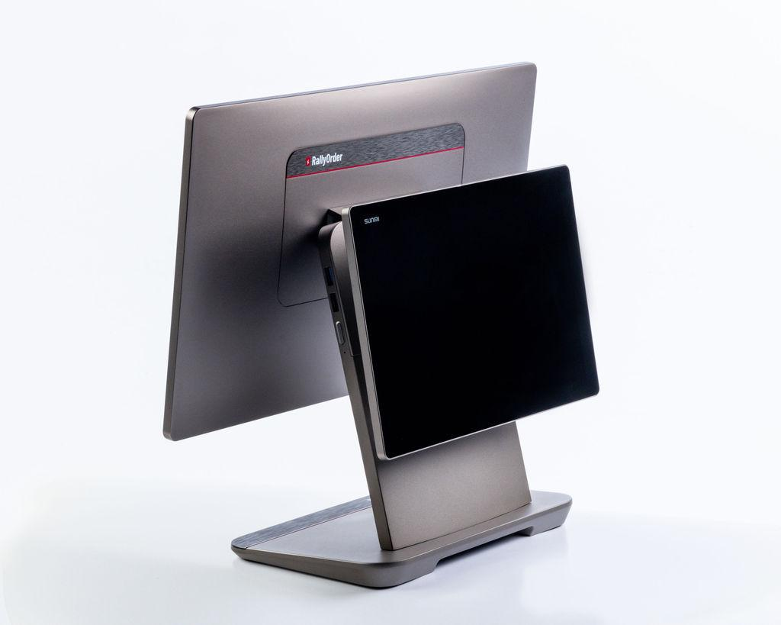
Point of Sale Hardware
Cashier Facing
Customer Facing
RallyOrder Product Walkthrough | Confidential
Notes:
POS primary screen. Large buttons for easy navigation. Categories built for school stores. Focused on speed and readability to move kids through the line.

Slide 7
Demo Time~!
RallyOrder Product Walkthrough | Confidential
Notes:
POS primary screen. Large buttons for easy navigation. Categories built for school stores. Focused on speed and readability to move kids through the line.

Slide 8
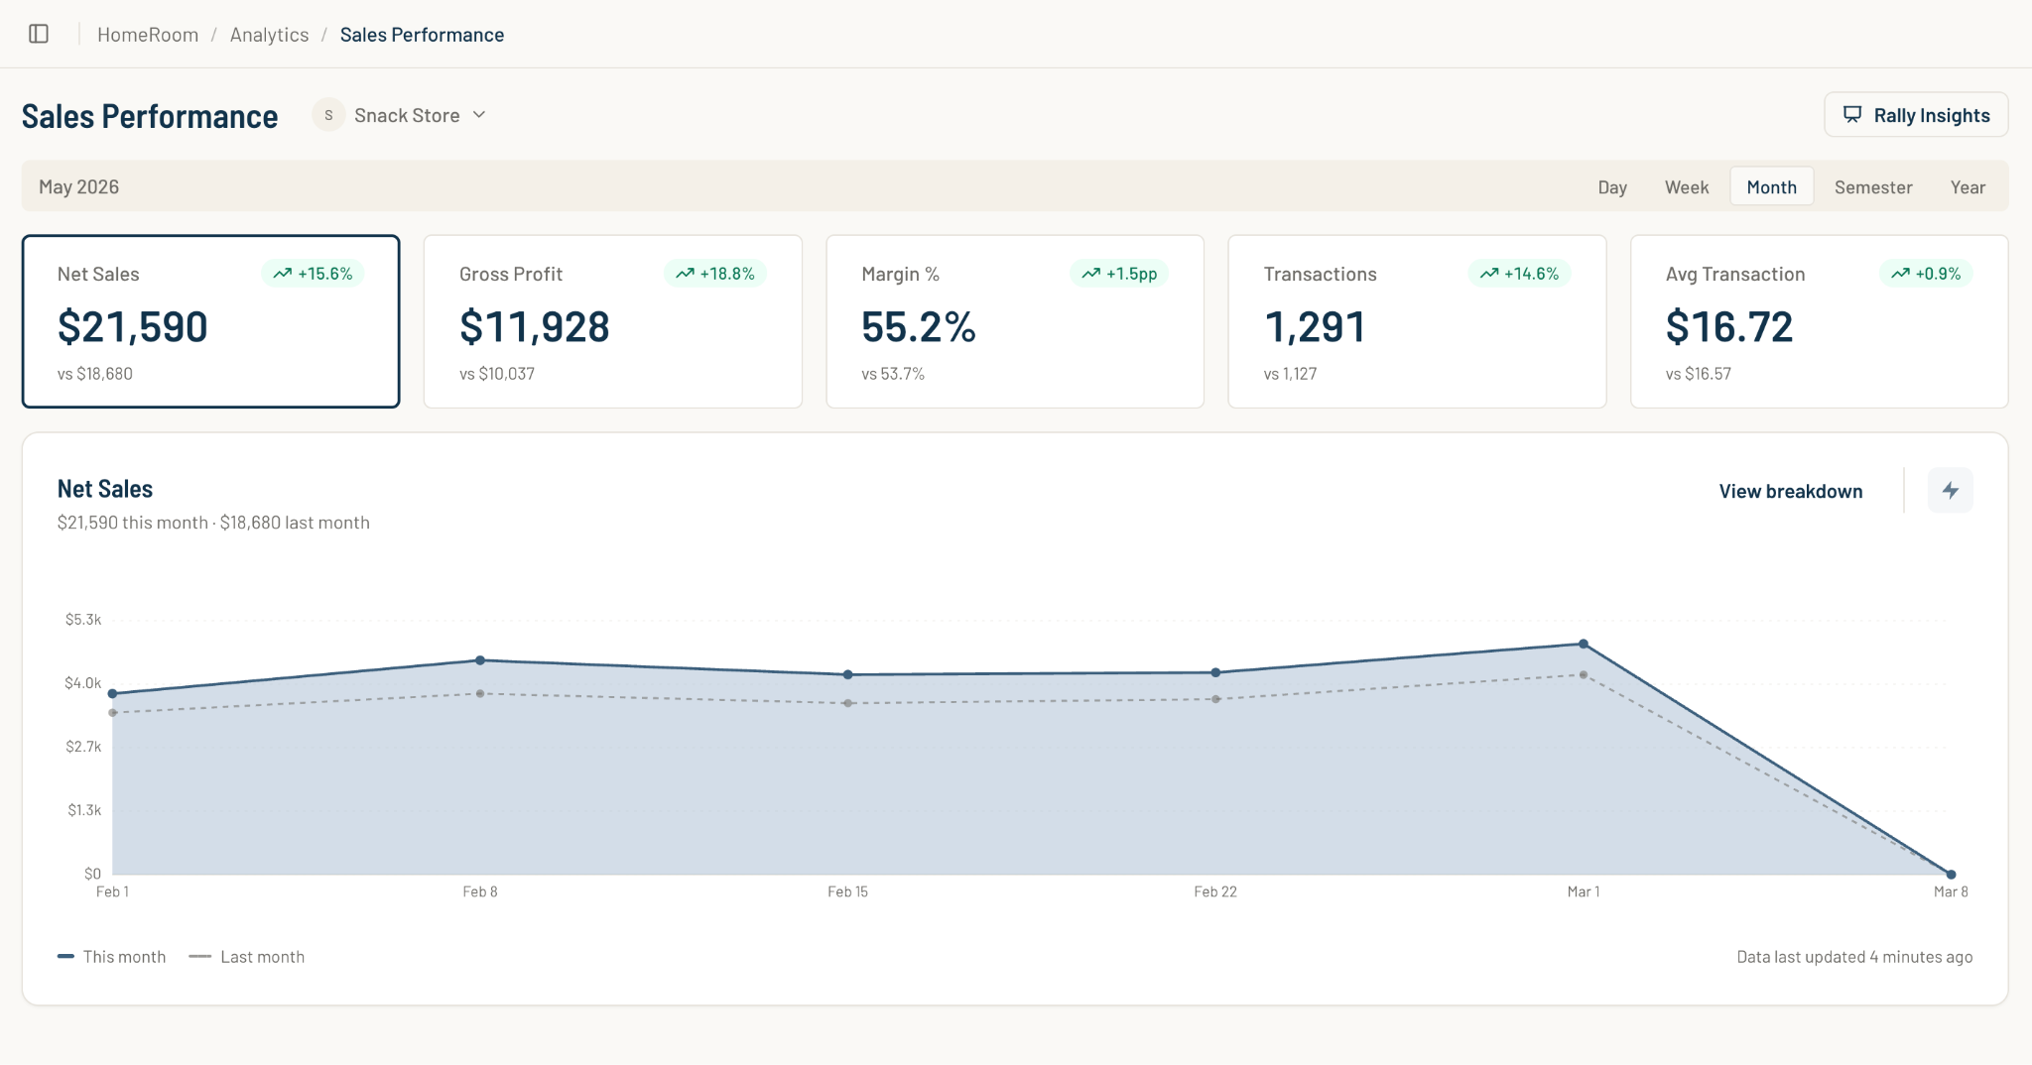
HomeRoom
HomeRoom is the connection that bridges the store and the classroom for both Students and Advisors.
Track key KPIs
Sales
Profitability
COGS
Operations
Inventory
Notes:
POS primary screen. Large buttons for easy navigation. Categories built for school stores. Focused on speed and readability to move kids through the line.

Slide 9
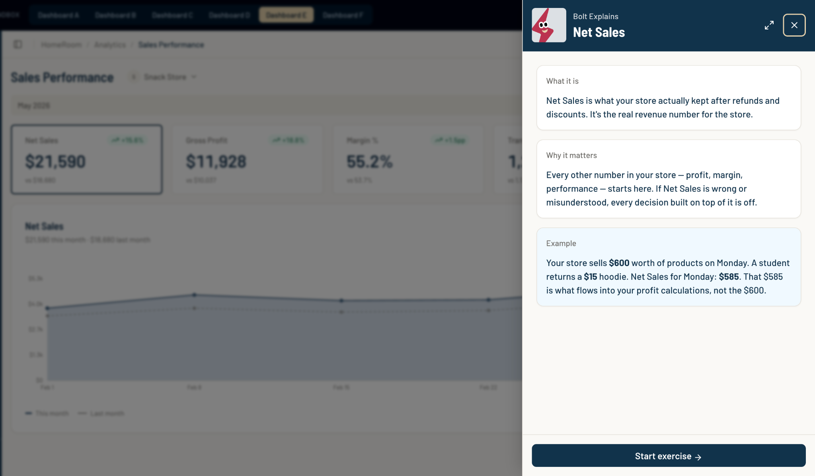
Always-On Learning
HomeRoom improves learning outcomes for students through our always-on-learning approach.
Bolt Explains is one of our education layers.
Integrated across HomeRoom to provide context and education opportunities for students at their own pace.
Notes:
POS primary screen. Large buttons for easy navigation. Categories built for school stores. Focused on speed and readability to move kids through the line.

Slide 10
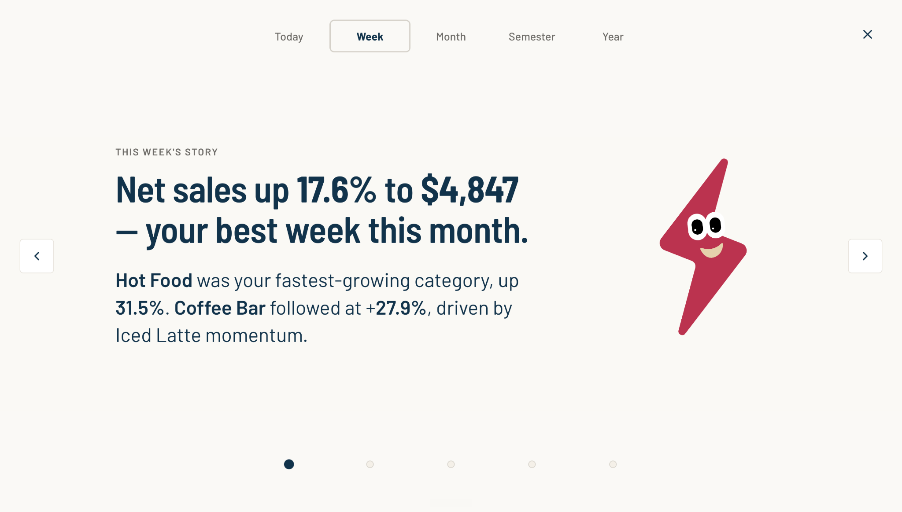
Presentation Mode
RallyOrder Product Walkthrough | Confidential

Slide 11
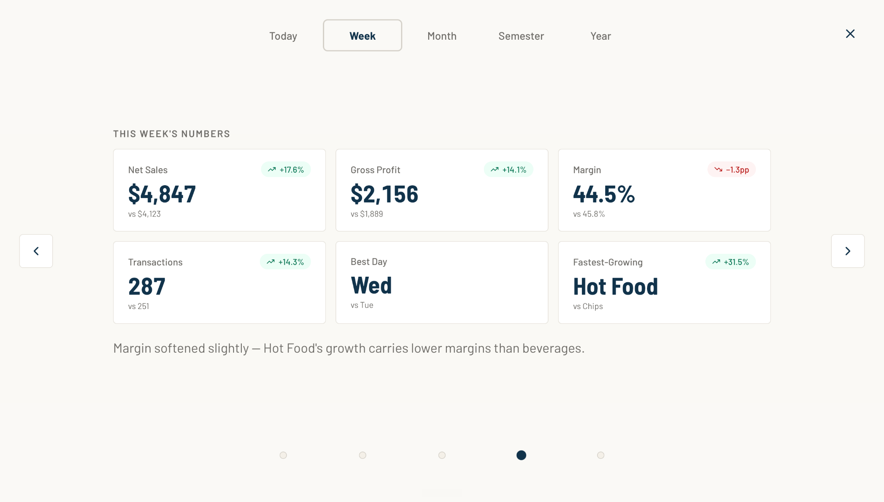
Presentation Mode
RallyOrder Product Walkthrough | Confidential

Slide 12
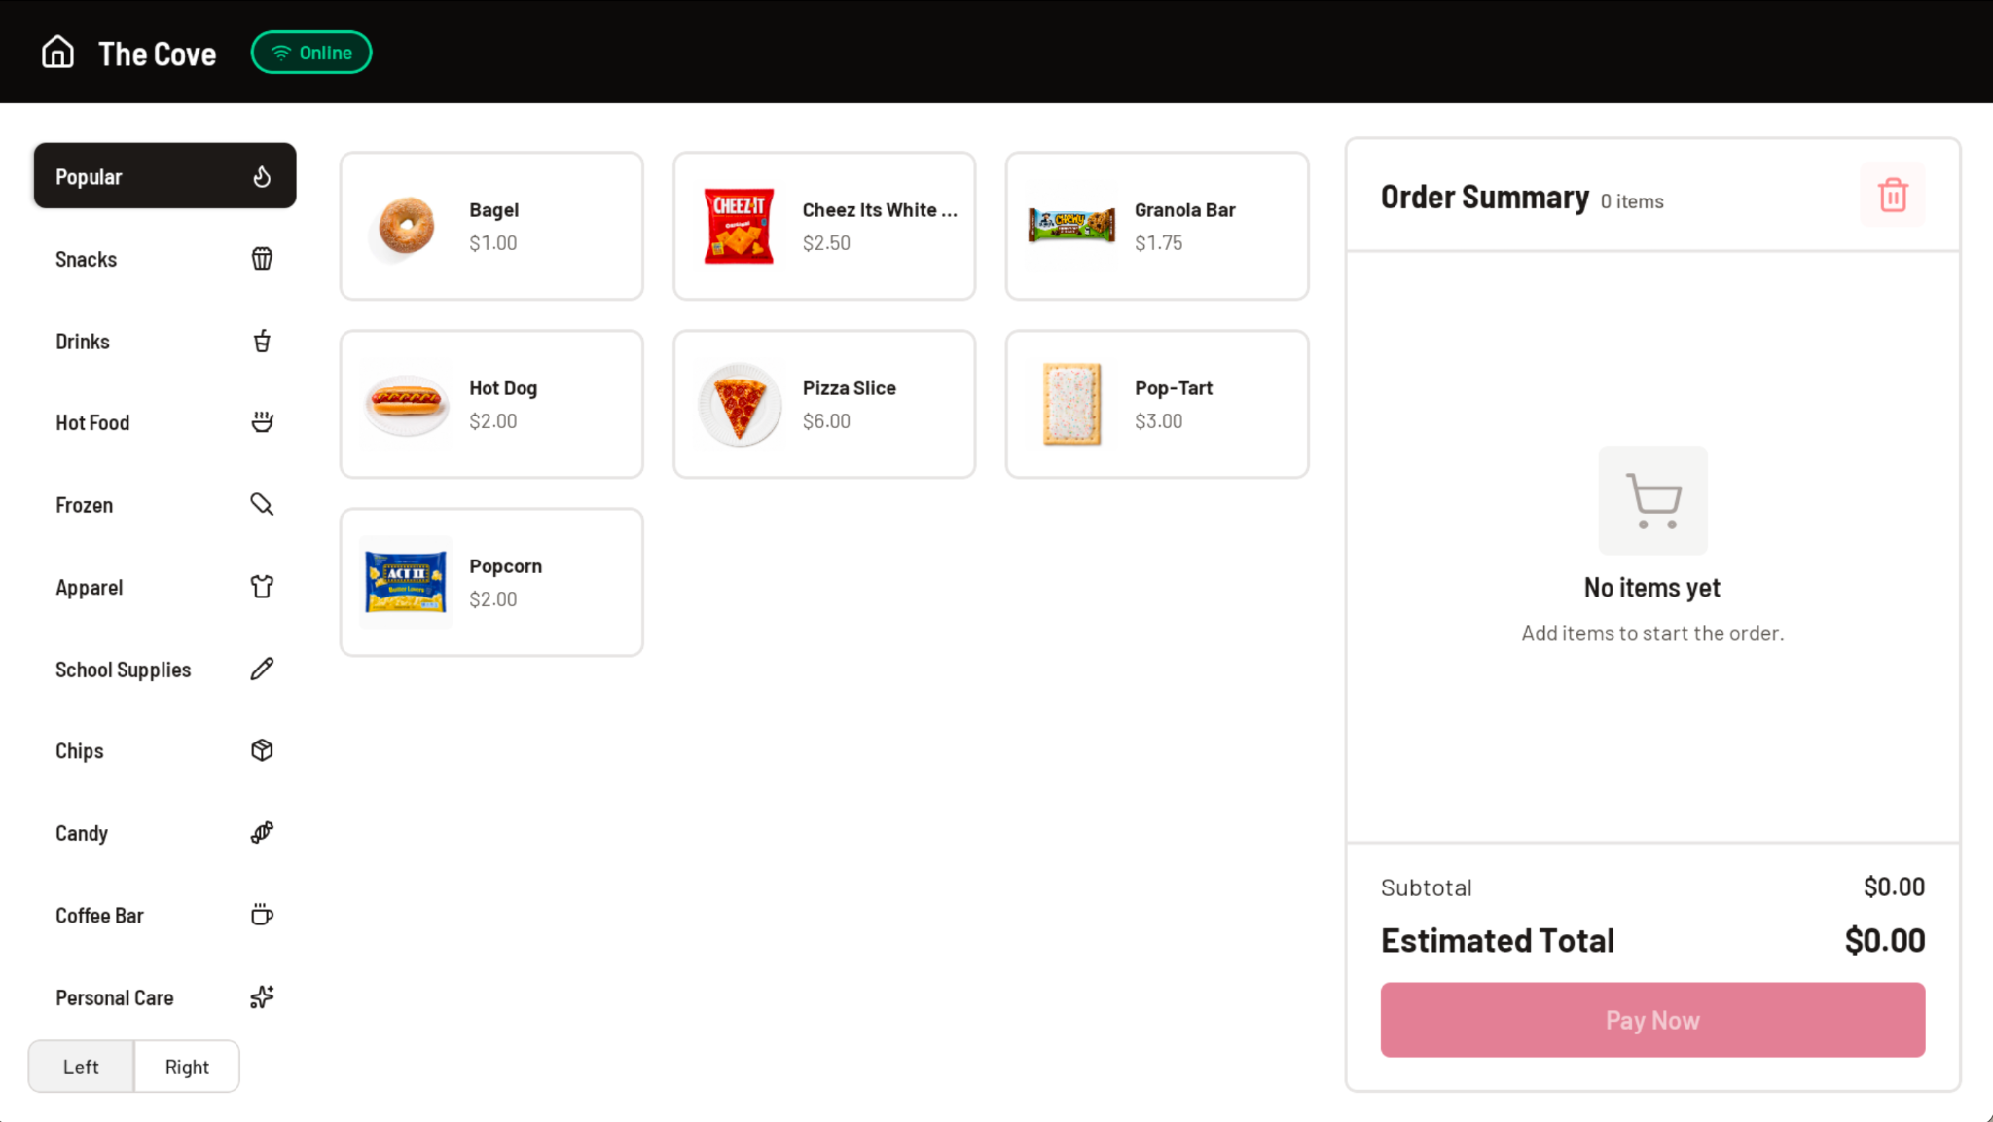
Point of Sale Operation
RallyOrder Product Walkthrough | Confidential
Notes:
POS primary screen. Large buttons for easy navigation. Categories built for school stores. Focused on speed and readability to move kids through the line.

Slide 13
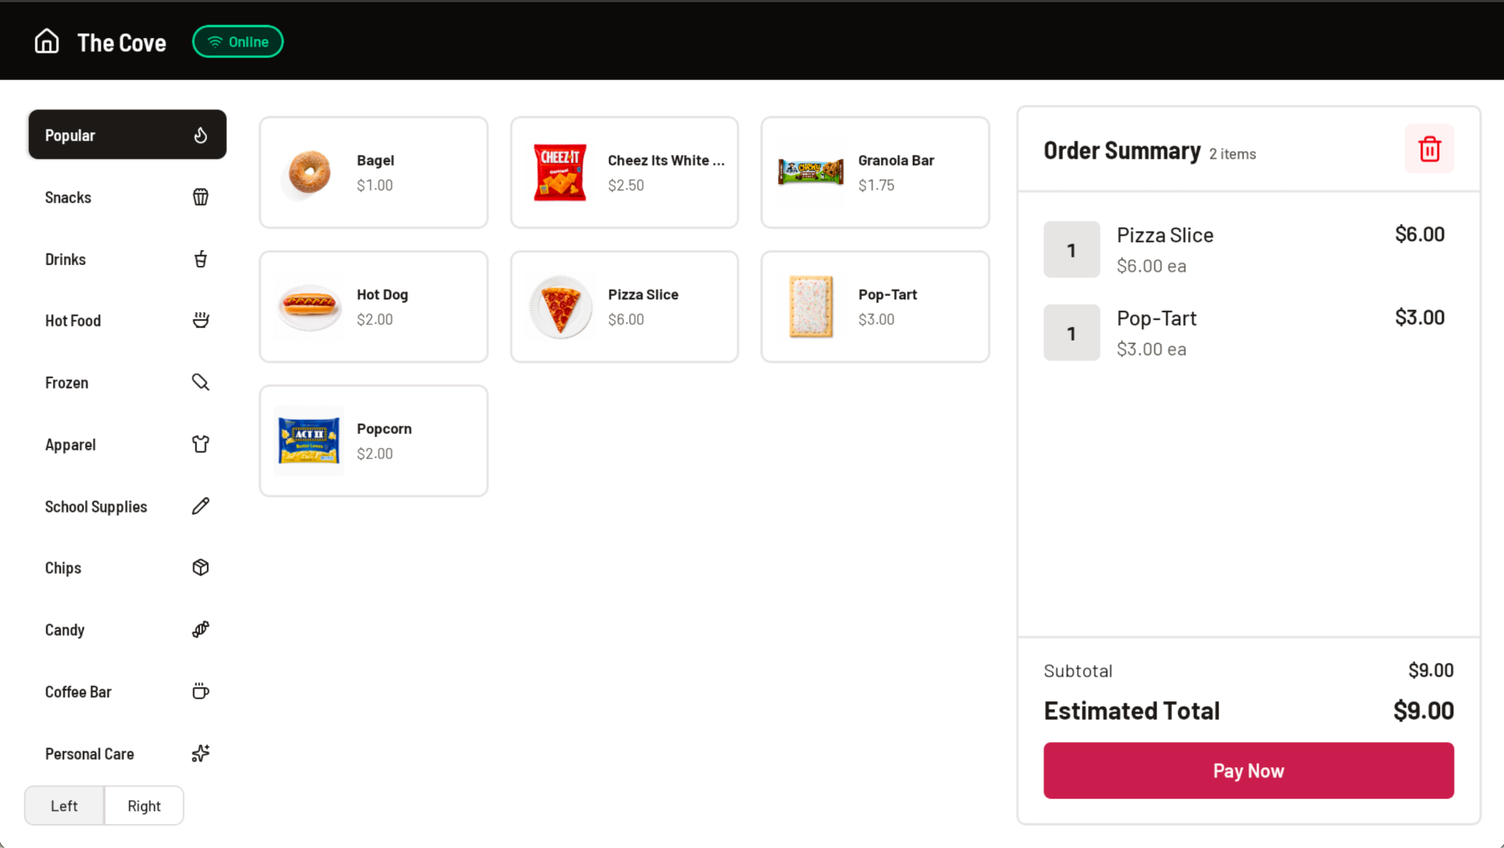
Add to Cart
RallyOrder Product Walkthrough | Confidential
Notes:
Checkout supports both Cash or Card as well as Split Payment processing.

Slide 14
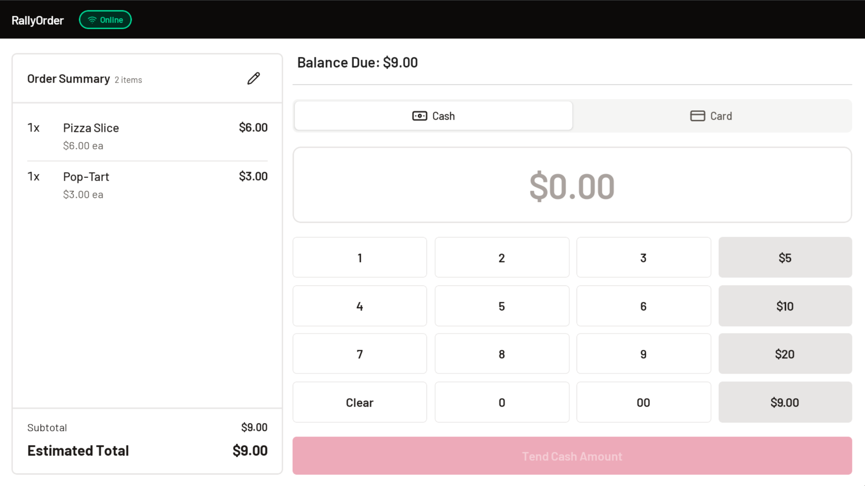
Cash Payment
RallyOrder Product Walkthrough | Confidential
Notes:
Checkout continued

Slide 15
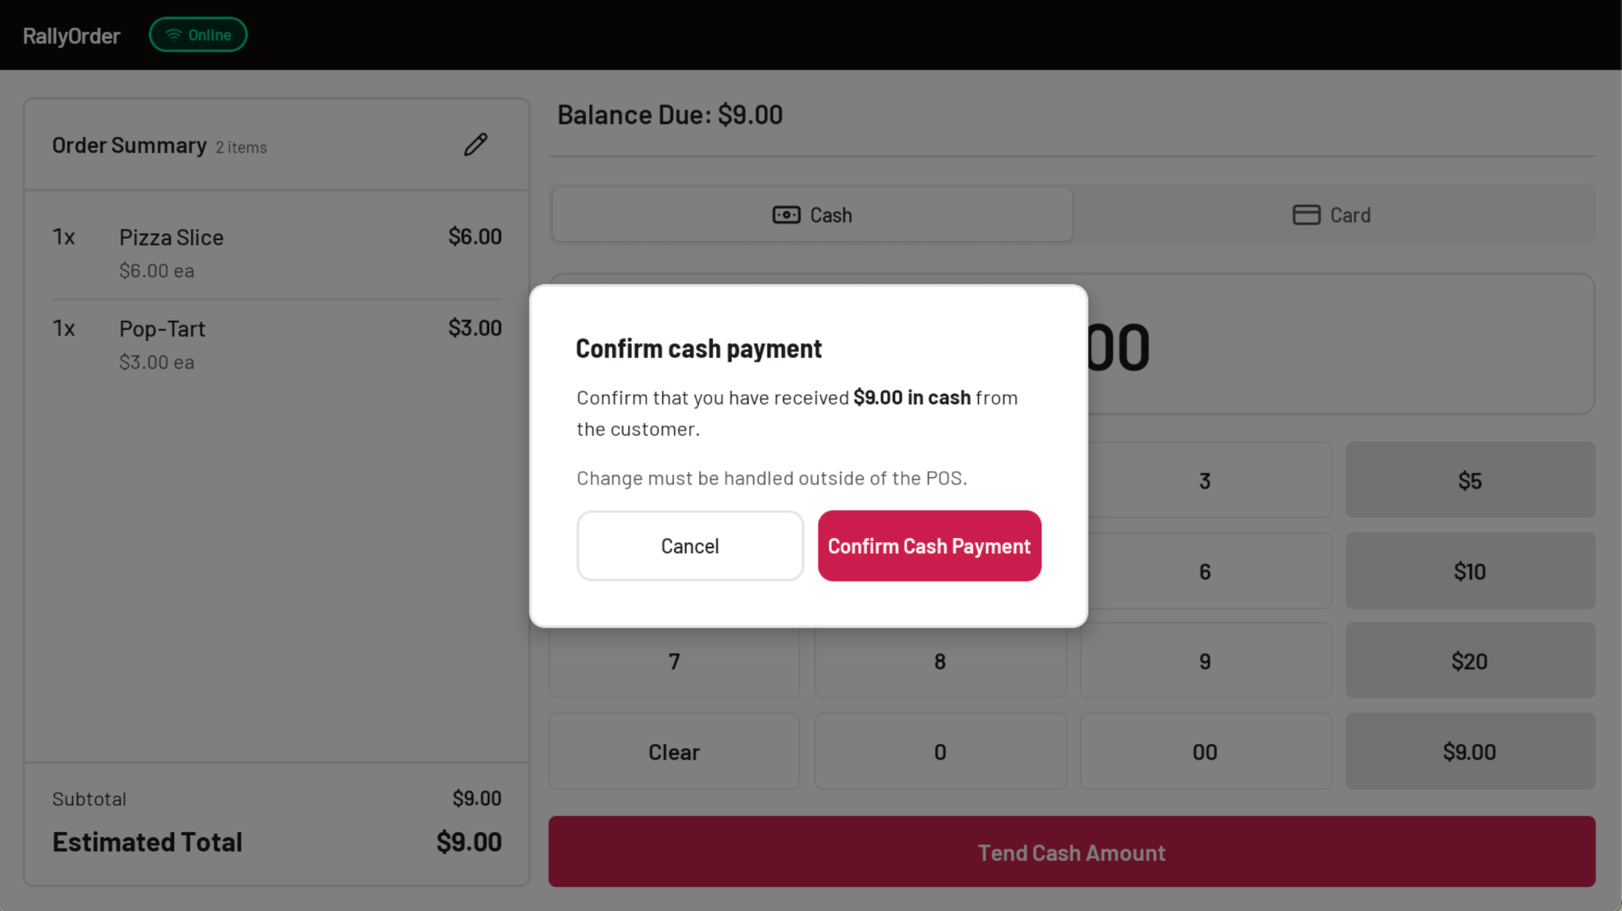
Cash Payment
RallyOrder Product Walkthrough | Confidential
Notes:
Checkout continued

Slide 16
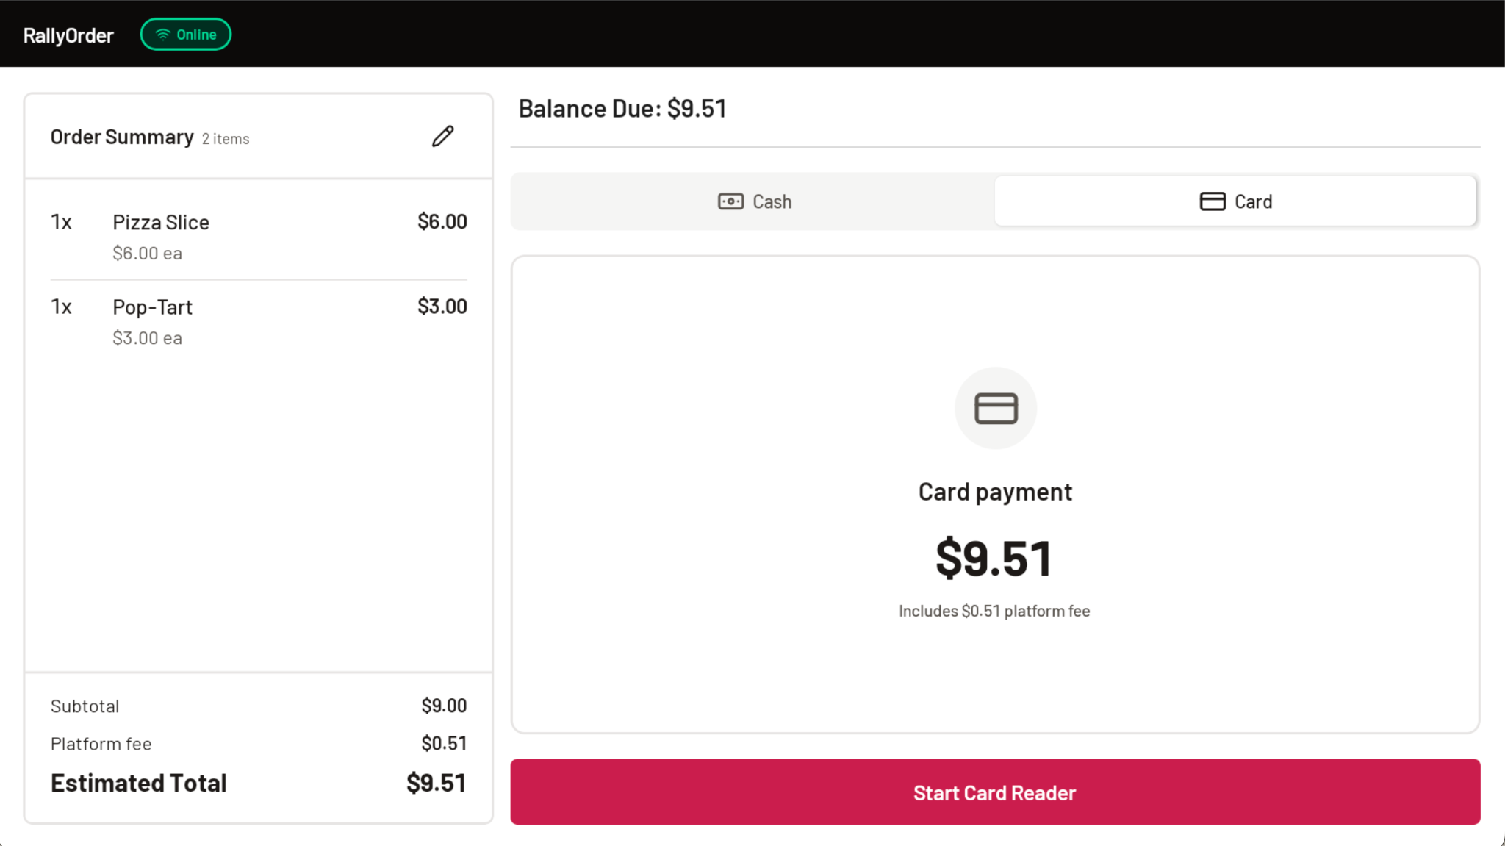
Card Payment
RallyOrder Product Walkthrough | Confidential
Notes:
Split Payments supported with a dedicated workflow for ease of operation

Slide 17
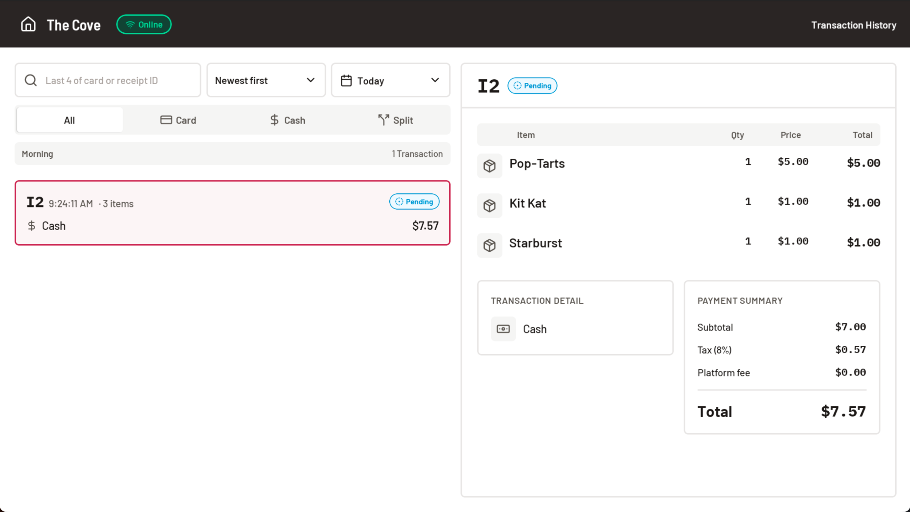
Transaction History
RallyOrder Product Walkthrough | Confidential
Notes:
Transaction History for refund processing or auditing orders and sales. Can configure refunds to require unique pin number (manager or advisor controlled)

Slide 18
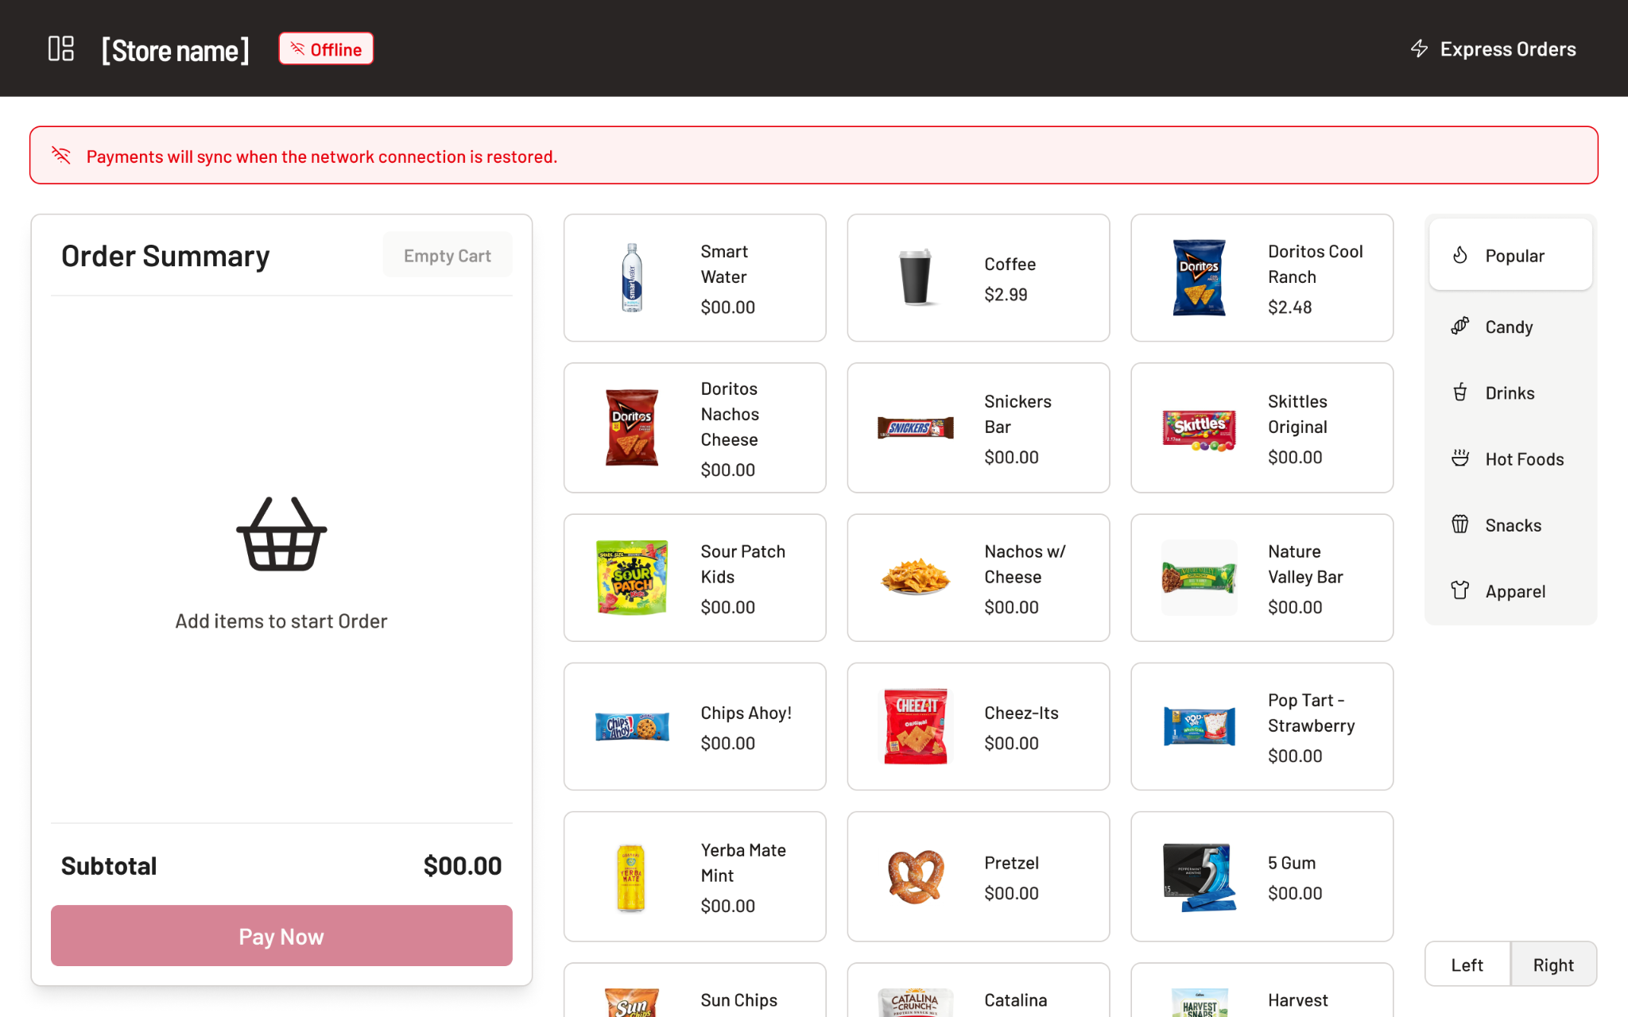
Offline Mode Supported
RallyOrder Product Walkthrough | Confidential
Notes:
Offline Mode for no wi-fi. POS will continue to take orders. Cash orders no change to process. Card orders are queued up to be processed when wi-fi returns. Can set a transaction limit (ex: $10) if desired, can set an overall limit (ex: $200) if desired.

Slide 19
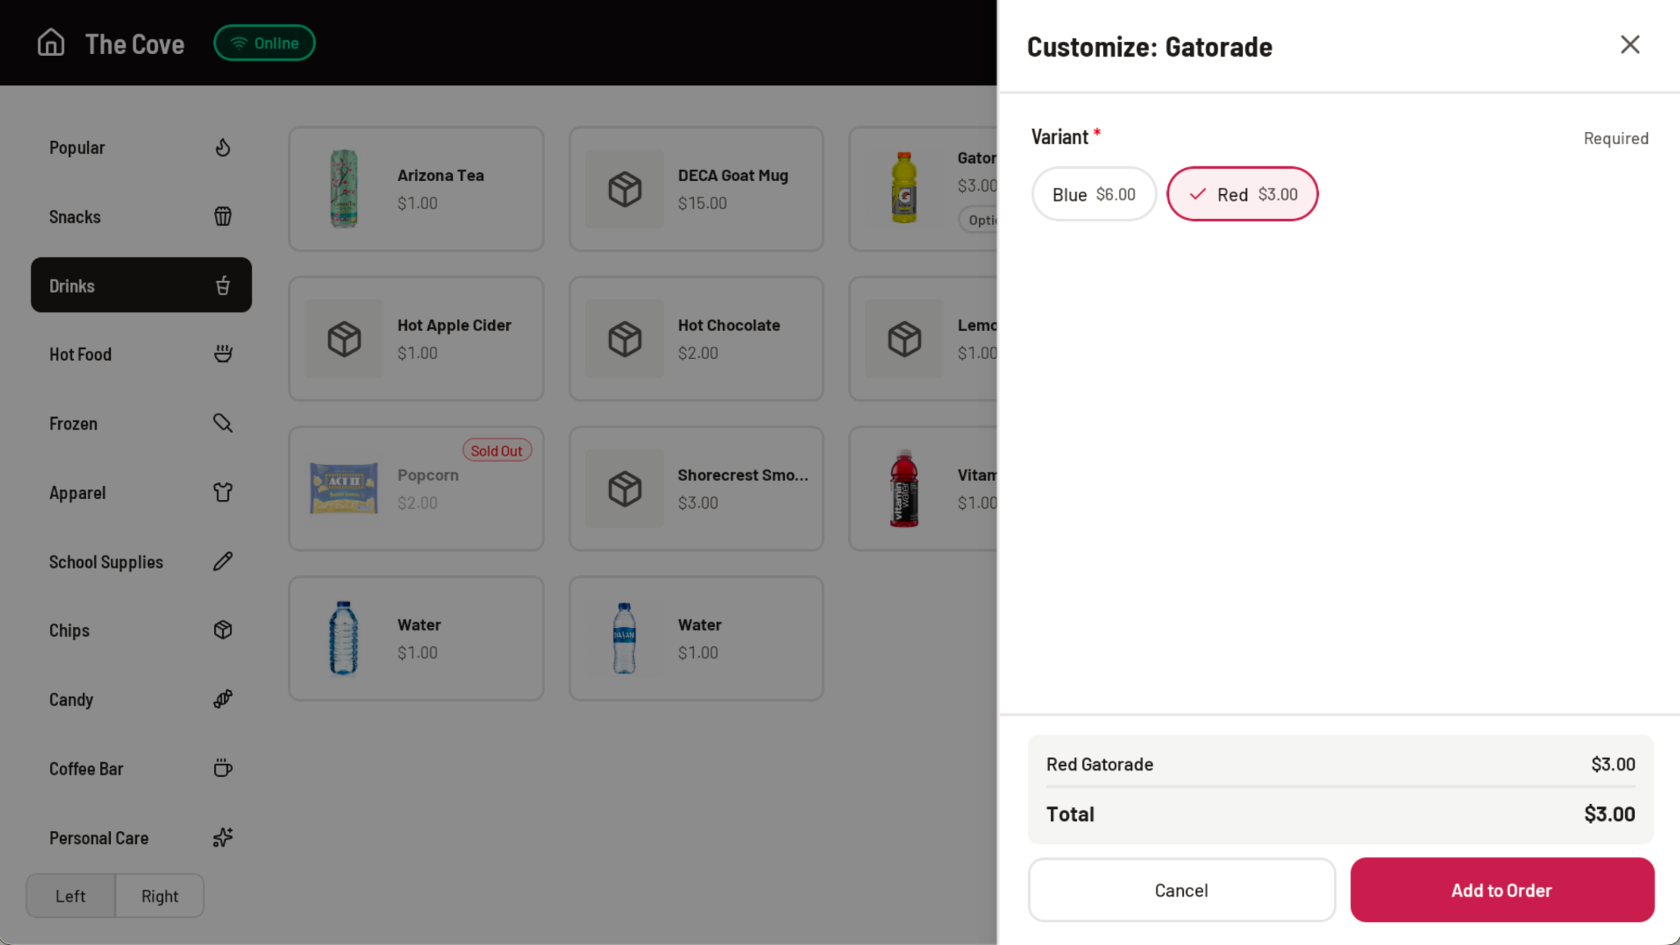
Variations
RallyOrder Product Walkthrough | Confidential
Notes:
POS supports item add-ons. Examples would be nachos, rice bowls w/ toppings, drinks w/ extras.

Slide 20
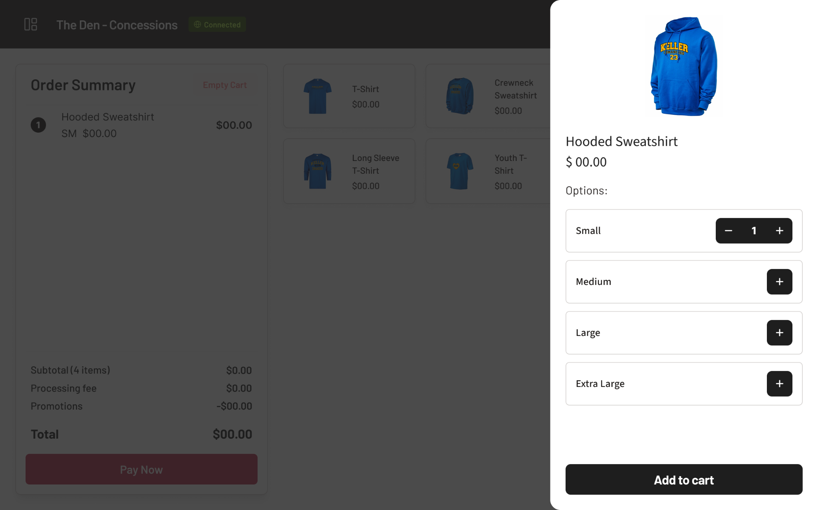
Apparel and Clothing
RallyOrder Product Walkthrough | Confidential
Notes:
POS supports clothing / apparel with size or color variations.

Slide 21
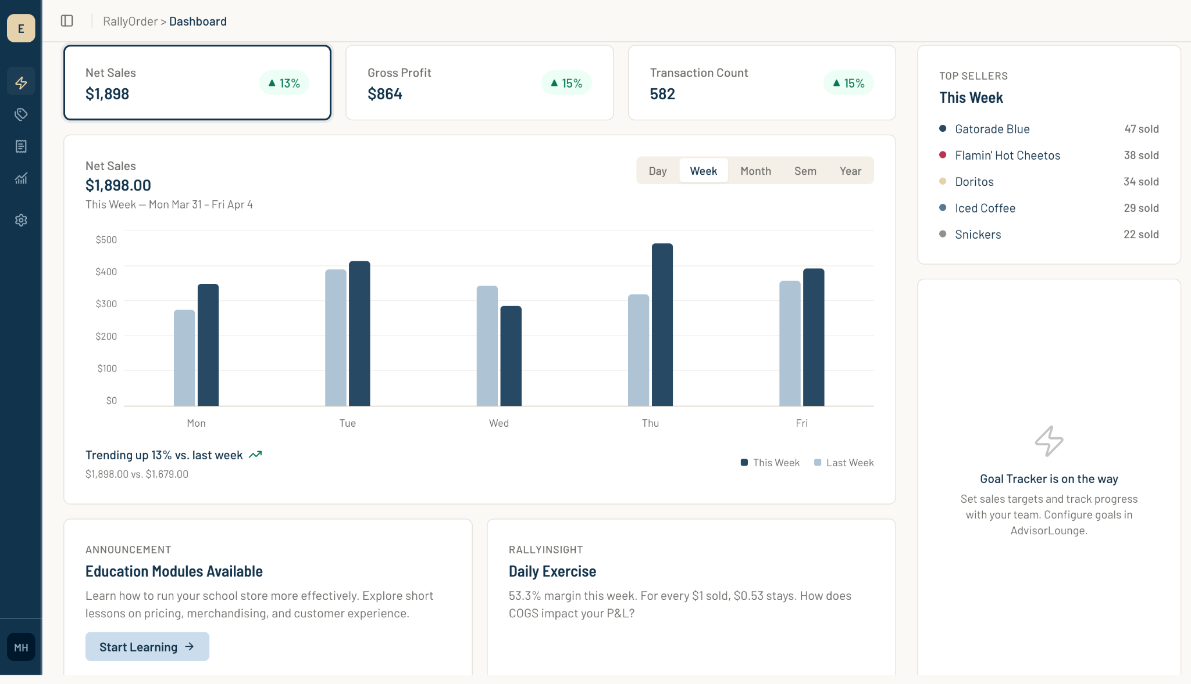
HomeRoom Dashboard
RallyOrder Product Walkthrough | Confidential

Slide 22
Presentation Mode
RallyOrder Product Walkthrough | Confidential

Slide 23
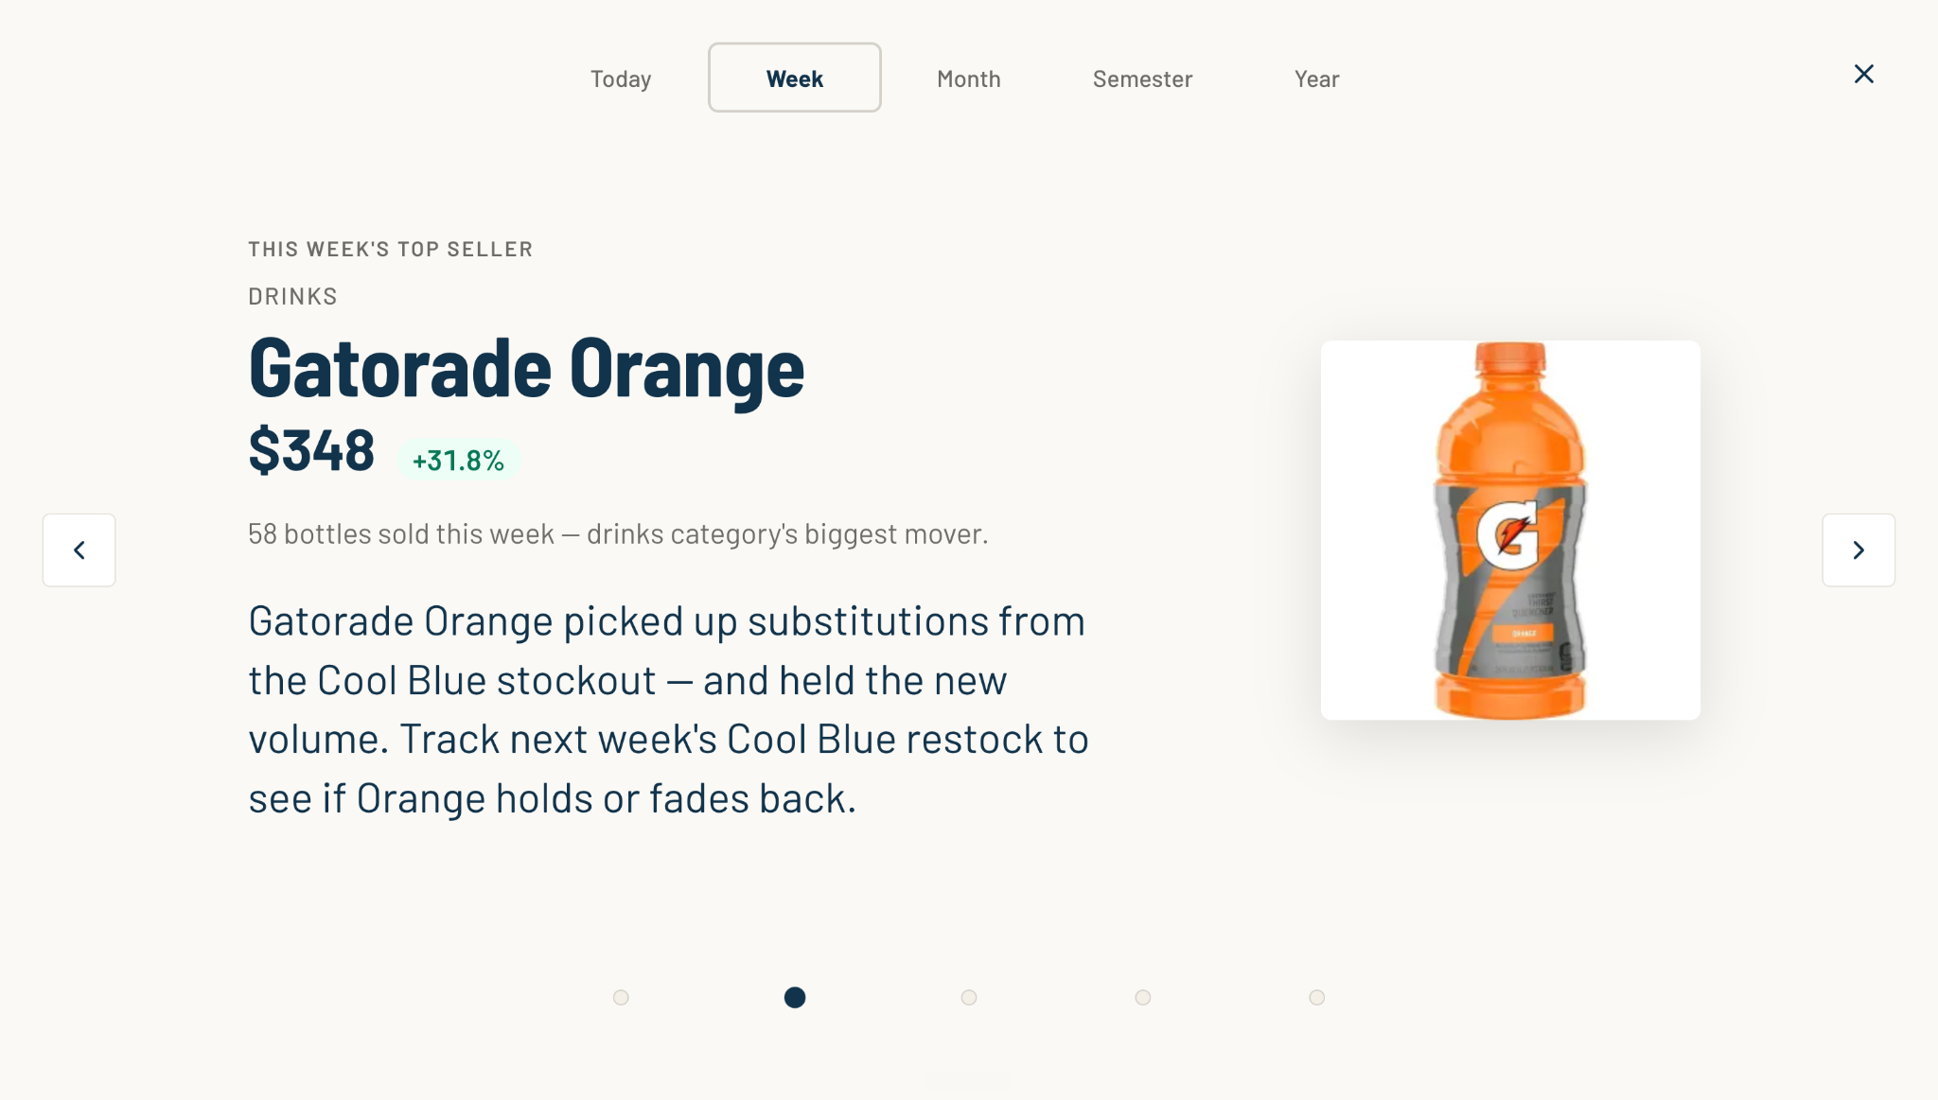
Your inventory
RallyOrder Product Walkthrough | Confidential

Slide 24
Key Metrics
RallyOrder Product Walkthrough | Confidential

Slide 25
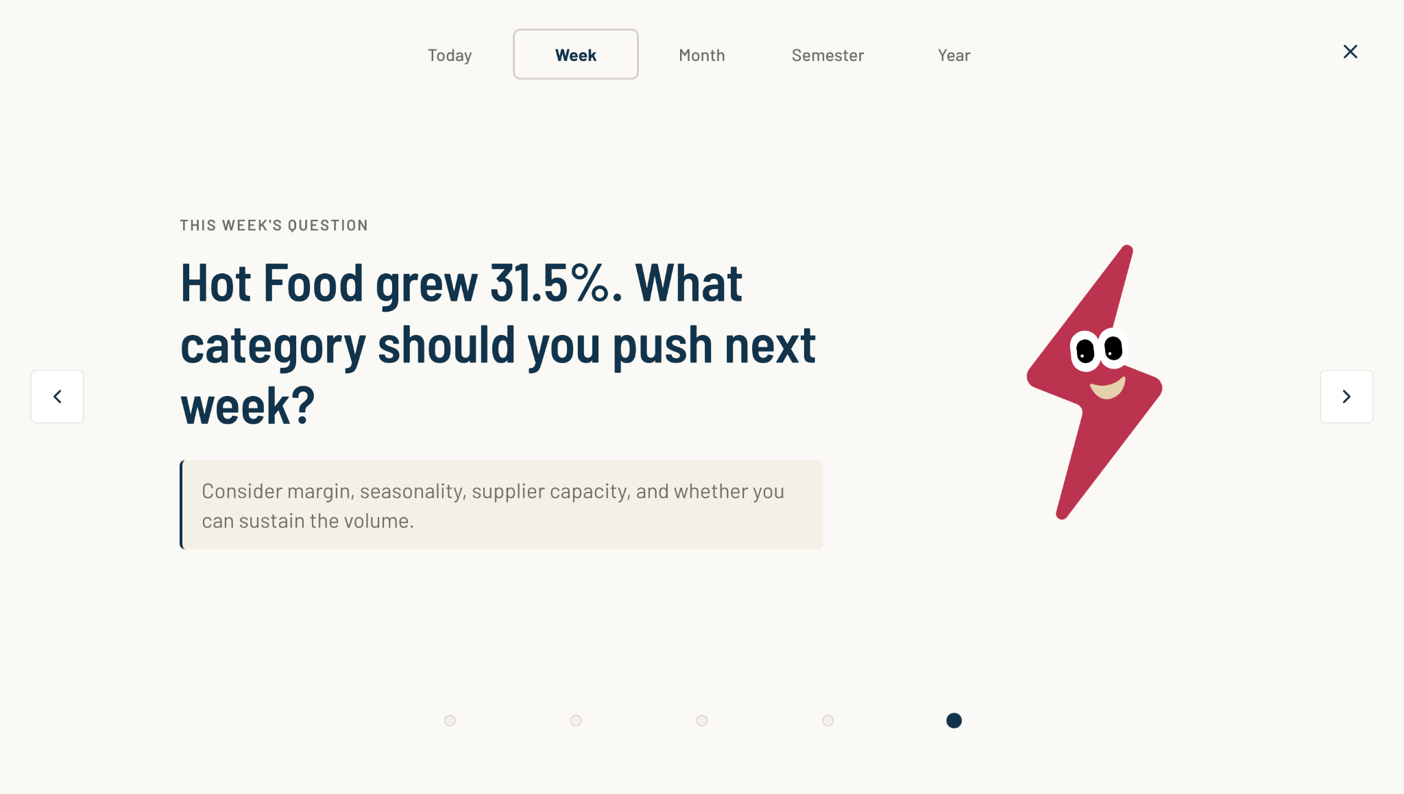
This weeks Question
RallyOrder Product Walkthrough | Confidential

Slide 26
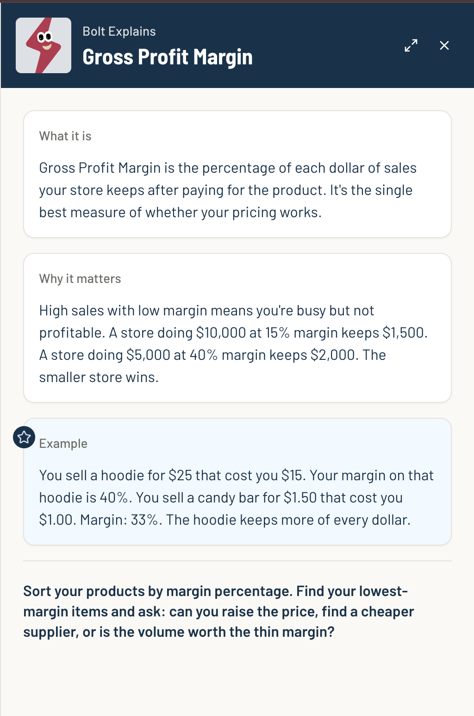
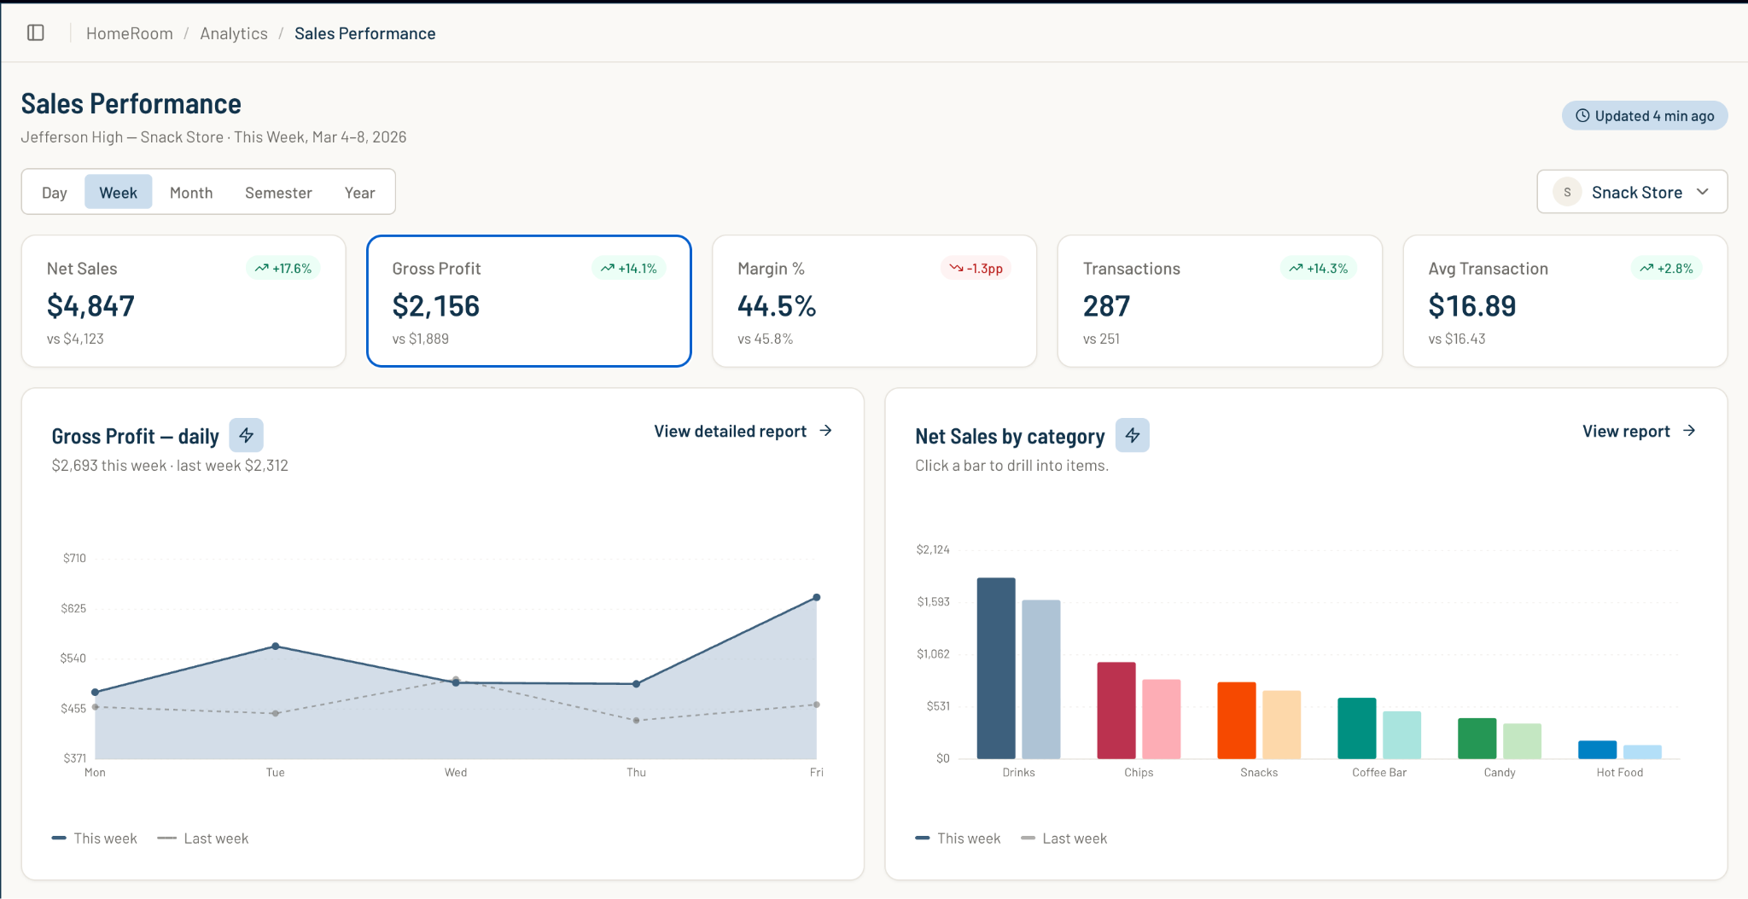
Learning Outcomes
RallyOrder Product Walkthrough | Confidential

Slide 27
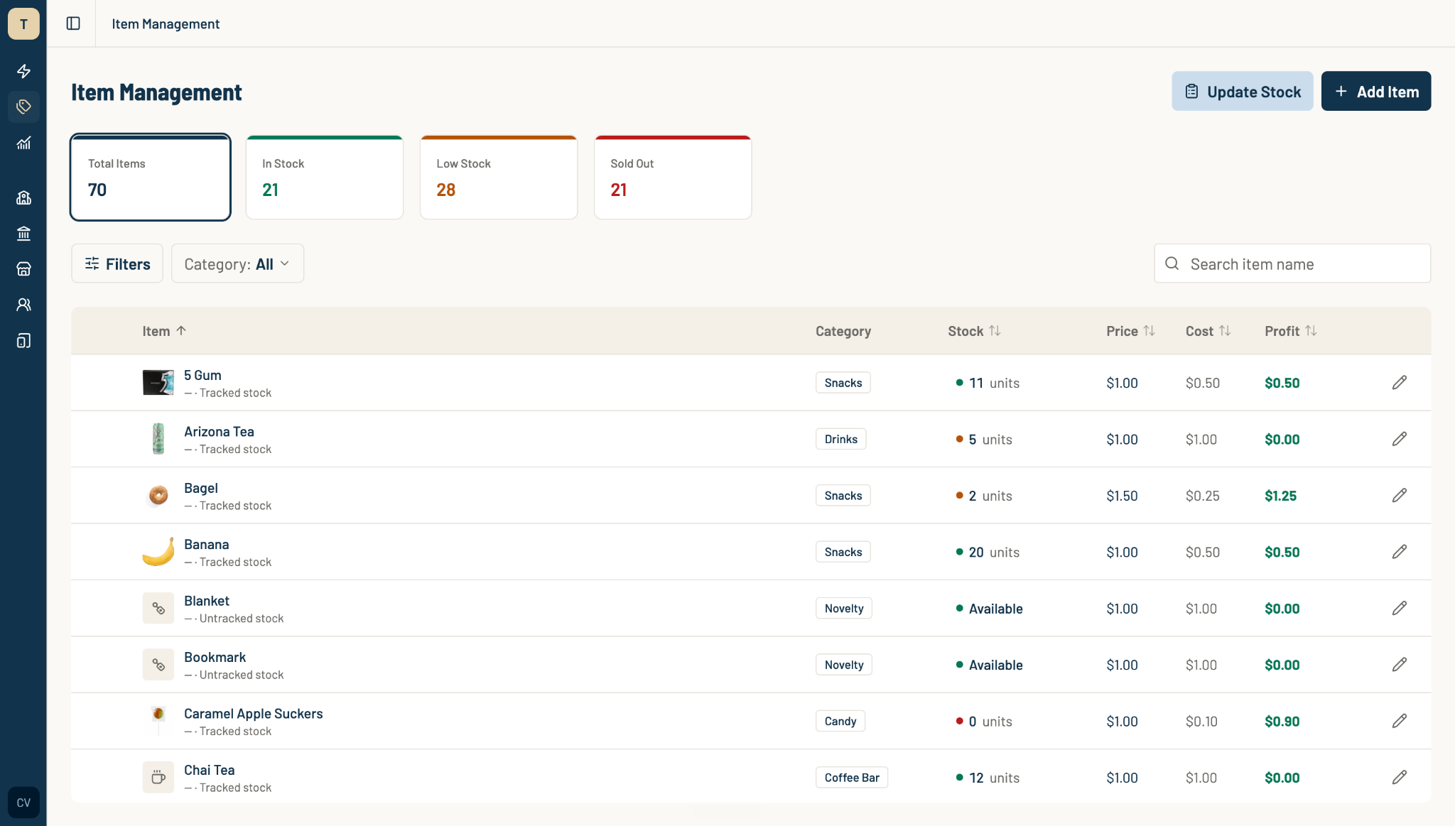
HomeRoom Inventory Management
RallyOrder Product Walkthrough | Confidential

Slide 28
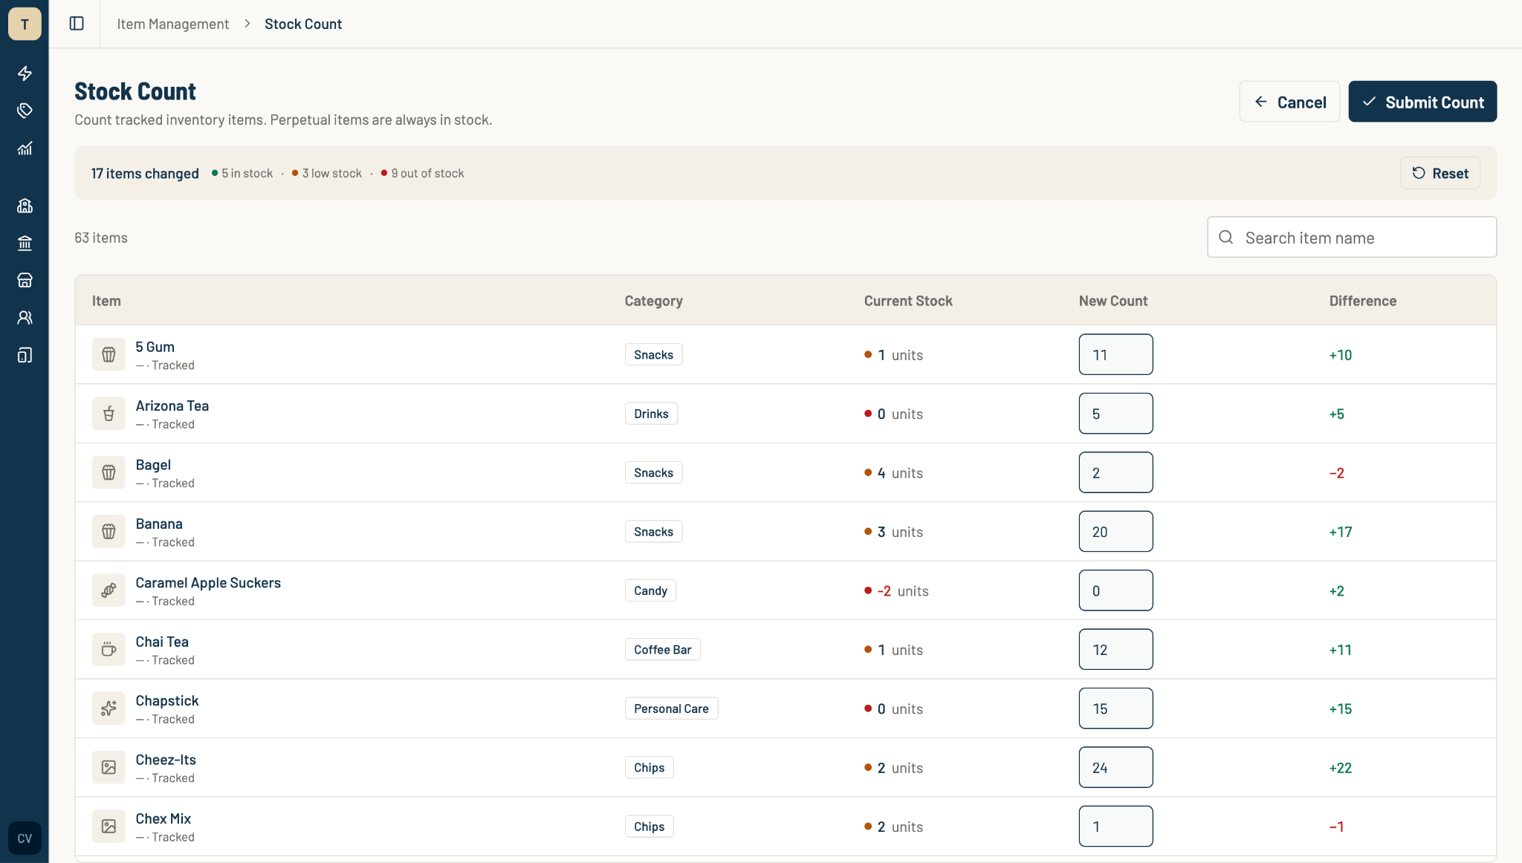
HomeRoom Stock Count
RallyOrder Product Walkthrough | Confidential

Slide 29
Thank you~!
Email us at
hello@rallyorder.com
Follow us at
RallyOrder@
rallyorder.com
RallyOrder Product Walkthrough | Confidential
Notes:
POS primary screen. Large buttons for easy navigation. Categories built for school stores. Focused on speed and readability to move kids through the line.

