Slide 1
Future-Ready in 15 Minutes
Low-Prep College & Career Activities for Busy FBLA Advisers

Slide 2
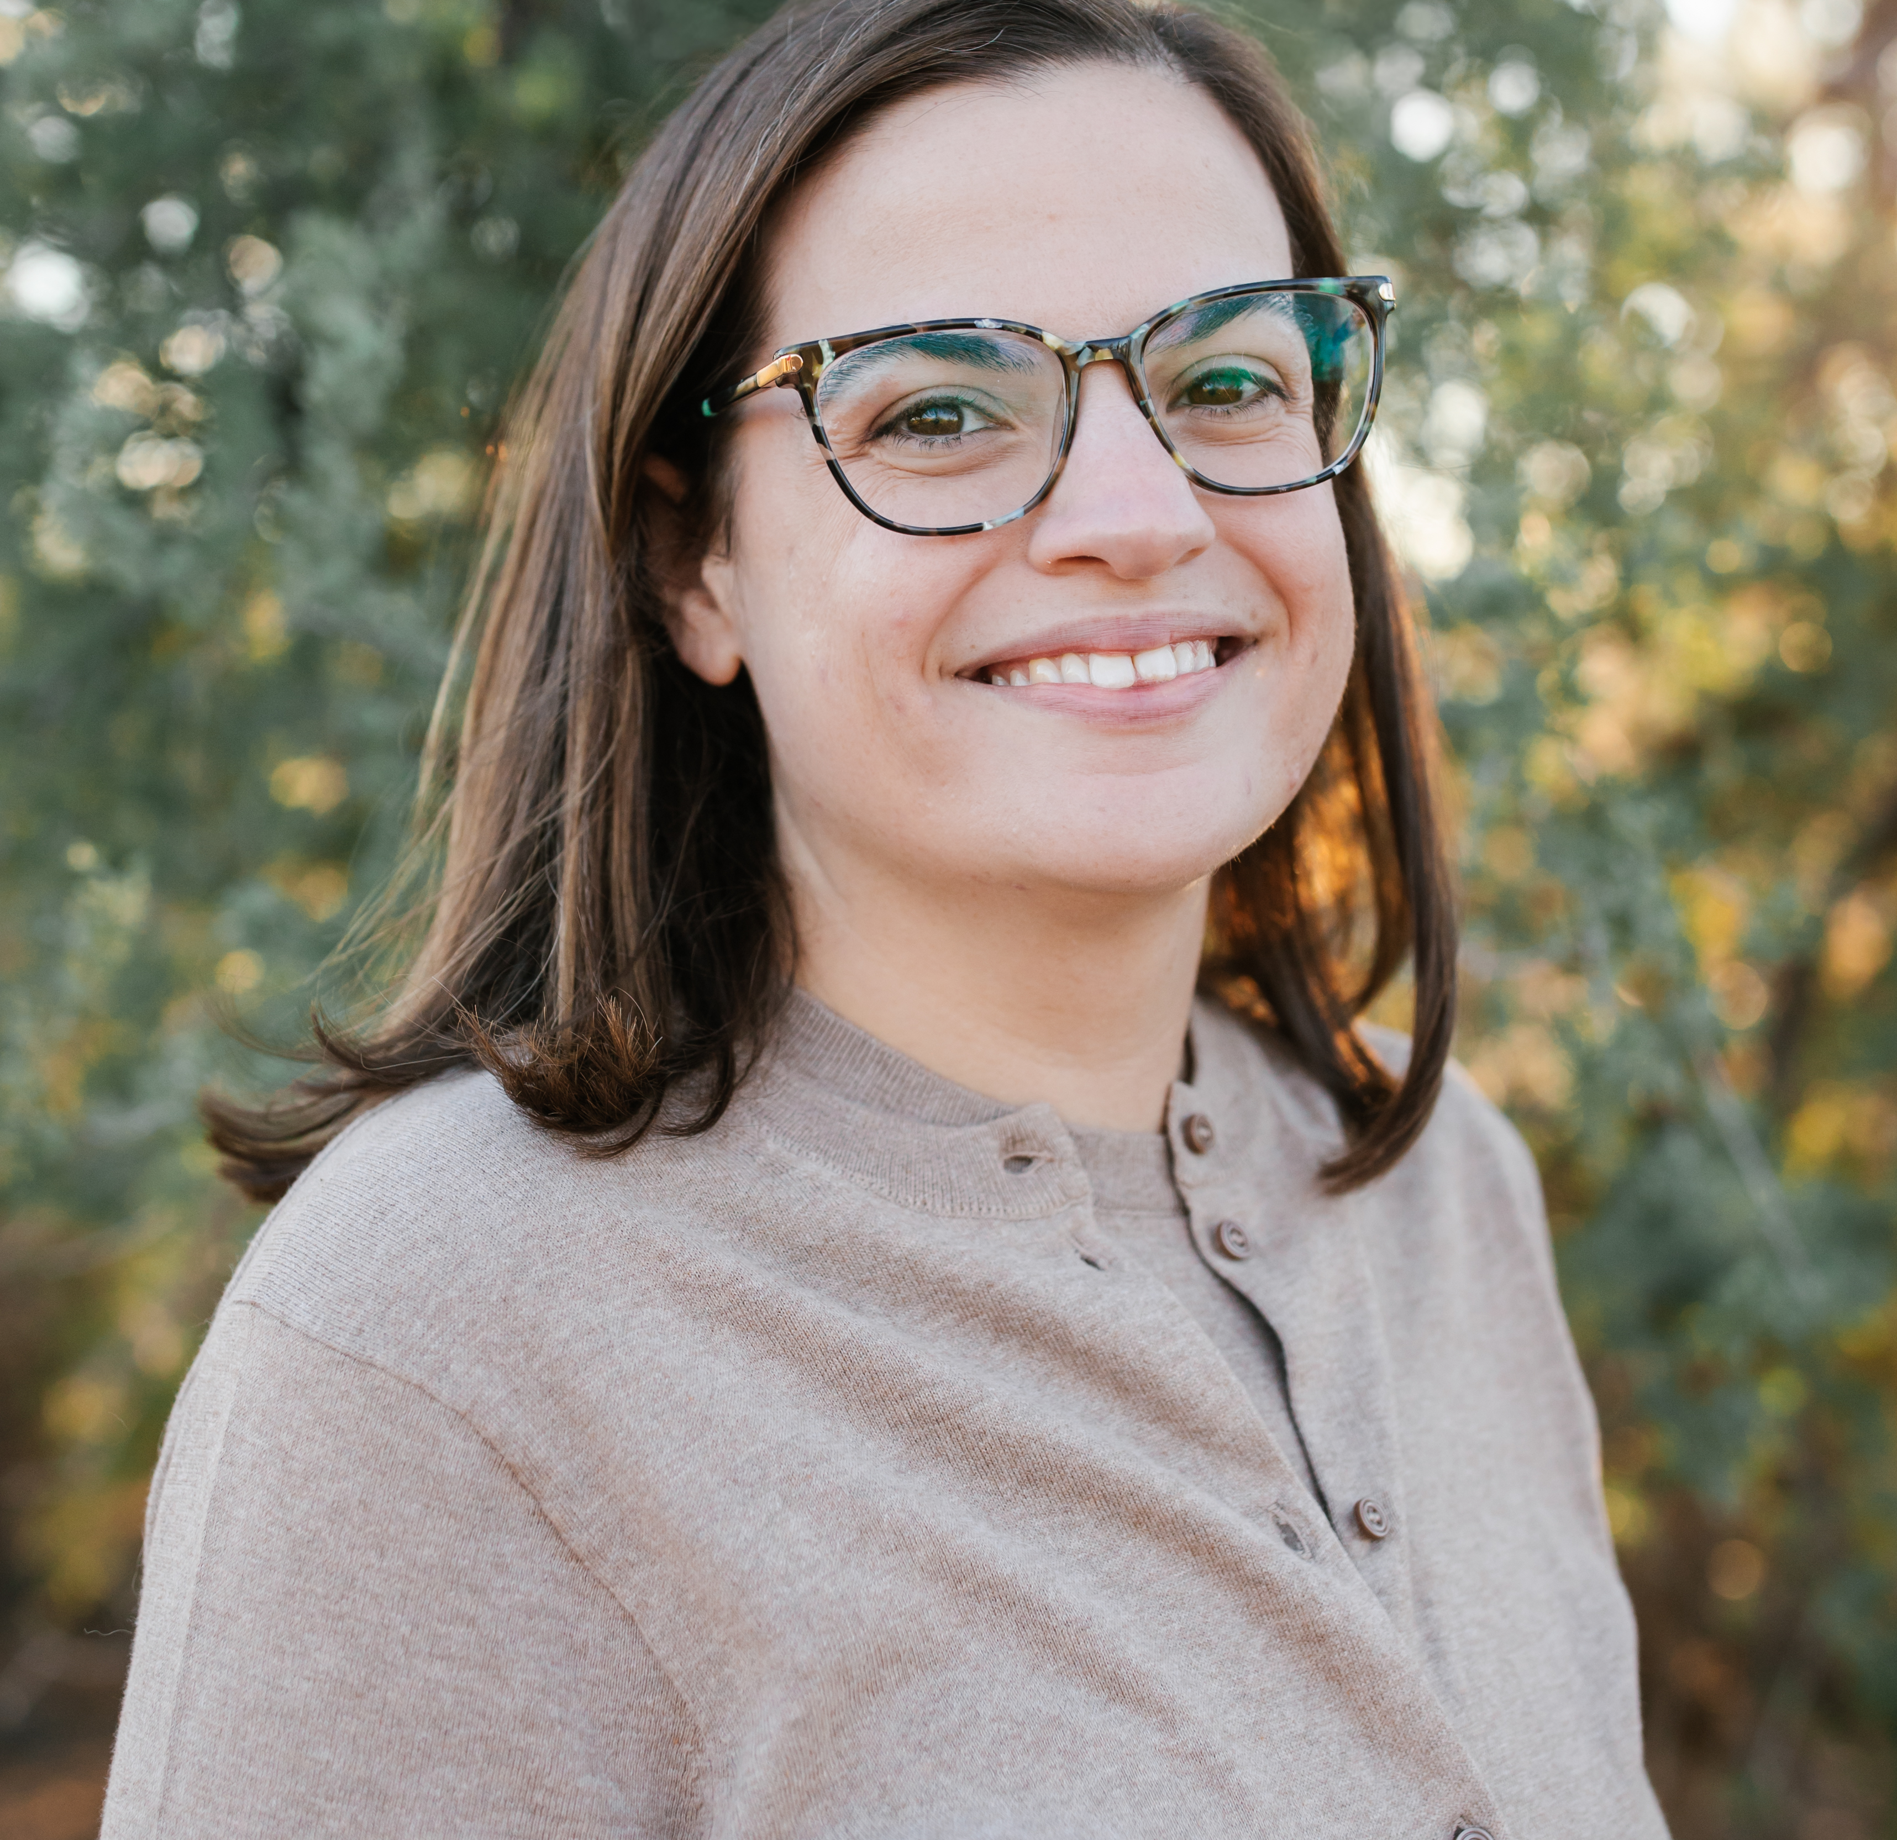
Welcome
Kayla Lugo
Demand Generation Manager
Encourage

Slide 3
Learning Objectives
By the end of this session, you will:
Explore two hands-on activities that you can integrate in your next chapter meeting with no additional preparation.
Leave with a completed action calendar that maps at least three resources to upcoming meetings and events.
Understand how Encourage’s free educator tools support DECA’s leadership development mission and saves you time.
Notes:
Emphasize: the goal is for advisers to leave with something DONE, not just inspired.
They will participate in two activities they can literally run at their next chapter meeting with zero additional prep.
They will complete a real action calendar before they leave the room.
Key message: this session is designed to be immediately useful, not just informational.

Slide 4
Let’s Get Started
Notes:
Say something like: 'We are going to do two quick activities together right now; the same ones you can bring back to your chapter this week.'
Make sure handouts are distributed before moving to slide 5.

Slide 5
You care. But you’re stretched thin.
The Gap
Students need college and career support
Competitions, meetings, and admin take priority
Most schools lack dedicated planning tools
Time for dee programming feels impossible
The Solution
Ready-to-use activities: 5-15 minutes each
No lesson planning and minimal prep required
Free tools built for advisors like you
Fits inside meetings you’re already running
Notes:
Then say: 'This tension is real. You care deeply about your students' futures, but the practical demands of running a chapter leave little room for deep career programming.’
Pause briefly, then: 'That is exactly what Encourage was built to solve. But before I show you the tools, let's experience two of them together.'
Transition directly into Activity 1.

Slide 6
Work Values Sort
Notes:
Transition slide — announce Activity 1: Work Values Sort.
Tell advisers: 'You are going to experience this activity exactly as your students would.'
Distribute the Work Values Sort handout now if not already on tables.
This activity typically takes 5-10 minutes in a chapter meeting and requires zero prep beyond printing the handout.

Slide 7
Sort the values on the next slide into these categories:
Most Important to Me
Somewhat Important
Less Important to Me
Then: Circle your TOP 3 from the “Most Important to Me” column
Notes:
Walk advisers through the instructions on screen.
Clarify: The value list on the NEXT slide is what they will sort. They write values into the correct column on their handout.
Emphasize: 'There are no right or wrong answers. This is personal—it is about what matters to YOU at work.'
Let them know you will give them about 2 minutes to sort and circle their top 3.

Slide 8
2 Minutes
Sort the values · Circle your top 3 · Reflect
Notes:
Start a 2-minute timer visible to the room.
Encourage advisers to genuinely sort the values — not just observe.
Walk the room during this time, observe engagement, and be ready to share your own top value when you reconvene.
Tip for advisers: this activity works great as a bell ringer or meeting opener. The projected value list does all the heavy lifting.

Slide 9
Value List
Creativity
Stability
Helping Others
Leadership
Independence
Recognition
Work-Life Balance
Income
Variety
Teamwork
Problem-Solving
Adventure
Community
Prestige
Learning
Entrepreneurship
Making a Difference
Structure
Flexibility
Competition
Anything else you can think of!
Notes:
Project this slide while advisers work. Leave it up for the full 2 minutes.
Optional: Sort your own values silently so you have a genuine answer ready to share.
Note for adviser use: this list can also be printed as individual cards for a card-sort version of the activity.

Slide 10
Share Your Experience in the Chat:
What is your #1 work value and why?
Did anything surprise you about your own choices?
Notes:
Give pairs 2 minutes for this conversation, then open to the full room.
Ask 2-3 people to share their #1 value and why.
Listen for variety. Values like stability, adventure, and making a difference all coming from the same room reinforces the message: there is no single right answer.
If time allows, ask: 'Did anyone put something in a different column than they expected?' This sparks good reflection.

Slide 11

Reflect as an Educator
How might a student’s top values shape their career and/or college choices?
Imagine running this before a guest speaker or competition prep—what door does it open?
Notes:
Shift perspective from participant to educator.
Key talking point: 'When you project that values list, conversation starts immediately. Students self-sort without needing a lot of direction; the activity does the work.'
Connect to FBLA: students who know their values make more intentional choices about competitive events, career pathways, and post-secondary plans.
Plant the seed for timing: 'This works especially well right before a guest speaker or industry site visit — it gives students a lens to bring into that experience.'

Slide 12
Career Inventory
Notes:
Transition slide — announce Activity 2: Career Inventory.
Distribute the Career Inventory handout now if not already on tables.
Frame it: 'This is the opening activity from Encourage's Career Curiosity lesson plan — a complete 20-45 minute lesson you can run anytime.'
Advisers will experience the first part of that lesson right now.

Slide 13
Career Inventory: List What You Know
You have 5 minutes. Here’s your prompt:
  Using some scratch paper near your desk or open a doc on your computer, list every career you can think of and note what level of education each one requires.
  Think about: your family, friends, neighbors, and community. What are their jobs?
  Keep listing until you run out of room or time.
Notes:
Advisers should have the Career Inventory handout (page 1 — the blank grid).
Read the prompt aloud or let advisers read it from the slide.
Encourage genuine participation: 'Think about every person in your life. Your family, your neighbors, the people who fixed your car or checked you out at the grocery store. What are their jobs?'

Slide 14
5 Minutes
List every career you know · Note the education required · Keep going until time is up
Notes:
Walk the room quietly — observe how lists develop and what careers come up most.
Notice: most lists skew toward visible, familiar careers. This is intentional and becomes the debrief point.
If advisers finish early, encourage them to keep going: 'Think about trades, service industries, healthcare roles, agricultural jobs, arts careers.'

Slide 15

Reflect as an Educator
What just happened in the room?
  Most lists skew toward visible, familiar careers.
  Students don’t know what they don’t know. This activity makes that gap visible without judgment.
The full Career Curiosity lesson plan includes
  This inventory activity
  Guided exploration of 4 new careers using Encourage
  A pair-and-share reflection
  An optional family interview assignment
Notes:
Facilitate a brief debrief: 'What did you notice about your own list?'
Key insight to draw out: Most lists are dominated by careers people have SEEN — teacher, doctor, lawyer, manager. Less visible careers (machinist, wind turbine technician, genetic counselor) rarely appear.
This is the pedagogical point: students don't know what they don't know. The Career Inventory makes that gap visible — gently, without judgment.
Introduce the full lesson plan: Page 2 of the handout shows Activity 2 — students explore 4 new careers (one per education level) using the Encourage app or onetonline.org.
The complete Career Curiosity lesson plan also includes a pair-and-share reflection and an optional family interview assignment.

Slide 16
Introduction to Encourage
Notes:
Transition to the platform overview section.
Frame: 'You have now experienced two of the activities. Let me take about 5 minutes to show you where all of this lives and what else is available to you and your students.'

Slide 17
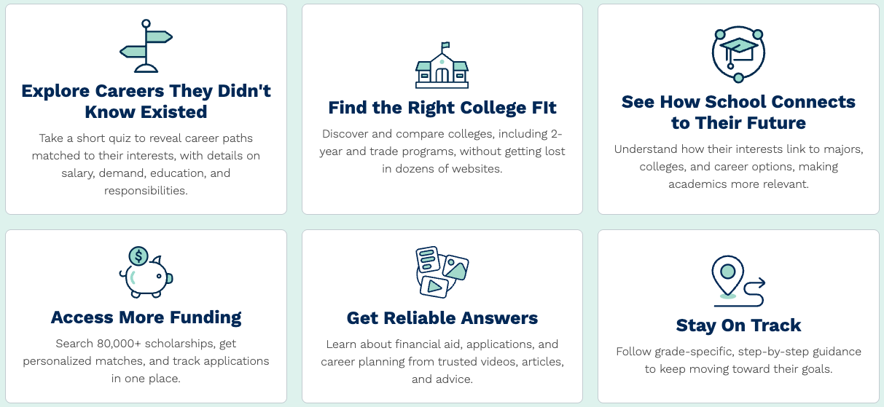
Encourage for Students
Where college and career exploration begins
Encourage is made for students ages 13+ in grades 8-12.
What can students do:
Notes:
Encourage is built for students ages 13+ in grades 8-12.
Core student features: career exploration, college search, scholarship discovery, self-assessments (values, interests, skills), and college and career planning tools.
Students can explore careers at different education levels — reinforcing the activity they just did.
Key message for advisers: students can use this independently, which means it works outside of scheduled class time too.

Slide 18
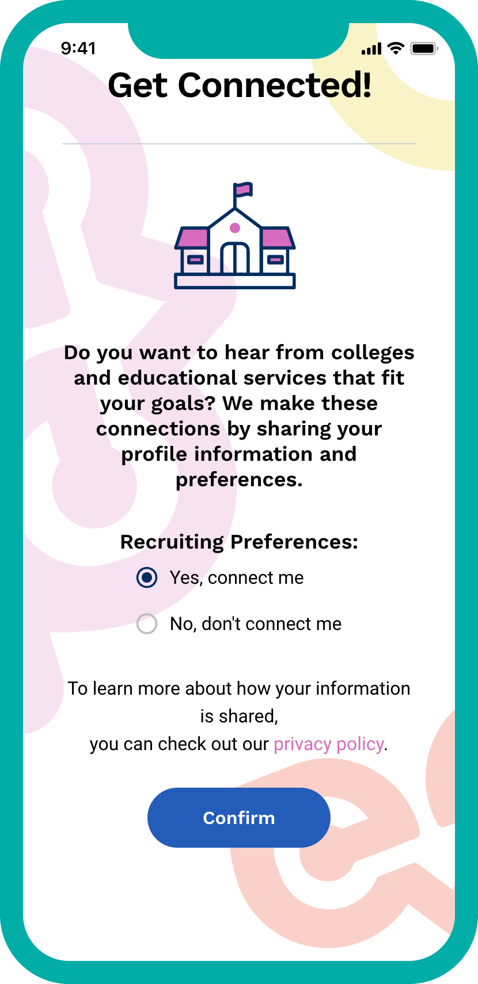

How is Encourage free?
Funded by our network of college and university partners participating in optional recruitment
Eduventures® research on 5.8 million students shows that optional recruitment programs like Encourage can eliminate the enrollment gap between first-generation and continuing-generation college students.
Notes:
This question always comes up — address it proactively.
Encourage is funded by colleges and universities who participate in optional student recruitment.
Key word: OPTIONAL. Recruitment does not change the student experience unless the student chooses to engage.
Research on 5.8 million students shows that optional recruitment programs like Encourage can eliminate the enrollment gap between first-generation and continuing-generation college students.
Frame it as a win-win: free tools for advisers and students, and a meaningful pathway to college for students who might not have otherwise seen themselves as college-bound.

Slide 19
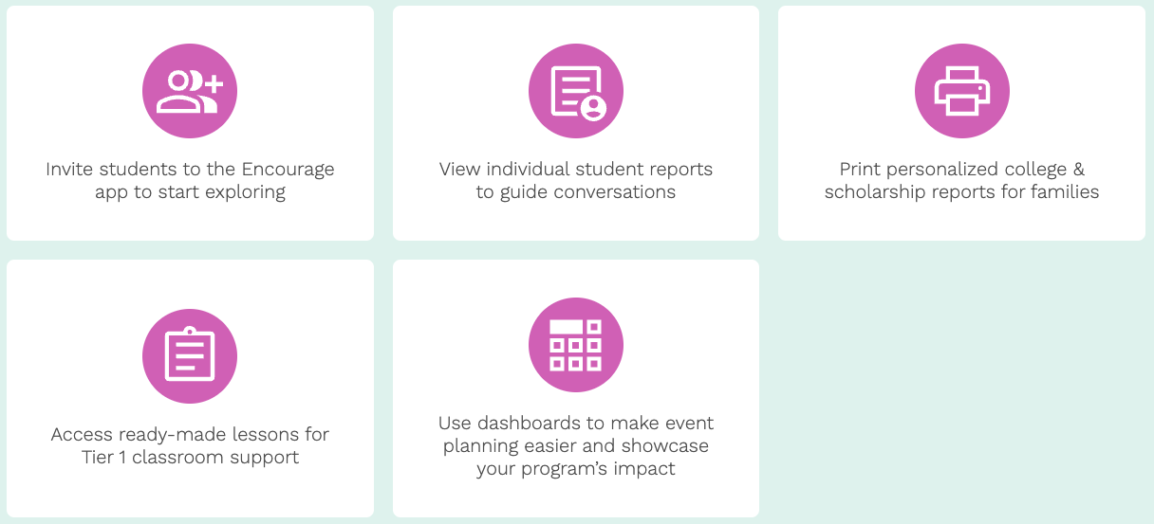
Encourage for Educators
Empower every student’s future with less prep
Encourage for Educators puts insights, resources, and ready-to-use tools at your fingertips, so you can guide students and show the impact of our work.
Notes:
This is what advisers get when they create their educator account.

Slide 20
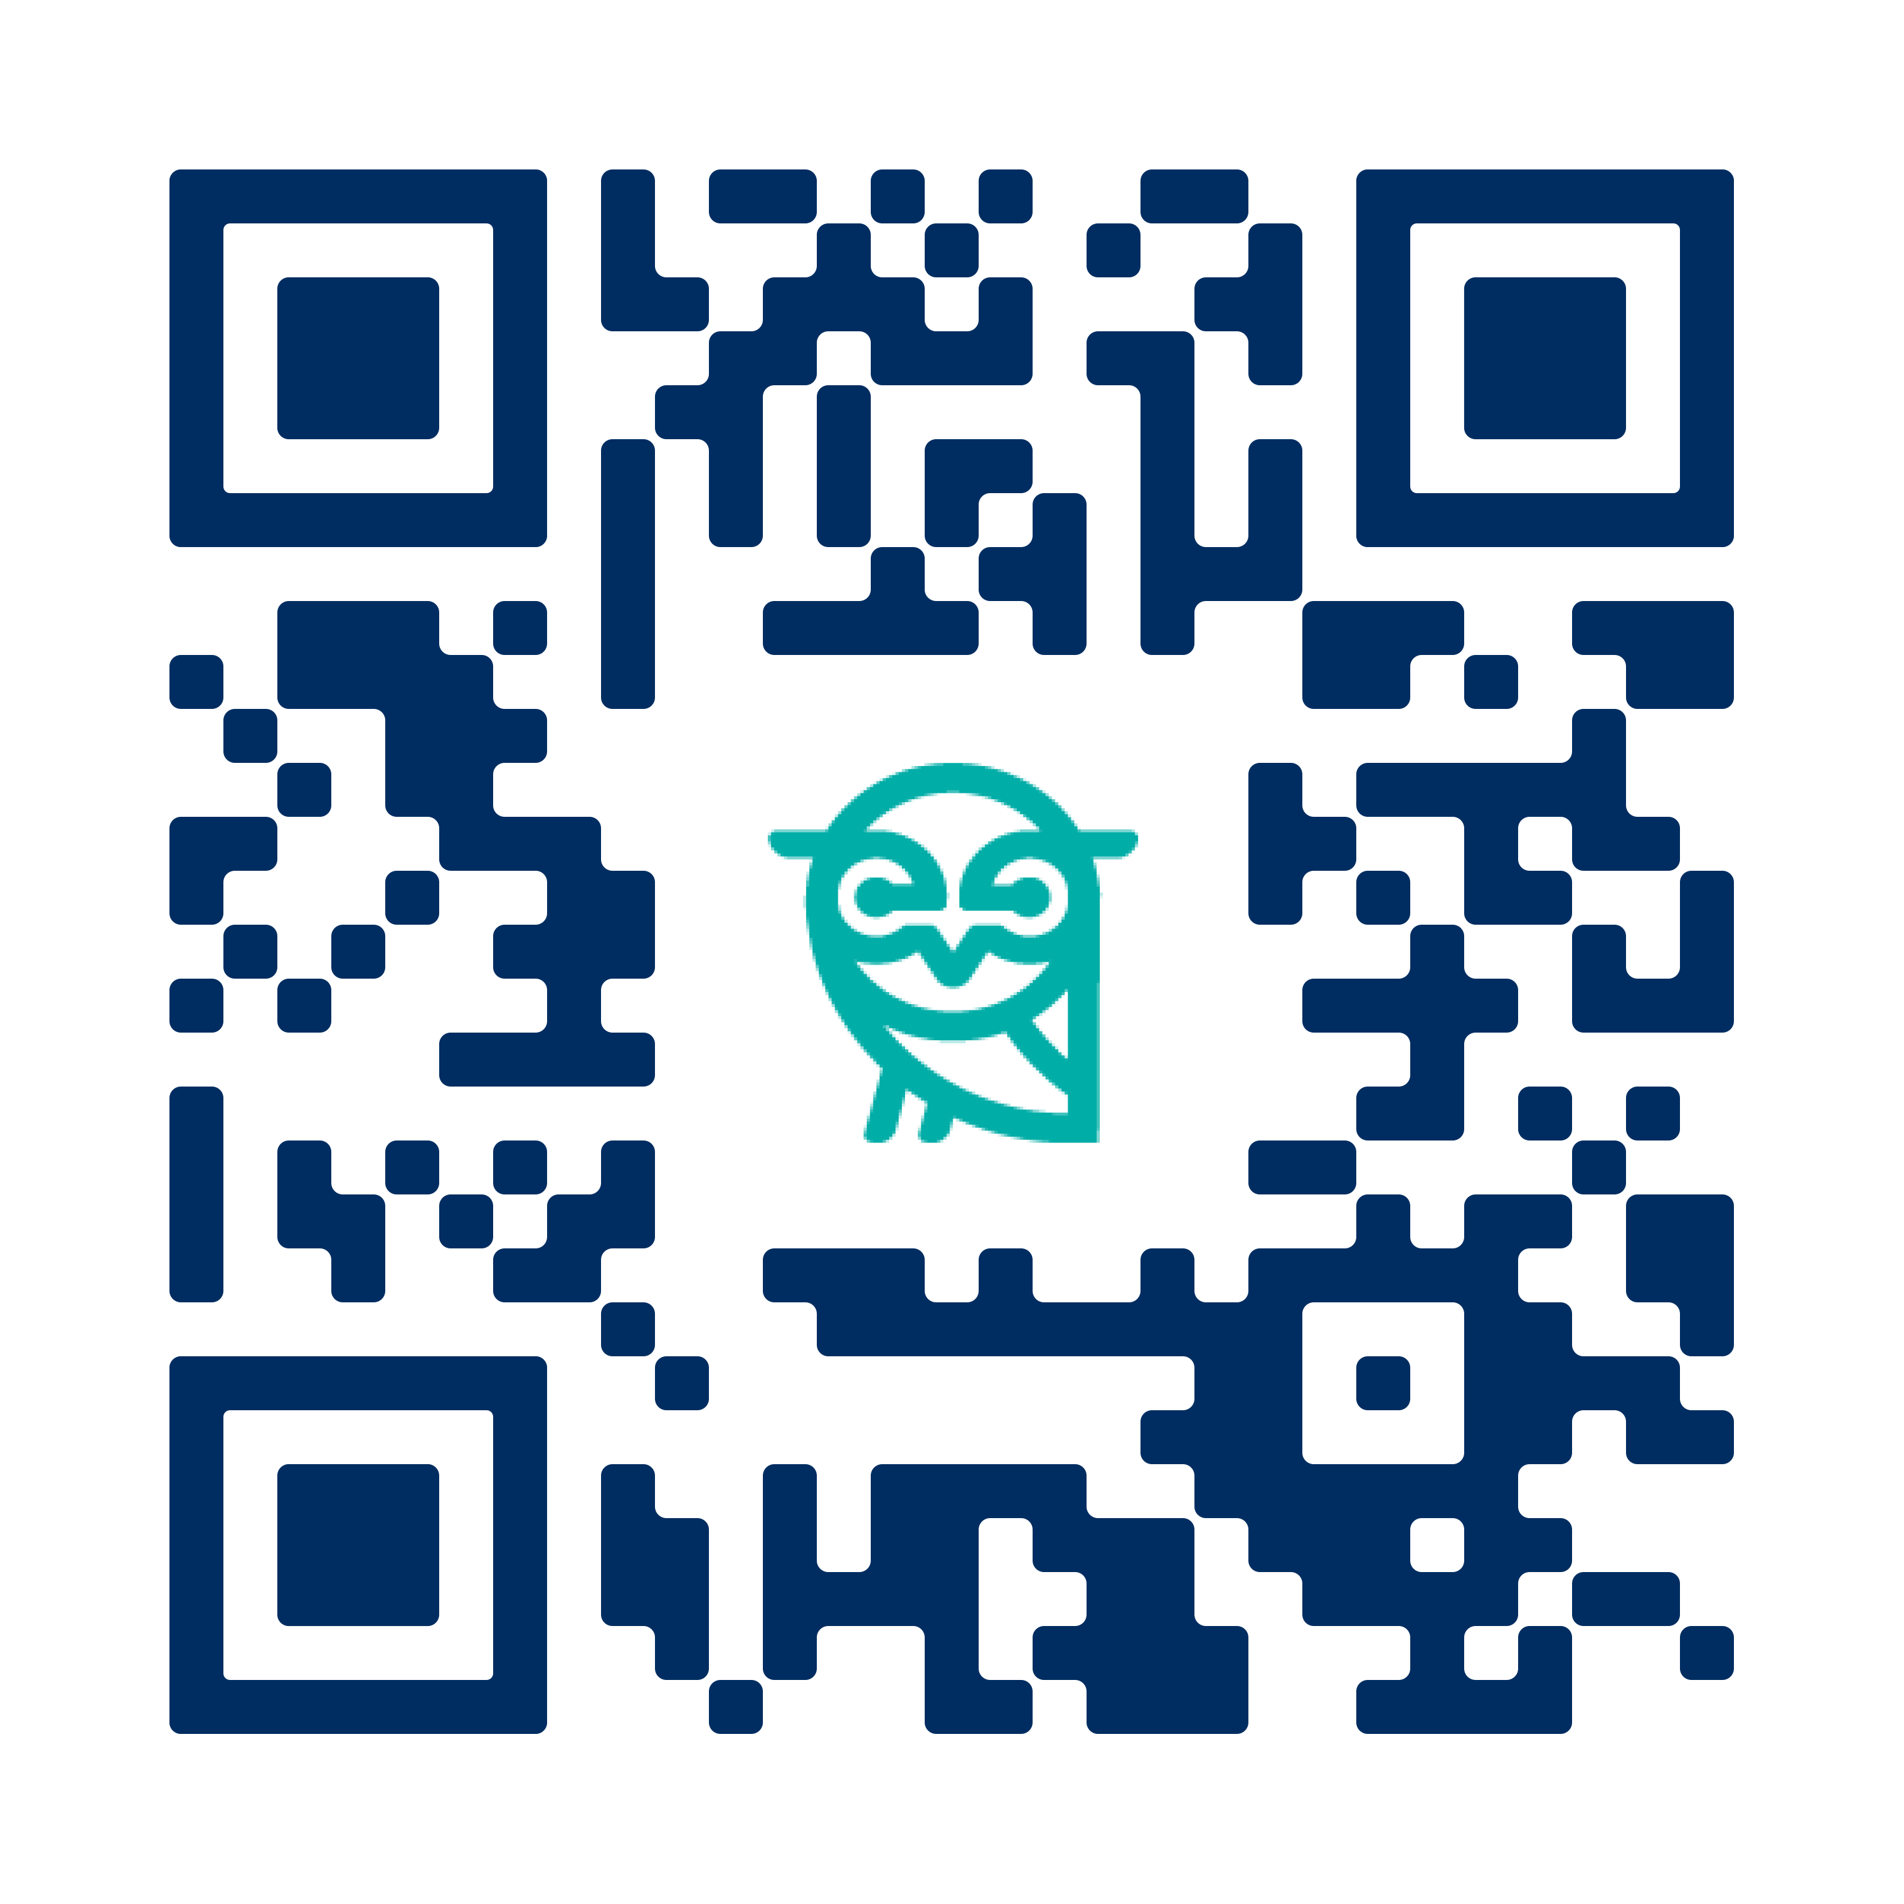
Get Started with Encourage
Scan the QR code or visit: encourageme.com/partners
Notes:
Direct advisers to scan the QR code or visit encourageme.com/partners/fbla.
This is the FBLA-specific sign-up page; all they need to do is fill out the form on this page to get started.
Remind them: they already wrote down when they will sign up on their Action Plan handout. Hold them to it!

Slide 21

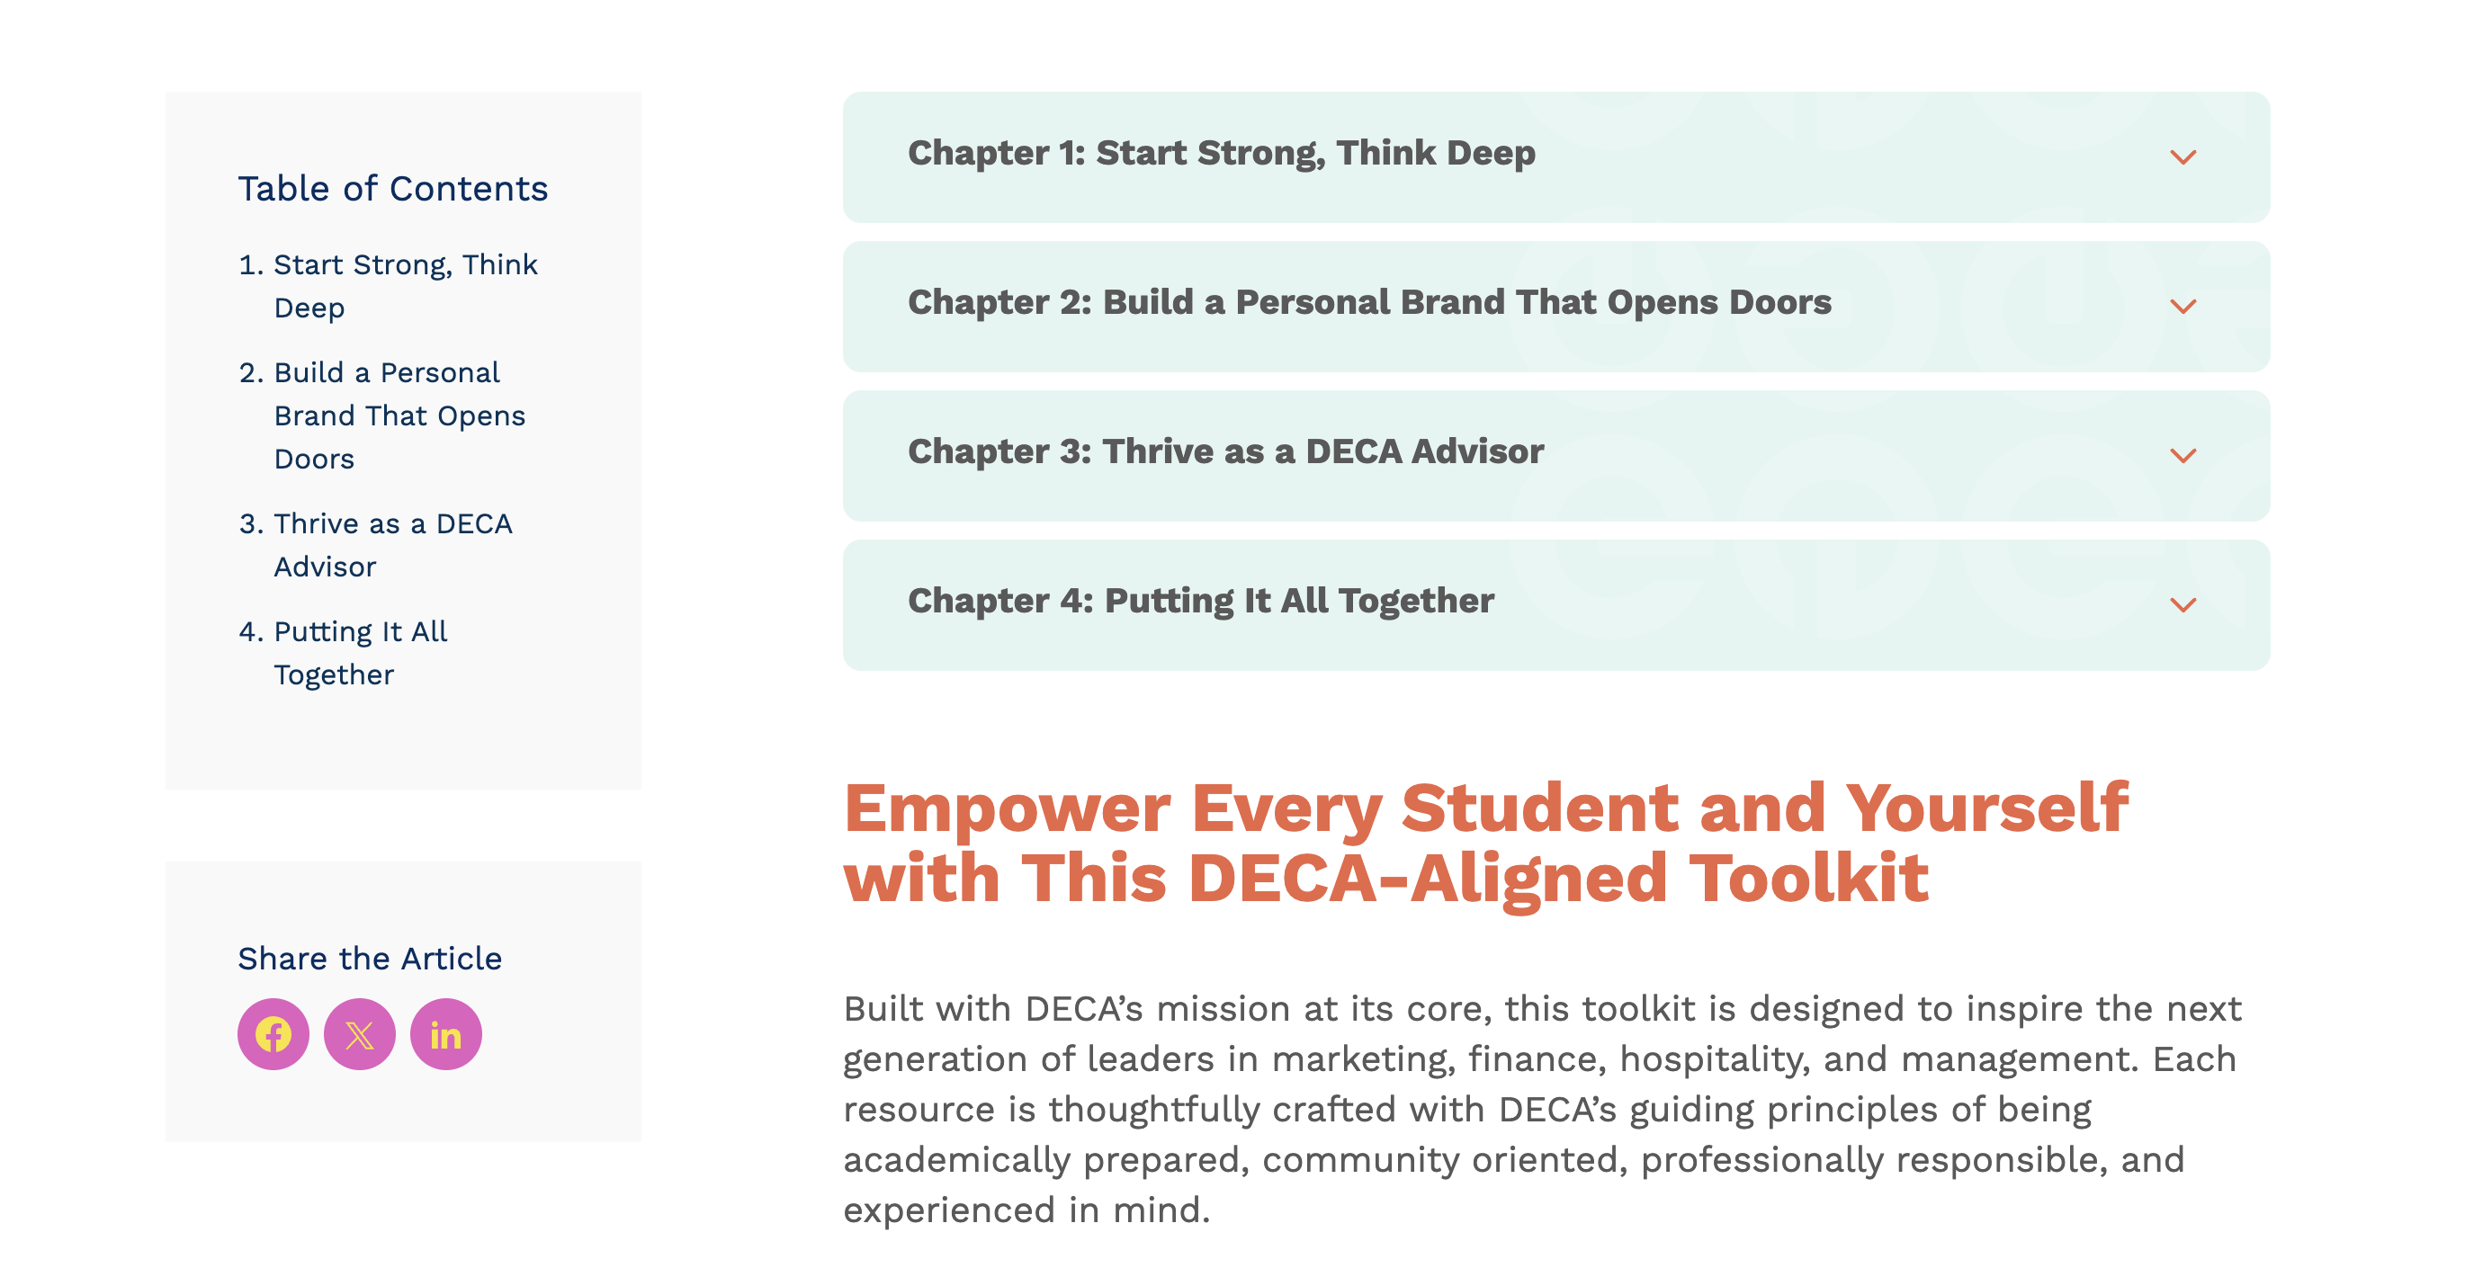
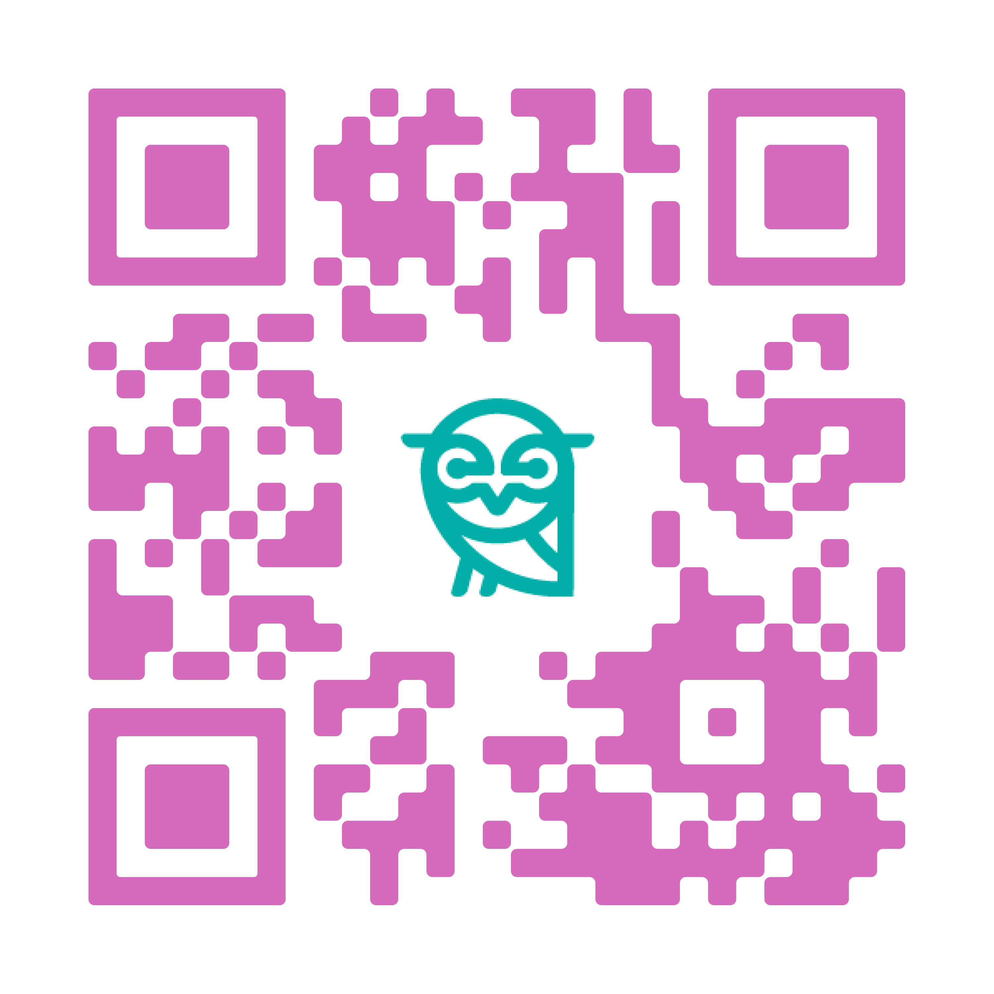
DECA-Specific Resources
Ready-to-use resources designed for DECA
This toolkit includes bell ringers and activities aligned with DECA’s mission
All resources are ready for you to implement at your next meeting!
Scan QR code to access the toolkit or visit encourageme.com/toolkit/deca
Notes:
The FBLA toolkit is a curated set of activities and resources aligned to FBLA's leadership and career development mission.
Everything in the toolkit is ready to implement — no lesson planning needed.
Direct advisers to scan the QR code or visit encourageme.com/toolkit/fbla.
Encourage them to bookmark this page and share it with their chapter leadership team.

Slide 22
Questions?
DECA@encourageme.com
Notes:
Open the floor for questions.
Direct follow-up questions to FBLA@encourageme.com.
Remind advisers about the FBLA-specific toolkit: encourageme.com/toolkit/fbla — everything they need to get started is there.
Thank them for their time and their dedication to their students.

