Slide 1
Role Play Deep Dive
Randi Bibiano – randi@deca.org
Competitive Events Specialist

Slide 2
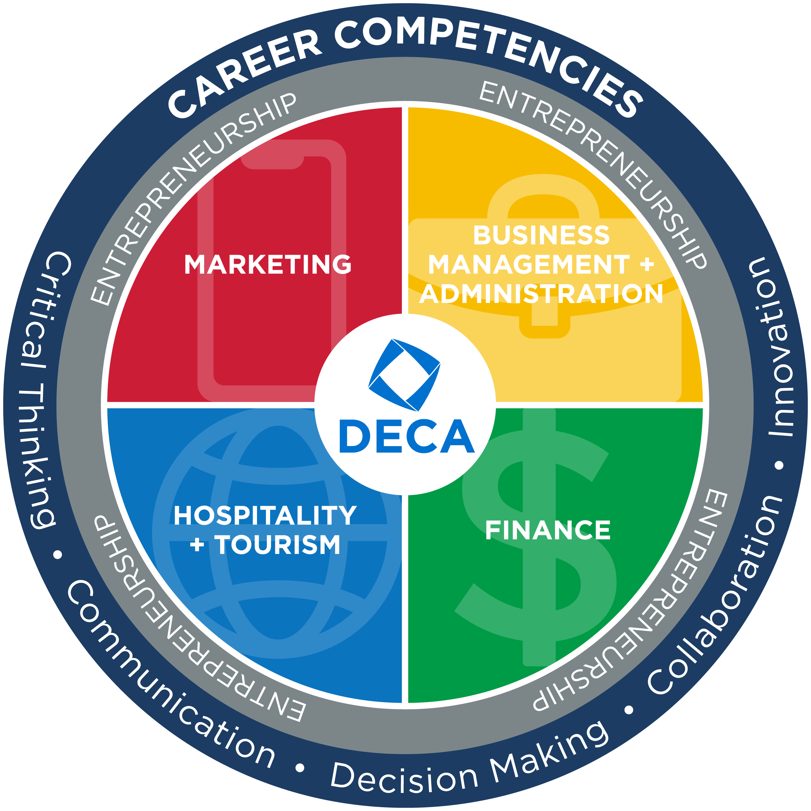
DECA
CONNECTS
Content Knowledge
  National Curriculum Standards
  Career Clusters®
  Career Pathways
  Instructional Areas
  Performance Indicators
Career Competencies
Academic Integration
Notes:
DECA’s Competitive Events Program is based on content knowledge, 21st Century Skills and Academic Integration. This presentation will define and discuss some important terms and concepts around these pillars.

Slide 3
PERFORMANCE INDICATOR LISTS
Based on National Curriculum Standards
MBA Research holds primary and secondary validation panels to ensure industry-validation
Personal Financial Literacy created by Jump$tart Coalition

Slide 4
INDUSTRY-VALIDATED
Variety of industry-based primary and secondary sources
  C-level business interviews
  Industry certifications
  Job websites for job descriptions
  Labor statistics
  Professional organizations
  White papers, journals, articles, webinars
  LinkedIn industry groups
Validation panels

Slide 5

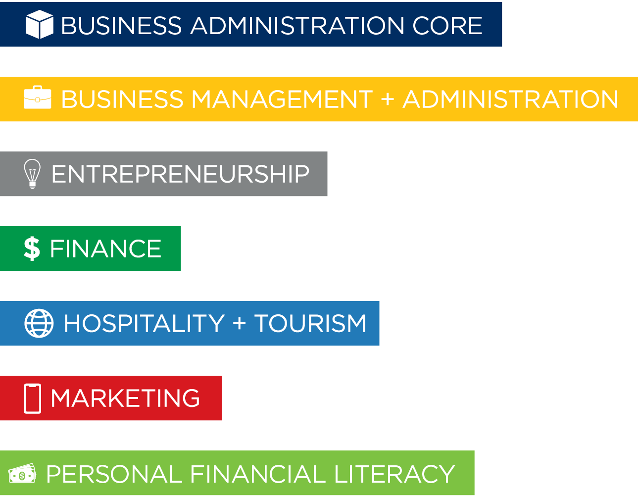
PERFORMANCE INDICATORS

Slide 6
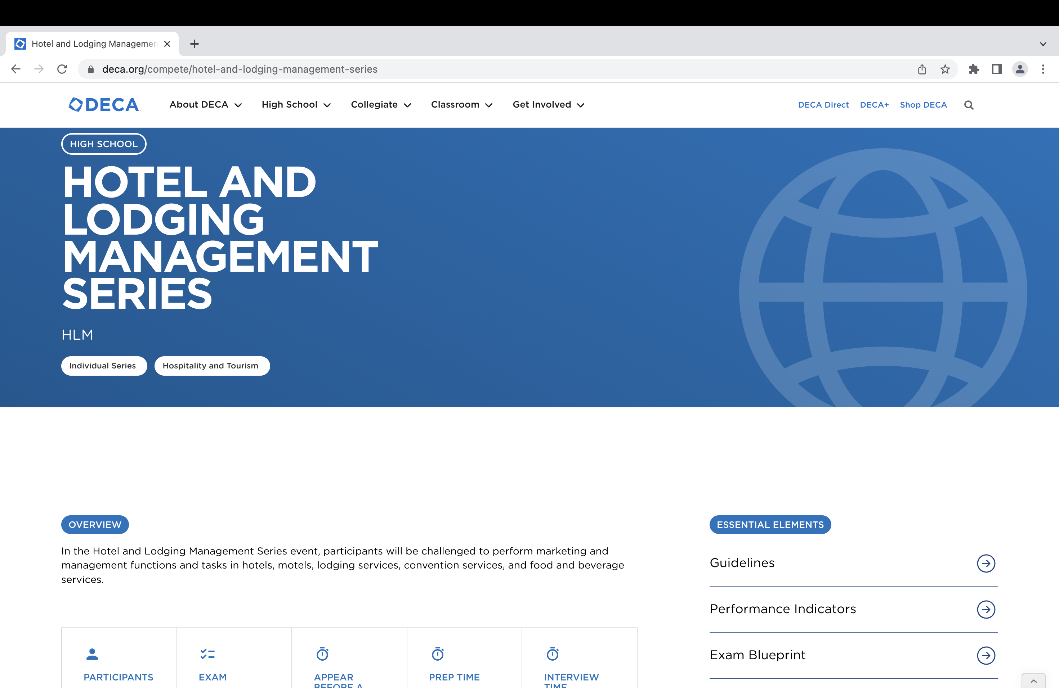

Slide 7
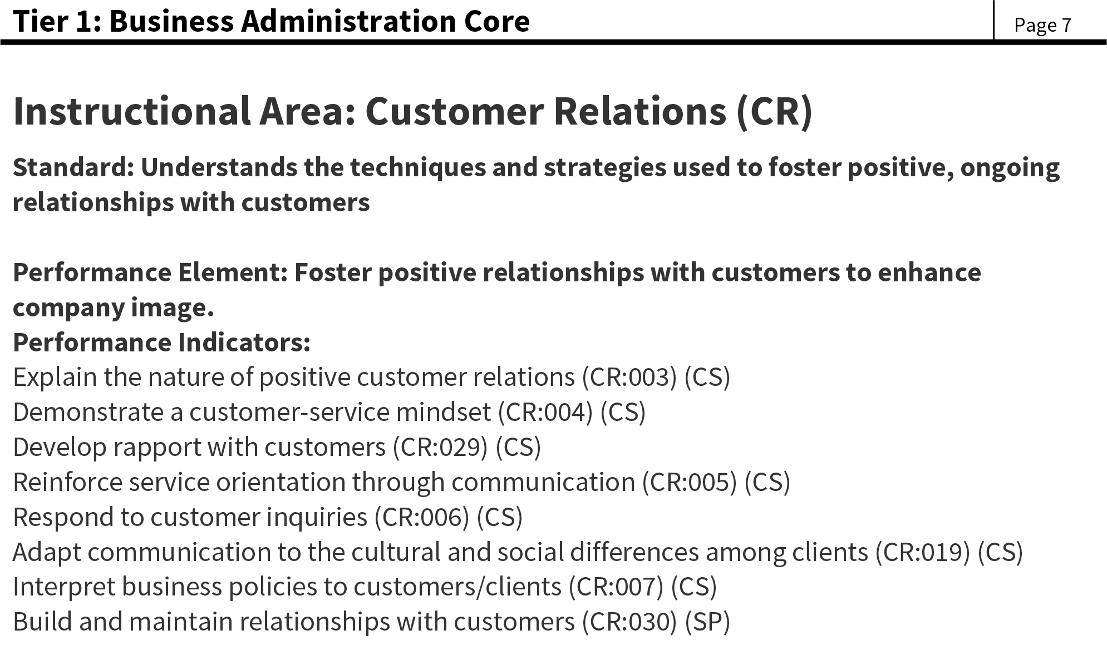
PERFORMANCE INDICATORS
Specific knowledge and skills students should know and be able to perform as it relates to a career.

Slide 8
CASE STUDY DESIGN
TYPES OF CASE STUDIES/ROLE-PLAYS
 | Participant | Prep | Presentation | Performance Indicators
Personal Financial Literacy | 1 | 10 minutes | 10 minutes | 3
Principles Events | 1 | 10 minutes | 10 minutes | 4
Individual Series Events | 1 | 10 minutes | 10 minutes | 5
Team Decision Making Events | 2 | 30 minutes | 15 minutes | 5*

Slide 9
Principles Events– IA + PI example
Principles of Marketing Event
Business Administration Core Performance Indicator List
4 total performance indicators
All 4 performance indicators from the same Instructional Area
Participant works at a grocery store and must resolve an issue for an unhappy customer.
Instructional Area: Customer Relations
All 4PIs are from the Customer Relations Instructional Area

Slide 10
Team Decision Making Events– IA + PI example
Travel & Tourism Team Decision Making Event
Hospitality and Tourism Career Cluster Performance Indicator List
*5 total performance indicators*
Must have one dominant Instructional Area (3/5)
Participant works for an airline and must decide the best method to communicate new policies to travelers.
Instructional Area: Communication Skills
At least 3 PIs are from the Communication Skills Instructional Area
No PIs from any pathway

Slide 11
Individual Series – IA + PI example
Apparel and Accessories Marketing Series Event
Marketing Career Cluster Performance Indicator List
5 total performance indicators
At least one PI from Merchandising Pathway
Must have one dominant Instructional Area (3/5)
Clothing store needs to get rid of excess winter inventory, participant must develop a pricing strategy.
Instructional Area: Pricing
At least 3 PIs are from the Pricing Instructional Area
At least 1 PI is from the Merchandising Pathway

Slide 12
ROLE-PLAY SAMPLE
Career Cluster
Career Pathway
Instructional Area
Solution
Career Competencies
Performance Indicators
Notes:
Each role-play and case study supports a specific career cluster and primary instructional area that is identified at the top of the first page of the event. DECA’s role-plays and case studies are developed through industry research to reflect current issues and trends in business and industry. The role-play and case study scenarios are connected to performance indicators. DECA members are challenged to develop a solution that incorporates the performance indicators relevant to the specific role-play or case study, while demonstrating 21st Century Skills. Individual Series Events are also connected to a specific career pathway.

Slide 13
Components

Slide 14
FORMAT
Student Role
Company
Judge Role
Deliverable

Slide 15
RESOURCES + CONNECTION TO CONTENT
Use Case Studies in Your Classroom deca.org/ceinclassroom
deca.org/compete
deca.org/resources
DECA+
Case Study of the Week

Slide 16
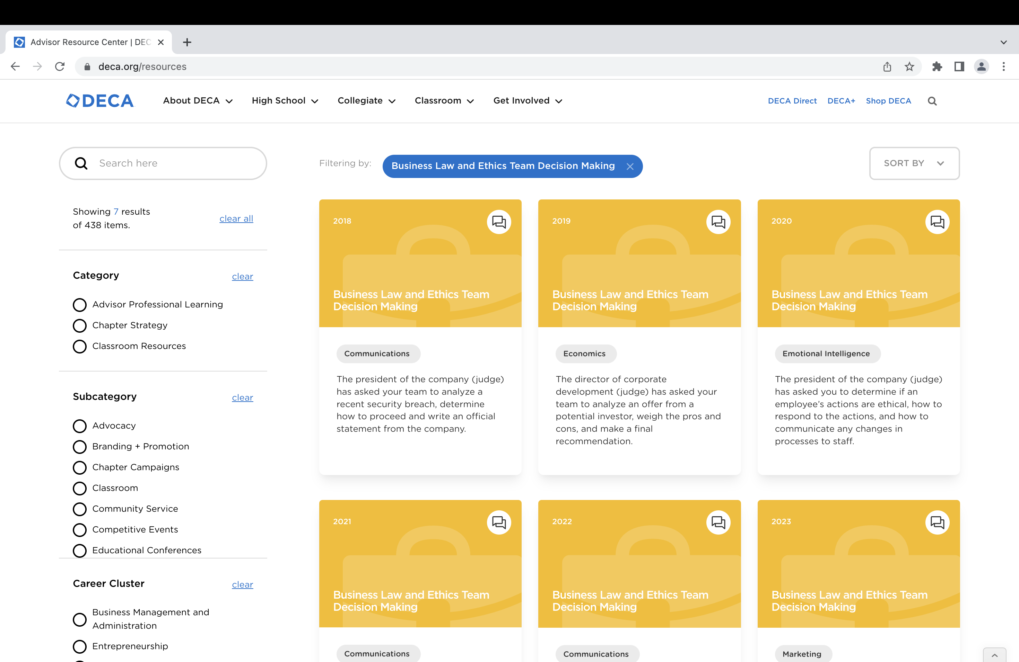

Slide 17
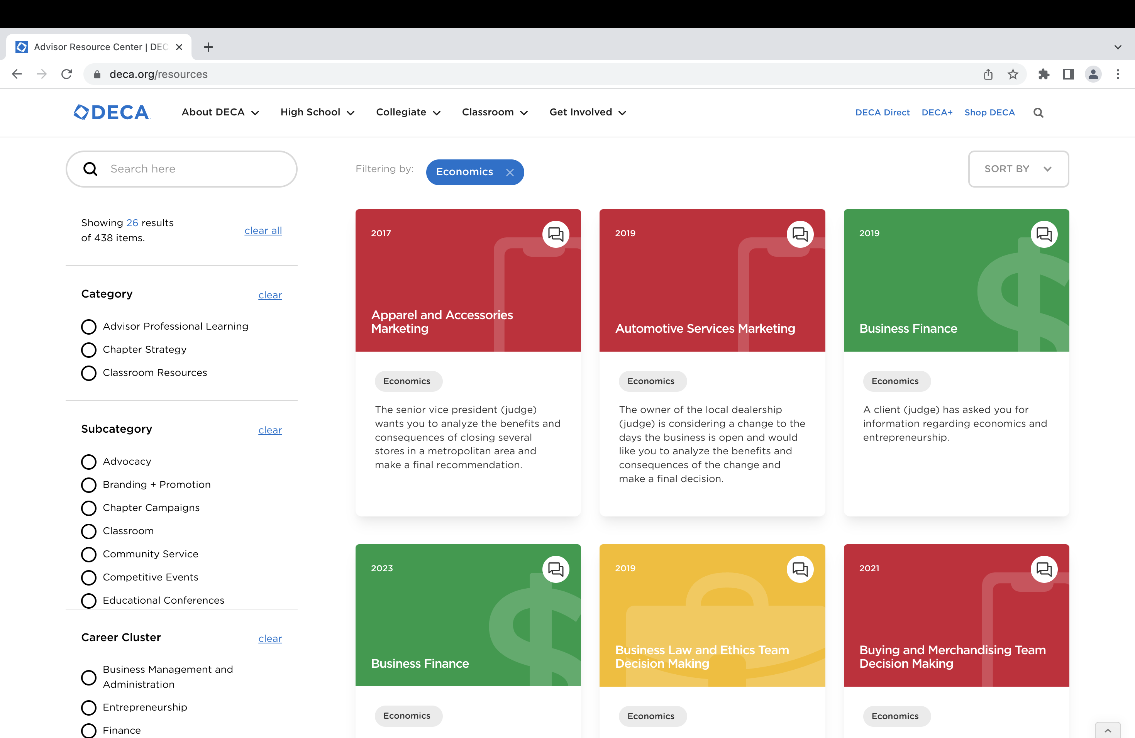

Slide 18
CLASSROOM STRATEGIES
Use deca.org/resources to explore various Instructional Areas as it relates to your curriculum
Use Case Study of the Week for warm-ups
Use case studies for partner practice – both as participant and as judge
Use as a writing exercise

Slide 19
COMPETITION STRATEGIES
No repeated Instructional Areas in a school year
No repeated Instructional Areas in the same competition level
(Entrepreneurship, Human Resources, Finance events, Marketing Communications)

Slide 20
Finding content
    Smart Brief emails (retail, HR, food marketing, ENT, tech, International, etc.)
    Daily briefs from national news sources (USA Today, New York Times, Washington Post, AdWeek, inc., etc.)
    Retail Brew, Marketing Brew
    Submissions from NAB partners/past judges
    Real-life experiences
    Decide if an article is simply an interesting story or a legitimate event idea
      Is there a task involved that will allow for various solutions?
      Will high school students/college students be able to provide legitimate solutions?
      Does the event idea match an IA needed for this competitive event year or should it be saved for next year? Will the idea still be relevant next year?

Slide 21
DISTRICT
INSTRUCTIONAL AREAS
Released mid-September each year

Slide 22
THANK YOU
Randi Bibiano
randi@deca.org

