Slide 1
NWEA MAP Data: Math Basics & Small Group Strategies
A report by: Rann Elementary 3rd grade team

Slide 2
About
Empowering Teachers to Use Assessment Data for Targeted Instruction
A Comprehensive Guide for Teachers New to MAP Data

Slide 3

What is NWEA MAP?
What is NWEA MAP?
MAP = Measures of Academic Progress – a computer-adaptive assessment measuring student achievement and growth
Purpose: Track math proficiency, identify instructional needs, and monitor progress over time
Assessment Type: Computer-adaptive; questions adjust in difficulty based on student responses
Frequency: Typically administered 2–3 times per year (fall, winter, spring)
Coverage: Assesses number sense, operations, algebraic thinking, geometry, measurement, data analysis, and problem-solving
It’s unique to each student, meant to inform instruction. No two students take the same test.

Slide 4
Key Terms
Example
Key Terms You Need to Know
RIT Scale: Rasch UnIT scale, from 0–300, measuring student ability; higher scores indicate stronger performance
Growth: The improvement a student makes from one testing period to the next, such as fall to winter
Percentile: Shows where a student ranks compared to peers nationally; for example, the 75th percentile means performing better than about 75% of similar students
Standard Error: A range around a score reflecting measurement uncertainty; use it as a band rather than an exact number
Benchmark: Expected performance level for a grade and season, such as fall, winter, or spring
“A student at the 60th percentile is performing better than about 6 out of every 10 students nationally.”

Slide 5
Why MAP Matters for Math Instruction
Precision: Identifies areas of strength and need, such as number sense, operations, fractions, geometry, and algebraic thinking
Differentiation: Allows you to group students by actual performance level and mathematical need, not assumptions
Growth Monitoring: Tracks progress toward goals and celebrates growth even when absolute performance is low
Early Intervention: Helps identify unfinished learning early and provides opportunities for targeted support
Data-Driven Decisions: Replaces guesswork with evidence and helps teachers adjust instruction based on student data
This data helps you spend your small-group time on what students actually need, not what you think they need.

Slide 6
The RIT Scale Explained
Range: 0–300; most students fall between approximately 150–250
What It Measures: Overall math ability across number sense, operations, algebraic thinking, geometry, measurement, data analysis, and problem-solving
Higher Scores: Indicate stronger mathematical reasoning, more complex problem-solving, and greater understanding of grade-level concepts
Lower Scores: May indicate unfinished learning in foundational concepts, difficulty applying procedures, and a need for intensive support
Grade Expectations: Each grade has typical RIT ranges; for example, a Grade 3 fall benchmark might be approximately 170–180, while a Grade 5 spring benchmark might be approximately 195–205
A Grade 3 student scoring 185 in fall is on track; a score of 165 suggests additional support may be needed in foundational math concepts.

Slide 7
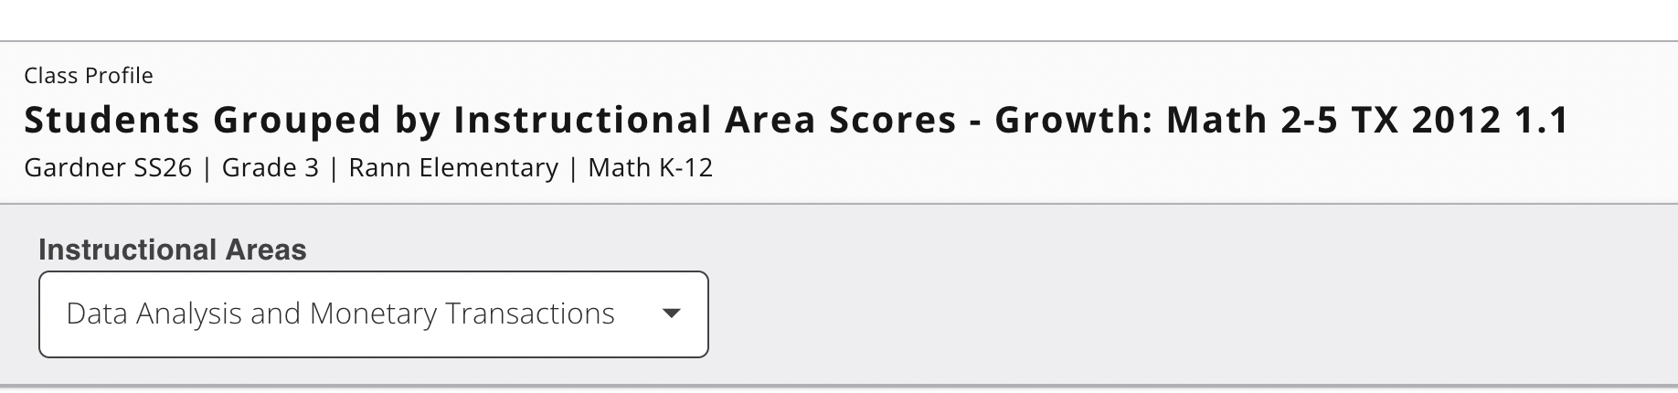

Interpreting Individual Student Scores
Math Achievement Level: Use the RIT score, learning statements, and district guidelines to understand the student’s current mathematical performance
Growth Trajectory: Compare the current score to the previous testing period; is the student growing, plateauing, or declining?
Benchmark Alignment: Is the student at, above, or below the seasonal benchmark for the grade?
Percentile Context: Where does the student rank nationally? What about within the class or school?
Action Question: “What does this score tell me about what this student needs to learn next?”
Maria scored 192 RIT, at the 75th percentile, and is above the winter benchmark. She is ready for more complex multi-step problems and algebraic reasoning. James scored 168, at the 25th percentile, and is below benchmark. He needs targeted support with number sense and computation.

Slide 8
Growth vs. Achievement
Achievement: Absolute performance level, represented by the RIT score—“Where is the student now?”
Growth: Improvement from one test to the next—“How much did the student improve?”
Why Both Matter: A student may have low achievement but strong growth and be on the right trajectory. Another may have high achievement but little growth and need additional challenge.
Growth Goals: NWEA provides expected growth targets; compare actual growth with those targets
Instructional Implication: Celebrate and reinforce growth while adjusting instruction to maintain momentum

Slide 9
Tier 1 – High Performers
Tier 1: High Performers (Top 25–33%)
Characteristics:
RIT scores at or above the grade-level benchmark
Typically at the 75th percentile or above
Demonstrate strong number sense, computation, reasoning, and problem-solving
Ready for complex, multi-step tasks and advanced mathematical thinking
Instructional Focus:
Complex, non-routine problem-solving
Multiple strategies and efficient methods
Justifying reasoning with models, equations, and precise mathematical language
Algebraic thinking, generalization, and pattern analysis
Enrichment tasks, mathematical investigations, and student-designed problems
These students need intellectual challenge and independence. Avoid simply assigning more of the same work. Push their thinking with open-ended tasks, multiple solutions, and opportunities to explain and defend their reasoning.

Slide 10
Tier 2 – On-Grade-Level Mathematicians
Tier 2: On-Grade-Level Mathematicians (Middle 33–50%)
Characteristics:
RIT scores at or near the grade-level benchmark
Demonstrate grade-level understanding of major math concepts
May have specific gaps, such as fraction equivalence, multi-digit computation, or interpreting word problems
Instructional Focus:
Grade-level tasks with guided support
Explicit problem-solving strategies, including identifying relevant information and representing the problem
Mathematical discourse and explanation of thinking
Practice connecting models, strategies, equations, and answers
Targeted review of prerequisite skills

Slide 11
Tier 3 – Developing Mathematicians
Tier 3: Developing Mathematicians (Lower 25–33%)
Characteristics:
RIT scores below the grade-level benchmark, often between the 25th and 49th percentiles
Struggle to apply grade-level concepts independently
May have gaps in number sense, operations, place value, fractions, or mathematical vocabulary
Need concrete models, visual representations, scaffolding, and repeated opportunities to apply strategies
Instructional Focus:
Tasks at an appropriate instructional level connected to grade-level standards
Explicit, systematic instruction in foundational number and operation concepts
Use of manipulatives, drawings, number lines, arrays, and visual models
Pre-teaching mathematical vocabulary and concepts before grade-level tasks
Guided problem-solving with gradual release of responsibility
Confidence-building and positive reinforcement

Slide 12
Flexible Grouping
Flexible Grouping: Keeping Groups Dynamic
Monitor Constantly: Use formative assessments, exit tickets, computation checks, math interviews, and problem-solving tasks every 2–3 weeks
Movement Criteria: Move students when they consistently demonstrate understanding and can apply strategies independently; regroup students when they need additional support or challenge
Growth Tracking: A student who grows 10+ RIT points may be ready for more advanced work; stagnation signals a need to adjust intervention or instruction
Communication: Inform families about group placement and progress; emphasize that movement is normal and positive
Re-assessment: Formally re-tier after each MAP testing window—fall, winter, and spring

Slide 13
Targeted Math Strategies by Tier
Tier 1 (High Performers):
Solve complex and non-routine problems
Compare multiple solution strategies
Generalize patterns and write algebraic rules
Defend solutions with models, equations, and evidence
Tier 2 (On-Grade-Level):
Represent problems with drawings, diagrams, and equations
Estimate before solving and check whether answers are reasonable
Explain mathematical thinking using precise vocabulary
Connect concrete models, visual representations, and symbolic procedures
Tier 3 (Developing):
Build number sense with manipulatives and visual models
Use number lines, ten-frames, arrays, and place-value charts
Practice fact strategies and computation with immediate feedback
Solve one-step problems using structured representations

Slide 14
Monitoring Progress Within Groups
Monitoring Progress Within Groups
Formative Assessments (use weekly or bi-weekly):
  Computation checks to assess accuracy and strategy use
  Math interviews to reveal student reasoning and misconceptions
  Exit tickets tied to the focus standard
  Problem-solving tasks requiring models and explanations
  Fact fluency and foundational skill checks
Data Tracking: Keep a simple record, such as a spreadsheet, checklist, or notebook, of each student’s progress by skill
Adjustment Frequency: Review data every 3–4 weeks; adjust instruction or grouping as needed
Red Flags: Stagnation, declining performance, persistent misconceptions, or continued errors on taught skills signal the need for an instructional change
Celebrate Growth: Share progress with students; build motivation, confidence, and productive mathematical habits
You do not need a complicated system. A simple checklist or spreadsheet showing which students have mastered each skill is powerful. Use it to inform daily instruction and regrouping.

Slide 15
Common Pitfalls to Avoid
Common Pitfalls: What NOT to Do
Over-Interpreting Single Scores: Do not move a student based on one test or a 3–5 RIT-point change; use trends and multiple data sources
Static Grouping: Avoid keeping students in the same tier all year; groups should shift as students grow and their needs change
Ignoring Growth: A student in Tier 3 with strong growth may not need to move to Tier 2 immediately, but the progress should be acknowledged and celebrated
Neglecting Tier 1: High performers still need quality instruction and challenge, not simply extra worksheets or independent work
Relying Solely on RIT Scores: Combine MAP with classroom data, observations, student work, and student voice

Slide 16

Action Planning
Next Steps: Your Action Plan
First:
Review your class MAP math data; identify RIT ranges, percentiles, and domain strengths and needs
Sketch out initial tiers based on achievement, growth, and specific math skills
Select one priority skill for each group, such as place value, multiplication, fractions, or problem-solving
Plan a short formative assessment to check each group’s priority skill
Prepare models, manipulatives, visual representations, and tasks matched to each group’s needs
Place these in bags with the TEKS on it that the group will be practicing. Have these ready to go so that you’re not working on it throughout the year.

Slide 17
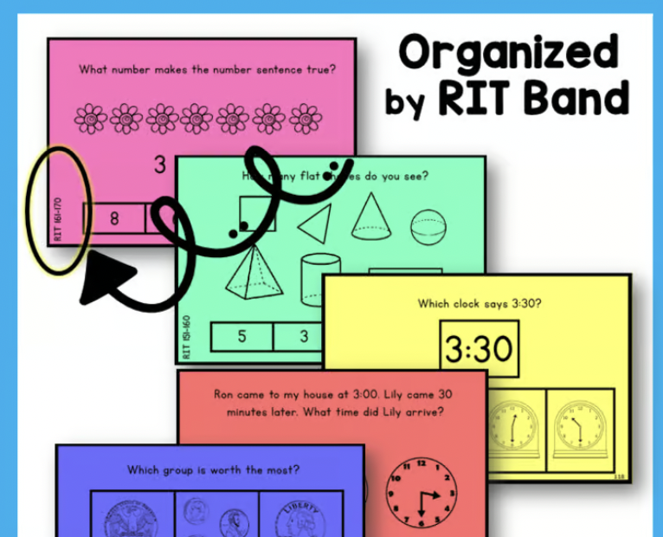
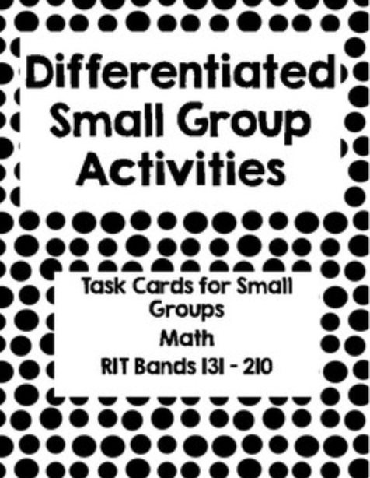
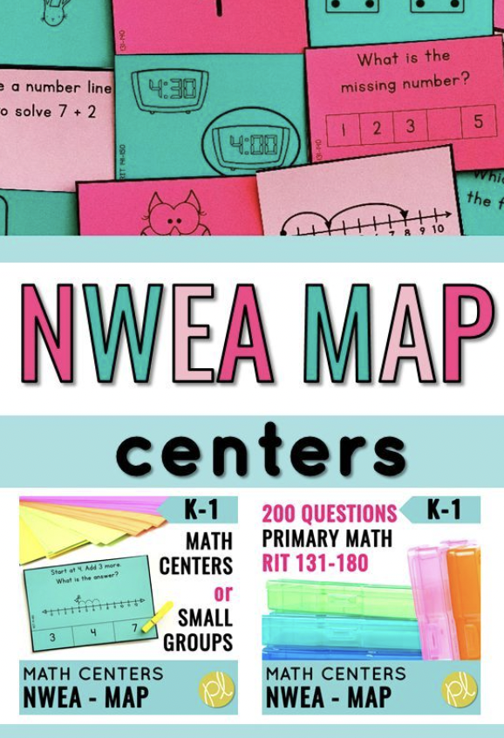
Start small. Choose one priority skill for each group, teach it intentionally, monitor progress, and adjust. The goal is not perfect grouping; it is more responsive math instruction that helps every student make meaningful progress.
If your bags are already made, you can simply grab a new bag when the need arises or shift children to the appropriate group.

Slide 18
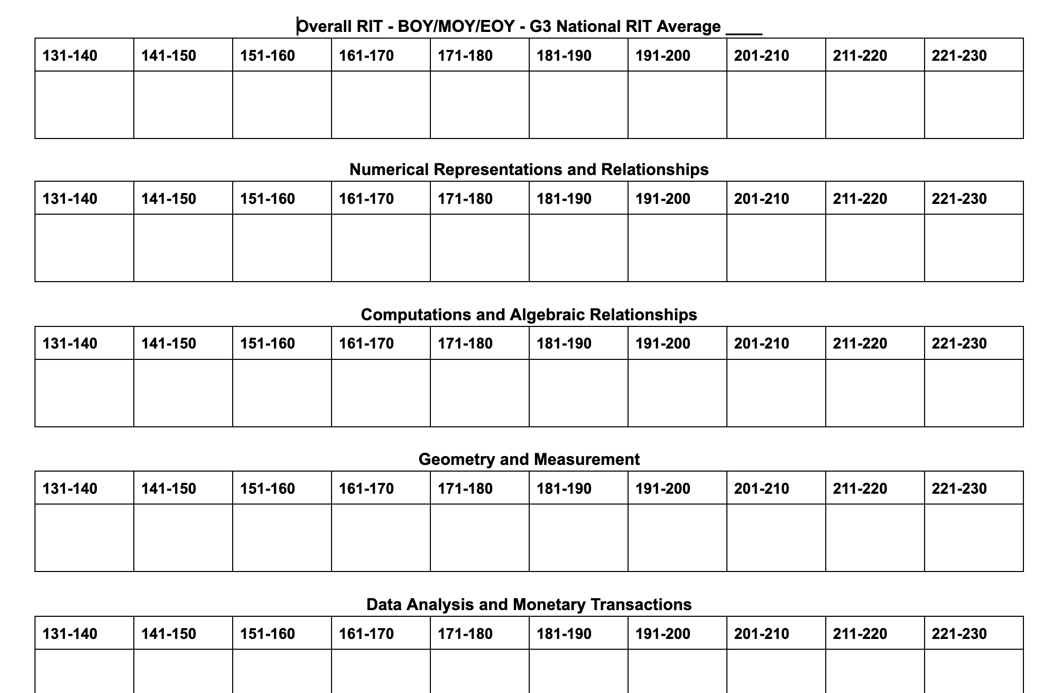
Numerical Representations and Relationships
Computations and Algebraic Relationships
Geometry and Measurement
Data Analysis and Money
RIT template
Sample report

