Slide 1


Slide 2
A question to begin:
Get a sticky note (hopefully you have one already!)
Write down 1 good thing that happened to you this week.
Write down 1 good thing about students and their note taking.
Write down 1 thing students have difficulty with while note taking.

Slide 3


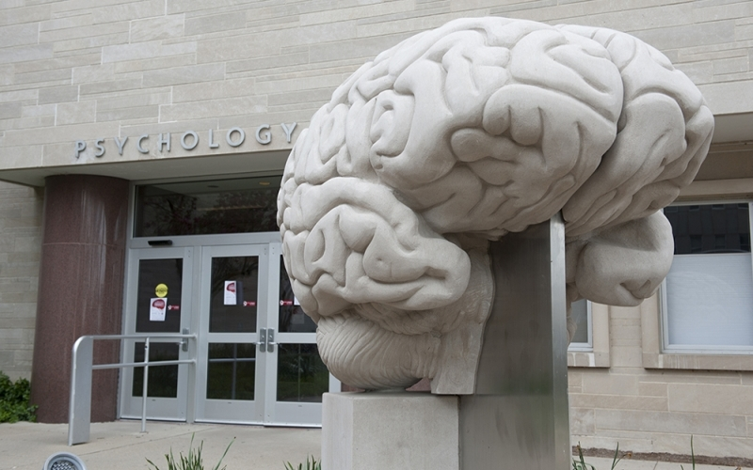
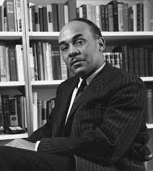
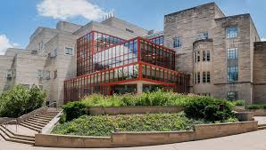

Boyd Science and School Autobiography:

Slide 4
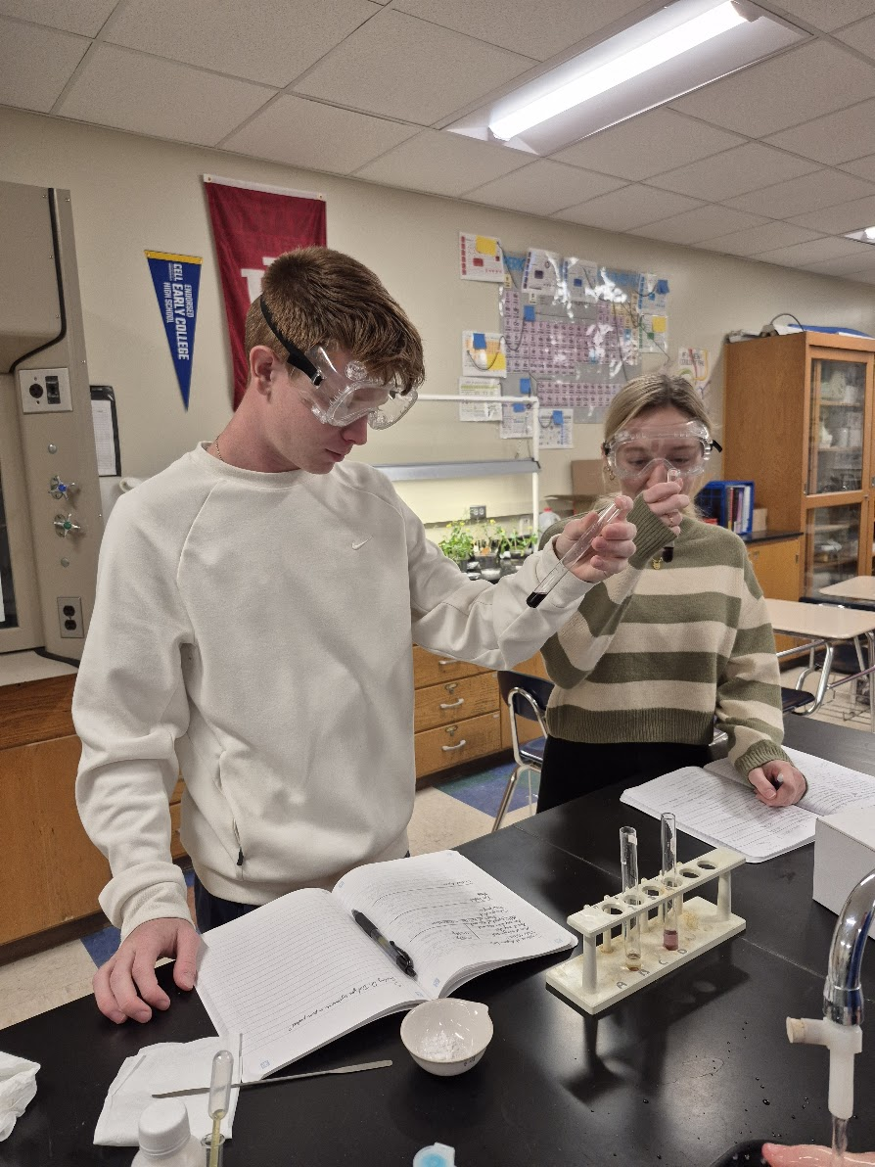
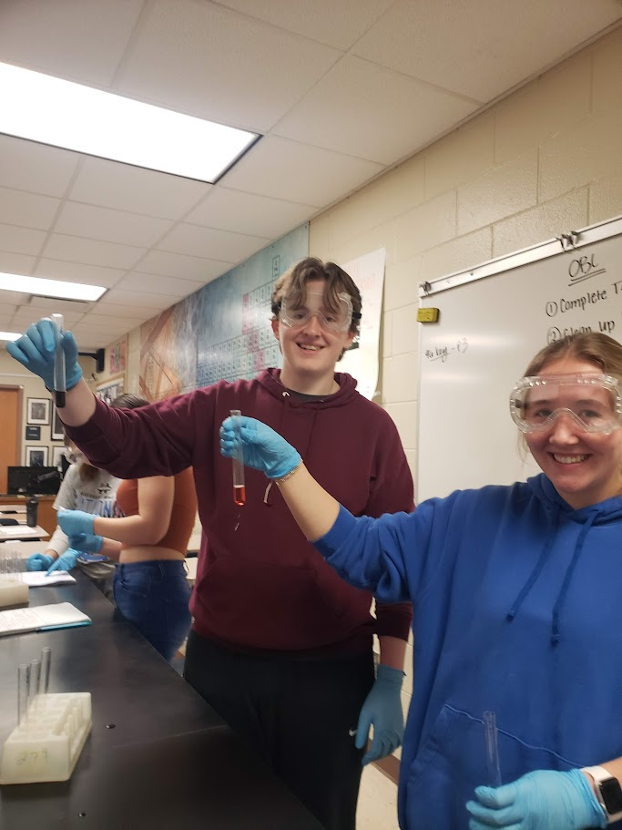
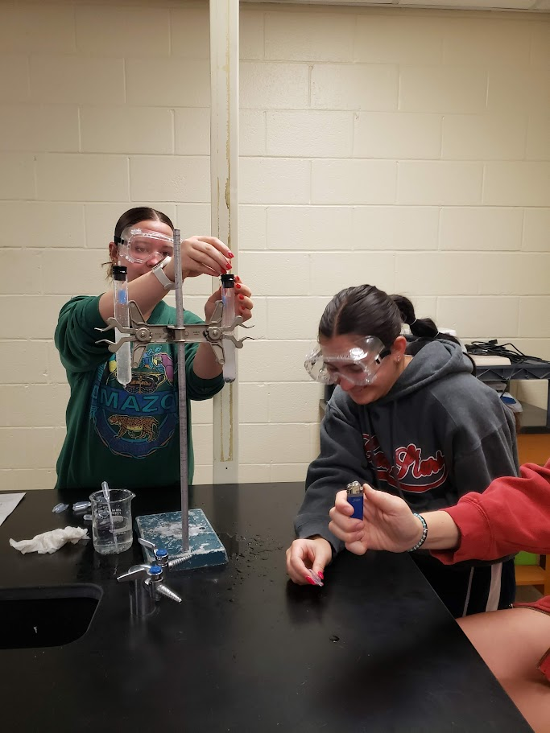
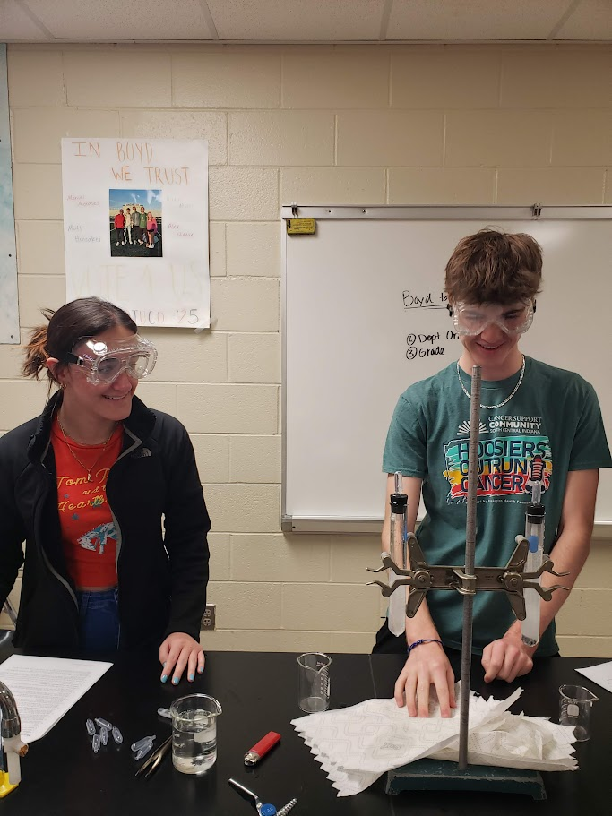
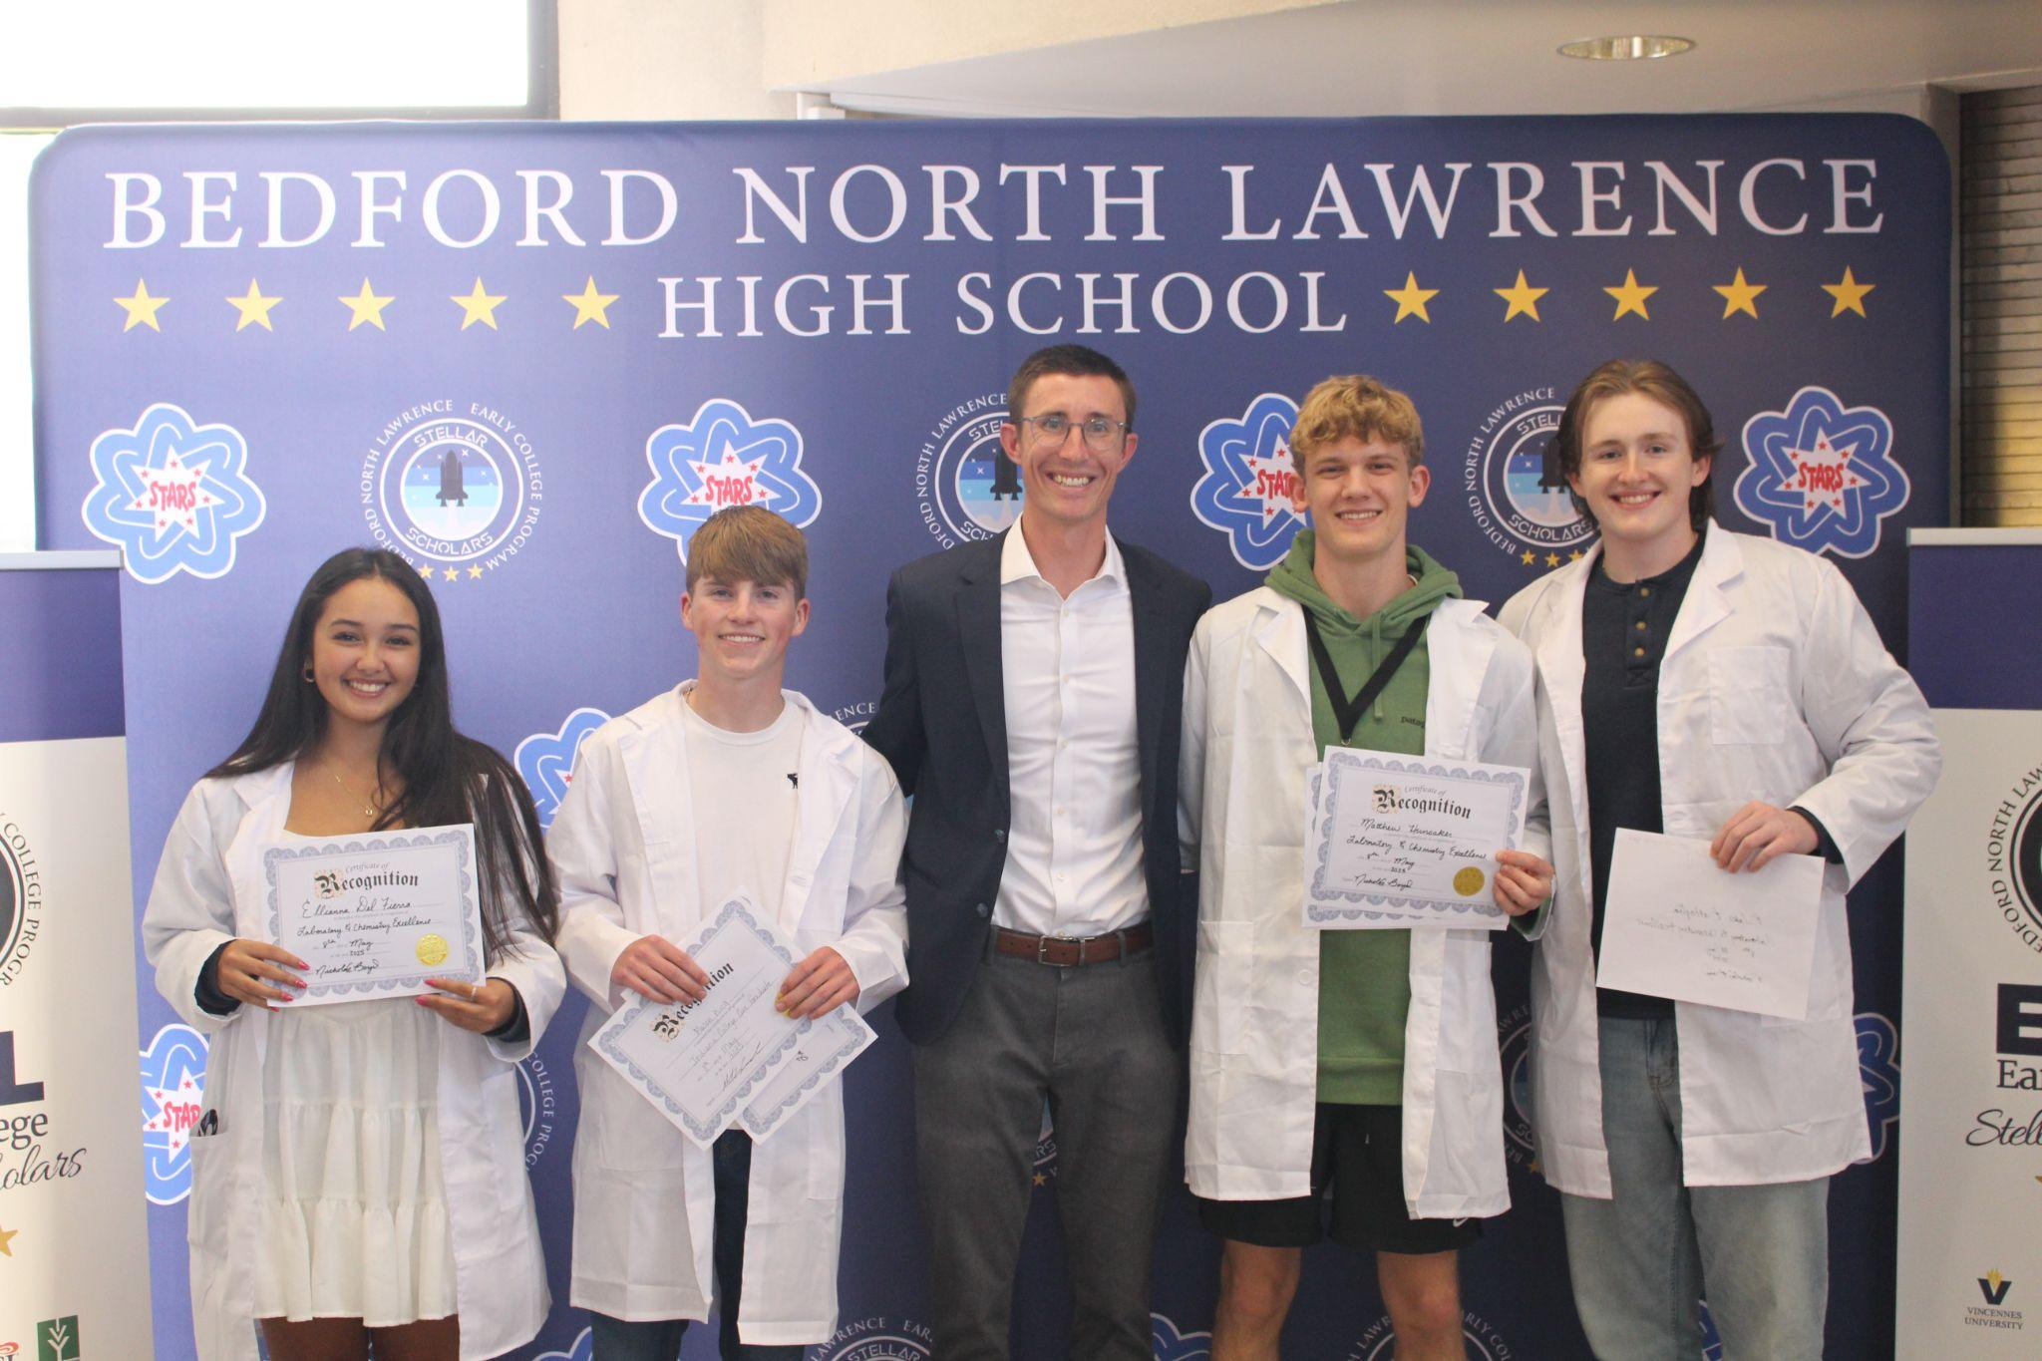
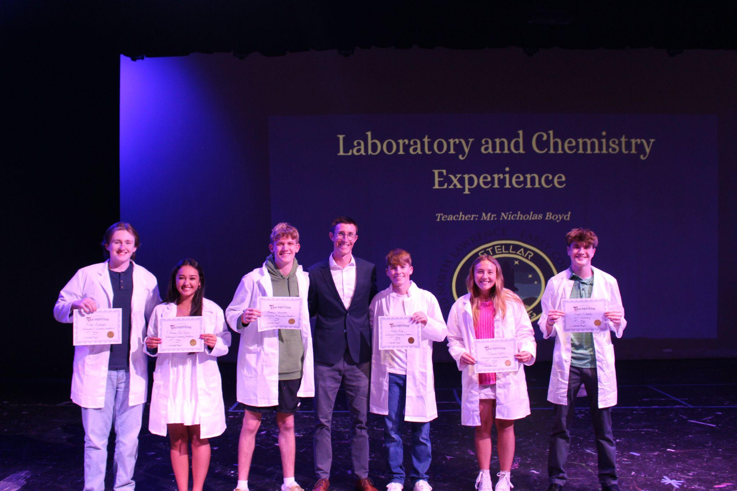

Slide 5
A couple disclosures to begin:
I don’t think there’s necessarily a “right” or “wrong” practice when it comes to how students take notes, but these are structures/protocols I use that I’ve seen really help students.
  Certainly it is dependent on the class, but these are things I have found to help students build their note taking skills.
I’ve seen improvements in skills, which I think is just as important as performance. Ultimately, if performance stays level and skill acquisition improves, then it’s worth it.

Slide 6
Where this began:
I had this question that really bothered me in the winter of 2024-2025:
What have people been doing to learn for centuries?
Notes:
So I was listening to a LOT of research about the most effective ways to learn and study. Listening to article reviews on medical school students, reading a lot about the most effective study strategies, and ultimately, I kind of took a step back and wondered, it led me to thinking….we’ve been reading and we’ve been writing. So WHY am I not prioritizing this in my classes? Obviously we spend time doing this, but how could I better integrate this into daily structures.

Slide 7
What I heard people consistently saying:
“Students don’t know how to take notes.”

Slide 8
What I heard people consistently saying:
Students don’t know how to take notes.
So I thought, well, that’s probably right, and I agree, so how about I teach them?

Slide 9
Part 1: What I was doing…
I don’t think it was all bad, but I just thought…could this be better? How can I better equip students with note taking skills?

Slide 10
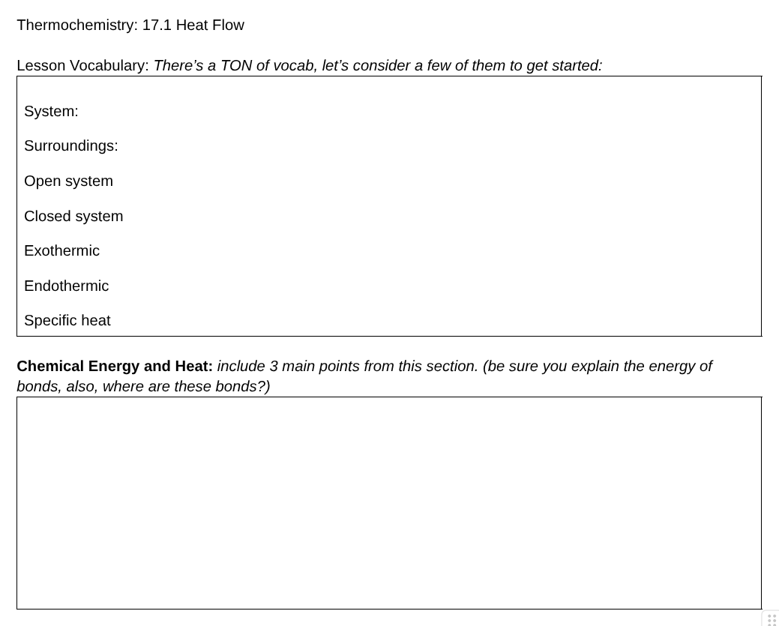
Using things like graphic organizers for students to take reading notes

Slide 11
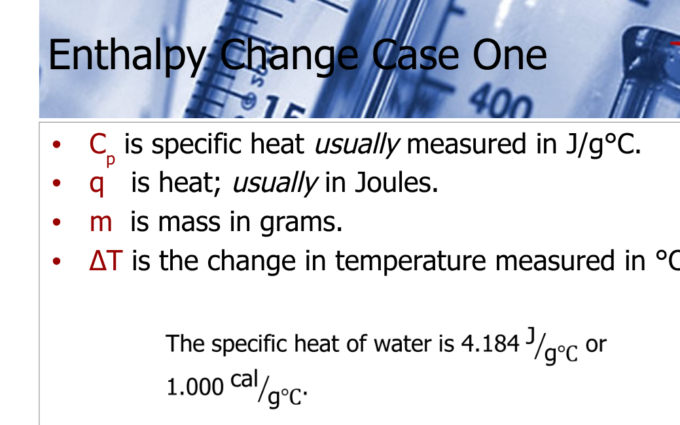
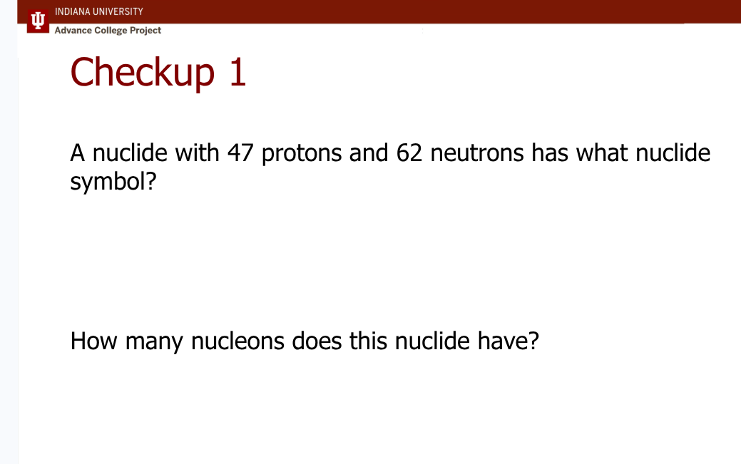
Using powerpoints/slideshows with embedded questions

Slide 12

Where to put these?
All of these notes and graphic organizers, daily warm ups, everything would go into a binder.
There was specific organizational practices for the binder, but it wasn’t super effective when it came time for students to prepare for tests, quizzes, and laboratories.

Slide 13
What I wanted students to do:
Slow down. Think. Process. Generate their own notes, ideas, drawings, and summaries for in class work, discussions, and readings.

Slide 14
These questions arose:
How can I help students become better at actively generating their own work?
At hand-writing in order to increase retention and information processing.
Simply to slow down and take their time.
If they don’t know how to take good notes, well, then my job needs to be to teach them how to do this over time.
Notes:
I really thought about this a lot, it kind of consumed me, but ultimately whatever you want to call it, it led me to thinking….we’ve been reading and we’ve been writing. So WHY am I not prioritizing this in my classes? Obviously we spend time doing this, but

Slide 15
What I had noticed about all the reading guides/graphic organizers:
Students are really really good at following the directions.
So I thought, how can I leverage directions to improve their note taking.

Slide 16
So, I just changed the structures and directions.
Instead of making a graphic organizer, I thought, why don’t I give them the directions to generate their own graphic organizers?
AND IT WORKED

Slide 17
It’s all about the set up.

Slide 18
Requirements:
I required every student to have a composition notebook OR spiral notebook. I provided notebooks if students couldn’t get one for the second day of class.
  AP Biology
  IU Chemistry C101/C121
  Chemistry 1
I specifically tell students they will hand-write A LOT. It will be slow, but that’s where learning happens.
Day 1, I post an assignment for them to complete on their own that looks like this….

Slide 19
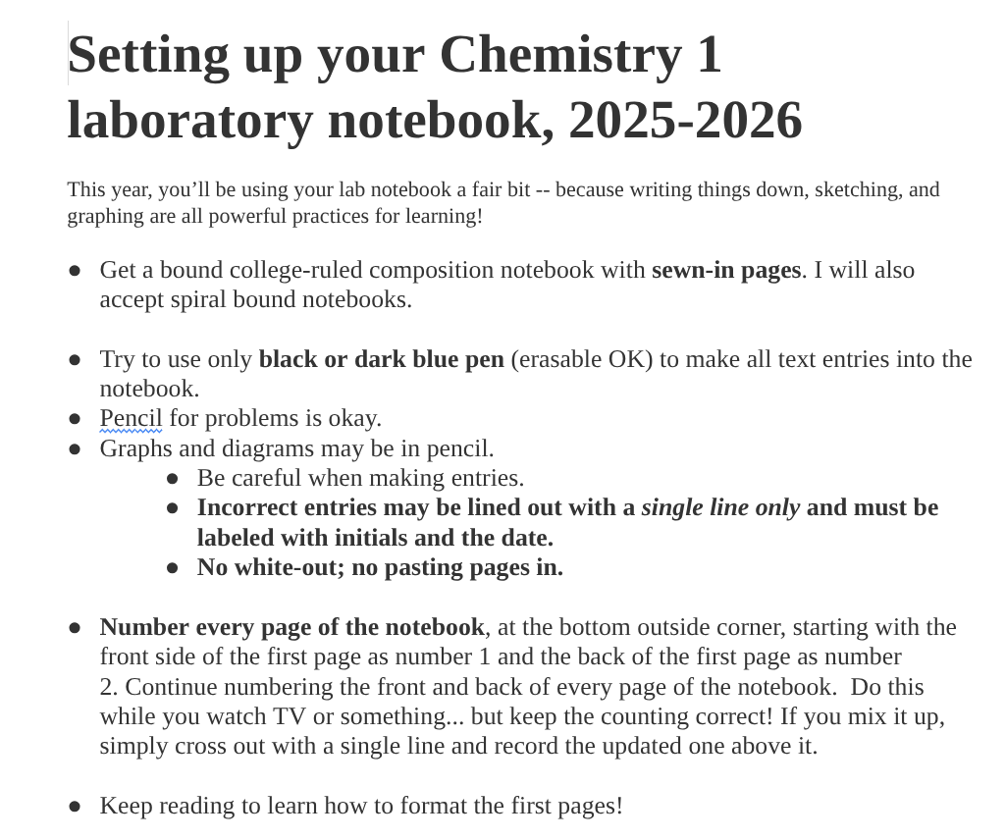
REMEMBER: Students are really good at following directions….
It’s all about structure!
Day 1: they receive this assignment and it needs to be done before class the next day.
Assignment adapted from one of my colleagues Dr. Matthew Williams and his mentor Dr. Kirsten Milks

Slide 20
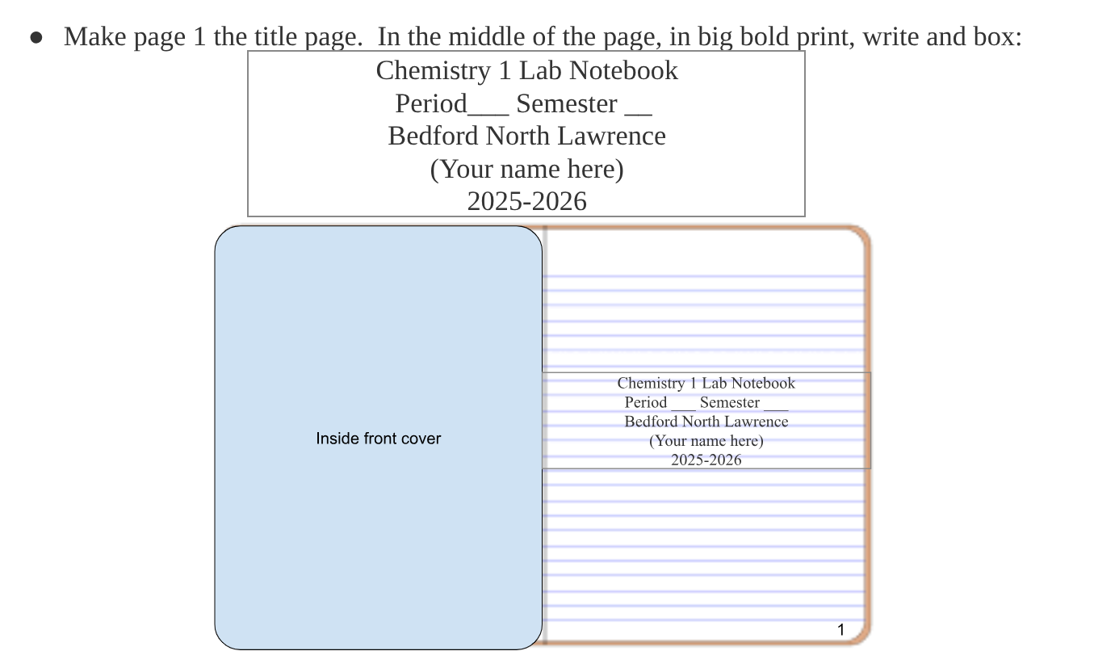

Slide 21
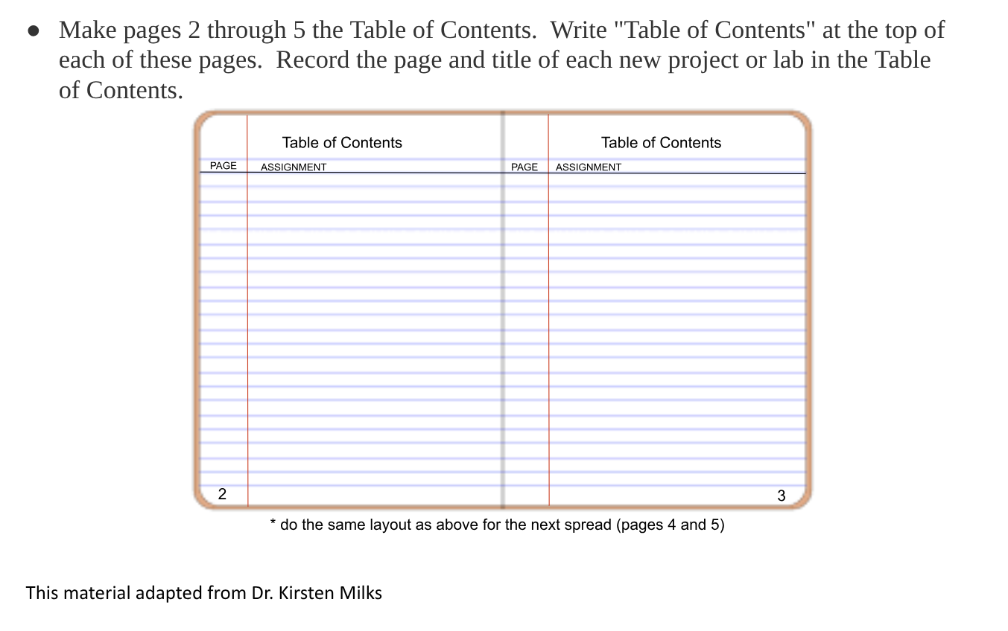

Slide 22
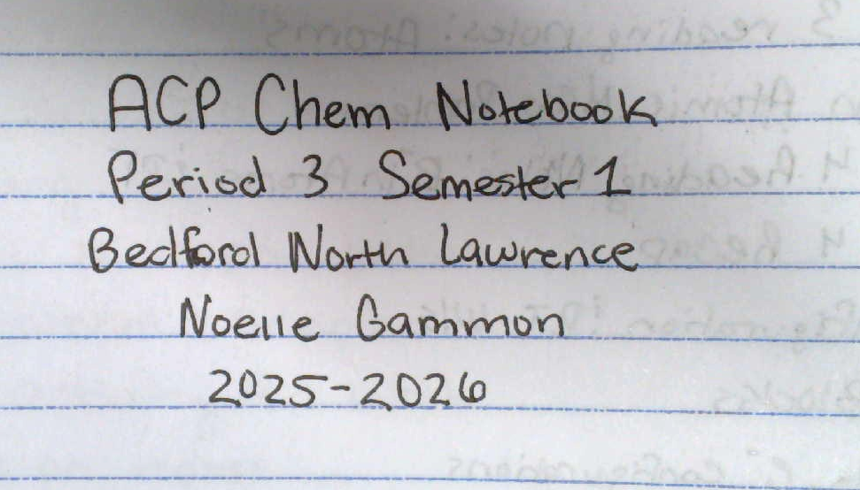
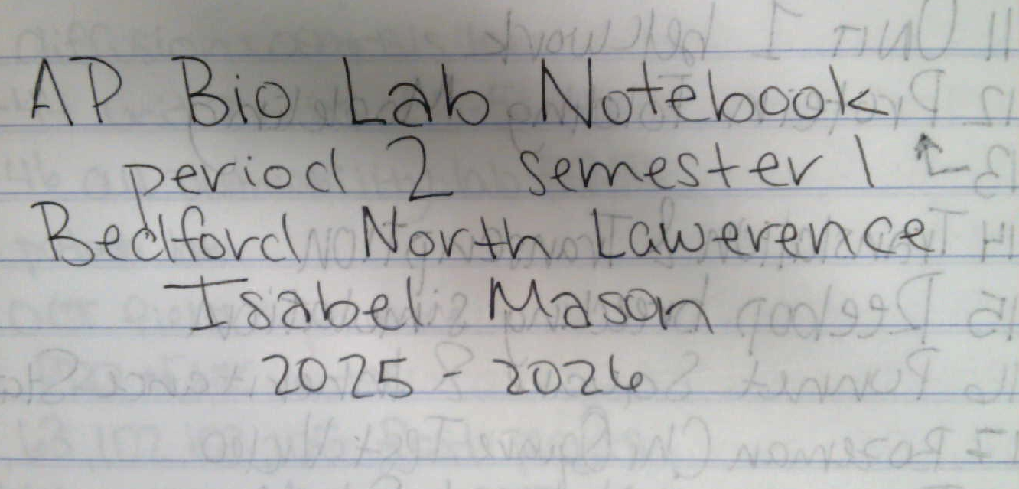

Slide 23
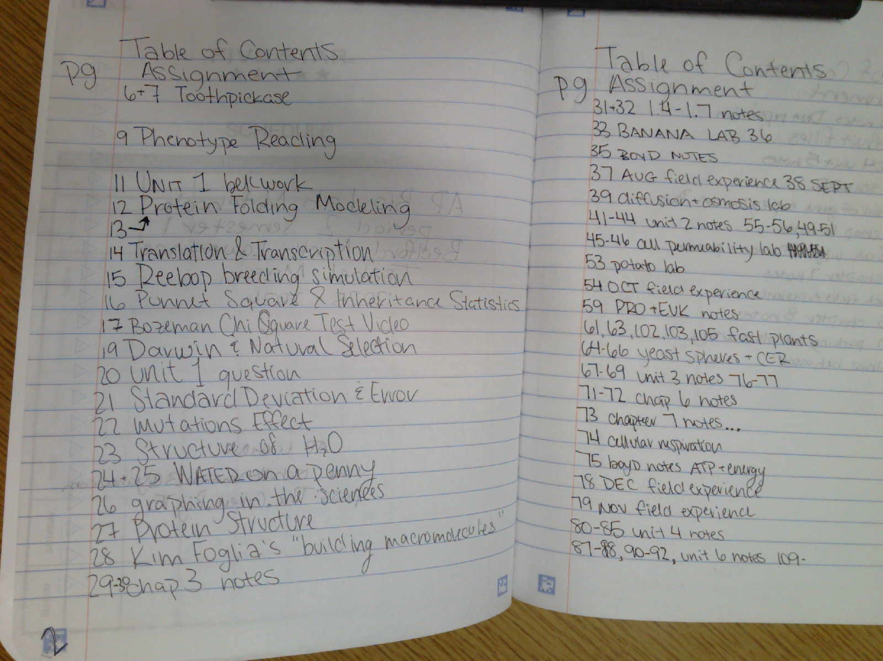

Slide 24
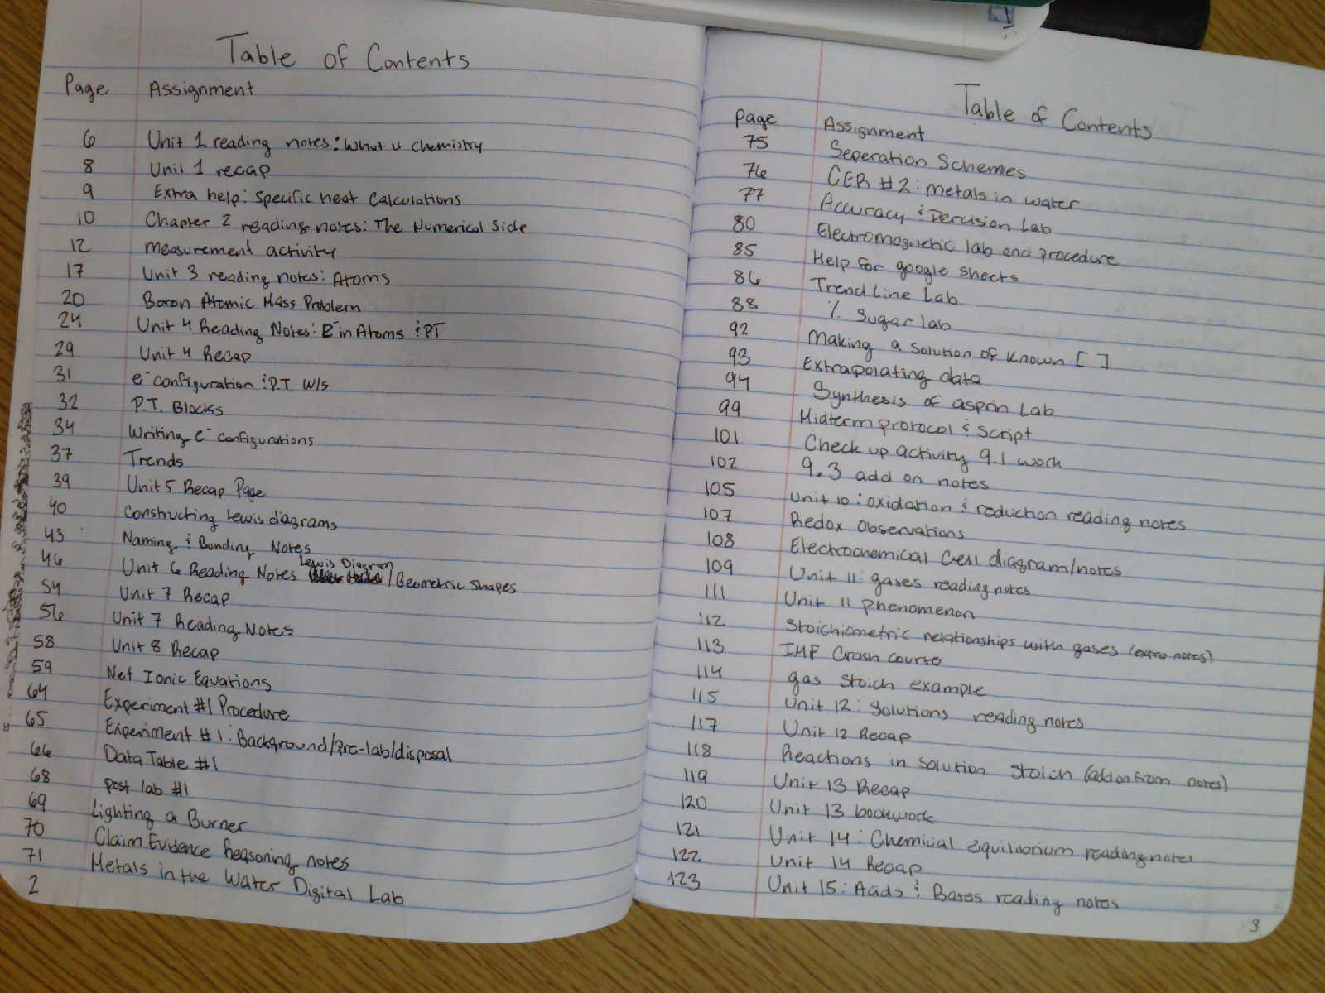

Slide 25
Hold them accountable early and often, and establish their rhythms for the class.
Dual Credit/AP: this is a homework assignment they complete and I grade, simply setting up the notebook.
Chemistry 1: I set this up together with them.

Slide 26
Reading notes and AP Daily video notes
Homework style notes - either completed outside of class or during class work time.

Slide 27
Setting up reading notes:
I give them very specific but vague instructions:
Specific enough that it guides students into effective note taking.
Vague enough that it forces students to generate for themselves.

Slide 28
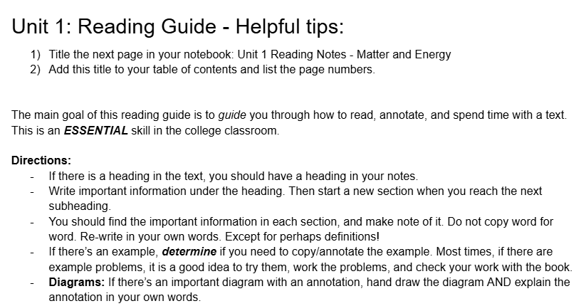

Slide 29
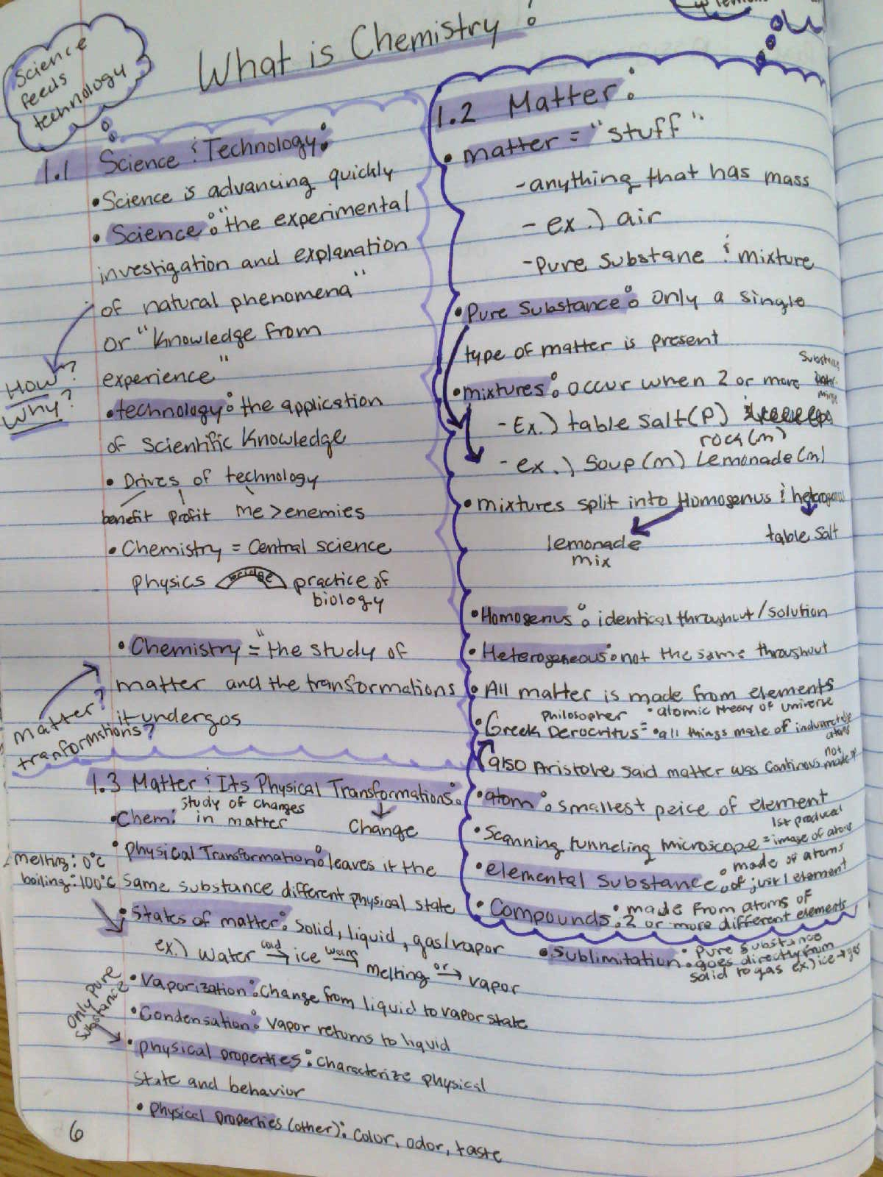
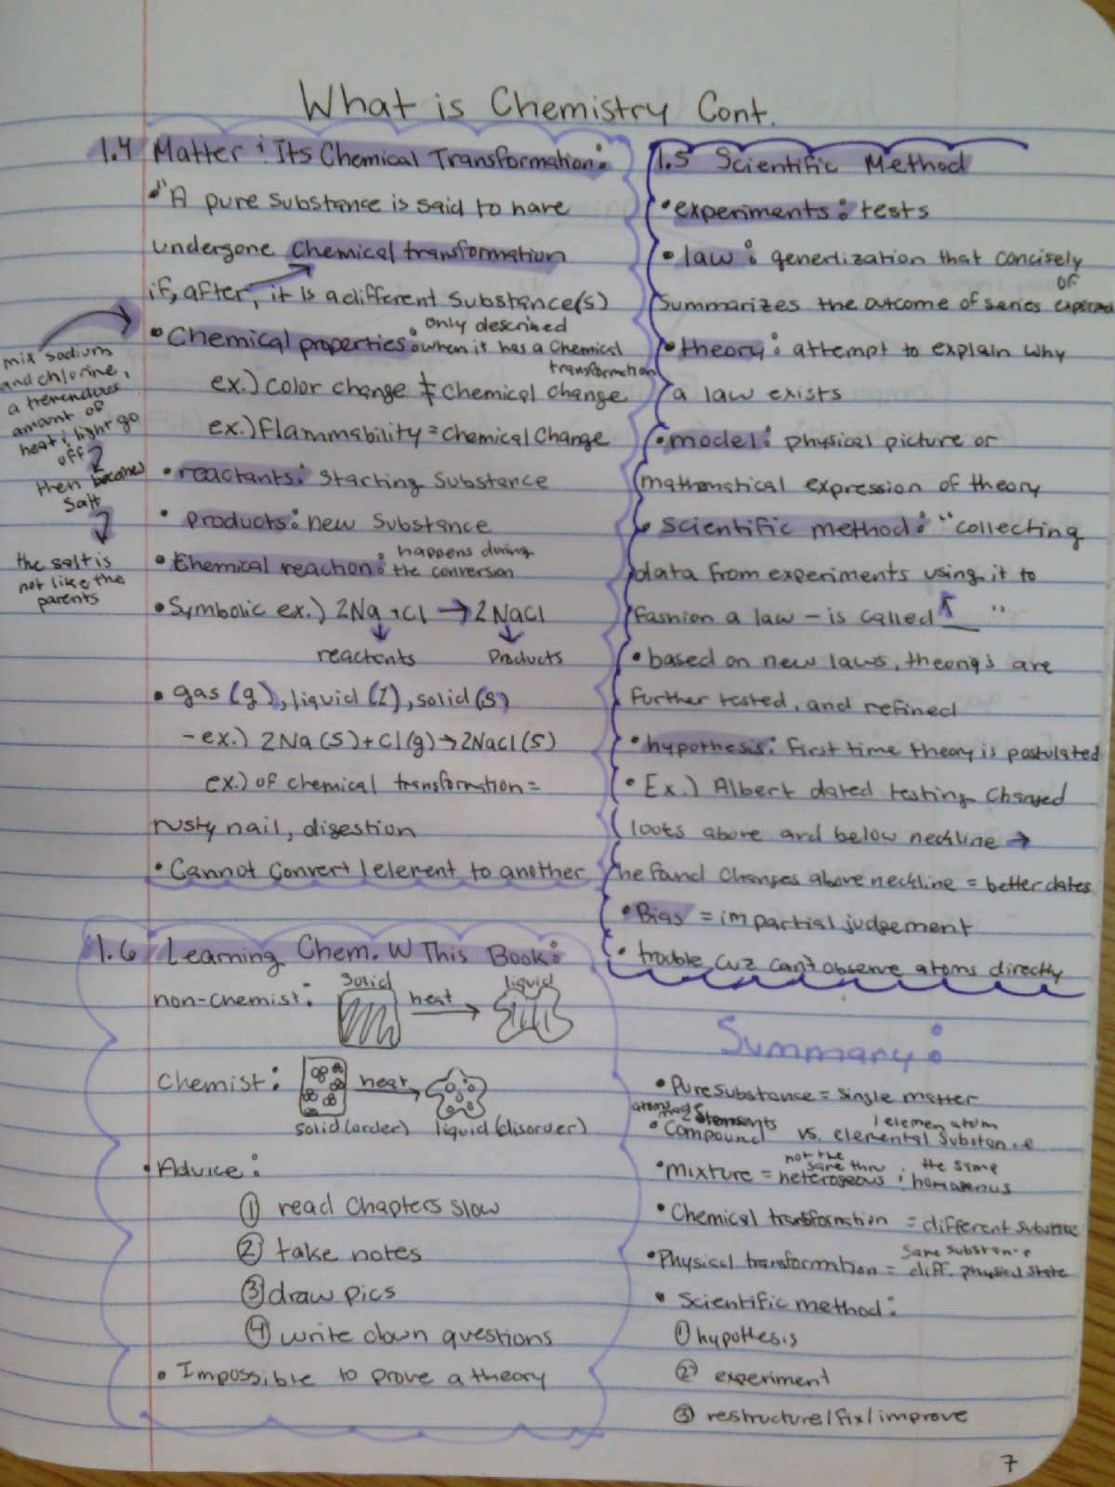

Slide 30
AP Bio - AP Daily video notes
The directions are the same, hand draw diagrams, include essential information and be able to answer the main focus of the AP topic per the course and exam description.
Enough direction to give students a specific focus, but not requiring specific styles. Because this lets students design, generate, and make their own notes.

Slide 31
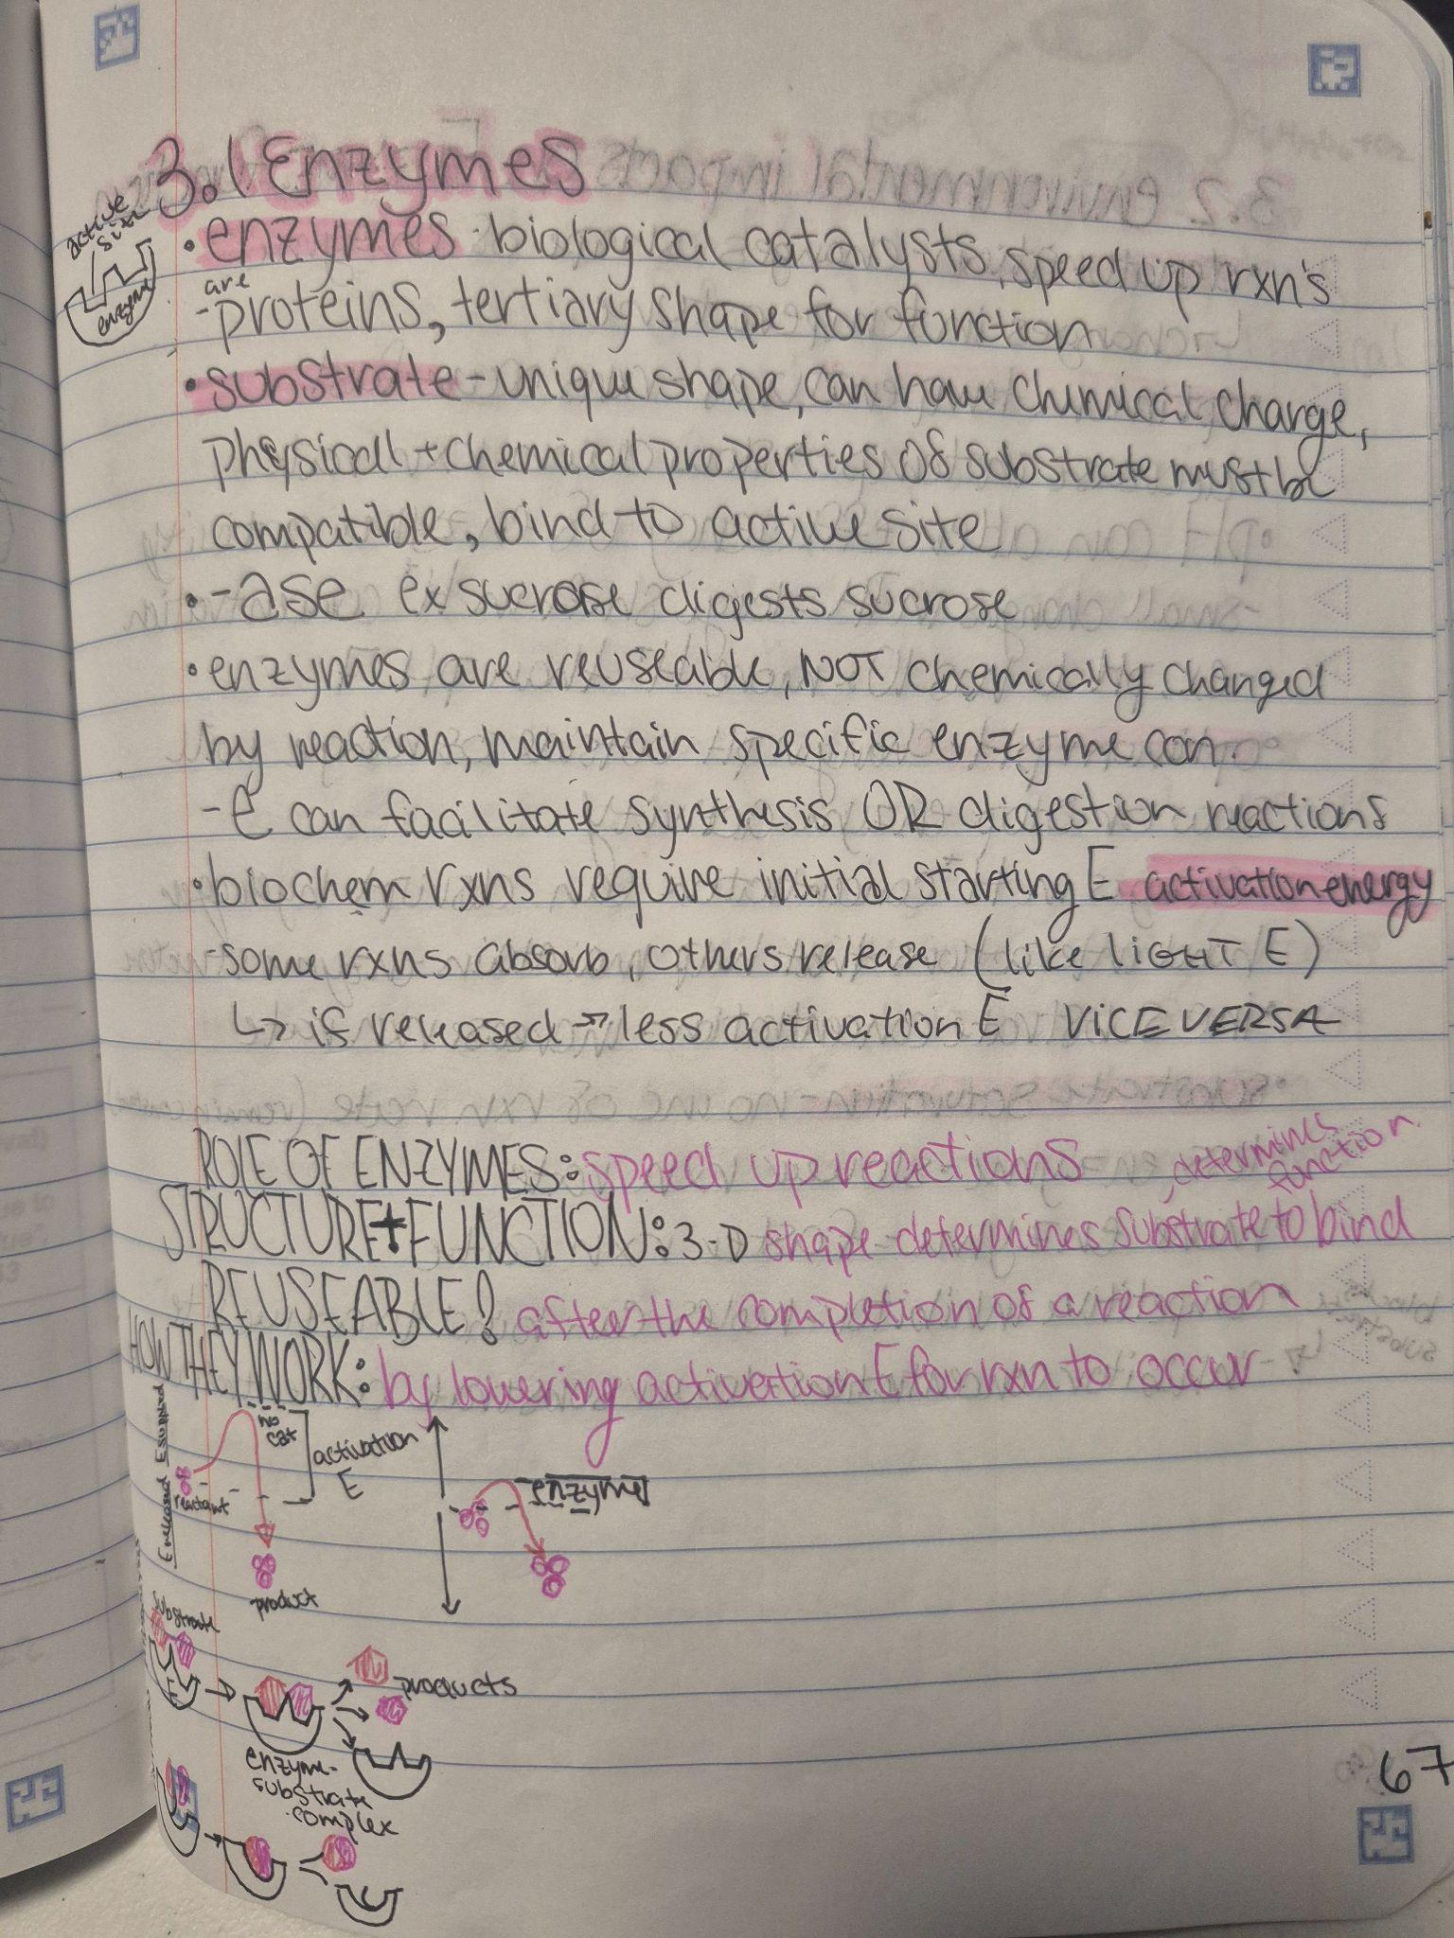
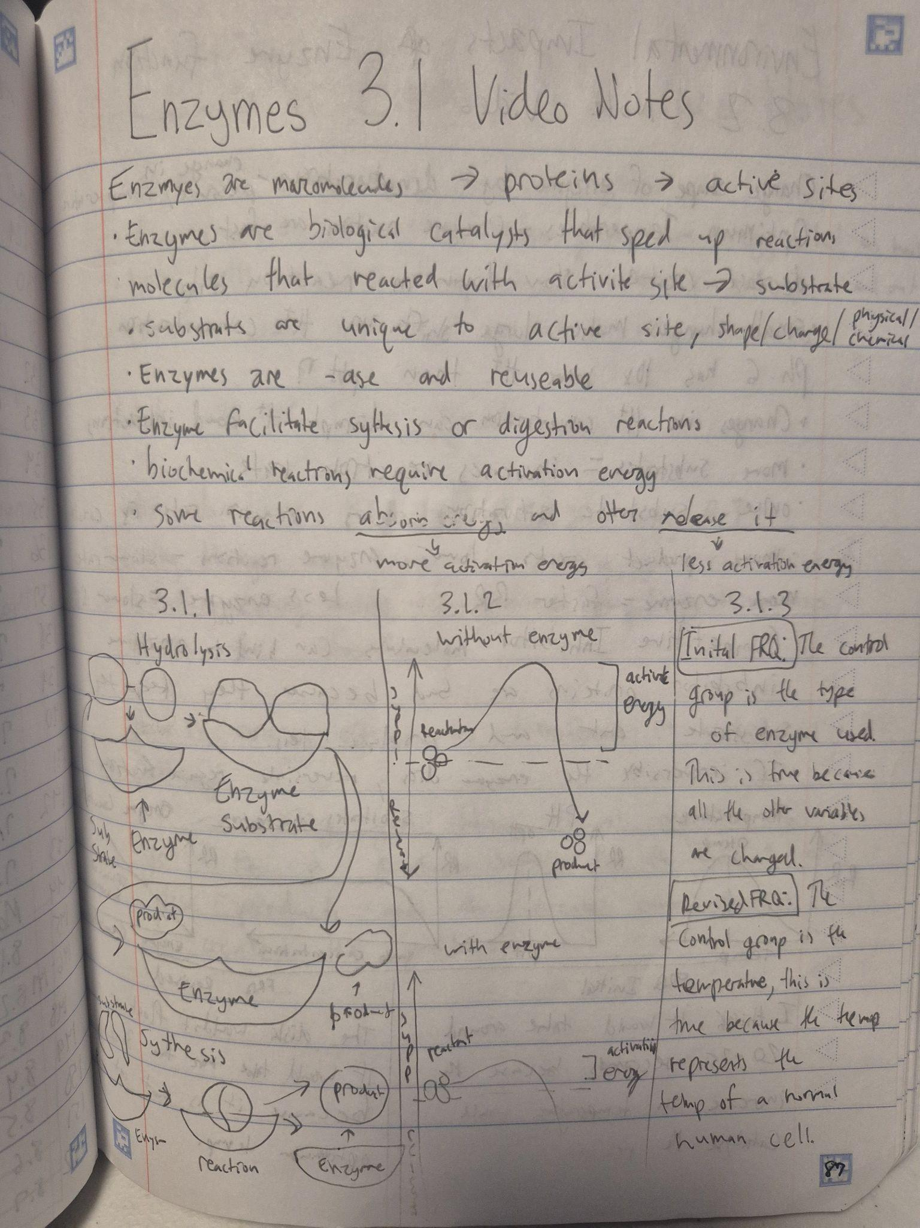

Slide 32
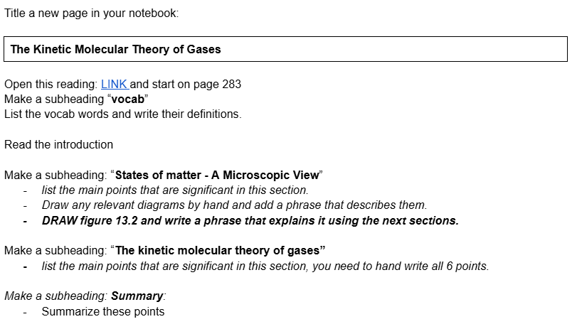
Those are dual credit examples, but I really ran with this in my Chemistry 1.
Notes:
I begin with VERY high structure to show students how to set up and organize their notetaking, even to the point of telling them to make a subheading.
This turned in to something like this:

Slide 33
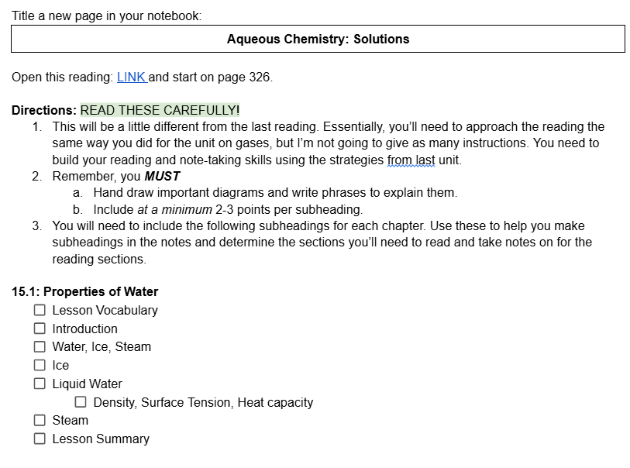
Notes:
Backing off the directions just a little bit but still giving them the specific subheadings I want them to read

Slide 34
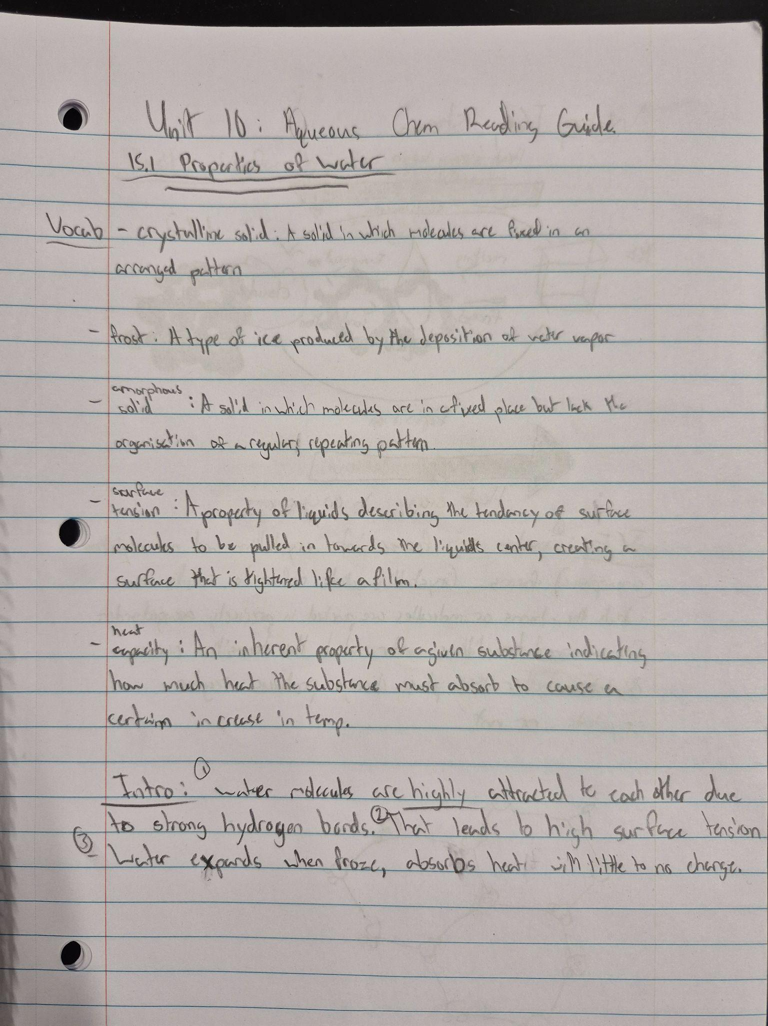
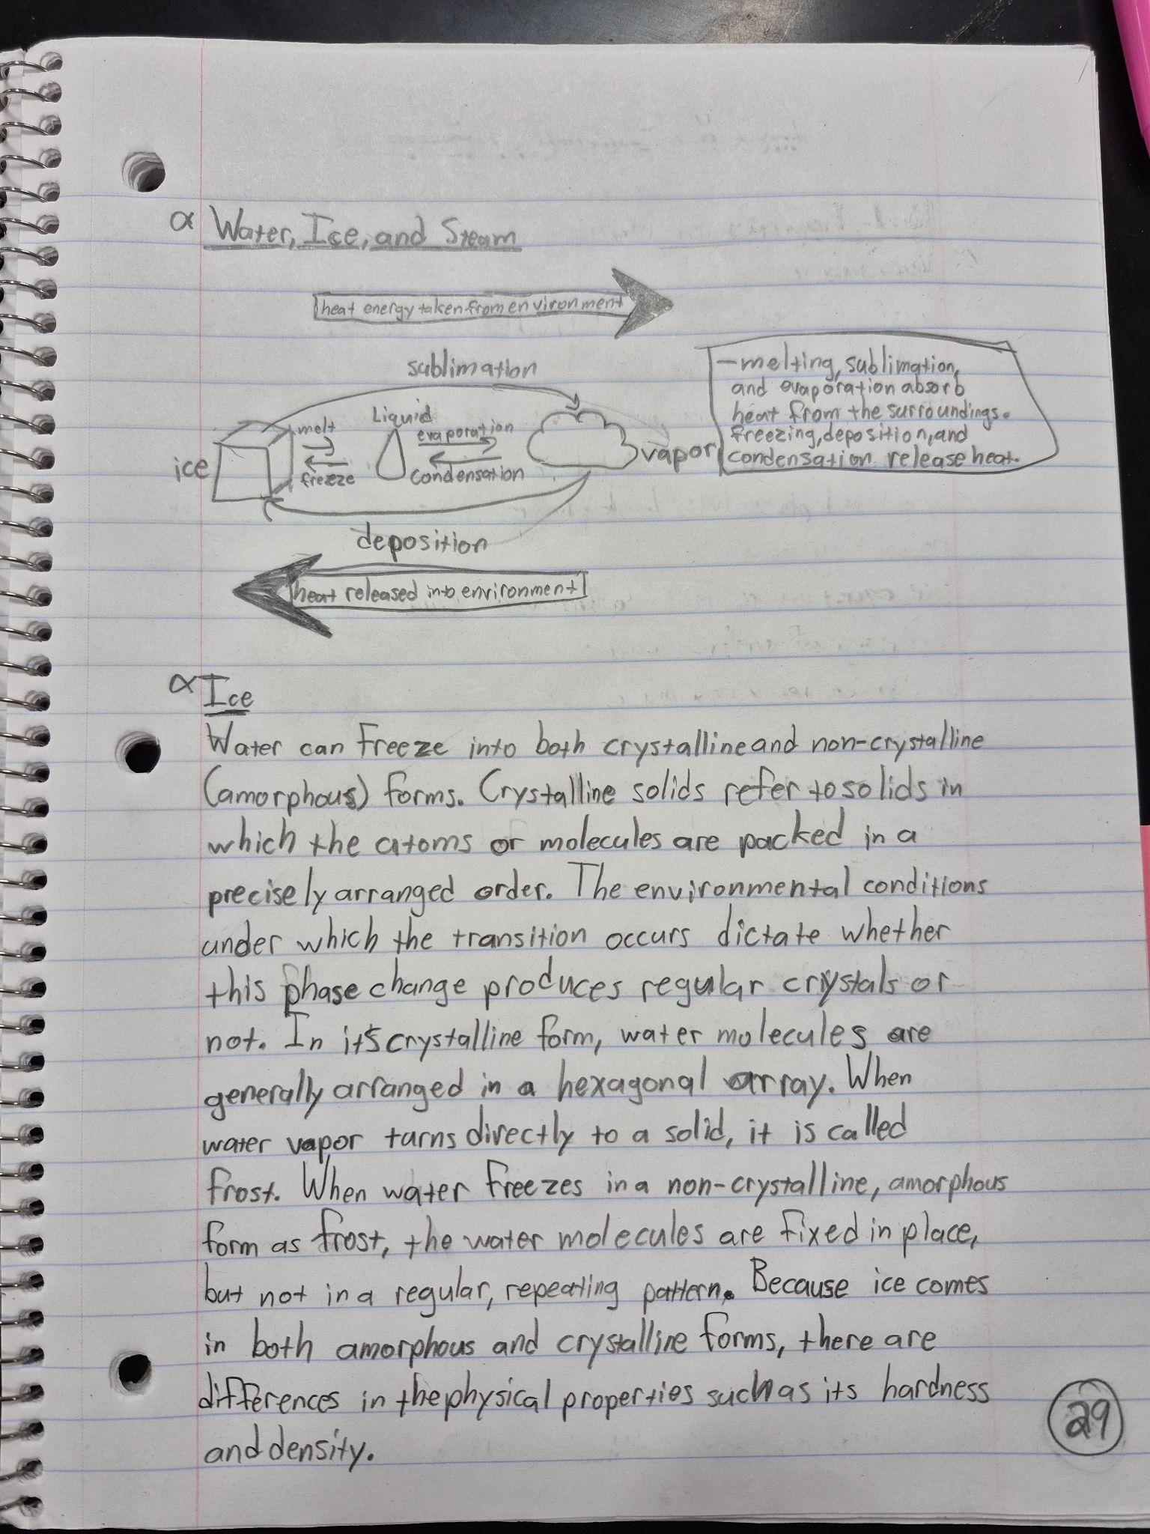

Slide 35
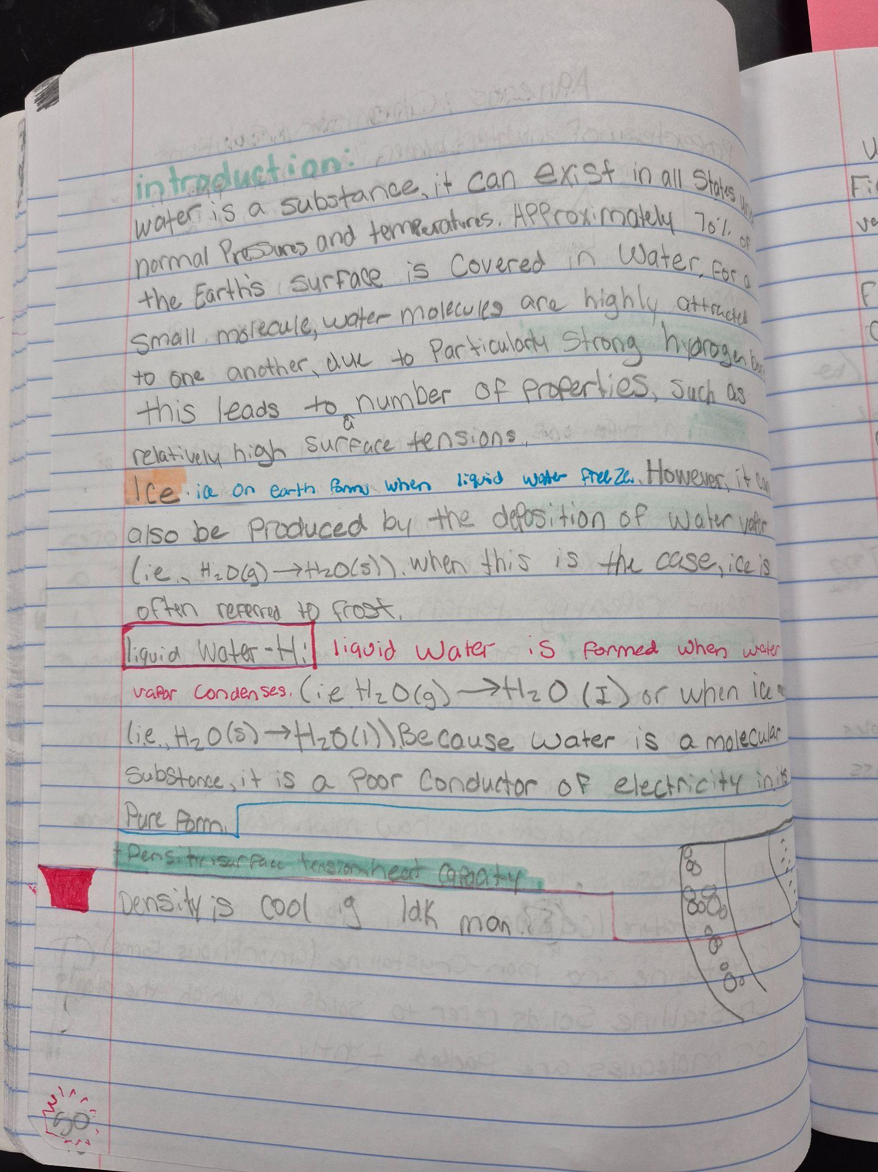
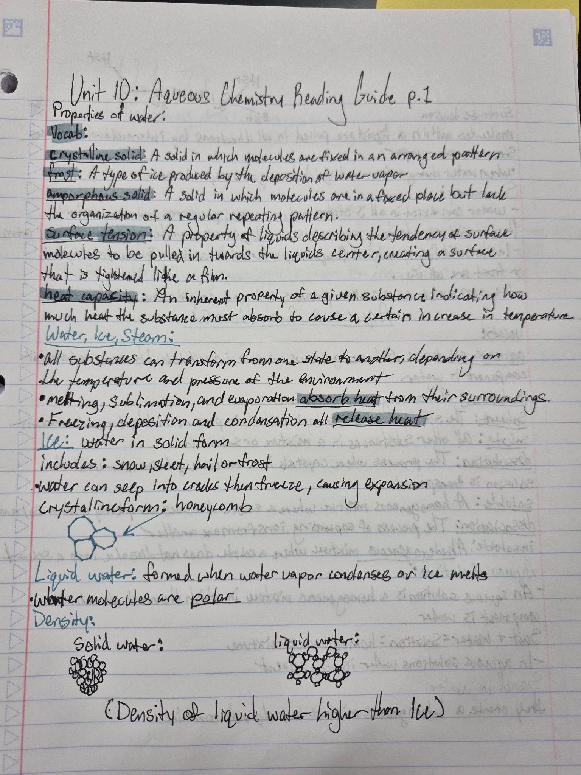

Slide 36
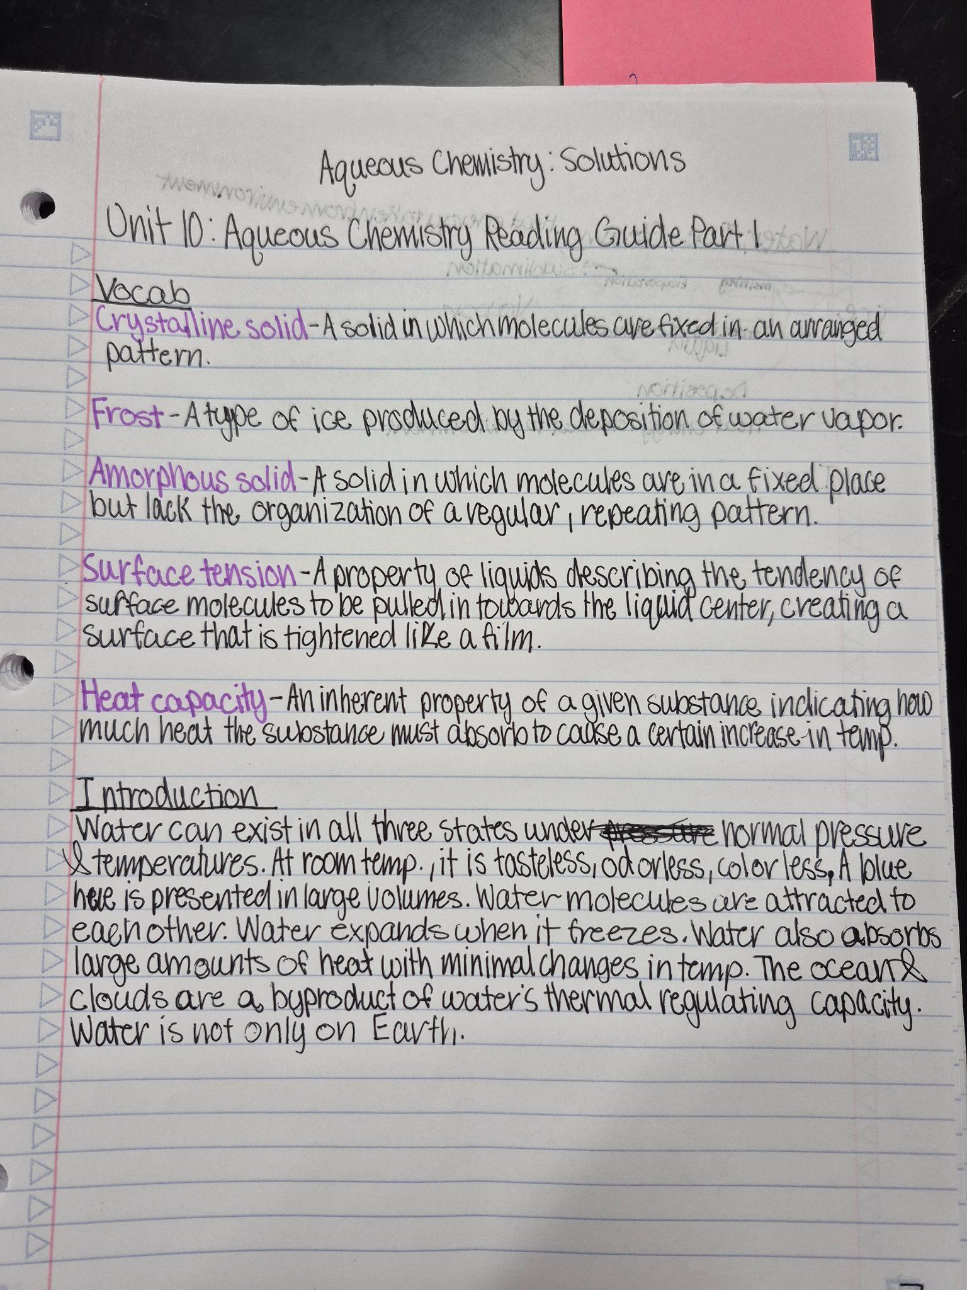
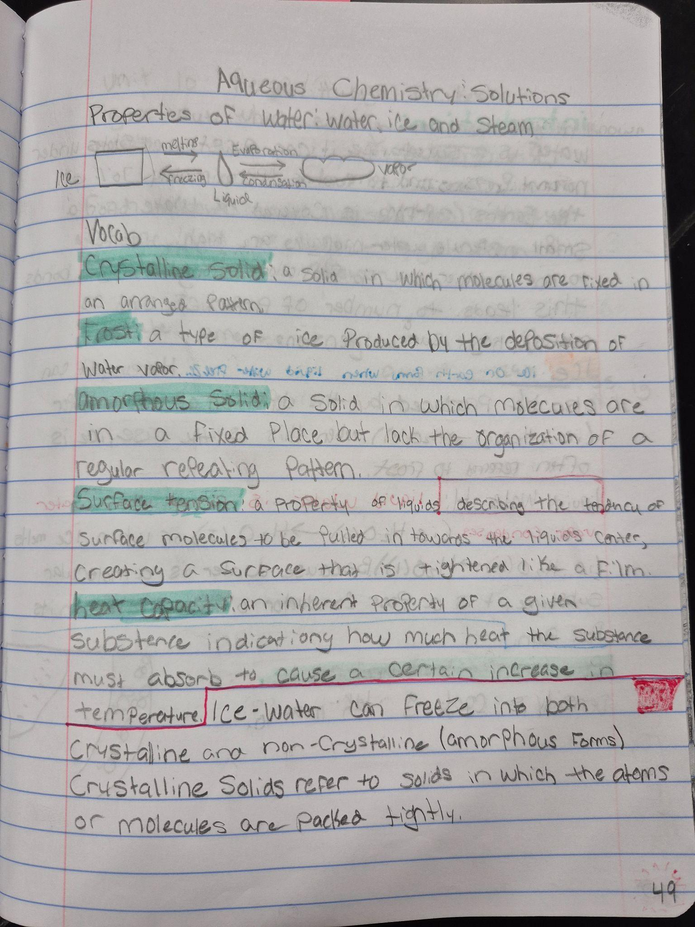

Slide 37
Some thoughts on what I’ve seen:
If they have just enough direction to guide them, I’ve been amazed with what they’ve done in their own notebooks.
At the end of the year/semester, I can just give them the specific pages, tell them what to title their notebook page and they can read and take notes on the text.
I’ve invested a lot into the Chemistry 1 students’ notebooks because they will go on to take dual credit courses. Then, hopefully at that point, they know how to do it!

Slide 38
How do you assess reading notes and AP daily style video notes?
Honestly, I’m not sure, I haven’t come up with a good plan.
  I tried giving “reading quizzes” this year but that was a complete flop.
My plan for next year: some type of revision based structure that ensures they’re really taking high quality notes. I’ll have them re-do them if they are insufficient and I’ll regrade. (yes, more work…)
  The goal isn’t to trick students into the skill but rather to have students develop and cultivate the skill.

Slide 39
Setting up in class notes: Dual Credit Chemistry

Slide 40
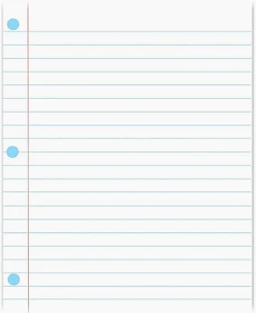
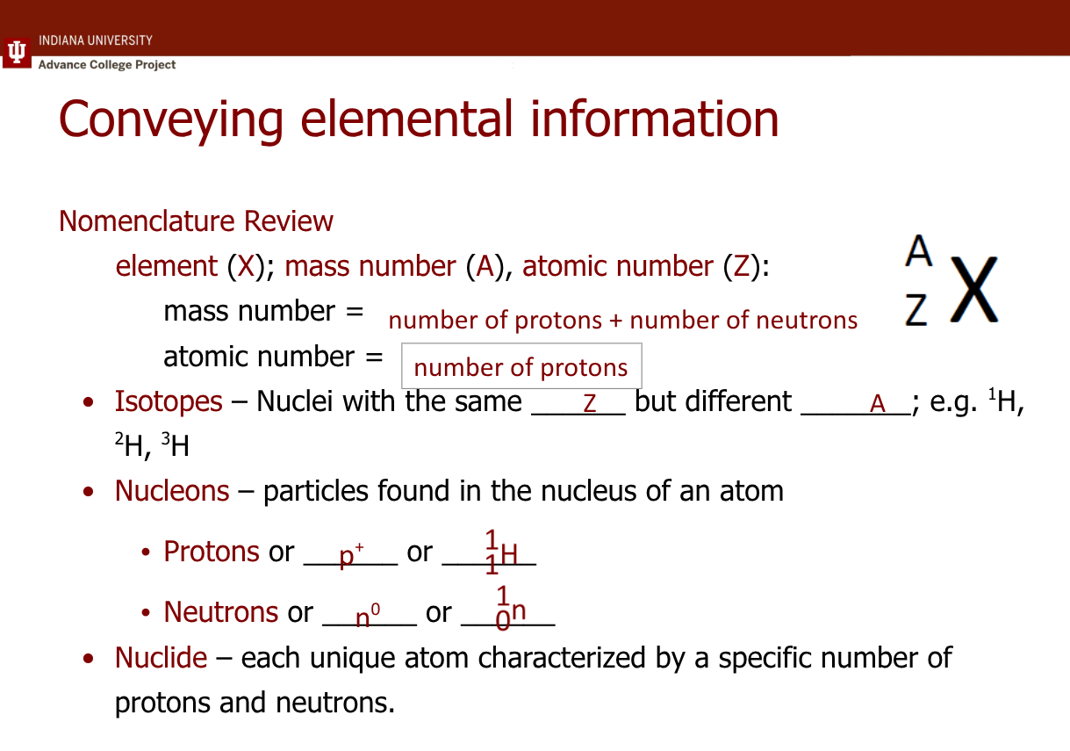
Protocol/Structure

Slide 41
Protocol/Structure
Direct instruction with a slideshow because there is so much information.
Stop lecture after one specific topic.
  That may be 1 slide, it may be 10 slides
Give students 3 minutes of silence to summarize the slides.
Give them 1 minute to verbalize it to the person next to them.
Yes, this does take time.
It is worth the time.

Slide 42
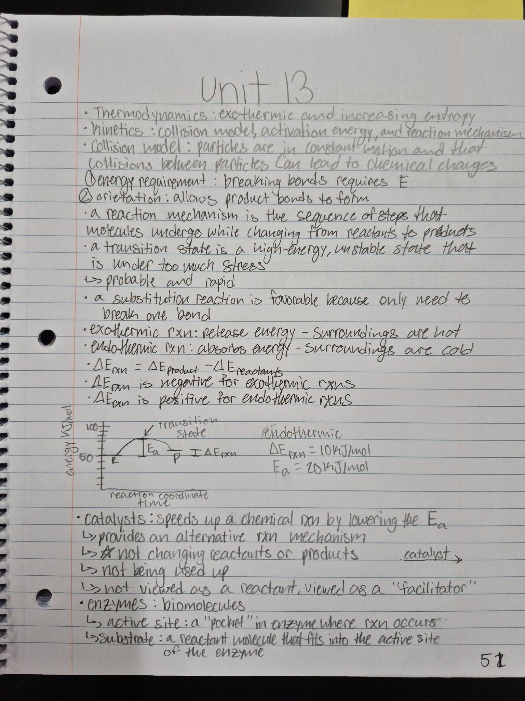
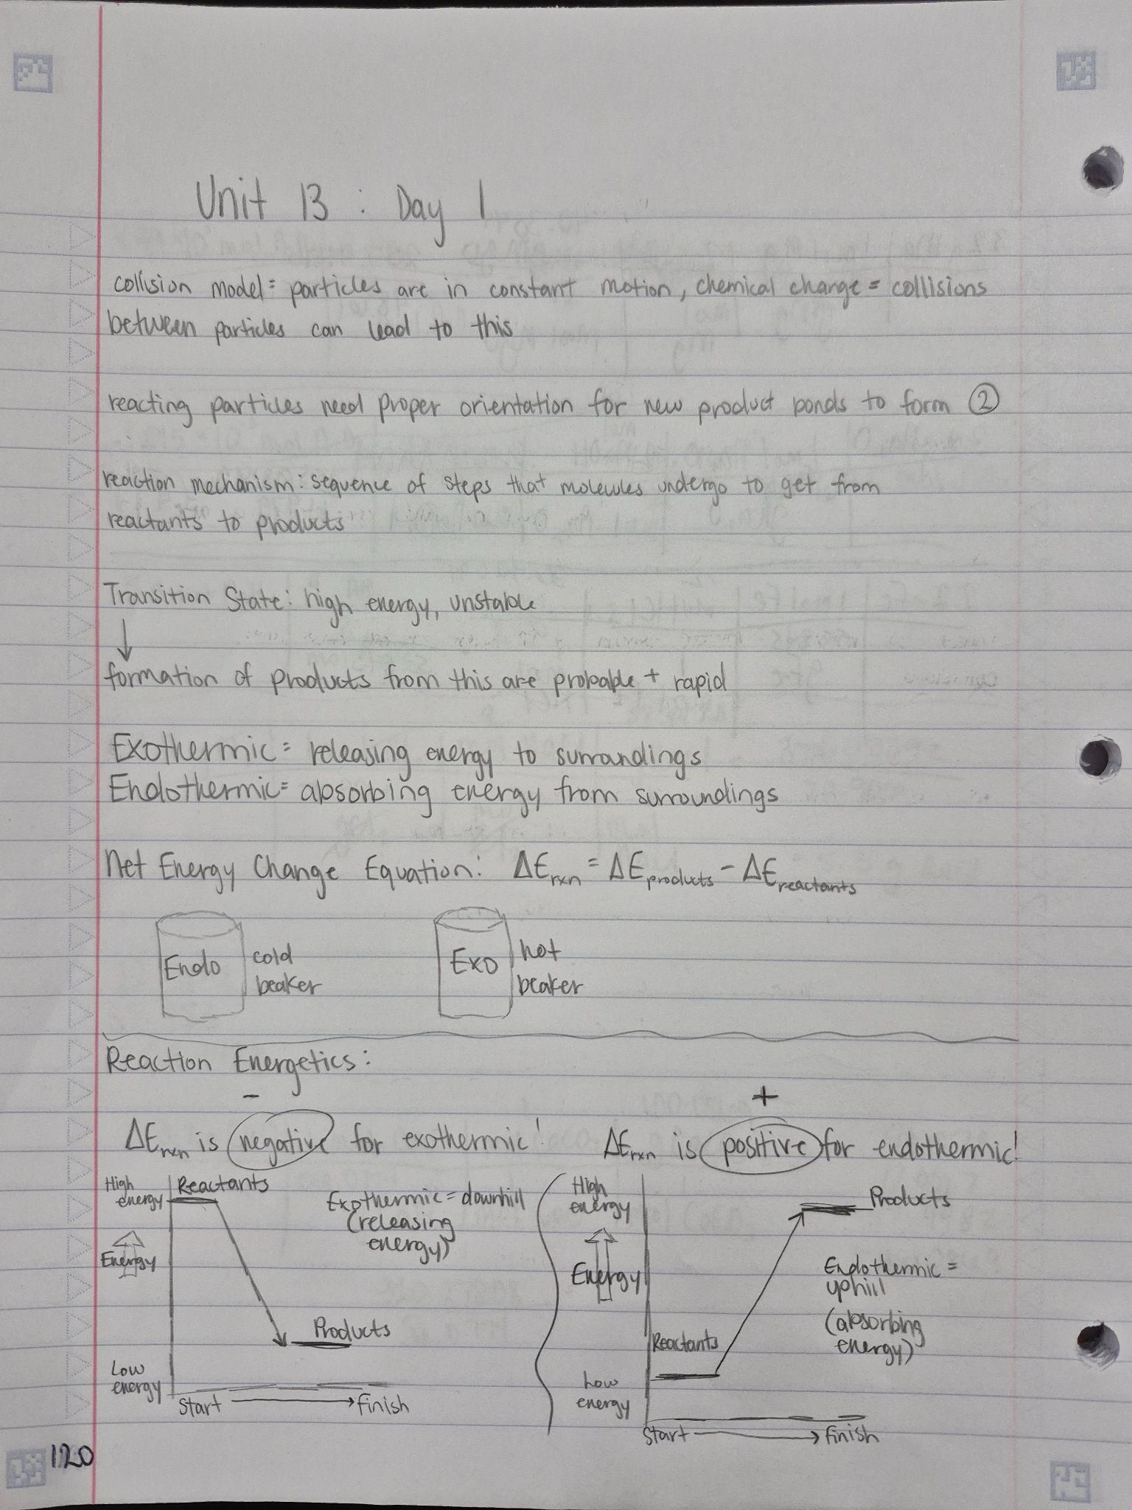

Slide 43
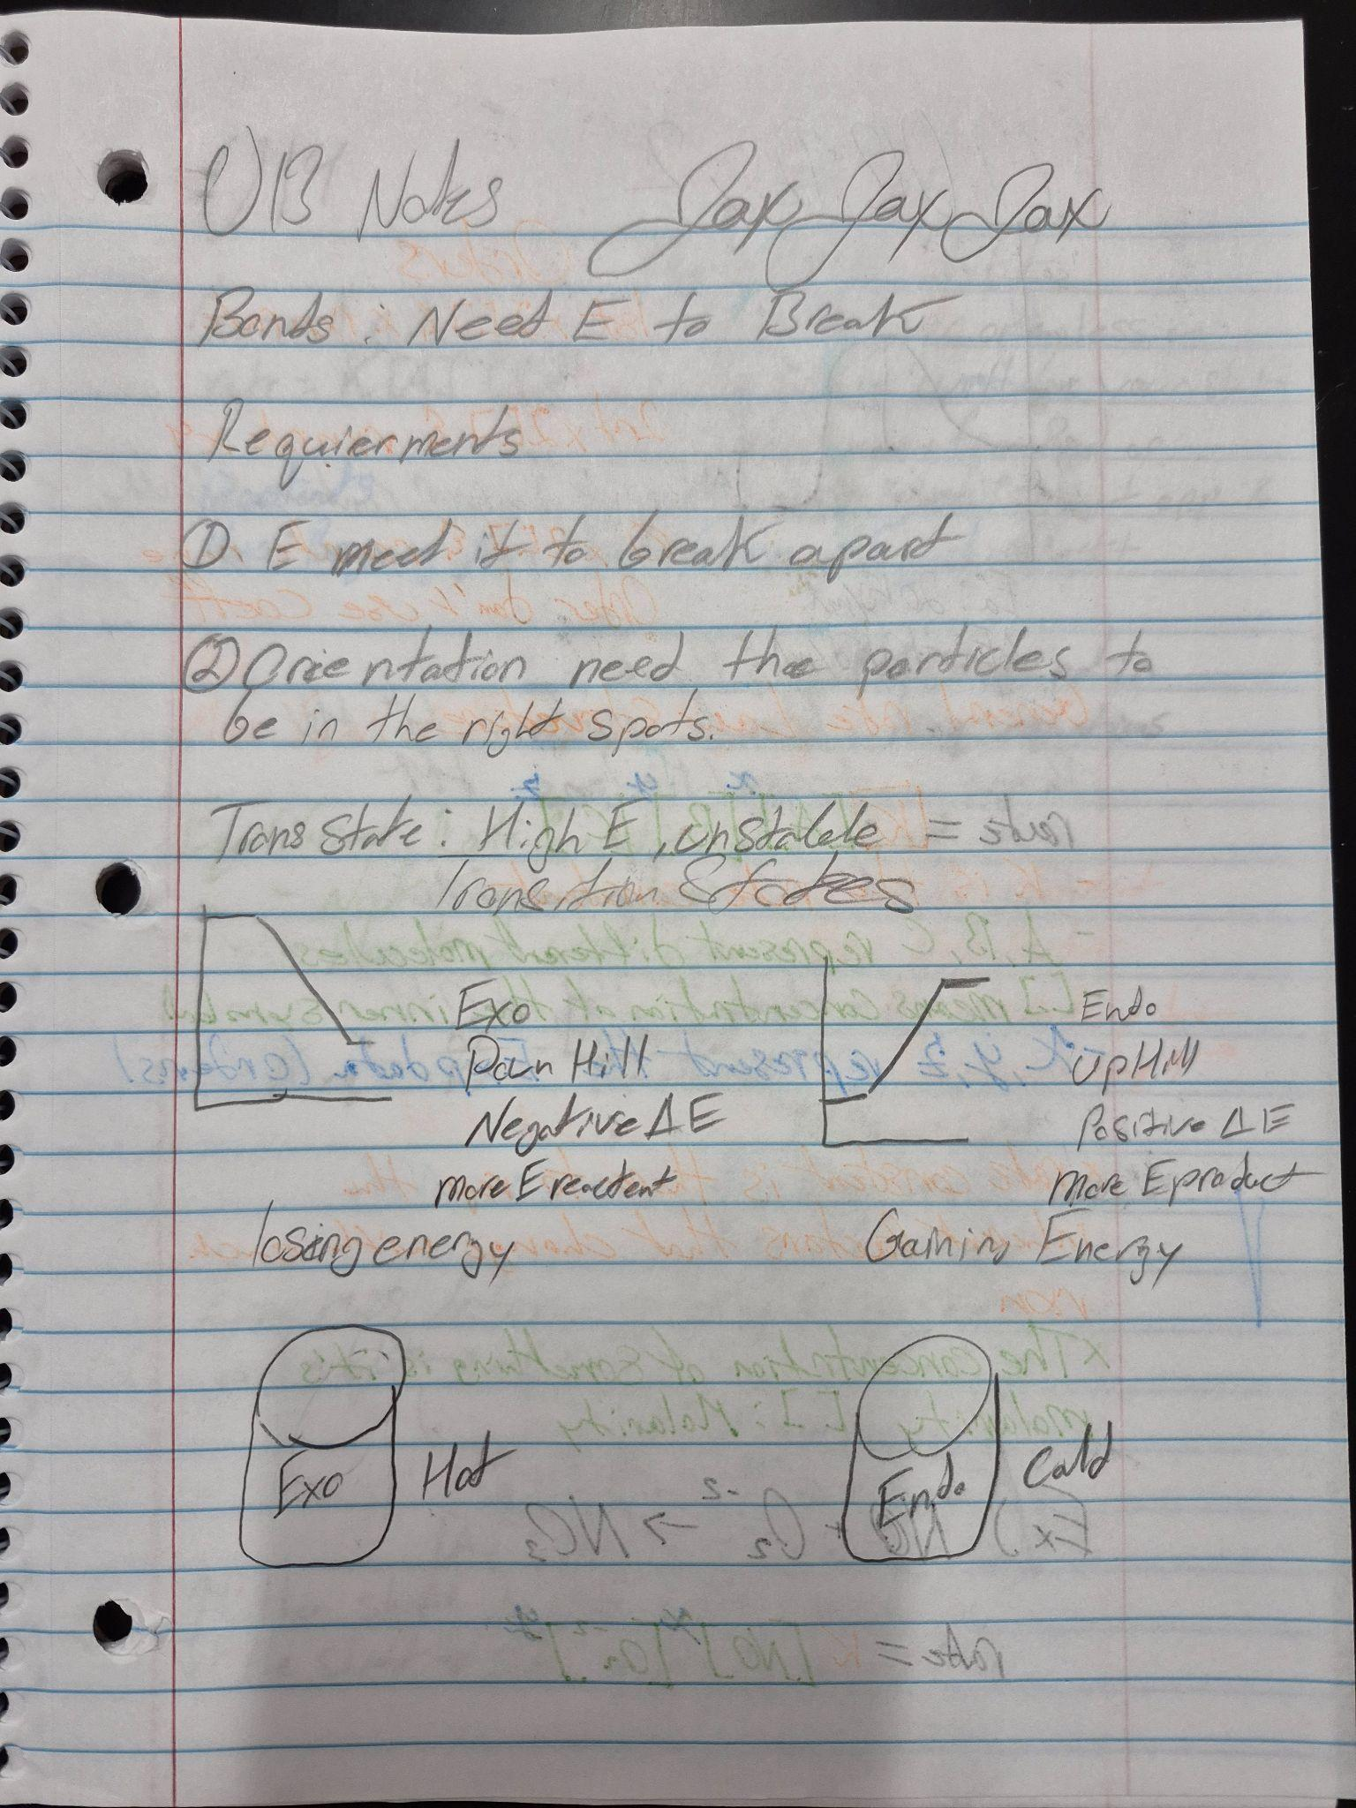
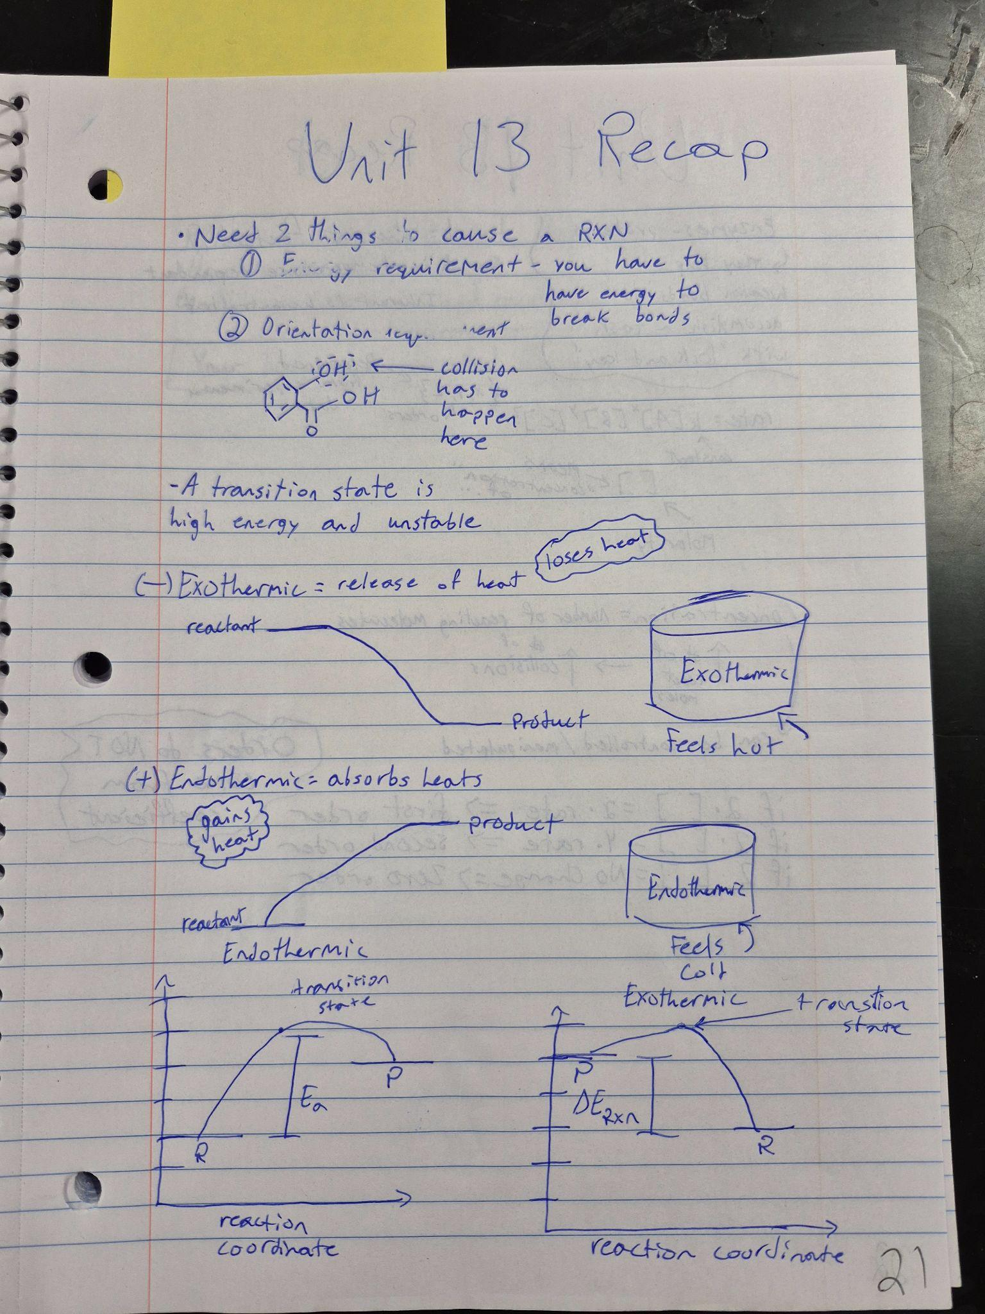

Slide 44
AP Biology Study Folders - 1 folder per unit
It’s all about the directions!
Students receive a “guideline” document. They generate the work.
Everything is hand drawn.
Adapted from Dr. Kirsten Milks adapted from Angelia Floyd

Slide 45
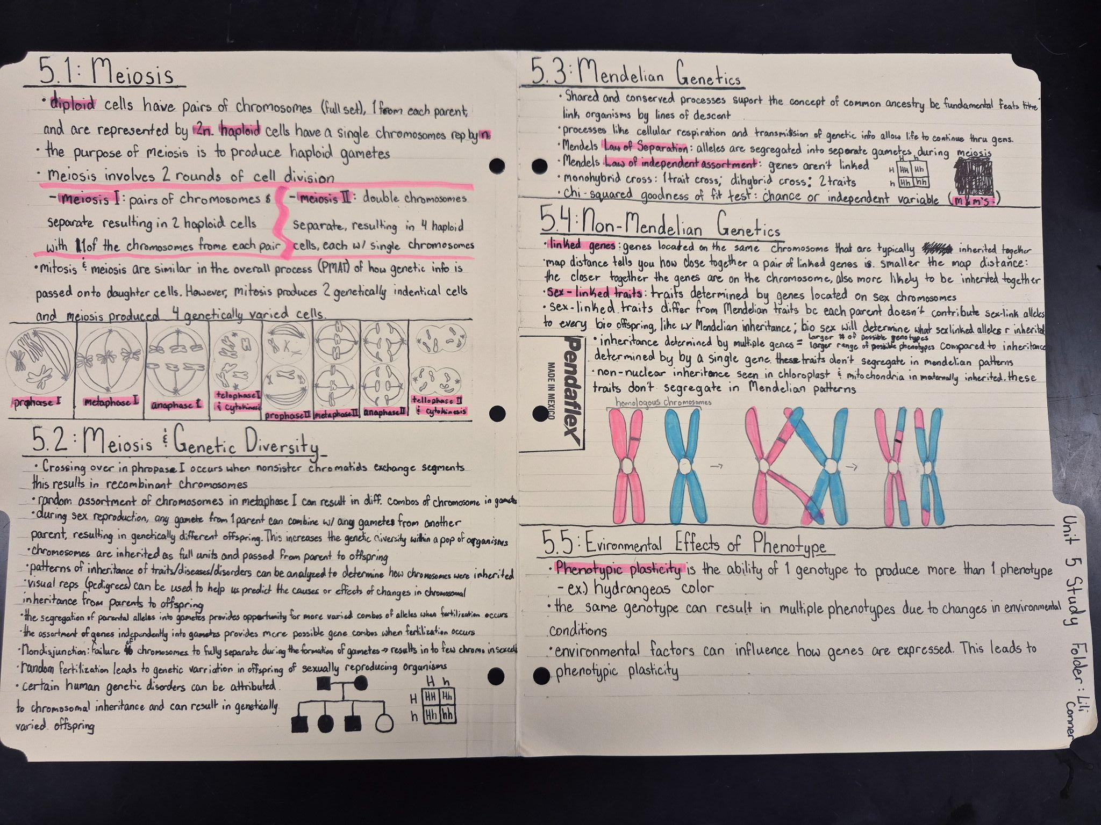

Slide 46
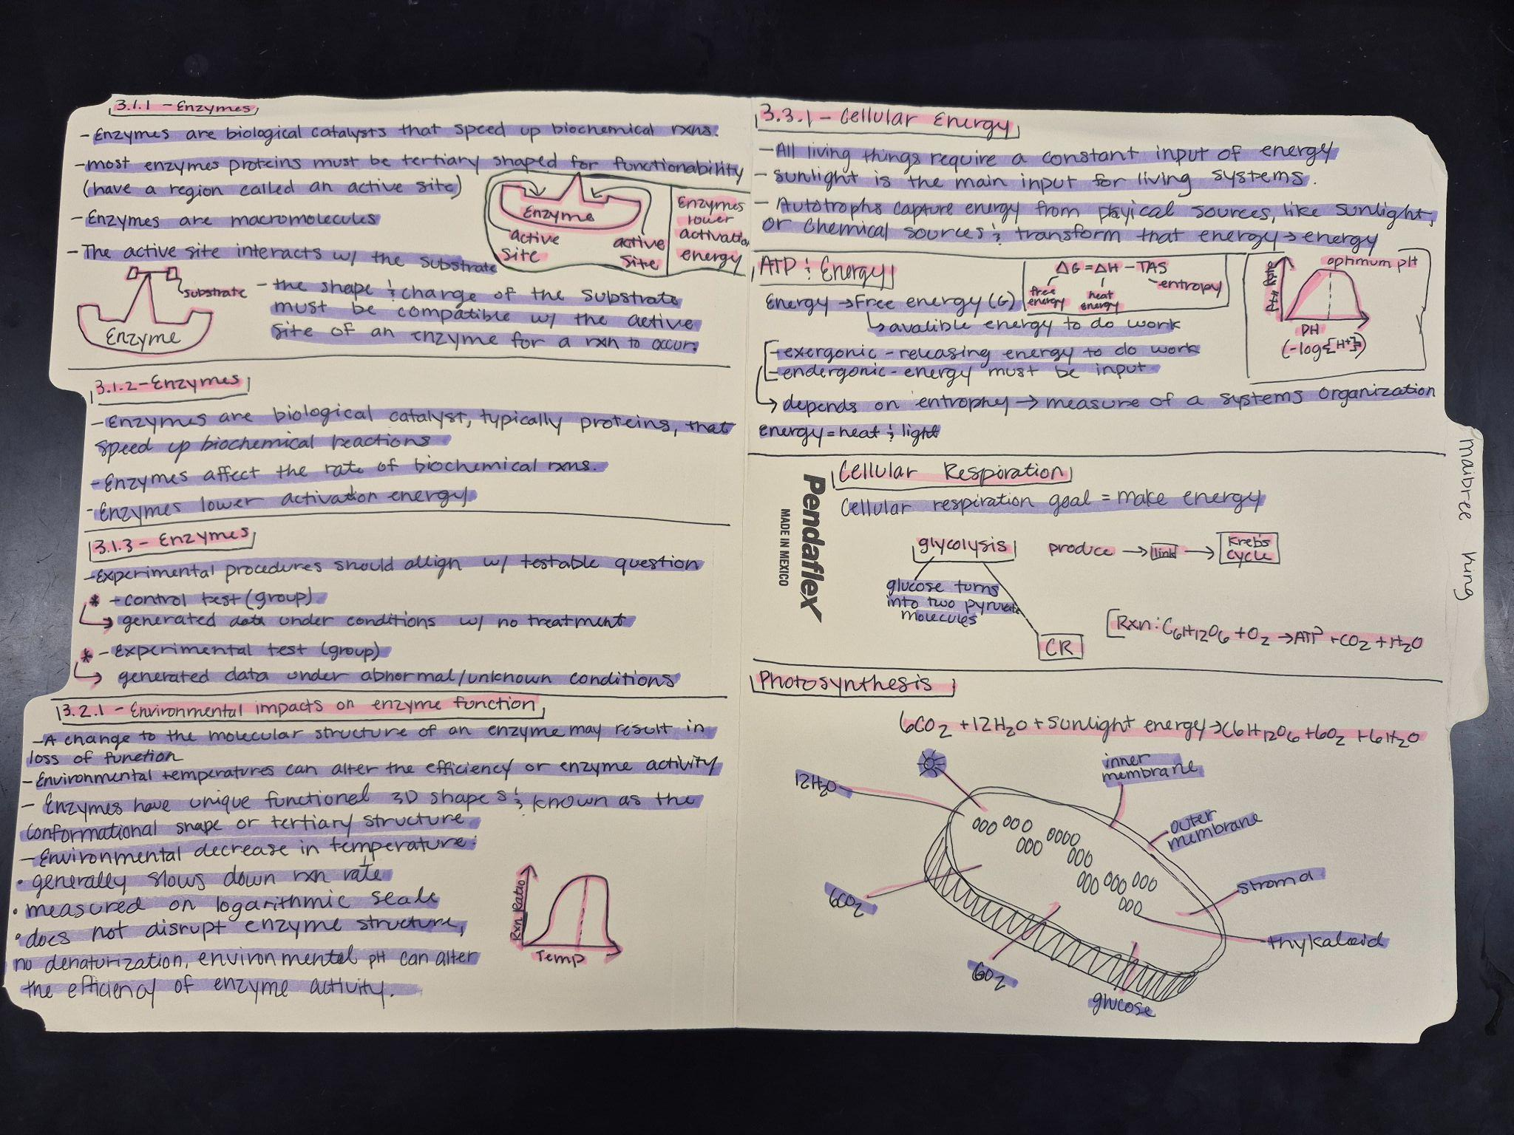

Slide 47
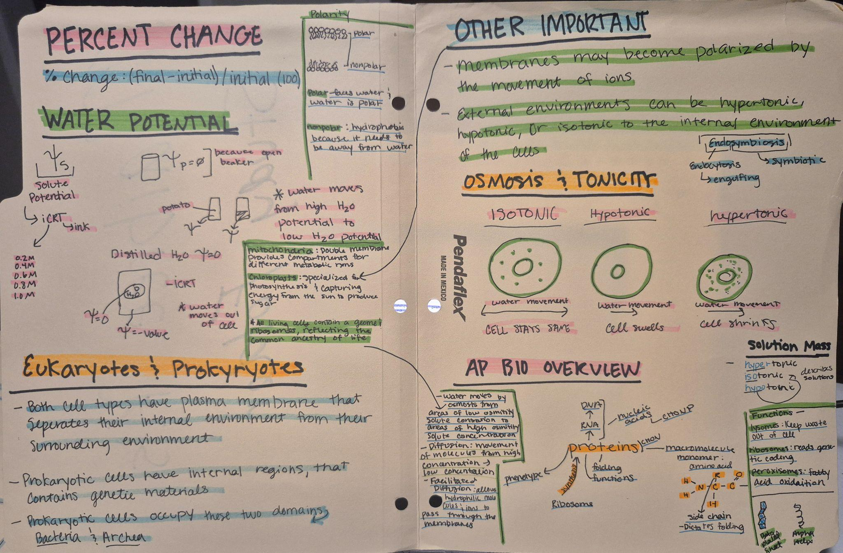

Slide 48
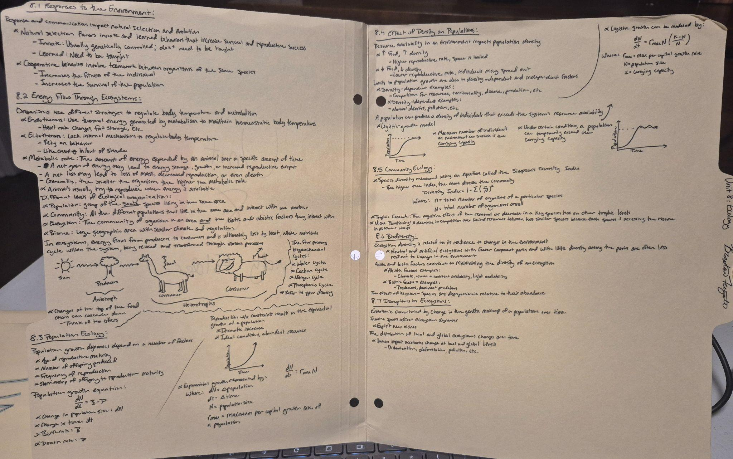

Slide 49
Science Specific Practices
Lab protocols and data analysis

Slide 50
Lab protocols:
Students are required to handwrite everything.
I post a digital laboratory protocol that includes
  Background
  Prelab
  Data tables
  Post lab
They’re required to:
  Read the background
  Hand-write the protocol
  Draw an image for each step
  Hand draw data tables, we will print and glue data tables if they’re really involved).
  Hand draw graphs
Adapted from Dr. Kirsten Milks adapted from Angelia Floyd

Slide 51
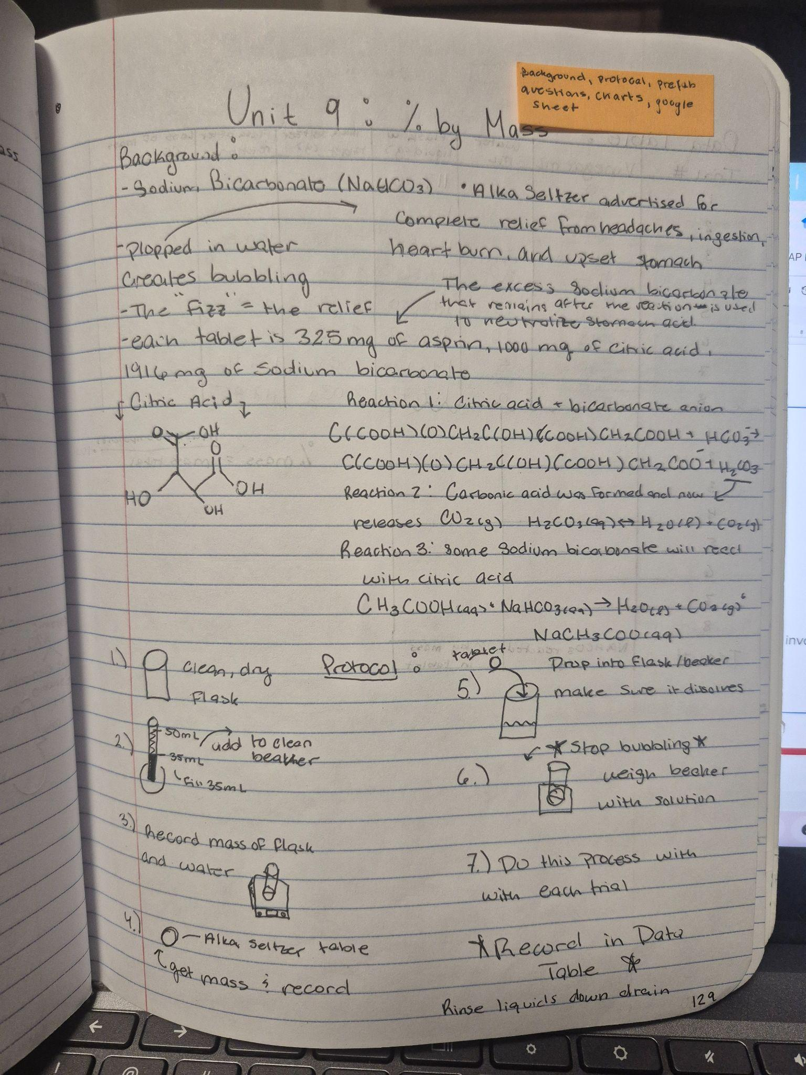
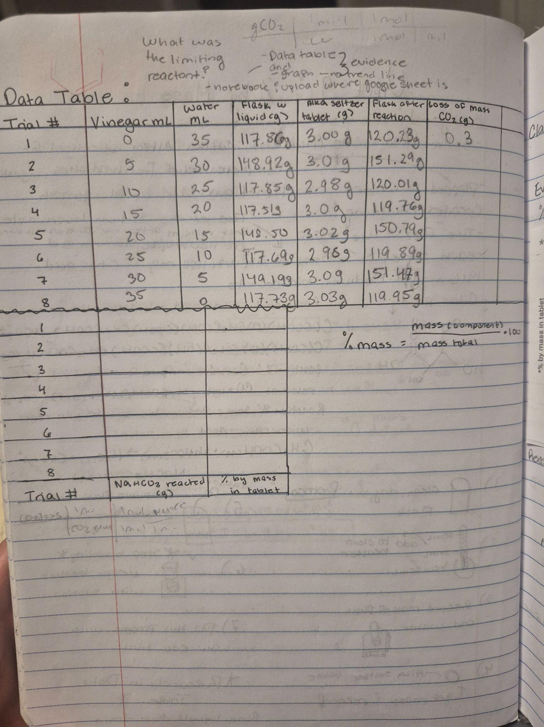
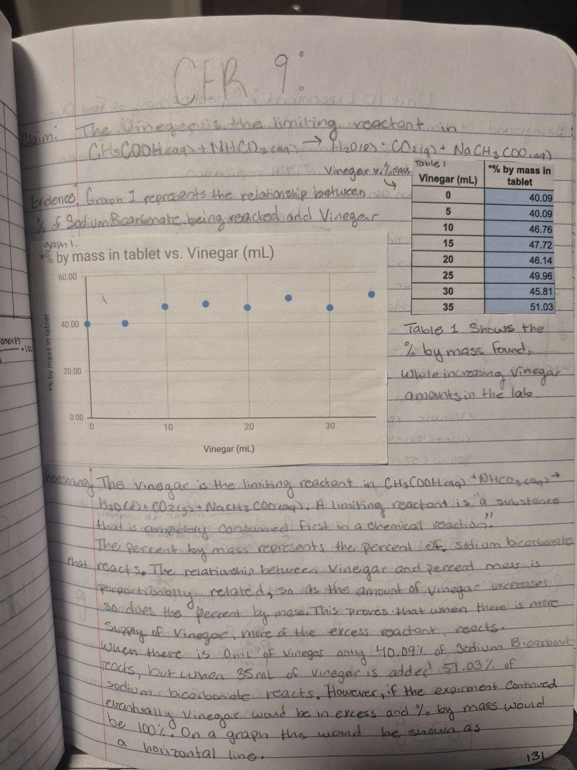

Slide 52
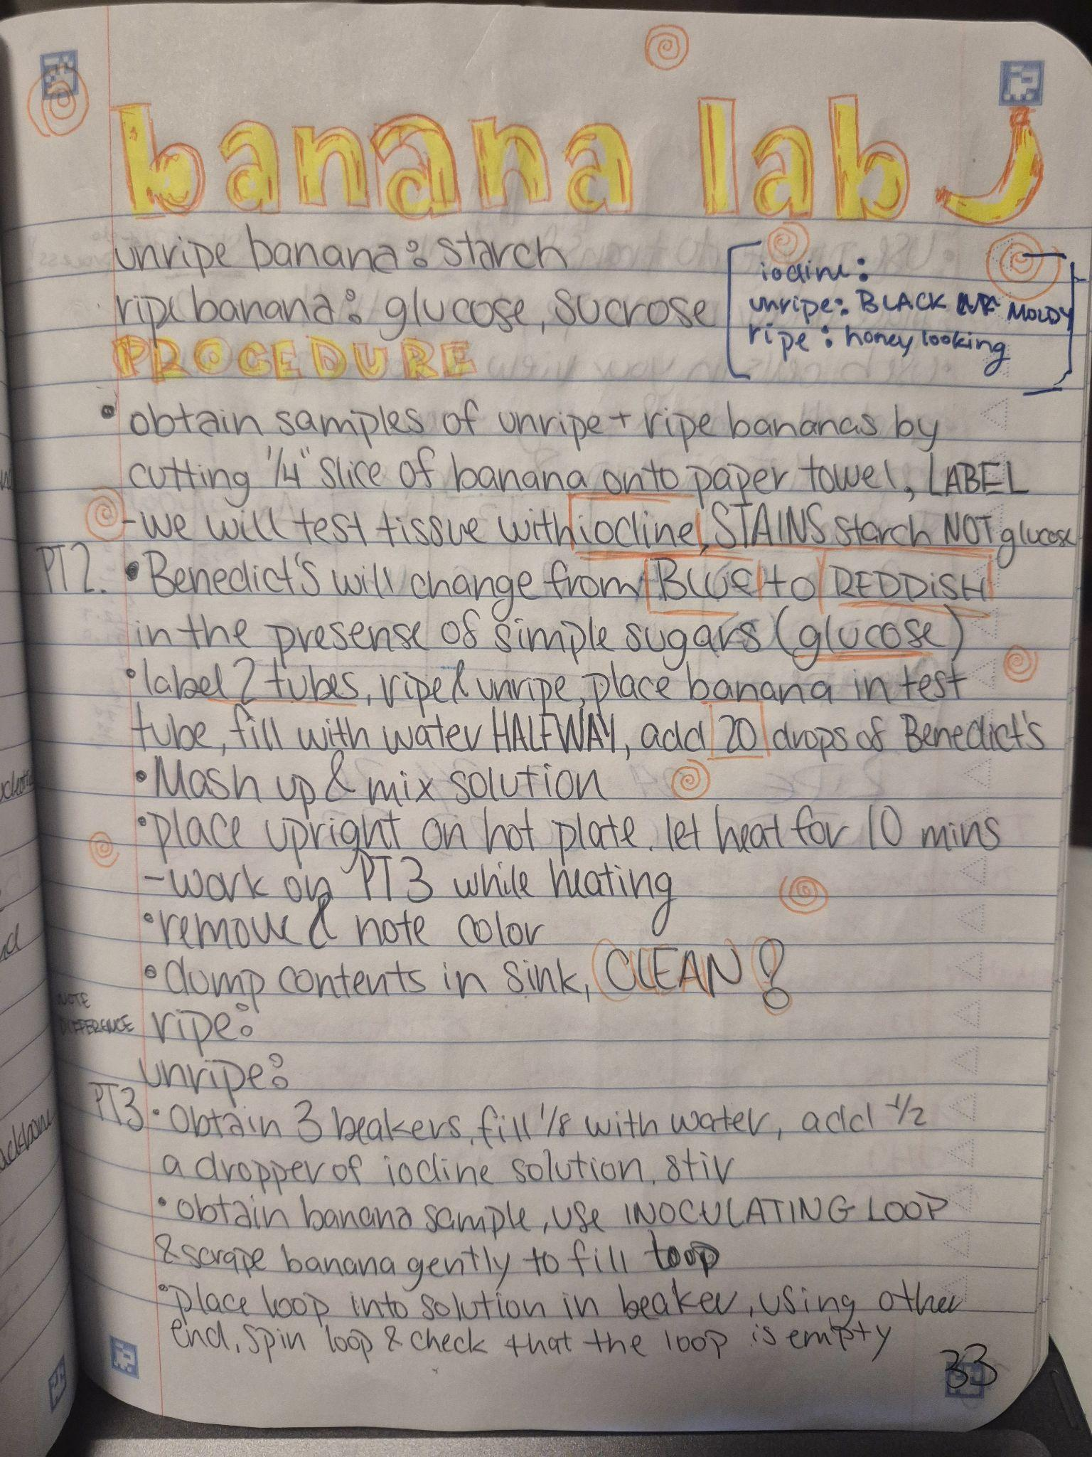
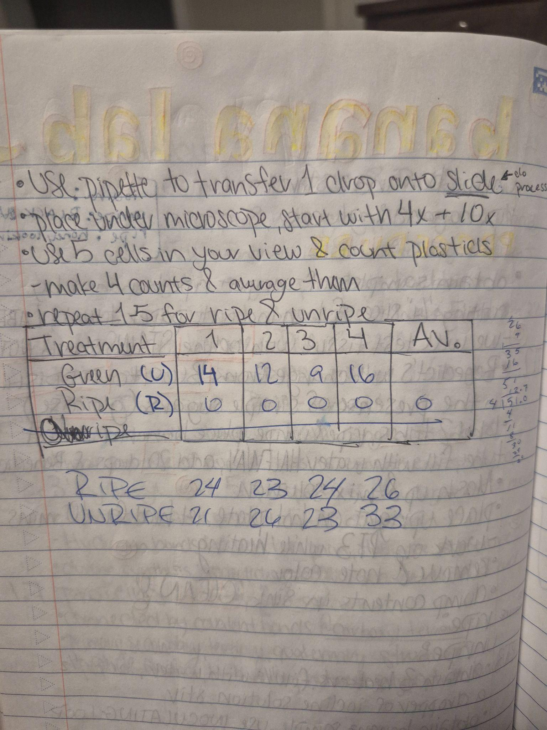

Slide 53
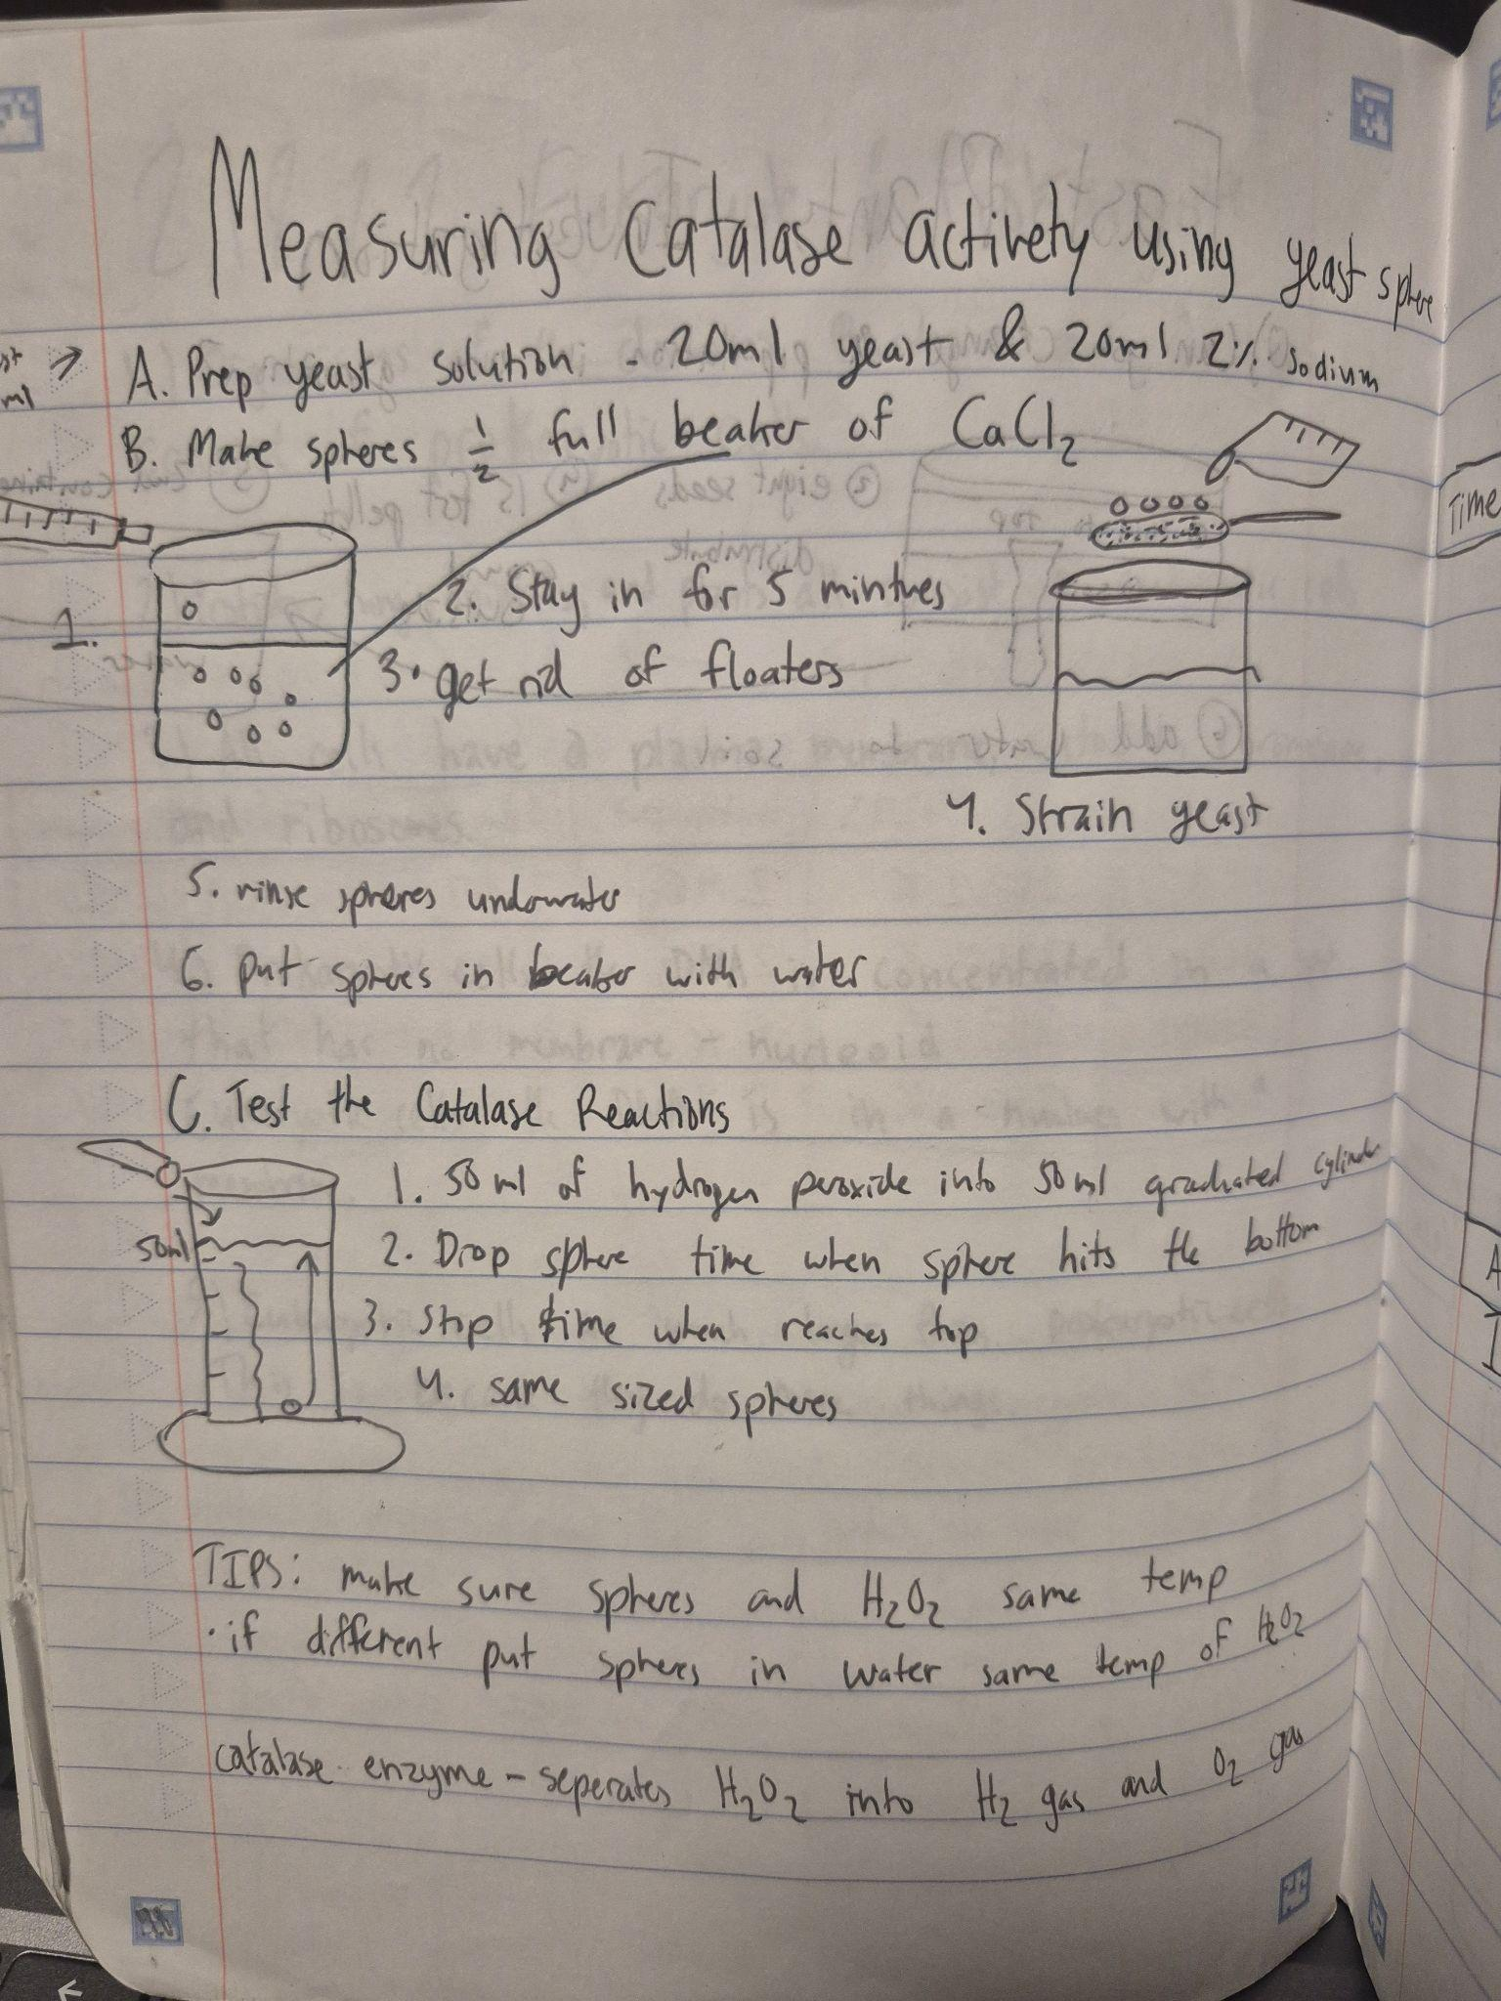
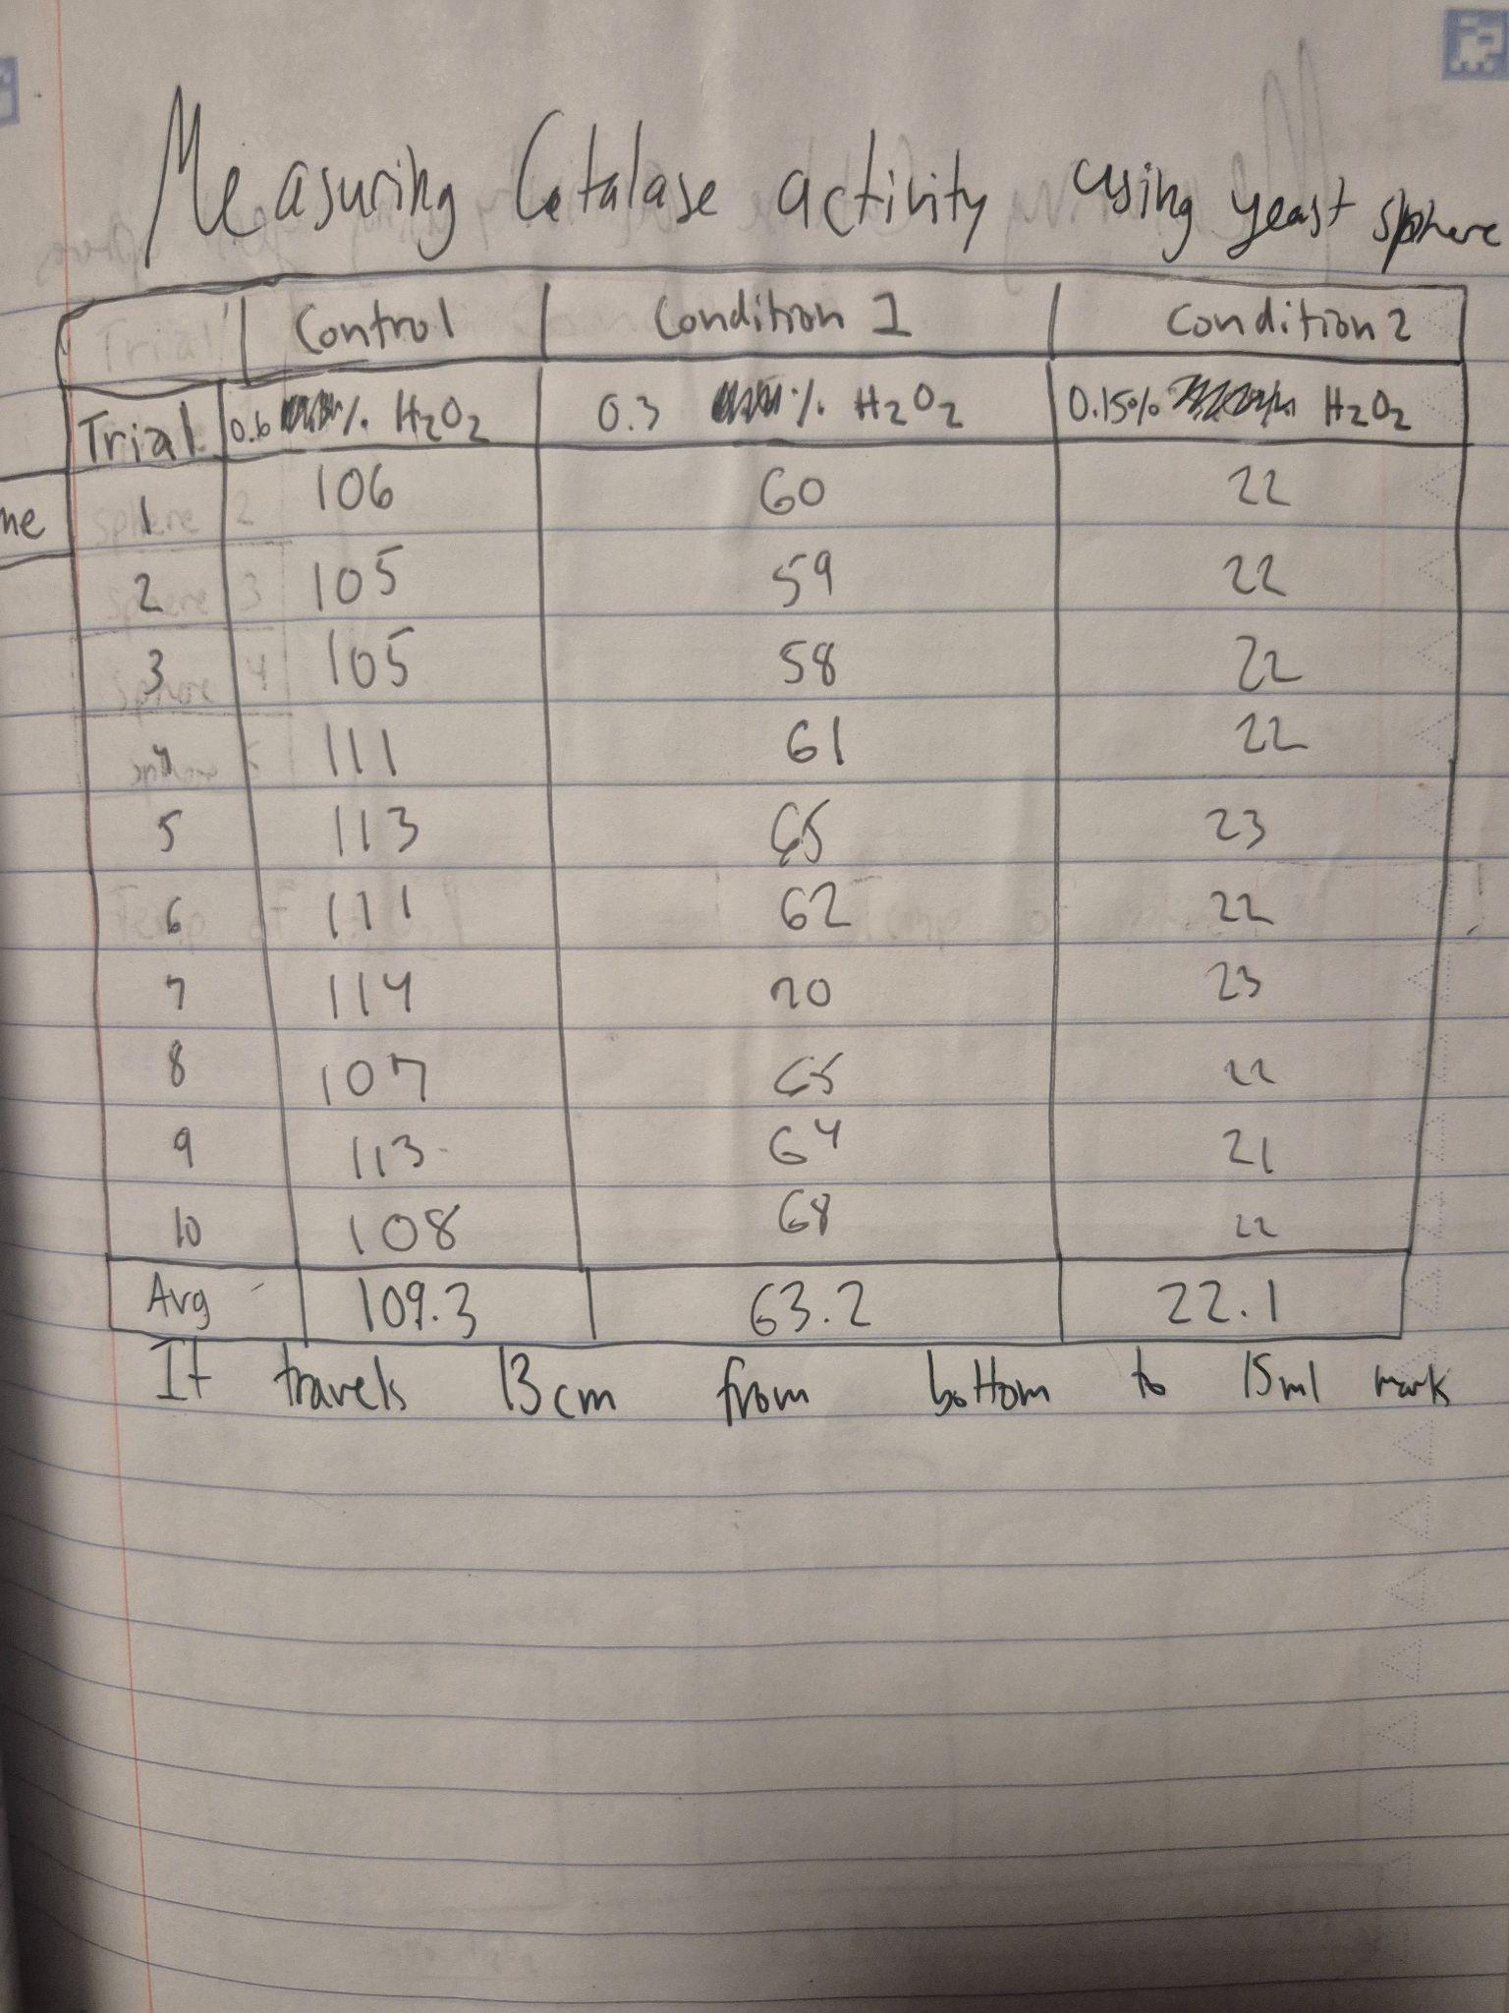

Slide 54
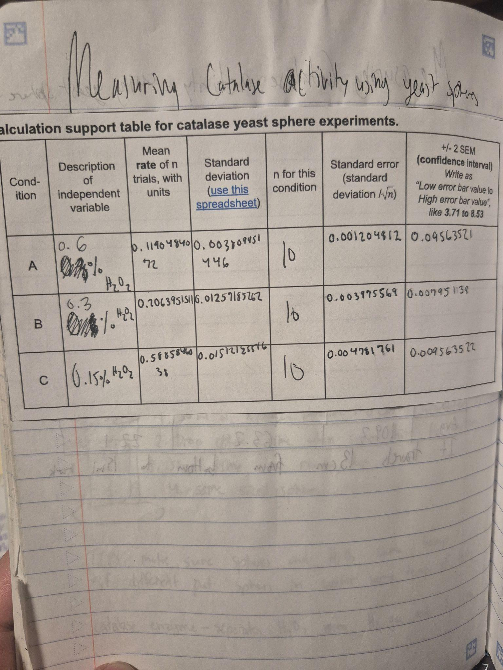


Slide 55



Slide 56



Slide 57
A few conclusions.
Students want to passively “study.” Reading notes that I had given them.
Students need to actively recall and generate their work.
Shifting to active recall during note taking AND self-practice.
The main things the best students do:
  Study alone
  Minimize distractions
  Chunk their study time
  Active recall.
They’re half way there just by forcing students to do so much handwriting in class.
They can do it, and they can generate some really good work!

Slide 58

Thanks!

