Slide 1


Slide 2


INDIANA COMMISSION FOR HIGHER EDUCATION
CHE TEAM
DOUG HARTER
DIRECTOR OF ACADEMIC AFFAIRS AND TRANSFER

Slide 3

INDIANA COMMISSION FOR HIGHER EDUCATION
INDIANA TRANSFER SYSTEM

Slide 4












INDIANA
TRANSFER
COMPONENTS
INDIANA COMMISSION FOR HIGHER EDUCATION
Notes:
CTL: 1.) Guaranteed to transfer and apply as a course equivalent (in most cases) Examples: Finite & Quantitative Reasoning 2.) Can be applied toward course requirements to earn a degree (in most cases) Example: English Composition (Purdue)

Slide 5
INDIANA COMMISSION FOR HIGHER EDUCATION
INDIANA
COLLEGE
CORE 101

Slide 6
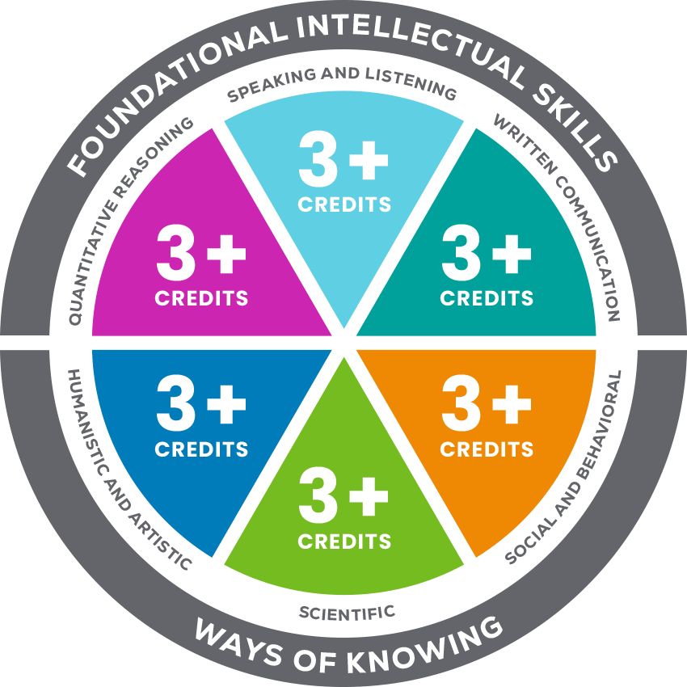
THE INDIANA COLLEGE CORE
INDIANA COMMISSION FOR HIGHER EDUCATION
A block of 30 credit hours of college-level general education coursework that applies and transfers seamlessly to all Indiana public higher education institutions and some private/independent institutions.
Courses are in six competency areas:
  Quantitative Reasoning
  Speaking and Listening
  Written Communication
  Humanistic and Artistic
  Scientific
  Social and Behavioral
Notes:
Emphasize the benefit of a block of 30 credit hours that is transferable versus credit earned in individual dual credit classes that may or may not transfer (not a CTL course).

Slide 7







INDIANA COMMISSION FOR HIGHER EDUCATION
INDIANA COLLEGE CORE GROUND RULES
A minimum of 3 credit hours must be earned in each competency area
Awarding institution determines the distribution of the remaining 12 hours.
AP/IB/Cambridge/CLEP may count toward fulfillment based on the equivalencies determined by the awarding institution
SEA 204-2026
At least 15 credit hours must be earned from the primary postsecondary provider
Successful completion of the Indiana College Core may not entirely fulfill the general education requirements at some postsecondary institutions and does not guarantee admission into a degree program
A minimum GPA of 2.0 for courses within the Indiana College Core is required

Slide 8


SEA 204-2026
INDIANA COMMISSION FOR HIGHER EDUCATION
AP & Cambridge International Exams Credit
State educational institutions must:
Award course credit, not simply academic or elective credit, for scores of 3, 4, or 5 on Advanced Placement exams and grades of “E” (e) or higher on Cambridge International A or AS Level exams when those examinations correspond to the state educational institution’s course in the Core Transfer Library.
Transfer and apply course credit in alignment with its own corresponding course in the Core Transfer Library.
Notes:
Section 16 of SEA 204 updates language governing the credit awarded by state educational institutions for satisfactory scores on Advanced Placement and Cambridge International exams.
This legislation will go into effect for the 2026-2027 school year for Fall 2027 student matriculation.

Slide 9



















INDIANA COMMISSION FOR HIGHER EDUCATION

Slide 10

WHAT ARE THE BENEFITS?
INDIANA COMMISSION FOR HIGHER EDUCATION
Dual Credit In General
Students are better prepared for college
Students get a head start on college at a fraction of the cost
Students will have a competitive advantage in the admissions process; are more likely to earn scholarships

Slide 11
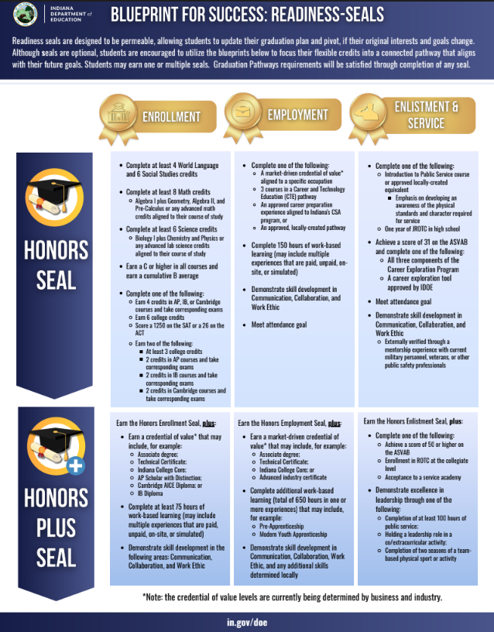
WHAT ARE THE BENEFITS?
INDIANA COMMISSION FOR HIGHER EDUCATION
Earning the Indiana College Core is one way for high school students to earn a credential of value, necessary for students to be awarded the Enrollment and/or Employment Honors Plus Seals.
  Earning the Enrollment Honors Plus Seal guarantees students automatic acceptance to all Indiana public higher education institutions and several private/independent institutions

Slide 12

INDIANA COMMISSION FOR HIGHER EDUCATION
STUDENT OUTCOMES
  91% of high school students who earned the Indiana College Core in 2023 enrolled in college, a much higher percentage than the statewide college-going rate (52%), as well as a higher percentage than any other group, such as:
    Students who took and passed an AP Exam (86%),
    Students who earned an Academic Honors Diploma (84%), and
    Students who earned an associate degree while in high school (86%), a trend that has been true every year since 2015.
Students who earn the Indiana College Core are more likely to enroll in college

Slide 13

INDIANA COMMISSION FOR HIGHER EDUCATION
STUDENT OUTCOMES
Students who earn the Indiana College Core demonstrate academic success while in college
  91% of Indiana College Core earners from the 2023 high school graduation cohort, who enrolled in an Indiana public college, persisted to the second year of college, compared to 78% of students overall.
  Those same students earned an average of 27 credit hours and a 3.2 GPA during their freshman year in college, compared with overall statewide averages of 23 credit hours and a 2.8 GPA.

Slide 14

INDIANA COMMISSION FOR HIGHER EDUCATION
STUDENT OUTCOMES
Students who earn the Indiana College Core are more likely to graduate on time from college
  67% of Indiana College Core earners from the 2021 high school graduation cohort, who enrolled in an Indiana public college, graduated on time from college, compared to 42% of students overall.

Slide 15
INTENTIONAL COURSE SELECTION
INDIANA COMMISSION FOR HIGHER EDUCATION
The Indiana College Core provides more intentionality in dual credit course selection.
Beyond completing general education requirements, a student should consider the schools they would like to attend and their intended postsecondary pathway.
  Colleges/Universities may have additional general education requirements beyond the Indiana College Core to meet their institutional general education core.
  Additionally, there may be major-specific general education courses required to be completed.
Questions to consider:
Which English course should I take?
How many semesters of world languages do I need to take?
What are the science or math requirements for my major?
Notes:
Examples: IU admissions requirement: Quantitative Reasoning will not meet Math requirements; IU Political Science major=2 years of World Language; Purdue Engineering/Biomedical Health Sciences majors (W131 or AP Language scores of 4 or 5)

Slide 16

INDIANA COMMISSION FOR HIGHER EDUCATION
TEACHER CREDENTIALING CONSIDERATIONS
Dual Enrollment
Use of secondary postsecondary providers
Indiana Course Access Portal (iCAP)

Slide 17

ACADEMIC PERFORMANCE GRANT
INDIANA COMMISSION FOR HIGHER EDUCATION
Schools will receive:
  $1,500 per student that completes the Indiana College Core ($1,491 FY26/$1,497 FY27)
  $2,500 per student that earns an associate’s degree in high school ($2,486 FY26/$2,495 FY27)
  $1,100 per student earning the Academic/Technical Honors Diploma (non STFC) ($1,094 FY26/$1,098 FY27); $1,500 per student with STFC assistance ($1,491 FY26/$1,497 FY27)
  $2,500 per student that earns the Enrollment or Employment Honors Plus Seal ($2,495 FY27)
  $900 per student that earns the Enlistment Honors Plus Seal ($873 FY27)
The Academic Performance Grant is distributed based on a student’s highest achievement while in high school.
Notes:
Next, let’s discuss the financial incentives for a school district to offer dual credit classes, and specifically, the Indiana College Core to its students.
As a part of HEA 1001-2025, the language establishing the Academic Performance Grant was amended. FY26 is the last year the dual credit component ($40 per credit hour completed/$1,200 maximum) is included in the APG and starting in FY27 new grants tied to students earning the Honors Plus Seals will be awarded.
These funds could be used to incentivize teachers to earn their Master’s degree or to complete 18 graduate credit hours to become credentialed to teach dual credit.

Slide 18
INDIANA COMMISSION FOR HIGHER EDUCATION
MY
COLLEGE
CORE

Slide 19

INDIANA COMMISSION FOR HIGHER EDUCATION
MY COLLEGE CORE
PLANNING TOOL
A one-stop resource for all things Indiana College Core.
Allows a student to see their high school Indiana College Core course options and to track their progress towards completion.
Allows a student to see whether, and how, courses will transfer to a different Indiana public institution, as well as the required courses needed in each TSAP program.
Students can share their plan with their parents and counselors.

Slide 20


INDIANA COMMISSION FOR HIGHER EDUCATION
COUNSELOR FEATURES
Access for counselors to view & edit student plans
Create folders to organize student plans
Use student plans to track completion of courses
Resource Guide created by postsecondary partners
https://mycollegecore.org/counselor-sign-up/

Slide 21
INDIANA COMMISSION FOR HIGHER EDUCATION
Q & A

Slide 22
INDIANA COMMISSION FOR HIGHER EDUCATION
NEW CREDENTIAL OF VALUE OPTION
A CTE pathway/ICC combination
12 credit hours of CTE pathway specific courses aligned to a NLPS pathway.
  Pathway options are limited to existing TSAP’s, to ensure transferability of courses by building upon the current framework/articulations in place.
18 credit hours of general education courses on the Core Transfer Library.
  Students are required to take 1 course from each of the 6 competency areas making up the Indiana College Core.
A minimum of 15 credit hours need to be earned through one postsecondary institution.
AP courses may substitute for a portion of the courses and satisfactory scores on corresponding AP exams must be earned.

Slide 23

CONTACT INFORMATION
For inquiries contact:
Indiana College Core Inbox
ICC@che.in.gov

Slide 24
