Slide 1


Slide 2



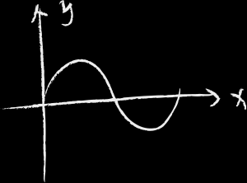



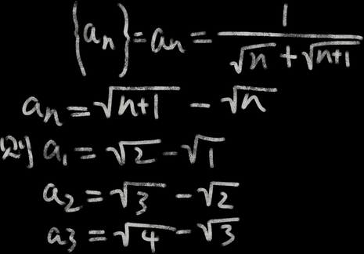




EC@GC
Building Relationships, Rigor and Expectations to Support EC Students

Slide 3

Who is in the room?
  What is the size of your school?
  What is something that you are proud of about your program?
  What is your favorite thing about your program?
  Is there an area you would like to improve for next year?

Slide 4


EC @ CG
  Greenwood, IN
  CGHS enrollment ~3,100
  Small learning community within a school
  First cohort was 2009-2010
  Approximately 620 students

Slide 5
EC @ CG:
Class of 2026
  2nd year of 100% completion of associate’s degree or ICC
    124 associate’s degrees
    25 ICC
    9,286 dual credits

Slide 6


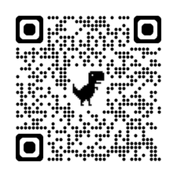
Building Relationships
  Re-Introduced program to 8th grade teachers
  8th grade Parent Night
  New promotional video
  EC Social
EC Video

Slide 7
Counseling Lessons
in the Classroom
  Understanding graduation requirements and ICC
  Use of My College Core to create online ICC plan
  Three year course plan

Slide 8



EC Ambassadors
Juniors and Seniors that apply to lead initiatives and activities throughout the year.
  Freshman orientation
  Ambassador bulletin board
  Thankful cards (teachers)
  Holiday Helpers
  Valentine’s Day/Acts of Kindness
  Teacher Appreciation Week

Slide 9
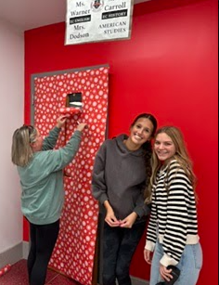
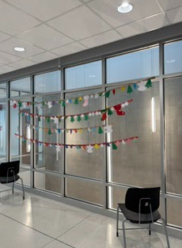
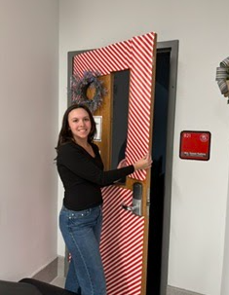
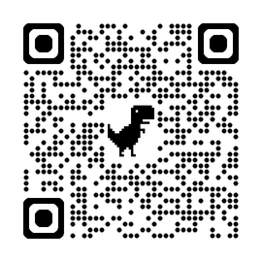


EC Counselor Appreciation Week Video
@CGHS Early College
Early College @CGHS

Slide 10
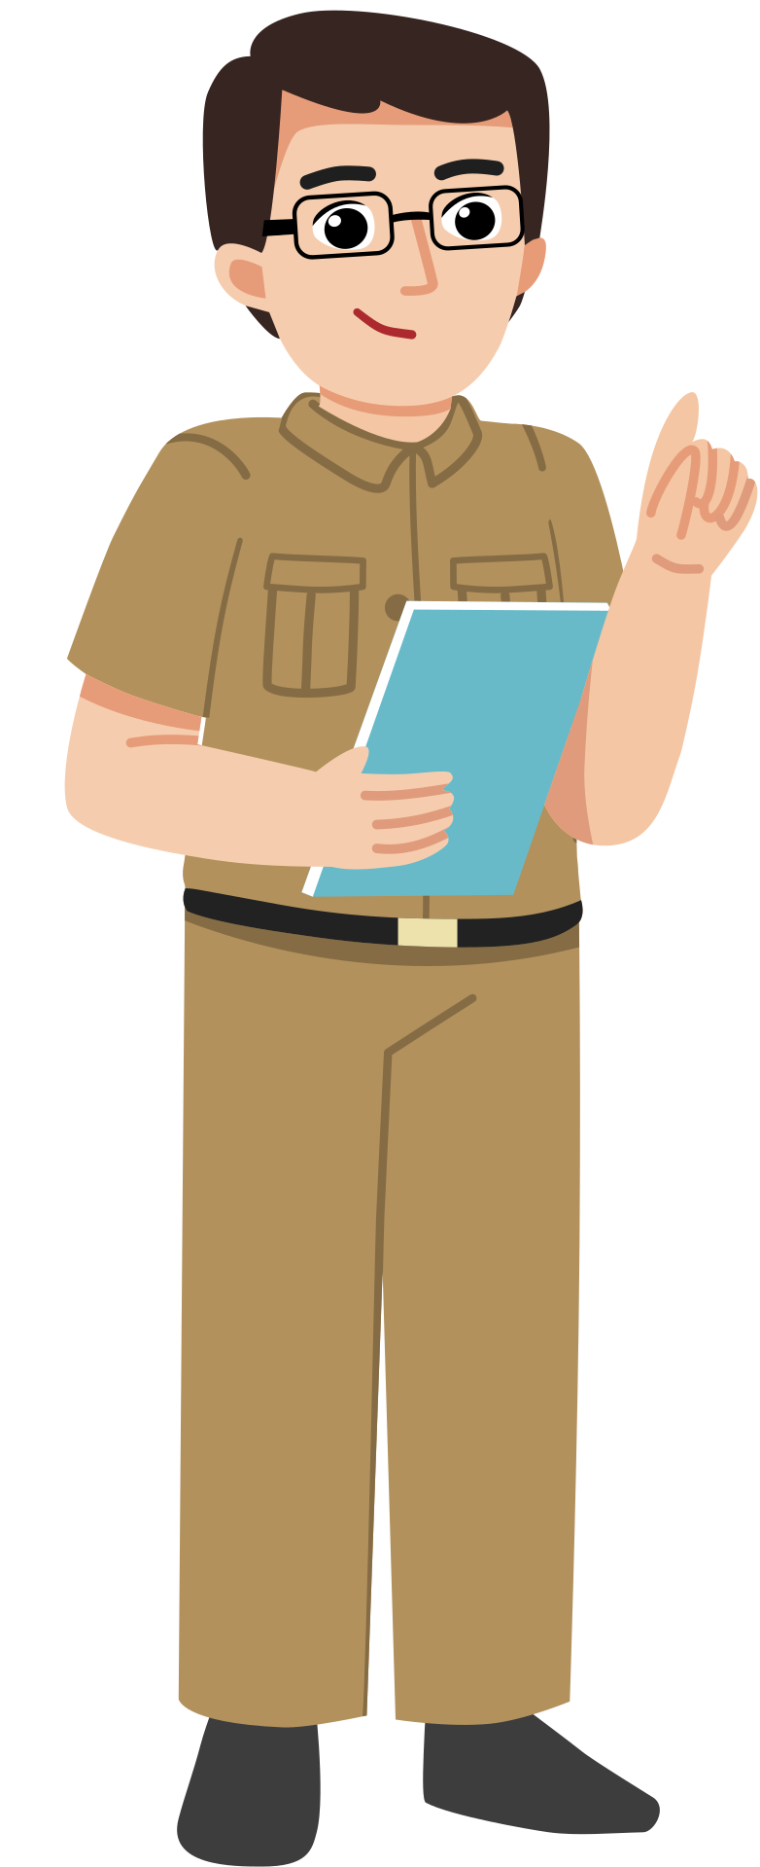
One Minute Meetings
I met with every EC STaR (homeroom) Grades 9-12 and asked them three questions:
  What is something you are proud of?
  What is your favorite thing about EC?
  Is there anything missing from EC that would help you as a student?

Slide 11


Slide 12

When the Rubber Hits the Road
  EC Tutors
    English, Math, and Science
  AIM
  Grade Checks-monthly
    Admin assigned to AIM
    STaR Teacher email
  Individual Meetings with Students
    Study Hall
  Parental Involvement/Mental Health

Slide 13
When the Rubber Hits the Road
  Academic Probation
    Level 1:
      Utilize Tutors
      AIM
      CTA Support (AIM/Tutors)
      Check-Ins (Admin/Counselor)

Slide 14
When the Rubber Hits the Road
  Academic Probation
    Level 2:
      All of Level 1 plus remove from dual credit courses until improvement occurs

Slide 15
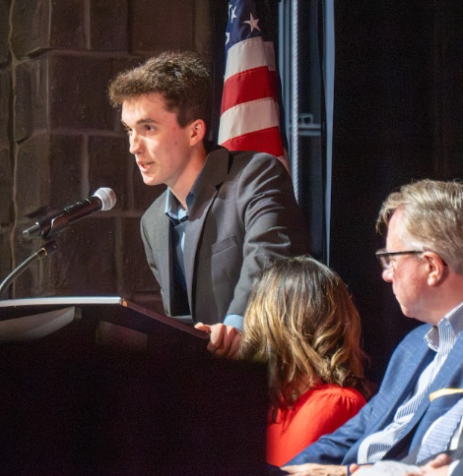

Teachers and Community
“I began to realize that the Early College teachers really seemed to care about every single student for who they were. They would ask us questions about our interests, clubs, activities, and anything else we might do outside of school.”
Deacon Norman~Class of 2026

Slide 16
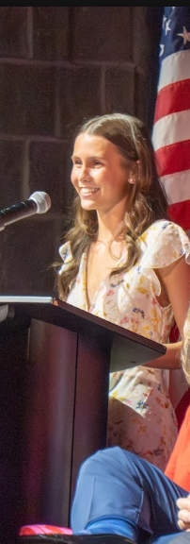
Our Teachers
“That may be the greatest gift we’ll take with us from Early College; the ability to see our own value because we’ve been surrounded by people who have seen it all along.” Selia Peters~Class of 2026

Slide 17
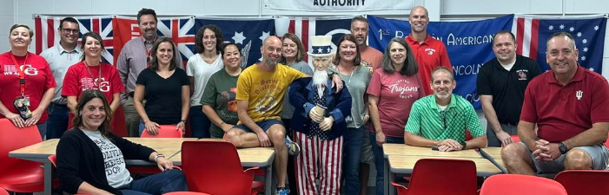
Our Counselors & Teachers

Slide 18
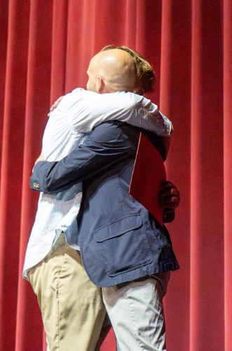
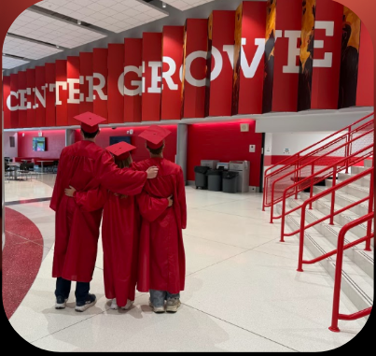
Our Counselors & Teachers

Slide 19
Questions for Us:
Jenn Perkins Director of EC
perkinsj@centergrove.k12.in.us
Shannon Fritz Director of Guidance
wiramfritzs@centergrove.k12.in.us

Slide 20
