Slide 1


Slide 2

Rural School, Big Impact: Thinking Outside of the Box
Presented By: Kindra Hovis & Tina Rue
Notes:
Both – Introduce ourselves & our bios

Slide 3
Shoals Demographics
Martin County Population (2025): 9,856
Corporation Enrollment: 564
Shoals High School Enrollment: 182
High School Diploma: 89%
Bachelor’s Degree or Higher: 13%
Free & Reduced Lunch: 60.91%
Notes:
Kindra

Slide 4
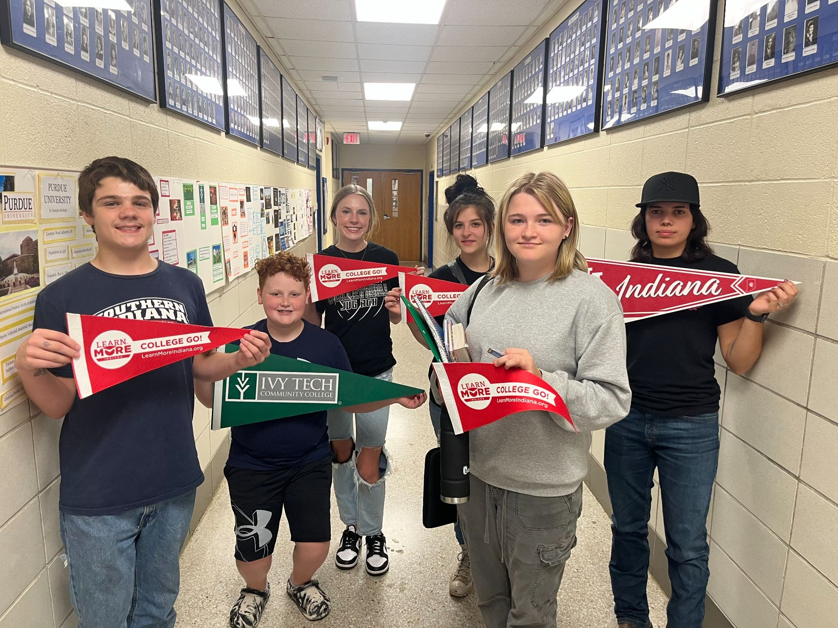

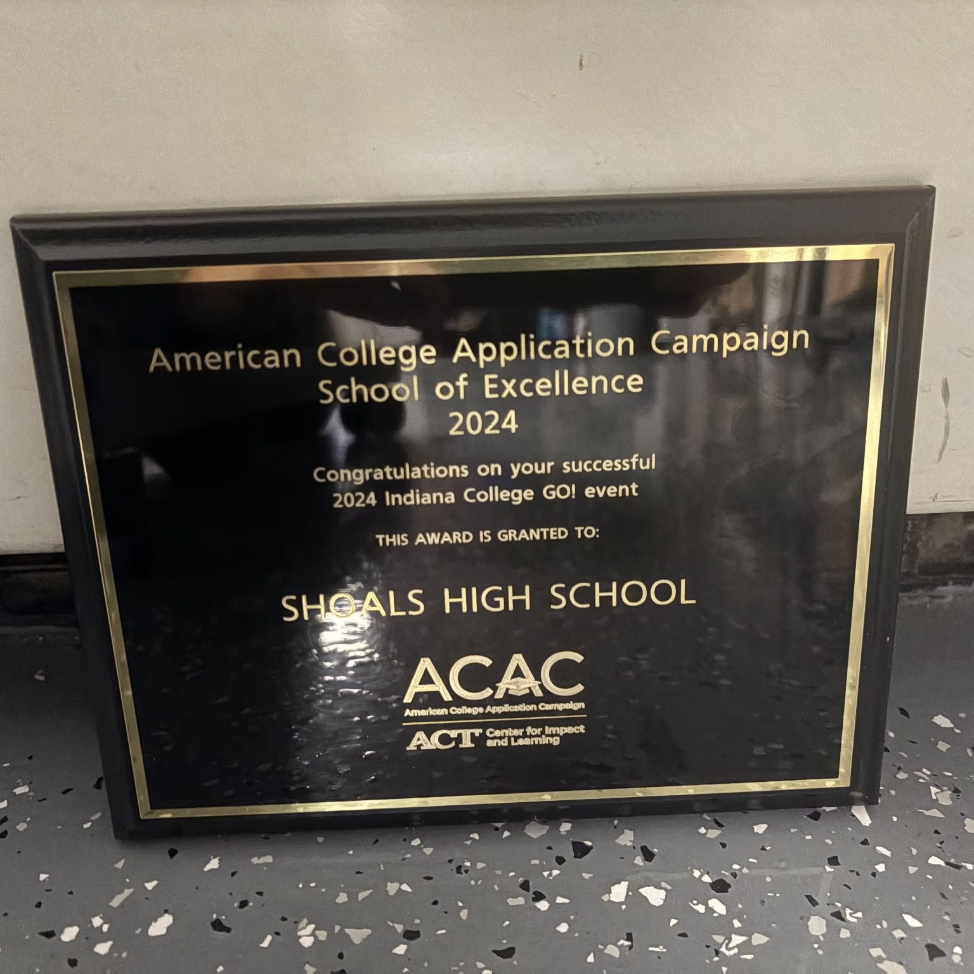
College Going Culture
Spirit Days
Daily activities & prize drawings
Campus-wide college visit day
2024 School of Excellence Award
CELL 25th Anniversary School Award (Top 10)
Notes:
Tina

Slide 5
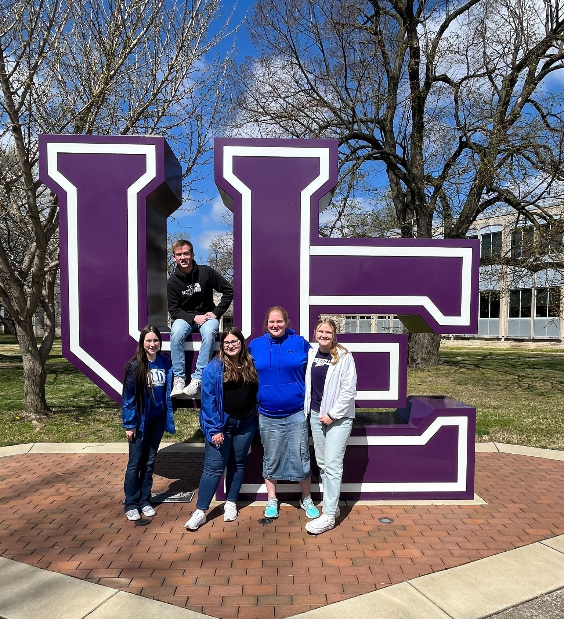
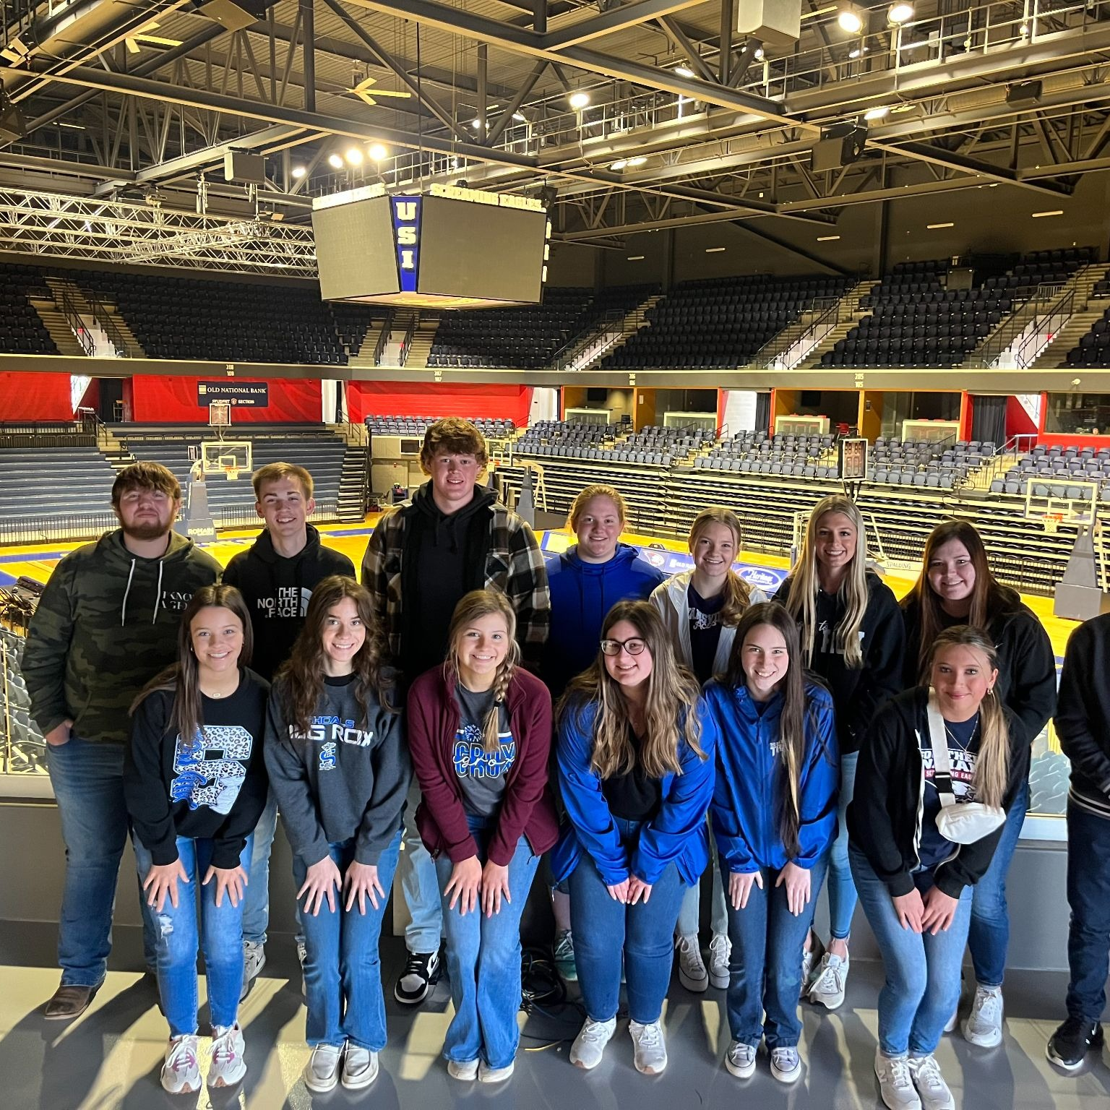
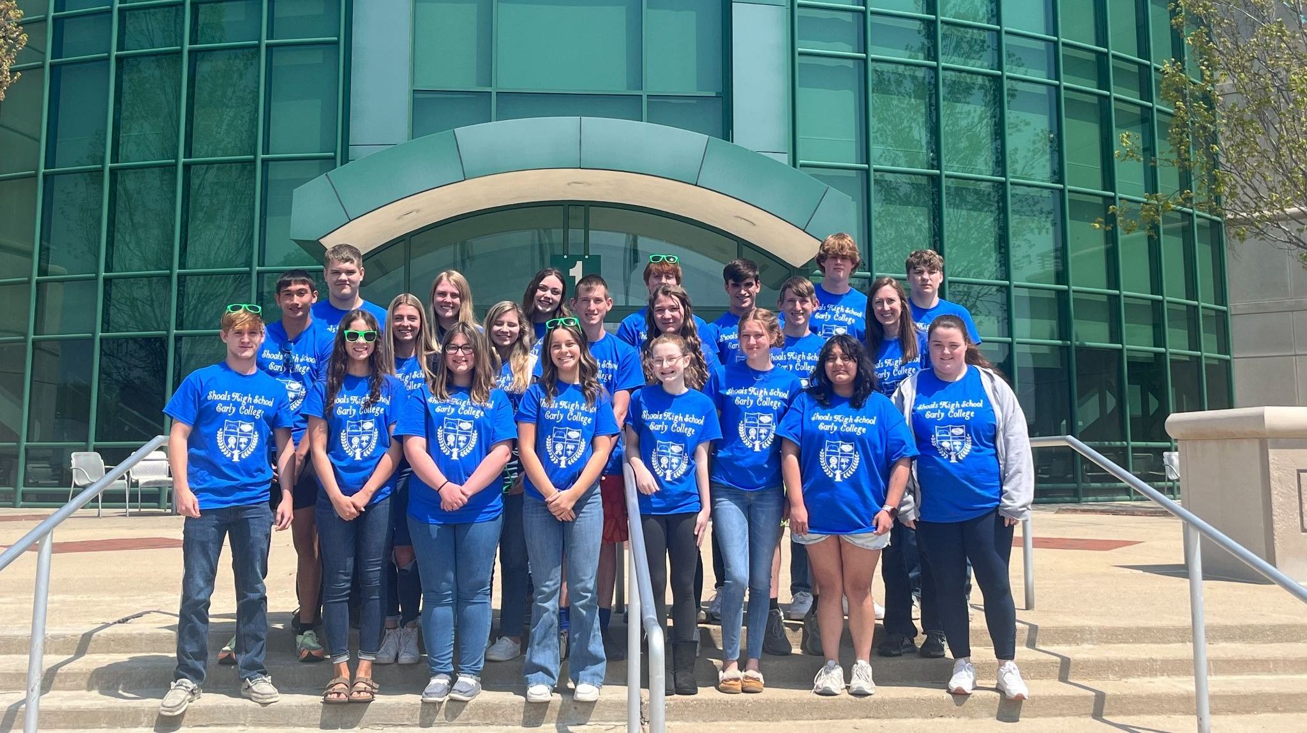
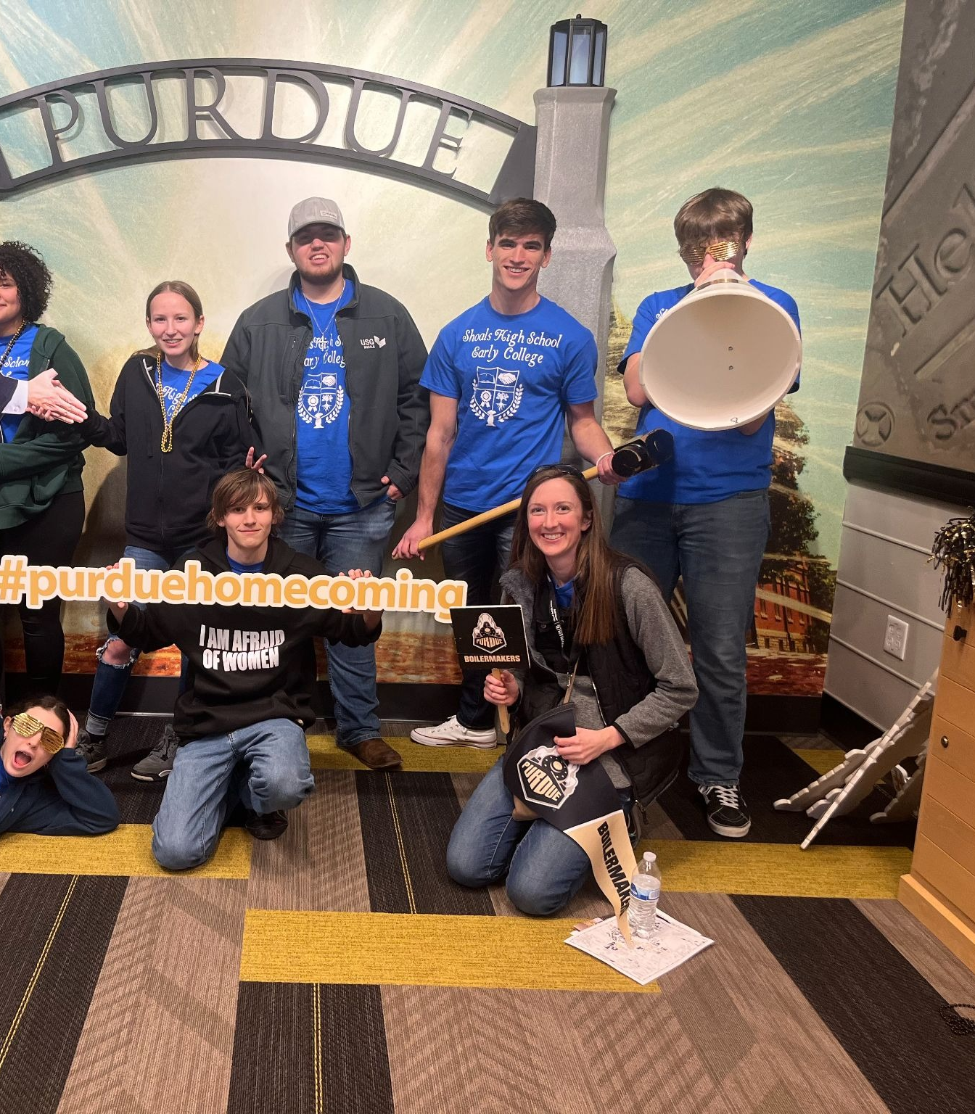
College-Campus Visit Day
Notes:
Tina

Slide 6
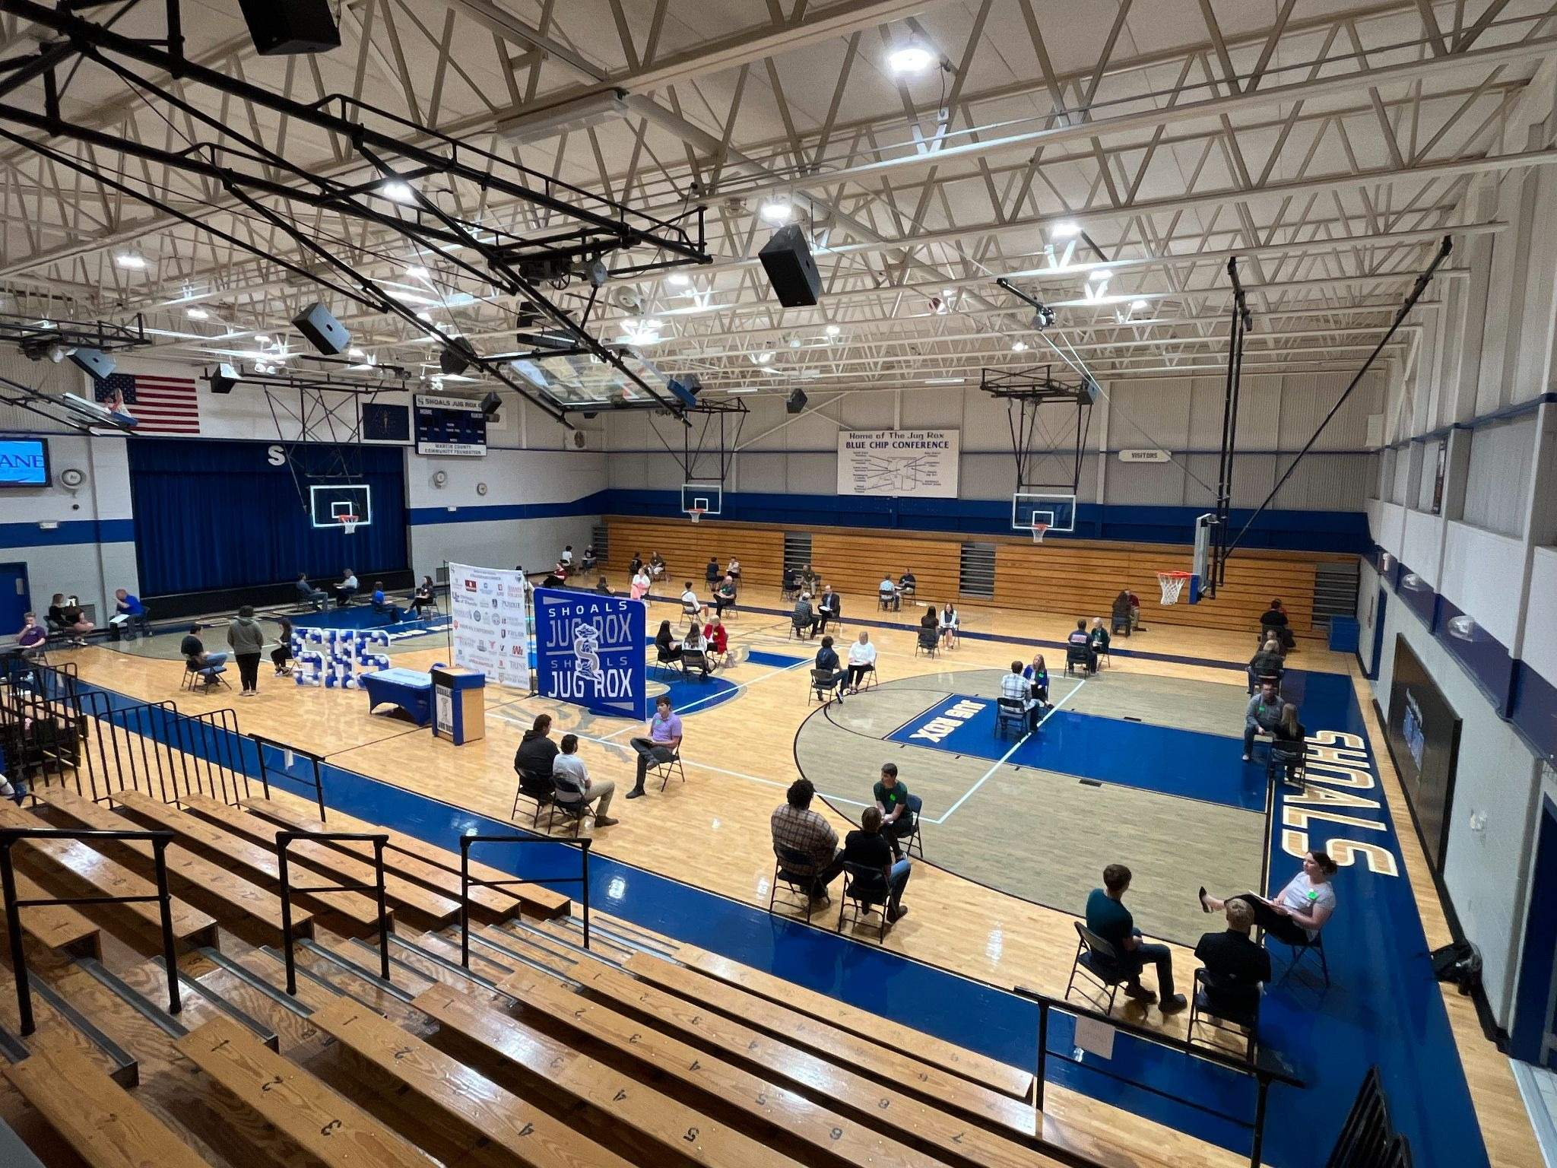
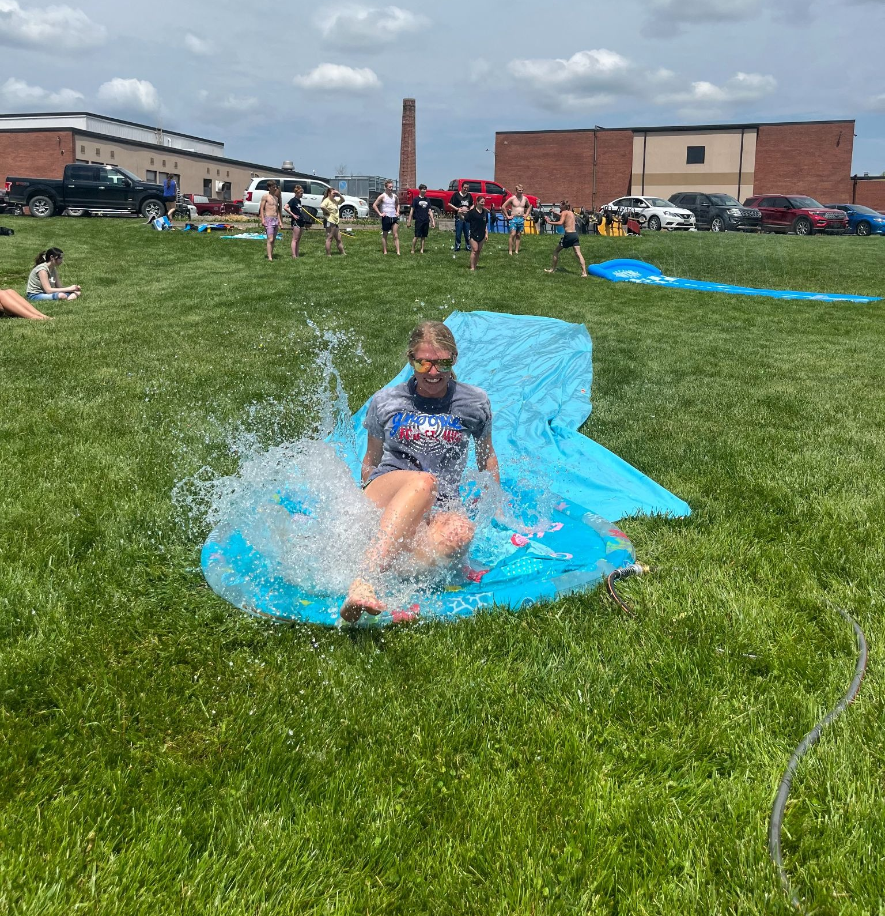
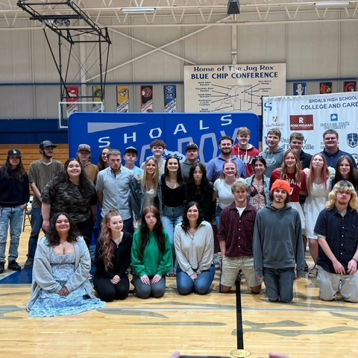

Senior Decision Day
Future plan declaration
Mock Interviews
Fun Afternoon
Notes:
Kindra

Slide 7
Supports for Student Success
Study Hour
FAFSA & INvested Support
Early College Parent Night
College & Career Fair
Alumni Mentorship
Vincennes University Dean of Instruction (Weekly Visits)
IU College Advising Corps Advisor (Twice a week & FREE)
Notes:
Tina

Slide 8
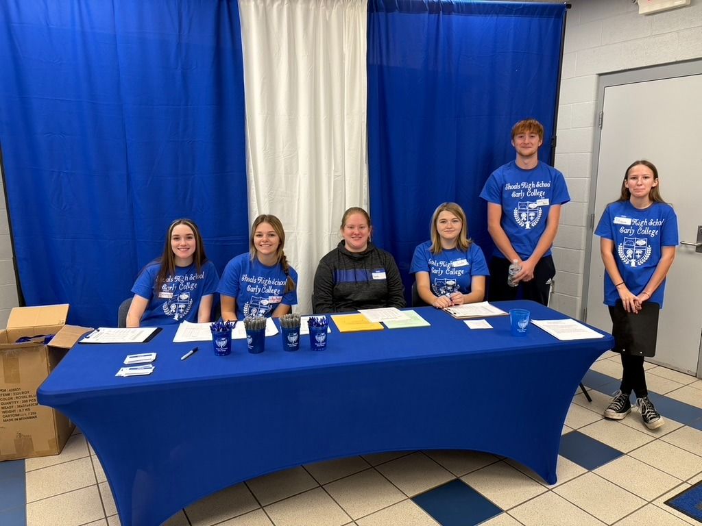

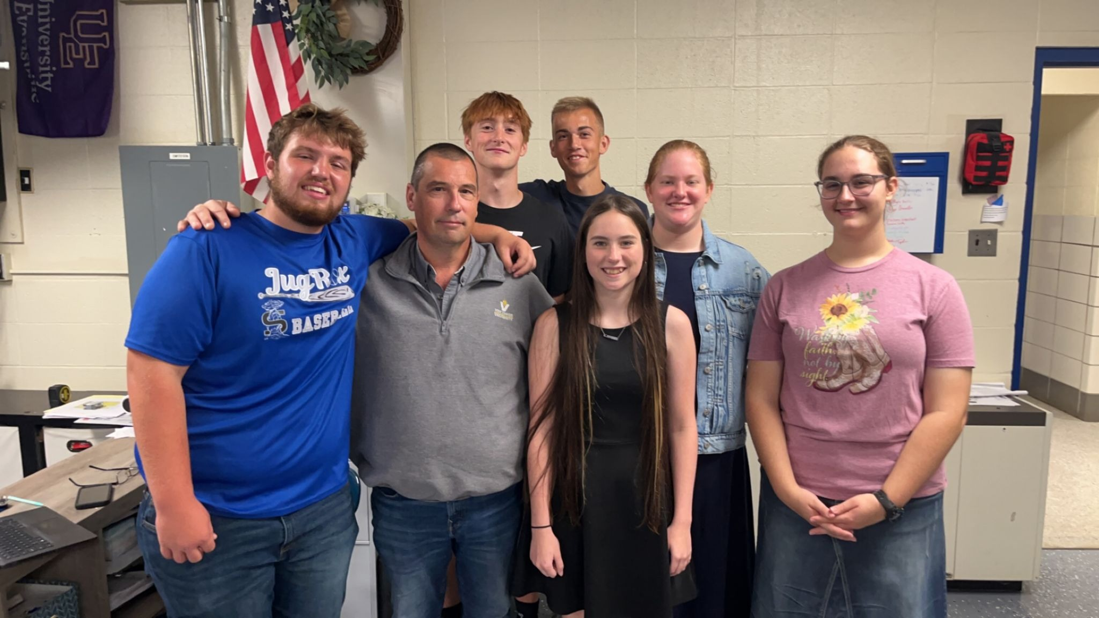
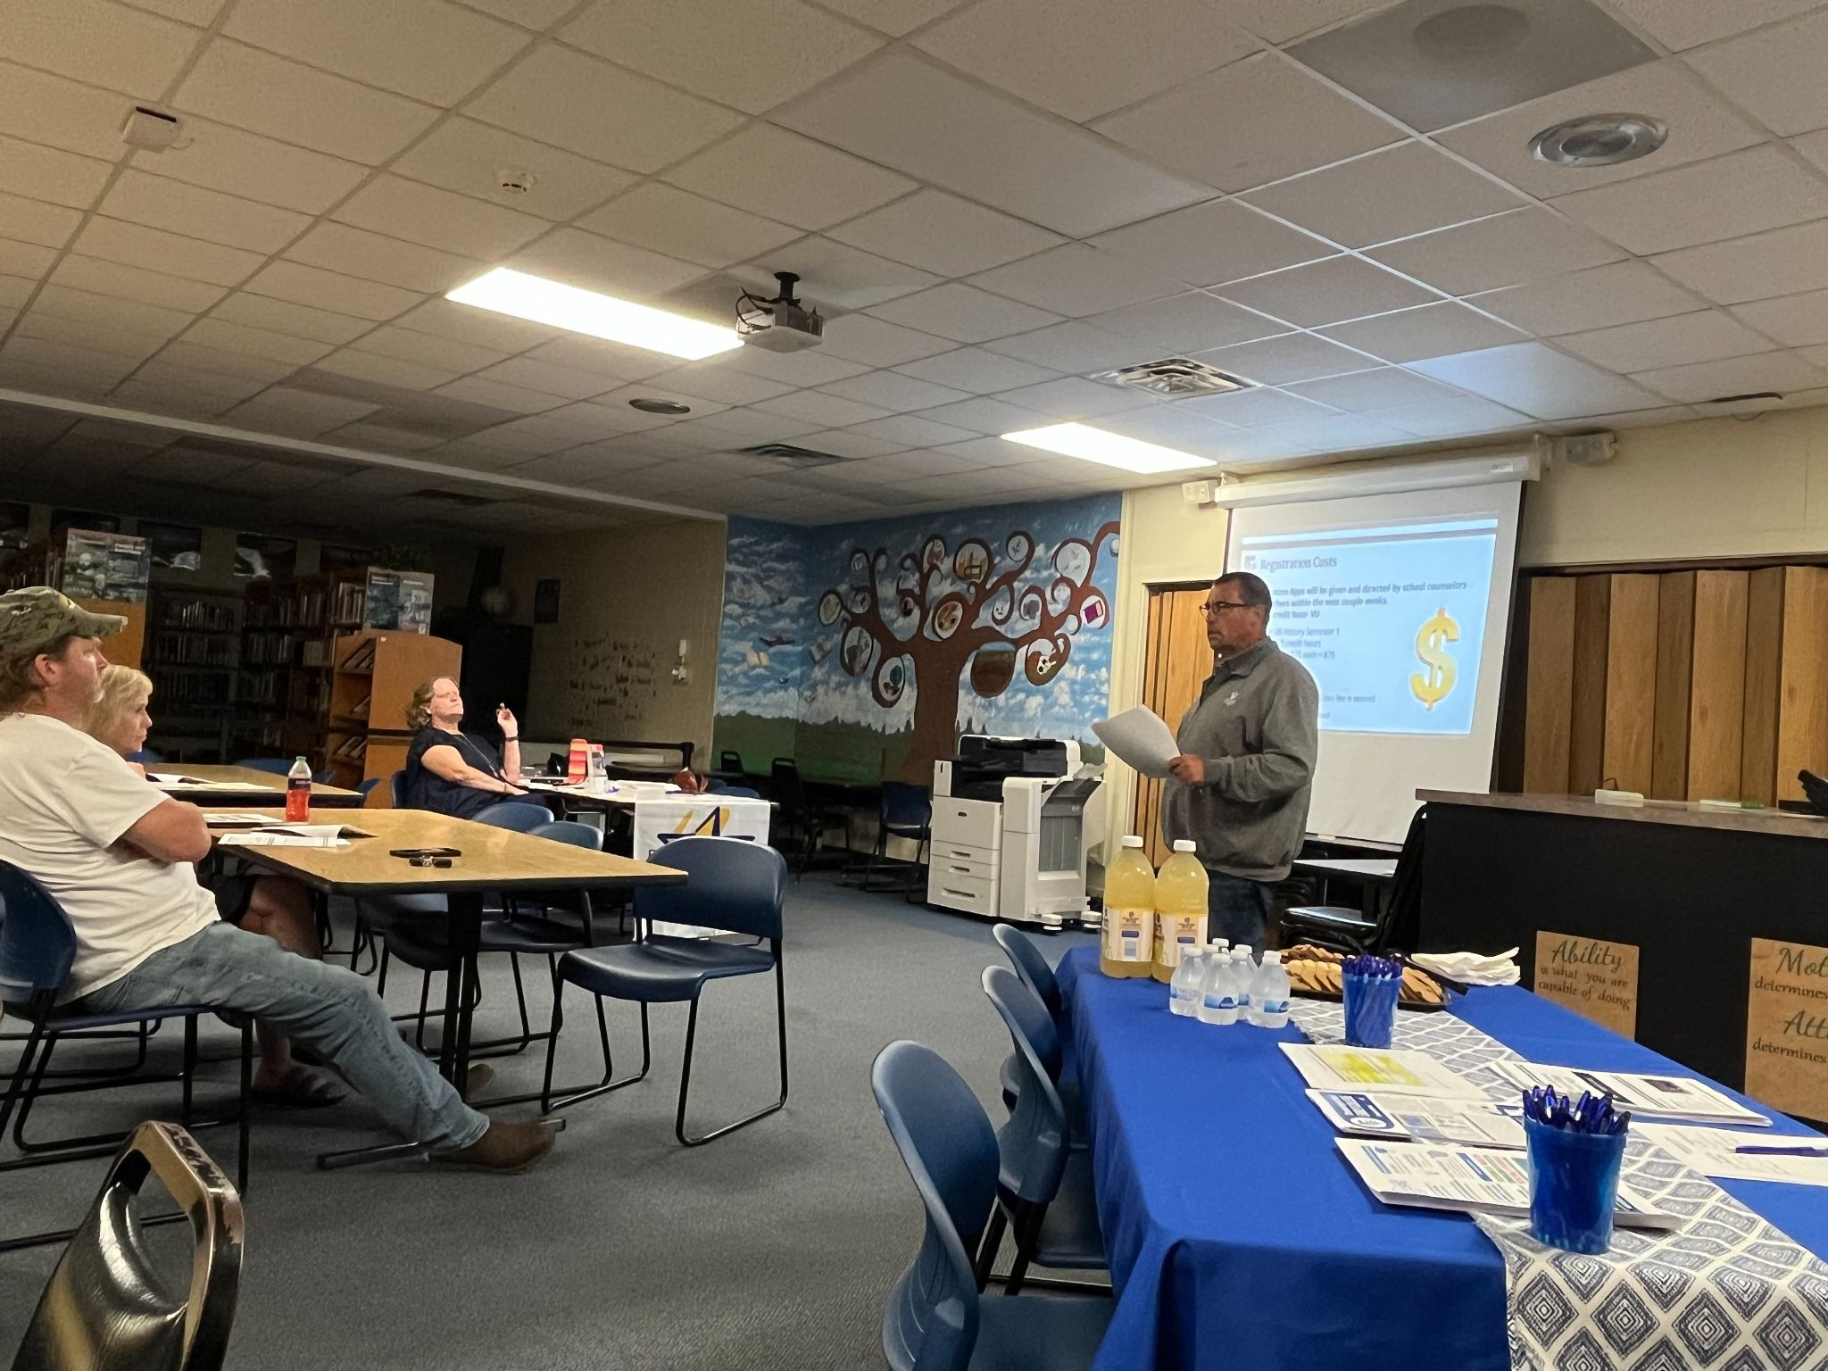
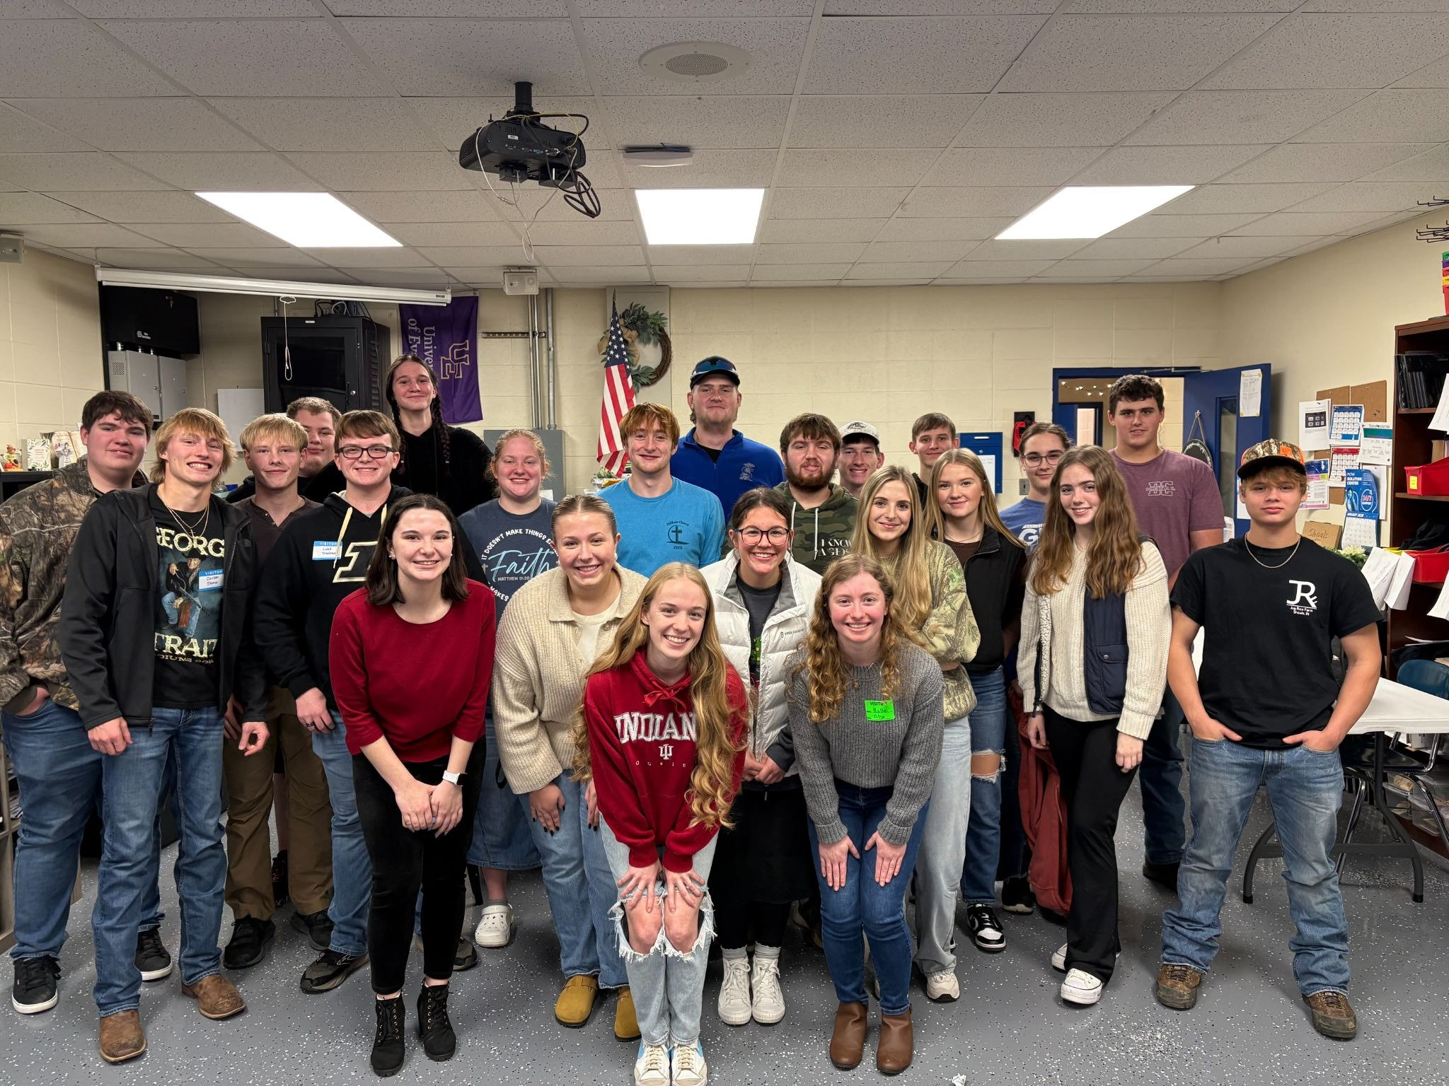
Supports for Student Success
Notes:
Kindra or Tina

Slide 9
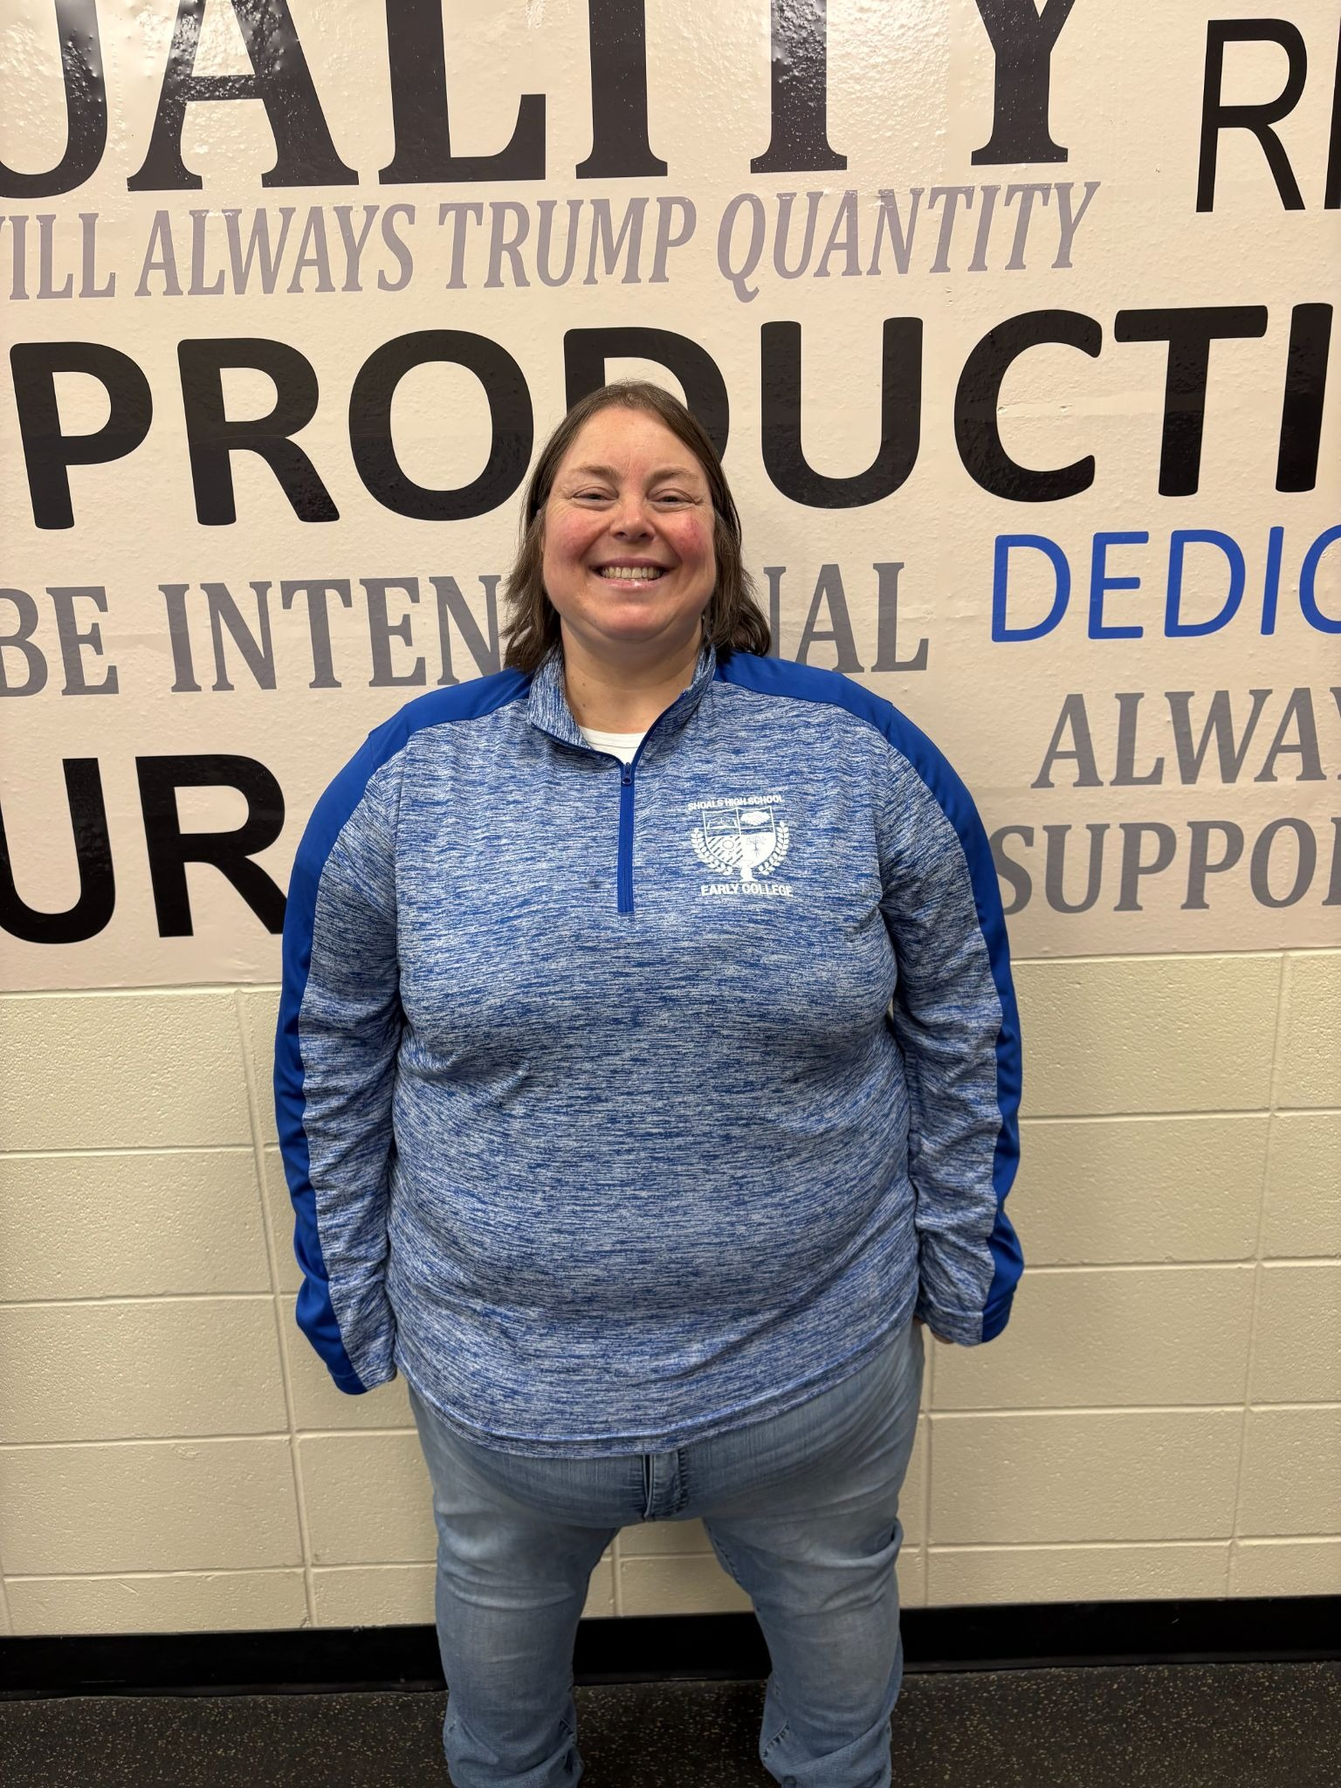
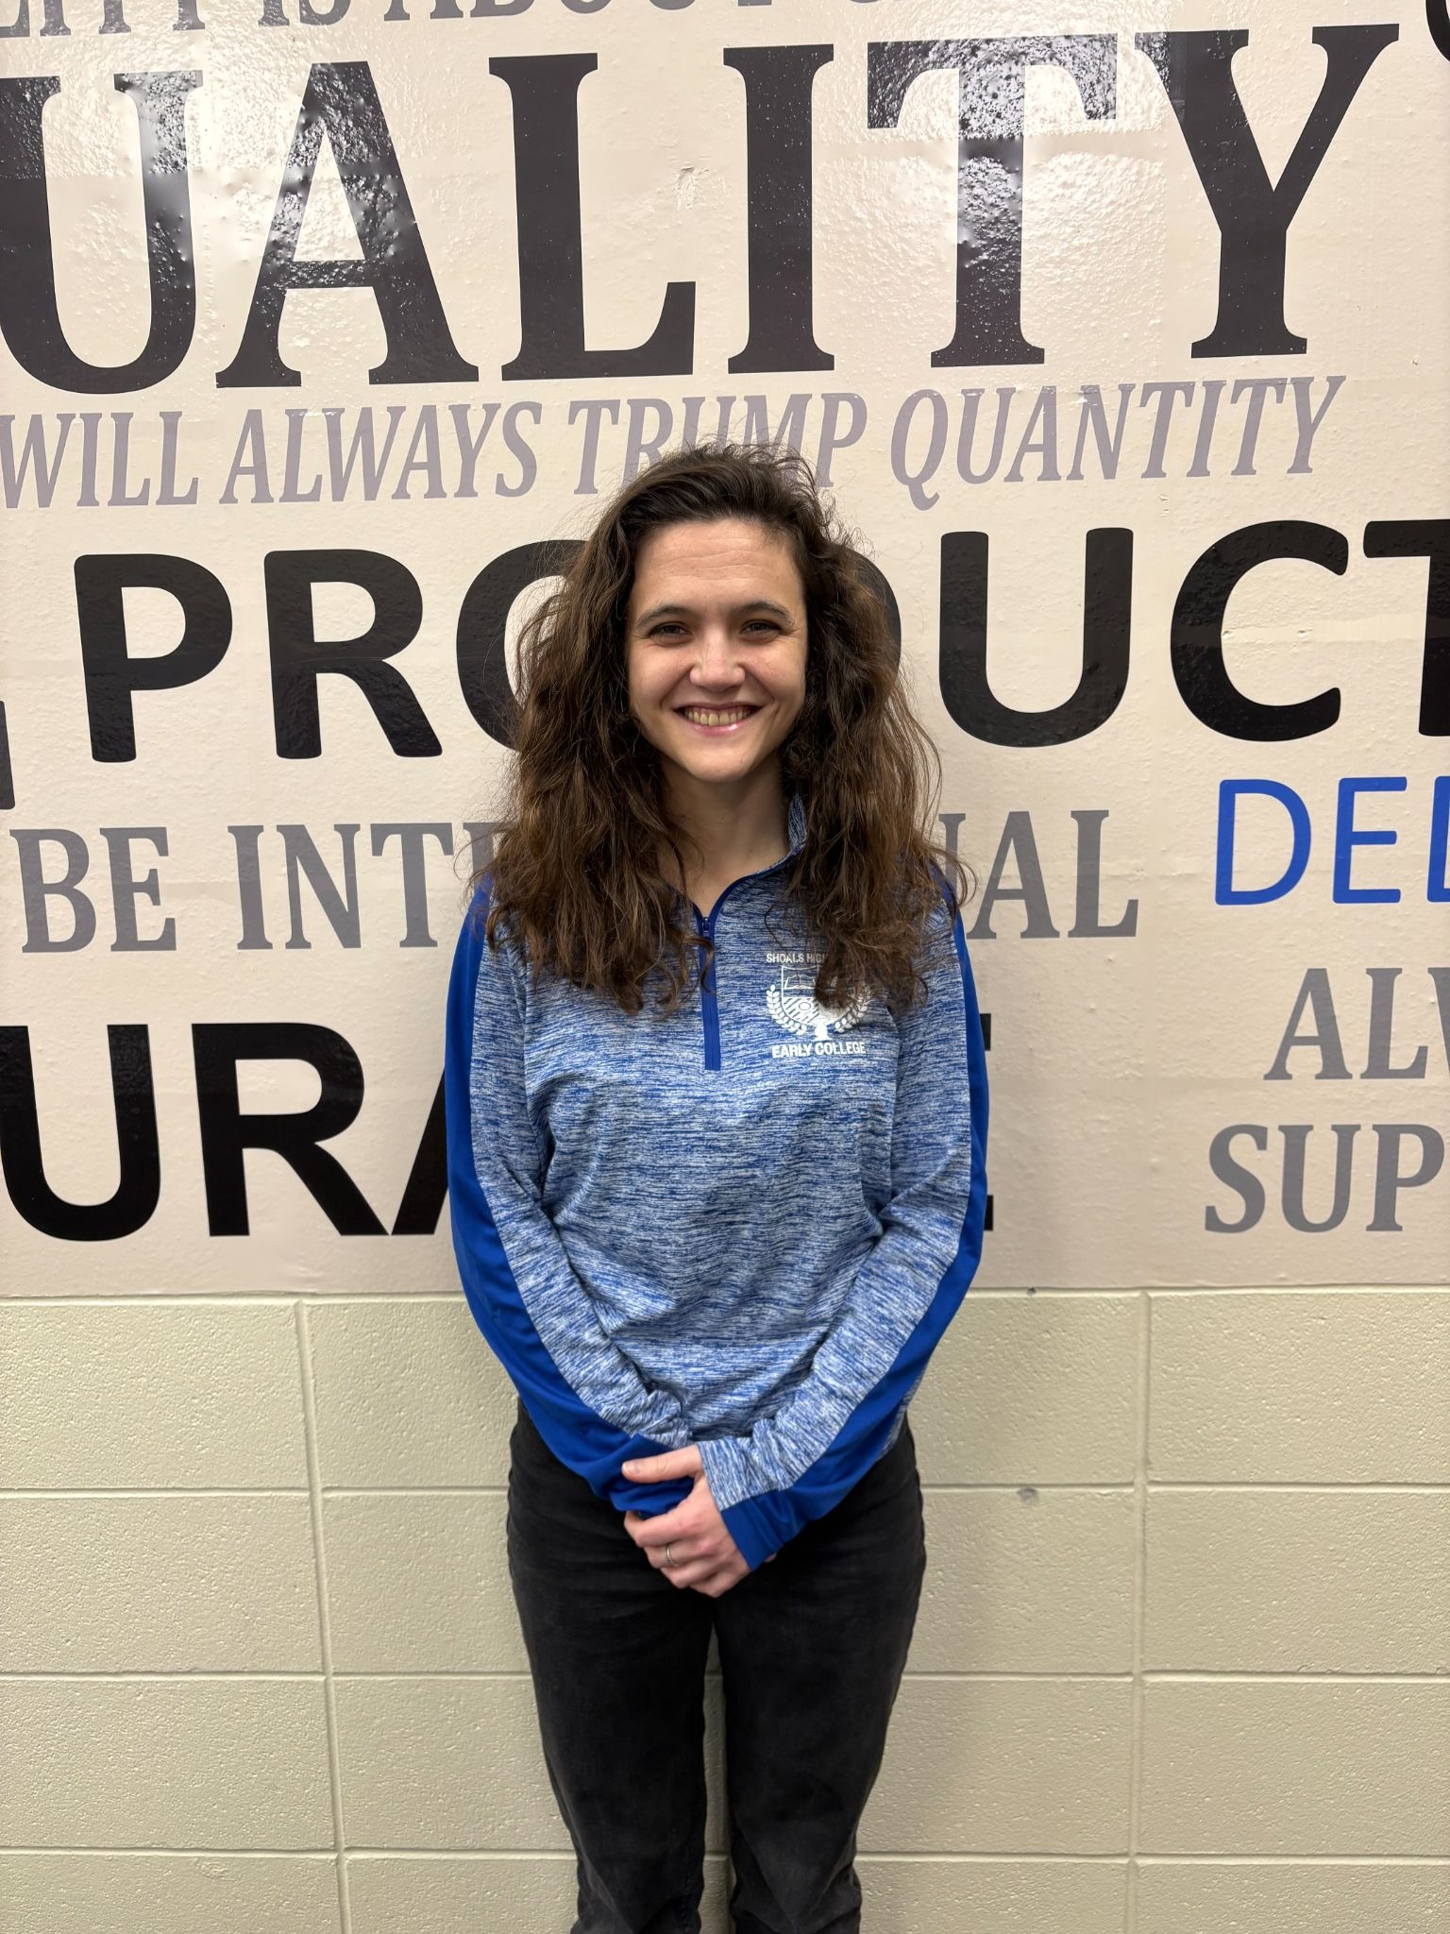
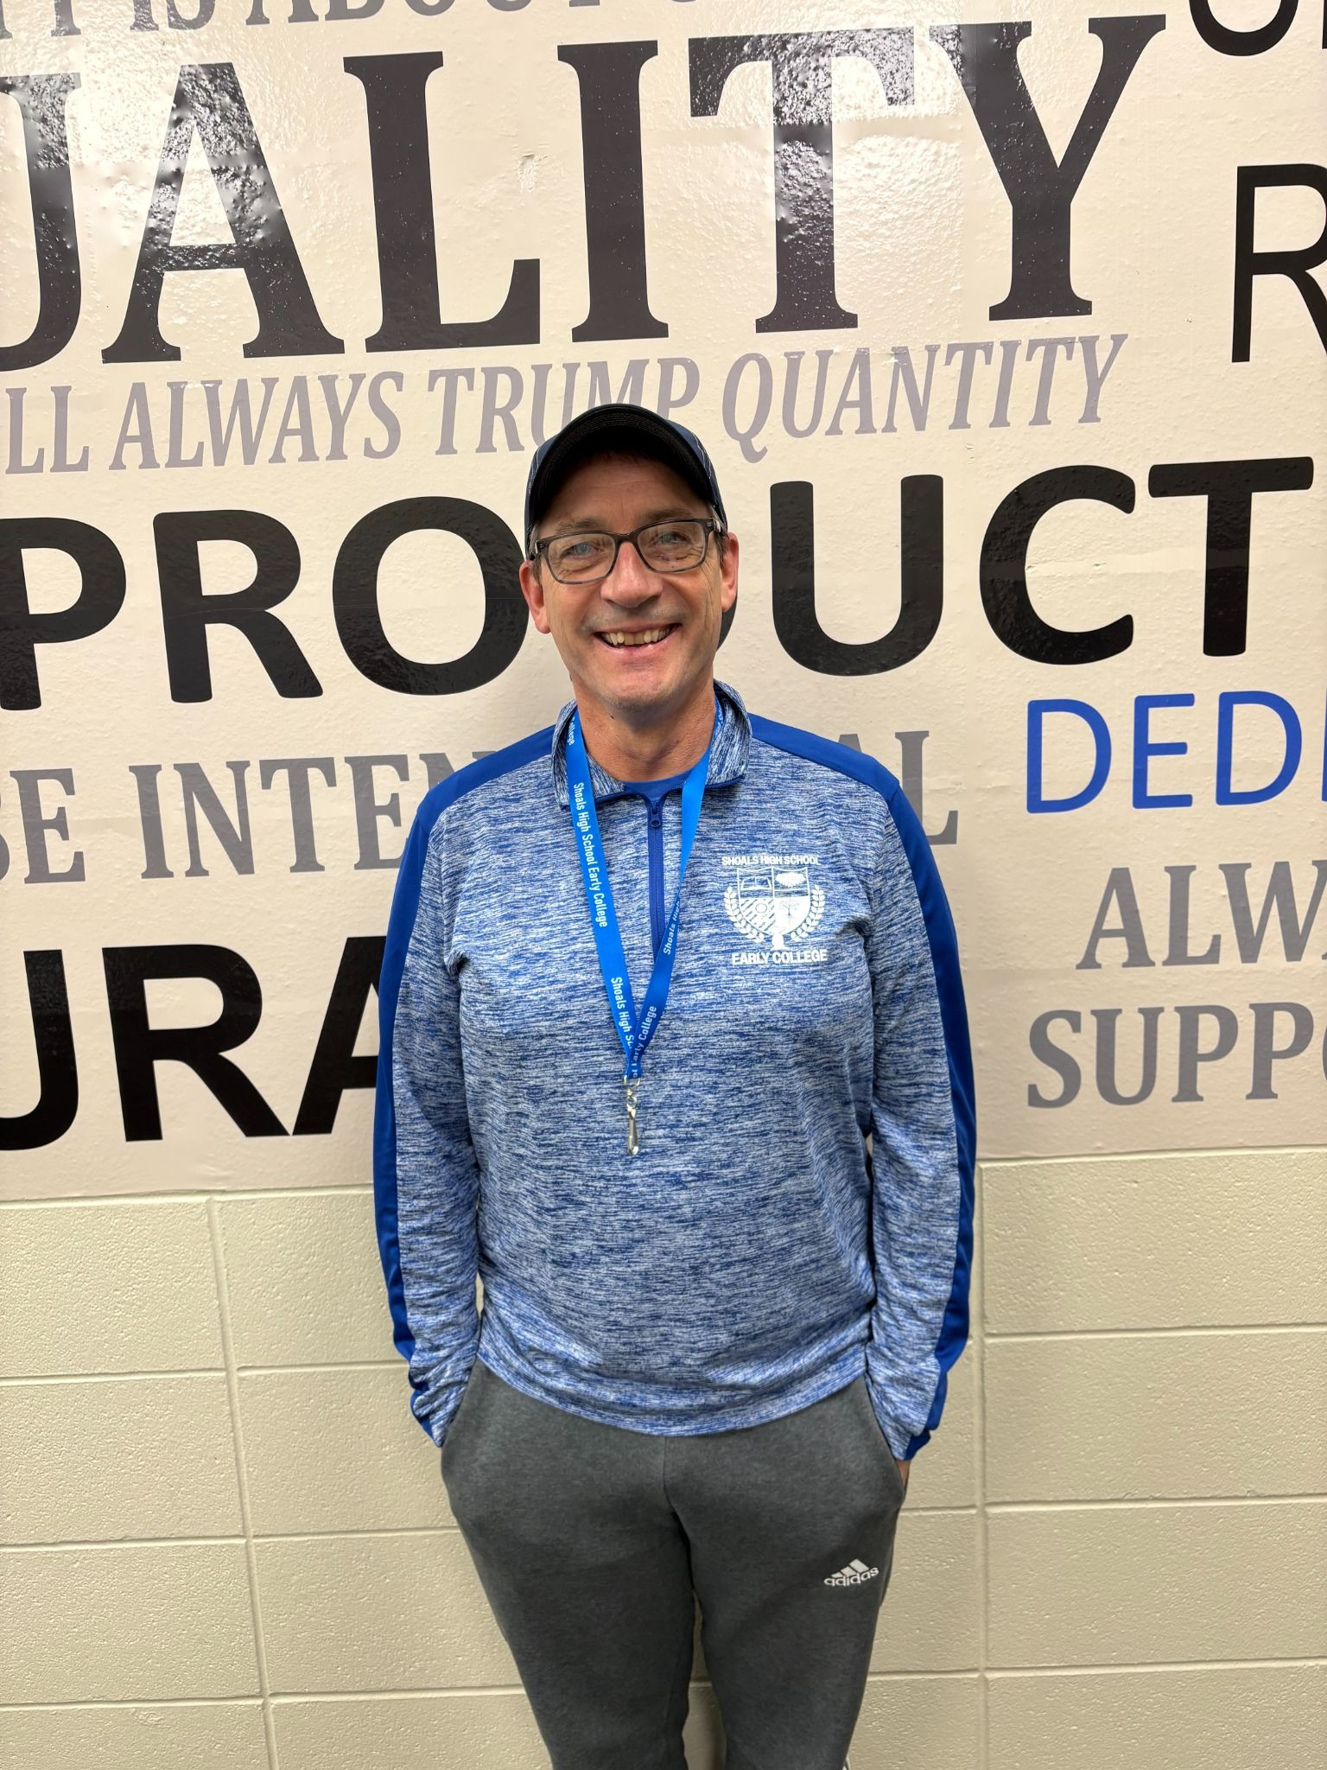
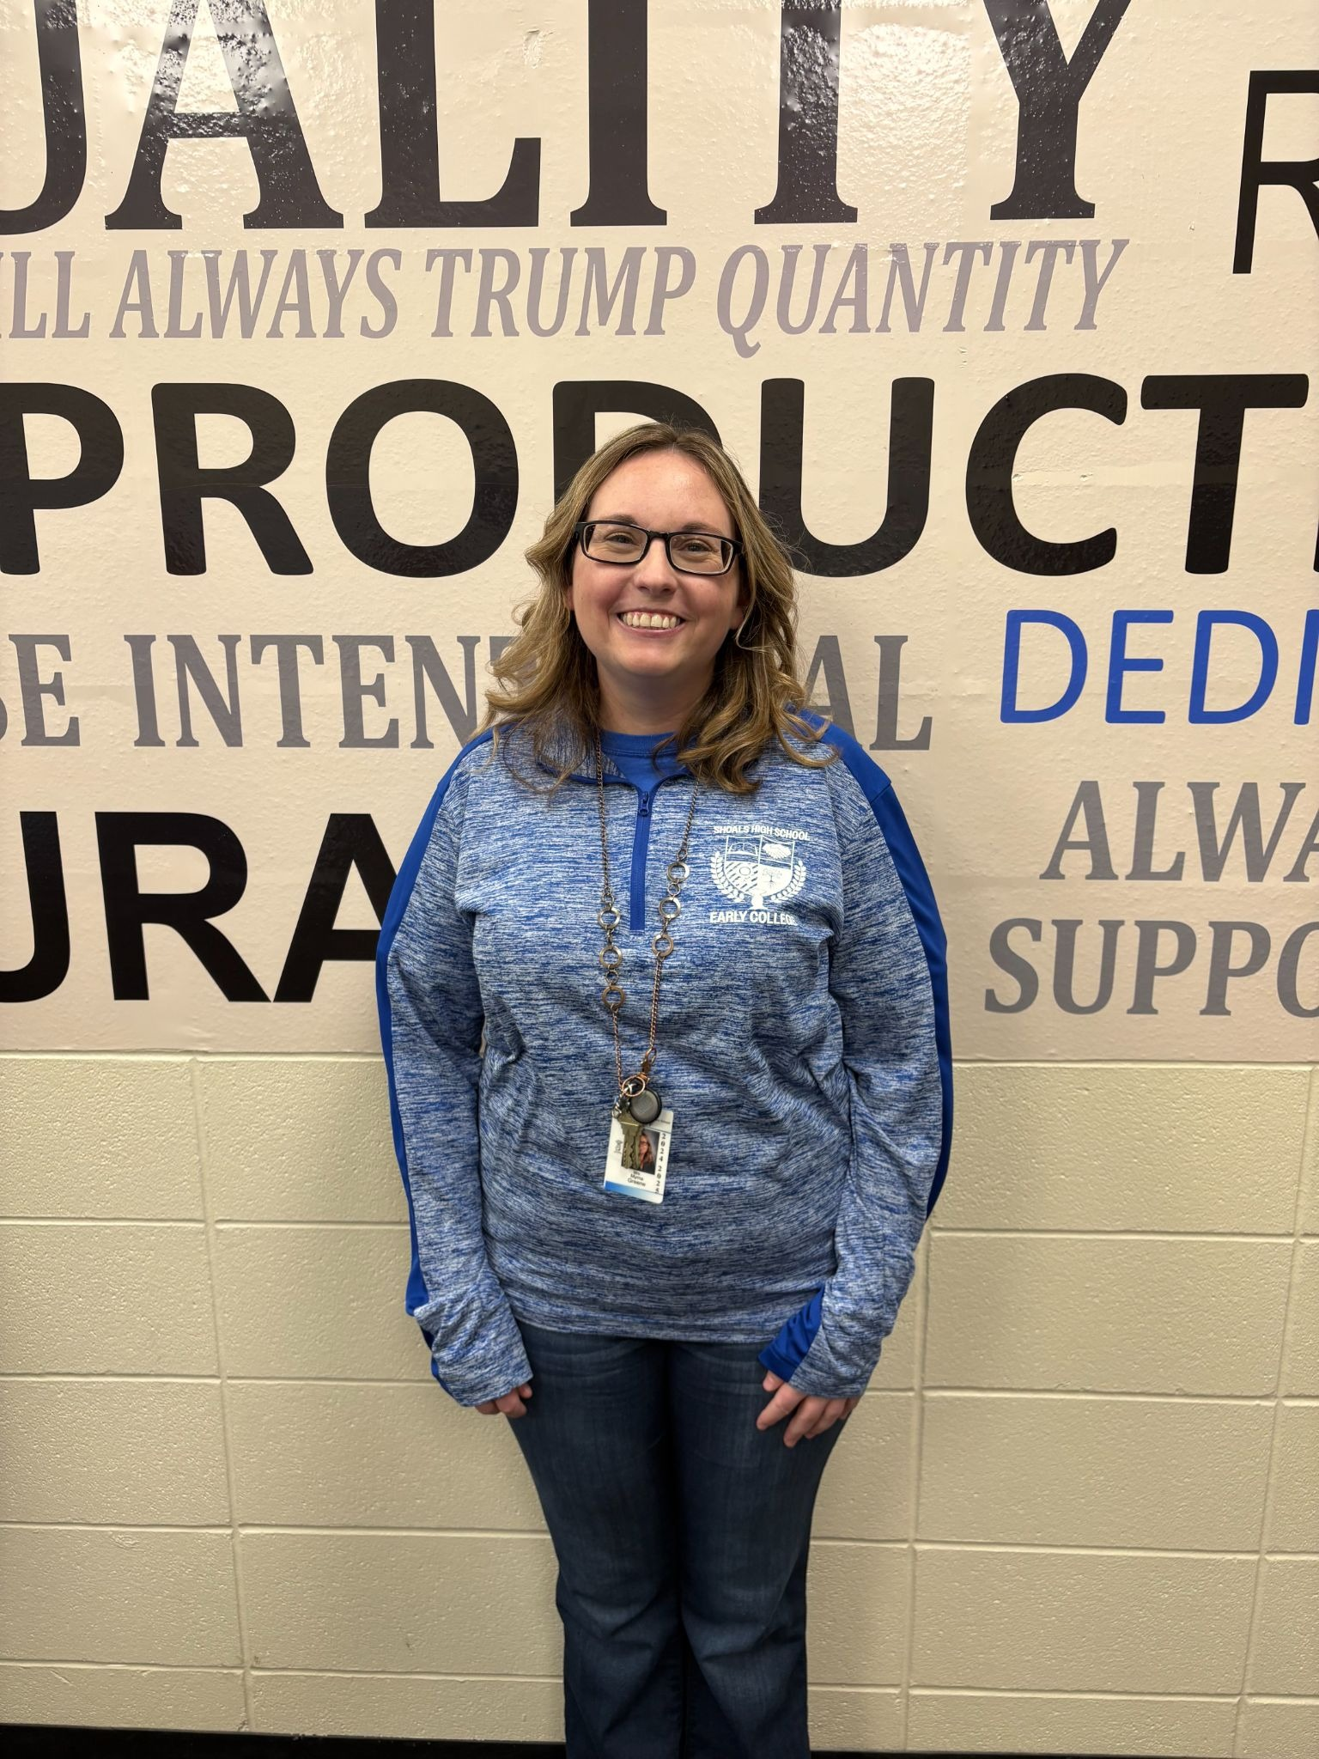
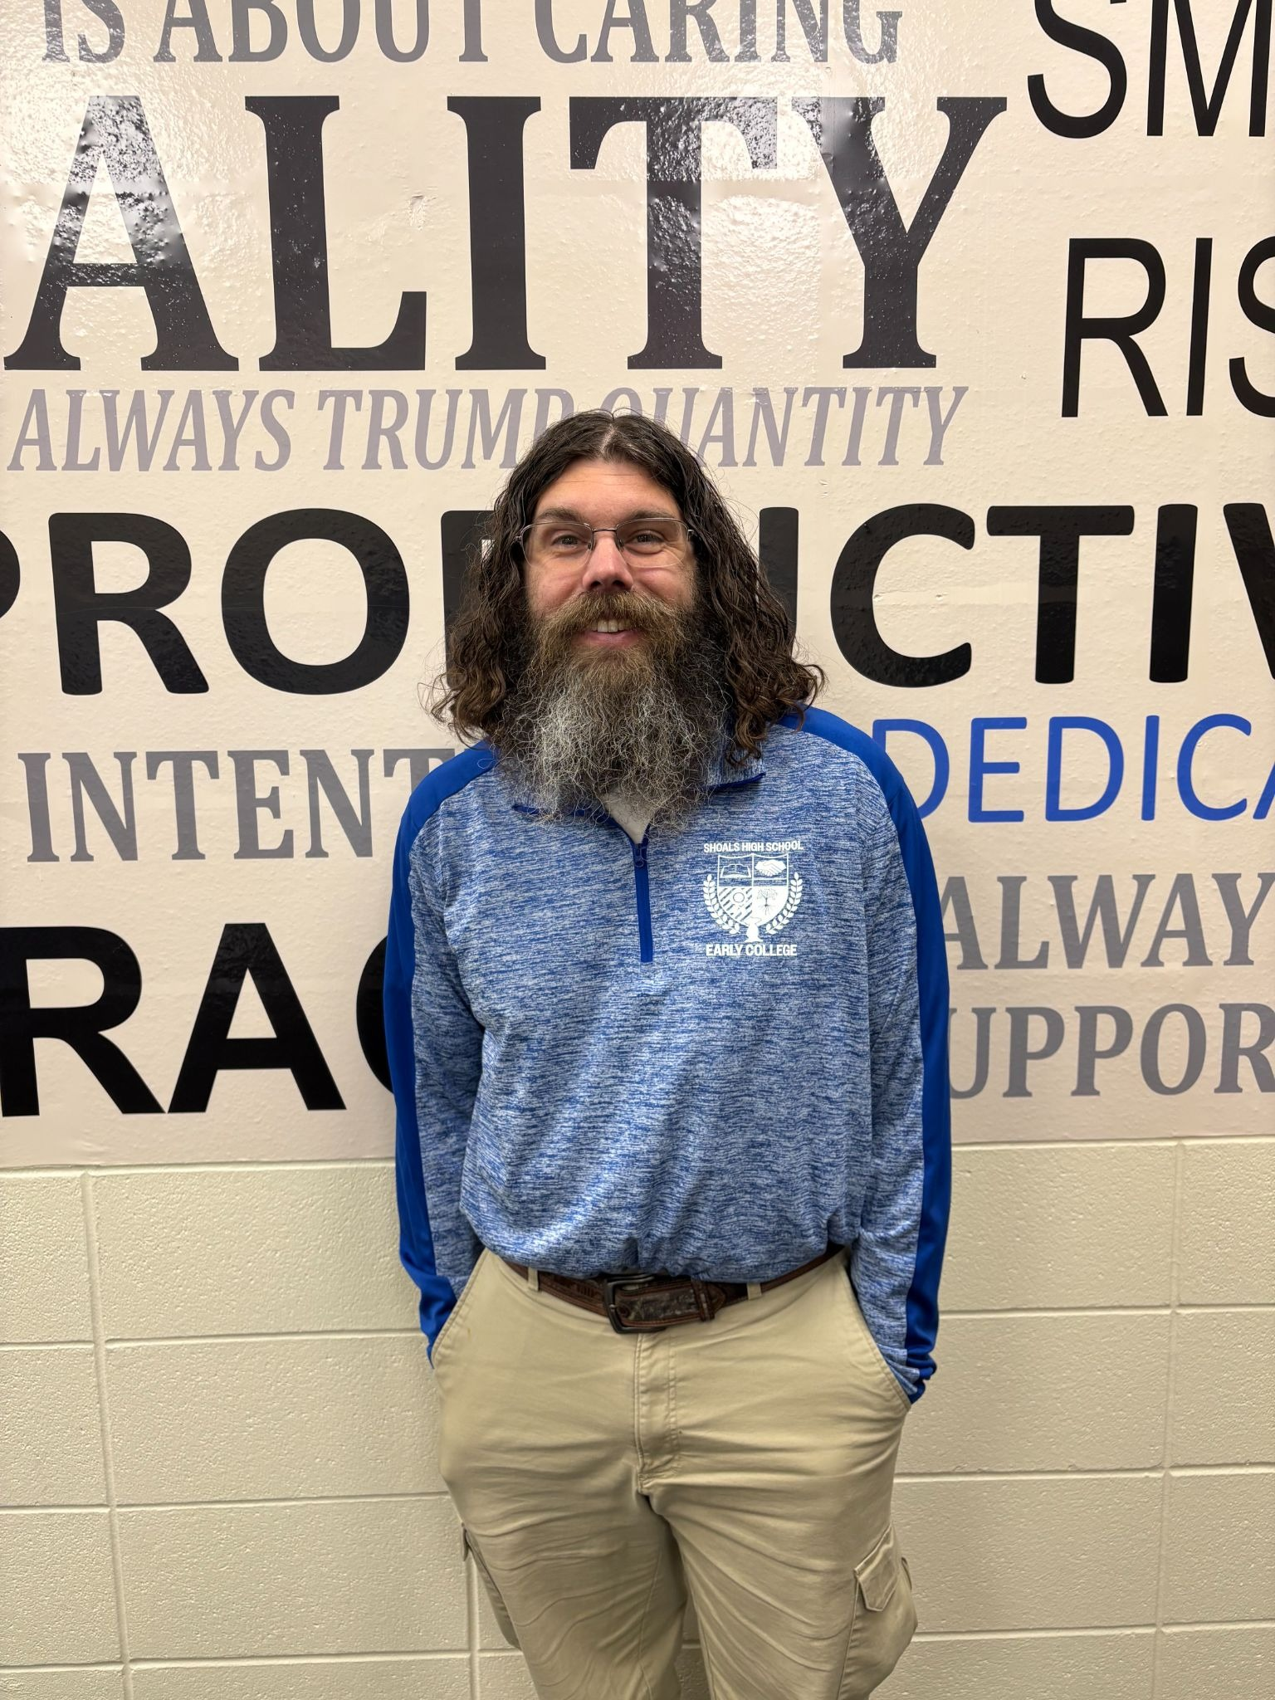
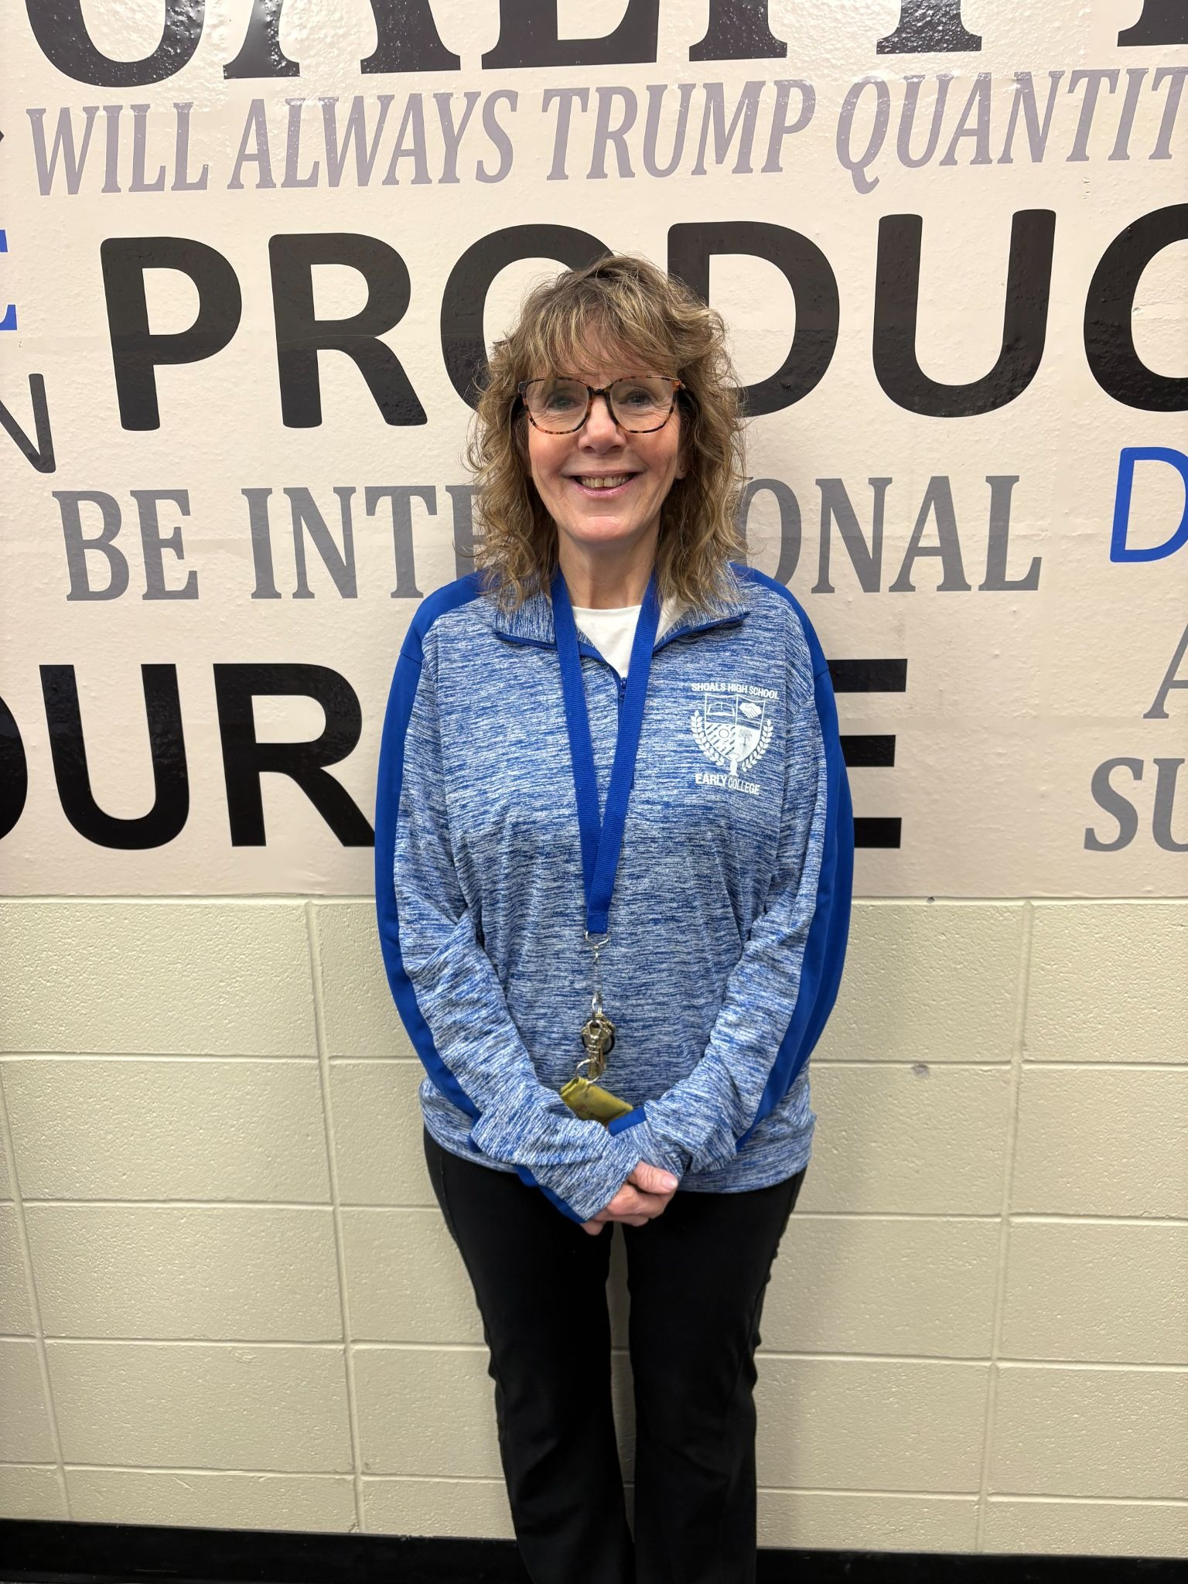
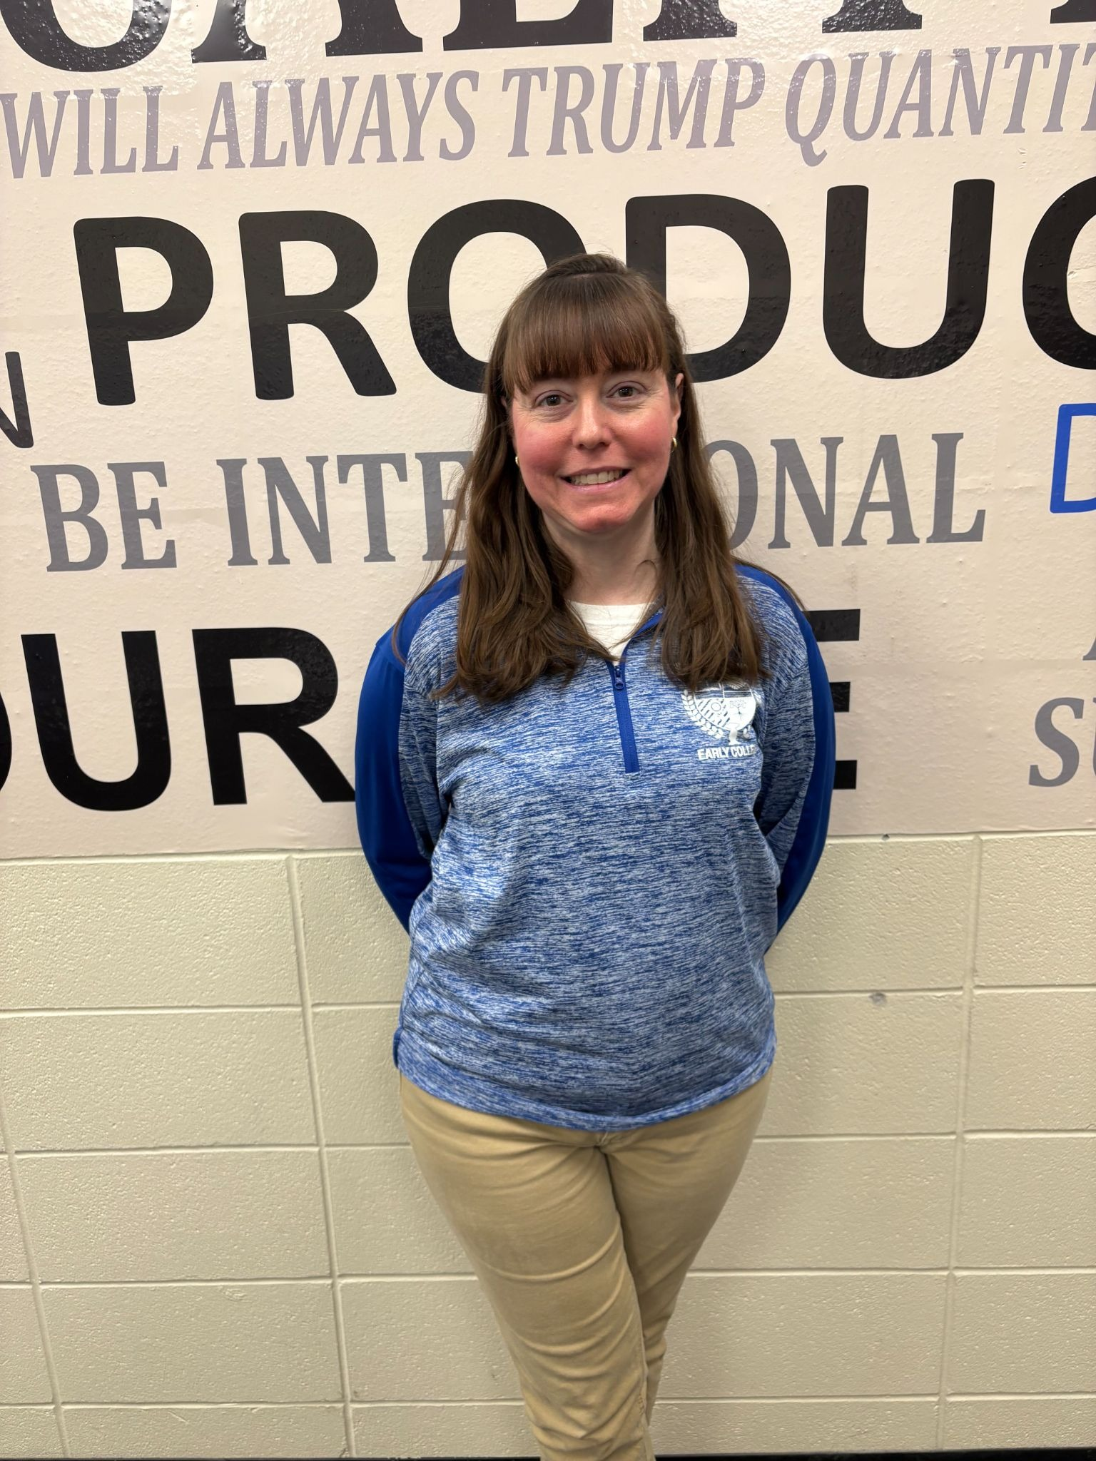
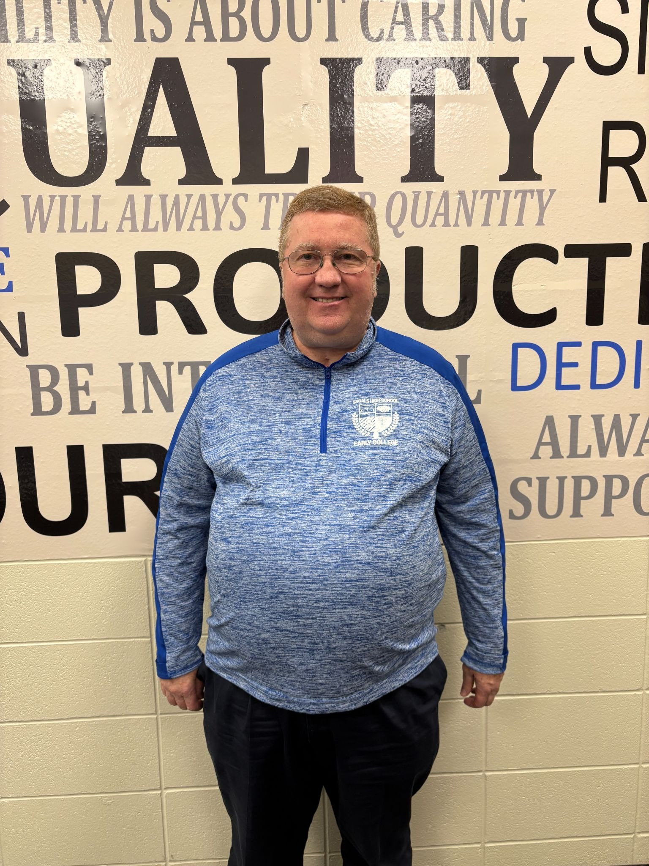
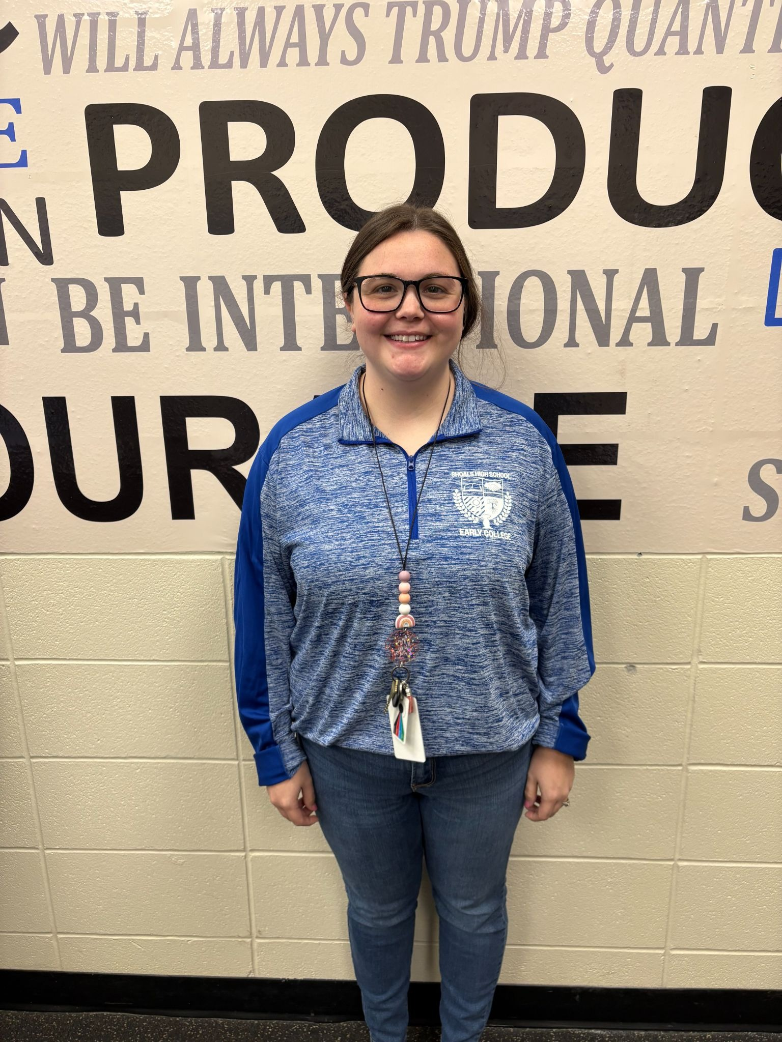
Our Early College Teachers
Ms. Terra Boyd
Biology
Miss Erin Cage
Spanish
Ms. Myrna Greene
Psychology
Mr. Dennis Dahlen
English & Speech
Mr. Jonathan Holt
Mathematics
Mr. Wes Stephenson
Chemistry
Mrs. Tina Rue
Social Studies
Mrs. Kelley Wellman-Covey
Human Services
Mrs. Theresa Holt
Health Science
Notes:
Kindra

Slide 10

Thinking Outside of the Box
Theresa Holt - Nursing
Myrna Greene - Psychology
Kelley Wellman-Covey – Human Services
Notes:
Kindra

Slide 11
Early College by the Number
 | 2020- 2021 | 2021- 2022 | 2022- 2023 | 2023- 2024 | 2024- 2025 | TOTAL (Since Fall 2020)
# Dual Credits Earned by Students | 711 credits earned | 683.5 credits earned | 701 credits earned | 807 credits earned | Estimated: 840 | 3,742.50
# ICCs awarded | 0 | 4 | 7 | 9 | 14 | 34
Estimated Tuition Dollars saved | $203,993.01 | $196,102.99 | $201,123.91 | $231,536.37 | Estimated: $241,004.40 | $1,073,760.68
Notes:
Kindra

Slide 12
Questions
Contact:
Tina Rue - Early College Teacher
ruet@shoals.k12.in.us
Kindra Hovis - Principal
hovisk@shoals.k12.in.us
Notes:
Both

Slide 13


