Slide 1


Slide 2
School Librarians:
The Secret to a Successful Dual Credit Program
Shauna Oakwood
Media Specialist and Dual Credit Teacher
Crispus Attucks High School
Indianapolis Public School

Slide 3
Media Specialist? School Librarian? What is what?
A Media Specialist/School Librarian/Teacher Librarian is:
A licensed teacher
Has an endorsement or degree in library and information science
Indiana School Librarian Standards emphasize:
Information and Technology Resources
Information and Knowledge
Independent Learning and Inquiry
Social Responsiblity and Collaborative Inquiry
Communication and Collaboration
Instruction and Assessment

Slide 4
Does your school have a school librarian?
Hold up 1 for yes, 2 for no, 3 for unsure

Slide 5
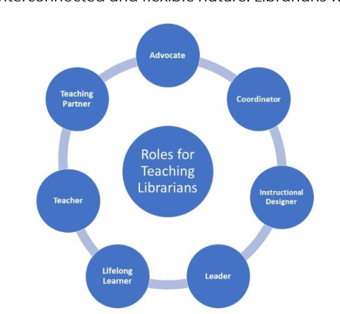
College Librarians
From “Roles and Strengths of Teaching Librarians” from the Association of College and Research Librarians (part of the American Library Association)

Slide 6
Ways I have supported my EC program since 2023
Research Lessons
Tech Support
Syllabus Design
Teaching
Check Ins
Library Liaison
Teaching databases, note taking, and documentation (MLA, APA, Chicago) for multiple subjects (English, History, Science)
Course registration, Knowledge Assessments, assignment submission on Canvas, Chromebook support
Support for English, Communications, Biology, and History, finding resources and texts
English and Communications courses
Academic, wellness, registration progress
Communication with university librarians to support student research

Slide 7
Supports for Students
Finding research articles and books
Checking out books or finding via ILL
How to use databases and features
Help communicate with teachers (make contact or help students with emails or prepare to talk)
Technology support (getting devices, printing, LMS help)
Grade check ins to identify assignments to complete or other areas of concern
Registration support

Slide 8
Supports for Teachers
Finding resources to support and supplement curriculum (articles, websites)
Convert materials to other formats (PDFs, convert to Docs)
Thought partner for curriculum planning/syllabus development
Support for online LMS
Study space for students to work independently or in small groups

Slide 9
Supports for EC Administration
Registration coordination (pull student groups, one on one support, directions for teachers and students)
Processing grade reports from credits dashboard
Observing new EC teachers to provide support and feedback as a non-evaluator
Sharing resources with administration and other teachers (connectedness survey, registration handouts, etc.)
Helping plan and support EC activities (get togethers, recruitment)
Connecting with K-14 partner to support program needs

Slide 10

How are we currently utilizing our librarian?
First turn and talk to a neighbor
Volunteers to share?

Slide 11
What is one new way we can draw upon our school librarian? Or how can we use this to support justifying the position?
First turn and talk to a neighbor
Volunteers to share?

Slide 12
Additional Research
Callison, D. (2007, June). Data on the instructional role of the library media specialist—are schools getting their money's worth? School Library Media Activities Monthly, 23(10). https://schoollibraryconnection.com/content/article/2207479
Collins, H. (2022, March 11). How to use your Media Specialist (and what to do if you don't have one!). Keep Indiana Learning. https://keepindianalearning.org/how-to-use-your-media-specialist/
Mowreader, A. (2023, February 15). Librarians target incoming students, collaborative measures. Inside Higher Ed. https://www.insidehighered.com/news/student-success/academic-life/2023/02/15/librarians-target-incoming-students-collaborative
Prather, A. (2025, January 27). Three ways libraries help you succeed in college. University of Health Sciences and Pharmacy in St. Louis. https://www.uhsp.edu/three-ways-libraries-help-you-succeed-in-college/

Slide 13
