Slide 1
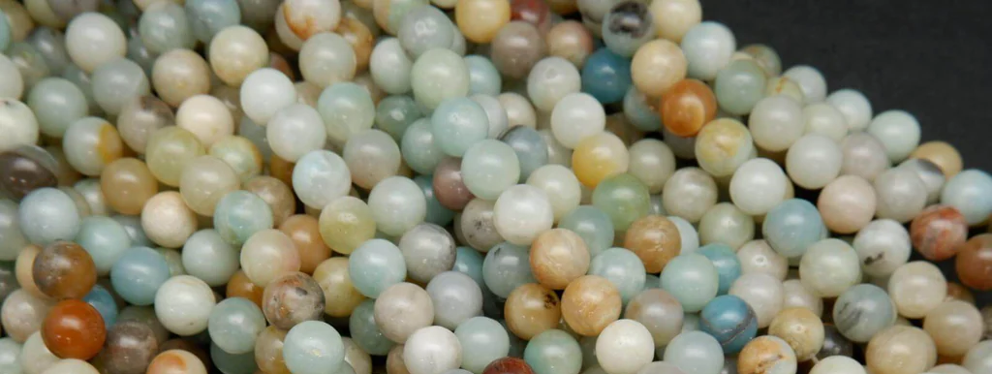
Meditative Mala Making
Workshop
Crystal Monteleone

Slide 2
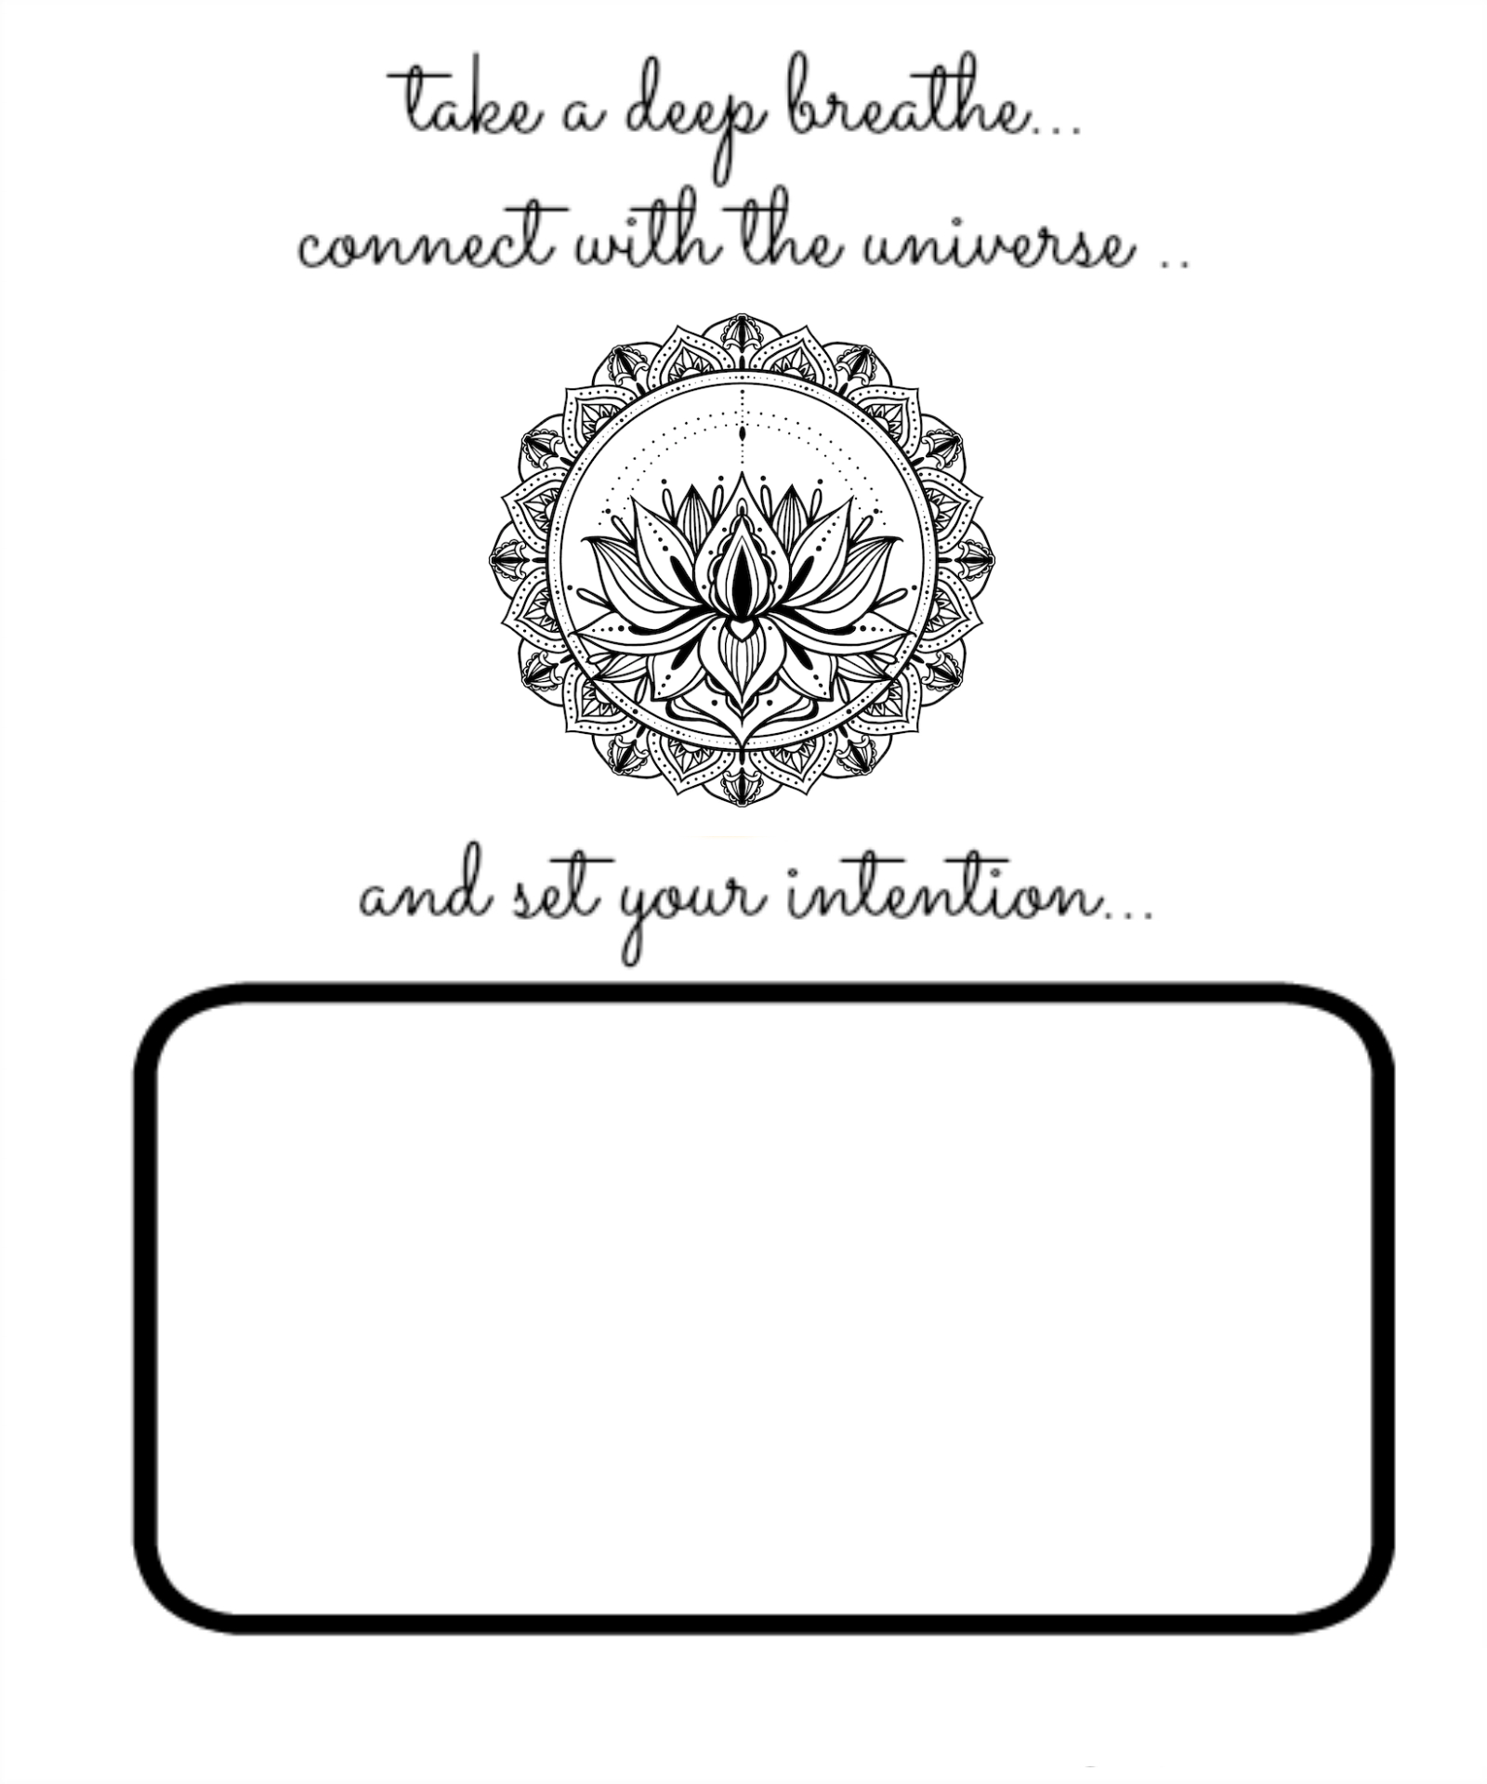
Intention setting
Let’s set the intention or affirmation for the mala we are going to make.
Take moment to listen to your heart and clarify what you want.
Write it down and be as creative as you want!
Examples:
I am love
All that I seek is already within me
I am abundance
May all be happy & healthy
I focus my energy on…
I dedicate this mala for…
May the person who wears this will be healthy
When focusing your energy to your intention while making the mala, your mala will become a powerful focal to manifest it.
“Energy flows where attention goes.” ~Tony Robbins

Slide 3
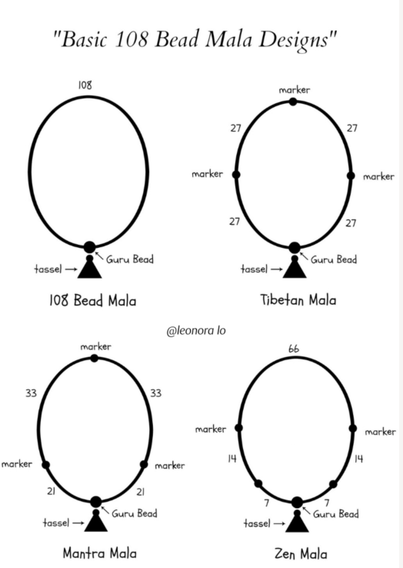
Time to mala!
108 beads
1 Guru bead
1 Tassel
Thread
Notes:
Tibetan Mala Beads - prayer beads, 108 mala, mala bracelet

Slide 4

WHAT IS A MALA
Mala beads are a set of beads that have traditionally been used in prayer and meditation to keep count of mantras during prayer or meditation. They have been used since roughly the 8th Century B.C.
In Sanskrit, Mala means a garland of beads and the process of repeating a mantra or phrase is called “japa”
However, this does not require formal religious or spiritual practice. Simply wear them as a reminder of an affirmation or intention you’ve set.

Slide 5
WHY 108 Beads
Astrology: there are 12 houses and 9 planets, 12 x 9 = 108
Heart Chakra: there are 108 energy lines connecting to the heart, with one of them believed to be the path to self realisation which lead to the crown chakra
Sun & Earth: the diameter of the sun is 108 times the diameter of earth. The distance from the sun to the earth is 108 times the diameter of the sun.
Desires: there are said have 108 earthly desires
Goddess Names: there are said to be 108 Indian goddess names
Enlightenment: there is a possibility of enlightenment with taking 108 breaths a day, while in deep meditation
Letters: while reciting the mantra in Sanskrit, the ancient script of India, within the Sanskrit alphabet there are 54 letters. Each letter has a feminine and masculine - totalling 108 letters.
Time: Some say there are 108 feelings, 36 related to the past, 36 related to the present, and last 36 related to the future.
There are many reasons or stories to why 108 beads. Some believe there are 108 stages on the journey of the human soul. The number 108 is considered to be sacred in many Eastern religions, representing the universe and oneness (1), nothing (0), and everything or infinity (8). It is also a Harshad number (“Great Joy”)- divisible by the sum of its parts. 1 + 0 + 8= 9 The number 108 can be divided by 9

Slide 6
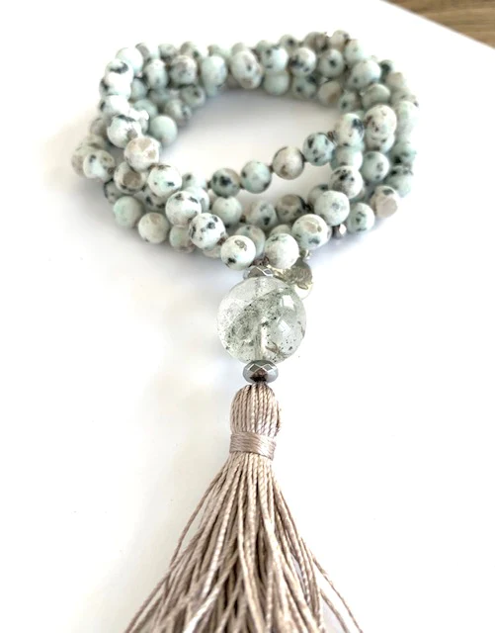
WHY a GuRU Bead & Tassel
The guru bead symbolises gratitude and connection to the divine - it is a way to say thank you to all the teachers who have helped on your path.
The tassel after the guru bead is symbolic of the transcendental state beyond the basic three states of waking, dreaming and deep sleep. It can also represent the wearer’s wish to cultivate prana (life force energy), and one’s yearning towards moksha (liberation).
In Buddhism, the tassel represents the roots of the lotus plant to remind the wearer of the analogy of “no mud, no lotus.”

Slide 7
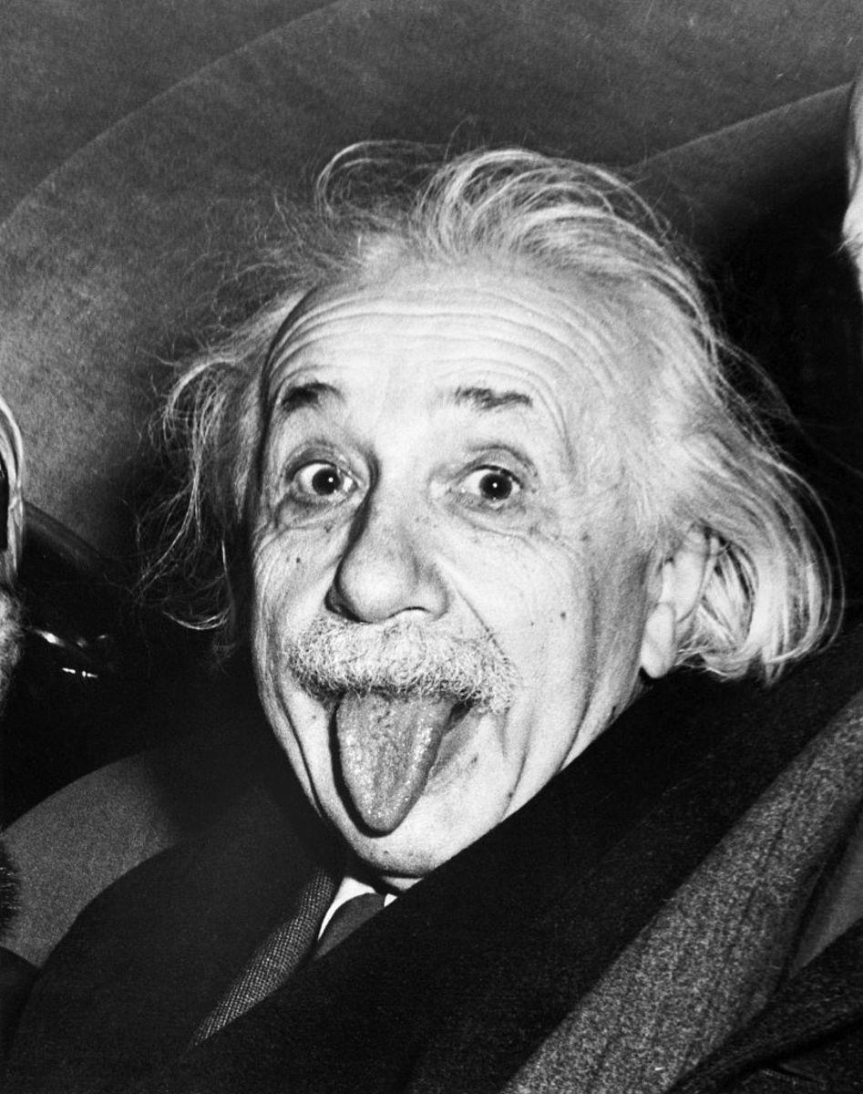
Einstein said, “Everything is energy and that’s all there is to it. Match the frequency of the reality you want and you cannot help but get that reality. It can be no other way. This is not philosophy. This is physics.”

Slide 8
Meditation Practice
Thoughts Ease
Absorbed in thought
We remember…Oh!
Meditation
Cycle
The Basics
Thoughts Increase
Relax & Forget
Bliss State
by Michael Conners
Notes:
https://www.google.com/url?sa=i&url=https%3A%2F%2Ftatfoundation.org%2Ftat-forum-archives%2Fforum2001-04.htm&psig=AOvVaw2xCcMmplWCRxTH7cP2pRKu&ust=1748465413476000&source=images&cd=vfe&opi=89978449&ved=0CBQQjRxqFwoTCIiAjrPDxI0DFQAAAAAdAAAAABAE

Slide 9

How to get started
Choose a time of day to meditate that works for you and your lifestyle.
Prepare you and your space for meditation by using incense, music, moving with intention, changing clothing or lighting a candle.
Choose an intention or mantra
Sit in a comfortable spot and settle in just focusing on the breath first.
When ready, start small with 3-5 minutes. Using your mantra, your breath, and your beads to ease into japa/mala meditation.

Slide 10
How to use your mala
Other tips
Hold your mala in your dominant hand.
Rest the mala on your middle or your ring finger (whichever feels most comfortable to you).
Start at the first bead next to the guru and use your thumb to count your mantra.
As you count, slowly draw each bead inward and leave the middle finger pointed somewhat outward so that it does not touch the mala. This finger represents the ego.
One mantra for each bead. Try chanting out loud at first, then whisper, then silently in the mind. See what feels best for you and notice the difference in your awareness.
When you reach the guru take a moment to pause and thank those who have come before you and your teachers who have helped you along your path.
Do not worry how fast or slow you are. You will naturally find a rhythm that is best for you.
You may find that you are naturally syncing your breath with your mantra. This is a great sign! Breathe naturally without force and let the rhythm come to you.
NO EFFORT
NO CONCENTRATION
NO EXPECTATIONS
NO RESISTANCE OR JUDGEMENT TO ANYTHING THAT COMES

Slide 11
Other Mantras
Om (aum, ohm) - This is the primordial sound, the sound of the Universe itself. It is the vibration of everything within and around you.
I am Love - Plain and simple a wonderful mantra for self-love, compassion, and all dimensions of love. This is a powerful mantra in English that can have a profound effect on how we treat ourselves and others.
Om Shanti (Om shan-tee) - This mantra is perfect for those who may not have an affinity to gods/goddess and want to focus on fostering more peace spiritually for oneself, in one’s physical life as well as for others in the world.
So Ham - This mantra is wonderful as it can directly correlate with the breath. Translated as “I am That. “That” can mean the Divine, She, He, Eternal, the Universe. “So” is the sound of the inhalation and “Ham” is the sound of the exhalation. It reminds us that we are all One.
Peace - Easy to remember and perfect for attracting greater peace in every facet of your life. Concentrating on this energy can create a sense of safety, calm, and loving energy towards yourself and others
May all beings everywhere be happy and free, and may the thoughts, words, and actions of my own life contribute in some way to that happiness and to that freedom for all
Ho'oponopono Prayer: I’m sorry, please forgive me, Thank You, I love you.

Slide 12
Activating our Mala
Use Light of the sun or moon, bathing the mala in its light for a few hours.
Essential Oils: with a few drops, massage the oil into the mala.
Sound: with a sound bowl or other instrument that you like you can transfer the frequency and vibration to the mala.
Burn Sage or incense and infuse the mala with the smoke.

