Slide 2
Intentional Push-In: Co-Teaching in Practical Ways
Jennifer Reiter-Cook, Ed.D.
Director of Education and School Development
RJA Summer Symposium 2026

Slide 3

Agenda
Purpose & Outcomes
Prior Knowledge
Research
Models of Co-Teaching
Closure & Questions
ThePhoto by PhotoAuthor is licensed under CCYYSA.
Notes:
12:00

Slide 4

Objective
Build general education teacher capacity to implement effective co-teaching practices that promote shared responsibility for all students, increase access to grade-level instruction, and support the academic, behavioral, and social success of students with disabilities in inclusive classrooms.
Notes:
12:05

Slide 5
Key Learning
General education teachers will understand the purpose and responsibilities of co-teaching, including shared planning, shared instruction, flexible grouping, differentiation, Universal Design for Learning (UDL), and collaboration with special education teachers to implement accommodations and Specially Designed Instruction (SDI). Teachers will learn how to create inclusive learning environments where all students actively participate and receive the support needed to meet learning goals.
Notes:
12:05

Slide 6
Action Steps
Provide professional learning on co-teaching models and effective collaboration practices, establish shared planning routines between general and special education teachers, identify instructional roles and responsibilities, implement UDL strategies and differentiated instruction, use student data and IEP information to guide instruction, and monitor effectiveness through classroom observations, collaboration meetings, and student progress data.
Notes:
12:05

Slide 7

Drawing on Prior Knowledge
Co-teaching video
Think-Pair-Share
Which models, if any, are you familiar with?
If you have experience with some form of co-teaching, what has worked and what have been the barriers?
Notes:
12:10-12:30

Slide 8
What does research show?
Establish shared vision and mutual respect (content expert/delivery expert)
Vary instructional models based on students' needs
Protect time for collaborative planning
Design instruction that benefits all students (UDL)
Build a culture of inclusion (LRE)
Notes:
12:30

Slide 9
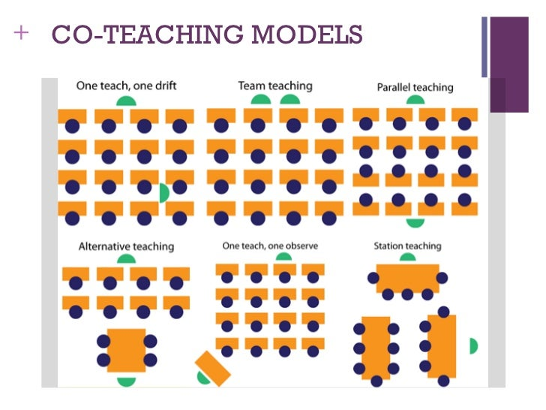
Models of Co-Teaching
Models of Co-Teaching Chart
One Teach, One Observe
One Teach, One Assist
Parallel Teaching
Station Teaching
Alternative Teaching
Team Teaching
CCYYSA
Notes:
12:40

Slide 10
Discussion & Reflection Questions
1. Planning & Roles (Group 1)
a. How can time be built into the schedule for co-teachers to plan effectively?
b. What practices can ensure both teachers feel equal ownership in the classroom?
2. Instructional Approaches (Group 2)
a. Which co-teaching model(s) would be most effective for your students and why?
b. How can differentiation be structured when using parallel or station teaching?
3. School-Wide Implementation (Group 3)
a. What training or resources would support your staff in adopting co-teaching?
b. What obstacles do you foresee, and how could they be addressed?
Notes:
12:45-1:15

Slide 11

Closure
Turn to a partner and share:
One key takeaway from our time
together that you will explore at
your school site, and
2. What do you need to establish effective
co-teaching opportunities?
Notes:
1:15-1:30

Slide 12

Questions

