Slide 1

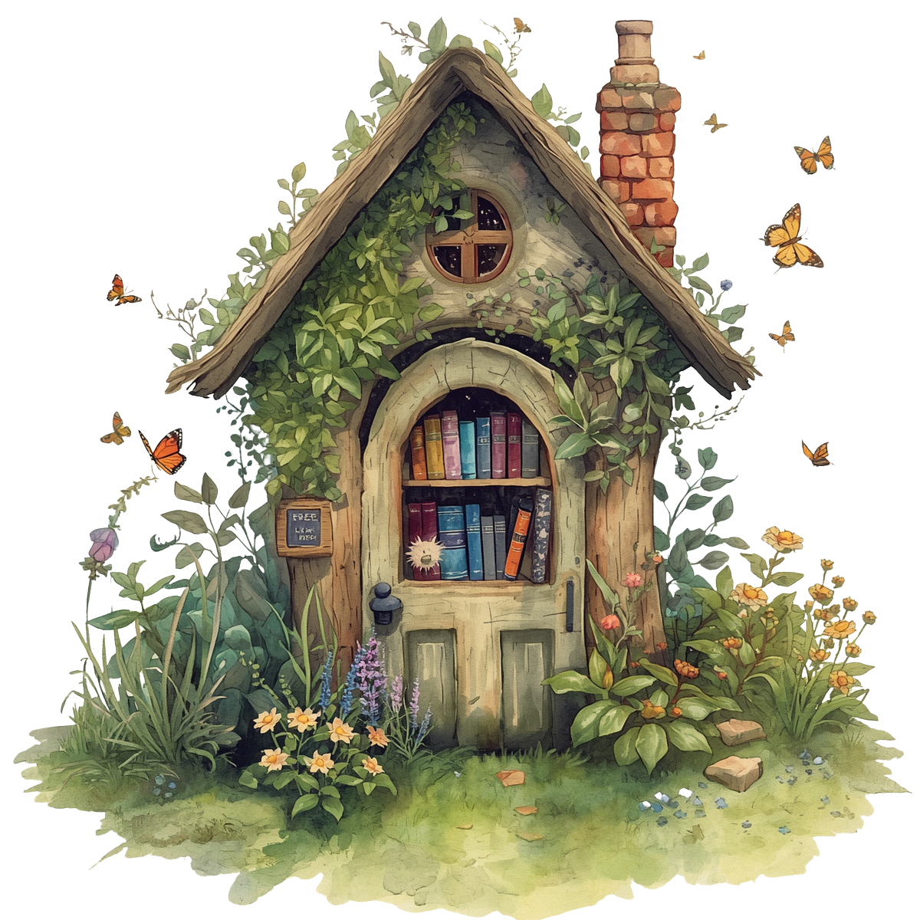
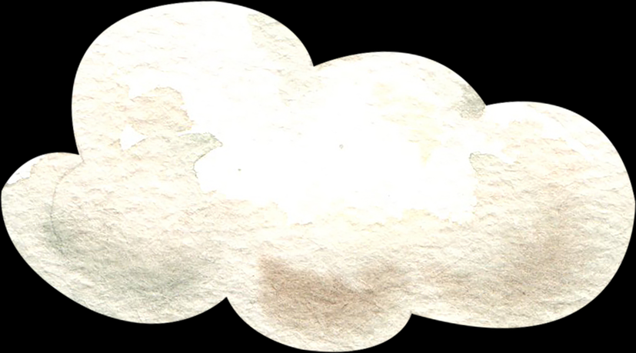
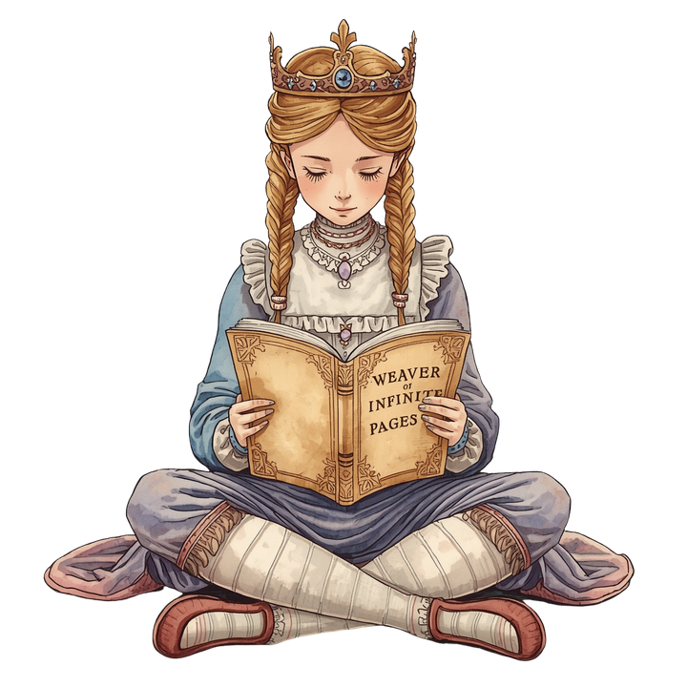

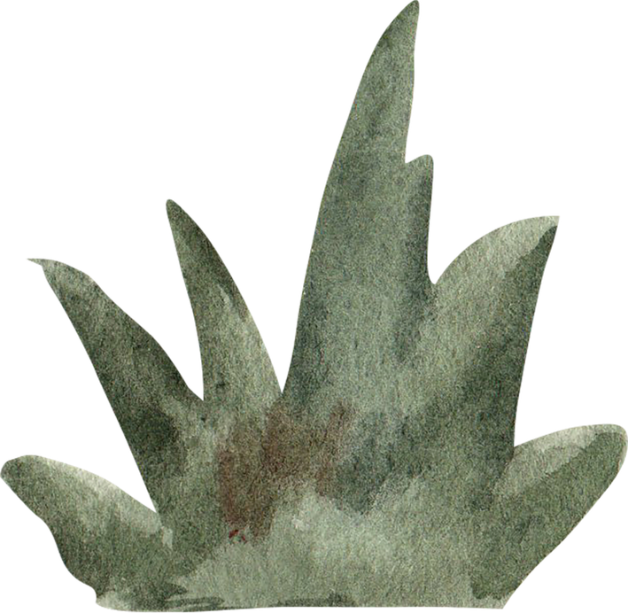

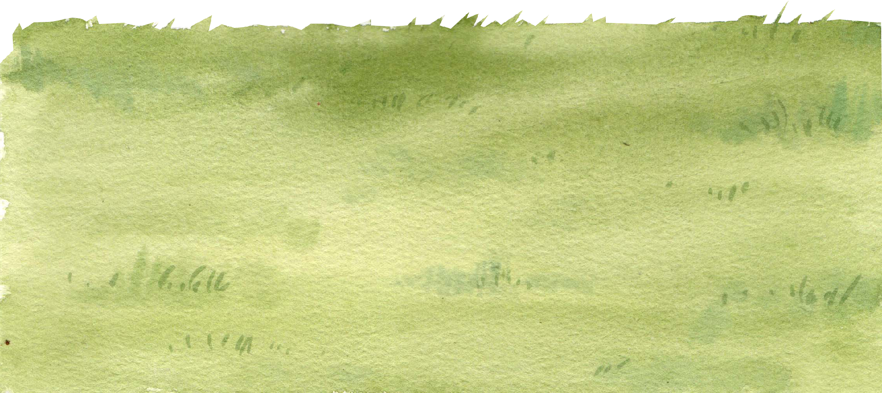
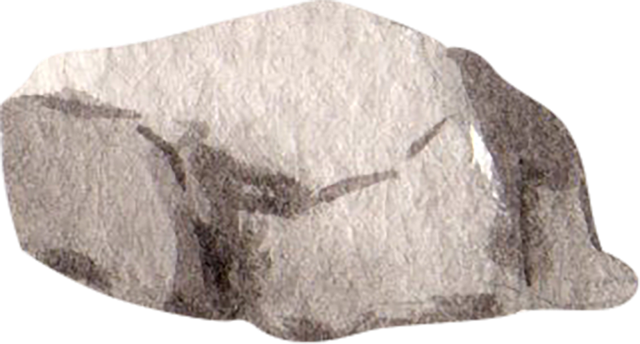
Presentation Link: go.ncdpi.gov/BackpackBooks
Companion Document: go.ncdpi.gov/BackPackBookDoc
BACKPACK BOOKS

Slide 2

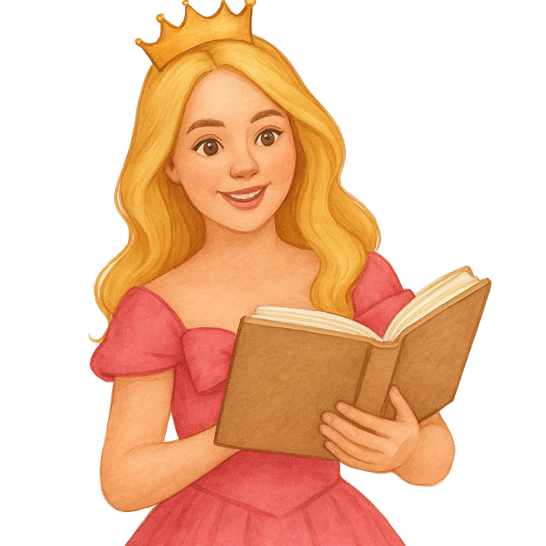
Presentation Link: go.ncdpi.gov/BackpackBooks
Companion Document: go.ncdpi.gov/BackPackBookDoc
Southwest Regional Consultant
Digital Teaching & School Connectivity
North Carolina Department of Instruction
LINDSEY SIPE
Lindsey.Sipe@dpi.nc.gov

Slide 3
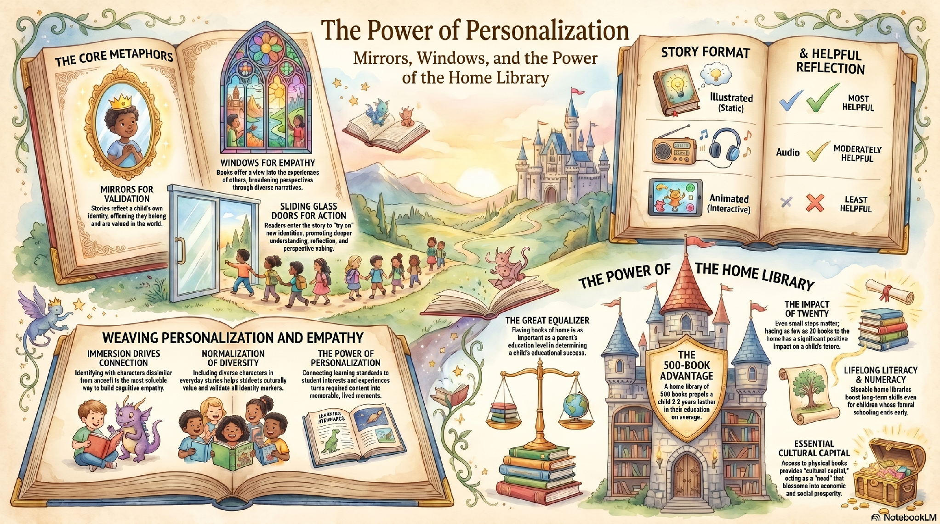

Slide 4
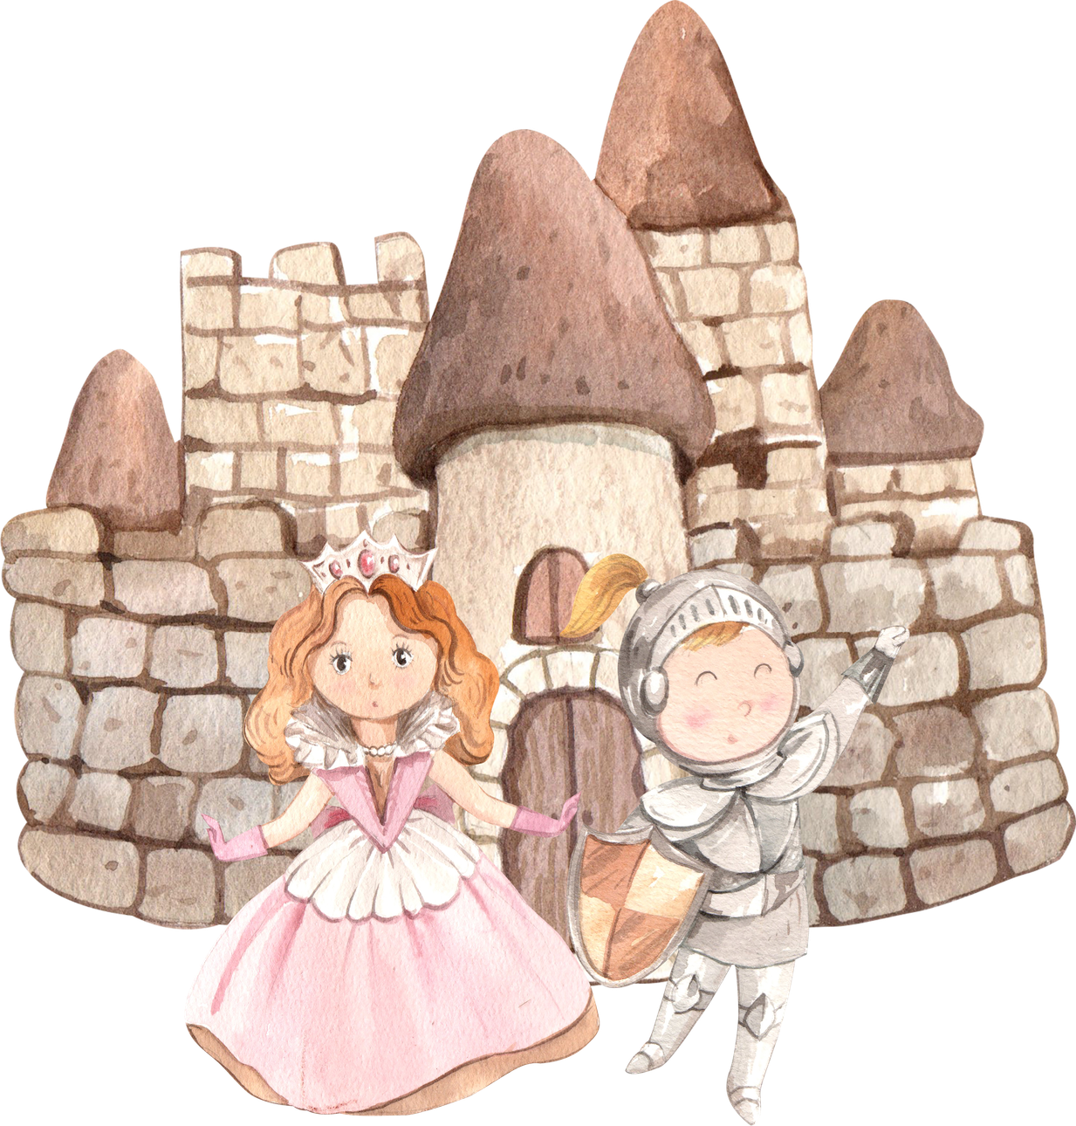
THE MAGIC OF PERSONALIZATION
When learning feels personal, students don’t just read the story- they live it!
  Connects learning standards to students’ real interests and experiences
  Builds confidence by giving students a role in the learning story
  Deepens understanding through relevant vocabulary and context
  Encourages empathy, curiosity, and voice
  Turns required content into meaningful, memorable moments
Presentation Link: go.ncdpi.gov/BackpackBooks
Companion Document: go.ncdpi.gov/BackPackBookDoc

Slide 5
THE MAGIC OF BOOKS AT HOME
The Power of the Home Library:
  Access to a home library of 500 books propels a child an average of 3.2 years further in their education.
  Closing the Achievement Gap: Having books in the home is as powerful a predictor of success as a parent’s own level of education.
  Having as few as 20 books at home significantly impacts a child's educational attainment.
  Fostering Brain Health and Focus: Early reading for pleasure is linked to improved brain structure, higher cognitive performance, and better mental wellbeing in adolescence.
Presentation Link: go.ncdpi.gov/BackpackBooks
Companion Document: go.ncdpi.gov/BackPackBookDoc

Slide 6
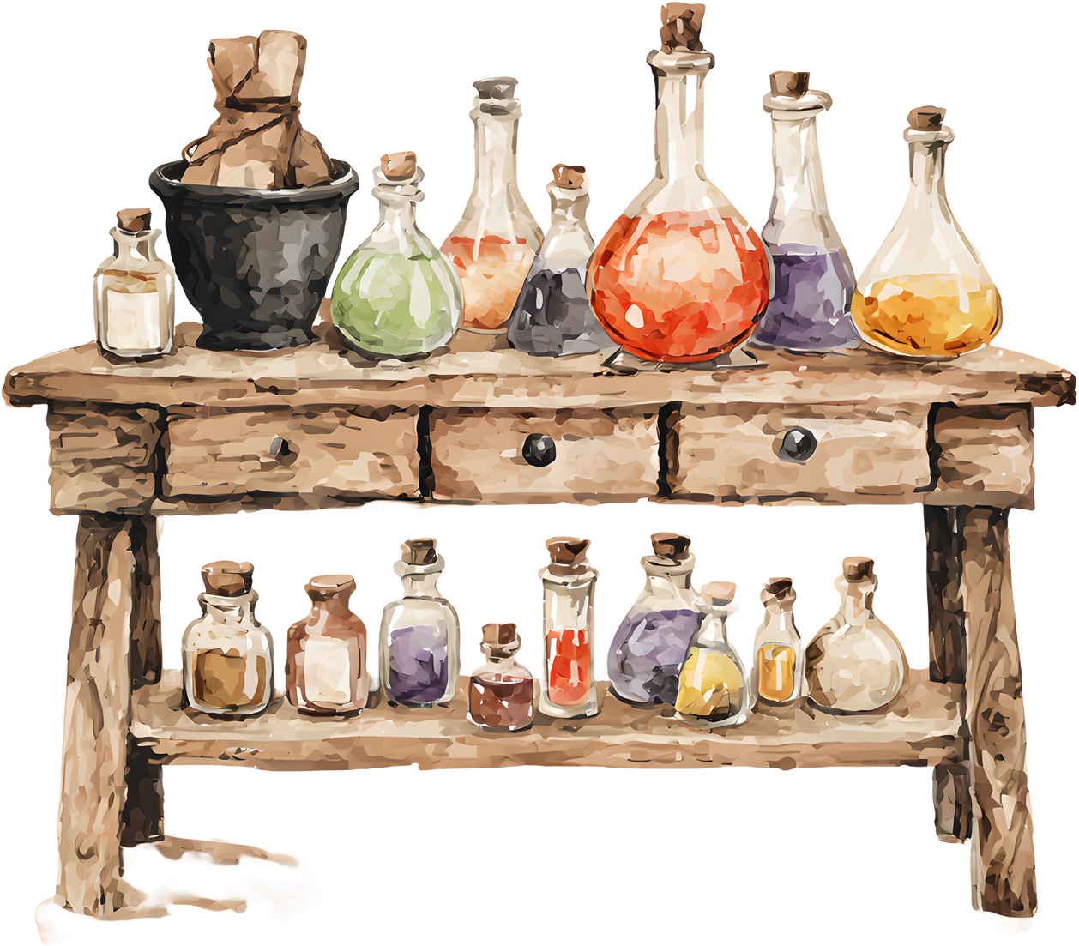
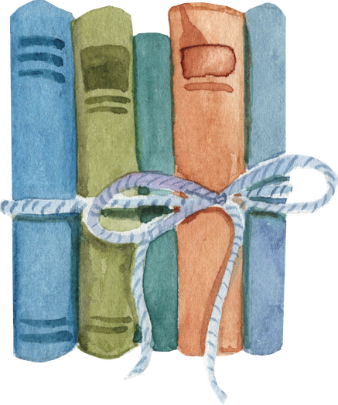
EVERY STORY STARTS SOMEWHERE
  Round One: Just Begin
  Think about your story, what are you inspired by?
    A standard
    An upcoming unit
    A funny story
    Your children
    Students
  Close your eyes and take a moment to imagine what you would like to include in your story.
  Begin Now at: gemini.google.com/gem/storybook
Presentation Link:
go.ncdpi.gov/BackpackBooks
Companion Document: go.ncdpi.gov/BackPackBookDoc

Slide 7
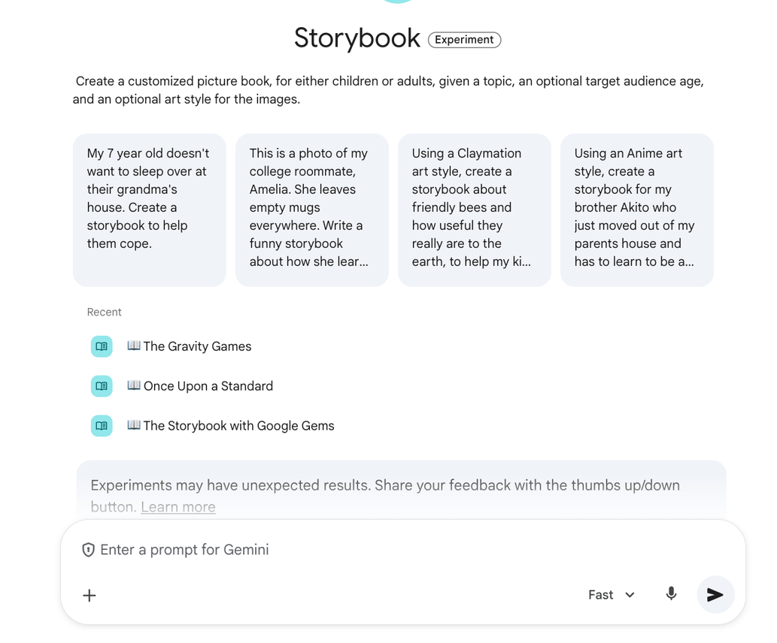
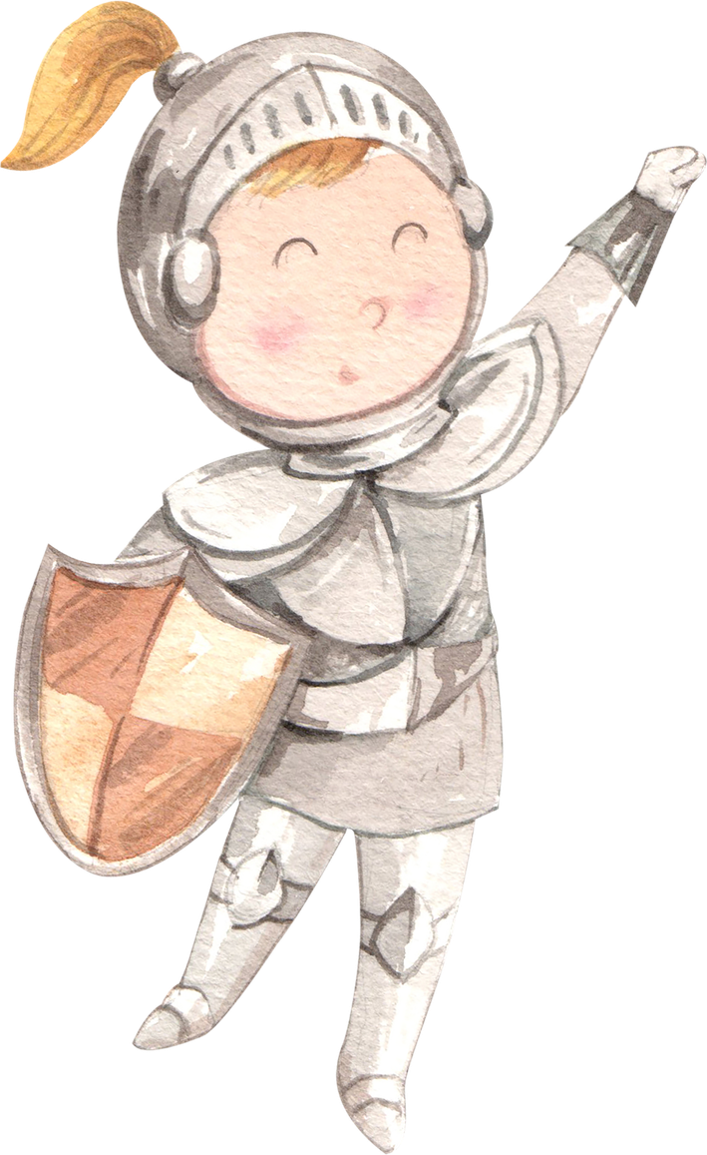
GETTING TO KNOW THE STORYBOOK KINGDOM
Gather round and take a look,
We’re learning how to use Storybook.
Tap Create to start your quest,
Choose the tool that fits you best.
Add a presentation full of slides,
Or write a doc where ideas glide.
You Made a doc to track your plan,
copy and paste when you can.
Add a word or standard to the flow,
A vocab term or sentence to show.
With every tap the magic grows,
And Storybook helps your learning glow.
Presentation Link: go.ncdpi.gov/BackpackBooks
Companion Document: go.ncdpi.gov/BackPackBookDoc

Slide 8
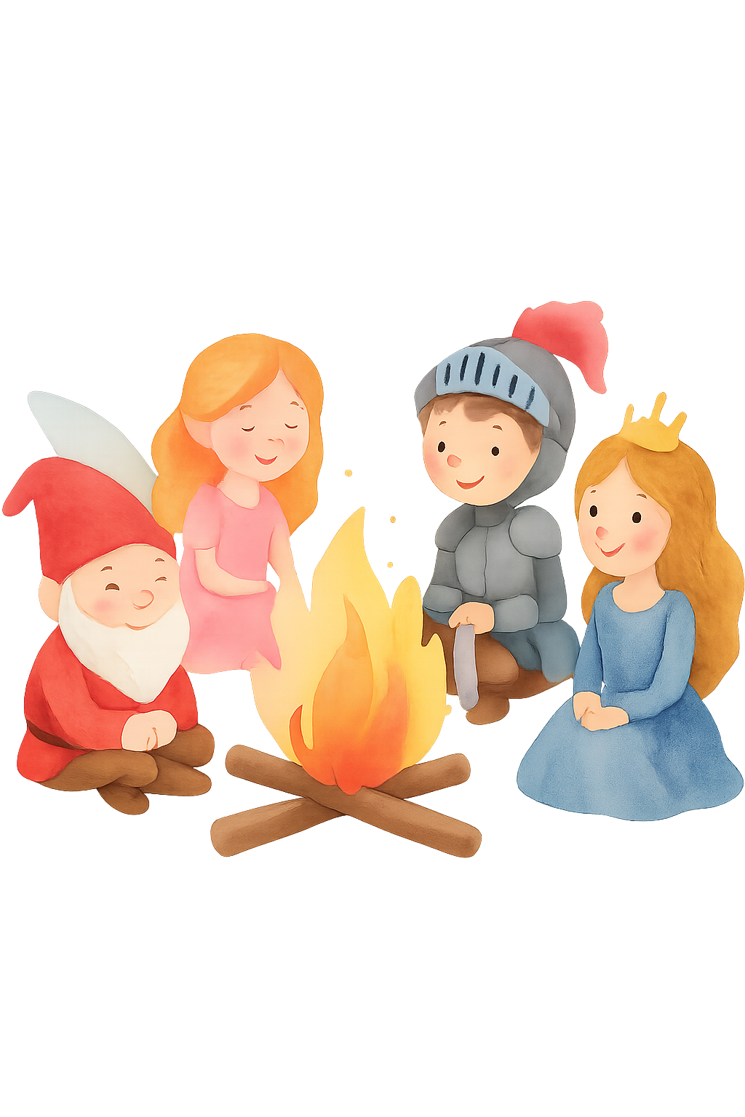
GATHER AROUND THE CAMPFIRE
Where every storyteller’s spark lights the next...
  How might your students connect to a story like yours?
  Take a moment to share what you are creating with a neighbor
  What modifications would you make based on the details they shared with you
  Any ah-ha moments?
Presentation Link: go.ncdpi.gov/BackpackBooks
Companion Document: go.ncdpi.gov/BackPackBookDoc

Slide 9
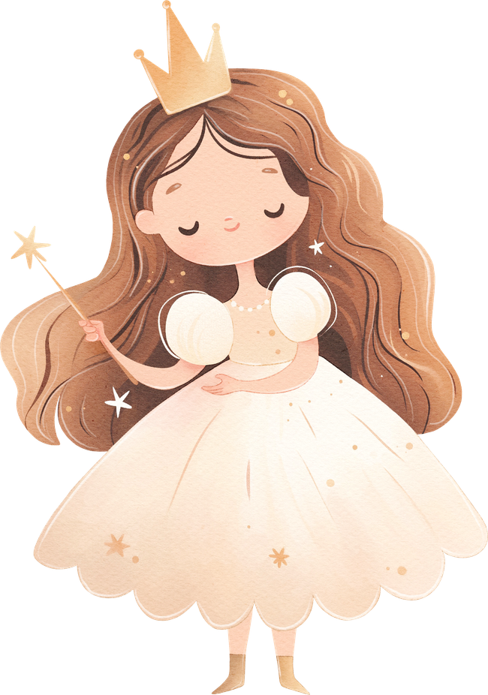
THE STORY COMES TO LIFE
When stories reflect real classrooms, they help students see that learning is about them...their voices, their world, their possibilities.
Let’s add the following details to our Storybook Set Up.
  The grade level and/or reading levels
  Details: The story includes students with the following names or aliases, interests or class dynamics.
  Story illustration techniques: Close your eyes what what would you like your story to look like
  Emotion & Tone: Let the story reflect the warmth, humor, or perseverance you see in your classroom.
  Learning Dynamics: Root your story in familiar learning experiences, projects, experiments, or shared challenges.
Presentation Link: go.ncdpi.gov/BackpackBooks
Companion Document: go.ncdpi.gov/BackPackBookDoc

Slide 10
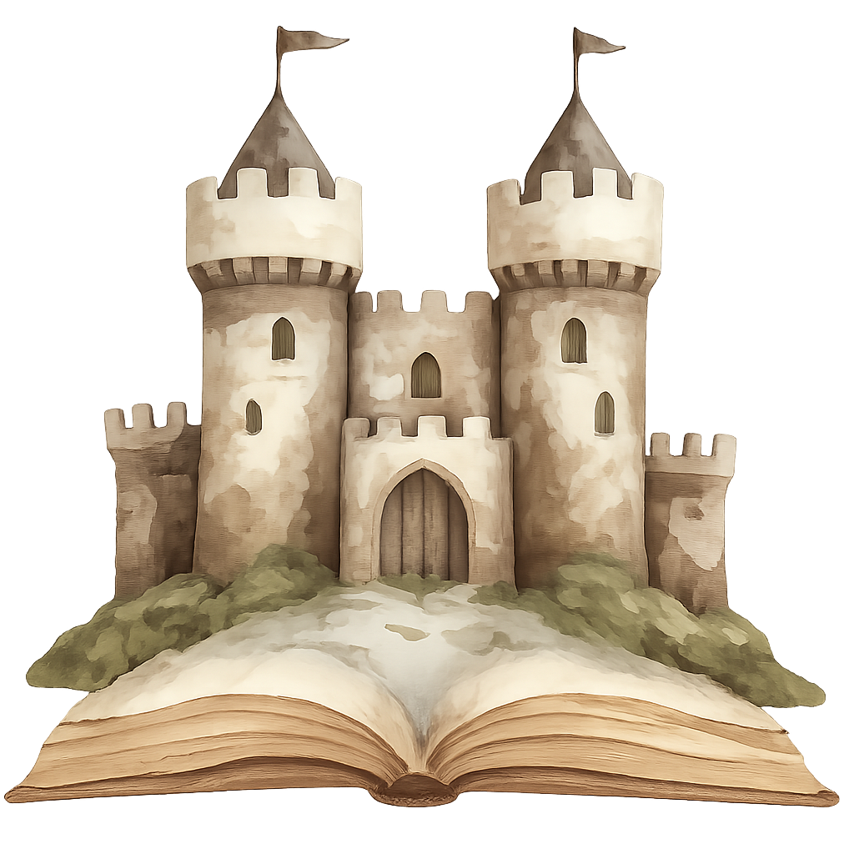
STORYBOOK SET UP
Take Two: Let’s rebuild bigger and better.
Join me at: go.ncdpi.gov/BackPackBookDoc
A Google document that will help us organize our thoughts for our story.
Presentation Link: go.ncdpi.gov/BackpackBooks
Companion Document: go.ncdpi.gov/BackPackBookDoc

Slide 11

WEAVING PURPOSE INTO PAGES
Stories become stronger when they’re woven with purpose.
  Select one card for the virtual deck:
    go.ncdpi.gov/OnceUponTaskCards
  Add that component to your story
  What detail are you adding? What impact will in make?
  Add that to this detail to your Storybook Set Up
Presentation Link: go.ncdpi.gov/BackpackBooks
Companion Document: go.ncdpi.gov/BackPackBookDoc

Slide 12
GETTING TO KNOW THE STORYBOOK KINGDOM
Take a look, let’s make it into a storybook:
Copy and paste your Prompt and let the generation begin!
Start your second story at: gemini.google.com/gem/storybook
Presentation Link: go.ncdpi.gov/BackpackBooks
Companion Document: go.ncdpi.gov/BackPackBookDoc

Slide 13
STORIES OF THE KINGDOM
  How did your stories differ?
  How did the details you added change and modify your story?
  What did you learn about connecting standards and personalization?
Presentation Link: go.ncdpi.gov/BackpackBooks
Companion Document: go.ncdpi.gov/BackPackBookDoc

Slide 14
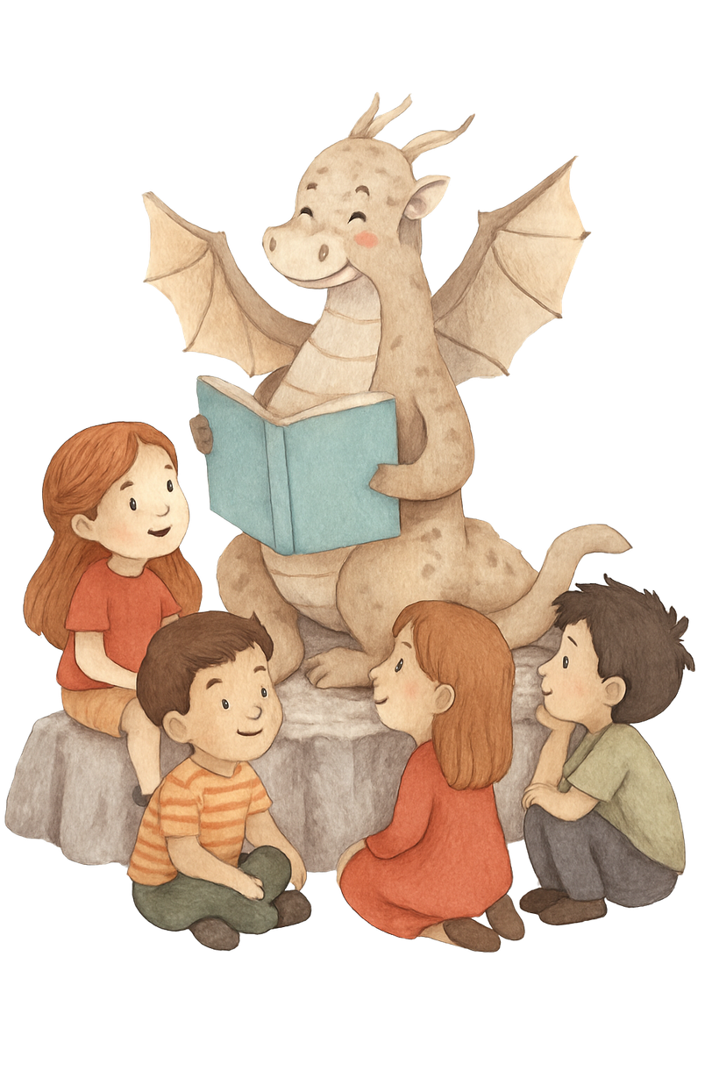
SHARING THE MAGIC WITH STUDENTS
There’s more than one way to bring the story to your students
Ideas for Sharing:
  Large group (you pull up the Storybook Gem)
  Record your screen (and Storybook)
    Optional: Your voice (or use the Listen feature) for read-alouds
  PDF printable
  Share with students via Google Drive and make available offline!
Presentation Link: go.ncdpi.gov/BackpackBooks
Companion Document: go.ncdpi.gov/BackPackBookDoc

Slide 15
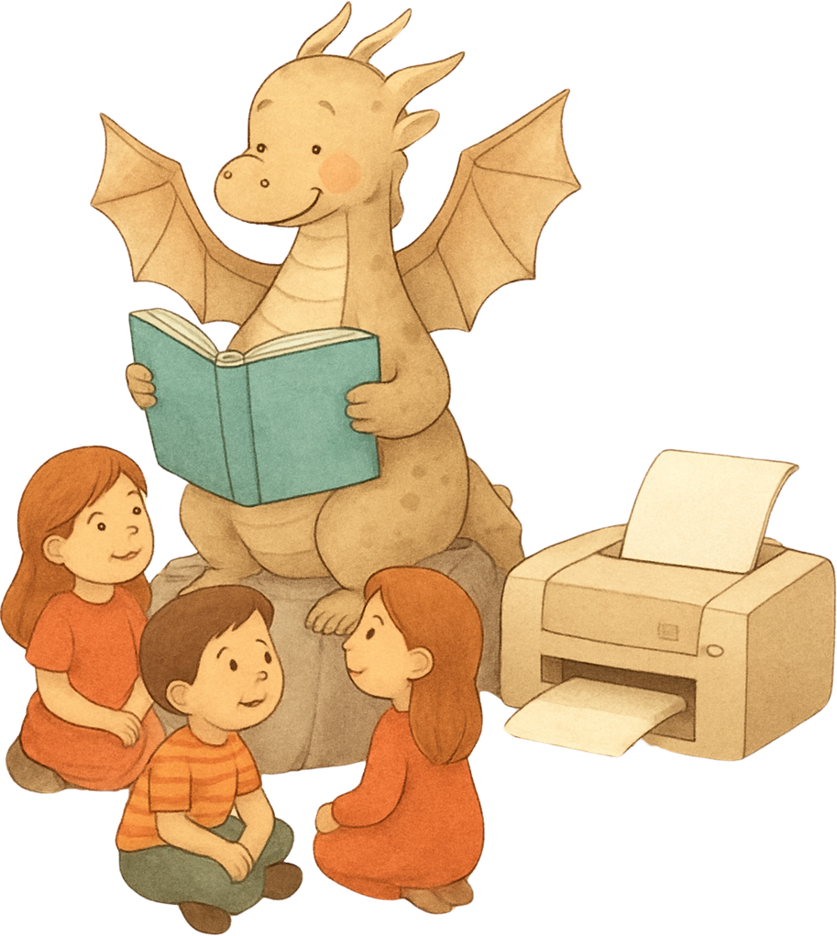
SHARING THE MAGIC WITH STUDENTS
There’s more than one way to bring the story to your students
Print it Out:
  Use this Claude Artifact to reconfigure the printing so you can print one page or in booklet style
  go.ncdpi.gov/BackbackPrint
  Follow the directions on Claude to download print
Presentation Link: go.ncdpi.gov/BackpackBooks
Companion Document: go.ncdpi.gov/BackPackBookDoc

Slide 16
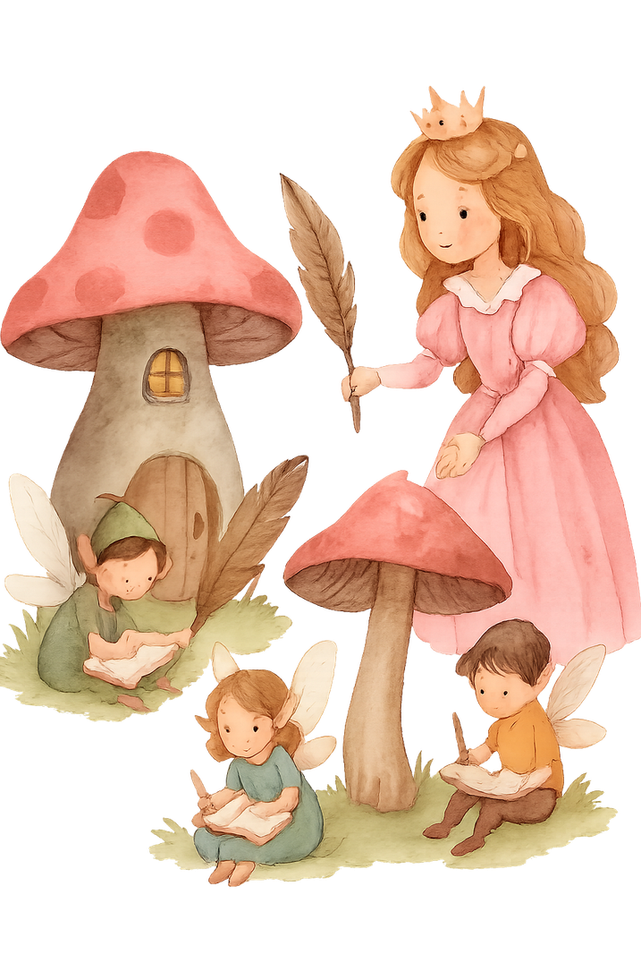
PASSING THE PEN: STUDENTS BECOME STORYTELLERS
When we guide students through the storytelling process, they discover their voice, their purpose, and their place in the story
  Model Together: Build a prompt as a class—students make suggestions
  Guided Writing Frames: Provide structured “Once upon a time…”
  Prompt Builders: Students craft their own story prompts in Docs or Slides. Choose some to generate in Gems.
Presentation Link: go.ncdpi.gov/BackpackBooks
Companion Document: go.ncdpi.gov/BackPackBookDoc

Slide 17
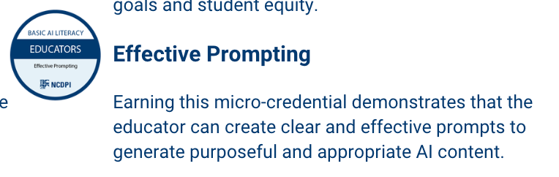
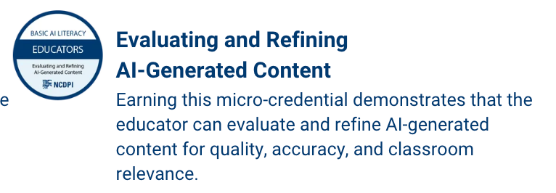
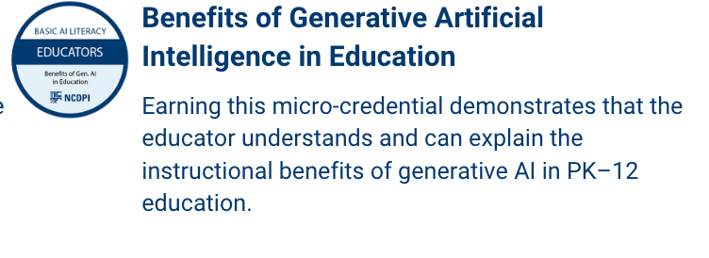
DPI MICROCREDENTIALS

Slide 18
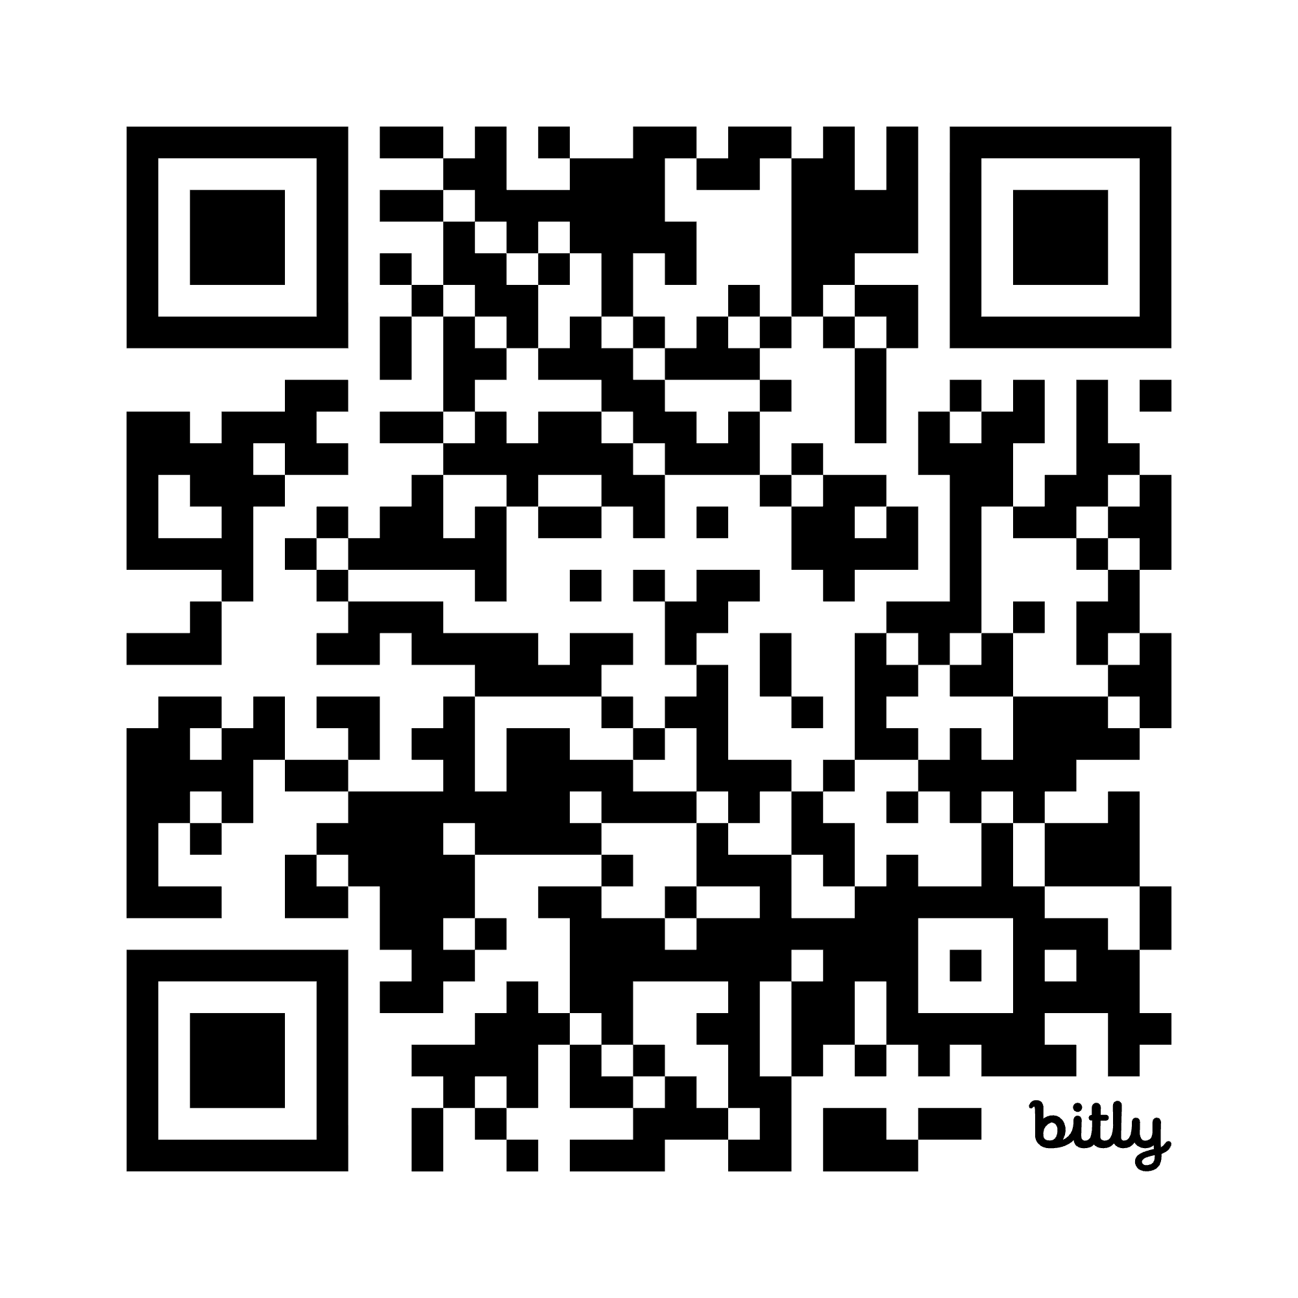
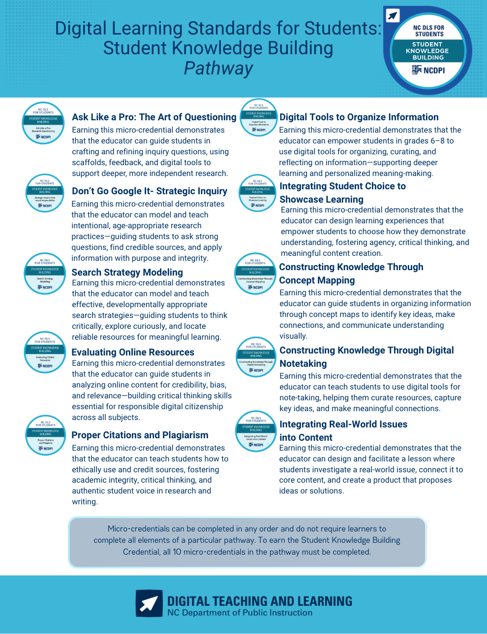
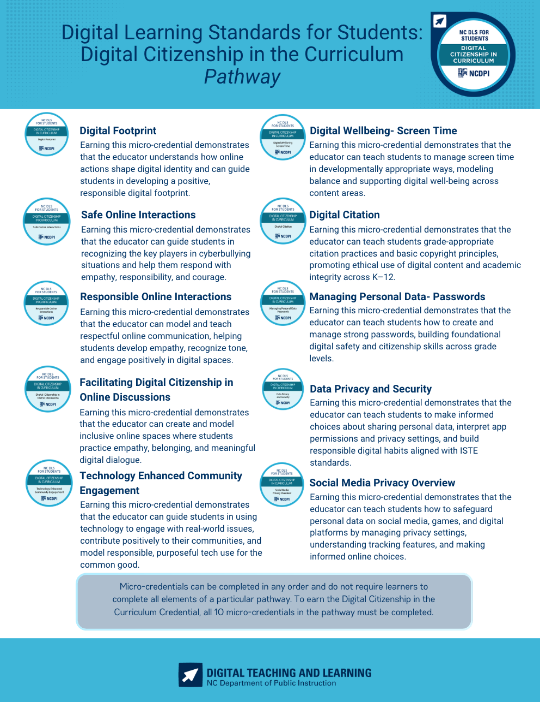
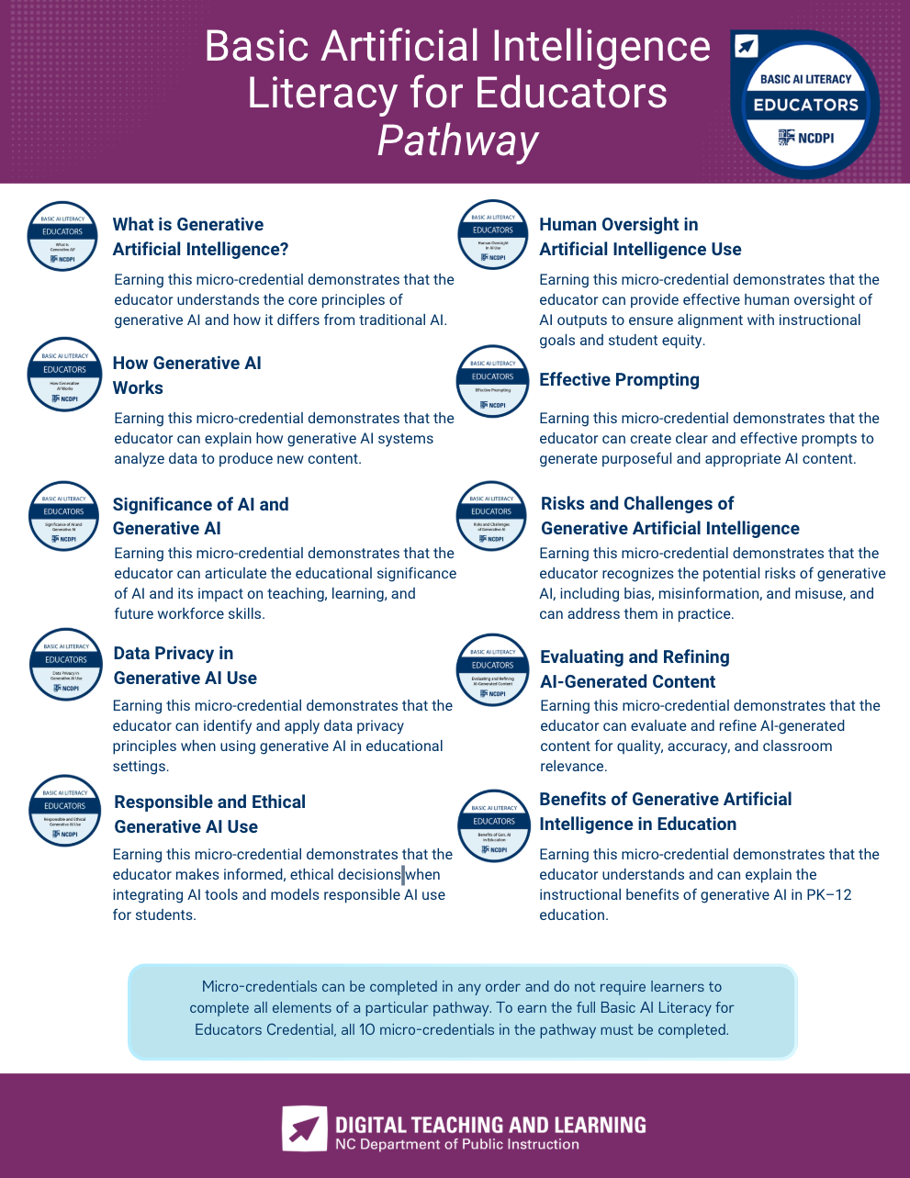
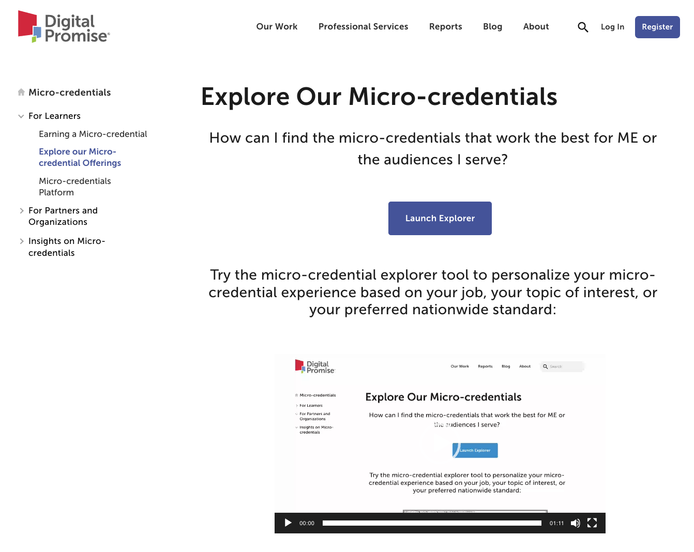
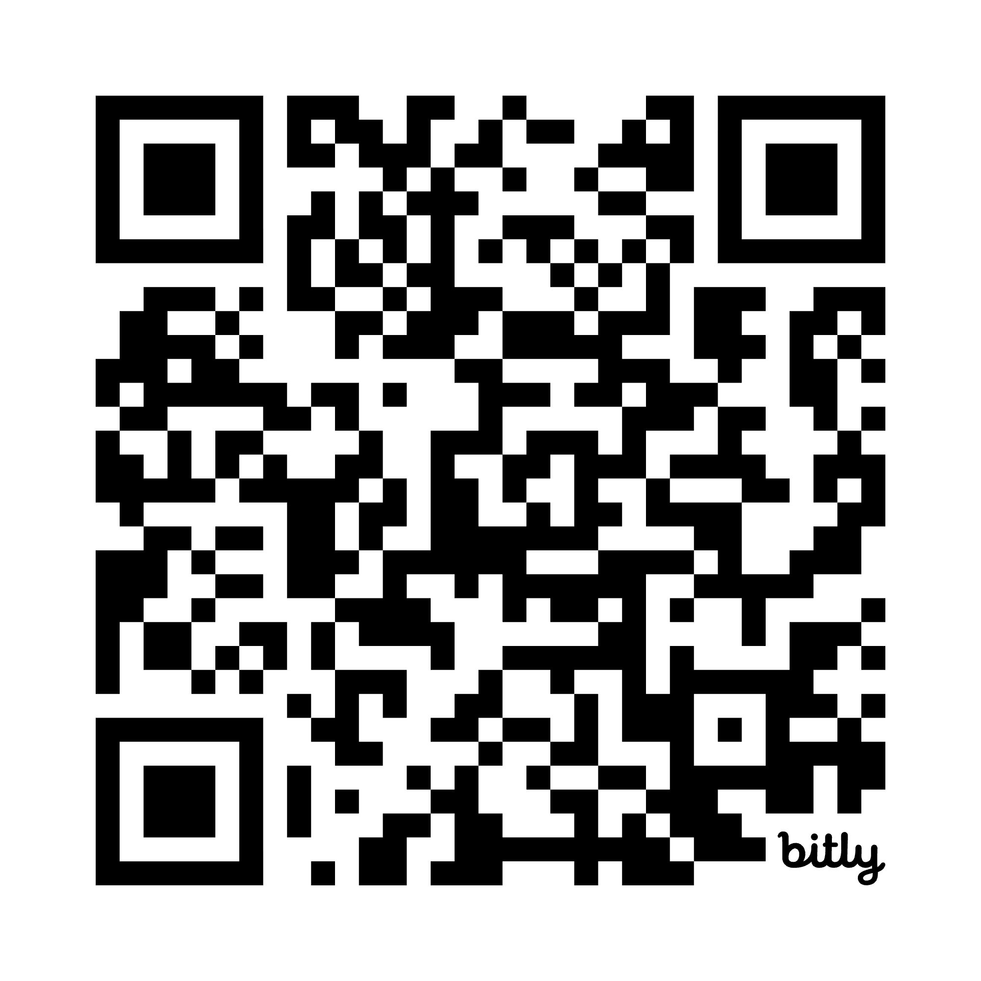


FIND AN MICRO-CREDENTIAL
THAT WORKS FOR YOU!
NC DPI - https://www.canva.com/design/DAG-VDHtts4/8FNNsfcH8CmhwArRphsaWQ/view
Digital Promise - https://digitalpromise.org/initiative/micro-credentials
Explore your topic further …
Notes:
Find a MC that fits your session and recommend it to the your attendees.
___________
On the last slide of your session, include a link to a micro-credential so they can explore your topic further if they are interested. Some sites where you might find an MC that fits your topic:
NC - https://www.canva.com/design/DAG-VDHtts4/8FNNsfcH8CmhwArRphsaWQ/view
Digital Promise - https://digitalpromise.org/initiative/micro-credentials

Slide 19
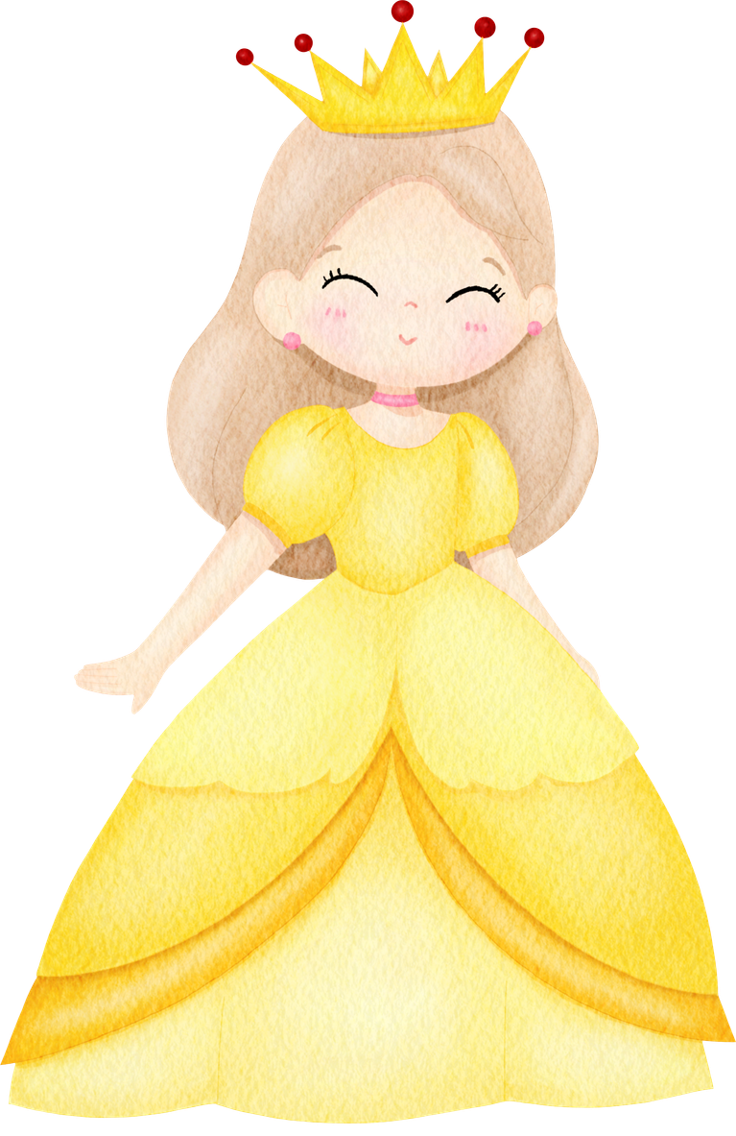
AND SO, ACROSS THE LANDS OF NORTH CAROLINA, TEACHERS BECAME STORYTELLERS AND LEARNERS LIVED HAPPILY EVER AFTER.
Presentation Link: go.ncdpi.gov/BackpackBooks
Companion Document: go.ncdpi.gov/BackPackBookDoc
Task Cards: go.ncdpi.gov/OnceUponTaskCards
Thank You!
Lindsey Sipe
Southwest Regional Consultant
NC Department of Instruction
Lindsey.Sipe@dpi.nc.gov
"Once Upon A Standard " by Lindsey Sipe is licensed under CC BY-NC-SA 4.0

