Slide 1
Secure Boot Chain Update What & How (you are already late)
Travis Collavo, Prabhakar H V
Notes:
Thanks for joining us for this session today! It’s an honor to have the opportunity to share with you all.
Today we're going to dive deep into one of the most critical security updates we're rolling out across the Windows ecosystem, the Secure Boot certificate update roll out, including what to expect and how to manage this update across your device fleet.
*How many of you are aware of this secure boot cert update?

Slide 2
Sponsors
Notes:
A brief thank you to the sponsors who make this conference possible.

Slide 3

That’s me
Travis Collavo
Microsoft, Core Security, Windows Servicing and Delivery
Role
Senior TPM
Focus
Windows Security
Hobbies
Vibe Coding + Family Time

Slide 4

That’s me
Prabhakara Hampanna Vrushabendrappa
Microsoft, Core Security, Windows Servicing and Delivery
Role
Principal GEM Architect
Focus
Windows Security
Hobbies
Tech enthusiast

Slide 5
Agenda
About Secure Boot
Secure Boot certificate updates
Monitoring Secure Boot Update Status
Secure Boot Certificate Deployment Methods
Trouble Shooting
Notes:
We will break down our session into two-parts.
In Part 1, I’ll talk about
what secure boot does,
how certificates play a role in this, and
what exactly is happening with these certificates,
and then for Part 2 I’ll pass it to Prabhakar to discuss the details on how to manage certificate rollouts at scale.

Slide 6
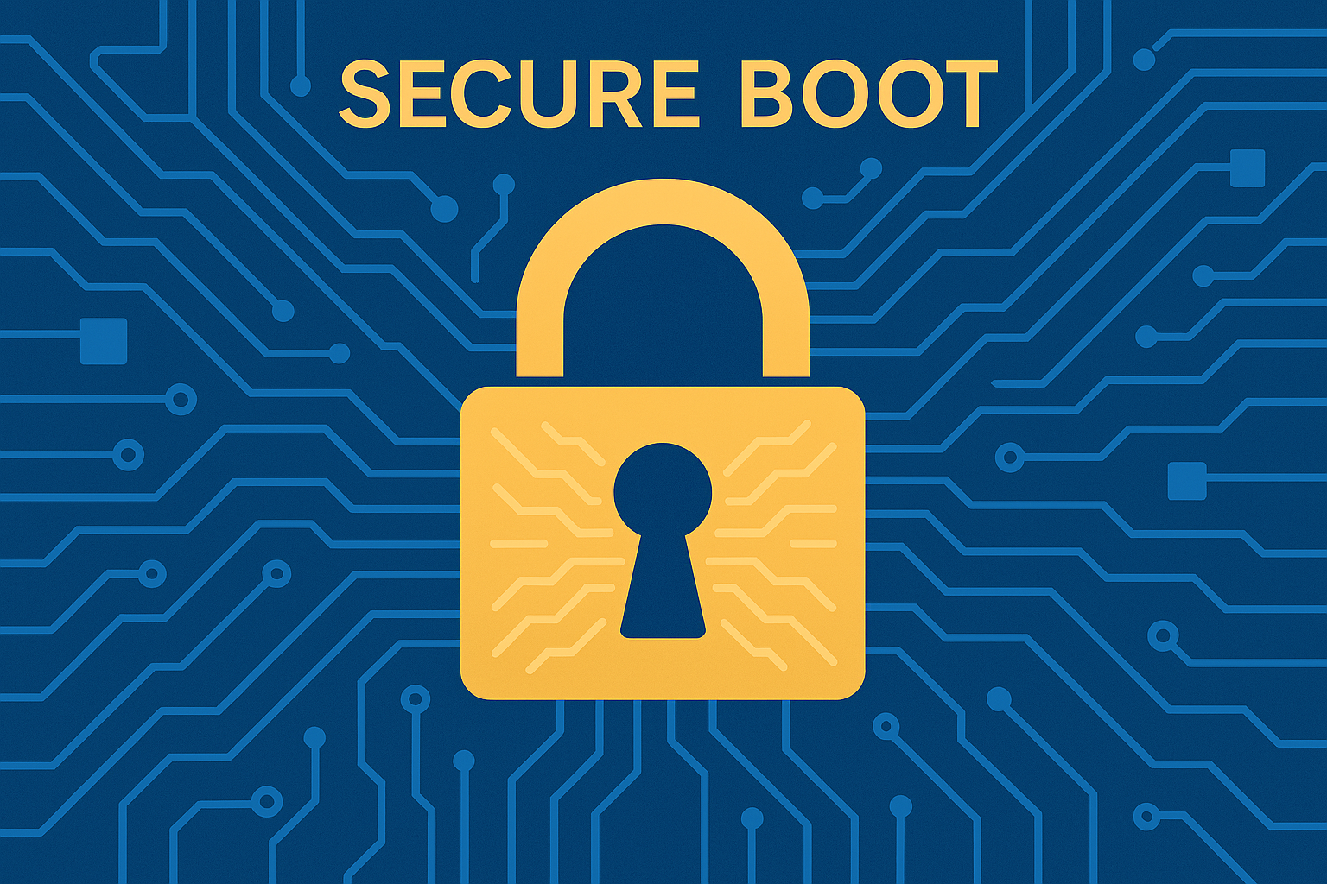
Overview
What it is
UEFI security standard that ensures only allowlisted, digitally signed code runs during system startup.
How it works
During boot, firmware verifies digital signatures of critical boot components against the trusted certificate database in UEFI.
Unsigned or untrusted code is blocked before Windows loads, preventing bootkits and unauthorized code.
Firmware ->Signature Check ->Trusted? -> Boot Continues
Notes:
What it is:
Before we start discussing the details of how to manage cert rollouts, it’s helpful to understand how secure boot actually works, so I’ll take a moment to walk you through the architecture.
First I’ll start with UEFI or Unified Extensible Firmware Interface – UEFI is a specification that defines a standardized interface, data structures, and protocols that the boot process must follow
Some of these components within UEFI are reserved specifically for Secure Boot, which is a part of the UEFI specification as a security standard designed to ensure that a computer boots only using software that is trusted.
How it works:
(verify EFI binaries <list> –set of trusted hash/certs)
As part of that boot process, Secure boot verifies the digital signature of EFI binaries like UEFI drivers,
the OS boot loader, and option ROMs against a set of trusted certificates or hashes stored in the UEFI firmware.
If a component isn't signed with a trusted key or it is explicitly put in a disallowed list, Secure boot will prevent it from running.
In this way, Secure Boot ensures that only EFI binaries signed by a trusted party can execute during the boot process.
This helps block low level malware such as boot kits or root kits from launching before the operating system.

Slide 7
Secure Boot Certificate Hierarchy
UEFI Secure Boot Trust Chain Architecture
ROOT OF TRUST
Platform Key (PK)
Self-signed OEM Certificate – The ultimate root of Secure Boot trust. Owned by the platform manufacturer (OEM). Signs and authorizes Key Exchange Key (KEK) updates. One PK exists per system.
Key Exchange Key (KEK)
Microsoft-Owned Certificate – Authorizes updates to DB and DBX. Multiple KEKs can coexist. DB/DBX updates must be KEK-signed. OEMs may add additional KEKs
ALLOW LIST
BLOCK LIST
Allowed Database (DB)
List of trusted certificates – Contains Root CAs and Intermediate CA certs that authorize:
Boot loaders (bootmgfw.efi)
Option ROMs
UEFI drivers & modules
Disallowed Database (DBX)
List of revoked signatures – Contains:
Authenticode hashes of known-bad binaries
Revoked publisher certificates
Compromised bootloader signatures
Notes:
Now let's delve a little deeper into the technical components of the Secure Boot architecture.
What you see here is the hierarchy of keys and databases that make up the Secure Boot Trust model.
Platform key:
At the top we have the Platform Key. This represents the root of trust for Secure Boot. This key is owned by the OEM
The Platform Key is the main key that controls who is allowed to make changes
KEK:
Next in in the hierarchy comes the key exchange key or the Kek.
Updates to the KEK are signed by the Platform Key, and it sits just below the PK in the hierarchy.
The Kek is used to sign updates to the allowed and the disallowed signature databases, which are also called the DB and the DBX.
Microsoft is supplying an updated KEK as part of the certificate update rollout, and the OEM’s firmware allows that update because the KEK cert update is signed by the PK.
DB
We then have the DB which is the allowed signature database.
This is a list of hashes and signing certificates for EFI binaries such as boot loaders & UEFI drivers
When these are signed by certs in the DB or their file hash matches a hash in the DB then they’re eligible to be loaded (one caveat).
For our cert update rollout, we’re adding new 2023 certificates to the DB so that firmware will trust an updated Windows boot loader and other components signed by the latest 2023 keys.
DBX
And, last but not least, we have the DBX which is also called the revoked signature database - this contains hashes or signing certificates for known malicious or vulnerable boot loaders or UEFI drivers that firmware should block.
For an EFI binary to be loaded, the DB checks have to allow it AND the DBX checks must not deny it.

Slide 8
Timeline - Secure Boot 2011 Certificate Expiration
Microsoft certificates issued in 2011 are expiring in 2026
Microsoft Corporation KEK CA 2011
Microsoft Windows Production PCA 2011
Key Exchange Key.
Expires: June 24, 2026
Impact: Cannot update DB/DBX
DB (Windows Signing)
Expires: Oct 19, 2026
Impact: Cannot update Windows boot manager
June 24, 2026
June 27, 2026
Oct 19, 2026
Microsoft Corporation UEFI CA 2011
DB (3rd Party Signing)
Expires: June 27, 2026
Impact: Cannot update 3P boot loaders and option ROMs
Notes:
While Secure Boot has been highly effective since it was first used by Windows in Windows 8, the cryptographic certificates used in Secure Boot have a finite lifespan
.
This ensures that signing algorithms are kept up to date, among other things
..
Certs provided & expiration:
Microsoft provided 3 Secure Boot certificates in 2011, one boot manager signing certificate, a KEK certificate, and a third party code signing cert.
And all of these 2011 era certificates are approaching their expiration dates:
The first certificate to expire on June 24, 2026 is the KEK 2011 certificate.
The next one to expire on June 27, 2026 is the 3rd-party signing 2011 certificate.
And the final certificate to expire on October 19, 2026 is the 2011 boot manager signing certificate.

Slide 9
New Secure Boot Certs/Keys being rolled out
New Certificate / Key Name | Type | Expiring Certificate | Purpose
Windows UEFI CA 2023 | DB | Windows PCA 2011 | Signs Windows boot manager
Microsoft UEFI CA 2023 | DB |  | Signs 3rd party boot loaders
Microsoft Option ROM UEFI CA 2023 | DB |  | New certificate that signs Option ROM modules.
Microsoft Corporation KEK 2K CA 2023 | KEK | Microsoft Corporation KEK CA 2011 | Authorizes updates to DB and DBX
Microsoft Corporation UEFI CA 2011
Notes:
Now let's look at exactly what's changing with this update.
We're replacing the 3 expiring 2011 certificates with new 2023 versions.
KEK update:
First I’ll discuss the certificate at the bottom – the new 2023 KEK certificate.
This one replaces the Microsoft Corporation KEK CA 2011 certificate
Again the KEK is used to sign updates to the DB and the DBX., and the new KEK update must be signed by the platform key to be accepted.
Microsoft has coordinated with OEMs to get KEK updates signed and ready for delivery via Windows Update.
Boot manager signing cert:
The second certificate that Microsoft is introducing is the Windows UEFI CA 2023 certificate.
This new certificate will sign the Windows Boot Manager and other first party boot components moving forward.
It replaces the Windows PCA 2011 certificate.
Now any new boot loader will be signed by this Windows UEFI CA 2023 certificate.
For a device to trust those new boot loaders, that cert must be present in the firmware DB, which is possible after the KEK is updated.
3P/OROM certs:
The next new certificate is the Microsoft UEFI CA 2023 certificate.
This is the first of two successors to Microsoft Corporation UEFI CA 2011 certificate.
The 2011 UEFI certificate was used to sign third party UEFI applications & boot loaders such as those for Linux AND it was used to sign option ROMs
The new Microsoft UEFI 2023 certificate is now specifically used for signing third party boot loaders.
For Option ROMs, a new, separate cert was created and is being installed into the DB - Microsoft Option ROM UEFI CA 2023
This split provides finer control and better security. If for some reason it’s necessary to revoke one of these certs, then the other will be unaffected.
Also, an organization can choose to trust the new Option ROM CA if they wish and add it to the DB, but leave out the 3rd party boot loader cert if they know they’re only going to use Windows.

Slide 10
Risks of Outdated Secure Boot Certificates
Loss of Boot-Level Security Updates
Expired certs can’t sign new boot components
Future boot-level vulnerabilities remain unpatched
Exposure to Future Threats
No new boot manager mitigations or DBX revocations without current KEK
Boot chain degrades over time, weakening VBS, BitLocker, Credential Guard
Compatibility Risks
Future Windows may require 2023-signed boot components
New hardware Option ROMs may fail to initialize
Notes:
Now let's look at some of the potential risks of outdated Secure Boot certificates.
Loss of Boot-Level Security Updates
First and foremost is the loss of boot level security updates.
After expiration, Microsoft can no longer use the old expired certificates to sign boot components that may need security fixes.
So, any new boot level security updates, for example a fix for a future vulnerability in the boot loader, wouldn’t be installable to devices that haven't updated to the new certificates because those devices wouldn’t trust the updated components.
Exposure to Future Threats
As time goes on, devices that didn't get the new certificates will become increasingly vulnerable.
If a new bootkit or security threat arises that exploits a previously trusted boot component, Microsoft would typically ship a DBX revocation to block it.
Devices without the 2023 KEK couldn’t apply that revocation, which means the known-malicious component would continue to be trusted by firmware.
Over time security would degrade as the boot chain becomes less-and-less trustworthy.
This indirectly degrades the security promises of other in-OS security features that assume that boot wasn't compromised.
Compatibility Risks
Future versions of Windows might require the new bootloader certificates, or the device may be unable to fully utilize new hardware.
GPU Option ROMs for example signed by the 2023 OROM cert may fail to function.
That being said, cert expiration isn’t the end of the world…..

Slide 11

What continues to work
Devices continue to boot
Monthly updates continue to install
Everyday app use, networking, browsing, and most OS features remain unchanged
Refer to kb5079373 for more details
Notes:
Continue to boot:
I'd like to stress that the vast majority of systems won't suddenly break if a certificate expires and the new ones aren't present.
The device does not instantly become unbootable with its current software.
It will continue to boot because Microsoft's servicing won’t deliver 2023-signed boot components to a device that hasn't received the 2023 certificates.
Updates:
Other monthly updates though will continue to install as they do now
Apps keep working:
Everyday apps will continue to work, and existing networking, browsing, and most other OS features remain unchanged.

Slide 12

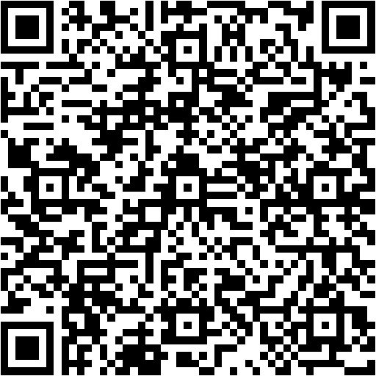
Take Action Now
https://aka.ms/GetSecureBoot
Guidance for Organizations and IT Professionals
Notes:
How many of your organizations have already started updating the Secure Boot certificates?
Thank you… If your organization hasn’t started updating secure boot certificates, take action now.
Secure Boot certificates are expiring soon and must be updated to new 2023 certs to ensure Microsoft can update security patches for Secure Boot and Boot manager.
We have provided detailed guidance on how to update certs at https://aka.ms/getsecureboot page
Also we have sub page withing getsecure boot for organizations and IT professionals.
Follow the guidance in these articles to ensure all devices in your fleet are updated.

Slide 13
Why Isn’t Microsoft Automatically installing Secure Boot Certs?
We are via High Confidence based Rollout!
Secure Boot certificate updates are device firmware sensitive.
Microsoft is doing Controlled Feature Rollout per device class(1->2->4->8->16->32….)
Devices grouped into buckets by device attributes
2.2 million device class buckets identified.
Buckets added to High Confidence group after sufficient success
When will my device get update?
Any device in device class send diagnostic data to Microsoft, will receive confidence level rating
Devices marked with “High Confidence” rating will be automatically updated
Notes:
So, Why isn’t’ Microsoft automatically updating the secure boot certs?
We are indeed updating the certs automatically via high confidence roll out method for all device classes visible to Microsoft via consumer segment.
If the any of the device types in your enterprise are visible to Microsoft in consumer segement we will update those devices automatically via high confidence roll out.
Why are we doing this? This is because certificate updates are applied to device firmware.
Some devices react negatively to certificate updates to UEFI variables. During our local testing, we found 50 lab devices not booting and OEM had to deliver new mother boards to address the issue.
Alarmed by this incident, Microsoft is taking conscious approach to use controlled feature roll out or CFR to update the devices.
We first pick 1 device per device class and if succeeded, update is expanded to more devices in gradual manner.
Once we have sufficient successes, we add the device class to high confidence category. All devices which have classified as high confidence will be automatically updated by Microsoft via Windows cumulative update as part of Patch Tuesday.
We have identified total of 2.2 million distinct device class buckets. Good news is so far we have updated more than 50% of devices successfully!!!
So it is likely that some of your devices in enterprise may have already gotten the update!!!
If a device class is not visible to Microsoft, then we will not be able to do automatic update using high confidence roll out method.
For such cases, enterprise need to take action.

Slide 14
How do I see my device status and confidence level?
Status and Confidence Level are logged in both event log and registry
1 System Event log scan (from TPM-WMI source)
1808 – All Secure Boot certs updated. No action needed
1801 - Update is needed.
2 Registry Key query
Computer\HKEY_LOCAL_MACHINE\SYSTEM\CurrentControlSet\Control\SecureBoot\Servicing
UEFICA2023Status
Updated - No action needed
NotStarted - Device need updates
InProgress - Update Process has started
UEFICA2023Error - Only set if device is failing Certificate updates
Device confidence rating field- ConfidenceLevel
Confidence Level | Meaning | Action Required
High Confidence | Microsoft has validated this device class is safe for updates | Automatically updated by Microsoft unless HighConfidenceOptOut is set
Under Observation - More Data Needed | Microsoft is still gathering Secure Boot Roll out Diagnostics data about these devices | Confidence Level will be updated as Microsoft gets more data
No Data Observed - Action Required | Device class is not known to Microsoft | Enterprise must test and plan rollout
Temporarily Paused | Known compatibility issues (e.g., HP Commercial BIOS) | May need BIOS updates. Check event ID 1802.
Not Supported - Known Limitation | Platform or hardware limitations (e.g. | Known issues. Contact OEM if any fix available. Else may need HW replacement
Notes:
So, how to check the secure boot update status and confidence rating for your device?
We provide two mechanisms to fetch the Secure Boot and confidence rating status.
Via event log or via registry key.
Secure Boot update events are logged in System event log under TPM-WMI channel.
Event ID 1808 is logged on devices where all certs are fully updated. If you see this event, then no further action is needed
Event ID 1801 is logged if device is missing 1 or more certificate updates. This device needs action to be taken.
You can also query the status from registry key using 2 regvalues
UEFICA2023Status value is set to updated if all certs are uptodate
Not Started is device hasn’t started update process. This needs action.
InProgress if updates are in progress
Sometimes, updates may fail. In such case, UEFICA2023Error value is set to last error code.
We also log error events in System event log which I will explain in later slide
Device confidence rating can be queries from both registry and event log using ConfidenceLevel Field.
The table shows 5 confidence categories each device bucket falls into..
As I explained, if confidence level is marked as High confidence, all devices under this category will be automatically updated
Under observation – More data needed means device is visible to Microsoft. We are monitoring the updates and soon will be moved to high confidence rating
If the ConfidenceLevel value is No Data observed, these devices are not visible to Microsoft and require enterprises to take action.
Temporarily paused means known firmware issues blocking the update. Check with OEM website and deploy latest available firmware updates to unblock the update
If devices have Not supported – known limitation as confidence rating, for these devices, OEMs have told us they no longer support these devices.
There is not path forward for these devices to get latest certs. Check with OEM if they can provide firmware update.
If not, hardware may need replacement as Boot security cannot be guaranteed as certs expiring soon.

Slide 15
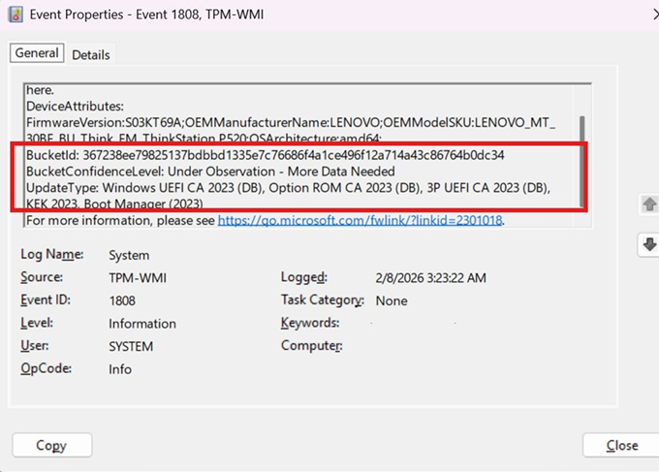
Secure Boot Status - Sample Event (1808)
UpdateType shows list of certificates safe to be installed for the bucket.
​
Third party certificates (Option ROM CA2023(DB) and 3B UEFI CA 2023 (DB) are applied only if device trusts Microsoft UEFICA 2011​
Notes:
Here is example 1808 event that is logged when system has all certificates updated.
This event has some useful information.
You can see bucket identifies that uniquely identify the device class, confidence rating for the device and list of secureboot updates that can be deployed.
Presence of this event indicate this device class is good to receive the update, and enterprise can safely update rest of the devices in the same bucket.
We still recommend enterprises testing few more devices under the bucket before broadly applying the new certificates to all devices in the bucket.

Slide 16
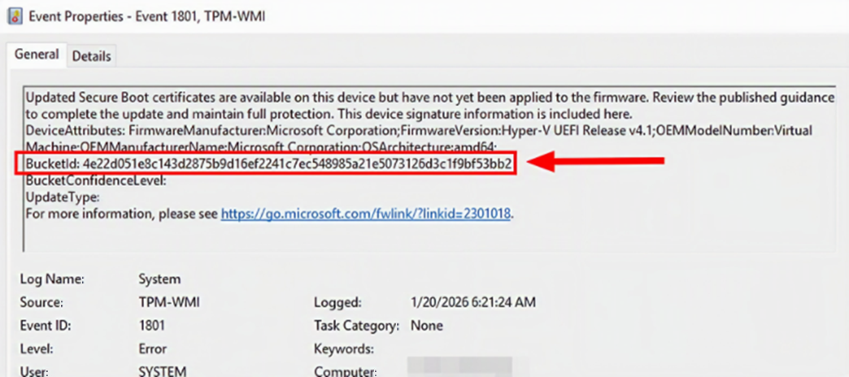

Secure Boot Status - Sample Event (1801)
Notes:
Here is the sample 1801 event which is logged when device is missing update to at least one secure boot certificate.
In this event also we log bucket ID details, Confidence level .
In this example confidence level is empty because device was not visible at the time when the snapshot was taken
We have fixed this issue in latest update so every device should receive confidence rating which you can leverage to take appropriate action per device

Slide 17
Monitoring Certificate update Status
Notes:
We looked at how to check Secure Boot update status for 1 device…
Let us look at how to monitor Secure Boot updates across your fleet of enterprise devices…

Slide 18

Windows AutoPatch Enrolled devices
Secure Boot status report in Windows Autopatch | Microsoft Learn
Notes:
If you have enrolled into Windows Autopatch, we have full reporting available through autopatch reporting.
The link here provides the guidance on how to view the autopatch report. QR code is also provided here.
Let us look at video demo from our colleague on how Autopatch reporting works.

Slide 19

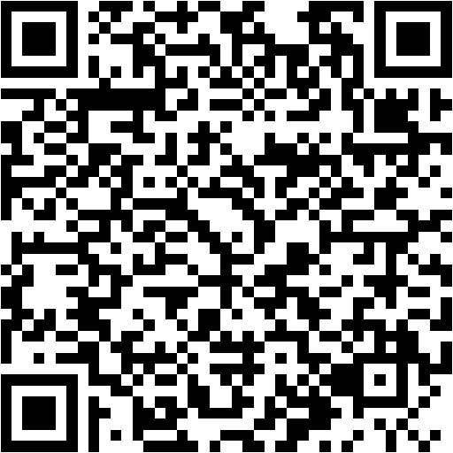
Status Monitoring Via Intune enrolled devices
Intune Monitoring Guidance
Monitoring Secure Boot certificate status with Microsoft Intune remediations - Microsoft Support
Sample Data Collection Script
Sample Secure Boot Inventory Data Collection script
Save the script as Detect-SecureBootCertUpdateStatus.ps1
Notes:
If you have enrolled into Intune device management and not enrolled to Autopatching, you can leverage Intune remediations to automate the secure boot reporting.
We have published detailed guidance on how to configure Intune Remediations using detection script at the link shared here.
Also we have provided the sample detection script here which you can leverage for detections. Currently the script is published as text in web page that you can copy.
We will be publishing the script as part of windows update in later update to enable you to directly run script from windows device.
Let us look at Video demo on how to configure Intune remediations.

Slide 20


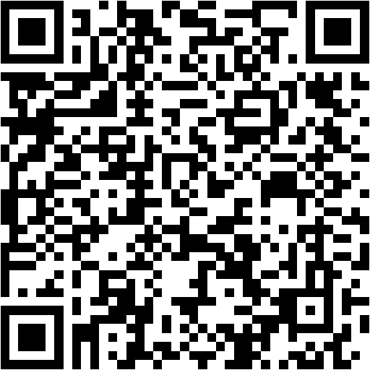
Sample scripts for Collection, aggregation and Monitoring [GPO]
Sample Guide how to setup enterprise monitoring via GPO
Sample Secure Boot E2E Automation Guide - Microsoft Support
Data Collection
Sample Secure Boot Inventory Data Collection script
Save the script as Detect-SecureBootCertUpdateStatus.ps1
GPO for Enterprise-wide collection
Script for GPO deployment: Sample Deploy-GPO-SecureBootCollection.ps1 script - Microsoft Support
Data Aggregation and Reporting
Script for Data Aggregation and reporting:
Sample Aggregate-SecureBootData.ps1 script - Microsoft Support
Notes:
Let us look at how enterprises can automate data collection aggregation and reporting for Secure Boot Status.
We have published the Data collection and monitoring script samples at https://aka.ms/getSecureBoot .
Links to the scripts are also provided in this slide. As I mentioned earlier, the scripts are published as text that you can copy.
We will be publishing the script as part of Windows update in the future which will enable you to execute directly from windows.
For monitoring status we have published Secure boot inventory collection script online which customers can download from the GetSecureBoot Microsoft support article.
Save this script as Detect-SecureBootCertUpdateStatus.ps1
Similarly download and store GPO configuration script and Aggregation scripts and save these as Deploy-GPO-SecureBootCollection.PS1 and Aggregate-SecureBootData.PS1
We have also published the guide on how to deploy these scripts for enterprise wide monitoring of Secure Boot status which can be found at https://aka.ms/getSecureBoot
Let us look at demo on how to deploy these scripts

Slide 21
Secure Boot Certificate updates Roll out methods

Slide 22



Microsoft Managed Opt in
Enterprises may opt in to Microsoft Managed Rollout on Desktop/Client devices
Key Value: MicrosoftUpdateManagedOptIn, 0x1
Under HKEY_LOCAL_MACHINE\SYSTEM\CurrentControlSet\Control\SecureBoot
GPO: Policy Name: Certificate Deployment via Controlled Feature Rollout
Intune: Policy Name: Configure Microsoft Update Managed Opt In
Enterprises need to Allow sending of required diagnostic data
Configure Windows diagnostic data in your organization - Windows Privacy | Microsoft Learn
Microsoft will leverage CFR/Controlled Feature Rollout for Enterprise devices opted in to Microsoft Managed Rollout for Safe Deployment

Slide 23


Roll out via Group Policy​
Determine all Action Required buckets.
Do Controlled testing on Action Required buckets.
Pick 1 device in each bucket and test to ensure update succeeds.
Registry key updates for Secure Boot: Windows devices with IT-managed updates - Microsoft Support
Keep increasing the number of devices slowly until all devices are up-to-date​.
References:
Group Policy Objects (GPO) method of Secure Boot for Windows devices with IT-managed updates - Microsoft Support
Windows Configuration System (WinCS) APIs for Secure Boot - Microsoft Support
Notes:
For the Active Directory environment, Microsoft have published two main methods for deploying the Certificates.
Via Group policy method by applying the AvailableUpdatesPolicy.
Or by leveraging WinCS CLI method.
Boths link that shows the guidance on how to deploy certificate roll out for each method are provided in the slide for reference.
Visit https://aka.ms/getsecureboot for detailed guidance.
As we mentioned in the earlier slides, enterprises must test and progressively roll out certificates across all devices that are classified as Action Required based on ConfidenceLevel.
First test on 1 device under each bucket and ensure devices can take the update. Keep increasing the number of devices slowly till all devices across all device buckets are uptodate.
If Enterprises have opted out from High Confidence based rollout, the AvaialbelUpdatesPolicy or WinCS configuration also need to applied to respective devices to ensure certs are updated on these devices as well.

Slide 24
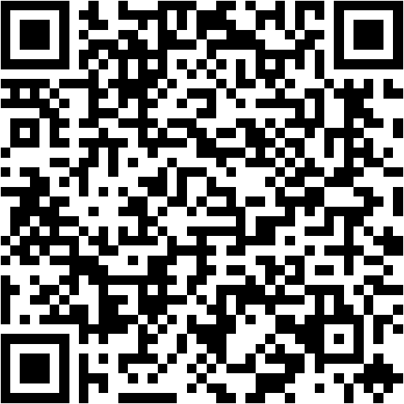
Progressive safe rollout strategy - Sample Automated Scripts for GPO​
Sample Progressive Rollout Guidance
And all sample scripts
Sample Secure Boot E2E Automation Guide - Microsoft Support
Sample Secure Boot Inventory Data Collection script
Save the script as Detect-SecureBootCertUpdateStatus.ps1
Data Collection
Notes:
Let us look at how whole Certificate roll out can be E2E automated using the rollout scripts that follow Progressive roll out strategy.
Pre-requisite for E2E automation is setting up data collection across all devices in the enterprise.
We have developed the E2E rollout scripts that implements the controlled or progressive rollout strategy.
The links to the E2E roll out guide and all necessary scripts to enable automated certificate rollout are provided here.

Slide 25
Roll out via Intune​
Determine all Action Required.
Reference: Microsoft Intune method of Secure Boot for Windows devices with IT-managed updates - Microsoft Support
For devices under Action Required category, do a controlled rollout by testing few devices and slowly increasing the speed.​
Notes:
So For Intune as well similar progressive rollout methodology need to be used to make sure Secure Boot updates are applied to devices in controlled manner across all of the devices enrolled to Intune.
The first step is to setting up the detection and monitoring which we explained earlier and then implement progressive/controlled roll out strategy.
For the devices that which shows confidence level as action required, first apply the intune Secure Boot Update policy to small set of devices.
Once devices report update is successful, gradually increase roll out to rest of the devices till all devices are updated across all buckets.

Slide 26
Troubleshooting

Slide 27
Troubleshooting Certificate update Failures​​
Collect the output of detection script published at Sample Secure Boot Inventory Data Collection script - Microsoft Support ​
This collects 30+ datapoints in the JSON format.​
Key fields to look from Detection script output
UEFICA2023Status - Updated, In Progress, Not Started, null​
UEFICA2023Error - Error code if update failed else null.​
UEFICA2023ErrorEvent - Last error event ID​ if error else null
AvailableUpdates - Any Value other than 0x4000 or 0x0 or 0x4400 means at least 1 certificate update is pending
SecureBootEnabled - True, False​
SecureBootTaskEnabled - True, False​
Collect System.evtx.​
Notes:
First, let us look at how to detect and trouble shoot certificate installation issues.
If customer reports of issues with applying the certificate updates, first take stock of the current state of the device from the detection script we have published.
The script can be downloaded from https://aka.ms/GetSecureBoot under Deployment and Monitoring Samples section.
The script dumps the overall status of the Secure Boot certificate update including update status, any errors that were reported, last error event, what certificate policies are applied including AvaialableUpdatesPolicy, WinCS confiuguration Status, whether or not task is enabled.
UEFICAStatus can have one of the 4 values “Updated”, “InProgress”, “NotStarted”, null . If this shows Updated, means everything is good and no issues with certificate rollout
InProgress could mean update is progressing or stalled due to errors. In this case, look at the UEFICA2023Error which shows if there was error reported.
If UEFICAStatus is NotStarted, this means customer has not set the policy yet or if policy has been set, it is not yet reflected on the device

Slide 28
Certificate update Failures- Digging in Deeper​​
Analyzing System event log​ TPM-WMI channel
Event ID: 1800
Windows detected a situation that requires a reboot - this is normal and updates get installed after reboot.​
Event ID: 1801
Not all certificates are updated. Check for other events below.
Event ID: 1802 - Known Firmware issues
Event ID: 1803 - Matching KEK not found​
Event ID: 1795
Unknown Firmware errors. Contact device manufacturer. Windows will retry on next reboot.​
Event ID: 1032 - Incompatible BitLocker Configuration​
Customer have likely configured group policy to force PCR7 configuration though PCR7 binding is not possible.​
Collect GPResult /H GPOutput.html​
Collect MSInfo32 (From Administrator window)​
Does PCR7 state shows Binding not possible?​
Notes:
Let us deep dive into types of certificate roll out issues when customers try to apply the certs.
When an update installation fails, Secure Boot task logs error events in the event log indicating what update failed and also cause of the failure.
This slide shows various types of failure events that can get logged when customer attempts to update the certificates
If Device firmware returns error when applying the update, TPM Task logs event ID 1795 indicating failure applying the update.
When this error event is logged, check device manufacturer’s website if OEM has published any firmware update and apply the latest available firmware update for the device to check if issue goes away.
The event ID 1800 is logged when task determines a reboot is needed to complete the updates. This is normal and update will proceed on next reboot.
TPM Task intentionally defers updates to next reboot on VSM enabled systems to prevent VSM Key loss issues and this is expected.
Event ID 1801 indicates not all required certificate updates are installed.
If customer did apply policy to deploy certs and still seeing this event, check for events 1795 and 1800 first.
If both are not found, check if other events shown in this slide are logged.
Event ID 1802 is logged when Windows is skipping updates for known firmware issues. For example, on some HP commercial devices, we skip the update if latest firmware updates are not applied.
HP has already published latest BIOS update which should unblock the updates once deployed
Another example is ARM64 devices which also require firmware updates from respective OEM to unblock the updates.
We will be publishing list of all known issues soon which customers can refer to map what each known issue logged in the event refers to.
Event ID 1803 is logged when matching KEK update for the device is not found.
For these cases, contact the device OEM on their plan for providing the signed KEK update to Microsoft for inclusion as part of Windows Update.
Event ID 1032 is logged when Customers have configured incompatible BitLocker PCR profile to force binding for PCR7 though BitLocker determined binding is not possible.
For such devices, collect the GPResult output and Collect MSInfo32 running as Administrator.
Does MSInfo shows PCR7 state as binding not possible? If so the BitLocker group policy configuration is preventing the update.
Customers in this condition have 2 options
Option1 - Suspend BitLocker to let SecureBoot proceed with the update. And then Reboot to enable BitLocker bind to final PCR7.
Option2 - Remove the Group policy related to BitLocker PCR configuration, force the group policy to make sure devices receive the updated policy. Suspend and resume the BitLocker on the device to update BitLocker PCR profiles.

Slide 29
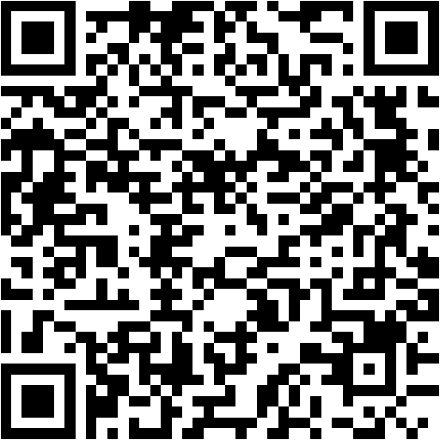
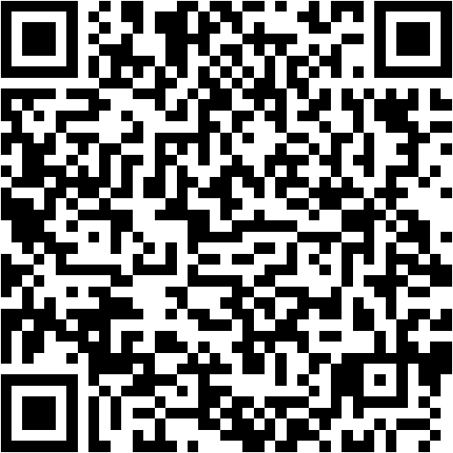
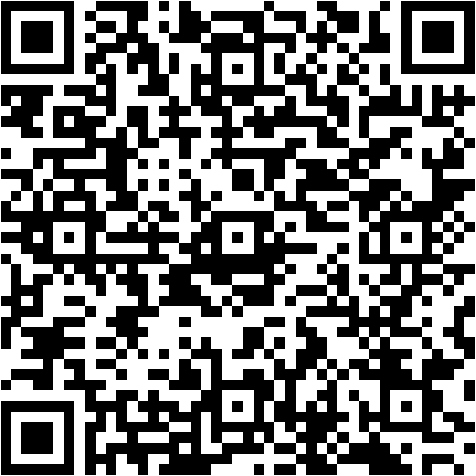
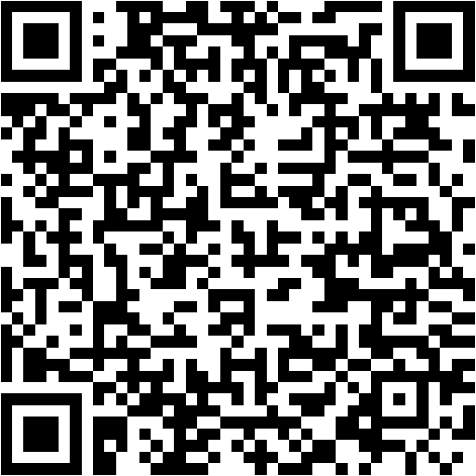
Trouble shooting references and FAQ
Secure Boot troubleshooting guide - Microsoft Support
Understanding Secure Boot Events 1802 and 1803 - Microsoft Support
OEM and ODM Guidance
Secure Boot AMA

Slide 30
Questions?

Slide 31

Thanks!
Please rate this session on Sched.com
We would love to hear what you liked and how we could improve!

