Slide 1
My top posts of 2025

Slide 2
Sponsors

Slide 3

About me
Andrew Taylor
Microsoft MVP · Microsoft Intune & Security Copilot
Role
CTO at Software Central
Focus
Intune · Graph · PowerShell

Slide 4


January

Slide 5
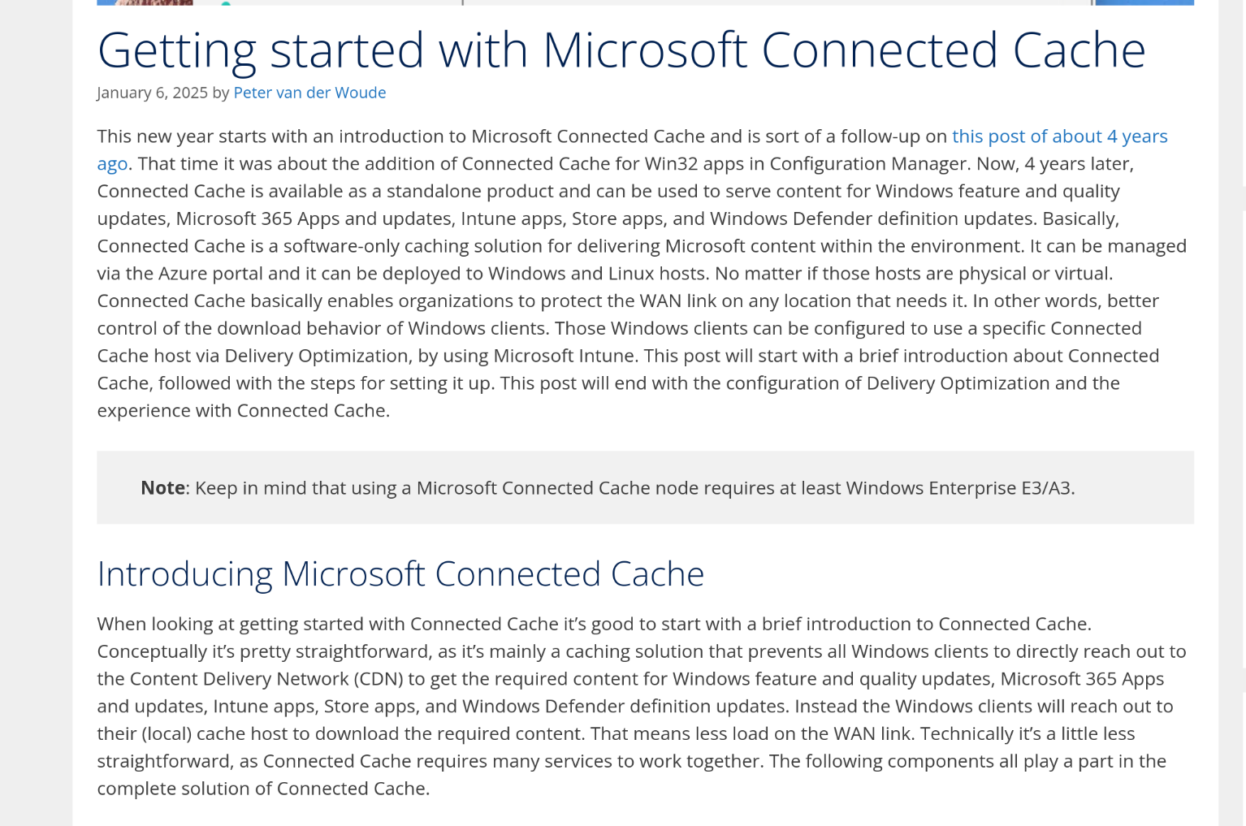
Getting Started with Connected Cache – Peter van der Woude
https://petervanderwoude.nl/post/getting-started-with-microsoft-connected-cache/

Slide 6

Graph Authentication – Ben Whitmore
https://msendpointmgr.com/2025/01/12/deep-diving-microsoft-graph-sdk-authentication-methods/

Slide 7
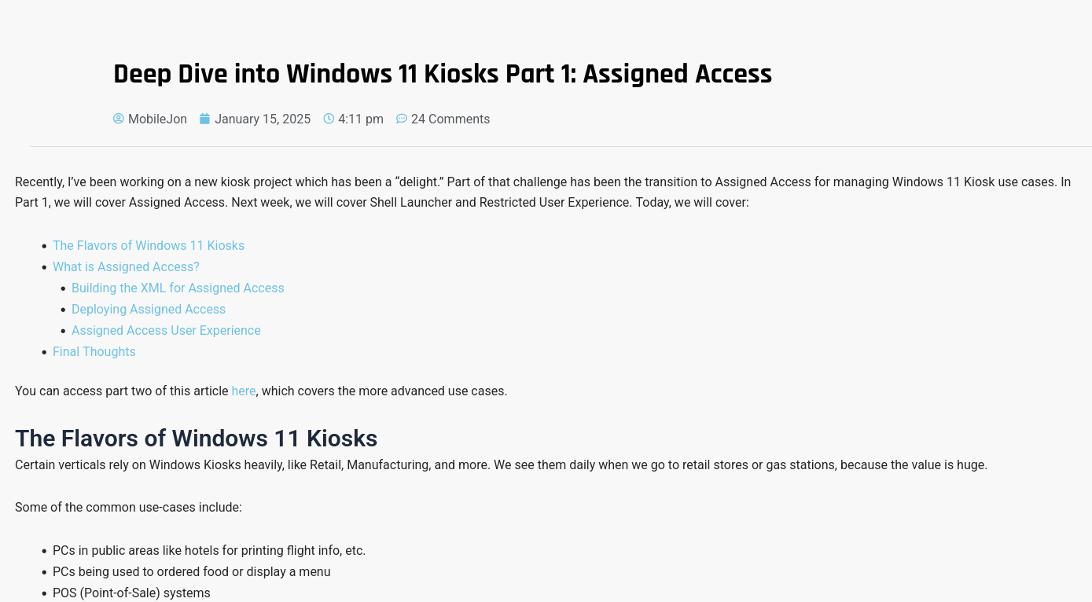
Windows Kiosks with Assigned Access – Jon Towles
https://mobile-jon.com/2025/01/15/deep-dive-into-windows-11-kiosks-part-1-assigned-access/

Slide 8


February

Slide 9
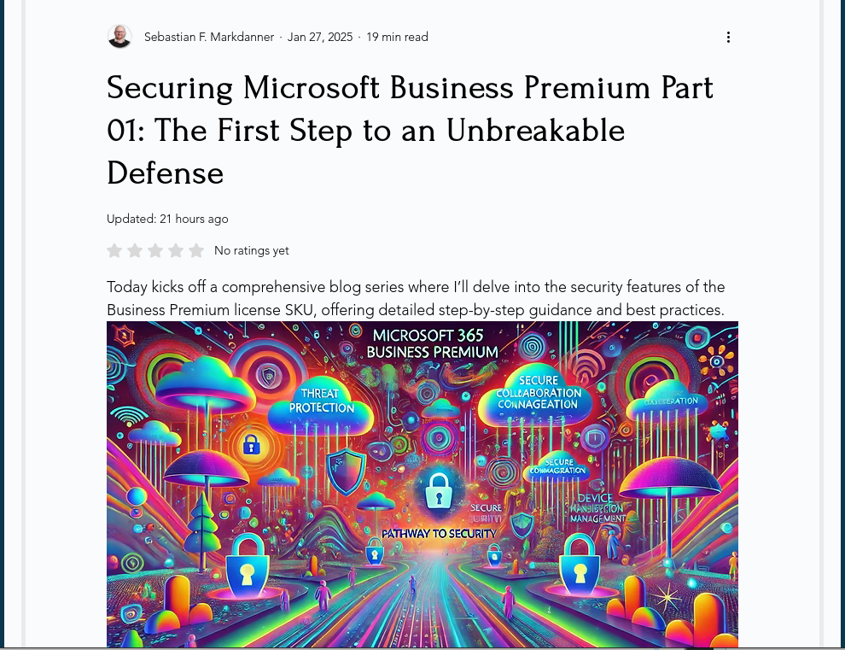
Securing a business premium tenant - Sebastian F. Markdanner
https://www.chanceofsecurity.com/post/securing-microsoft-business-premium-part-01-laying-the-foundation

Slide 10
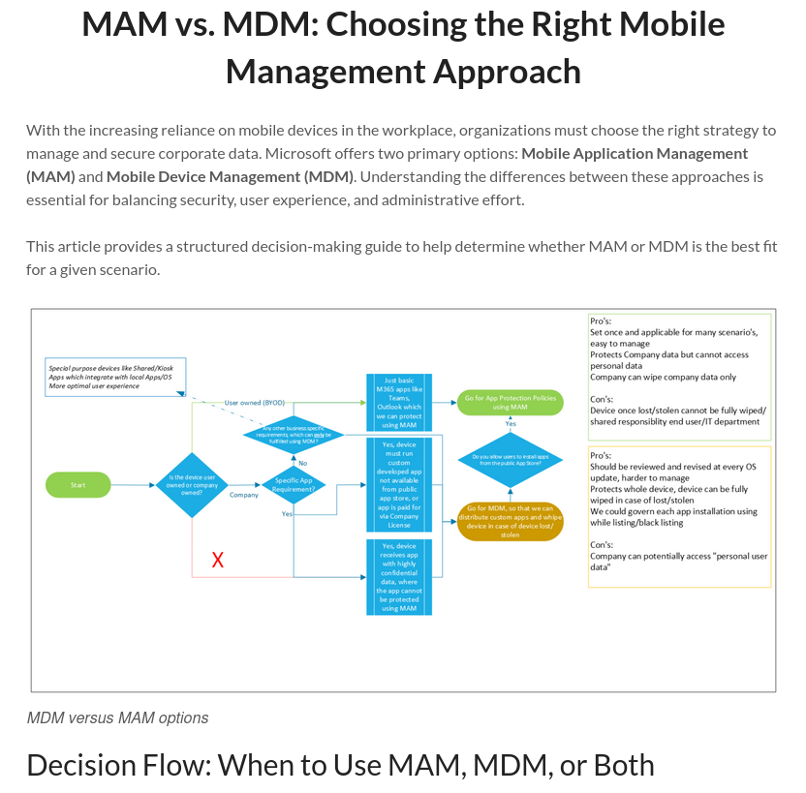
Picking between MAM and MDM – Kenneth van Surksum
https://www.vansurksum.com/2025/02/11/mam-vs-mdm-choosing-the-right-mobile-management-approach/

Slide 11
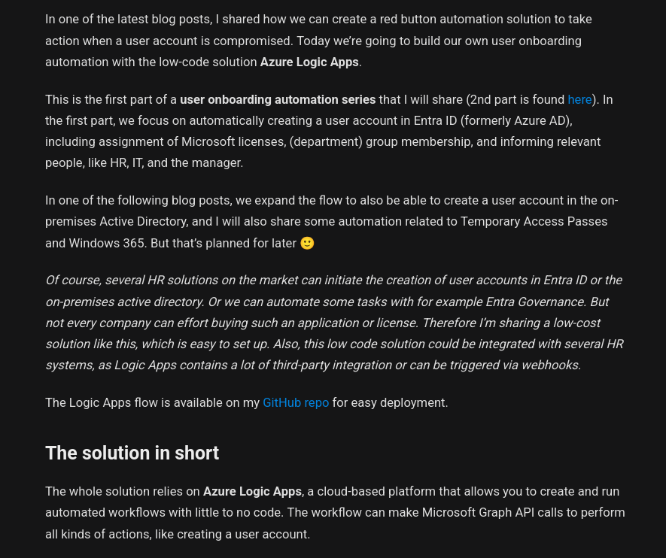
Automated User Onboarding – Peter Klapwijk
https://inthecloud247.com/build-your-own-user-onboarding-automation-entra-id-user-account-creation/

Slide 12
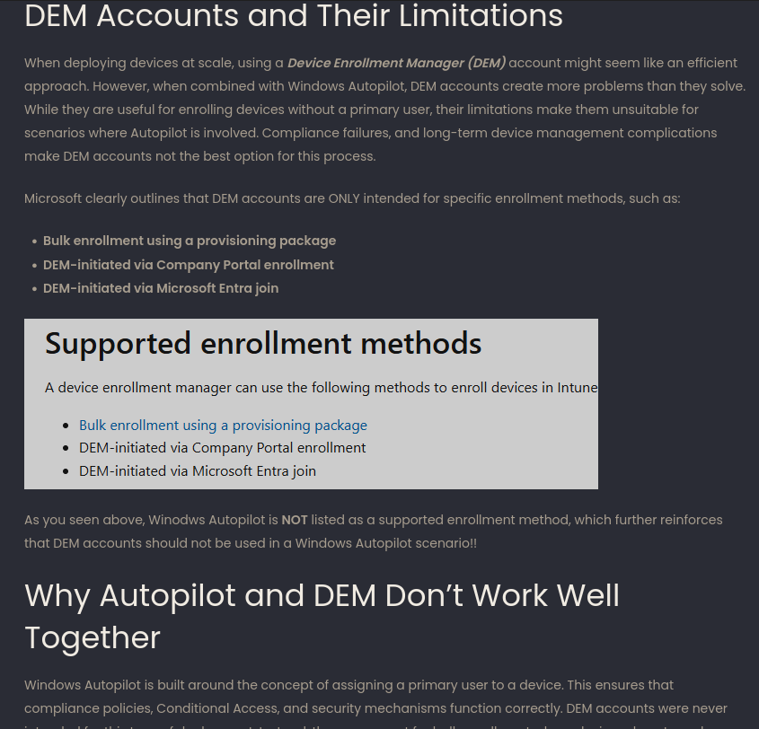
Don’t use DEM with AP – Rudy Ooms
https://call4cloud.nl/using-a-dem-account-windows-autopilot-is-a-bad-idea/

Slide 13
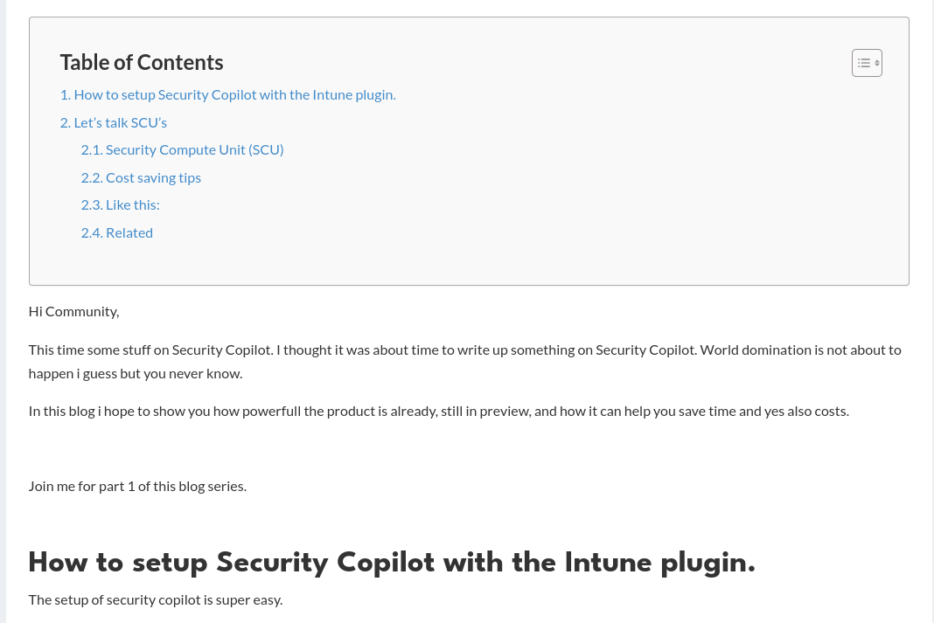
Security Copilot – Joery Van den Bosch
https://intunestuff.com/2025/07/14/security-copilot-1/

Slide 14



March

Slide 15
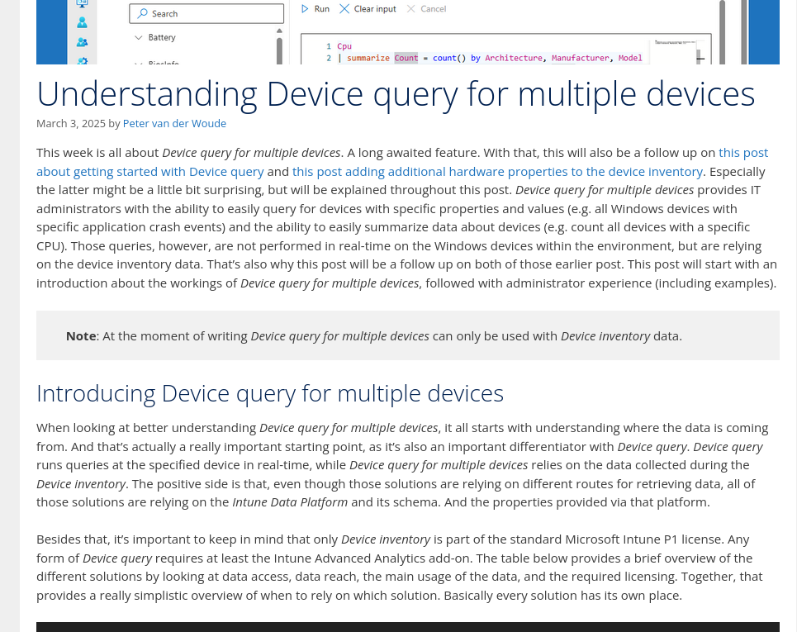
Device Query for multiple devices – Peter van der Woude
https://petervanderwoude.nl/post/understanding-device-query-for-multiple-devices/

Slide 16
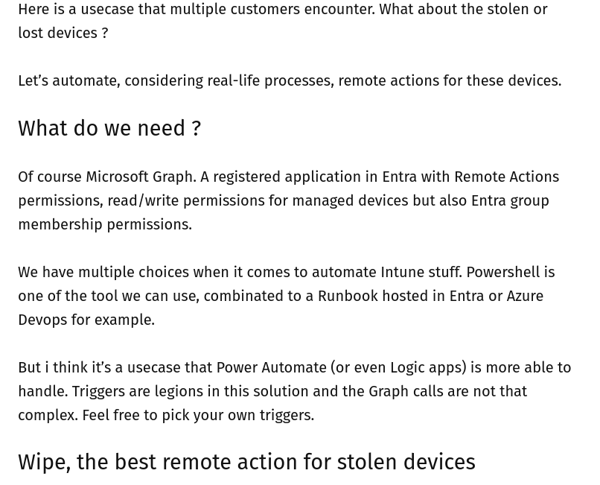
Automate Wipe for Lost Devices – Tom Machaco
https://poemtomdm.fr/2025/03/11/intune-power-automate-automate-wipe-remote-action-for-lost-devices/

Slide 17
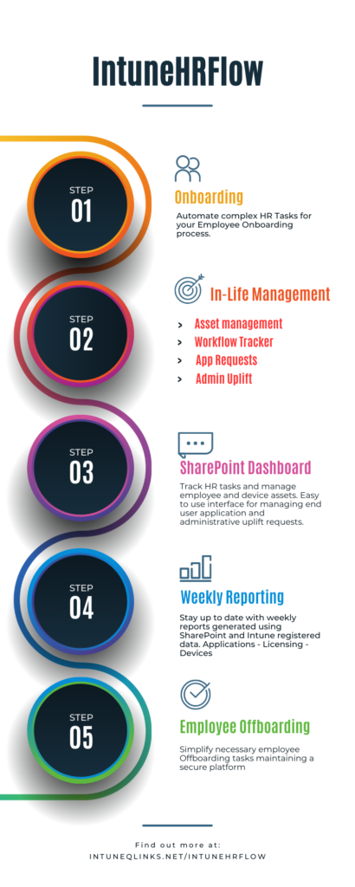
HR Flow – Onboarding and Offboarding – Andy Jones
https://move2modern.uk/index.php/2025/03/24/intunehrflow-automate-employee-onboarding-and-offboarding/

Slide 18

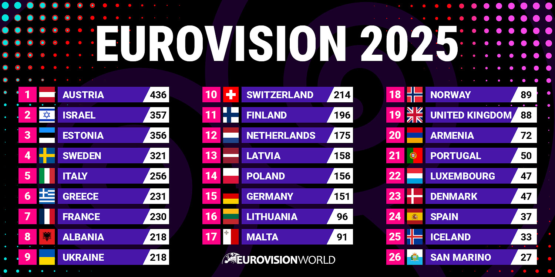

April

Slide 19
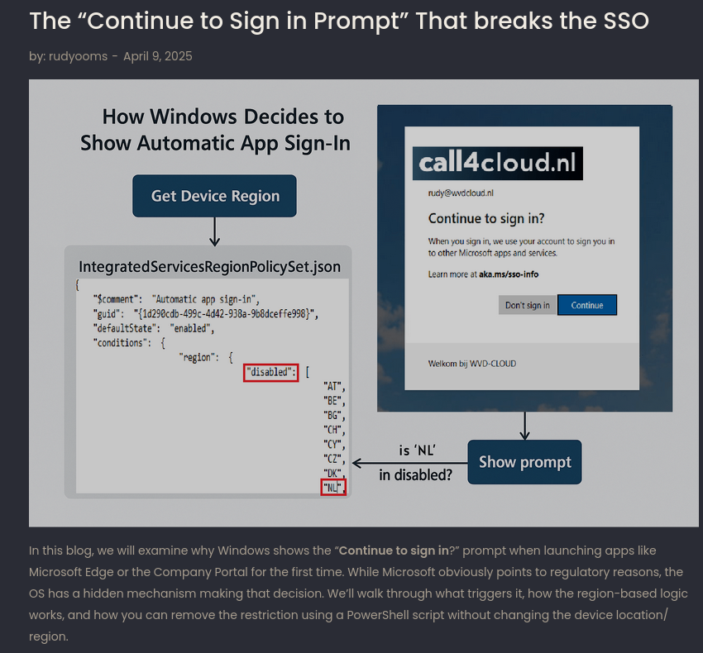
SSO not quite so silent – Rudy Ooms
https://call4cloud.nl/continue-to-sign-in-prompt-sso-dma/

Slide 20
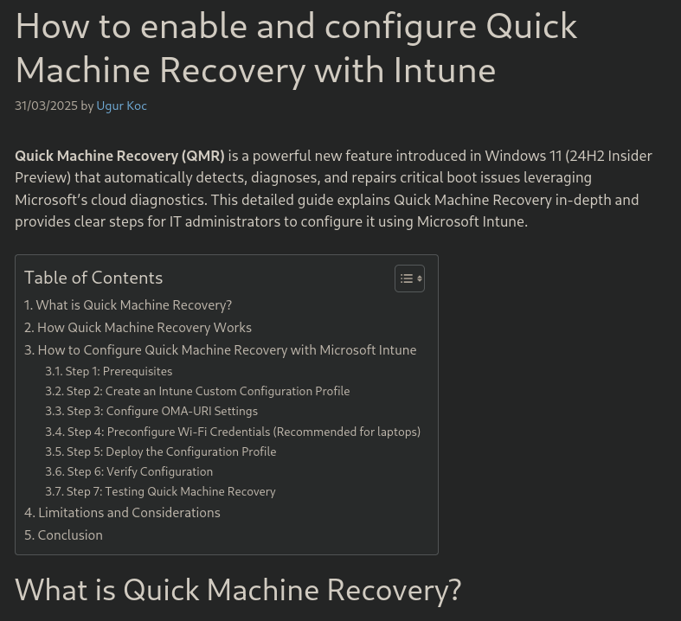
Enabling Quick Recovery – Ugur Koc
https://ugurkoc.de/how-to-enable-and-configure-quick-machine-recovery-with-intune/

Slide 21
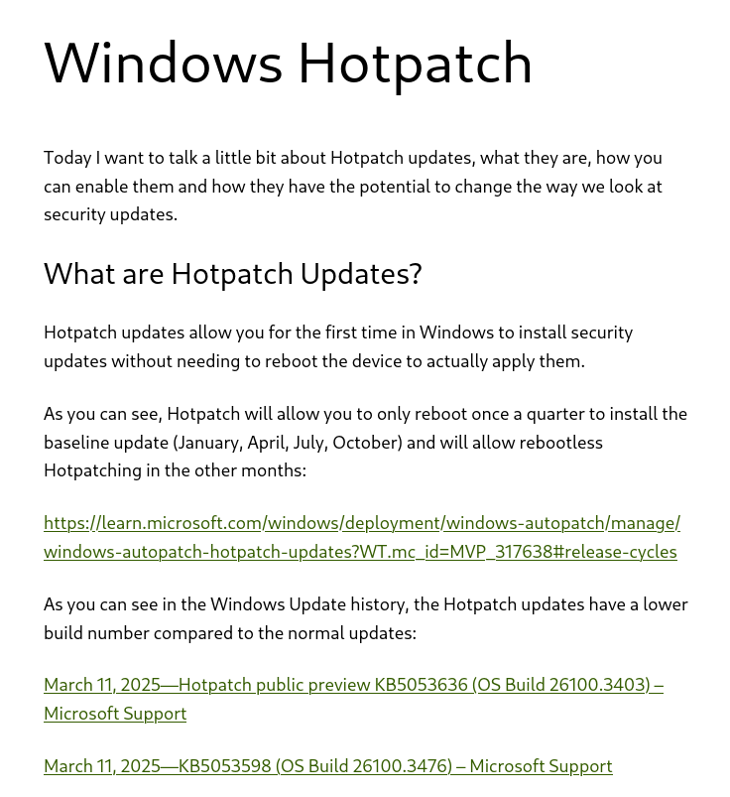
Hotpach – Michael Meier
https://mikemdm.de/2025/04/06/windows-hotpatch/

Slide 22

May

Slide 23

Intune, PowerShell and Graph Best practices – Damien Van Robaeys
https://www.systanddeploy.com/2024/08/intune-powershell-and-graph-api-best.html

Slide 24
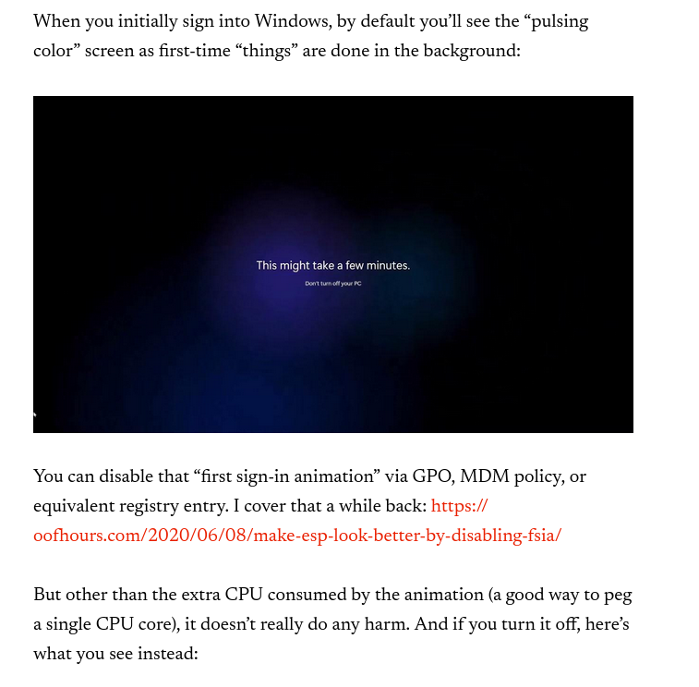
What happens when you login – Michael Niehaus
https://oofhours.com/2025/05/02/whats-really-happening-on-first-user-logon/

Slide 25
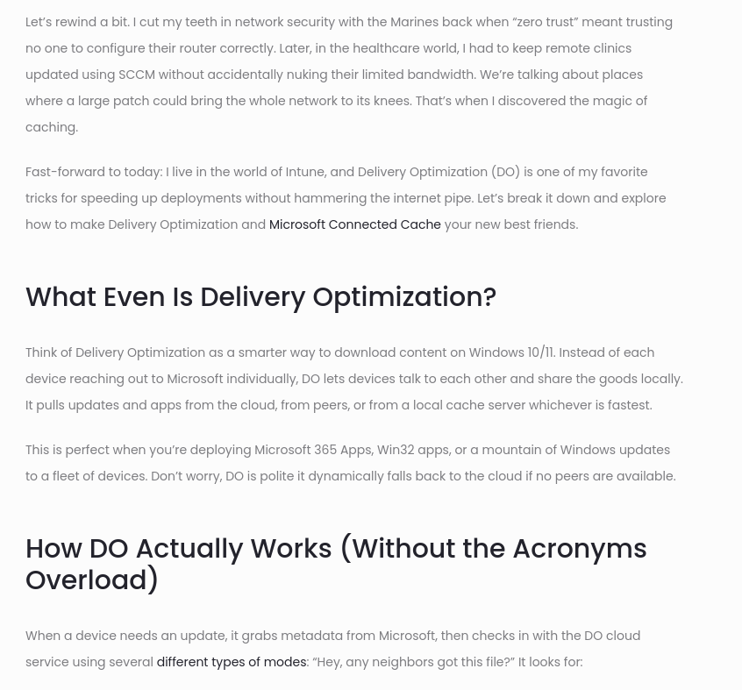
Configure Connected Cache – Dustin Gullett
https://zerototrust.tech/boost-your-bandwidth-a-friendly-guide-to-delivery-optimization-and-connected-cache/

Slide 26




June

Slide 27
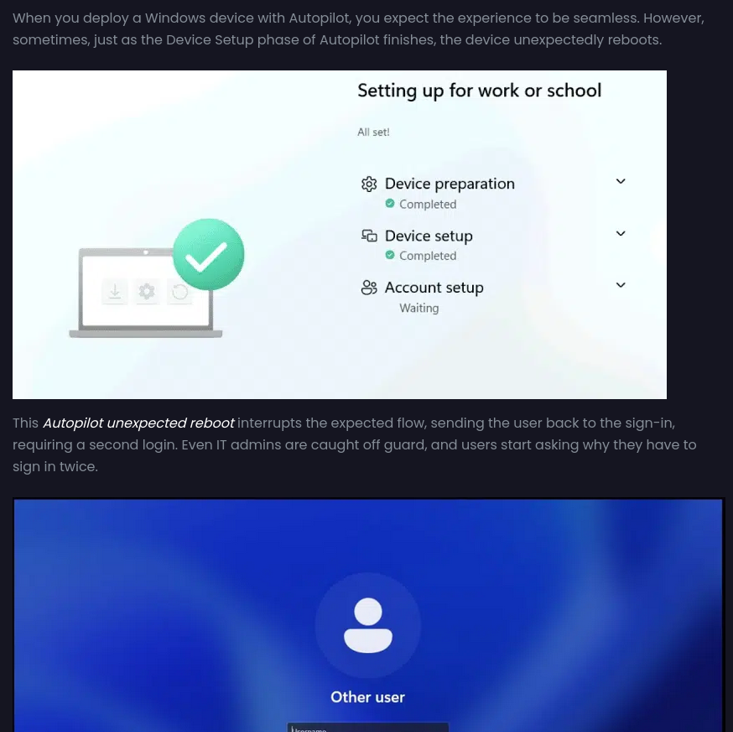
What causes reboots during OOBE – Rudy Ooms
https://patchmypc.com/blog/autopilot-unexpected-reboot-autopilot-second-login-screen/

Slide 28
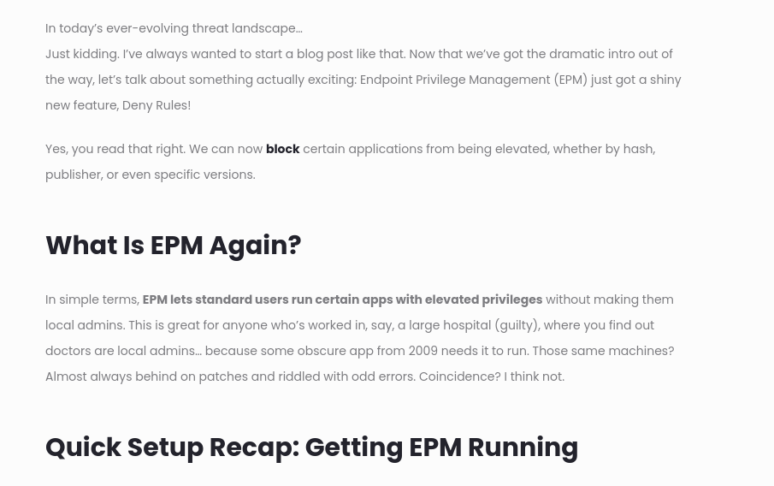
EPM Support Approved – Dustin Gullett
https://zerototrust.tech/deny-deny-deny-a-look-at-epms-newest-superpower/

Slide 29


July

Slide 30

Top 10 Community Tools – Niklas Tinner
https://www.oceanleaf.ch/my-top-10-intune-community-tools/

Slide 31
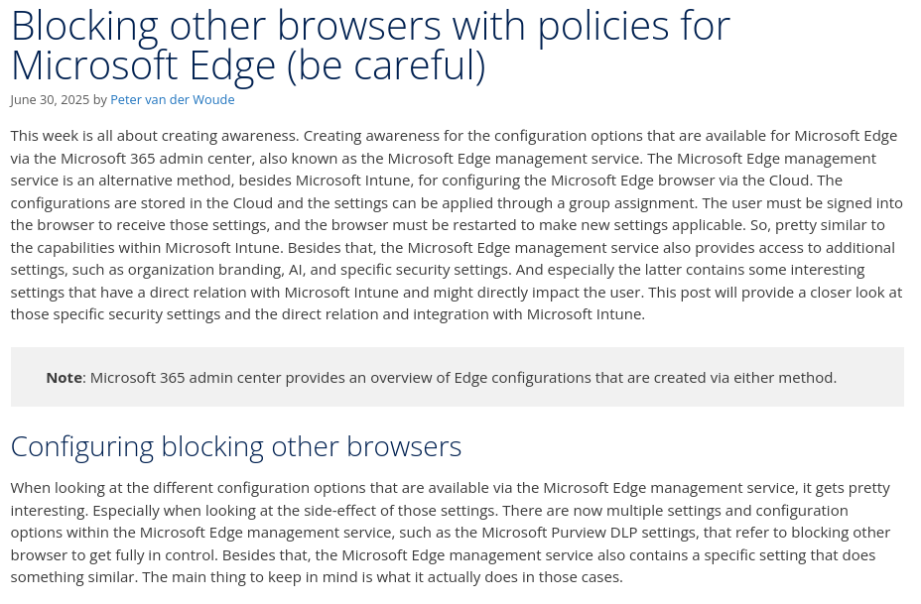
Blocking other browsers – Peter van der Woude
https://petervanderwoude.nl/post/blocking-other-browsers-with-policies-for-microsoft-edge-be-careful/

Slide 32
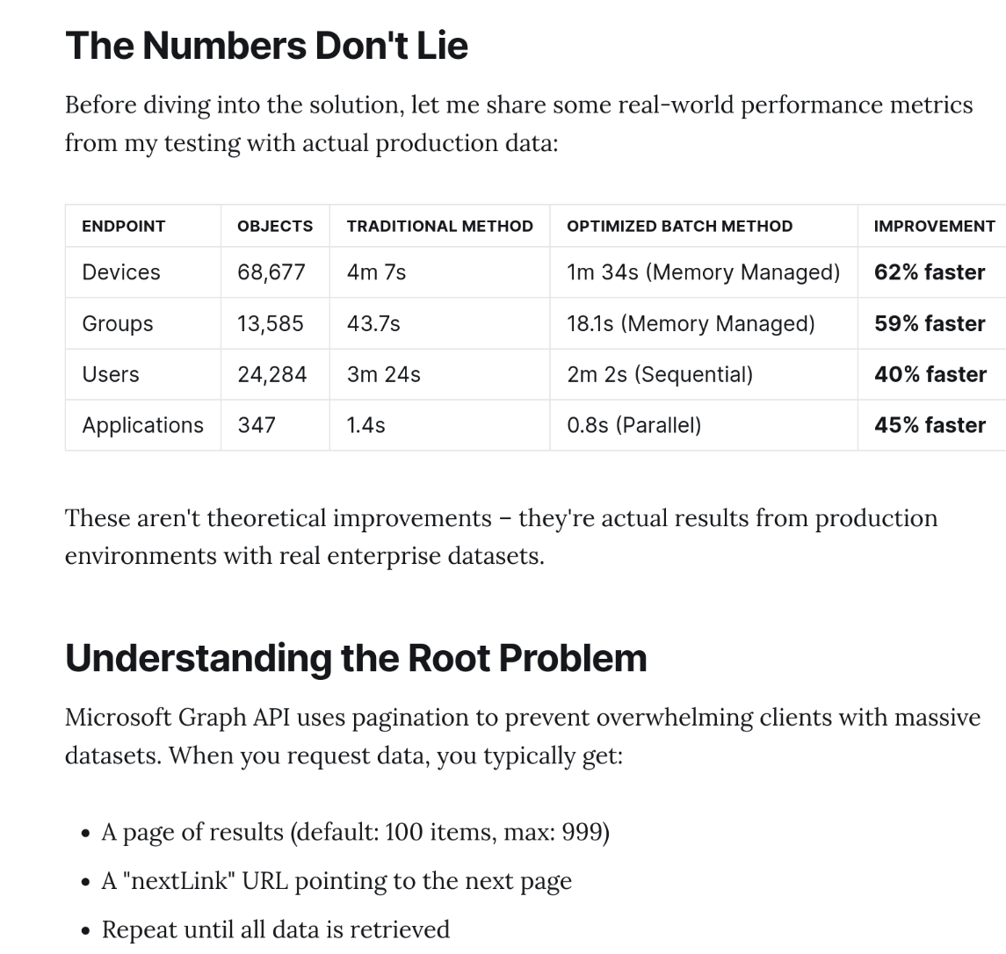
Supercharge Microsoft Graph API Data Retrieval with PowerShell Batch Requests – Jorge Suarez
https://www.jorgeasaur.us/supercharge-microsoft-graph-api-data-retrieval-with-powershell-batch-requests/

Slide 33

Mastering App Control for Business – Patrick Seltmann
https://www.ctrlshiftenter.cloud/2025/03/09/mastering-app-control-for-business-part-1-introduction-key-concept/

Slide 34
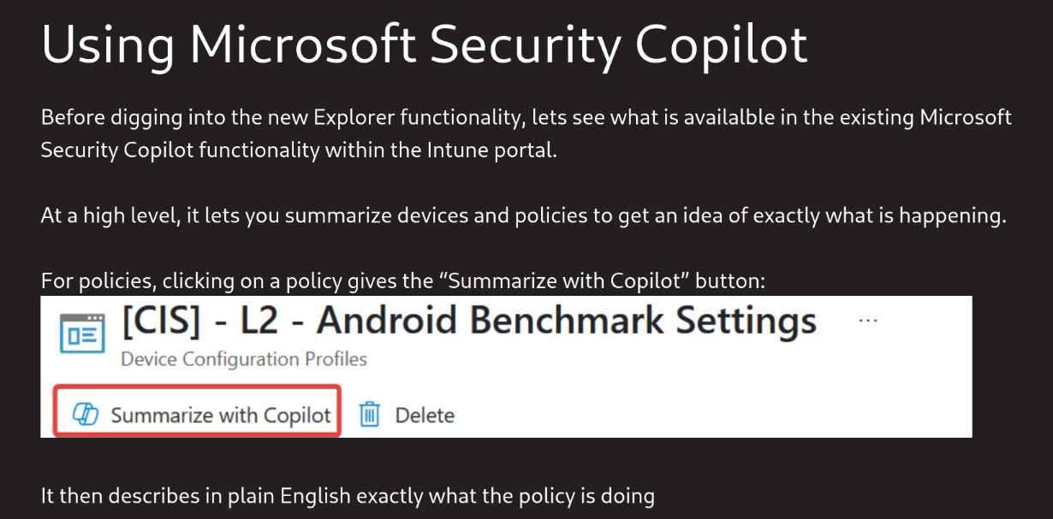
Can Microsoft Security Copilot really help with day-to-day Intune tasks? - Me
https://andrewstaylor.com/2025/07/14/can-microsoft-security-copilot-really-help-with-day-to-day-intune-tasks/

Slide 35


August

Slide 36
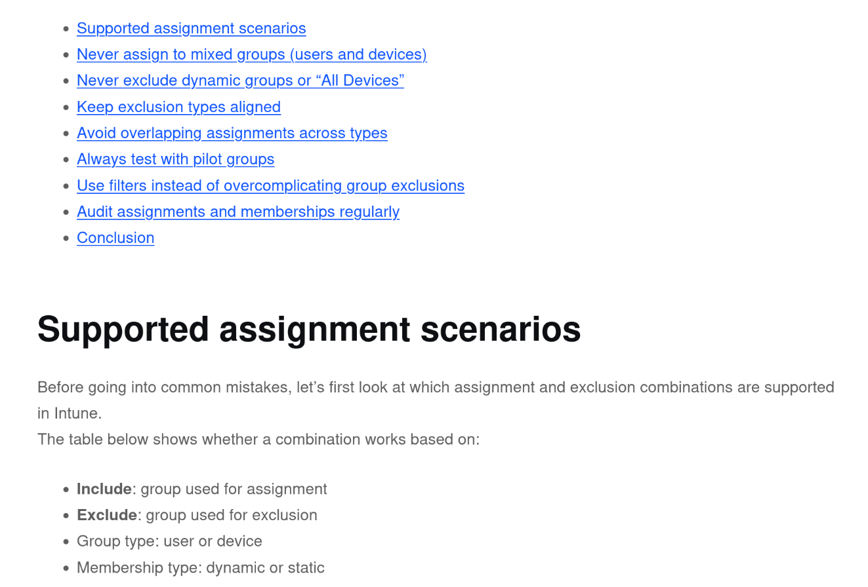
Mastering Assignments in Intune: Group Targeting Done Right – Florian Salzmann
https://scloud.work/mastering-assignments-in-intune-group-targeting-done-right/

Slide 37
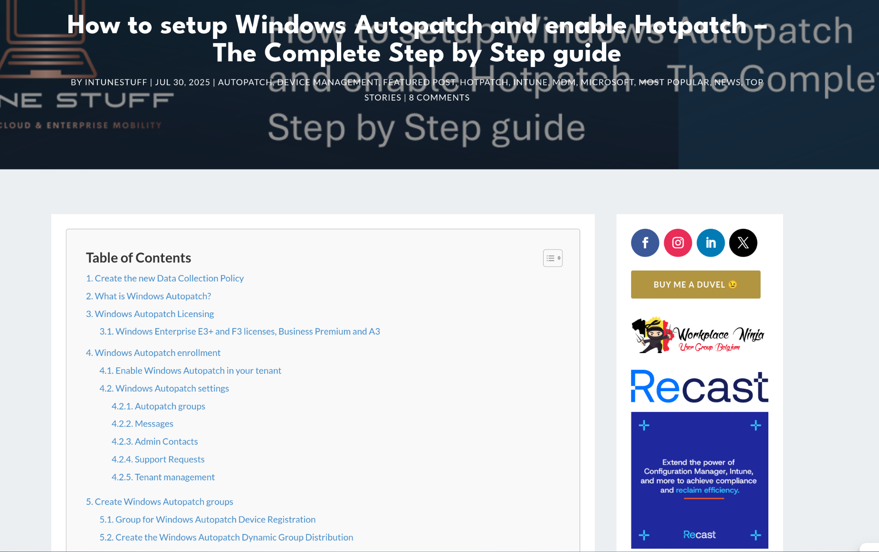
How to setup Windows Autopatch and enable Hotpatch – The Complete Step by Step guide - Joery Van den Bosch
https://intunestuff.com/2025/07/30/windows-autopatch-hotpatch/

Slide 38
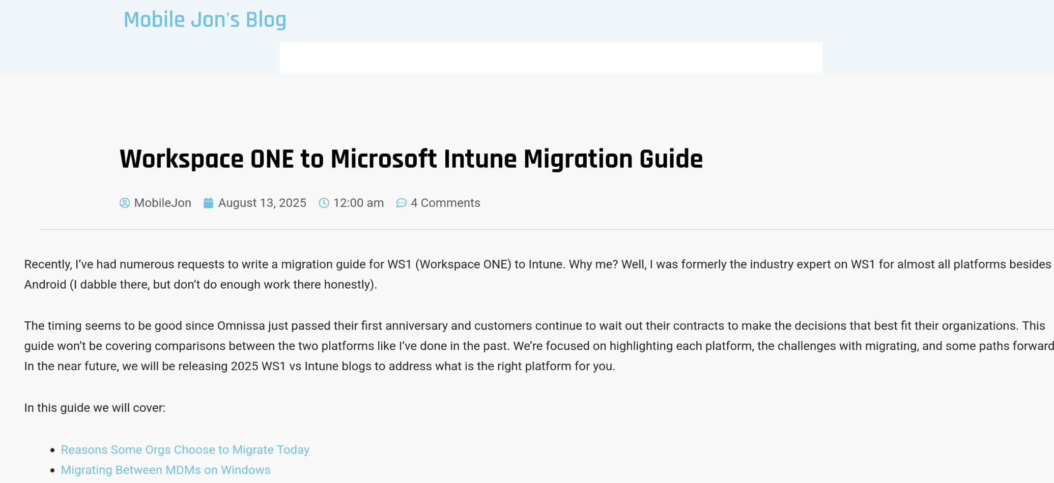
Workspace ONE to Microsoft Intune Migration Guide – Jon Towles
https://mobile-jon.com/2025/08/13/workspace-one-to-microsoft-intune-migration-guide/

Slide 39



September

Slide 40
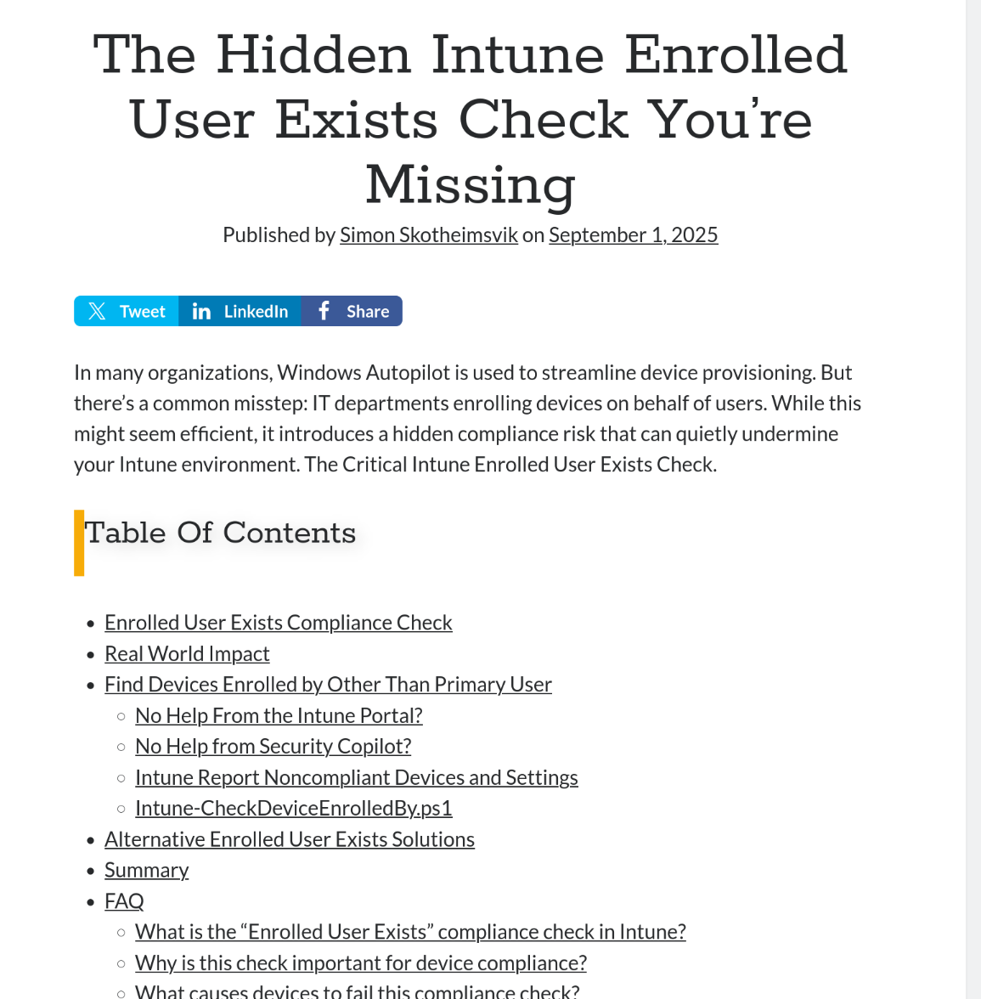
The Hidden Intune Enrolled User Exists Check You’re Missing - Simon Skotheimsvik
https://skotheimsvik.no/the-hidden-intune-enrolled-user-exists-check-youre-missing

Slide 41
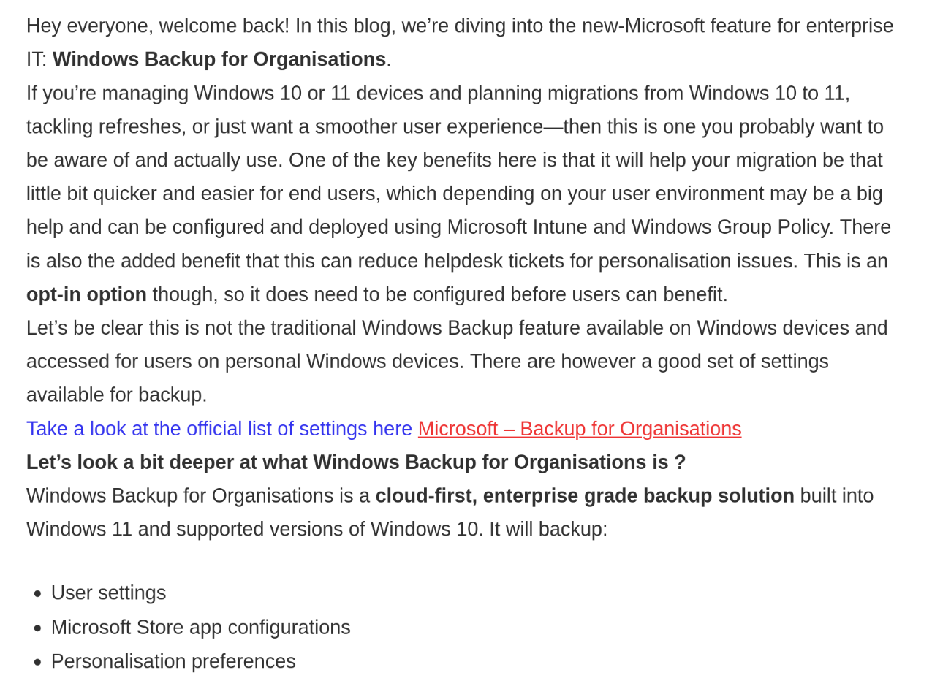
Getting to know – Windows Backup for Organisations – Andy Jones
https://move2modern.uk/index.php/2025/09/21/getting-to-know-windows-backup-for-organisations/

Slide 42
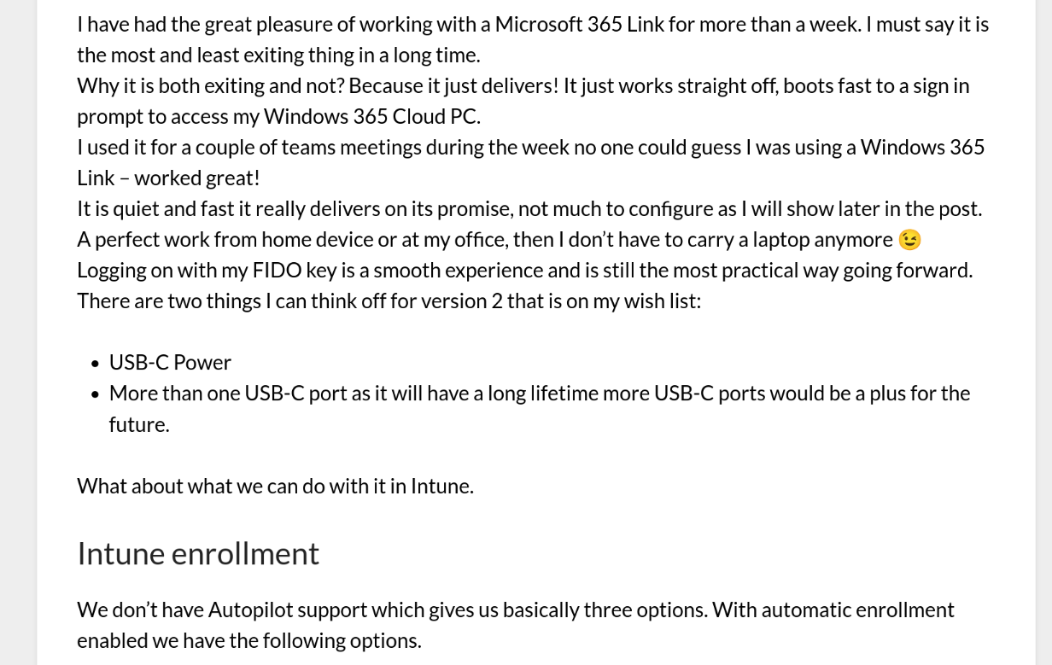
Windows 365 Link – a week and some - Jörgen Nilsson
https://ccmexec.com/2025/09/windows-365-link-a-week-and-some/

Slide 43



October

Slide 44
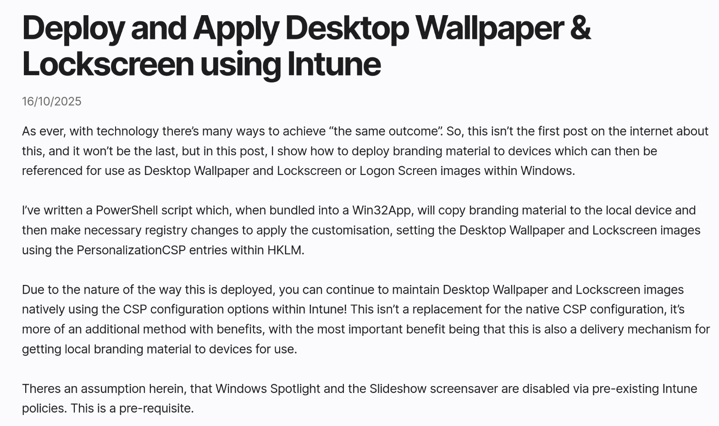
Deploy and Apply Desktop Wallpaper & Lockscreen using Intune – James Vincent
https://jamesvincent.co.uk/2025/10/16/deploy-and-apply-desktop-wallpaper-lockscreen-using-intune/

Slide 45
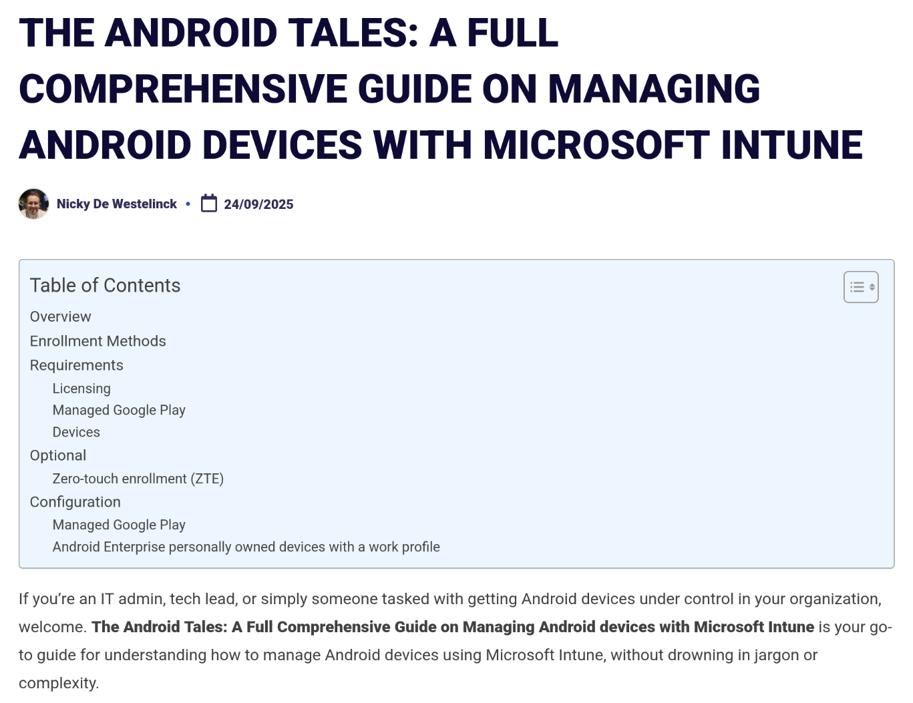
The Android Tales: A Full Comprehensive Guide on Managing Android devices with Microsoft Intune - Nicky De Westelinck
https://www.nickydewestelinck.be/2025/09/24/the-android-tales-a-full-comprehensive-guide-on-managing-android-devices-with-microsoft-intune/

Slide 46
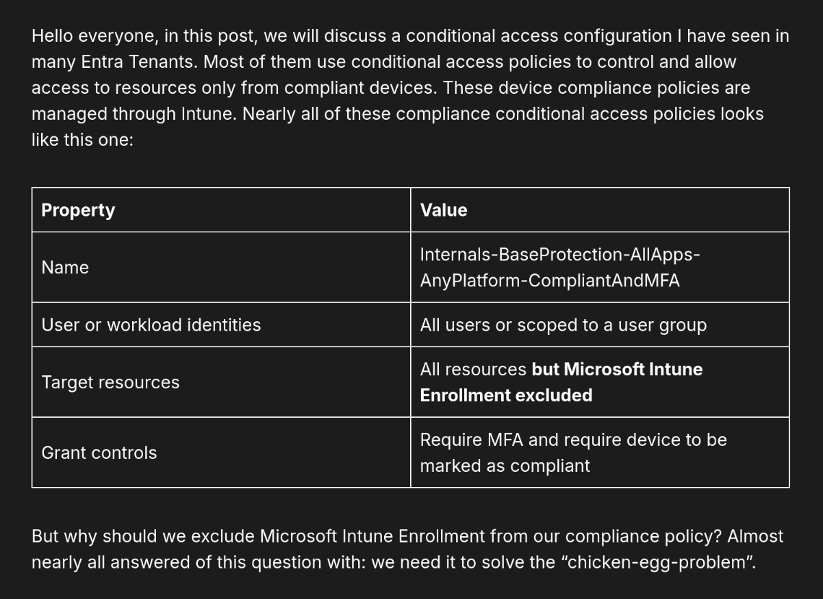
Should you exclude “Microsoft Intune Enrollment” from your compliance CAP or not? – Patrick Seltmann
https://www.ctrlshiftenter.cloud/2025/10/12/should-you-exclude-microsoft-intune-enrollment-from-your-compliance-cap-or-not/

Slide 47


November

Slide 48
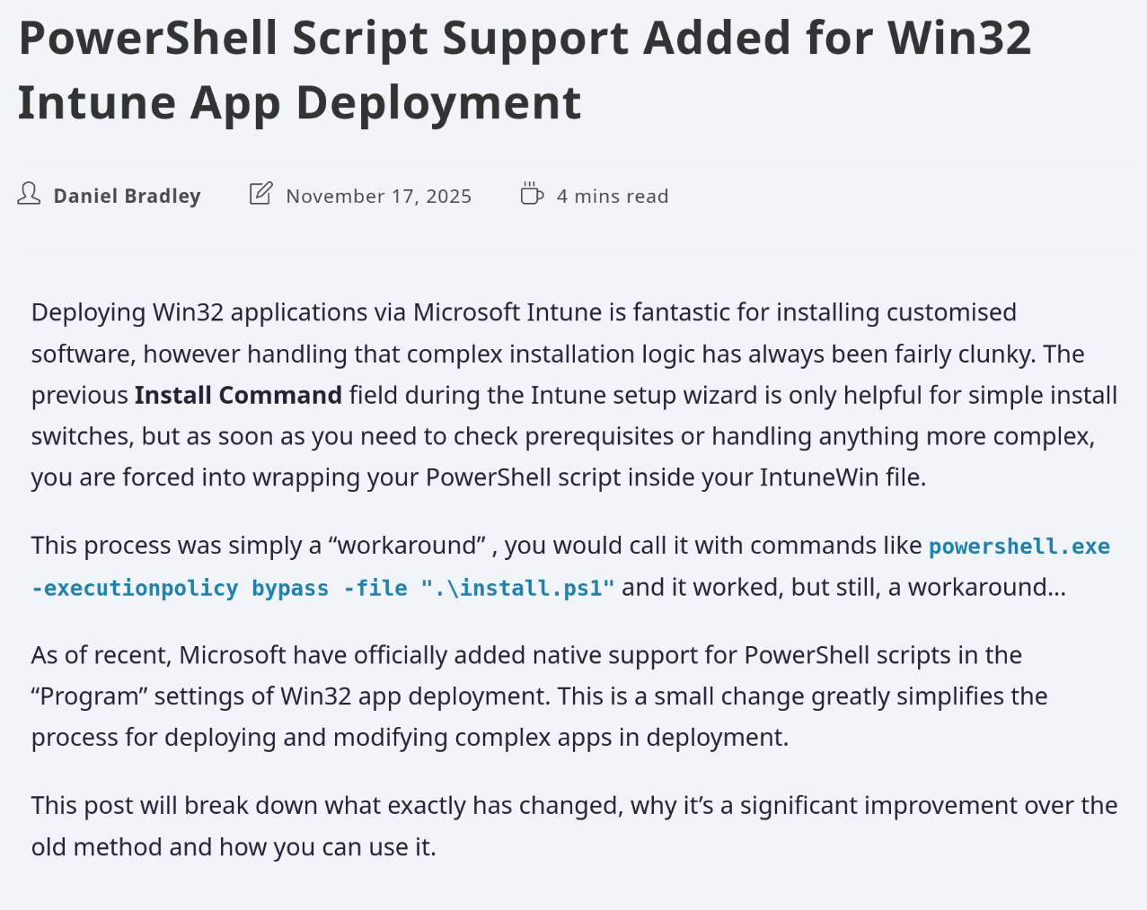
PowerShell Script Support Added for Win32 Intune App Deployment – Daniel Bradley
https://ourcloudnetwork.com/powershell-script-support-added-for-win32-intune-app-deployment/

Slide 49
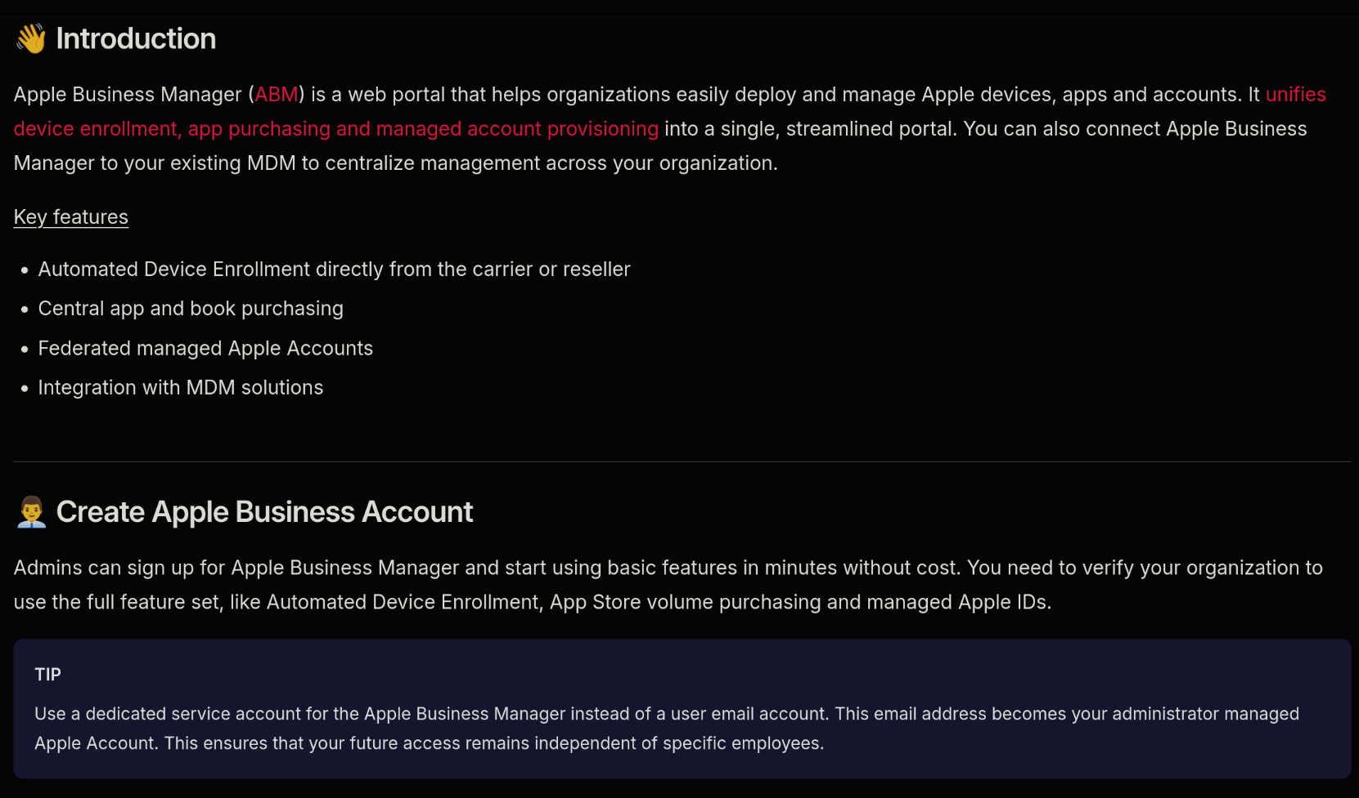
Apple Business Manager – Michael Frank
https://michaelsendpoint.com/intune/ABM.html

Slide 50
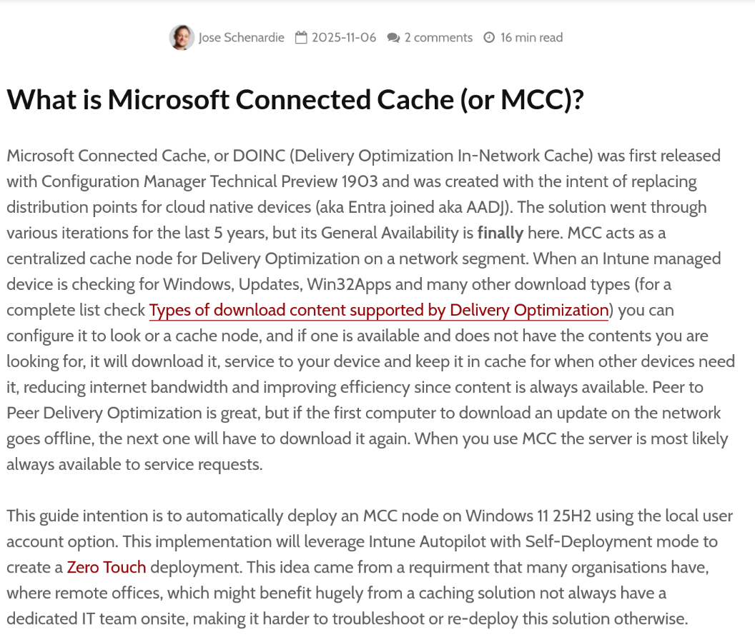
Zero-Touch Microsoft Connected Cache with Intune - Jose Schenardie
https://msendpointmgr.com/2025/11/06/zero-touch-microsoft-connected-cache-with-intune/

Slide 51

A beginners guide to Microsoft Graph API rate limiting in Intune – Ben Whitmore
https://msendpointmgr.com/2025/11/08/graph-api-rate-limiting-in-intune/

Slide 52
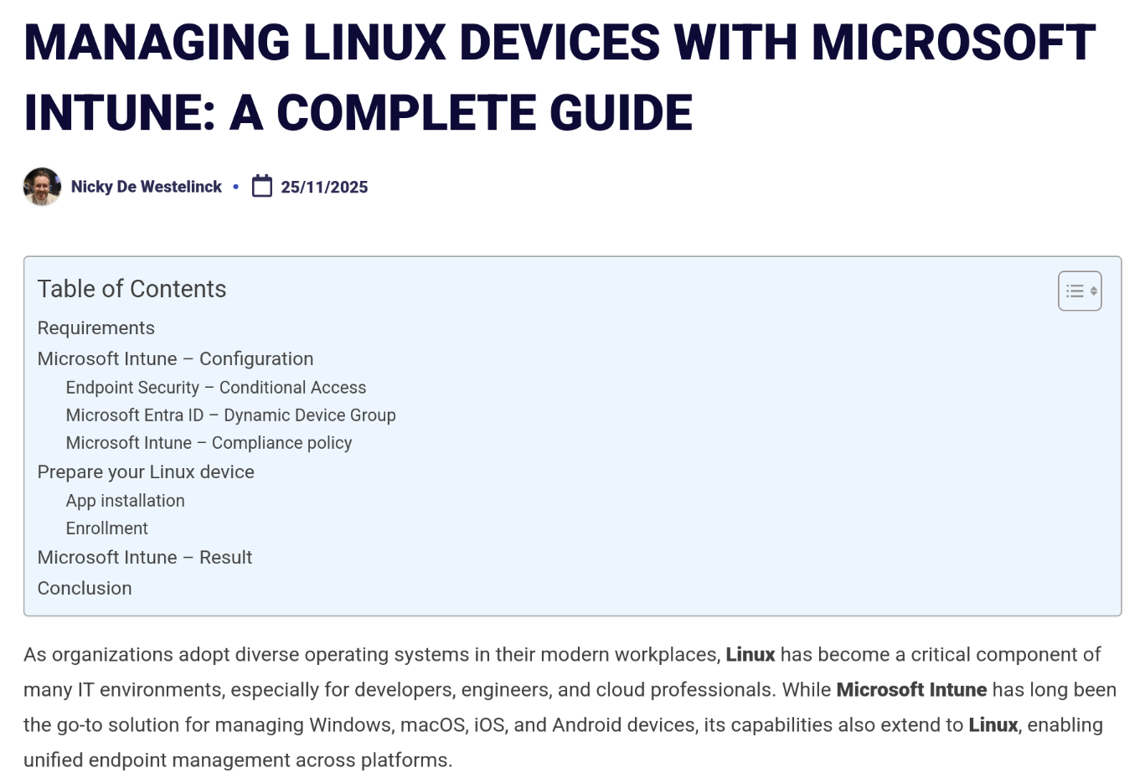
Managing Linux Devices with Microsoft Intune: A Complete Guide - Nicky De Westelinck
https://www.nickydewestelinck.be/2025/11/25/managing-linux-devices-with-microsoft-intune-a-complete-guide/

Slide 53



December

Slide 54
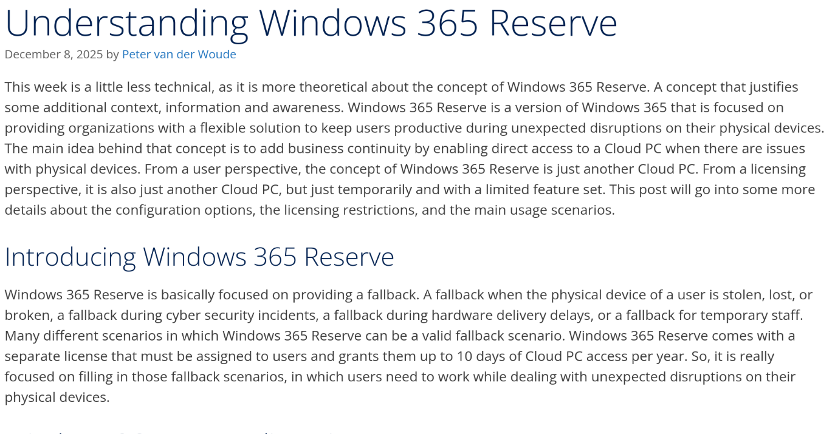
Understanding Windows 365 Reserve - Peter van der Woude
https://petervanderwoude.nl/post/understanding-windows-365-reserve/

Slide 55
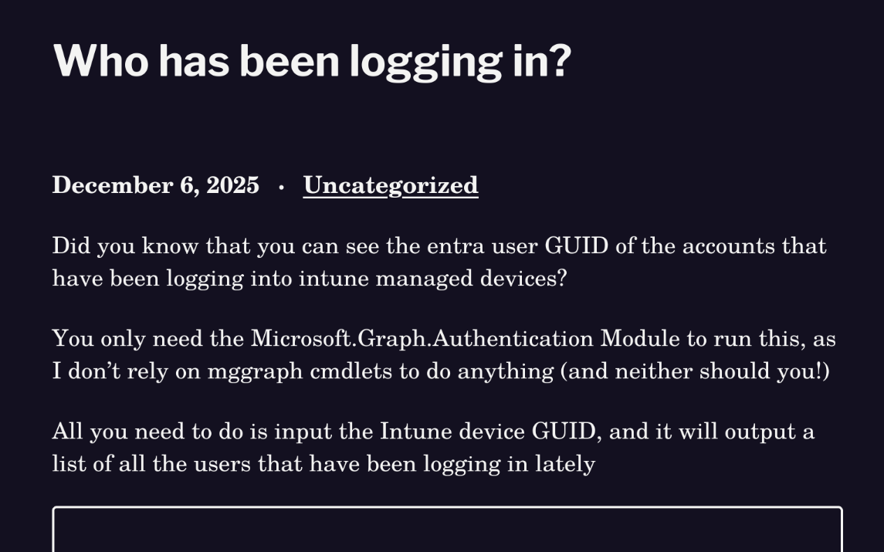
Who has been logging in? - Jóhannes Kristjánsson
https://johannesblog.com/2025/12/06/who-has-been-logging-in/

Slide 56
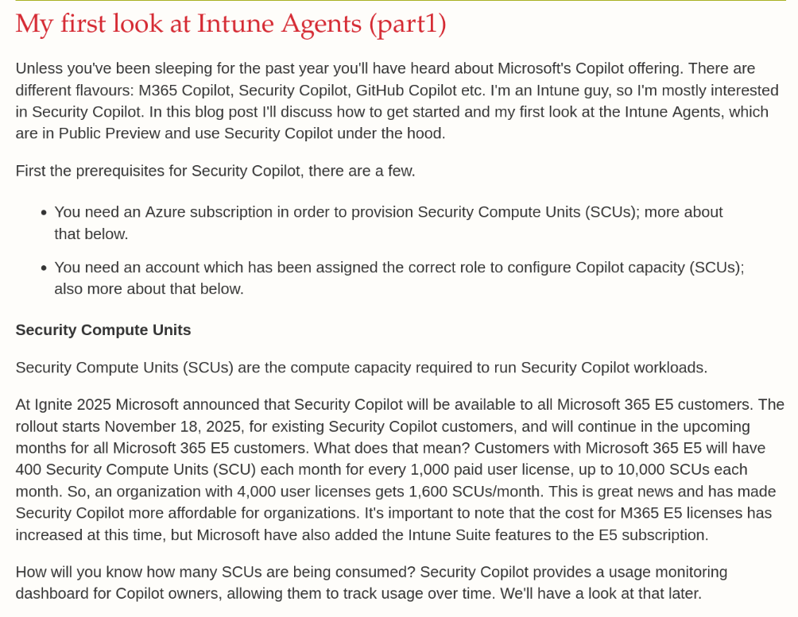
My first look at Intune Agents – Gerry Hampson
https://gerryhampsoncm.blogspot.com/2025/12/my-first-look-at-intune-agents.html

Slide 57
Please rate this session on Sched.com (highly)
We would love to hear what you liked and how we could improve!
Thanks!

