Slide 1
Apple Device Administration Essentials
A Beginner's Guide & Best Practices for Deploying Apple Devices
Somesh Pathak & Oktay Sari

Slide 2
Sponsors

Slide 3


Somesh Pathak
Microsoft MVP · Security
Role
Manager, Modern Workplace Engineering, Avanade
Focus
Intune · Security · Copilot · M365 Administration
www.intuneirl.com
in/someshpathak/
newsletters/life-in-tremors

Slide 4

Boots on the Ground, Head in the Cloud - Just a digital Cowboy, Ridin' the Rains of Change! 🤠💨
Oktay Sari
Microsoft MVP · Security & Windows and Devices
Role
Self Employed, Modern Workplace Consultant
@All Things Cloud BV
Focus
Intune · Security · macOS · Windows 365 · CIS · NIST
https://allthingscloud.blog
https://www.linkedin.com/in/oktaysari/

Slide 5


Slide 6
Agenda
Three parts covering everything you need to confidently deploy and manage Apple devices in your organization.
Foundations & Planning
Identity, Config & Content
Security, Scaling & Wrap-up

Slide 7
Part 1 — Foundations & Planning
Apple ecosystem
Apple Business Manager/ Apple School Manager
Managed Apple Accounts
Enrollment methods,
MDM selection
Setup Assistant

Slide 8
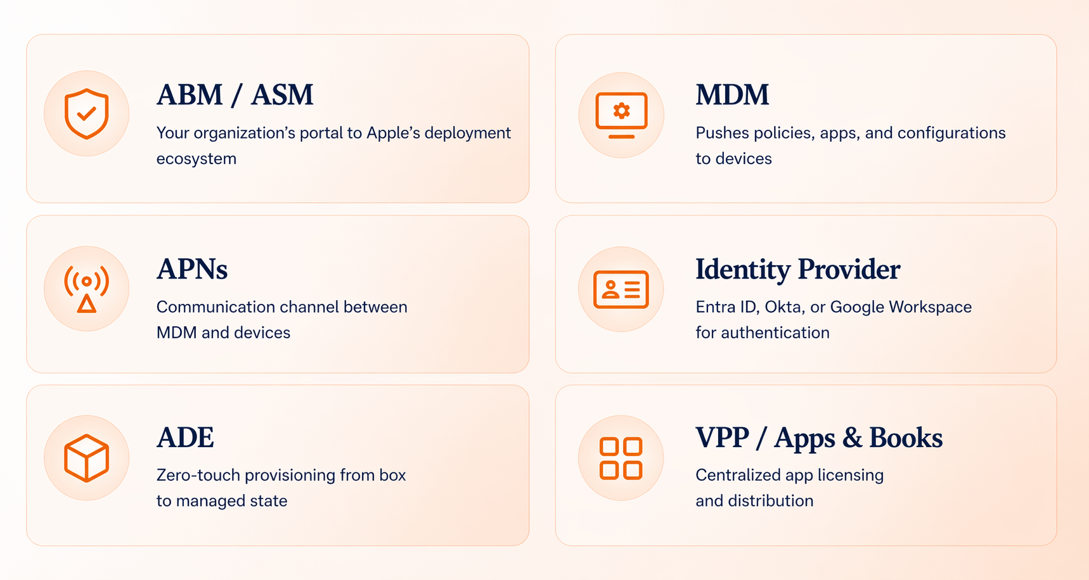
Intro to Apple Platform Deployment
Apple devices are designed to be managed as an integrated system — hardware, software, apps, and services working together through six core building blocks.

Slide 9
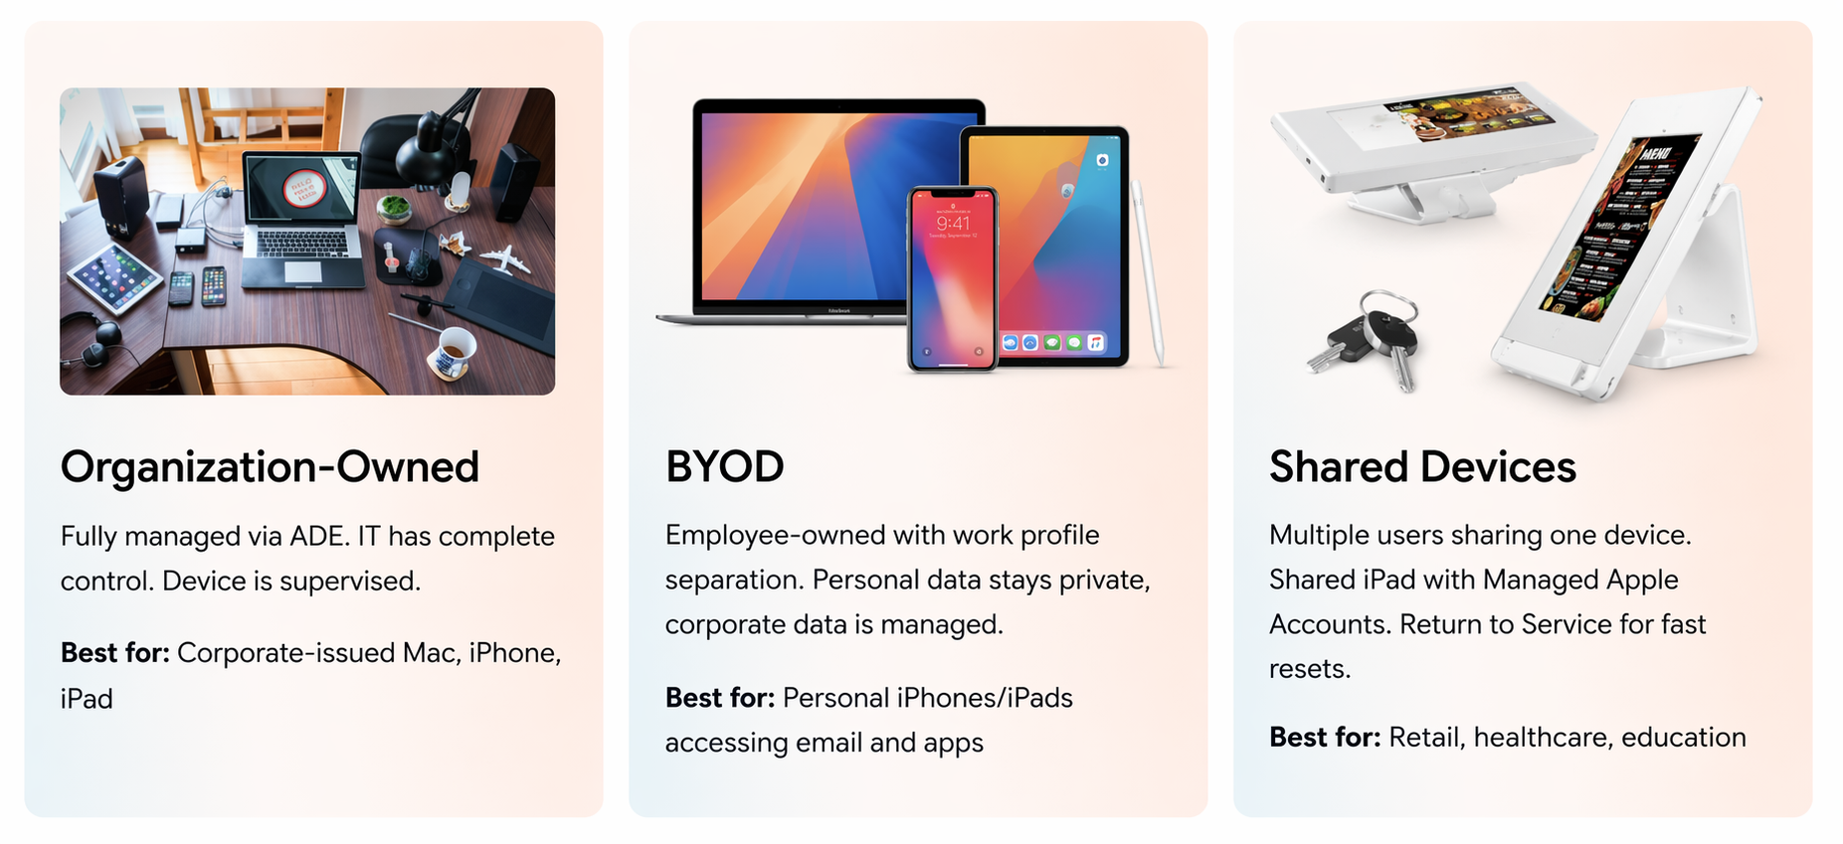
Choosing a Deployment Model
Your deployment model determines the enrollment method and level of IT control. Apple supports three primary models.

Slide 10
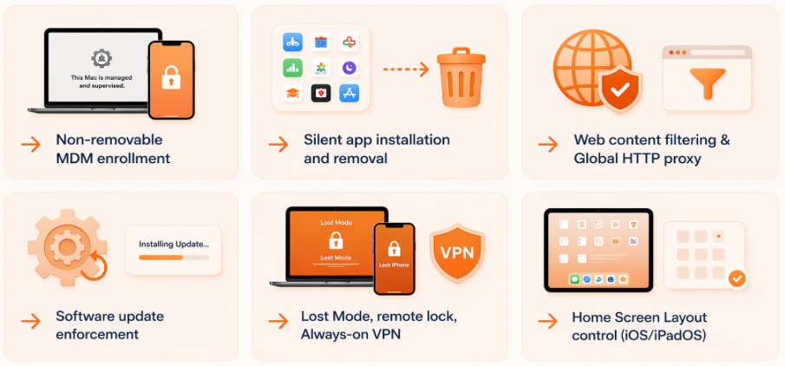
Device Supervision
Supervision is a special mode that gives IT full management control over a device. It can only be enabled through ADE or Apple Configurator — not after initial setup without a wipe.

Slide 11
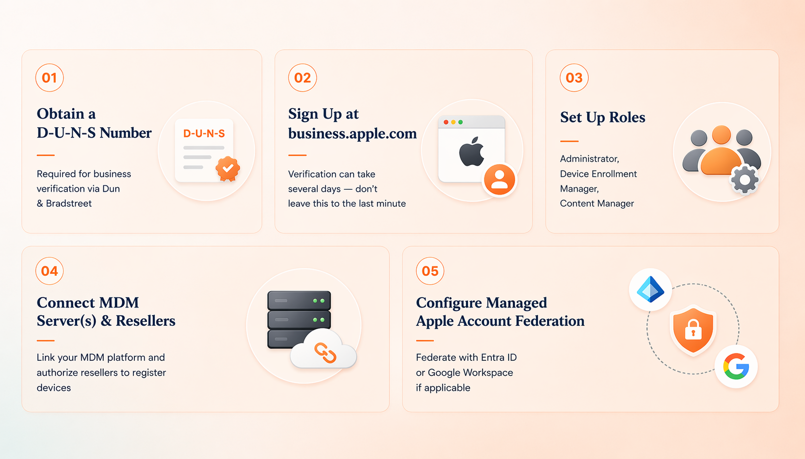
Apple Business Manager — Setup & Overview
ABM is your organization's free portal to Apple's deployment ecosystem — covering device enrollment, app licensing, and identity management. Start the enrollment process early; Apple's verification takes time.

Slide 12
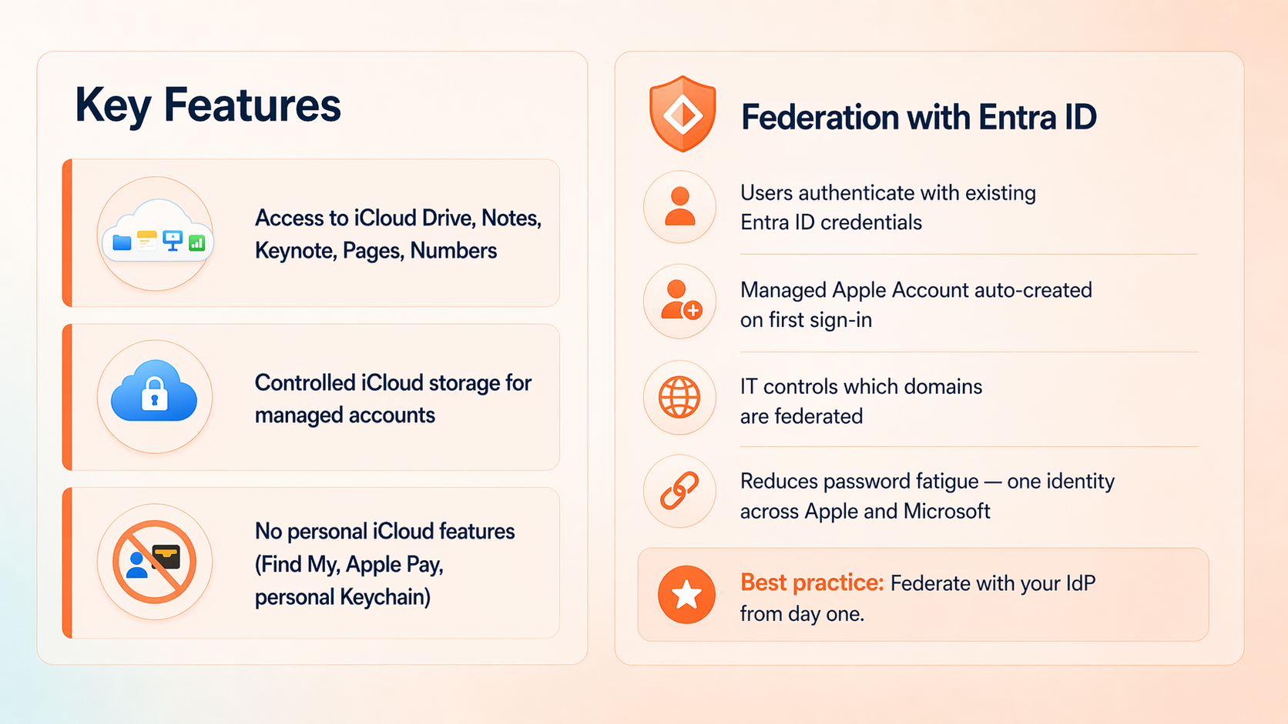
Managed Apple Accounts
Organizational Apple IDs created and owned by your company through ABM — separate from personal Apple IDs and fully under IT control.

Slide 13
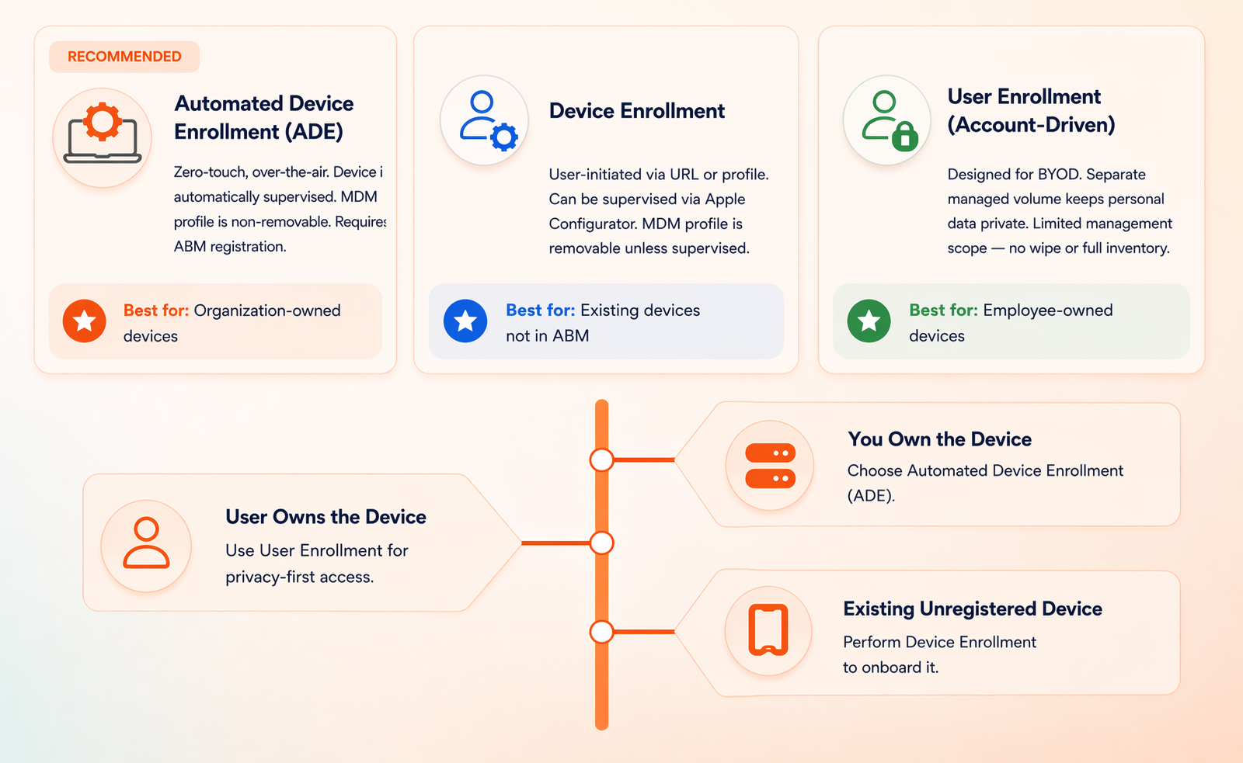
Enrollment Methods for Apple Devices
Apple offers three enrollment methods, each suited to a different ownership scenario. The right choice depends on who owns the device.

Slide 14
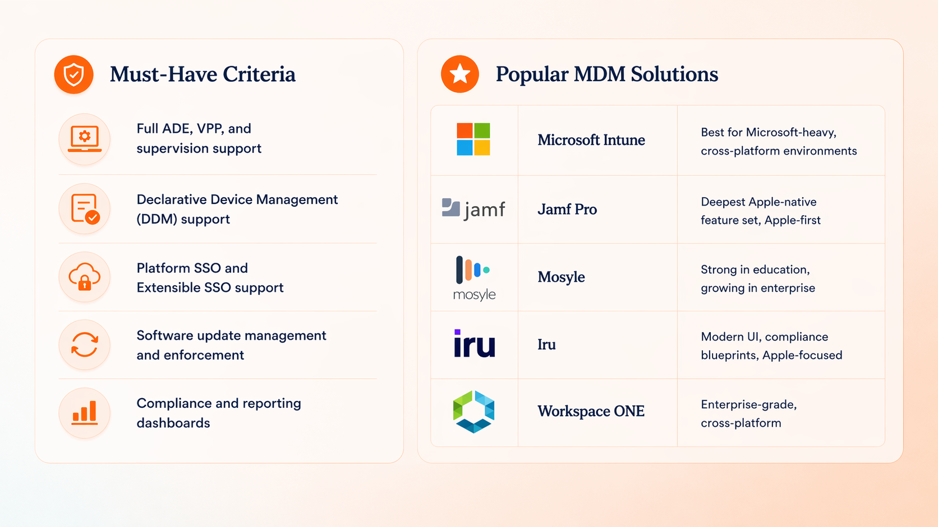
Choosing a Device Management Service (MDM)
Your MDM is the central platform for managing Apple devices. Evaluate candidates against these criteria before committing.

Slide 15
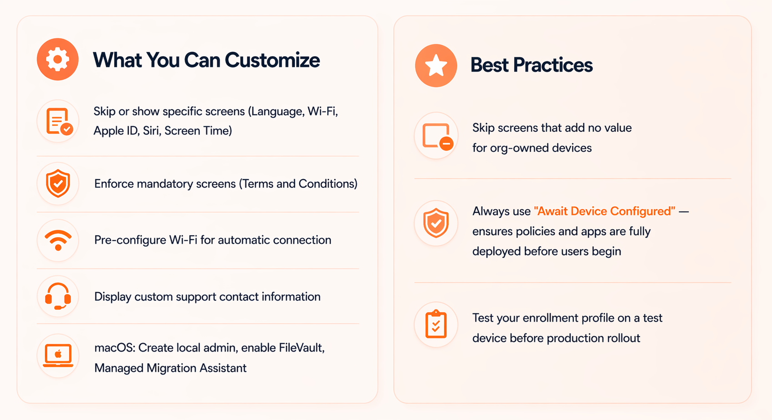
Setup Assistant — Controlling the First-Run Experience
Setup Assistant is what users see on first power-on. With MDM and ADE, you control every screen they encounter.

Slide 16
Part 2 — Identity, Configuration & Content
Connecting Identity Providers
Configuring Devices
Deploying Apps, and Managing Updates

Slide 17
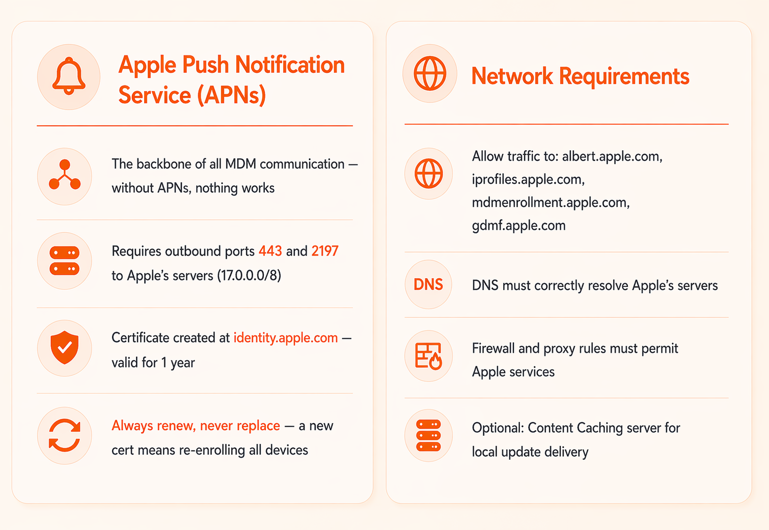
Prepare Your Environment — Network & APNs
Test APNs connectivity before enrollment. A silently blocked port 443 or 2197 will break MDM with no clear error.

Slide 18
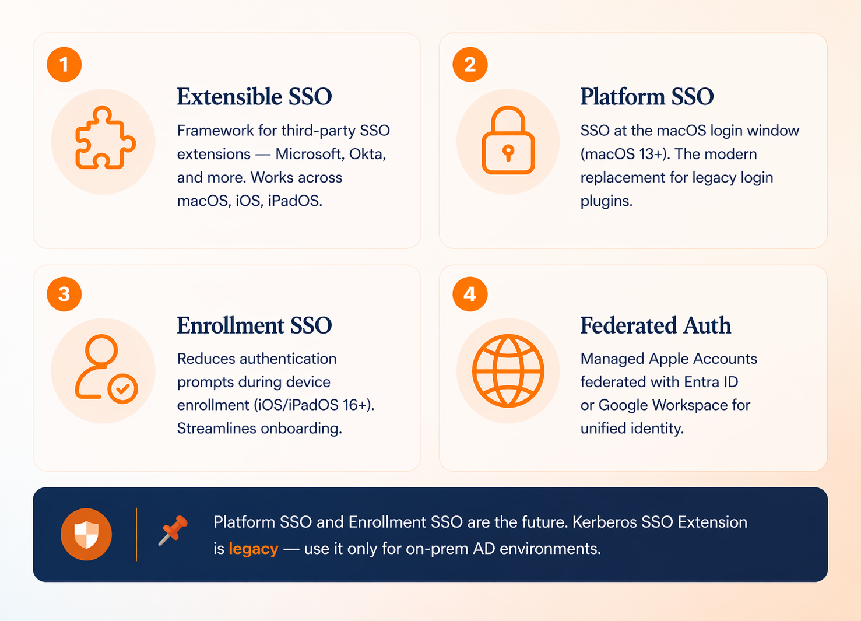
SSO Overview — Why Identity Integration Matters
Apple devices support enterprise identity services for seamless, secure authentication — reducing friction for users and strengthening compliance for IT.

Slide 19
Platform SSO for macOS
macOS User
Single Sign-On Platform
Identity Provider
SSO Extension App
Request access to app
Redirect to IDP for authentication
Presents authentication interface
User enters credentials
Validate credentials & issues SSO token
Grant access token
Access app with token
Checks validity of token
Confirm token validity
Grant accesss to app
macOS User
Single Sign-on Platform
Identity Provider
SSO Extension App

Slide 20
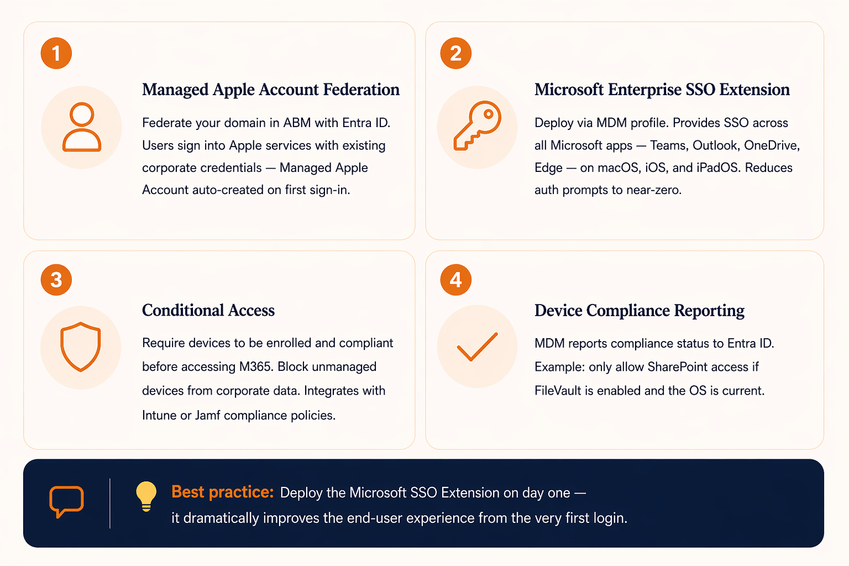
Integrate with Microsoft Entra ID

Slide 21
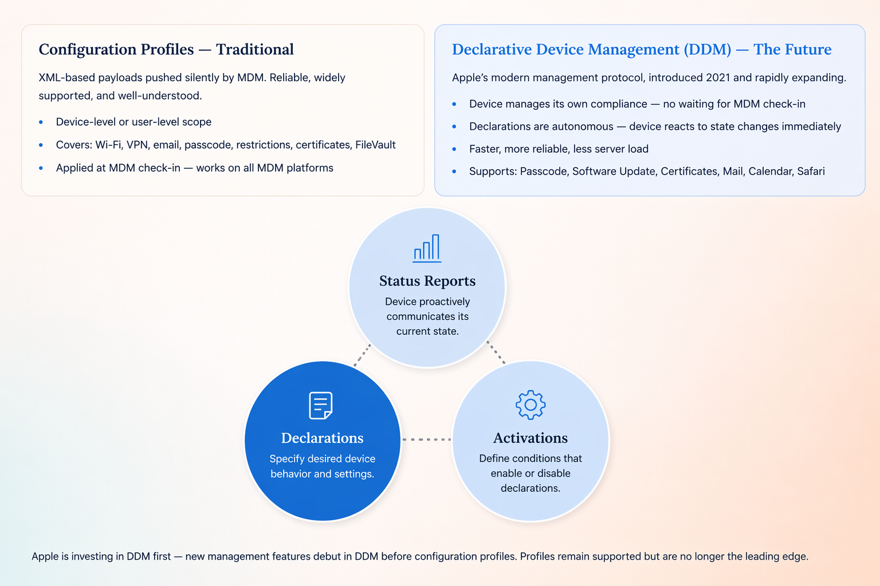
Device Management Configuration Options

Slide 22
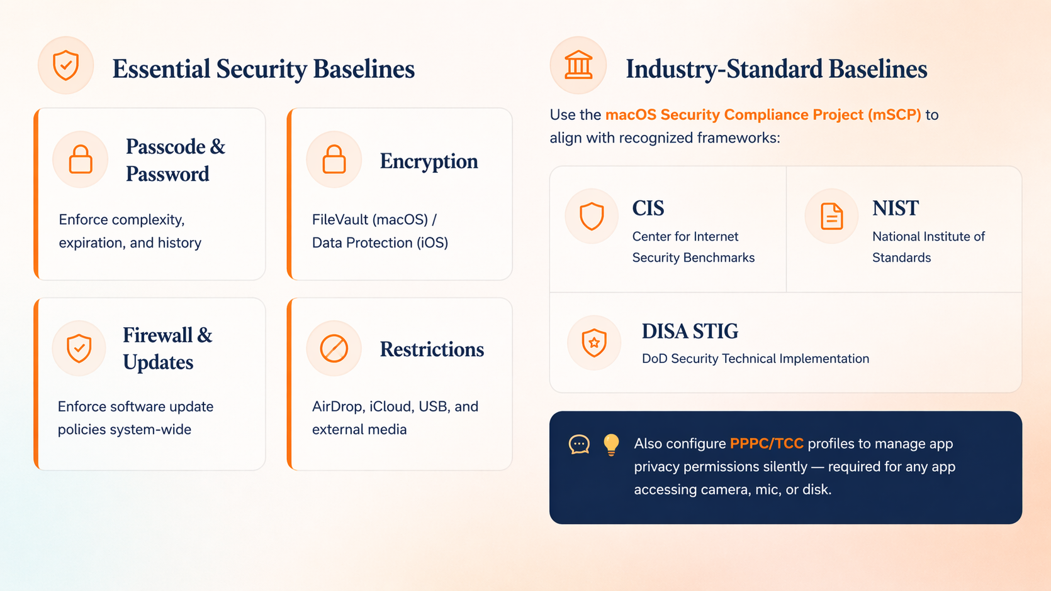
Configuration Profiles & Security Baselines
Payloads pushed silently via MDM. Can be scoped at the device level or user level — no user interaction required.

Slide 23
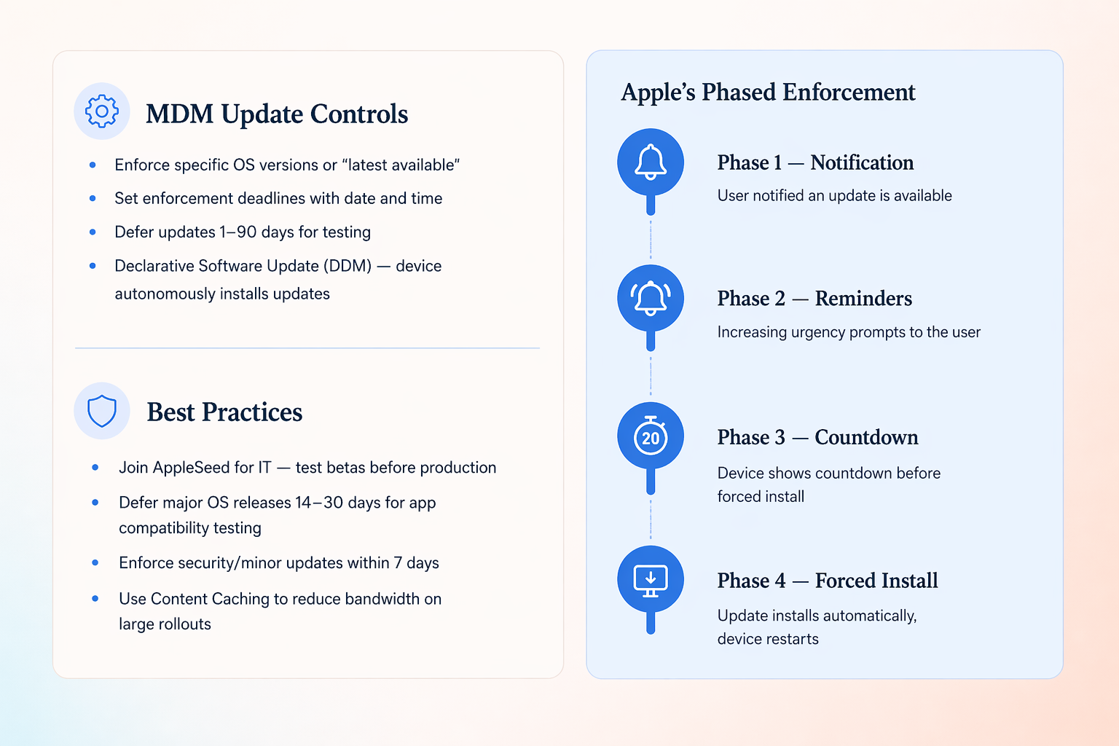
Manage Software Updates

Slide 24
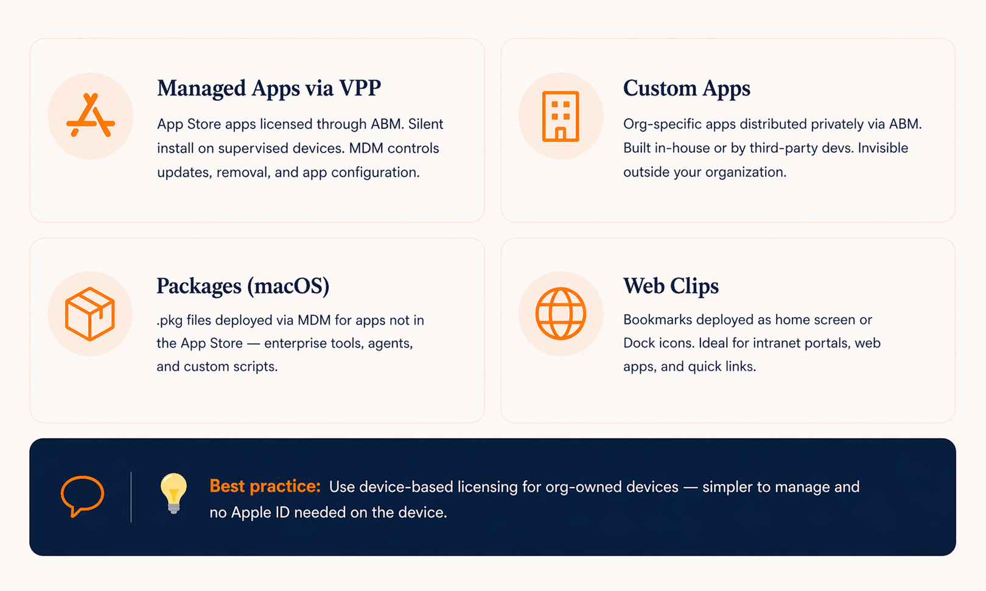
Distribute Content — Apps & Books (VPP)
Apple Business Manager's Apps & Books (formerly VPP) is the central hub for licensing and distributing apps across your organization — silently, at scale, with no Apple ID required on supervised devices.

Slide 25
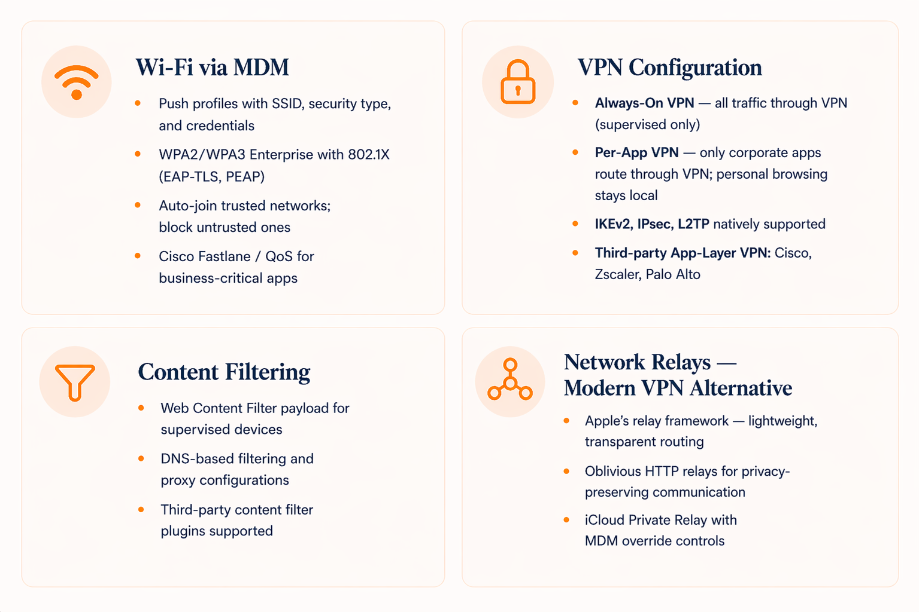
Networks — Wi-Fi, VPN & Relays

Slide 26
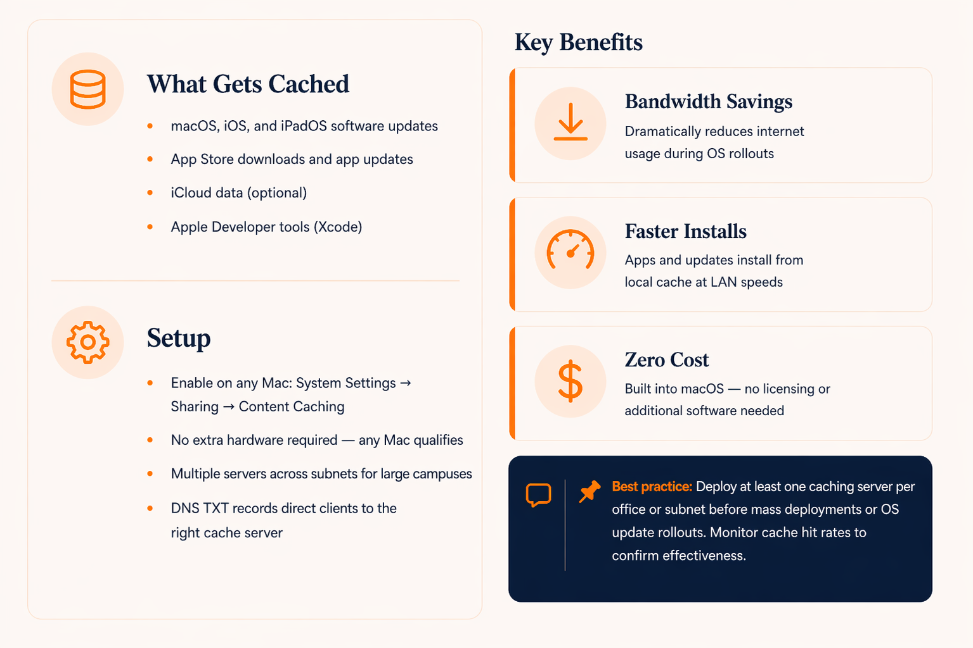
Content Caching — Speed Up Deployments

Slide 27
Part 3 — Security & Scaling
Securing devices
Understanding platform differences
Scaling your deployment, and governance essentials
Configuring Devices
Deploying Apps, and Managing Updates

Slide 28
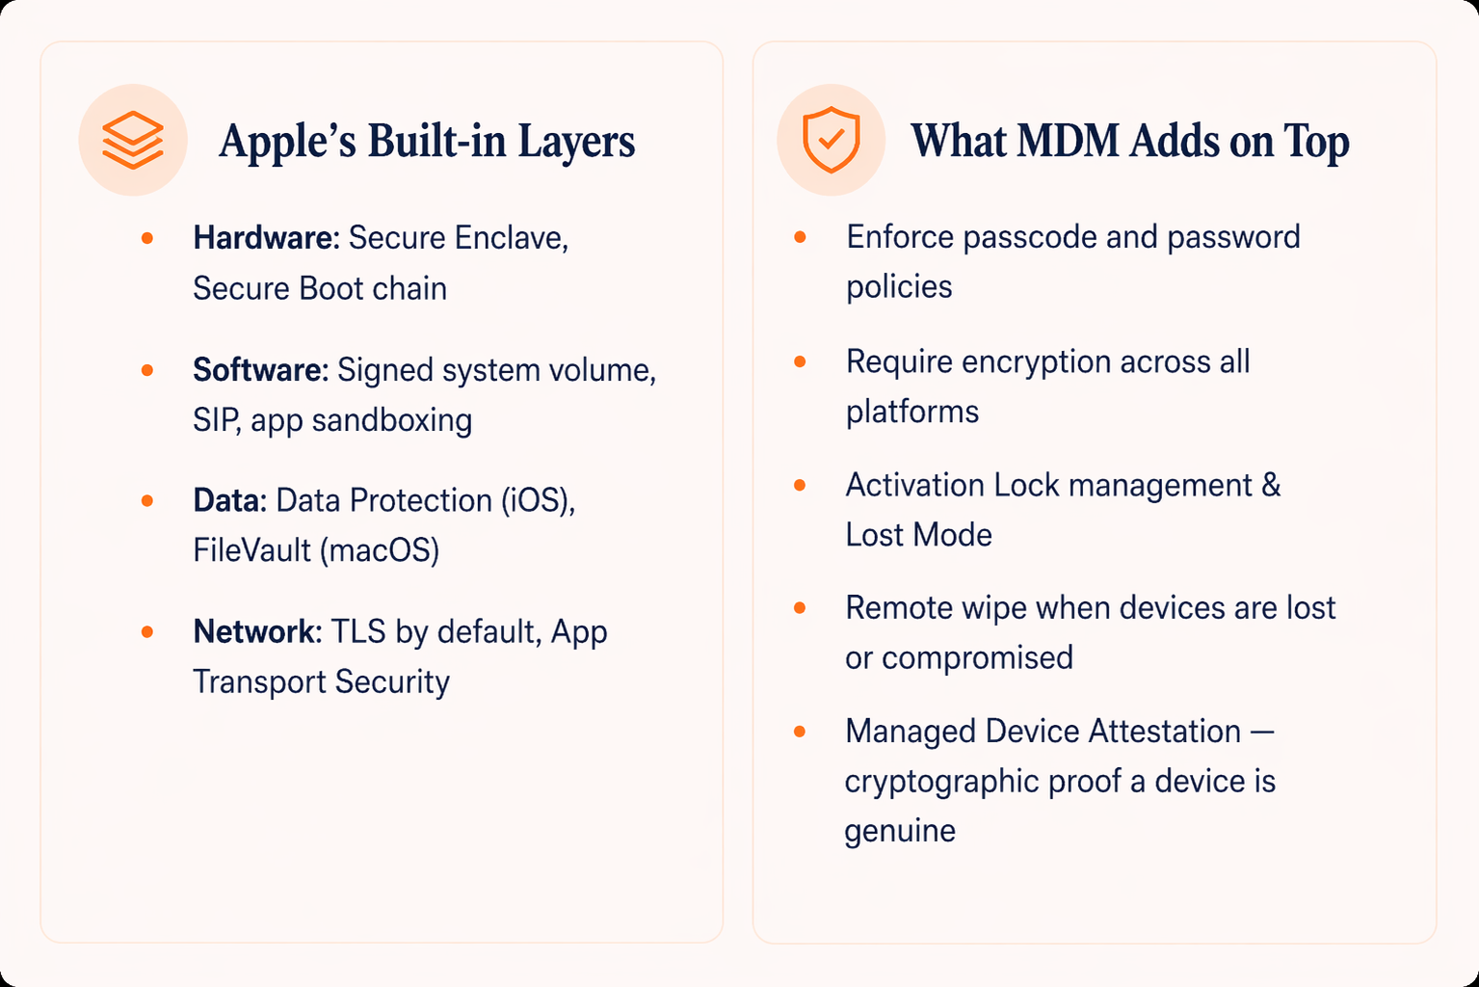
Ensure Device Security — Overview
Apple devices ship with deep, layered security built in. MDM's role is to enforce organizational policy on top of that strong foundation.

Slide 29
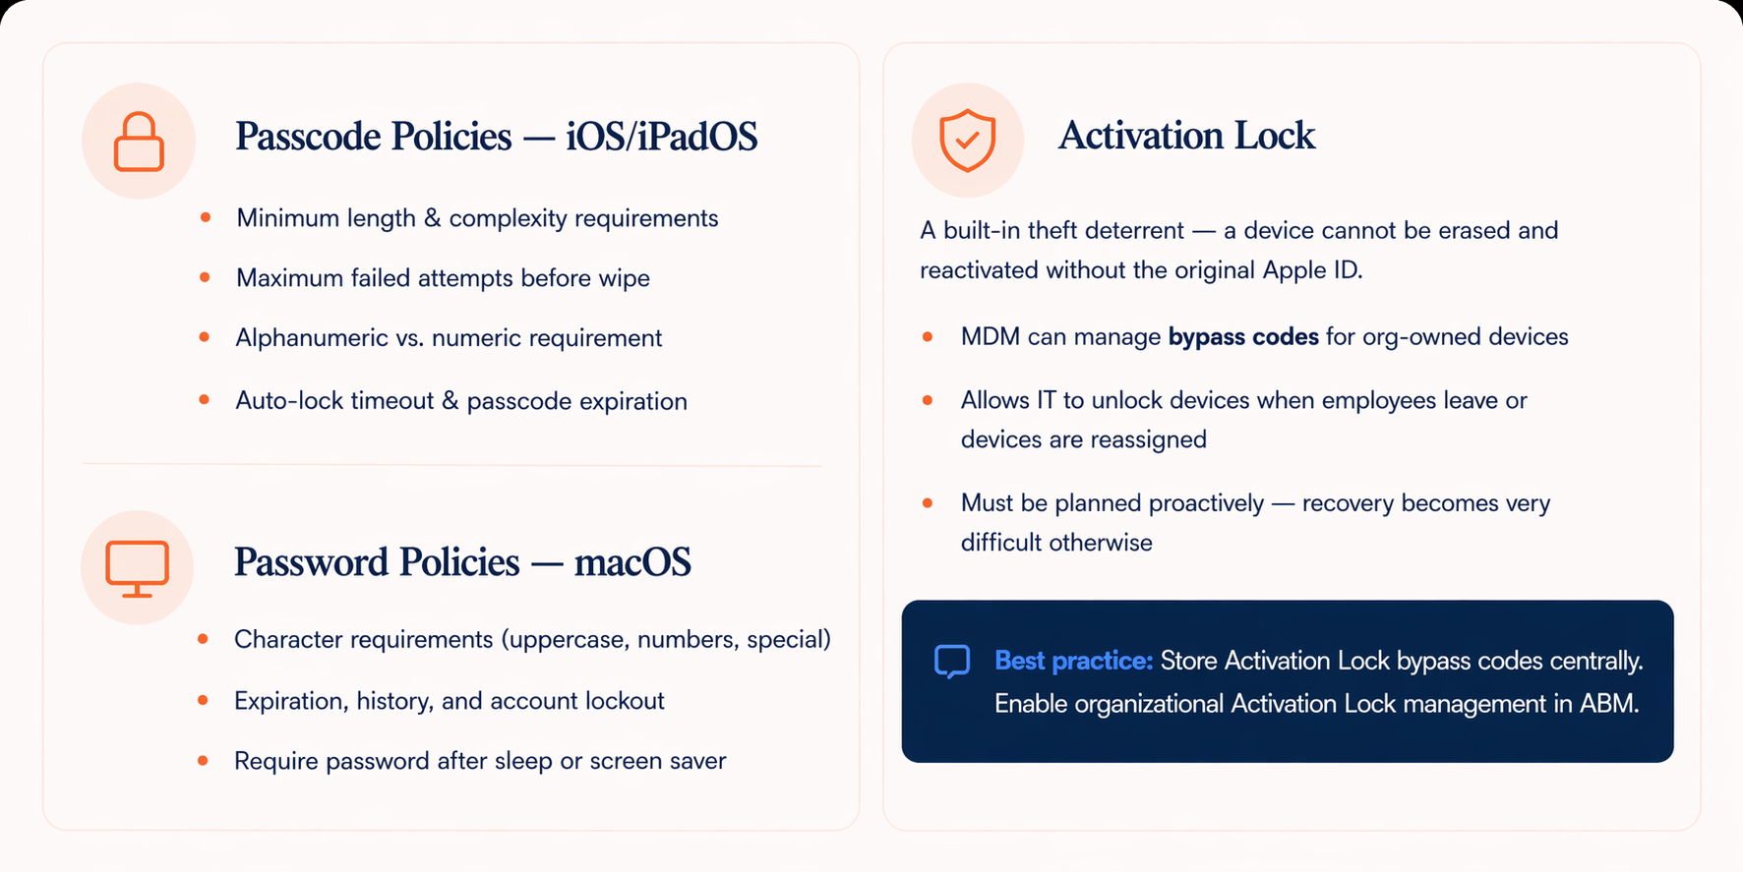
Password Policies & Activation Lock

Slide 30
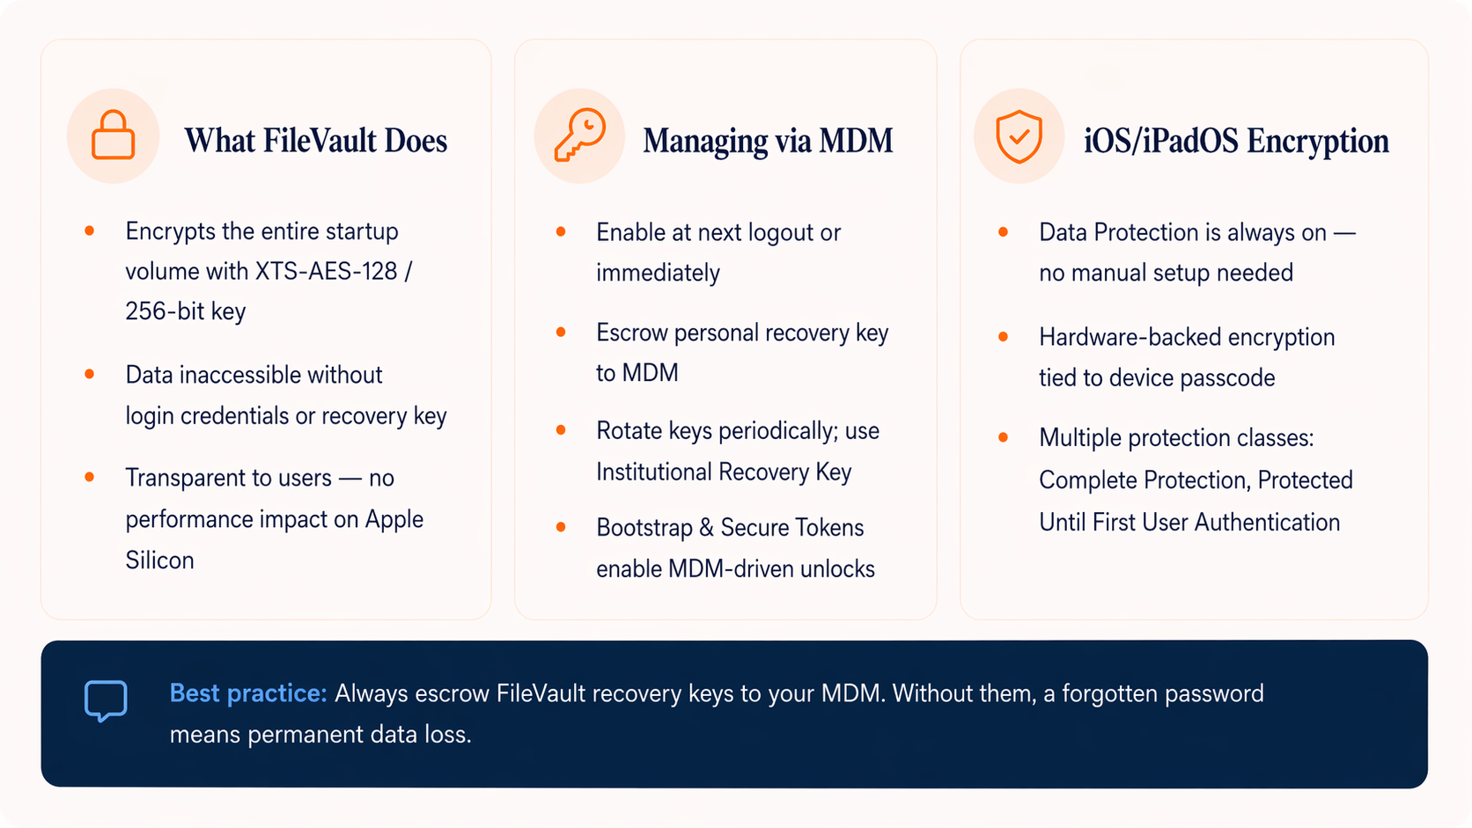
FileVault & Disk Encryption
FileVault is macOS full-disk encryption — essential for protecting data on lost or stolen machines.

Slide 31
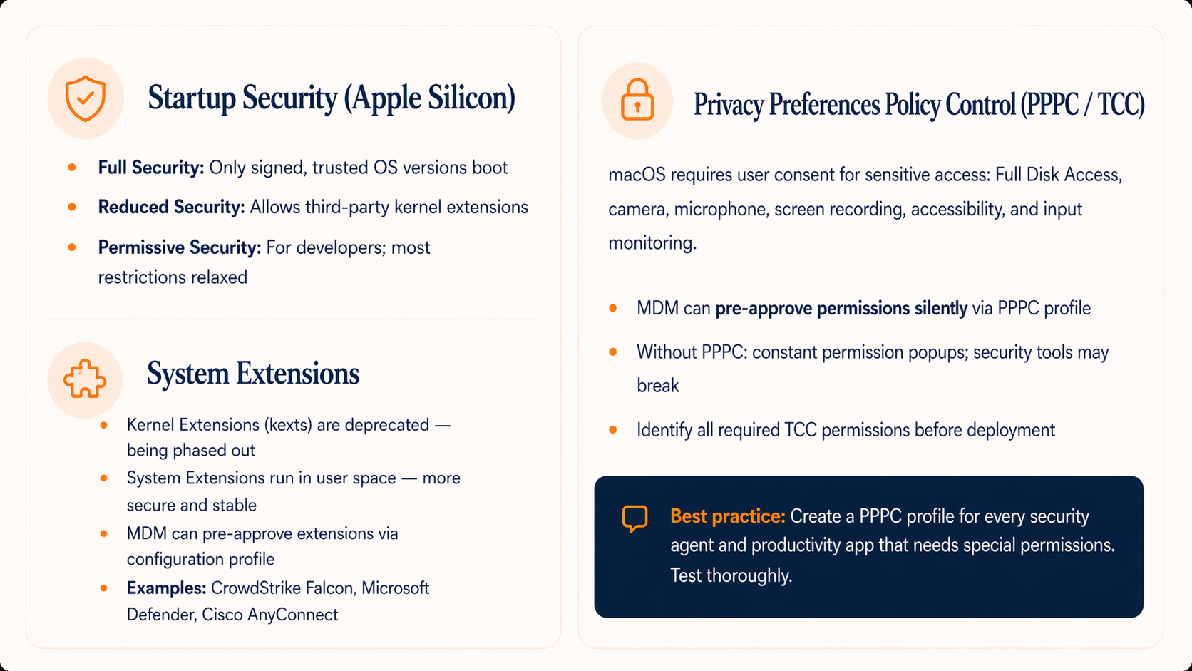
macOS System Security — Extensions & Startup
macOS has unique security layers that IT admins must understand and configure before deployment.

Slide 32
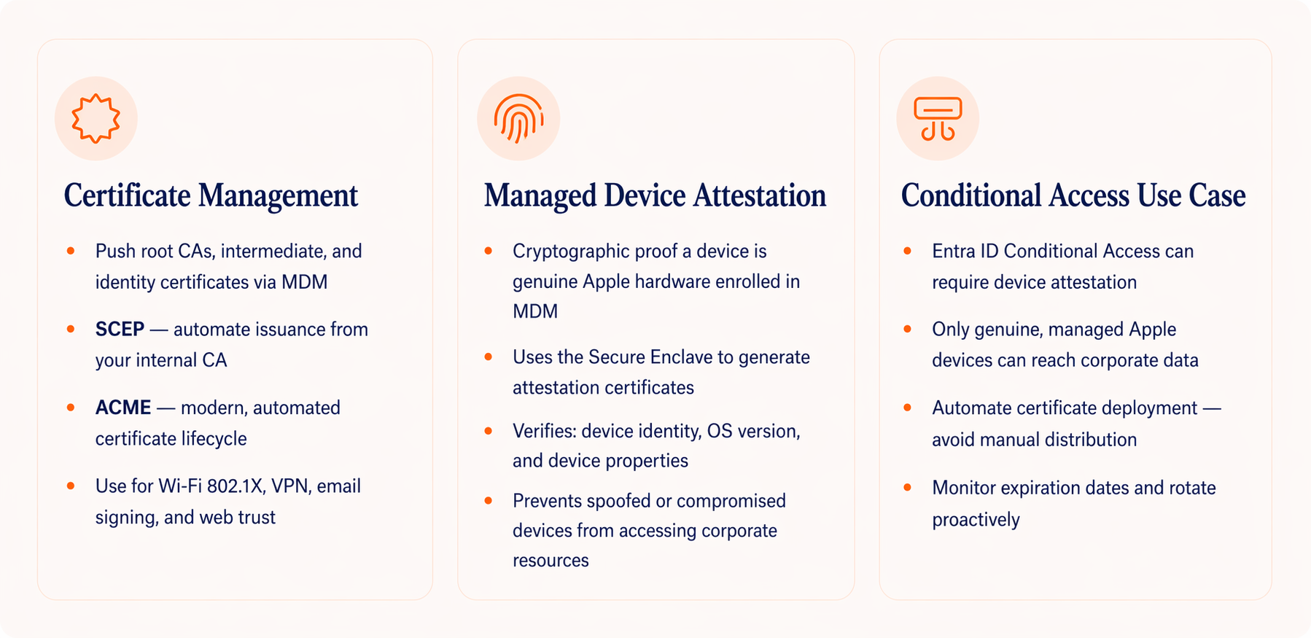
Certificates & Managed Device Attestation
Certificate management and device trust verification are foundational for secure access to corporate resources.

Slide 33
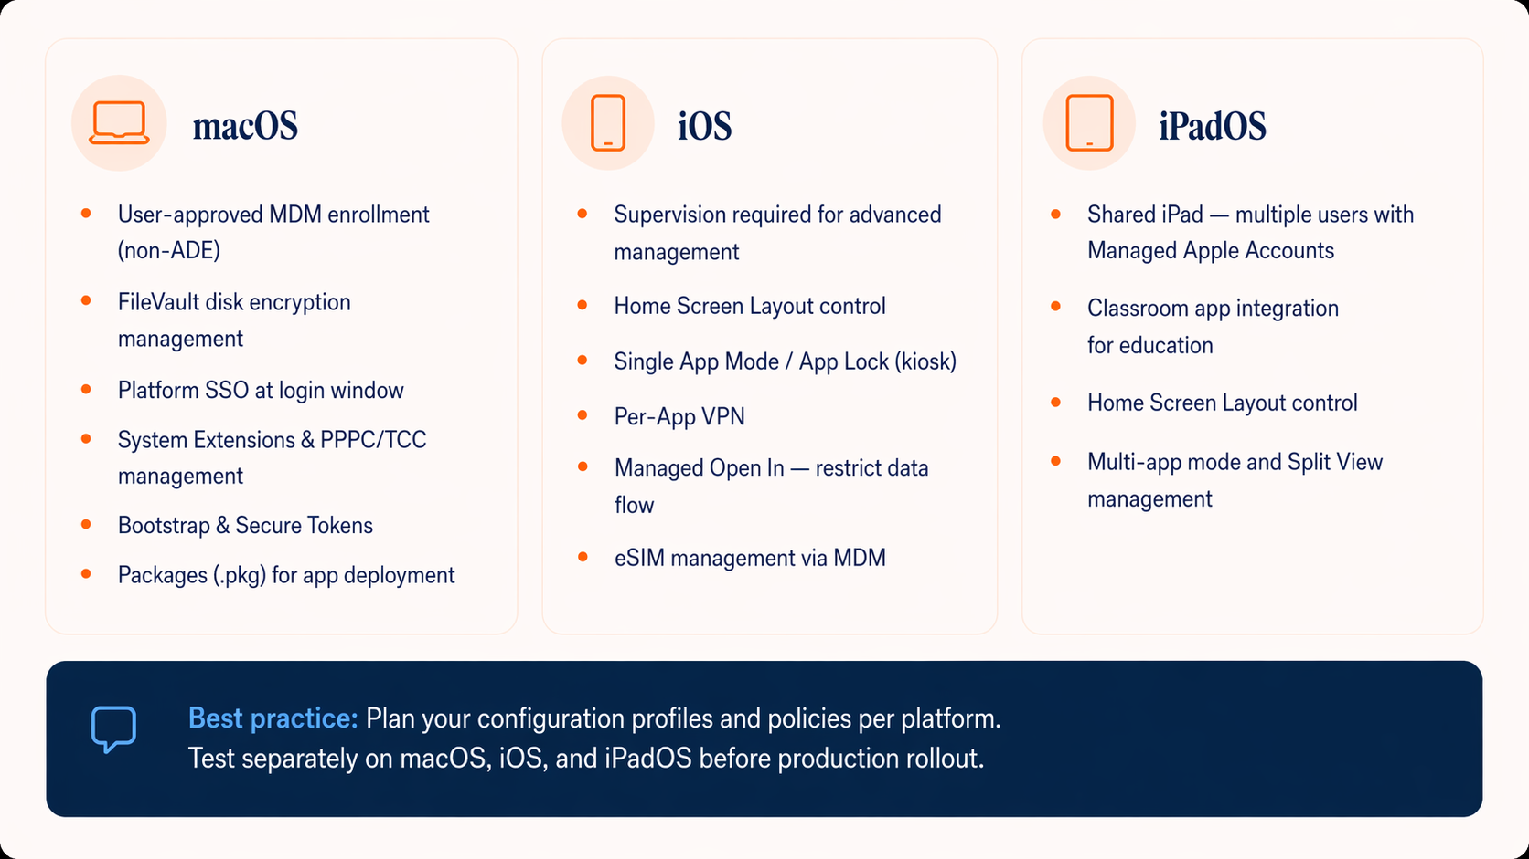
macOS vs. iOS vs. iPadOS — Platform Differences
Each Apple platform has unique management capabilities. Do not assume one-size-fits-all. Plan, configure, and test per platform.

Slide 34
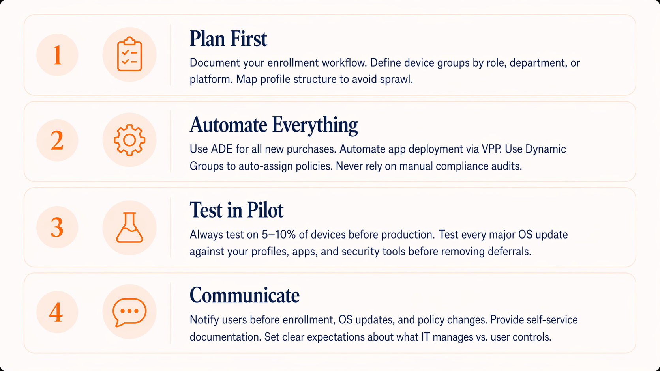
Scaling from 1 to 1,000+ Devices
Scaling Apple device management requires deliberate planning, automation, and clear communication before you grow.

Slide 35
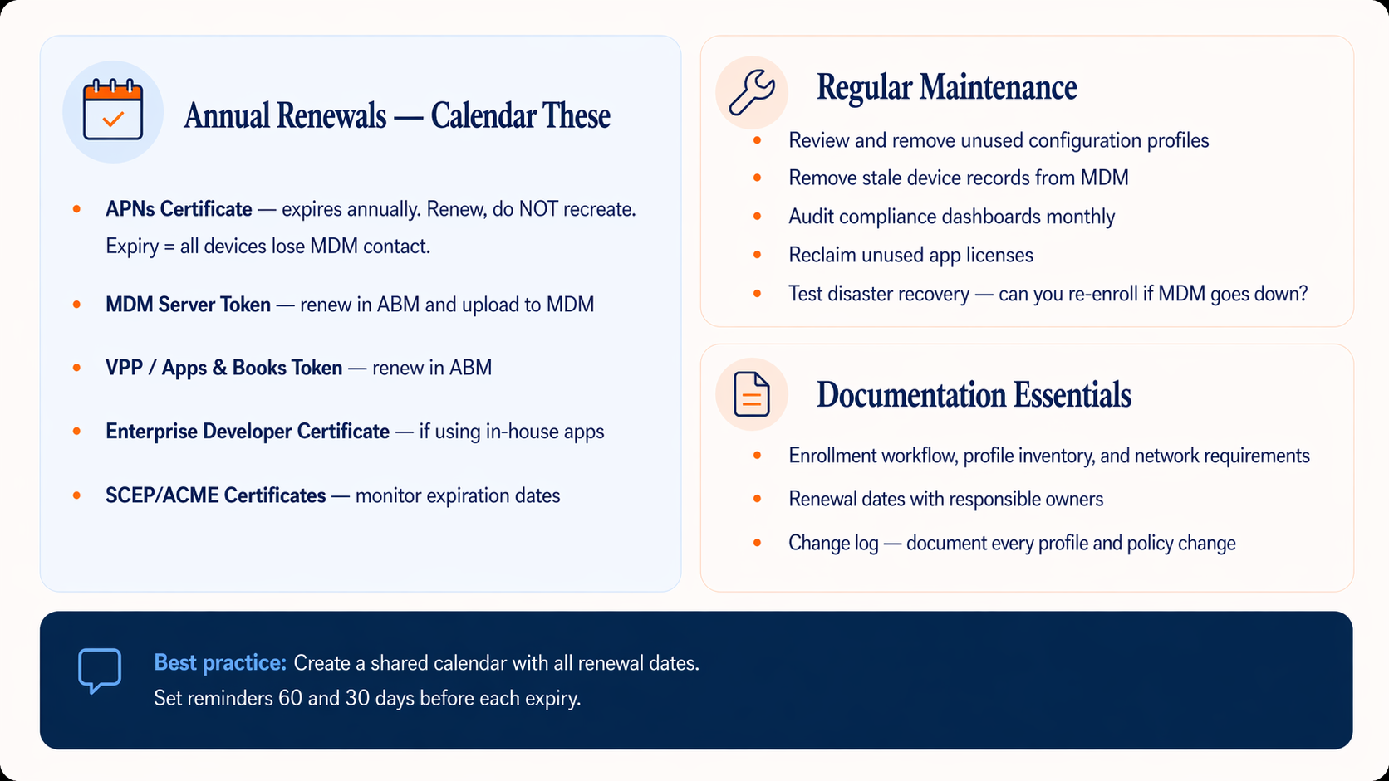
Governance — Renewals, Maintenance & Documentation
Ongoing governance keeps your deployment healthy and prevents sudden, painful outages.

Slide 36
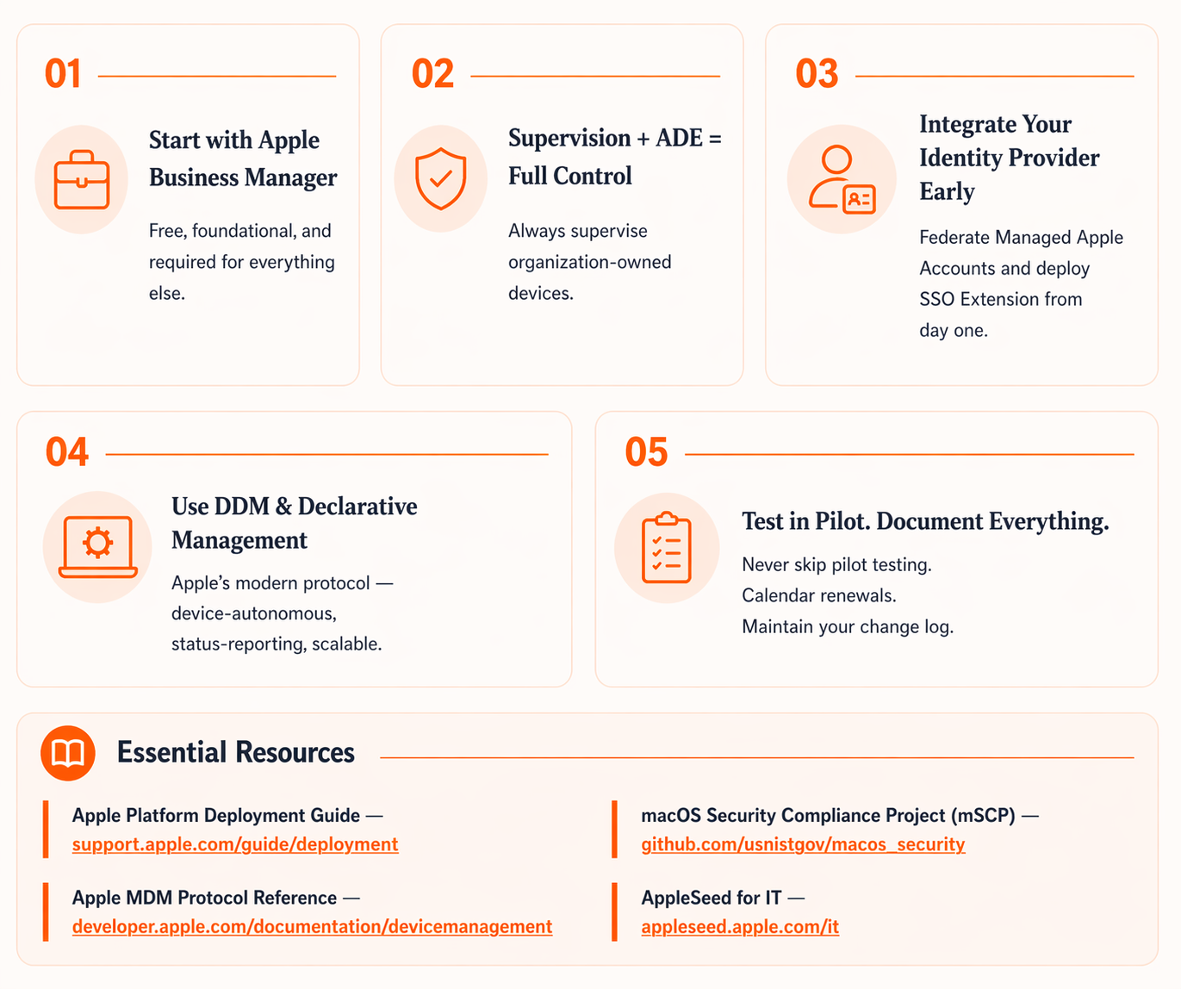
Key Takeaways & Resources
Ongoing governance keeps your deployment healthy and prevents sudden, painful outages.

Slide 37
Thanks!
Please rate this session on Sched.com
We would love to hear what you liked and how we could improve!

