Slide 1
Inside Intune Architecture, Scale, and Performance
Sangeetha Visweswaran
Cristina Osorio Valenzuela

Slide 2
Sponsors

Slide 3


Cristina Osorio Valenzuela
Role
Senior CxE Product Manager
Focus
Intune · Windows · Copilot
LinkedIn:
www.linkedin.com/in/cristinaosoriovalenzuela

Slide 4

Sangeetha Visweswaran
Role
VP of Engineering, Microsoft Intune
Focus
Intune · ConfigMgr. Security . Copilot
LinkedIn:
Sangee(tha) Visweswaran | LinkedIn
Hobbies:
Long distance biking

Slide 5

What we’ve been working on
1
2
3
4
4
5
Optimizing load, Improving performance
Check-in prioritization
Notifications consistency
Resilient notifications
Workload optimizations

Slide 6
Check-in scale and performance

Slide 7

Intune architecture journey
Pull model
Intelligent, priority aware
Push model
Adoption
Time

Slide 8
What is eventual consistency?
System where changes are not immediately reflected across all devices but will converge to a consistent state over time.
In large-scale environments, eventual consistency offers a more resilient and scalable approach.
Key Characteristics
Delayed Synchronization
Replica Convergence
Conflict Resolution
High availability

Slide 9
Device check-ins types
Client initiated
Change based
Single device
Device enrollment, Sync/Wipe,
Get app from company portal,
….
User logon,
scheduled check-ins
(time or event based, depending on platform)
Assignment changes: content, membership, app store updates…
Our focus: Important check-ins happen fast and reliably without interruptions

Slide 10
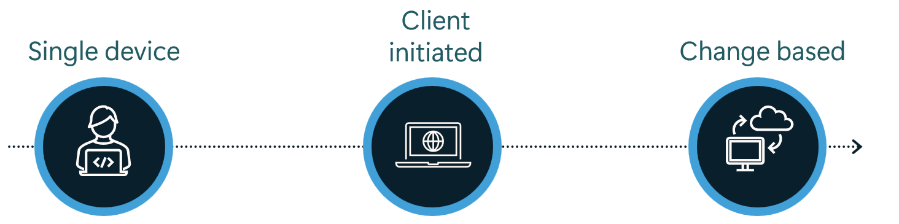
Change based check-ins (the ‘fast lane’)
When a change happens, Intune notifies affected devices
Admin targets (or un-targets) payloads (apps, policies, resources) to Entra security groups (users or devices).
Admin modifies contents of the targeted payloads that result in payload version change (though no memberships changes).
Entra group membership changes. Like adding or removing members to an Entra group
Store app version updates as app developers upload new versions of pre-targeted store apps.
Some changes happen behind the scenes, and are not obvious to admins
Not all changes today trigger a notification, e.g adding an app as available

Slide 11

Change based behind the scenes
Compute Applicable devices
Trigger: An action that results in change to device configuration
Compile: List of devices directly or indirectly affected that should be notified
Filter: Apply per-organization, per-device notification quotas
Queue: Queues notification requests
Process: Process queued notification requests w/ cross tenant fairness
Notify: Sends notifications to online devices or partners (Apple, Google…)
Check-in: Online devices check-in
Policy/App refresh: Gateways compute RSOP, take needed actions on the device
Reporting: Reports status back to the Intune console
Notify devices
This is where most of the latency occurs
Remediate devices

Slide 12
The importance of managing traffic
Notifications
Device check-in
Could some check-ins
be safely skipped or deprioritized?
40% Notification based check-ins did not result in remediations
65% of MDM check-ins
did not require any remediations.
Were we incorrectly notifying devices?
Several optimizations reducing 25-35% unnecessary notifications
Payload change
Intune attempts notifications
Platform service notification attempts (Windows, Apple, Google)
Assignment filtered devices
Check-in stack has been re-designed to scale vertically and horizontally to support ~40% more sessions!
Online devices
Devices truly needing changes
Applicable user/devices

Slide 13
Outcomes: Check-in performance
25-35% Reduction in unnecessary notifications
25% (avg)
Reduced remediation times
(up to) 4x
Notification speed increase
30%
Reduction in delayed
check-ins
>97% change-based check-ins processed on first attempt
25% increase in processed check-ins during peak hours

Slide 14
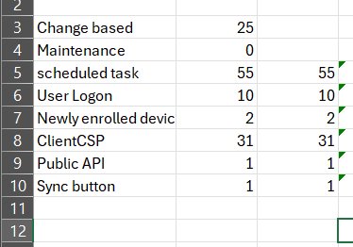
Device check-in traffic
Scheduled (aka Maintenance) task
Some alerts that are considered non-operational
Newly enrolled devices
Service side Changes
Sync buttons
Some alerts (Threat detection, User Log On)
Public API
Public API
Sync buttons
Non-maintenance (incl. Change based)
Device initiated changes (incl. some maintenance)
Change based
Maintenance
Newly enrolled devices
User logon
Scheduled task (maintenance)
all traffic was prioritized equally until device/organization limits were met
When limits were hit, a portion of check-ins are deprioritized

Slide 15
Device check-in prioritization
Maintenance
Non maintenance
Scheduled task
Change based
User logon
Other client initiated
Newly enrolled devices
Sync buttons
Other client initiated (non-operational)
Public API
Our prioritization algorithm only differentiated between maintenance and non-maintenance

Slide 16
Improved device check-in prioritization
Pending changes
Maintenance
Non-maintenance
New: When limits are hit, devices with pending changes will be prioritized above the rest, regardless of check-in reason

Slide 17
Eventual Consistency, before
How the system worked
What we’ve observed
1 fast notification per device per 30 mins
Further requests were neither attempted nor queued
Whatever was missed, delayed til next device check-in
30% of notifications within a 30- minute window targeted the same devices.
90% of multiple changes
occur within 15 minutes.
Most of the time, one well time notification would be enough
Leading to inconsistent experience and delayed remediation, specially during peak hours

Slide 18
Eventual consistency, after
Per-Device Notification Timer
When server side change is detected, a timer starts.
If no additional changes occur within 3 minutes, a notification is sent.
If more changes occur, notification is queued for up to 10 minutes (in 2 min increments).
After a notification is sent, further requests are queued for the next hour. At the start of hour, notification is sent again, and the timer starts again.
A device may opportunistically receive notifications faster when capacity allows
D1
N1
D2
N1
D2
N2
D1, C1
D2, C1
D2
C2
D2
C3
Min 1 3 5 30 60

Slide 19
The ‘Fast Lane’ high level architecture
Up to 10% of devices fall into this category
Interactive scenarios
Device actions
Server side changes (payload, membership, assignment)
Scheduled maintenance (iOS)
THE BLACK BOX
magic ‘happens’ (when it happens)
WNS
MDM
APNS
IME
Device
HIGH PRIORITY QUEUE
MMPC
FCM
REGULAR QUEUE
Others…
Platform specific notification systems
Check-in gateways
Intune Notification Services
Delivery delays, failures
Offline devices, busy, locked, power saving mode, user not signed in…

Slide 20
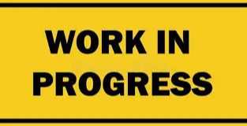
The ‘Fast Lane’ high level architecture
URI #1
Remote actions
Device enrollment
noncompliance alerts
…
MDM
Device actions,
Interactive scenarios,
WNS
INTUNE NOTIFICATION SERVICES
IC3
INTUNE MANAGEMENT EXTENSION
Classic apps
Custom compliance
Scripts
…
IME
Server side changes (payload, membership, assignment…)
URI #3
EPM elevation rules, policies
Inventory policies
MMPC
Device notification channels
Check-in gateways
After: Centralized with IC3
Before: Decentralized Notification Flow

Slide 21
Smarter check-in prioritization
Classification | Definition | Scenarios
Critical | Process urgently, avoid delays | Newly enrolled devices
 |  | Some device actions (e.g. sync, wipe)
 |  | Critical device alerts (e.g. malware found, compliance change)
 |  | Sync buttons
High | Important but not always urgent, impact of delay is moderate | Service side Changes
 |  | Devices reporting back remediation status from prior check-ins (ie: app install status)
 |  | Devices that haven’t completed a check-in recently
 |  | Client drifts
Medium | Normal user activity | User Logon
Low | Where delays would not impact productivity, security or compliance | Scheduled task
 |  | Public API (Medium? Low?)
Classification | Scenarios
Non-maintenance | Newly enrolled devices
 | Service side Changes
 | Sync buttons
 | Some alerts (Threat detection, User Log On)
 | Public API
Maintenance | Some alerts that are considered non-operational
 | Scheduled task

Slide 22
Smarter check-in prioritization
The insights we are building
The smarts we are adding
Granular prioritization beyond maintenance / non-maintenance
Tracking devices with pending changes
Combine multiple signals to adjust priority
Adjusting quotas dynamically to accommodate surge in changes
Higher priorities retry faster, while lower are slower.
Include # retries into prioritization formula.
All critical check-ins
on 1st attempt
All high-pri check-ins
within 1-hour
Outcomes:

Slide 23
Outcomes: Consistent notifications
No dropped notifications
Time-bound delivery expectations
  Minimal (minutes) impact to single change scenarios
Better experience for back-to-back change scenarios
Device actions and small changes (ie: lab devices) unimpacted.
Fast lane is coming for additional payloads
Windows/Mac IMEs:
  Classic apps
  Scripts
  Custom compliance
MMP-C policy and configurations
  EPM
  Inventory
  …

Slide 24
Notifications resiliency
Customer outcomes
Coming soon to:
Reliability improvements
Delivery receipts
Intent/Prioritization
Online/End user presence
Troubleshooting and diagnosability
Remote Help, EPM requests
Windows Classic apps
Scripts
Custom Compliance
Device Actions
MDM Policies and configuration changes (IC3 first, WNS as fallback)
Action item: Review your network and firewall rules. See https://aka.ms/intune-endpoints

Slide 25
iOS maintenance check-ins
Apple devices don’t have client-initiated maintenance check-ins, they are always service initiated.
The old design
The new design
Outcomes
Maintenance check-ins /day
Notifications (device channel + user channel on shared devices) per maintenance check-in
share check-in volume during peak hours
Off-peak hours
Request two maintenance check-ins per device
Peak hours
Notify devices that did not check in off-peak
Defer devices that
already checked in off-peak OR
Had a successful check-in in last 8 hours AND
  No change pending OR
  Change pending but device responded Not Now
Faster delivery for ~99.5% changes
10% reduction in delayed check-ins
No device is left without regular check-ins
  40%

Slide 26
In summary…
Intune is evolving into an intelligent, priority-aware system
The ‘Fast lane’ is coming to all gateways and for all payloads
All these scenarios have now higher priority, and will avoid delays
Newly enrolled devices
Device actions
Devices with critical alerts incl. compliance
Devices pending changes from server drifts
Devices reporting back remediation status from prior check-in.
Devices pending changes from client drifts.
Devices without recent check-ins
Reducing the noise
Elevating important signals
Ensuring no devices are left behind
Optimizing load,
improving performance,
Consistent notifications
check-in prioritization,
change tracking
Smarter maintenance,
Resilient notifications

Slide 27
Workload latencies

Slide 28


Other investments
Enrollment
Compliance
Applications
Reports

Slide 29
Client-driven compliance evaluation
🚨 Problem
Security gap: The current compliance refresh windows (up to ~8 hrs) is an unacceptable security exposure window.
No Timely Drift Signal: Intune lacks real‑time visibility when device configuration drifts
✅ Solution
⚡ Detect Drift in Minutes
Intune detects configuration drift in mins
Triggers immediate compliance re‑evaluation.
🧰 Enabled by Windows IME (Sidecar)
👁️ Centrally monitors drift of all compliance settings.
📜 Includes custom compliance scripts.
🔍 Continuous State Verification
Computes configuration hash. Compares against last eval.
🚀 Upon Drift Detection
Initiates MDM + IME check‑ins to update compliance state promptly.

Slide 30
Comprehensive Device Sync & "FedEx Tracking"
🚨 Problem
Admins initiate a Device Sync expecting all workloads to be refreshed.
Device sync is limited to MDM channel. No support for Sidecar, IME, scripts.
Functionality of Device Sync is opaque to admins. No visibility into progress and outcome.
✅ Solution
Sync via all channels/GWs.
Real-time progress report.
Transcript after the sync completes.
  What was applied/removed?
  Compliance eval outcome?
  What succeeded vs failed and why?

Slide 31
Reporting freshness and scale

Slide 32
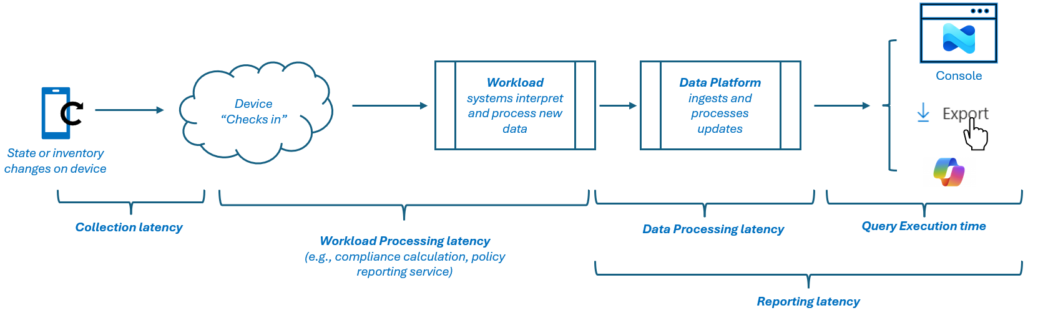
Accurate and Fresh Data
Perspective End-to-End (E2E)

Slide 33
Accurate and Fresh Data
Perspective – Data Processing Latency

Slide 34
Accurate and Fresh Data
Perspective End-to-End (E2E)
Tackling in segments, we’ll get to an E2E data freshness

Slide 35
Thanks!
Please rate this session on Sched.com
We would love to hear what you liked and how we could improve!

