Slide 1
Top 18 mistakes when setting up a new environment

Slide 2
Sponsors

Slide 3

About me
Andrew Taylor
Microsoft MVP · Microsoft Intune & Security Copilot
Role
CTO at Software Central
Focus
Intune · Graph · PowerShell

Slide 4
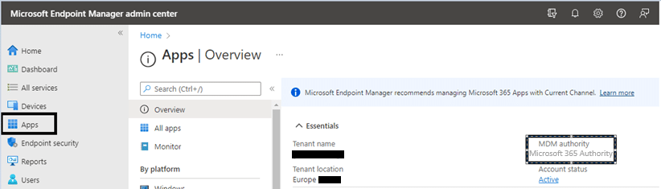
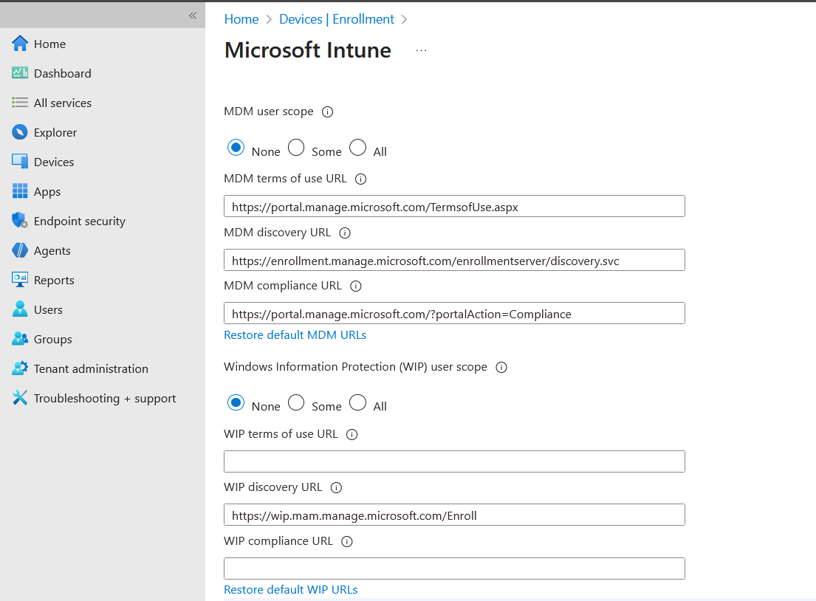
MDM off, or set to O365

Slide 5
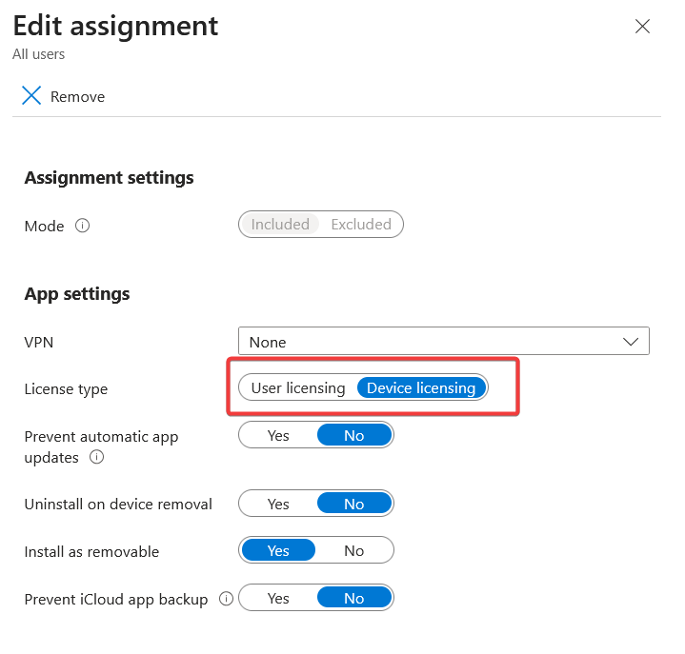
VPP Apps set to User license

Slide 6
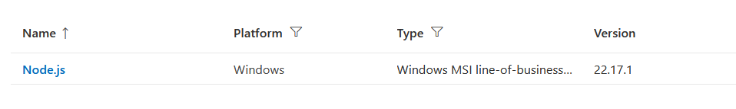
MSI LOB

Slide 7
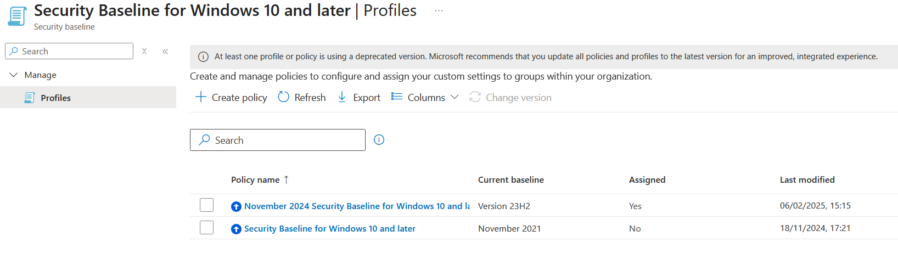
Security Baselines

Slide 8
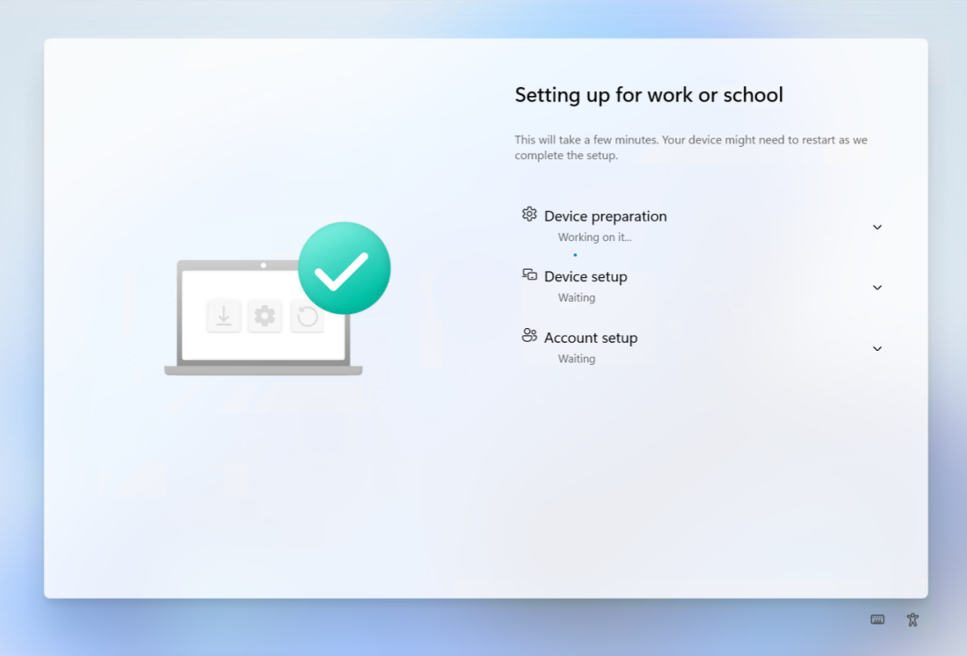
Platform scripts stalling ESP

Slide 9
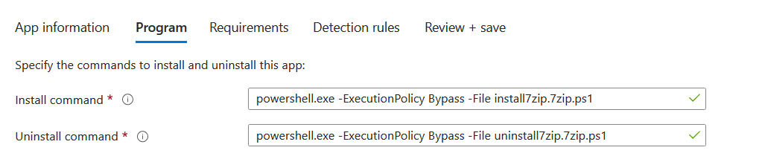
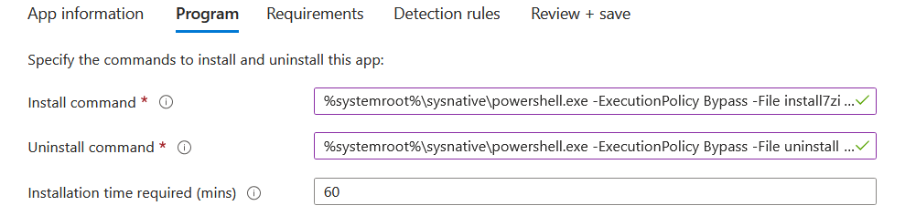
32-bit PowerShell
https://call4cloud.nl/sysnative-64-bit-ime-intune-syswow64-wow6432node/

Slide 10
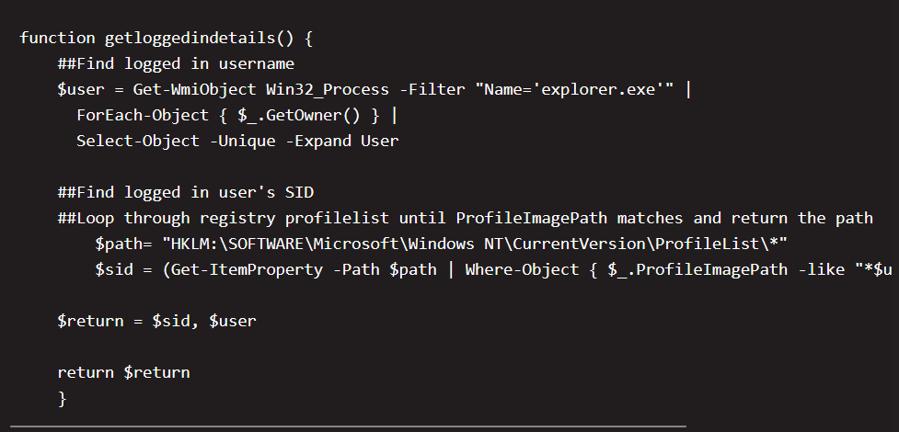
Detection Script on user installs
https://andrewstaylor.com/2022/04/19/demystifying-intune-custom-app-detection-scripts/

Slide 11
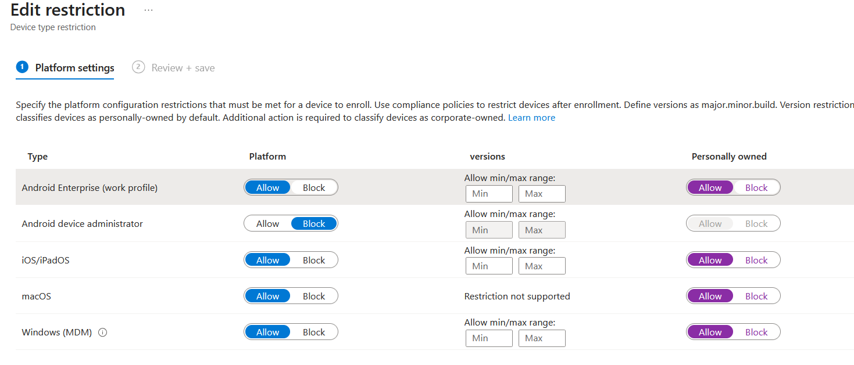
Personal devices

Slide 12
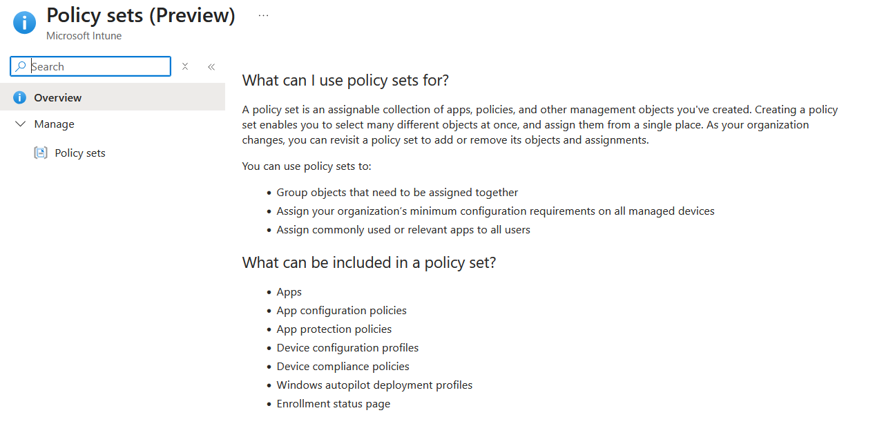
Policy sets (preview)

Slide 13
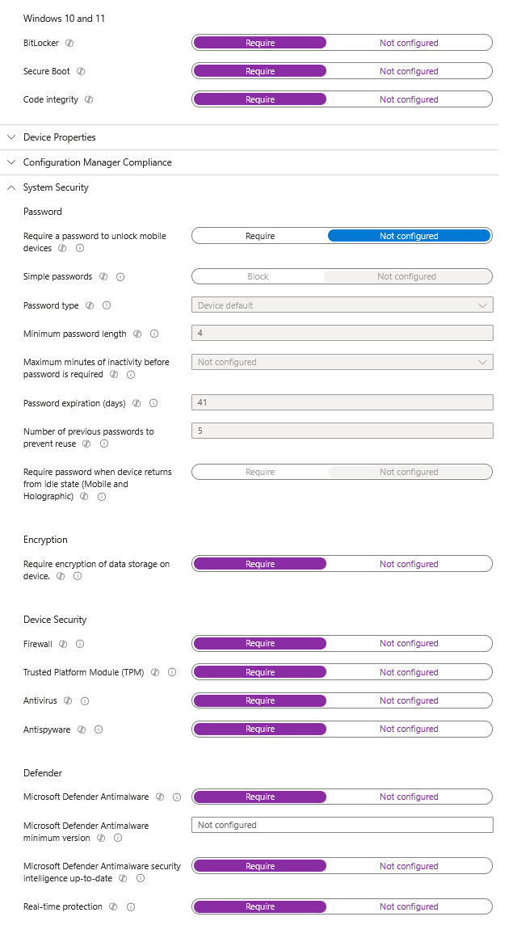
Massive compliance policies

Slide 14
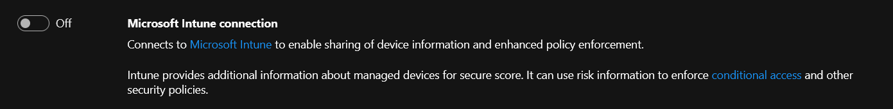
MDE not onboarding

Slide 15
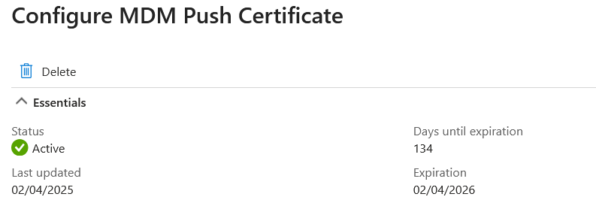
Not monitoring Apple certs

Slide 16
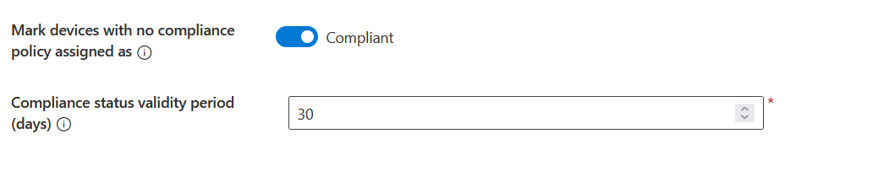
Default compliance without policy

Slide 17
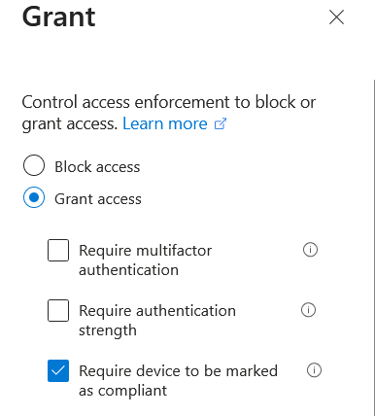
Compliance without CA

Slide 18
Lift and shift GPOs

Slide 19
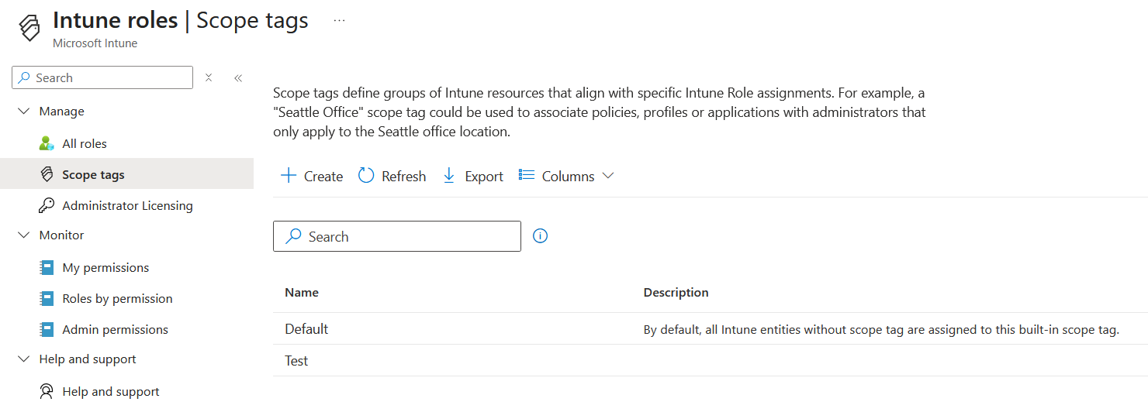
Adding scope tags after building environment

Slide 20
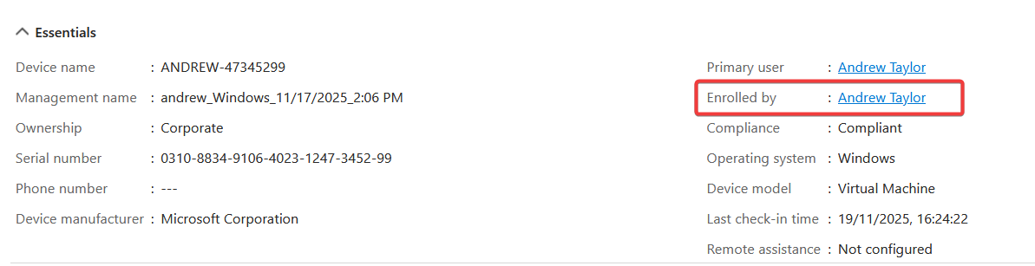
Using a DEM account or enrolling with admin account
https://call4cloud.nl/using-a-dem-account-windows-autopilot-is-a-bad-idea/

Slide 21
Hybrid Autopilot
no.

Slide 22
Please rate this session on Sched.com (highly)
We would love to hear what you liked and how we could improve!
Thanks!

