Slide 1
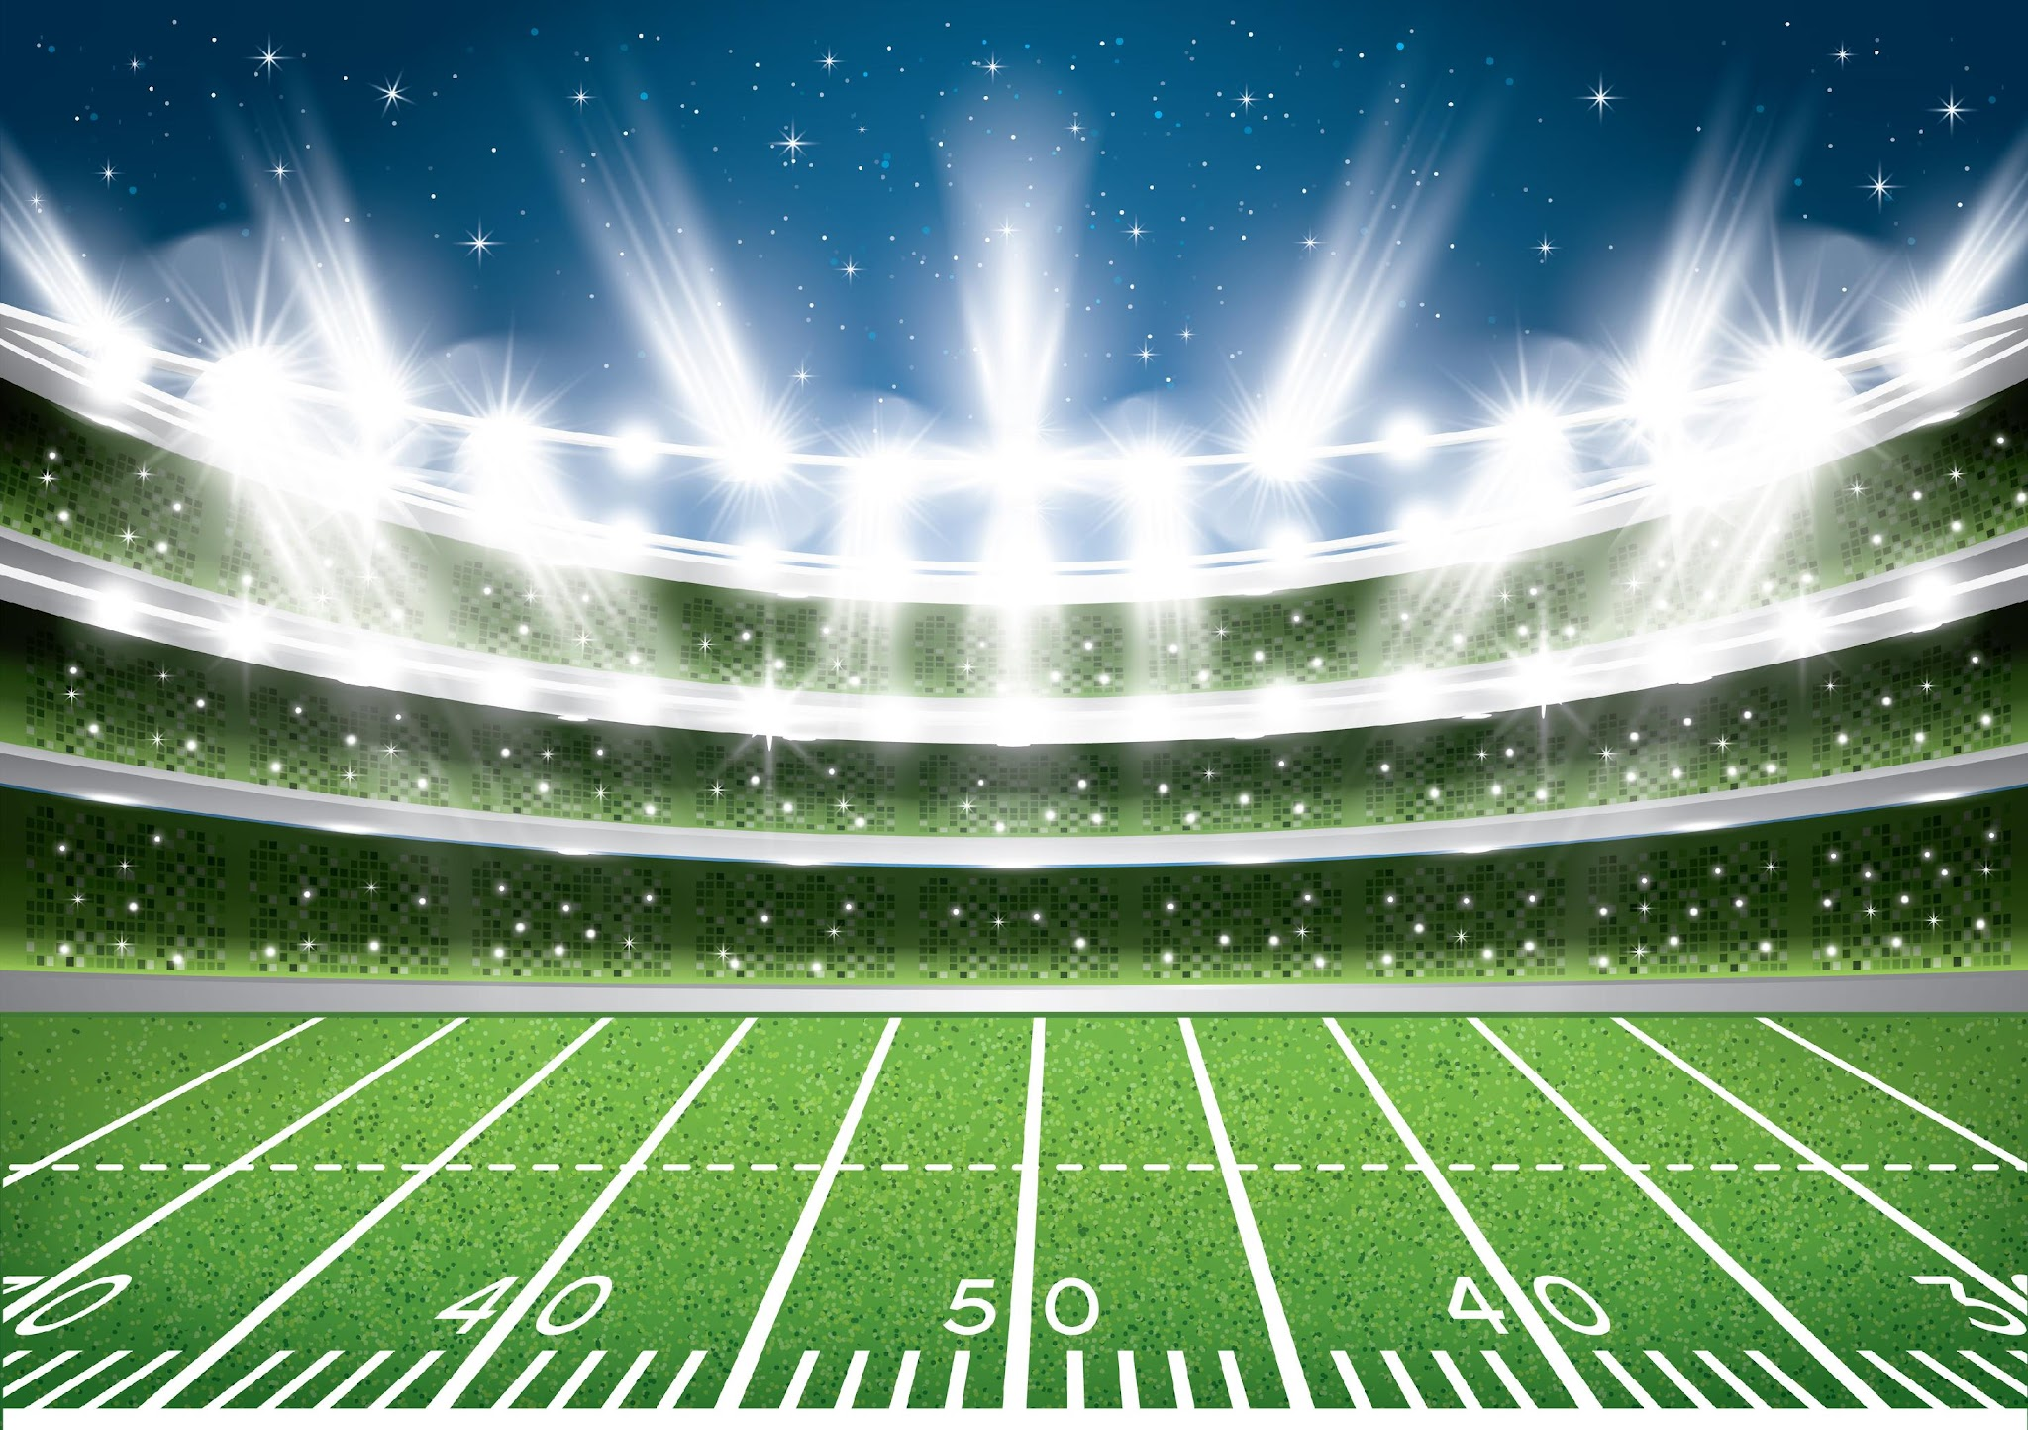


Slide 2


To Receive Credit for this session, make sure you complete the survey at the end

Slide 3
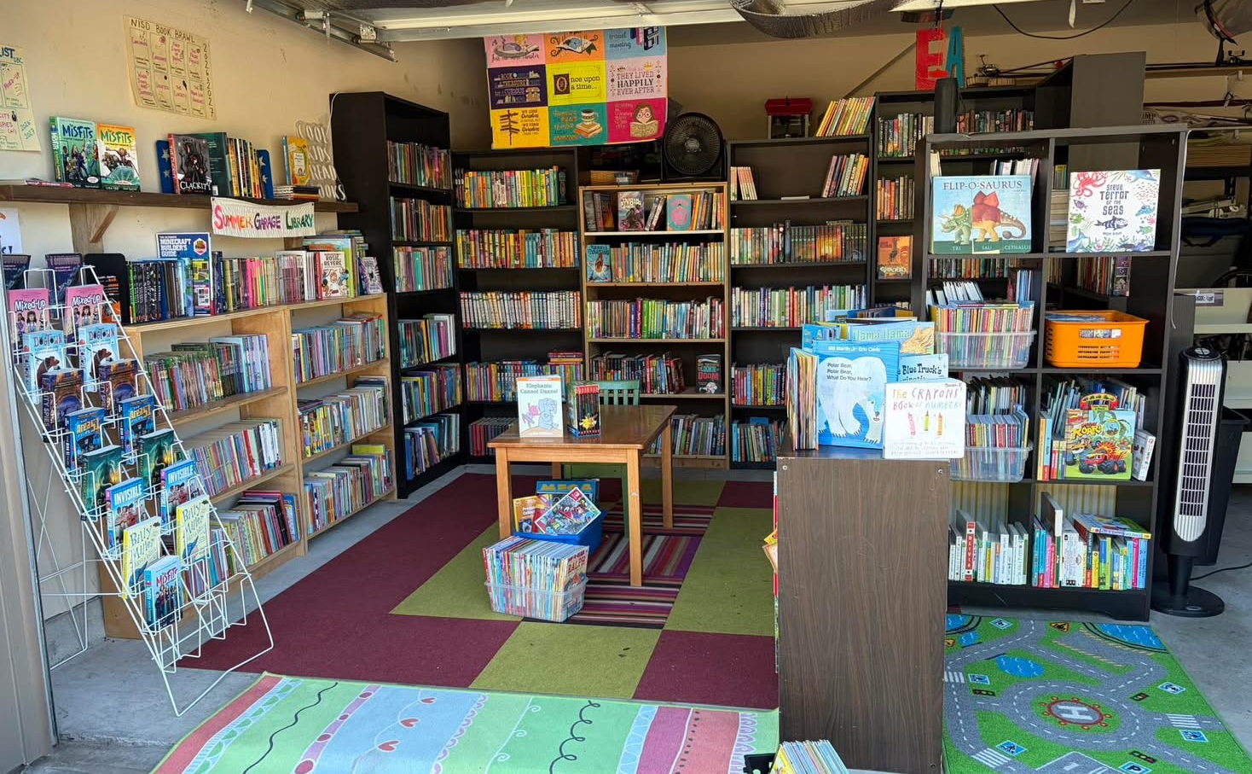
The Summer Garage Library
No Offseason for Reading

Slide 4
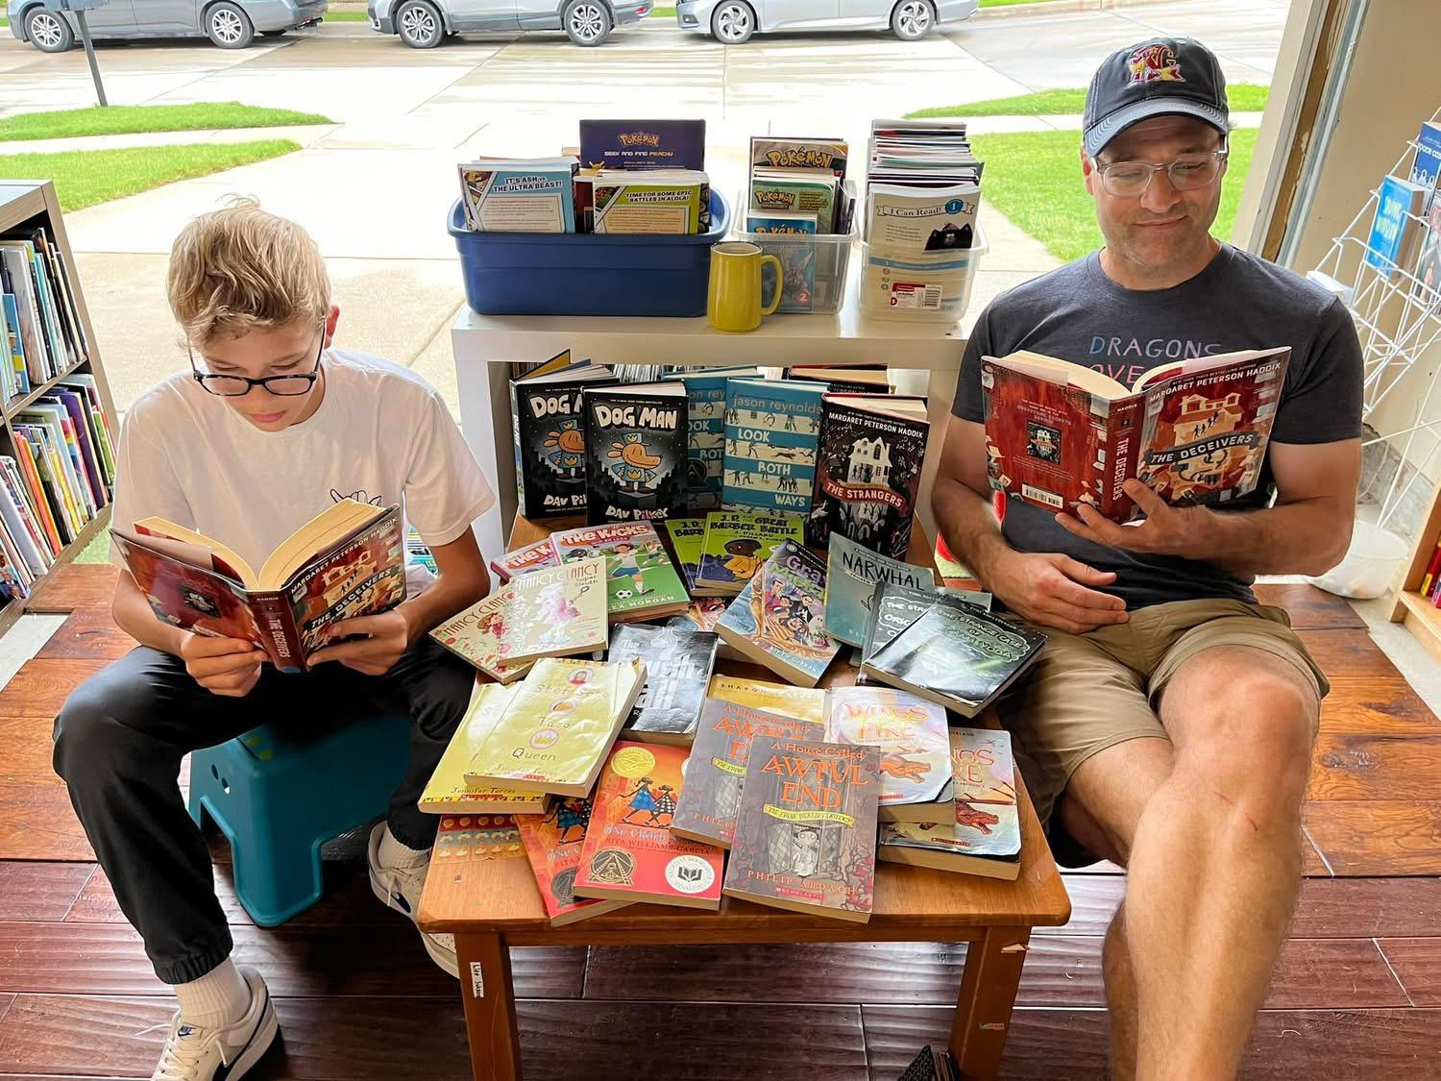
Clark Droege-Byron Nelson Junior, Teaching and Training Program, fisherman
Brian Droege-4th Grade Teacher at Kay Granger (10th year), father of four

Slide 5
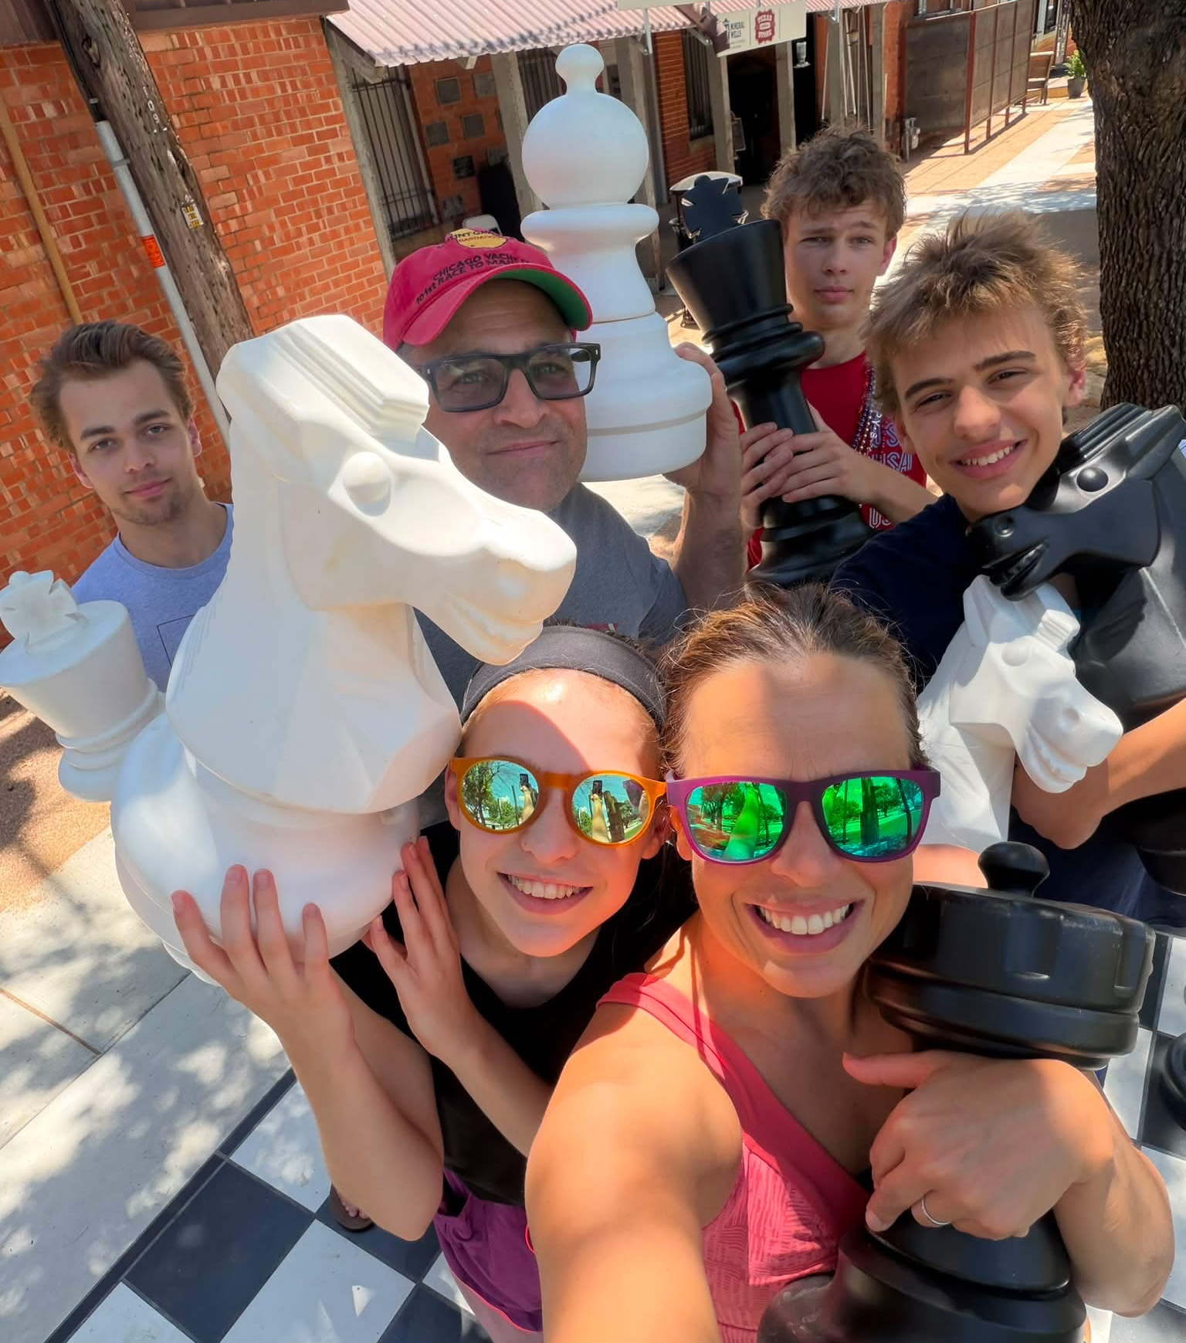
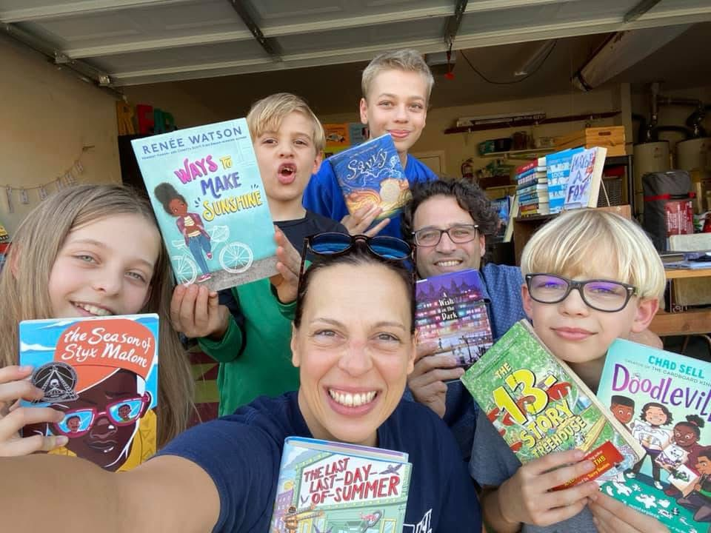
The SGL Team
Edmund- freshman, Colorado School of Mines
Dax-freshman, Byron Nelson, Culinary Program
Penelope-senior, Byron Nelson (aka-girl with the most books)
Diana Brodeur-marketing and communications professional, swim coach, mother of four

Slide 6
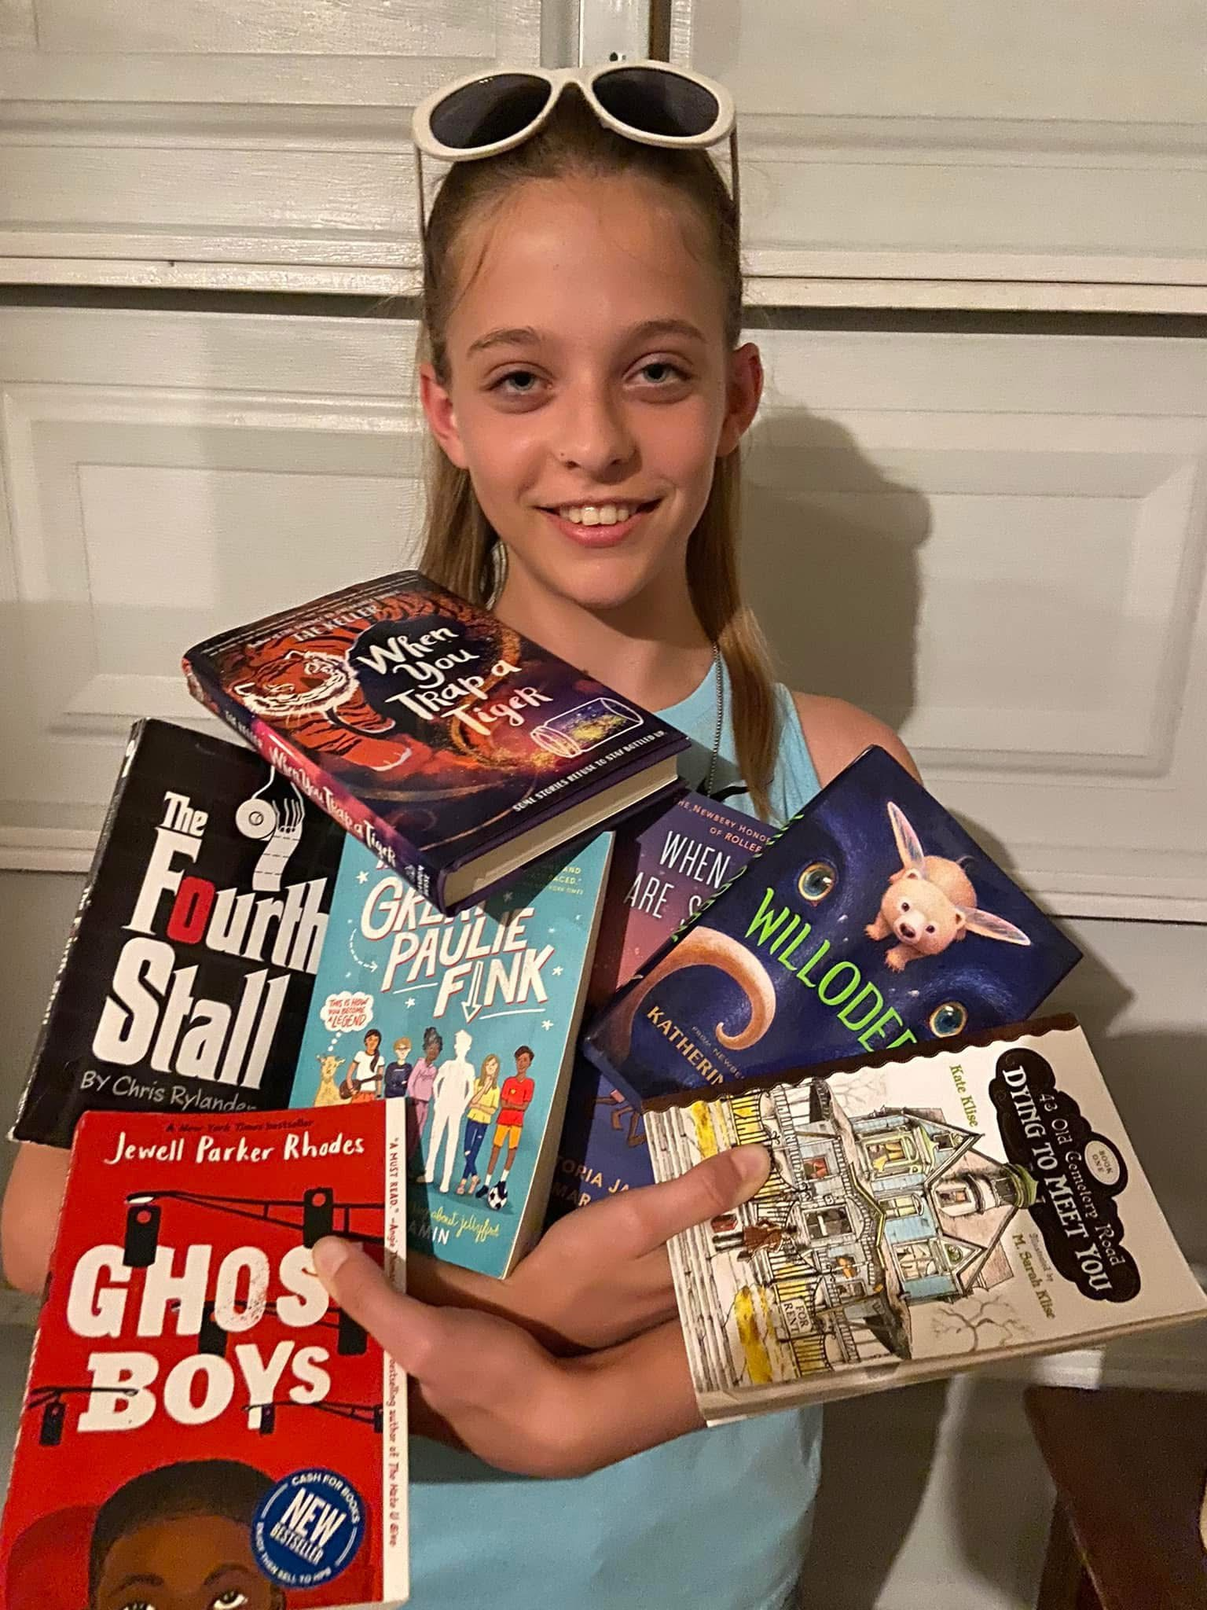
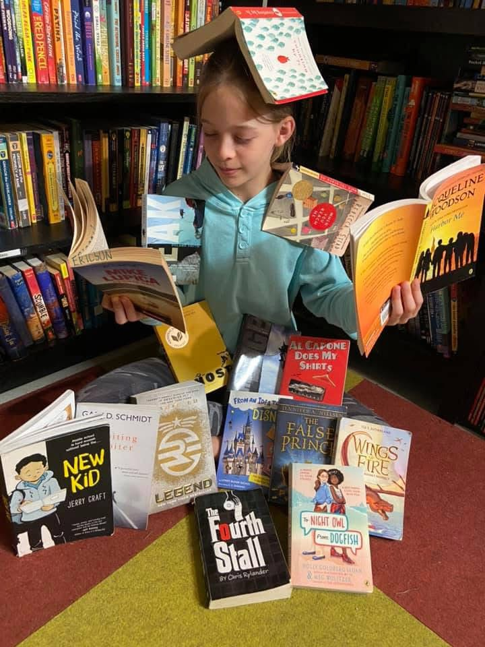
Head Librarian

Slide 7
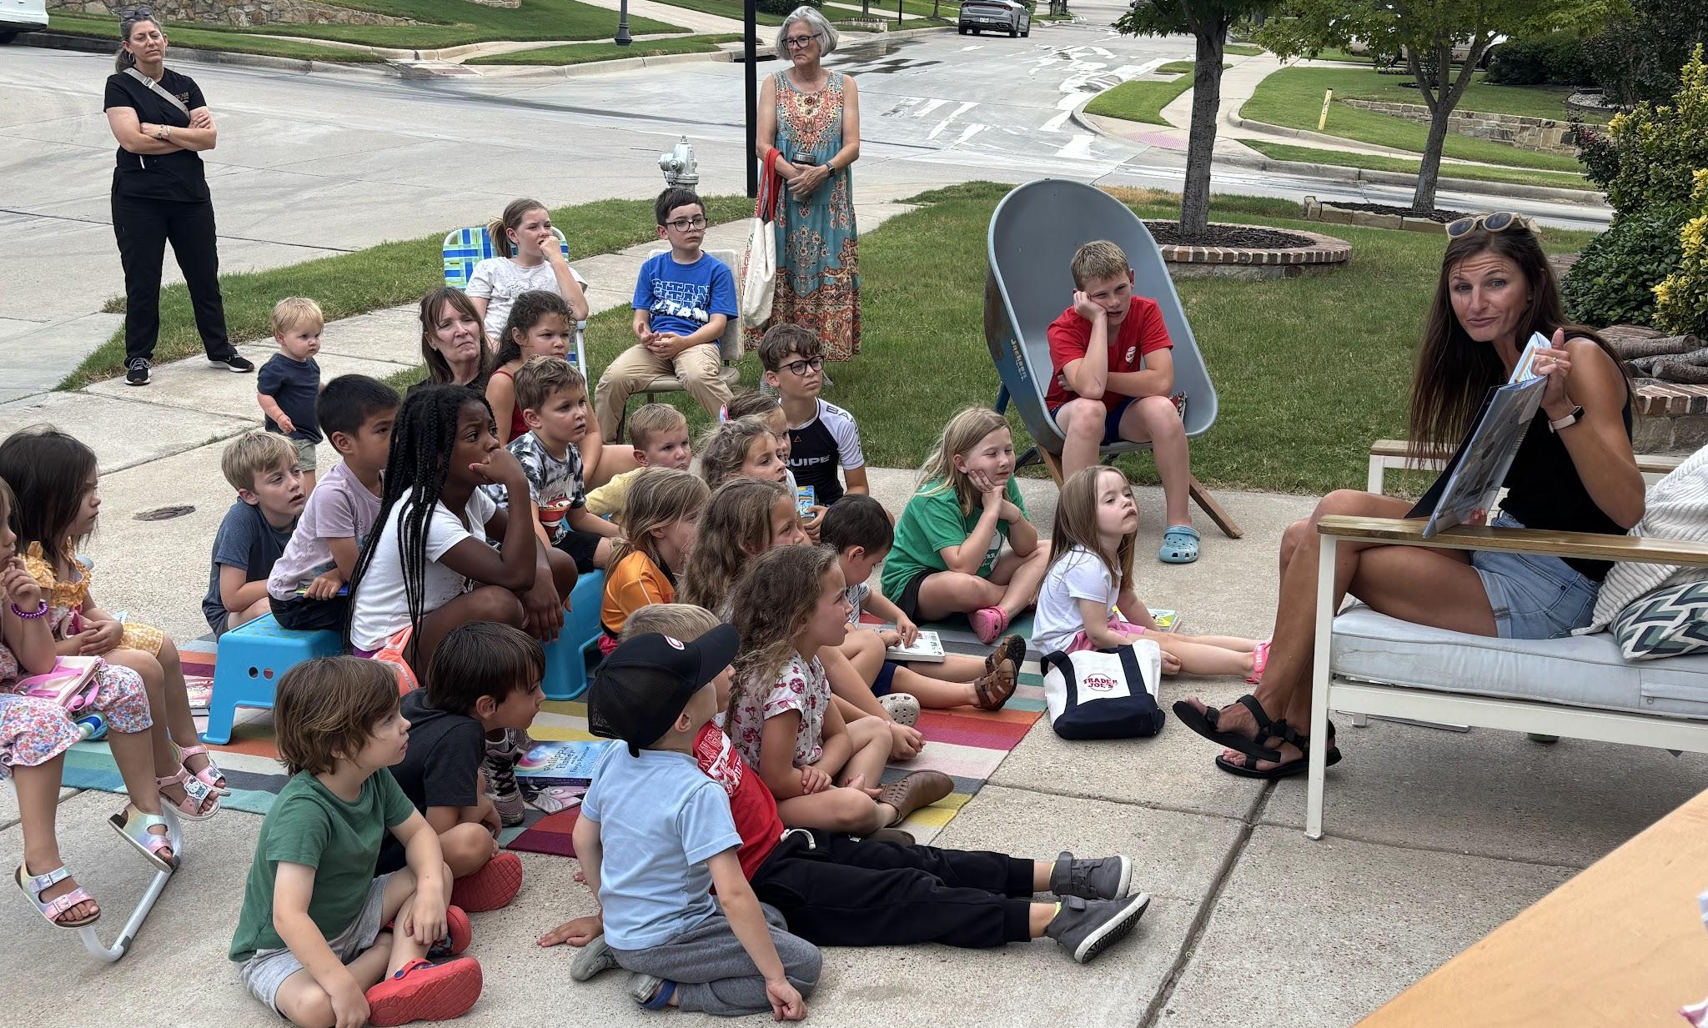
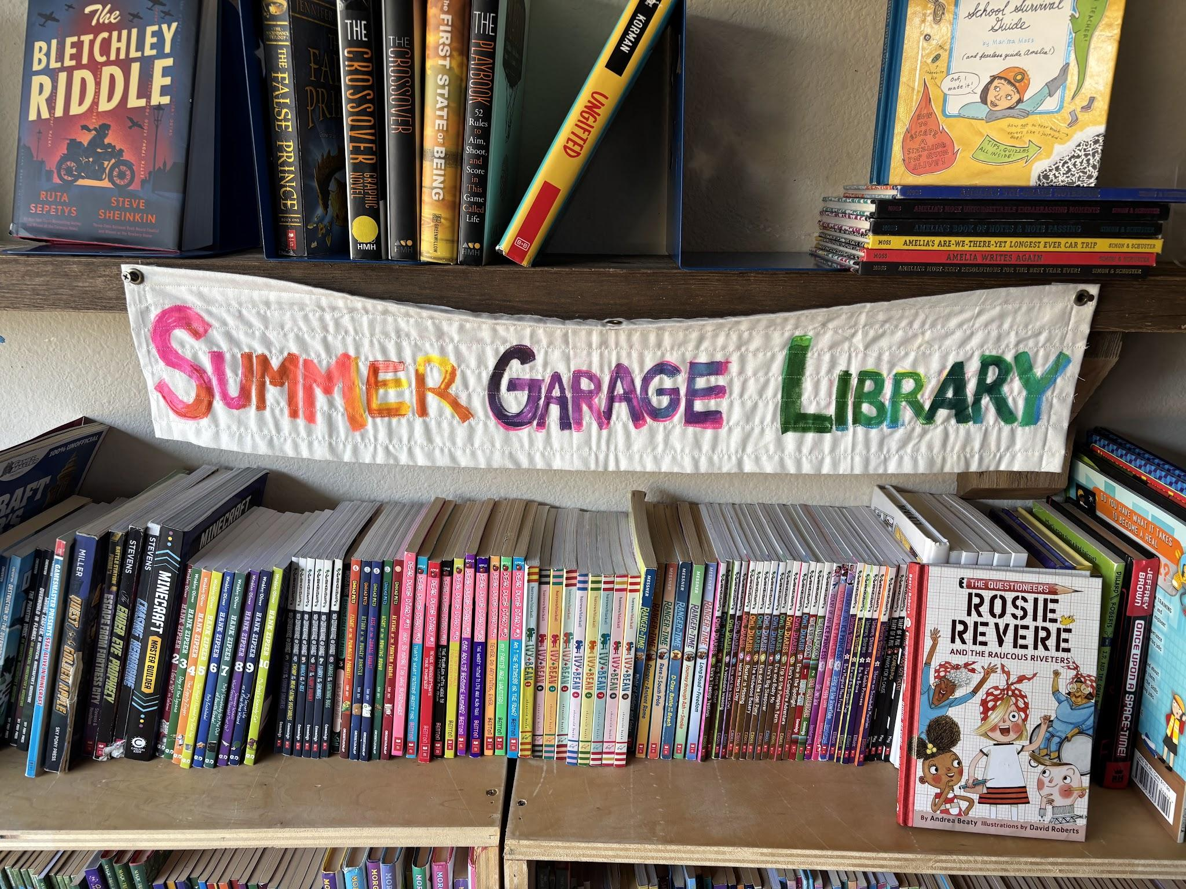
The Game:
Building a Community of Readers

Slide 8
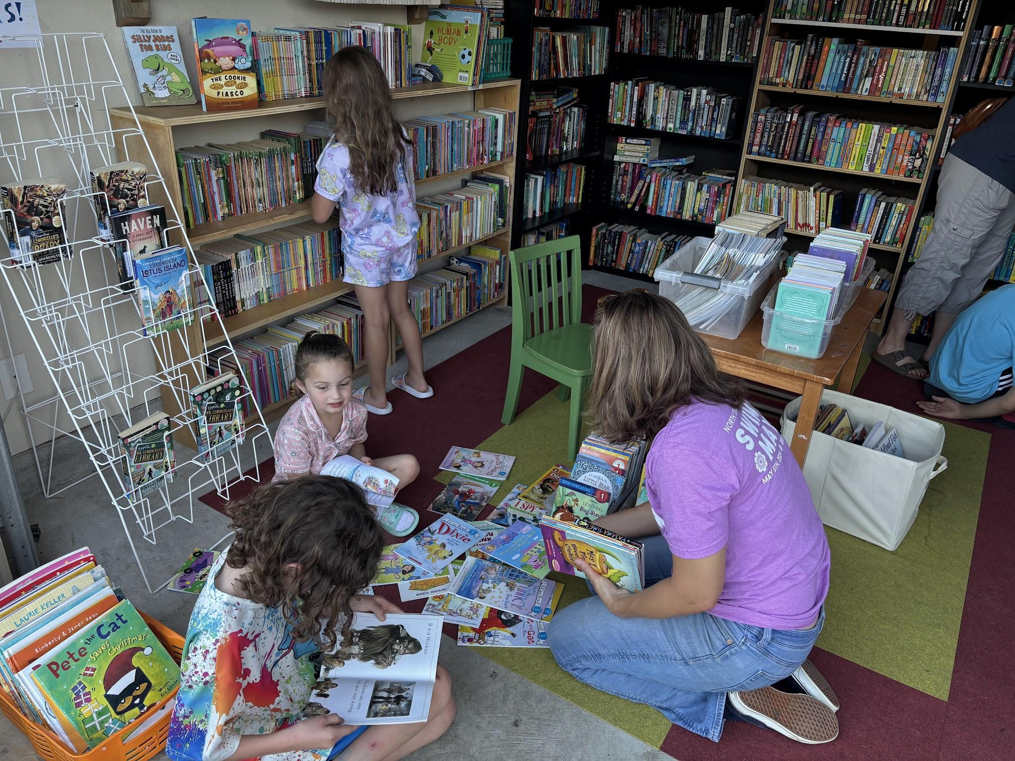
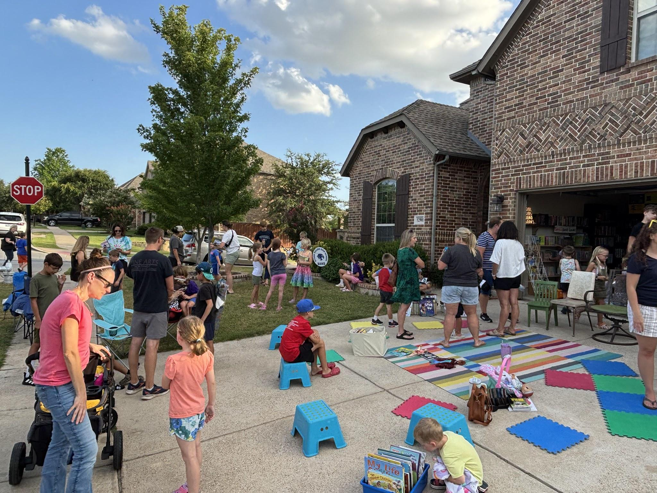
The Game:
Building a Community of Readers

Slide 9
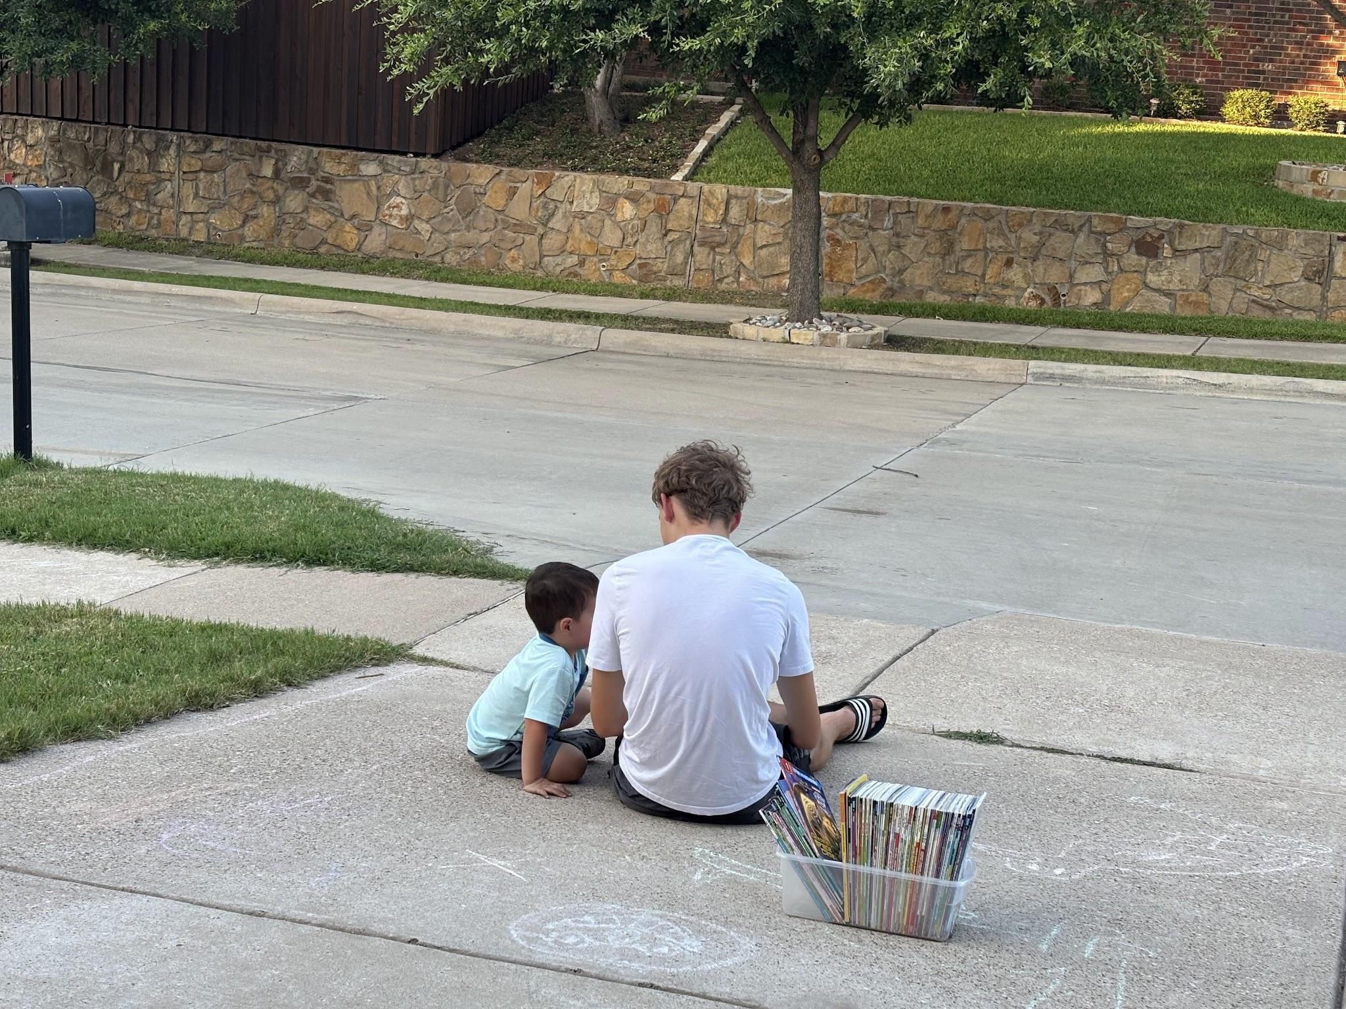
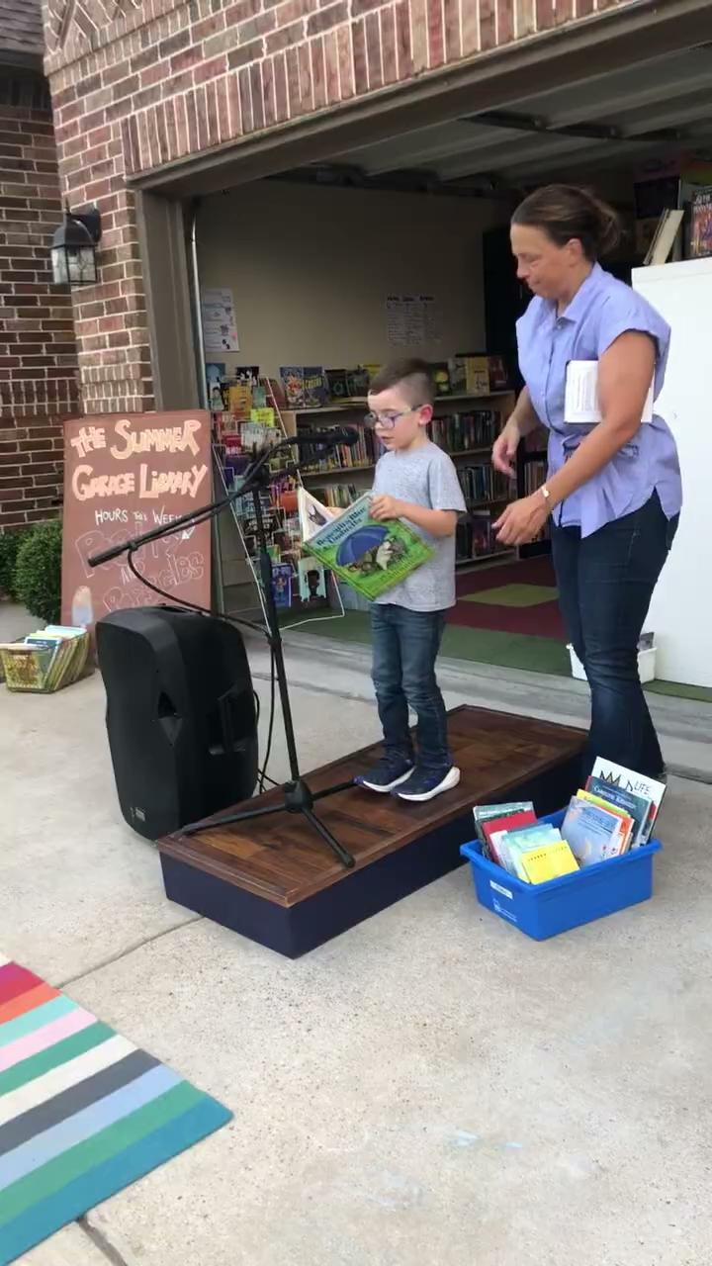
The Game:
Building a Community of Readers

Slide 10
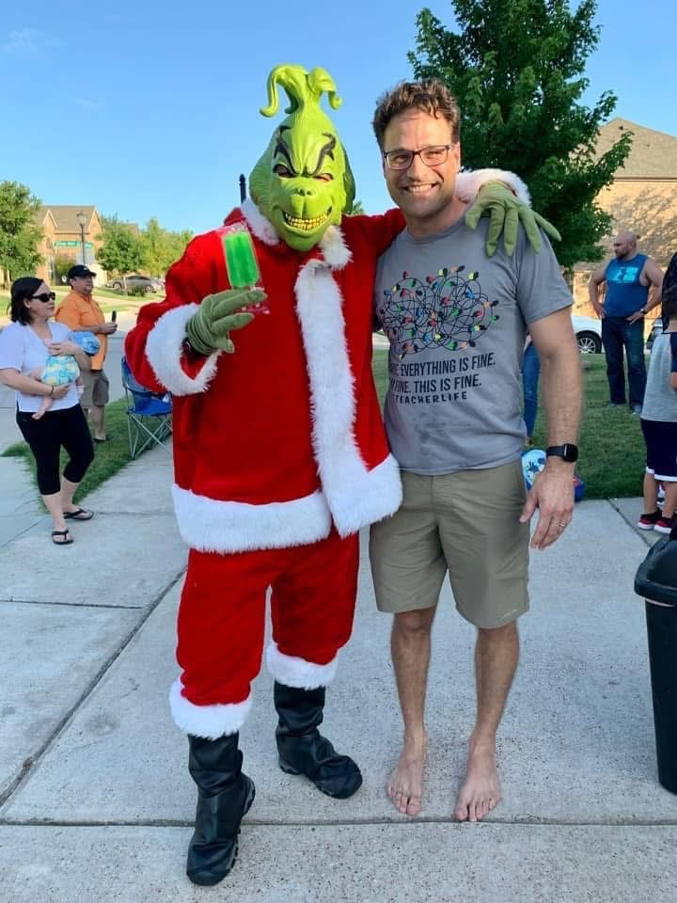
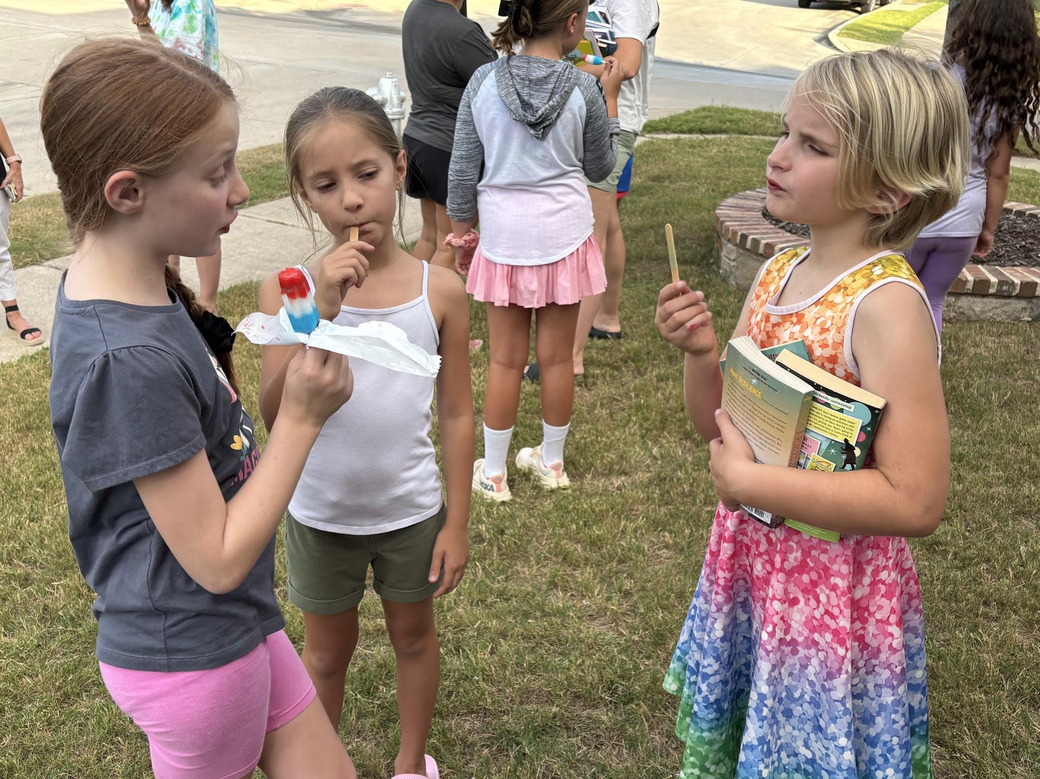
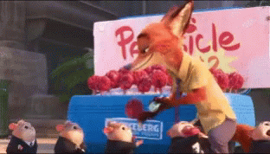
The Game:
Building a Community of Readers

Slide 11
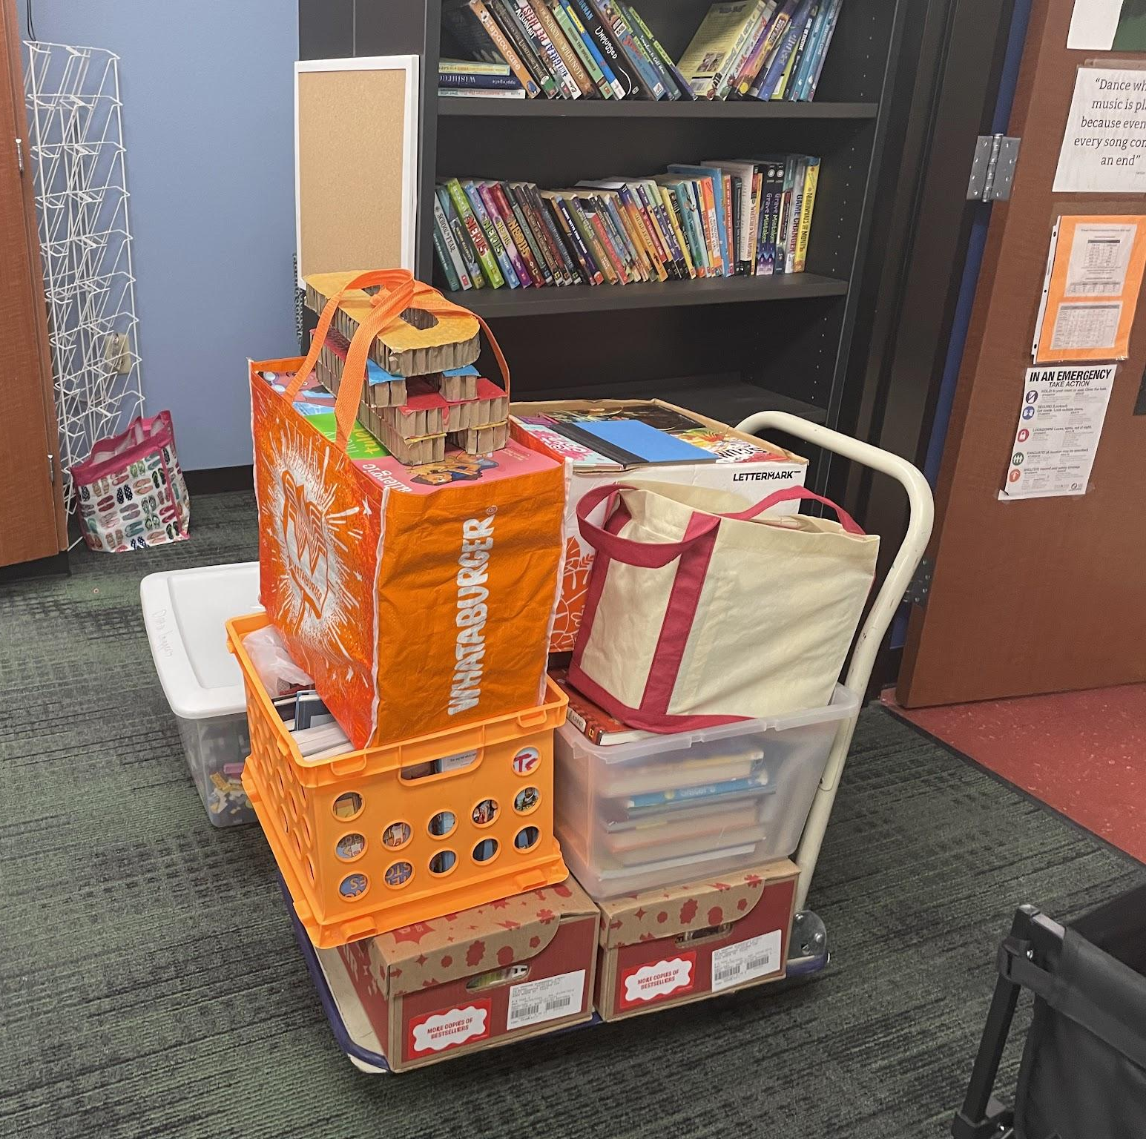
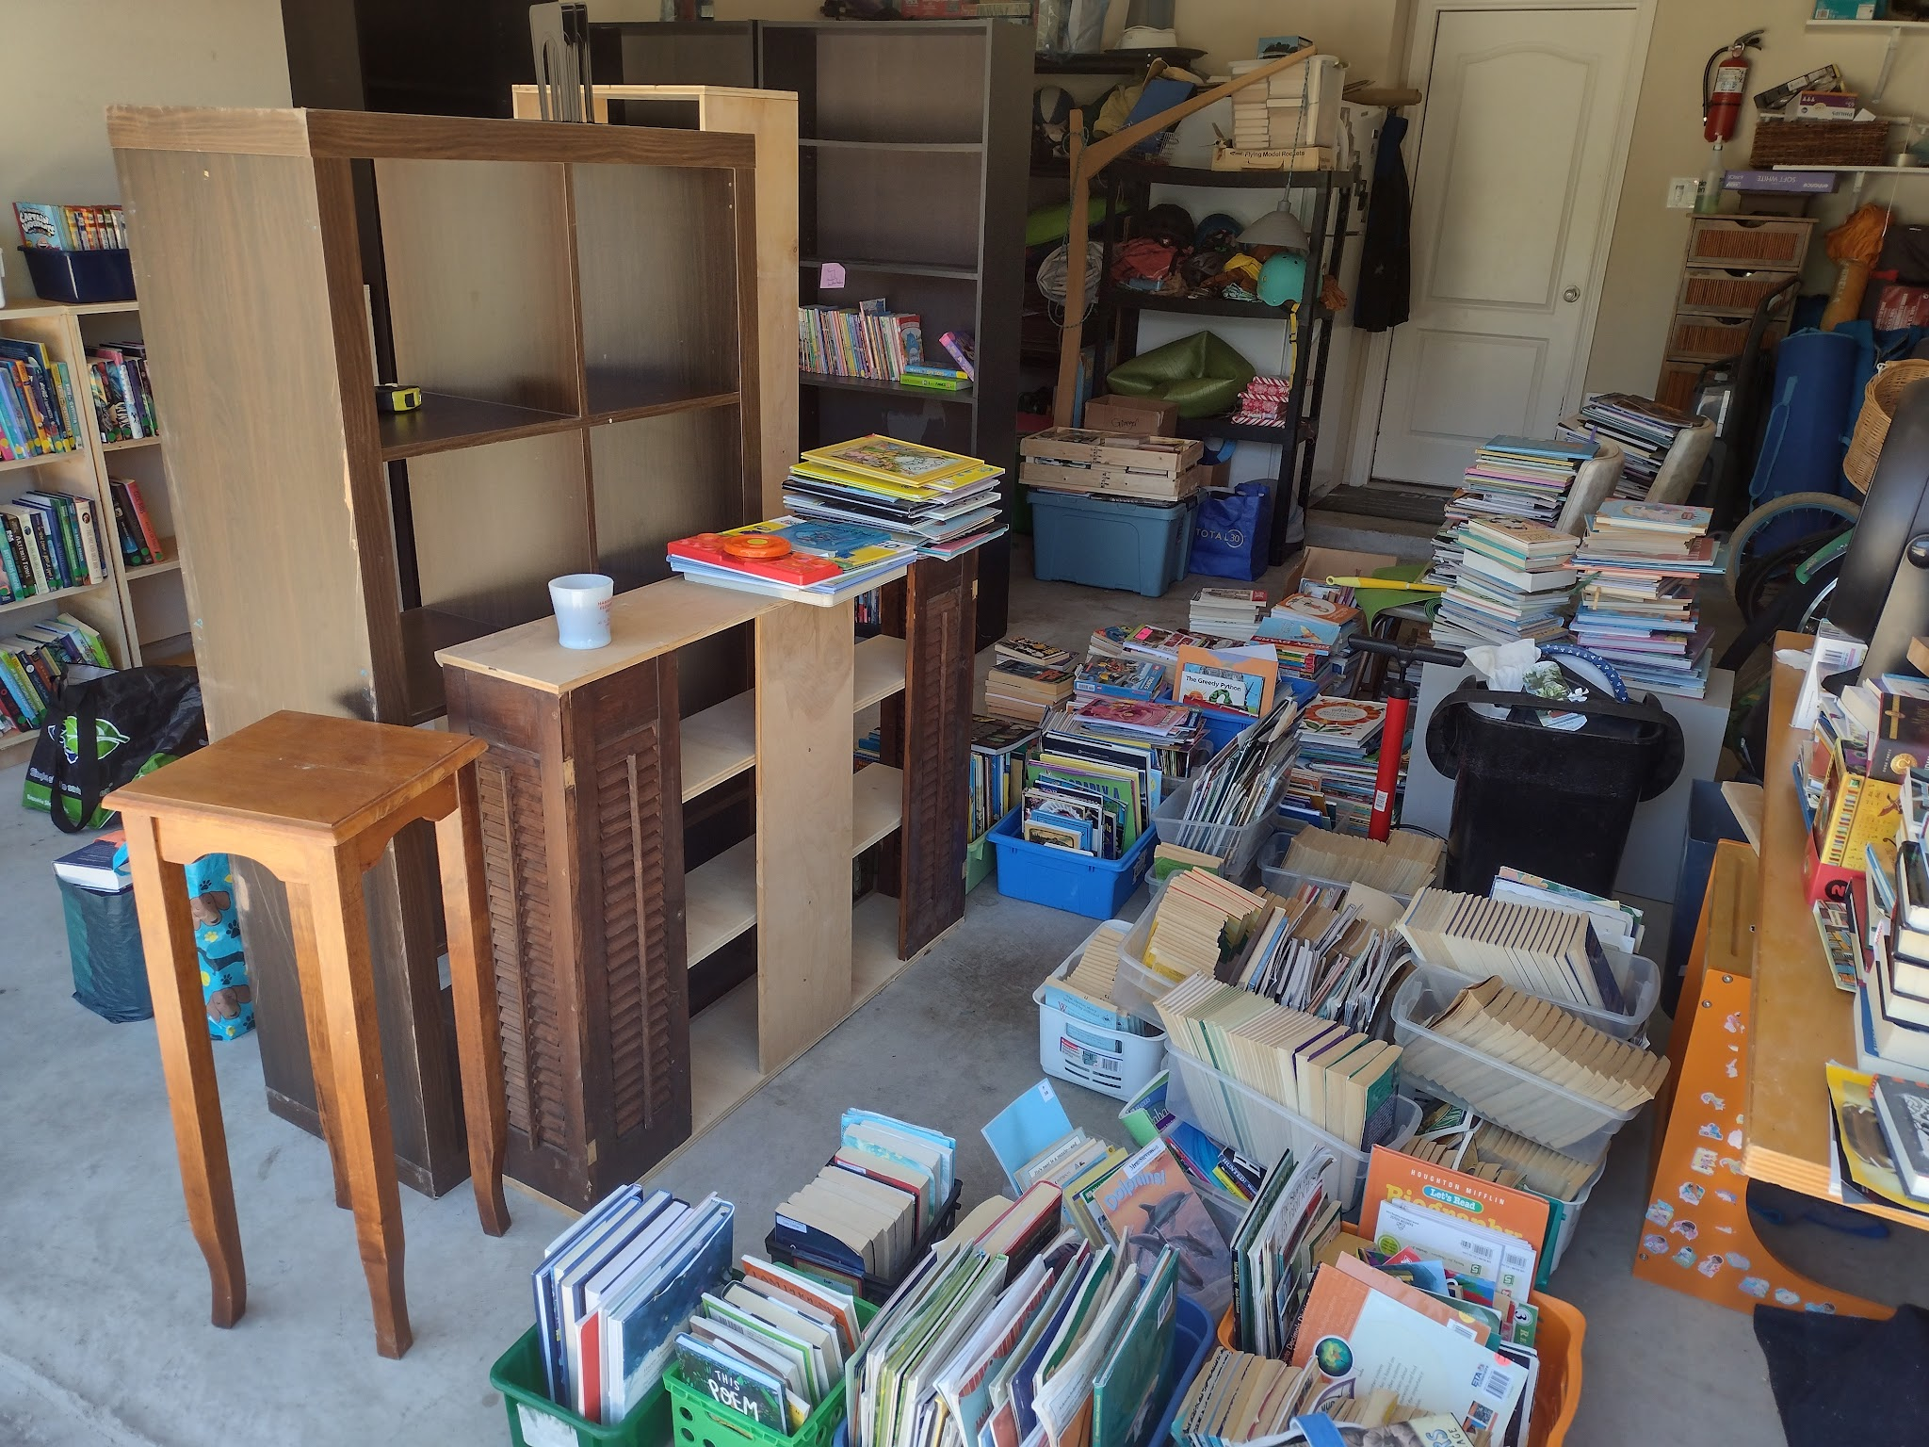
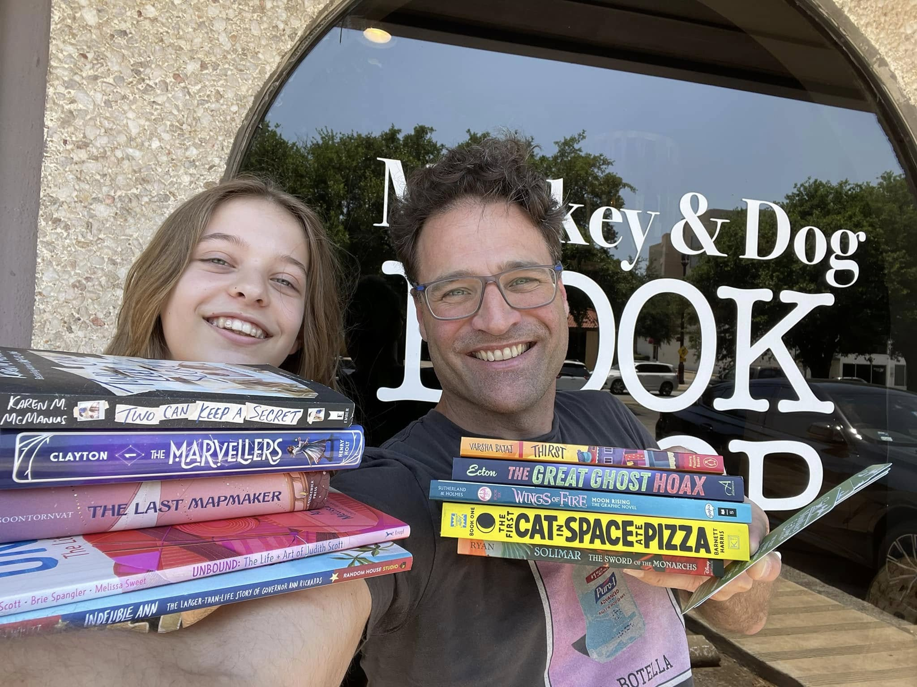
The Game Plan: Acquisitions
family collection
classroom library
donations, donations, donations
partnerships

Slide 12
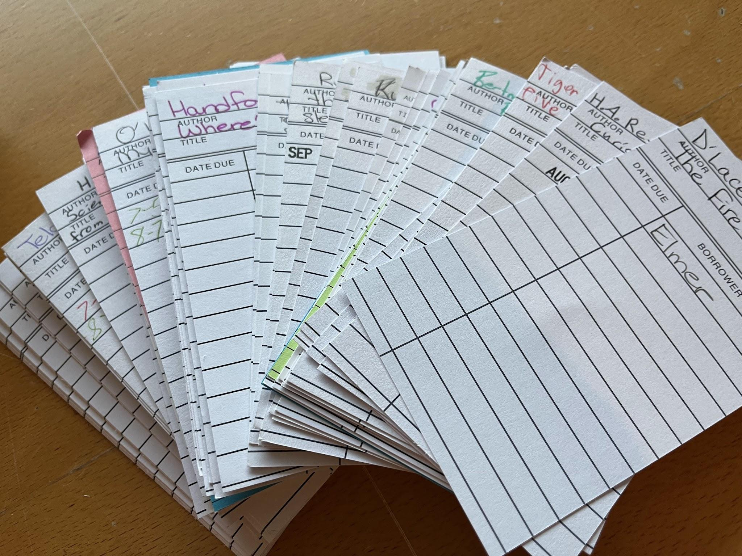
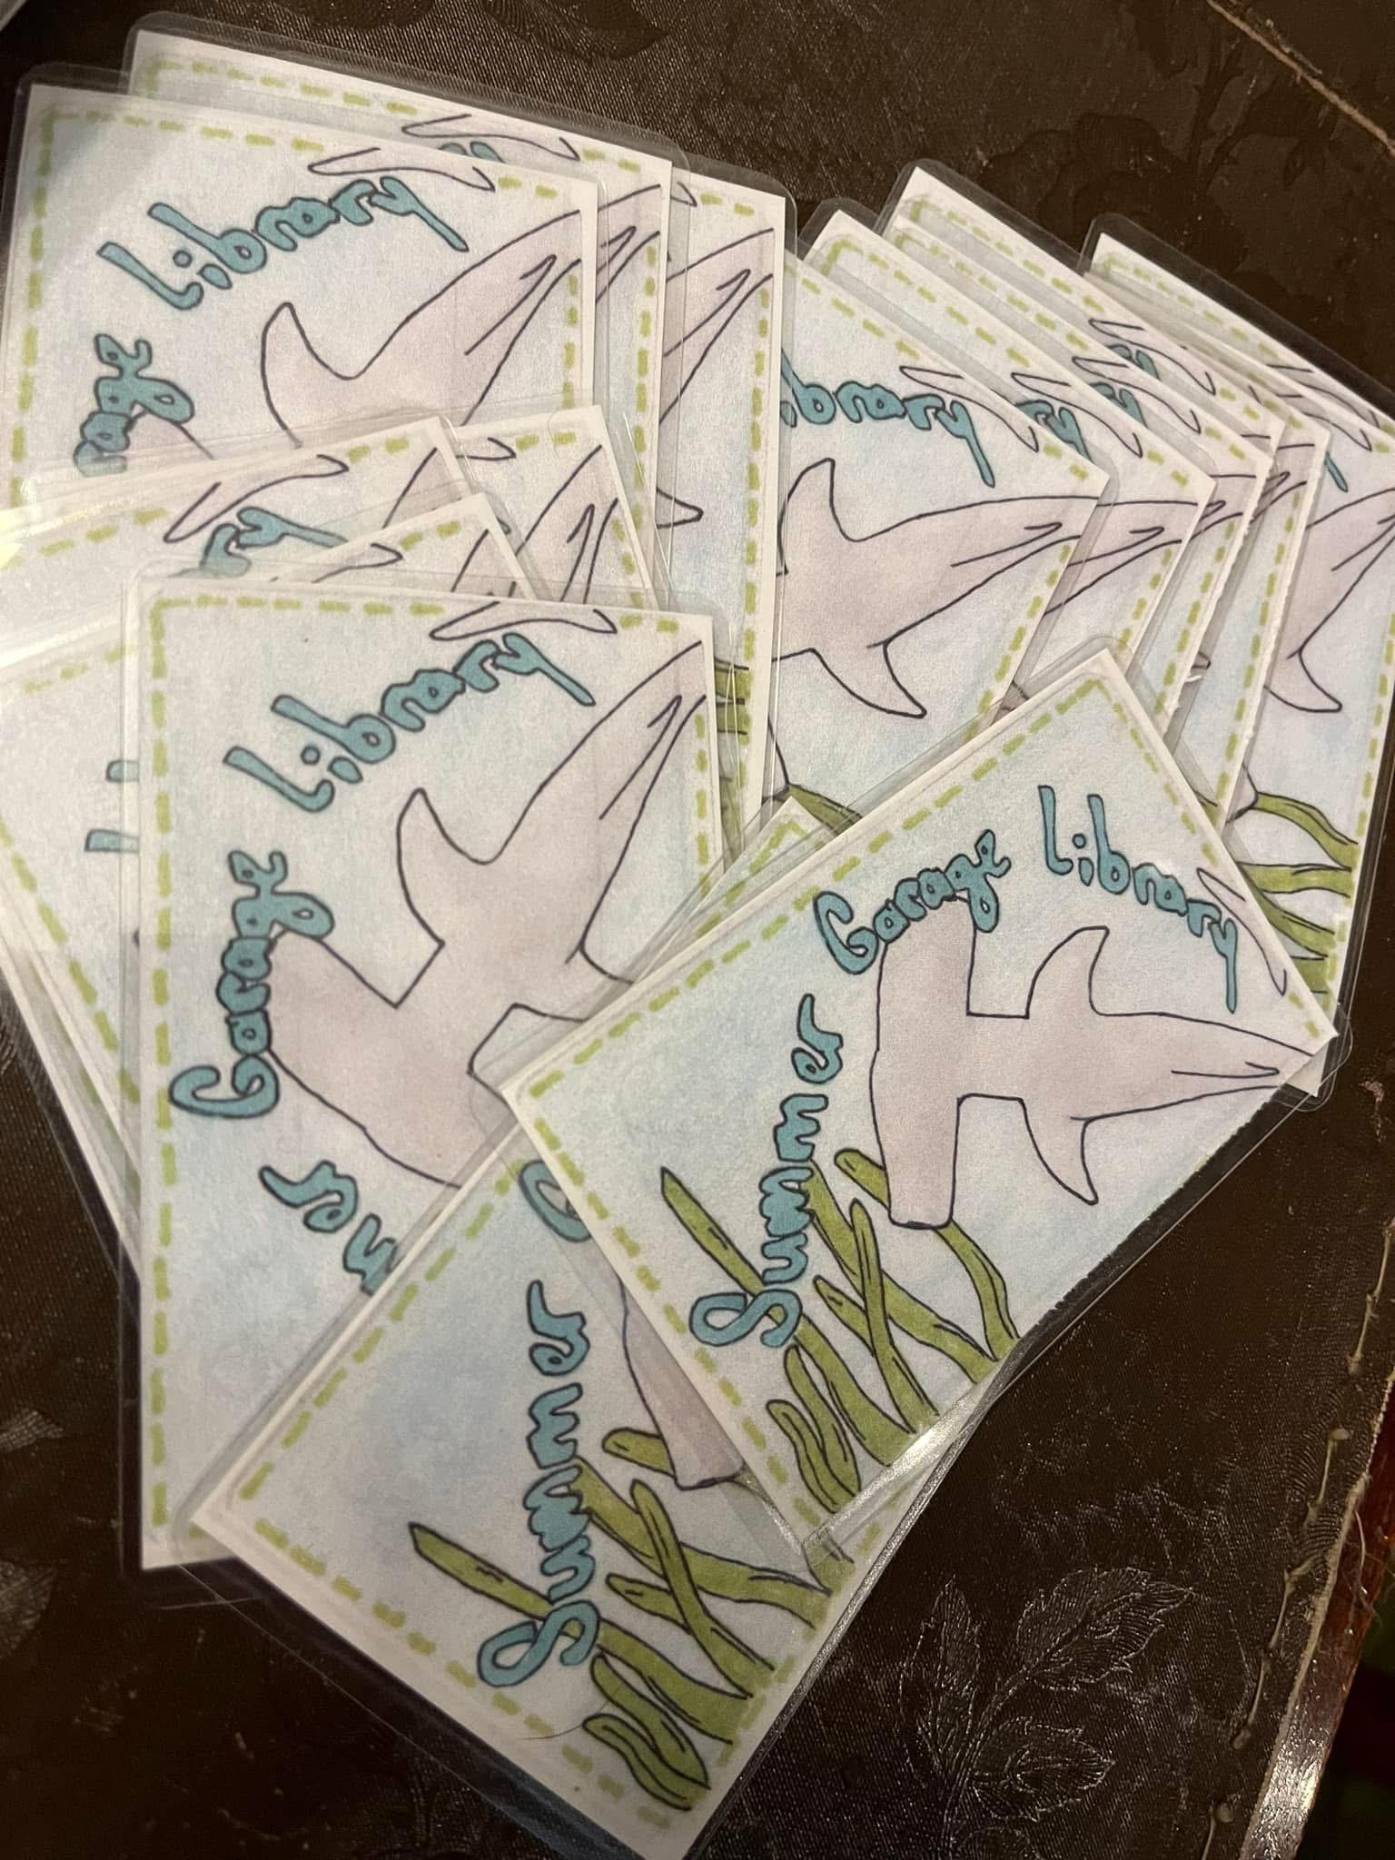
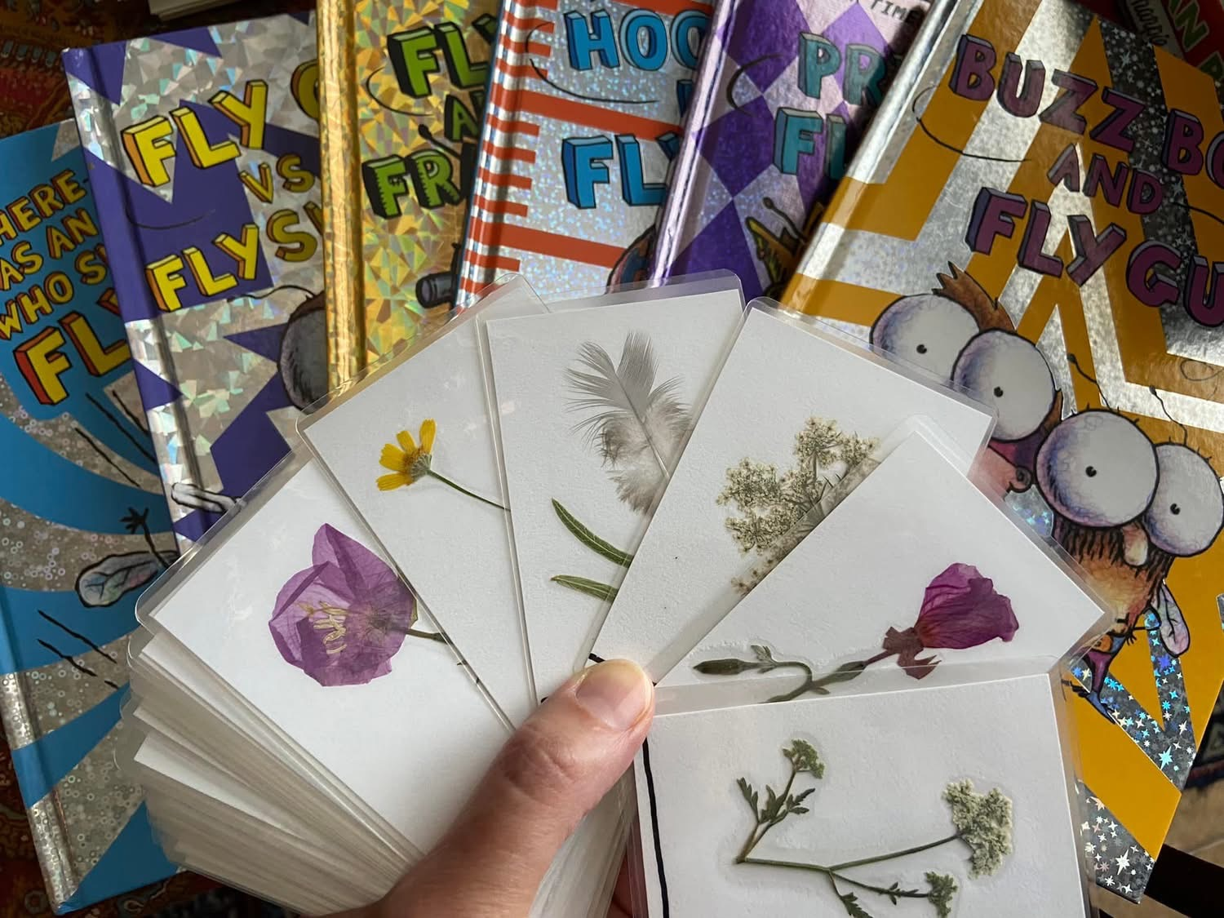

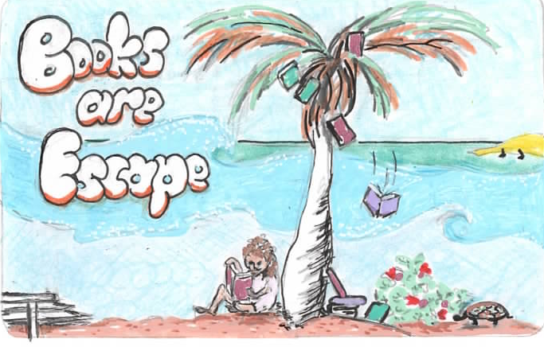
The Game Plan: Management
library cards
checkout cards
collections management
weeding

Slide 13
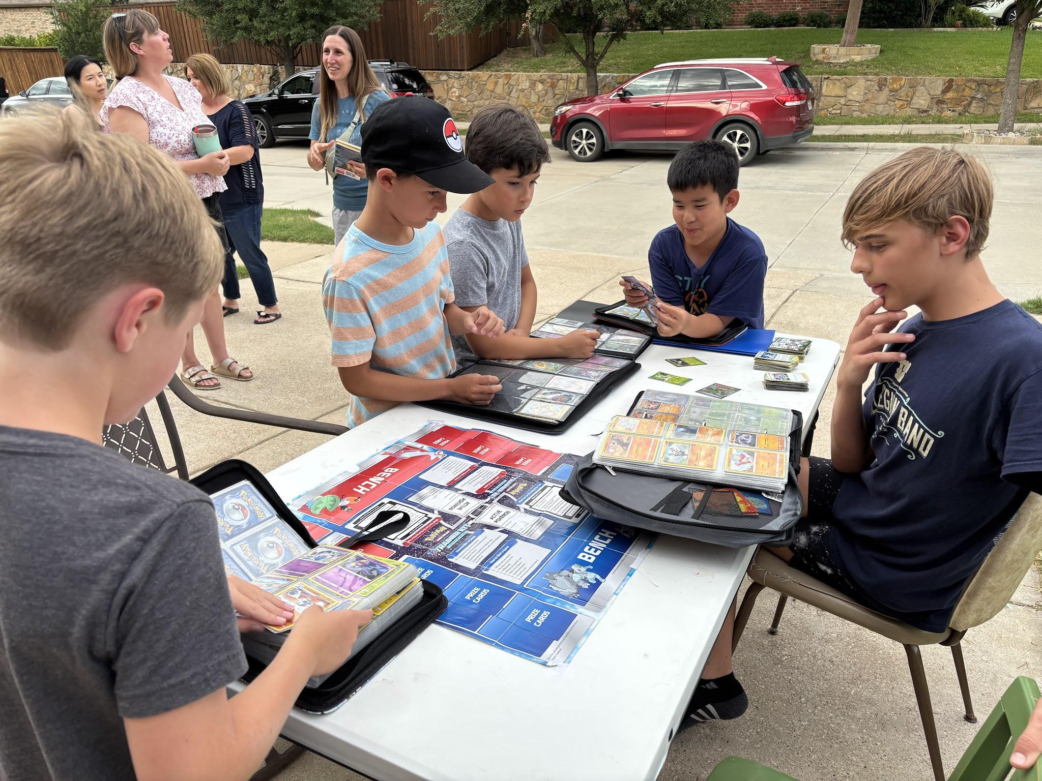
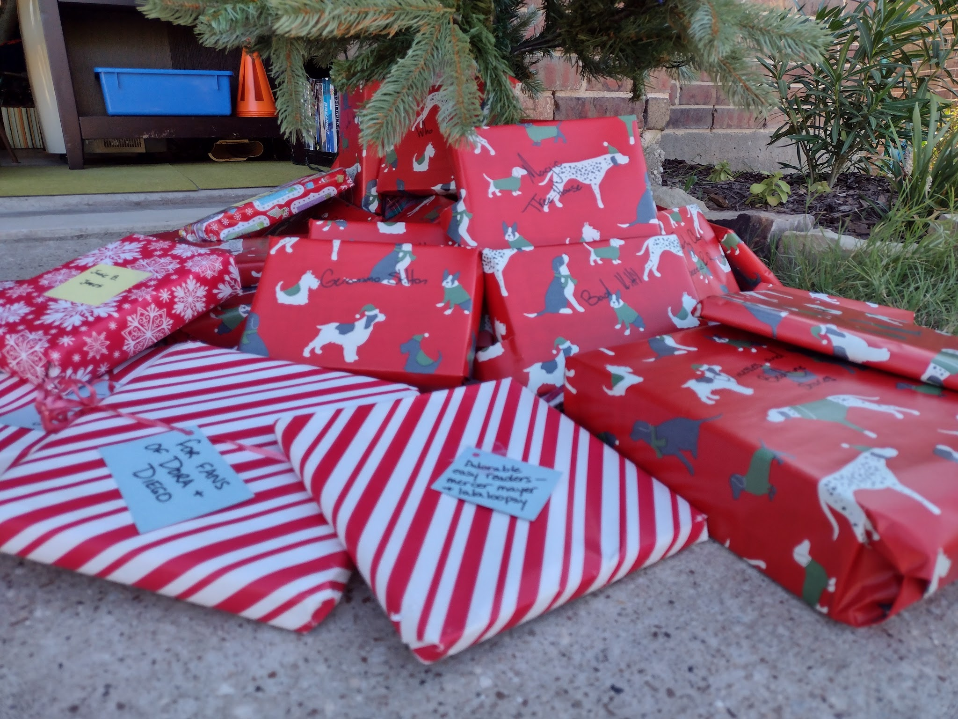
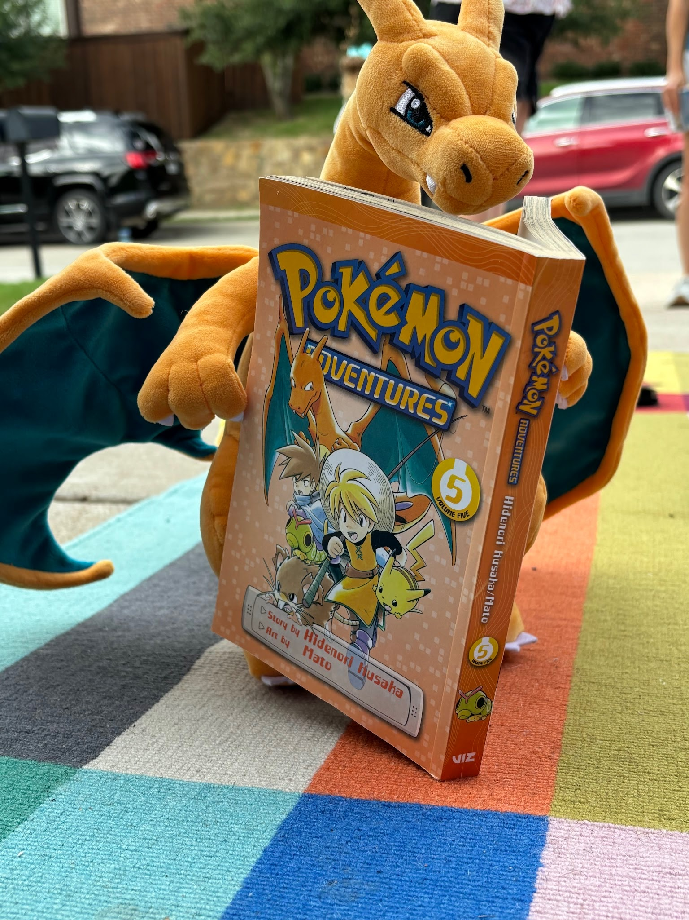
The Game Plan: Events
Game Night
Pokemon
Crafts
Poetry Night
Christmas in July
and…

Slide 14
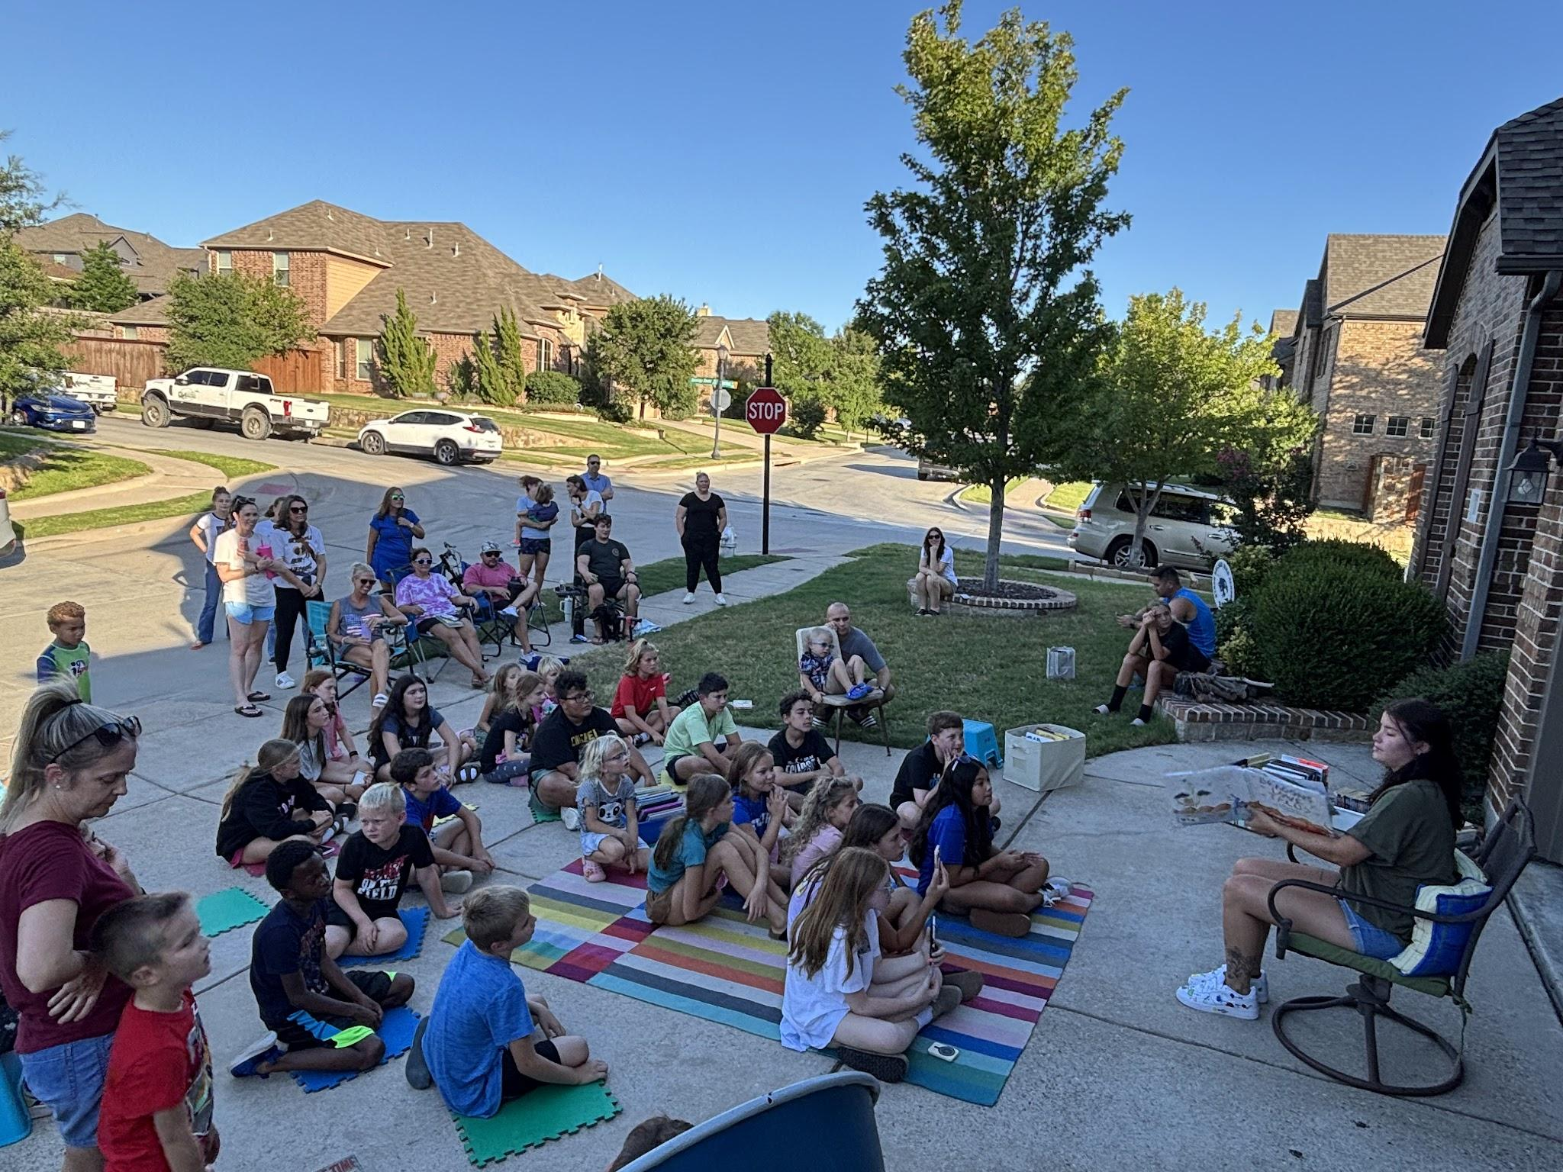
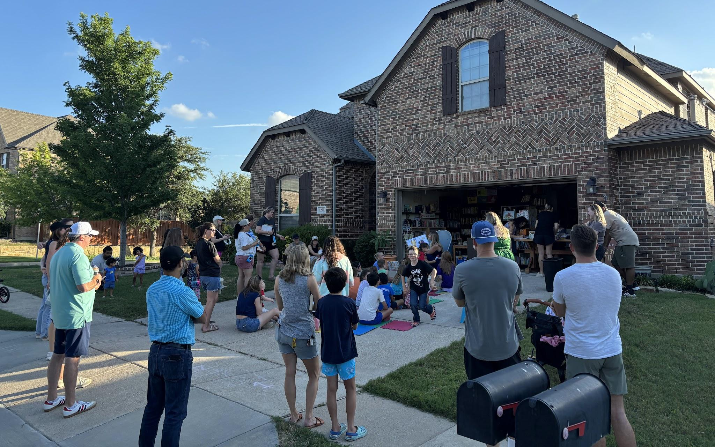
The Game Plan: Events
Local celebrity read alouds!!!

Slide 15
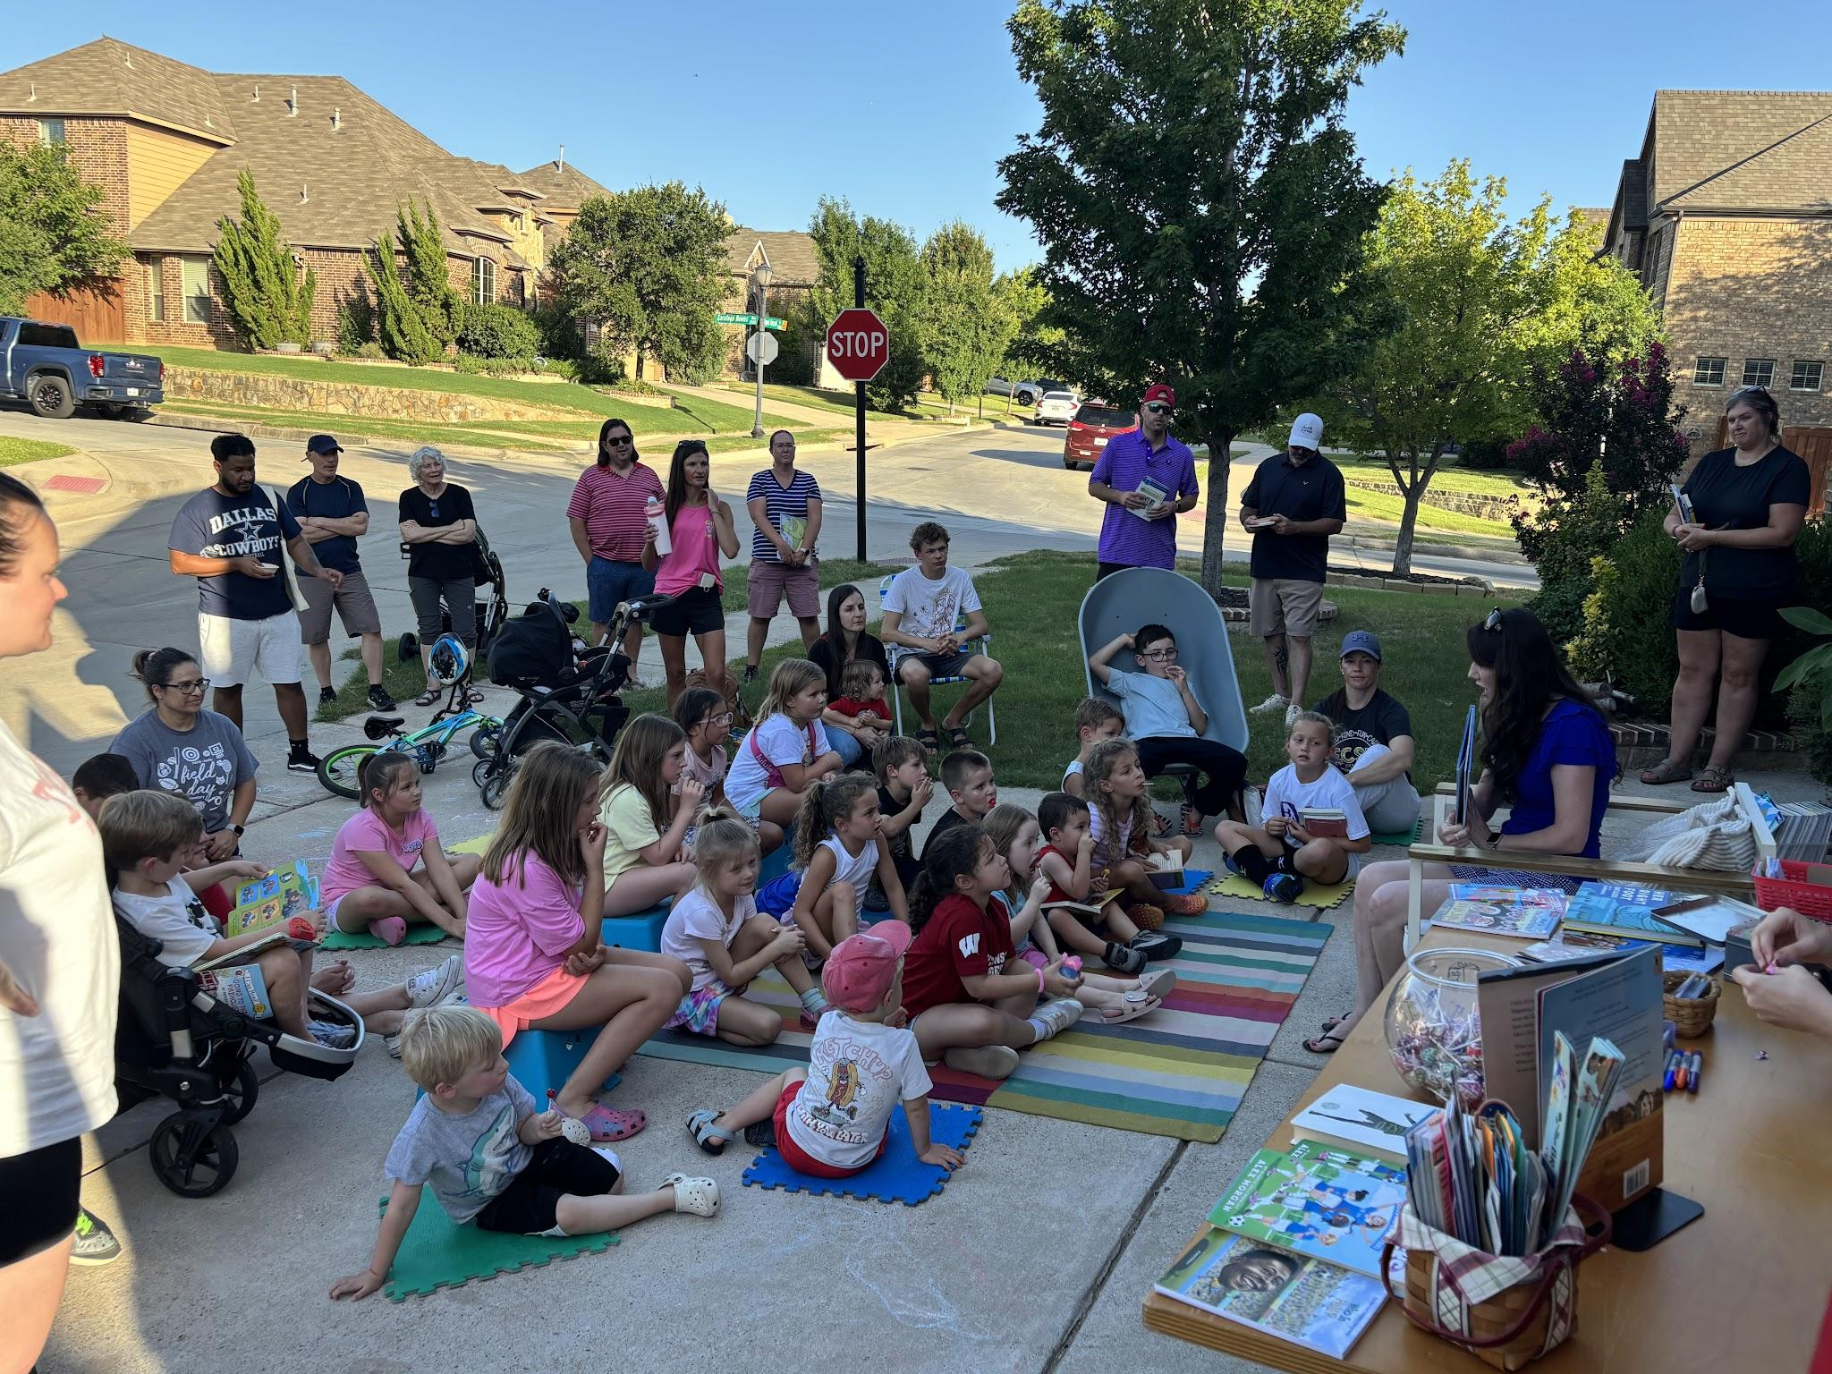
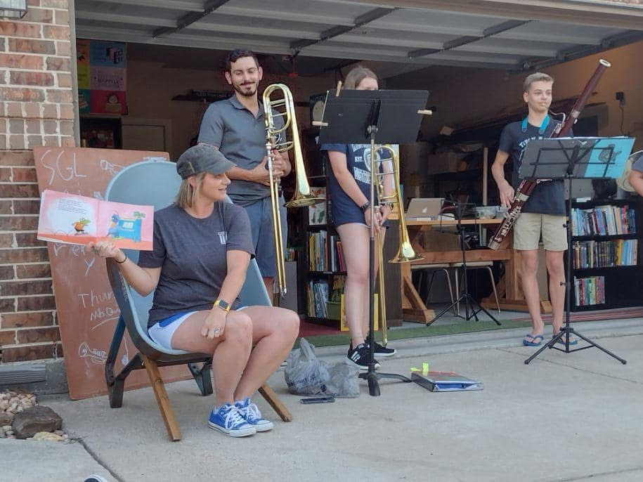
The Game Plan: Events

Slide 16
Halftime

Slide 17
Ten Words or Less
Describe/summarize one of our library’s most popular books in ten words or less.
no words from the title
no character names
PRIZES

Slide 18
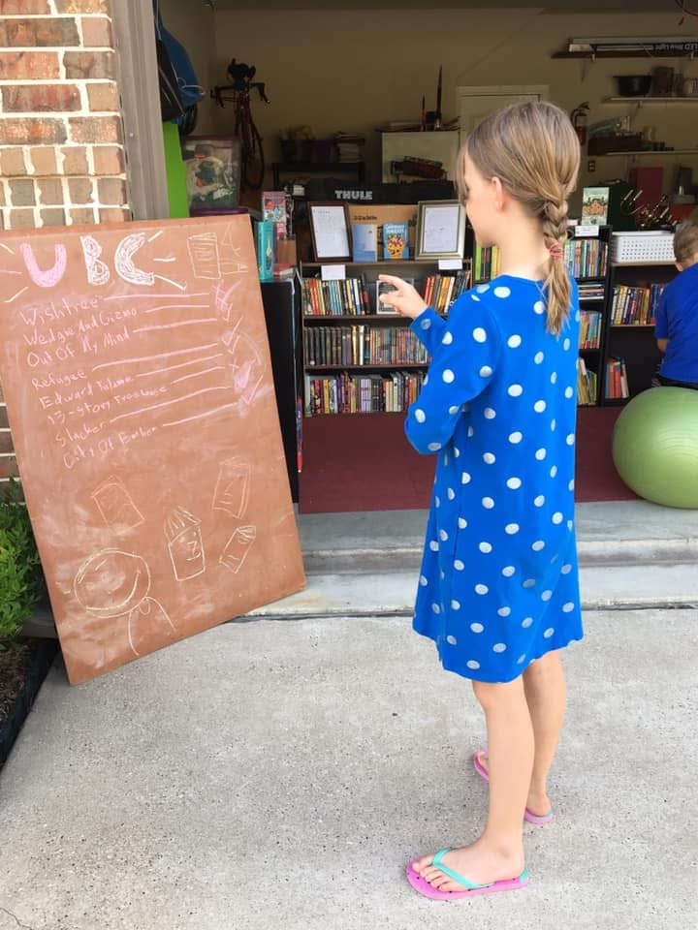
The Game Plan: Communication
Facebook
Instagram
neighborhood pages
school related outlets
signs

Slide 19
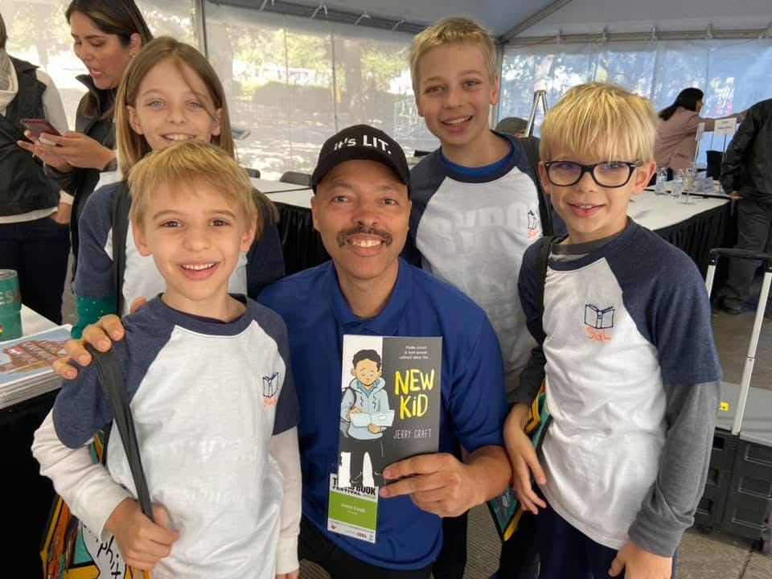
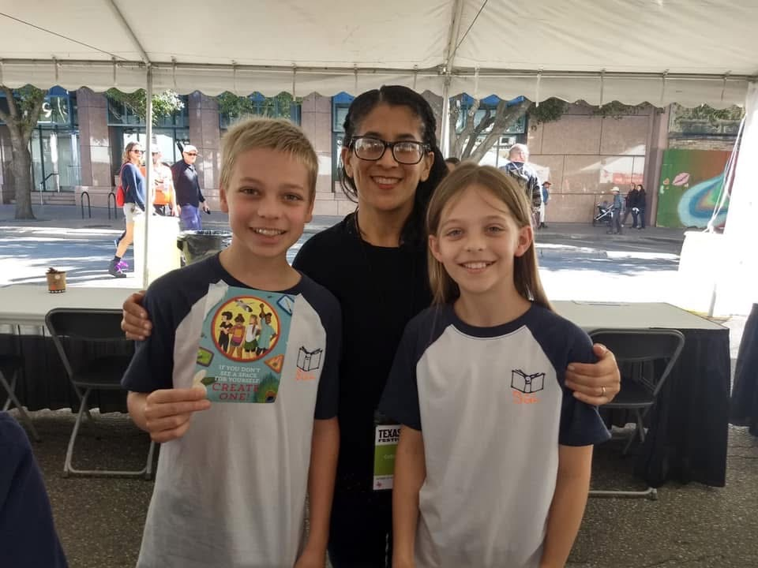
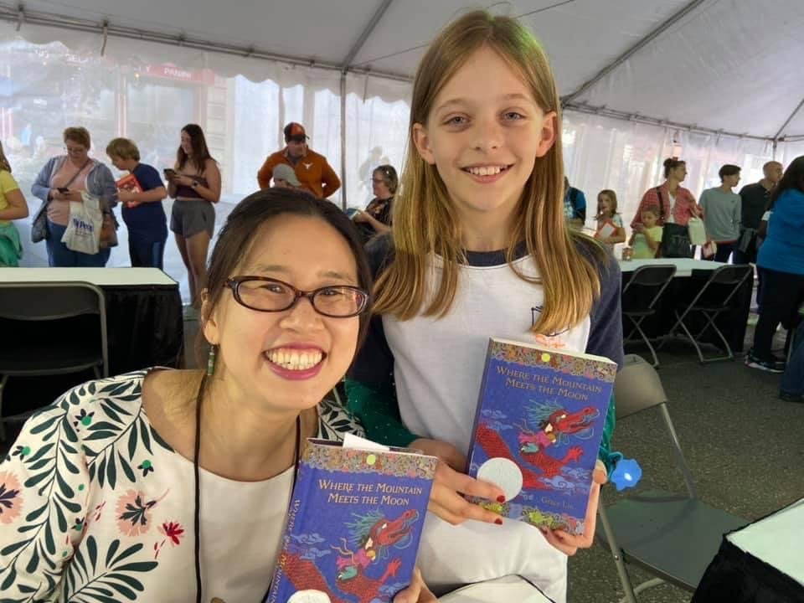
Team History

Slide 20
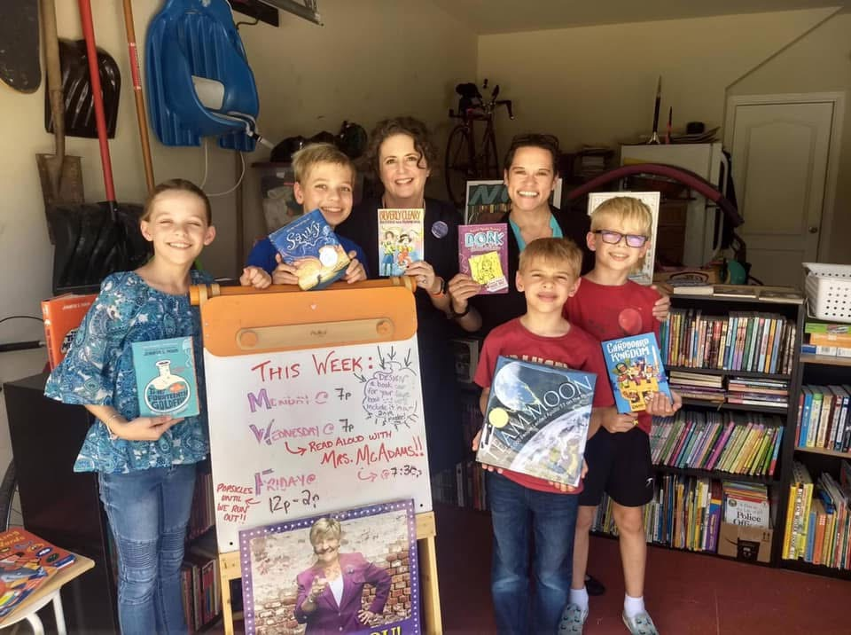
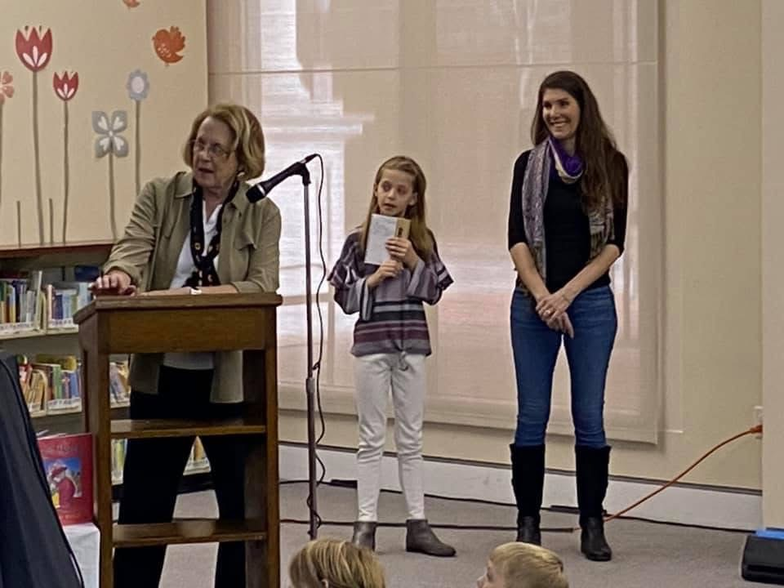
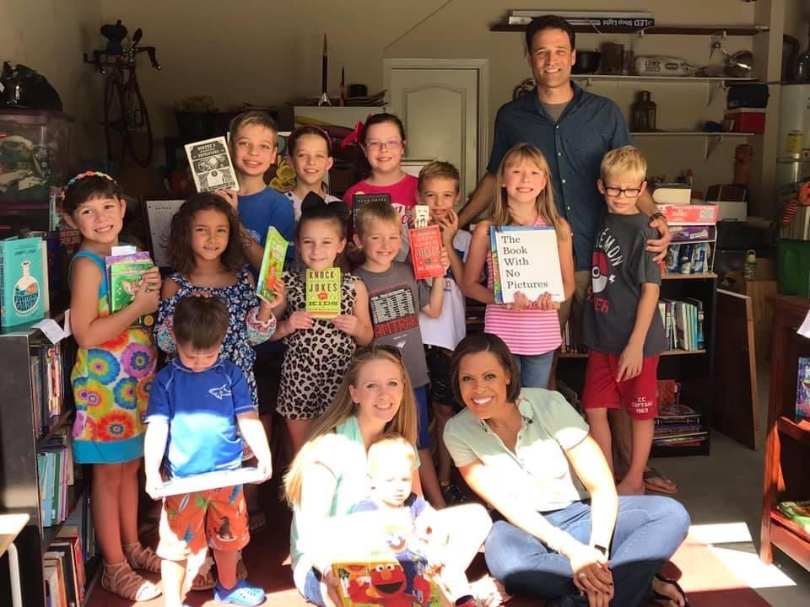
Team History

Slide 21
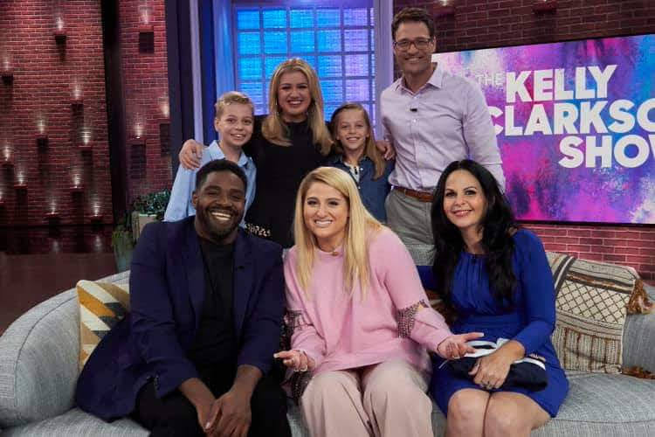
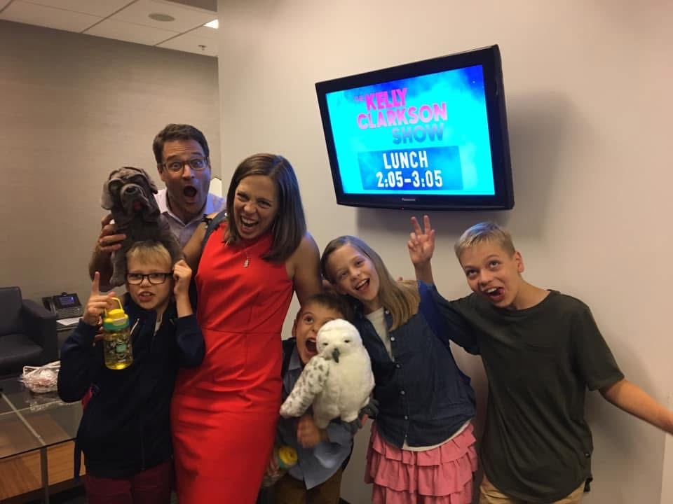
Team History

Slide 22
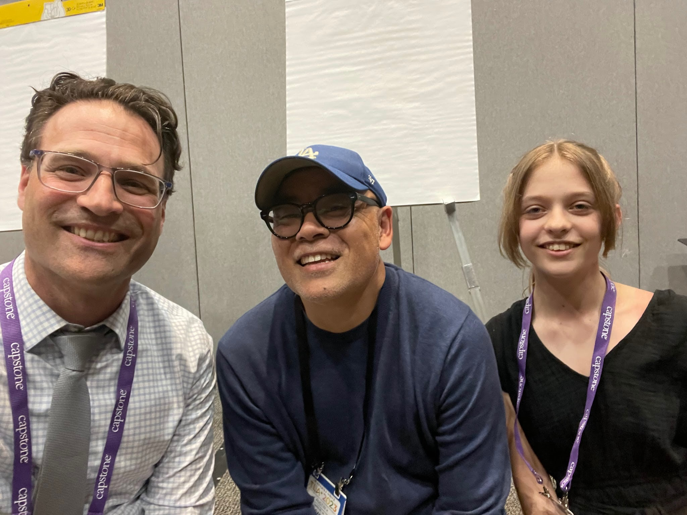
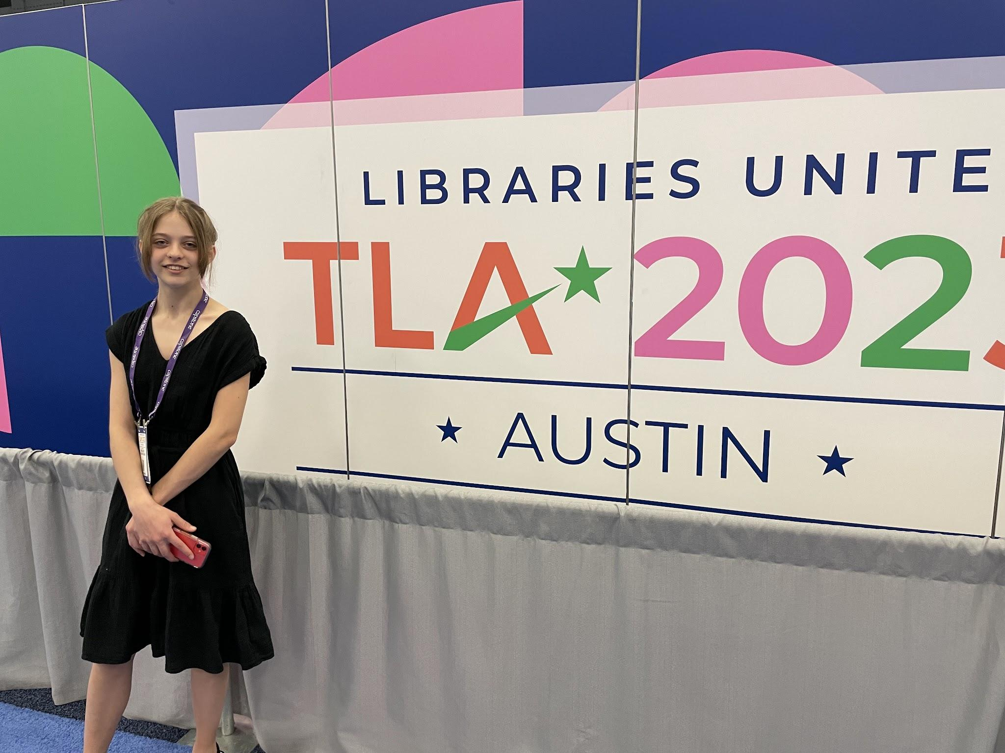
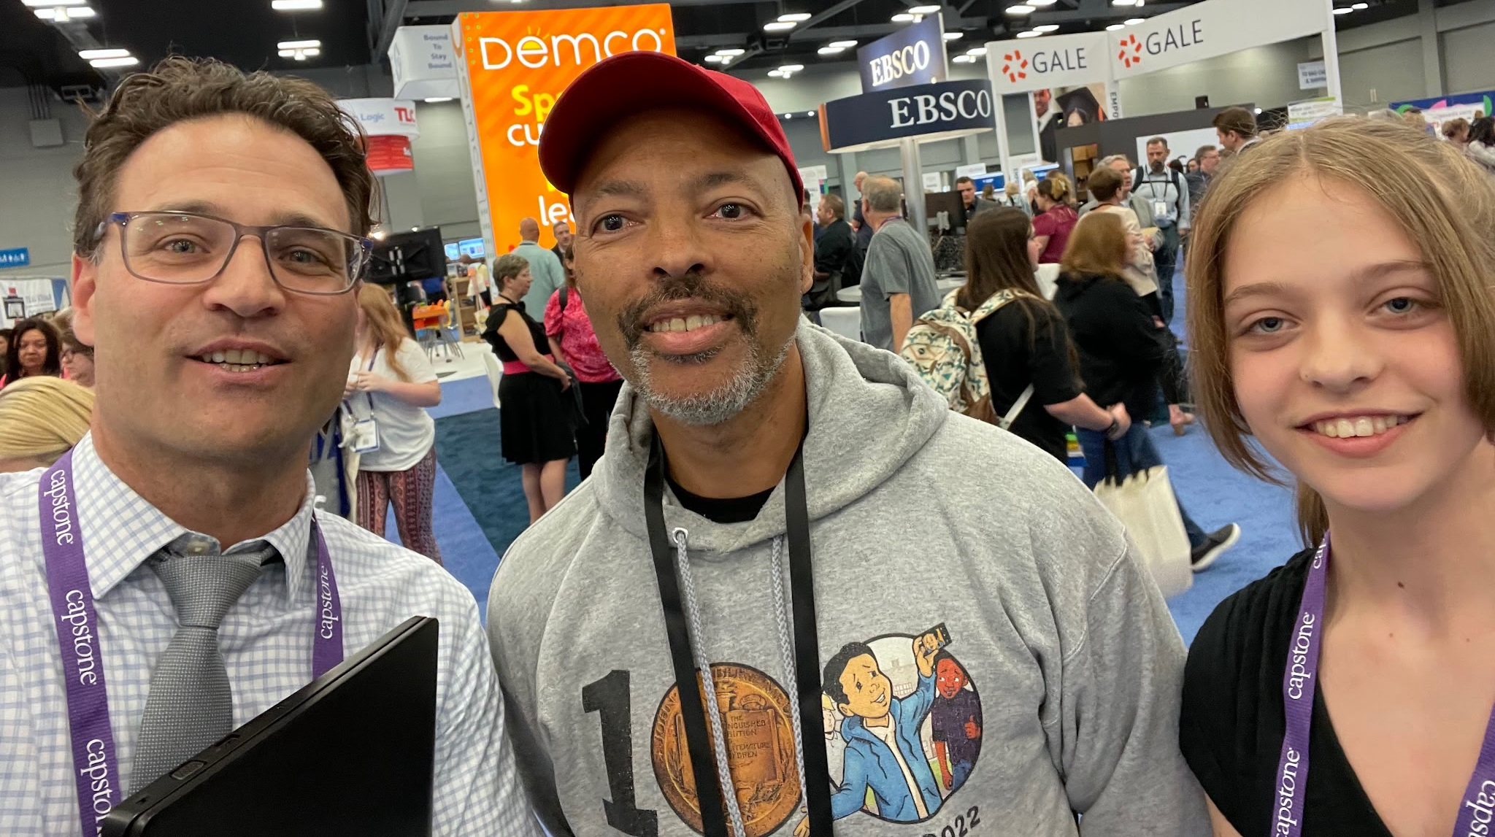
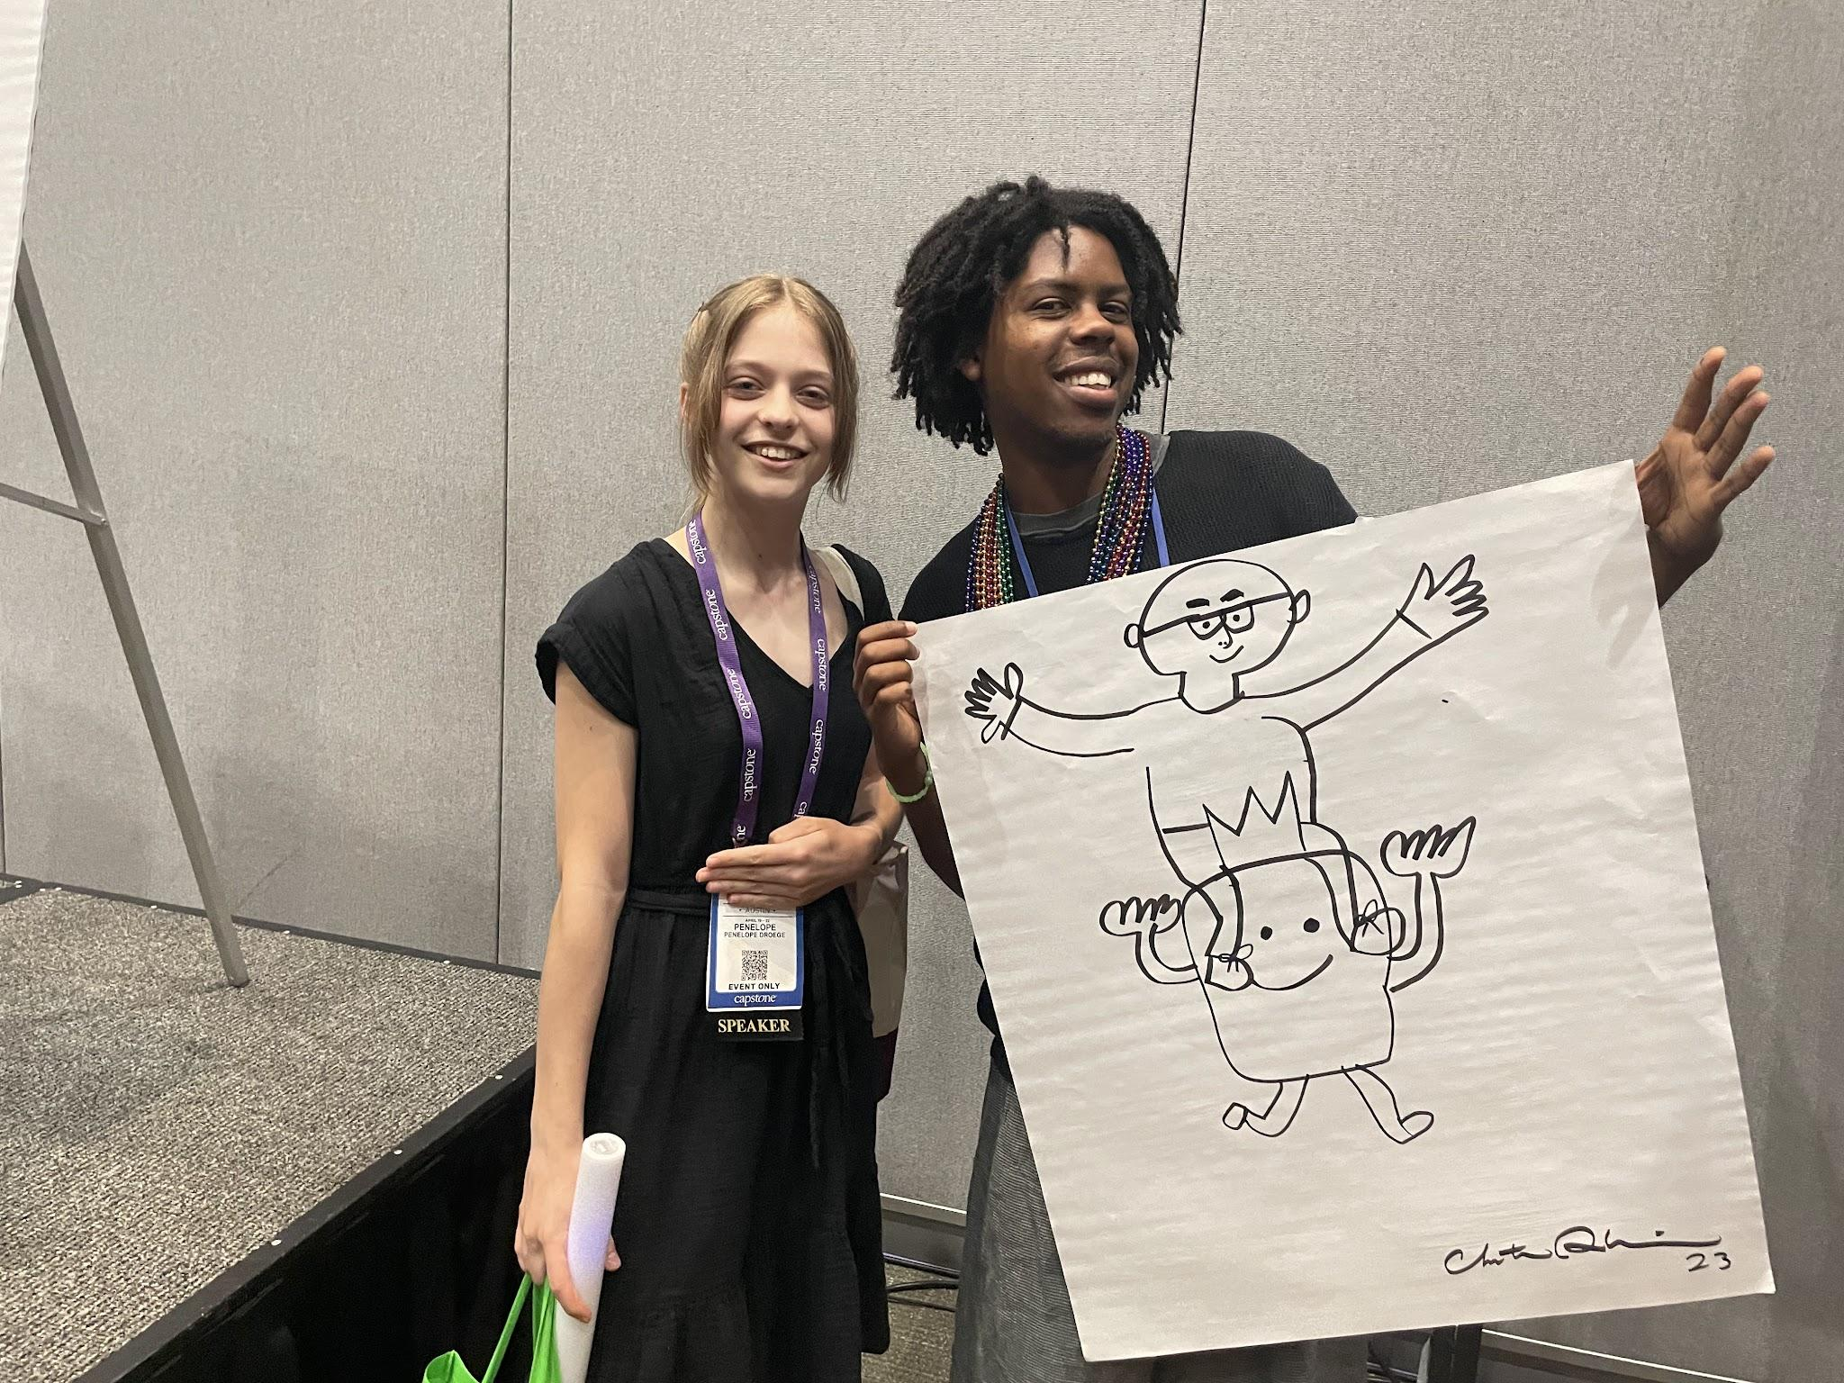
Team History

Slide 23
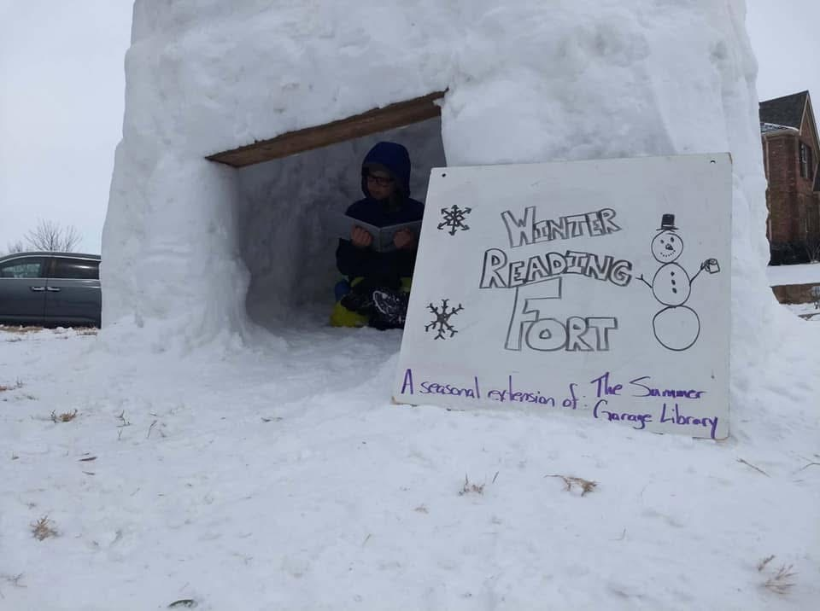
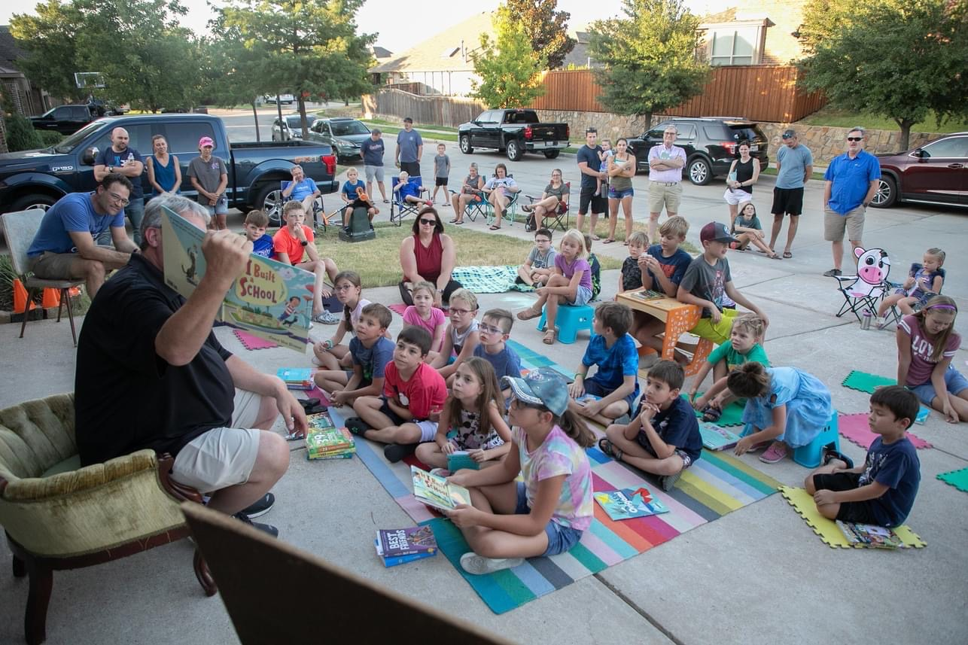
Team History

Slide 24
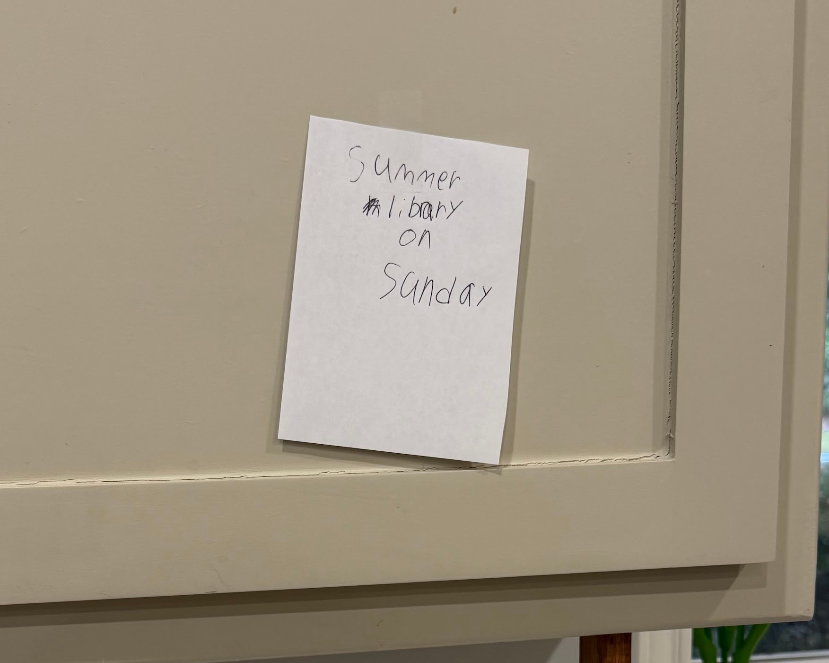
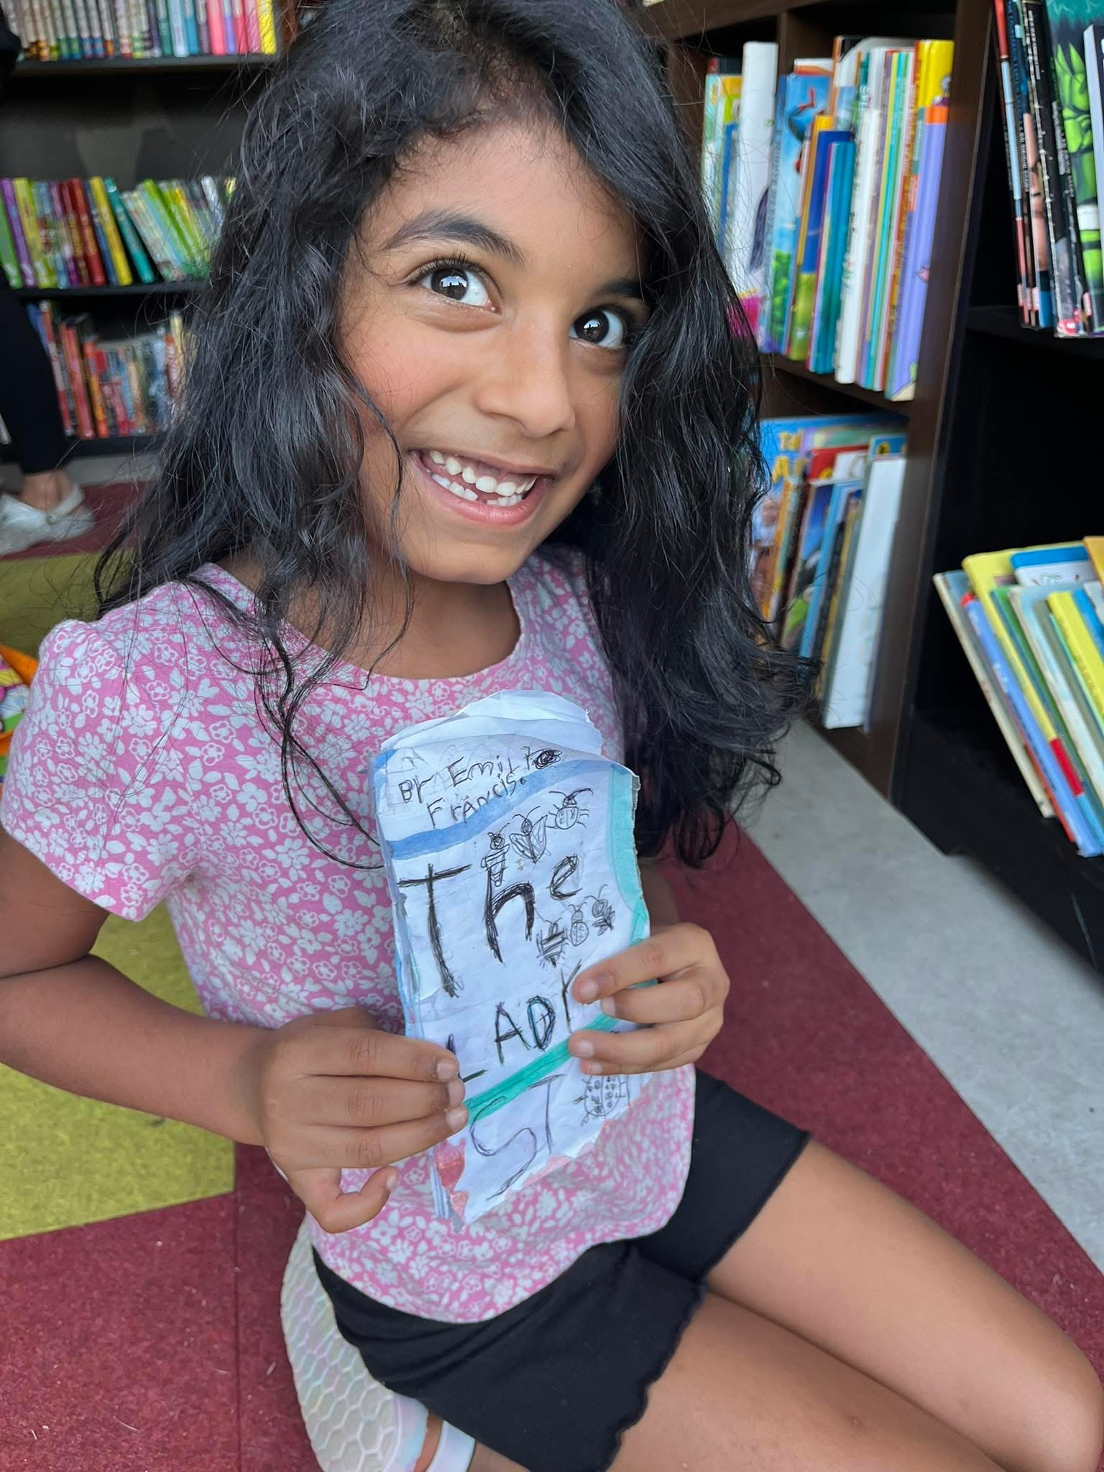
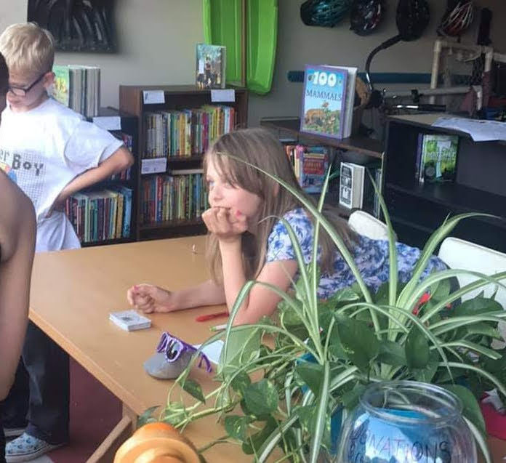
SGL Franchise:
Building Your Community of Readers

Slide 25
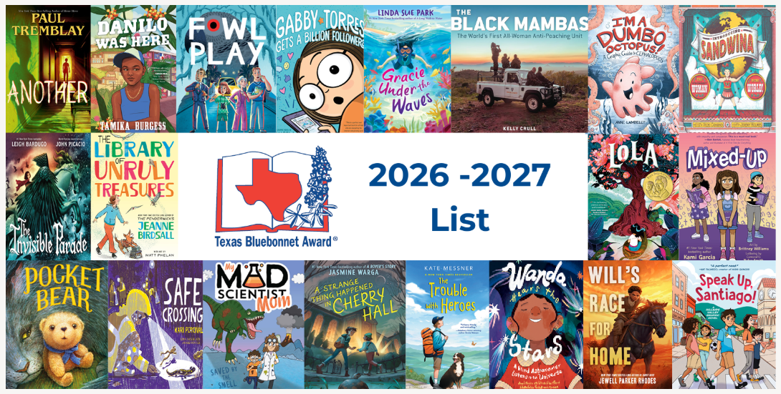
Texas Bluebonnet Books:

Slide 26
Texas Bluebonnet Books: Book Tasting
Book Tasting How To

Slide 27
Texas Bluebonnet Books:
Book Talk Tips
Keep it brief (30 sec. to 2 min.)
Hook-question, dramatic scene, awesome fact
Big Ideas-characters, conflict, setting, genre (no spoilers)
Connections-personal, text to text, why you love it

Slide 28
Colby Sharp
Skeleton and Cat

Slide 29

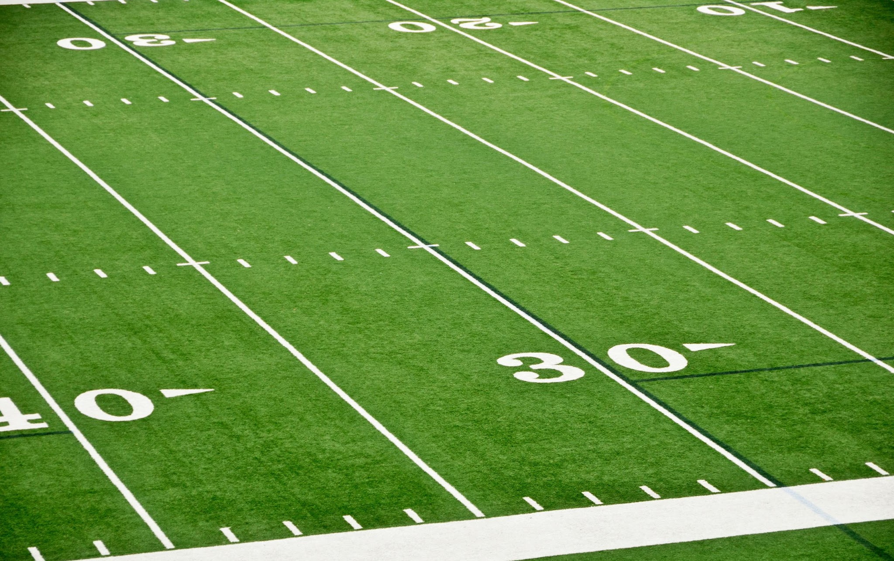




Want Attendance Credit?
To receive attendance credit for all sessions, you must fill out the feedback form after each session. You can get to the feedback form by using the tinyurl below or scanning the QR code. Please do so within 30 minutes of the session ending. You will receive a copy of your response, so you can make sure you did your survey and to check attendance. Save this for your records!
https://tinyurl.com/ENGAGE26FB

