Slide 1
Canvas Makeover
Course Design that Works
tinyurl.com/CanvasIT
CANVAS MAKEOVER MODULE

Slide 2
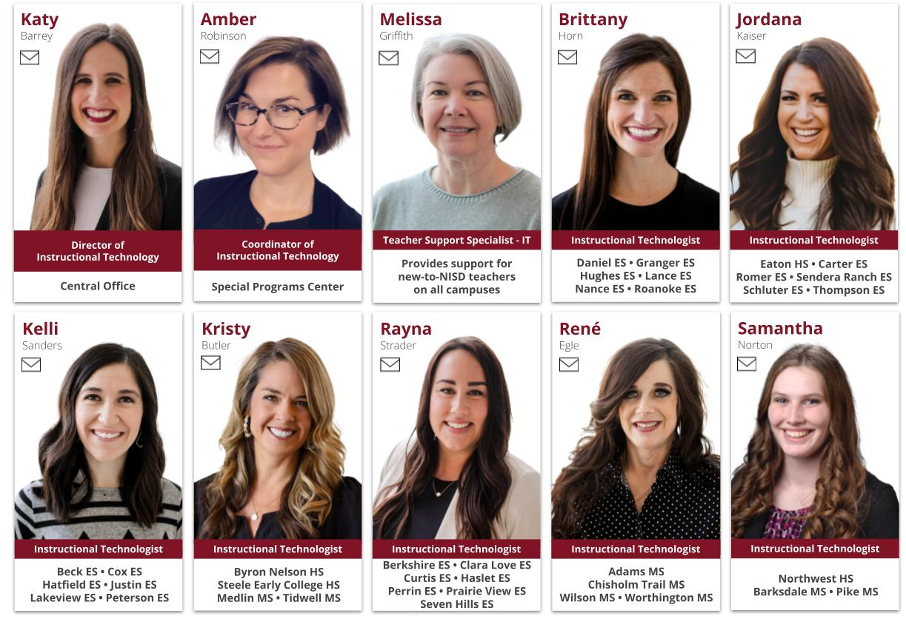
tinyurl.com/myNISDit
Notes:
Kels

Slide 3



Universal Design for Learning (UDL)
The CAST UDL Guidelines™ ensure all learners access and participate in meaningful, challenging opportunities across any discipline.
Multiple Means of
Engagement
Multiple Means of Representation
Multiple Means of Action & Expression
Design experiences based on students’ interests and motivations. Focus on why they learn by fostering autonomy and self-regulation.
Provide more than one way to access content. Support perception and comprehension through varied media and sensory formats.
Offer students multiple ways to demonstrate understanding. Focus on how they learn through flexible physical and cognitive expression.
CHOICE IN TOOLS & CONTENT
E-BOOKS, VIDEOS, & MANIPULATIVES
DIGITAL MEDIA CHOICE BOARDS
Dive deeper into UDL
Notes:
Before diving deep into Canvas, we want you to understand why course design matters. We often design content for the ‘average’ student. The Universal Design For Learning guidelines point out that every brain in our classroom processes information differently.
Multiple Means of Engagement refers to designing learning experiences based on students’ interests and motivations (e.g., giving students choice in their learning experience, the content, and the technologies they use).
Multiple Means of Representation means providing more than one way to access and learn the content (e.g., an e-book that features text, embedded videos, and virtual manipulatives).
Multiple Means of Action and Expression provides students with multiple ways to show their understanding of the content (e.g., giving them a digital media choice board).
In our training today, you will notice that we give you choice and have various means of representations (videos, text, pictures, etc). By the end of today, we hope that you are able to take some of these ideas and apply them to your courses.
Evaluating Accessibility Chapter

Slide 4
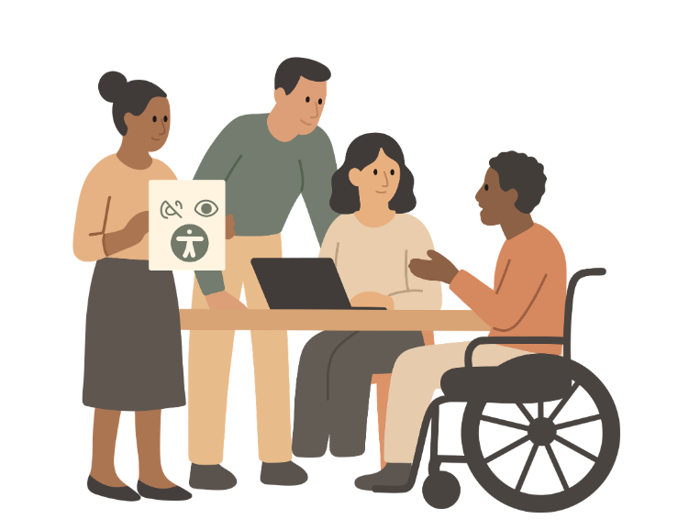
Design for Everyone: Understanding WCAG
WCAG stands for Web Content Accessibility Guidelines.
WCAG is the gold standard for ensuring the internet is usable for everyone. The goal is to create digital classrooms that remove barriers for students with visual, auditory, motor, or cognitive differences.
Checkout Evaluating Accessibility
Notes:
Before we dive into making our Canvas courses look amazing, we have to talk about a vital standard called WCAG, or the Web Content Accessibility Guidelines. I don't want you to think of this as a set of rules from a legal handbook. I want you to think of this as inclusive design. When a student walks into your physical classroom, you make sure there is a clear path to their desk, right? You make sure a student in a wheelchair can get into the room, and a student with low vision sits near the front. WCAG is simply doing that exact same work, but in our digital classrooms.

Slide 5




Design for Everyone: POUR Design
Perceivable
Operable
Understandable
Robust
Can students see and hear it?
Can students navigate it easily?
Is it easy to read?
Does it work on any device?
High color contrast, Alt-text on images
Clean navigation, keyboard-friendly button
Left-aligned text, predictable layouts
Design that works on phones & computers
Dive deeper into POUR
Notes:
To keep it simple today, remember the acronym P.O.U.R.
👉We want our content to be Perceivable—meaning colors contrast sharply and images have text descriptions.
👉We want it Operable—big, clean buttons that are easy to tap on a phone or trackpad.
👉We want it Understandable—no crazy fonts or centered essays that strain the eyes.
👉And we want it Robust—meaning it scales perfectly whether a kid is on a Chromebook or a parent is on their iPhone.
AEM Center POUR Principles

Slide 6

Building the Framework
Core vocabulary, settings, and navigation for reliable student experiences

Slide 7


Building the Framework
Organizational consistency across student/family-facing courses in NISD
Design content that is equitable and WCAG compliant

Slide 8
Building the Framework
Organizational consistency across student/family-facing courses in NISD
Core vocabulary, settings, and navigation for reliable student experiences
Design content that is equitable and WCAG compliant
Notes:
Alright team, we are kicking off our first choice block by looking at the structural integrity of your course. Think of this as laying the concrete before you start decorating the house. If these three pieces aren't solid, students get lost, parents get confused, and you spend half your semester answering tech-support emails instead of teaching. You have three adventures to choose from in this block:
👉Home Page: This is your digital front door. We must have organizational consistency across all campuses and pages. Many parents have multiple students at various campuses, and students have multiple courses they need to navigate through. Through consistency, students can quickly identify the location for course materials.
👉Fundamentals: This is our course health-check. You’ll make sure you understand the terminology, clean up the navigation menu and consistent settings that are predictable for your students
👉Accessibility: Designing for all means making sure our pages are readable. You’ll learn how to use the built-in accessibility checker, add proper alt-text to your images, and format headers so screen readers can seamlessly navigate your course.

Slide 9



Maximizing Learning Impact
Roadmaps that organizes files, assignments, and pages to scaffold
Create meaningful, automated checks for understanding with feedback
Scale high-quality content effortlessly with consistent, reusable design
Notes:
Welcome back. Now that our framework is laid, we are moving into the engine of your Canvas course: how you package your instruction and track student growth. This block is all about shifting Canvas from a passive 'digital file cabinet' into an active 'feedback machine' that saves you time. Your next three choices are:
👉Modules: This is your instructional roadmap. You'll learn how to organize your files, assignments, and pages into a sequential, scaffolded path that guides students through a unit without them ever asking, 'What do I do next?'
👉Quizzes: Here, we'll demystify the difference between Classic and New Quizzes. You'll learn how to pick the right engine for the right task and how to use advanced question types to get better data.
👉Templates: This is your ultimate time-saver. Instead of building every single Canvas page from scratch, you will learn how to build or apply beautiful, reusable templates so your course looks highly cohesive with half the effort.

Slide 10



Reaching Every Learner
Organize time and manage expectations with due dates
Create flexible opportunities for diverse learning
Transform grading with feedback, rubrics, and comment libraries
Notes:
For our final block, we are taking our polished courses and making sure they can actually reach every single student who walks through your door. This ties directly back to our UDL framework—ensuring equity, clear expectations, and flexible pathways. Your final three choices are:
👉Calendar: This is the executive-functioning hero of Canvas. You'll learn how to use the calendar and assignment pacing to help students manage their time, track due dates, and reduce anxiety.
👉Differentiation: This is where the magic happens. You’ll explore how to use Canvas to assign different tasks to different students or groups, customize due dates, and provide flexible choice boards that respect student interest and pace.
👉Grading: This is our efficiency powerhouse. You'll explore how to build a robust Comment Library in SpeedGrader and map out rubrics so you can give high-impact, actionable feedback in seconds instead of minutes.

Slide 11
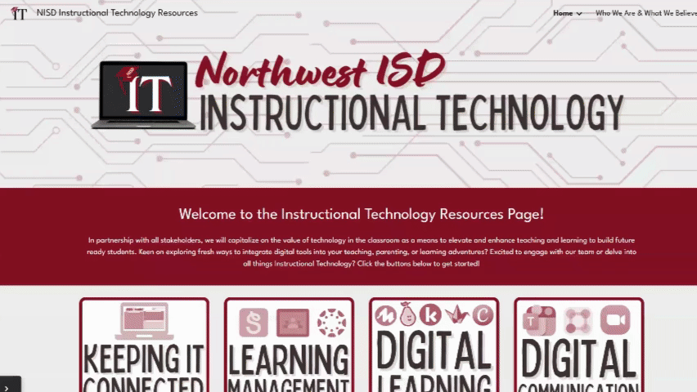
tinyurl.com/myNISDit
itresources.nisdtx.org
Notes:
Kels

Slide 12
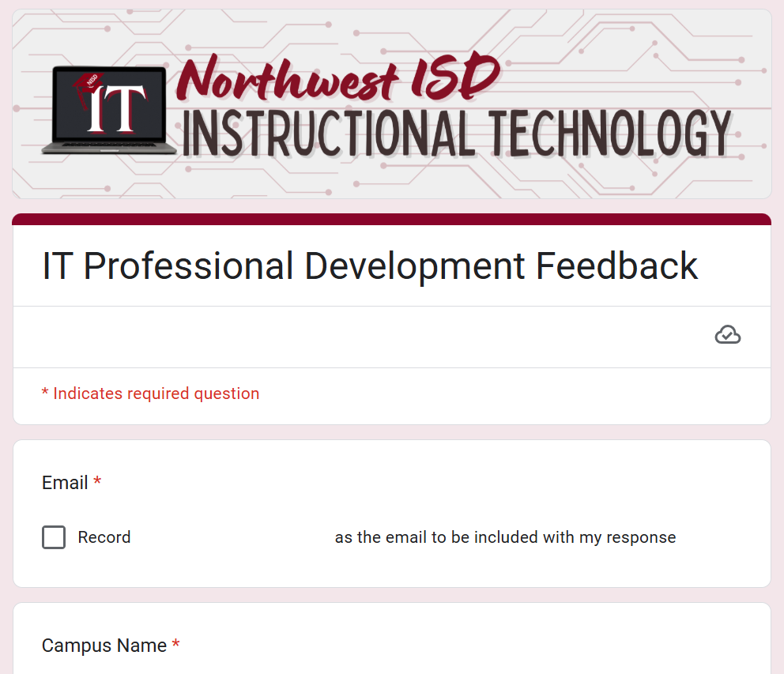
Canvas Makeover
tinyurl.com/nisdITpd
Course Design that Works

Slide 13




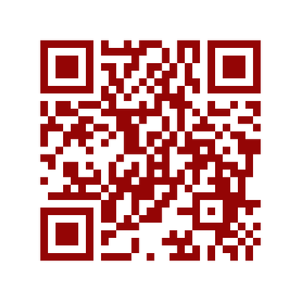

Want Attendance Credit?
To receive attendance credit for all sessions, you must fill out the feedback form after each session. You can get to the feedback form by using the tinyurl below or scanning the QR code. Please do so within 30 minutes of the session ending. You will receive a copy of your response, so you can make sure you did your survey and to check attendance. Save this for your records!
https://tinyurl.com/ENGAGE26FB

