Slide 1






Giving Students Ownership Through Student Discrourse
Learning Target: I will be able to facilitate purposeful, hands-down discussions that increase student thinking, engagement, and academic discourse throughout a lesson.
Author’s website

Slide 2


Slide 3
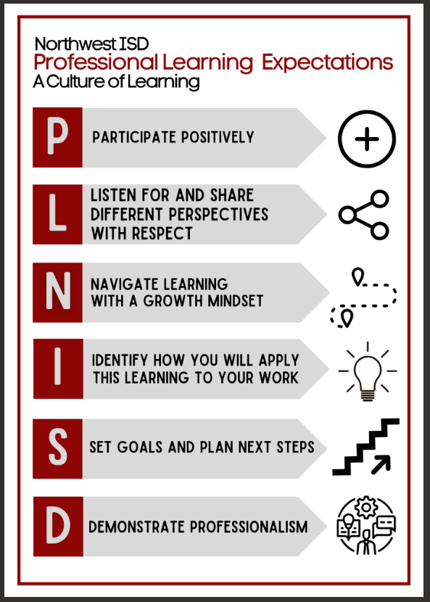
Author’s website

Slide 4
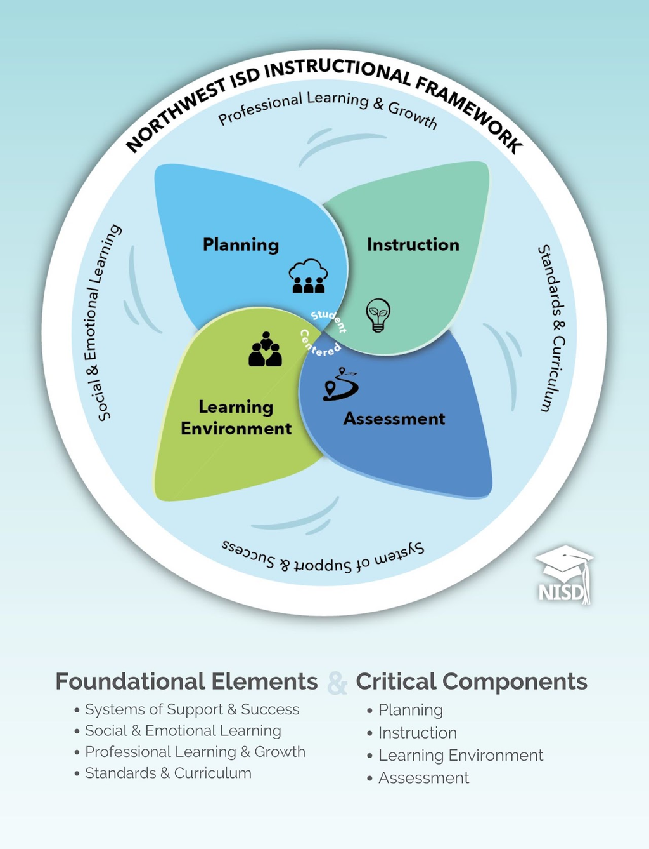

Slide 5

Which is bigger?
Author’s website

Slide 6
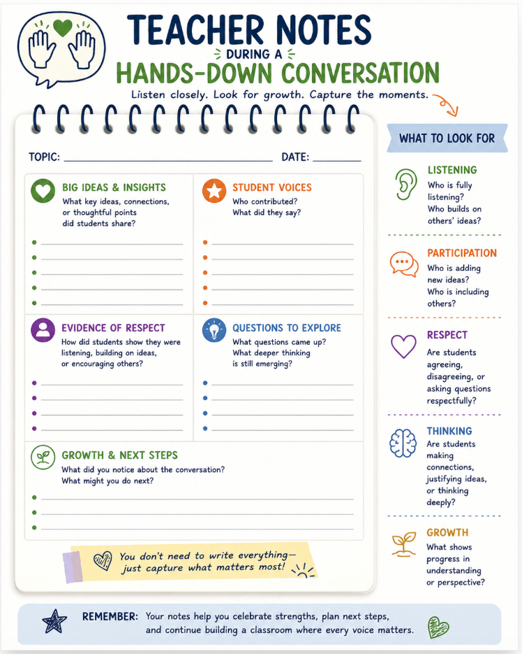



Vocabulary:
Area
Length
Width
Perpendicular
Base
Height
__________
Misconceptions:
  Area is adding all sides together
  Confusing Perimeter and area
Notice:
  6 students did not talk
  Many students had background knowledge of area
Formula
Polygon
Students I need to pull:
  identifying Length, width, and base: Jax, Rex, Carmine
  Extensinon: irregular Polygons: Jazmyn, Colton, Roman
Author’s website

Slide 7
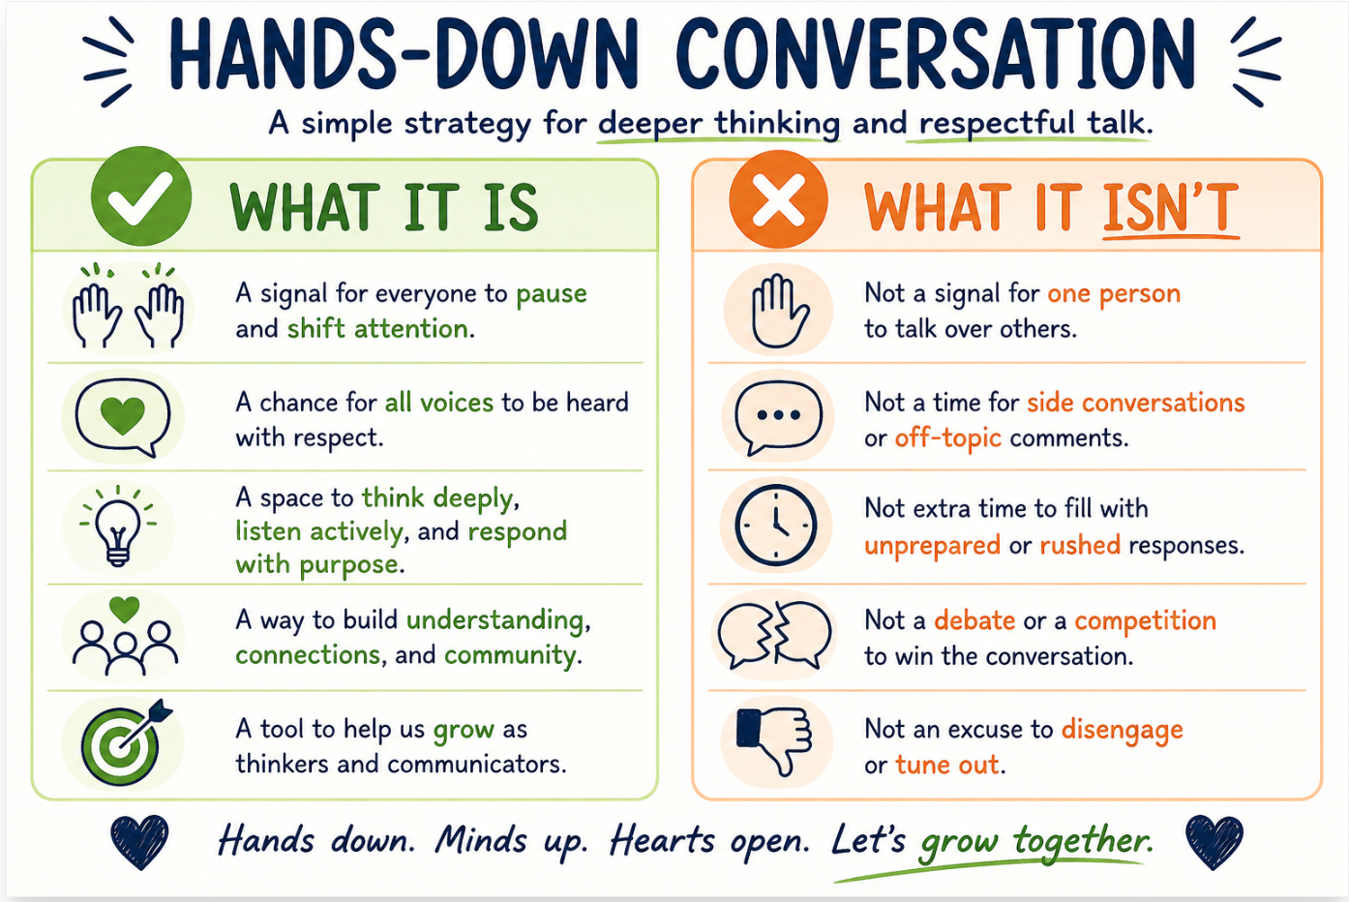

Slide 8
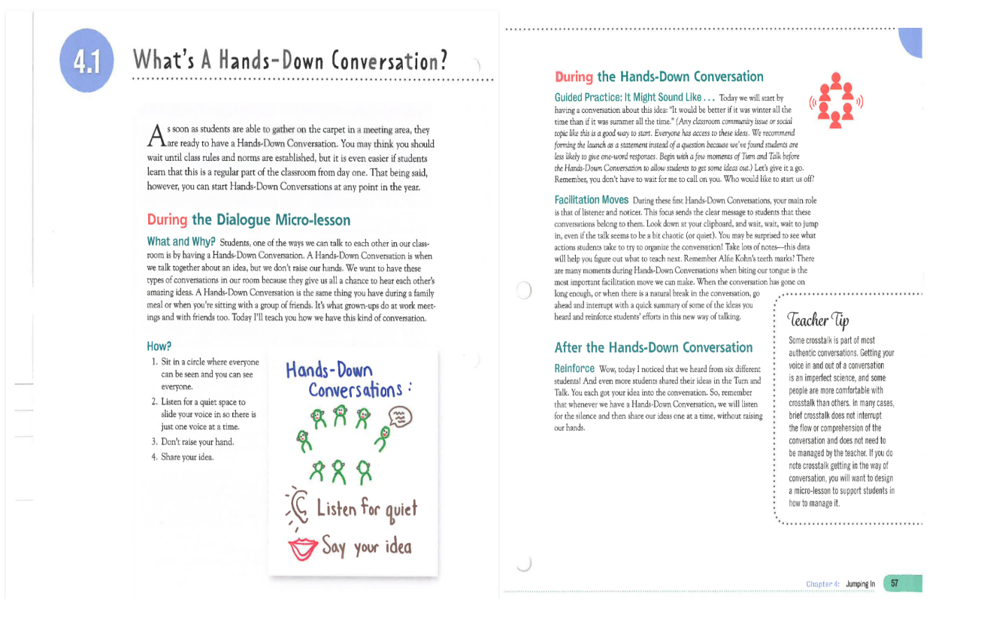
Tips:
  Set expectations
    Be respectful
Mini Lessons
Author’s website

Slide 9
How does this align with what we already do?
Our Vision:
NISD empowers learners and leaders to positively impact the world
Stragetic Goal #3
3.2 Culture: NISD will model and instill a culture of belonging where all students, staff, families, and community voices are heard and valued.
Author’s website

Slide 10
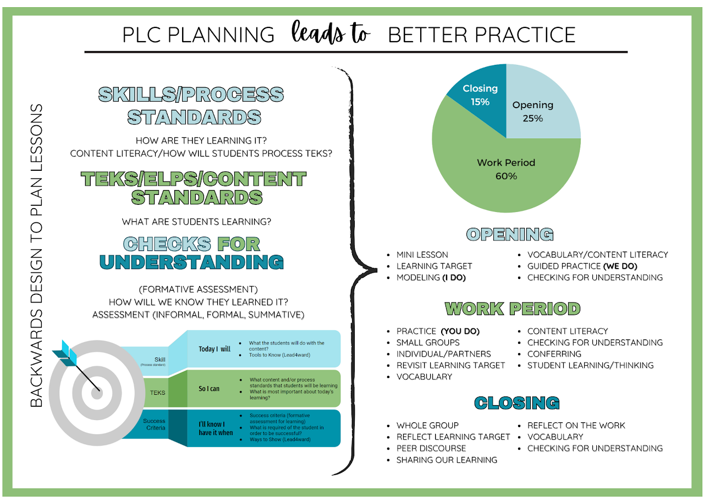
Where does this fit in?
Author’s website

Slide 11
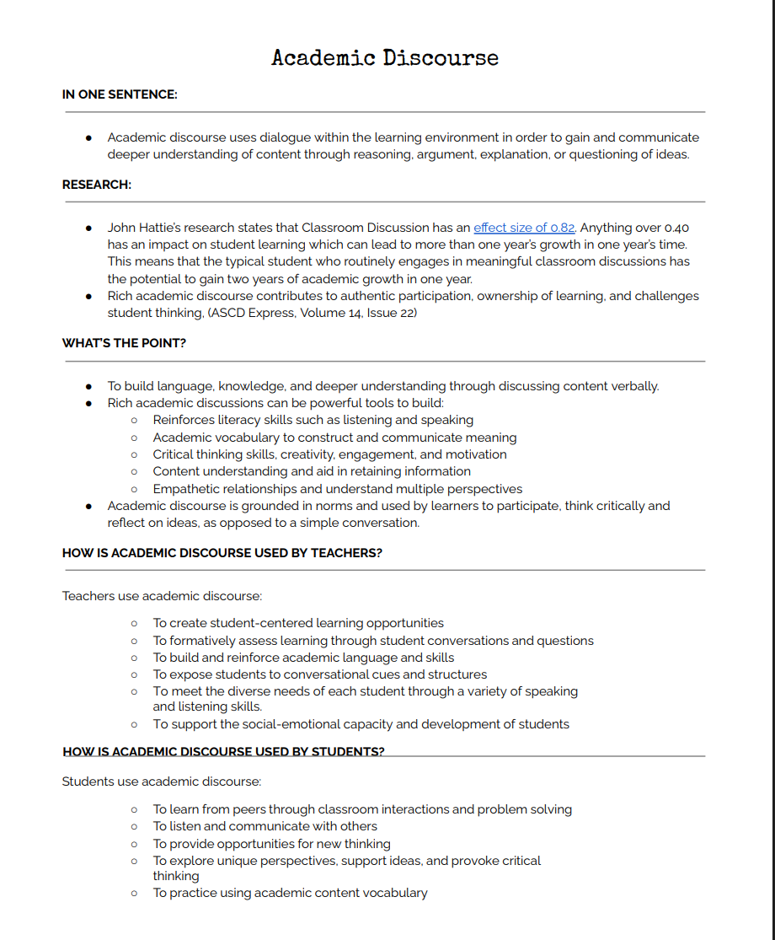
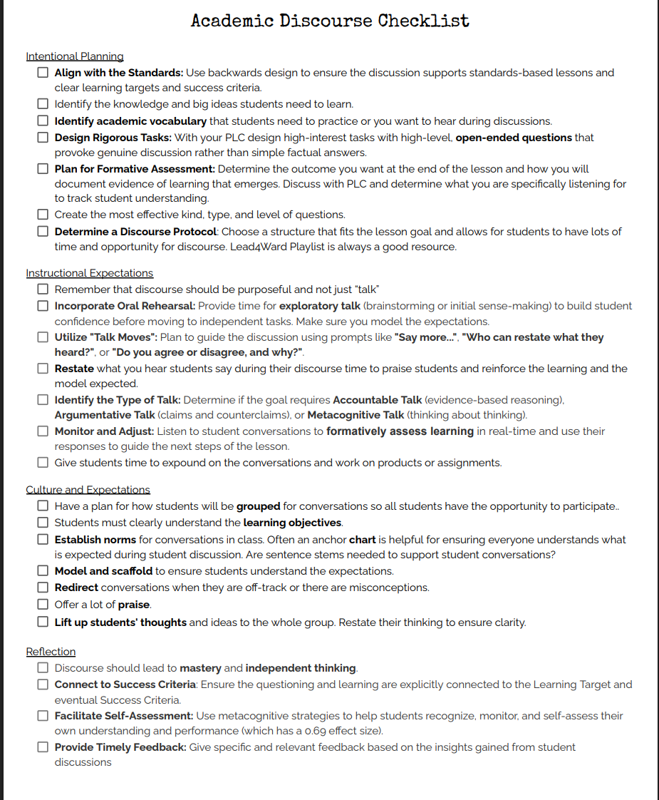
Author’s website

Slide 12
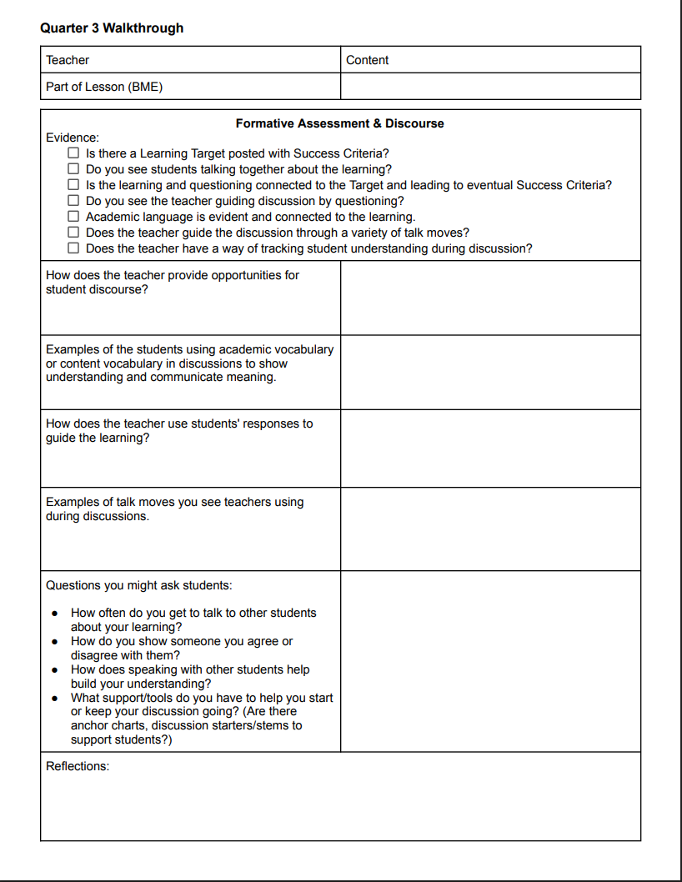
Author’s website

Slide 13


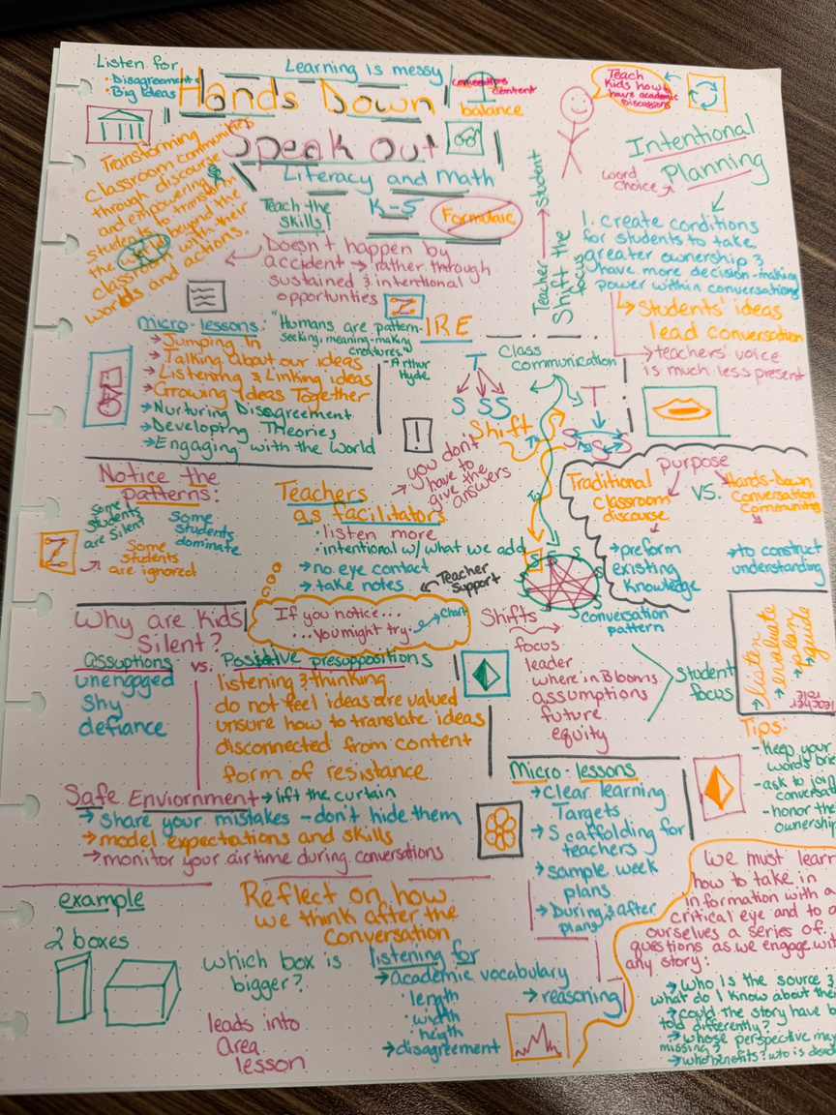

Slide 14
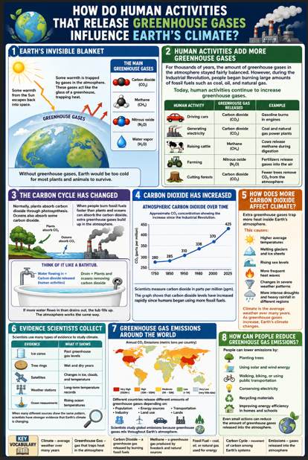
What is important about the Earth’s Climate?
Author’s website

Slide 15
Question:
How does human activities that release
greenhouse gases influence Earth’s climate?
Author’s website

Slide 16
Facilitation Support
Author’s website

Slide 18


