Slide 1

Today’s Learning Targets
I will compare two ways to build student readiness: before-class frontloading and in-class frontloading,
so that I can choose a routine that fits my students.
I will know I have it when I can sketch one lesson routine I could try in the next two weeks.
I will identify where students will use the content through discussion, whiteboards, labs, CER, or practice,
so that class time is spent on thinking and application, not just copying information.
I will know I have it when I can name the thinking task students will do after they have the background knowledge.

Slide 2


To Receive Credit for this session, make sure you complete the survey at the end

Slide 3


Warm Up: Where Do Students Get Lost?
Think about the last unit you taught.
Where did students struggle most?
□ Learning new vocabulary?
□ Taking notes?
□ Applying what they learned?
□ Explaining their thinking?
□ Solving problems independently?
https://tinyurl.com/4s7hwa59
Notes:
That's what eventually changed my classroom. I realized I was spending most of class giving information, and then asking students to do the hardest thinking at home. I wanted to reverse that—not by flipping my classroom—but by protecting time for students to think while I was in the room.

Slide 4
Teaching Smarter, Not Longer
My goal isn't to lecture less.
My goal is to create more time for students to think while I'm in the room.
Students need enough background knowledge to participate.
I don't want note-taking competing with listening.
I want class time spent solving, discussing, questioning, and experimenting.
I want frequent checkpoints before the test—not surprises on the test.
Notes:
This isn't a presentation about flipping your classroom. Honestly, I tried more of that last year, and I learned pretty quickly that my on-level students weren't consistently doing the work outside of class. Some loved it, but many came in unprepared, and that wasn't setting anyone up for success.
What I kept was the idea that students need enough background knowledge before we ask them to think deeply. The difference is that now much more of that preparation happens in class. My routines changed, but the goal stayed the same: I want students spending more class time thinking and less time just copying.

Slide 5
It's Hard to Think While You're Copying
Copying notes isn't the same as processing ideas.
Students struggle when they're expected to listen, write, and understand simultaneously.
If students have the basic information first, class time can focus on discussion, reasoning, and application.
Freeman et al. (2014); Sweller (Cognitive Load Theory)
Notes:
I don't think lecture is bad. I lecture every single week.
What I've changed is when students are copying and when they're thinking.
If students are frantically trying to copy every word off the screen, they're not really listening to me.
So now we separate those jobs as much as we can.

Slide 6
Build Background. Then Build Thinking.
Students need enough information to participate—not enough to master the topic.
Give students access to the basic information first.
  Guided notes
  Vocabulary
  Short reading (summary guides help here)
  Demonstration
Then use class time for:
  Discussion
  Whiteboards
  Labs
  CER
  Problem solving
Bottom line:
Background knowledge is the starting point, not the finish line.
Notes:
One thing I've changed since I first gave this presentation is where this background knowledge comes from.
Sometimes students get it from guided notes.
Sometimes it's a short teacher explanation.
Sometimes it's a demonstration.
Sometimes it's a reading.
I don't really care where the background comes from.
What I care about is that students have enough information to participate in the thinking.
Building Thinking Classrooms isn't asking students to think without support. It's asking us to stop spending all of class delivering information. If I can shorten that part and give students the tools they need, then we have more time for the interesting work.

Slide 7
Two Ways to Build Readiness
Option 1: Before-Class Frontload
Students complete a short prep task before class
Class starts with a quick readiness check
Best fit: students complete prep consistently
Option 2: In-Class Frontload + First Use
Students build the background during the first 10–15 minutes
Teacher teaches the difficult parts
Students use the content before they leave
Best fit: prep needs to happen in class
Same goal:
Students are ready to think, discuss, and apply.
Notes:
The original version of this session focused more on before-class frontloading. Students completed a short summary or reading before class, and then we used class time for checks, discussion, and whiteboards.
That worked well for some students. The students who completed the prep came in much more ready.
But I also learned that not every class will consistently do that work before class. So I started thinking of frontloading as preparation, not necessarily homework.
Sometimes readiness happens before class. Sometimes it has to happen during the first 10–15 minutes of class. The goal is the same either way: students need enough background knowledge to participate in the thinking.

Slide 8
Option 1: Before-Class Frontload
Students complete a short prep task before class for example: Reading, video, summary (provide a guide) or your class notes
Start with a quick readiness check (pulled directly from the material)
Use class time for thinking and application
Best fit: classes that reliably complete prep
Notes:
This is where the original version of this PD started.
Students completed a short summary, reading, or video guide before class. The goal was not mastery. The goal was for students to walk in with enough background knowledge that they were not hearing every word for the first time.
Then class could start with a quick readiness check and move into whiteboards, labs, discussion, or practice.
When students actually did the prep, this worked really well. They asked better questions, participated more, and had more confidence during class.
The key is that the prep has to be short, clear, and connected to what happens in class.

Slide 9
Option 1 Flow: One Formative Grade Over Three Days
Day 1: Readiness Check — 15%
Prep task completed before class
3–5 question open-note check
Confirms students did not walk in cold
Day 2: Whiteboard / Group Reasoning — 35%
Students use notes to answer group questions
Teacher checks completion and reasoning
Misconceptions become visible
Day 3: Practice or Mastery Check — 50%
Practice problems, short quiz, or Canvas check
Feedback before the test
Predictable on purpose. Flexible in practice.
Notes:
For Option 1, I used the three days together as one formative grade.
Day 1 was a short readiness check worth 15%. That held students accountable for the prep task, but it was still open-note and low pressure.
Day 2 was the whiteboard or group reasoning day worth 35%. This was where students used their notes, talked through the content, and showed me their thinking.
Day 3 was the practice or mastery check worth 50%. That could be practice problems, a short quiz, or a Canvas check depending on the unit.
The point was not that everyone has to use these exact percentages. The point is that the routine added up to one formative grade, so students saw that each part mattered without me creating three separate major grades.

Slide 10
A Complete Example (Start to Finish)
Frontload (Before Day 1 – 5–10 minutes) Students read 2–3 pages OR watch a short video (vocabulary, pre-lab, something introductory) Complete a guided summary or checklist Focus on vocabulary and big ideas, not mastery | Day 1 — Readiness Check 3–5 open-note questions pulled directly from the frontload Not timed; low pressure Purpose: confirm students didn’t walk in cold Proceed to explore activity (lab, card sort, etc) Homework: Students read and summarize, or copy notes
Day 2 — Active Learning Students work in groups on whiteboards Questions require using notes, not guessing Teacher circulates to clarify misconceptions Credit is based on preparation and engagement | Day 3 — Practice or Check Practice problems OR short quiz Students get feedback before the unit test Homework: Frontload to start cycle again.

Slide 11
One Structure. Four Core Subjects.
Structure stays the same. Content changes.
🧪 Science Pre-Day: Read lab background + summarize key terms Day 1: 5-question readiness check (open note) Day 2: Whiteboards: classify, predict, explain Day 3: Practice problems or short quiz + Canvas check | 🧮 Math Pre-Day: Watch example video or copy worked example Day 1: 3 warm-up problems from the example Day 2: Whiteboards: solve + justify reasoning Day 3: Practice set or exit quiz
📚 English Pre-Day: Read text + annotate claims or themes Day 1: 3-question comprehension or claim check Day 2: Group CER / paragraph / discussion Day 3: Short constructed response or quiz | 🌎 Social Studies Pre-Day: Read primary source or background article Day 1: Source-based readiness questions Day 2: Whiteboards: cause/effect, CER, timelines Day 3: Practice questions or document analysis
Notes:
Before we go any further, I want to pause and show you this works across content areas.
The structure stays the same — what changes is the material.

Slide 12
Day 1: Ready or Not?
Readiness Check — 15% of the formative grade
3–5 questions pulled directly from the prep task
Open-note, low pressure, and actively monitored
Checks vocabulary, key ideas, or background knowledge
Confirms students are ready for the activity
Purpose:
Students do the minimum thinking needed to participate.
Notes:
I kept this small on purpose. It was only 15% of the formative grade because I did not want the readiness check to become the whole grade.
But it had to count for something. If it did not count, many students would not complete the prep.
The questions came directly from the summary, reading, or notes. This was not a trick quiz. It was a quick check to make sure students had enough background to participate in the lab, discussion, or whiteboard work.

Slide 13

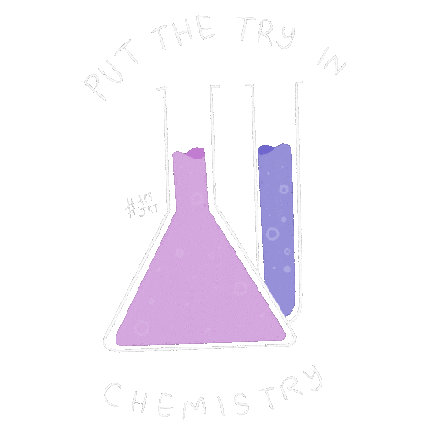

Warm up: CER
Prelab Check
Energy Densities Lab
HOMEWORK:
eText: Introduction to Energy
Anchoring Phenomena CER:
Why are wildfires so difficult to extinguish?
When trying to answer this claim, evidence, reasoning think of the following questions to help yourself along:
What is fire? How is it made? What is the difference between a campfire and a wildfire? Do they burn different things? What does a fire need?
Agenda

Slide 14
Day 2: Whiteboard Collaboration
Group Reasoning — 35% of the formative grade
Students use notes to answer group questions
Start with vocabulary so I can check completion
Move into classification, explanation, or problem solving
Teacher circulates and checks reasoning
Misconceptions are visible immediately
The notes become a tool, not the assignment.
Notes:
Day 2 was worth 35% of the formative grade because this was the active thinking day.
Students used their notes to answer questions on whiteboards. I usually started with vocabulary or basic recall so I had time to check whether notes were complete.
Then the questions moved into classification, explanation, prediction, or problem solving.
This made misconceptions visible while students were still working, instead of waiting until a quiz or test.

Slide 15
Warm up
Introduction to Energy Poster
HOMEWORK:
Catch up Night
Warm Up:
Draw and label examples of each term:
Energy
Kinetic Energy
Potential Energy
Agenda

Slide 16
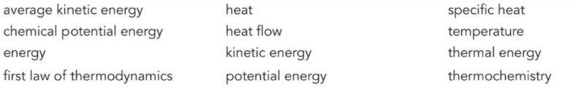
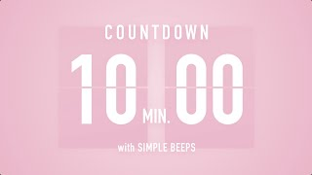
Define:
In your own words define the following:

Slide 17
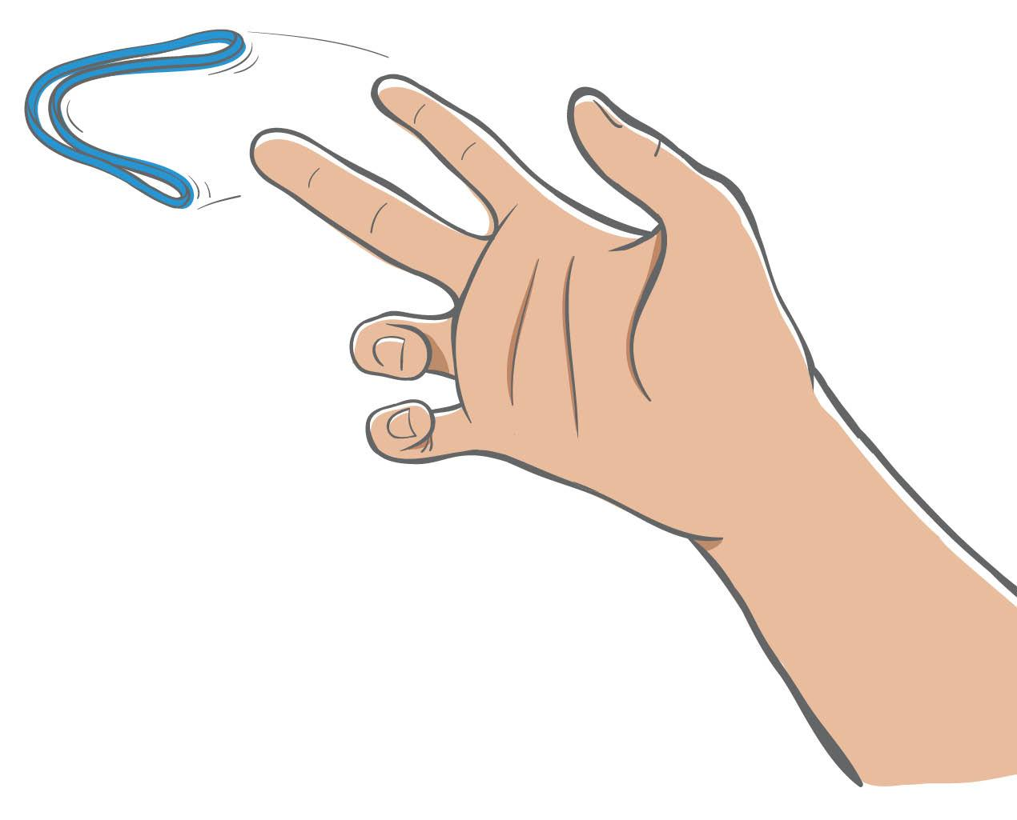
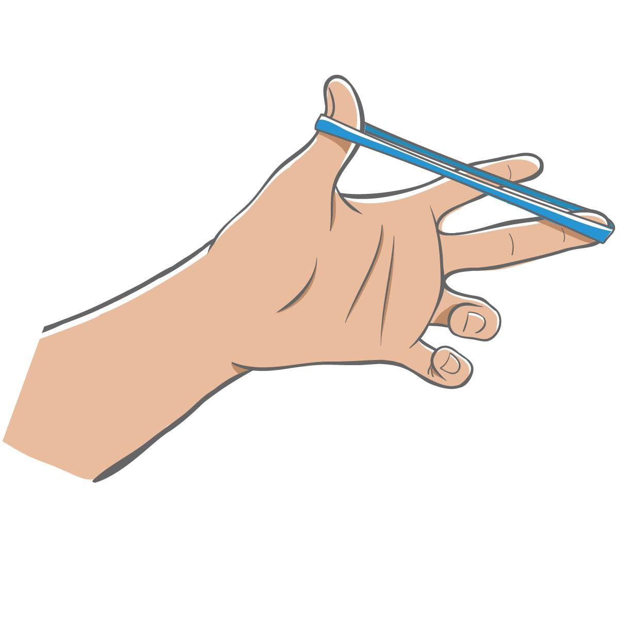
Definitions of Energy
How would you define energy?
Energy is the capacity to do work or produce heat.
Kinetic Energy
(motion)
Would you define each of the following types of energy as potential or kinetic energy? Explain your reasoning.
a) Chemical energy is the energy stored in the bonds of a molecule or compound.
b) Thermal energy is the movement and vibrations of particles in a substance.
c) Electrical energy is energy in the movement of charged particles.
Potential Energy
(stored energy)
Notes:
Ask: How would you define energy? (Sample answers: Energy is something that moves. Energy is heat or light.) Click to reveal the definition. Explain that energy can be defined as the capacity to do work or produce heat.
Explain that energy comes in many forms that can be classified as either potential energy (stored energy) or kinetic energy (motion). Ask: Which rubber band would represent potential energy, and which rubber band would represent kinetic energy? (Answer: The left picture shows potential energy, and the right shows kinetic energy.) Click to reveal the correct labels.
Ask: Would you define each of the following types of energy as potential or kinetic energy? Explain your reasoning.
a) Chemical energy is the energy stored in the bonds of a molecule or compound. (Answer: This is potential energy because the energy is stored.)
b) Thermal energy is the movement and vibrations of particles in a substance. (Answer: This is kinetic energy because it is described as movement.)
c) Electrical energy is energy in the movement of charged particles. (Answer: This is kinetic energy because it is described as movement.)

Slide 18
Day 3: Make It Stick Practice or Mastery Check — 50% of the formative grade
Skill-heavy units:
Group practice
Manipulatives
Lead-forward strategies
Practice problems
Concept-heavy units:
Short open-note quiz
Canvas mastery check
Exit ticket or discussion follow-up
Purpose:
Students get feedback before the unit test.
Notes:
Day 3 was the largest part of the formative grade because this was where students showed more independent understanding.
In skill-heavy units, this might be practice problems or group practice.
In concept-heavy units, this might be a short quiz or Canvas check.
I kept quizzes open-note because I wanted students using the resources they had built. The goal was feedback before the test, not a surprise.

Slide 19
Warm up
Intro to Energy Practice
Revisit
HOMEWORK:
CANVAS - Intro to Energy
Lab Background
Warm Up:
Draw and label examples of each term:
Law of Conservation of Energy
Heat Flow
Convert the following: (hint 0 celsius equals 273 kelvin)
300K to ℃
100℃ to K
Agenda

Slide 20
When Life Happens (Because It Will)
Day 1 (Lab): Use provided lab data; complete pre-lab check next class or in tutorials
Day 2 (Whiteboards): Submit responses through Canvas link
Day 3 (Practice/Quiz): One-day extension for Canvas quiz or make-up quiz
Standard absence policy applies.
Notes:
This system is equitable because it has clear, simple procedures for absences.
— If students miss lab day, they use pre-collected absent-student data.
— If they miss whiteboard day, they complete a digital submission.
— If they miss practice or quiz day, they get an extra day or make up the quiz in tutorials.
Nothing disappears, and nothing becomes unmanageable. This maintains instructional continuity and prevents students from falling behind

Slide 21
Scaffolding & Accommodations
Scaffolded summaries: Fill-in-the-blank supports for developing learners
(Lower grades may remain here as needed)
Guided summaries: Structured prompts that move students toward independent summarizing
Checklists: Ensure key ideas are captured without over-scaffolding
Prep options: Videos or lecture slides paired with guides to support note-taking

Slide 22
Support Without Lowering the Bar
Copies of notes: Summary guides or checklists are provided in place of full note copies
Extended time: Given on homework and quizzes; pre-lab checks and whiteboard work are untimed
Speech-to-text: Accepted when needed for students to access the material
Chunked reading: Content is split across pre-lab and reading, notes, or prep materials ; text-to-speech tools are available

Slide 23
Option 2: In-Class Frontload + First Use
Same goal. Different location.
When before-class prep is not consistent:
Build the background during the first 10–15 minutes
Teach the parts students are most likely to misunderstand
Use the content before students leave
Use what you see to plan Day 2
Keep the same three-day structure
Frontloading only works if students use it.
Notes:
Option 1 worked best when students actually completed the prep before class. But with some of my on-level classes, that was not always consistent. Some students would rather take the zero than do the homework.
So instead of giving up on frontloading, I moved the preparation into class.
But this is the important part: Option 2 is not just “copy notes at the beginning of class.” If students only copy information and never use it, I have not really changed anything.
The goal is still the same. Students build enough background to participate, I teach the parts that need teacher explanation, and then they use the content before they leave.

Slide 24
Option 2 Flow: In-Class Frontload
Day 1: Build Background + First Use
Guided notes, vocabulary, short reading, or teacher explanation
Teacher teaches the difficult parts
Students try the content before they leave
Day 2: Use the Content
Whiteboards, labs, CER, discussion, sorting, problem solving, or targeted practice
Students use notes as a resource
Teacher checks reasoning and misconceptions
Day 3: Practice or Mastery Check
Practice, quiz, Canvas check, exit ticket, or reteach
Feedback before the test
Same three-day idea. Prep happens in class. Same 15 / 35 / 50 structure. Different evidence.

Slide 25
Different subjects. Same instructional approach.
🧪 Science Get Ready: Guided notes or vocabulary Teach: Examples, discussion, demonstrations Students Think: Labs, CER, whiteboards Check: Exit ticket, Canvas, quiz | 🧮 Math Get Ready: Notes or worked examples Teach: Model problem solving Students Think: Whiteboards, practice, stations Check: Exit ticket or quiz
📚 English Get Ready: Read and annotate Teach: Mini lesson Students Think: Discussion, writing, CER Check: Exit ticket or short response | 🌎 Social Studies Get Ready: Read source or background Teach: Mini lesson Students Think: Discussion, analysis, timelines Check: Exit ticket or document analysis
Notes:
I'm a chemistry teacher, so naturally my examples are science. But this isn't really about chemistry.
The structure is the same across content areas.
Students get the background they need.
The teacher clarifies important ideas.
Students spend time applying or discussing the content.
Then we check understanding.

Slide 26
Day 1: Build Background + First Use
Students spend 10–15 minutes building the background
I circulate, answer questions, and check for confusion
Chromebooks close before direct instruction
I teach the parts that need teacher explanation
Students use the content before they leave
Bottom line:
The notes are not the lesson. They are the tool.
Notes:
This is probably the biggest change I've made since I first presented this session.
Instead of expecting all of the preparation to happen at home, we've built that time into class.
Students spend the first 10–15 minutes getting their notes organized while I circulate. I can answer questions one-on-one and catch misunderstandings before we start the lesson.
Once the Chromebooks close, students can focus on the lesson instead of trying to copy every word off the screen.

Slide 27

Build Notes — 10–15 min
Go over content
First Use: Energy Practice
Exit Ticket
Warm up:
You will have 15 minutes to build today’s background. Then we will close Chromebooks, work through the hard parts, and use the notes before you leave.
Agenda
Notes:
Last year this lesson started differently. This year I'd actually skip the warm-up and use that time for guided notes. Once everyone has the notes, we close the Chromebooks and go through the important ideas together.

Slide 28
Teach the Hard Parts
Focus on the concepts students struggle with.
Move quickly through vocabulary and straightforward ideas.
Ask questions throughout the lesson.
Use examples before independent practice.
Notes:
Since students already have the notes in front of them, I'm not spending my time waiting for everyone to finish copying.
Instead, I spend my time teaching.
I don't read every slide.
I stop where students typically struggle.
We spend more time talking about misconceptions, working examples, and making connections.
If something is straightforward, we move on.
If something is difficult, we slow down.
Just because it's in the notes doesn't mean it deserves equal class time.

Slide 29
Day 1 Non-Negotiable: First Use Before They Leave
Use the practice you already have
Work 1–2 problems
Sort or classify key concepts
Let students compare answers
Give quick feedback before they leave
Notes:
This does not mean creating a whole new activity.
Most of us already have practice built into our notes. The problem is that we often run out of time and skip it.
I am trying to guard the last few minutes of notes day so students leave having tried the content at least once.
That might be one conversion problem, one concept sort, one partner explanation, or one whiteboard question.
The important part is that students get feedback before they leave. Then tomorrow’s practice day starts at a better place because I already know who is ready, who needs a little support, and who is completely lost.

Slide 30
What Makes This Different?
Notes Day with First Practice
Teach the most important ideas
Protect time for one first attempt
Students leave having tried the skill
Teacher sees confusion today
Practice day starts with better groups and support
Traditional Notes Day
Finish as many slides as possible
Practice happens only if there is time
Students leave with definitions
Teacher finds out tomorrow who is lost
Practice day starts cold
The change is not adding more work.
The change is guarding time for feedback before students leave.
Notes:
This may look like a normal notes day, but the difference is what I protect at the end.
In the past, if we ran short on time, practice was the first thing to go.
Now I try to protect that last piece because students need to try the content at least once while I am still there to help.
It also gives me information before the full practice day. I can see who is ready, who needs a small push, and who needs me immediately tomorrow.

Slide 31
Example: Energy Notes
First practice before they leave:
cal ↔ J conversion
°C ↔ K conversion
Heat transfer sort
Endothermic/exothermic sort
I would slow down on:
Heat vs. temperature
System vs. surroundings
Endothermic vs. exothermic
Thermochemical equations
I would move faster through:
Basic definitions
Energy units
Conductor/insulator vocabulary
Simple recall slides
Goal:
Students leave notes day having tried the content once.
Notes:
This is a real Energy notes deck. I’m not going to teach the whole chemistry lesson to you, but I would not give every slide the same amount of time. Some slides are just vocabulary or review. I move through those quickly.
The places I slow down are where students usually confuse ideas: heat versus temperature, system versus surroundings, and endothermic versus exothermic.
Then I want to guard time for at least one first-practice task before students leave. The notes already have practice built in. I don’t need to create something brand new. I just need to make sure students actually use it and get feedback before tomorrow’s practice day.

Slide 32
-evaporation of alcohol
-leaves burning
-boiling of water
-melting of ice
-water cooling
-freezing of water
Endothermic or Exothermic?
Endothermic
Exothermic
Endothermic
Endothermic
Exothermic
Exothermic
Notes:
This is the kind of slide I mean. This is already in my notes. The shift is making sure students actually do it, compare answers, and get feedback before they leave.

Slide 33
Day 2: Use the Content More Deeply
Students use their notes as a resource.
Because I saw first use on Day 1, I can plan Day 2 more intentionally:
Ready students: independent or extension practice
Almost there: partner or group reasoning
Lost students: small-group reteach first
Common misconception: quick whole-class correction
Whole class: whiteboards, CER, lab connection, sorting, or problem solving
15% — quick readiness check using Day 1 notes at the start of Day 2
35% — Day 2 thinking task: poster, whiteboards, CER, lab connection, or group reasoning
Notes:
Day 2 is where Option 2 becomes useful. Because students tried the content before they left on Day 1, I am not starting practice day blind.
I already have a general idea of who is ready, who needs a partner, and who needs me immediately.
The activity can change. It might be whiteboards, a practice page, a concept sort, a poster, a lab analysis, or even examples from the notes that students now try on their own.
The important part is that students are using their notes. The notes are not the assignment. The notes are the resource.
This is also where the fast feedback tracker can help. I do not need a perfect data system. I just need enough information to decide who needs what next.

Slide 34
Day 3: Practice or Mastery Check
Students show what is sticking.
Skill-heavy content: practice problems, whiteboards, or group practice
Concept-heavy content: short open-note quiz, Canvas check, or exit ticket
Teacher uses results to reteach, regroup, or move forward
Purpose:
Feedback before the test — not surprises on the test.
50% — Day 3 practice or mastery check
Notes:
Day 3 is where students show what is starting to stick. This can look a lot like the Day 3 from Option 1.
If the content is skill-heavy, students may need more practice problems, whiteboards, or group practice.
If the content is concept-heavy, this might be a short open-note quiz, a Canvas check, an exit ticket, or a discussion follow-up.
The point is not to surprise students. The point is to get feedback before the test so I know whether to reteach, regroup, or move forward.

Slide 35
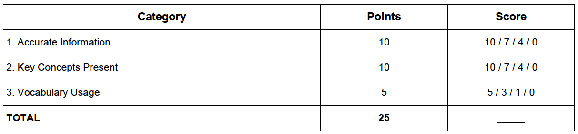
Accountability Without Overgrading
For group work, practice, posters, or whiteboards:
Facts are correct
Required ideas are included
Key terms are used and explained
I am grading engagement with the thinking — not perfection.
Notes:
This is where I have to be realistic about my students.
If the practice, discussion, or group work does not count at all, some students will not participate.
But I also do not want to create a grading nightmare for myself.
So I keep the rubric simple. Are the facts mostly correct? Did they include the required ideas? Did they use the vocabulary correctly?
The goal is not to grade every sentence. The goal is to make the work matter enough that students engage with it.

Slide 36
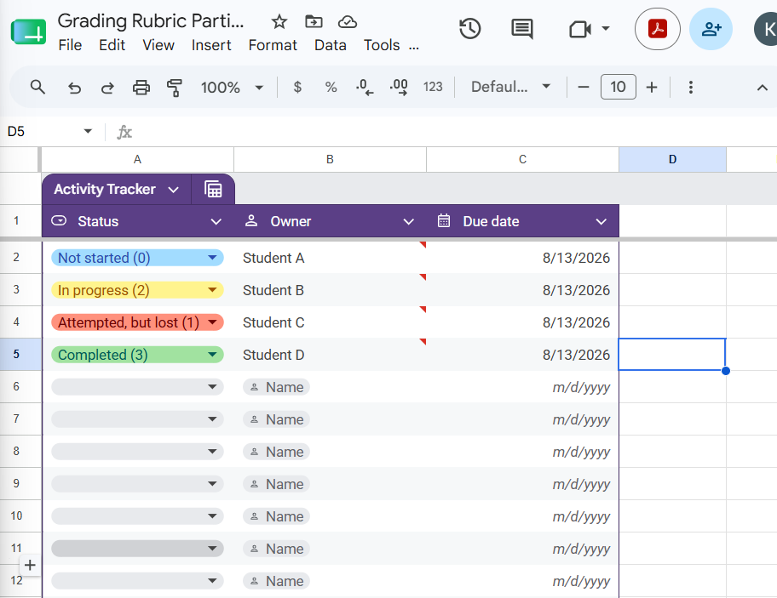
Fast Feedback Tracker
Use a simple Google Sheet on your iPad.
Check work while students are practicing
Track completion, accuracy, and misconceptions
Sort by class period or skill
Use the data to plan groups for tomorrow
Students realize you are actually looking
The goal is not more grading.
The goal is faster feedback.
Keep it simple enough to use while walking around.
https://docs.google.com/spreadsheets/d/1udziCh2QnUzJYPY92tpo6qQoOK0V6xktxecbwPT4218/copy
Notes:
I know the district wants us using iPads, so this is one way to make that useful instead of just another device.
While students are working, I can walk around with a Google Sheet open and quickly mark what I see.
I am not trying to deeply grade every problem in the moment. I just want a fast record of who attempted it, who was accurate, and what misconceptions showed up.
If students see me doing this consistently, they realize the work matters. Eventually, it becomes partly a bluff because they know I might check it.
The real benefit is that it gives me information for the next day. I can sort by class period, group students more intentionally, and know who needs me first.

Slide 37
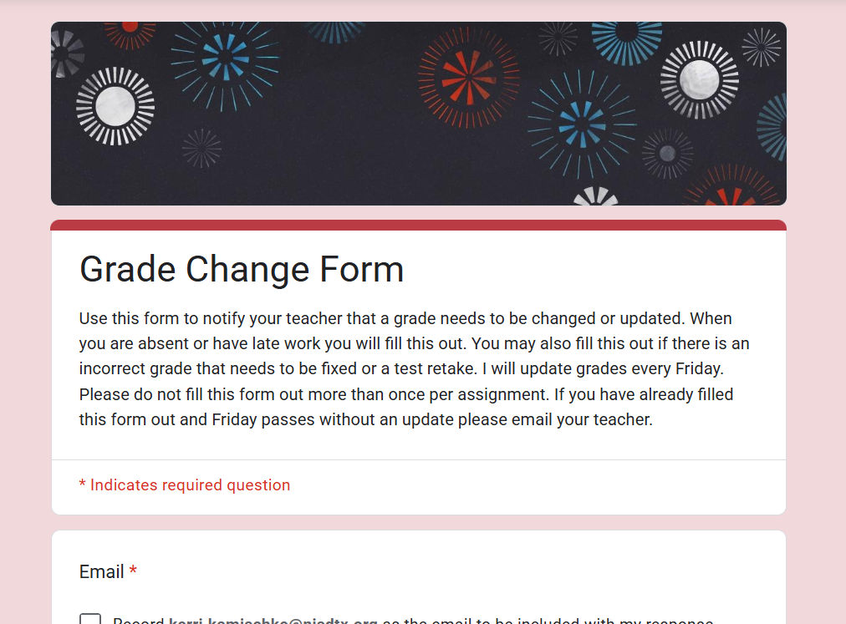
Grade Change Form
The same form is used all year
The form is pinned at the top of the current Canvas module
Grade changes are not processed via email
Students receive an automatic copy of their submission for tracking

Slide 38
Grades Without the Guesswork
Timestamp Email Address Last Name First Name Class Period FULL Name of Assignment (You can copy and paste from HAC) | Reason for grade change (Retest, makeup, latework, incorrect grade) Original Due Date (You can get this off HAC) Date turned in Grade on Assignment (I do check the grade in canvas.) Comments, concerns or accomidations

Slide 39
Questions & Real-World Scenarios
Clarifying questions about the structure or workflow?
What happens if a class doesn’t engage with whiteboard work?
What happens if most students don’t complete the frontload?
Feel free to reach out if you have questions or suggestions! Kerri.kamischke@nisdtx.org

Slide 40
Build One You Could Actually Try
Choose one pathway:
Option 1: Before-Class Frontload
Prep task
Day 1 readiness check
Day 2 group reasoning
Day 3 practice/check
Option 2: In-Class Frontload + First Use
Day 1: Build background + first use
Day 2: Use the content more deeply
Day 3: Practice/check
How will students get feedback before the test?
Build your own template

Slide 41






Want Attendance Credit?
To receive attendance credit for all sessions, you must fill out the feedback form after each session. You can get to the feedback form by using the tinyurl below or scanning the QR code. Please do so within 30 minutes of the session ending. You will receive a copy of your response, so you can make sure you did your survey and to check attendance. Save this for your records!
https://tinyurl.com/ENGAGE26FB

