Slide 1

Ready, Set, Relax said Frankie:
The 3 R's to Calm
Presented by Brianna Moran and Stephen Rousseau
Northwest ISD Wellness Series

Slide 2
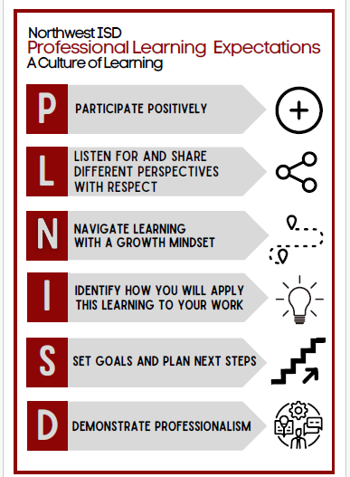

Slide 3

Complete evaluation at the end of the session to obtain credit.

Slide 4



The Wellness-Learning Loop
Regulated Staff
Ready Students
A regulated nervous system in educators is the primary prerequisite for co-regulation in the classroom. When you are calm, your students feel safe.
Students in low-stress environments can access their prefrontal cortex, the center for executive function, logic, and deep learning.

Slide 5






The Three R's Framework
Recognizing
Rendering
Restoring
Identifying your personal stress triggers and early warning signs before burnout sets in.
Utilizing targeted techniques to reduce stress and mitigate negative responses in real-time.
Re-establishing balance to behavioral and emotional functioning for long-term health.

Slide 6

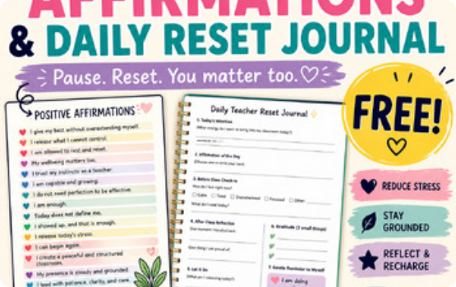
Recognizing Stress Triggers
Physiological Signs: Rapid heartbeat, shallow breathing, or tension headaches.
Behavioral Cues: Irritability, withdrawal, or difficulty making decisions.
Classroom Triggers: High noise levels, unmanaged transitions, or sensory overload.

Slide 7

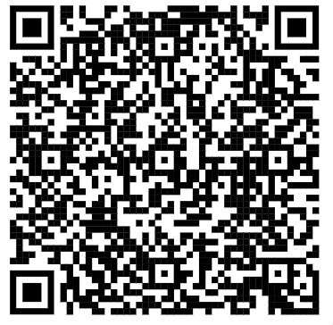
Action: What Are Your Triggers?
Psychology Today Stress Quiz
Identify exactly what pushes your buttons. Understanding the *source* of your stress allows for precise "Rendering" of solutions.
https://www.psychologytoday.com/us/tests/health/what-are-your-stress-triggers
SCAN TO TAKE THE TEST

Slide 8
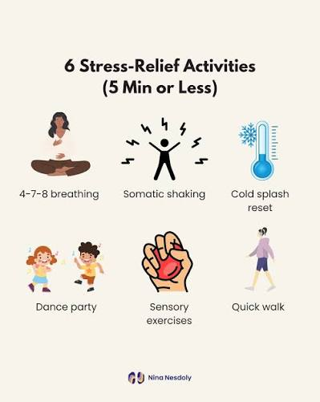
Rendering: Mild Stress Relief
Box Breathing: Inhale for 4, hold for 4, exhale for 4, hold for 4. Resets the autonomic nervous system.
Sensory Reset: Splash cold water on your face or use grounding methods.
The 90-Second Rule: Wait out the biological clock of an emotional surge.
Box Breathing Video
Star Breathing Video

Slide 9
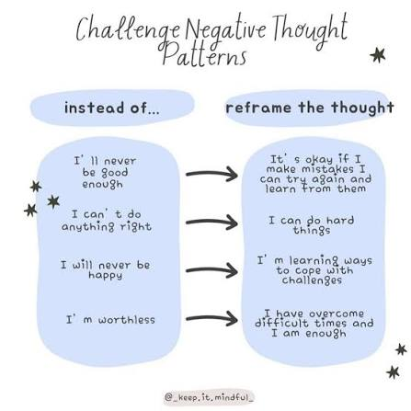
Rendering: Moderate Stress Relief
Progressive Muscle Relaxation: Systematically tense and release muscle groups to disrupt mental anxiety loops.
Cognitive Reframing (The 3 Cs): Catch negative talk, Check validity, and Change the narrative.
Radical Boundary Allocation: Protect home life bandwidth with hard digital boundaries.
Muscle Relaxation Video

Slide 10
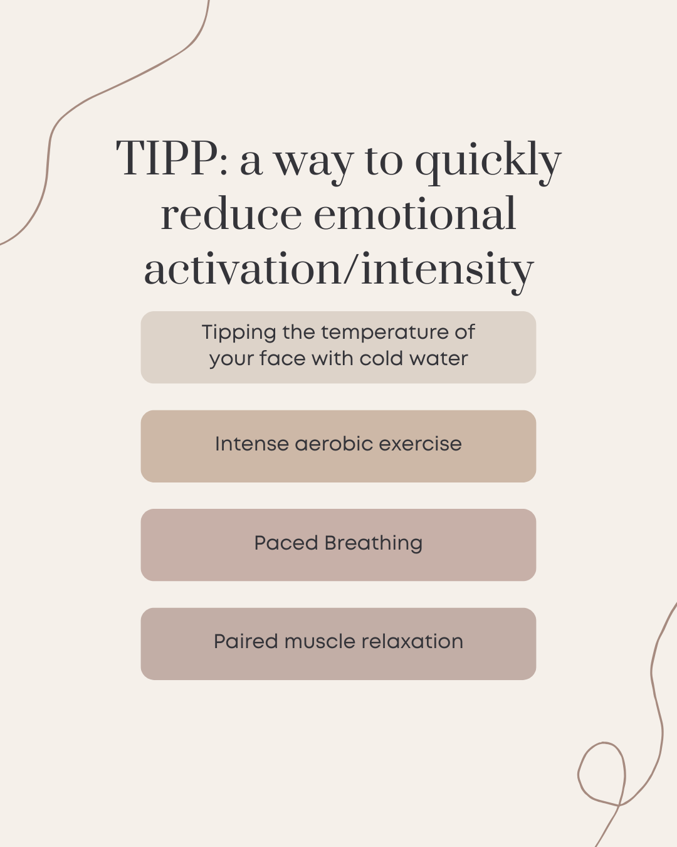
Rendering: Severe Stress Relief
The TIPP Protocol: Alter neurochemistry instantly with Temperature (ice), Intense exercise, Paced breathing, and Paired relaxation.
Strategic Triage: Postpone non-essential tasks and utilize district templates to drop immediate operational load.
Professional Escalation: Activate formal support structures, including leadership or the confidential EAP.

Slide 11

Rendering: Student Success
Promote learning by creating "Safe Brain" environments:
Collaborative Learning: Reduces the threat of isolation.
Visual Schedules: Provides predictability and safety.
Calm Down Corners: Allows for student self-regulation.

Slide 12



Rendering Student Success: Environment & Systems
Collaborative Learning
Visual Schedules
Calm Down Corners
Establishes environmental safety through strict predictability.
Provides physical infrastructure for self-directed containment.
Removes the performance anxiety of public solo tracking.
Iconic Flowcharts: Non-readers self-track.
Sensory Station: Sand timers, kinetic squish assets.
Think-Pair-Share: Low-risk low-stakes pairing.
Time-Marker Blocks: Avoids surprise shifts.
Jigsaw Groups: Shared ownership of text blocks.
"Now/Next" Cards: Scaffolds high-anxiety transitions.
Guided Step Cards: Sequence graphics for deep breaths.
Peer Editing Circles: Normalizes mistakes as revisions.
Boundaried Comfort: Bean bags away from central eye-lines.

Slide 13


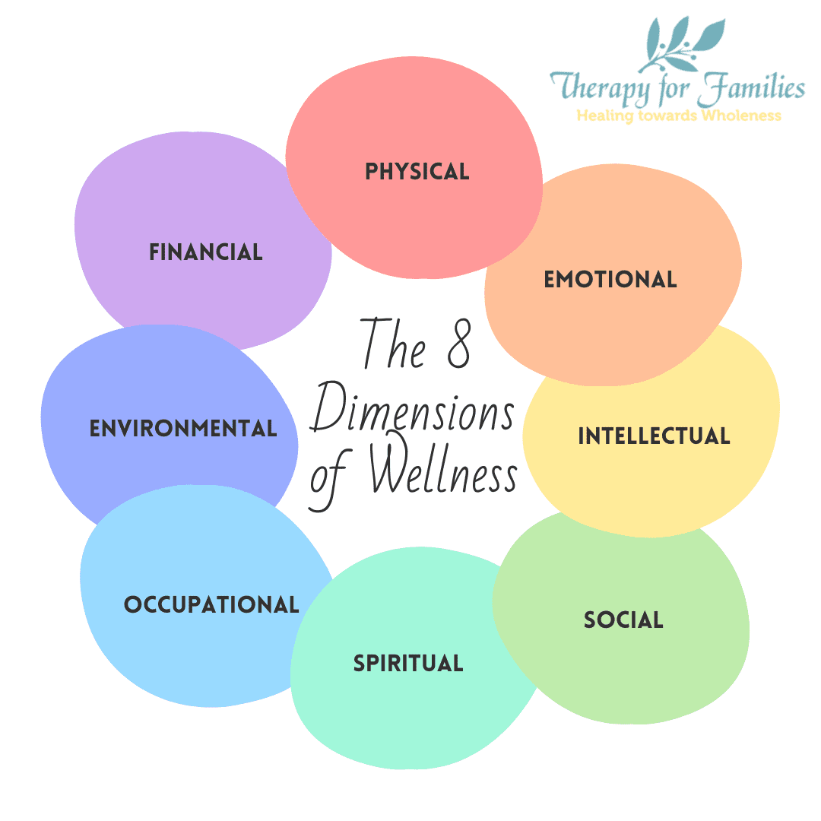
Restoring Equilibrium
Emotional Balance
Physiological Balance
Establish firm boundaries between "School You" and "Home You." Protect your rest and replenishment time fiercely.
Prioritize sleep, nutrition, and physical activity. These foundations provide biological resilience.
Create physical end-of-day transitions. Give your body a clear signal that the workday is done. Move your body.
Rest and be “unproductive” without guilt. Rest is productive.
Set emotional boundaries with work. Recognize that tomorrow’s tasks are for tomorrow.

Slide 14

Restoring Our Culture
The Power of Connection
Peer support is the ultimate buffer against school-based stress. We restore culture through:
Regular wellness check-ins.
Celebrating "Micro-Wins" together.
Creating a "psychologically safe" lounge.

Slide 15
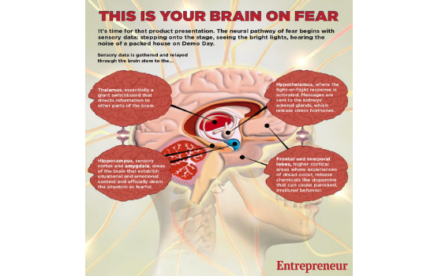
The Science of Stress
Chronic stress causes the Amygdala to take control, "handcuffing" the Prefrontal Cortex. This leads to:
Reduced creativity.
Impaired working memory.
Decreased empathy and patience.
Wellness isn't optional; it's a pedagogical tool.

Slide 16


Cognitive Impacts in the Classroom
Domain | Staff Manifestation | Student Manifestation
Reduced Creativity | Relying on repetitive worksheets; inability to pivot during lesson ruts. | Writer's block; difficulty with open-ended "What if?" questions.
Impaired Memory | Forgetting multi-step admin tasks; losing track of the lecture mid-flow. | Difficulty following 3-step directions; "zoning out" during instruction.
Decreased Empathy | Viewing student distress as "defiance"; decreased patience with colleagues. | Increased peer conflict; inability to see another's perspective or feelings.

Slide 17
Recapping Our Learning Targets
RECOGNIZING: Identified personal physiological and behavioral stress triggers via self-assessment.
RENDERING: Practiced situational techniques (Box Breathing, TIPP) for mild, moderate, and severe stress.
RESTORING: Developed a plan for long-term behavioral and emotional equilibrium.
SCIENTIFIC LINK: Explored the physiological connection between educator wellness and student academic success.
Ready to go back to the classroom with a "Calm Brain."

Slide 18
Ready to Relax?
Which "R" will you implement this week?
Thank you for your dedication to your students and yourself.
Brianna Moran & Stephen Rousseau

Slide 19


Want Attendance Credit?
To receive attendance credit for all sessions, you must fill out the feedback form after each session. You can get to the feedback form by using the tinyurl below or scanning the QR code. Please do so within 30 minutes of the session ending. You will receive a copy of your response, so you can make sure you did your survey and to check attendance. Save this for your records!
https://tinyurl.com/ENGAGE26FB

Slide 20
References & Resources
Source | Resource Topic | Key Takeaway
Psychology Today | Stress Triggers Test | Identify core stressors for targeted relief.
Classroom WISE | Mental Health for K-12 | Creating trauma-informed environments.
National Wellness Inst. | Staff Wellness Strategies | The 6 dimensions of occupational wellness.
Greater Good Education | Teacher Resilience | Practices for preventing empathetic burnout.

Slide 21





Image Sources
https://ecdn.teacherspayteachers.com/thumbitem/Free-Teacher-Affirmations-Reflection-Journal-Mindfulness-Daily-Reset-16211153-1777530078/original-16211153-1.jpg
Source: www.teacherspayteachers.com
https://www.instagram.com/p/DRumyNaEdIe/
https://baudrytherapy.com/wp-content/uploads/2023/03/destress-monday-deep-breathing-infographic.png
Source: baudrytherapy.com
https://www.eschoolnews.com/files/2025/02/k-12-innovation.jpeg
Source: www.eschoolnews.com
https://inventionlandinstitute.com/wp/wp-content/uploads/2018/09/happy-teachers.jpg
Source: inventionlandeducation.com
https://cdn.shopify.com/s/files/1/2232/5125/files/Fear_brain_large.jpg?v=1521768009
Source: tacmedaustralia.com.au

