Slide 1

Hands-On ADI Exploration
Grade Level/Content | Day | Time
6th Grade | Wednesday, 7/22 | 8:30 am
7th Grade | Wednesday, 7/22 | 10:15 am
8th Grade | Wednesday, 7/22 | 1:00 pm
Biology | Wednesday, 7/22 | 2:45 pm
Chemistry | Wednesday, 7/22 | 2:45 pm
https://bit.ly/4eXtMQC

Slide 2



Slide 3


To Receive Credit for this session, make sure you complete the survey at the end

Slide 4
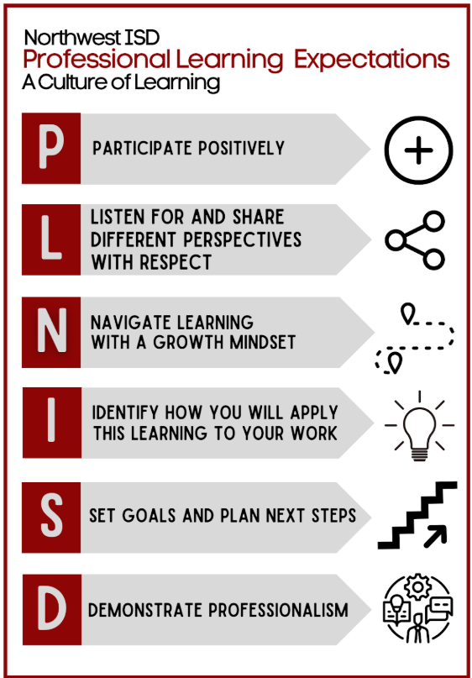
Which of these Learning Expectations do you feel is the most important and why?
Notes:
Think-Pair-Share: Ask participants to read these bullet points. Which one are you going to commit to today?

Slide 5
Learning Target
plan and conduct investigations using appropriate tools and models,
Today I will
[Insert TEKS here.]
So I can
I’ll know I have it when
I can explain the Plan and Do stages of the ADI process and their effect on student learning outcomes.

Slide 6

Argument Driven Inquiry (ADI) Overview
Want to learn more about ADI?
You can join the ADI Crash Course, an asynchronous Canvas course
or attend the ADI 1.0 training in Summer 2027.

Slide 7
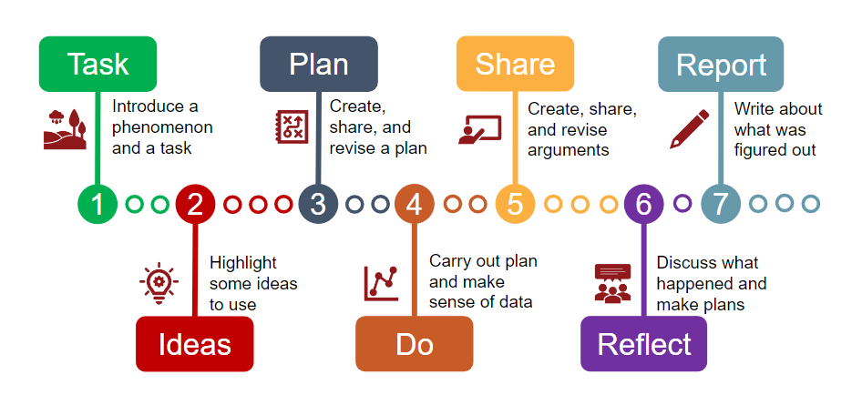
Argument Driven Inquiry Stages

Slide 8
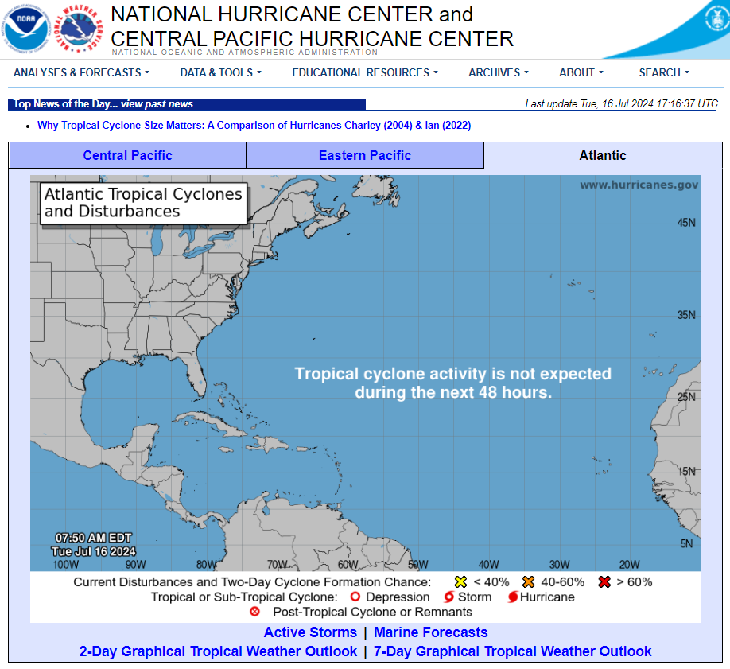
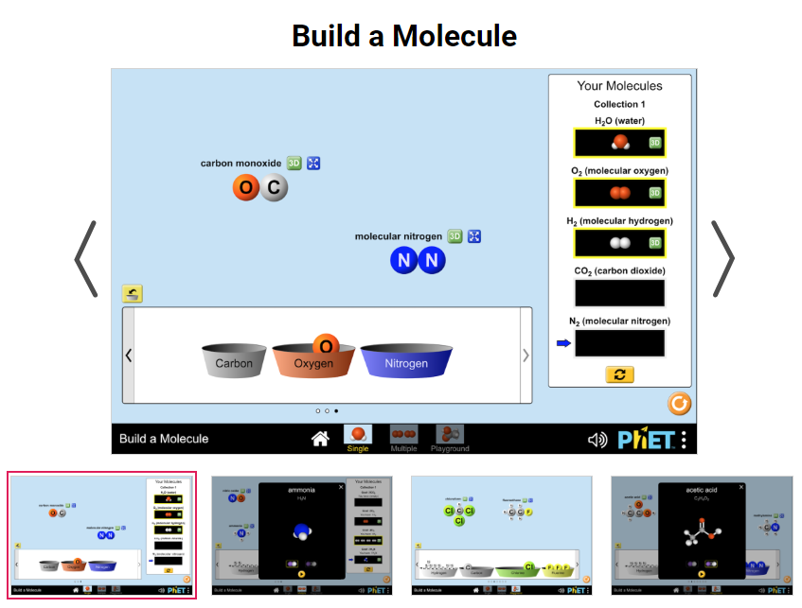
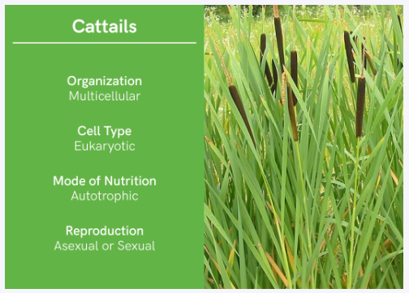
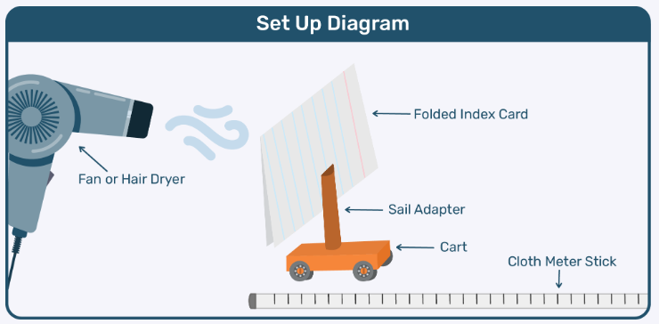
Types of Investigations
ADI Investigations are designed to be either an inquiry or an application activity.
There are 4 types of investigations:
Hands-On | Data/Research | Digital Simulation | Cards

Slide 9

Types of Data

Slide 10
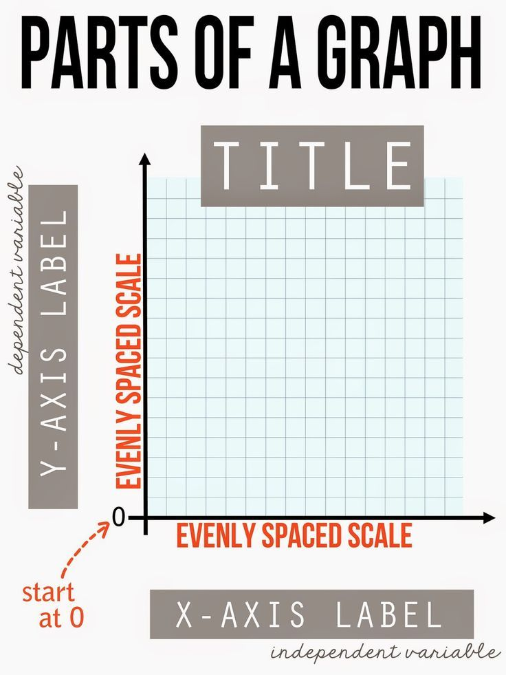
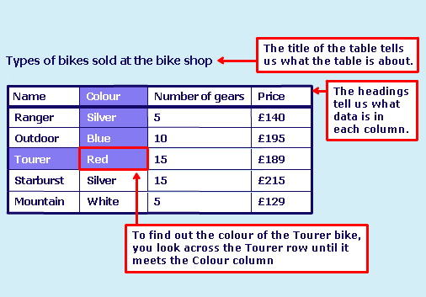
Tables and Graphs

Slide 11
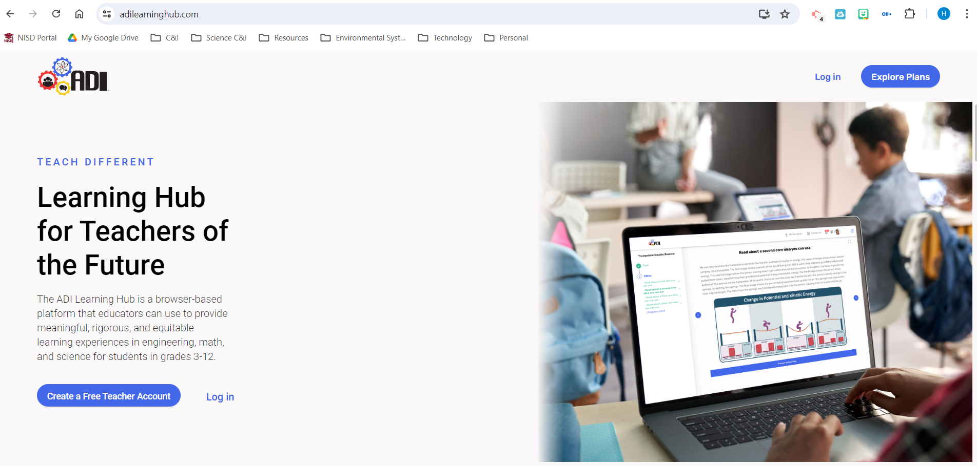
ADI Learning Hub

Slide 12




Let the Inquiry Begin!
1st Nine Weeks | 2nd Nine Weeks
3rd Nine Weeks | 4th Nine Weeks
Notes:
Give a 5 - 10 minute break after we complete two inquiry labs.

Slide 13






Want Attendance Credit?
To receive attendance credit for all sessions, you must fill out the feedback form after each session. You can get to the feedback form by using the tinyurl below or scanning the QR code. Please do so within 30 minutes of the session ending. You will receive a copy of your response, so you can make sure you did your survey and to check attendance. Save this for your records!
https://tinyurl.com/ENGAGE26FB

