Slide 1
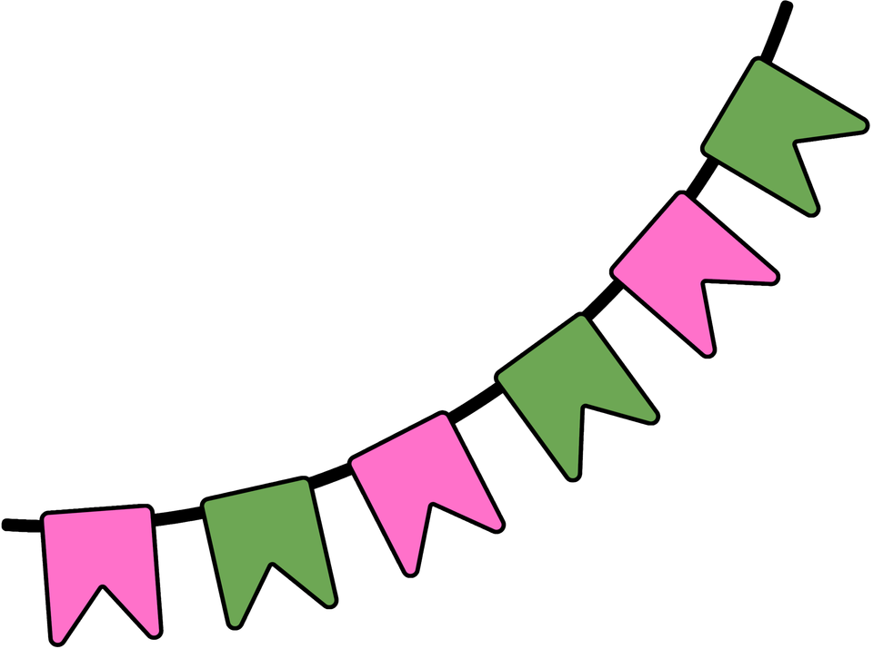

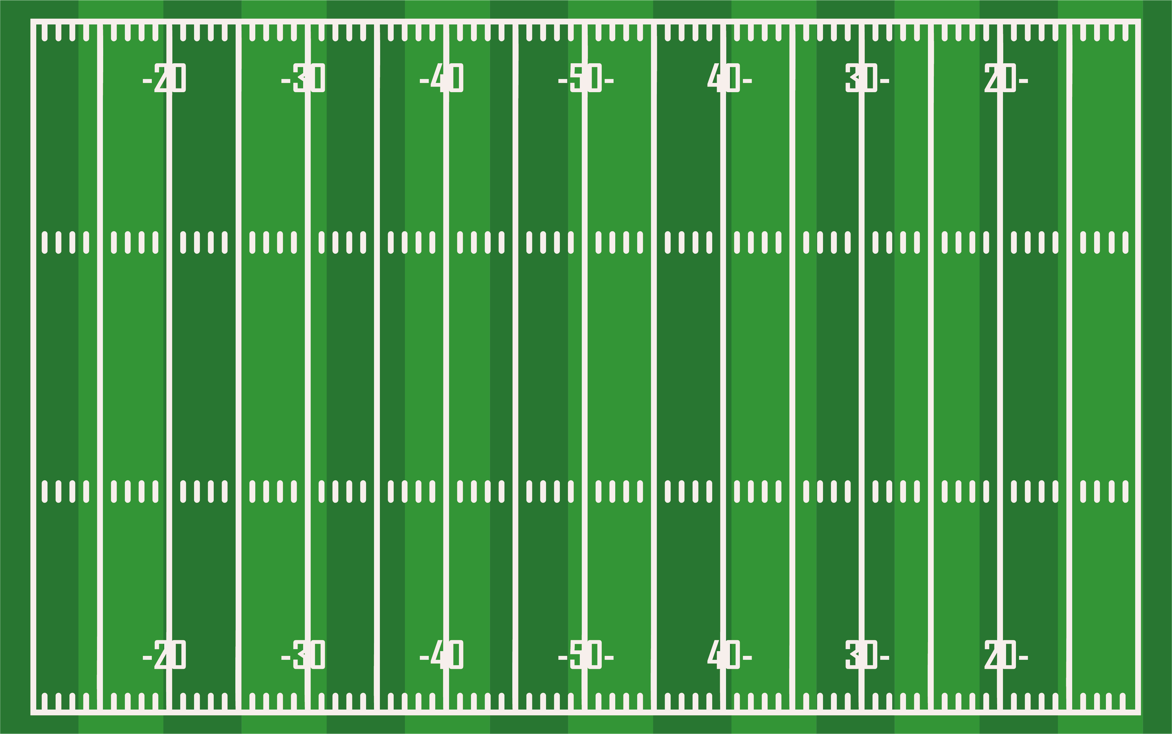
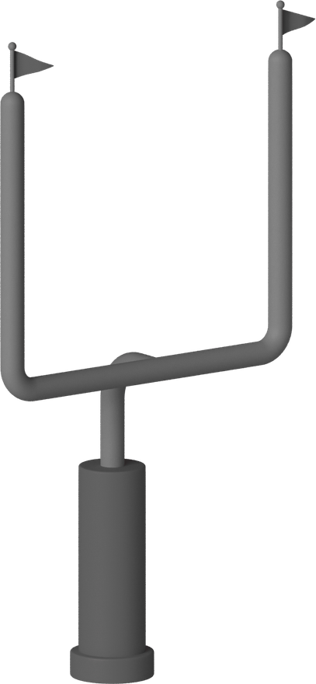



PLAYMAKERS IN THE CLASSROOM
Monitoring That Changes the Game
Brittany Rios, M.Ed., NBCT
Kindergarten Teacher Lakeview Elementary

Slide 2
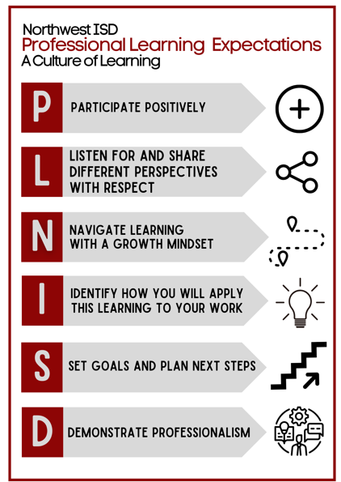

To receive credit for this session, please fill out the survey at the end.

Slide 3


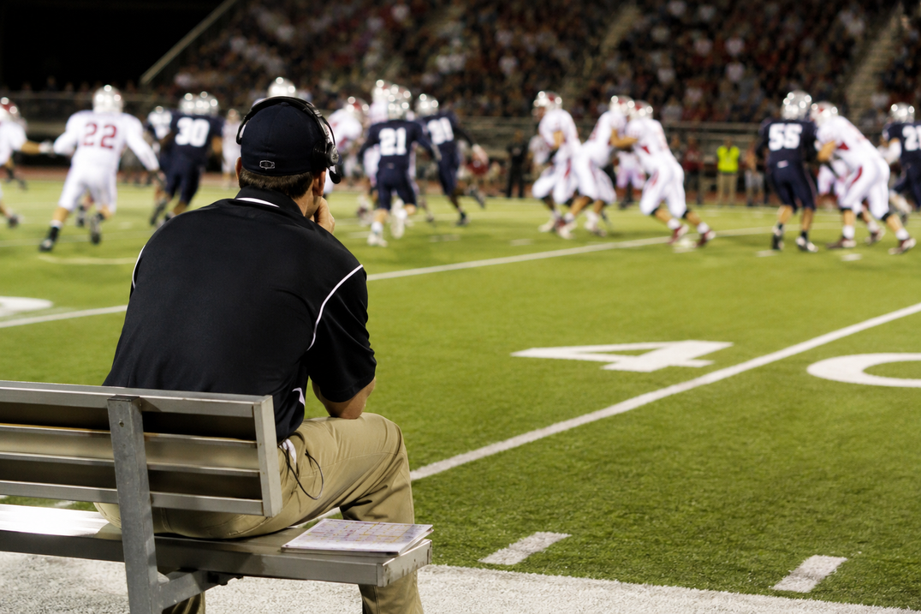

LET’S KICK OFF!
Could this coach lead a winning team?
Notes:
After they say no...
Smile and say:
"I agree."
(Pause.)
"So why do we sometimes try to teach that way?"

Slide 4

then why do we sometimes try to teach that way?
Notes:
After they say no...
Smile and say:
"I agree."
(Pause.)
"So why do we sometimes try to teach that way?"

Slide 5
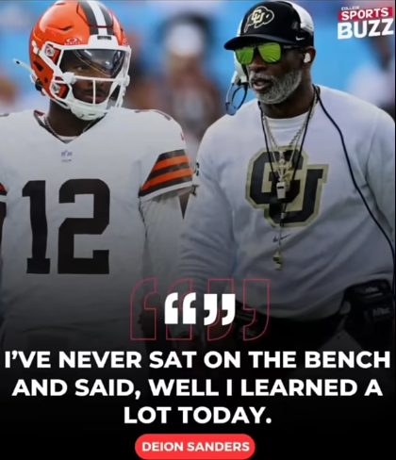
why monitoring matters
The best coaches don't stay in one place.
They move.
They observe.
They give feedback.
They make adjustments while the game is still being played

Slide 6
READ THE FIELD
can you spot it?
Teachers are coaches too
A real kindergarten whiteboard from UFLI.
A math journal page.
A writing sample.
⏱️ You have 15 seconds.
Which students need your support?
Notes:
"You have 15 seconds."
"Without leaving your seat, decide which students need your help, who deserves a star, and what feedback you'd give."
Start a 15-second timer.

Slide 7
READ THE FIELD
can you spot it?
Which students need your support?
Notes:
After time is up:
"Who felt confident?"
"Who wasn't quite sure?"
"Why was it difficult?"
"You were trying to monitor learning from a distance."
Pause.
"Now imagine trying to do that with 22 kindergarteners...or 28 fifth graders."
"That's why intentional monitoring matters."

Slide 8
Play #1: What is Aggressive Monitoring?
Aggressive Monitoring is the intentional practice of circulating through the classroom to observe student learning, provide immediate feedback, and make instructional decisions in real time.
Notes:
"Now that we've established why monitoring matters, let's talk about what aggressive monitoring actually is."
"Aggressive monitoring isn't about walking laps around your classroom."
(Pause.)
"It's intentional."
Click to reveal each point one at a time.
👀 Observe Every Learner
"As you circulate, you're collecting evidence. You're asking yourself, 'Who has it? Who almost has it? Who needs me right now?'"
💬 Provide Immediate Feedback
"The magic happens in the moment. Instead of waiting until after the lesson to grade papers, we coach students while they're still learning."
📊 Use What You Notice
"Everything you observe helps you make your next instructional decision. Maybe one student needs a quick reminder. Maybe a small group needs a reteach. Maybe several students are ready to be challenged."

Slide 9
Play #1: What is Aggressive Monitoring?
It's about catching learning while it's happening.
The teacher:
👀 Observes every learner
💬 Provides immediate feedback
📊 Uses what they notice to guide instruction
Monitor with purpose—not just movement.
Notes:
"Now that we've established why monitoring matters, let's talk about what aggressive monitoring actually is."
"Aggressive monitoring isn't about walking laps around your classroom."
(Pause.)
"It's intentional."
Click to reveal each point one at a time.
👀 Observe Every Learner
"As you circulate, you're collecting evidence. You're asking yourself, 'Who has it? Who almost has it? Who needs me right now?'"
💬 Provide Immediate Feedback
"The magic happens in the moment. Instead of waiting until after the lesson to grade papers, we coach students while they're still learning."
📊 Use What You Notice
"Everything you observe helps you make your next instructional decision. Maybe one student needs a quick reminder. Maybe a small group needs a reteach. Maybe several students are ready to be challenged."

Slide 10
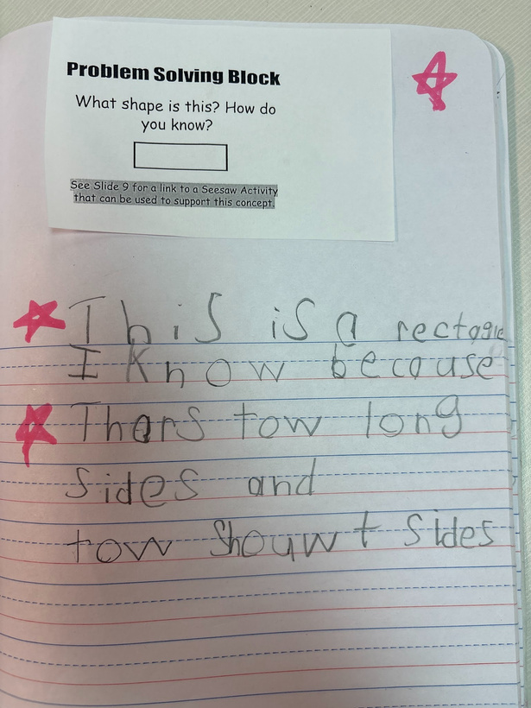
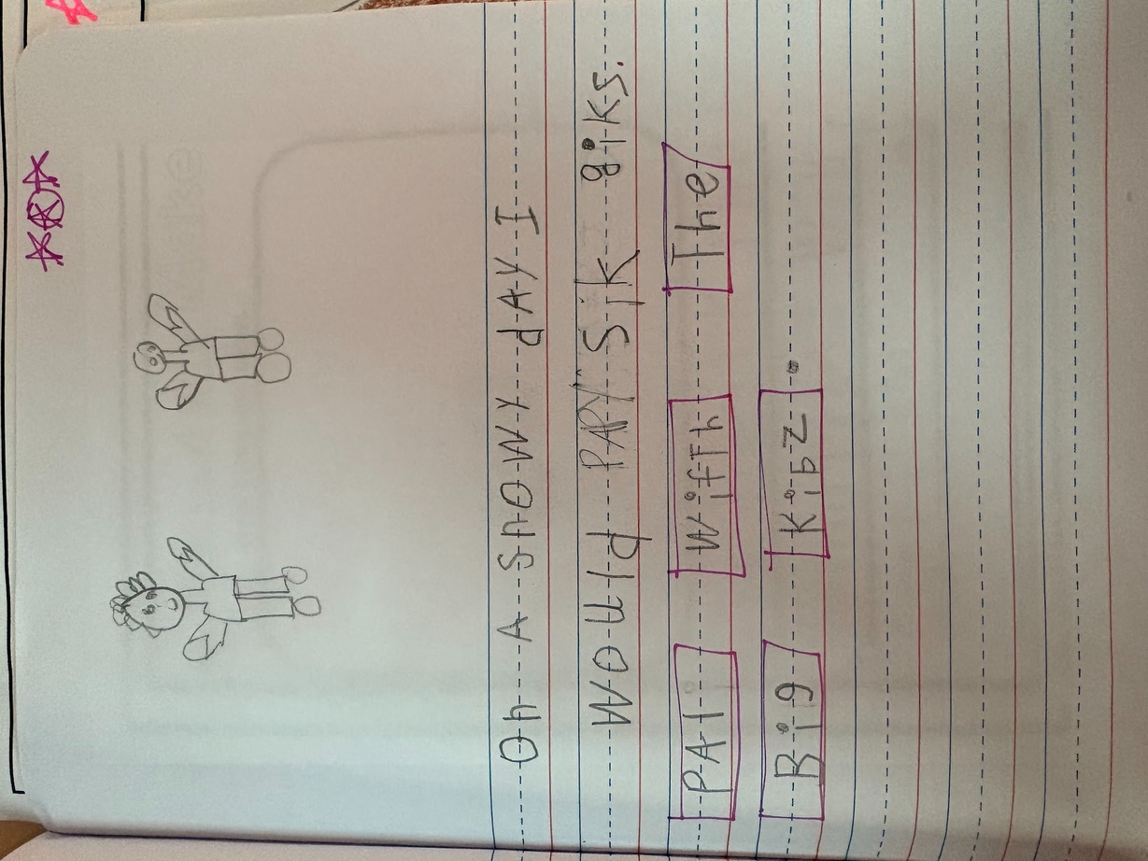

COACH IN THE MOMENT
There is power in catching students getting it right!
⭐ A special Monitoring Pen
A simple tool with a big impact.
Notes:
Hold up your pen.
"This may not look like anything special, but it's honestly one of my favorite instructional tools."
(Pause.)
"When I'm aggressively monitoring, this pen is always in my hand."
"As I circulate, if I see a student demonstrating the skill correctly, I leave a quick star or check."
"It only takes a second, but to my students, it means everything."
Then tell your story.
Something like:
"My kindergarteners get so excited when they see this pen coming. They're not waiting for a grade—they're excited because they're getting immediate feedback while they're still learning."

Slide 11

🏈 Play #2: Stay in Motion
How to aggressively monitor
👀 ➜ 🚶 ➜ 💬 ➜ 📊
1. Scan
Observe every student.
2. Circulate
Move with purpose
using “laps”.
3. Coach
Give immediate feedback.
4. Adjust
Use what you learned to
guide instruction.
Ask Yourself...
✔️ Have I seen every student?
✔️ Do I know who understands?
✔️ Did I leave immediate feedback?
✔️ What will I do with this information?
Notes:
After time is up:
"Who felt confident?"
"Who wasn't quite sure?"
"Why was it difficult?"
"Exactly."
"You were trying to monitor learning from a distance."
Pause.
"Now imagine trying to do that with 22 kindergarteners...or 28 fifth graders."
"That's why aggressive monitoring matters."

Slide 12
🏈 Play #2: Stay in Motion
How to aggressively monitor
👀 ➜ 🚶 ➜ 💬 ➜ 📊
1. Scan
Observe every student.
2. Circulate
Move with purpose.
3. Coach
Give immediate feedback.
4. Adjust
Use what you learned to
guide instruction.
Turn to someone near you. Which of these four steps do you think teachers do the best? Which one do you think we skip the most?
Notes:
After time is up:
"Who felt confident?"
"Who wasn't quite sure?"
"Why was it difficult?"
"Exactly."
"You were trying to monitor learning from a distance."
Pause.
"Now imagine trying to do that with 22 kindergarteners...or 28 fifth graders."
"That's why aggressive monitoring matters."

Slide 13
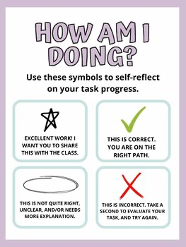
🏈 Play #3: See it in action
What does it look like in the classroom?
  Select a skill to look for and explain it to students
  Circulate and stop briefly at each student (5-10 seconds)
  Write a symbol on student paper showing immediate feedback
?
Notes:
After time is up:
"Who felt confident?"
"Who wasn't quite sure?"
"Why was it difficult?"
"Exactly."
"You were trying to monitor learning from a distance."
Pause.
"Now imagine trying to do that with 22 kindergarteners...or 28 fifth graders."
"That's why aggressive monitoring matters."

Slide 14

🏈 Play #3: See it in action
What does it look like in the classroom?
Notes:
After time is up:
"Who felt confident?"
"Who wasn't quite sure?"
"Why was it difficult?"
"Exactly."
"You were trying to monitor learning from a distance."
Pause.
"Now imagine trying to do that with 22 kindergarteners...or 28 fifth graders."
"That's why aggressive monitoring matters."

Slide 15
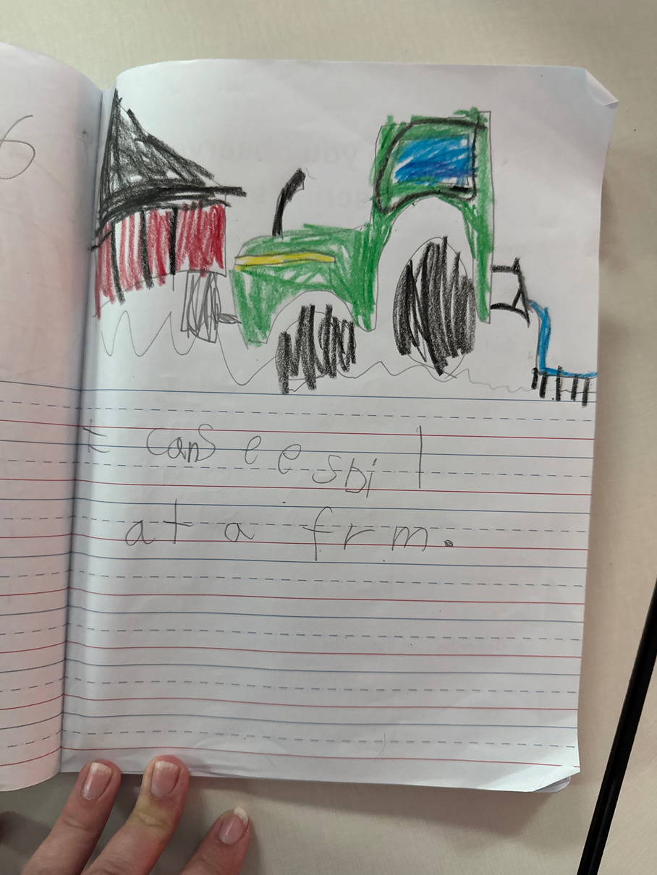
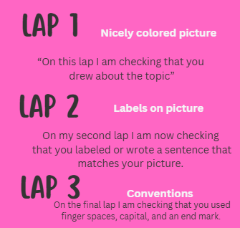
🏈 Play #3: See it in action
Kindergarten: writing
Notes:
After time is up:
"Who felt confident?"
"Who wasn't quite sure?"
"Why was it difficult?"
"Exactly."
"You were trying to monitor learning from a distance."
Pause.
"Now imagine trying to do that with 22 kindergarteners...or 28 fifth graders."
"That's why aggressive monitoring matters."

Slide 16
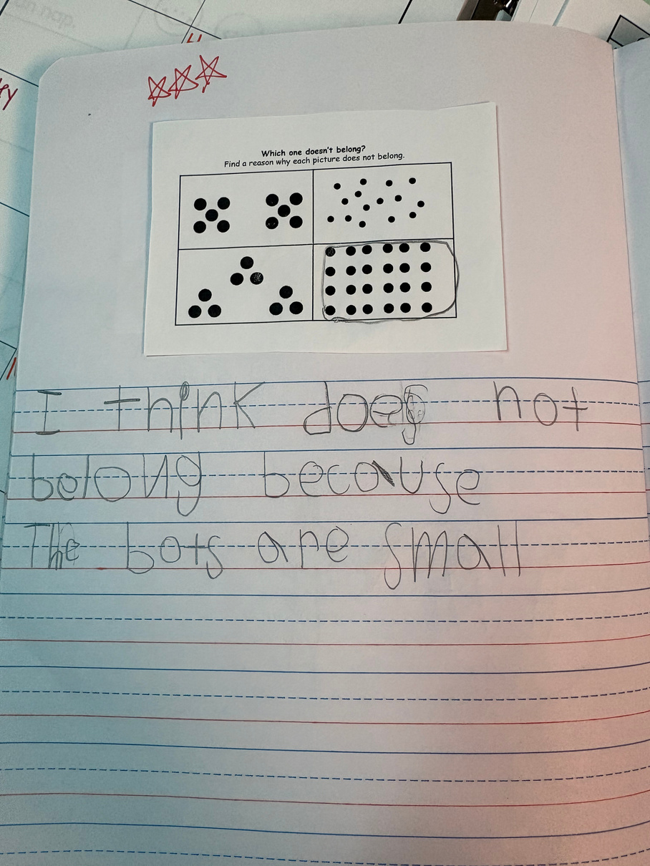
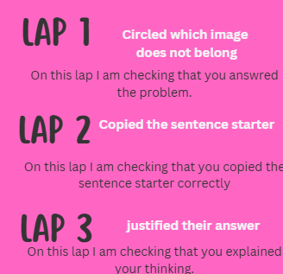
🏈 Play #3: See it in action
Kindergarten: math
Notes:
After time is up:
"Who felt confident?"
"Who wasn't quite sure?"
"Why was it difficult?"
"Exactly."
"You were trying to monitor learning from a distance."
Pause.
"Now imagine trying to do that with 22 kindergarteners...or 28 fifth graders."
"That's why aggressive monitoring matters."

Slide 17
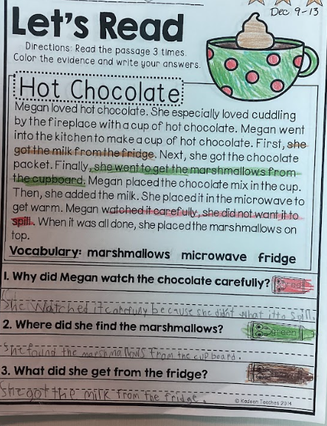
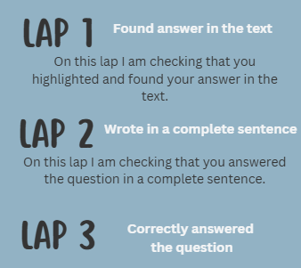
🏈 Play #3: See it in action
First & Second Grade: ELA
Notes:
After time is up:
"Who felt confident?"
"Who wasn't quite sure?"
"Why was it difficult?"
"Exactly."
"You were trying to monitor learning from a distance."
Pause.
"Now imagine trying to do that with 22 kindergarteners...or 28 fifth graders."
"That's why aggressive monitoring matters."

Slide 18
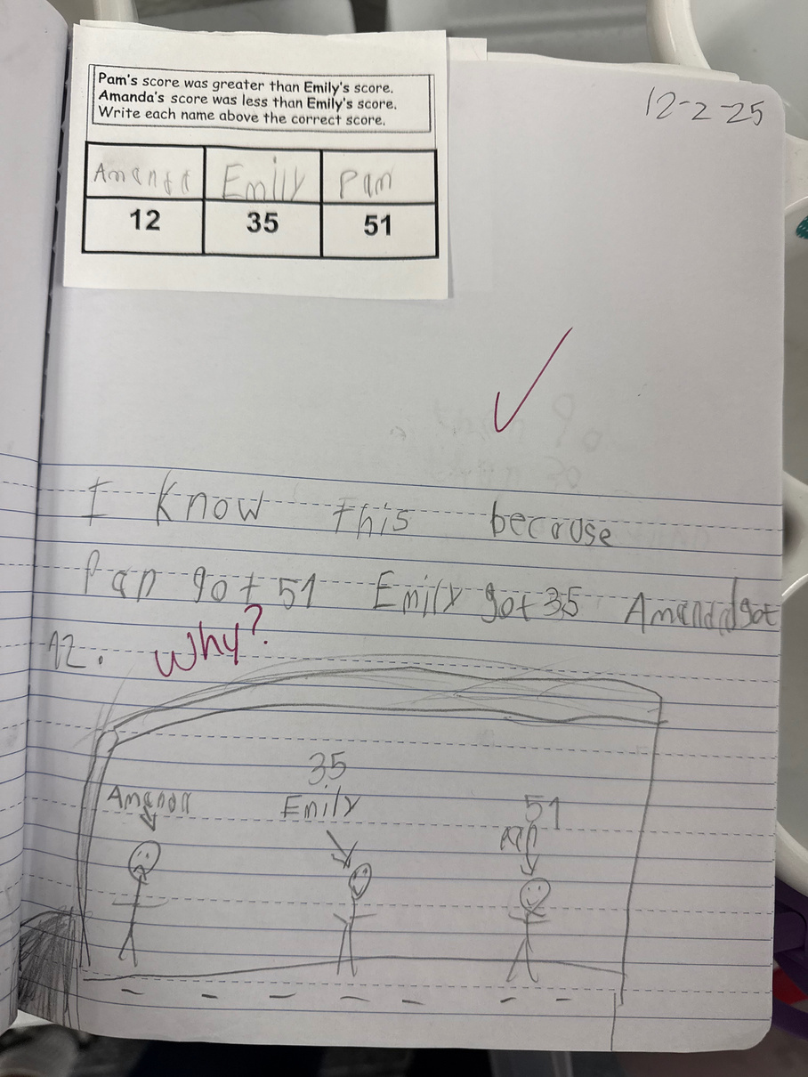
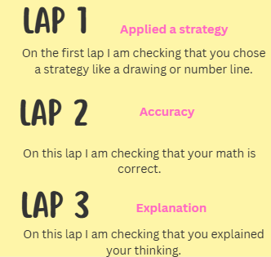
🏈 Play #3: See it in action
First & Second Grade: Math
Notes:
After time is up:
"Who felt confident?"
"Who wasn't quite sure?"
"Why was it difficult?"
"Exactly."
"You were trying to monitor learning from a distance."
Pause.
"Now imagine trying to do that with 22 kindergarteners...or 28 fifth graders."
"That's why aggressive monitoring matters."

Slide 19
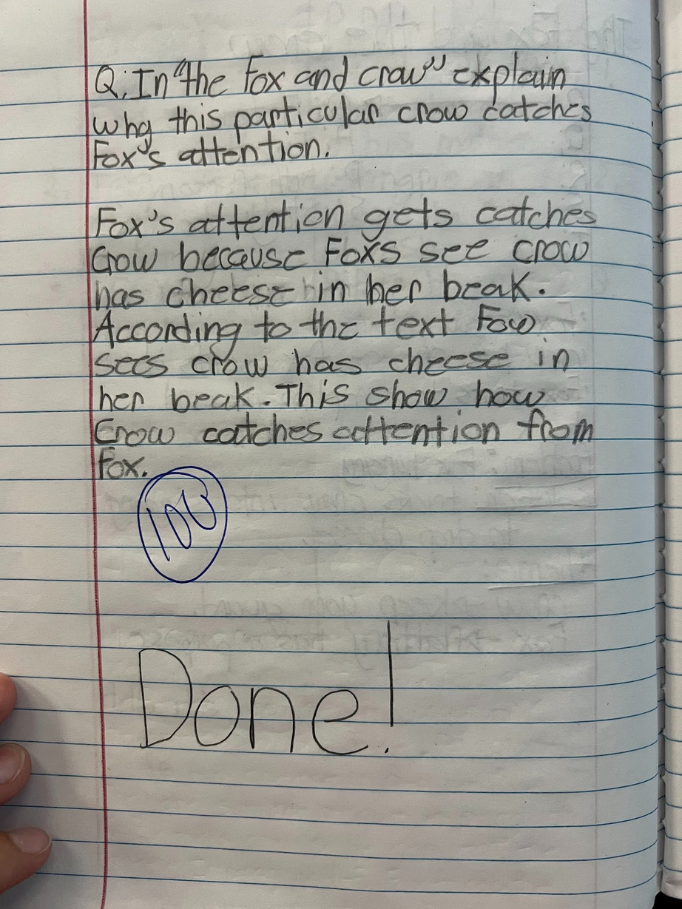
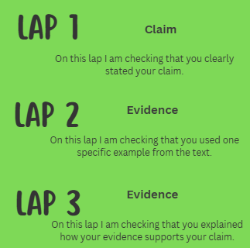
🏈 Play #3: See it in action
Third, Fourth & Fifth Grade: ELA
Notes:
After time is up:
"Who felt confident?"
"Who wasn't quite sure?"
"Why was it difficult?"
"Exactly."
"You were trying to monitor learning from a distance."
Pause.
"Now imagine trying to do that with 22 kindergarteners...or 28 fifth graders."
"That's why aggressive monitoring matters."

Slide 20
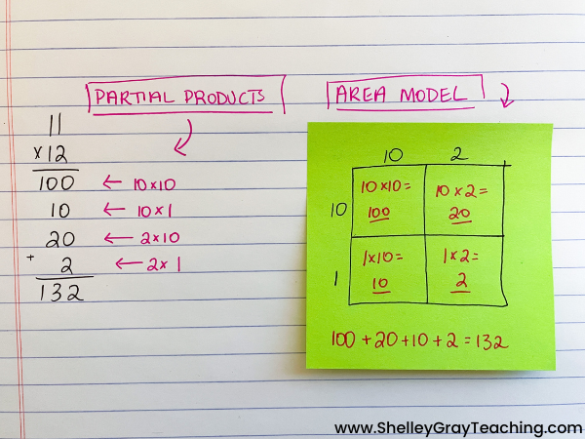
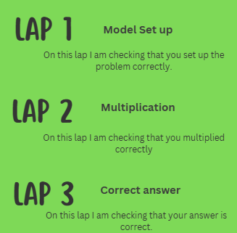
🏈 Play #3: See it in action
Third, Fourth & Fifth Grade: Math
Notes:
After time is up:
"Who felt confident?"
"Who wasn't quite sure?"
"Why was it difficult?"
"Exactly."
"You were trying to monitor learning from a distance."
Pause.
"Now imagine trying to do that with 22 kindergarteners...or 28 fifth graders."
"That's why aggressive monitoring matters."

Slide 21
FINAL HUDDLE
⭐ What's one area you feel you can use this in your own classroom?
⭐ What's one way you'll make your monitoring more intentional?

Slide 22
