Slide 1


Slide 2
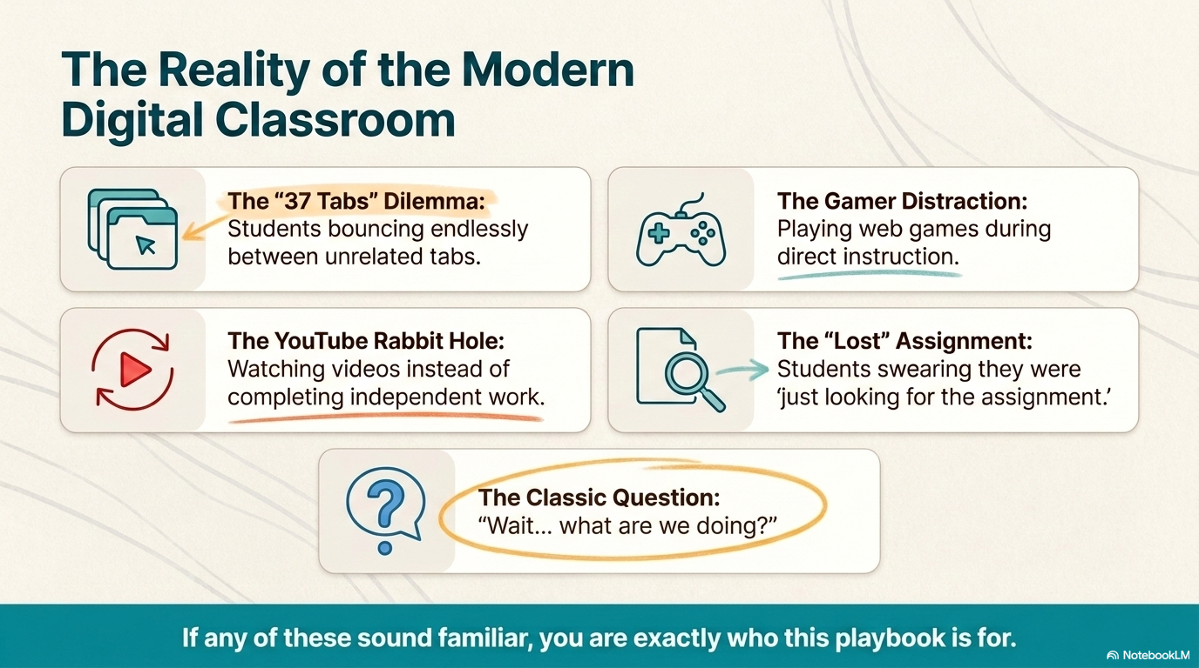

Slide 3
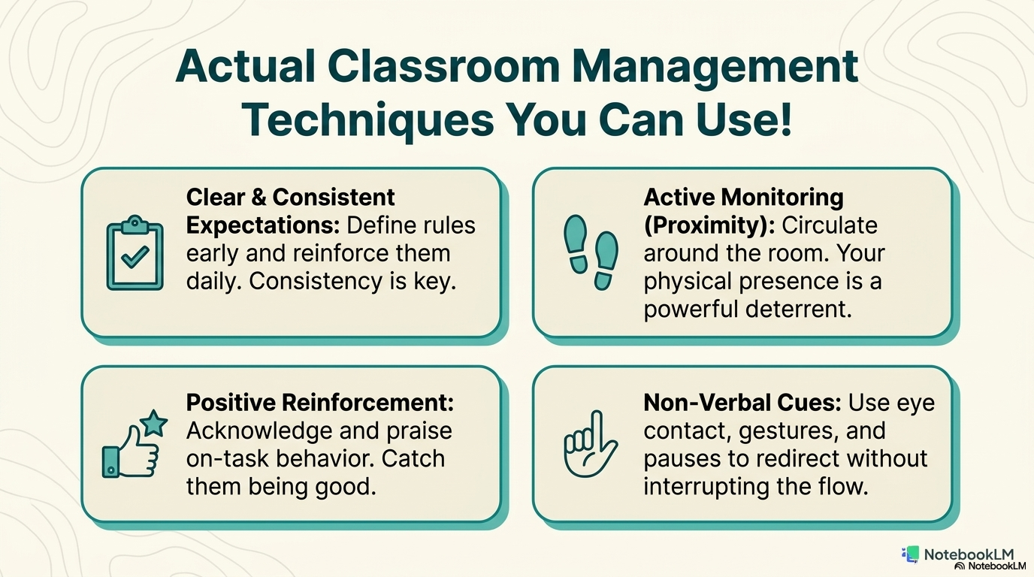

Slide 4
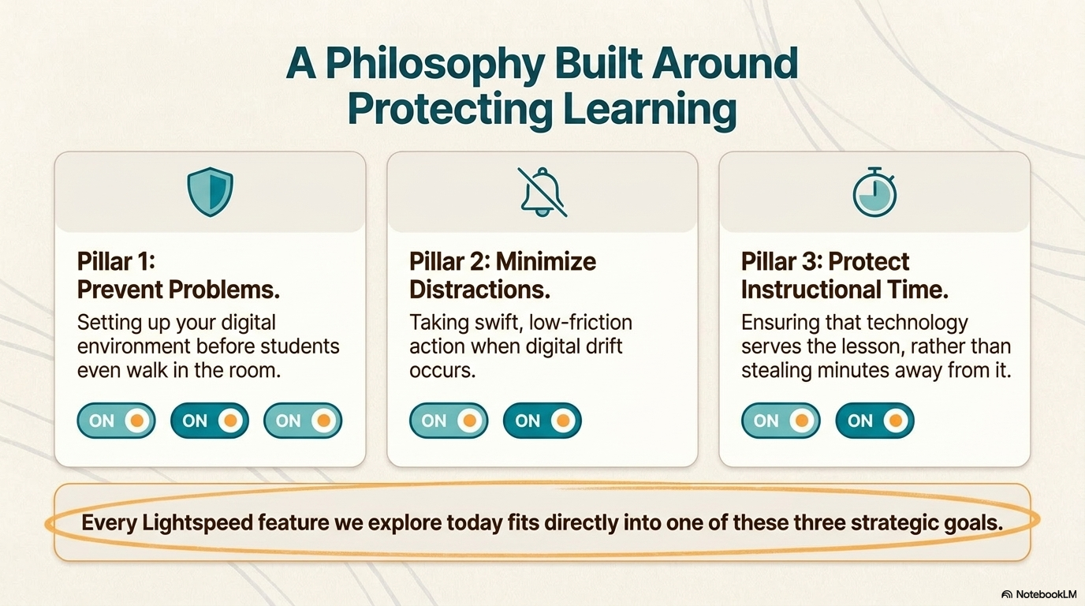

Slide 5
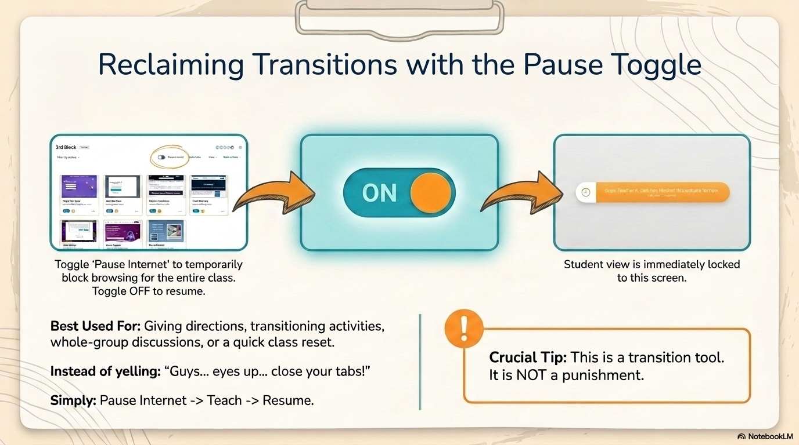

Slide 6
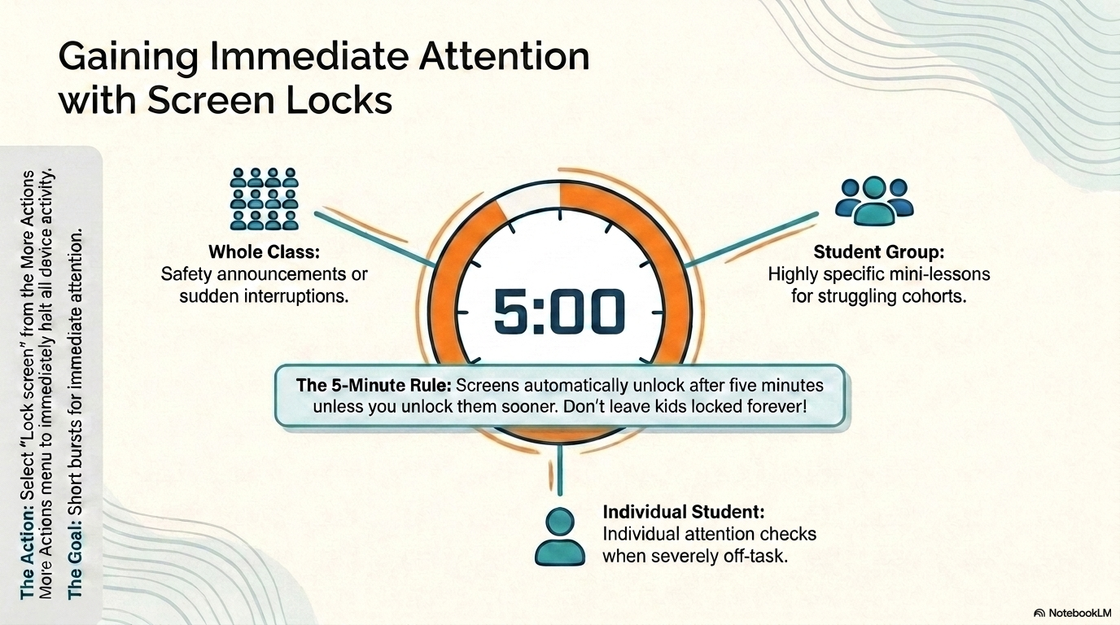

Slide 7
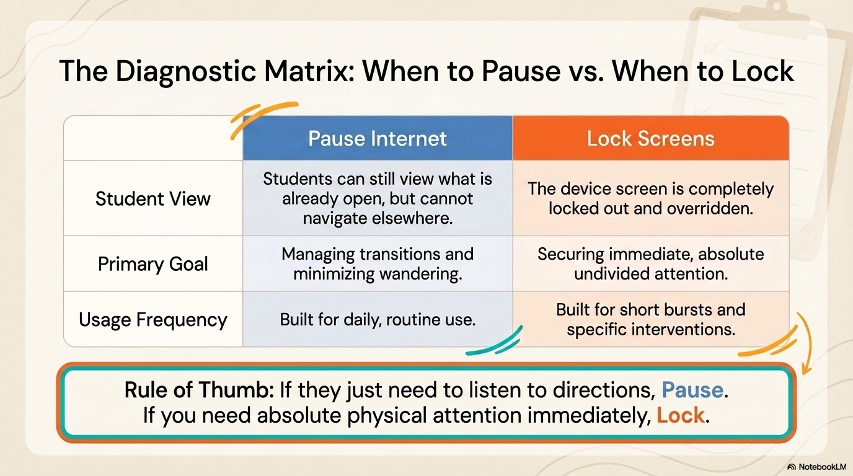

Slide 8
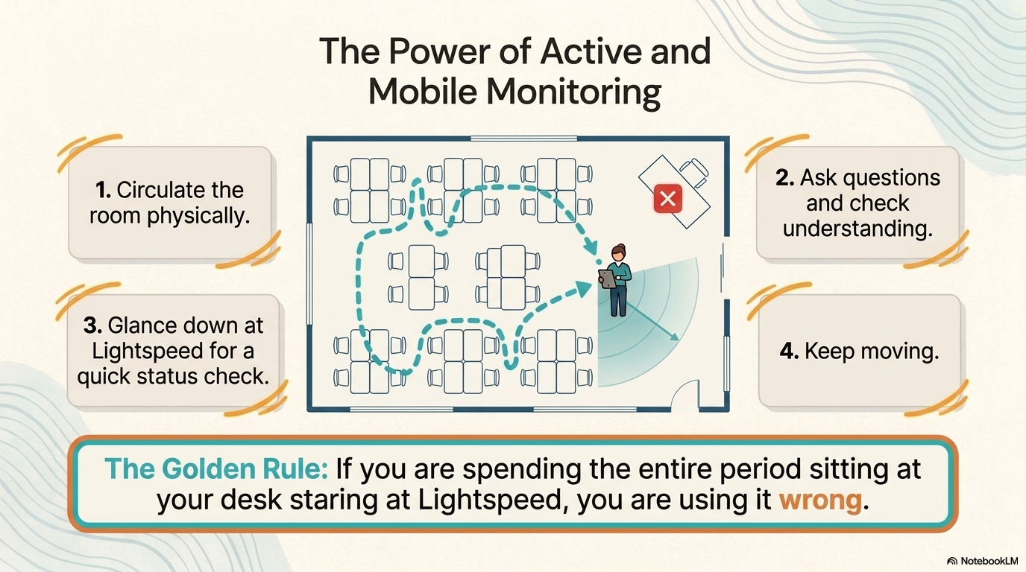

Slide 9
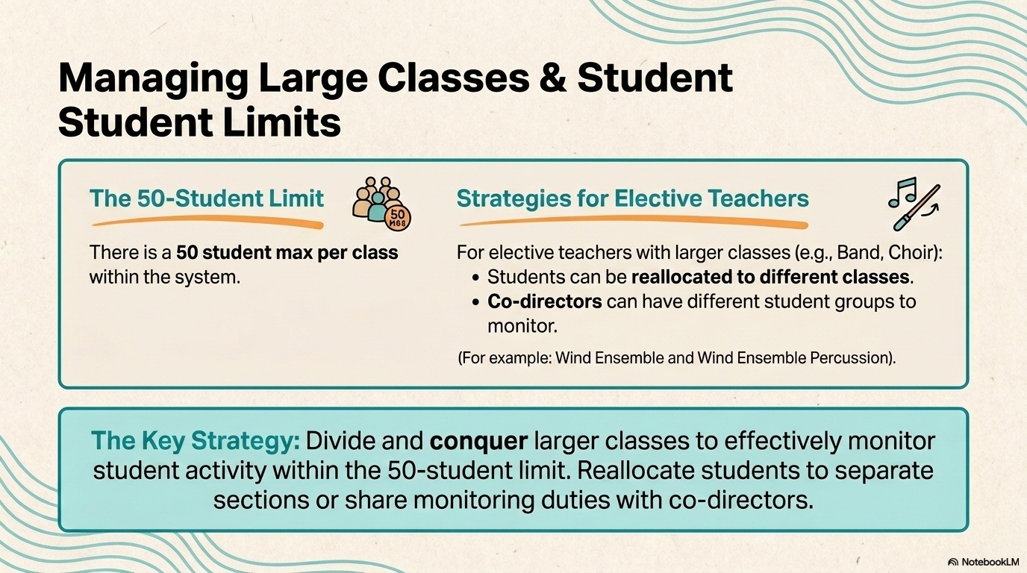

Slide 10
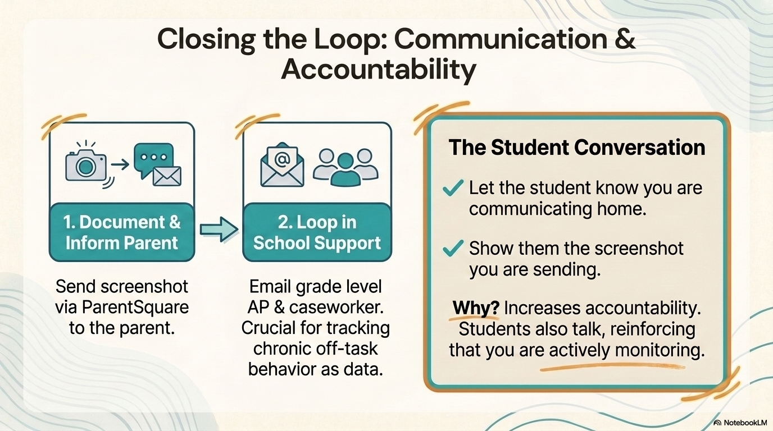

Slide 11
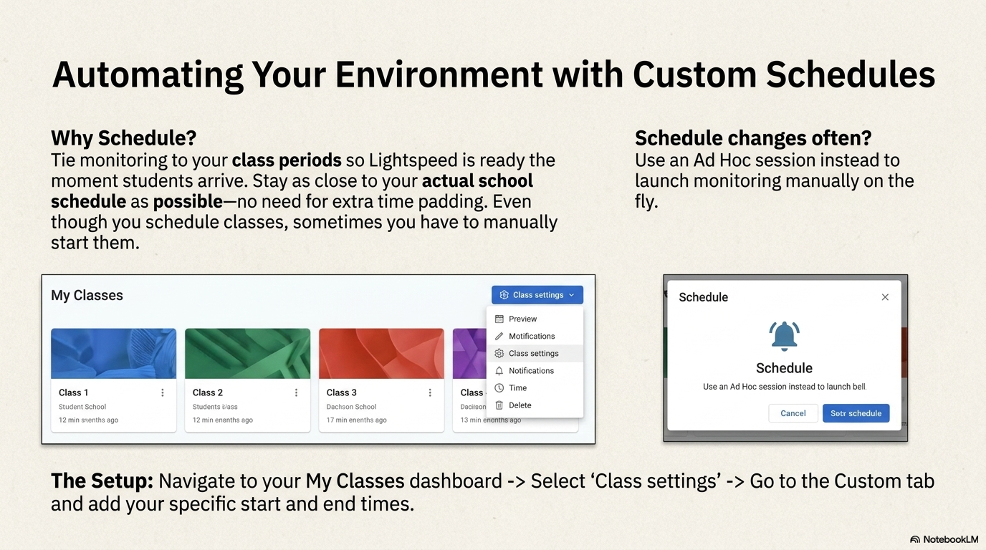

Slide 12
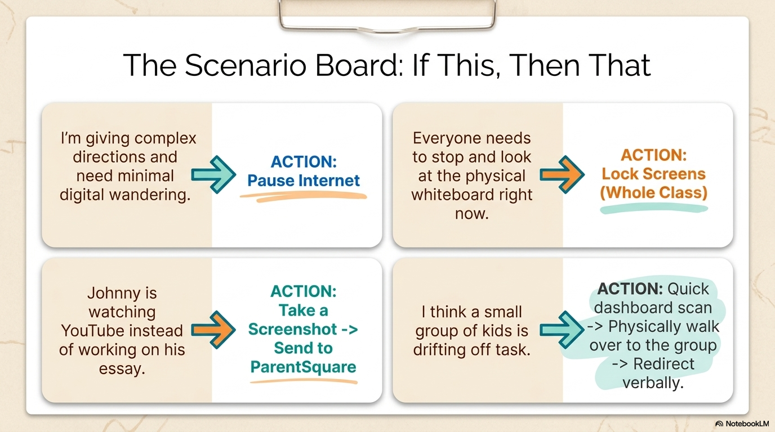

Slide 13


Slide 14


Slide 15




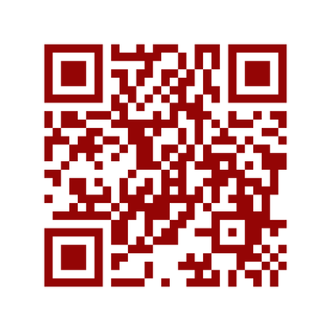

Want Attendance Credit?
To receive attendance credit for all sessions, you must fill out the feedback form after each session. You can get to the feedback form by using the tinyurl below or scanning the QR code. Please do so within 30 minutes of the session ending. You will receive a copy of your response, so you can make sure you did your survey and to check attendance. Save this for your records!
https://tinyurl.com/ENGAGE26FB

