Slide 1
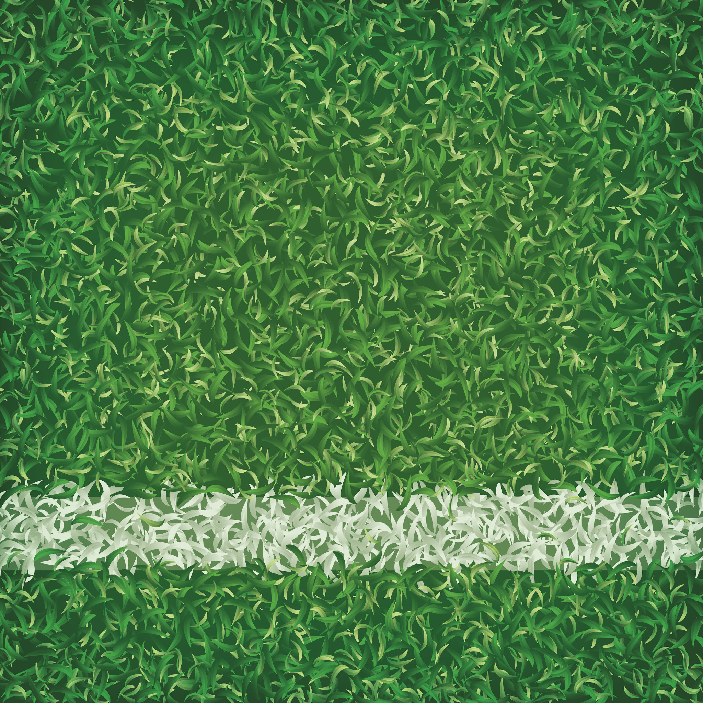

To Receive Credit for this session, make sure you complete the survey at the end

Slide 2

A Student Engagement Boost:
The Predictive Essay
Presenter: Joshua Talley
Assistant Principal, Barksdale MS
Notes:
🍐 This is a Pear Deck Text Slide
🍐 To edit the type of question, go back to the "Make Your Lessons Interactive" in the Pear Deck sidebar.

Slide 3
Today I will… participate in a predictive essay.
So I can… identify new ways to encourage student engagement.
I know I have it when… Create an outline for my own predictive essay.

Slide 4
Agenda:
Predictive Essay practice run
Discussion
Create Your Own
To Receive Credit for this session, make sure you complete the survey at the end

Slide 5
Predictive Essay, Day 1
Daily Agenda:
Review
Intro
Activity
Paragraph(s)

Slide 6
INTRODUCTION OUTLINE
Answer the following questions in your outline.
Notes:
🍐 This is a Pear Deck Multiple Choice Slide
🍐🍐 Your current options are: A: San Antonio, B: Fort Worth, C: Galveston
🍐🍐 Correct options are: C: Galveston

Slide 7
Review:
What city was the major port, and largest city, of Texas in the 1800s?
Dallas
Houston
Galveston
Notes:
🍐 This is a Pear Deck Multiple Choice Slide
🍐🍐 Your current options are: A: San Antonio, B: Fort Worth, C: Galveston
🍐🍐 Correct options are: C: Galveston

Slide 8
Why would people be interested in moving to an area with a large, active port?
Notes:
🍐 This is a Pear Deck Text Slide

Slide 9
Review:
What region is Galveston located in?
Gulf Coastal Plains
North Central Plains
Mountain and Basin
Notes:
🍐 This is a Pear Deck Multiple Choice Slide
🍐🍐 Your current options are: A: Island in the Coastal Plains, B: Desert in the Mountain and Basins, C: Swamp in the Coastal Plain
🍐🍐 Correct options are: A: Island in the Coastal Plains

Slide 10
What dangerous weather pattern is common along the Texas Gulf Coast?
Tornadoes
Hurricanes
Blizzards
Notes:
🍐 This is a Pear Deck Multiple Choice Slide
🍐🍐 Your current options are: A: Tornado, B: Hurricanes, C: Blizzards
🍐🍐 Correct options are: B: Hurricanes

Slide 11
Using your outline, create a brief paragraph summarizing this information.
(4 Sentences)
Notes:
🍐 This is a Pear Deck Multiple Choice Slide
🍐🍐 Your current options are: A: Tornado, B: Hurricanes, C: Blizzards
🍐🍐 Correct options are: B: Hurricanes

Slide 12
In the 1800s Galveston was the largest port and city in Texas.
People were drawn to the opportunities created by industrialization.
New jobs and industries, supported by factories and shipping, made the city grow quickly.
Galveston is located in the Gulf Coastal Plains and hurricanes are common.
Notes:
🍐 This is a Pear Deck Text Slide

Slide 13
Student Learning Target
Today I will… Analyze Primary and Secondary sources about the Galveston Hurricane.
So I can… identify the impact of climate on human geography.
I know I have it when… I can write a paragraph predicting the impact of the Galveston Hurricane.

Slide 14
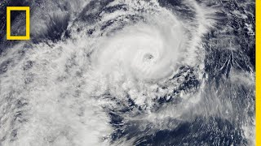
Notes:
🍐 This is a Pear Deck Text Slide
🍐 To edit the type of question, go back to the "Make Your Lessons Interactive" in the Pear Deck sidebar.

Slide 15
With an increase in hurricanes every year, some people became concerned about Galveston’s location.
For the next 7 minutes, analyze the secondary source about the reaction to hurricanes.
Notes:
🍐 This is a Pear Deck Multiple Choice Slide
🍐🍐 Your current options are: A: Tornado, B: Hurricanes, C: Blizzards
🍐🍐 Correct options are: B: Hurricanes

Slide 16
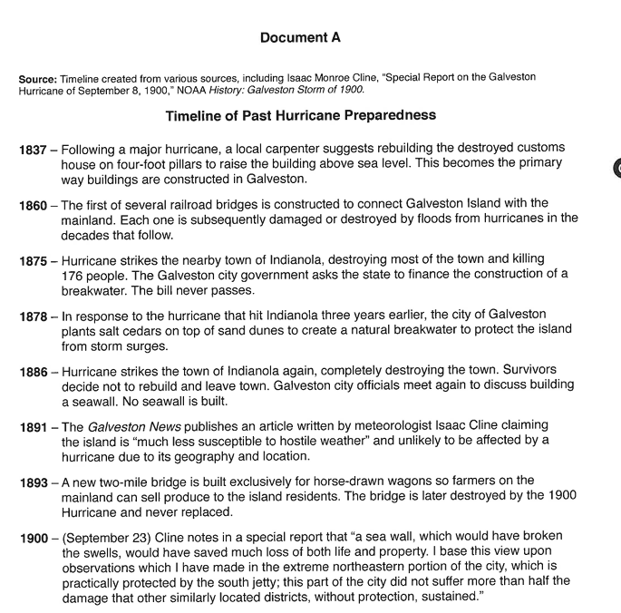
What suggestions were made about the buildings in 1837?
What happened in 1875 to Indianola? What about in 1886?
How was Galveston described in 1891 by Isaac Cline?
Did Cline support his own claim in 1900? Why?
Notes:
🍐 This is a Pear Deck Multiple Choice Slide
🍐🍐 Your current options are: A: Tornado, B: Hurricanes, C: Blizzards
🍐🍐 Correct options are: B: Hurricanes

Slide 17
In 1900 a storm struck Galveston.
For the next 7 minutes, analyze the secondary source about the reaction to hurricanes.
Notes:
🍐 This is a Pear Deck Multiple Choice Slide
🍐🍐 Your current options are: A: Tornado, B: Hurricanes, C: Blizzards
🍐🍐 Correct options are: B: Hurricanes

Slide 18
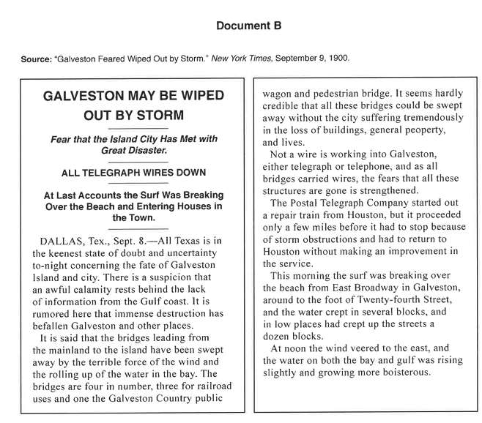
What happened to the bridges leading into the island?
What happened to the lines of communication between the mainland and the island?
Based on the damage in the surrounding area, how might Galveston be affected?
What impact would the destroyed bridges and communication lines have on Galveston?
Notes:
🍐 This is a Pear Deck Multiple Choice Slide
🍐🍐 Your current options are: A: Tornado, B: Hurricanes, C: Blizzards
🍐🍐 Correct options are: B: Hurricanes

Slide 19
On the next page of your journal, write a 4-6 sentence paragraph predicting the situation in Galveston.
How bad do you think the damage is?
What could have been done to prevent this situation?
What is your proof?
Notes:
🍐 This is a Pear Deck Multiple Choice Slide
🍐🍐 Your current options are: A: Tornado, B: Hurricanes, C: Blizzards
🍐🍐 Correct options are: B: Hurricanes

Slide 20
Predictive Essay, Day 2
Daily Agenda:
Review
Intro
Activity
Paragraph(s)

Slide 21
Review:
What happened in Galveston on September 8, 1900?
Notes:
🍐 This is a Pear Deck Multiple Choice Slide
🍐🍐 Your current options are: A: Large Hurricane, B: Small Storm
🍐🍐 Correct options are: A: Large Hurricane

Slide 22
Review:
What did people think about Galveston hurricanes before 1900?
Notes:
🍐 This is a Pear Deck Text Slide

Slide 23
Review:
What happened to communication and bridges in Galveston after the storm?
Notes:
🍐 This is a Pear Deck Multiple Choice Slide
🍐🍐 Your current options are: A: Communications were open, B: Bridges were damaged but usable, C: Bridges and communication systems were destroyed
🍐🍐 Correct options are: C: Bridges and communication systems were destroyed

Slide 24
Today I will… Analyze Primary sources about the Galveston Hurricane.
So I can… identify the impact of climate on human geography.
I know I have it when… I can write a paragraph describing the impact of the Galveston Hurricane.

Slide 25
Yesterday we discussed what people thought the situation in Galveston might have been after the Hurricane.
Take 7 minutes to analyze Document C and answer the questions regarding what actually happened.
Notes:
🍐 This is a Pear Deck Multiple Choice Slide
🍐🍐 Your current options are: A: Tornado, B: Hurricanes, C: Blizzards
🍐🍐 Correct options are: B: Hurricanes

Slide 26
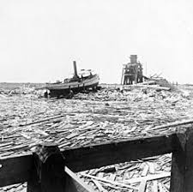
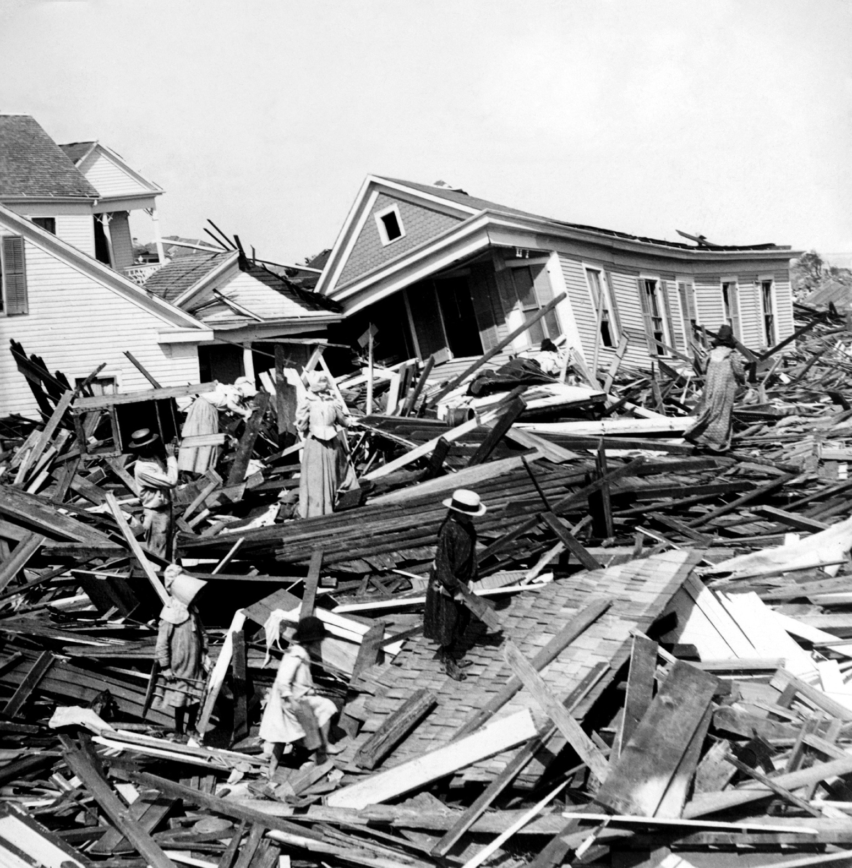
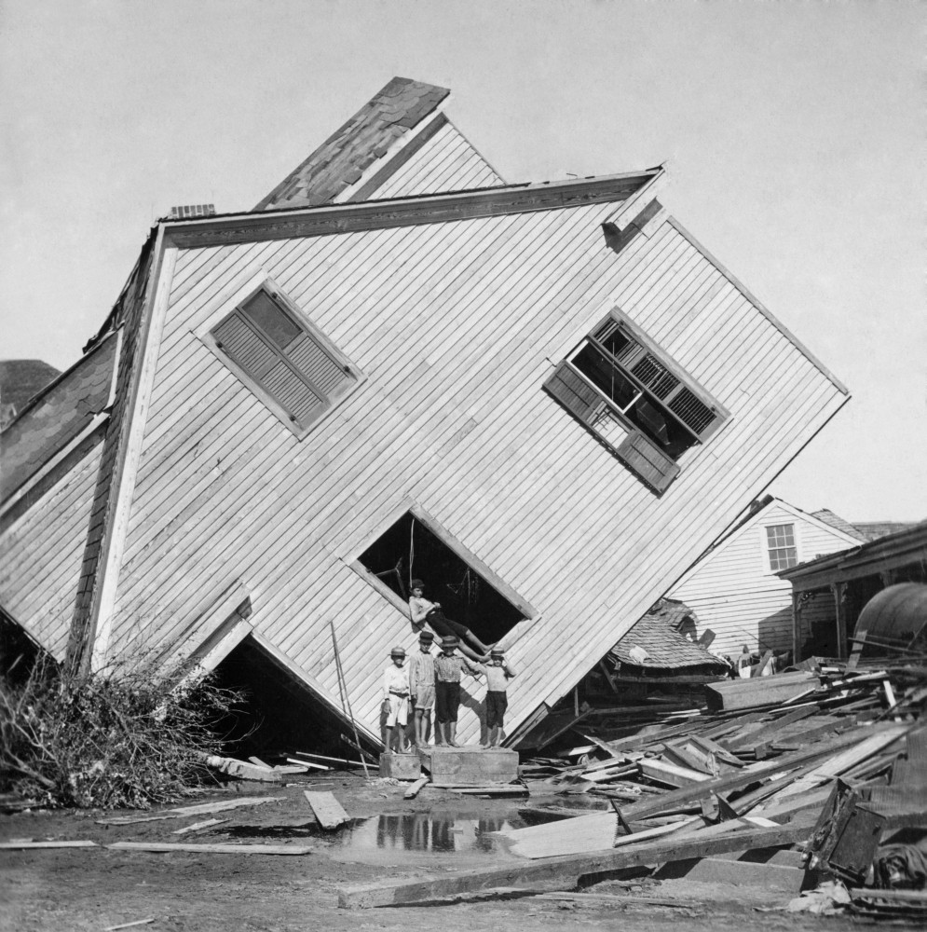
Joseph D. Sayers, New deputy of Sheriff of Galveston, TX, Telegram
I have been deputized by the Mayor and citizen committee of Galveston to inform you that the city of Galveston is in ruins and certainly many hundreds if not a thousand are dead. The tragedy is one of the most fightful in recent time. Help must be given by the state and nation or the suffering will be appalling. Food, clothing, and money will be needed. The whole south side of the city for three locks in from the Gulf is swept clear of every building… Water supply is cut off and food stocks damaged by salt water. All bridges washed away… Corpses are everywhere.
According to the telegram, what is the potential loss of human life?
What were the property damages like in Galveston?
Based on the Telegram and the images, what was the situation like in Galveston for survivors?
Notes:
🍐 This is a Pear Deck Multiple Choice Slide
🍐🍐 Your current options are: A: Tornado, B: Hurricanes, C: Blizzards
🍐🍐 Correct options are: B: Hurricanes

Slide 27
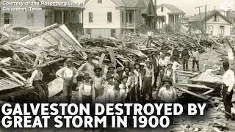
Take notes as you watch the video
Notes:
🍐 This is a Pear Deck Multiple Choice Slide
🍐🍐 Your current options are: A: Tornado, B: Hurricanes, C: Blizzards
🍐🍐 Correct options are: B: Hurricanes

Slide 28
In your journal:
Write a 4-6 sentence paragraph describing how your prediction was right or wrong.
Did your prediction line up with the description in the telegram?
Could this outcome have been avoided? How?
Use all three sources to answer the question.
Notes:
🍐 This is a Pear Deck Multiple Choice Slide
🍐🍐 Your current options are: A: Tornado, B: Hurricanes, C: Blizzards
🍐🍐 Correct options are: B: Hurricanes

Slide 29
Discussion

Slide 30
Why Predictive Essays?
Novelty
  Students enjoy the mystery provided by the initial documents.
  The Galveston Hurricane is not fun to talk about longer than 5 minutes… but my kids ate this up because of the presentation.
Rigor
  Student must analyze and adjust their thinking or established ideas.
Adaptable
  DBQs become novel again and it provides a new approach to document analysis.
  It can be used to encourage literacy based practice in any subject.

Slide 31
Differentiation and Extension
Differentiation:
  Digital for students who need reading assistance
  Chunking - Paragraph/Guiding Question pairing
  Sentence stems to guide students to your desired outcome
Extension:
  Additional “Lost Document”
  In Their Shoes: Not just what did you learn, but how would you conduct yourself in the predictive phase.
  Now I Know…: How would you conduct yourself in the situation with the hindsight to succeed?

Slide 32
How could you use this in your class with your content?
What kind of benefit could this have to your team as a whole?

Slide 33


Make your own!
The remainder of time for this session is for your. Consider a topic you would have your students research.
What documents could you use to guide students or you would like to focus on?
What are you wanting them to learn, and how can you have them consider it BEFORE they learn it?
Want Attendance Credit?
To receive attendance credit for all sessions, you must fill out the feedback form after each session. You can get to the feedback form by using the tinyurl below or scanning the QR code. Please do so within 30 minutes of the session ending. You will receive a copy of your response, so you can make sure you did your survey and to check attendance. Save this for your records!
https://tinyurl.com/ENGAGE26FB
Want these slides?
https://tinyurl.com/Predictive-Essay
Documents used

