Slide 1

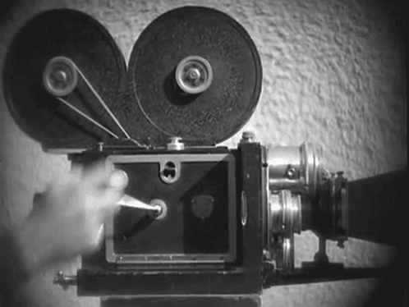

Recording with Annotate

Slide 2


Introductions
Jennifer Bantell
CTMS
Tier 1 Math Interventionist
jennifer.bantell@nisdtx.org
Monica Rehwaldt
CTMS
Pre-Algebra and GT Pre-Algebra
monica.rehwaldtchisn@nisdtx.org

Slide 3
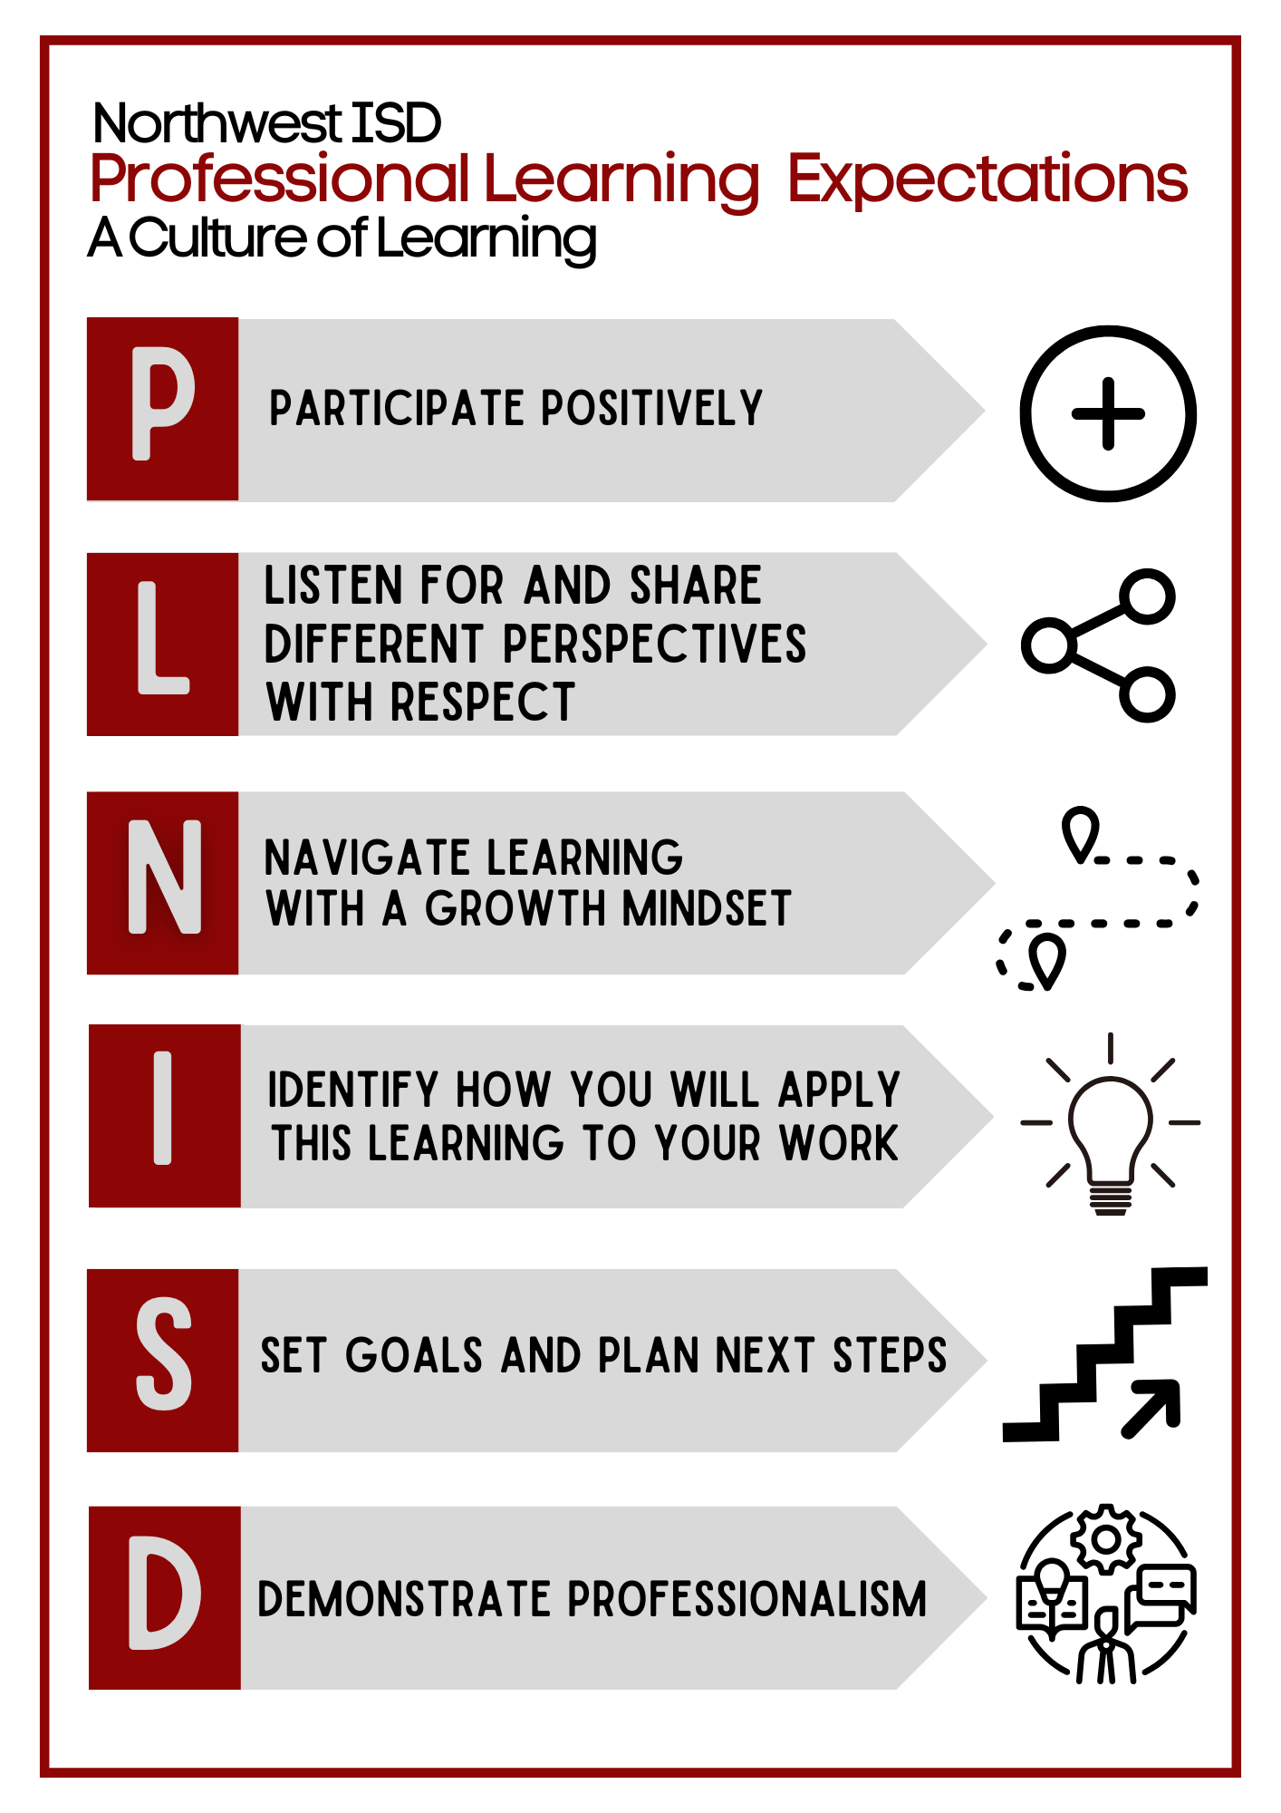

Slide 4


To Receive Credit for this session, make sure you complete the survey at the end

Slide 5



1
Learning Target
Today I will listen actively to others’ contributions and engage respectfully in an academic discussion,
So I can identify relevant information and evaluate how students will benefit from its use.
I’ll know I have it when I can successfully integrate what I’ve learned into my classroom practices.
What is Annotate.net
2
Why & How We Used It
3
Recording Videos
4
Embedding In Canvas
5
YouTube/EdPuzzles

Slide 6




01
What is Annotate.net

Slide 7

What is Annotate.net?

Slide 8
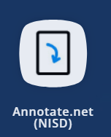
How do you currently use Annotate.net
in your classroom?

Slide 9

02
Why & How We Used It

Slide 10

Discovered by accident!
OSS Student
Loom
Screencastify
Annotate

Slide 11


Test Reviews
Recorded so students could watch at home or in the classroom for extra explanation and practice before a test.
Test Corrections
Students could watch video & make corrections before retakes.
How We Used Recordings
Guest Educator Lessons & Absent Students
Great way for students to still get the lesson and not fall behind the other classes.
Extra Practice
If there was a concept we went over quickly and knew further explanation and practice were needed.

Slide 12


03
Recording Videos

Slide 13

Steps to Logging Into Annotate.net on Laptop
Sign into Annotate.net - sign in with Google, click on my name. Laptop first, then iPad.

Slide 14

Steps to Logging Into Annotate.net on iPad

Slide 15
Steps to Recording a Single Video
Remote Desktop
Hit Red circle in bottom left corner
Title - Untitled 001, make sure Record mic audio is checked, decide if you want closed captioning. CREATE
Allow to use your Microphone
Start Talking and Teaching.
Done - hit blinking red circle - stop to end. Pause for a quick break.
Stop - saving clip - you are done.
HAVING STUDENTS IN YOUR VIDEO
Make sure you have permission from parents. (Media Release Form)
Record with only student voice or from behind students.

Slide 16
Steps to Recording a Video with Scenes
Remote Desktop
Hit Red circle in bottom left corner
Title - Untitled 001, make sure Record mic audio is checked, decide if you want closed captioning. CREATE
Allow to use your Microphone
Start Talking and Teaching.
Done - hit blinking red circle - stop to end. Pause for a quick break.
Stop
Hit Red circle again.
Click Append to previous clip OK
Click CREATE
Repeat steps for additional scenes

Slide 17
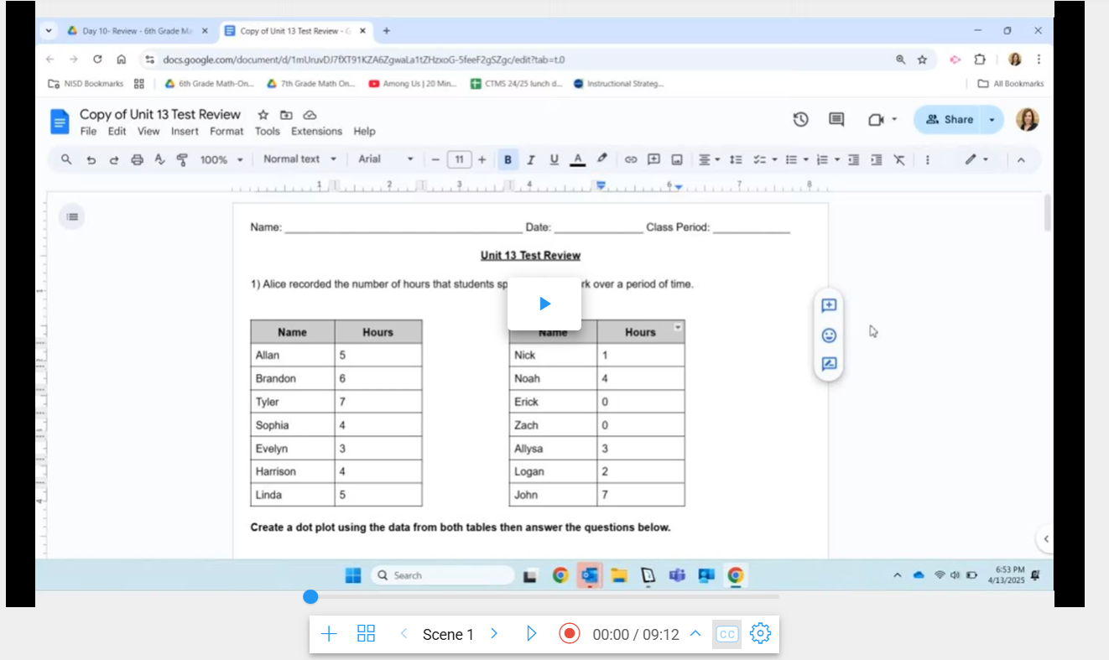

Slide 18
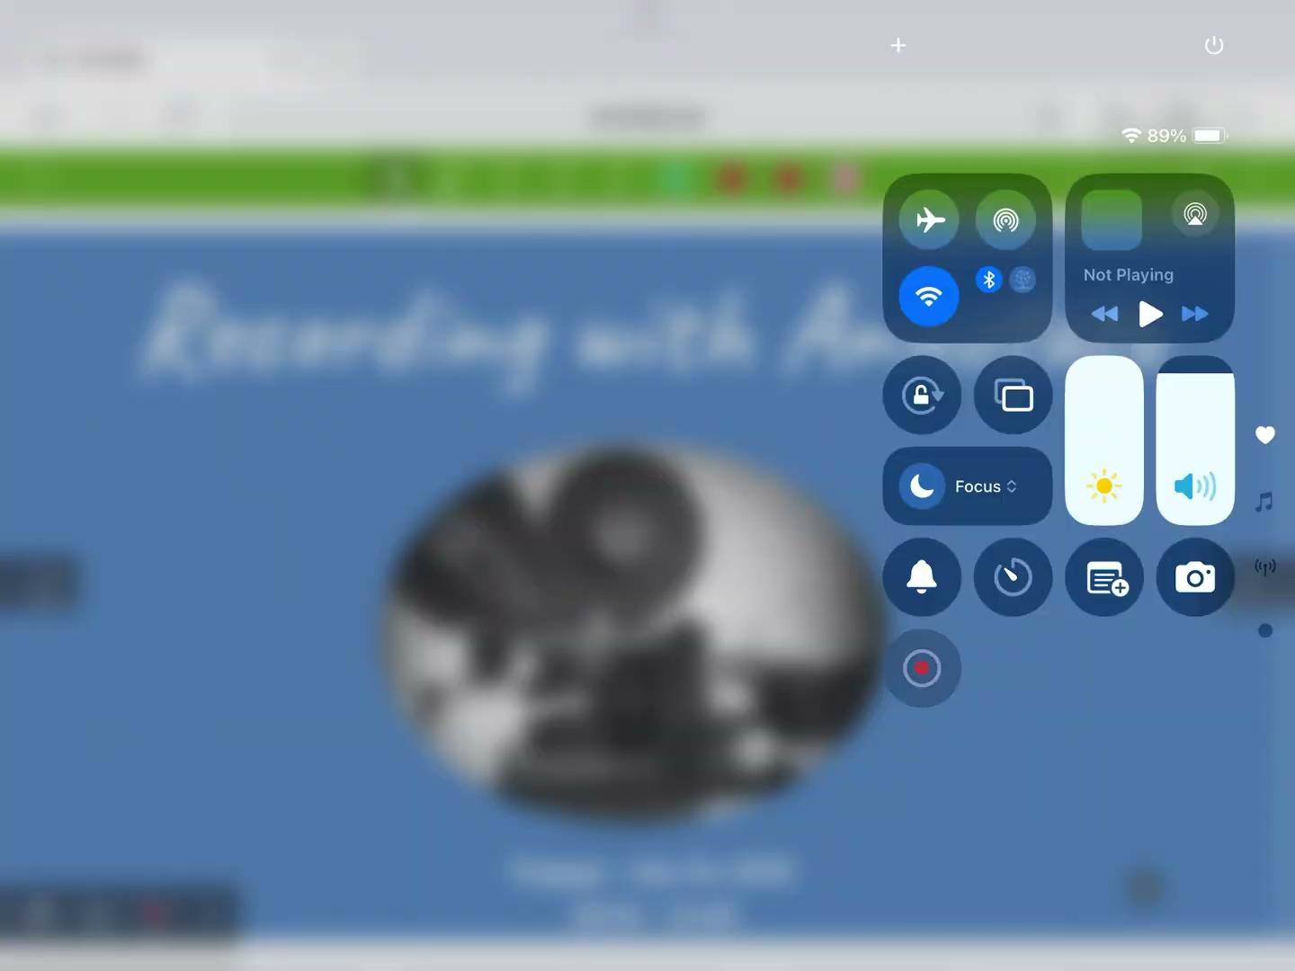
Deleting a Scene
Record your video, making the different scenes.
Go back to your video library.
Click on video with the scene you want to delete.
Click on the scene you want to delete.
Click on settings wheel.
Pick - Delete Scene

Slide 19



04
Embedding Video into Canvas

Slide 20
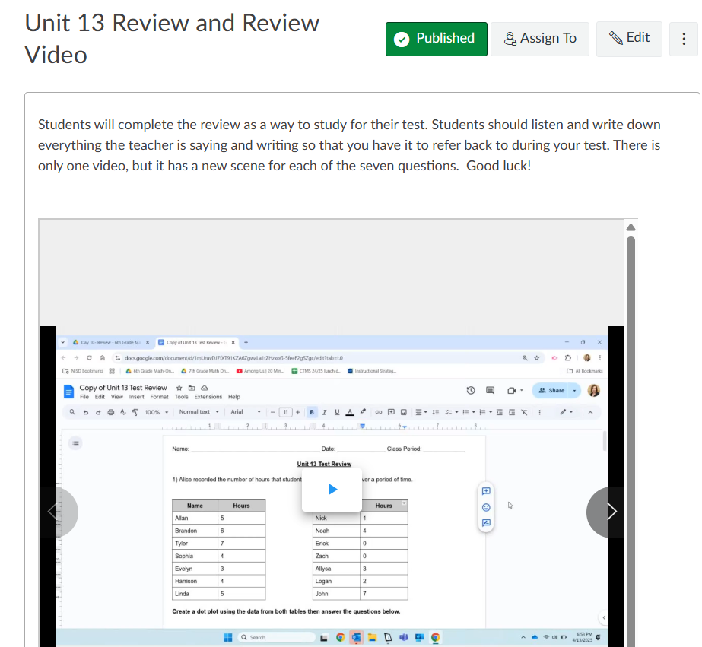
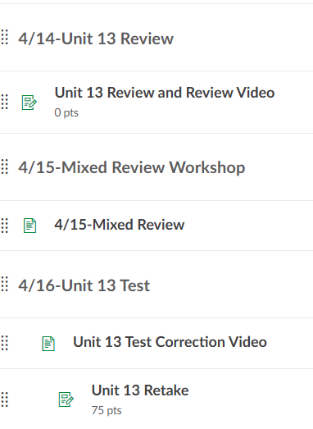
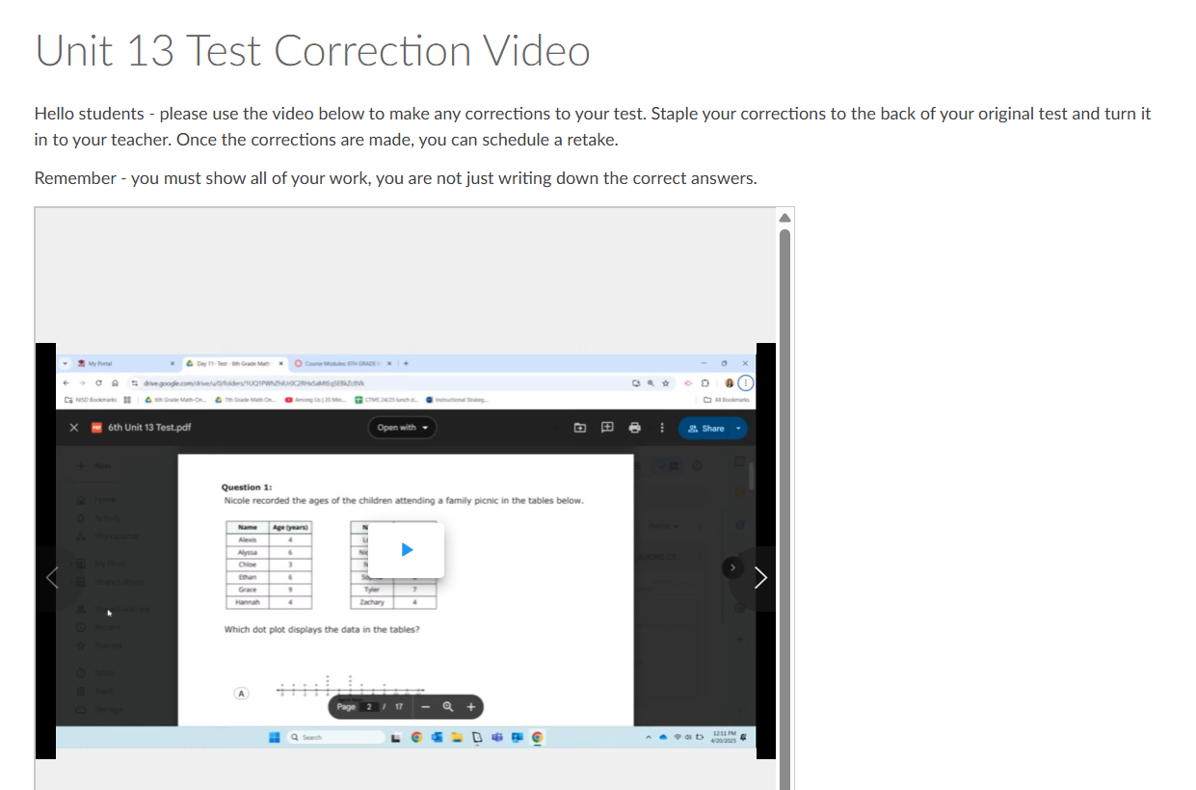

Slide 21
Embedding an Annotate Video into Canvas Steps
Canvas:
Set up your module or add to existing module
Set up your assignment/page
Click on your assignment/page - pick Edit
Click on three vertical dots
Click on Embed (little cloud)
Annotate:
Next to your video to load, click on three vertical dots
Embed
Change to 700x700
Control A, Control C
Canvas:
Control V into Embed
Submit

Slide 22


05
YouTube/EdPuzzles

Slide 23
Uploading an Annotate Video to YouTube

Slide 24
Changing an Annotate Video to an EdPuzzle & Adding Questions

Slide 25

Let’s Try It

Slide 26

Take Away Opportunity
Learning Target
Today I will listen actively to others’ contributions and engage respectfully in an academic discussion,
So I can identify relevant information and evaluate how students will benefit from its use.
I’ll know I have it when I can successfully integrate what I’ve learned into my classroom practices.
Using a sticky note, share one take away from this session that you can implement in your classroom right away.
QUESTIONS
Notes:
write on sticky notes and share them as a whole group, leave sticky note on the board as you leave the room

Slide 27






Want Attendance Credit?
To receive attendance credit for all sessions, you must fill out the feedback form after each session. You can get to the feedback form by using the tinyurl below or scanning the QR code. Please do so within 30 minutes of the session ending. You will receive a copy of your response, so you can make sure you did your survey and to check attendance. Save this for your records!
https://tinyurl.com/ENGAGE26FB

