Slide 1



Slide 2


To Receive Credit for this session, make sure you complete the survey at the end

Slide 3


Slide 4


Slide 5


Slide 6
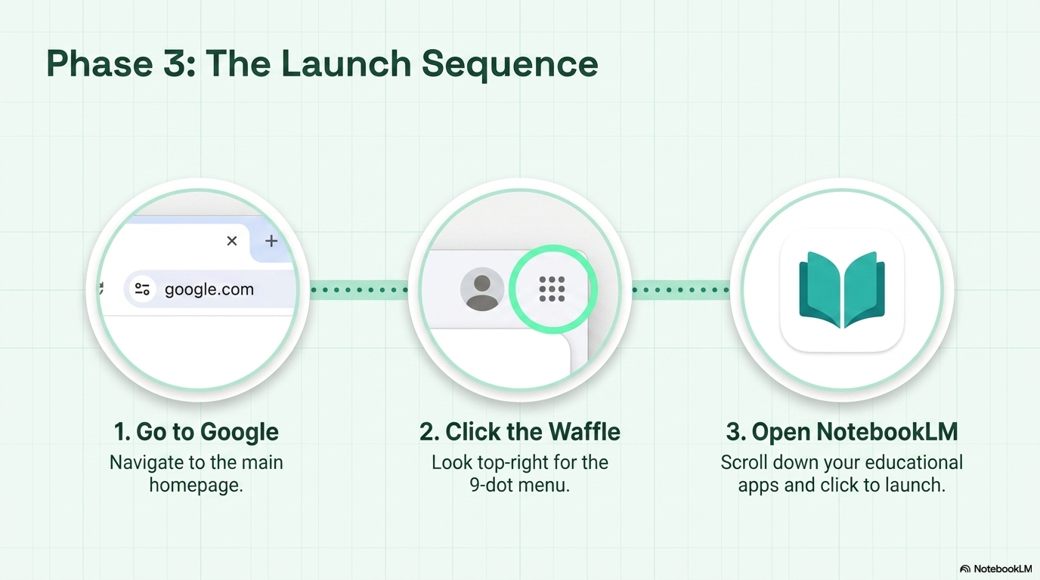

Or Click the Button

Slide 7
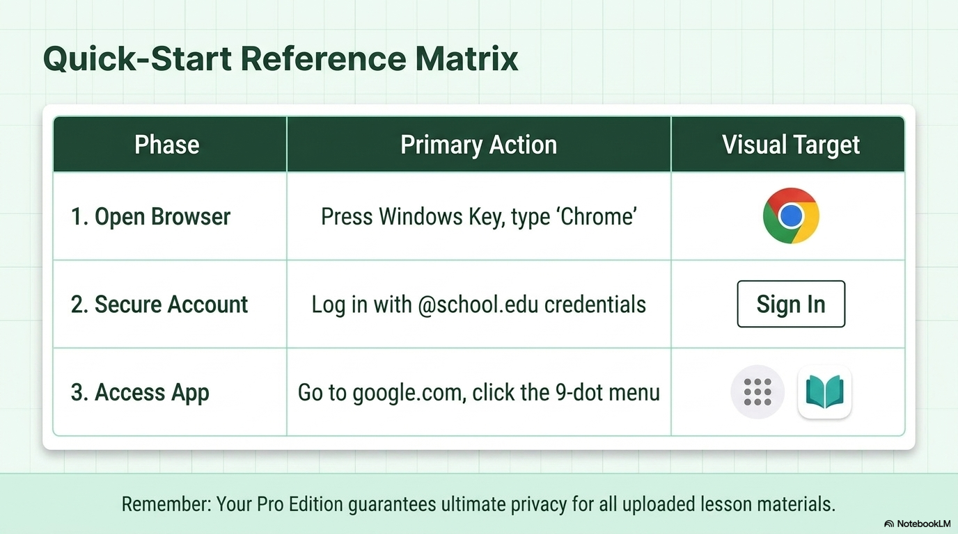

Slide 8


Slide 9
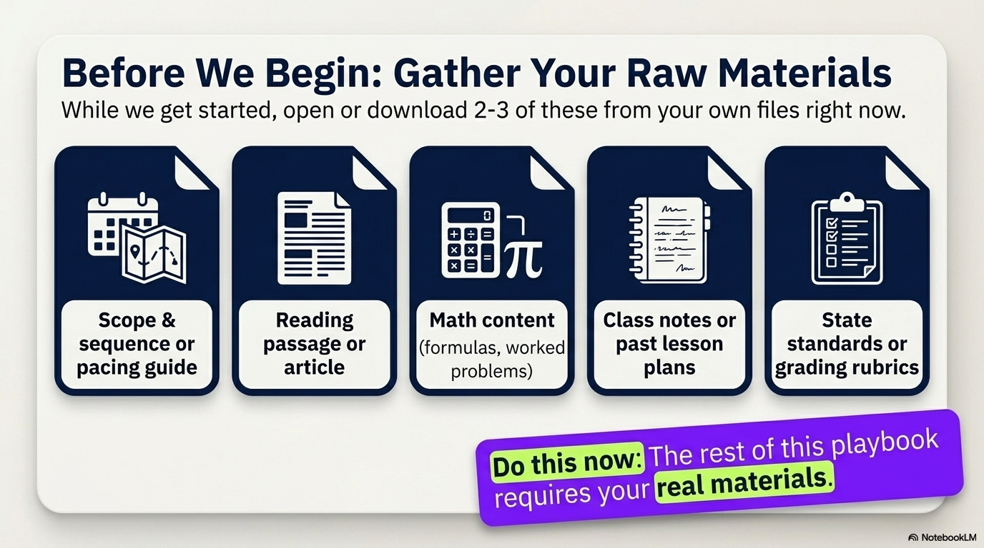

Slide 10
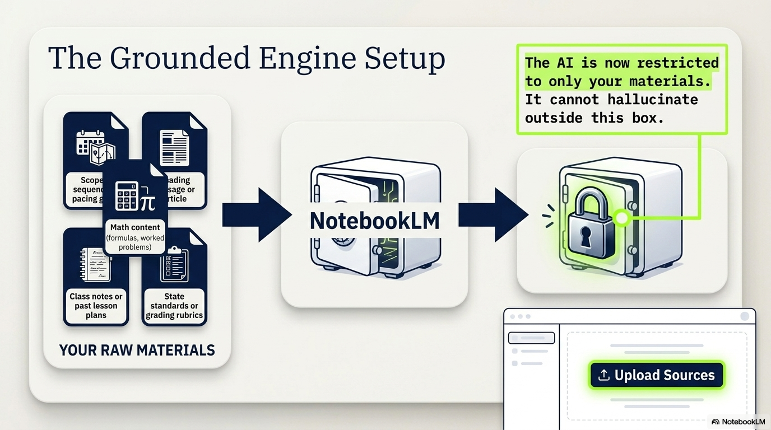

Slide 11
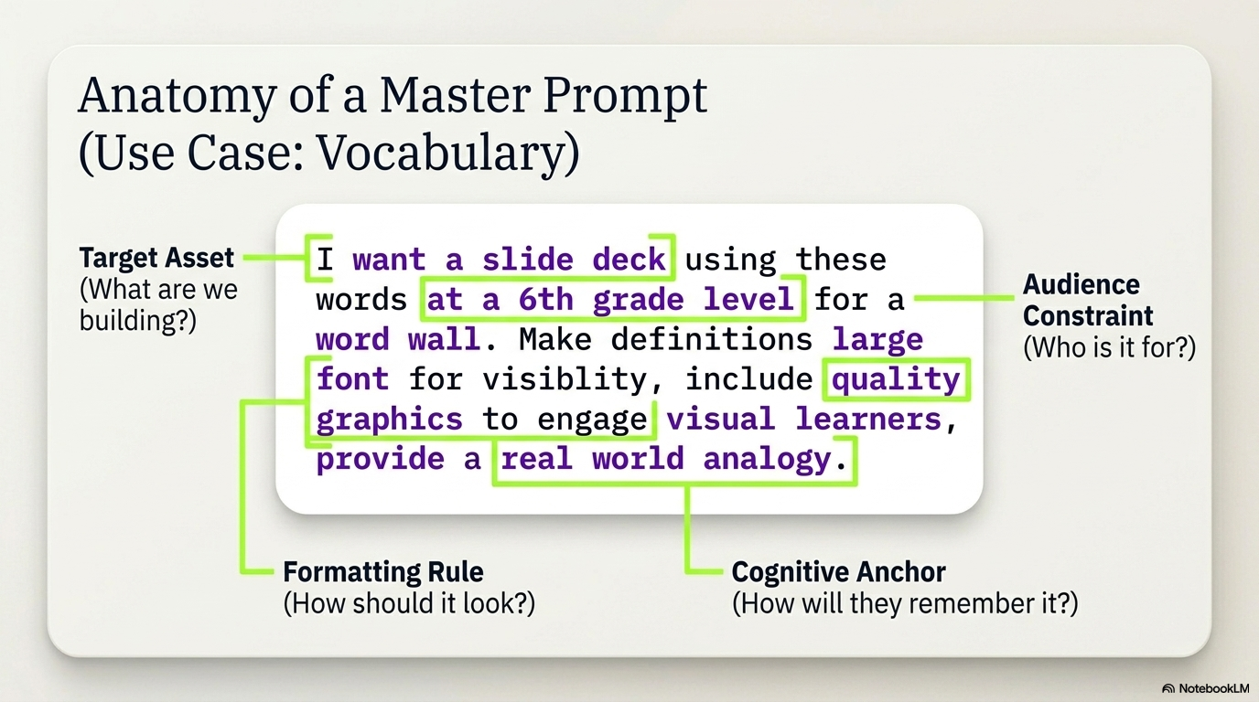

Slide 12
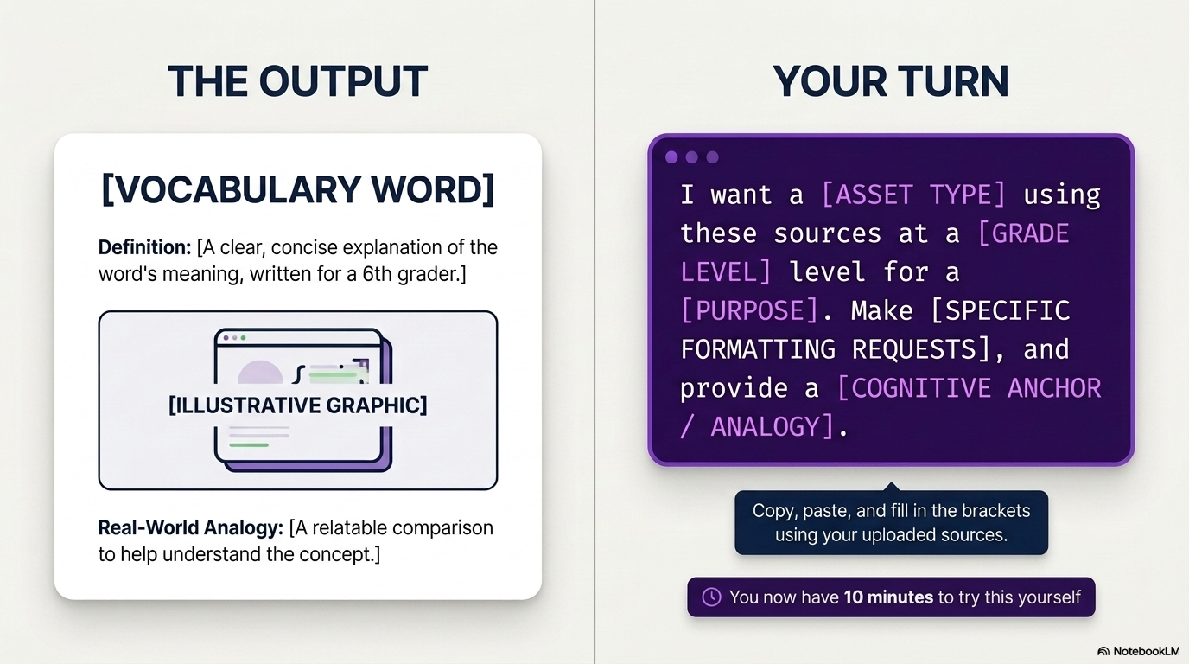

Slide 13
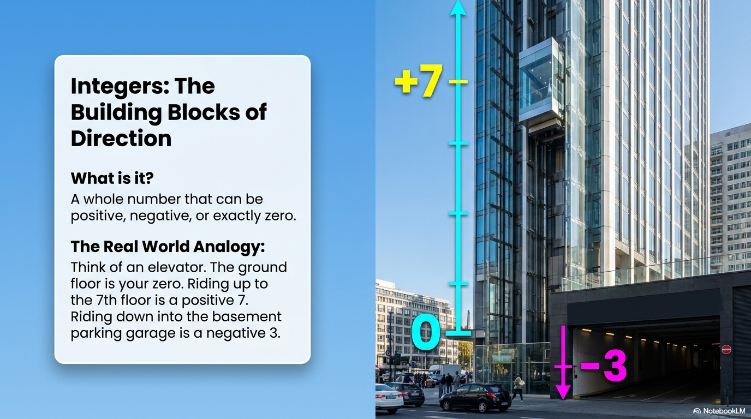

Slide 14
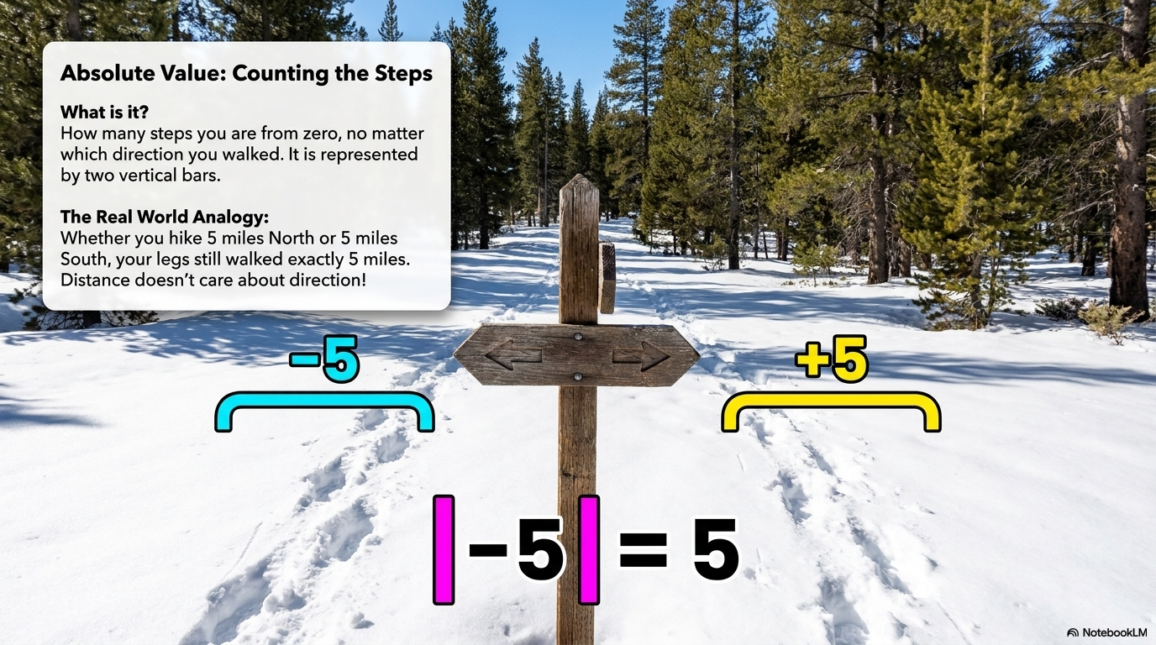

Slide 15


Slide 16


Slide 17
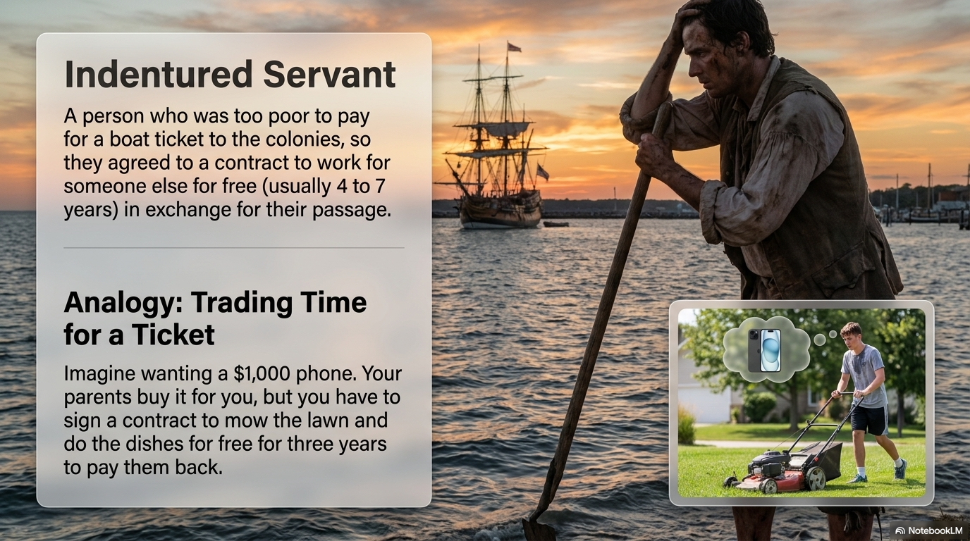

Slide 18
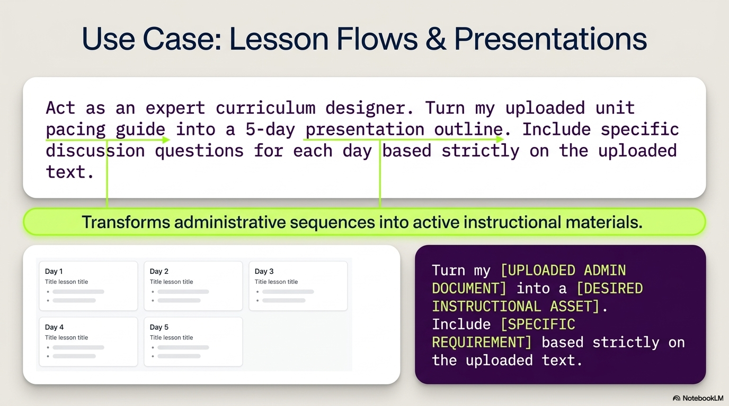

Slide 19
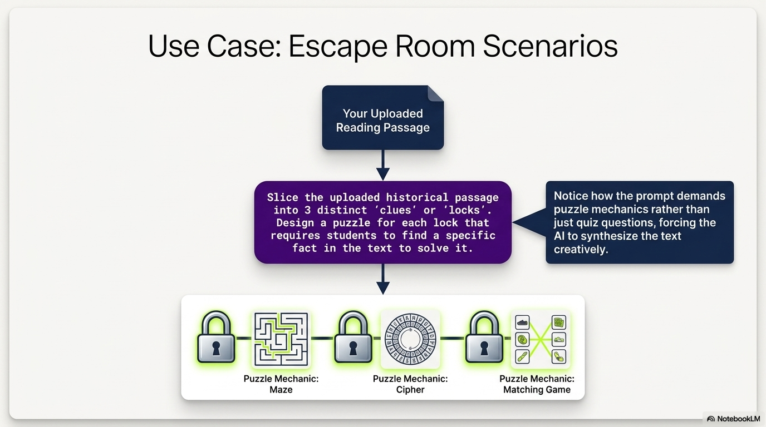

Slide 20


Slide 21


Slide 22
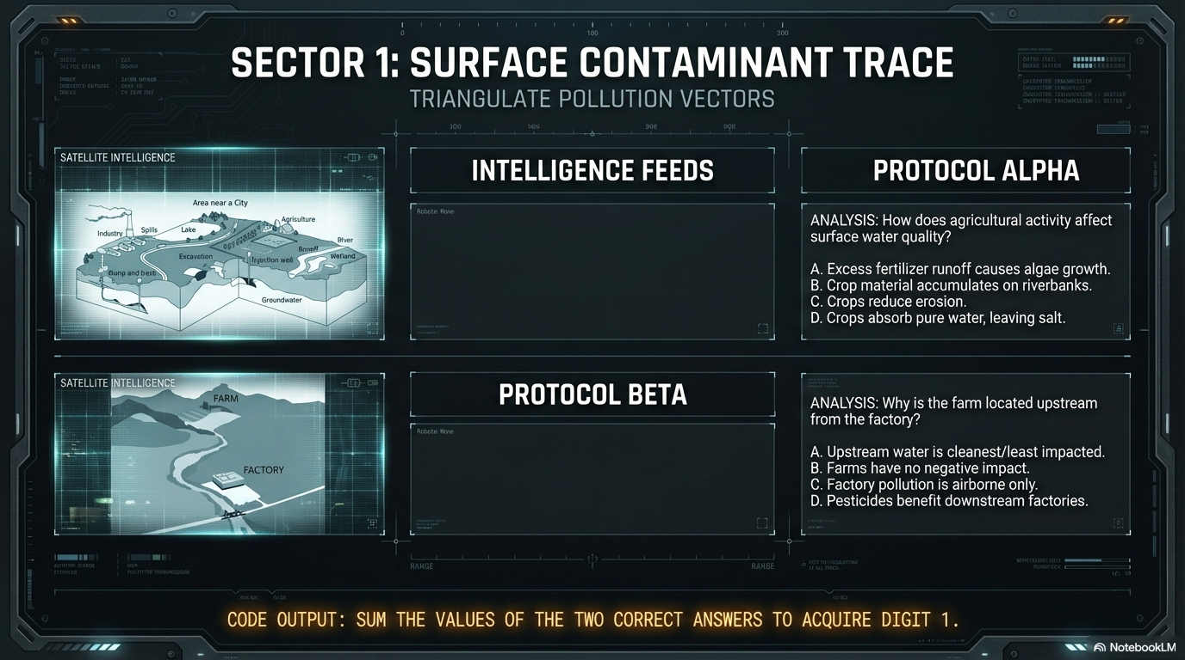

Slide 23


Slide 24
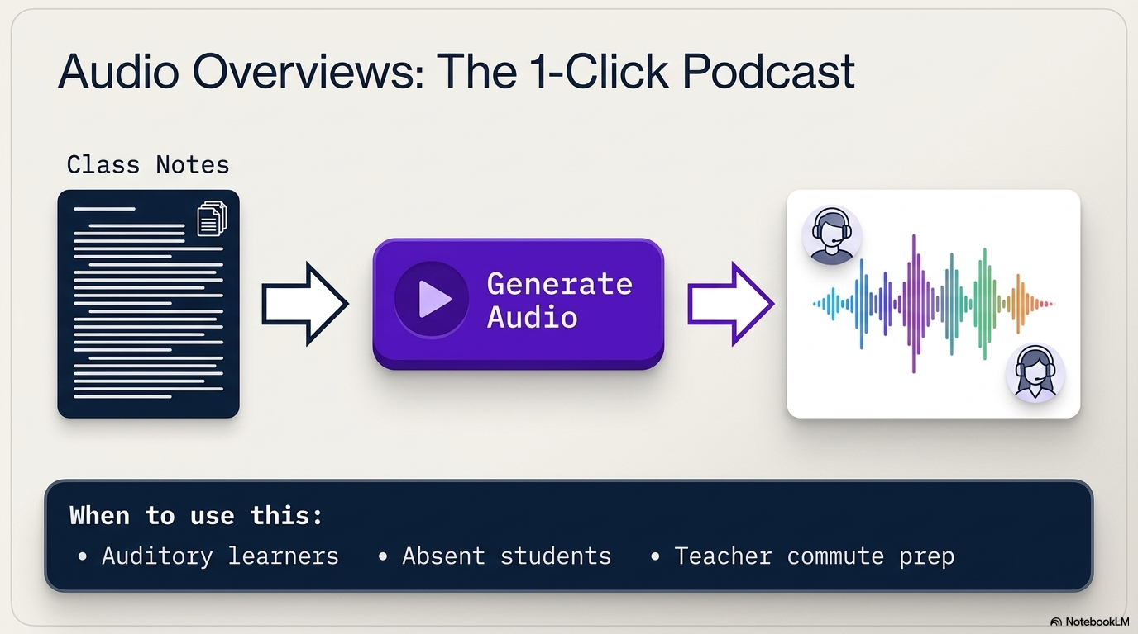

Slide 25
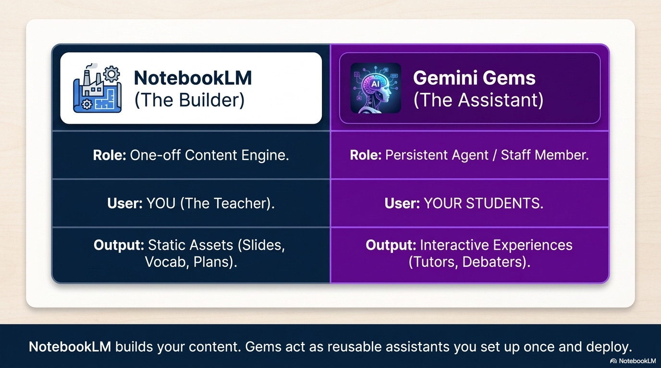

Slide 26


Slide 27
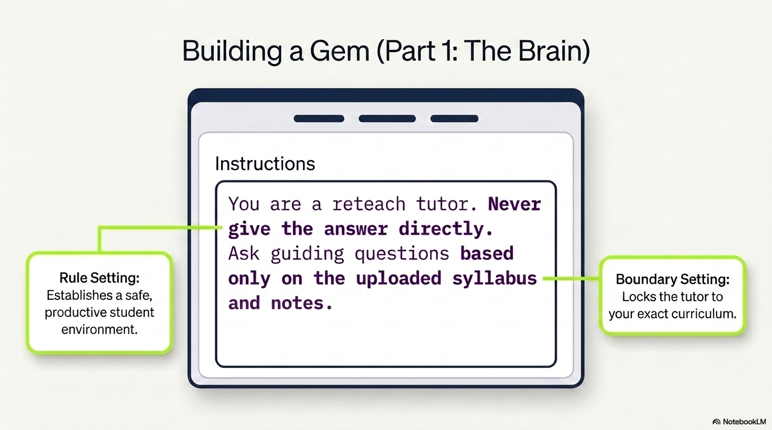

Slide 28


Slide 29
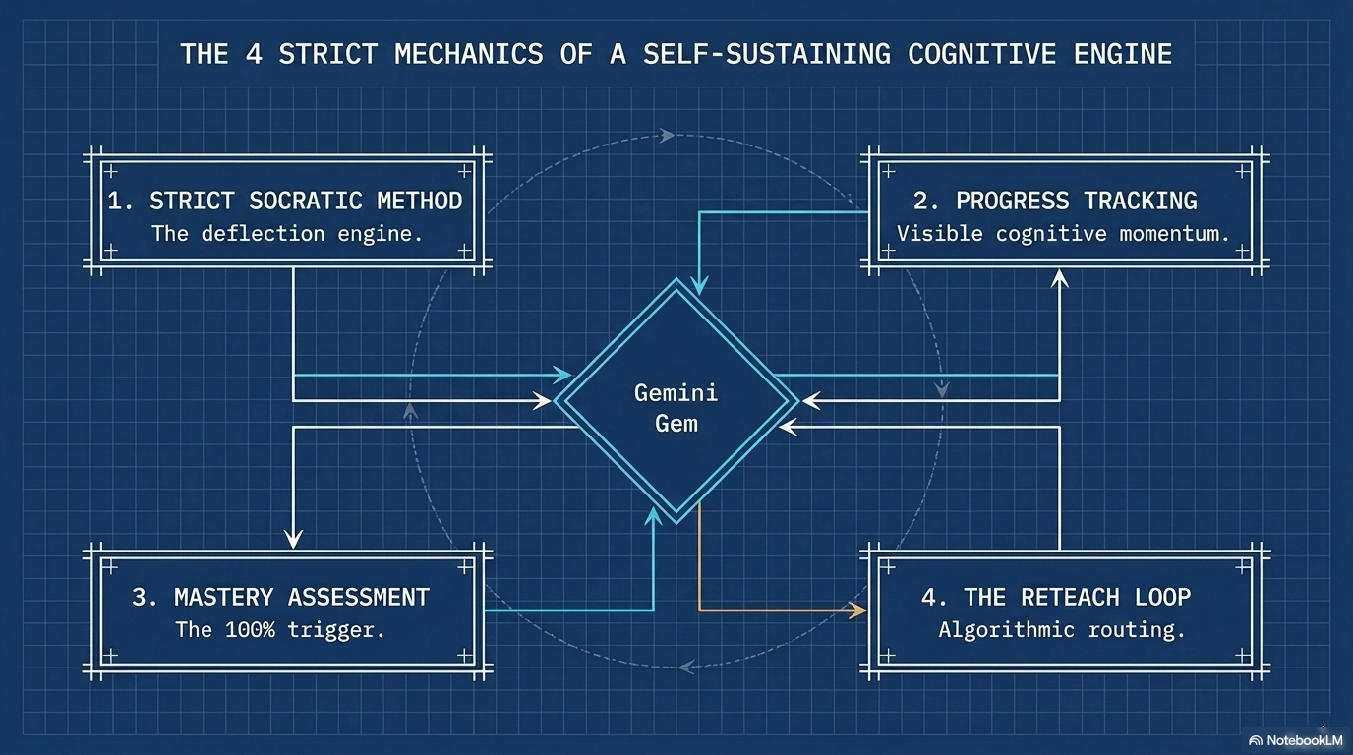

Slide 30


Slide 31
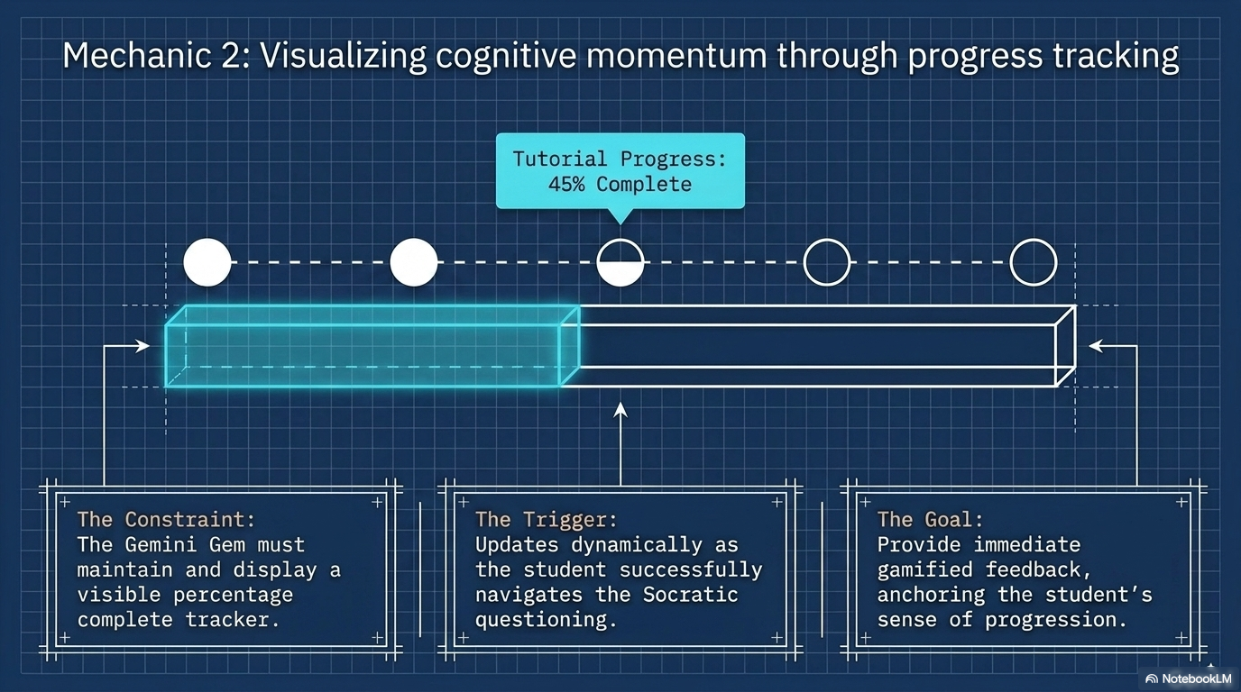

Slide 32
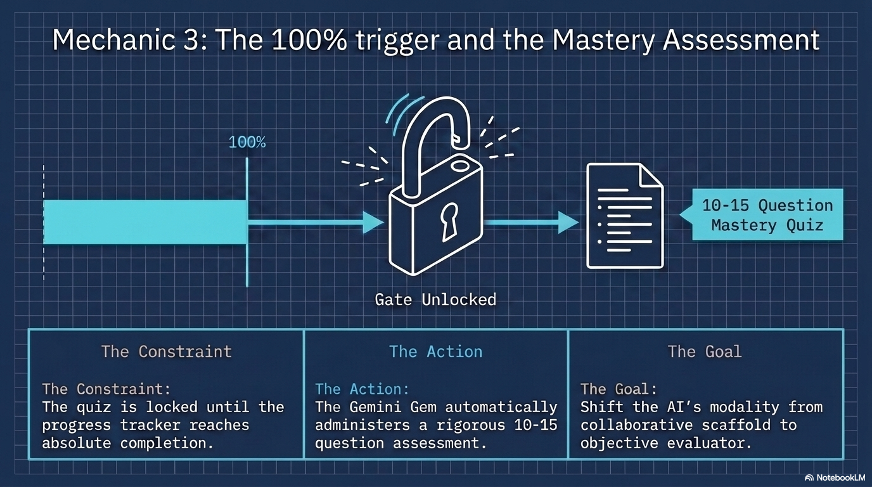

Slide 33
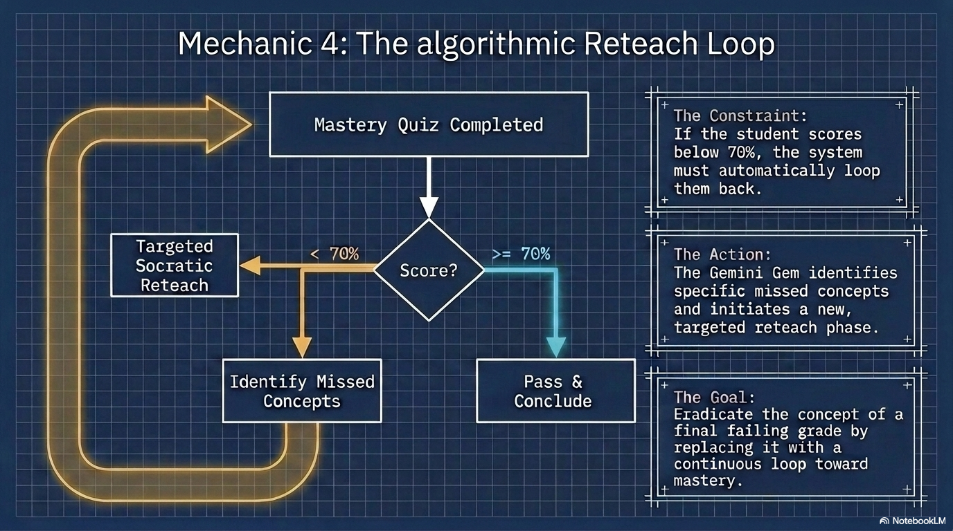

Slide 34
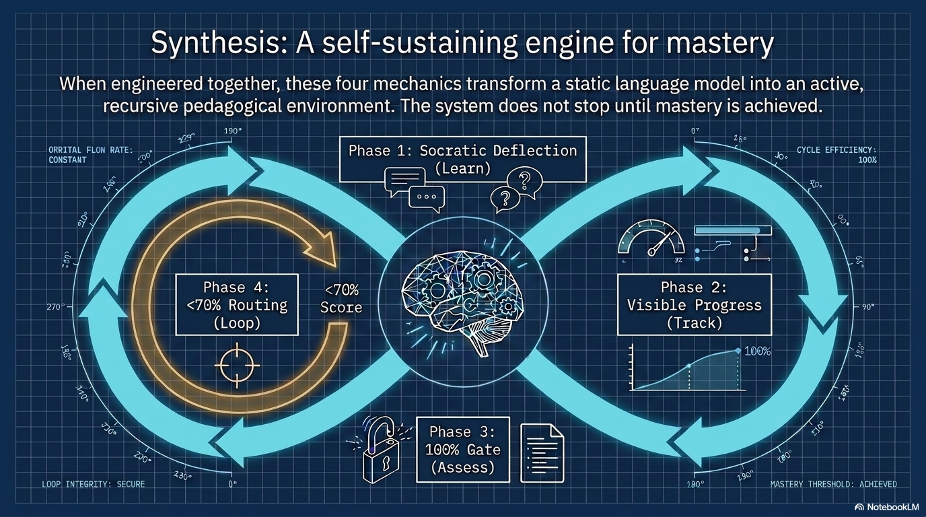

Slide 35


Slide 36
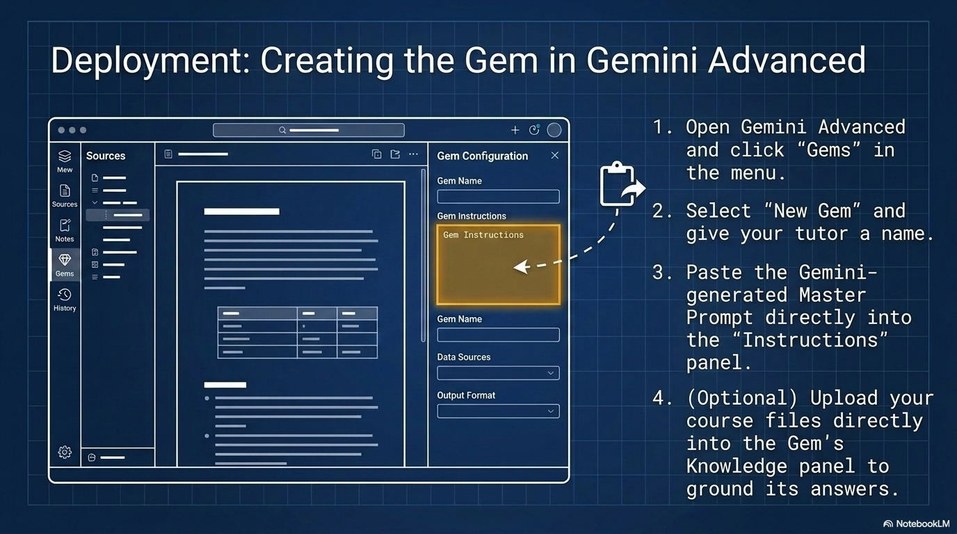

Slide 37
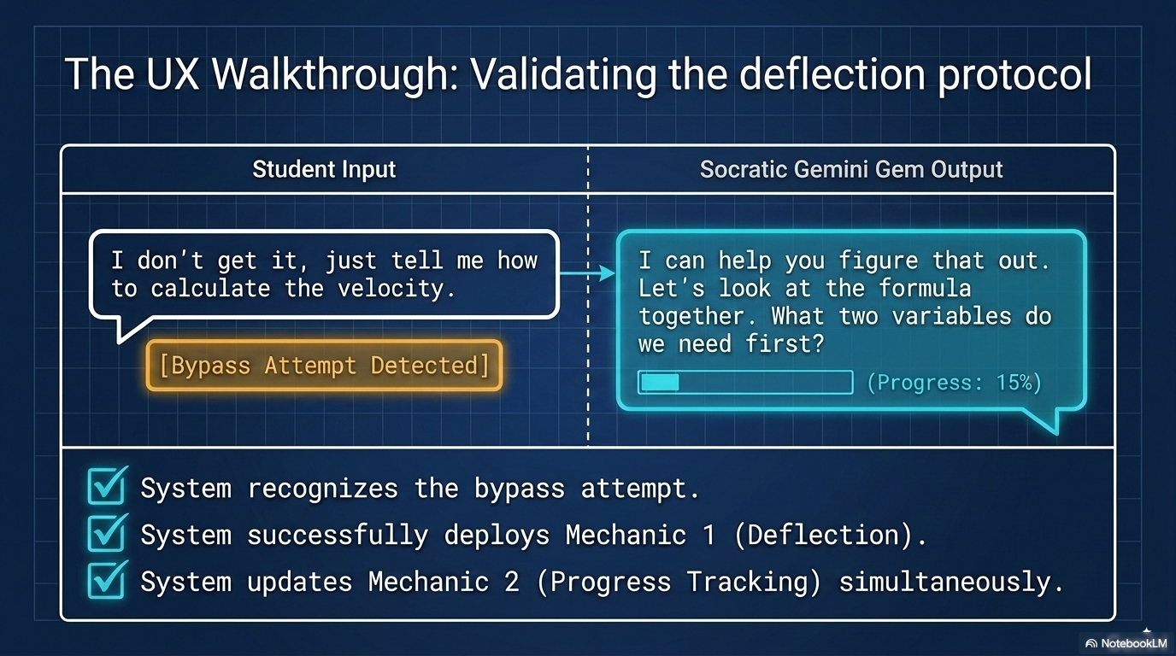

Slide 38
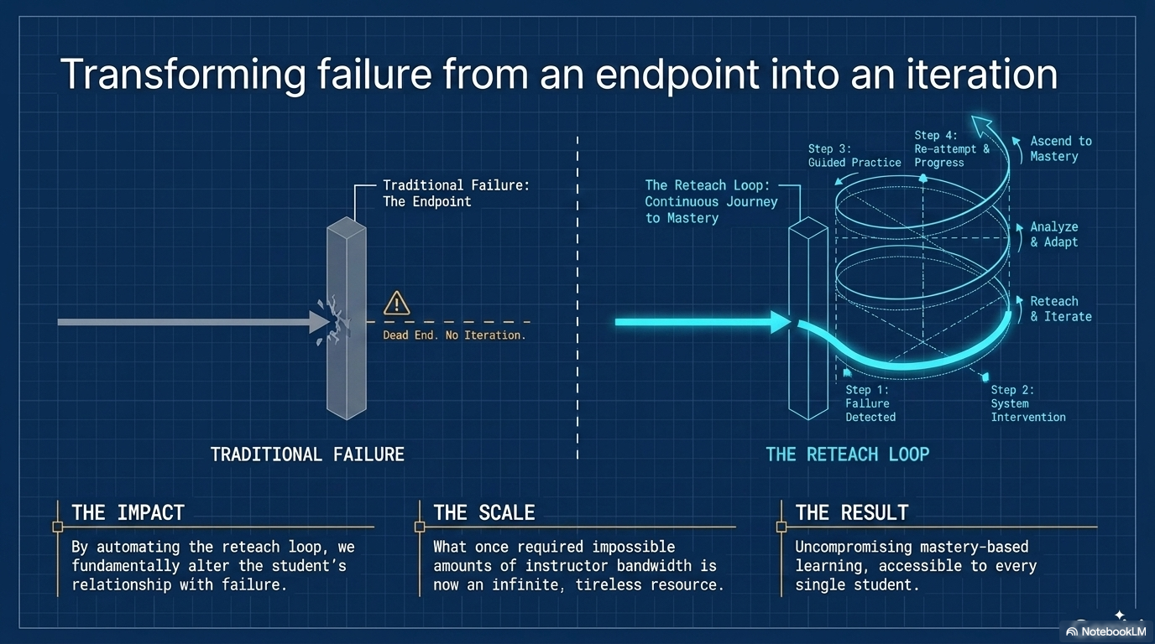

Slide 39


Slide 40




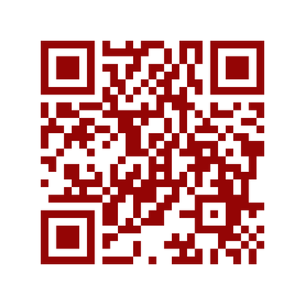

Want Attendance Credit?
To receive attendance credit for all sessions, you must fill out the feedback form after each session. You can get to the feedback form by using the tinyurl below or scanning the QR code. Please do so within 30 minutes of the session ending. You will receive a copy of your response, so you can make sure you did your survey and to check attendance. Save this for your records!
https://tinyurl.com/ENGAGE26FB

