Slide 2

TO RECIEVE CREDIT FOR THIS SESSION, MAKE SURE YOU COMPLETE THE SURVEY AT THE END

Slide 3









  Tools that Make a Difference: A Classroom System for Progress Monitoring and Personalized Learning
BRANDIE WOLF
GRACIE BARNHILL

Slide 4



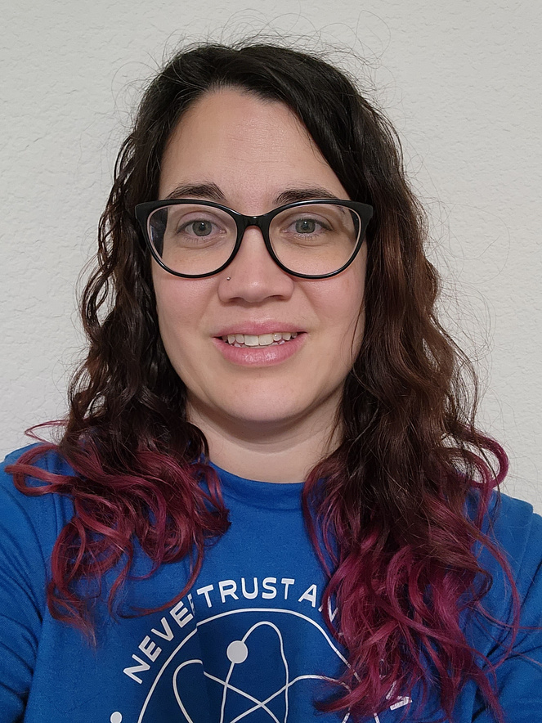






The team
Brandie Wolf
Gracie Barnhill

Slide 5


Objectives
Binders
Progress Monitoring
Remediation
Templates
Accountability Incentives

Slide 6


Binders
Why did we switch?
  Messy, disorganized notebooks are NOT helpful resources for students, and they are impossible to FIX
  Cutting and gluing/taping/stapling things into notebooks is both messy and a time waster
  Notebooks tend to get torn up pretty easily
W

Slide 7



Binders
Pros & Cons
Pros
  NO cutting/gluing/taping/stapling ever - more assignments. Less stealing of supplies. Less mess.
  Things can be removed, re-ordered, replaced by just popping open the rings
  Binders are typically more durable than notebooks
  More space!
Cons
  Yes, you have to remember to hole punch everything you print...OR, you now have a job for that student that always wants to help...
  Papers can fall out/be pulled out...this happens with notebooks too, but now you can easily put them BACK
  Binder rings can pop open...yes, it stinks, but it’s not THAT common
  Take up more space...science is fortunate here, I wish that all of us had more space in our rooms!
B

Slide 8


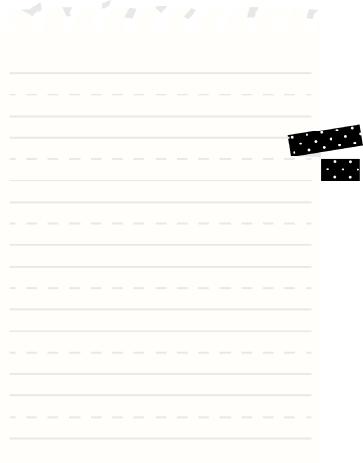
Binders
Organization
  1
  2
  3
Table of Contents
Unit Dividers
Numbering Pages
W

Slide 9






Binders
Table of Contents
Digital “master” copy kept by teacher, posted in Canvas for students and parents to see/check whenever they need
Teachers choice whether students keep one written in their binder
Other ideas: table of contents PER UNIT kept behind or ON the unit divider, students keep their own table of contents- more common for teachers that don’t mind if students are on the same “page”
W

Slide 10
Binders
Unit Divider
  We like to put our dividers on colored paper to differentiate each unit.
  Unit Goal and action steps to meet the goal.
  Feeling monitor - asking how they feel about the beginning of the unit.
  Unit vocabulary words that we take as a formative grade due the day before the test.
  We build in Extra Credit opportunities in each unit; these are the ONLY EC offered in our classes and they know
  Feeling monitor - asking how they feel about the end of the unit.
W

Slide 11

Binders
Numbering Pages
Put numbers on any pages you PRINT for students
Leaves out confusion of “what was that assignment called” “what does it look like?” when organizing binder
One number does NOT have to equal one sheet of paper; ie notes can be multiple pages without being multiple page numbers (think of them as “entry” numbers)
Hoping this helps when binders do pop open.
B

Slide 12

Reflection Time
  Are there other tools that you use for your binders/notebook/organization?
  How would you use these tools in your classroom?
  Is there anything that you would do differently ?
  Is there anything you would be willing to share?

Slide 13
Progress Monitoring
Progress Monitoring
  Pretest, formative assignment, and Unit test scores. (objective is to see growth).
  I can statements (rate their knowledge)
  Test reflection broken down by TEKS (the needed reports are available for MS now, but not HS)
  Do you need to retest? (students can send email home and copy teacher)
B

Slide 14

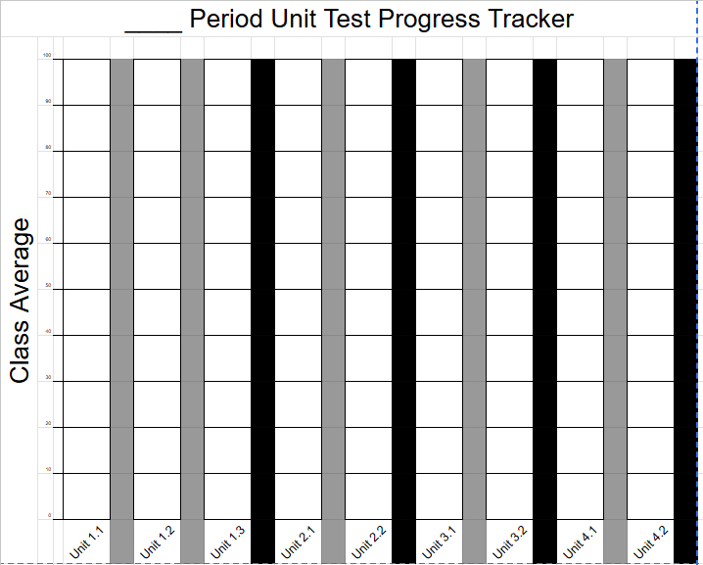
Progress Monitoring
You can make poster versions for the class averages and put them on the wall.
You can print this on a regular page for the binder and students can fill it out at the beginning and end of each unit.
In a reflection (on our PM sheets), students can reflect on what they did or did not do in that unit to show growth
W

Slide 15
Reflection Time
  Are there other tools that you use for progress monitoring?
  How would you use these tools in your classroom?
  Is there anything that you would do differently ?
  Is there anything you would be willing to share?

Slide 16
Remediation
Remediation
  To reteach the students you can use Edpuzzle or google vids. This allows students that cannot attend a tutorial to have a proper reteach. If they fail their reteach, they must attend a tutorial before they can retest.
  To take the retest they will receive a code.
  For students with restricted chromebooks, you can use the app My Video Spot, in your portal. This can allow access to any Youtube video. Your portal profile must be in staff duo mode. You can do this by clicking on the person icon in the top right of the screen.
    Canvas Mastery Paths- this is a work in progress for us, but could be a useful tool to auto-differentiate
B

Slide 17
Reflection Time
  Are there other tools that you use for remediation?
  How would you use these tools in your classroom?
  Is there anything that you would do differently ?
  Is there anything you would be willing to share?

Slide 18
Templates
Templates
  We use one set of slides per unit and put them at the top of our Canvas module for easy access.
  This is an example of how we use our daily slides.
  Students answer entry- exit ticket questions on the template posted on the next slide.
  In our daily slides we use voice level slides that have our agenda on them. This lets students know the expectations.
  After the learning target, we go over a behavior target. Thank you Mrs. Belcoff from Pike.
W

Slide 19
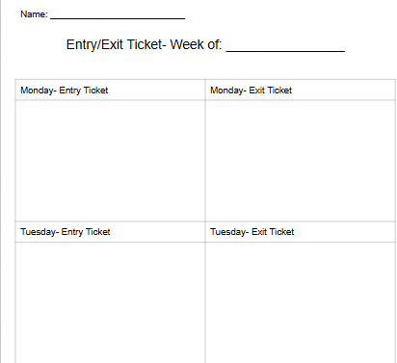
You can differentiate how to use this template. You could have honors answer in full sentences. For on level, you could pre type the questions. For EB’s you can translate them or add visual vocabulary.
Templates
B

Slide 20
Reflection Time
  Are there other tools that you use for templates?
  How would you use these tools in your classroom?
  Is there anything that you would do differently ?
  Is there anything you would be willing to share?

Slide 21
Accountability Incentives
Accountability Incentives
  Print student detail sheet from HAC. Students must address missing work, and get signed by a parent. The reward is up to you. If the student does not have missing work, they just get a signature.
  We post two extra credit assignments to Canvas at the beginning of each unit for 5 extra credit points each. These are due the day before the unit test.
  We check binders on test day to make sure that unit is in order and everything is complete. This is counted as a grade trade.
  We post a LONG unit review at the beginning of the unit. This is due two days before test day for 10 bonus points on the lowest formative.
W

Slide 22
Reflection Time
  Are there other tools that you use for acountability incentives?
  How would you use these tools in your classroom?
  Is there anything that you would do differently ?
  Is there anything you would be willing to share?

Slide 24






Thank you
  Questions? Ideas? Concerns?

