Slide 1
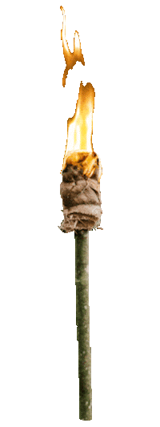



Slide 2



Slide 3
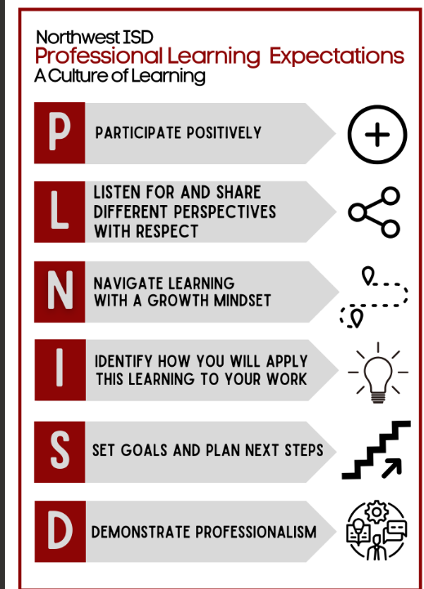

Slide 4

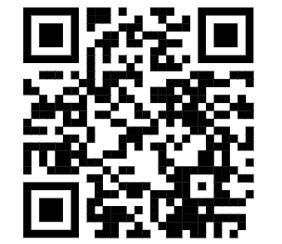
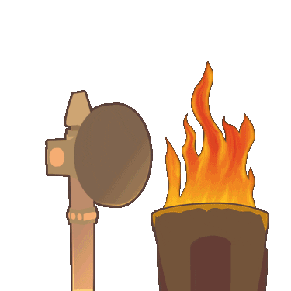
Surviving Routines & Procedures and much more
BACK TO SCHOOL
Monday | Tuesday | Wednesday | Thursday | Friday
 |  | Routines and Procedures Classroom Expectations Survivor teacher Packet Morning Slides/ Survivor | Routines and Procedures | First Tribe meeting

Slide 5

Welcome to Survivor!
This game is intended to provide challenge and foster community building skills!
On the first day you will launch the challenge by setting up groups and have the students Set up camp! “Home Sweet Home”
You will explain the first Survivor Challenge
You can also let them create a tribe name and decorate a flag.
Since it’s the first day of school, the first challenge can be a fun way to teach Routines and Procedures

Slide 6
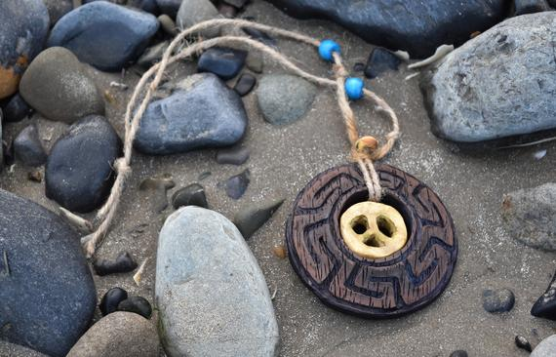
Important Items
Hidden Immunity Idols - Look for hidden immunity idols around the classroom, school, and community.
Immunity Idol - Tribes will receive the immunity idol for winning a challenge.
Soul Survivor - The castaway with the most beads will be crowned the soul survivor of Season 4!

Slide 7
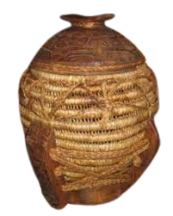
Tribal Council
Every member gets a bead
Vote on team member that was a team player, worked hard, and has accomplished goals (no missing homework).
Castaways may not vote for himself/herself.
Jeff will “Tally the Votes”- winner will earn a bead!

Slide 8
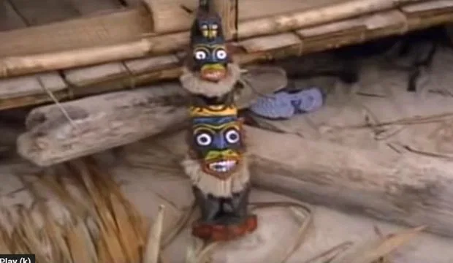
C.Y.O Immunity Idol

Slide 9
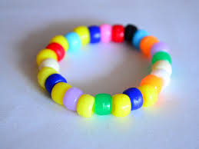
Ways to earn BEADS for your Survivor bracelet:
Participate in a challenge
Participate in Tribal Council
Be the castaway with the most votes
Do exceptionally well on individual daily work, assessments, etc
Hidden immunity idols
First challenge- we are looking for routines and procedures

Slide 10

Who Will be crowned our Sole Survivor? Let’s take a look at how to launch it with your:
Morning Slides Survivor First Nine Weeks

Slide 11
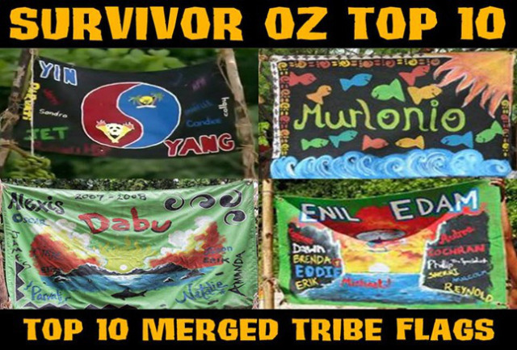
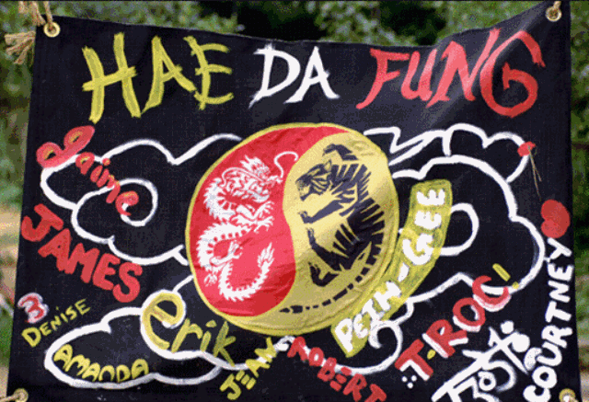
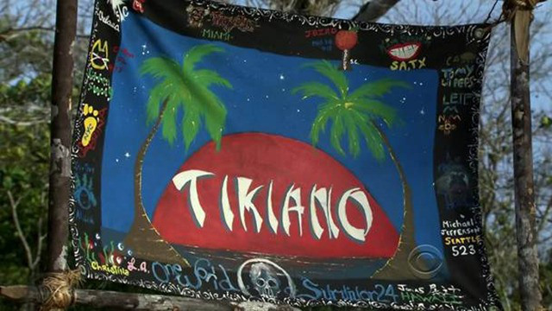


Slide 12



Slide 13

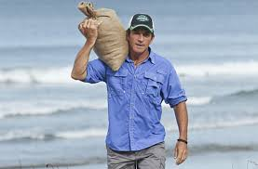
Here comes the host Jeff Probst with your bag of white rice...your food for the next 39 days. Bon Appetit!

Slide 14
Dearest Parents,
We are excited to announce that our class will be participating in the game of “Survivor” Classroom Edition: Season 4. We have been huge fans of the show and thought this would be an exciting way to get students working together as a team and challenging their minds! Hence the words...
Outwork
Outplay
Outlast!
If you have seen “Survivor” before, this game will be set-up very similarly. There will be tribes, challenges, immunity, rewards, tribal buffs, tribal council, and of course the math curriculum built as our core.
Traditionally, the game votes someone off the island, but in our Classroom Island, we are going to vote for the tribe member who has shown the most teamwork.
Students will earn beads throughout the weeks for being successful on the daily math work, winning challenges, and getting the most votes from tribal council. The student who has the most beads will be named the… SOLE SURVIVOR!
We teachers will be playing the hosts, Jeff Probst.
We would love your creative ideas to help us collect/create the following items:
Container to “tally the votes”
Hidden immunity idols - these can be homemade
Buffs: we are asking that each student please bring in $1.00 for this and we will purchase them from Amazon.
Empty Clorox/Lysol Wipe containers large containers only please (~1 lb 2 oz)
Beads (if you have some around the house)
If you have any questions or feedback, please contact us. Thank You!!

Slide 15
Monday
What are you teaching?
Tell your survivor groups that this week they will start earning points for following daily routines and procedures
For following your classroom expectations
Let them know they will earn points for giving you their best effort on assignments
Surprise them with “survivor points” if you observe them in common areas- Think of how you will track the points

Slide 16
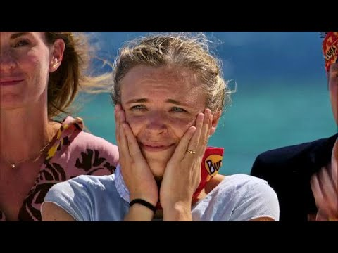


Slide 17

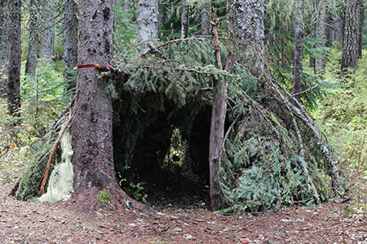
Module 5 Topic B Lessons 4-6
Welcome to your camp…
Home Sweet Home!

Slide 18
Tuesday
Announce who is in the lead
Make sure they know what they are working towards
Keep the rewards simple
Let your admin and fellow teachers know that your students are working towards earning points

Slide 19



Slide 20

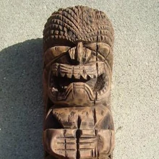

Module 5 Topic B Lessons 7-9
Day Three…
Will you win Immunity?
___________________ Can outlast the rest!

Slide 21
Wednesday
What are you teaching?
Use the survivor challenge to enforce what you are teaching this week
Take a moment to look at your curriculum and instruction materials, what can you give points for this week?
Think through how long you want this first challenge to be? (How long will it take you to know if groups need to be changed?)

Slide 22

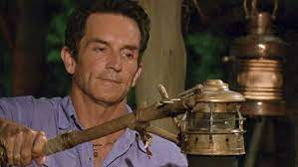
Whose torch will be snuffed?!

Slide 23
Thursday
What are you teaching?
Think of how the survivor challenge can help boost community in your room
By this point, they’ve been working together for a week- consider giving points for the teams that work well together or can tell you facts about their team
Consider engaging your admin team and asking them to be honorary members of each team

Slide 24

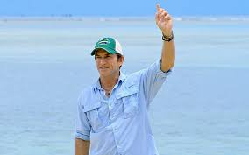
Here we go… for immunity, survivors ready… Go!

Slide 25
Friday
Second Tribal Council!
Consider doing a small reward for the team that has earned the most points
Encourage students to display their team banner in the hall
If your school has announcements, consider having the winning team announced to boost the challenge

Slide 26






Slide 27
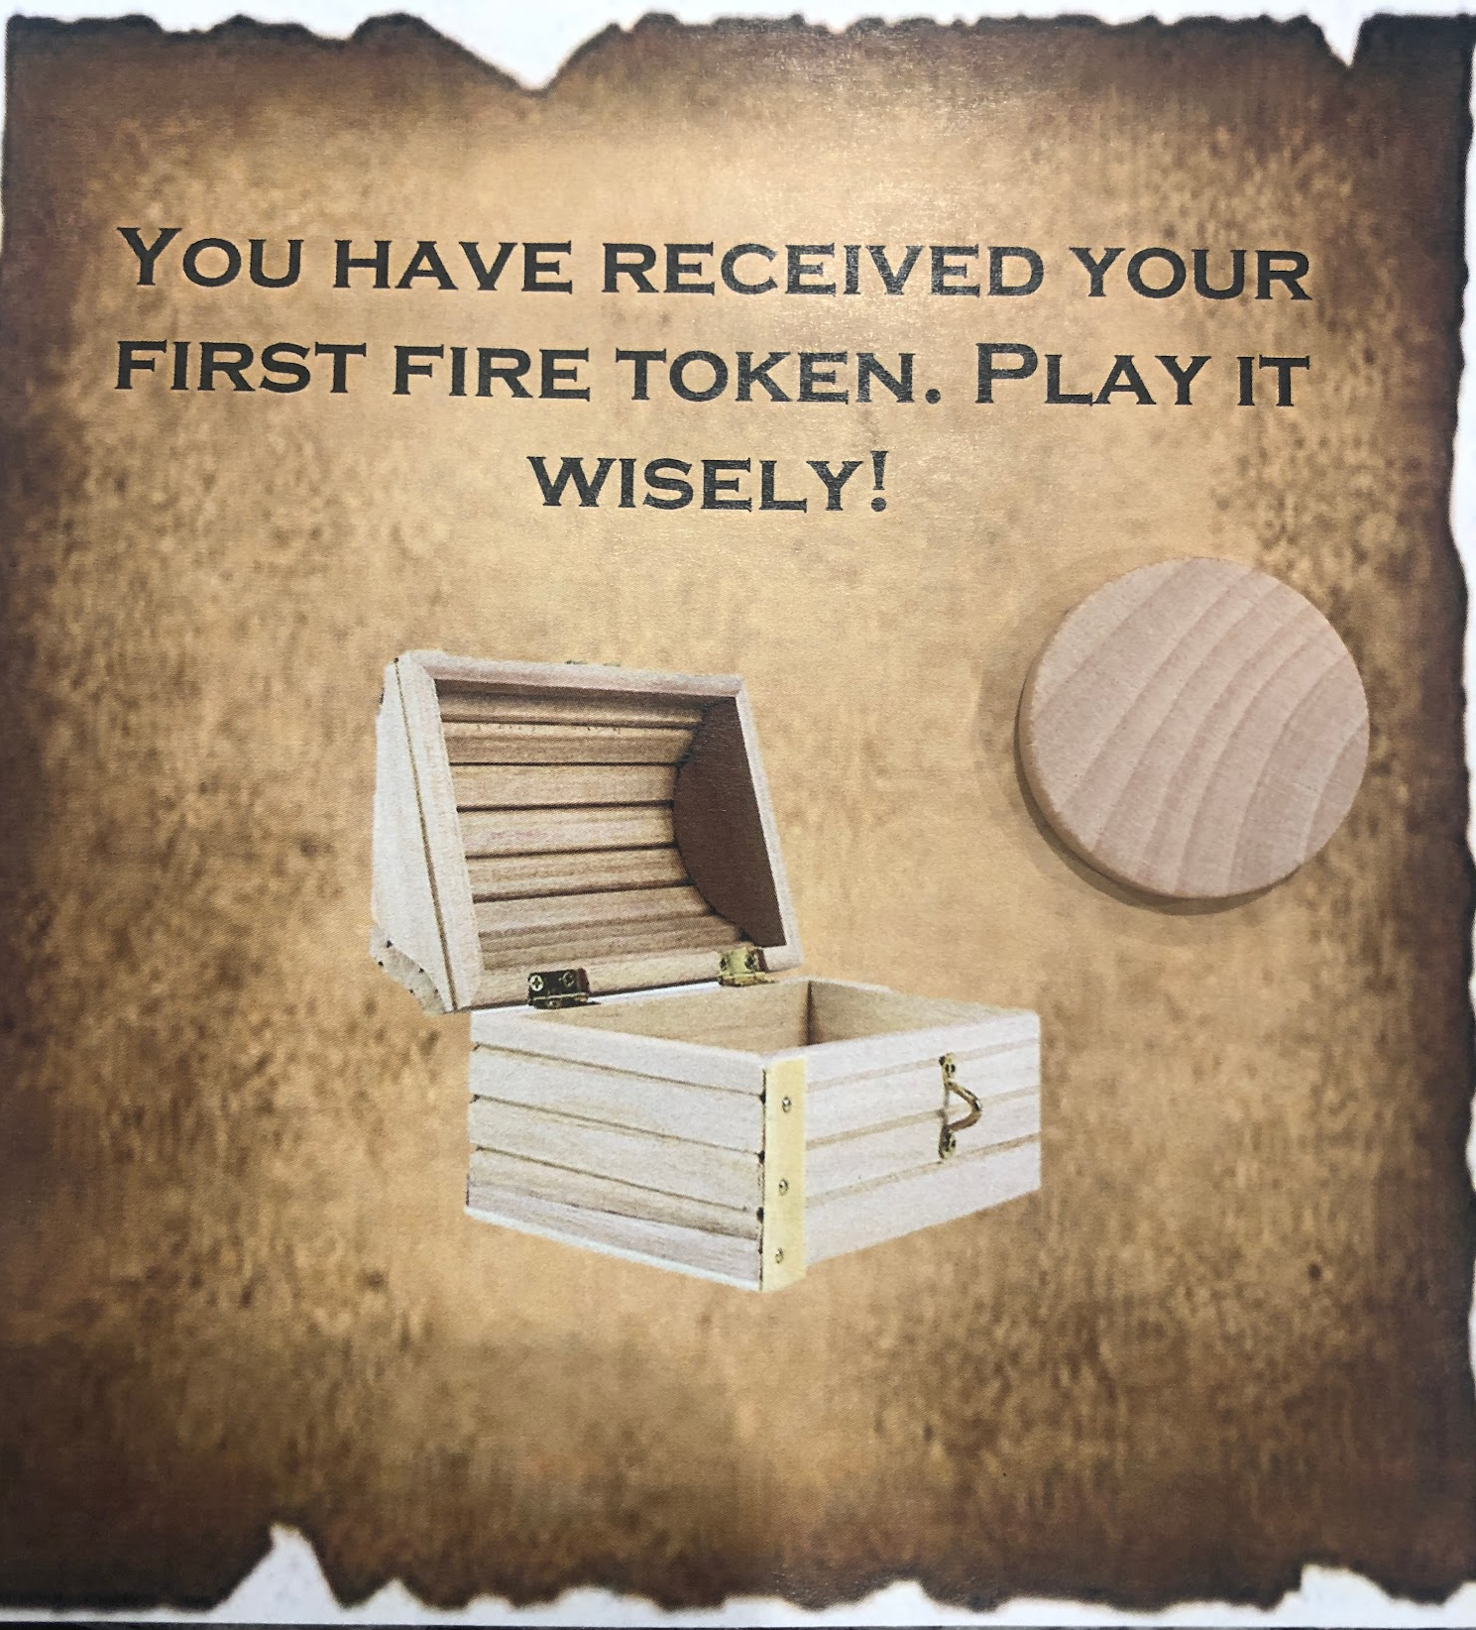
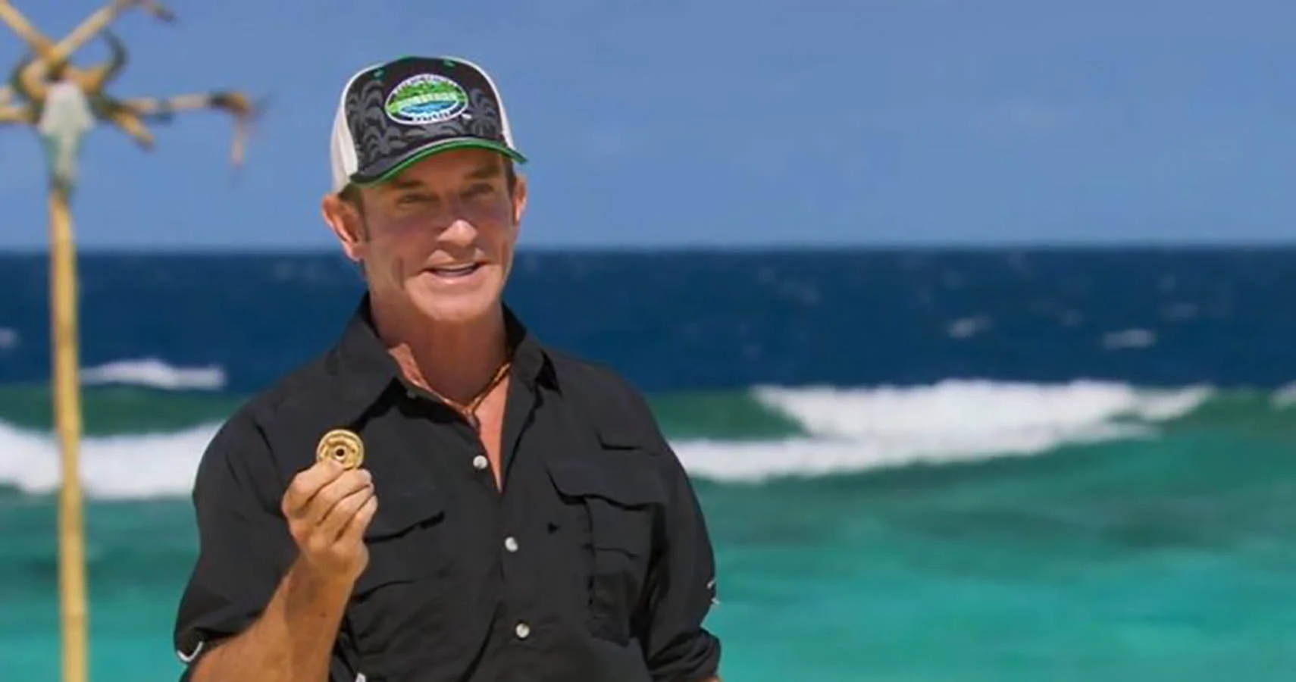
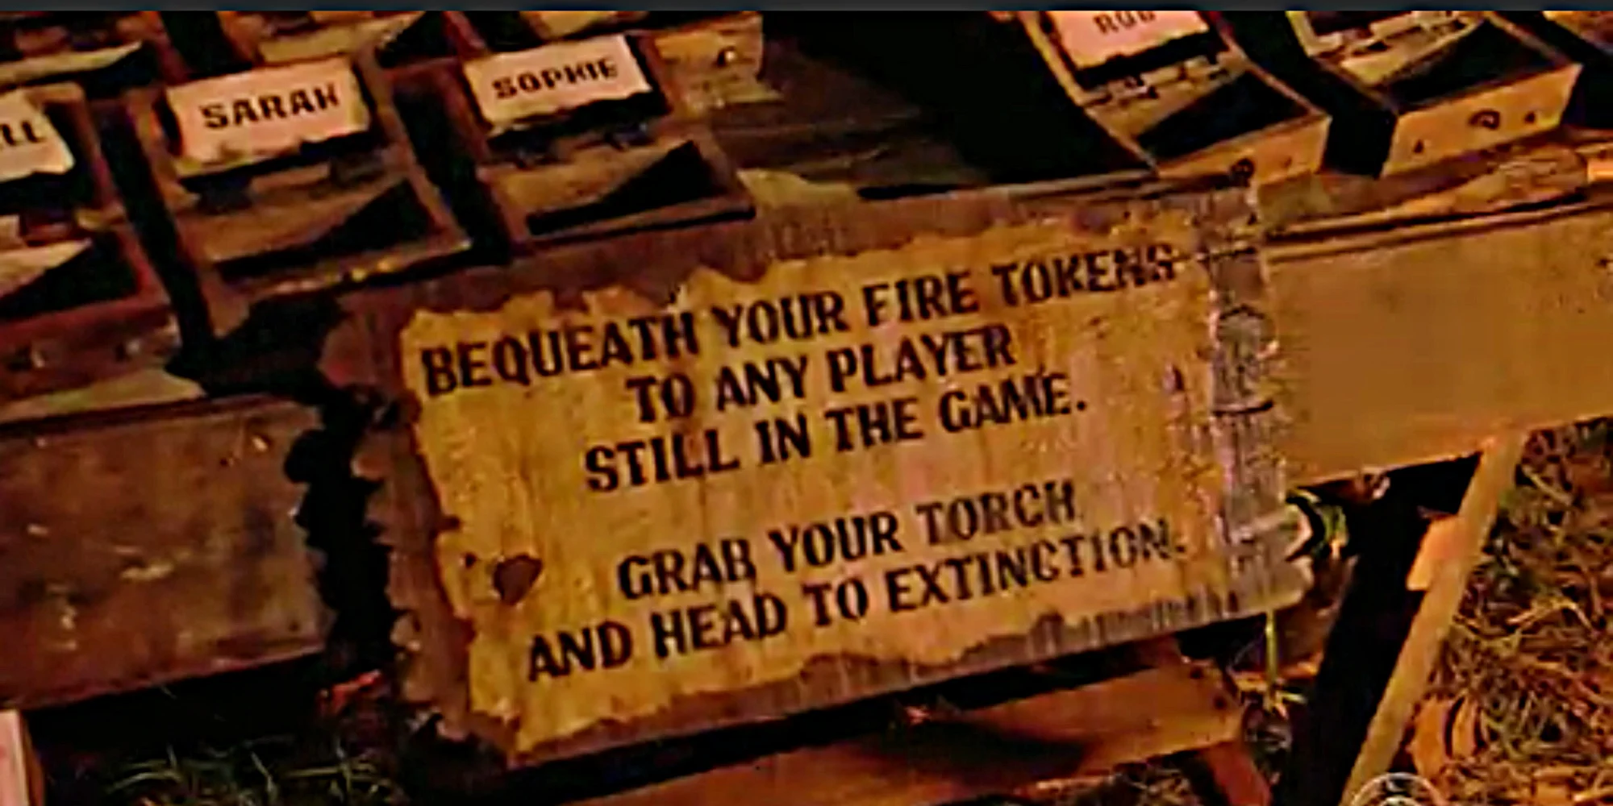

Slide 28
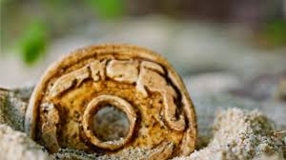
Don’t Forget to use your Fire Tokens….
Play them Wisely Survivors!

Slide 29

Stay Tuned for Next Week’s Survivor Challenge to win a Special Idol Bead on your Bracelet!

Slide 30
Here we go… for immunity, survivors ready… Go!

Slide 31

The Edge of Extinction is a desolate, abandoned beach with even fewer amenities than the main island: contestants on the Edge of Extinction may either wait for an opportunity to re-join the main game or may choose to leave the game at any point by raising a white sail.

Slide 32
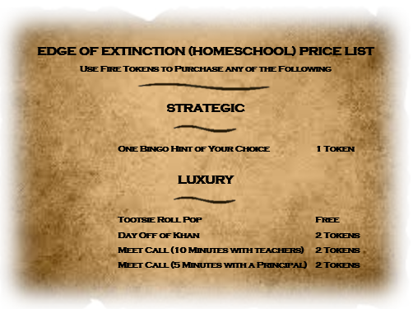
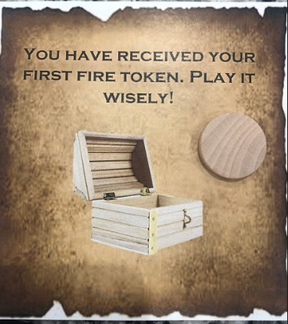

Slide 33
Daily Assignments

Slide 34
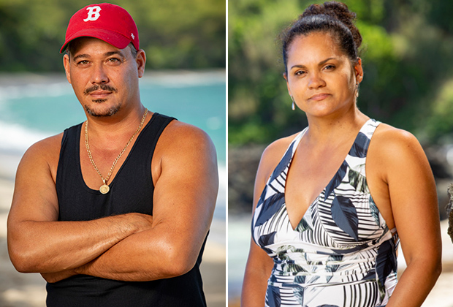
Survivor Clip of the Day (Optional)
“It's a tough principle, but fear keeps people loyal. If they're afraid they have something to lose, then they'll do what they're told to do. That's straight out of the godfather. It's true.” - Boston Rob
Sandra is the queen of Survivor. Just ask her, she’ll tell you! And as the only two-time winner the show has ever seen, she has earned the title.

Slide 35

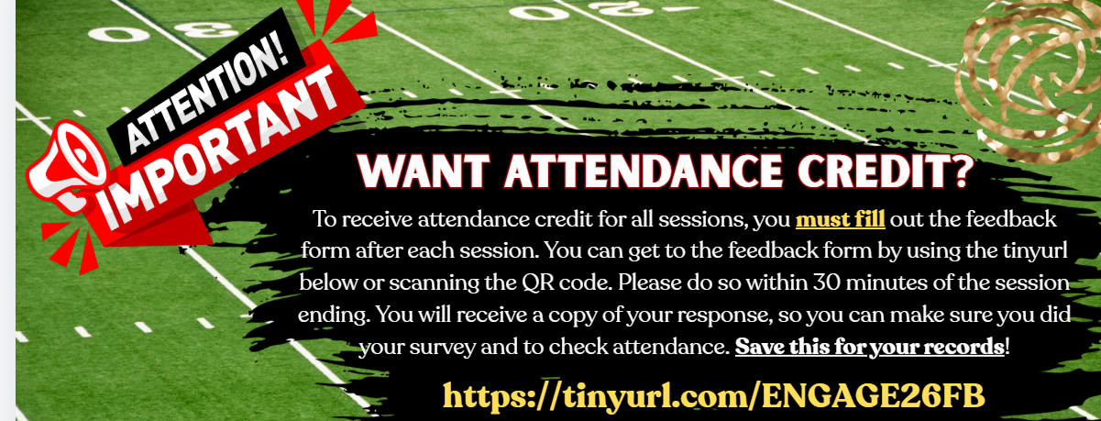
Survivor Spirit!

Slide 36
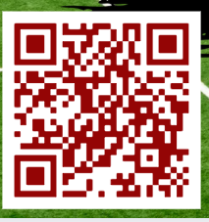

Sole Survivors!

Slide 37


Slide 38


Slide 39
