Slide 1



Slide 2


To Receive Credit for this session, make sure you complete the survey at the end

Slide 3
Trauma Informed Teaching
Mandi Allen (Hatfield)
Stephani Casey (Nance)

Slide 4
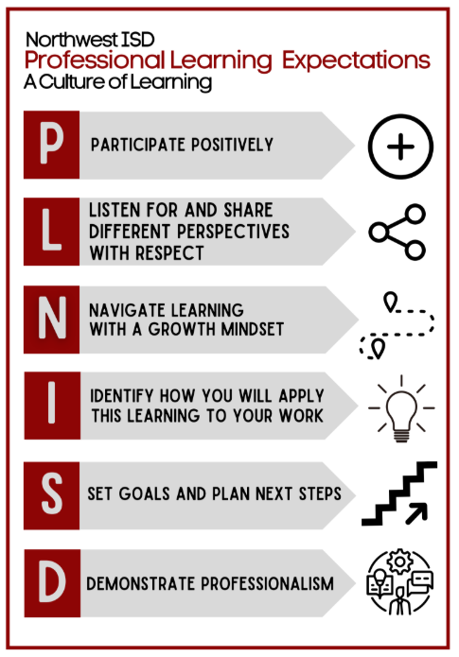

Slide 5
Introduction
Mandi Allen
Background-BSW, M.Ed., C&I
6 ½ years in social work
NISD teacher for 18 years (Kindergarten for 11 years, Pre-K for 7 years)
Stephani Casey
NISD teacher for 13 years (2nd Grade for 5 years, Pre-K for 8 years)
Slides from: https: slidesgo.com

Slide 6
Trauma Informed
Teaching
Slides from: https: slidesgo.com

Slide 7
Table of contents
01
02
03
04
05
What is trauma?
Possible causes
Consequences of trauma
Working with students experiencing trauma
References

Slide 8
01
What is trauma?
Childhood trauma

Slide 9
What is childhood trauma?
"Trauma would be the impact that produces suffering as a consequence of exposure to events that jeopardize the physical-emotional integrity and safety of people. In these situations, the person may feel overloaded and overwhelmed by not having sufficient resources to cope or adequately overcome such event"
Maria Dolores Rodriguez Dominguez (2023)

Slide 10
What is
childhood trauma?
When we talk about childhood trauma, we refer to the impact that a potentially traumatic situation has generated or is generating in a child.
This state of trauma can affect the child in his or her development and learning.

Slide 11

Discussion Questions
Think about a child who struggles in your class? What might that child carry in their invisible backpack?
Examples:
Parents arguing
Moving
Food insecurity
Sleep problems
Parent working a lot or at night
Foster care
Domestic violence
Loss of a caregiver
Abuse
Many of our students are carrying things they are too little to explain.

Slide 12
02
Possible causes
Causes of childhood trauma

Slide 13
Although we tend to think that a trauma is caused by a single event that generates post-traumatic stress disorder, there are situations that, repeated over time, can leave a similar imprint.

Slide 14
Causes of childhood trauma
In this way, experts distinguish between:
Due to a serious but one-time event such as, for example, living through or witnessing an accident
Simple trauma
Prolonged situations over time such as bullying, physical or psychological abuse (direct or indirect), emotional neglect, community violence in at-risk contexts, etc
Complex trauma

Slide 15
Examples:
Trauma results from experiencing or witnessing events that are physically or emotionally harmful.
May include abuse, neglect, violence, natural disasters, loss, or serious accidents.
Effects can be immediate or appear later in development.
Trauma can overwhelm a child's ability to cope, children may not have the vocabulary or language to express their experience/trauma.

Slide 16
How Common is Childhood Trauma?
It is estimated that among a healthy cohort of children, 26% will witness or experience a traumatic event before the age of 4 years (Briggs-Gowan, Ford, Fraleigh, McCarthy, & Carter, 2010).
Children from all backgrounds and socioeconomic levels can experience trauma
Many children have multiple traumatic experiences
The COVID-19 pandemic increased childhood trauma exposure
Early childhood educators are often first to recognize signs of trauma

Slide 17
Discussion (3-4 minutes)
Which of these causes of trauma surprised you the most for young children?
This helps teachers realize that trauma isn’t always something extreme.
Sometimes trauma is not one big event but ongoing stress.

Slide 18
03
Consequences of trauma
t
Behaviors or signs

Slide 19
Behaviors or signs
Difficulty in interacting with others
Poor school performance
Generalized anxiety
Emotional management problems
Behaviors or signs
Eating and sleeping problems
Learning difficulties
Panic attacks
Withdrawal or isolation

Slide 20
Recognizing Signs of Trauma in Pre-K
Regression in previously mastered skills
Excessive crying or difficulty being comforted
Separation anxiety or clinginess
Sleep disturbances and nightmares
Aggressive behaviors or extreme reactions
Withdrawal from activities previously enjoyed
Physical complaints stomach aches headaches
Difficulty focusing or following directions
Repetitive play that mimics traumatic events
Heightened startle response

Slide 21

Trauma and Brain Development
ISP Fostering. “How Trauma Affects a Child’s Brain.” YouTube, 20 Sept. 2023, www.youtube.com/watch?v=0H8zifMOAkA.

Slide 22
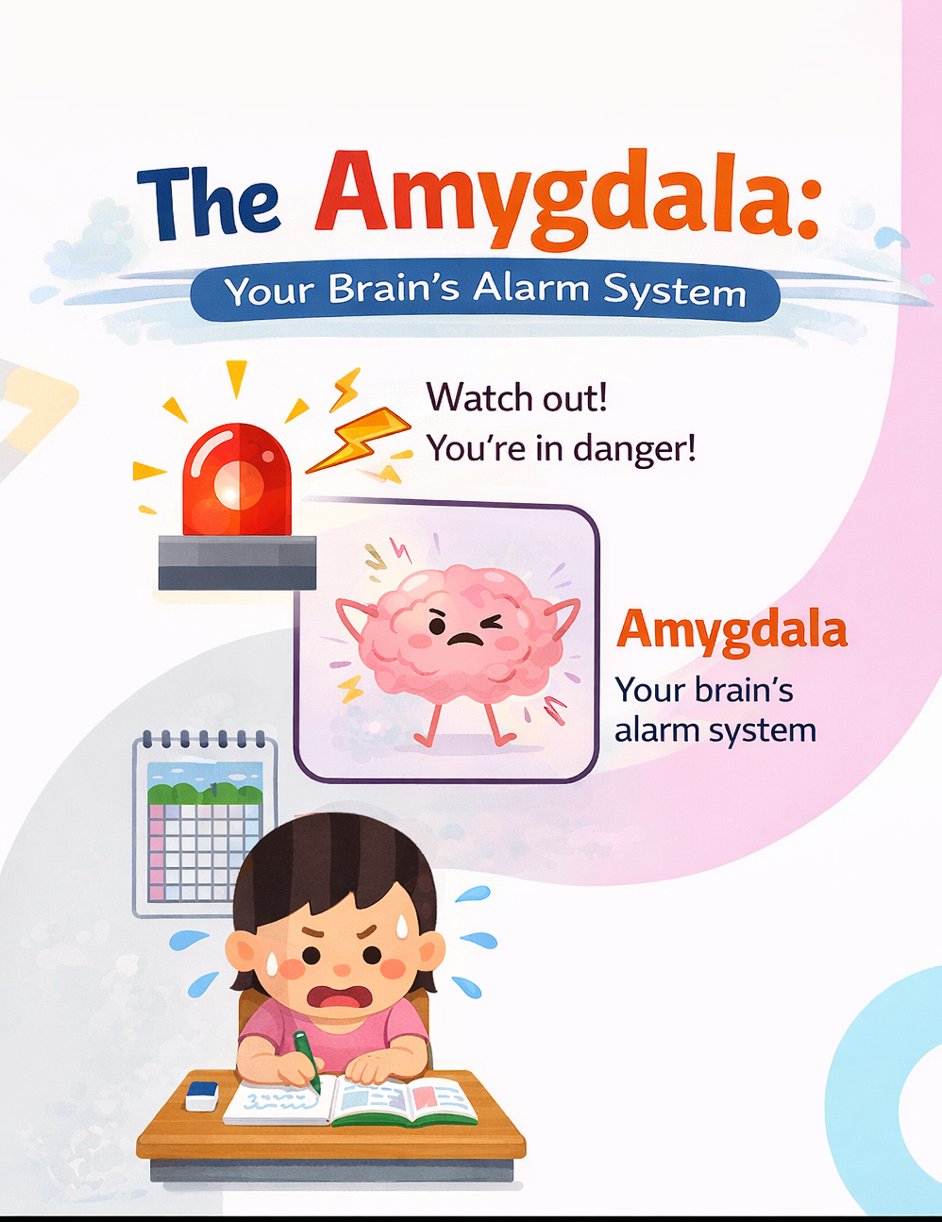
When a child experiences trauma or ongoing stress, their brain’s alarm system (the amygdala) becomes very sensitive.
Instead of only going off during real danger, the alarm can start going off during normal school situations.
Things that might trigger it:
a loud voice
a sudden change in routine
conflict with a friend
being corrected by a teacher
separation from a caregiver
To the child’s brain, these moments can feel like danger, even when they aren’t.
When this happens, the brain automatically goes into survival mode.

Slide 23
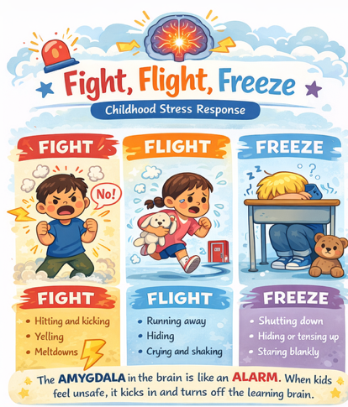

Slide 24
The Brain and Trauma
Early childhood is a critical period for brain development
Trauma can alter brain structure and function
Stress response system may become overactive
Fight flight or freeze responses become default reactions
Reduced capacity for emotional regulation
Difficulty forming secure attachments
Learning and memory systems can be affected
Executive function skills may be compromised
The brain can heal with proper support and intervention

Slide 25
Discussion
What might a child need most from adults at school if they are experiencing stress or trauma at home?
This helps teachers start thinking about their role as protective factors.
Think about a time in your own life when you were stressed or overwhelmed. How did that affect your ability to concentrate or stay calm?

Slide 26
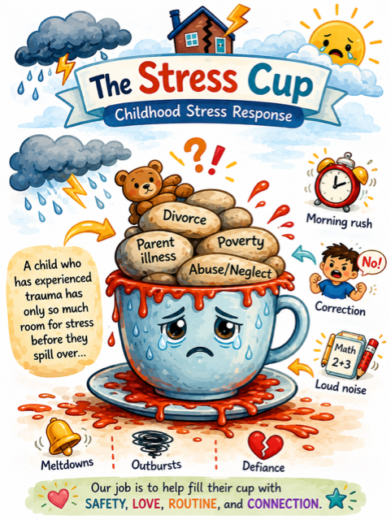
Many behaviors we label as misbehavior are actually a child’s nervous system trying to protect them.

Slide 27
Working with students experiencing trauma
04
What to do in the classroom

Slide 28

Responding to Trauma-Related Behaviors in Early Childhood Settings
CECE Early Childhood Videos at Eastern CT State U. (2023). Responding to Trauma-Related Behaviors in Early Childhood Settings. YouTube.

Slide 29
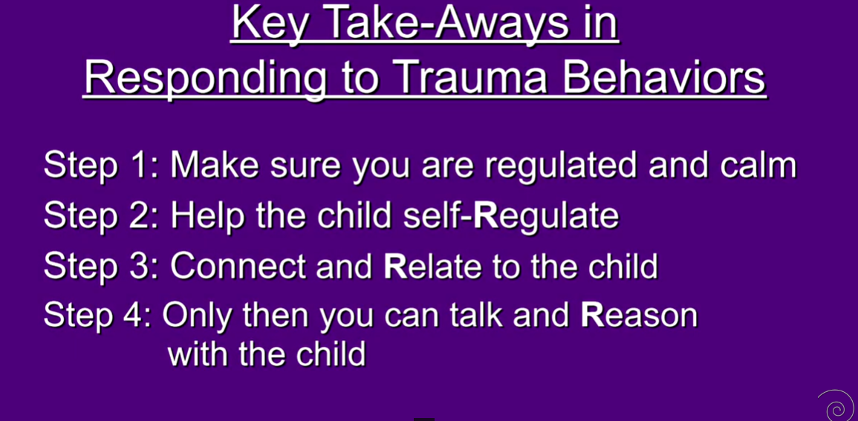
CECE Early Childhood Videos at Eastern CT State U. (2023). Responding to Trauma-Related Behaviors in Early Childhood Settings. YouTube.

Slide 30
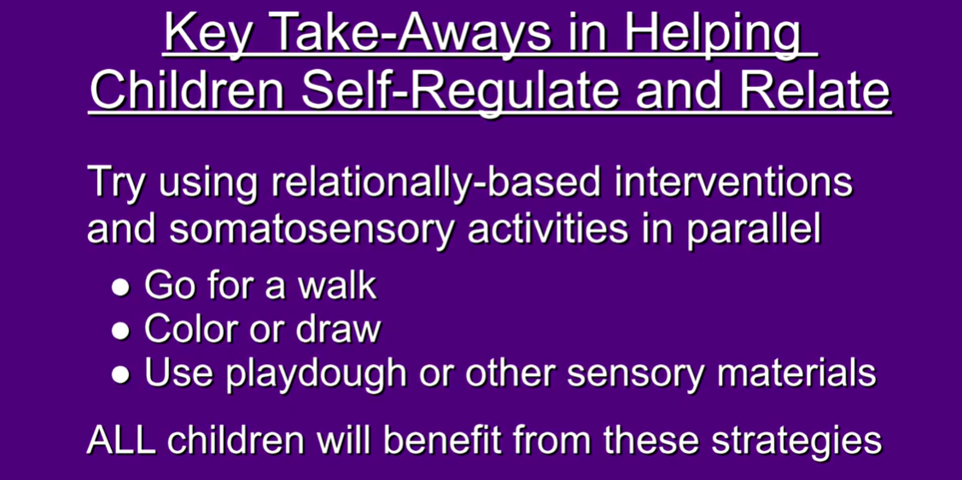
CECE Early Childhood Videos at Eastern CT State U. (2023). Responding to Trauma-Related Behaviors in Early Childhood Settings. YouTube.

Slide 31
Creating a Trauma-Sensitive Pre-K Classroom
Establish consistent daily routines and clear expectations
Provide visual schedules and prepare children for transitions
Create calm, organized physical spaces with minimal clutter
Include cozy corners for self-regulation
Reduce sensory overload harsh lighting loud noises
Offer choices to build sense of control and autonomy
Use visual supports for communication and expectations
Incorporate movement breaks throughout the day
Maintain predictable adult responses and boundaries
Use and teach calming techniques

Slide 32
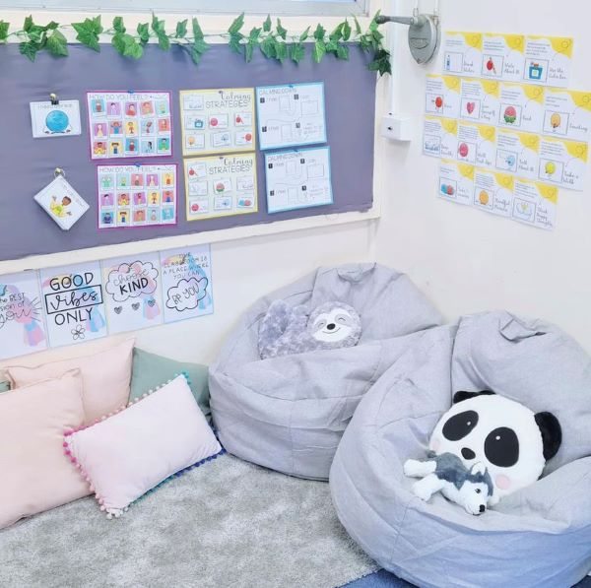
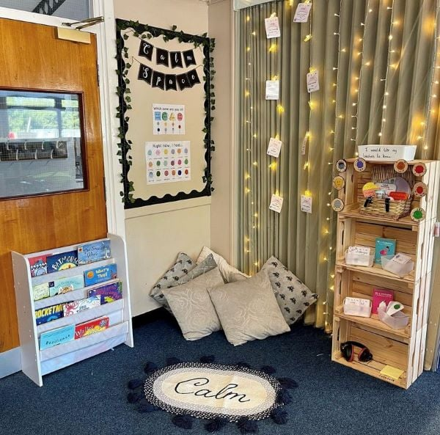

Slide 33
Reflection
Think about students you’ve had in the past. Are there any that may have been through trauma? Would you handle it differently?

Slide 34
If this topic sparked your curiosity, and you want to learn more…
Recommended Books
***📚 What Happened to You? – Oprah Winfrey & Dr. Bruce Perry
Shifts the question from “What’s wrong with you?” to “What happened to you?”
***📚 The Whole-Brain Child – Daniel Siegel & Tina Payne Bryson
Understanding how children’s brains develop and how we can help them regulate emotions.
📚 Childhood Disrupted – Donna Jackson Nakazawa
📚 The Body Keeps the Score – Bessel van der Kolk
ECS Region 11
The Heart Work
Trauma Informed Care
for Early Childhood Principals and Educators

Slide 35






Want Attendance Credit?
To receive attendance credit for all sessions, you must fill out the feedback form after each session. You can get to the feedback form by using the tinyurl below or scanning the QR code. Please do so within 30 minutes of the session ending. You will receive a copy of your response, so you can make sure you did your survey and to check attendance. Save this for your records!
https://tinyurl.com/ENGAGE26FB

Slide 36

Thanks!
Amanda Allen
Pre-K
W.R. Hatfield Elementary
Stephani Casey
Pre-K
Nance Elementary
“Children don’t need perfect teachers. They need safe, caring adults who understand them.”

Slide 37
05
References

Slide 38
References
PETALES Association (n.d.) How trauma affects the school environment https://xn--petalesespaa-khb.org/como-afecta-el-trauma-en-el-entorno-escolar/
Rodríguez, M.D. (2023). Trauma, family, and education: Experiences and perspectives. JONED. Journal of Neuroeducation 4(1): 38-51. doi: 10.1344/joned.v4i1.42374
ISP Fostering. “How Trauma Affects a Child’s Brain.” YouTube, 20 Sept. 2023, www.youtube.com/watch?v=0H8zifMOAkA.
Snyder, F. J., Roberts, Y. H., Crusto, C. A., Connell, C. M., Griffin, A., Finley, M. K., Radway, S., Marshall, T., & Kaufman, J. S. (2012). Exposure to traumatic events and the behavioral health of children enrolled in an early childhood system of care. Journal of traumatic stress, 25(6), 700–704. https://doi.org/10.1002/jts.21756
CECE Early Childhood Videos at Eastern CT State U. (2023). Responding to Trauma-Related Behaviors in Early Childhood Settings. YouTube.

